Slide 1
Protecting Your Information Assets
Bob Clark, Director of Archives
Hillel Arnold, Associate Director of Archives & Chief Digital Strategies Officer
Rockefeller Archive Center

Slide 2
Agenda
Who we are
Core concepts in information management
Q&A

Slide 3
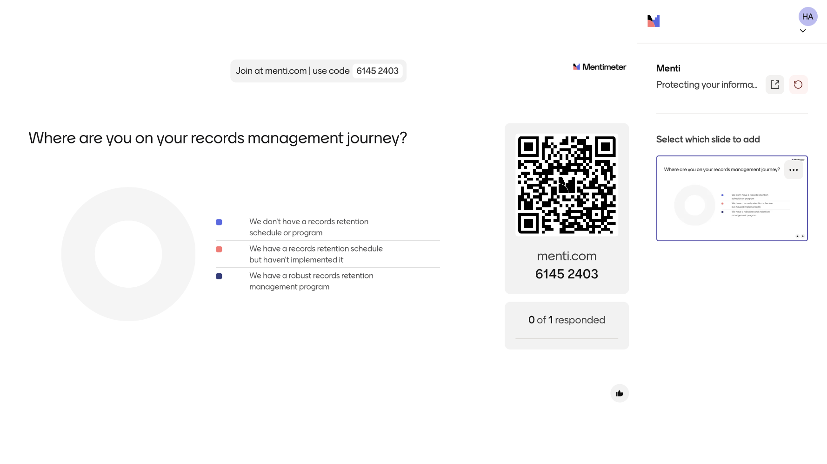
Where are you on your records management journey?

Slide 4
Who we are

Slide 5
Rockefeller Archive Center
Founded in 1974
Home for philanthropic records of institutional philanthropies, family foundations, and limited life foundations
Advocacy and strategy for information governance and archives across the philanthropic sector

Slide 6
Our Roles
Director of Archives
Point of contact for foundation leaders who want to know why their records matter
Associate Director of Archives & Chief Digital Strategies Officer
Shape strategies for acquisition, preservation and access to digital records

Slide 7
Core Concepts

Slide 8
Information is an asset
Information has value, just like your financial resources, physical assets, and people
This value is realized through ongoing stewardship of records

Slide 9
Articulate your goals
Not all organizations are the same, not all information management programs are the same
Where you want to go determines what you do:
Enhancing learning and evaluation
Celebrating an anniversary
Reducing your carbon footprint
Meeting legal compliance requirements
Providing public access to your archive
We're spending down next year and suddenly care about our legacy!

Slide 10
Develop a records retention policy and retention schedule
Forms the foundation for a successful records management program
Helps you understand your records landscape:
Systems
Identify categories of records
Articulate retention periods and final disposition

Slide 11
Focus on content, not format or storage
Group records by the information they contain, not file format or where they are stored
Similar information often exists in multiple places
Multiple kinds of information exist in a single storage location (for example email)
Focusing on content allows you to activate value and mitigate risk

Slide 12
A foundation for changing technologies
Emerging technologies can augment (but not replace) records management
Proactively design exit paths from systems
Archival export for grants management systems

Slide 13
It’s a program, not a project
Cleanup is exhausting and imperfect; prevent messes before they happen
Consider a day-forward approach to the work; you can go back and clean up later
Records management is people management

Slide 14
It takes all of us
Connect records management with organizational mission and values
Deliver consistent and regular messaging across the organization
On and offboarding
Regular cleanup days
Foster leadership and practitioner buy-in
Build collaboration across organizational areas

Slide 15
The time to start is now!

Slide 16
Q&A

Slide 17
Resources
ArchivingPhilanthropy.org
Includes the Advancing Foundation Archives 2019 Conference Proceedings and a resource library
Advancing Foundation Archives network is coming!
Fluxx Exporter

