Slide 1
The Author-topic model for authors and Documents
Team Doctrina Apparatus

Slide 2
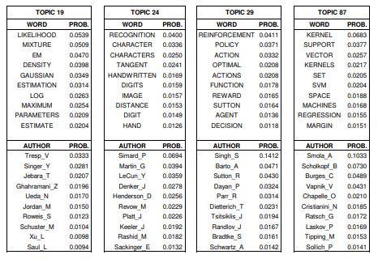
Author-topic model
This model provides simple probabilistic model for exploring the relationships between authors, documents, topics and words.
Topic is defined as probability distribution over words and is discovered automatically with unsupervised learning.
At the same time, author’s interest to that topic is simultaneously quantified.

Slide 3
Topic model and author model
For author model, the interests of authors are directly modeled with probability distributions over words.
For topic model, there is a topic distribution for a document and word distribution within that topic.
Document d
TOPIC | PROB.
1 | 0.05
2 | 0.04
3 | 0.03
4 | 0.02
5 | 0.01
Author: John_Ho
WORD | PROB.
machine | 0.0823
learning | 0.0497
unsupervised | 0.0234
supervised | 0.0226
python | 0.0224
C++ | 0.0166
natural | 0.0151
language | 0.0134
processing | 0.0131
continuous | 0.0121
Topic 1
WORD | PROB.
machine | 0.0823
learning | 0.0497
unsupervised | 0.0234
supervised | 0.0226
python | 0.0224
C++ | 0.0166

Slide 4
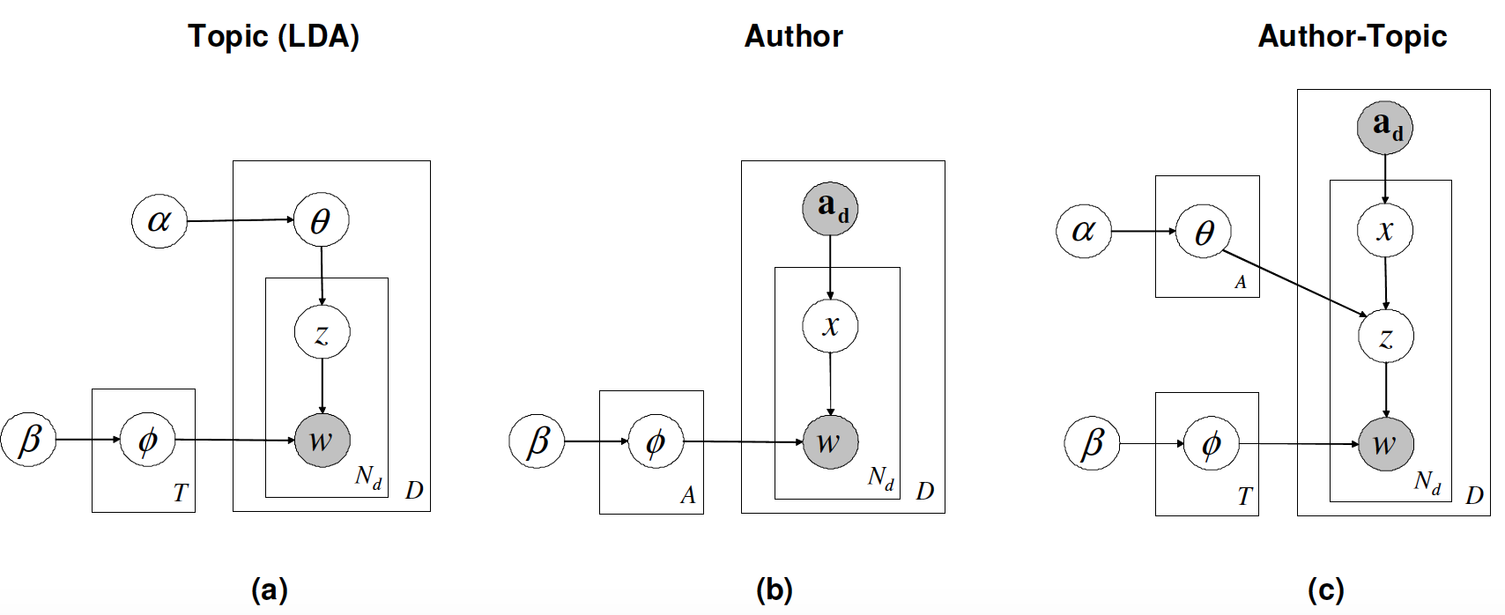

Model description

Slide 5
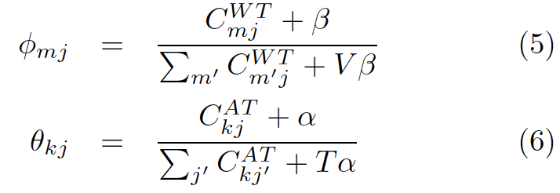
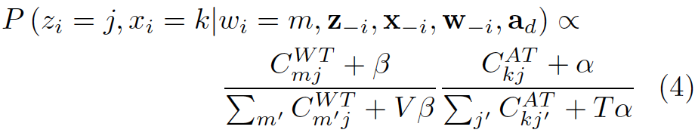
Parameter estimation by Gibbs sampling
Step 1 Assign words to random topics and authors.
Step 2 Apply Equation (4) to every word in the text and do assignment accordingly.
Step 3 Repeat step 2, 2000 times and save the word by topic matrix (5) and author by topic matrix (6).

Slide 7

Our Applications
First Application
Judge the author based on a given paragraph.
Second Application
Detect the Most Surprising and Least Surprising Papers for an Author.

Slide 8
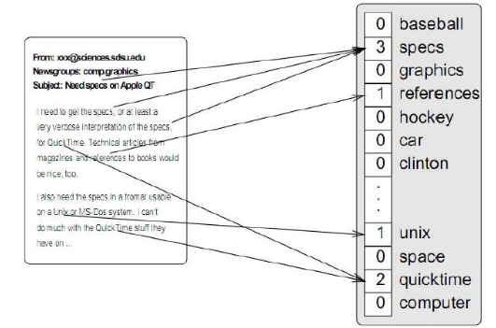
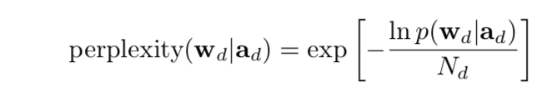
First Application_Judge the author based on a given paragraph.
1. Get data for "bag of words" models
2. Gibbs sampling
Get the sample at the 2000th iteration
Extract a series of topics words
Estimate Time Cost
For the NIPS data set, 2000 iterations of the Gibbs sampler took 12 hours of wall-clock time on a standard PC workstation (22 seconds per iteration). For Citeseer took 111 hours for 700 iterations (9.5 minutes per iteration).
3. Perplexity: Measure the performance of probability model.
A well trained model----Higher probability to get normal sentence， lower perplexity
4. A randomly generated set of training words
Make predictions on the other words
Compare 3 models
Done!
Judge the author based on a given paragraph!

Slide 9

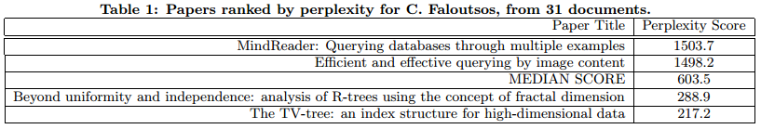
Second Application_Detect the Most Surprising and Least Surprising Papers for an Author
Symmetric KL divergence: the distance between authors i and j
The smaller the value of Symmetric KL divergence, the more similar the styles of these authors are.
Explore the range of perplexity scores that the model assigns to papers from specific authors
Most surprising ——highest perplexity
Least surprising——lowest perplexity
Done !!
Detect the Most Surprising and Least Surprising Papers for an Author!!

Slide 10
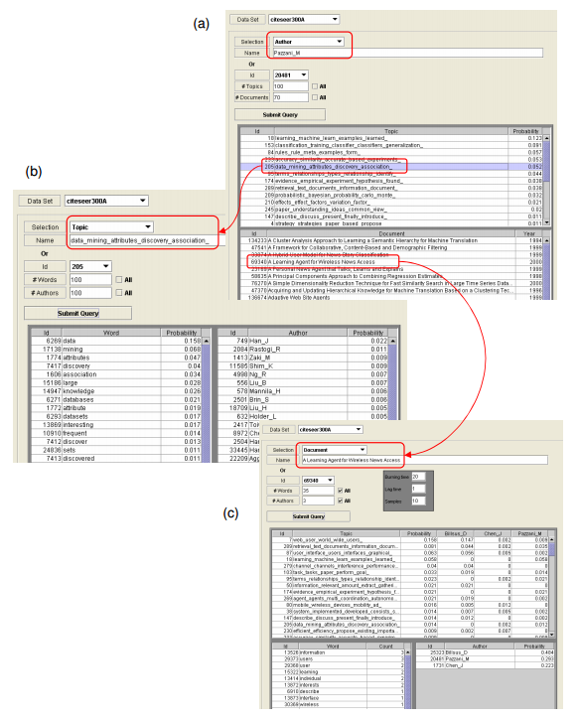
visual interface
——Query authors, topics and words

Slide 11
Thank you
Team Doctrina Apparatus

