Slide 1


The Author-topic model applied to tweets for Bitcoin price prediction
Team Doctrina Apparatus
HO Ngok Chao
CHEN Zhiwei

Slide 2
Abstract
First step, we used Tweets of selected accounts and author topic model to find topic (word distribution).
Second step, Topic Trends (time series) are identified for twitter text across time.
Third Step, these topic trends are then used as input features for neural network, LSTM to predict Bitcoin price.

Slide 3
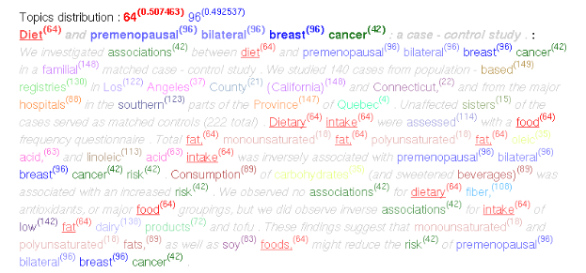
Literature review
What is Topic model? What is Author-Topic Model?

Slide 4
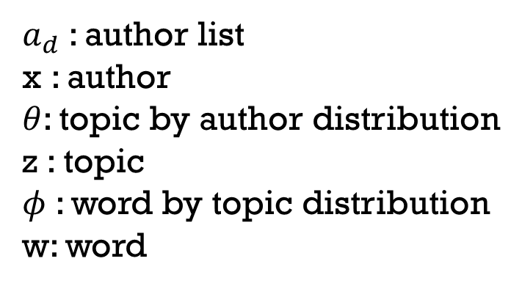
Generative Mechanism of author topic model
$a_{d}$: author list
x : author
$θ$: topic by author distribution
z : topic
$φ$: word by topic distribution
w: word

Slide 5
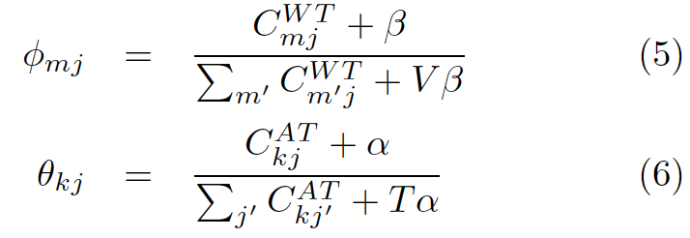
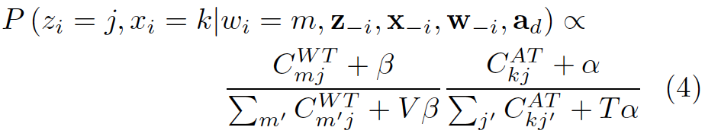
Parameter estimation by Gibbs sampling
Step 1 Assign words to random topics and authors.
Step 2 Apply Equation (4) to every word in the text and do assignment accordingly.
Step 3 Repeat step 2, 2000 times and save the word by topic matrix (5) and author by topic matrix (6).

Slide 6
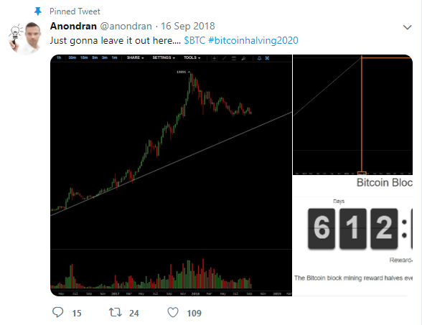
9 Authors
@anondran
@dtapscott
@francispouilot
@HeyTaiZen
@iamjosephyoung
@jonmatonis
@TuurDemeester
@VinnyLingham
@woonomic

Slide 7
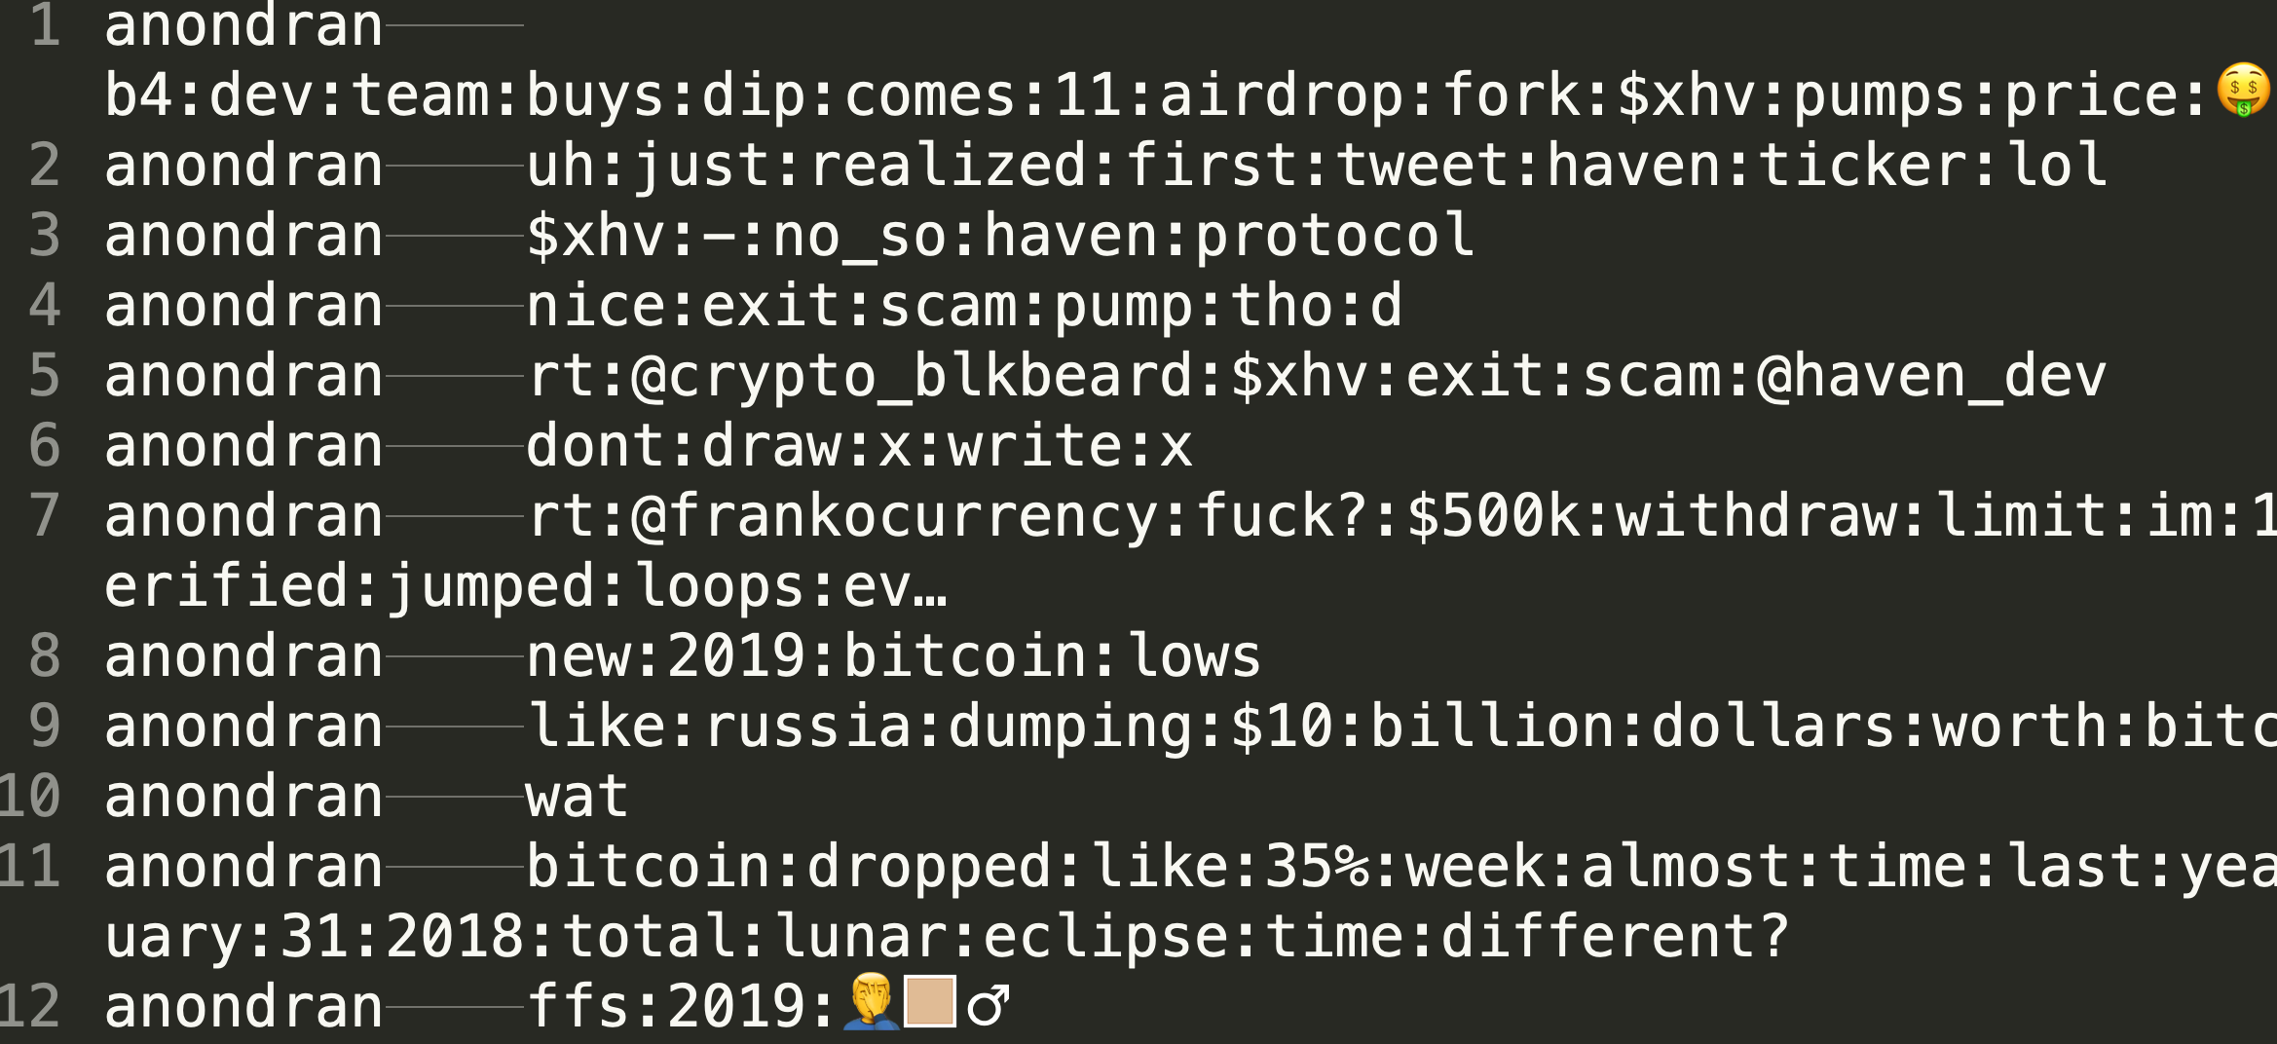
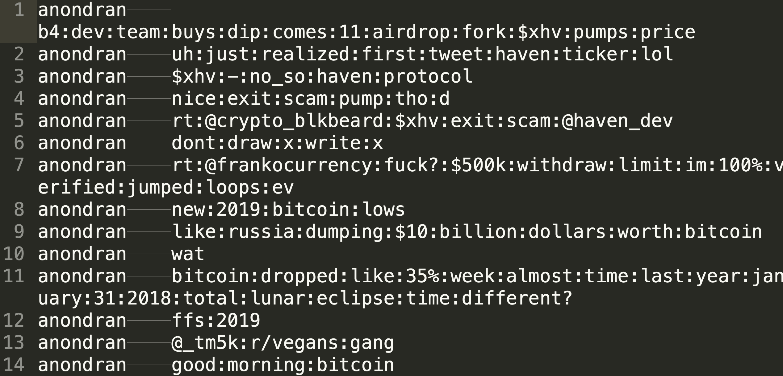
Data cleaning (with and without emoji)

Slide 8
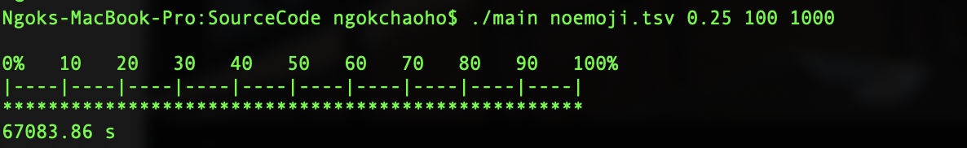

Implementation
Implemented on C++
In this experiment, Number of documents D = 50811, Number of author A = 9. Number of topics is chosen to be 100 and 1000 iterations before $φ$ and $θ$ is saved.
Time consumption: 19 hours for 1000 iterations 100 topics

Slide 9
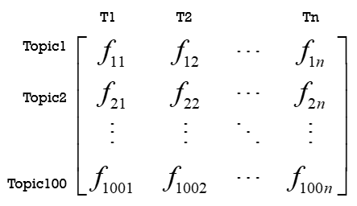
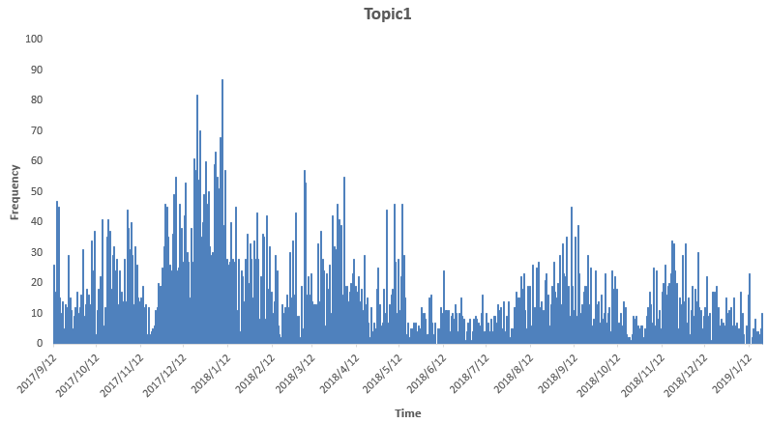
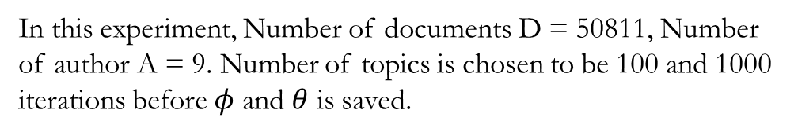
Topic trend
Step 1 Determine which topic the words belongs to according to its highest probability over 100 topics
Step 2 count the frequency of the words under each topic
Step 3 Generate time-distributed matrix for different topics
Topic Distribution
Topic Trend Graph
In this experiment, Number of documents D = 50811, Number of author A = 9. Number of topics is chosen to be 100 and 1000 iterations before $φ$ and $θ$ is saved.

Slide 10
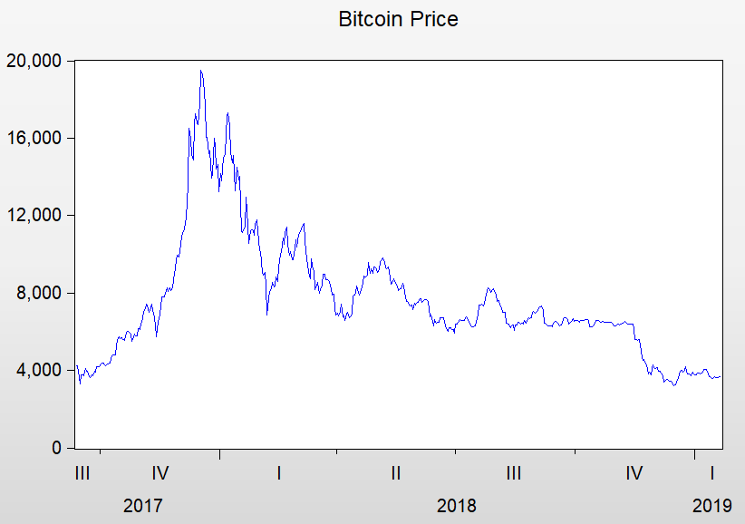
EMPIRICAL TEST
Step 1 ADF TEST
Step 2 Linear regression
R-Square<1%, Non-linear
ADF | t-Statistic | Prob.*
DIF_LOG_PRICE | -21.08865 | 0.0000
DPRICE | -20.62311 | 0.0000
DIF_LOG_PRICE: difference of log(price)
DPRICE: difference of price

Slide 11
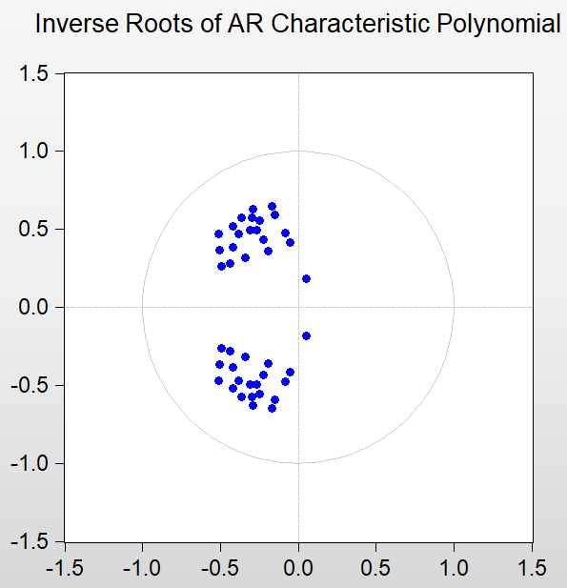
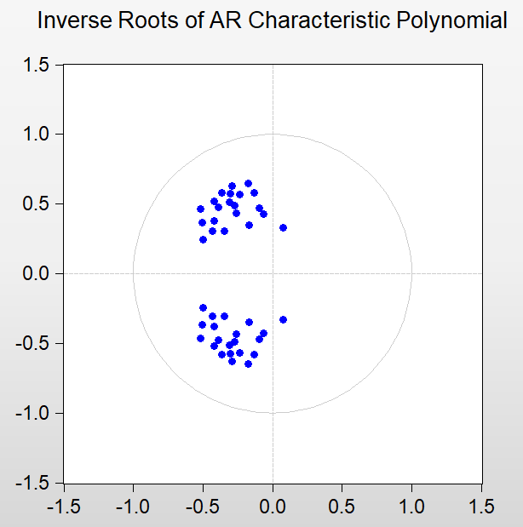
Step 3 Granger Causality Test
 |  | Topics
DIF_LOG_PRICE | <0.05 | D2/D6/D8/D9/D13/D22/D33/D29/D36/D37/D54/D55/D58/D63/D66/D67/D68/D85/D93
 | <0.1 | (Include above)D16/D17/D19/D26/D33/D65/D78/D86
DPRICE | <0.05 | D13/D14/D16/D19/D2/D22/D23/D29/D32/D33/D35/D36/D39/D49/D58/D59/D6/D66/D67/D69/D77/D79/D8/D99/D100
 | <0.1 | (Include above)D1/D17/D41/D62/D78/D93/D94
Common factors:
D2/D13/D22/D23/D29/D36/D58/D6/D66/D67/D69/D8/D17/D93
So to reduce the numbers of factors, We use their common factors
Step 4 AR Graph
DIF_LOG_PRICE
DPRICE

Slide 12
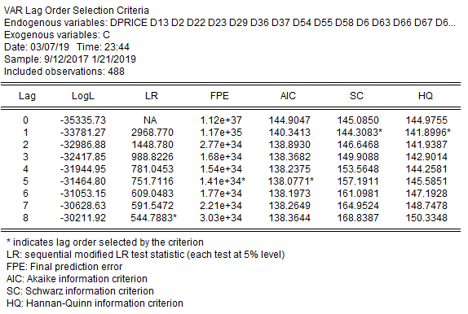
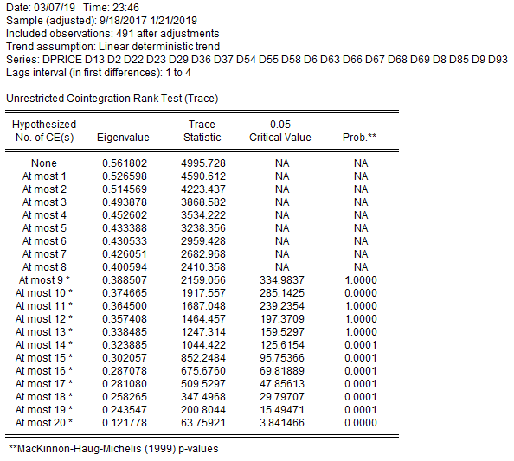
Step 5 Lag_Structure
DPRICE lag-order=5
DIF_LOG_PRICE lag-order>15
So we can use DPRICE rather than DIF_LOG_PRICE
to show the lag-period influence.
Step 6 Cointegration Test

Slide 13
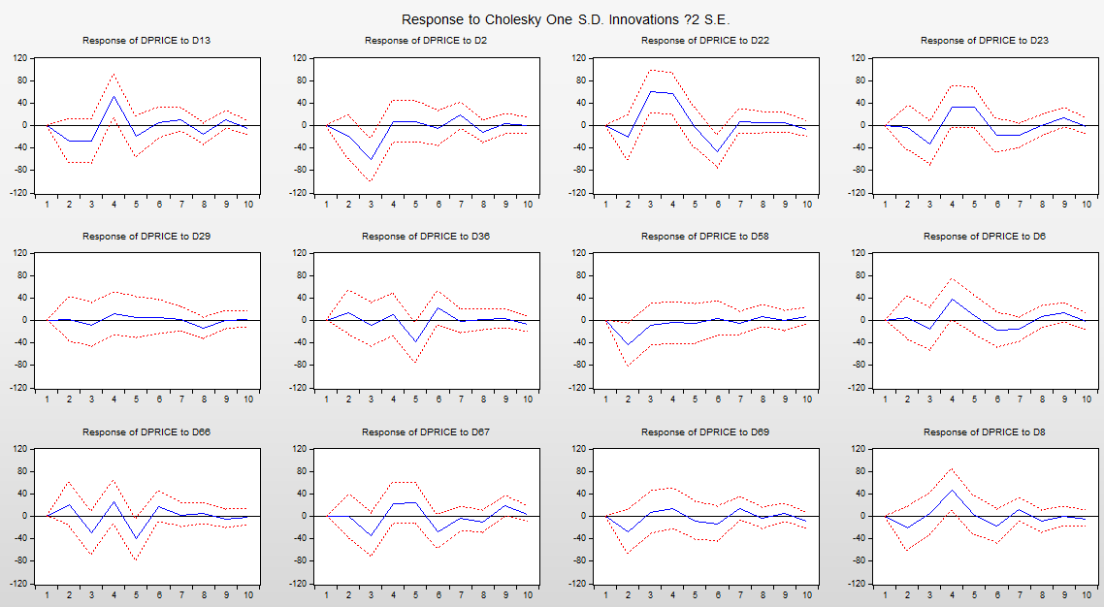
Step 7 PCA
PCA result is not useful, after 10 PCs can only over 85% total variance.
Step 8 Impulse Responses
Can read the fluctuation direction from the graph.
Finally converge to zero.

Slide 14
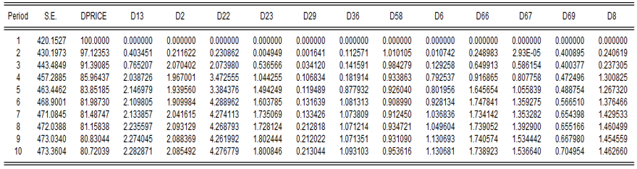
Step 9 Variance Decomposition
Most of the variance is caused by the price fluctuation itself
Until 10 periods, D22 cause 4.27%, D13 and D2 cause 2%

Slide 15
Step 10 Advanced Comparison
Use the data with emoji (emoji also contains a lot of information nowadays)
Re-run and Re-test
Common factors:
D13/D14/D2/D22/D23/D29/D36/D54/D58/D6/D66/D67/D69/D8/D85/D9
Red highlight is the additional factors compared with the results without emoji

Slide 16
Thank you
Team Doctrina Apparatus

