Slide 1
Robust Median Reversion Strategy
Group Name: Alpha
Members: HO Ngok Chao, FENG Tiantian,
HU Mingyue, ZHU Haolin, SU Yulu

Slide 2
Content
Portfolio Selection
Median Reversion
Robust Median Reversion (‘RMR’)
RMR Algorithm
Four other models
Experiment-1
Experiment-2
Conclusion

Slide 3
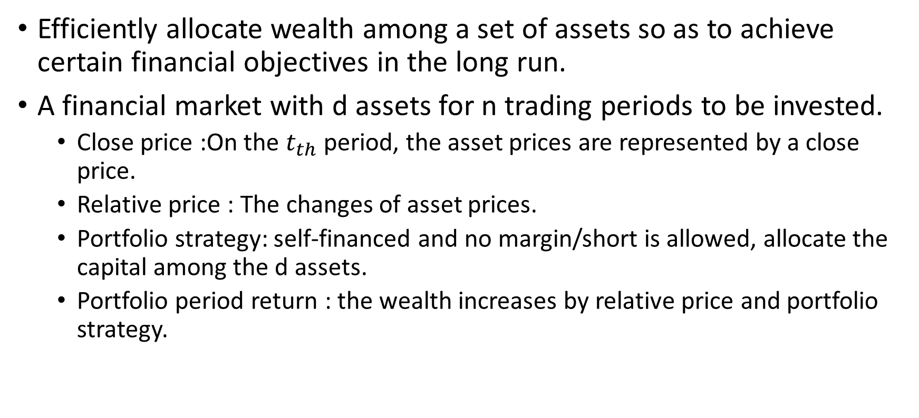
Portfolio Selection
Efficiently allocate wealth among a set of assets so as to achieve certain financial objectives in the long run.
A financial market with d assets for n trading periods to be invested.
Close price :On the $t_{th}$ period, the asset prices are represented by a close price.
Relative price : The changes of asset prices.
Portfolio strategy: self-financed and no margin/short is allowed, allocate the capital among the d assets.
Portfolio period return : the wealth increases by relative price and portfolio strategy.

Slide 4
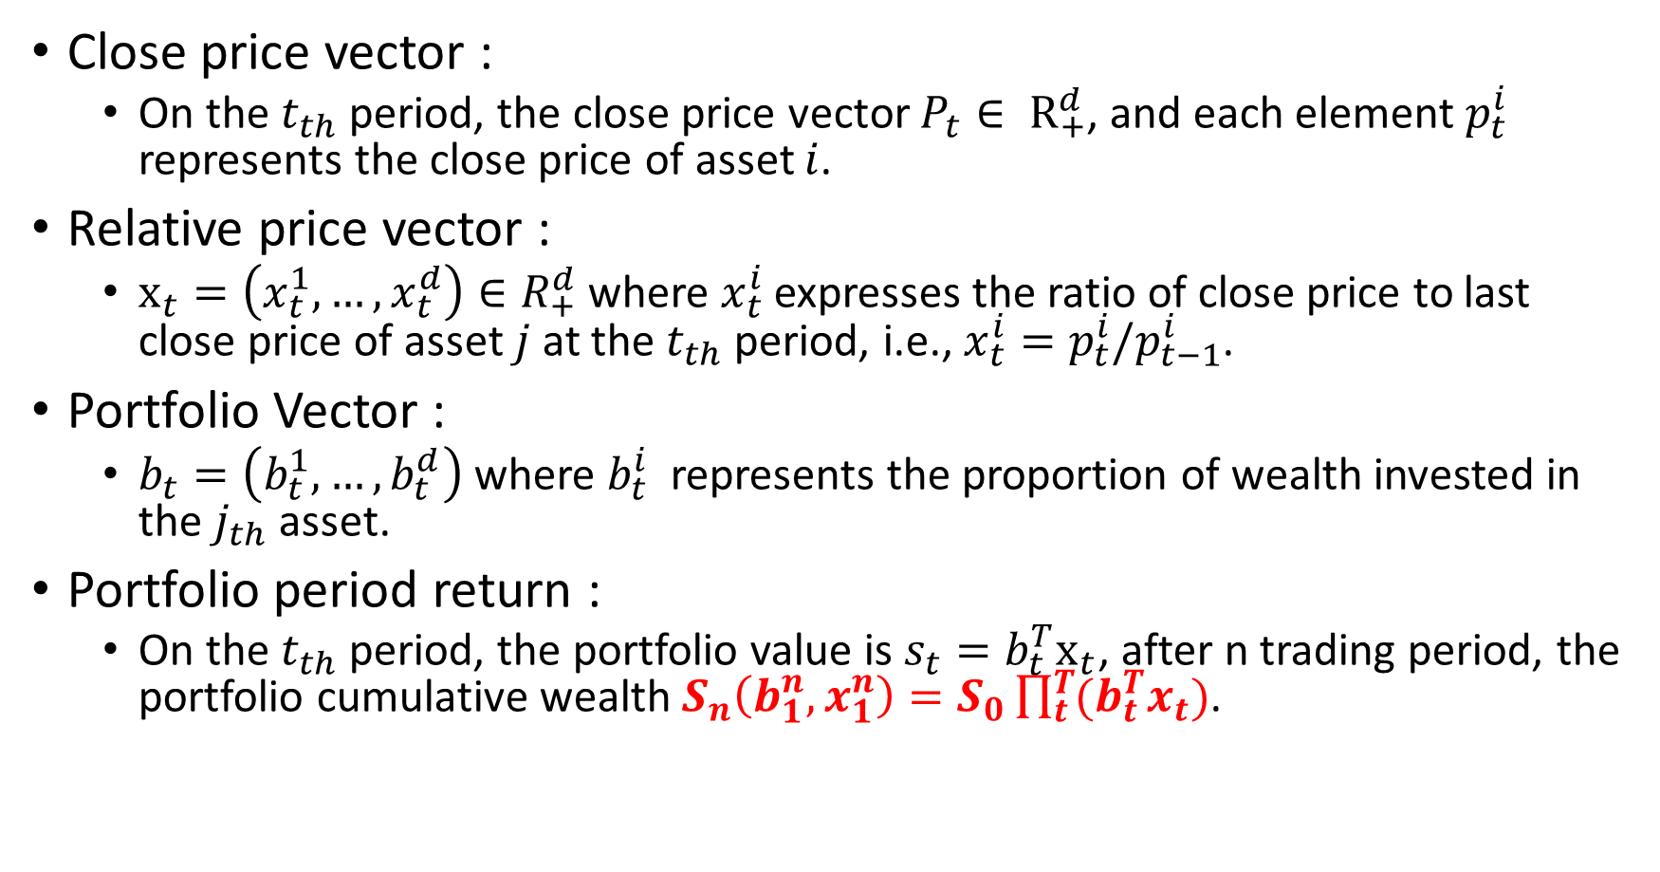
Portfolio Selection
Close price vector :
On the $t_{th}$ period, the close price vector $P_{t}∈ R_{+}^{d}$, and each element $p_{t}^{i}$ represents the close price of asset $i$.
Relative price vector :
$x_{t}=\left(x_{t}^{1},…,x_{t}^{d}\right)∈R_{+}^{d}$ where $x_{t}^{i}$ expresses the ratio of close price to last close price of asset $j$ at the $t_{th}$ period, i.e., $x_{t}^{i}=p_{t}^{i}/p_{t−1}^{i}$.
Portfolio Vector :
$b_{t}=\left(b_{t}^{1},…,b_{t}^{d}\right)$where $b_{t}^{i}$ represents the proportion of wealth invested in the $j_{th}$ asset.
Portfolio period return :
On the $t_{th}$ period, the portfolio value is $s_{t}=b_{t}^{T}x_{t}$, after n trading period, the portfolio cumulative wealth $S_{n}\left(b_{1}^{n},x_{1}^{n}\right)=S_{0}\prod_{t}^{T}{(b_{t}^{T}x_{t})}$.

Slide 5
Assumptions
1) Transaction cost:
we assume no transaction cost or taxes in this PS model;
2) Market liquidity:
we assume that one can buy and sell required quantities at last closing price of any given trading period;
3) Impact cost:
we assume that market behavior is not affected by a PS strategy.

Slide 6
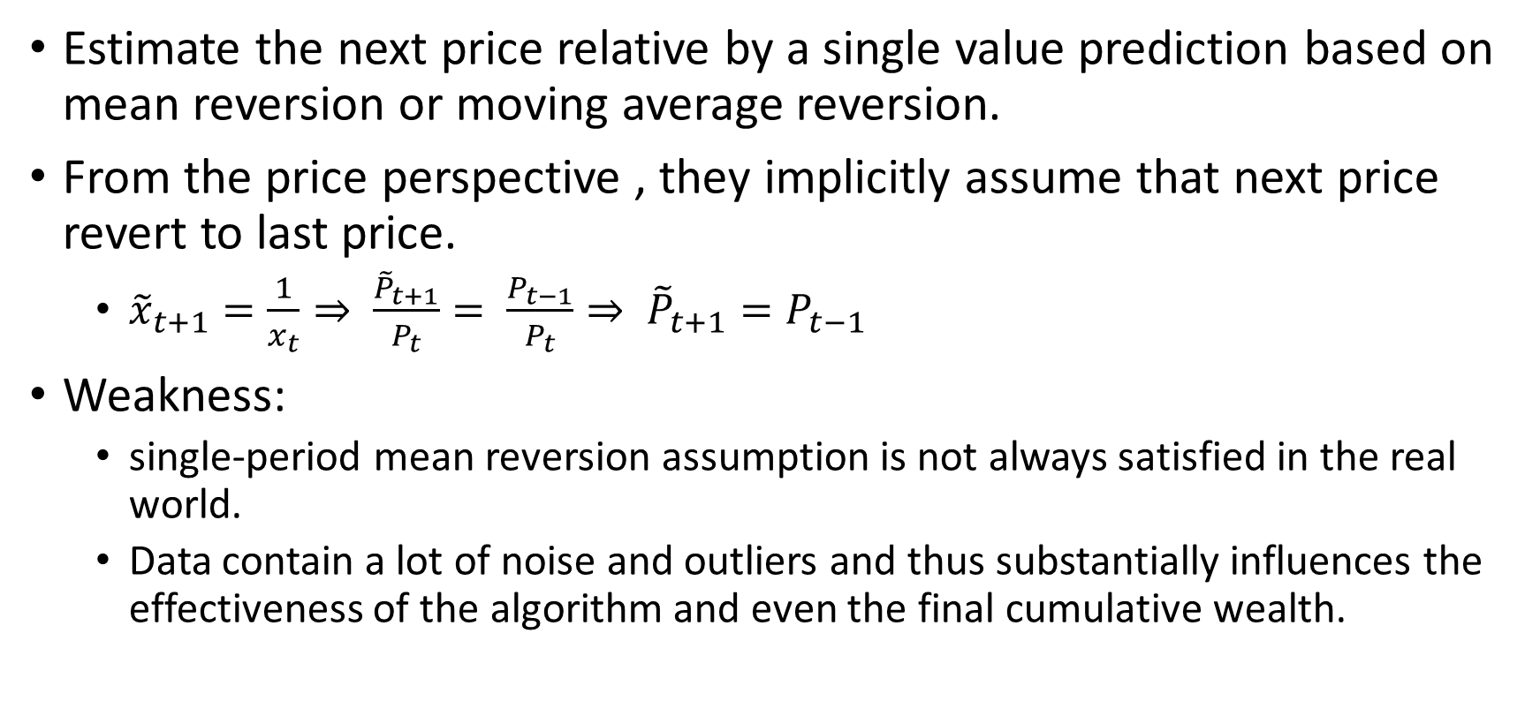
Mean Reversion
Estimate the next price relative by a single value prediction based on mean reversion or moving average reversion.
From the price perspective , they implicitly assume that next price revert to last price.
${\tilde{x}}_{t+1}=\frac{1}{x_{t}}⇒ \frac{{\tilde{P}}_{t+1}}{P_{t}}= \frac{P_{t−1}}{P_{t}}⇒ {\tilde{P}}_{t+1}=P_{t−1}$
Weakness:
single-period mean reversion assumption is not always satisfied in the real world.
Data contain a lot of noise and outliers and thus substantially influences the effectiveness of the algorithm and even the final cumulative wealth.

Slide 7
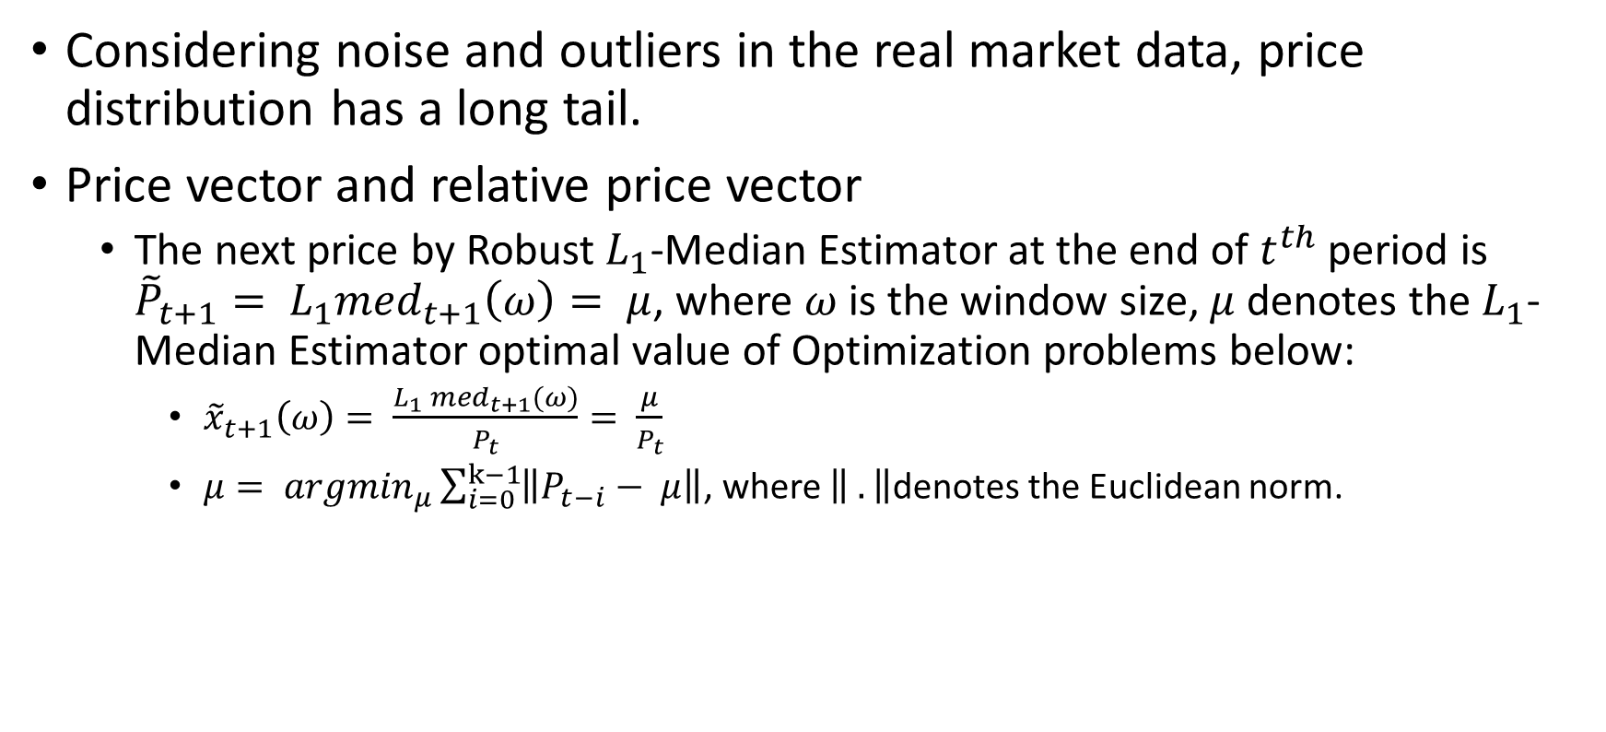
Robust Mean Reversion (‘RMR’)
Considering noise and outliers in the real market data, price distribution has a long tail.
Price vector and relative price vector
The next price by Robust$L_{1}$-Median Estimator at the end of $t^{th}$ period is ${\tilde{P}}_{t+1}= L_{1}{med}_{t+1}\left(ω\right)= μ$, where $ω$ is the window size, $μ$ denotes the $L_{1}$-Median Estimator optimal value of Optimization problems below:
${\tilde{x}}_{t+1}\left(ω\right)= \frac{L_{1} {med}_{t+1}(ω)}{P_{t}}= \frac{μ}{P_{t}}$
$μ= {argmin}_{μ}\sum_{i=0}^{k−1}{\left\|P_{t−i}− μ\right\|}$, where $\left\| .\right\|$denotes the Euclidean norm.

Slide 8

Robust Mean Reversion (‘RMR’)
Portfolio Vector
The basic idea is to maximize the expected return $b×{\tilde{x}}_{t+1}$ while keeping last portfolio information via regularization:
$b_{t+1}= {argmin}_{b∈∆d}{\frac{1}{2}\left\|b−b_{t}\right\|}^{2} s.t. b^{T}{\tilde{x}}_{t+1}≥ε$.
The above formulation attempts to find an optimal portfolio by minimizing the deviation from last portfolio $b_{t}$ under the condition of $b^{T}{\tilde{x}}_{t+1}≥ε$.

Slide 9
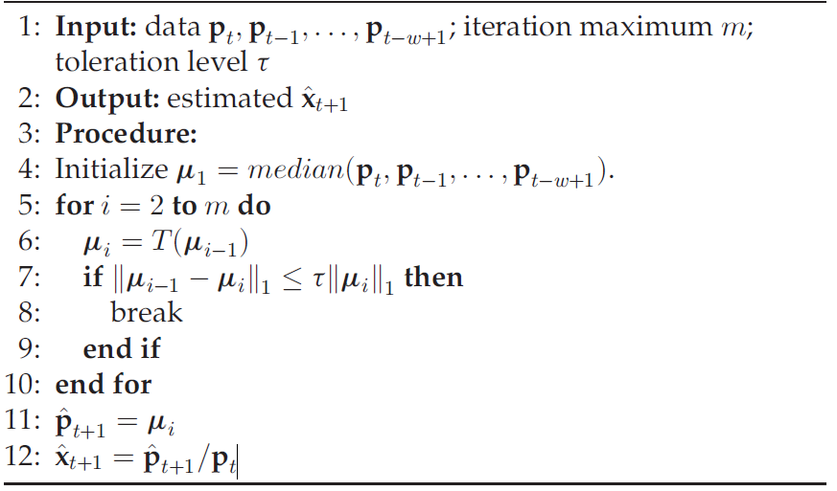
RMR Algorithm
1. Price and relative price

Slide 10
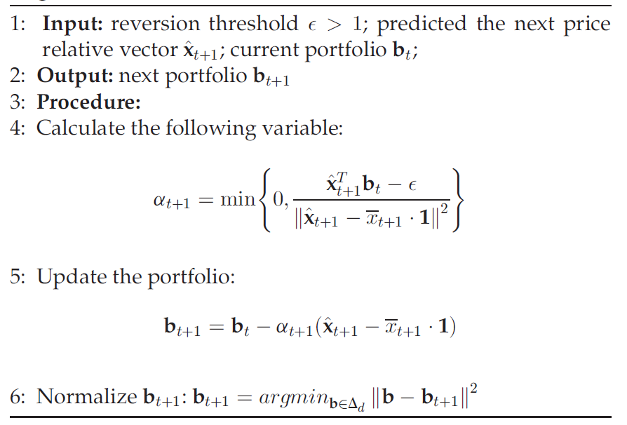
RMR Algorithm
2. Portfolio

Slide 11
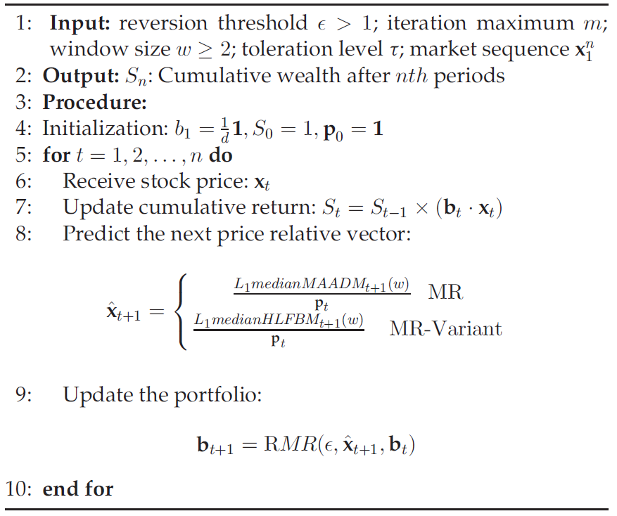
RMR Algorithm
3. Portfolio period return

Slide 12
Four other models
Best-stock (‘BEST’)
Buys the best stock over the period.
Obviously a hindsight strategy.
Passive aggressive mean reversion (‘PAMR’)
Estimate the next price relative as the inverse of last price relative
Adopt the single-period mean reversion assumption, not satisfied with reality
Cannot exempt from the influence of noise and outliers

Slide 13
Four other models
Online Moving Average Reversion (‘OLMAR’)
predicts the next price relative using moving averages and explores the multi-period mean reversion
Cannot exempt from the influence of noise and outliers
Market
buys assets according to a pre-defined weight and holds until the end.
In hindsight, the optimal strategy over a sequence of price relatives is the Best-stock.

Slide 14
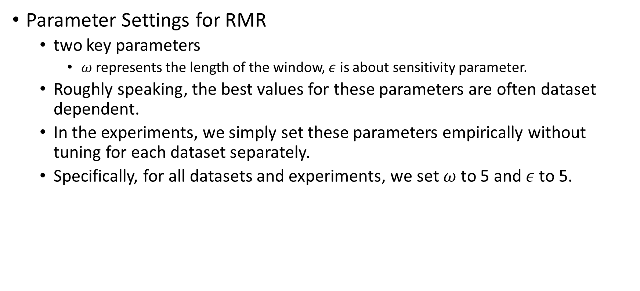
Experiments
Parameter Settings for RMR
two key parameters
$ω$represents the length of the window, $ε$ is about sensitivity parameter.
Roughly speaking, the best values for these parameters are often dataset dependent.
In the experiments, we simply set these parameters empirically without tuning for each dataset separately.
Specifically, for all datasets and experiments, we set $ω$to 5 and$ε$to 5.

Slide 15
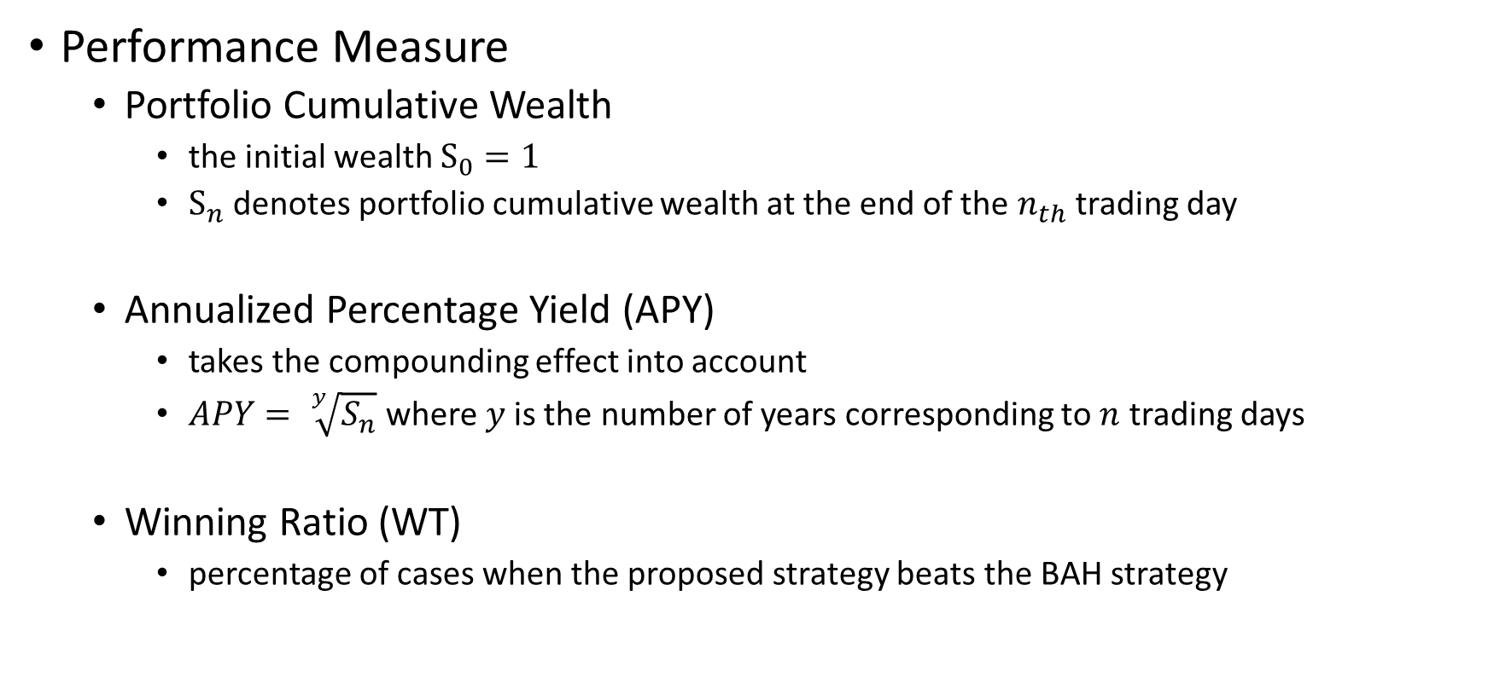
Experiments
Performance Measure
Portfolio Cumulative Wealth
the initial wealth $S_{0}=1$
$S_{n}$ denotes portfolio cumulative wealth at the end of the $n_{th}$ trading day
Annualized Percentage Yield (APY)
takes the compounding effect into account
$APY= \sqrt[y]{S_{n}}$ where $y$is the number of years corresponding to $n$ trading days
Winning Ratio (WT)
percentage of cases when the proposed strategy beats the BAH strategy

Slide 16
Experiments-1
Datasets
Data set | Region | Time Frame | #days | #assets
DJIA | US | 14/01/2001 - 14/01-2003 | 507 | 30
SP500 | US | 02/01/1998 - 31/01/2003 | 1276 | 25
TSE | CA | 04/01/1994 - 31/12/1998 | 1259 | 88
MSCI | Global | 01/04/2006 – 31/03/2010 | 1043 | 24
NYSE(O) | US | 03/04-1962 – 31/12/1984 | 5651 | 36
NYSE(N) | US | 01/01/1985 – 30/06/2010 | 6431 | 23

Slide 17
Experiments-1
Results - DJIA

Slide 18
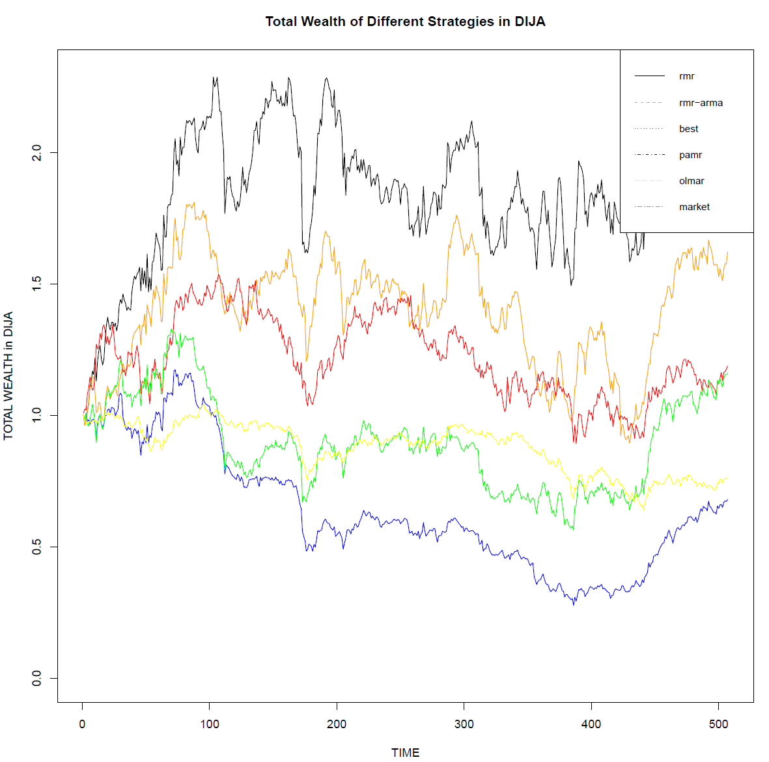

Slide 19
Experiments-1
Results – SP500

Slide 20
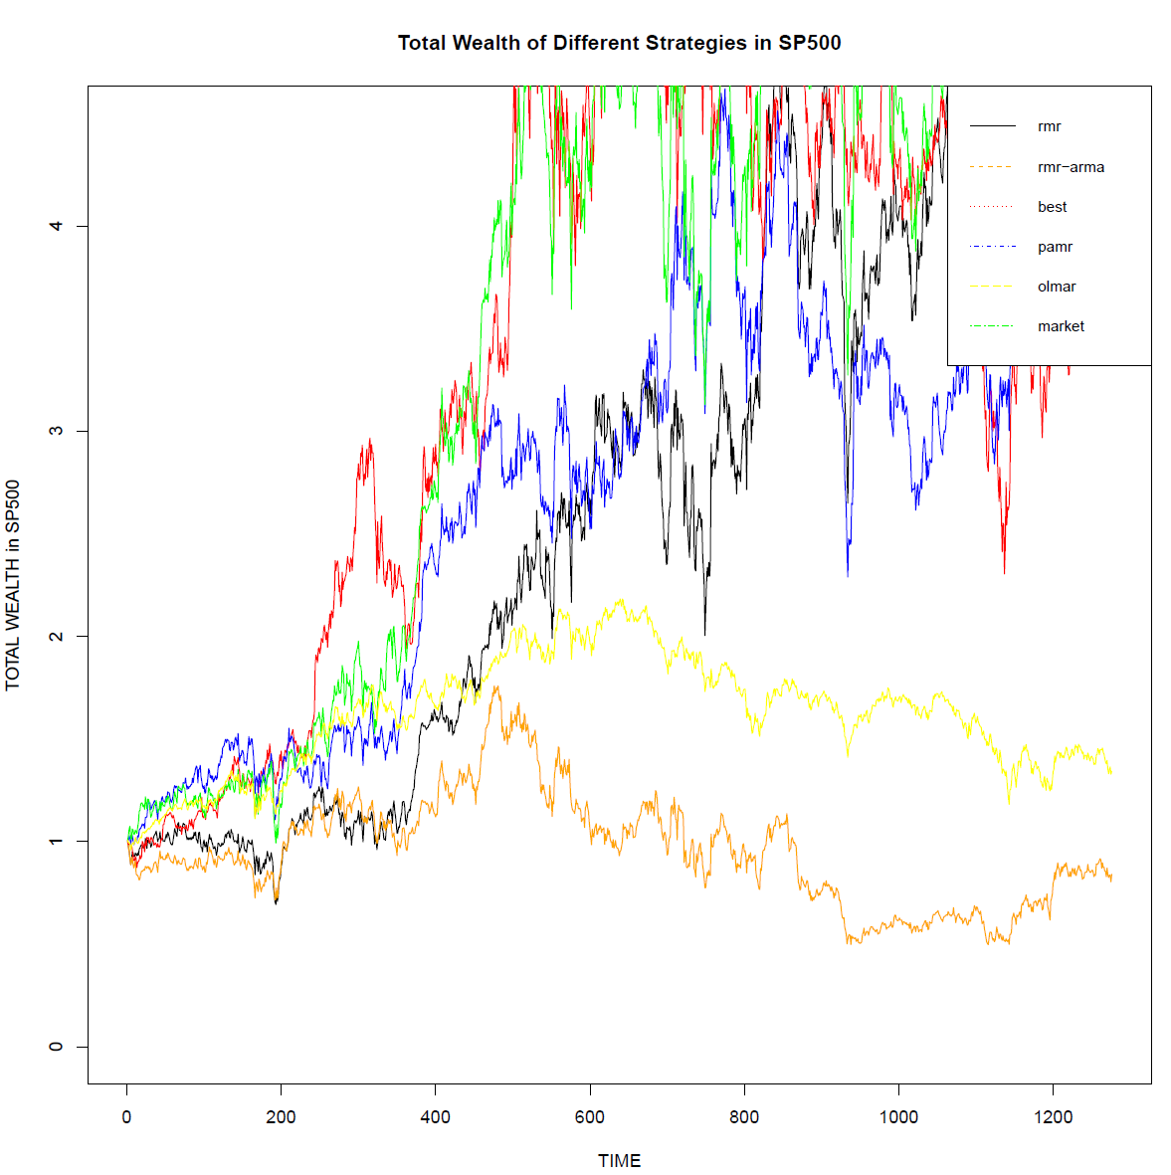

Slide 21
Experiments-1
Results – TSE

Slide 22
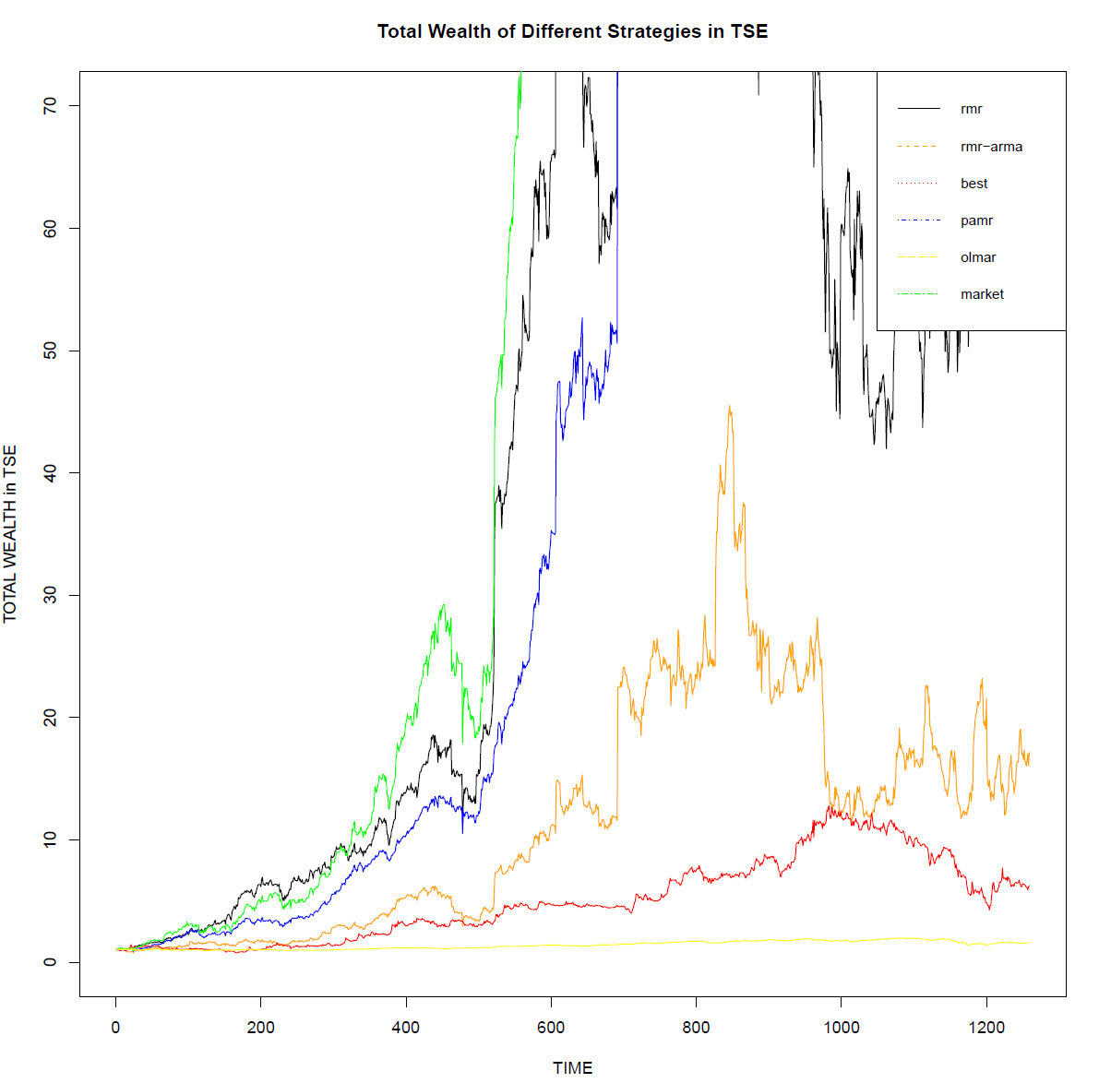

Slide 23
Experiments-1
Results – MSCI

Slide 24
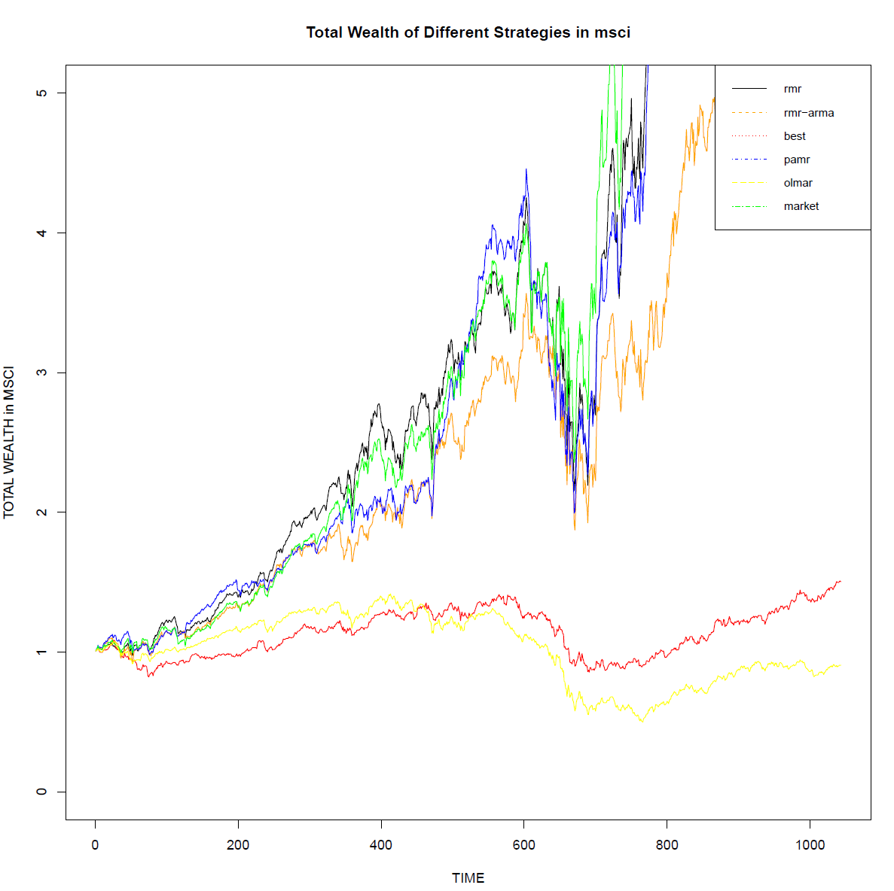

Slide 25
Experiments-1
Conclusion
1. RMR in combination with ARMA did good job in the original.

Slide 26
Experiments-2
Datasets
Data set | Region | Time Frame | #days | #assets
BE500 | UK | 09/01/1995 - 01/01-2018 | 5993 | 435
IBOV | BR | 04/01/1995 - 28/12/2017 | 5988 | 56
NDX | US | 04/01/1995 – 29/12/2017 | 5995 | 85
NKY | JP | 04/01/1995 – 29/12/2017 | 5990 | 213
TWSE | TW | 06/01/1995 – 29/12/2017 | 5992 | 733

Slide 27
Experiments-2
Results – NDX P1

Slide 28
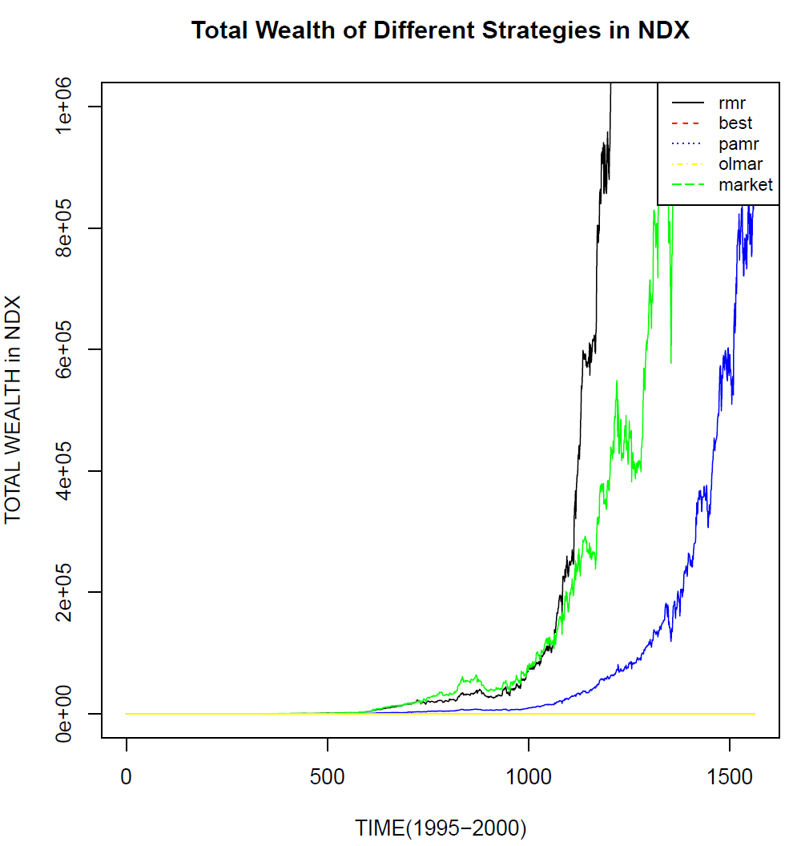

Slide 29
Experiments-2
Results – BE500 P1

Slide 30
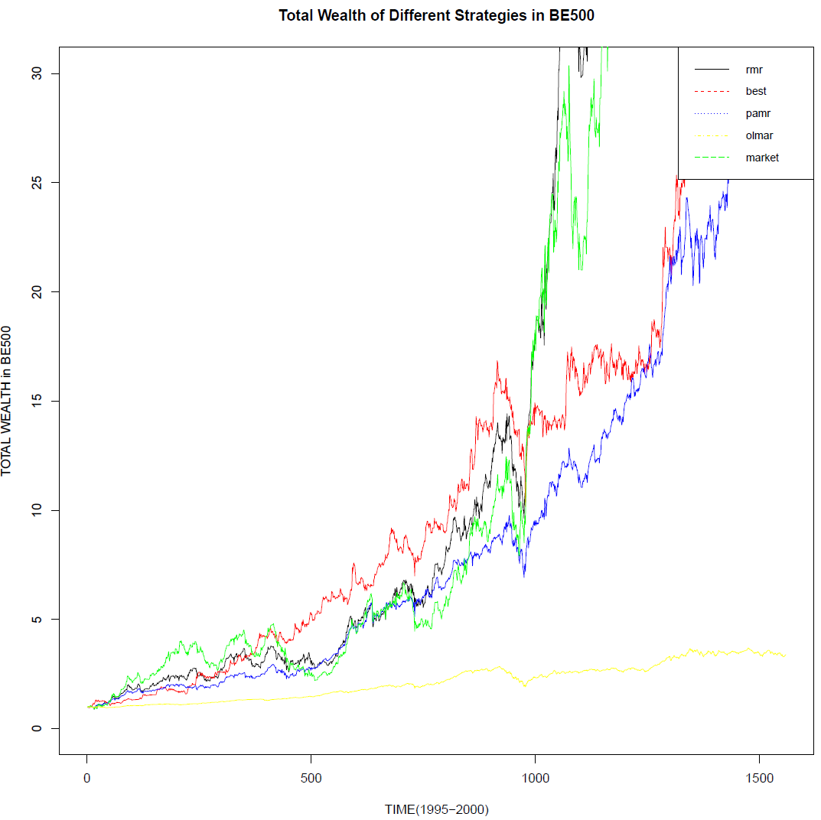

Slide 31
Experiments-2
Results-IBOV-p1

Slide 32
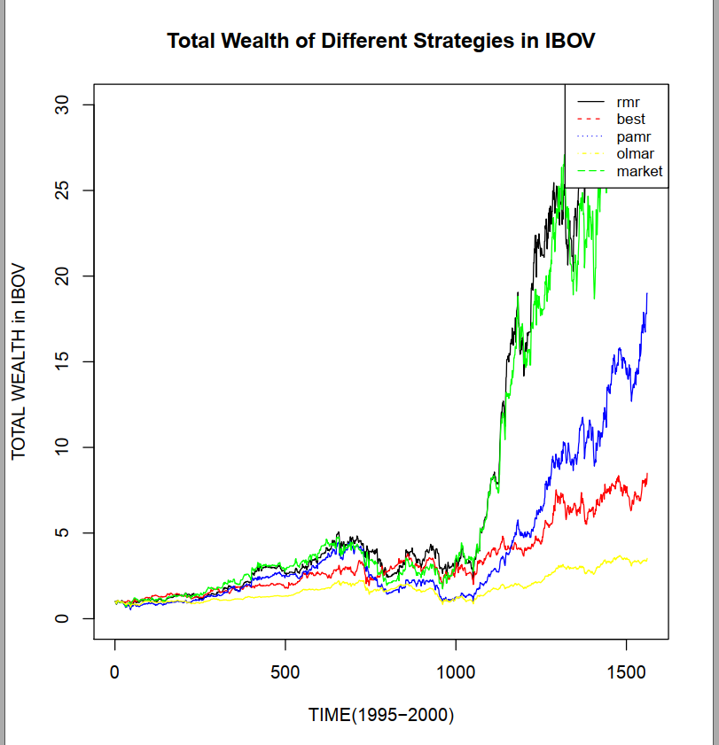

Slide 33
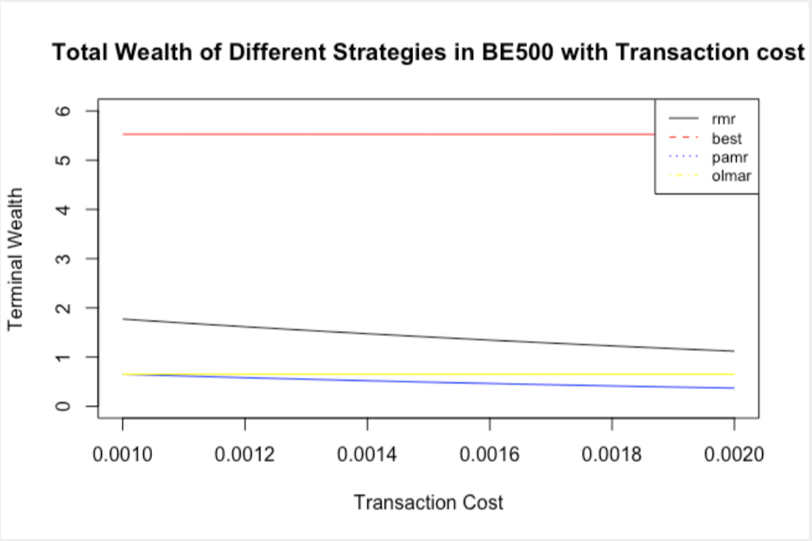
Experiments-2 (add tc)
Improvement:
add transaction cost to observe the performance of RMR.

Slide 34
Experiments-2 (add tc)
Result Analysis:
1. Because BEST strategy has the lowest turn-over rate, which means the lowest tansaction cost, BEST has very good performance.
2.RMR's performanc is largely affected by tansaction cost and it's suitable for market with low tc, like US.

Slide 35
Experiments-2
Exception – BE500 P3

Slide 36
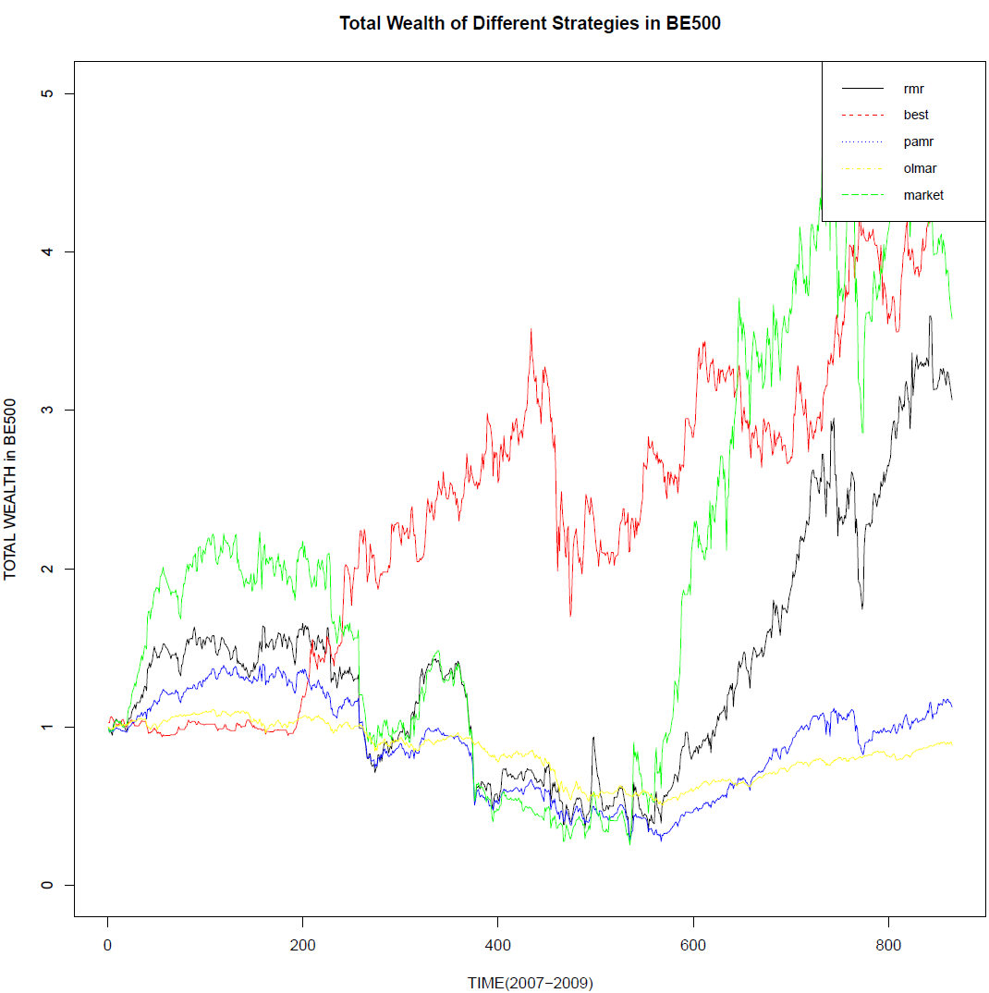

Slide 37
Experiments-2
Exception – IBOV P2

Slide 38
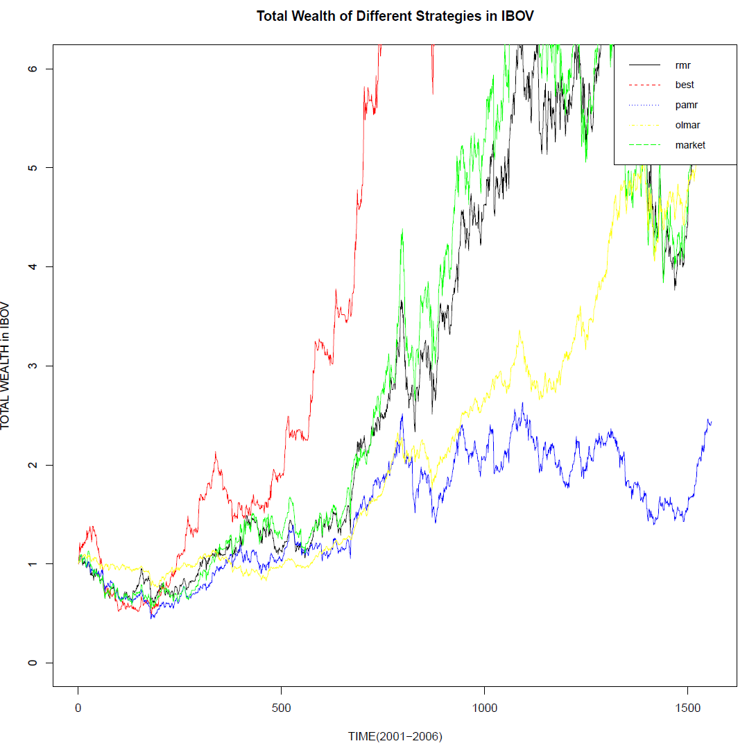

Slide 39
Experiments-2
Conclusion
1. RMR perform well in most markets but there're some exceptions.
2. RMR's performance is highly impacted by transaction cost.
3.During financial crisis, momentum strategy has better performance.

Slide 40
Reference
D. Huang, J. Zhou, B. Li, S. Hoi, and S. Zhou, “Robust Median Reversion Strategy for Online Portfolio Selection,” IEEE TRANSACTIONS ON KNOWLEDGE AND DATA ENGINEERING, VOL. 28, NO. 9, SEPTEMBER 2016.
B. Li and S. C. H. Ho, “On-line portfolio selection with moving average reversion,” in Proc. Int. Conf. Mach. Learning, 2012, pp. 273–228.
B. Li, P. Zhao, S. C. Hoi, and V. Gopalkrishnan, “PAMR: Passive aggressive mean reversion strategy for portfolio selection,” Mach. Learn., vol. 87, no. 2, pp. 221–258, May 2012.

