Slide 1
Robust Median Reversion Strategy
Group Name: Alpha
Members: HO Ngok Chao, FENG Tiantian,
HU Mingyue, ZHU Haolin, SU Yulu

Slide 2
Content
Portfolio Selection
Median Reversion
Robust Median Reversion (‘RMR’)
RMR Algorithm
Four other models
Experiment-1
Experiment-2
Conclusion

Slide 3



Challenges

Slide 4
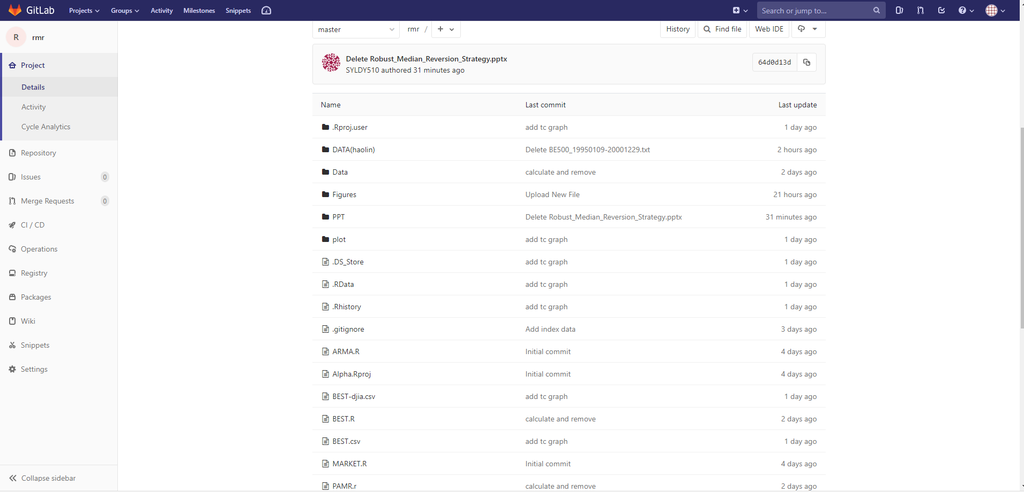
Our solution

Slide 5
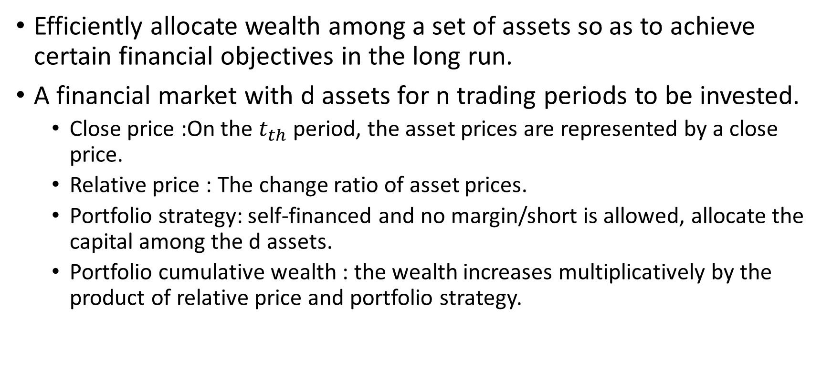
Portfolio Selection
Efficiently allocate wealth among a set of assets so as to achieve certain financial objectives in the long run.
A financial market with d assets for n trading periods to be invested.
Close price :On the $t_{th}$ period, the asset prices are represented by a close price.
Relative price : The change ratio of asset prices.
Portfolio strategy: self-financed and no margin/short is allowed, allocate the capital among the d assets.
Portfolio cumulative wealth : the wealth increases multiplicatively by the product of relative price and portfolio strategy.

Slide 6
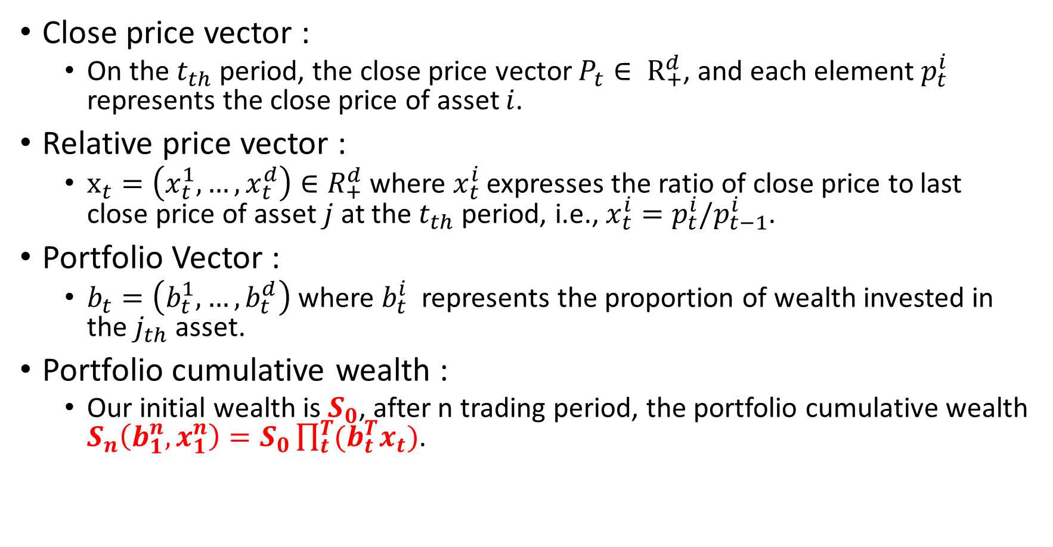
Portfolio Selection
Close price vector :
On the $t_{th}$ period, the close price vector $P_{t}∈ R_{+}^{d}$, and each element $p_{t}^{i}$ represents the close price of asset $i$.
Relative price vector :
$x_{t}=\left(x_{t}^{1},…,x_{t}^{d}\right)∈R_{+}^{d}$ where $x_{t}^{i}$ expresses the ratio of close price to last close price of asset $j$ at the $t_{th}$ period, i.e., $x_{t}^{i}=p_{t}^{i}/p_{t−1}^{i}$.
Portfolio Vector :
$b_{t}=\left(b_{t}^{1},…,b_{t}^{d}\right)$where $b_{t}^{i}$ represents the proportion of wealth invested in the $j_{th}$ asset.
Portfolio cumulative wealth :
Our initial wealth is $S_{0}$, after n trading period, the portfolio cumulative wealth $S_{n}\left(b_{1}^{n},x_{1}^{n}\right)=S_{0}\prod_{t}^{T}{(b_{t}^{T}x_{t})}$.

Slide 7
Assumptions
1) Transaction cost:
we assume no transaction cost or taxes in this PS model;
2) Market liquidity:
we assume that one can buy and sell required quantities at last closing price of any given trading period;
3) Impact cost:
we assume that market behavior is not affected by a PS strategy.

Slide 8
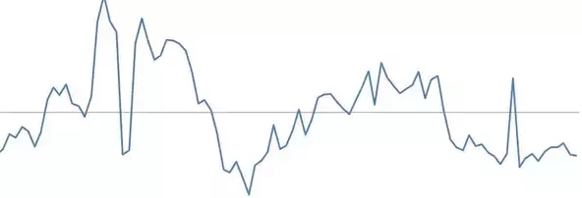
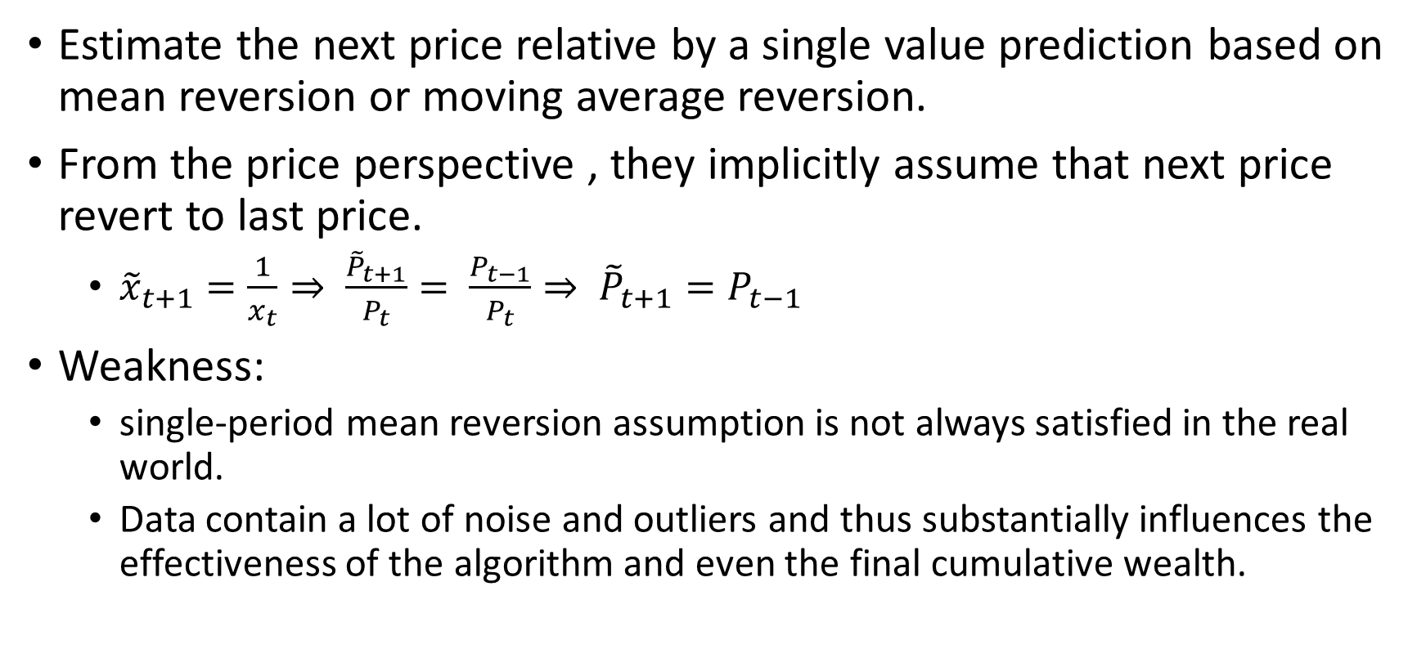
Mean Reversion
Estimate the next price relative by a single value prediction based on mean reversion or moving average reversion.
From the price perspective , they implicitly assume that next price revert to last price.
${\tilde{x}}_{t+1}=\frac{1}{x_{t}}⇒ \frac{{\tilde{P}}_{t+1}}{P_{t}}= \frac{P_{t−1}}{P_{t}}⇒ {\tilde{P}}_{t+1}=P_{t−1}$
Weakness:
single-period mean reversion assumption is not always satisfied in the real world.
Data contain a lot of noise and outliers and thus substantially influences the effectiveness of the algorithm and even the final cumulative wealth.

Slide 9
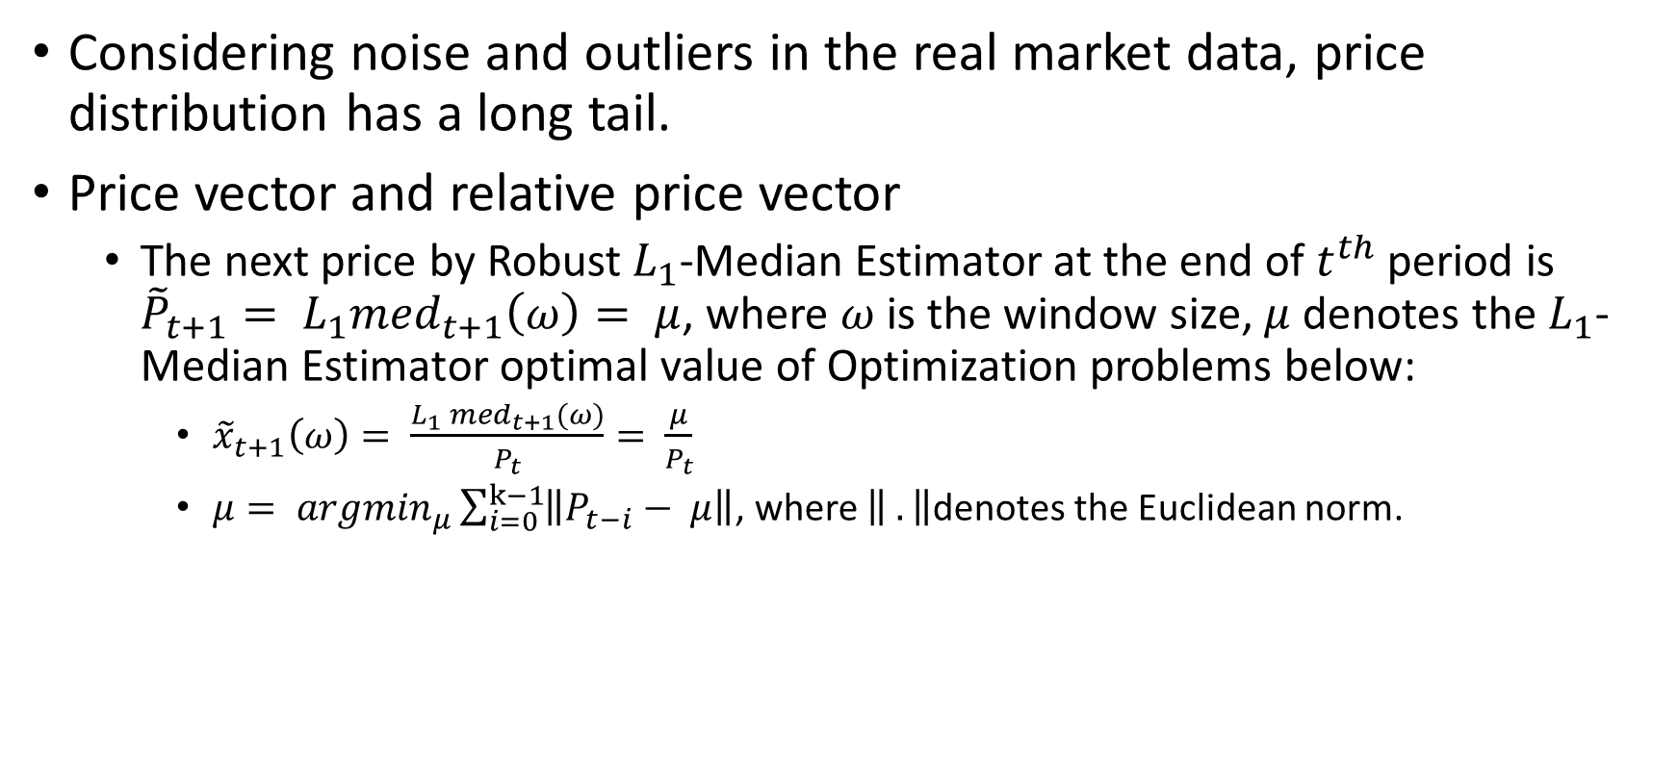
Robust Mean Reversion (‘RMR’) – 1st Optimization Problem
Considering noise and outliers in the real market data, price distribution has a long tail.
Price vector and relative price vector
The next price by Robust$L_{1}$-Median Estimator at the end of $t^{th}$ period is ${\tilde{P}}_{t+1}= L_{1}{med}_{t+1}\left(ω\right)= μ$, where $ω$ is the window size, $μ$ denotes the $L_{1}$-Median Estimator optimal value of Optimization problems below:
${\tilde{x}}_{t+1}\left(ω\right)= \frac{L_{1} {med}_{t+1}(ω)}{P_{t}}= \frac{μ}{P_{t}}$
$μ= {argmin}_{μ}\sum_{i=0}^{k−1}{\left\|P_{t−i}− μ\right\|}$, where $\left\| .\right\|$denotes the Euclidean norm.

Slide 10

Robust Mean Reversion (‘RMR’) – 2nd Optimization Problem
Portfolio Vector
$b_{t+1}= {argmin}_{b∈∆d}{\frac{1}{2}\left\|b−b_{t}\right\|}^{2} s.t. b^{T}{\tilde{x}}_{t+1}≥ε$.
The above formulation attempts to find an optimal portfolio by minimizing the deviation from last portfolio $b_{t}$ under the condition of $b^{T}{\tilde{x}}_{t+1}≥ε$.

Slide 11
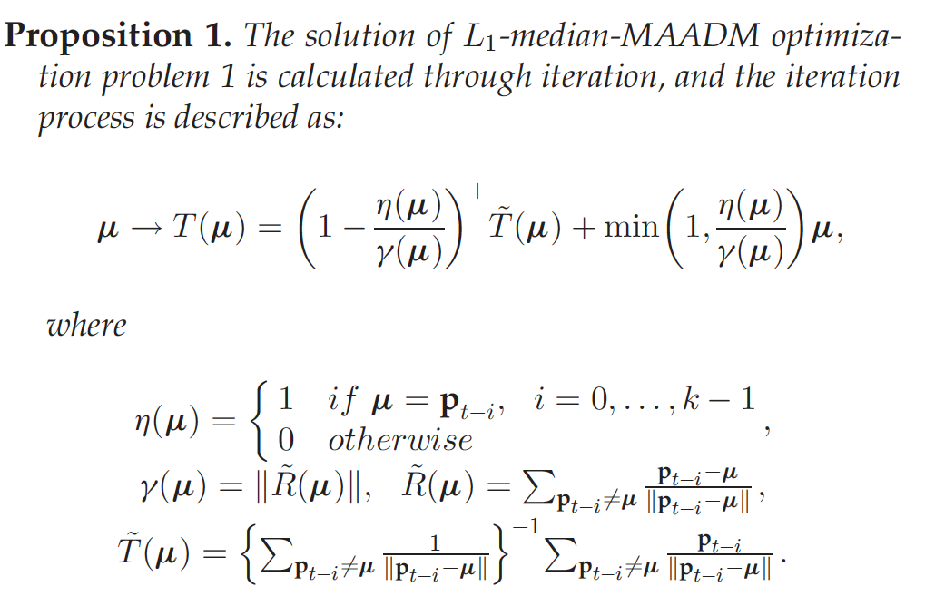
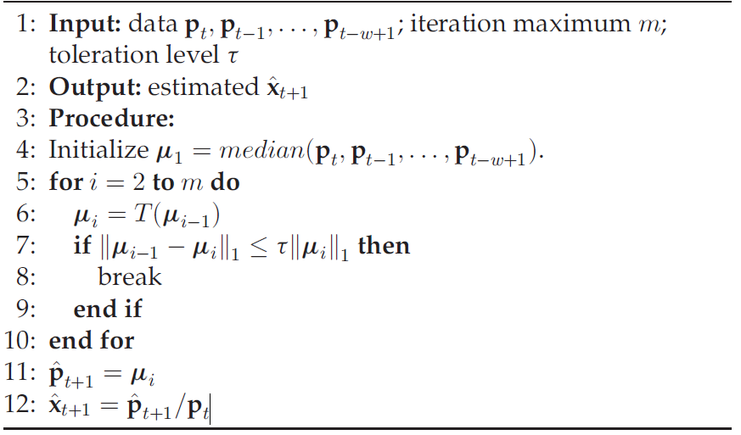
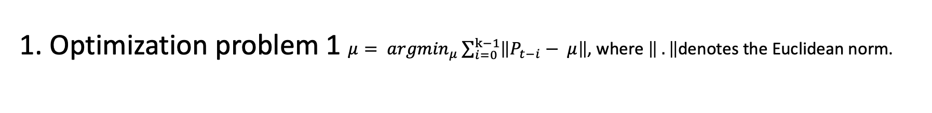
RMR Algorithm
1. Optimization problem 1 $μ= {argmin}_{μ}\sum_{i=0}^{k−1}{\left\|P_{t−i}− μ\right\|}$, where $\left\| .\right\|$denotes the Euclidean norm.

Slide 12
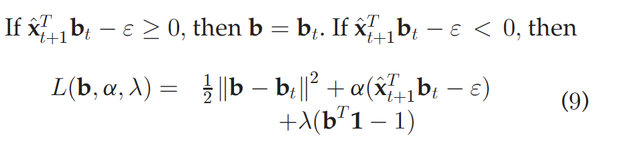
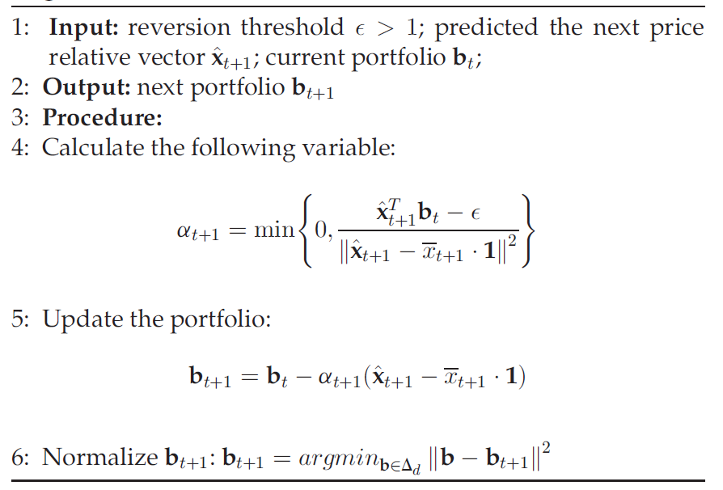
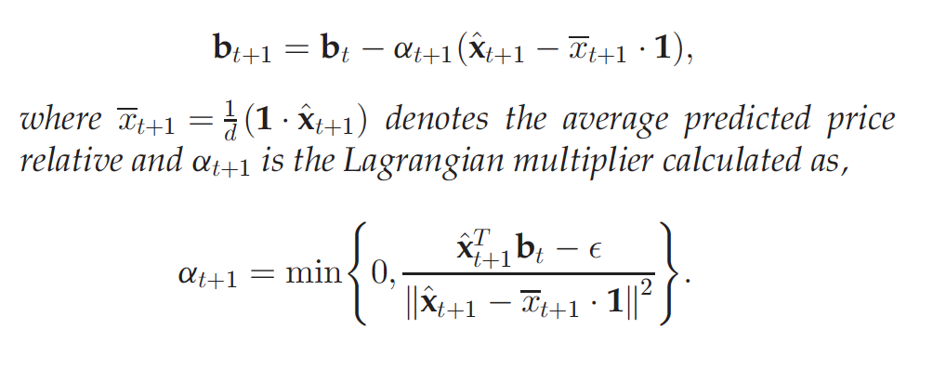
RMR Algorithm
2. Optimization problem 2 $b_{t+1}= {argmin}_{b∈∆d}{\frac{1}{2}\left\|b−b_{t}\right\|}^{2} s.t. b^{T}{\tilde{x}}_{t+1}≥ε$.
Solution:

Slide 13
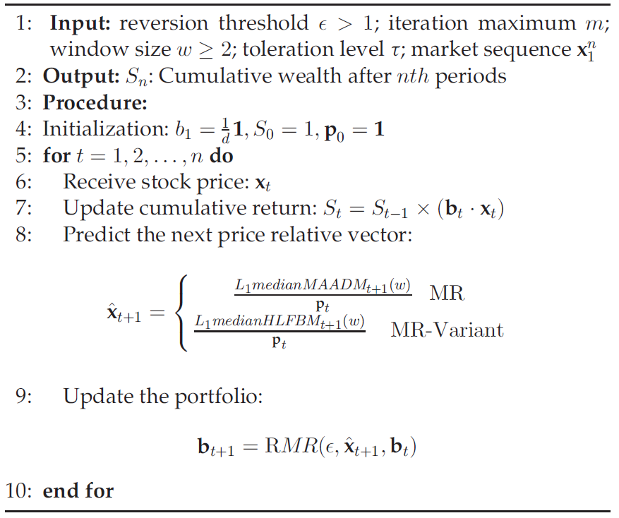
RMR Algorithm
3. Summary

Slide 14
Four other models
Best-stock (‘BEST’)
Buys the best stock over the period.
Obviously a hindsight strategy.
Passive aggressive mean reversion (‘PAMR’)
Estimate the next price relative as the inverse of last price relative
Adopt the single-period mean reversion assumption, not satisfied with reality
Cannot exempt from the influence of noise and outliers

Slide 15
Four other models
Online Moving Average Reversion (‘OLMAR’)
predicts the next price relative using moving averages and explores the multi-period mean reversion
Cannot exempt from the influence of noise and outliers
Market
buys assets according to a pre-defined weight and holds until the end.
In the experiment, we used equal weight.

Slide 16
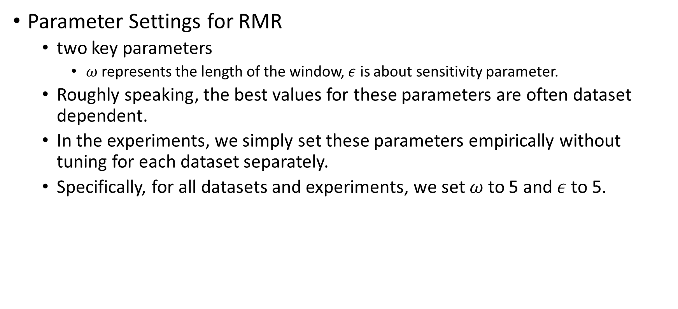
Experiments
Parameter Settings for RMR
two key parameters
$ω$represents the length of the window, $ε$ is about sensitivity parameter.
Roughly speaking, the best values for these parameters are often dataset dependent.
In the experiments, we simply set these parameters empirically without tuning for each dataset separately.
Specifically, for all datasets and experiments, we set $ω$to 5 and$ε$to 5.

Slide 17
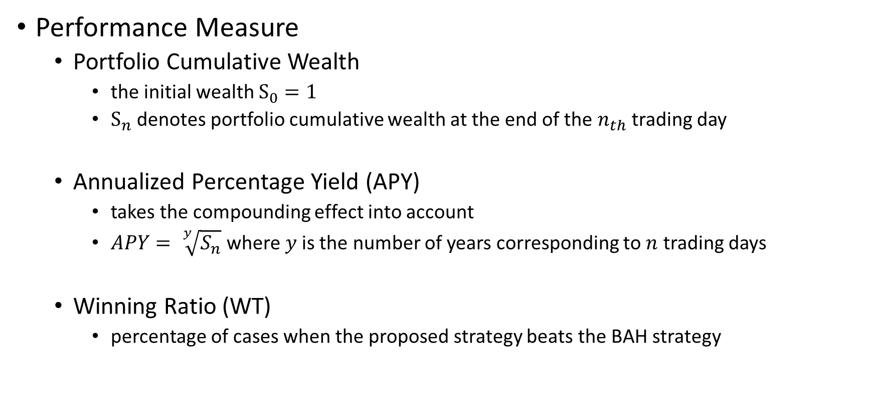
Experiments
Performance Measure
Portfolio Cumulative Wealth
the initial wealth $S_{0}=1$
$S_{n}$ denotes portfolio cumulative wealth at the end of the $n_{th}$ trading day
Annualized Percentage Yield (APY)
takes the compounding effect into account
$APY= \sqrt[y]{S_{n}}$ where $y$is the number of years corresponding to $n$ trading days
Winning Ratio (WT)
percentage of cases when the proposed strategy beats the BAH strategy

Slide 18
Experiments-1
Datasets
Data set | Region | Time Frame | #days | #assets
DJIA | US | 14/01/2001 - 14/01-2003 | 507 | 30
SP500 | US | 02/01/1998 - 31/01/2003 | 1276 | 25
TSE | CA | 04/01/1994 - 31/12/1998 | 1259 | 88
MSCI | Global | 01/04/2006 – 31/03/2010 | 1043 | 24
NYSE(O) | US | 03/04-1962 – 31/12/1984 | 5651 | 36
NYSE(N) | US | 01/01/1985 – 30/06/2010 | 6431 | 23

Slide 19
Experiments-1
Results - DJIA

Slide 20
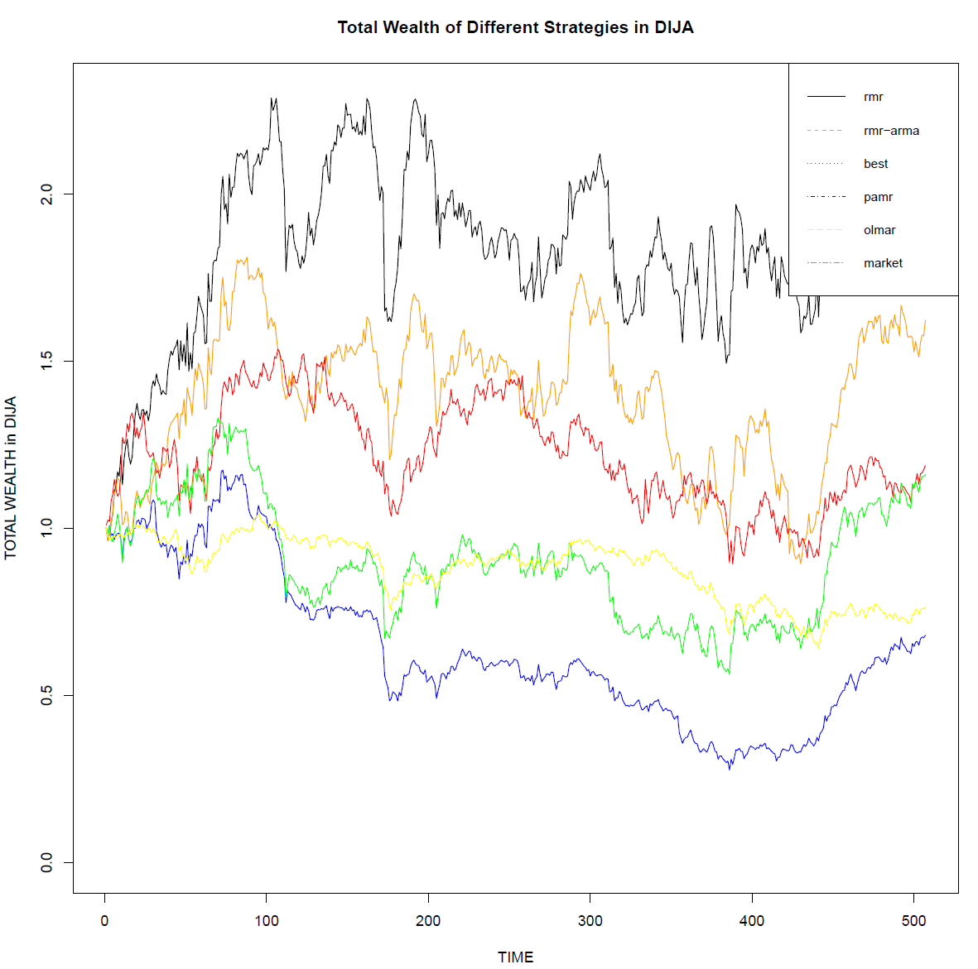

Slide 21
Experiments-1
Results – SP500

Slide 22
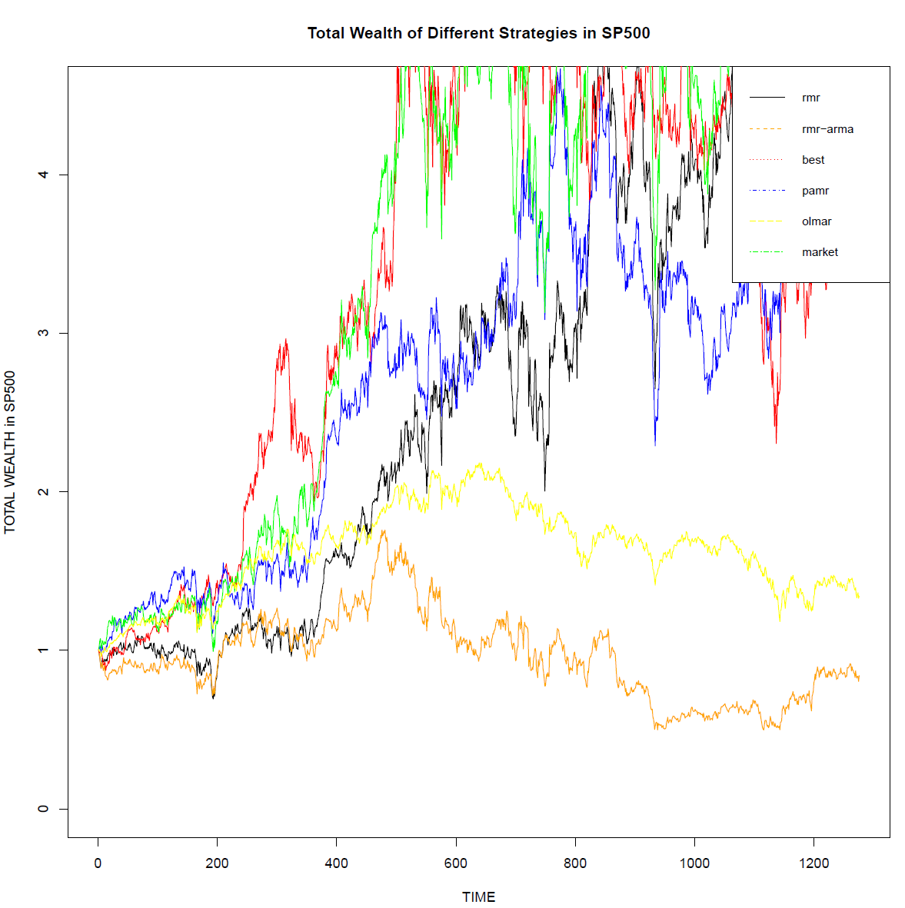

Slide 23
Experiments-1
Results – TSE

Slide 24
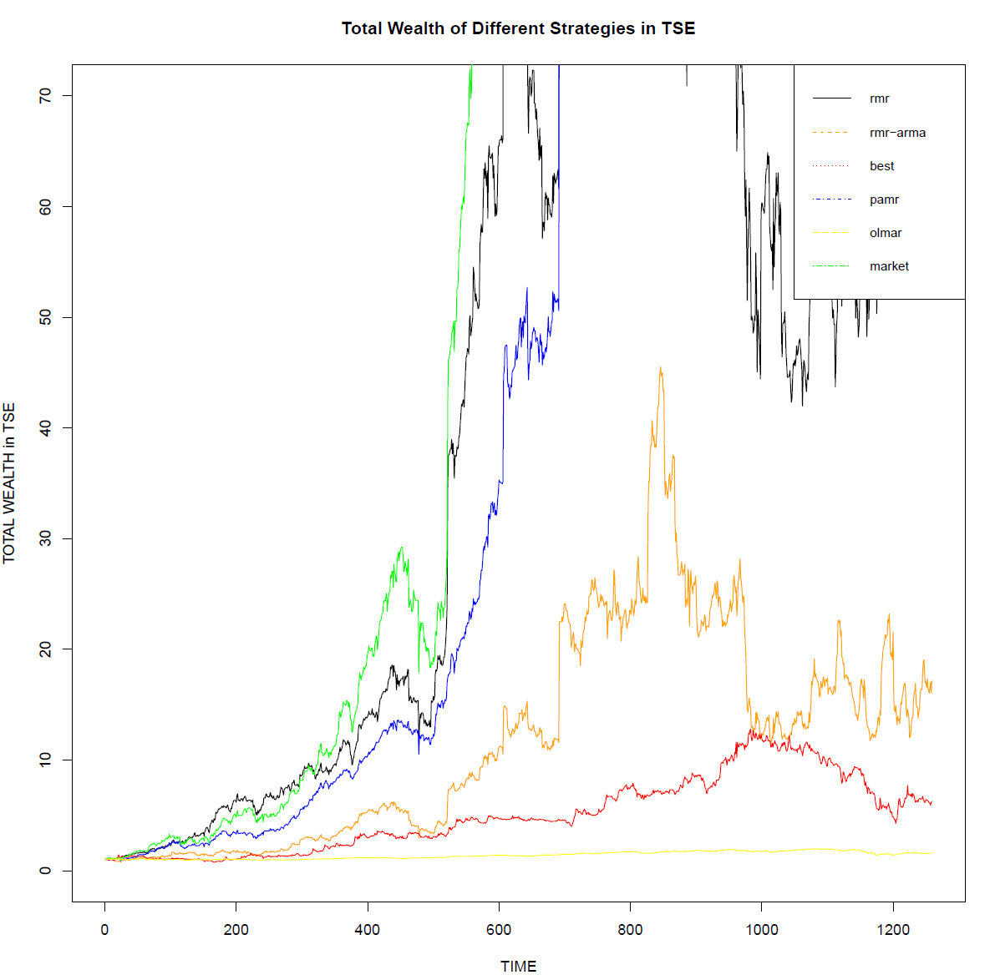

Slide 25
Experiments-1
Results – MSCI

Slide 26
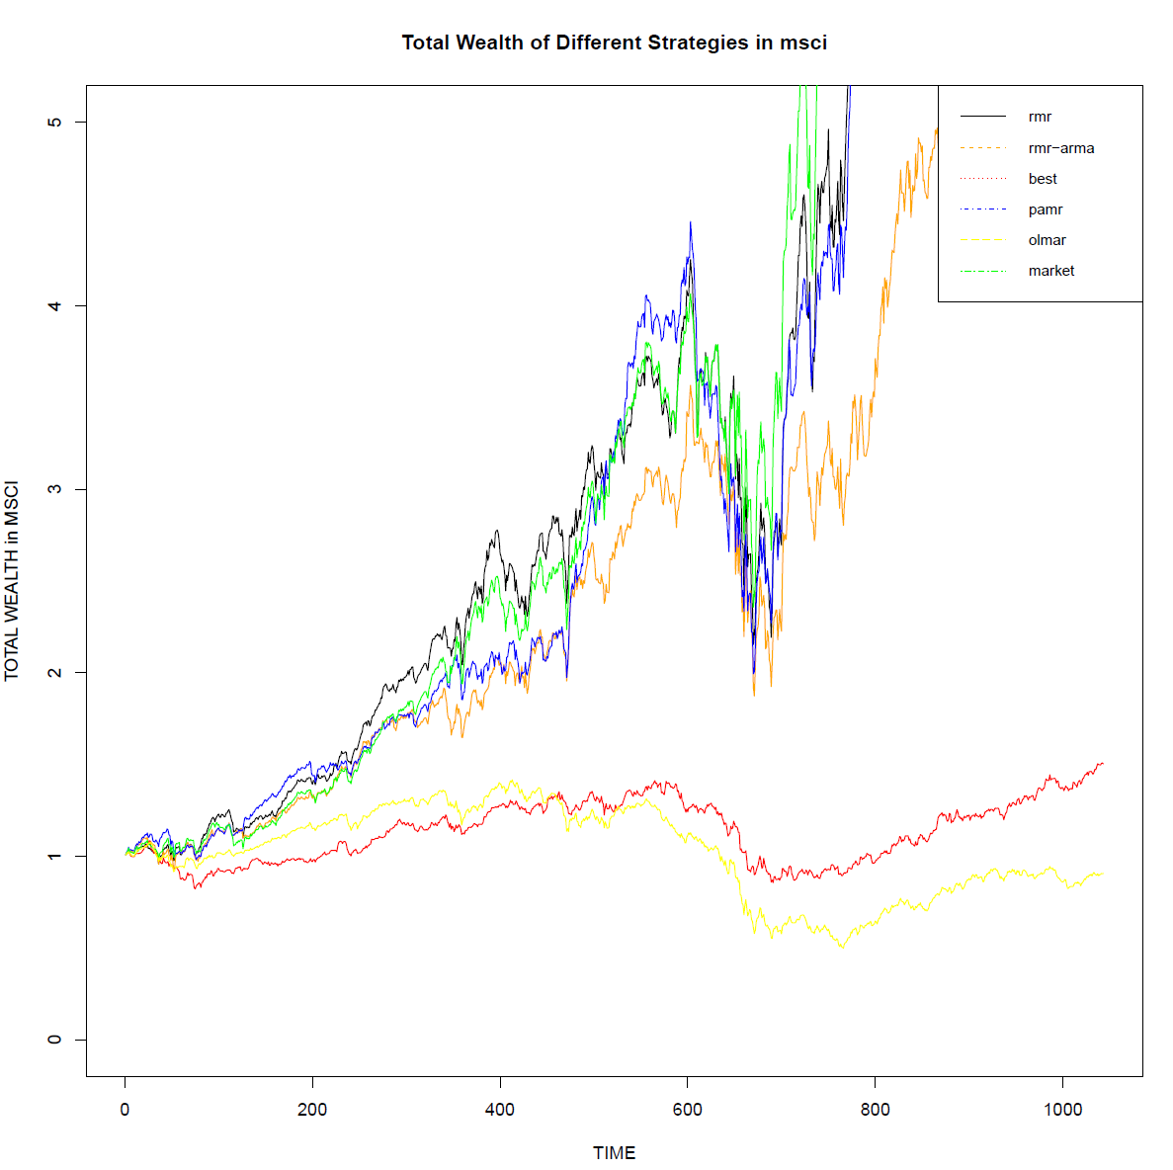

Slide 27
Experiments-1
Conclusion

Slide 28
Experiments-2
Datasets
Data set | Region | Time Frame | #days | #assets
BE500 | UK | 05/01/1995 - 14/01-2003
IBOV | BR | 05/01/1995 - 31/01/2003
NDX | US
NKY | JP
TWSE | TW

Slide 29
Experiments-2
Results – NDX P1

Slide 30
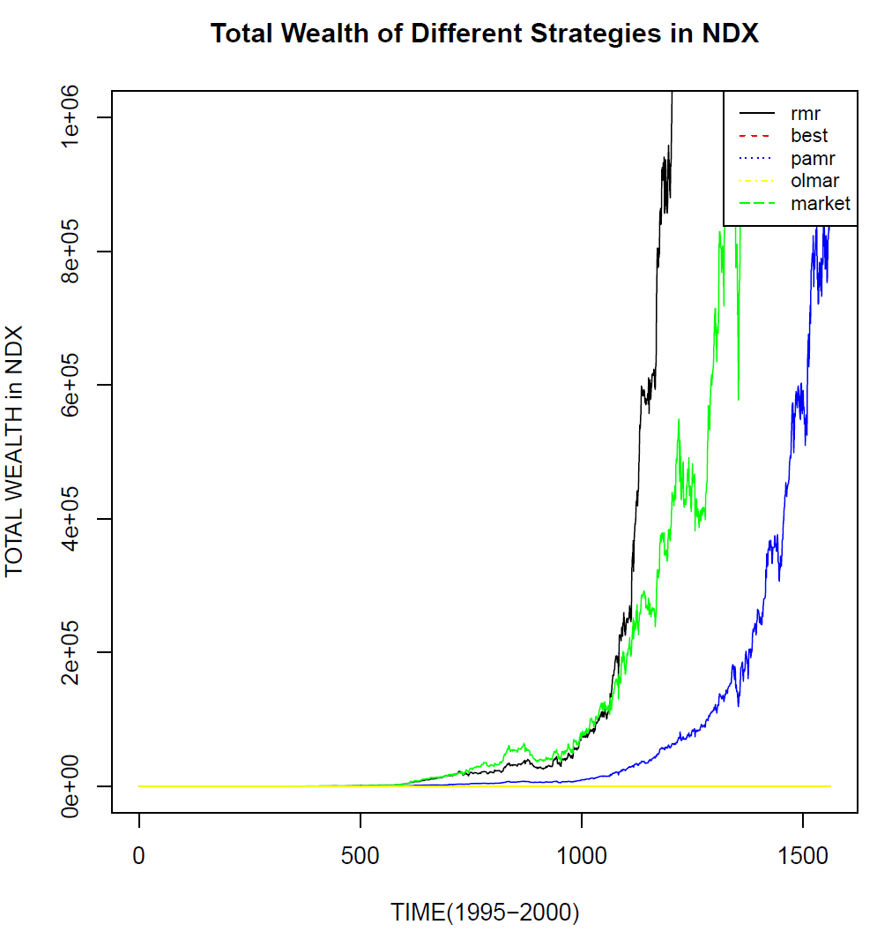

Slide 31
Experiments-2
Results – BE500 P1

Slide 32
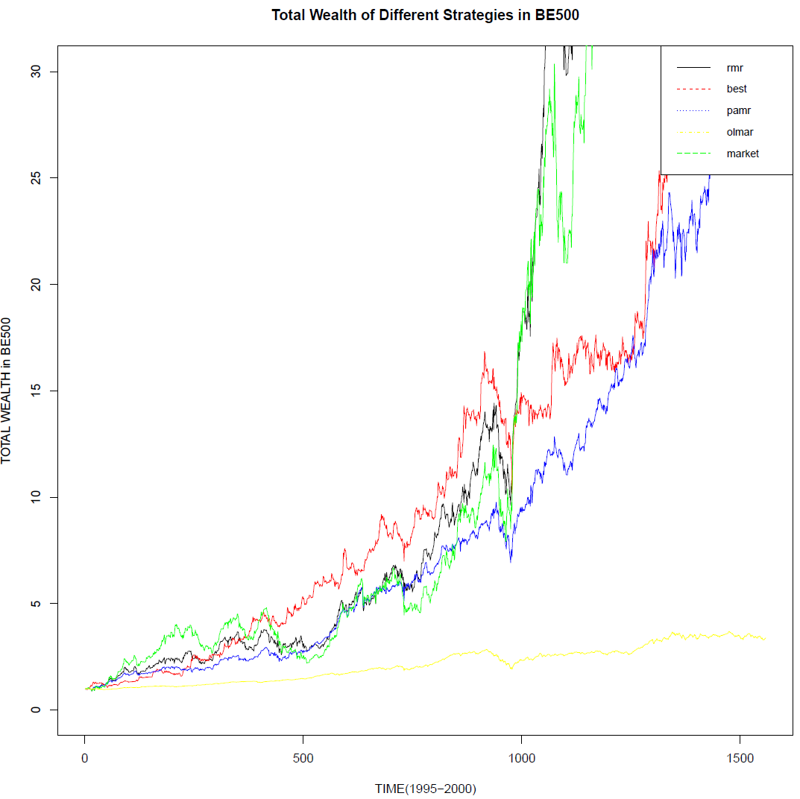

Slide 33
Experiments-2
Exception – BE500 P3

Slide 34
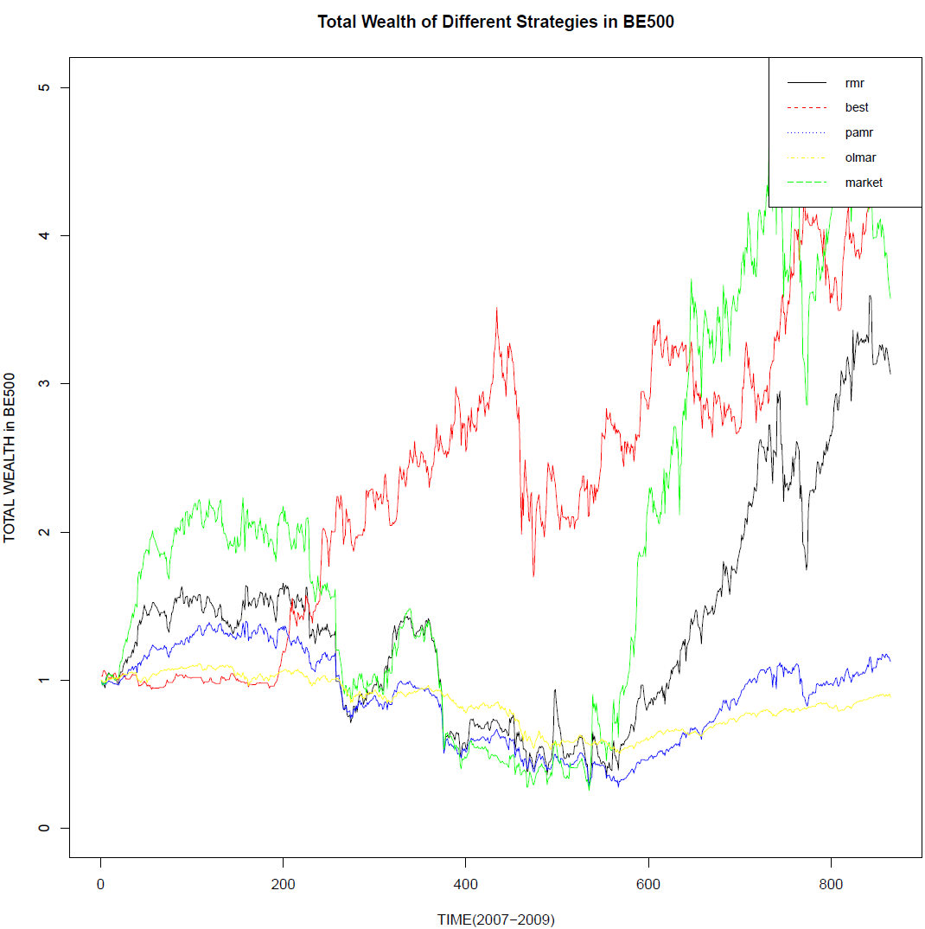

Slide 35
Experiments-2
Exception – IBOV P2

Slide 36
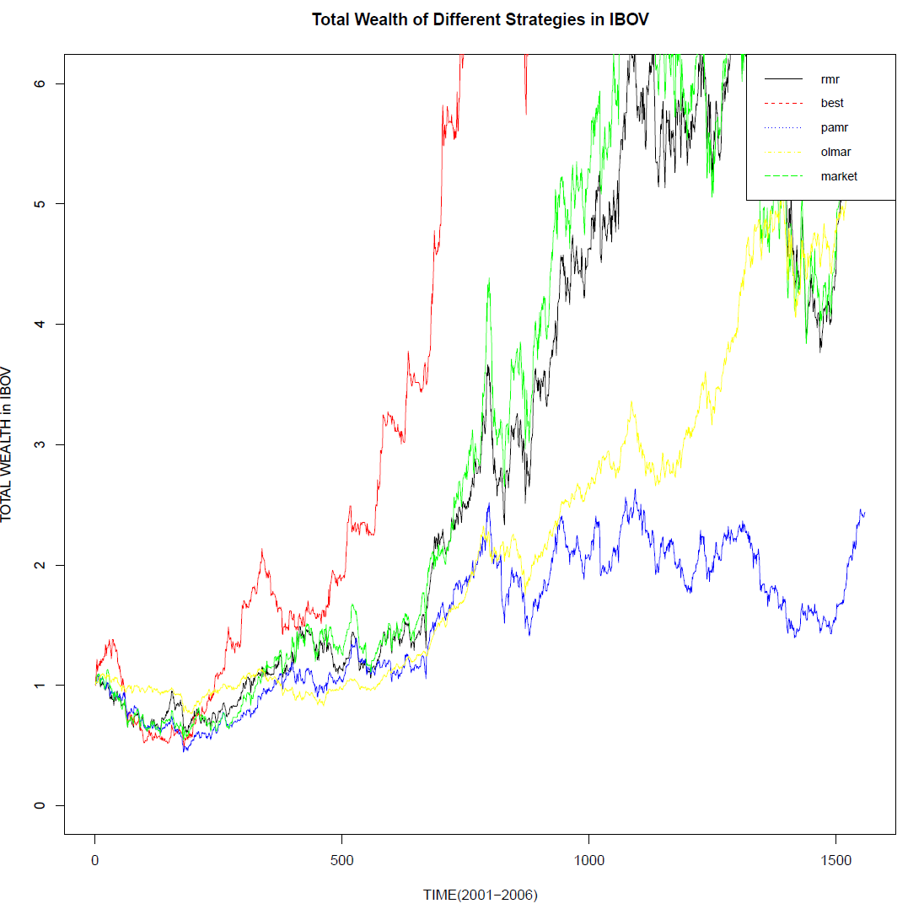

Slide 37
Conclusion

Slide 38
Reference
D. Huang, J. Zhou, B. Li, S. Hoi, and S. Zhou, “Robust Median Reversion Strategy for Online Portfolio Selection,” IEEE TRANSACTIONS ON KNOWLEDGE AND DATA ENGINEERING, VOL. 28, NO. 9, SEPTEMBER 2016.
B. Li and S. C. H. Ho, “On-line portfolio selection with moving average reversion,” in Proc. Int. Conf. Mach. Learning, 2012, pp. 273–228.
B. Li, P. Zhao and S. C. H. Ho, “PAMR: Passive aggressive mean reversion strategy for portfolio selection,” Mach. Learning, May 2012, VOL. 87, Issue 2, pp. 221-258.

