Slide 1
Bank Analytics & Business Case
Ngoné Lo
April 2021

Slide 2
Data Manipulation Query Answer Summary Page
What branch has the most number of customers?
ANSWER: The branch with the most number of customers is branch 1029 with 151 customers
How old is the oldest customer as of 2019-07-01?
ANSWER: The oldest customer is 107 years/ 38968 days old as of 2019-07-01.
How many accounts does the oldest customer have?
ANSWER: The oldest customer has 2 account(s).
How many transactions went to Starbucks in April?
ANSWER: 395 transactions went to Starbucks in April.
How much was spent on Starbucks in April?
ANSWER: The amount spent on Starbucks in April is 1720.87 CAD.
Hypothesis Testing: Is the average spend at Starbucks (statistically) significantly different in April compared to June?
ANSWER: No, the average spent at Starbucks is not (statistically) significantly different in April compared to June.
Which date exhibited the highest average spend above trend at Starbucks (based on a 10-period moving average, ignoring missing dates)?
ANSWER: The date exhibiting the highest average spent above trend is 2018-10-18

Slide 3
Data Manipulation Query Answer Code
Branch with most customers
unique_branch_cust = df_accts.drop_duplicates(subset=['branchNumber', 'cust_id’])
MostCustBranch = Counter(unique_branch_cust.branchNumber).most_common(1)
print("The branch with the most number of customers is branch", MostCustBranch[0][0], "with",MostCustBranch[0][1], "customers")
Age of oldest customer as of 2019-07-01
idOldest=df_custs[df_custs['birthDate'] == min(df_custs['birthDate'])]['id']
ageDays=(datetime.strptime('2019-7-1', "%Y-%m-%d") - min(df_custs['birthDate'])).days
ageYear=round(ageDays/365.25)
print('The oldest customer is', ageYear, 'years/', ageDays, 'days old as of 2019-07-01, is the customer with the id ',
list(idOldest), ', and was born on', min(df_custs['birthDate']).date(), '.')
Oldest customer number of accounts
idOldest=df_custs[df_custs['birthDate'] == min(df_custs['birthDate'])]['id']
print('The oldest customer has', (df_accts[df_accts['cust_id']==list(idOldest)[0]]).shape[0], 'account(s).’)
Number of transactions to Starbucks
print((df_tx[(df_tx['originationDateTime'].dt.month==4) & (df_tx['description'].str.contains('STARBUCKS'))]).shape[0],
'transactions went to Starbucks in April.’)
Dollars spent at Starbucks
print('The amount spent on Starbucks in April is',
df_tx[(df_tx['originationDateTime'].dt.month==4) & (df_tx['description'].str.contains('STARBUCKS'))]['currencyAmount'].sum(),
'CAD.')

Slide 4
Data Manipulation Query Answer Code
Hypothesis Test - Starbucks April and June statistical significance spend comparison
StarbucksApril=df_tx[(df_tx['originationDateTime'].dt.month==4) & (df_tx['description'].str.contains('STARBUCKS'))][['currencyAmount']]
StarbucksJune=df_tx[(df_tx['originationDateTime'].dt.month==6) & (df_tx['description'].str.contains('STARBUCKS'))][['currencyAmount’]]
sb.distplot(StarbucksApril['currencyAmount'])
sb.distplot(StarbucksJune['currencyAmount’]);
np.var(StarbucksApril['currencyAmount’])
np.var(StarbucksJune['currencyAmount’])
stat, p = ttest_ind(StarbucksApril['currencyAmount'], StarbucksJune['currencyAmount'])
print('t =', stat)
print('p =', p)
Highest average spend above trend at Starbucks (based on a 10-period moving average, ignoring missing dates)
sbks_tx = df_tx[df_tx['description'].str.contains('STARBUCKS')][['originationDateTime','currencyAmount']]
sbks_tx['originalDate'] = sbks_tx['originationDateTime'].dt.date
sbks_tx.drop(['originationDateTime'], axis=1, inplace=True)
sbks_tx_agg = pd.DataFrame(sbks_tx.groupby(['originalDate']).mean()).sort_values(by=['originalDate'])
sbks_tx_agg.reset_index(level=0, inplace=True)
sbks_tx_agg.rename(columns={'currencyAmount': 'averageSpent'}, inplace=True)
sbks_tx_agg['averageAboveTrend'] = sbks_tx_agg['averageSpent'] - sbks_tx_agg.iloc[:,1].rolling(window=10).mean()
bestDate=sbks_tx_agg[sbks_tx_agg['averageAboveTrend'] == np.nanmax(sbks_tx_agg['averageAboveTrend'])]['originalDate']
print('The date exhibiting the highest average spent above trend is', list(bestDate)[0])

Slide 5
Business Case Questions
We are planning to launch a new product focused on a specific merchant category (e.g. travel credit card). Which specific merchant category would you like to focus on for this new product? Please explain your rationale for this category incorporating both the insights derived from the data and other concepts where you see fit.
Identify and describe various segments of customers within the data. Consider applying segmenting/clustering techniques to aid in the development of your answer.
Of the segments that you created in question 2, which specific segment would you like to target for this new product? Why would you target them? What are the potential challenges/risks to consider when targeting this segment vs. others?

Slide 6
Business Case Approach
For question 1, we will conduct some explorative data analysis to uncover the trends in volume and frequency of the transactions by merchant type
For question 2, we will conduct exploratory data analysis with stratification using the categorical variables work activity, relationship status, and habitation status as well as the numerical variables age (as of 2019-07-01 from their birthdate), total income, balance (total from debit and savings accounts), number of transfers, and average transfer amount.
We will also apply K-means clustering using the variables age, total income, balance, number of transfers, and average transfer amount.
We exclude gender and education level from the analysis because of ethical considerations.
Because we determined Transfer as the best merchant category in question 1, we computed and included the number of transfers and average transfer amount for each customer in our approach for question 2.

Slide 7
Executive Summary
For question 1, we concluded that the best merchant category to focus on is “Transfer” because it generates a lot of traffic both in terms of volume and frequency. Indeed, in terms of number of transactions, unique customers, and percentage of income, the category “Transfer” outperforms the other merchant categories. Additionally, when we look at the customer level, it is also the modal mode. In other words, the modal transaction of most customers is Transfer. The transfer category trends also mirror the trend for Income. A product focusing on Transfer could also have an impact on Income which in turns can impact account balance.
These are the reasons why we choose Transfer as the best merchant category.
We identified three segments of customers:
Young customers with no income, average number of transfers (7-8) and low average transfer amount ($339 CAD, below average).
Middle-aged customers with middle class income, average number of transfers (7-8) and high average transfer amount ($1278 CAD, above average).
Middle-aged customers with middle-class income, no transfer history and very low average transfer amount.
For a new “Transfer” product, we would target segment 2: middle-aged customers with middle class income, average number of transfers and high average transfer amount.

Slide 8
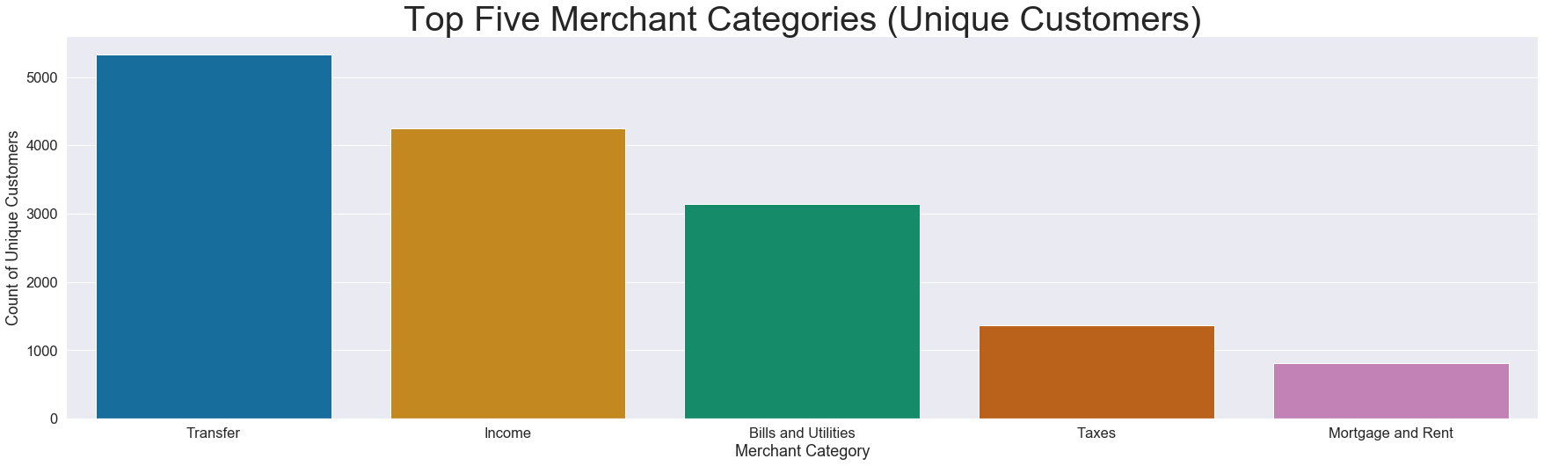
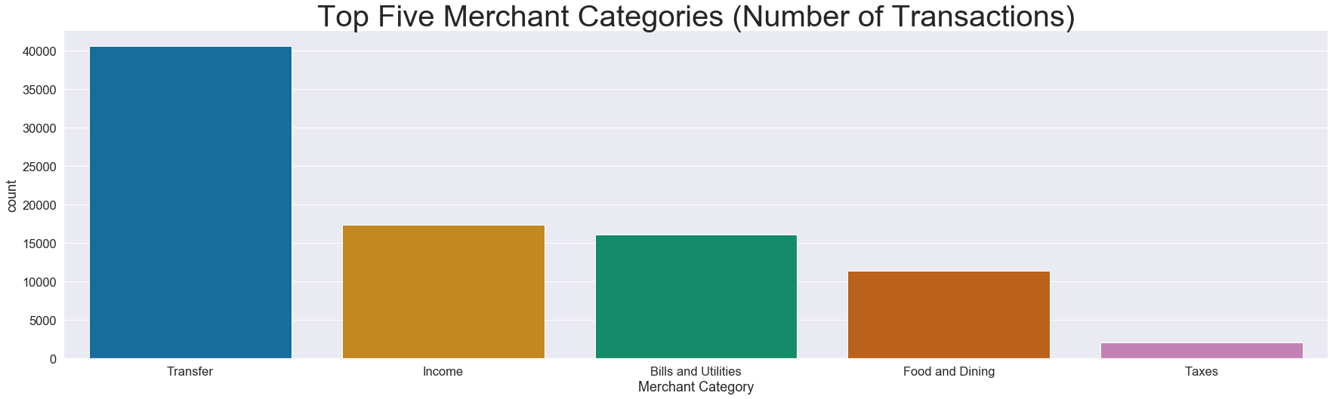
Presentation of Findings (Question 1)
The Transfer category surpass the other merchant categories in terms of sheer number of transactions.
In terms of unique customers, almost all customers have made use of the transfer category at least once (5328 out 5645 customers). The modal transaction of most customers is also Transfer.

Slide 9
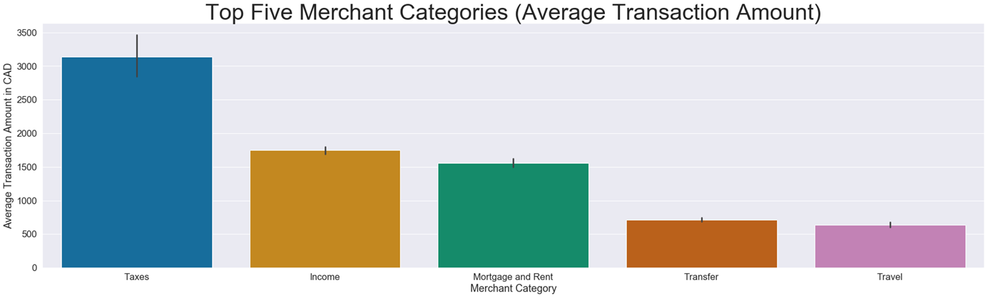
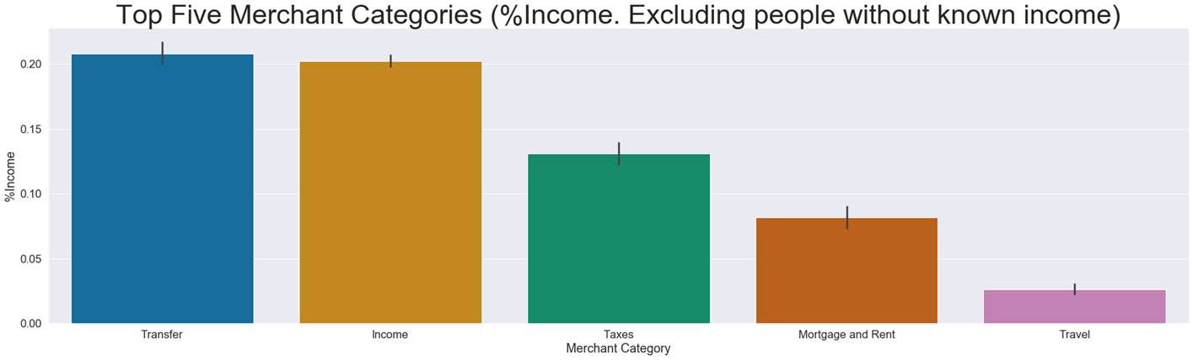
Presentation of Findings (Question 1 Cont.)
The average transaction amount in CAD of the Transfer category is around 700
Costumers with income on average spend around 20% their income on transfers. The same applies to income.

Slide 10
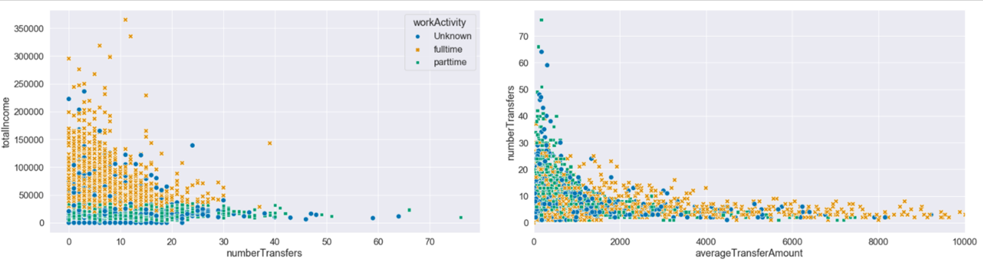
Presentation of Findings (Question 2: EDA)
Expectations verified through exploratory data analysis:
Customers working full-time earn more than those working part-time.
Customers with unknown work activity are mostly under 20 and over 70 years old. Hence, they are probably not in the workforce yet or are already retired.
The segment of younger customers is majoritarily comprised by customers working part-time or with unknown work activity.
Single customers are mostly young, widowed customers are mostly old, and married customers are mostly in working age.
Customers living with parent are mostly young. They also earn less income and transfer low to moderate amount of money.
New Information on customers:
The extremely high 'number of transfers’ (30+) are done by part-timers and customers with unknown work activity, and the extremely high 'average transfer amount’ ($4,000) are done by full-time and unknown work activity customers.

Slide 11
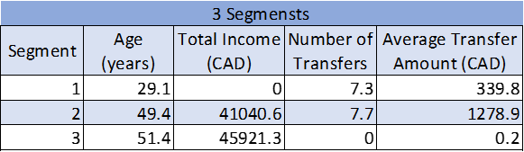
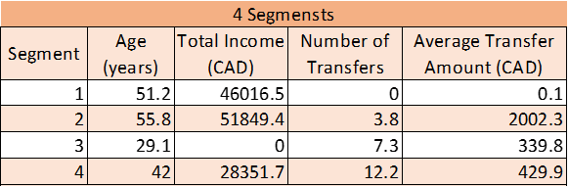
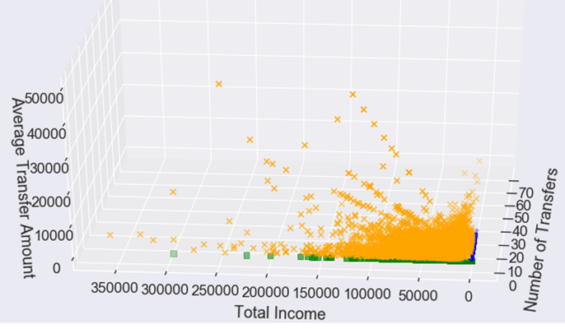
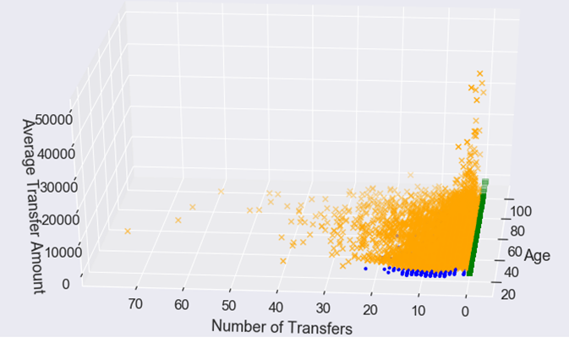
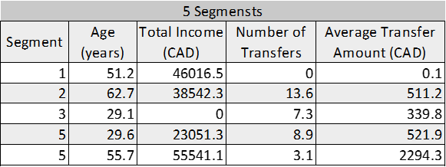
Presentation of Findings (Question 2: K-means Clustering)
We applied different number of clusters (K=3, 4, and 5). The best results were obtained for K=3.
We identified three segments of customers:
Segment 1: Young customers with no income, average number of transfers (7-8) and low average transfer amount ($339 CAD, below average). This group most certainly includes customers living with parent and is majoritarily comprised by customers working part-time or with unknown work activity.
Segment 2: Middle-aged customers with middle-class income, average number of transfers (7-8) and high average transfer amount ($1278 CAD, above average). Based on the EDA , the typical profile of a customer in this segment is: married, living with a spouse and working full-time.
Segment 3: Middle-aged customers with middle class income, no transfer history and very low average transfer amount.

Slide 12
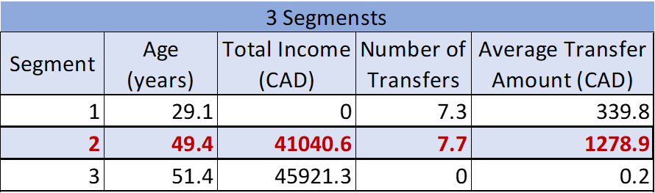
Presentation of Findings (Question 3: Segment 2 as Target)
We would target the customer segment of middle-aged customers with middle-class income, average number of transfers (7-8) and high average transfer amount ($1278 CAD, above average), who based on the EDA, is typically married, living with a spouse, and working full-time. On average, they make the highest number of transfers and move more money than the other segments of customers.
They could also be the segment that benefits the most from a product geared towards “Transfer” based on how frequent this merchant category is.
In terms of challenges, determining how to best customize and advertise the new product to the target segment while not alienating the rest of the customers might be an issue given how widely used this merchant category is. There is also the risk of over-generalizing the needs and expectations our target segment might have for this new product.

