Slide 1

BIKE buyer case study
Ngoni Mombeshora

Slide 2
AGENDA
Data Exploration
Modelling
Useful Information
Marketing
Summary

Slide 3
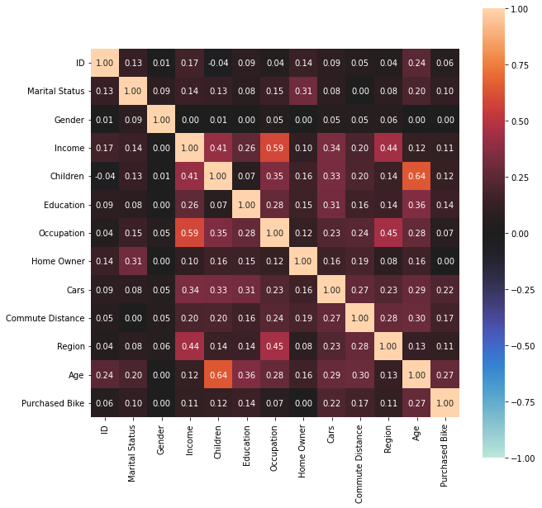
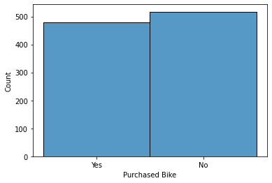
Data exploration

Slide 4
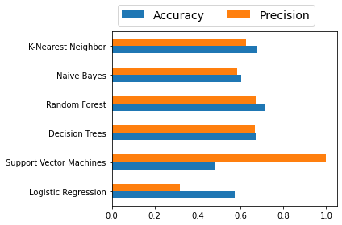
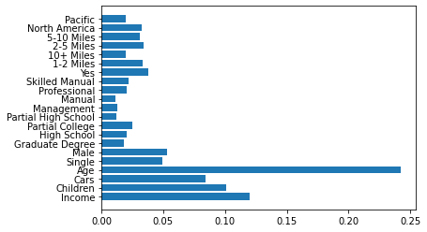
modelling

Slide 5
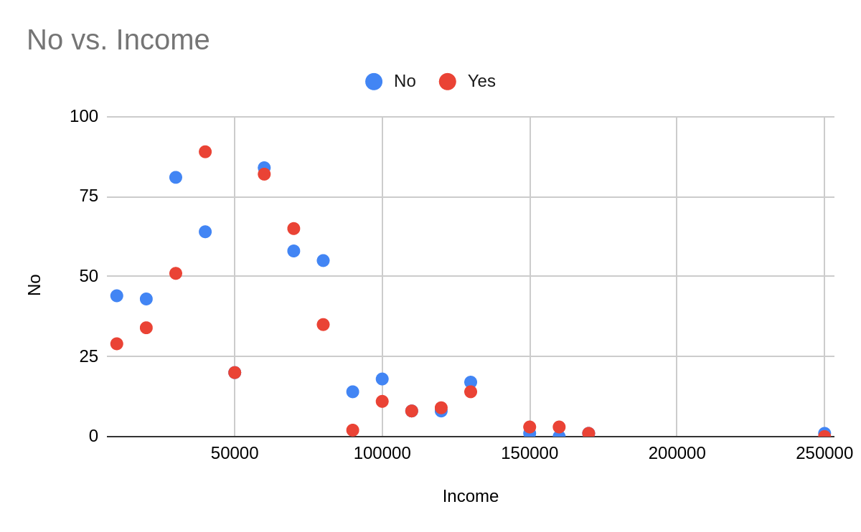
USEFUL INFORMATON
Annual revenue growth

Slide 6
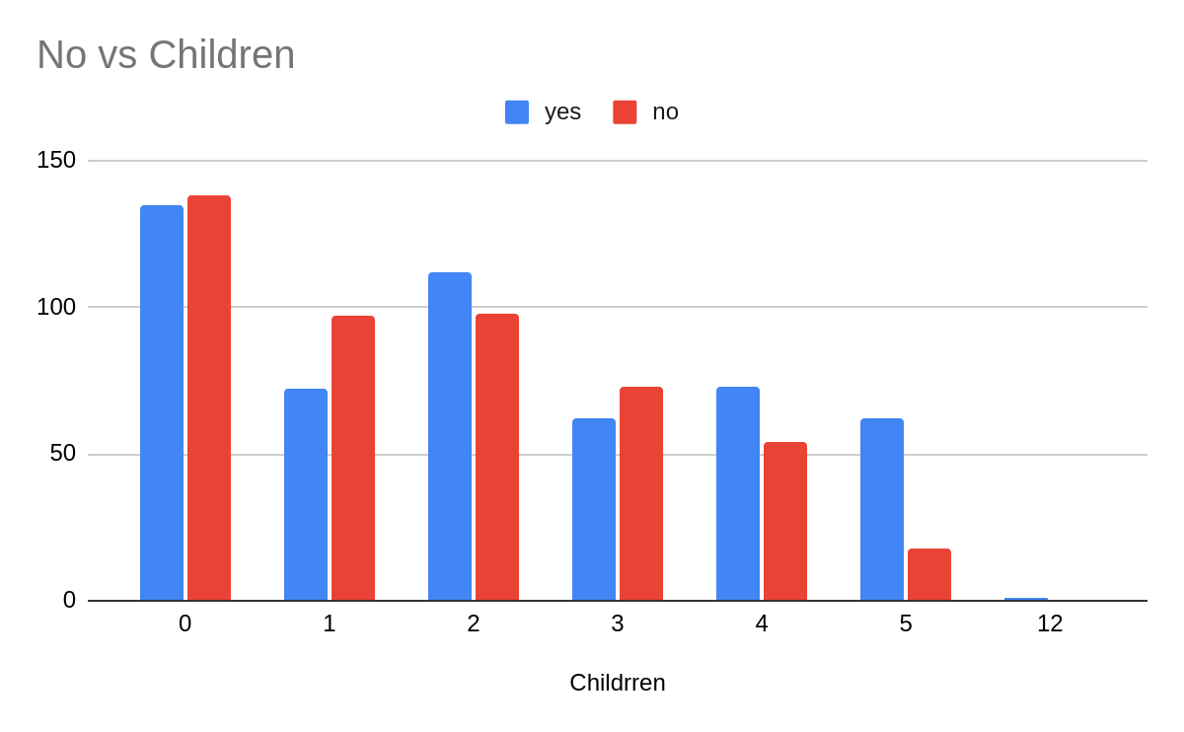
USEFUL INFORMATON
Annual revenue growth

Slide 7
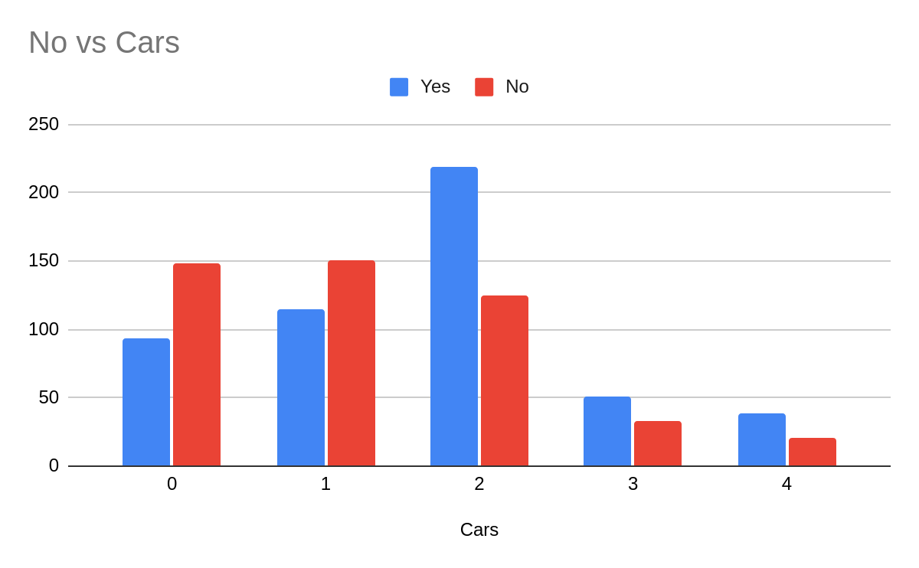
USEFUL INFORMATON

Slide 8
Target market and marketing
Lower to lower-middle income earners
2 children and less
2 cars or less
Social Media, Google ads, Youtube
Product design (What is the target market mainly using bikes for?)
Pricing strategy (Promotions, discounts)
Further info
Bike usage (e.g commute, deliveries)
Actual location of individuals (e.g closer to CDB, outskirts etc)
Deploy to production
Deploy and assess, a dip in performance would require some retraining or eploying a better classification algorithms.

Slide 9

Thank you
Ngoni Mombeshora

