Slide 1
Mini Supermarket Management System
Class Name: PF08 Group Name: Group 04
Member: Nguyễn Quyết Thắng
Trần Văn Huân
Nguyễn Vũ Huân

Slide 2
Objectives
Proposed System
Actor Mannager
Actor Casher
Mannager function
Insert product
Update product
Accounts Management
Orders Management
The scope of the project to be applied
Checkout and update invoice
Create and update product

Slide 3
Objectives
3. System Name
Mini supermarkets management system
4. Deployment Environment
JDk13
5. Development Tools
Visual Studio Code
My SQL WorkBench
IntelliJ IDEA
Window 10
JDK13

Slide 4
Objectives
6. Customer Requirements
- The customer needs a system with the following functions:
+ Management products (quantity, price, information) of products in store
+ Export sales invoices and statistics on the amount of invoices issued
+ Security by event login
+ Divide separate functions for managers and employees
+ Create and management account of cashiers

Slide 5
Customer Requirements
1. Login
2. Create Order
3. Update Order
4.Insert Product
5. Update Product
6. Management Account

Slide 6
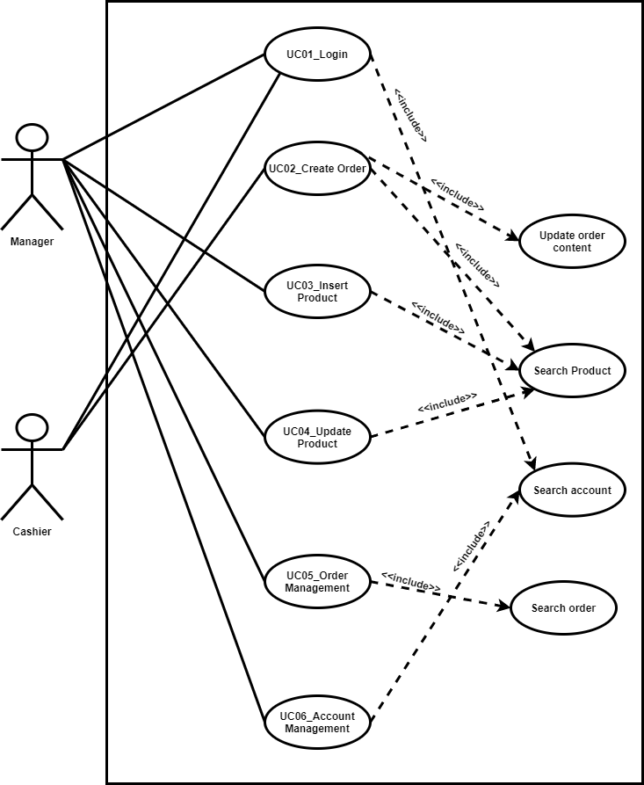
Use Case

Slide 7
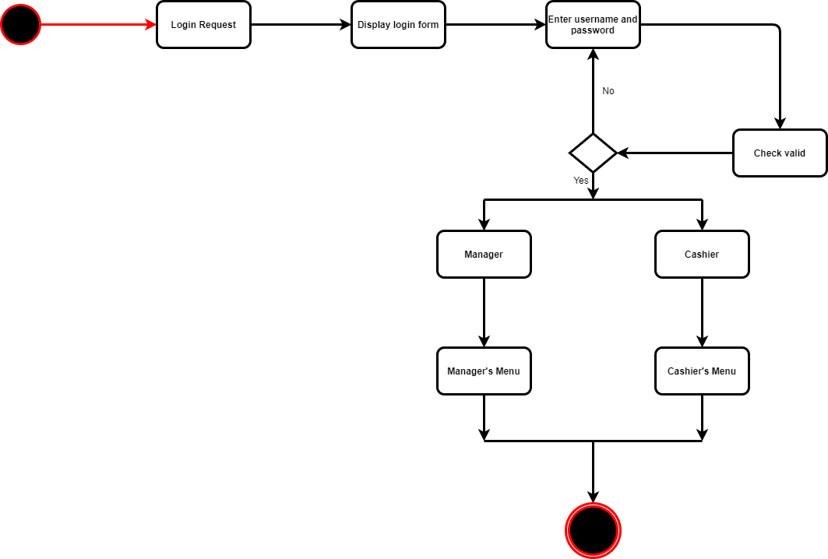
Activity Diagram
1.Login

Slide 8
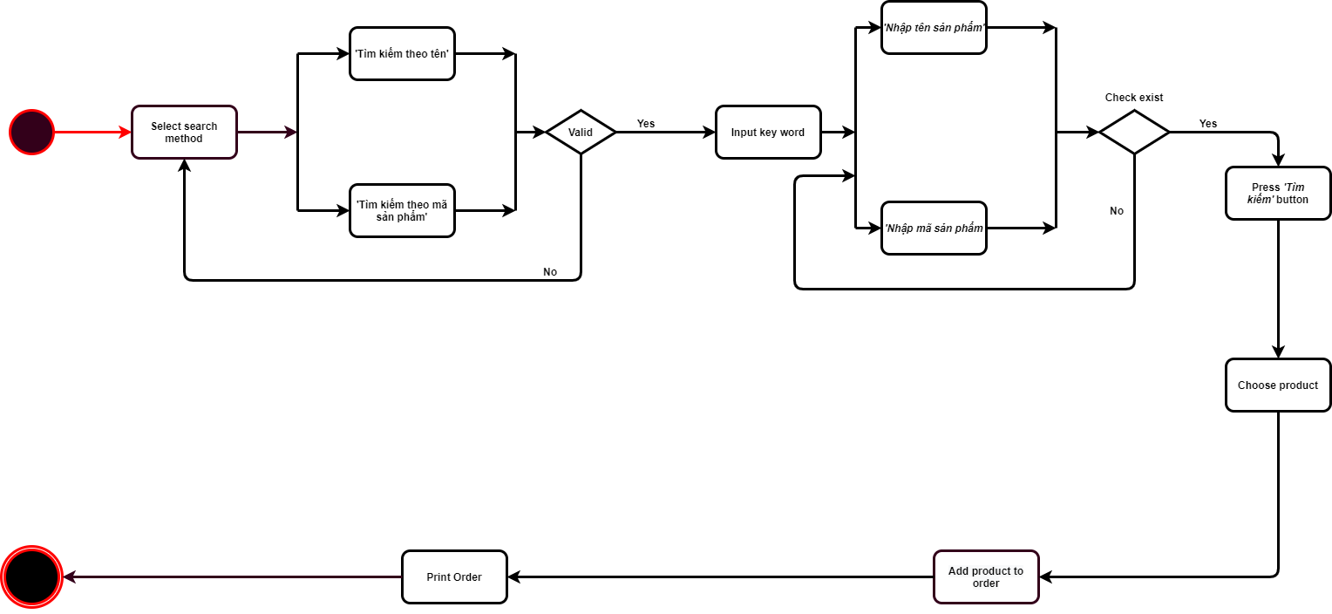
Activity Diagram
2.Create order

Slide 9
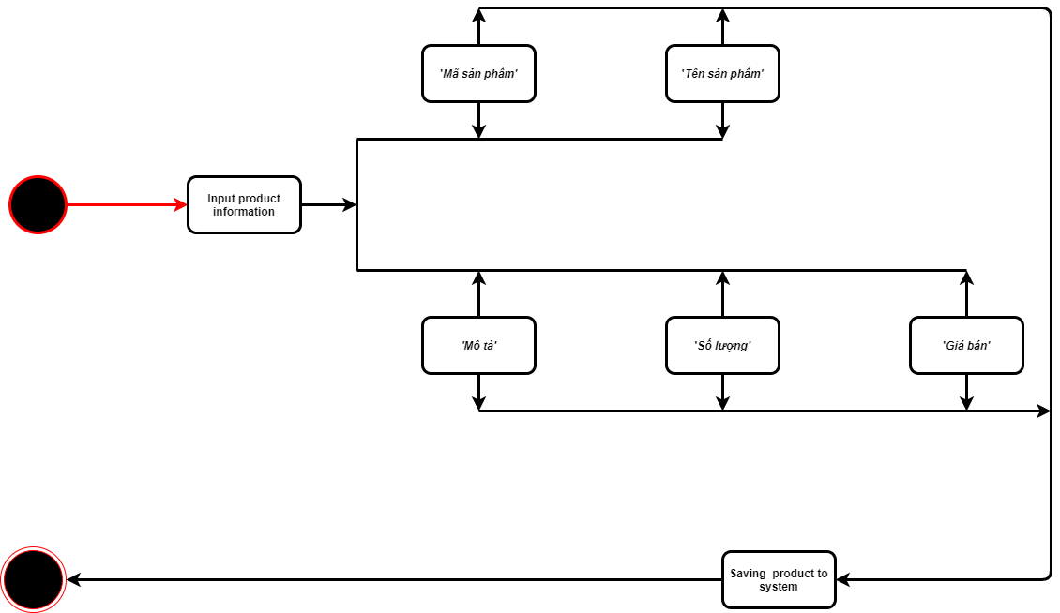
Activity Diagram
3.Update order

Slide 10
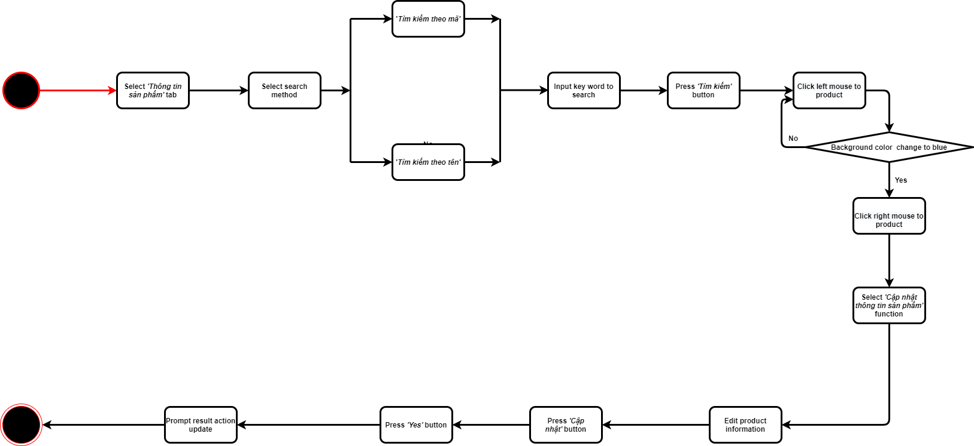
Activity Diagram
4.Insert product

Slide 11
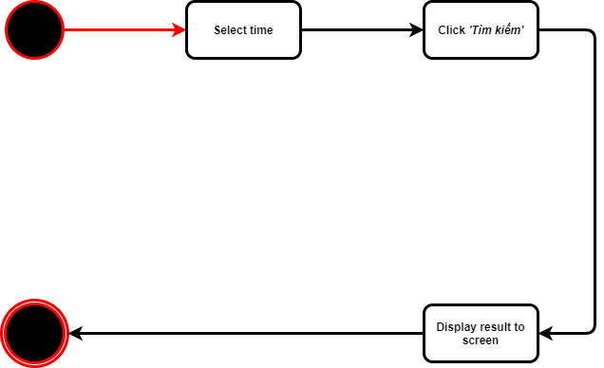
Activity Diagram
5.Input product

Slide 12
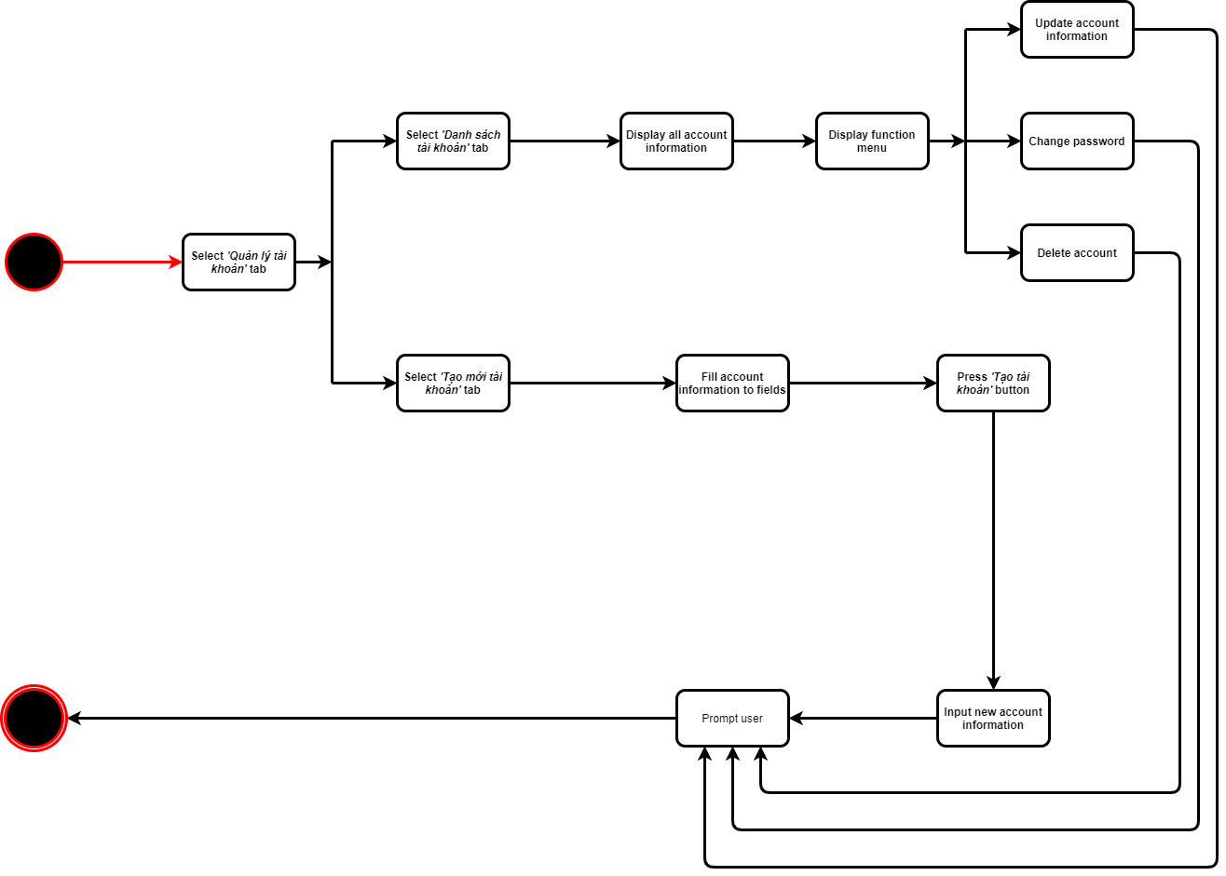
Activity Diagram
6. Management Account

Slide 13
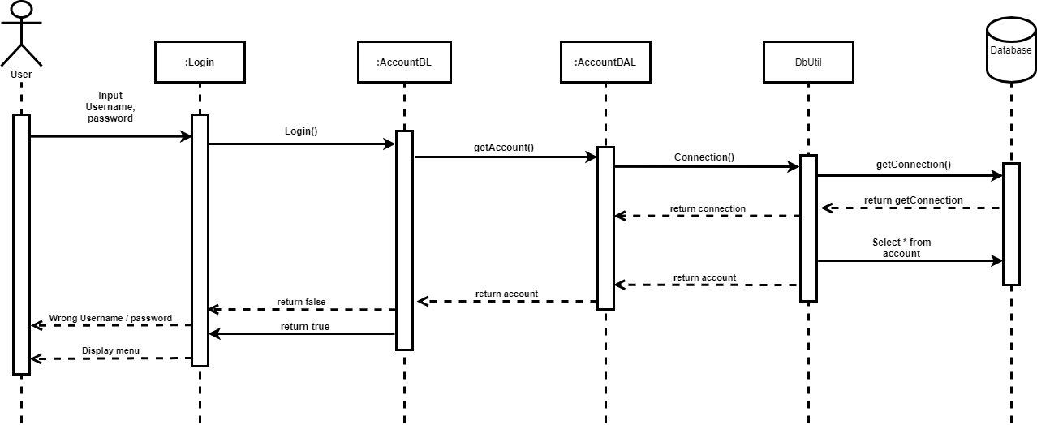
Sequence Diagram
1.Login

Slide 14
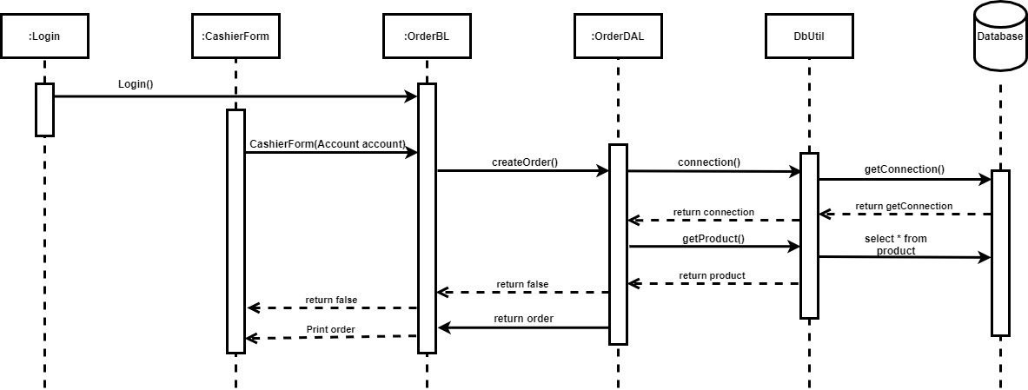
Sequence Diagram
2.Create order

Slide 15
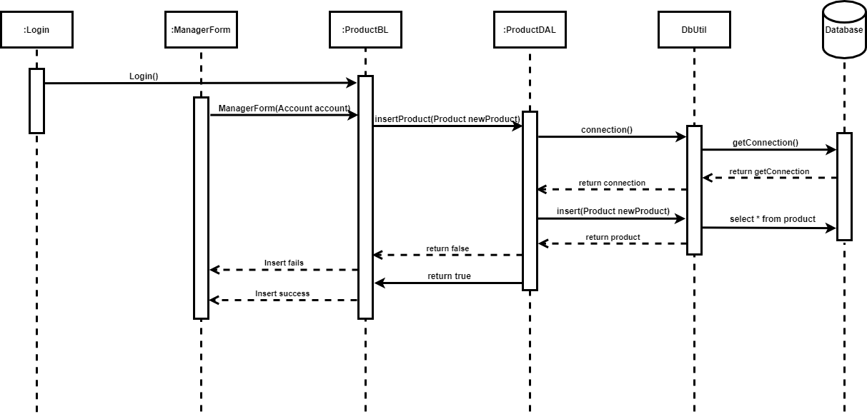
Sequence Diagram
3.Update order

Slide 16
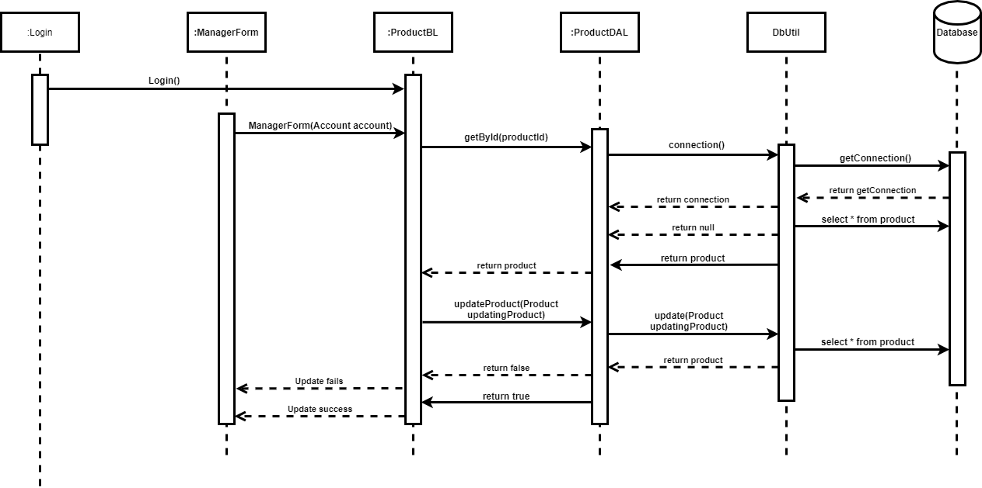
Sequence Diagram
4.Insert product

Slide 17
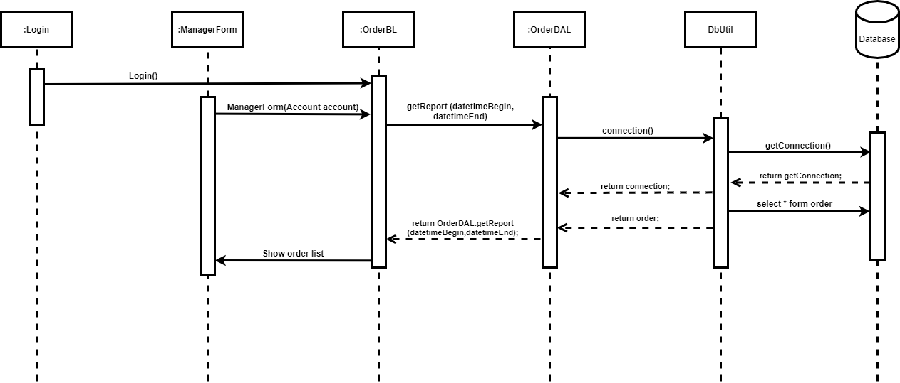
Sequence Diagram
5.Update product

Slide 18
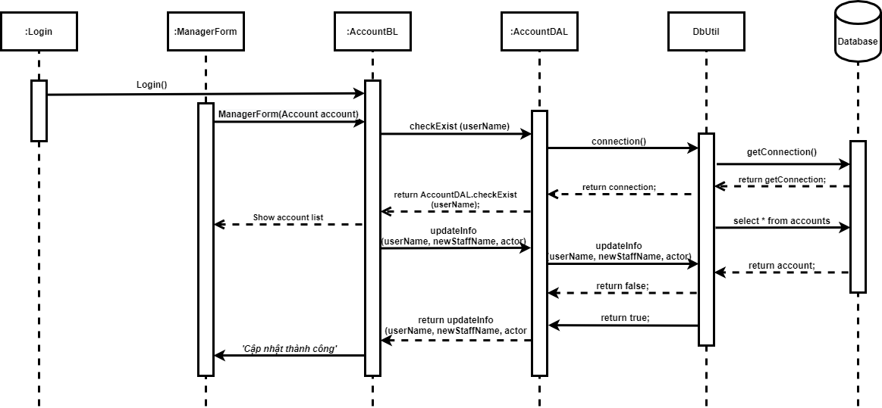
Sequence Diagram
6. Management Account

Slide 19
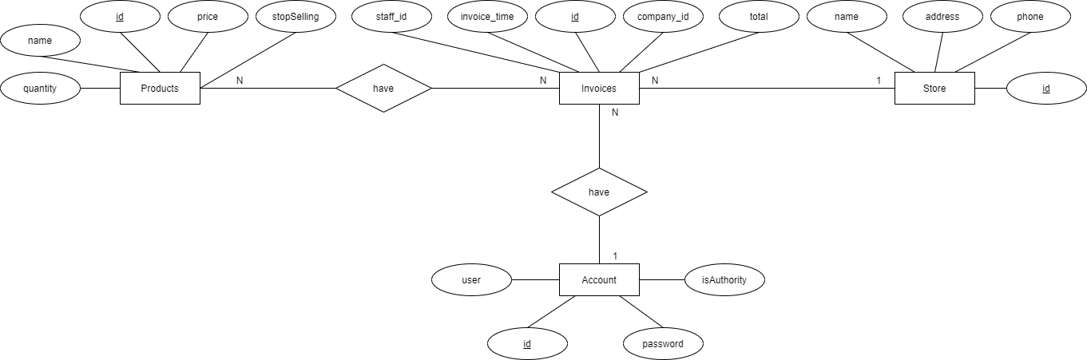
Entity Relationship Diagram

Slide 20
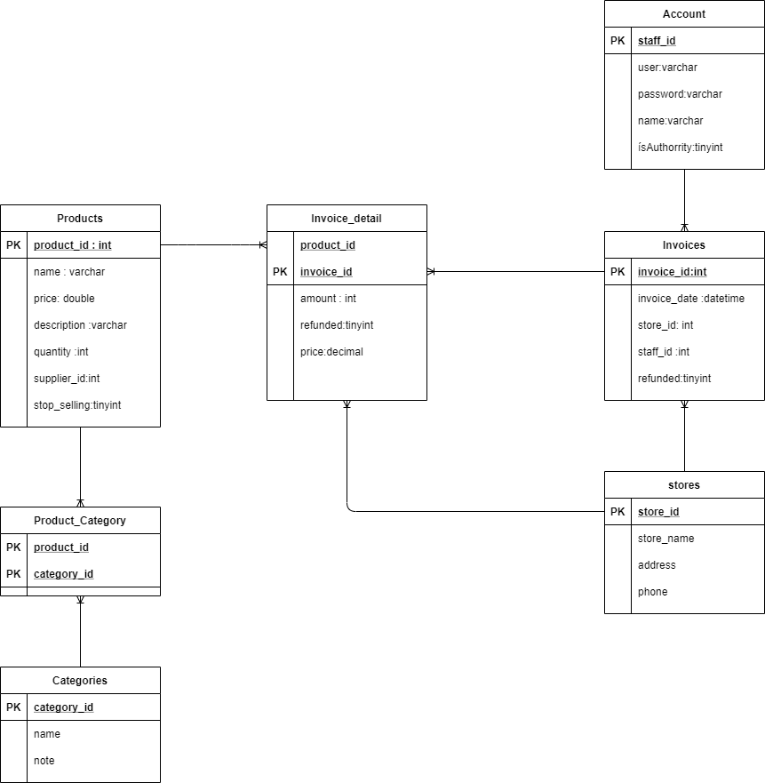
Entity Relationship Diagram

Slide 21
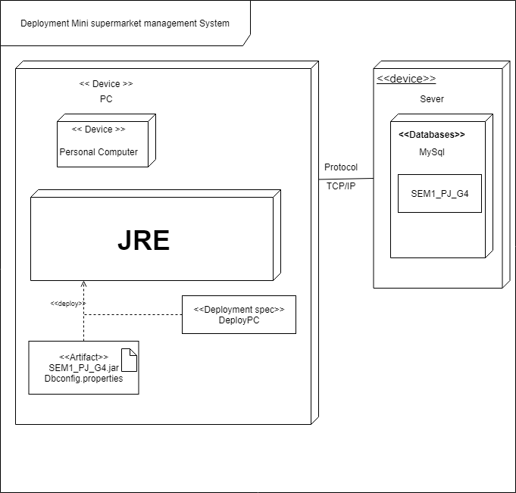
Deployment Diagram

Slide 22
Assign work to each team member
Group 4 | Minisupermarker MS
No | Task name | Description | Start Date | End Date | Member | Self assessment
1 | System design | System model architecture | 24/07/2020 |  | Nguyễn Quyết Thắng
2 | Use case design | Design system features | 30/07/2020 |  | Nguyễn Quyết Thắng, Trần Văn Huân, Nguyễn Vũ Huân
3 | Entity relationships design | Identify the entities in the system and the relationships between them | 28/07/2020 | 29/07/2020 | Trần Văn Huân Nguyễn Quyết Thắng

Slide 23
Assign work to each team member
Group 4 | Minisupermarker MS
No | Task name | Description | Start Date | End Date | Member | Self assessment
4 | Entity relationships design details | Construct tables that represent properties of entities and the relationship between entities | 28/07/2020 | 29/07/2020 | Trần Văn Huân Nguyễn Quyết Thắng
5 | Design database | Database building | 30/07/2020 | 06/08/2020 | Nguyễn Quyết Thắng
6 | Use case description | Describe in detail the use case | 01/08/2020 | 06/08/2020 | Nguyễn Quyết Thắng Trần Văn Huân Nguyễn Vũ Huân

Slide 24
Assign work to each team member
Group 4 | Minisupermarker MS
No | Task name | Description | Start Date | End Date | Member | Self assessment
7 | Design activity diagram for each use case | Design the system's task processing flowchart for each use case | 01/08/2020 | 07/08/2020 | Nguyễn Vũ Huân Trần Văn Huân Nguyễn Quyết Thắng
8 | Design sequence diagram for each use case | Design sequence diagrams for the system's workflow for each use case | 01/08/2020 | 25/08/2020 | Trần Văn Huân Nguyễn Vũ Huân Nguyễn Quyết Thắng
9 | Class diagram for system | Designing detailed drawing class for the system | 03/08/2020 | 20/08/2020 | Trần Văn Huân Nguyễn Vũ Huân Nguyễn Quyết Thắng

Slide 25
Assign work to each team member
Group 4 | Minisupermarker MS
No | Task name | Description | Start Date | End Date | Member | Self assessment
10 | Coding | Write code based on class diagrams | 15/08/2020 | 26/8/2020 | Nguyễn Quyết Thắng Trần Văn Huân Nguyễn Vũ Huân
11 | Bug fixes, optimizations upgrades for the code | Fix errors, optimize code, upgrade system features | 15/8/2020 | 25/08/2020 | Nguyễn Quyết Thắng
12 | Deployment diagram | Drawing up the project environment | 01/08/2020 | 26/08/2020 | Nguyễn Quyết Thắng Trần Văn Huân Nguyễn Vũ Huân

Slide 26
Assign work to each team member
Group 4 | Minisupermarker MS
No | Task name | Description | Start Date | End Date | Member | Self assessment
13 | Attach report | Report writing | 07/08/2020 | 26/08/2020 | Nguyễn Quyết Thắng Trần Văn Huân Nguyễn Vũ Huân
14 | Wriet slides | Presentation material | 26/08/2020 | 26/08/2020 | Nguyễn Vũ Huân Trần Văn Huân Nguyễn Quyết Thắng

Slide 27


Slide 28
Q & A

