Slide 1
Website for fashion store
Semester : Semester 2
Class Name : WD05
Group Name : WD05-Group03
Instructors : Lam Vu Tran, Sinh Nguyen Xuan
Member : NDE19021_NguyenQuyetThang

Slide 2
Objectives
Project Introduction
System Analysis
System Design
Testing
Deployment
Summary

Slide 3
Introduction to Project : Name and Description
Project name :
Website for fashion store
Description:
This website has all the basic functions such as: member registration, purchase, product presentation, product management and invoice

Slide 4
Introduction to Project : Customer Requirements
Good UI Design
Show products list
Classify the product
Easy manage for product
Show Product Detail
Sale Online

Slide 5
Introduction to Project : Development Technology
Language:
Using HTML, CSS , JS for UI
Using C#,JS to present data on UI
Using C# for backend
Using SQL Server for RDBMS
Framework and Library
Using EF core for working with database
Bootstrap 3,JQuery,Sweet Alert to design UI
Development Tool:
VS Code, Visual Studio, Microsoft SQL Server Management Studio
Windows PowerShell
AdobeXD

Slide 6
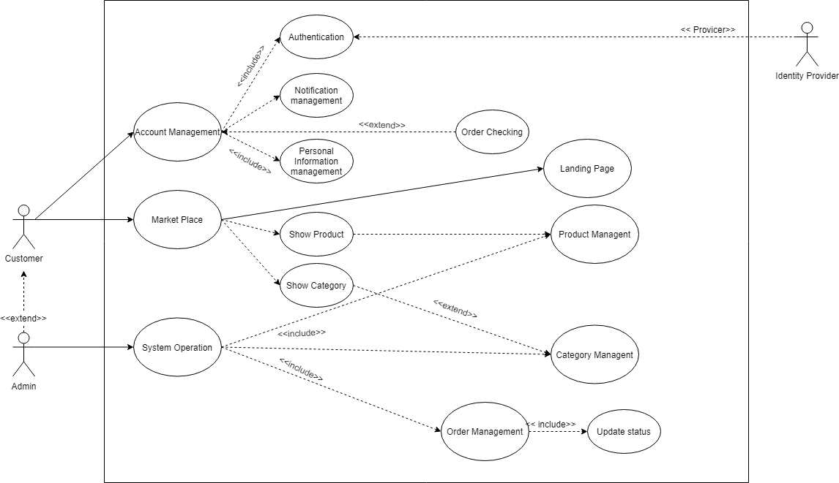
System Analysis : Use Case - Overall Diagram

Slide 7
System Analysis : Use Case-Use Case List
Landing Page
Online Shopping eCommerce System :
User Management ( Register, Login, External Login, Manage Profile,...)
Market Place
Order Management
Notification
Internal Operation System
Order Management System
Categories and Products Management
(Optional) Reporting website
(Optional) Configuration

Slide 8
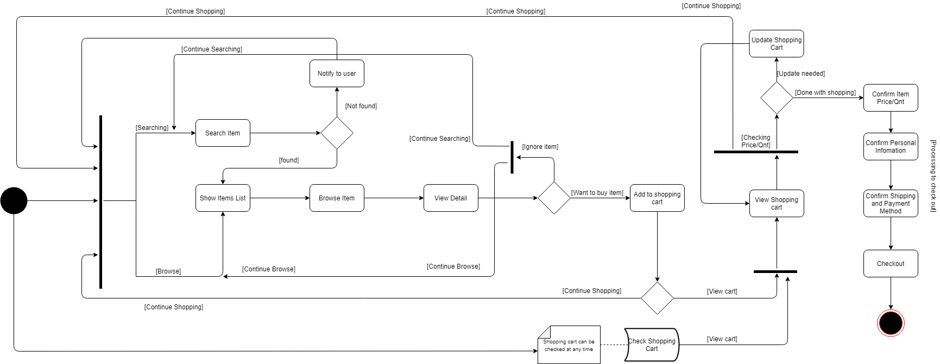
Activity Diagram-Shopping Activity Diagram

Slide 9
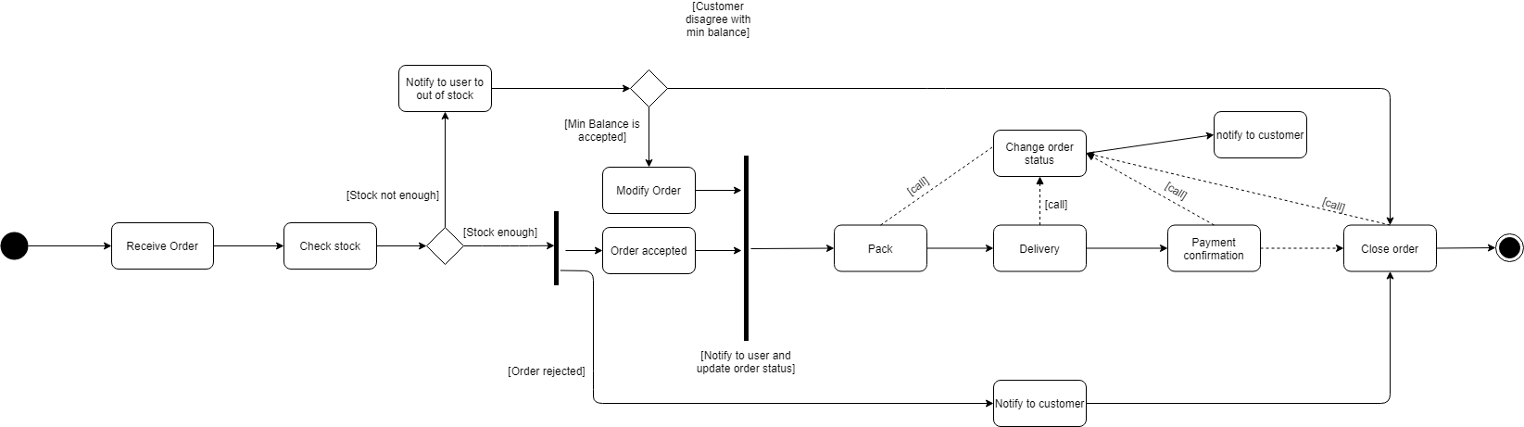
Activity Diagram: Order Management Activity Diagram

Slide 10
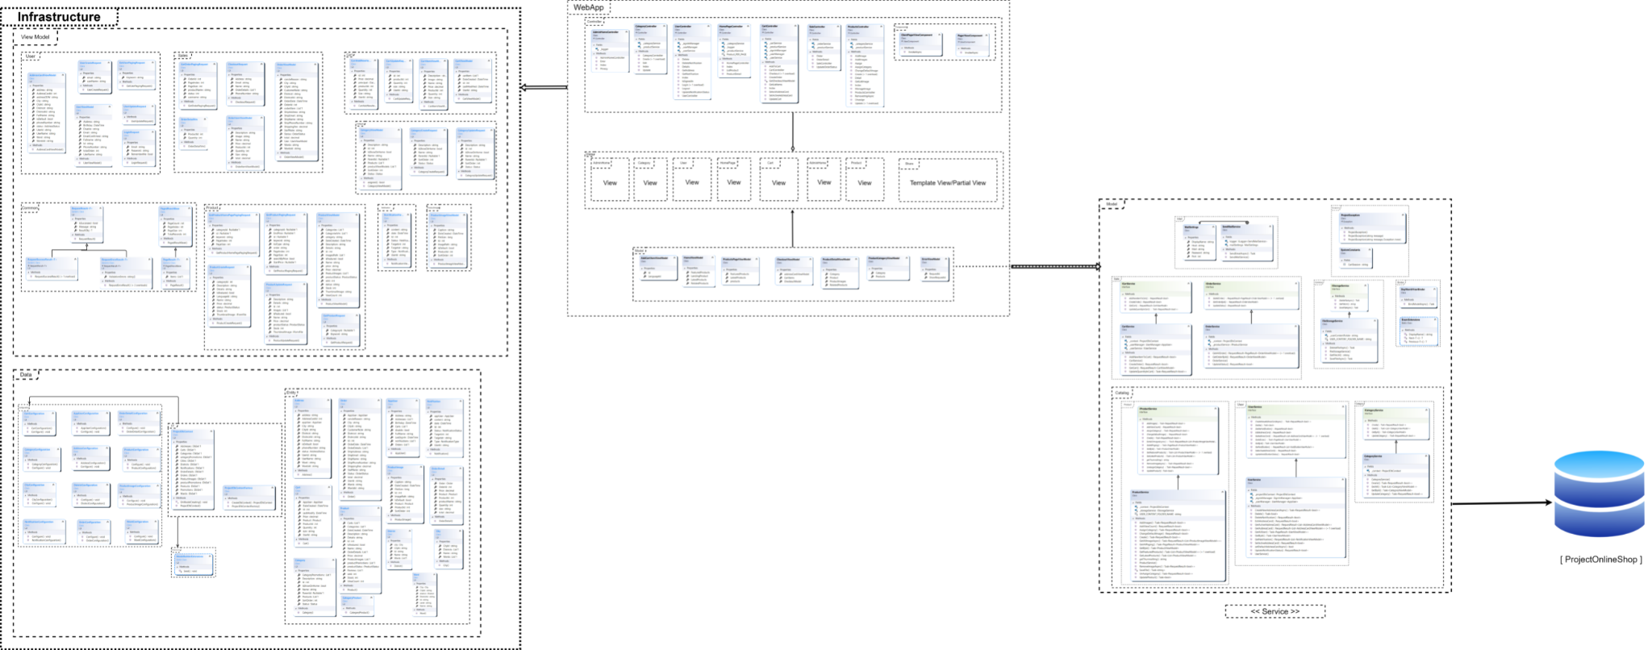
Design Detail : Class Diagram

Slide 11
Design Detail : Create Order Sequence Diagram
<<See in PDF File>>

Slide 12
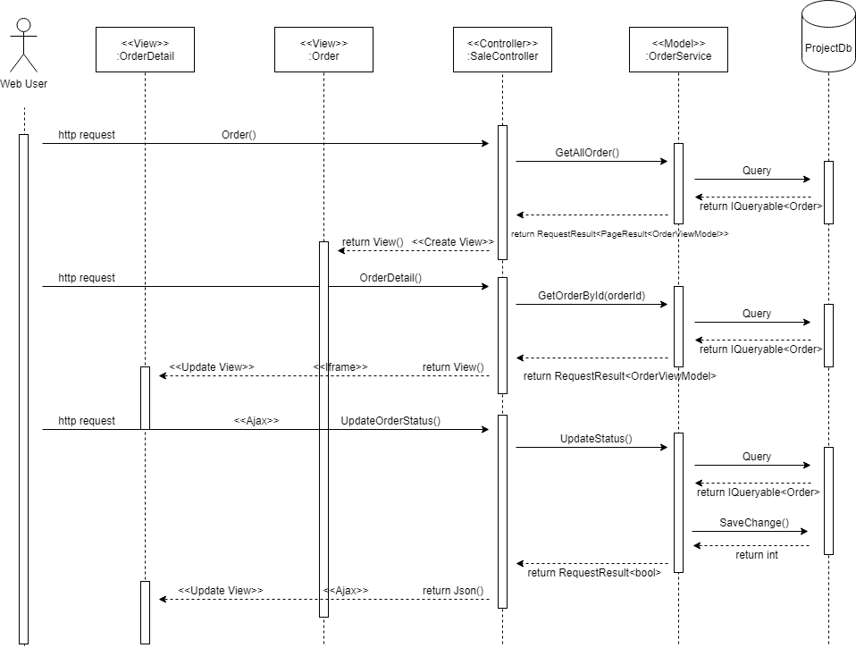
Design Detail : Order management Sequence Diagram

Slide 13
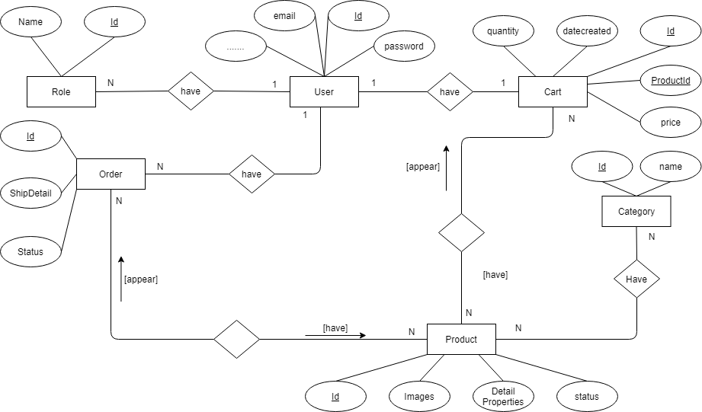
Design Detail : Entity Relationship Diagram (ERD)

Slide 14
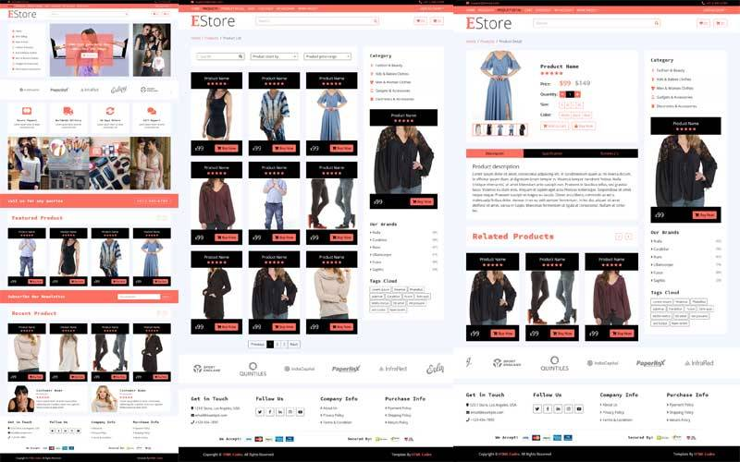
Design Detail : UI/UX Design

Slide 15
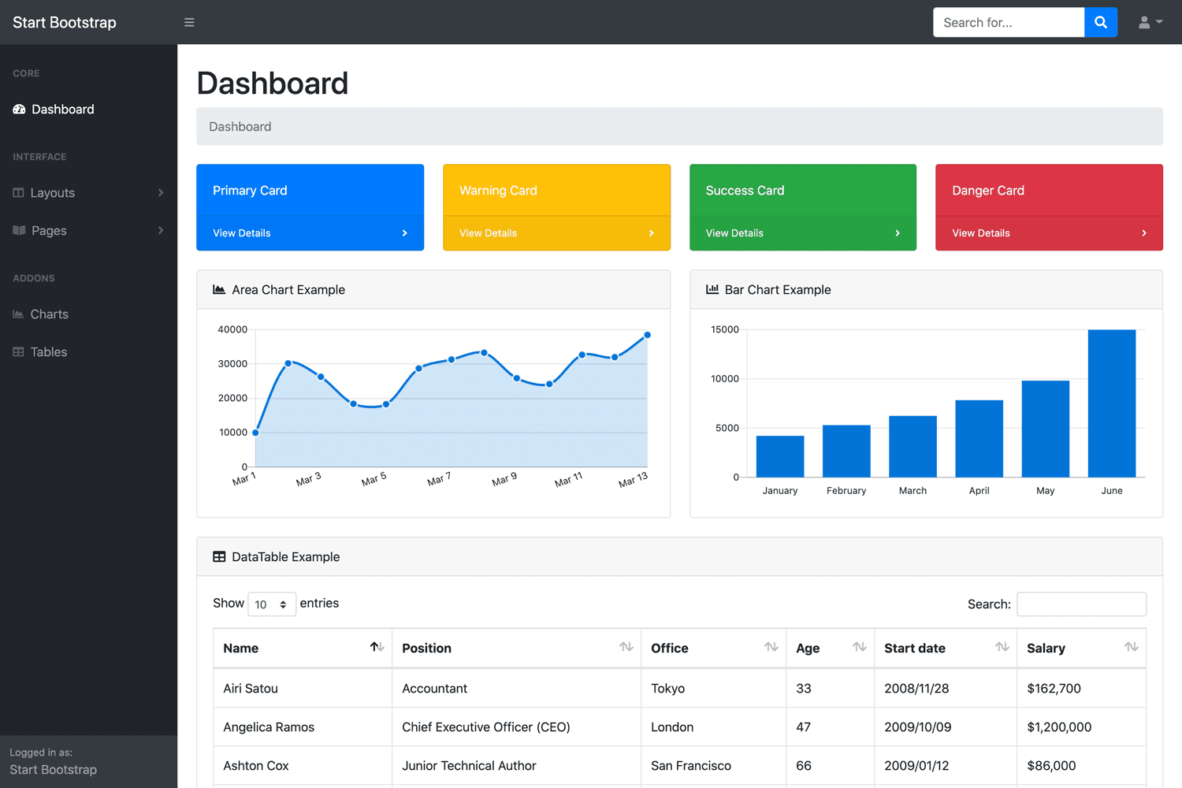
Design Detai : UI/UX Design

Slide 16
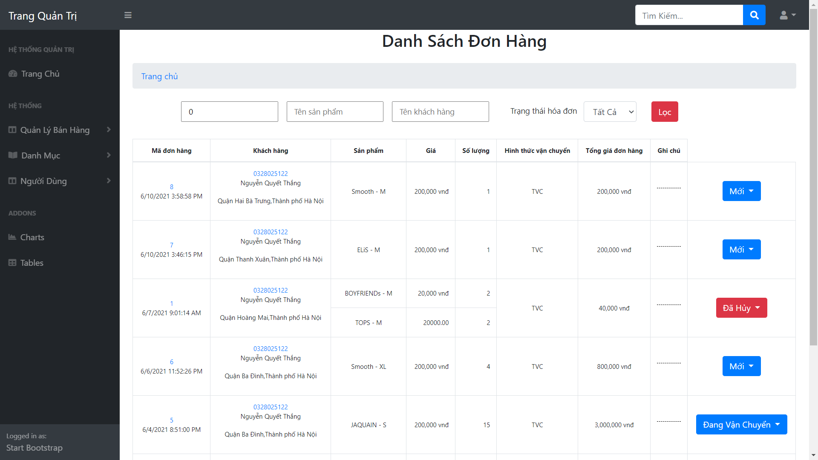
Design Detail :UI/UX Design

Slide 17
Testing : Unit Test Sumary
General test case :
Verify UI
Verify dynamic result display correctly on page
Product buy flow :
Verify logic flow from begin to the end
Catch Exception cause by users
User (Buyer) Registration

Slide 18
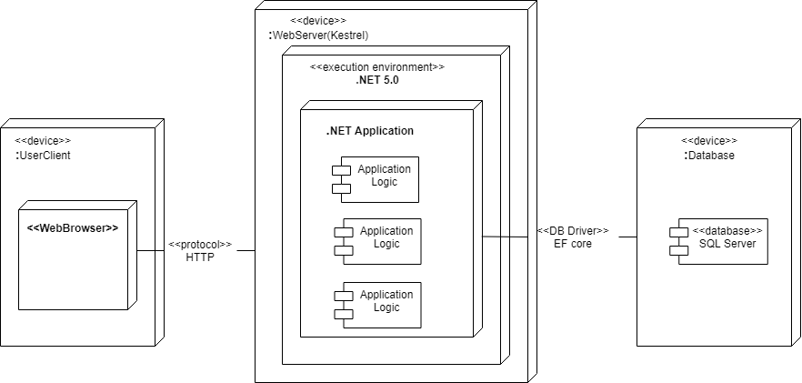
Deployment : Deployment Diagram

Slide 19
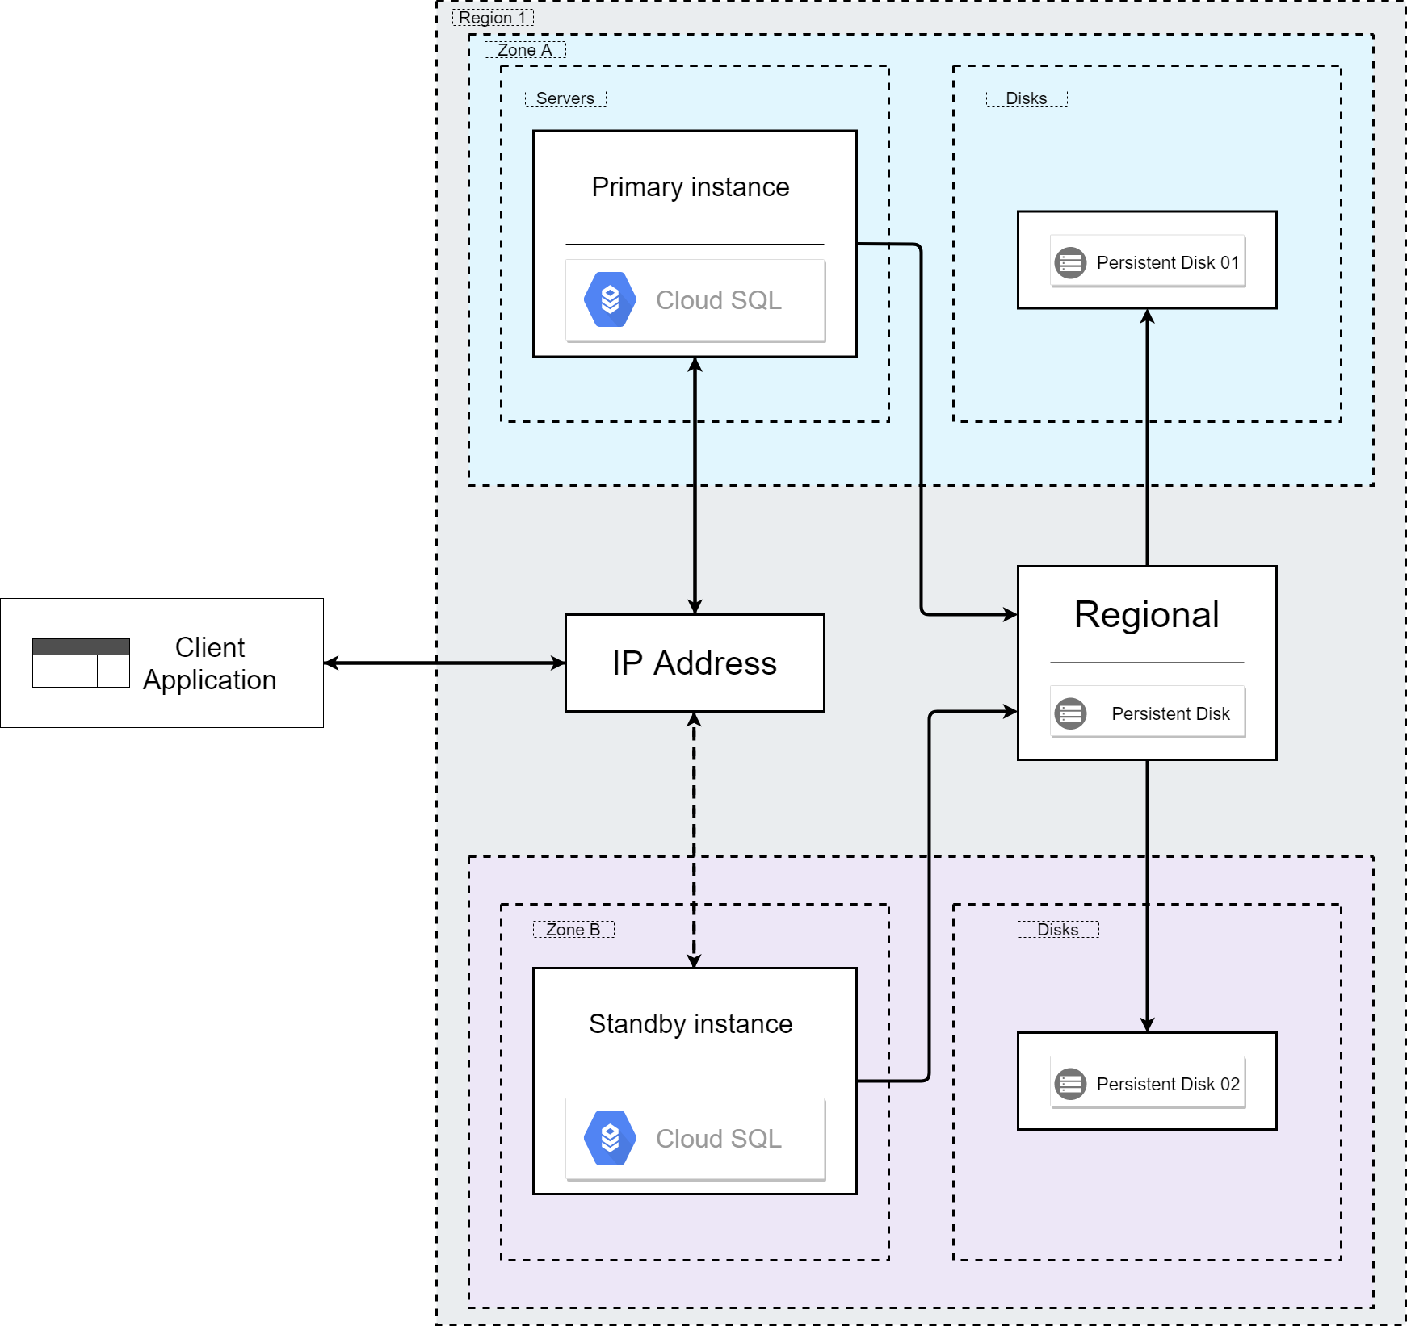
Deployment : Deployment Diagram-Cloud DB

Slide 20
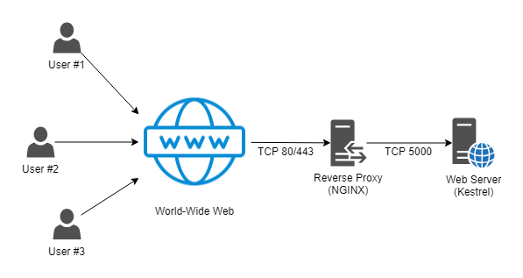
Deployment : Deploy/Maintenance to Nginx on Ubuntu
-How it work :

Slide 21
Task Assign (to each team member)
Nde19021_NguyenQuyetThang :
Business Analyst
Design System
Coding
Write Document
Deploy , Maintain
Testing

Slide 22
Summary
.NET Coding experience
Time Management
Ability to self-study , self-research , finding document
Fixing error
Never give up

Slide 23


Slide 24
Q & A

