Slide 1
Gender Awareness in African Society
A Photographic Essay
By Jane muthoni
REG NO:C026-01-1012/2021

Slide 2
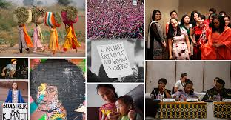

Slide 3
Introduction
Brief overview of gender awareness in african society:
Gender awareness involves understanding and recognizing the different roles, responsibilities, and needs of men and women in society.
It highlights the importance of equality and the need to address gender-based disparities
Importance of the issue:
Gender inequality can hinder social and economic development.
Promoting gender awareness is crucial for achieving sustainable development and human rights

Slide 4
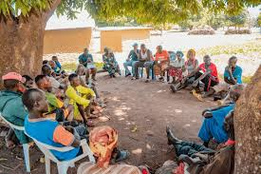

Slide 5
Historical Context
Historical roles of men and women in african communities:
Traditionally, men were often seen as the breadwinners and decision-makers, while women were primarily responsible for domestic duties and caregiving.
However, women also played significant roles in agriculture, trade, and local governance.

Slide 6
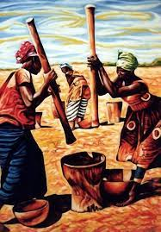
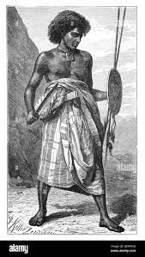

Slide 7
Modern Shifts in Gender Roles
Changes in gender roles in contemporary african society:
- Increased participation of women in the workforce and education.
- Men are increasingly involved in household duties and caregiving roles.
- Changing perceptions of masculinity and femininity.

Slide 8
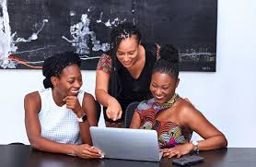
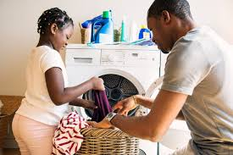

Slide 9
Education and Gender Equality
Importance of education in promoting gender equality:
Education empowers women and girls, leading to better economic opportunities and health outcomes.
Gender-sensitive education policies can address disparities and promote inclusivity.

Slide 10
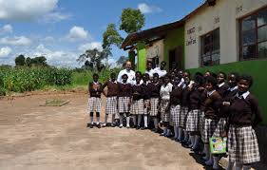


Slide 11
Women in Leadership
Increasing presence of women in leadership roles:
Growing number of women in political positions, corporate leadership, and community governance.
Role models and mentors are paving the way for future generations of women leaders.

Slide 12
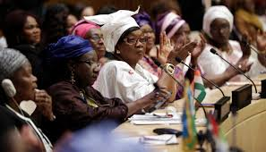
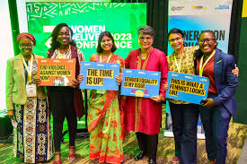
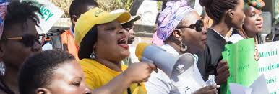

Slide 13
Challenges Faced by Women
Challenges such as gender-based violence, discrimination, and lack of opportunities:
High prevalence of domestic violence and sexual harassment.
Limited access to education, healthcare, and economic resources.
Societal norms and stereotypes that restrict women's potential.

Slide 14
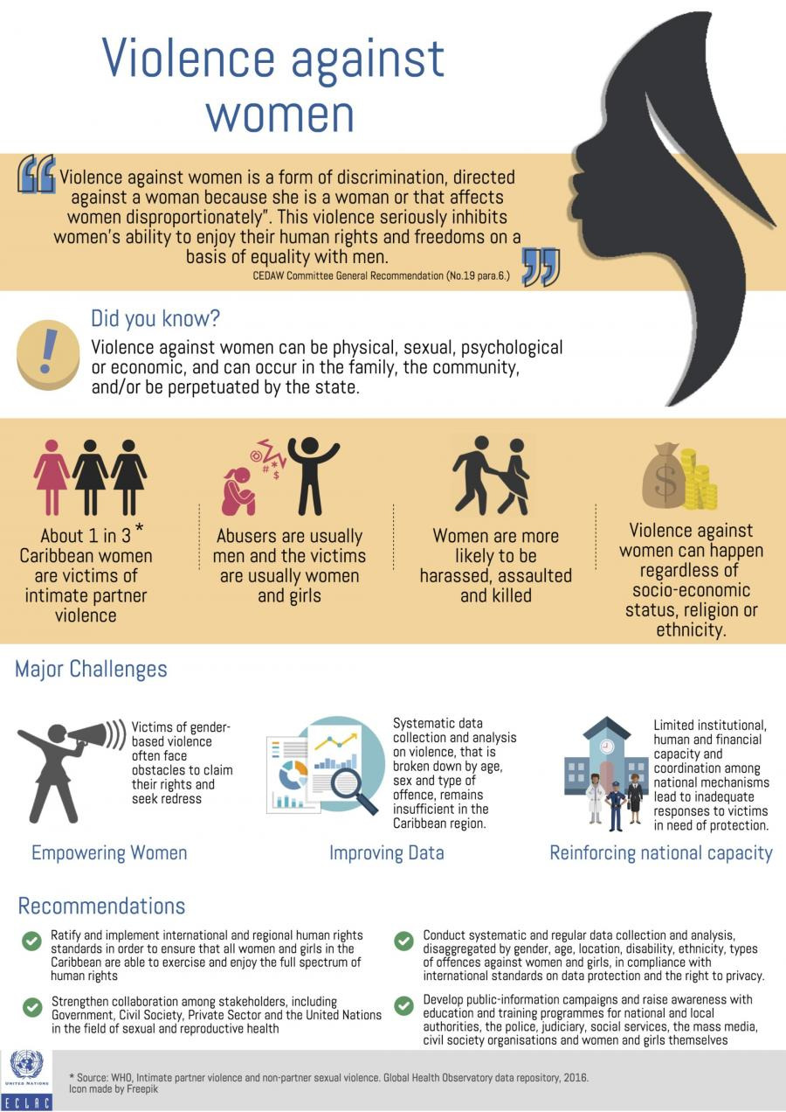
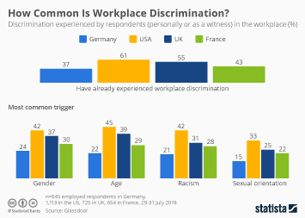

Slide 15
Empowerment Programs
Programs and initiatives aimed at empowering women and promoting gender equality:
Community-based initiatives focusing on skills training, financial literacy, and entrepreneurship.
National and international programs supporting women's rights and empowerment.

Slide 16
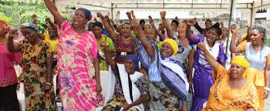
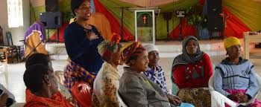

Slide 17
Role of Men in Promoting Gender Awareness
How men are contributing to gender awareness and equality:
Male allies advocating for gender equality and challenging harmful stereotypes.
Programs encouraging men to take active roles in family and community life.

Slide 18
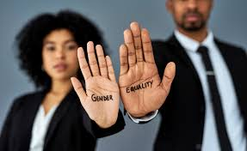
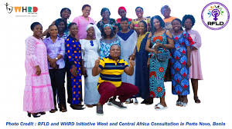

Slide 19
Cultural Practices and Gender
Impact of cultural practices on gender roles and equality:
Some traditional practices reinforce gender inequality, such as early marriage and female genital mutilation.
Positive cultural practices that promote respect and equality between genders.

Slide 20
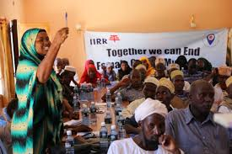
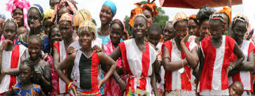

Slide 21
Legal and Policy Frameworks
Laws and policies supporting gender equality in africa:
Legal frameworks that protect women's rights and promote gender equality.
Implementation and enforcement challenges.

Slide 22
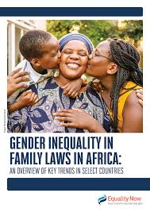
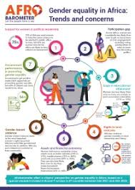

Slide 23
Success Stories
Success stories of individuals or communities promoting gender awareness:
Inspiring stories of women and men who have made significant contributions to gender equality.
Community initiatives that have successfully addressed gender disparities.

Slide 24



Slide 25
Future Directions
Future prospects for gender awareness and equality in african society:
Ongoing efforts and future plans to further promote gender equality.
The role of youth and technology in driving change.

Slide 26

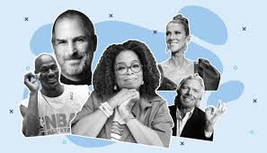

Slide 27
Conclusion
Recap of the importance of gender awareness and the progress made.
Highlight the role of education, policy, and community efforts in promoting gender equality.

