Slide 1
Book world: Innovation in book borrowing and lending Management
By Girishom Ngonze
REG NO: C026-01-2771/2021

Slide 2
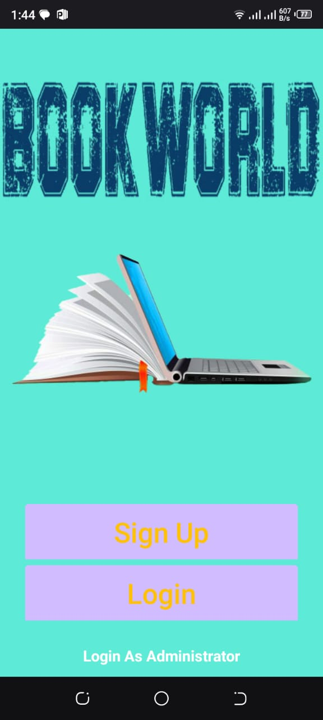
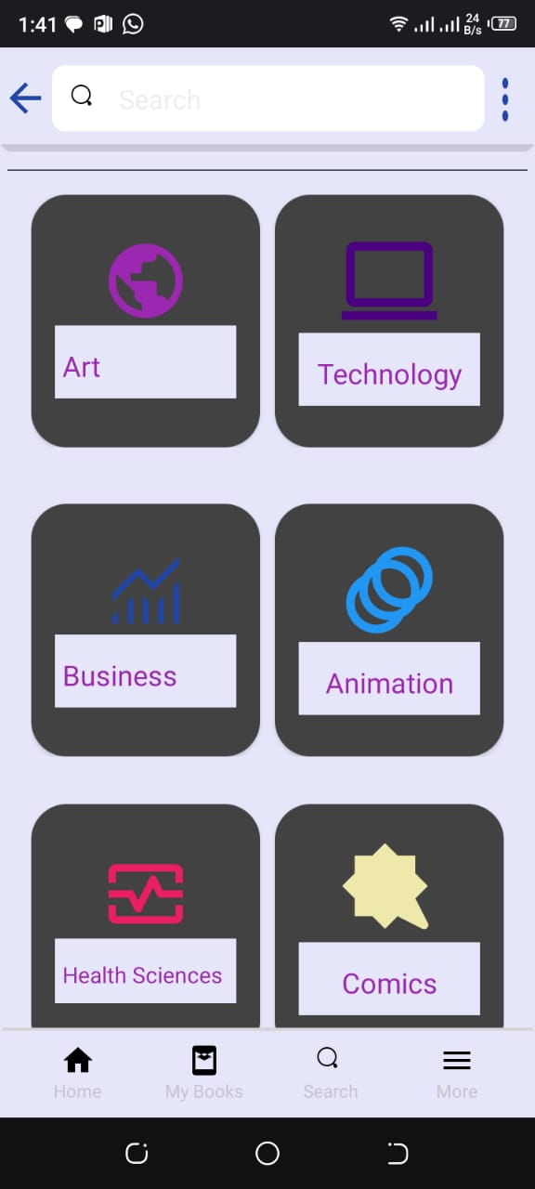
SAMPLE UI

Slide 3
Introduction
Overview of the book world project and its significance in book borrowing and lending management.

Slide 4
Problem Statement
Limited accessibility. Accessing a lot of books physically is a great challenge due to the geographical barriers that exist between individuals.
Limited availability. In a community setting, acquiring some certain genres of books may prove futile as number of people requiring the book is many.
Lack of Community engagement. Traditional forms of sharing books lack a sense of community interaction among the readers. The absence of the social aspect diminishes the reading experience of many readers.

Slide 5
Project Objectives
To investigate into the existing literature in order to get what is required in developing an android based book sharing application.
To implement an android application that is user friendly interface and easy to use by all kinds of readers.
To implement an application with a dynamic book pricing concept that is friendly and efficient to all users.
To develop an application that allows users to borrow and lend books

Slide 6
Innovation in Waste Collection
Implementation of smart bins:
- Sensor technology for waste level detection
- Data collection and analysis for efficient waste collection routes

Slide 7
Community Involvement
Engaging the community:
- Educational campaigns
- Collaborations with local libraries

Slide 8
Technology Integration
Leveraging technology for book lending and borrowing management:
- Mobile apps for library management
- Online platforms for books exchange
- Blockchain for transparent book sharing management

Slide 9
Pilot Project
Details of the pilot project:
- Location: Nanyuki
- Duration: 7 months
- Key activities and expected outcomes

Slide 10
Data Collection and Analysis
Methods for data collection:
Interviews- Conduct interviews with potential users, enthusiastic readers so as to get valuable insights into their preferences and expectations. Gather features and functionalities they expect from the application and their sharing behaviour.
Surveys and Questionnaires- Create online surveys or questionnaires and distribute them to a wider audience so as to get their reading and technological preferences.
Observation- Observe the behaviours of different students and identify different ways in which they acquire books and the availability if the books they read.
Focus Groups- Organize a group of diverse potential users for discussion in order to get their views about the application. This helps to get first-hand information and also the attitude of the potential users towards the application.

Slide 11
Environmental Impact
Positive environmental outcomes:
- Reduction in deforestation for papers
- Decrease in pollution levels
- Conservation of natural resources

Slide 12
Economic Benefits
Economic advantages of the project:
- Cost savings in book borrowing and lending management
- Creation of cohesive book communities where books can get a bigger market

Slide 13
Challenges and Solutions
Addressing potential challenges:
- Public resistance to change from old means of book lending and borrowing.
- Technical issues with lending or borrowing books.
- Solutions and contingency plans.

Slide 14
Partnerships and Collaborations
Collaborative efforts:
- Partnerships with local governments
- Collaborations with private companies
- Engagement with NGOs and community groups

Slide 15
Sustainability Plan
Ensuring long-term sustainability:
- Continuous improvement strategies
- Regular monitoring and evaluation
- Scaling the project to other regions

Slide 16
Future Innovations
Exploring future possibilities:
- Integration of AI and machine learning
- Development of circular economy models
- Innovations in online bookshop/sharing technologies

Slide 17
Project Timeline
Detailed project timeline:
- Planning phase
- Implementation phase
- Monitoring and evaluation phase

Slide 18
Budget and Funding
Financial aspects:
- Budget breakdown
- Funding sources
- Financial sustainability of the project

Slide 19
Impact Assessment
Measuring project impact:
- Key performance indicators
- Short-term and long-term impact
- Reporting and transparency

Slide 20
Conclusion
Summary of the book world project:
- Innovation in book management.
- Positive environmental and economic impact
- Future vision for sustainable book management
- Thank you for your attention.

