Slide 2
SKEMPI database
3,000+ mutants with known binding affinity
From a total of 169 protein pairs
169 pairs are id’ed using the PDB entry id (4 alphanumeric characters) + ’_’ +chain id 1 + ‘_’ chain id 2

Slide 3
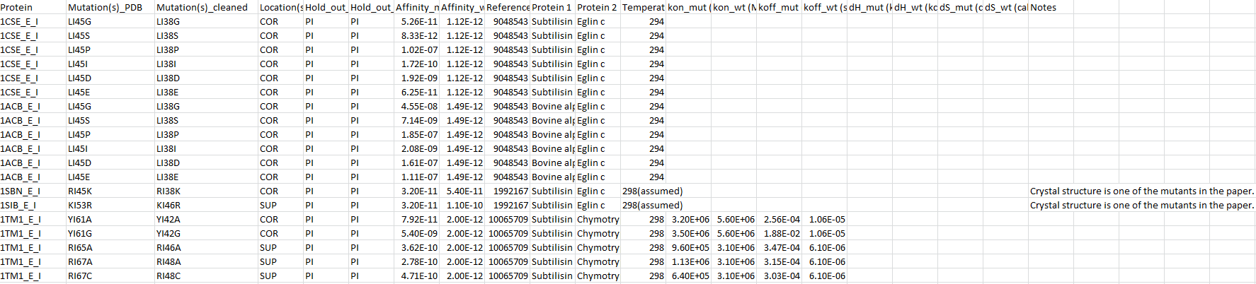
SKEMPI database
PDB and chain ID

Slide 4
Step 1: Mapping from PDB to Uniprot
A file is available from the PDB website (or rather, PDBsum, which contains additional annotation for PDB) that allows mapping from PDB to Uniprot ID
pdb_chain_uniprot.csv
PDB id : Uniprot ID
PDB start/end : Uniprot start/end

Slide 5
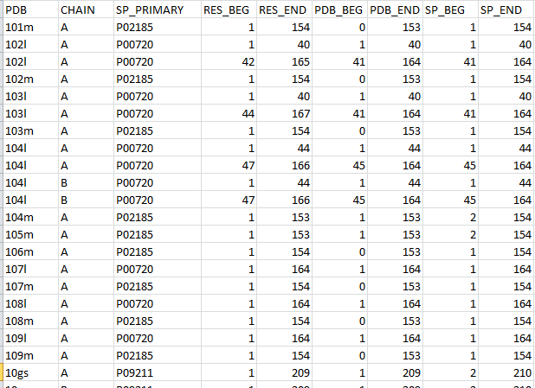
Step 1: Mapping from PDB to Uniprot
chain ID
Uniprot / Swissprot ID
PDB ID

Slide 6
Step 2: Mapping from Uniprot to PIRSF (Protein Information Resource Superfamily)
A file is available from the PIR website which allows mapping from Uniprot to PIR
Uniprot ID : PIRSF ID
Uniprot ID : species taxid
Much more
iproclass.tb

Slide 7
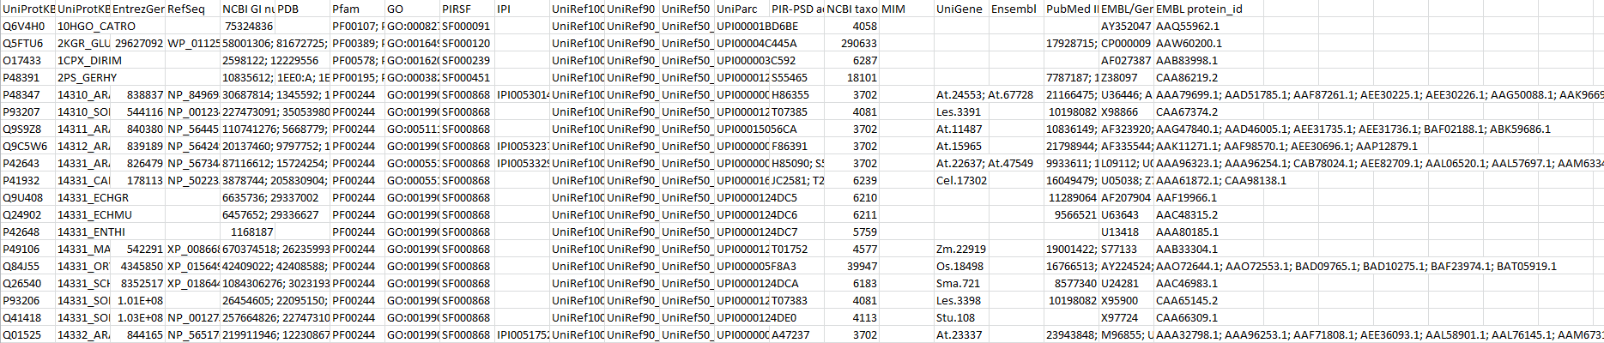
Step 2: Mapping from Uniprot to PIRSF
Uniprot ID
PIRSF ID
Taxonomic ID (organism)

Slide 8
Step 3: Collecting all PIRSF family members
The file iproclass.tb actually contains complete information for all PIRSF families
This includes all family members and the species they are from

Slide 9
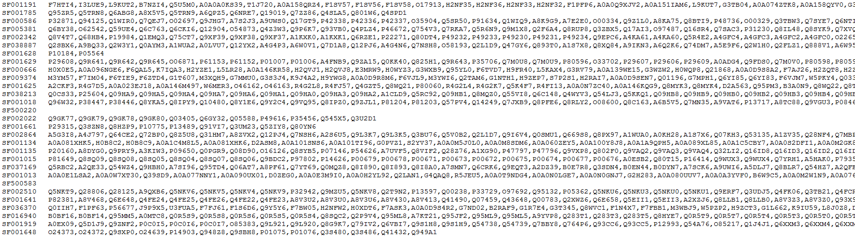
Step 3: Collecting all PIRSF family members
PIRSF ID
Family members (Uniprot IDs)

Slide 10
Step 1-3 summary
Started with
PDB_chain1_chain2 ids
Now have
PIRSF_family1_allmembers + PIRSF_family2_allmembers

Slide 11
Step 1-3 summary
PDBid_chain1
PDBid_chain2
Uniprot id 1
Uniprot id 2
PIRSF fam 1
PIRSF fam 2
PIRSF fam 1 Uniprot ids
PIRSF fam 2 Uniprot ids

Slide 12
Step 4: Finding potentially interacting protein pairs from SKEMPI-pair derived PIRSF families
PIRSF fam 1 members, PIRSF fam 2 members
Pair members from 1 and 2 that come from the same species (same taxid)

Slide 13
Step 4: Finding potentially interacting protein pairs from SKEMPI-pair derived PIRSF families
PIRSF fam 1
Same taxid
PIRSF fam 2

Slide 14
Step 5: Creating paired fasta files
Concatenate protein sequences of paired proteins from Step 4 as a single string with no spaces

Slide 15
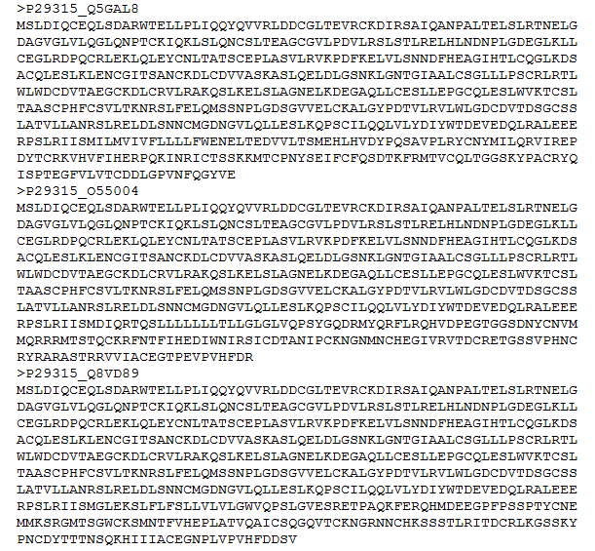
Step 5: Creating paired fasta files
P29315 sequence
Q5GAL8
sequence

Slide 16
Step 6: Create aligned paired fasta files
Run MUSCLE on paired fasta files, generates aligned paired fasta files

Slide 17
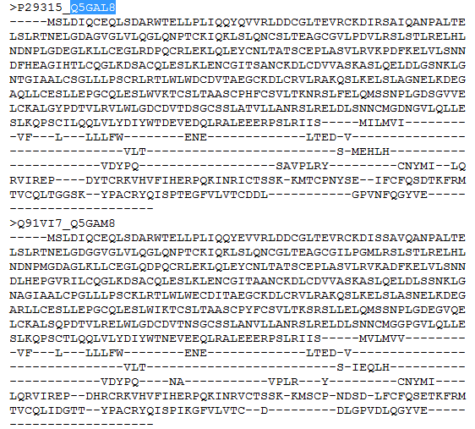
Step 6: Create aligned paired fasta files

Slide 18
Step 7: convert paired alignment from fasta to aln format
This is also a capability in MUSCLE
Uses the “convert_alignment.py” python script, part of MUSCLE package
In my view, this is a pointless step because all it does is remove the headers from the fasta alignment file, but CCMPred is a very finicky program and requires a very specific format for input. Using the fasta alignment is what caused the bug with incomplete output earlier. Bioinformatics is full of file format massaging. It’s a pain.

Slide 19
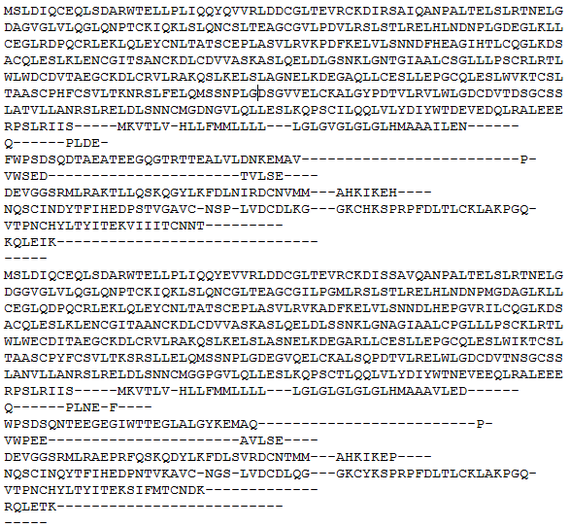
Step 7: convert paired alignment from fasta to aln format

Slide 20
Step 8: Run CCMPred on paired alignment (aln format) files
Run it!
Download output

Slide 21
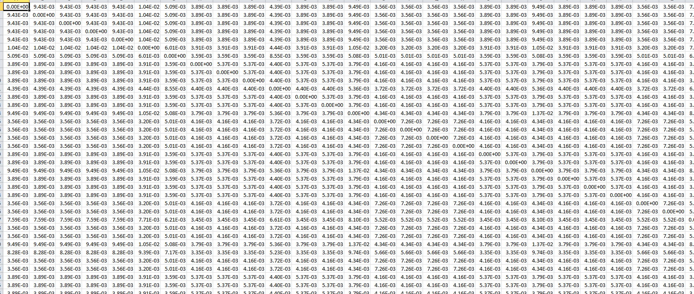
Step 8: Run CCMPred on paired alignment (aln format) files
799 columns
(length of protein A + protein B)
799 rows
(length of protein A + protein B)

Slide 22
To do:
Step 9: Determine an appropriate threshold for CCMPred output, for calculating contacts (I suspect top 5-10% of values in the raw matrix)
Step 10: Create intra-protein, inter-protein networks
Step 11: Derive features of mutations based on intra and inter-protein contacts (# nodes traversed during intra-protein contact network “walk”, topology of network during “walk” to inter-protein contacts)
Step 12: Train RBFNN using features from 11
Step 13: Apply trained RBFNN on your receptor-ligand pair, using random mutations as input and obtaining (hopefully) binding-enhanced mutants as output

