Slide 1
Lab Presentation
Nikhil Gopal
Sarah Roberts
Monisha Sharma
Angie Ulrich

Slide 2
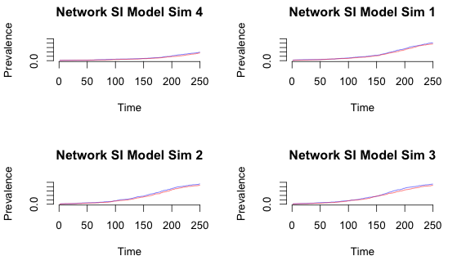
Transmission Rate
Notes:
0.5 for first 20, then:
0.05, 0.25, 0.5, 0.75

Slide 3
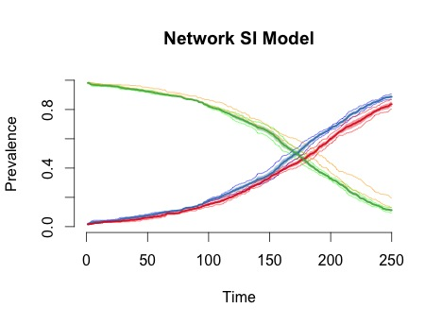
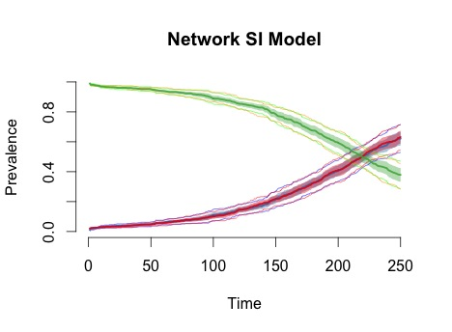
Original Degree Distribution
Effect of Degree Distribution
Serial Monogamy, 20% isolates
Susceptibles: green = F, orange = M. Infecteds: blue = F, red = M

Slide 4
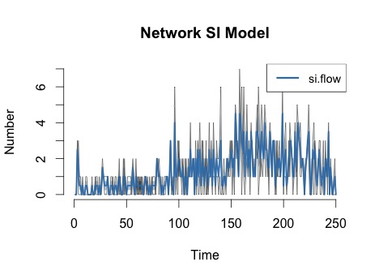
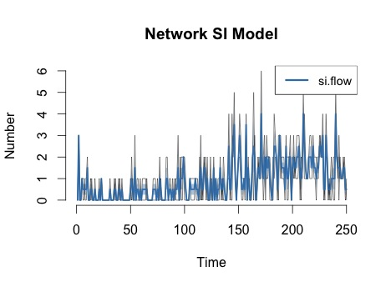
Effect of Degree Distribution: Incidence
Serial Monogamy, 20% isolates
Original Degree Distribution

Slide 5
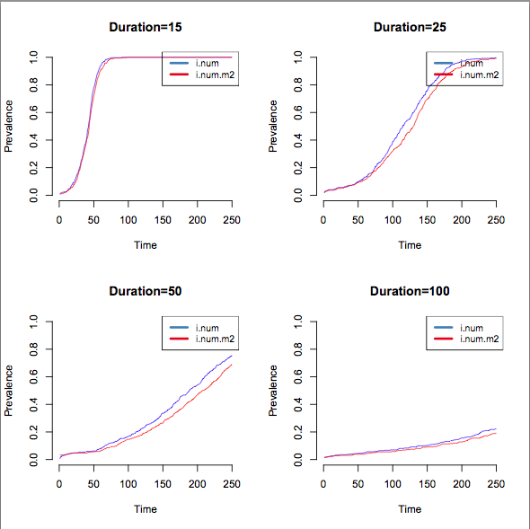

Slide 6
Thanks
Conclusions
Shorter duration = faster infection since higher partner turnover rate
Higher transmission rate = faster increase in prevalence
Some code available at http://github.com/ngopal/statnetWorkshop
Notes:
0.5 for first 20, then:
0.05, 0.25, 0.5, 0.75

