Slide 1
Introduction
Data Structures and Algorithm Analysis in C, by Mark Allen Weiss, 2nd edition, 1997, Addison-Wesley, ISBN 0-201-49840-5
Danang University of Science and Technology
Dang Thien Binh
dtbinh@dut.udn.vn

Slide 2
Class Overview
Introduction to many of the basic data structures used in computer software
  Understand the data structures
  Analyze the algorithms that use them
  Know when to apply them
Practice using these data structures by writing programs
IT faculty <number>/15

Slide 3
Goal
You will understand
  what the tools are for storing and processing common data types
  which tools are appropriate for which need
So that you will be able to
  make good design choices as a developer, project manager, or system customer
IT faculty <number>/15

Slide 4
Course Topics
Introduction to Algorithm Analysis
Lists, Stacks, Queues
Search Algorithms and Trees
Hashing and Heaps
Sorting
Disjoint Sets
Graph Algorithms
IT faculty <number>/15

Slide 5
Readings and References
Reading
  Chapter 1, Data Structures and Algorithm Analysis in C, by Weiss
Other References
  Sections 1-3, Pointers and Memory, by Parlante
IT faculty <number>/15

Slide 6
Data Structures: What?
Need to organize program data according to problem being solved
Abstract Data Type (ADT) - A data object and a set of operations for manipulating it
  List ADT with operations insert and delete
  Stack ADT with operations push and pop
Note similarity to Java classes
  Private data structure and public methods
IT faculty <number>/15

Slide 7
Data Structures: Why?
Program design depends crucially on how data is structured for use by the program
  Implementation of some operations may become easier or harder
  Speed of program may dramatically decrease or increase
  Memory used may increase or decrease
  Debugging may be become easier or harder
IT faculty <number>/15

Slide 8
Algorithms Analysis: What?
What is an algorithm?
  A sequence of steps (a “program”) that accomplishes a task
Many different algorithms may correctly solve a given task
  but will it be within this lifetime?
  will it require gigabytes of main memory?
IT faculty <number>/15

Slide 9
Algorithms Analysis: Why?
Understand the mathematical fundamentals needed to analyze algorithms
Learn how to compare the efficiency of different algorithms in terms of running time and memory usage
Study a number of standard algorithms for data manipulation and learn to use them for solving new problems
IT faculty <number>/15

Slide 10
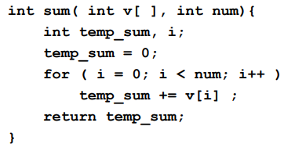
A Simple Function
Find the sum of the first num integers stored in an array v.
IT faculty <number>/15

Slide 11
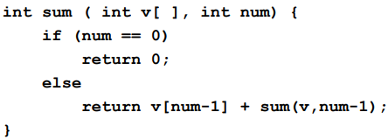
Programming via Recursion
Write a recursive function to find the sum of the first num integers stored in array v
IT faculty <number>/15

Slide 12
Proof by Induction
Basis Step: The algorithm is correct for a base case or two by inspection.
Inductive Hypothesis (n=k): Assume that the algorithm works correctly for the first k cases, for any k.
Inductive Step (n=k+1): Given the hypothesis above, show that the k+1 case will be calculated correctly.
IT faculty <number>/15

Slide 13
Program Correctness by Induction
Basis Step: sum(v,0) = 0.
Inductive Hypothesis (n=k): Assume sum(v,k) correctly returns sum of first k elements of v, i.e. v[0]+v[1]+…+v[k-1].
Inductive Step (n=k+1): sum(v,n) returns v[k]+sum(v,k) which is the sum of first k+1 elements of v.
IT faculty <number>/15

Slide 14
Algorithms vs Programs
Proving correctness of an algorithm is very important
  a well-designed algorithm is guaranteed to work correctly, and its performance can be estimated
Proving correctness of a program (an implementation) is fraught with weird bugs
  Abstract Data Types are a way to bridge the gap between mathematical algorithms and programs
IT faculty <number>/15

Slide 15
Readings and References
Reading
  Chapter 1, Data Structures and Algorithm Analysis in C, by Weiss
Other References
  Sections 1-3, Pointers and Memory, by Parlante
IT faculty <number>/15

