Slide 1
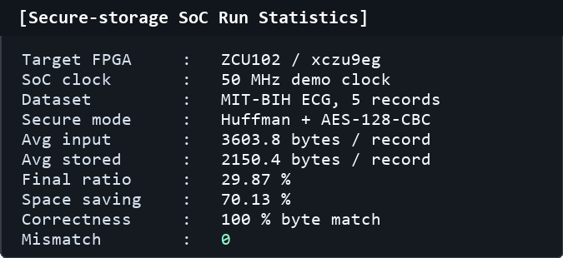
C
HO CHI MINH CITY UNIVERSITY OF TECHNOLOGY
AND EDUCATION
HCMUTE
HCMC University of Technology and Education
DESIGN QUALITY EVALUATION
Performance Evaluation
Comparison with ECG Huffman + CBC-AES Paper
Direct RTL/FPGA verification on ECG secure-storage workload
Metric
ECG CBC-AES Paper [1]
This Work
Correctness
Improvement (%)
Compression
ratio
35.015%
29.87%
100%
+14.69%
Space
saving
64.985%
70.13%
100%
+7.92%
PRD / byte
match
0.411
0 mismatch
byte-exact RX
100%
0%
Compression
time
~3.8641 s
1.056 ms
TX comp-only
100%
+99.97%
Decompression
time
~0.5818 s
0.483 ms
RX Huffman
100%
+99.92%
Encryption
time
~2.7106 s
29.6 us
TX AES
100%
+99.999%
Decryption
time
~3.0449 s
69.2 us
RX AES
100%
+99.998%
Compression +
encryption
~6.5747 s
1.065 ms
TX path
100%
+99.98%
TX/RX cycles
N/R
53233 TX
24222 RX
100%
0%
29.87%
70.13%
100%
TX/RX throughput
N/R
6.828 MB/s TX-in
15.072 MB/s RX-out
100%
0%
final ratio
raw ECG saving
byte match
Source:
[1] A lossless compression and encryption mechanism for remote monitoring of ECG data
using Huffman coding and CBC-AES, FGCS 2019; simulated in MATLAB 2018a on Windows 7,
i5 2nd Gen, 8 GB RAM. N/R = not reported.
Note: ML precision is TP/(TP+FP); this slide uses byte-match correctness = matched bytes/total bytes.
RTL timing is measured from perf counters at 50 MHz on the five MIT-BIH records.
Comparison input set:
MIT-BIH records: 100, 106, 112, 117, 213
Raw reference: 7200 B/record = 3600 samples x 2 B
SoC input avg 3603.8 B; stored avg 2150.4 B
Paper platform: MATLAB 2018a, Win7 64-bit, i5 2nd Gen, 8 GB RAM
Application target: embedded secure data storage with compression, encryption, and byte-exact readback.

