Slide 1
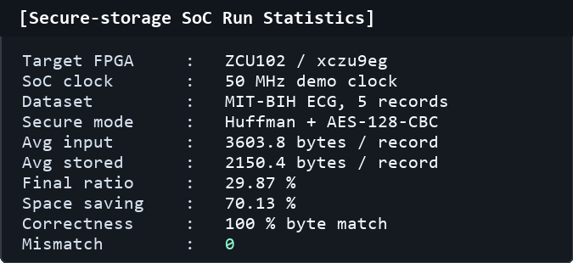
C
HO CHI MINH CITY UNIVERSITY OF TECHNOLOGY
AND EDUCATION
HCMC University of Technology and Education
DESIGN QUALITY EVALUATION
RTL/FPGA Run Evidence
Comparison Summary
Secure-storage workload on MIT-BIH ECG records
Paper baseline: ECG Huffman + CBC-AES [1]
Metric
Paper [1]
This Work
Evaluation
Final ratio
35.015%
29.87%
+14.69%
Space saving
64.985%
70.13%
+7.92%
Huff. comp.
~3.8641 s
1.056 ms
+99.97%
Huff. decomp.
~0.5818 s
0.483 ms
+99.92%
AES encrypt
~2.7106 s
29.6 us
+99.999%
29.87%
70.13%
100%
AES decrypt
~3.0449 s
69.2 us
+99.998%
final ratio
space saving
byte match
Readback
PRD 0.411
0 mismatch
100% match
[1] FGCS 2019 ECG Huffman + CBC-AES paper. Paper platform: MATLAB 2018a, Windows 7 64-bit, i5 2nd Gen, 8 GB RAM.
Input type: MIT-BIH ECG records | Avg input: 3603.8 bytes/record | Raw reference: 7200 bytes/record

