Slide 1

On the Notion of Independence: Quantifying the Difference Between Independent and Mainstream Cinema
Comparative Social Research
Paris 2022
Master Thesis by Nikita Gorynin

Slide 2
Comparative Social Research
Nikita Gorynin
On the Notion of Independence: Quantifying the Difference Between Independent and Mainstream Cinema
Table of contents
Introduction………………………………………………………………………………..3
Literature background.………………………………………………………………..4
Data Source.………………………………………………………….…………………….7
Methodology..………………………………………………………….………………...8
Theoretical framework.………………………………………………………….….10
Descriptive statistics….…………………………………………….…………………12
Results.……………………………………………….……………………………………..14
Conclusion ……………………………………………….……………………………….20
Limitations and future directions…………….…………………………………21

Slide 3
Comparative Social Research
Nikita Gorynin
On the Notion of Independence: Quantifying the Difference Between Independent and Mainstream Cinema
Introduction
The concept of “Indie” as opposed to “Mainstream” is common in culture – same notions are used for music and literature
Division between “Indie” and “Mainstream” is hard to approach quantitatively to obtain a clear distinction
Border between the two seems blurring – see “Nomadland” and “Sound of Metal” on Oscars-2021
Social Network Analysis of production teams can be used to formalize the division
What quantifiable differences between mainstream and independent cinema can be found in the structure of their production team’s network?

Slide 4
Comparative Social Research
Nikita Gorynin
On the Notion of Independence: Quantifying the Difference Between Independent and Mainstream Cinema
Literature background
Focus on the US as the largest and well-studied region
US Independent movie scene emerged in 1980’s as an opposition to the Hollywood cinematography (Ortner, 2012)
Independent film festivals were established specifically to showcase independent films (Ortner, 2012)
Is the difference on a production or a reception side?
Independent films as “anti-economy” true art vs major studio films as commercial and dominant mass art (Bourdieau, 1993)
If there is an opposition – what form does it take?
“Indie” shifts its meaning from literally independent (from major studios) to just hip and edgy in 1990-s (Newman, 2009)
More Hollywood stars work in smaller movies (Shelton, 2019)

Slide 5
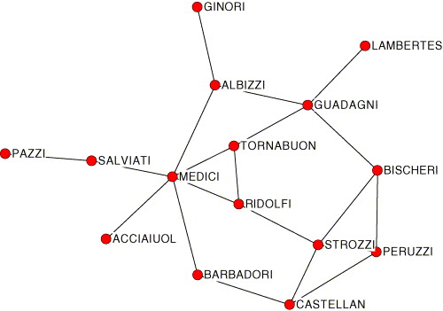
Comparative Social Research
Nikita Gorynin
On the Notion of Independence: Quantifying the Difference Between Independent and Mainstream Cinema
Literature background
Main idea – ties in society (but not only) can be modeled with graphs (Borgatti & Halgin, 2011)
Cinema industry can be modeled with networks as well
Communities found in a network match with real-life communities (Gleiser & Danon, 2003)
Network of marriages among Renaissance Florence families
(Padgett & Ansell, 1993)

Slide 6
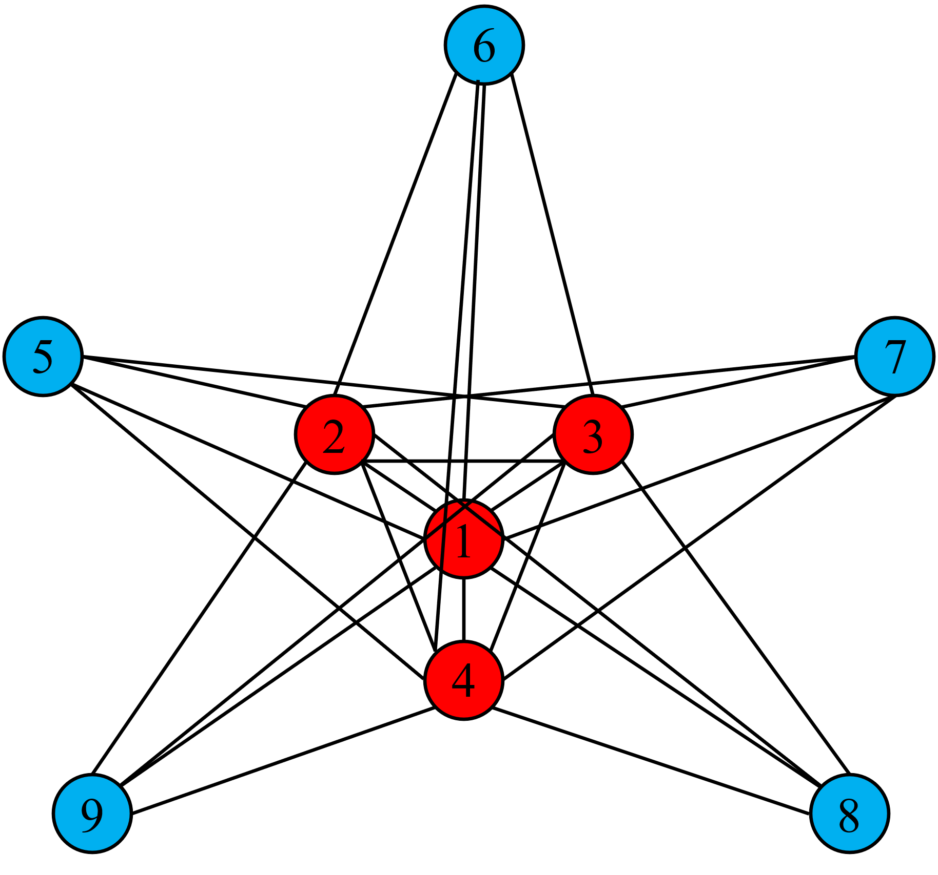
Comparative Social Research
Nikita Gorynin
On the Notion of Independence: Quantifying the Difference Between Independent and Mainstream Cinema
Literature background
Certain topologies, such as core-periphery structure, are common in networks (Laumann & Pappi, 2013)
C-P structure found in scientific citation networks (Doreian, 1985), business organizations (Barsky, 2007) etc.
Hollywood accounts for 66-84% of US cinema production
US cinema network is expected to be core-peripheric, with independent films on periphery
Network with perfect core-periphery structure:
red nodes (1-4) form a core, blue nodes (5-9) form a periphery

Slide 7
Comparative Social Research
Nikita Gorynin
On the Notion of Independence: Quantifying the Difference Between Independent and Mainstream Cinema
Data source
Data for the study comes from IMDB – ready-to-use datasets on movies and crew + parsed data on awards and countries
4 awards were selected to sample independent and mainstream films – 2 for independent and 2 for mainstream
Independent awards - Independent Spirit and Sundance
Mainstream awards – Academy awards (Oscars) and Golden Globes
Only nominees of “Best film” category or it’s analogue were considered for each award

Slide 8
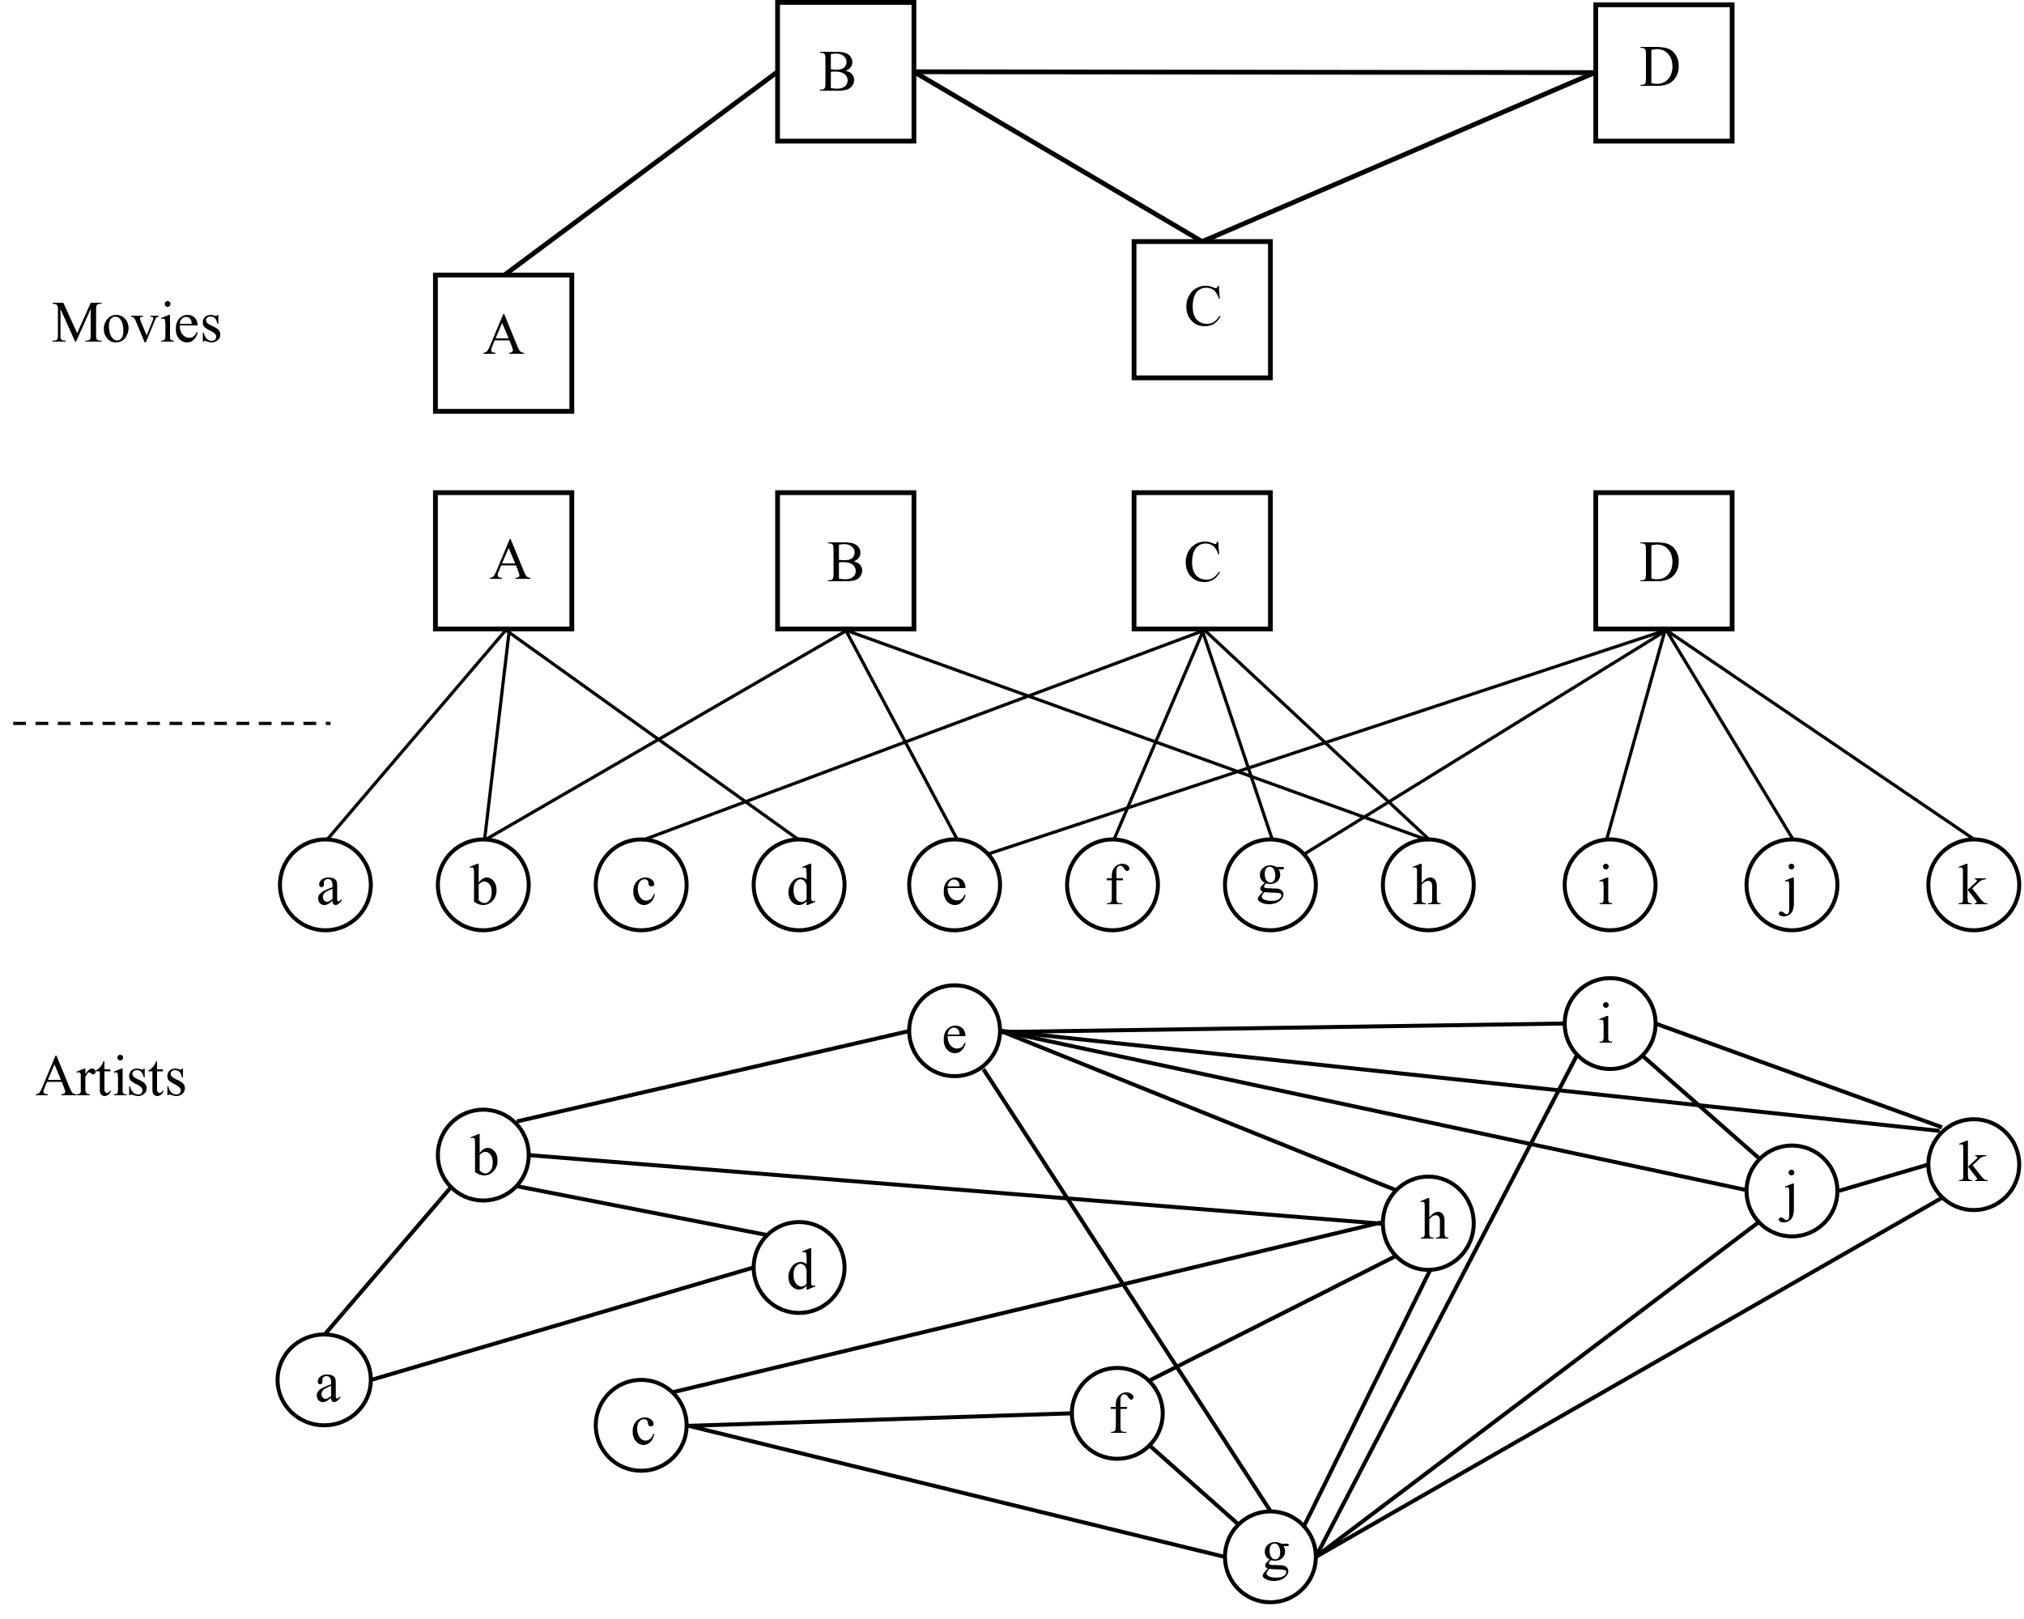
Comparative Social Research
Nikita Gorynin
On the Notion of Independence: Quantifying the Difference Between Independent and Mainstream Cinema
Methodology
Analyzed projection
Only “core crew” was taken into account: producer, director, writer, editor, cinematographer, production designer and composer (Cattani & Ferriani, 2008)
List of crew members for each movie was transformed into bipartite graph
Only movies, produced in US in 1986-2020 were analyzed
For each network, collaborations within previous 5 years were taken into account: 1986-1990, 1987-1991…2016-2020 (Uzzi & Spiro, 2005)
84,677 films and 186,308 crew members analyzed in total, of which 760 films are award nominees
Bipartite graph and its projections on the movie layer (top) and artist layer (bottom)

Slide 9
Comparative Social Research
Nikita Gorynin
On the Notion of Independence: Quantifying the Difference Between Independent and Mainstream Cinema
Methodology
Degree – count of all connections of the node, simplest measure of it’s centrality within a network
Isolates – nodes of the network without connections to other nodes, represents a “new blood” on the scene
Centralization of the network – extend, to which the elements differ in their degrees, the stronger centralization in a network, the more visible communities become (Neuberger, 2020)
Correlation with the perfect core-periphery model – extend, to which this model is applicable

Slide 10
Comparative Social Research
Nikita Gorynin
On the Notion of Independence: Quantifying the Difference Between Independent and Mainstream Cinema
Theoretical framework
Main research question – “What quantifiable differences between mainstream and independent cinema can be found in the structure of their production team’s network?”. First set of hypothesis – general differences:
H1.a) Total network of US movies will become less centralized in the period of 1990 - 2020.
H1.b) Independent nominees will have weaker ties with other movies in the network compared to the average level at least at the starting point.
H1.c) Difference in strength of ties between independent nominees and average level will decrease over time (independent nominees will get increasingly more connected).
H1.d) Independent nominees will have weaker ties with other movies in the network compared to the mainstream nominees at least at the starting point.
H1.e) Difference in strength of ties between independent and mainstream nominees will decrease over time.
H1.f) Mainstream nominees will have ties with other movies in the network similar to the average level at least at the starting point.
H1.g) Difference in strength of ties between mainstream nominees and average level will be stable over time.

Slide 11
Comparative Social Research
Nikita Gorynin
On the Notion of Independence: Quantifying the Difference Between Independent and Mainstream Cinema
Theoretical framework
Second set of hypothesis to test core-periphery model:
H2.a) Total network of US movies will demonstrate core-periphery structure at least at the starting point
H2.b) The extend, to which the network will exhibit core-periphery structure will decrease over time
H2.c) Independent nominees will mostly reside on the periphery of the total network at the starting point
H2.d) Share of Independent nominees in the core will increase over time
H2.e) Mainstream nominees will mostly reside in the core of the total network at the starting point
H2.f) Share of mainstream nominees in the core will be stable over time

Slide 12
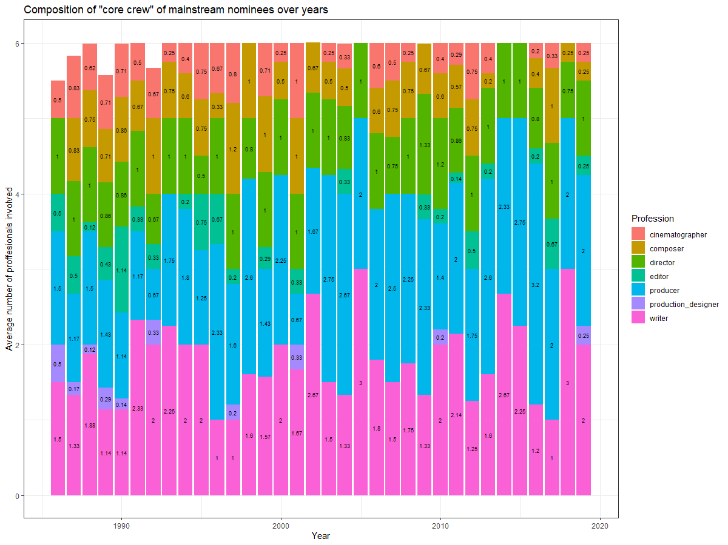
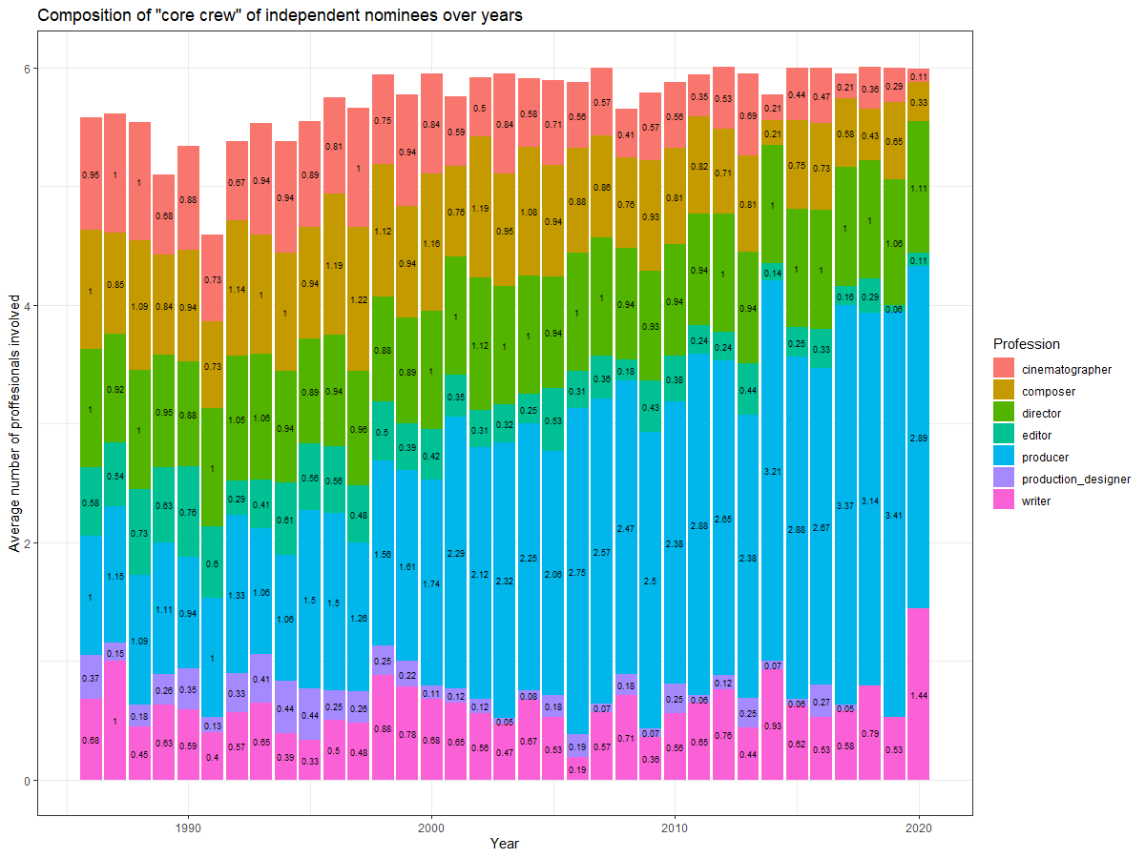
Comparative Social Research
Nikita Gorynin
On the Notion of Independence: Quantifying the Difference Between Independent and Mainstream Cinema
Descriptive statistics
Share of producers involved in the independent movie’s production teams increased by 189% and is 22% higher then average level
and 15% higher then level for mainstream movies in 2020

Slide 13
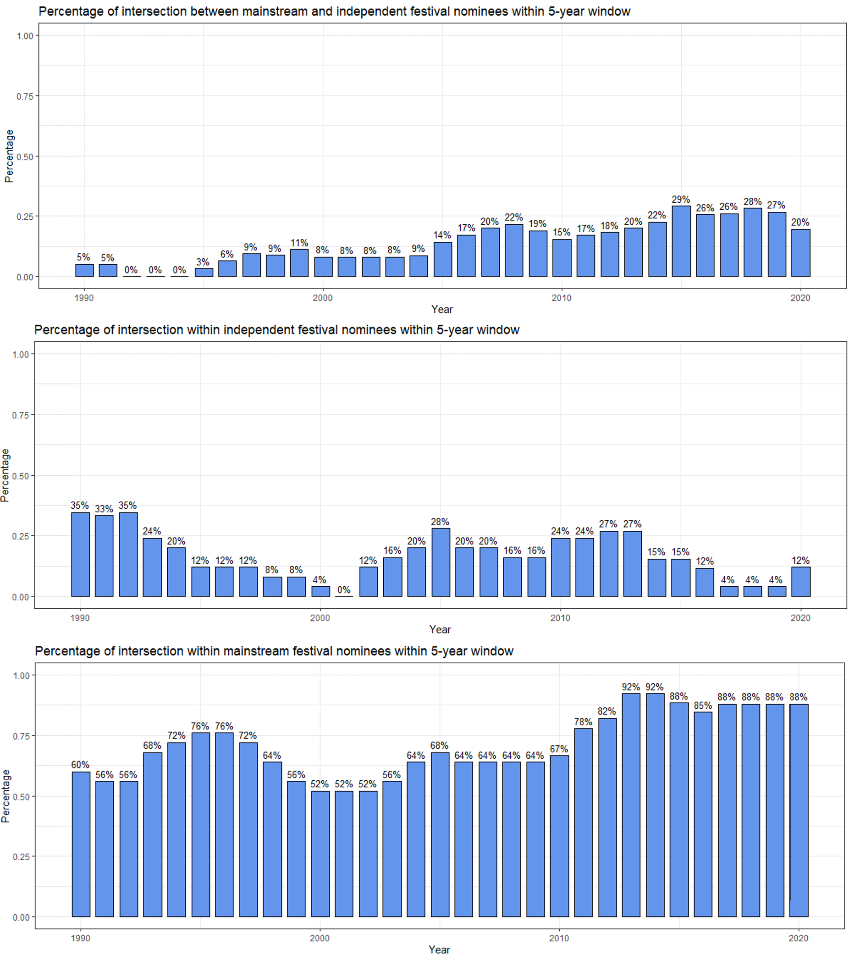
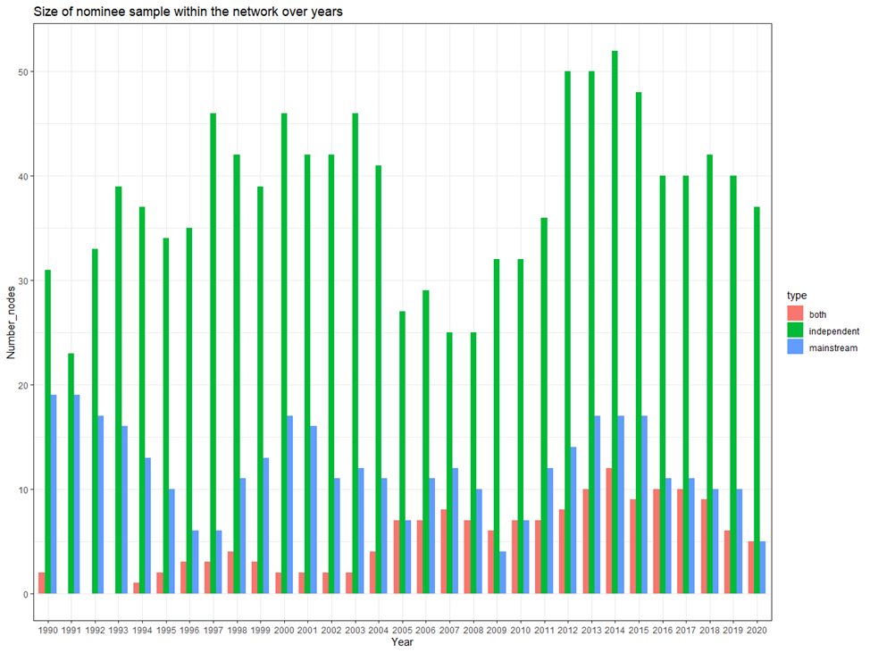
Comparative Social Research
Nikita Gorynin
On the Notion of Independence: Quantifying the Difference Between Independent and Mainstream Cinema
Descriptive statistics
On average, 20 independent nominees and 11 mainstream nominees annually
Intersections between mainstream and independent awards grow over time, intersections within mainstream awards exceed 50%

Slide 14
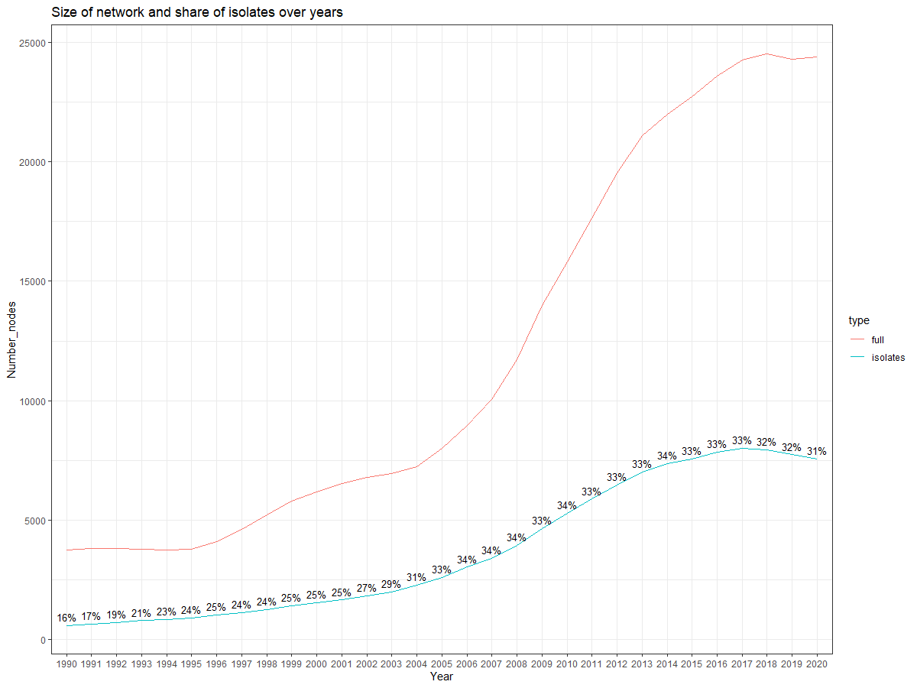
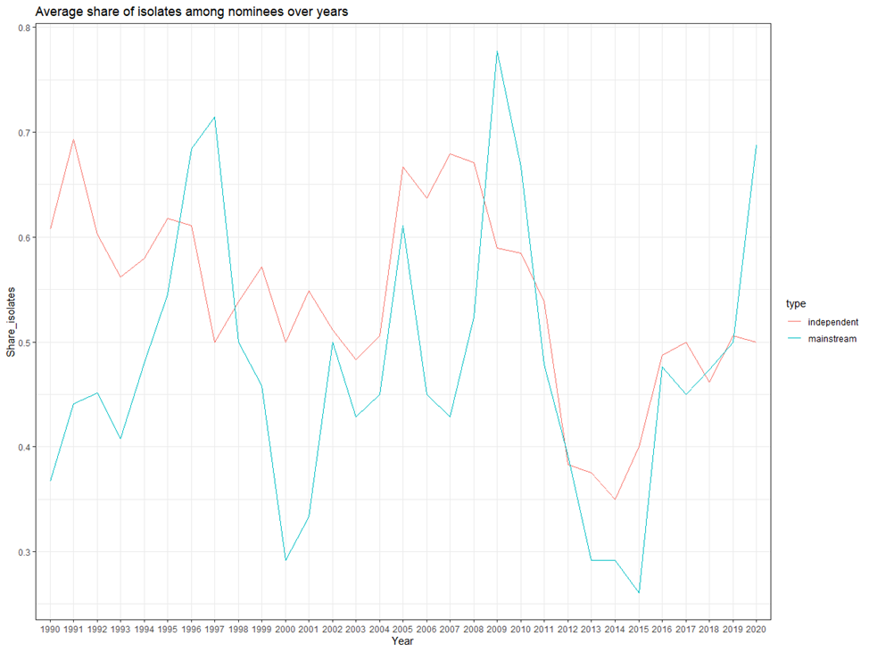
Comparative Social Research
Nikita Gorynin
On the Notion of Independence: Quantifying the Difference Between Independent and Mainstream Cinema
Results
Share of isolates for nominees do not follow the general trend, independent nominees have higher share of isolates

Slide 15
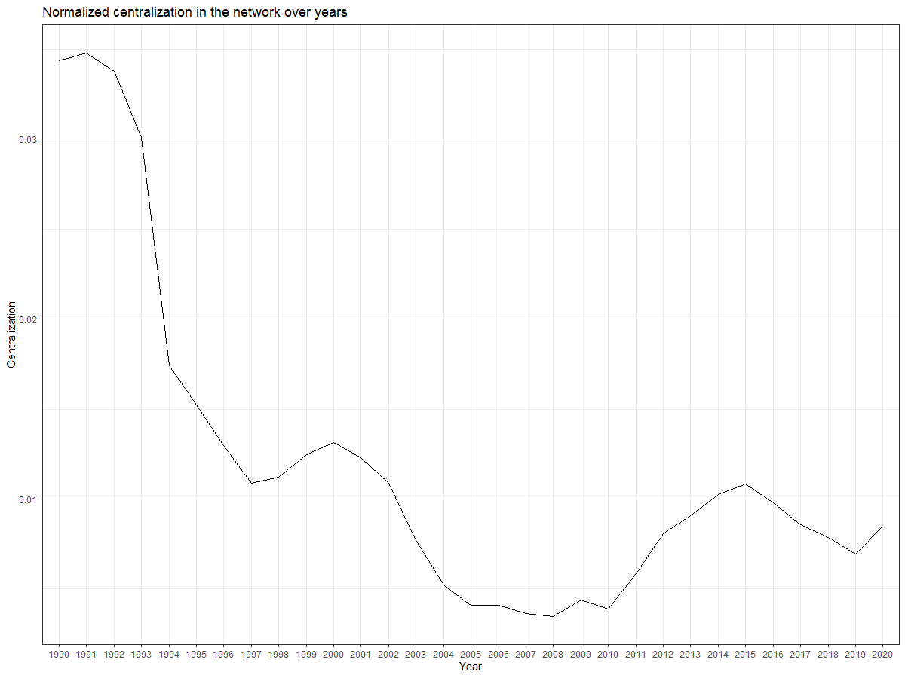
Comparative Social Research
Nikita Gorynin
On the Notion of Independence: Quantifying the Difference Between Independent and Mainstream Cinema
Results
Centralization falls - H1.a hypothesis is supported

Slide 16
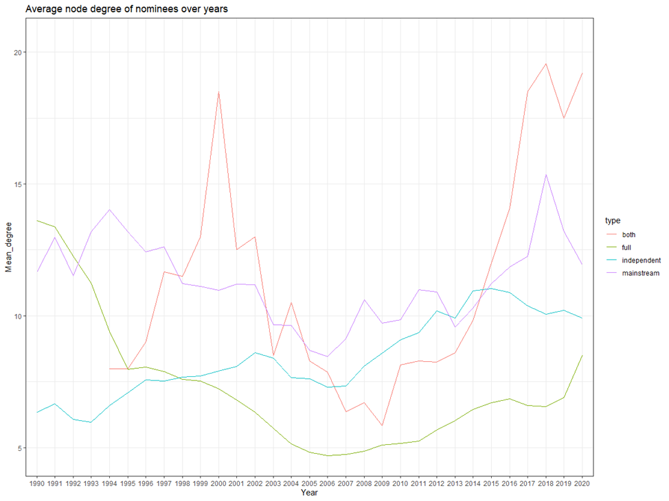
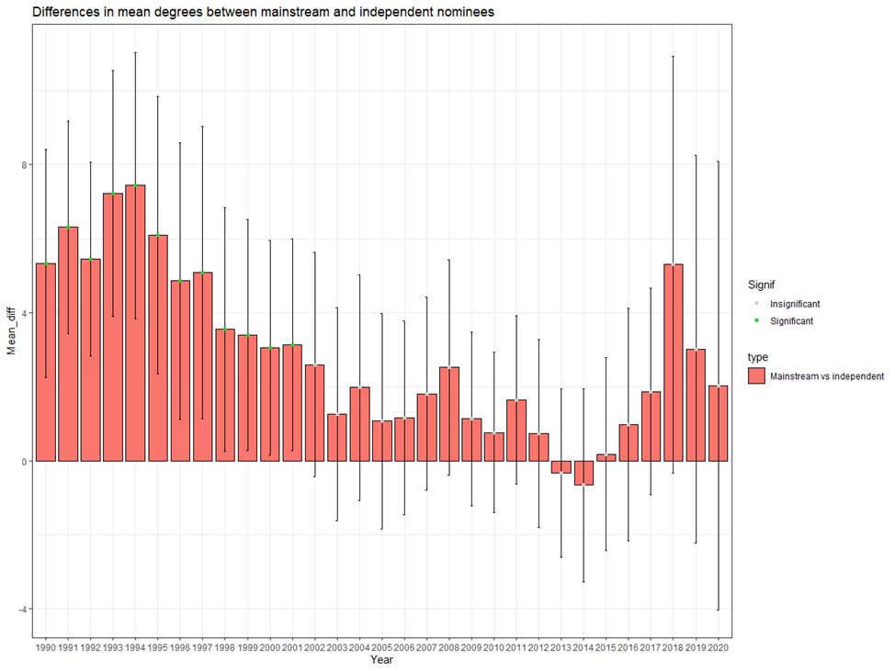
Comparative Social Research
Nikita Gorynin
On the Notion of Independence: Quantifying the Difference Between Independent and Mainstream Cinema
Results
Independent nominees had significantly lower degrees then mainstream nominees only until the year 2001 H1.d and H1.e are supported

Slide 17
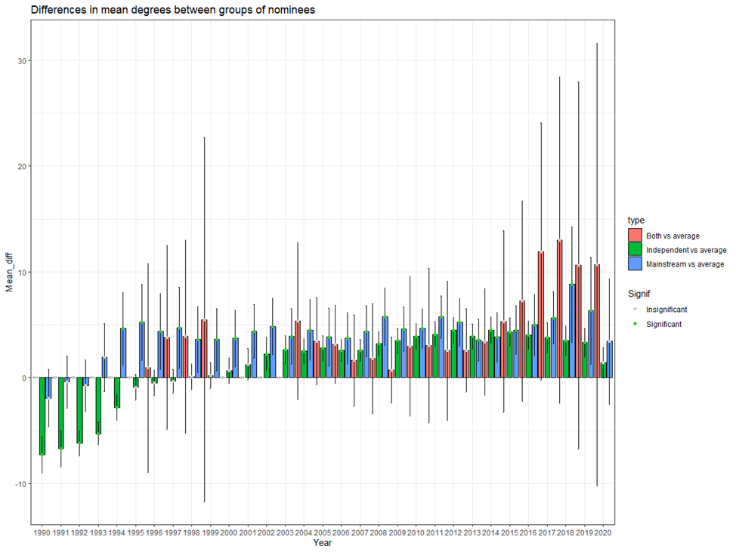
Comparative Social Research
Nikita Gorynin
On the Notion of Independence: Quantifying the Difference Between Independent and Mainstream Cinema
Results
Independent nominees had degree lower than average until the year 1994, then had the average degrees in 1995-2001 and became more connected from 2002.
H1.b supported, H1.c partly supported
Conversely, mainstream nominees had average degrees until the year 1994 and became more strongly connected from 1995 to 2019.
H1.f supported, H1.g is not supported

Slide 18
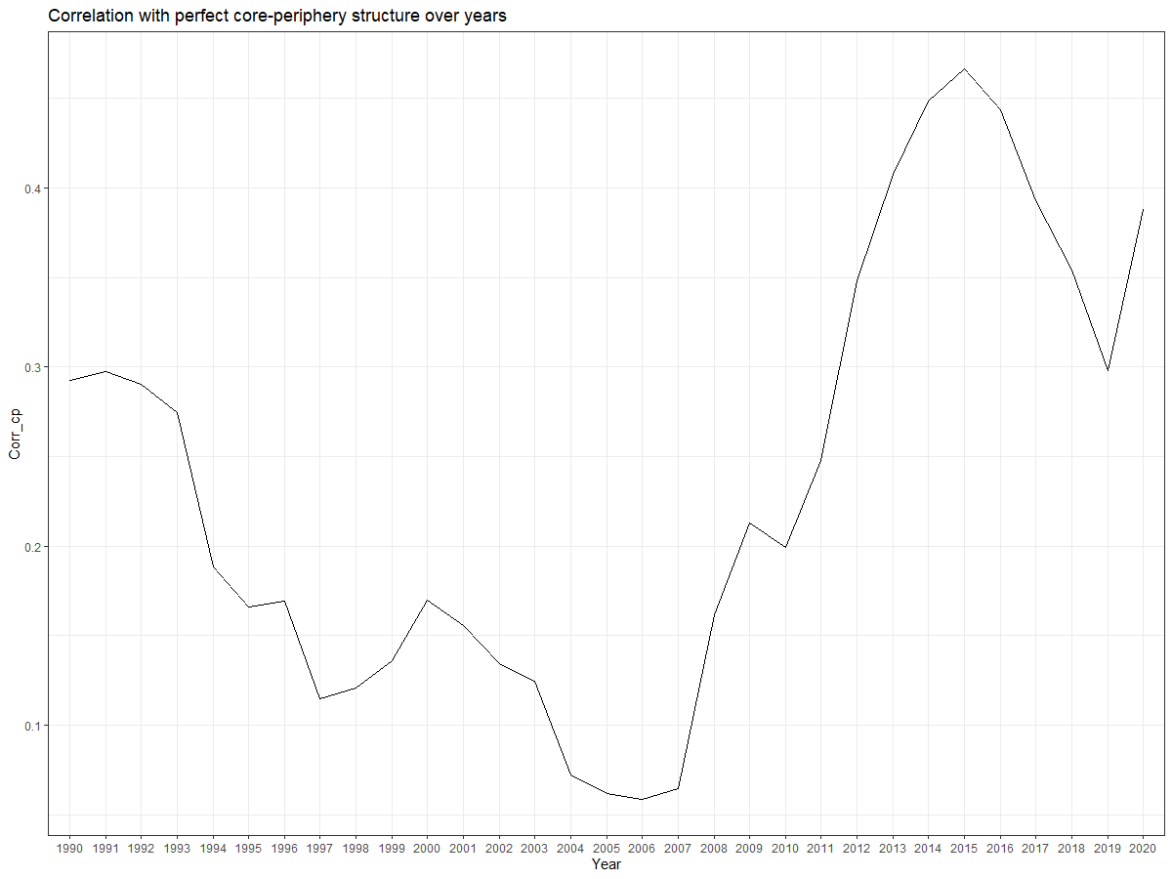
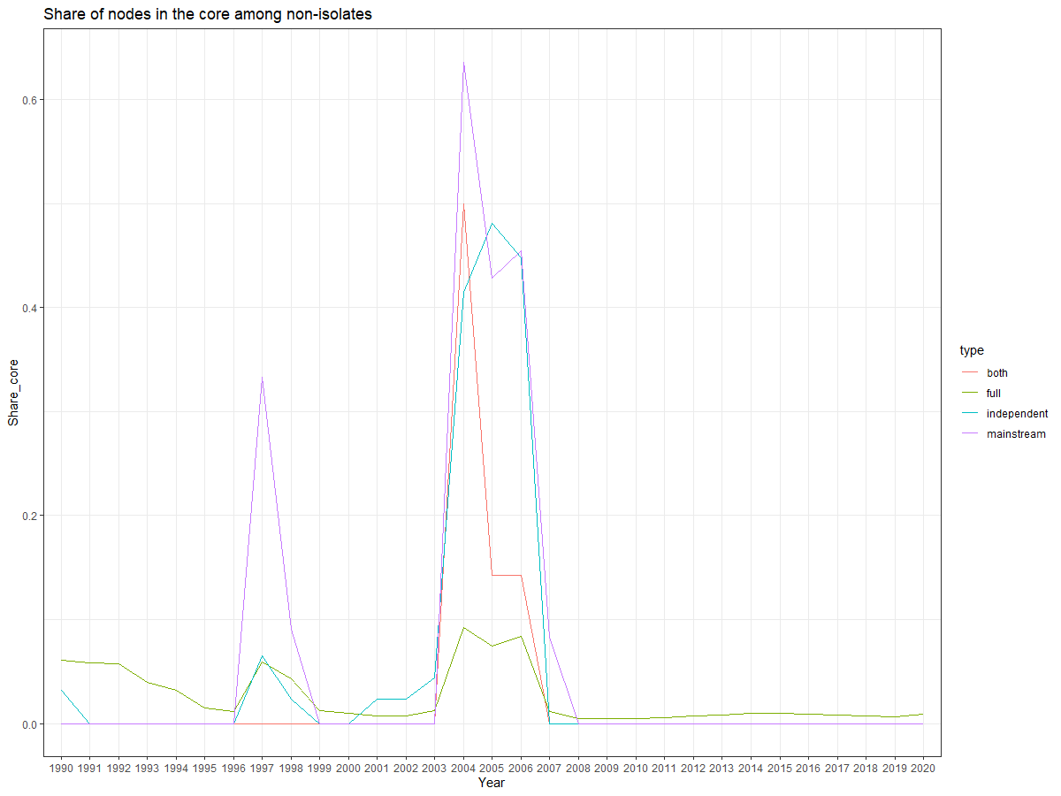
Comparative Social Research
Nikita Gorynin
On the Notion of Independence: Quantifying the Difference Between Independent and Mainstream Cinema
Results
Correlation with c-p model is weak and has ambiguous dynamics - H2.a not supported, H2.b partly supported
Share of nominees in either core or periphery is meaningless, H2.c-H2.f are not appropriate

Slide 19
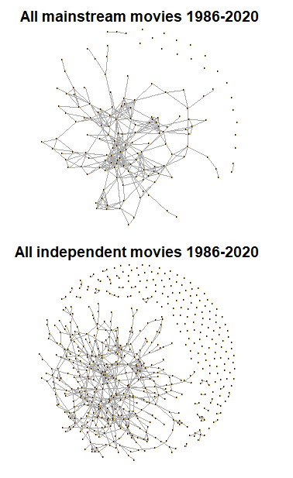
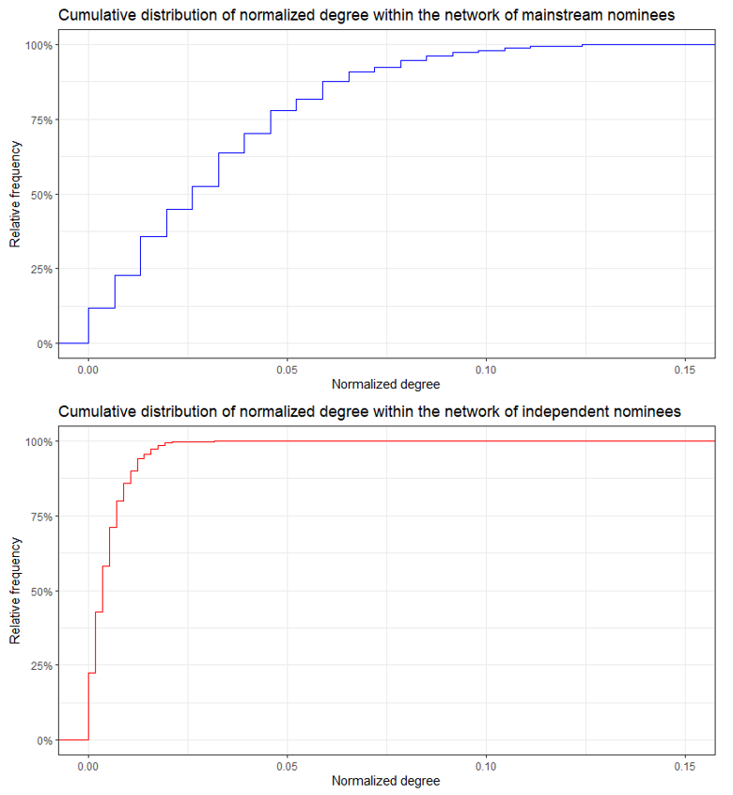
Comparative Social Research
Nikita Gorynin
On the Notion of Independence: Quantifying the Difference Between Independent and Mainstream Cinema
Results
Mainstream nominees are more strongly interconnected between each other – mean normalized node degree for them is 6.5 times higher than that of independent nominees
Independent movie scene is less interconnected than mainstream movie scene

Slide 20
Comparative Social Research
Nikita Gorynin
On the Notion of Independence: Quantifying the Difference Between Independent and Mainstream Cinema
Conclusion
Cinema network does not demonstrate a core-periphery structure, contrary to expectations
Cinema network is becoming less centralized over time, as expected
Independent nominees expectedly shared less artists with other films, compared to mainstream nominees and average level at the start
Over time, independent nominees became as connected as mainstream nominees, surpassing the average level
Over time, more producers are involved into production of independent films, surpassing the mainstream and average level
Intersections within independent nominees are much smaller then between mainstream nominees
Independent movie scene is much less interconnected then mainstream scene
Evidence, that independent and mainstream films started as significantly different by their position in the global film network
Evidence, that differences in connectivity are washing off
Evidence that two scenes are different in their internal organization and differences are increasing

Slide 21
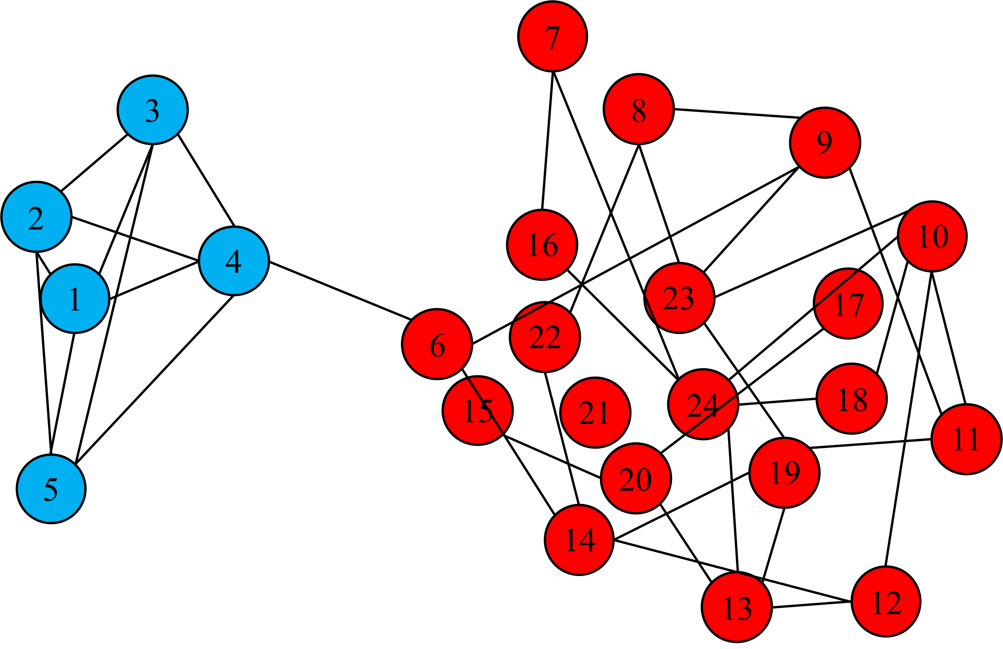
Comparative Social Research
Nikita Gorynin
On the Notion of Independence: Quantifying the Difference Between Independent and Mainstream Cinema
Limitations and future directions
Proposed core-periphery model does not fit – other models might be tested
Small sample sizes – more awards and categories might be used
Actual dynamics is much more complex then proposed – more precise time-series model can be utilized
Impossible to completely deconfound effect of independence from the effect of nomination
Network organized into two communities

Slide 22
Thank you!

