Slide 1
Priority Queues (Heaps)
Cpt S 223. School of EECS, WSU
Notes:
Cpt S 223
Washington State University

Slide 2
Motivation
Queues are a standard mechanism for ordering tasks on a first-come, first-served basis
However, some tasks may be more important or timely than others (higher priority)
Priority queues
  Store tasks using a partial ordering based on priority
  Ensure highest priority task at head of queue
Heaps are the underlying data structure of priority queues
Cpt S 223. School of EECS, WSU
Notes:
Cpt S 223
Washington State University

Slide 3
Priority Queues: Specification
Main operations
  insert (i.e., enqueue)
    Dynamic insert
    specification of a priority level (0-high, 1,2.. Low)
  deleteMin (i.e., dequeue)
    Finds the current minimum element (read: “highest priority”) in the queue, deletes it from the queue, and returns it
Performance goal is for operations to be “fast”
Cpt S 223. School of EECS, WSU
Notes:
Cpt S 223
Washington State University

Slide 4
Using priority queues
4
10
19
5
3
13
8
11
22
insert()
deleteMin()
Dequeues the next element
with the highest priority
2
Cpt S 223. School of EECS, WSU
Notes:
Cpt S 223
Washington State University

Slide 5
Simple Implementations
Can we build a data structure better suited to store and retrieve priorities?
…
Unordered linked list
  O(1) insert
  O(n) deleteMin
Ordered linked list
  O(n) insert
  O(1) deleteMin
Ordered array
  O(lg n + n) insert
  O(n) deleteMin
Balanced BST
  O(log₂n) insert and deleteMin
5
2
10
3
3
5
…
10
2
2 | 3 | 5 | … | 10
Cpt S 223. School of EECS, WSU
Notes:
Cpt S 223
Washington State University

Slide 6
Binary Heap
A priority queue data structure
Cpt S 223. School of EECS, WSU
Notes:
Cpt S 223
Washington State University

Slide 7
Binary Heap
A binary heap is a binary tree with two properties
  Structure property
  Heap-order property
Cpt S 223. School of EECS, WSU
Notes:
Cpt S 223
Washington State University

Slide 8
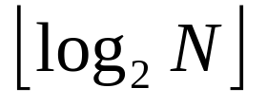
Structure Property
A binary heap is a complete binary tree
    Each level (except possibly the bottom most level) is completely filled
    The bottom most level may be partially filled
    (from left to right)
Height of a complete binary tree with N elements is
Cpt S 223. School of EECS, WSU
Notes:
Cpt S 223
Washington State University

Slide 9
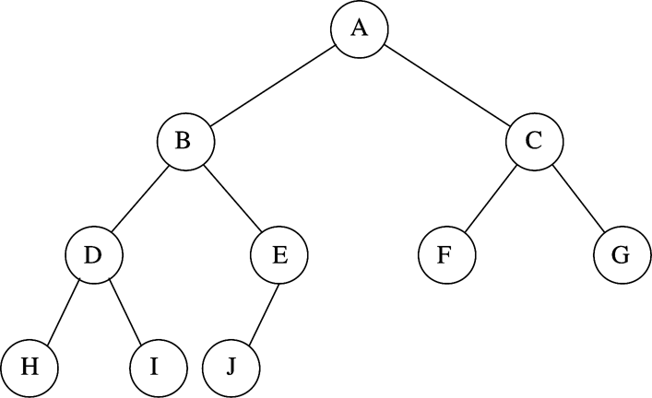
Binary Heap Example
Structure property
N=10
Every level (except last) saturated
Array representation:
Cpt S 223. School of EECS, WSU
Notes:
Cpt S 223
Washington State University

Slide 10
Heap-order Property
Heap-order property (for a “MinHeap”)
  For every node X, key(parent(X)) ≤ key(X)
  Except root node, which has no parent
Thus, minimum key always at root
  Alternatively, for a “MaxHeap”, always keep the maximum key at the root
Insert and deleteMin must maintain heap-order property
Cpt S 223. School of EECS, WSU
Notes:
Cpt S 223
Washington State University

Slide 11
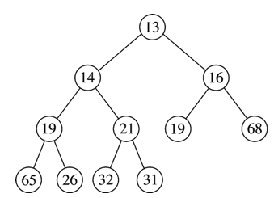
Heap Order Property
Minimum element
Duplicates are allowed
No order implied for elements which do not share ancestor-descendant relationship
≤
≤
≤
≤
≤
≤
≤
≤
≤
≤
Cpt S 223. School of EECS, WSU
Notes:
Cpt S 223
Washington State University

Slide 12

Implementing Complete Binary Trees as Arrays
Given element at position i in the array
  Left child(i) = at position 2i
  Right child(i) = at position 2i + 1
  Parent(i) = at position
i
2i
2i + 1
i/2
Cpt S 223. School of EECS, WSU
Notes:
Cpt S 223
Washington State University

Slide 13
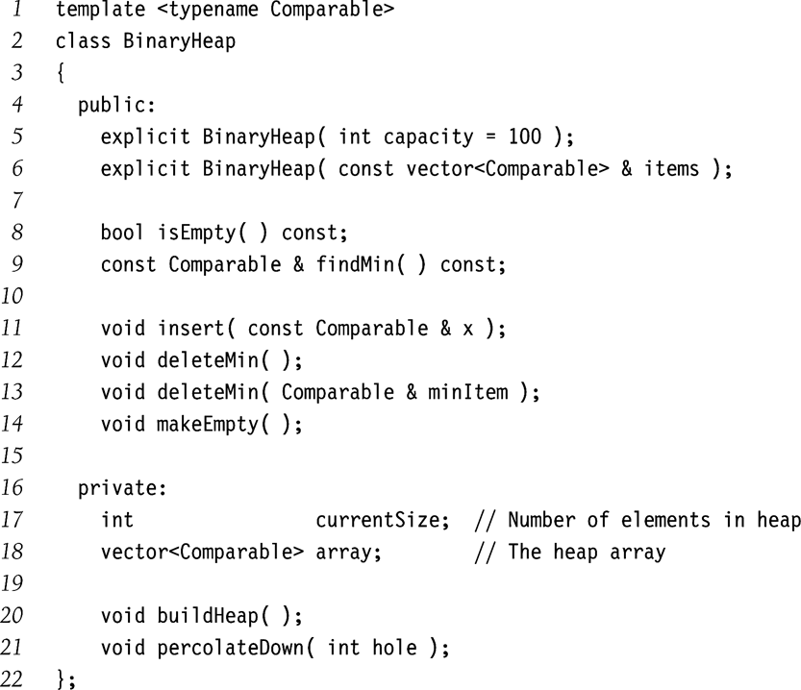
Just finds the Min without deleting it
insert
deleteMin
Note: a general delete()
function is not as important
for heaps
but could be implemented
Stores the heap as
a vector
Fix heap after deleteMin
Cpt S 223. School of EECS, WSU
Notes:
Cpt S 223
Washington State University

Slide 14
Heap Insert
Insert new element into the heap at the next available slot (“hole”)
  According to maintaining a complete binary tree
Then, “percolate” the element up the heap while heap-order property not satisfied
Cpt S 223. School of EECS, WSU
Notes:
Cpt S 223
Washington State University

Slide 15
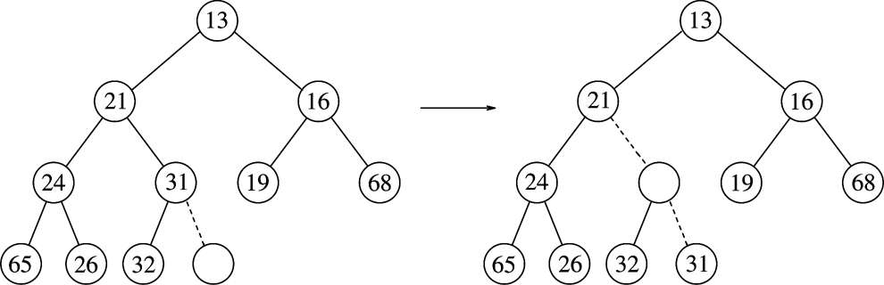
Heap Insert: Example
Percolating Up
Insert 14:
14
hole
Cpt S 223. School of EECS, WSU
Notes:
Cpt S 223
Washington State University

Slide 16
Heap Insert: Example
Percolating Up
(1)
14 vs. 31
Insert 14:
14
14
hole
Cpt S 223. School of EECS, WSU
Notes:
Cpt S 223
Washington State University

Slide 17
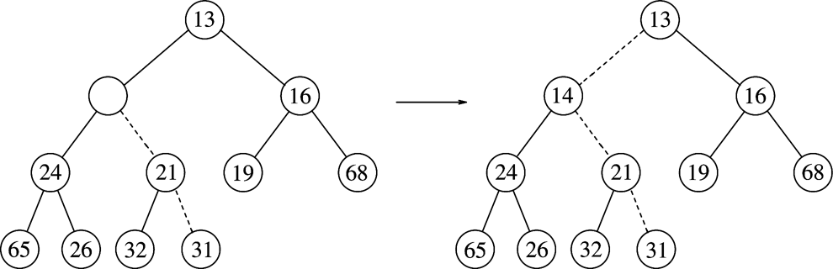
Heap Insert: Example
Percolating Up
(1)
14 vs. 31
Insert 14:
14
14
hole
(2)
14 vs. 21
14
Cpt S 223. School of EECS, WSU
Notes:
Cpt S 223
Washington State University

Slide 18
Heap Insert: Example
Percolating Up
(1)
14 vs. 31
Insert 14:
14
hole
(2)
14 vs. 21
(3)
14 vs. 13
Heap order prop
14
Structure prop
Path of percolation up
Cpt S 223. School of EECS, WSU
Notes:
Cpt S 223
Washington State University

Slide 19
Heap Insert: Implementation
// assume array implementation
void insert( const Comparable &x) {
?
}
Cpt S 223. School of EECS, WSU
Notes:
Cpt S 223
Washington State University

Slide 20
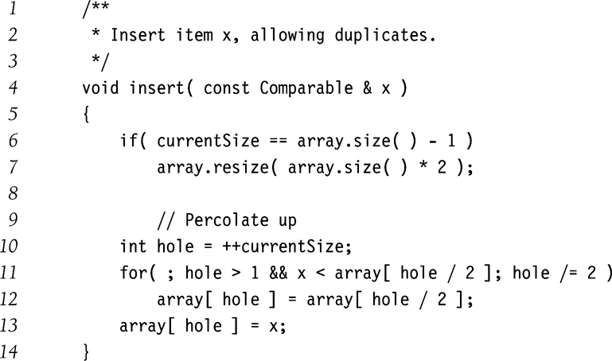
Heap Insert: Implementation
O(log N) time
Cpt S 223. School of EECS, WSU
Notes:
Cpt S 223
Washington State University

Slide 21
Heap DeleteMin
Minimum element is always at the root
Heap decreases by one in size
Move last element into hole at root
Percolate down while heap-order property not satisfied
Cpt S 223. School of EECS, WSU
Notes:
Cpt S 223
Washington State University

Slide 22
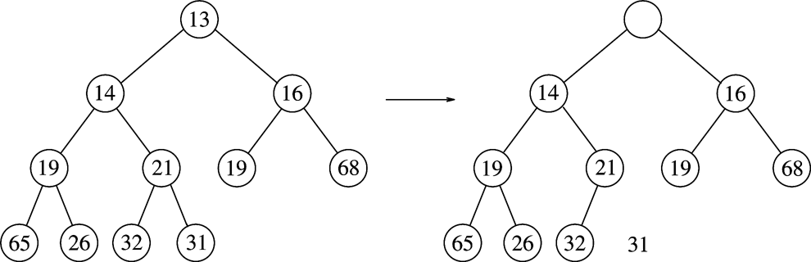
Heap DeleteMin: Example
Percolating down…
Make this position empty
Cpt S 223. School of EECS, WSU
Notes:
Cpt S 223
Washington State University

Slide 23
Heap DeleteMin: Example
Percolating down…
Copy 31 temporarily
here and move it down
Make this position empty
Is 31 > min(14,16)?
Yes - swap 31 with min(14,16)
Cpt S 223. School of EECS, WSU
Notes:
Cpt S 223
Washington State University

Slide 24
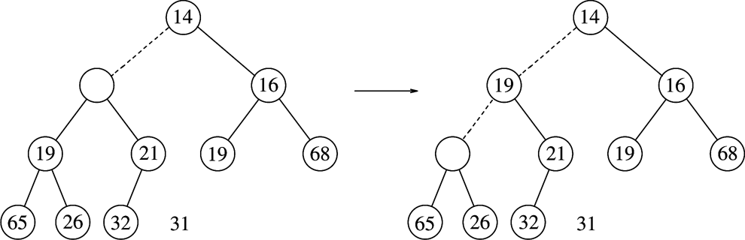
Heap DeleteMin: Example
Percolating down…
31
Is 31 > min(19,21)?
Yes - swap 31 with min(19,21)
Cpt S 223. School of EECS, WSU
Notes:
Cpt S 223
Washington State University

Slide 25
Heap DeleteMin: Example
Percolating down…
31
31
Is 31 > min(19,21)?
Yes - swap 31 with min(19,21)
Is 31 > min(65,26)?
Yes - swap 31 with min(65,26)
Percolating down…
Cpt S 223. School of EECS, WSU
Notes:
Cpt S 223
Washington State University

Slide 26
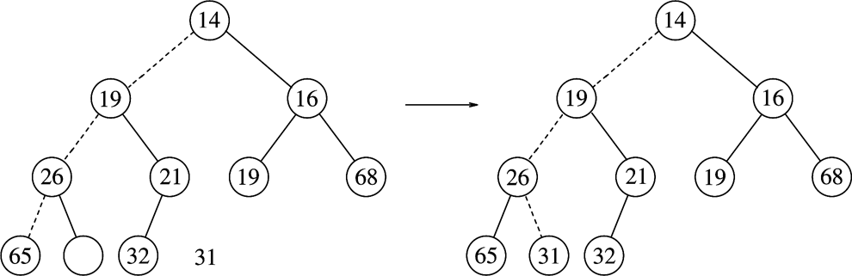
Heap DeleteMin: Example
Percolating down…
31
Percolating down…
Cpt S 223. School of EECS, WSU
Notes:
Cpt S 223
Washington State University

Slide 27
Heap DeleteMin: Example
Percolating down…
31
Heap order prop
Structure prop
Cpt S 223. School of EECS, WSU
Notes:
Cpt S 223
Washington State University

Slide 28
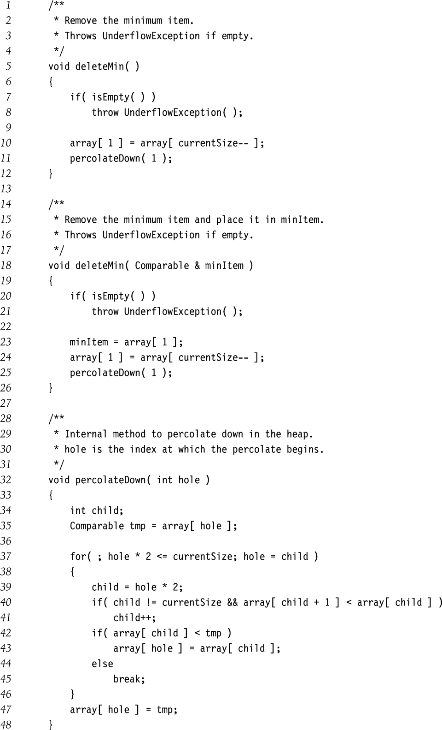
Heap DeleteMin: Implementation
O(log N) time
Cpt S 223. School of EECS, WSU
Notes:
Cpt S 223
Washington State University

Slide 29
Heap DeleteMin: Implementation
Percolate down
Left child
Right child
Pick child to swap with
Cpt S 223. School of EECS, WSU
Notes:
Cpt S 223
Washington State University

Slide 30
Other Heap Operations
decreaseKey(p,v)
  Lowers the current value of item p to new priority value v
  Need to percolate up
  E.g., promote a job
increaseKey(p,v)
  Increases the current value of item p to new priority value v
  Need to percolate down
  E.g., demote a job
remove(p)
  First, decreaseKey(p,-∞)
  Then, deleteMin
  E.g., abort/cancel a job
Run-times for all three functions?
O(lg n)
Cpt S 223. School of EECS, WSU
Notes:
Cpt S 223
Washington State University

Slide 31
Improving Heap Insert Time
What if all N elements are all available upfront?
To build a heap with N elements:
  Default method takes O(N lg N) time
  We will now see a new method called buildHeap() that will take O(N) time - i.e., optimal
Cpt S 223. School of EECS, WSU
Notes:
Cpt S 223
Washington State University

Slide 32
Building a Heap
Construct heap from initial set of N items
Solution 1
  Perform N inserts
  O(N log₂ N) worst-case
Solution 2 (use buildHeap())
  Randomly populate initial heap with structure property
  Perform a percolate-down from each internal node (H[size/2] to H[1])
    To take care of heap order property
Cpt S 223. School of EECS, WSU
Notes:
Cpt S 223
Washington State University

Slide 33
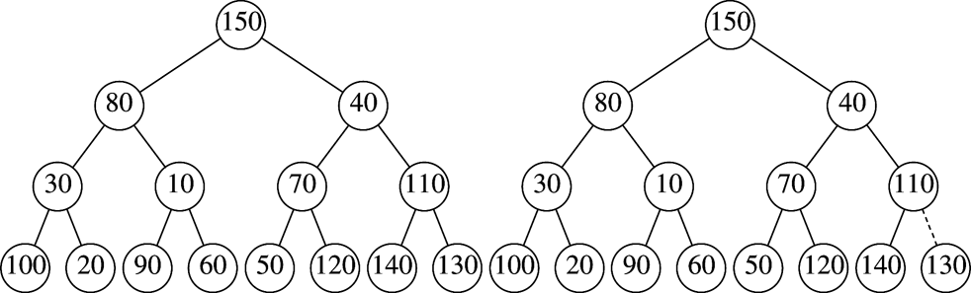
BuildHeap Example
Input: { 150, 80, 40, 10, 70, 110, 30, 120, 140, 60, 50, 130, 100, 20, 90 }
Leaves are all valid heaps (implicitly)
So, let us look at each internal node,
from bottom to top,
and fix if necessary
Arbitrarily assign elements to heap nodes
Structure property satisfied
Heap order property violated
Leaves are all valid heaps (implicit)
Cpt S 223. School of EECS, WSU
Notes:
Cpt S 223
Washington State University

Slide 34
BuildHeap Example
Swap with left child
Nothing to do
Randomly initialized heap
Structure property satisfied
Heap order property violated
Leaves are all valid heaps (implicit)
Cpt S 223. School of EECS, WSU
Notes:
Cpt S 223
Washington State University

Slide 35
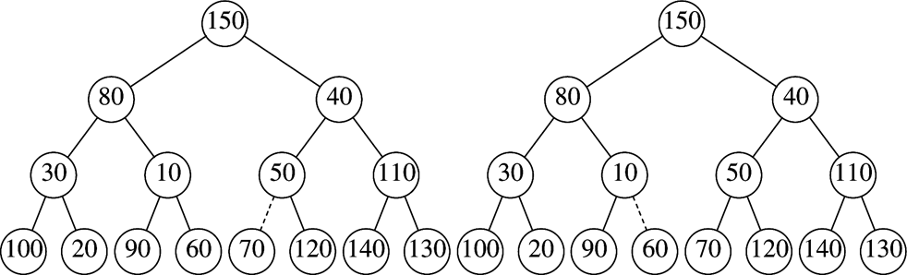
BuildHeap Example
Swap with right child
Nothing to do
Dotted lines show path of percolating down
Cpt S 223. School of EECS, WSU
Notes:
Cpt S 223
Washington State University

Slide 36
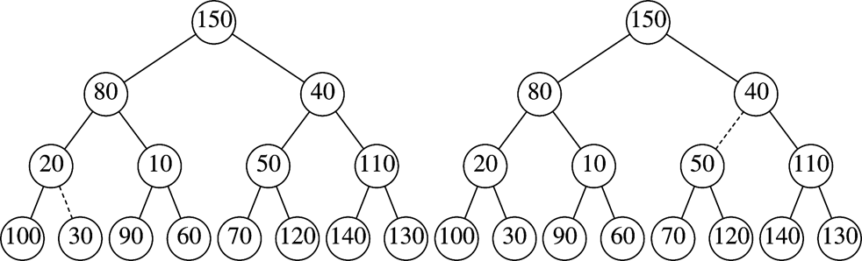
BuildHeap Example
Swap with right child
& then with 60
Nothing to do
Dotted lines show path of percolating down
Cpt S 223. School of EECS, WSU
Notes:
Cpt S 223
Washington State University

Slide 37
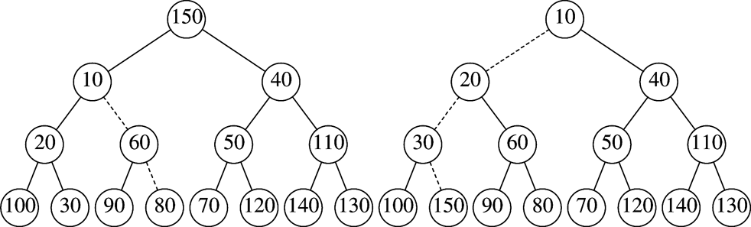
BuildHeap Example
Swap path
Final Heap
Dotted lines show path of percolating down
Cpt S 223. School of EECS, WSU
Notes:
Cpt S 223
Washington State University

Slide 38
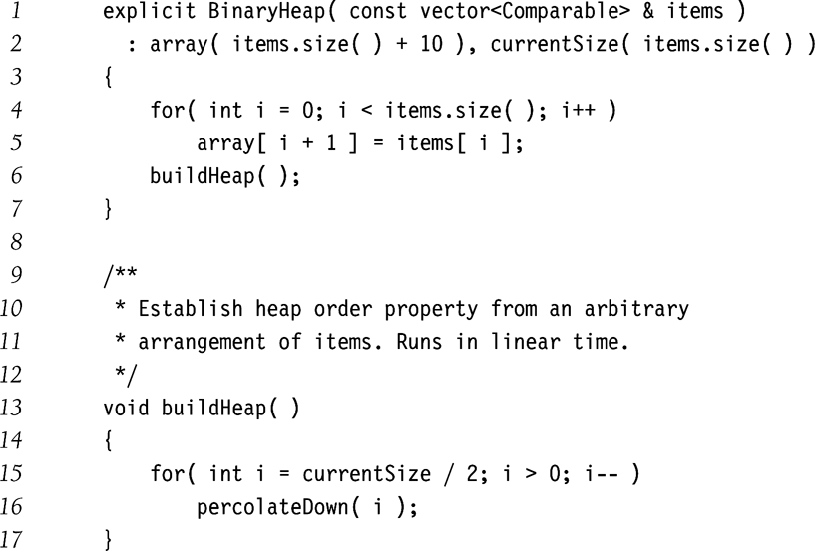
BuildHeap Implementation
Start with lowest, rightmost internal node
Cpt S 223. School of EECS, WSU
Notes:
Cpt S 223
Washington State University

Slide 39
BuildHeap() : Run-time Analysis
Run-time = ?
  O(sum of the heights of all the internal nodes)
  because we may have to percolate all the way down to fix every internal node in the worst-case
Theorem 6.1
  For a perfect binary tree of height h, the sum of heights of all nodes is 2^{h+1} – 1 – (h + 1)
Since h=lg N, then sum of heights is O(N)
Will be slightly better in practice
HOW?
Implication: Each insertion costs O(1) amortized time
Cpt S 223. School of EECS, WSU
Notes:
Cpt S 223
Washington State University

Slide 40
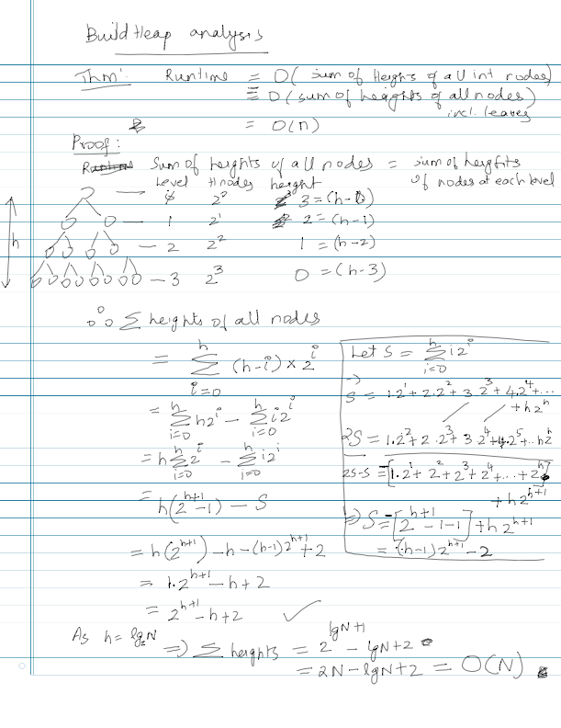
Cpt S 223. School of EECS, WSU
Notes:
Cpt S 223
Washington State University

Slide 41
Binary Heap Operations
Worst-case Analysis
Height of heap is
insert: O(lg N) for each insert
  In practice, expect less
buildHeap insert: O(N) for N inserts
deleteMin: O(lg N)
decreaseKey: O(lg N)
increaseKey: O(lg N)
remove: O(lg N)
Cpt S 223. School of EECS, WSU
Notes:
Cpt S 223
Washington State University

Slide 42
Applications
Operating system scheduling
  Process jobs by priority
Graph algorithms
  Find shortest path
Event simulation
  Instead of checking for events at each time click, look up next event to happen
Cpt S 223. School of EECS, WSU
Notes:
Cpt S 223
Washington State University

Slide 43
An Application:
The Selection Problem
Given a list of n elements, find the k^{th} smallest element
Algorithm 1:
  Sort the list => O(n log n)
  Pick the k^{th} element => O(1)
A better algorithm:
  Use a binary heap (minheap)
Cpt S 223. School of EECS, WSU
Notes:
Cpt S 223
Washington State University

Slide 44
Selection using a MinHeap
Input: n elements
Algorithm:
  buildHeap(n) ==> O(n)
  Perform k deleteMin() operations ==> O(k log n)
  Report the k^{th} deleteMin output ==> O(1)
Total run-time = O(n + k log n)
If k = O(n/log n) then the run-time becomes O(n)
Cpt S 223. School of EECS, WSU
Notes:
Cpt S 223
Washington State University

Slide 45
Other Types of Heaps
Binomial Heaps
d-Heaps
  Generalization of binary heaps (ie., 2-Heaps)
Leftist Heaps
  Supports merging of two heaps in o(m+n) time (ie., sub-linear)
Skew Heaps
  O(log n) amortized run-time
Fibonacci Heaps
Cpt S 223. School of EECS, WSU
Notes:
Cpt S 223
Washington State University

Slide 46
Run-time Per Operation
 | Insert | DeleteMin | Merge (=H₁+H₂)
Binary heap | O(log n) worst-case O(1) amortized for buildHeap | O(log n) | O(n)
Leftist Heap | O(log n) | O(log n) | O(log n)
Skew Heap | O(log n) | O(log n) | O(log n)
Binomial Heap | O(log n) worst case O(1) amortized for sequence of n inserts | O(log n) | O(log n)
Fibonacci Heap | O(1) | O(log n) | O(1)
Cpt S 223. School of EECS, WSU
Notes:
Cpt S 223
Washington State University

Slide 47
Priority Queues in STL
Uses Binary heap
Default is MaxHeap
Methods
  Push, top, pop, empty, clear
#include <priority_queue>
int main ()
{
priority_queue<int> Q;
Q.push (10);
cout << Q.top ();
Q.pop ();
}
Calls DeleteMax()
For MinHeap: declare priority_queue as:
priority_queue<int, vector<int>, greater<int>> Q;
Refer to Book Chapter 6, Fig 6.57 for an example
Cpt S 223. School of EECS, WSU
Notes:
Cpt S 223
Washington State University

Slide 48
Binomial Heaps
Cpt S 223. School of EECS, WSU
Notes:
Cpt S 223
Washington State University

Slide 49
Binomial Heap
A binomial heap is a forest of heap-ordered binomial trees, satisfying:
  i) Structure property, and
  ii) Heap order property
A binomial heap is different from binary heap in that:
  Its structure property is totally different
  Its heap-order property (within each binomial tree) is the same as in a binary heap
Cpt S 223. School of EECS, WSU
Notes:
Cpt S 223
Washington State University

Slide 50
Definition: A “Binomial Tree” B_{k}
Note: A binomial tree need not be a binary tree
A binomial tree of height k is called B_{k}:
  It has 2^{k} nodes
  The number of nodes at depth d = ( )
k
d
k
( ) is the form of the co-efficients in binomial theorem
d
Depth:
B₃:
#nodes:
(
3
d=0
)
0
(
3
d=1
)
1
(
3
d=2
)
2
d=3
(
3
Cpt S 223. School of EECS, WSU
)
3
Notes:
Cpt S 223
Washington State University

Slide 51
What will a Binomial Heap with n=31 nodes look like?
We know that:
  i) A binomial heap should be a forest of binomial trees
  ii) Each binomial tree has power of 2 elements
So how many binomial trees do we need?
B₄
B₃
B₂
B₁
B₀
n = 31 = (1 1 1 1 1)₂
Cpt S 223. School of EECS, WSU
Notes:
Cpt S 223
Washington State University

Slide 52
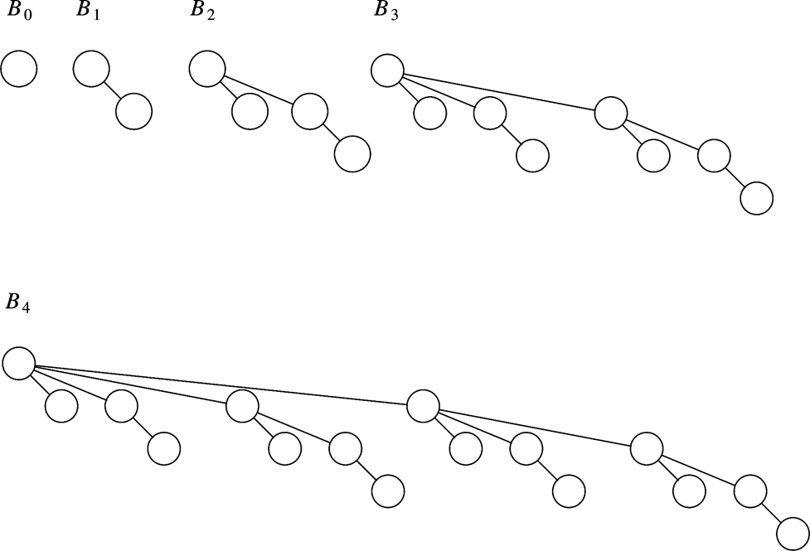
A Binomial Heap w/ n=31 nodes
B₄
B₃
B₂
B₁
B₀
B_{i} == B_{i-1} + B_{i-1}
n = 31 = (1 1 1 1 1)₂
B₀
B₁
Forest of binomial trees {B₀, B₁, B₂, B₃, B₄ }
B₃
B₂
Cpt S 223. School of EECS, WSU
Notes:
Cpt S 223
Washington State University

Slide 53
Binomial Heap Property
Lemma: There exists a binomial heap for every positive value of n
Proof:
  All values of n can be represented in binary representation
    Have one binomial tree for each power of two with co-efficient of 1
    Eg., n=10 ==> (1010)₂ ==> forest contains {B₃, B₁}
Cpt S 223. School of EECS, WSU
Notes:
Cpt S 223
Washington State University

Slide 54
Binomial Heaps: Heap-Order Property
Each binomial tree should contain the minimum element at the root of every subtree
  Just like binary heap, except that the tree here is a binomial tree structure (and not a complete binary tree)
The order of elements across binomial trees is irrelevant
Cpt S 223. School of EECS, WSU
Notes:
Cpt S 223
Washington State University

Slide 55
Definition: Binomial Heaps
A binomial heap of n nodes is:
  (Structure Property) A forest of binomial trees as dictated by the binary representation of n
  (Heap-Order Property) Each binomial tree is a min-heap or a max-heap
Cpt S 223. School of EECS, WSU
Notes:
Cpt S 223
Washington State University

Slide 56
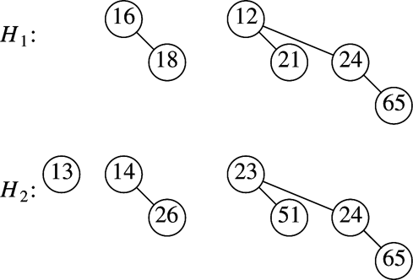
Binomial Heaps: Examples
Two different heaps:
Cpt S 223. School of EECS, WSU
Notes:
Cpt S 223
Washington State University

Slide 57
Key Properties
Could there be multiple trees of the same height in a binomial heap?
What is the upper bound on the number of binomial trees in a binomial heap of n nodes?
Given n, can we tell (for sure) if B_{k} exists?
no
lg n
B_{k} exists if and only if:
the k^{th} least significant bit is 1
in the binary representation of n
Cpt S 223. School of EECS, WSU
Notes:
Cpt S 223
Washington State University

Slide 58
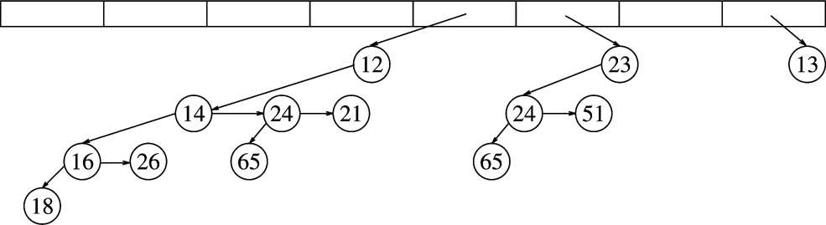
An Implementation of a Binomial Heap
Maintain a linked list of
tree pointers (for the forest)
Example: n=13 == (1101)₂
B₇
B₆
B₅
B₄
B₃
B₂
B₁
B₀
Shown using the
left-child, right-sibling pointer method
Analogous to a bit-based representation of a binary number n
Cpt S 223. School of EECS, WSU
Notes:
Cpt S 223
Washington State University

Slide 59
Binomial Heap: Operations
x <= DeleteMin()
Insert(x)
Merge(H₁, H₂)
Cpt S 223. School of EECS, WSU
Notes:
Cpt S 223
Washington State University

Slide 60
DeleteMin()
Goal: Given a binomial heap, H, find the minimum and delete it
Observation: The root of each binomial tree in H contains its minimum element
Approach: Therefore, return the minimum of all the roots (minimums)
Complexity: O(log n) comparisons
(because there are only O(log n) trees)
Cpt S 223. School of EECS, WSU
Notes:
Cpt S 223
Washington State University

Slide 61
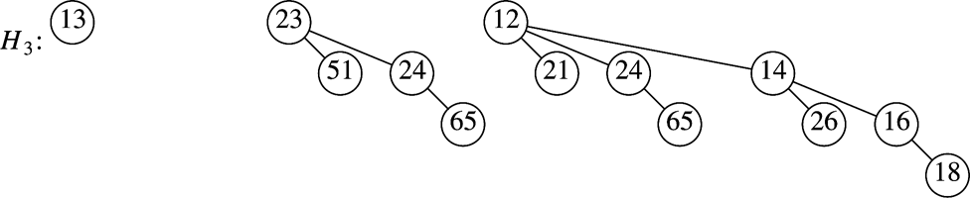
FindMin() & DeleteMin() Example
B₀
B₂
B₃
B₀’
B₁’
B₂’
For DeleteMin(): After delete, how to adjust the heap?
New Heap : Merge { B₀, B₂ } & { B₀’, B₁’, B₂’ }
Cpt S 223. School of EECS, WSU
Notes:
Cpt S 223
Washington State University

Slide 62
Insert(x) in Binomial Heap
Goal: To insert a new element x into a binomial heap H
Observation:
  Element x can be viewed as a single element binomial heap
    => Insert (H,x) == Merge(H, {x})
So, if we decide how to do merge we will automatically
figure out how to implement both insert() and deleteMin()
Cpt S 223. School of EECS, WSU
Notes:
Cpt S 223
Washington State University

Slide 63
Merge(H₁,H₂)
Let n₁ be the number of nodes in H₁
Let n₂ be the number of nodes in H₂
Therefore, the new heap is going to have n₁ + n₂ nodes
  Assume n = n₁ + n₂
Logic:
  Merge trees of same height, starting from lowest height trees
  If only one tree of a given height, then just copy that
  Otherwise, need to do carryover (just like adding two binary numbers)
Cpt S 223. School of EECS, WSU
Notes:
Cpt S 223
Washington State University

Slide 64
Merge: Example
Idea: merge tree of same heights
+
copy
B₀
B₁
B₂
?
?
13
Cpt S 223. School of EECS, WSU
Notes:
Cpt S 223
Washington State University

Slide 65
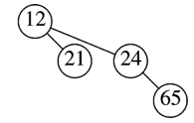
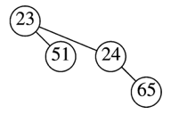
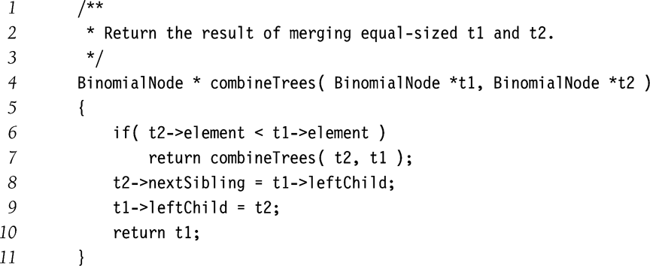
How to Merge Two Binomial Trees of the Same Height?
B₂:
B₃:
B₂:
+
Simply compare the roots
Cpt S 223. School of EECS, WSU
Note: Merge is defined for only binomial trees with the same height
Notes:
Cpt S 223
Washington State University

Slide 66
Merge(H₁,H₂) example
carryover
+
?
13
14
26
16
26
Cpt S 223. School of EECS, WSU
Notes:
Cpt S 223
Washington State University

Slide 67
How to Merge more than two binomial trees of the same height?
Merging more than 2 binomial trees of the same height could generate carry-overs
+
14
?
+
26
16
26
Merge any two and leave the third as carry-over
Cpt S 223. School of EECS, WSU
Notes:
Cpt S 223
Washington State University

Slide 68
Merge(H₁,H₂) : Example
Input:
+
Output:
There are two other possible answers
Merge cost log(max{n₁,n₂}) = O(log n) comparisons
Cpt S 223. School of EECS, WSU
Notes:
Cpt S 223
Washington State University

Slide 69
Run-time Complexities
Merge takes O(log n) comparisons
Corollary:
  Insert and DeleteMin also take O(log n)
It can be further proved that an uninterrupted sequence of m Insert operations takes only O(m) time per operation, implying O(1) amortize time per insert
  Proof Hint:
    For each insertion, if i is the least significant bit position with a 0, then number of comparisons required to do the next insert is i+1
    If you count the #bit flips for each insert, going from insert of the first element to the insert of the last (n^{th}) element, then
    => amortized run-time of O(1) per insert
unaffected
affected
10010111
1
--------------
10011000
Cpt S 223. School of EECS, WSU
Notes:
Cpt S 223
Washington State University

Slide 70
Binomial Queue Run-time Summary
Insert
  O(lg n) worst-case
  O(1) amortized time if insertion is done in an uninterrupted sequence (i.e., without being intervened by deleteMins)
DeleteMin, FindMin
  O(lg n) worst-case
Merge
  O(lg n) worst-case
Cpt S 223. School of EECS, WSU
Notes:
Cpt S 223
Washington State University

Slide 71
Run-time Per Operation
 | Insert | DeleteMin | Merge (=H₁+H₂)
Binary heap | O(log n) worst-case O(1) amortized for buildHeap | O(log n) | O(n)
Leftist Heap | O(log n) | O(log n) | O(log n)
Skew Heap | O(log n) | O(log n) | O(log n)
Binomial Heap | O(log n) worst case O(1) amortized for sequence of n inserts | O(log n) | O(log n)
Fibonacci Heap | O(1) | O(log n) | O(1)
Cpt S 223. School of EECS, WSU
Notes:
Cpt S 223
Washington State University

Slide 72
Summary
Priority queues maintain the minimum or maximum element of a set
Support O(log N) operations worst-case
  insert, deleteMin, merge
Many applications in support of other algorithms
Cpt S 223. School of EECS, WSU
Notes:
Cpt S 223
Washington State University

