Slide 1
Presentation 2: NodeJs

Slide 2
I. NPM
- Npm (Node.js Project Manage) NPM is a package manager for Node.js packages, or modules if you like .
- The npm program is installed on your computer when you install Node.js
- How do I know if npm is installed ? => Open your Terminal and type:
npm -v.
- Create project nodejs with npm : npm init.
- Install package : npm install <package_name>.
- Use packege : vd: var express = require('express');

Slide 3
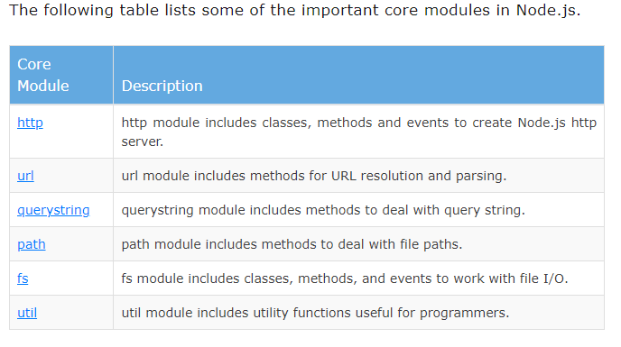
II Nodejs - Modules, Export, Require
1 Node.js Core Modules
- Node.js Local Module

