Slide 1
What is Next.js?
The React Framework
For Production

Slide 2
What is Next.js?
Next.js provides a robust set of features such as server-side rendering, automatic code splitting, static site generation, and many more that make building modern web applications a breeze.
Developers can build static websites, dynamic websites, or hybrid websites with ease. Next.js supports server-side rendering, client-side rendering, and static site generation, which makes it flexible enough to handle any use case.
Next.js is also optimized for performance and SEO, as it allows for server-side rendering of content, which ensures fast initial load times and helps search engines crawl and index the pages. It also provides automatic code splitting, which means that only the code necessary for each page is loaded, reducing the load time and improving performance.

Slide 3
What is Next.js?
SEO Optimization
Incremental Build
Built-in Performance and Caching
Developer Experience
Dynamic Web Development
Data Handling
Page Pre-Rendering
Scalability: best choices for building large-scale apps
Static Websites, Large, Multi-User Websites, Hybrid Web Apps

Slide 4
Next.js Examples of Websites
Netflix
Twitch
ChatGPT
Uber
Docker
Invision
Magic Leap

Slide 5
Go for Next.js when
You are building a large-scale app to manage lots of content and data that will also grow in the future. If you combine a headless CMS with Next.js features, you will get high flexibility.

Slide 6
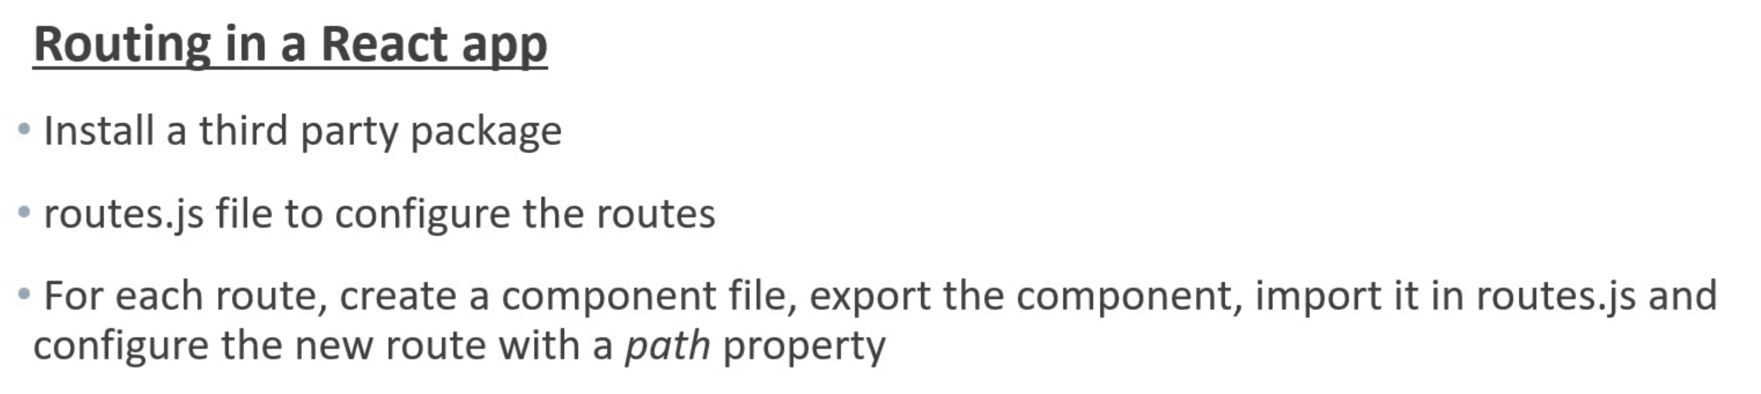
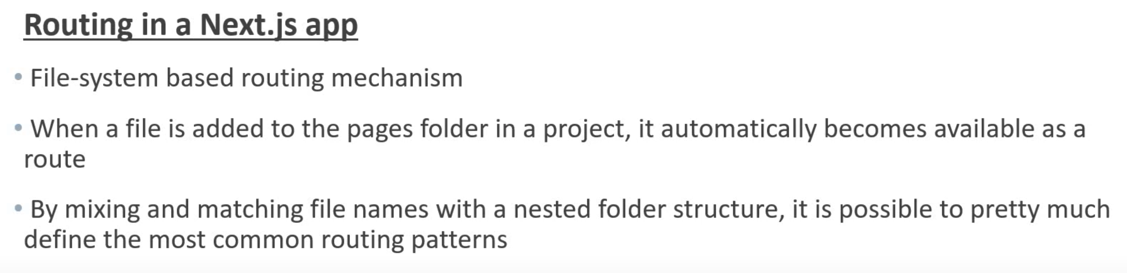
Routing

Slide 7
Routing

Slide 8
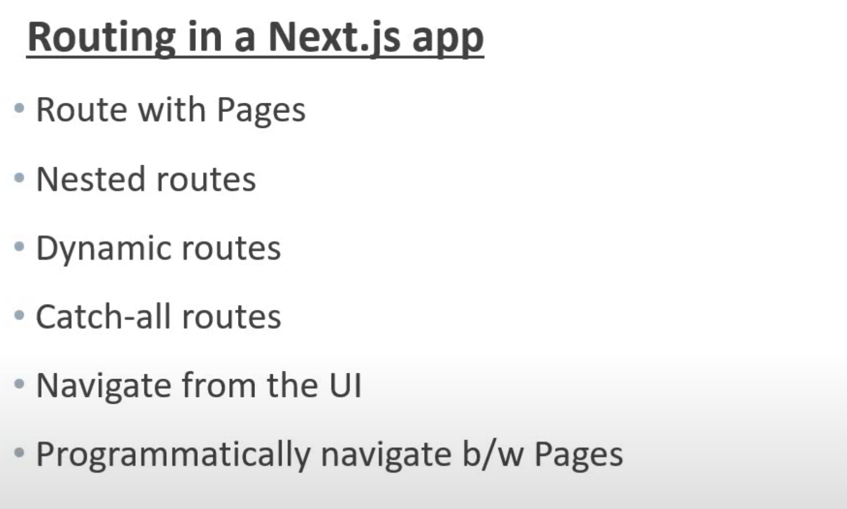
Routing

Slide 9
Routing Examples
Routing with Page
Dynamic Routes
Nested Dynamic Routes
Catch all Routes
Link and Navigating

Slide 10
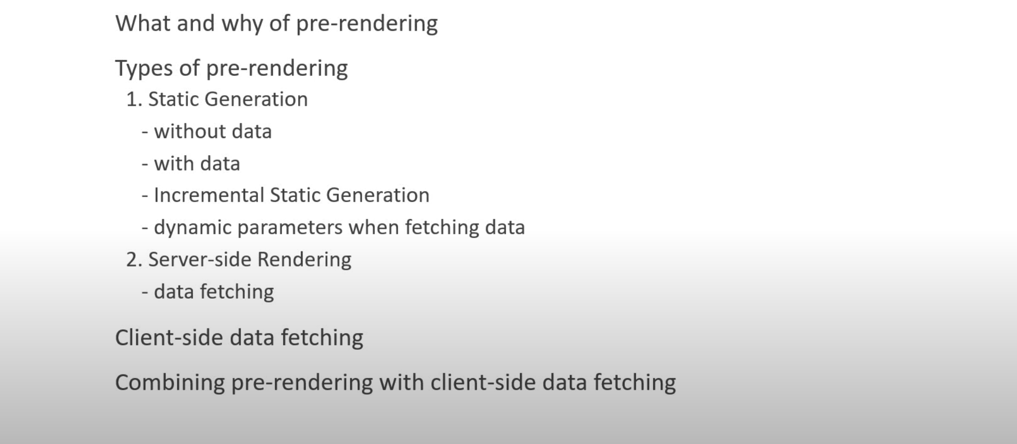
Pre-Render & Data Fetching

Slide 11
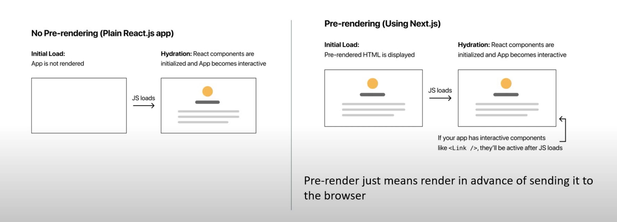
Pre-Render & Data Fetching (Cont)

Slide 12
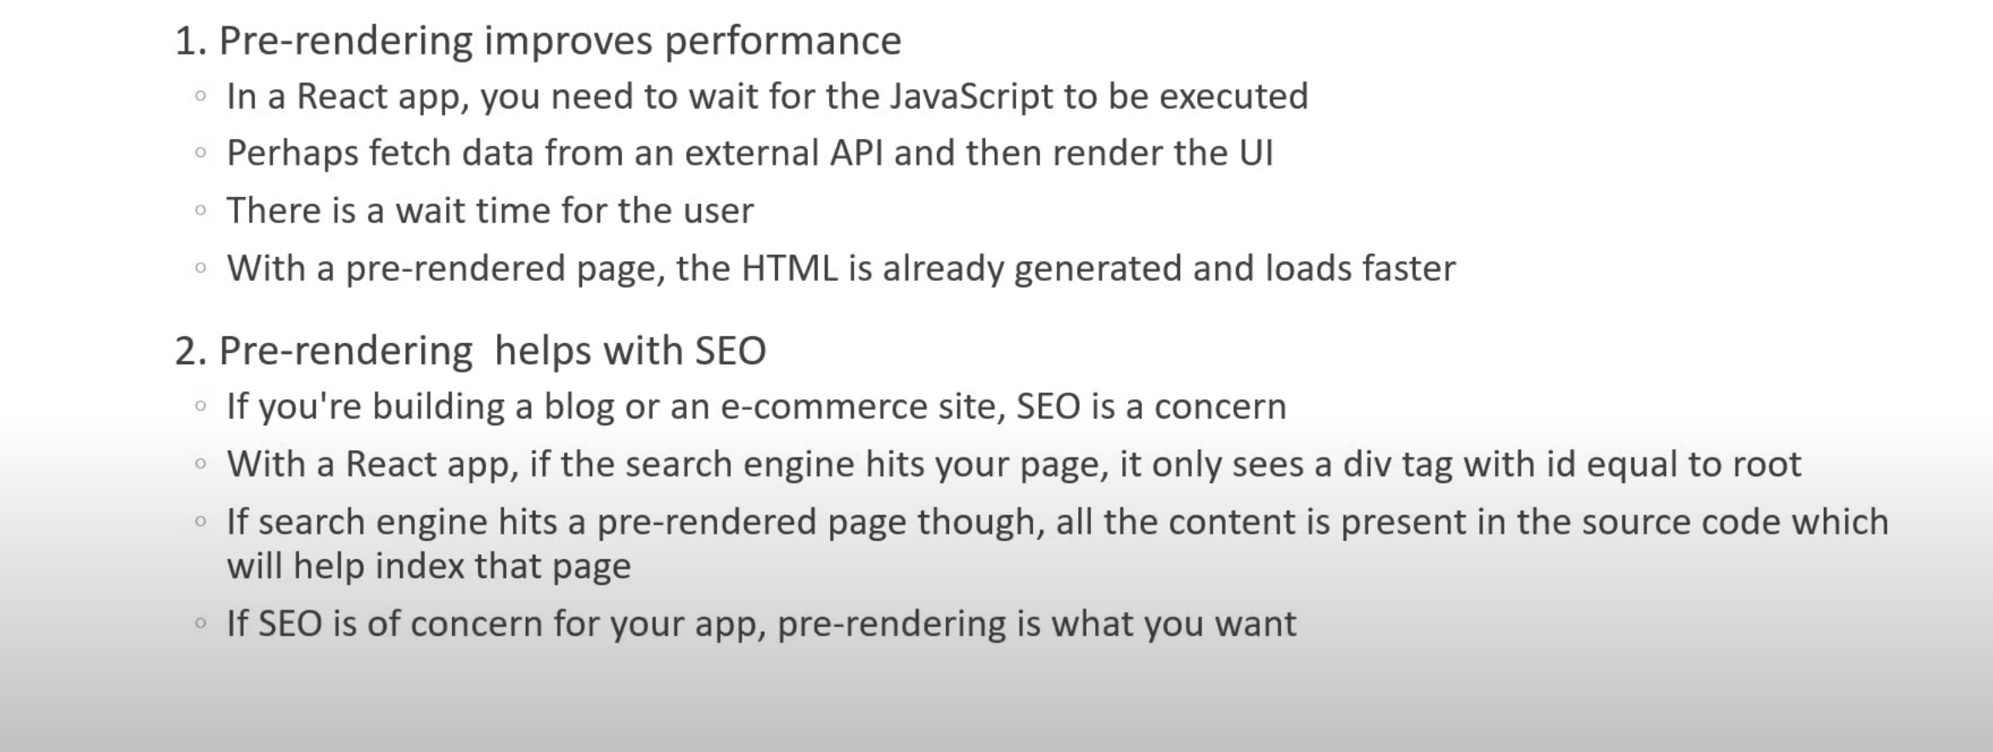
Why Pre-Render?

Slide 13
Pre-Render & Data Fetching Examples
Static Generation
Static Generation with getStaticProps

Slide 14
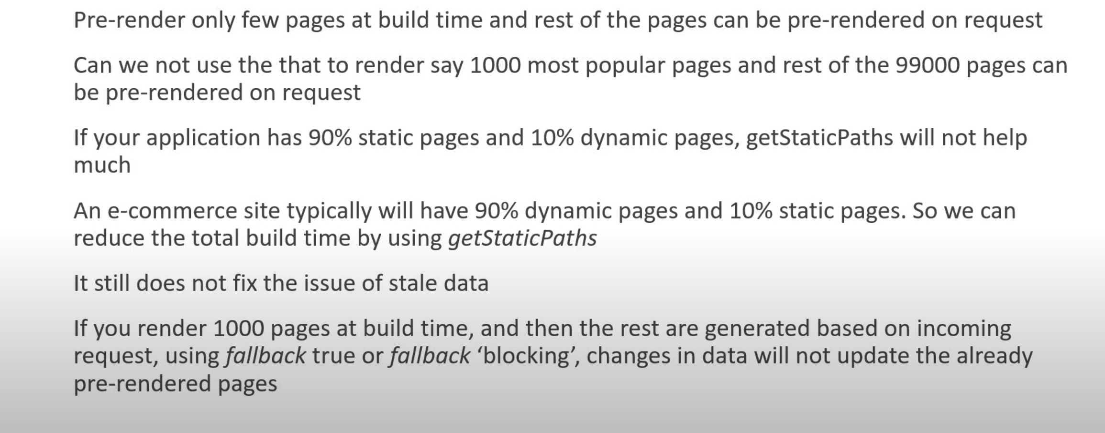
Incremental Static Regeneration

Slide 15
Incremental Static Regeneration Examples
revalidate: seconds
On-demand Revalidation

Slide 16
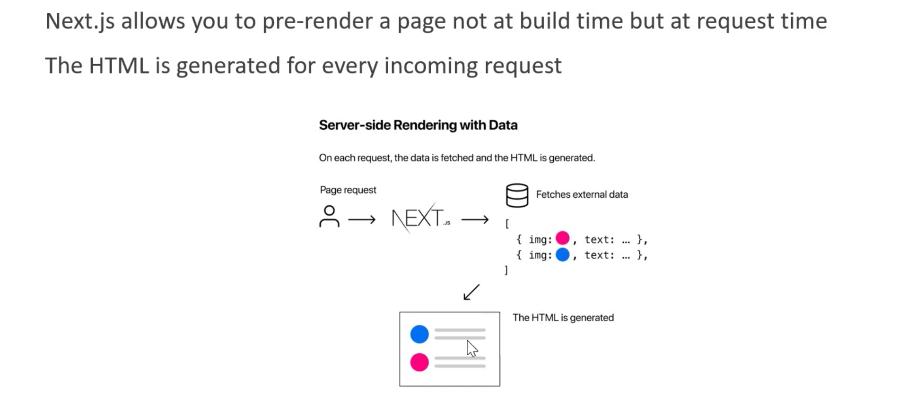
Server-side Rendering

Slide 17
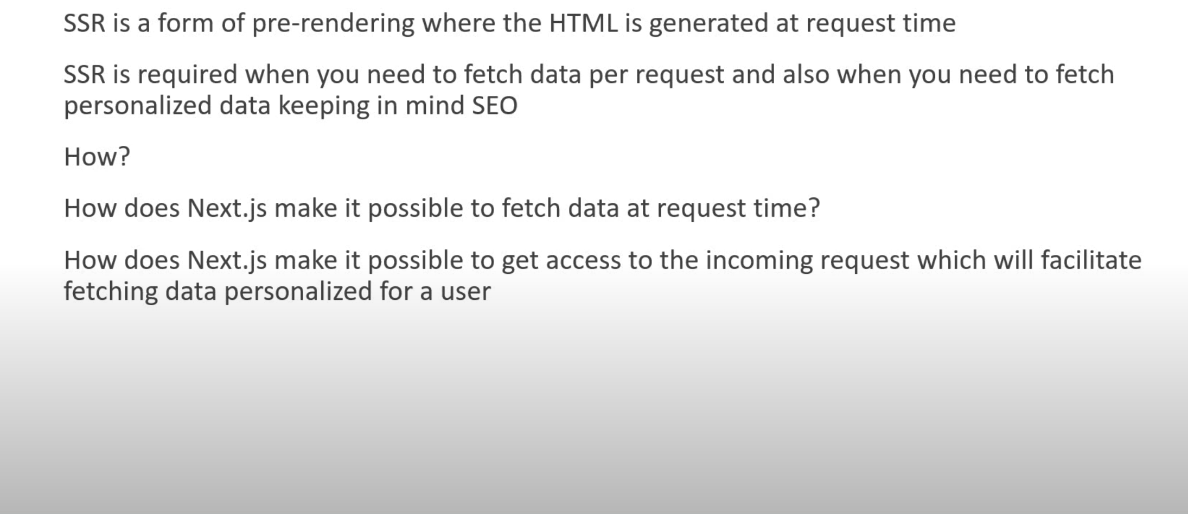
Server-side Rendering

Slide 18
Server-side Rendering Examples
getServerSideProps

