Slide 1
Analysis and prediction of Crude oil prices
Submitted by-
Neha Goushal

Slide 2
Contents
Introduction of dataset
Insights and external factors
Price prediction
Correlation between NY Harbor and US Gulf Coast

Slide 3
Introduction of dataset
Data source - https://www.eia.gov/dnav/pet/pet_pri_spt_s1_m.htm
Date range:1986 to 2019
Products: 'Crude Oil', 'Conventional Gasoline', 'RBOB Regular Gasoline', 'Heating Oil', 'Diesel Fuel', 'Kerosene Type Jet Fuel', 'Propane’
Performed analysis and prediction using ML on crude oil prices

Slide 4
INSIGHTS from data and how it relates to the external factors

Slide 5
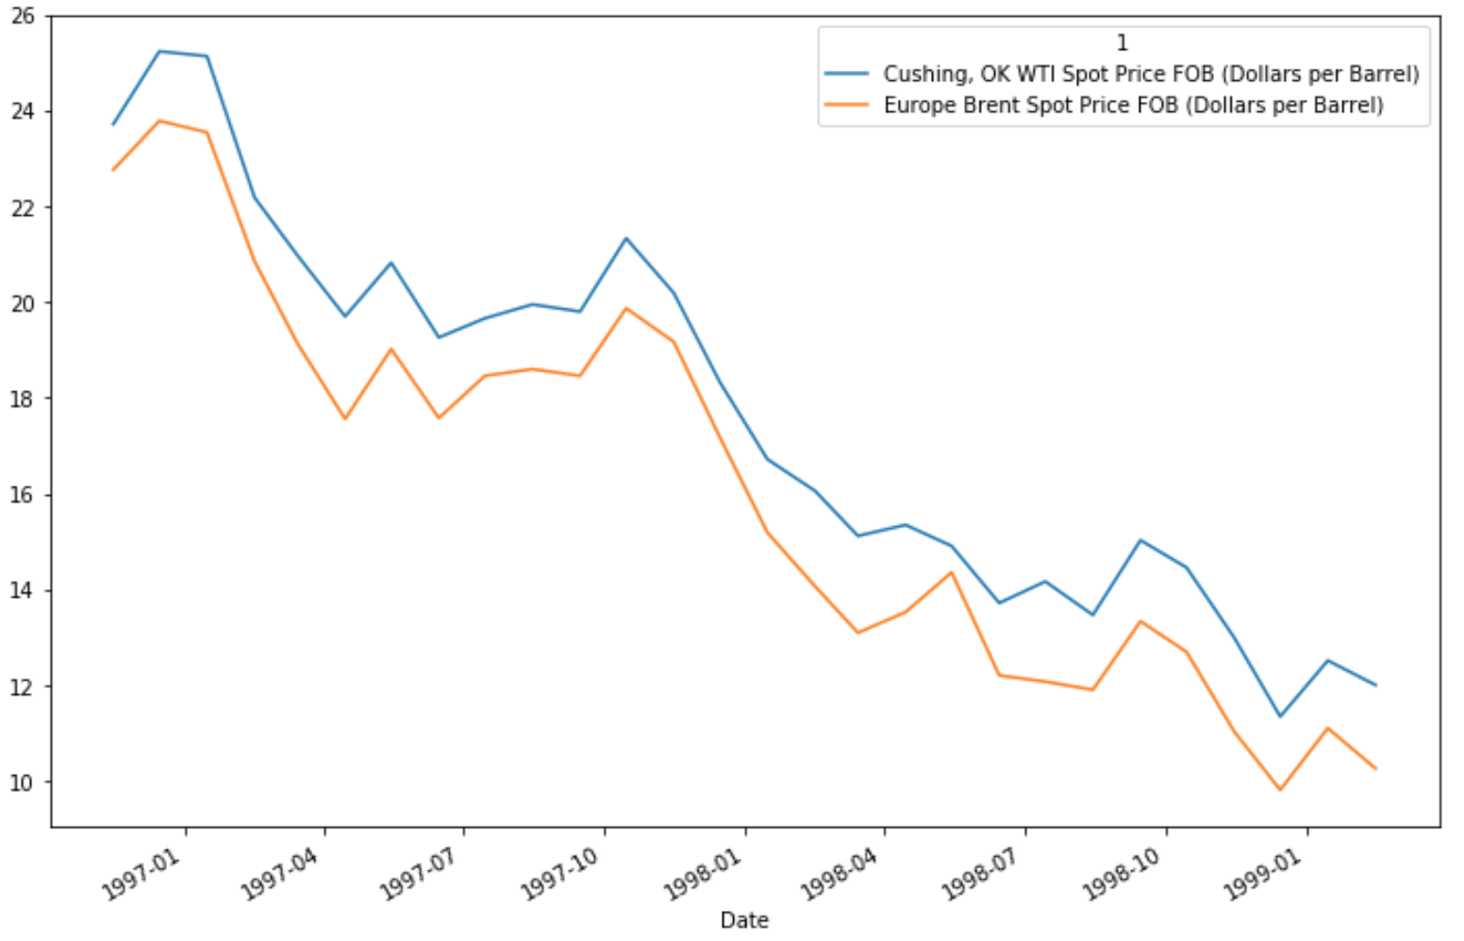
Insight I
Prices fell remarkably in the period 1997–1998 due to the slowdown of Asian economic growth and it was the lowest (11.35 $/barrel in December,1998) over the period of last12 years (1986-1998).
Source: https://en.wikipedia.org/wiki/1997_Asian_financial_crisis
Notes:
Consider talking about:
Pricing
Delivery dates

Slide 6
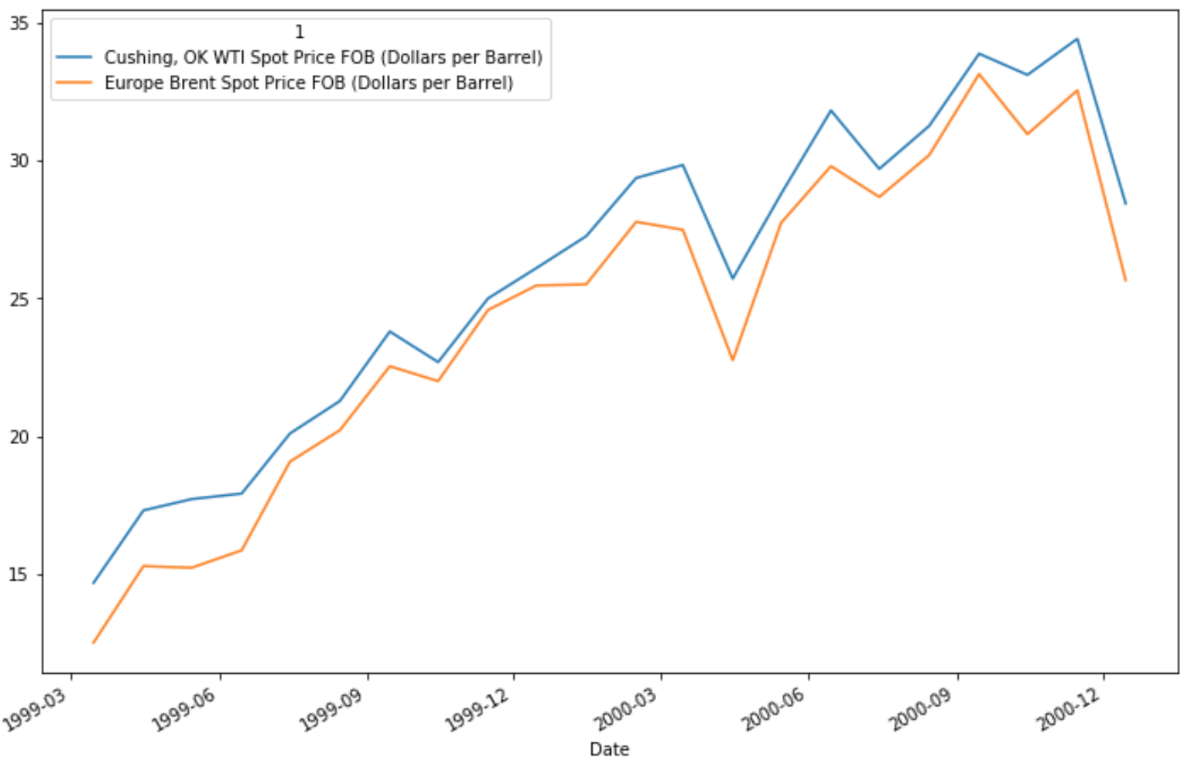
Insight II
Prices began to rise again from 2000. OPEC (Organization of Petroleum Export Countries) curtailed the production of crude oil by 4.2 million barrels per day between 2000 and 2001, resulting in an increase in crude oil prices.
Source: “OPEC move hits oil prices” https://money.cnn.com/2000/03/29/worldbiz/opec_cut/
Notes:
Consider talking about:
Pricing
Delivery dates

Slide 7
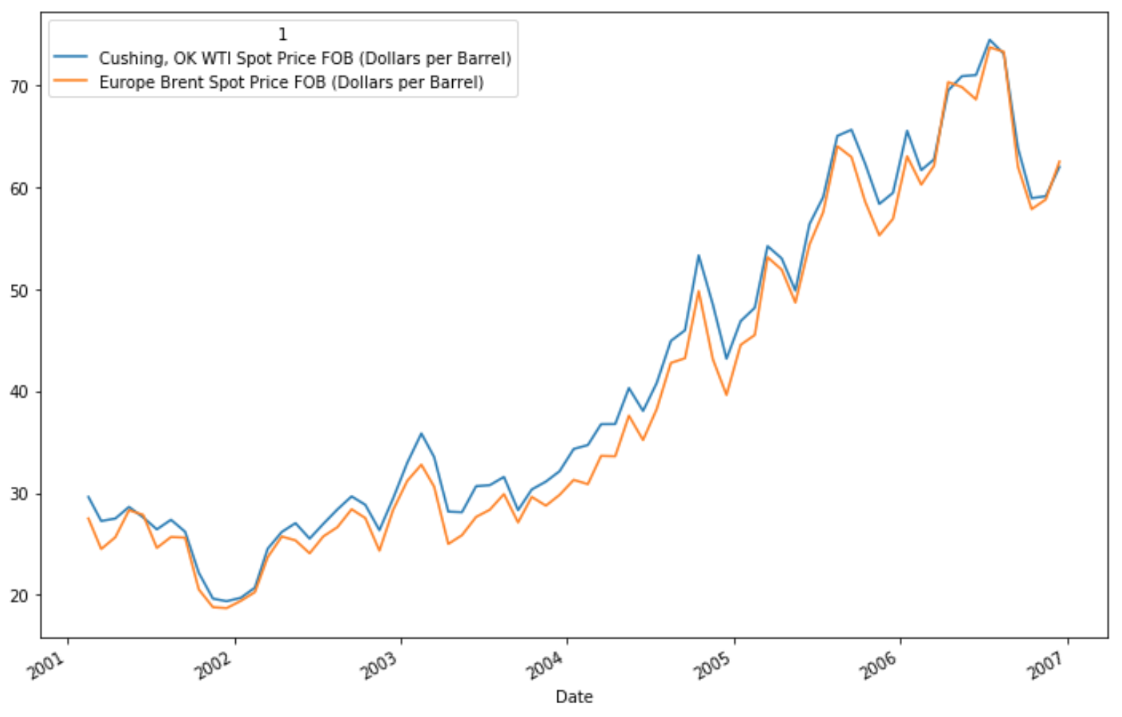
Insight III
In 2001, 9/11 attack and the invasion of Iraq raised concerns about the stability of the Middle East’s production which caused a dip in prices.
Then, Crude oil prices kept rising for a variety of reasons including North Korea’s missile launches, the crisis between Israel and Lebanon and Iranian nuclear brinksmanship.
Source: 2000s energy crisis https://en.wikipedia.org/wiki/2000s_energy_crisis
Notes:
Consider talking about:
Pricing
Delivery dates

Slide 8
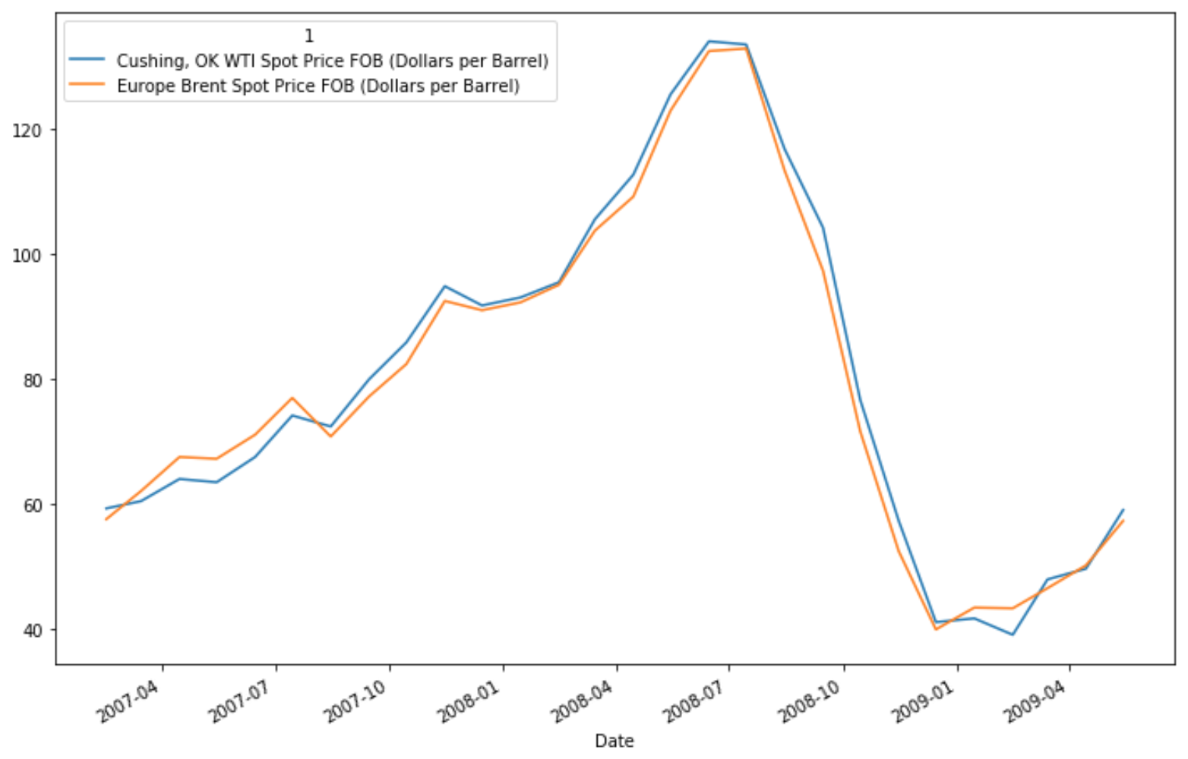
Insight IV
In July 2008, it reached its peak point(133.37 $/barrel), which was also the highest price in last 22 years (1986-2008)
Then came the global financial crisis when prices plummet 78.1% from July to December (41 $/barrel)
Source: https://en.wikipedia.org/wiki/Financial_crisis_of_2007%E2%80%932008
Notes:
Consider talking about:
Pricing
Delivery dates

Slide 9
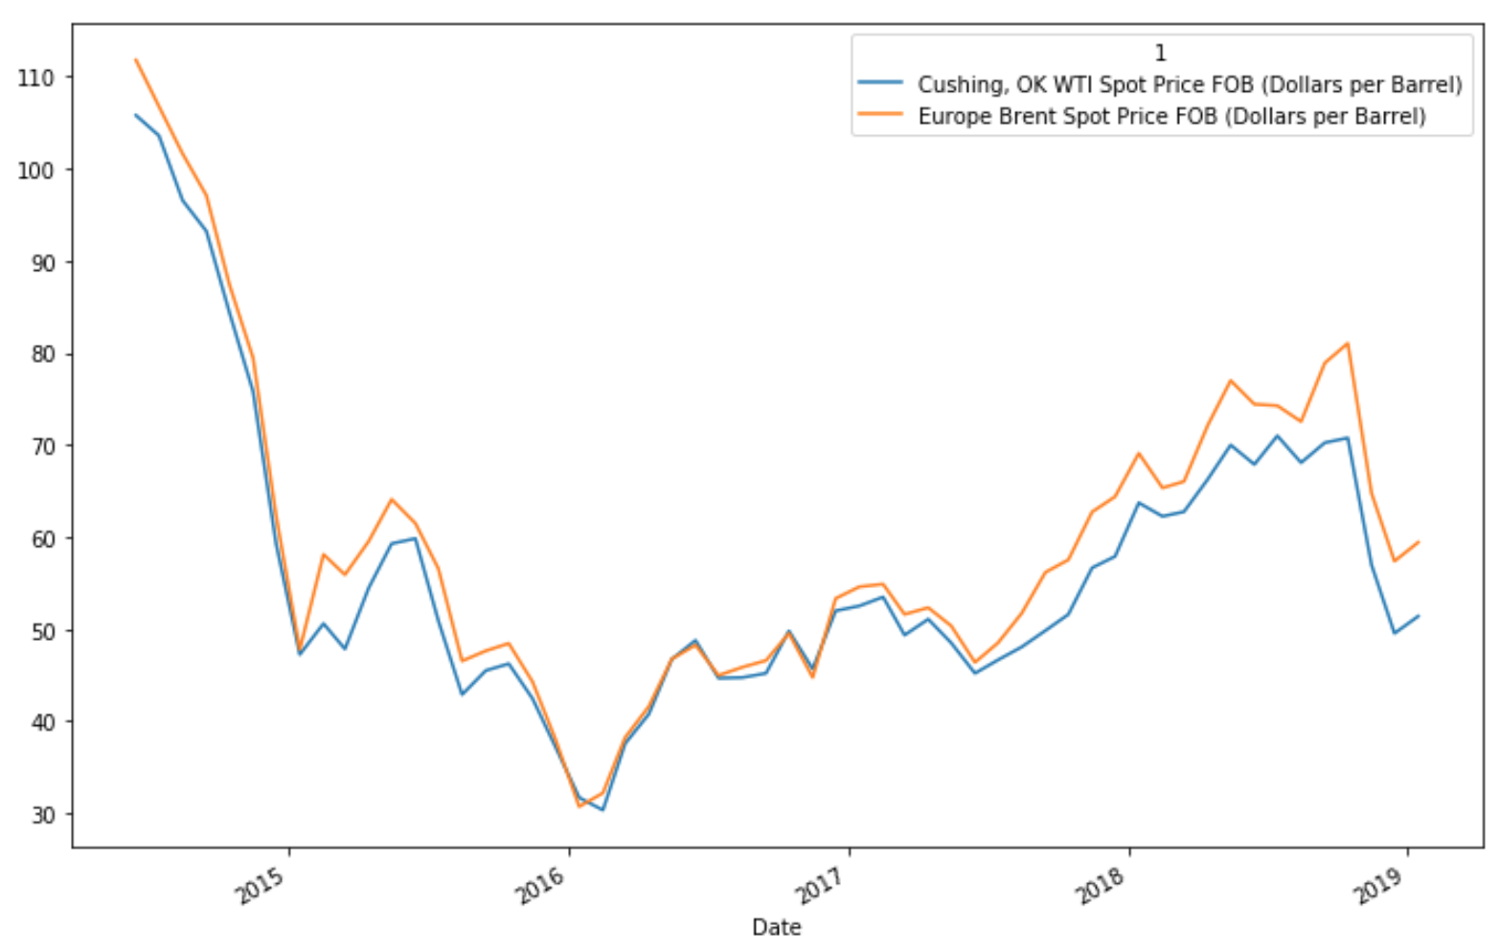
Insight V
In 2014, prices crashed again from July to December due to strong production in the United States and Russia. OPEC’s November decision to maintain production further damaged the market heading into 2015.
January 2016, the prices were lowest again (31.68 $/barrel) over the last 12 years (2003-Jan 2016)
Source: “OPEC starts a price war with the US” https://www.vox.com/2014/11/28/7302827/oil-prices-opec
Notes:
Consider talking about:
Pricing
Delivery dates

Slide 10
Crude oil price prediction

Slide 11
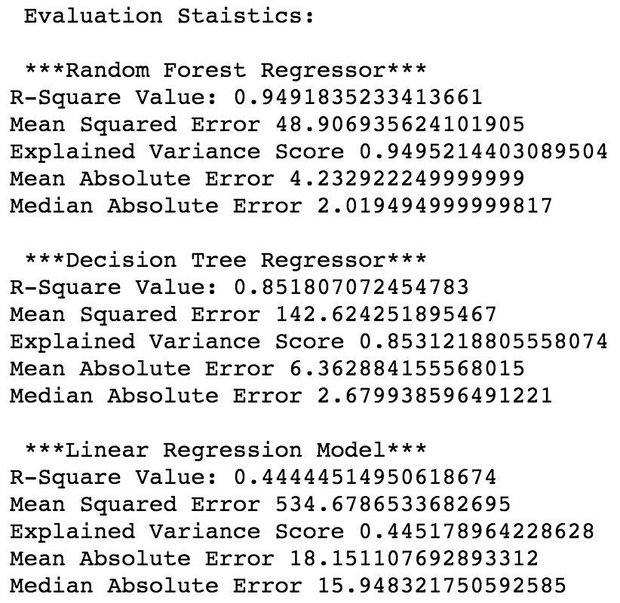
ML Models 1. Random Forest Regressor 2. Decision Tree Regressor 3. Linear Regression Model

Slide 12
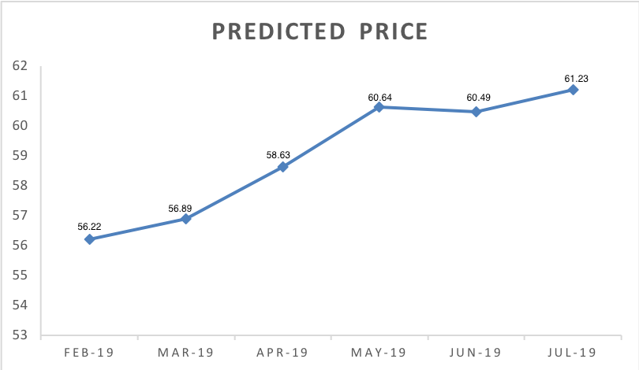
Prices for next 6 months
Chose to apply Random Forest Regressor

Slide 13
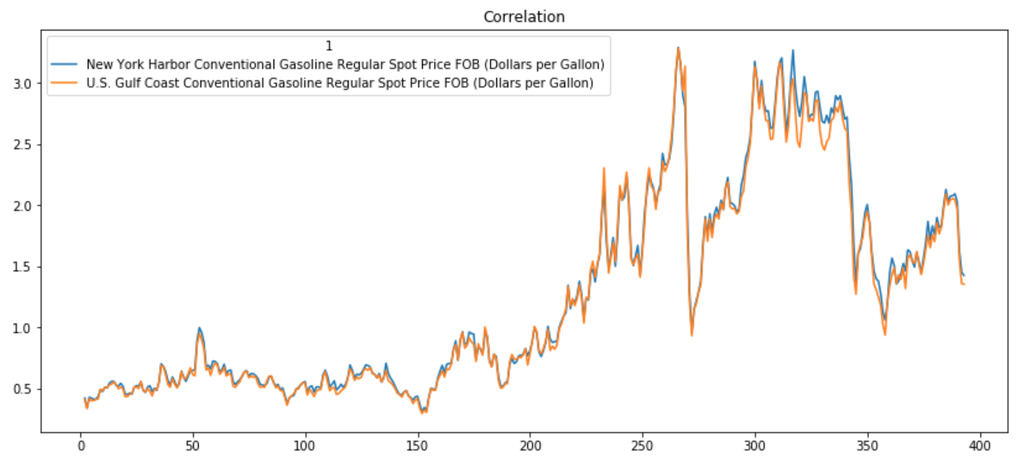
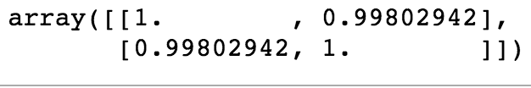
Correlation
Correlation between New York Harbor Conventional Gasoline and US Gulf Coast Conventional Gasoline = 0.9980294191948083
Strong positive correlation
Correlation matrix

Slide 14
Thankyou!

