Slide 1
Agenda
Body Area Network
Channel Model
Network topology around the body

Slide 2
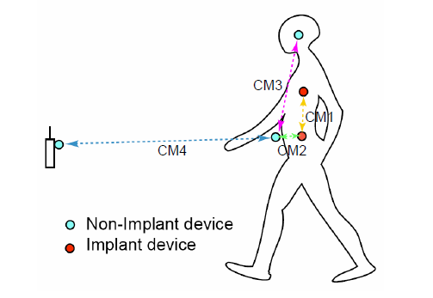
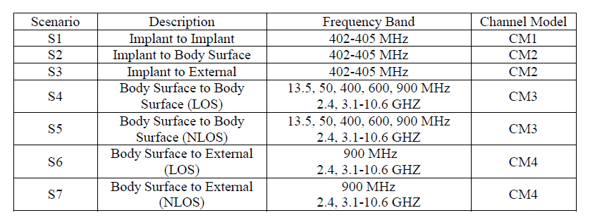
IEEE P802.15-08–0780 summarizes the channel modeling in IEEE 802.15.6 (Body Area Network)
Notes:
2

Slide 3
Channel Model:
Theoretical: based on fundamental principle of electromagnetic propagation
Empirical: based on propagation measurements and provide statistical model of the channel

Slide 4
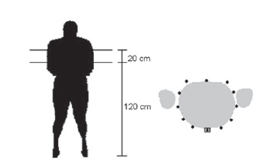
Propagation around the torso
channel model at 900MHz and 2.4GHz based on measurements around the torso.
Fort et al. “Indoor body-area channel model for narrowband Communications”, IET Microwave and Antenna Propagation 2007

Slide 5
Propagation loss around the torso.
EM waves can propagate around the body via two paths. One path is the penetration inside the body and the second path is the creeping wave that follows the surface of the body.
Simulations with the software showed that the penetration resulted in a substantially higher loss.
The creeping wave that turned clockwise starts to interfere with the one that turned anticlockwise. In dual-slope models, this angle is classically called a breakpoint. In the interference region, the decay is smaller but the variability of the field is much larger. The width of that zone depends on the relative strength and on the wavelength of the creeping waves. It is then logically smaller at 2.4 GHz. The decay coefficients, gi, the breakpoint angle ybp and the standard deviations are detailed in each Figure.
J. Ryckaert, P. DeDoncker, S. Donnay, A. Delehoye, and R. Meys,“Channel model for wireless communication around the human body,”Electron. Lett., vol. 40, no. 9, pp. 543–544, Apr.

Slide 6
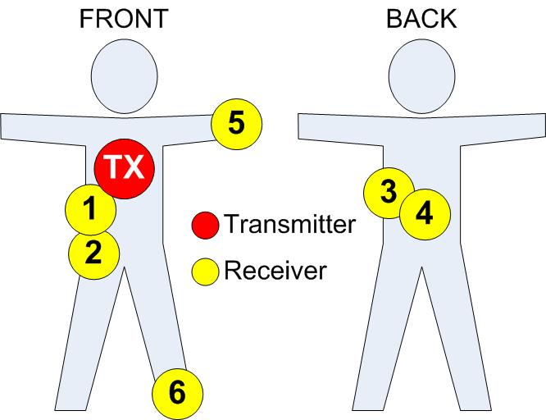
F. Di Franco, C. Tachtatzis, B. Graham, D. C. Tracey, N. F. Timmons, J. Morrison,” On-Body Wireless Channel Characterisation”, IEEE Sensors Conference 2011, October 2011
Experimental channel model characterization
Scenarios:
Indoors and Outdoors
Sitting, Standing Still, Walking, Running
6
Notes:
6
6

Slide 7
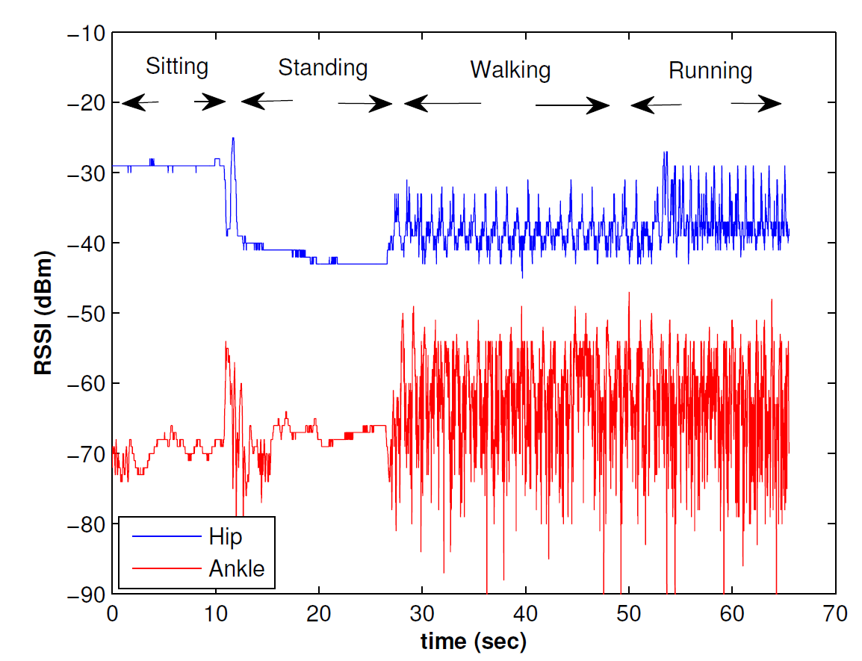
Temporal variation of the RSSI for two links when subject performs activities (chest to hip and chest to ankle)
Notes:
7

Slide 8

Analysis of the Received Signal Strength
Received Signal Power Components
Mean Path Gain
Dependant on range, TX and Rx position, presence of Line of Sight (LOS), distance between antenna and body.
Fading
Large Scale Fading – Slow Fluctuations
Small Scale Fading – Rapid Fluctuations
F. Di Franco, C. Tachtatzis, B. Graham, D. C. Tracey, N. F. Timmons, J. Morrison,” On-Body Wireless Channel Characterisation”, IEEE Sensors Conference 2011, October 2011
8
Notes:
We analyse the envelope received signal power P(t_{n}) as the product of three components: the mean path gain G₀, large-scale fading (or shadowing) L(t_{n}) and small-scale fading S(t_{n}).
The Mean Path Gain is range dependant and is dependant on the relative position of the transmitter and receiver, the presence of LOS, the antenna used, and the distance between the antenna and the body, which is why care was taken to ensure that the inverted F antenna of the motes used was 2cm away from the subjects body during the tests.
The fluctuation of the signal envelope around the mean is known as fading:
The slow fluctuations which is caused by shadowing effects due to the obstruction from human body it is known as large scale fading.
The rapid fluctuation of the received signal from the constructive and deconstructive combination of different paths as a result of reflection, scattering and diffraction (Multipath) is known as small scale fading.
8

Slide 9
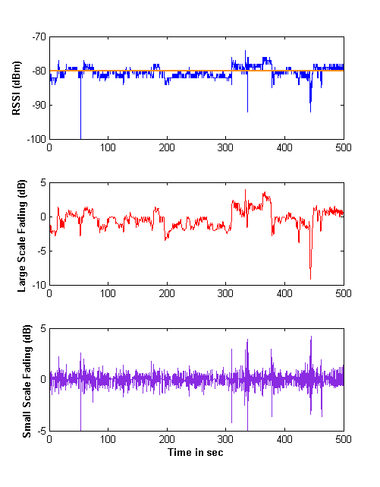




=
+
+
in dB
Mean Path Gain
Large Scale Fading– Slow Fluctuations
Small Scale Fading – Rapid Fluctuations

Slide 10
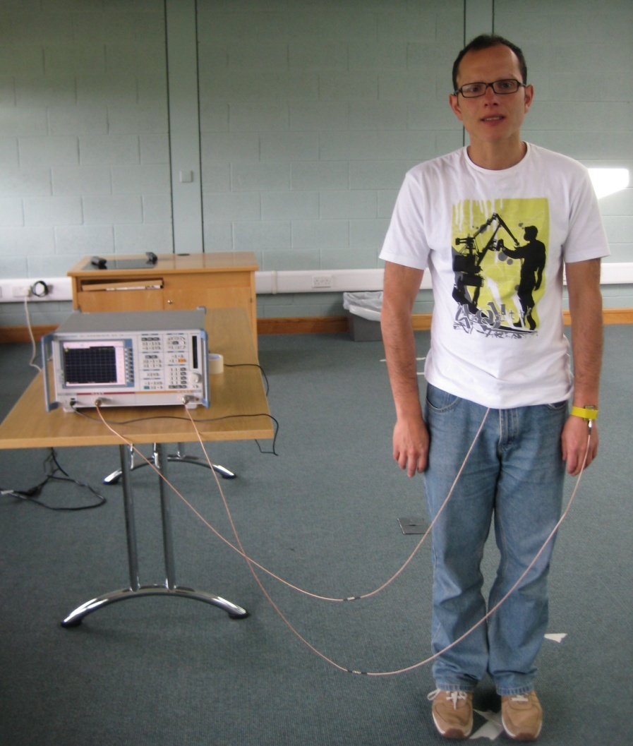
Experimental Characterization (II)
Two antennas placed on defined body positions and subjects instructed to stay motionless on a marked room location
Di Franco at al. “The effect of body shape and gender on Wireless Body Area Network on-body channels” MECAP 2010.

Slide 11
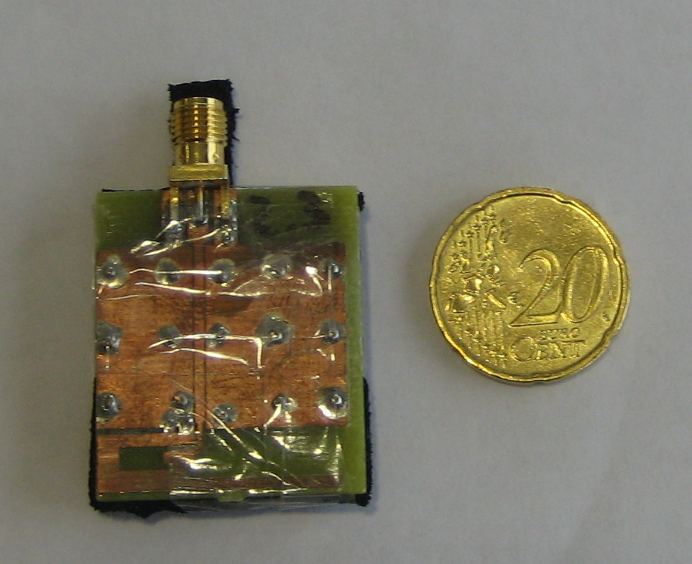
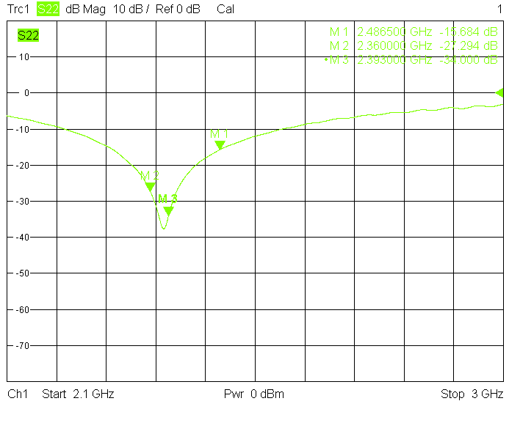
Experimental Procedure
Connect two inverted-F PCB antennas on the two VNA ports, antennas are tuned on the body surface
Notes:
5mm from the body surface WE selected that freq because it is under FCC approval for medical application.

Slide 12
Experimental Procedure
The VNA was used to capture signals for 30 s at sampling rate of 100 Hz
Each measurement was repeated 3 times on each subject
16 volunteer subjects for the experiments

Slide 13
Subject Respiration
Notes:
After some filtering the effect of respiration can be seen

Slide 14
Subjects characteristics & Path Loss
Notes:
We measure the path gain on 16 subjects with different physical characteristics as shown in Table 1: gender (8 males and 8 females), age (from 20 to 63), height (160 to 185 cm) , weight (from 51 to 119 kg)

Slide 15
Gender Path Loss
Notes:
The results showed that the average path loss varies between 60 dB and 80 dB depending on the subject. Additionally, it was observed that females suffer less path loss in comparison to men. This could be justified by the reduced distance between the torso and the wrist in women. However, weak correlation was found between average path loss and distance.

Slide 16
Distribution of Fading
Common distributions were best fitted to the measurements and ranked using the Akaike Information Criteria
Rice Distribution was the best suited
The K parameter of the Rice distribution is:
K->0 Ricean distribution approximates the Rayleigh distribution
K->inf Ricean approximates the Gaussian distribution
Notes:
K->0 Ricean distribution approximates the Rayleigh distribution
K->inf Ricean approximates the Gaussian distribution

Slide 17
Path Loss and Ricean K-factor

Slide 18
Topology Analysis in WBAN: Motivation
How reliable is a link in WBAN using different output transmit power levels?
Do retransmissions increase substantially the data reliability in WBAN environment?
Does human movements affect simultaneously signal propagation on different links?
How can energy efficiency and network lifetime be maximized?
Fabio Di Franco, Ilenia Tinnirello, Yu Ge "1 Hop or 2 Hops: Topology Analysis in Body Area Network" accepted at EuCNC 2014

Slide 19
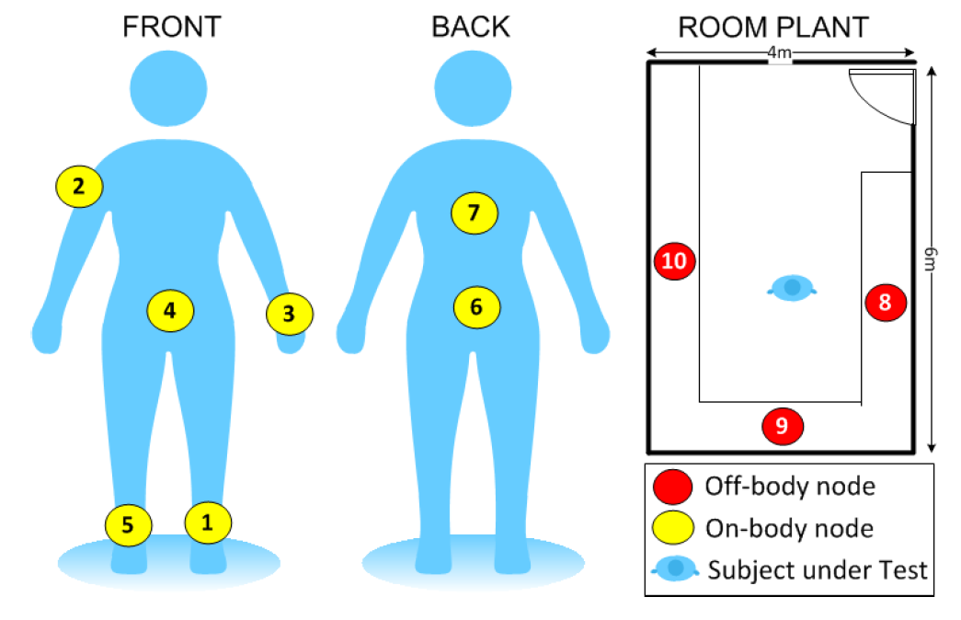
Design an experiment for having a map of the propagation condition over time all around the body

Slide 20
Experimental quasi-synchronous mesh network
On-body nodes broadcasts a frame every 25ms at 0dBm in a round-robin manner and they listen the rest of the time . They form a full-mesh network.
The off-body nodes receive the frame sent by each on-body device and store each received data frame and the associated Received Signal Strength Indicator (RSSI) for subsequent analysis.
Each subject conducted his normal office activities for an hour inside the room, with no-pre-arranged activities.

Slide 21
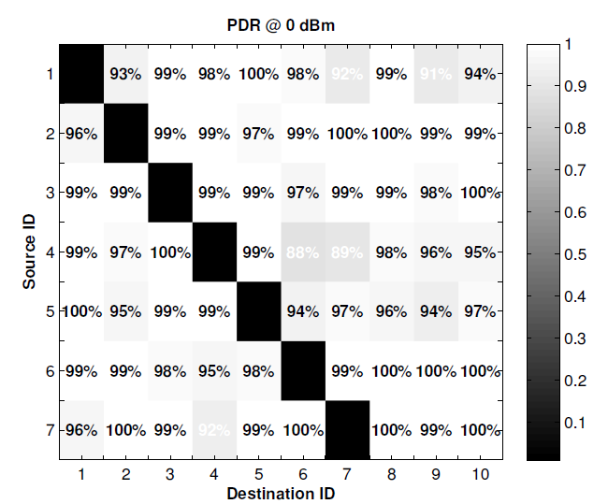
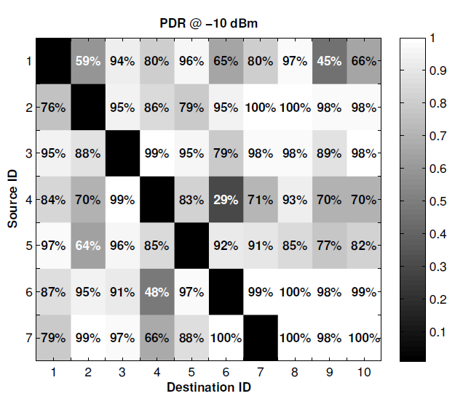
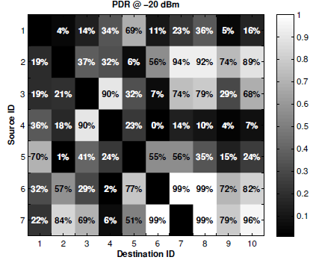
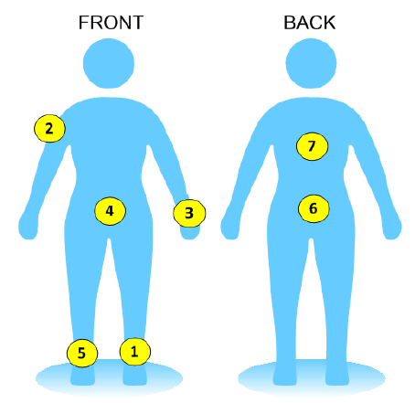
Packet Delivery Ratio (PDR) at different power level

Slide 22
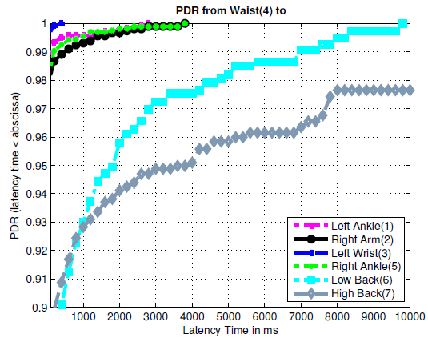
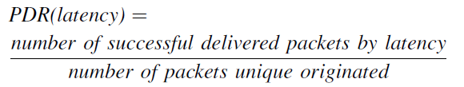
Effect of Retransmissions on data reliability at 0dBm

Slide 23
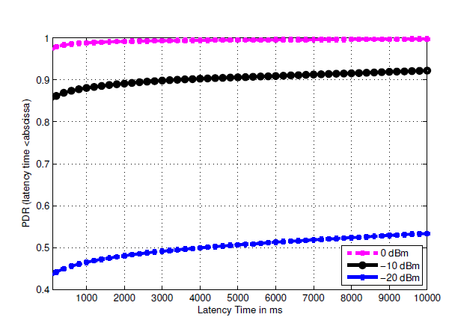
Effect of Retransmissions on data reliability at different TX power levels
23

Slide 24
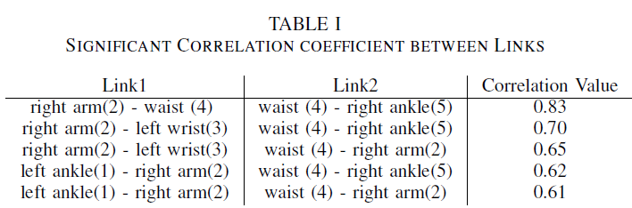


Movements affect simultaneously signal propagation
How is the reliability of 2-hop communication affected?
i
k
j
=
Only if links have an independent probability of successful delivered

Slide 25
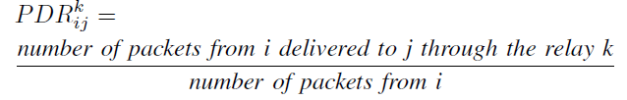
Movements affect simultaneously signal propagation
How is the reliability of 2-hop communication affected?
i
k
j

Slide 26
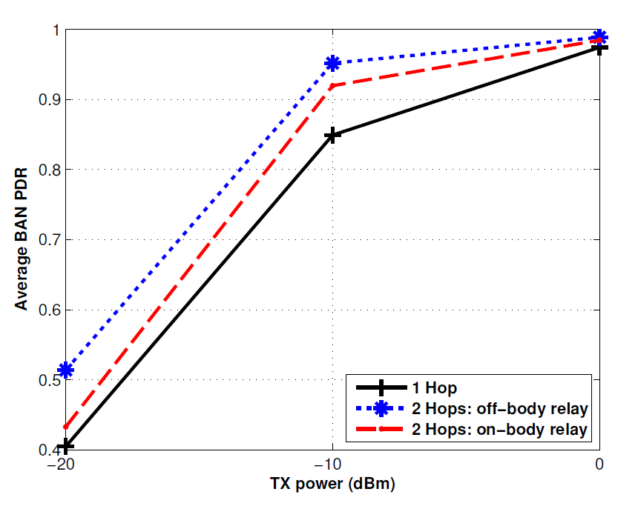
1 Hop or 2 hops: Topology Analysis
Data Reliability

Slide 27
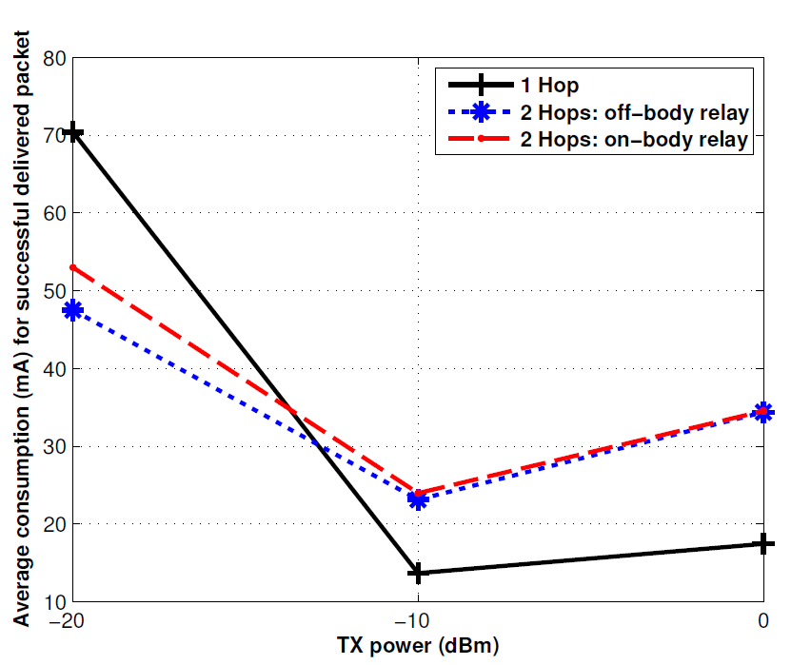
1 Hop or 2 hops: Topology Analysis
Energy efficiency

Slide 28
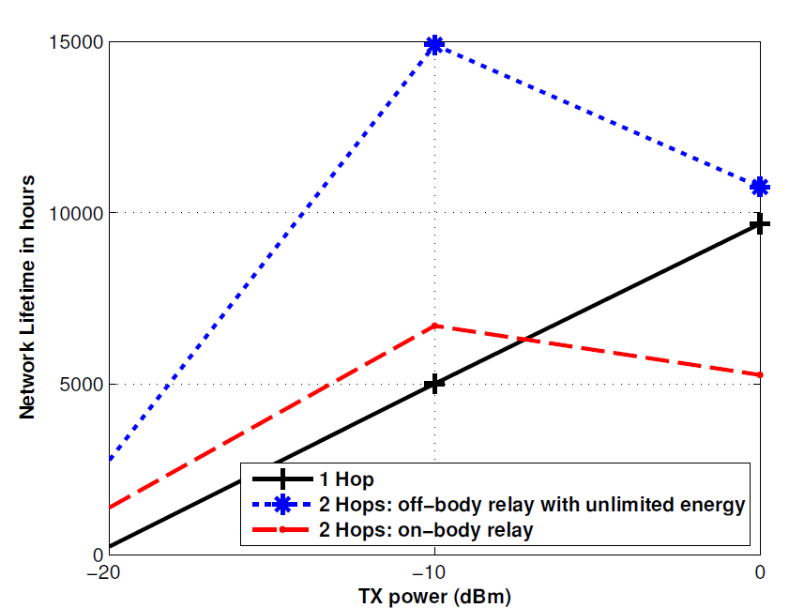
1 Hop or 2 hops: Topology Analysis
Network Lifetime

Slide 29
Conclusion (I)
WBAN Data are reliable at 0dBm in direct communication: the links shadow by the trunk suffers packet loss at 0dBm
Best energy efficient scheme is to use direct communication at -10dBm
2-hop communications is advisable only for links with poor direct communication and, in this case, an off-body relay link is advisable

Slide 30
Conclusion (II)
Movements affect link propagations. It must be taken into account in network simulations because links propagation are not linear independent
Network Lifetime is maximized using off-body relay with unlimited energy

Slide 32
Journal paper accepted at IET WSS
32
Transmit power control algorithm for IEEE 802.15.6

Slide 33
Motivation
33
Transmit power control method not based on models: posture, movements of human subject, the postures, the surrounding environments and different antennas will make the model too complex to implement on energy-constrained devices.
Our approach is based on an real-time estimation of channel gain for the specific link hub-node and change the transmitted power according to the channel condition.

Slide 34
IEEE802.15.6 scheduled allocation
34

Slide 35

How the TPC algorithm works
The prediction of the channel gain is based on the past Received Signal Strength Indicator (RSSI) of the beacon frames as they are received by each node.
The Channel Gain Estimation
is computed based on RSSI and previous channel gain estimation
α is the forgetness factor that controls the weight of the past estimations and its value is between 0 and 1
35

Slide 36
How the TPC algorithm works
36
The Mean Squared Error of the channel gain is calculated

Slide 37
MSE for Chest-Ankle link
37

Slide 38
Which is the best α?
38
Notes:
38
The optimum forgeteness factor varies greatly for various locations and delays which impacts the estimator accuracy.

Slide 39
How to minimize the MSE dinamically?
39
The optimum forgetness factor α varies greatly for various locations and delays which impacts the estimator accuracy.
the mean squared error is minimized using a line search algorithm:
In every iteration the node computes the MSE of the last N superframes
The MSE is evaluated for 3 values based on the optimal α found in the previous iteration: α, α+ε α-ε.
The optimal α at this iteration is found minimizing the MSE

Slide 40
Line search Algorithm
40

Slide 41
Comparison among different channel gain estimators
41

Slide 42
Fade Margin
42
The channel estimator can track the large-scale fading but the small-scale fading is by definition rapid and cannot be tracked (the channel gain is estimated every superframe i.e.150 ms in the studied case).
The characteristics of the small scale fading (distributions and its parameters) depend on the device positions and the human activity and are not known apriori.

Slide 43
Level Crossing Rate
43

Slide 44
Results with PER=0
44

Slide 45
Results with no retransmissions
45
Notes:
45
Our proposed algorithm saves 25% of energy for Chest-Side, Chest-Hip and Chest-Arm links respect to fixed -10dBm output power. It is due to the low power budget of these links which are most of the time in Line-of-Sight[DiFranco].
For Chest-Dorsi, Chest-Back and Chest-Ankle our algorithm saves respectively 23%, 20% and 21% respect to the -10dBm fixed transmitted power but at cost of a higher PER.
The Xiao’s algorithm has the same power consumption as our proposed one for Chest-Side and Chest-Hip. For the Chest-Dorsi link our algorithm saves 3% energy respect to the Xiao’s Aggressive strategy with similar PER. For the Chest-Back link our algorithm saves 7% energy respect to Xiao’s Aggressive strategy, although the PER will increase from 4% to 5%. For the Chest-Ankle link our algorithm saves 3% energy and decreases the PER by 1% respect to Xiao’s Balanced strategy.

