Slide 1

Snake Game
Nguyen Pham
Melinda Van
Project Final Presentation
Fall 2021

Slide 2
Introduction
What is this project is about:
For this project, our team built a Snake game on the NEXYS A7 FPGA board.
User controls a snake to eat diamonds generated at random locations inside the play area.
Snake length and speed increases as it eat more diamonds.
Game will be over if a snake’s head hits the wall of the play area or any other object.
We used SystemVerilog language to implement the game and then used Assembly language to check the scoreboard for the game.
Applications of the design:
Play Game for fun
Good SOC level experience to build the game.

Slide 3
Introduction
Game rules
Users use on-board push buttons (BTNU, BTND, BTNL, BTNR) to control the movement of the snake
If the snake collides with the border, the game is over. The game screen will flash a red strike and then display a black screen
If users get 10 points, the screen will flash a green strike and then display a black screen indicating they have won the game
To play again, users need to upload the bitstream on the FPGA board
The center push button will act as a reset button for the diamond (food) and the score if users want to continue playing with a long snake body

Slide 4
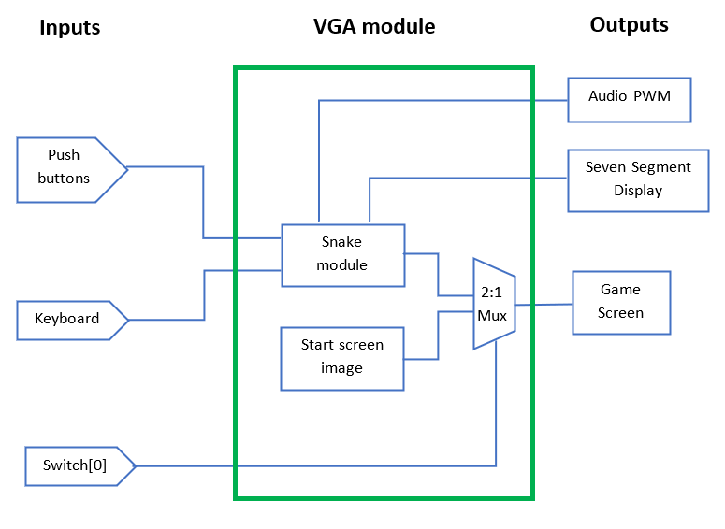
Design Steps Followed
Block diagram

Slide 5
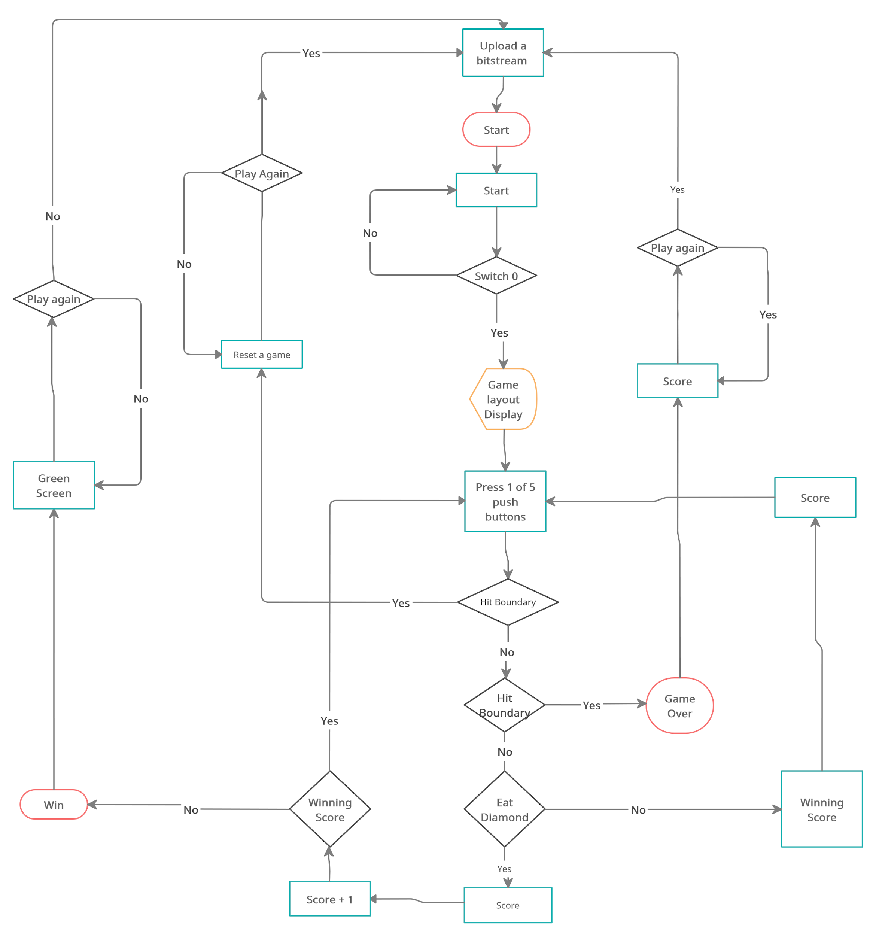
Design Steps Followed
Design Flow Chart

Slide 6
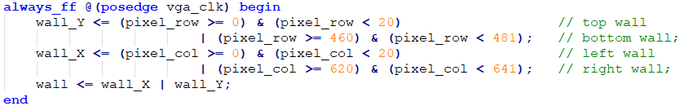
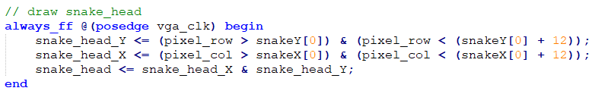
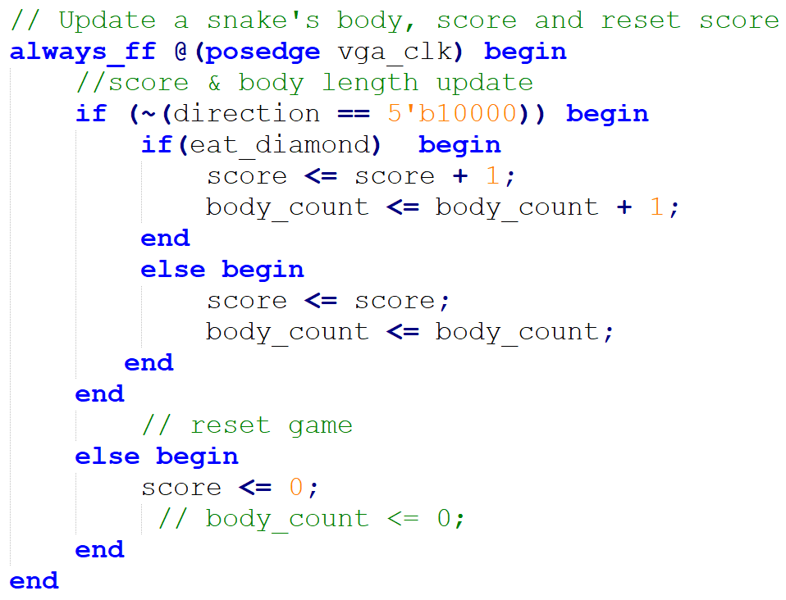
Design Steps Followed
Play Area
Snake Head
Score and Snake body update

Slide 7
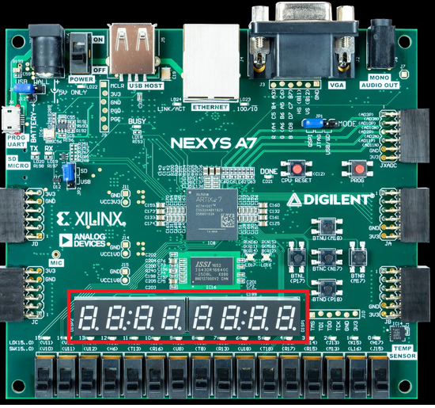
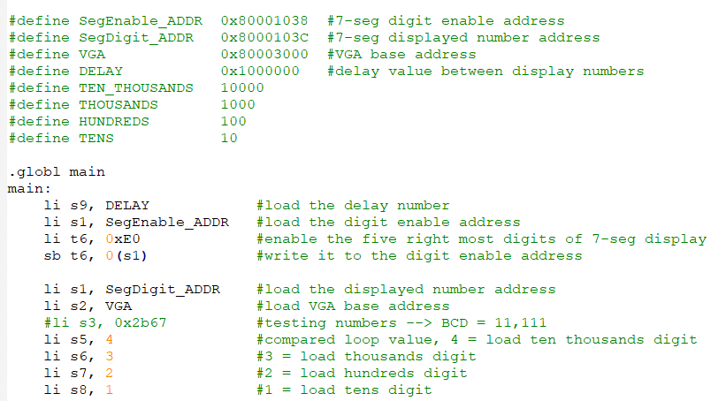
Design Steps Followed
7-segment displays update the score each-time snake hits a diamond.
7-seg on the board Assembly code example

Slide 8
Live Demonstration
https://drive.google.com/file/d/1nu2T614RHBj9v6vCKFZCcBi6MKNO7YVA/view?ts=61b2cd71

Slide 9
Results
Switch interface works to start the game and reset the game.
An image and a sound track are on as the game is loaded
Sound tracks are on during the game.
A snake moves as per user inputs.
A score updates as snake eats a diamond and reset to 0 when pressing the center button.
Game over condition works when a snake hits a boundary or objects inside the boundaries.
When score reaches to a winning score, green screen is displayed.
The green outputs to entire screen as winning.
The red outputs to entire screen as gameover.

Slide 10
Design challenges Faced
The challenges that were faced during the project:
Not enough block memory to store RGB image for the start game screen and troubleshoot DRC error during routing
Not enough memory to store audio data
Long run times (~45 min)
WNS increases as we added more features to our game, or when VGA reset connects to Wishbone Reset instead of the ground
Unable to output the solid color to the entire screen
Struggled to implement dynamic array to grow snake body length
Game score increased in an unexpected way because of eat diamond logic

Slide 11
Design challenges Faced
How we resolved them
Used greyscale image as a compromise solution
Resampled audio data to 8kHz to minimize the size of audio coe files and only play for a dew
Splitted combinational logic into smaller combo logic with clocks added in between to reduce WNS
Developed algorithm with a “for loop” in hardware/system verilog. This for loop works different in software
Changed the condition when the snake consumes the diamond

Slide 12
Q & A
?

