Slide 1
Project Progress Overview
Targets, Planning, and Achievements

Slide 2
Task Breakdown
Targets:
Define and create namespaces and network policies
Setup Prometheus and Grafana for metrics collection and dashboards
Setup Grafana dashboard reporter
Grant users read-only access to Grafana
Create alerts in Grafana (bonus)

Slide 3
Implementation
Lab setup
K8S cluster (Vagrant/Ansible, AKS)
Calico deploy
Namespace and Network Policies
Create dbs and apps namespaces
K8S manifests for network policies
Prometheus and Grafana Setup
Kube-Prometheus-stack (Helm chart)
Metrics collection and dashboards.
Namespace-wise and pod-wise dashboards
Pod metrics/custom dashboards
PVC dashboard
Create k8s service token (read-only config)
Grafana reporter
Grafana image render
grafana-reporter executor
Cronjob for dashboard converting (pdf) and send email
Alert
Rules for PVC usage
Email notification

Slide 4
Code References
Code Implementation:
ngphban00/creatingly (github.com)
How to follow the codes?
README (in root folder) for lab setup
README (in each sub folder) for each task activities

Slide 5
Screenshots of Achieved Targets
Lab setup
Namespaces (dbs, apps, calico)
Sample app (Knote + Mongo DB)
Network policies
Code templates
Testing
Dashboards
Namespace-wise
Pod-wise
Pod’s custom metrics
PVC
Reporter
Implementation diagram
Job runs
Email screenshot
PDF reports
Grafana access
Service account setup
Steps to access

Slide 6
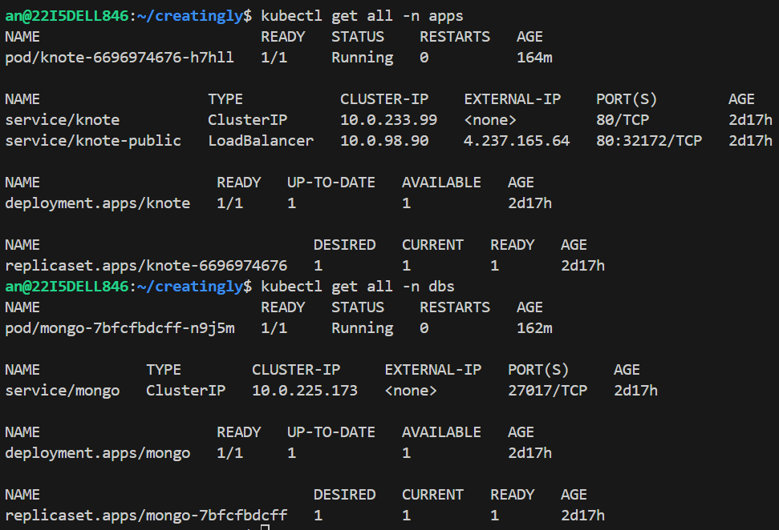
Lab setup
Namespace: apps, dbs

Slide 7
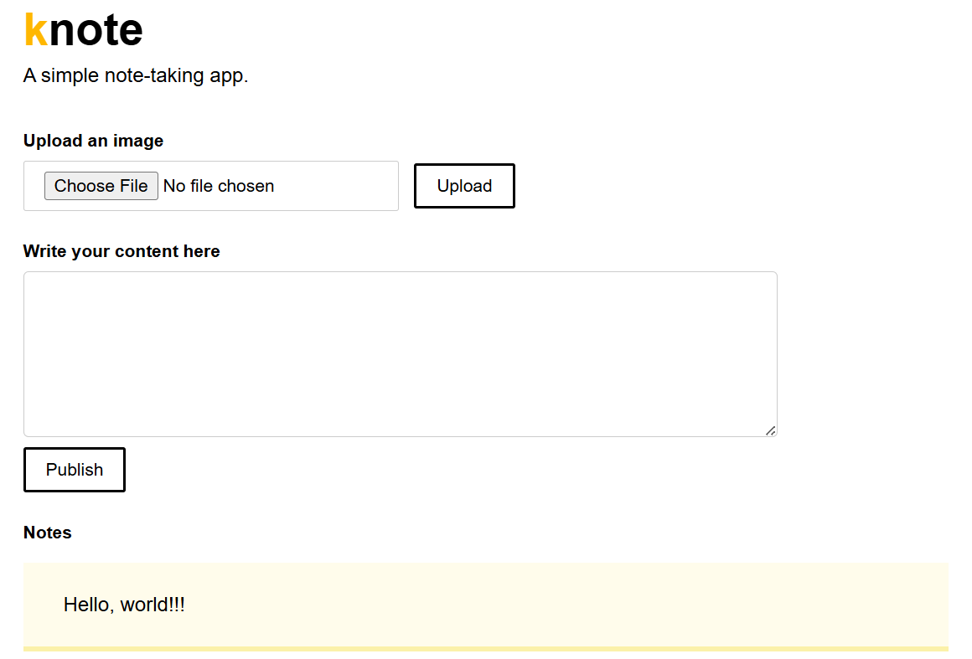
Lab setup
Sample app: knote

Slide 8
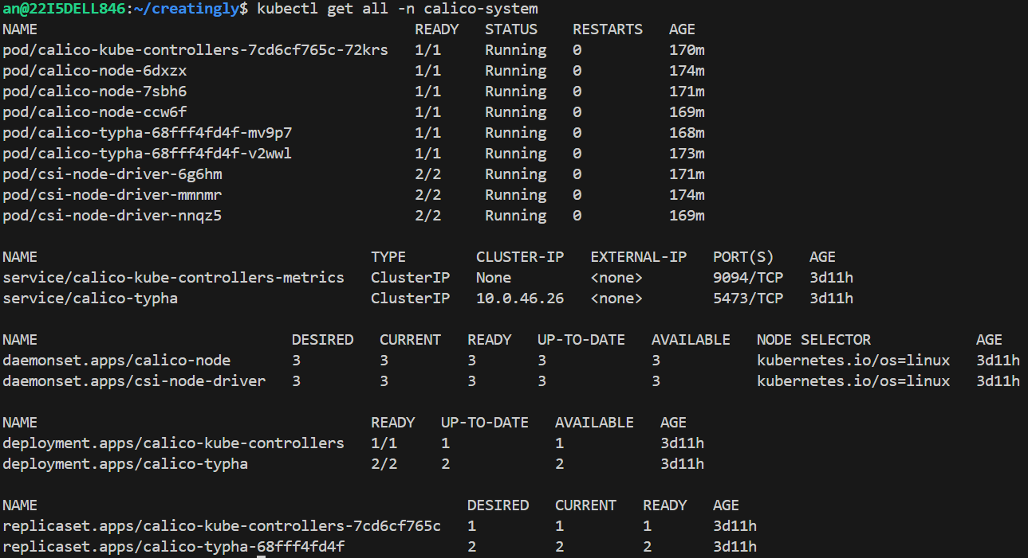
Lab setup
Calico namespace

Slide 9
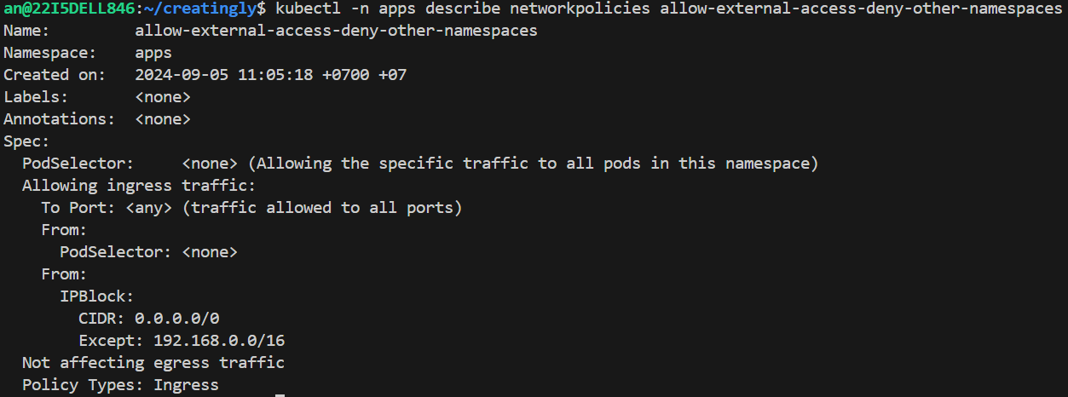
Network polices
Namespace: apps
Allow external access, deny access from other namespaces

Slide 10
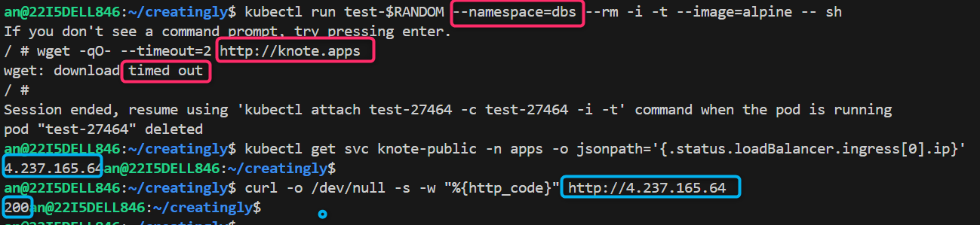
Network polices
Namespace: apps
Allow external access, deny access from other namespaces

Slide 11
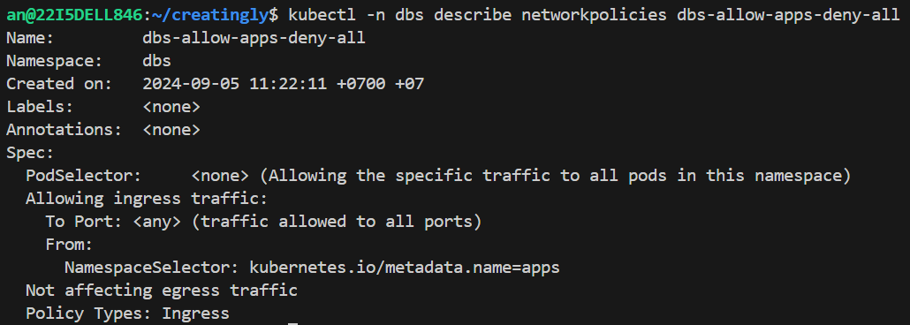
Network polices
Namespace: dbs
Allow access from apps ns, deny access from other namespaces

Slide 12
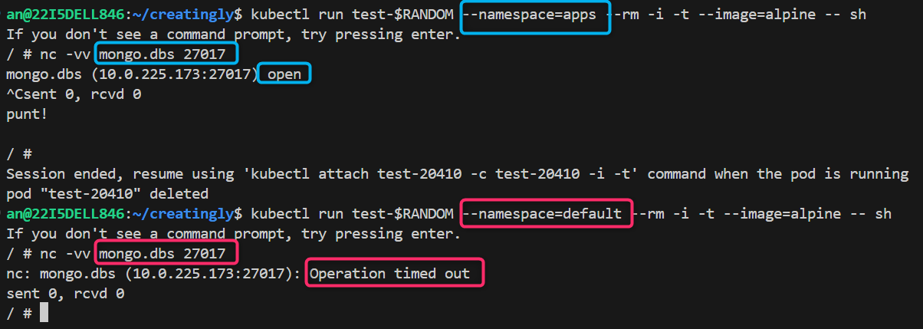
Network polices
Namespace: dbs
Allow access from apps ns, deny access from other namespaces

Slide 13
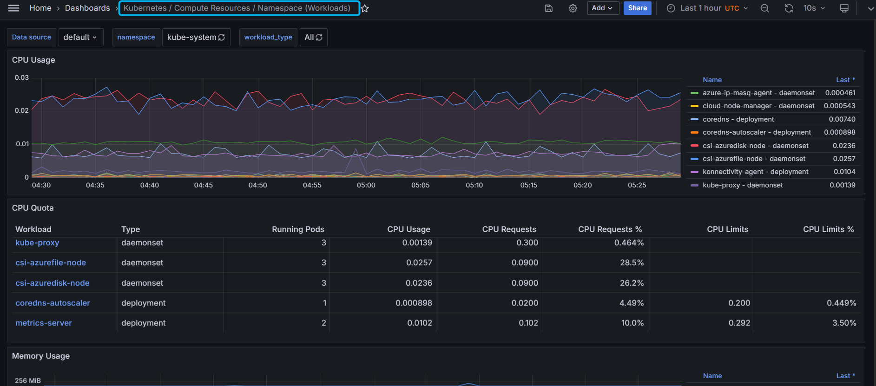
Dashboard
Namespace wise (workloads)

Slide 14
Dashboard
Pod wise (CPU, RAM)

Slide 15
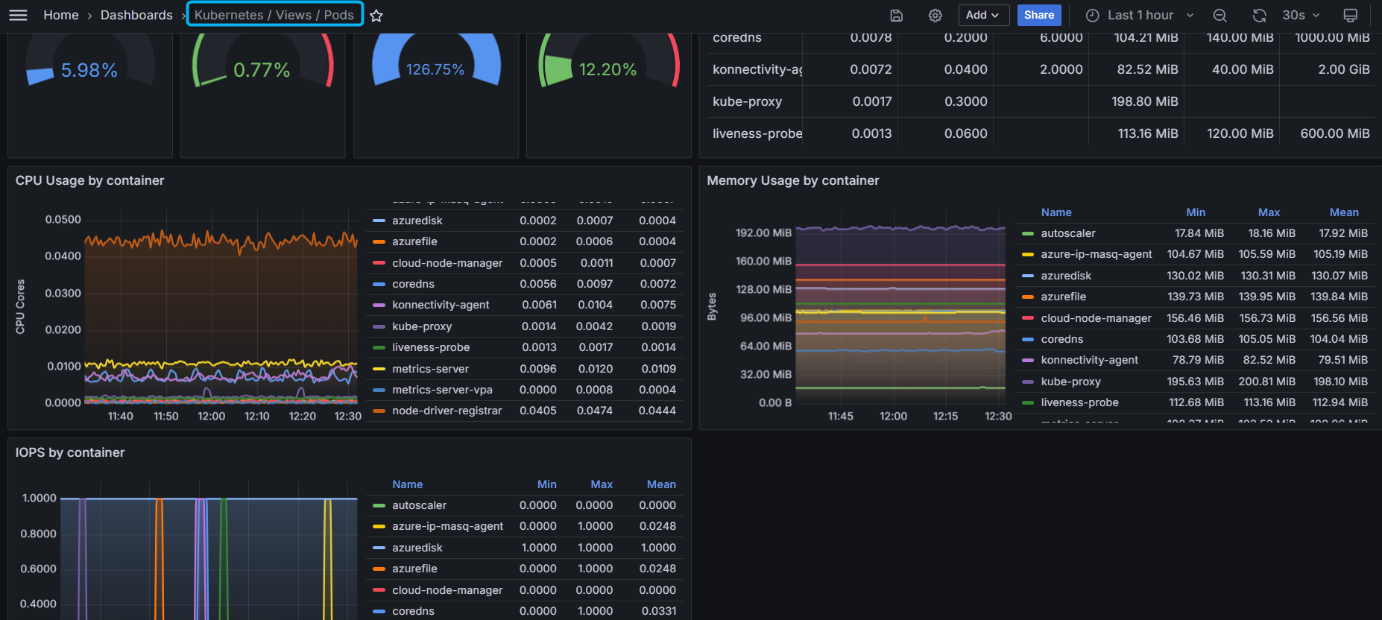
Dashboard
Pod custom (CPU, RAM)

Slide 16
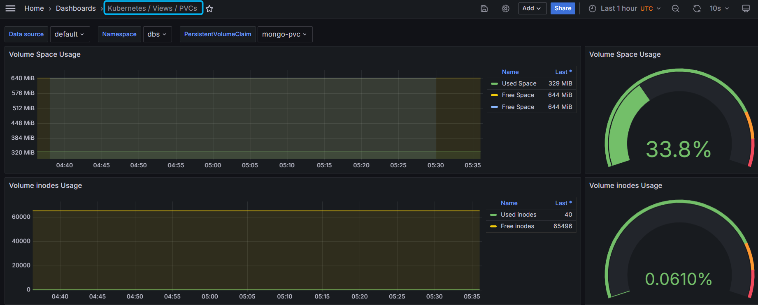
Dashboard
PVC

Slide 17
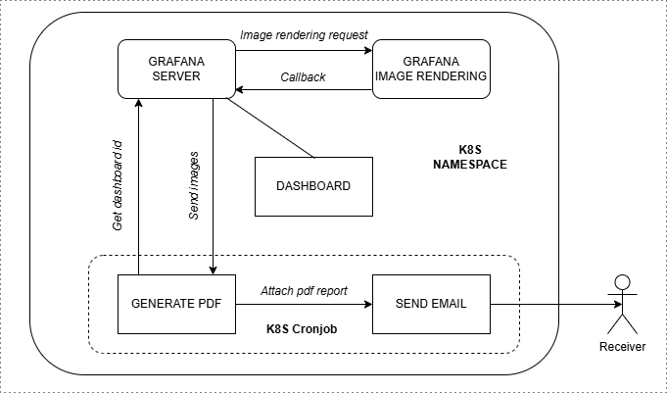
Reporter
Implementation

Slide 18
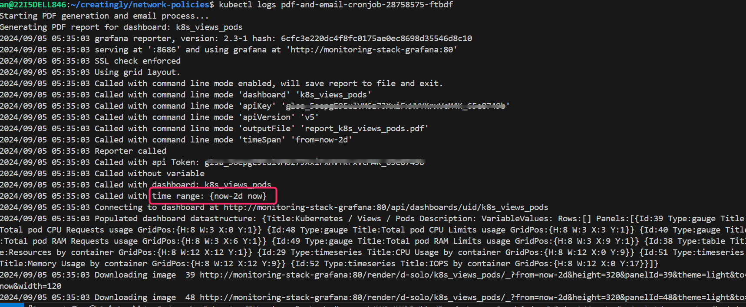
Reporter
Job runs

Slide 19
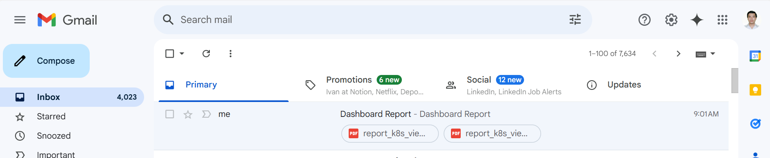
Reporter
Email attachments

Slide 20
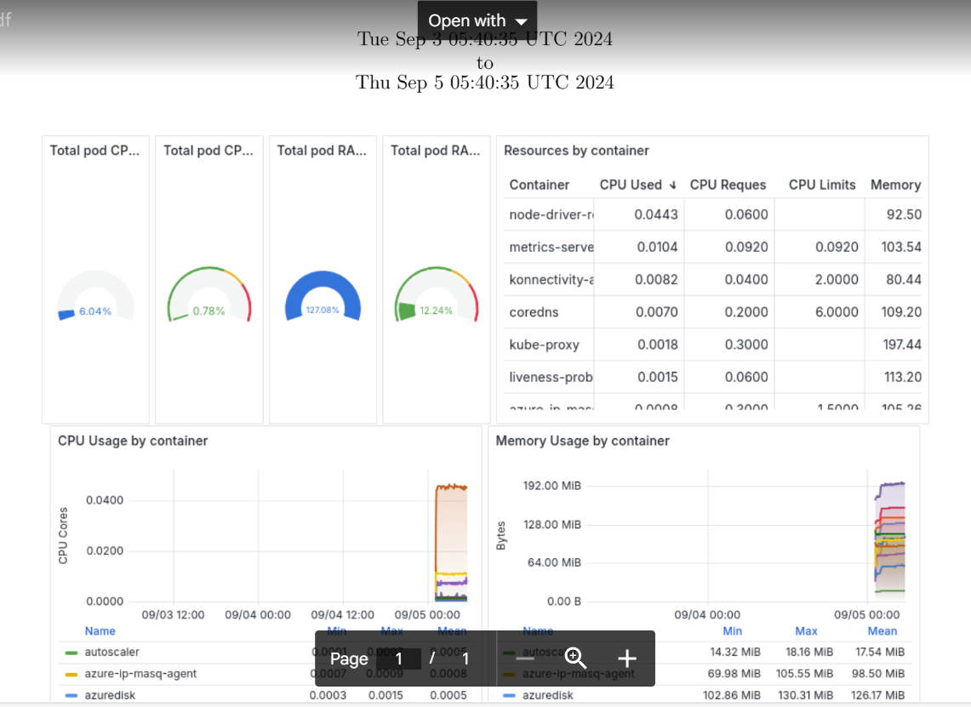
Reporter
PDF reports

Slide 21
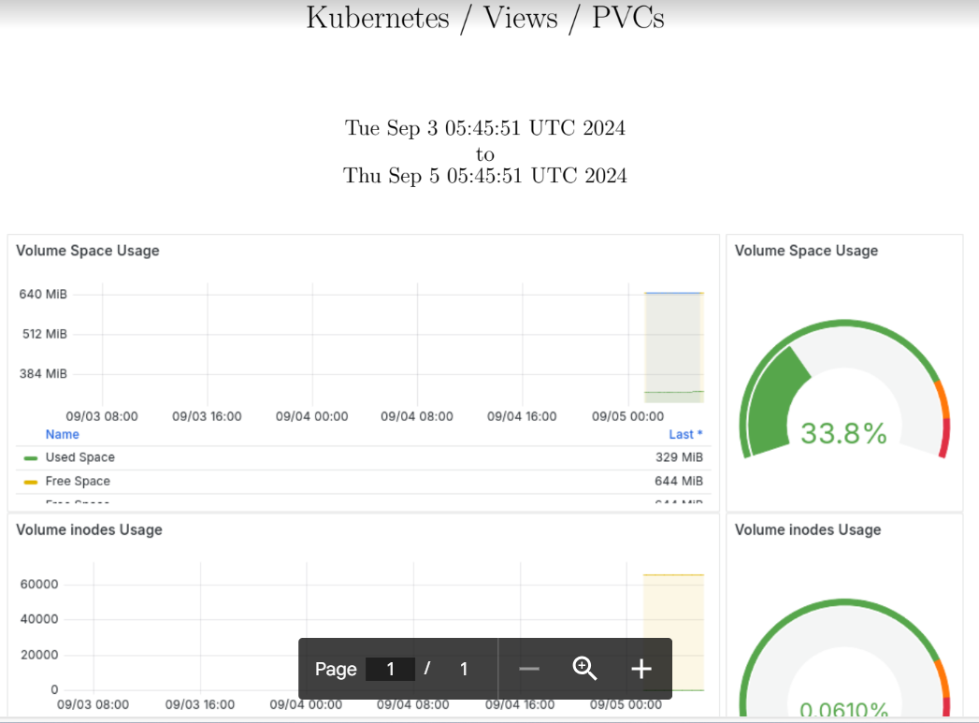
Reporter
PDF reports

Slide 22
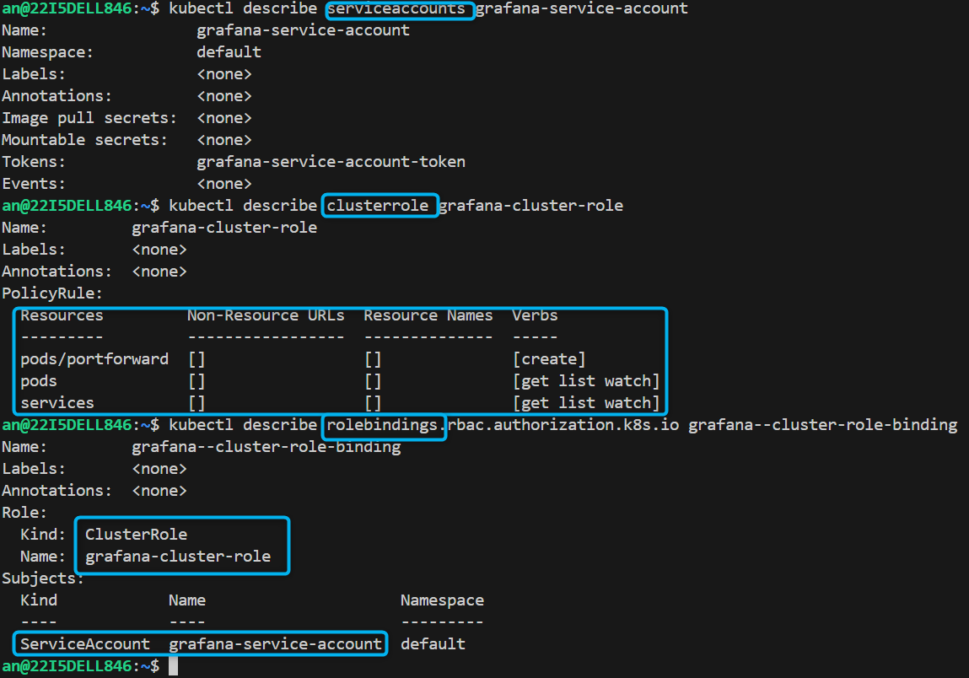
Grafana access
Service account

Slide 23
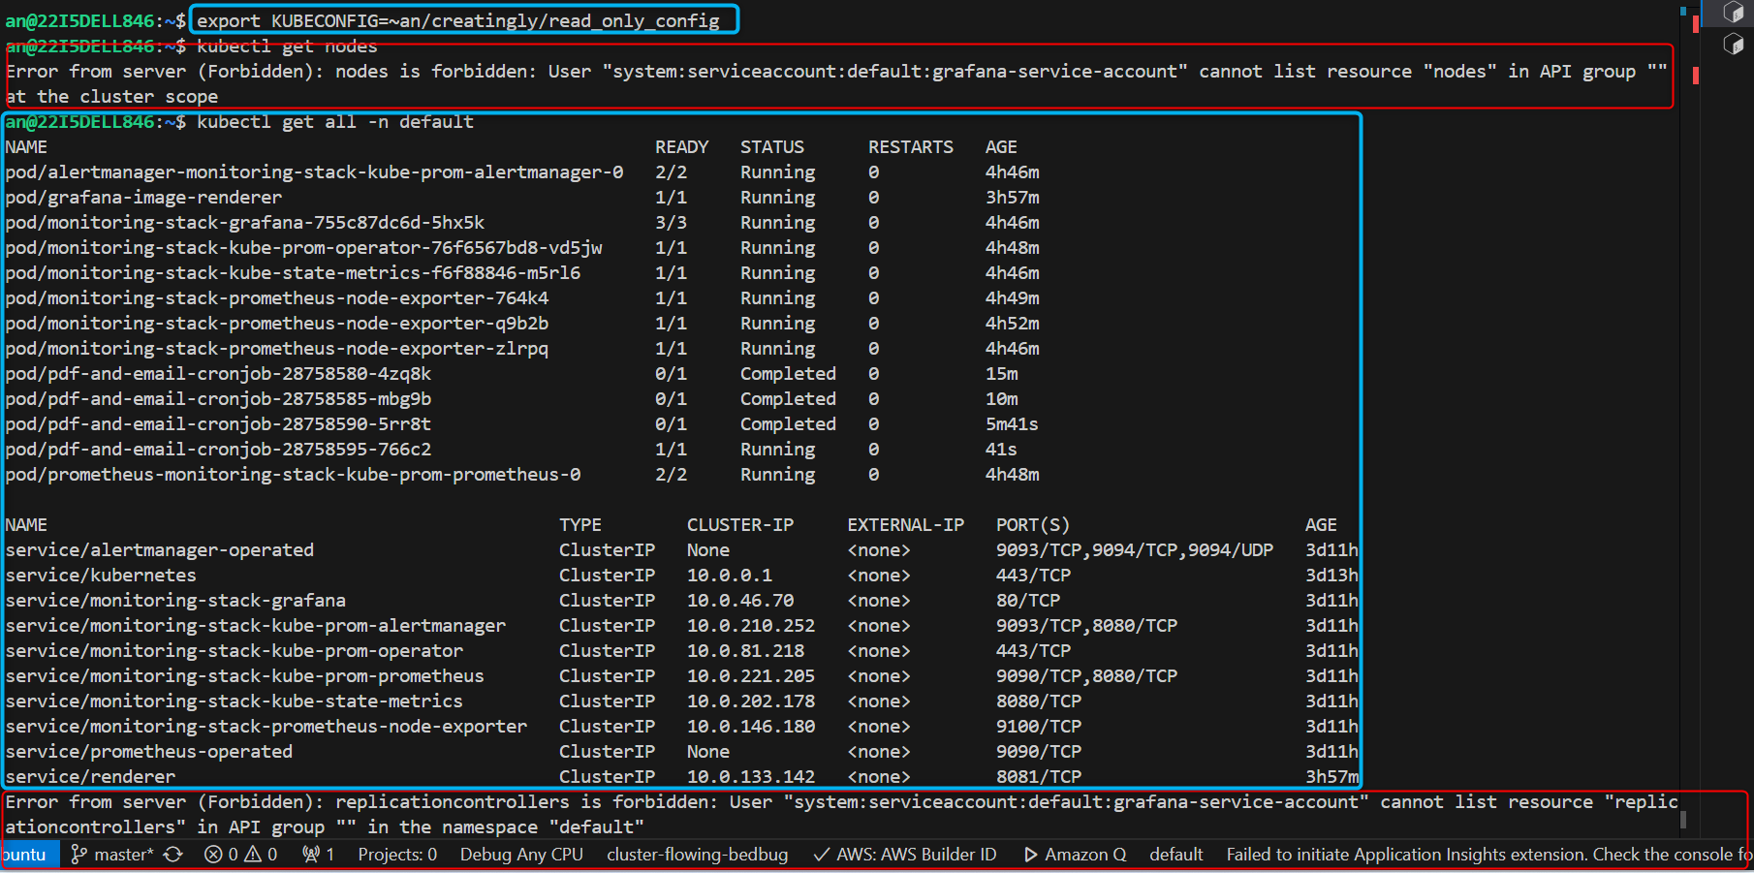
Grafana access
Permissions

Slide 24
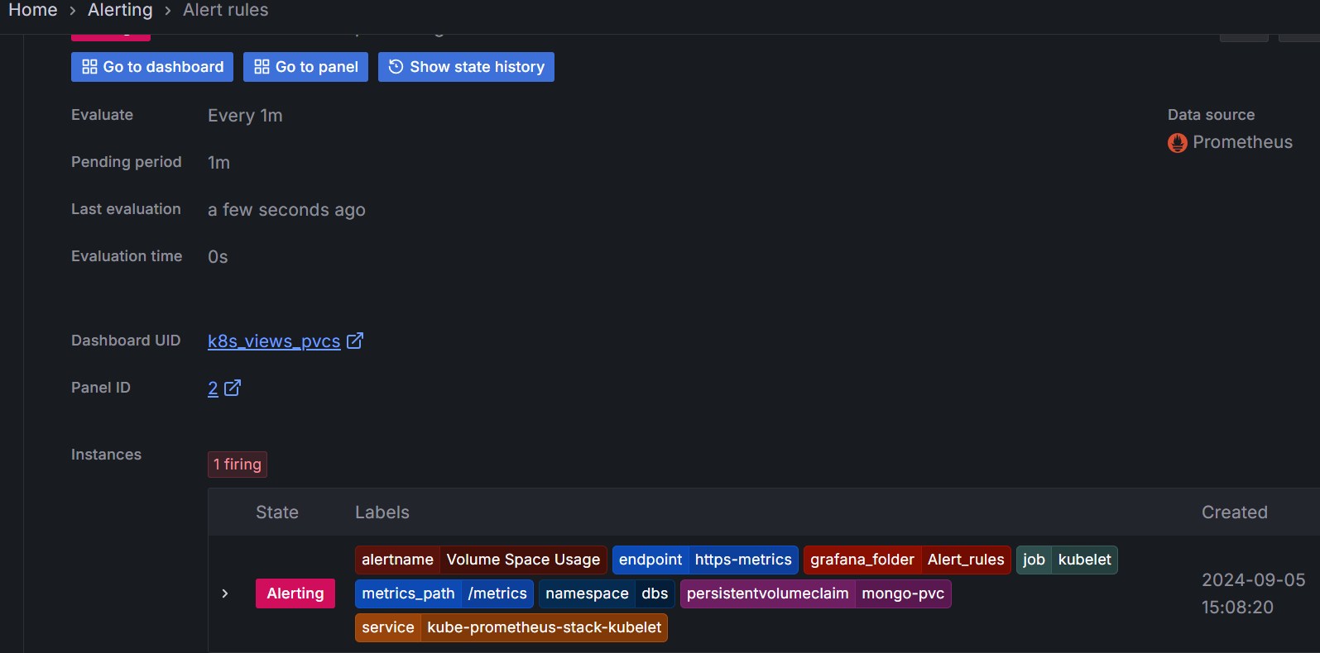
Alert
Rule

Slide 25
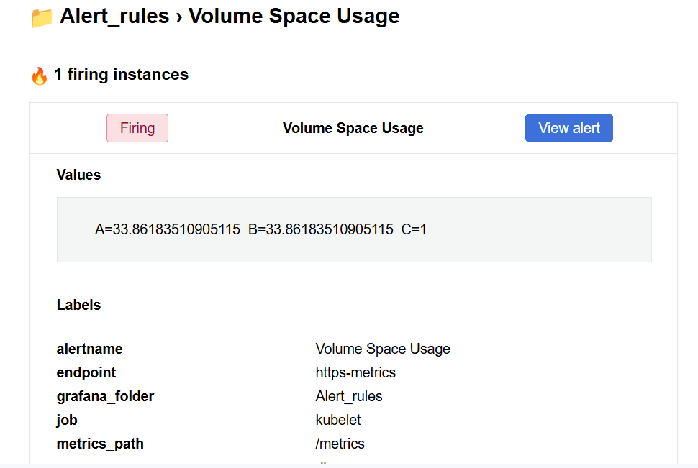
Alert
Email received

Slide 26
Challenges & Solutions
Challenges:
kubelet sometime does not expose all expected metrics (or all-zero metrics)
kubelet_volume_stats_capacity_bytes
container_fs_*
Solutions:
Check kubelet configs
Make sure not using “manual” storage class
Use a cloud k8s

Slide 27
Next Steps
Remaining tasks:
Automate for provisioning
a custom dashboard
a service monitor for an app
alert rules

Slide 28
Recap
Achievements so far.
Network policies
Custom dashboards
Dashboard reports
Grafana read access
Set alerting rules
Q&A

