Slide 1
A general framework of particle swarm optimization
FTC 2022 - Future Technologies Conference 2022
20-21 October 2022 | Hybrid Event | Vancouver, Canada
Prof. Dr. Loc Nguyen, PhD, PostDoc
Founder of Loc Nguyen’s Academic Network, Vietnam
Email: ng_phloc@yahoo.com
Homepage: www.locnguyen.net

Slide 2
Abstract
Particle swarm optimization (PSO) is an effective algorithm to solve the optimization problem in case that derivative of target function is inexistent or difficult to be determined. Because PSO has many parameters and variants, I propose a general framework of PSO called GPSO which aggregates important parameters and generalizes important variants so that researchers can customize PSO easily. Moreover, two main properties of PSO are exploration and exploitation. The exploration property aims to avoid premature converging so as to reach global optimal solution whereas the exploitation property aims to motivate PSO to converge as fast as possible. These two aspects are equally important. Therefore, GPSO also aims to balance the exploration and the exploitation. It is expected that GPSO supports users to tune parameters for not only solving premature problem but also fast convergence.

Slide 3
Table of contents
Introduction
GPSO with probabilistic constriction
Experimental results
Conclusions

Slide 4
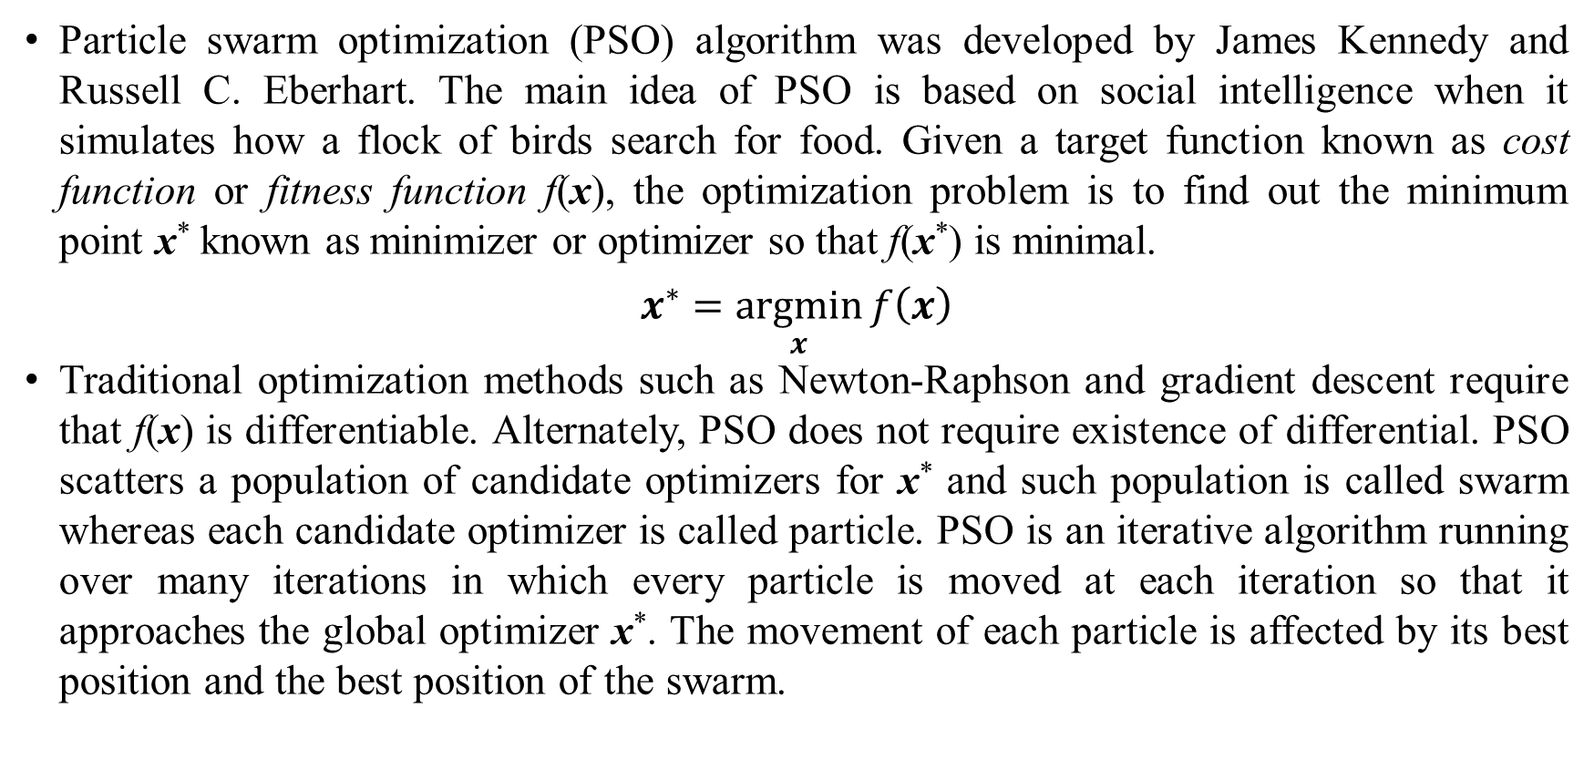
1. Introduction
Particle swarm optimization (PSO) algorithm was developed by James Kennedy and Russell C. Eberhart. The main idea of PSO is based on social intelligence when it simulates how a flock of birds search for food. Given a target function known as cost function or fitness function f(x), the optimization problem is to find out the minimum point x* known as minimizer or optimizer so that f(x*) is minimal.
$$x^{∗}=\underset{x}{argmin}{f\left(x\right)}$$
Traditional optimization methods such as Newton-Raphson and gradient descent require that f(x) is differentiable. Alternately, PSO does not require existence of differential. PSO scatters a population of candidate optimizers for x* and such population is called swarm whereas each candidate optimizer is called particle. PSO is an iterative algorithm running over many iterations in which every particle is moved at each iteration so that it approaches the global optimizer x*. The movement of each particle is affected by its best position and the best position of the swarm.

Slide 5
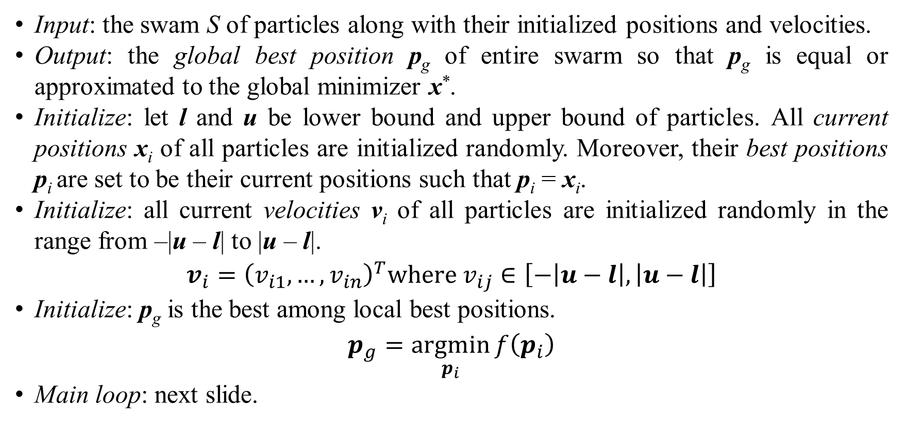
1. Introduction
Input: the swam S of particles along with their initialized positions and velocities.
Output: the global best position p_{g} of entire swarm so that p_{g} is equal or approximated to the global minimizer x*.
Initialize: let l and u be lower bound and upper bound of particles. All current positions x_{i} of all particles are initialized randomly. Moreover, their best positions p_{i} are set to be their current positions such that p_{i} = x_{i}.
Initialize: all current velocities v_{i} of all particles are initialized randomly in the range from –|u – l| to |u – l|.
$$v_{i}={\left(v_{i1},…,v_{in}\right)}^{T}where v_{ij}∈\left[−\left|u−l\right|,\left|u−l\right|\right]$$
Initialize: p_{g} is the best among local best positions.
$$p_{g}=\underset{p_{i}}{argmin}{f\left(p_{i}\right)}$$
Main loop: next slide.

Slide 6
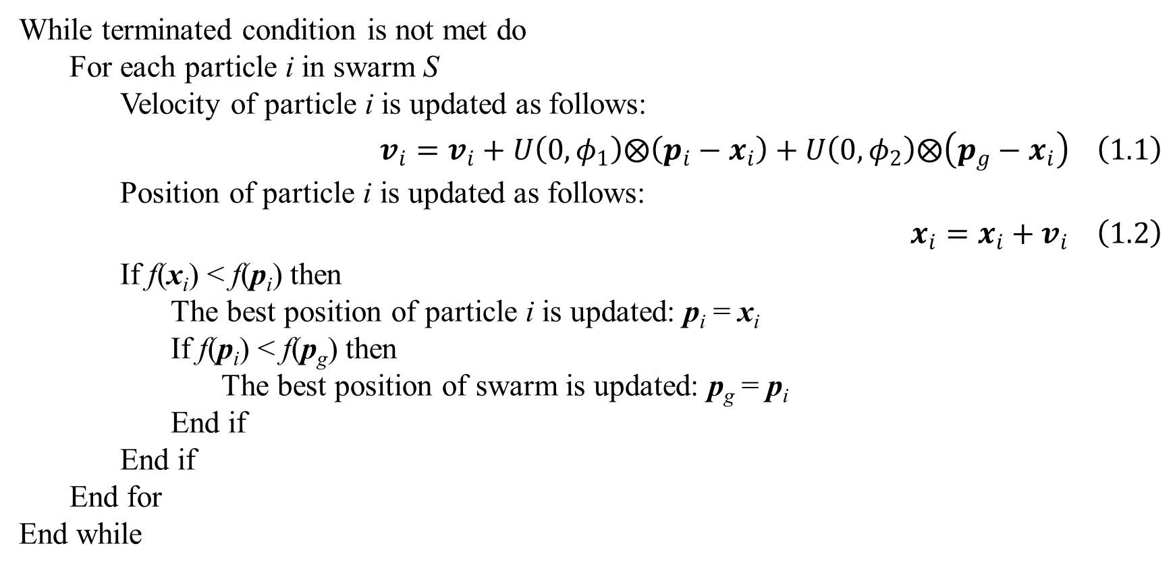
1. Introduction
While terminated condition is not met do
For each particle i in swarm S
Velocity of particle i is updated as follows:
$$v_{i}=v_{i}+U\left(0,φ_{1}\right)⨂\left(p_{i}−x_{i}\right)+U\left(0,φ_{2}\right)⨂\left(p_{g}−x_{i}\right) \left(1.1\right)$$
Position of particle i is updated as follows:
$$x_{i}=x_{i}+v_{i} \left(1.2\right)$$
If f(x_{i}) < f(p_{i}) then
The best position of particle i is updated: p_{i} = x_{i}
If f(p_{i}) < f(p_{g}) then
The best position of swarm is updated: p_{g} = p_{i}
End if
End if
End for
End while

Slide 7
1. Introduction
Equation 1.1 is the heart of PSO, which is velocity update rule. Equation 1.2 is position update rule.
Two most popular terminated conditions are that the cost function at p_{g} which is evaluated as f(p_{g}) is small enough or PSO ran over a large enough number of iterations.
Functions U(0, ϕ₁) and U(0, ϕ₂) generate random vector whose elements are random numbers in ranges [0, ϕ₁] and [0, ϕ₂], respectively.
The operator ⨂ denotes component-wise multiplication of two points [2, p. 3].
Notes:
$$U\left(0,φ_{1}\right)={\left(r_{11},r_{12},…,r_{1n}\right)}^{T} where 0≤r_{1j}≤φ_{1}$$
$$U\left(0,φ_{2}\right)={\left(r_{21},r_{22},…,r_{2n}\right)}^{T} where 0≤r_{2j}≤φ_{2}$$
$$U\left(0,φ_{1}\right)⊗x_{j}=\left(\begin{matrix}r_{11}x_{i1} \\ r_{12}x_{i2} \\ ⋮ \\ r_{1n}x_{in}\end{matrix}\right)$$

Slide 8
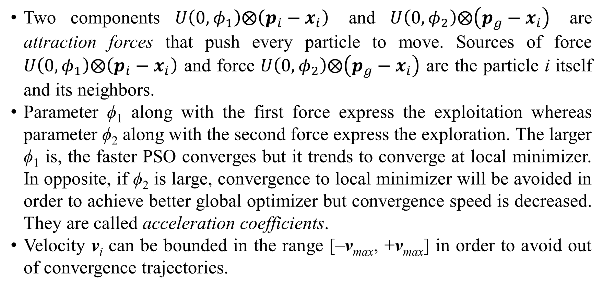
1. Introduction
Two components $U\left(0,φ_{1}\right)⨂\left(p_{i}−x_{i}\right)$ and $U\left(0,φ_{2}\right)⨂\left(p_{g}−x_{i}\right)$ are attraction forces that push every particle to move. Sources of force $U\left(0,φ_{1}\right)⨂\left(p_{i}−x_{i}\right)$ and force $U\left(0,φ_{2}\right)⨂\left(p_{g}−x_{i}\right)$ are the particle i itself and its neighbors.
Parameter ϕ₁ along with the first force express the exploitation whereas parameter ϕ₂ along with the second force express the exploration. The larger ϕ₁ is, the faster PSO converges but it trends to converge at local minimizer. In opposite, if ϕ₂ is large, convergence to local minimizer will be avoided in order to achieve better global optimizer but convergence speed is decreased. They are called acceleration coefficients.
Velocity v_{i} can be bounded in the range [–v_{max}, +v_{max}] in order to avoid out of convergence trajectories.
Notes:
Parameters ϕ₁ and ϕ₂ are also called acceleration coefficients or attraction coefficients. Especially, ϕ₁ is called cognitive weight and ϕ₂ is called social weight because ϕ₁ reflects thinking of particle itself in moving and ϕ₂ reflects influence of entire swarm on every particle in moving. The popular values of them are ϕ₁ = ϕ₂ = 1.4962.
The parameter v_{max} is not popular because there are some other parameters such as inertial weight and constriction coefficient (mentioned later) which are used to damp the dynamics of particles. Favorite values for the size of swarm (the number of particles) are ranged from 20 to 50.

Slide 9
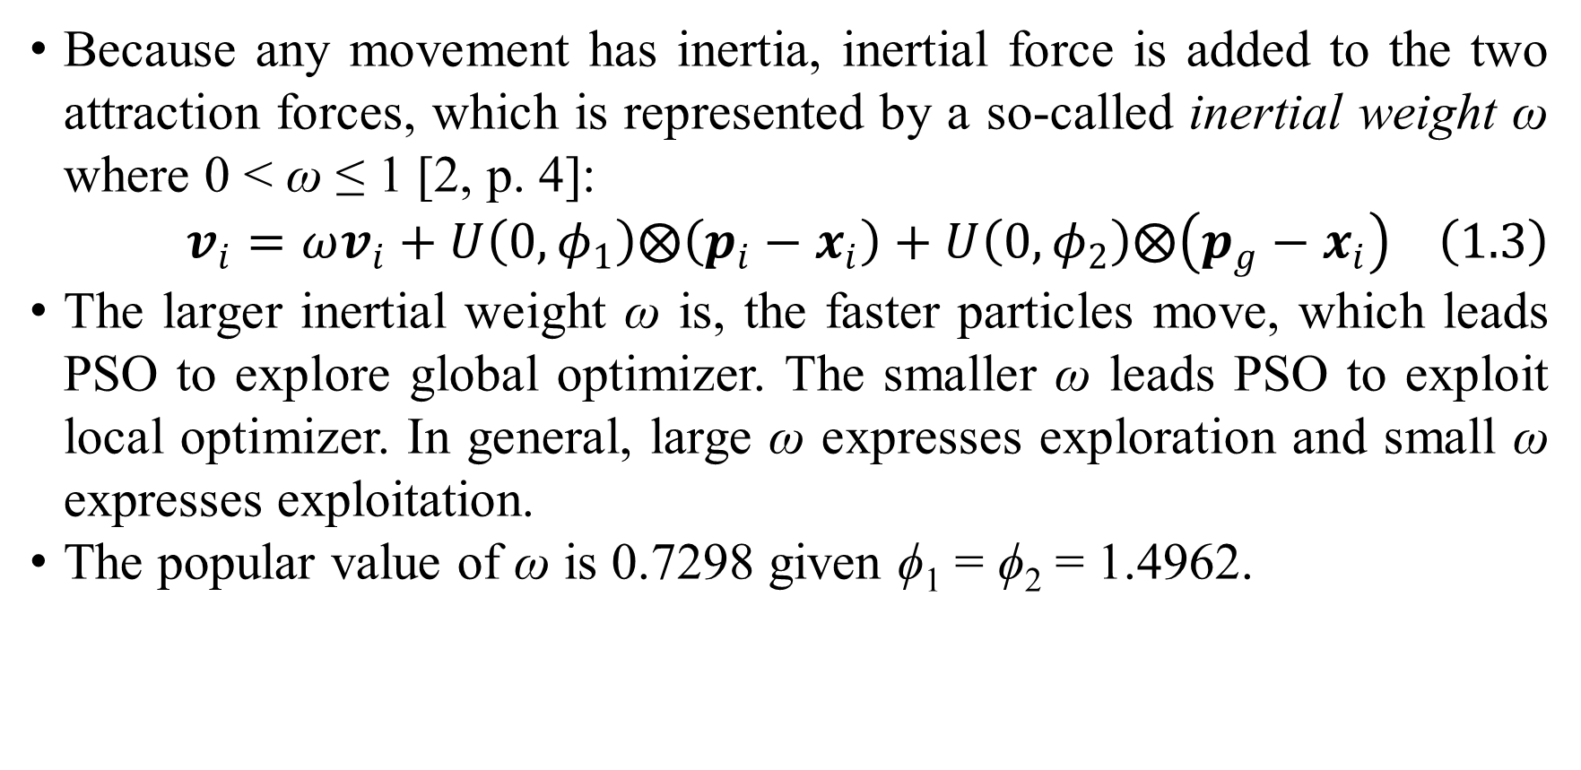
1. Introduction
Because any movement has inertia, inertial force is added to the two attraction forces, which is represented by a so-called inertial weight ω where 0 < ω ≤ 1 [2, p. 4]:
$$v_{i}=ωv_{i}+U\left(0,φ_{1}\right)⨂\left(p_{i}−x_{i}\right)+U\left(0,φ_{2}\right)⨂\left(p_{g}−x_{i}\right) \left(1.3\right)$$
The larger inertial weight ω is, the faster particles move, which leads PSO to explore global optimizer. The smaller ω leads PSO to exploit local optimizer. In general, large ω expresses exploration and small ω expresses exploitation.
The popular value of ω is 0.7298 given ϕ₁ = ϕ₂ = 1.4962.
Notes:
Note that moving fast does not imply fast convergence. The inverse 1–ω is known as friction coefficient.

Slide 10
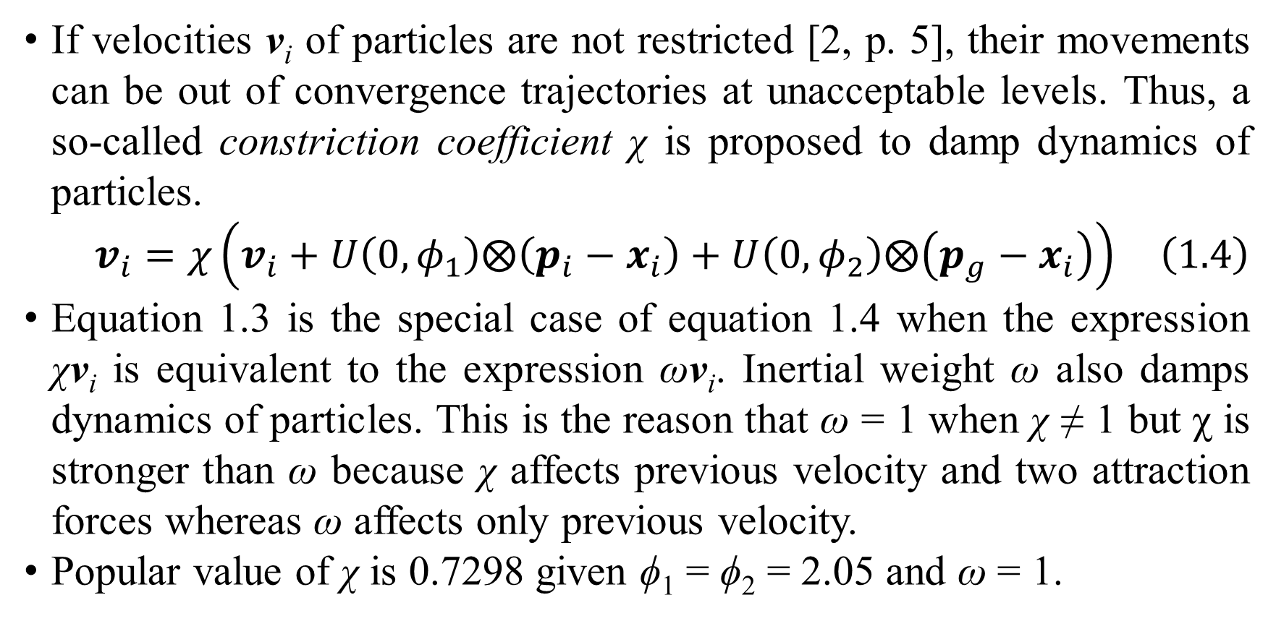
1. Introduction
If velocities v_{i} of particles are not restricted [2, p. 5], their movements can be out of convergence trajectories at unacceptable levels. Thus, a so-called constriction coefficient χ is proposed to damp dynamics of particles.
$$v_{i}=χ\left(v_{i}+U\left(0,φ_{1}\right)⨂\left(p_{i}−x_{i}\right)+U\left(0,φ_{2}\right)⨂\left(p_{g}−x_{i}\right)\right) \left(1.4\right)$$
Equation 1.3 is the special case of equation 1.4 when the expression χv_{i} is equivalent to the expression ωv_{i}. Inertial weight ω also damps dynamics of particles. This is the reason that ω = 1 when χ ≠ 1 but χ is stronger than ω because χ affects previous velocity and two attraction forces whereas ω affects only previous velocity.
Popular value of χ is 0.7298 given ϕ₁ = ϕ₂ = 2.05 and ω = 1.

Slide 11
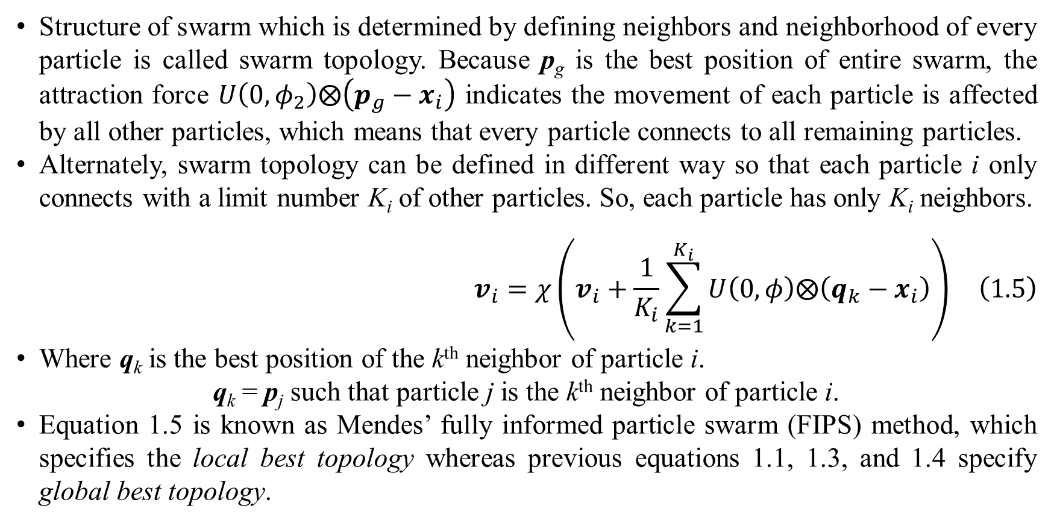
1. Introduction
Structure of swarm which is determined by defining neighbors and neighborhood of every particle is called swarm topology. Because p_{g} is the best position of entire swarm, the attraction force $U\left(0,φ_{2}\right)⨂\left(p_{g}−x_{i}\right)$ indicates the movement of each particle is affected by all other particles, which means that every particle connects to all remaining particles.
Alternately, swarm topology can be defined in different way so that each particle i only connects with a limit number K_{i} of other particles. So, each particle has only K_{i} neighbors.
$$v_{i}=χ\left(v_{i}+\frac{1}{K_{i}}\sum_{k=1}^{K_{i}}{U\left(0,φ\right)⨂\left(q_{k}−x_{i}\right)}\right) \left(1.5\right)$$
Where q_{k} is the best position of the k^{th} neighbor of particle i.
q_{k} = p_{j} such that particle j is the k^{th} neighbor of particle i.
Equation 1.5 is known as Mendes’ fully informed particle swarm (FIPS) method, which specifies the local best topology whereas previous equations 1.1, 1.3, and 1.4 specify global best topology.
Notes:
For explaining easily global best topology, suppose particles are vertices of a graph, fully connected swarm topology implies that such graph is fully connected, in which all vertices are connected together. In local best topology, particle i is also its neighbor. Thus, in equation 1.5, the set of K_{i} neighbors includes particle i. The two parameters ϕ₁ and ϕ₂ are reduced into only one parameter ϕ > 0, which implies the strengths of all attraction forces from all neighbors on particle i are equal. The popular value of ϕ is ϕ = 2.05 given χ = 0.7298.

Slide 12
1. Introduction
In global best topology specified by equations 1.1, 1.3, and 1.4, only one best position p_{g} of entire swarm is kept track. In local best topology specified by equation 1.5, many best positions from groups implied by neighbors are kept track. Hence, FIPS converges slowly but avoids converging at local optimizer. In other words, local best topology aims to exploration rather than exploitation. However, at a compromise, FIPS makes convergence speed of PSO slow because the exploitation is scarified for the exploration.
Therefore, I propose a general framework of PSO in next section which aims to balance the exploration and the exploitation.

Slide 13
2. GPSO with probabilistic constriction
The two main aspects of PSO are exploration and exploitation. The exploration aspect aims to avoid premature converging so as to reach global optimizer whereas the exploitation aspect aims to motivate PSO to converge as fast as possible. Besides exploitation property can help PSO to converge more accurately regardless of local optimizer or global optimizer. These two aspects are equally important.
Consequently, two problems corresponding to the exploration and exploitation are premature problem and dynamic problem. Solutions of the premature problem are to improve the exploration and solutions of the dynamic problem are to improve the exploitation. Inertial weight and constriction coefficient are common solutions for dynamic problem. Solutions of premature problem relates to increase dynamic ability of particles such as:
Dynamic topology.
Change of fitness function.
Adaptation includes tuning coefficients, adding particles, removing particles, and changing particle properties.
Diversity control.

Slide 14
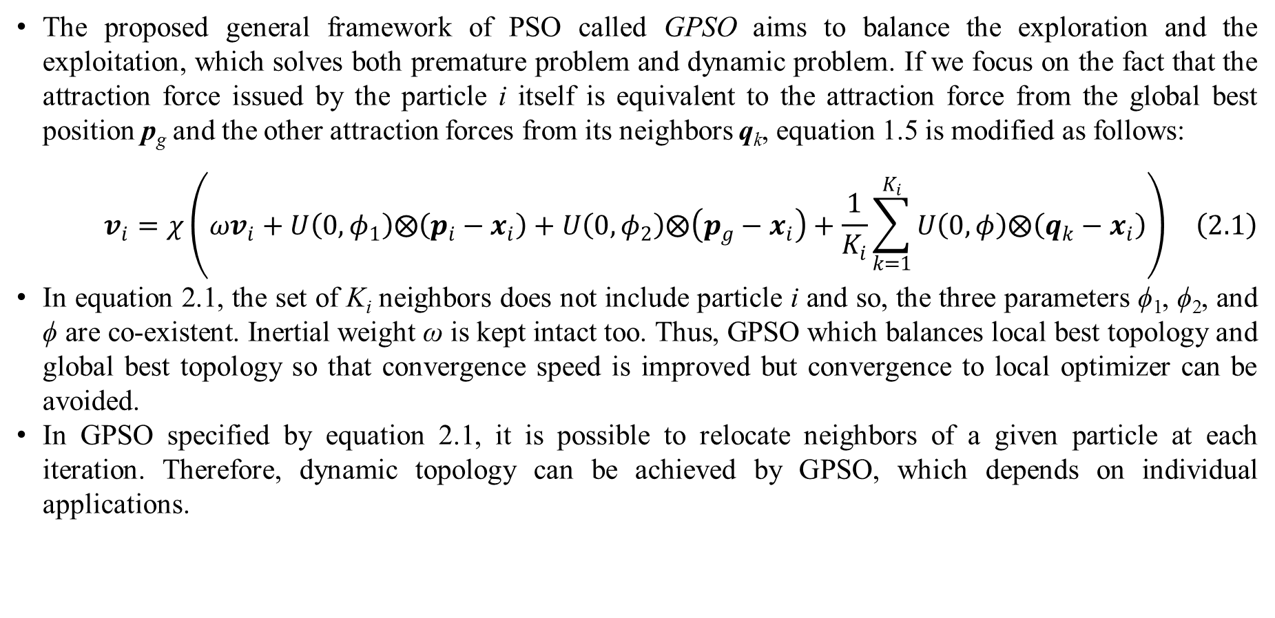
2. GPSO with probabilistic constriction
The proposed general framework of PSO called GPSO aims to balance the exploration and the exploitation, which solves both premature problem and dynamic problem. If we focus on the fact that the attraction force issued by the particle i itself is equivalent to the attraction force from the global best position p_{g} and the other attraction forces from its neighbors q_{k}, equation 1.5 is modified as follows:
$$v_{i}=χ\left(ωv_{i}+U\left(0,φ_{1}\right)⨂\left(p_{i}−x_{i}\right)+U\left(0,φ_{2}\right)⨂\left(p_{g}−x_{i}\right)+\frac{1}{K_{i}}\sum_{k=1}^{K_{i}}{U\left(0,φ\right)⨂\left(q_{k}−x_{i}\right)}\right) \left(2.1\right)$$
In equation 2.1, the set of K_{i} neighbors does not include particle i and so, the three parameters ϕ₁, ϕ₂, and ϕ are co-existent. Inertial weight ω is kept intact too. Thus, GPSO which balances local best topology and global best topology so that convergence speed is improved but convergence to local optimizer can be avoided.
In GPSO specified by equation 2.1, it is possible to relocate neighbors of a given particle at each iteration. Therefore, dynamic topology can be achieved by GPSO, which depends on individual applications.
Notes:
Inertial weight and constriction coefficient are common solutions for dynamic problem. Local best topology and dynamic topology are common solutions of premature problem. The topology from equations 1.1, 1.3, 1.4, and 1.5 is static [2, p. 6] because it is kept intact over all iterations.

Slide 15
2. GPSO with probabilistic constriction
In PSO theory, solutions of dynamic problem are to improve the exploitation so that PSO can converge as fast as possible. Inertial weight and constriction coefficient are common solutions for dynamic problem. Hence, constriction coefficient is tuned with GPSO. However, tuning a parameter does not mean that such parameter is modified simply at each iteration because the modification must be solid and based on valuable knowledge.
Fortunately, Kennedy and Eberhart [2, p. 13], [3, p. 3], [4, p. 51] proposed bare bones PSO (BBPSO) in which they asserted that, given x_{i} = (x_{i1}, x_{i2},…, x_{in})^{T}, p_{i} = (p_{i1}, p_{i2},…, p_{in})^{T}, and p_{g} = (p_{g1}, p_{g2},…, p_{gn})^{T}, the j^{th} element x_{ij} of x_{i} follows normal distribution with mean (p_{ij}+p_{gj})/2 and variance (p_{ij}–p_{gj})². Based on this valuable knowledge, I tune constriction parameter χ with normal distribution at each iteration.

Slide 16
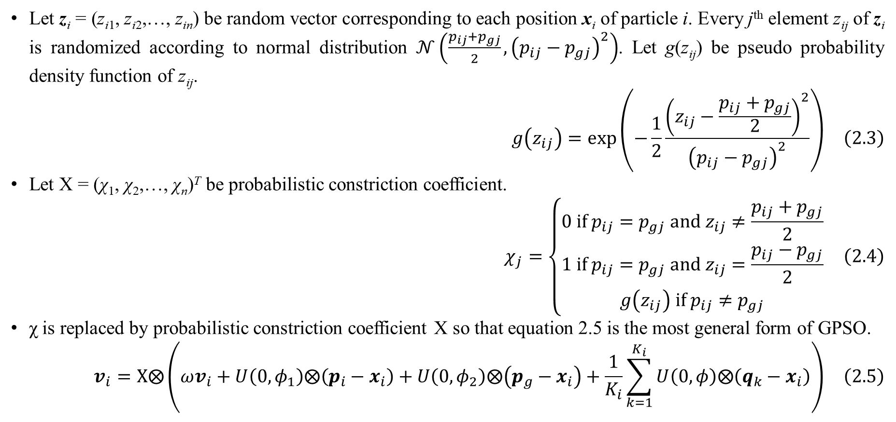
2. GPSO with probabilistic constriction
Let z_{i} = (z_{i1}, z_{i2},…, z_{in}) be random vector corresponding to each position x_{i} of particle i. Every j^{th} element z_{ij} of z_{i} is randomized according to normal distribution $𝒩\left(\frac{p_{ij}+p_{gj}}{2},{\left(p_{ij}−p_{gj}\right)}^{2}\right)$. Let g(z_{ij}) be pseudo probability density function of z_{ij}.
$$g\left(z_{ij}\right)=exp\left(−\frac{1}{2}\frac{{\left(z_{ij}−\frac{p_{ij}+p_{gj}}{2}\right)}^{2}}{{\left(p_{ij}−p_{gj}\right)}^{2}}\right) \left(2.3\right)$$
Let Χ = (χ₁, χ₂,…, χ_{n})^{T} be probabilistic constriction coefficient.
$$χ_{j}=\left\{\begin{matrix}0 if p_{ij}=p_{gj} and z_{ij}≠\frac{p_{ij}+p_{gj}}{2} \\ 1 if p_{ij}=p_{gj} and z_{ij}=\frac{p_{ij}−p_{gj}}{2} \\ g\left(z_{ij}\right) if p_{ij}≠p_{gj}\end{matrix}\right. \left(2.4\right)$$
χ is replaced by probabilistic constriction coefficient Χ so that equation 2.5 is the most general form of GPSO.
$$v_{i}=Χ⨂\left(ωv_{i}+U\left(0,φ_{1}\right)⨂\left(p_{i}−x_{i}\right)+U\left(0,φ_{2}\right)⨂\left(p_{g}−x_{i}\right)+\frac{1}{K_{i}}\sum_{k=1}^{K_{i}}{U\left(0,φ\right)⨂\left(q_{k}−x_{i}\right)}\right) \left(2.5\right)$$

Slide 17
2. GPSO with probabilistic constriction
According to equation 2.5 with probabilistic constriction coefficient Χ, the closer to global best position p_{g} the local best position p_{i} is, the more dynamic the position x_{i} is, which aims to exploration for converging to global optimizer. The farer to global best position p_{g} the local best position p_{i} is, the less dynamic the position p_{i} is, which aims to exploitation for fast convergence. This is purpose of adding probabilistic constriction coefficient Χ to equation 2.1 for solving dynamic problem.
As a convention, GPSO specified by equation 2.5 is called probabilistic GPSO. Source code of GPSO and probabilistic GPSO is available at
https://github.com/ngphloc/ai/tree/main/3_implementation/src/net/ea/pso

Slide 18
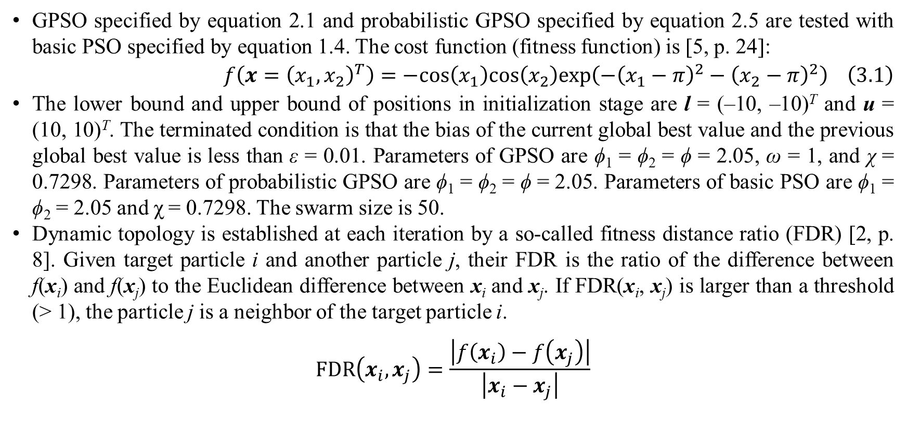
3. Experimental results
GPSO specified by equation 2.1 and probabilistic GPSO specified by equation 2.5 are tested with basic PSO specified by equation 1.4. The cost function (fitness function) is [5, p. 24]:
$$f\left(x={\left(x_{1},x_{2}\right)}^{T}\right)=−cos\left(x_{1}\right)cos\left(x_{2}\right)exp\left(−{\left(x_{1}−π\right)}^{2}−{\left(x_{2}−π\right)}^{2}\right) \left(3.1\right)$$
The lower bound and upper bound of positions in initialization stage are l = (–10, –10)^{T} and u = (10, 10)^{T}. The terminated condition is that the bias of the current global best value and the previous global best value is less than ε = 0.01. Parameters of GPSO are ϕ₁ = ϕ₂ = ϕ = 2.05, ω = 1, and χ = 0.7298. Parameters of probabilistic GPSO are ϕ₁ = ϕ₂ = ϕ = 2.05. Parameters of basic PSO are ϕ₁ = ϕ₂ = 2.05 and χ = 0.7298. The swarm size is 50.
Dynamic topology is established at each iteration by a so-called fitness distance ratio (FDR) [2, p. 8]. Given target particle i and another particle j, their FDR is the ratio of the difference between f(x_{i}) and f(x_{j}) to the Euclidean difference between x_{i} and x_{j}. If FDR(x_{i}, x_{j}) is larger than a threshold (> 1), the particle j is a neighbor of the target particle i.
$$FDR\left(x_{i},x_{j}\right)=\frac{\left|f\left(x_{i}\right)−f\left(x_{j}\right)\right|}{\left|x_{i}−x_{j}\right|}$$

Slide 19
3. Experimental results
The true best value of the target function specified by equation 3.1 is –1 and its true global optimizer is x* = (3.1416, 3.1416)^{T}. From the experiment, basic PSO, GPSO, and probabilistic GPSO converge to best values –0.9842, –0.9973, and –0.9999 with global best positions (3.0421, 3.1151)^{T}, (3.1837, 3.1352)^{T}, and (3.1464, 3.1485)^{T} after 6, 18, and 18 iterations, respectively.
Fitness bias and optimizer bias of probabilistic PSO are smallest. Therefore, probabilistic PSO is the preeminent one. Basic PSO converges soonest after 6 iterations but basic PSO copes with the premature problem due to lowest converged fitness value whereas both GPSO and probabilistic GPSO solve the premature problem with better converged fitness values (–0.9973 and –0.9999) but they require more iterations (18). The reason that GPSO is better than basic PSO is combination of local best topology and global best topology in GPSO. The event that probabilistic GPSO is better than GPSO proves that the probabilistic constriction coefficient can solve the dynamic problem.
 | Fitness bias | Optimizer bias | Converged iteration
Basic PSO | 0.0158 | (0.0995, 0.0265)^{T} | 6
GPSO | 0.0027 | (0.0421, 0.0064)^{T} | 18
Probabilistic GPSO | 0.0001 | (0.0048, 0.0069)^{T} | 18

Slide 20
3. Experimental results
About fitness bias, probabilistic GPSO is 27 times better than normal GPSO, which implies that the exploitation is as important as the exploration. In some situations where there are many local optimizers, reaching a good enough local optimizer can be acceptable and more feasible than reaching the global optimizer absolutely. Practical PSO attracts researchers’ attention because it solves the complexity problem of pure mathematics in global optimization which gets stuck in how to find assuredly the global optimizer. Therefore, that the probabilistic GPSO improves convergence speed is meaningful.
Moreover, it does not restrict the dynamics of particles. Indeed, it keeps the dynamics of particles towards optimal trends with support of probabilistic distribution. Thus, it also balances two PSO properties such as exploration and exploitation.

Slide 21
4. Conclusions
The first purpose of GPSO which is to aggregate important parameters and to generalize important variants is completed with the general form of velocity update rule but the second purpose which is to balance the two PSO properties such as exploration and exploitation is reached at moderate rate although experimental results showed that GPSO and probabilistic GPSO are better than basic PSO due to combination of local best topology and global best topology along with definition of probabilistic constriction coefficient which proved improvement of global convergence. The reason of balance at moderate rate is that dynamic topology in GPSO is supported indirectly via general form of velocity update rule, which is impractical because researchers must modify source code of GPSO in order to define dynamic topology.
Moreover, premature problem is solved by many other solutions such as dynamic topology, change of fitness function, adaptation (tuning coefficients, adding particles, removing particles, changing particle properties), and diversity control over iterations. In future trend, I will implement dynamic solutions with support of other evolutionary algorithms like artificial bee colony algorithm and genetic algorithm. Moreover, I will research how to apply PSO into learning neural network..

Slide 22
References
Wikipedia, "Particle swarm optimization," Wikimedia Foundation, 7 March 2017. [Online]. Available: https://en.wikipedia.org/wiki/Particle_swarm_optimization. [Accessed 8 April 2017].
R. Poli, J. Kennedy and T. Blackwell, "Particle swarm optimization," Swarm Intelligence, vol. 1, no. 1, pp. 33-57, June 2007.
F. Pan, X. Hu, R. Eberhart and Y. Chen, "An Analysis of Bare Bones Particle Swarm," in IEEE Swarm Intelligence Symposium 2008 (SIS 2008), St. Louis, MO, US, 2008.
M. M. al-Rifaie and T. Blackwell, "Bare Bones Particle Swarms with Jumps," in International Conference on Swarm Intelligence, Brussels, 2012.
K. Sharma, V. Chhamunya, P. C. Gupta, H. Sharma and J. C. Bansal, "Fitness based Particle Swarm Optimization," International Journal of System Assurance Engineering and Management, vol. 6, no. 3, pp. 319-329, September 2015.

Slide 23
Thank you for attention

