Slide 1
Tutorial on EM algorithm – Part 4
Prof. Dr. Loc Nguyen, PhD, PostDoc
Founder of Loc Nguyen’s Academic Network, Vietnam
Email: ng_phloc@yahoo.com
Homepage: www.locnguyen.net

Slide 2
Abstract
This is chapter 4 “Variants of EM algorithm” in my book “Tutorial on EM algorithm”, which focuses on EM variants. The main purpose of expectation maximization (EM) algorithm, also GEM algorithm, is to maximize the log-likelihood L(Θ) = log(g(Y|Θ)) with observed data Y by maximizing the conditional expectation Q(Θ’|Θ). Such Q(Θ’|Θ) is defined fixedly in E-step. Therefore, most variants of EM algorithm focus on how to maximize Q(Θ’|Θ) in M-step more effectively so that EM is faster or more accurate.

Slide 3
Table of contents
EM with prior probability
EM with Newton-Raphson method
EM with Aitken acceleration
ECM algorithm

Slide 4
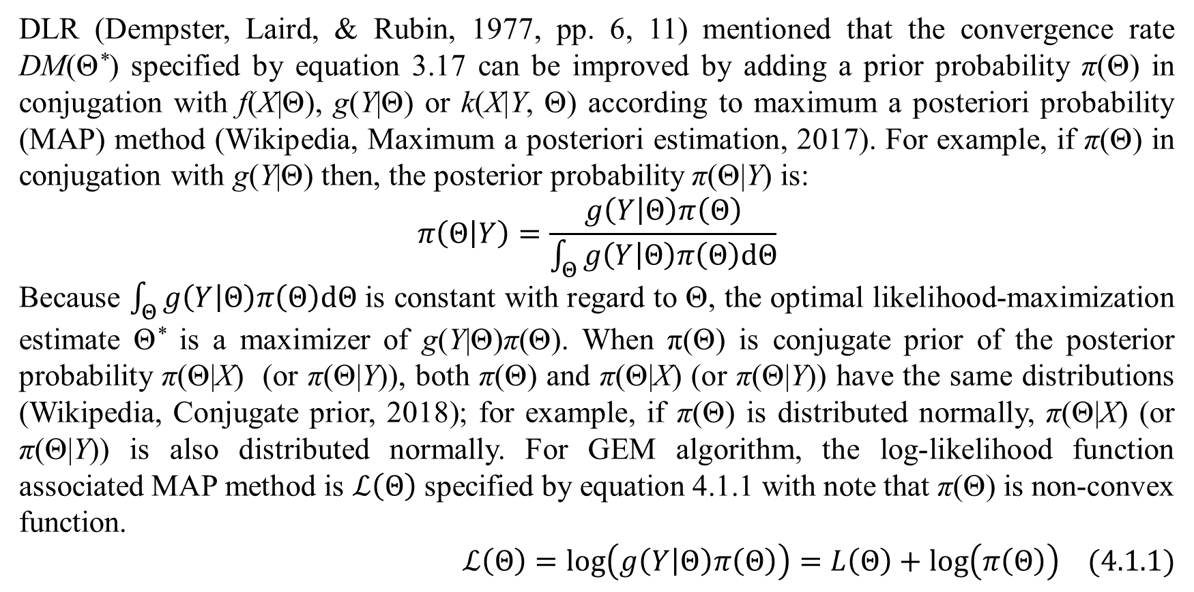
1. EM with prior probability
DLR (Dempster, Laird, & Rubin, 1977, pp. 6, 11) mentioned that the convergence rate DM(Θ*) specified by equation 3.17 can be improved by adding a prior probability π(Θ) in conjugation with f(X|Θ), g(Y|Θ) or k(X|Y, Θ) according to maximum a posteriori probability (MAP) method (Wikipedia, Maximum a posteriori estimation, 2017). For example, if π(Θ) in conjugation with g(Y|Θ) then, the posterior probability π(Θ|Y) is:
$$π\left(Θ | Y\right)=\frac{g\left(Y | Θ\right)π\left(Θ\right)}{\int_{Θ}{g\left(Y | Θ\right)π\left(Θ\right)dΘ}}$$
Because $\int_{Θ}{g\left(Y | Θ\right)π\left(Θ\right)dΘ}$ is constant with regard to Θ, the optimal likelihood-maximization estimate Θ* is a maximizer of g(Y|Θ)π(Θ). When π(Θ) is conjugate prior of the posterior probability π(Θ|X) (or π(Θ|Y)), both π(Θ) and π(Θ|X) (or π(Θ|Y)) have the same distributions (Wikipedia, Conjugate prior, 2018); for example, if π(Θ) is distributed normally, π(Θ|X) (or π(Θ|Y)) is also distributed normally. For GEM algorithm, the log-likelihood function associated MAP method is $ℒ\left(Θ\right)$ specified by equation 4.1.1 with note that π(Θ) is non-convex function.
$$ℒ\left(Θ\right)=log\left(g\left(Y | Θ\right)π\left(Θ\right)\right)=L\left(Θ\right)+log\left(π\left(Θ\right)\right) (4.1.1)$$

Slide 5
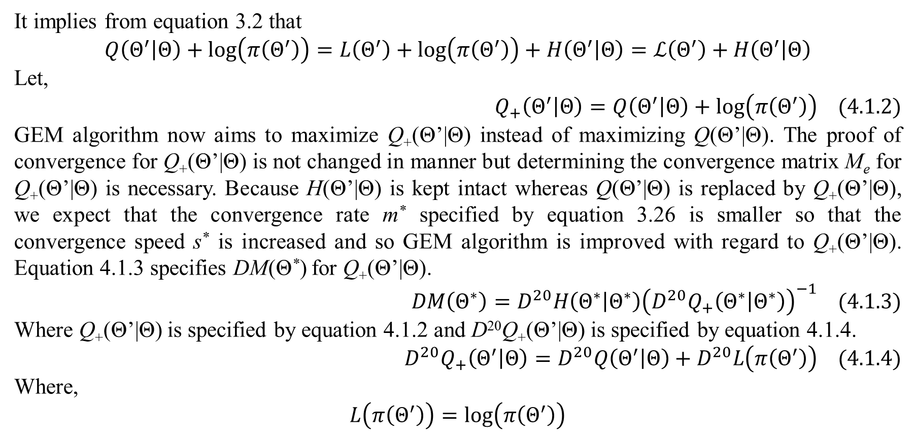
1. EM with prior probability
It implies from equation 3.2 that
$$Q\left(Θ^{′} | Θ\right)+log\left(π\left(Θ^{′}\right)\right)=L\left(Θ^{′}\right)+log\left(π\left(Θ^{′}\right)\right)+H\left(Θ^{′} | Θ\right)=ℒ\left(Θ^{′}\right)+H\left(Θ^{′} | Θ\right)$$
Let,
$$Q_{+}\left(Θ^{′} | Θ\right)=Q\left(Θ^{′} | Θ\right)+log\left(π\left(Θ^{′}\right)\right) (4.1.2)$$
GEM algorithm now aims to maximize Q₊(Θ’|Θ) instead of maximizing Q(Θ’|Θ). The proof of convergence for Q₊(Θ’|Θ) is not changed in manner but determining the convergence matrix M_{e} for Q₊(Θ’|Θ) is necessary. Because H(Θ’|Θ) is kept intact whereas Q(Θ’|Θ) is replaced by Q₊(Θ’|Θ), we expect that the convergence rate m* specified by equation 3.26 is smaller so that the convergence speed s* is increased and so GEM algorithm is improved with regard to Q₊(Θ’|Θ). Equation 4.1.3 specifies DM(Θ*) for Q₊(Θ’|Θ).
$$DM\left(Θ^{∗}\right)=D^{20}H\left(Θ^{∗} | Θ^{∗}\right){\left(D^{20}Q_{+}\left(Θ^{∗} | Θ^{∗}\right)\right)}^{−1} (4.1.3)$$
Where Q₊(Θ’|Θ) is specified by equation 4.1.2 and D²⁰Q₊(Θ’|Θ) is specified by equation 4.1.4.
$$D^{20}Q_{+}\left(Θ^{′} | Θ\right)=D^{20}Q\left(Θ^{′} | Θ\right)+D^{20}L\left(π\left(Θ^{′}\right)\right) (4.1.4)$$
Where,
$$L\left(π\left(Θ^{′}\right)\right)=log\left(π\left(Θ^{′}\right)\right)$$

Slide 6
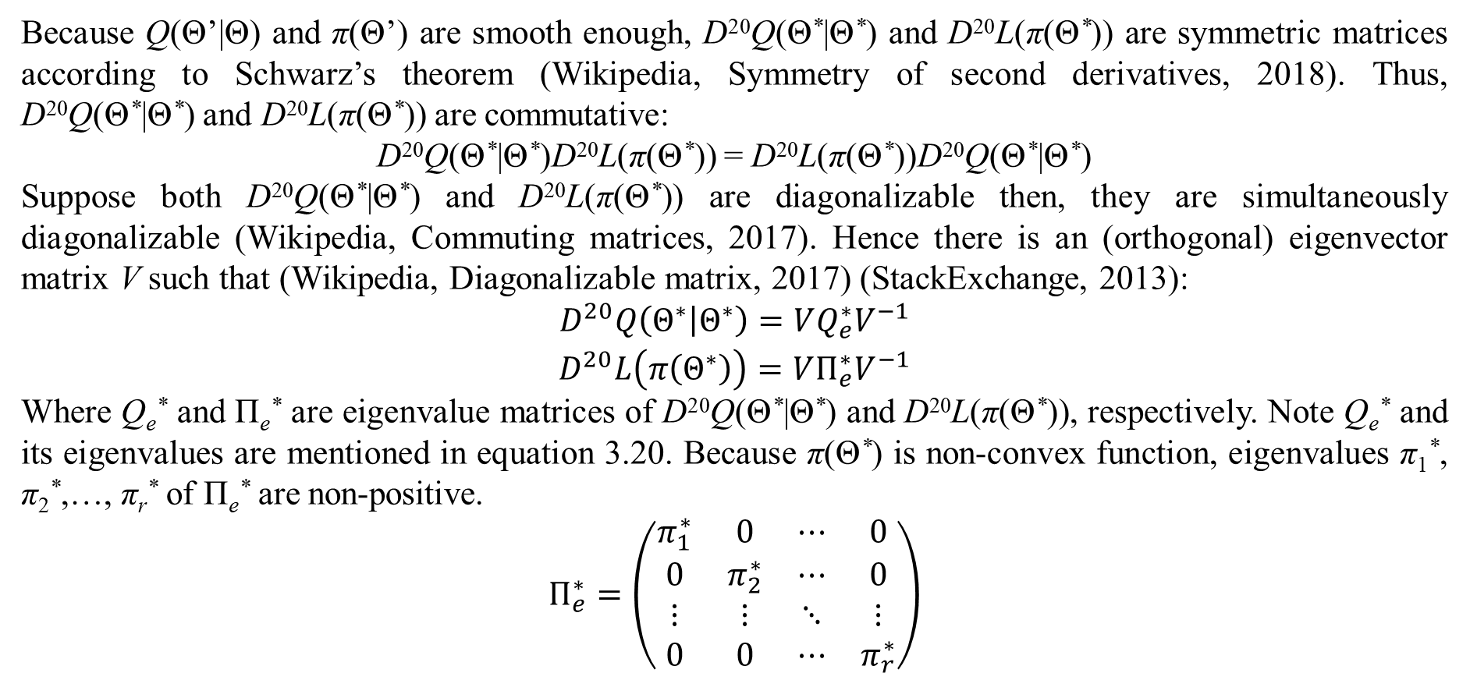
1. EM with prior probability
Because Q(Θ’|Θ) and π(Θ’) are smooth enough, D²⁰Q(Θ*|Θ*) and D²⁰L(π(Θ*)) are symmetric matrices according to Schwarz’s theorem (Wikipedia, Symmetry of second derivatives, 2018). Thus, D²⁰Q(Θ*|Θ*) and D²⁰L(π(Θ*)) are commutative:
D²⁰Q(Θ*|Θ*)D²⁰L(π(Θ*)) = D²⁰L(π(Θ*))D²⁰Q(Θ*|Θ*)
Suppose both D²⁰Q(Θ*|Θ*) and D²⁰L(π(Θ*)) are diagonalizable then, they are simultaneously diagonalizable (Wikipedia, Commuting matrices, 2017). Hence there is an (orthogonal) eigenvector matrix V such that (Wikipedia, Diagonalizable matrix, 2017) (StackExchange, 2013):
$$\begin{matrix}D^{20}Q\left(Θ^{∗} | Θ^{∗}\right)=VQ_{e}^{∗}V^{−1} \\ D^{20}L\left(π\left(Θ^{∗}\right)\right)=VΠ_{e}^{∗}V^{−1}\end{matrix}$$
Where Q_{e}* and Π_{e}* are eigenvalue matrices of D²⁰Q(Θ*|Θ*) and D²⁰L(π(Θ*)), respectively. Note Q_{e}* and its eigenvalues are mentioned in equation 3.20. Because π(Θ*) is non-convex function, eigenvalues π₁*, π₂*,…, π_{r}* of Π_{e}* are non-positive.
$$Π_{e}^{∗}=\left(\begin{matrix}π_{1}^{∗} & 0 & ⋯ & 0 \\ 0 & π_{2}^{∗} & ⋯ & 0 \\ ⋮ & ⋮ & ⋱ & ⋮ \\ 0 & 0 & ⋯ & π_{r}^{∗}\end{matrix}\right)$$

Slide 7
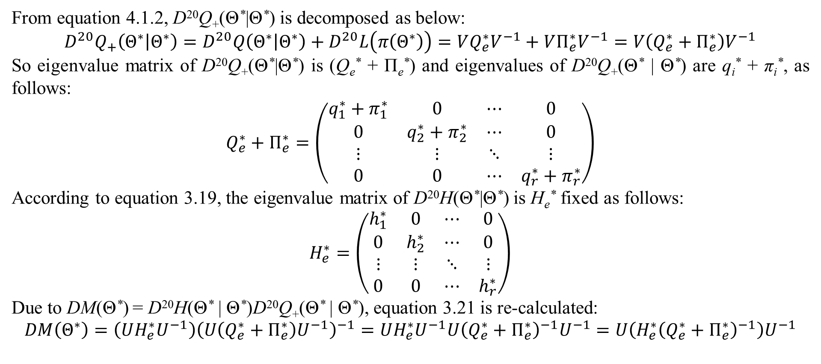
1. EM with prior probability
From equation 4.1.2, D²⁰Q₊(Θ*|Θ*) is decomposed as below:
$$D^{20}Q_{+}\left(Θ^{∗} | Θ^{∗}\right)=D^{20}Q\left(Θ^{∗} | Θ^{∗}\right)+D^{20}L\left(π\left(Θ^{∗}\right)\right)=VQ_{e}^{∗}V^{−1}+VΠ_{e}^{∗}V^{−1}=V\left(Q_{e}^{∗}+Π_{e}^{∗}\right)V^{−1}$$
So eigenvalue matrix of D²⁰Q₊(Θ*|Θ*) is (Q_{e}* + Π_{e}*) and eigenvalues of D²⁰Q₊(Θ* | Θ*) are q_{i}* + π_{i}*, as follows:
$$Q_{e}^{∗}+Π_{e}^{∗}=\left(\begin{matrix}q_{1}^{∗}+π_{1}^{∗} & 0 & ⋯ & 0 \\ 0 & q_{2}^{∗}+π_{2}^{∗} & ⋯ & 0 \\ ⋮ & ⋮ & ⋱ & ⋮ \\ 0 & 0 & ⋯ & q_{r}^{∗}+π_{r}^{∗}\end{matrix}\right)$$
According to equation 3.19, the eigenvalue matrix of D²⁰H(Θ*|Θ*) is H_{e}* fixed as follows:
$$H_{e}^{∗}=\left(\begin{matrix}h_{1}^{∗} & 0 & ⋯ & 0 \\ 0 & h_{2}^{∗} & ⋯ & 0 \\ ⋮ & ⋮ & ⋱ & ⋮ \\ 0 & 0 & ⋯ & h_{r}^{∗}\end{matrix}\right)$$
Due to DM(Θ*) = D²⁰H(Θ* | Θ*)D²⁰Q₊(Θ* | Θ*), equation 3.21 is re-calculated:
$$DM\left(Θ^{∗}\right)=\left(UH_{e}^{∗}U^{−1}\right){\left(U\left(Q_{e}^{∗}+Π_{e}^{∗}\right)U^{−1}\right)}^{−1}=UH_{e}^{∗}U^{−1}U{\left(Q_{e}^{∗}+Π_{e}^{∗}\right)}^{−1}U^{−1}=U\left(H_{e}^{∗}{\left(Q_{e}^{∗}+Π_{e}^{∗}\right)}^{−1}\right)U^{−1}$$

Slide 8
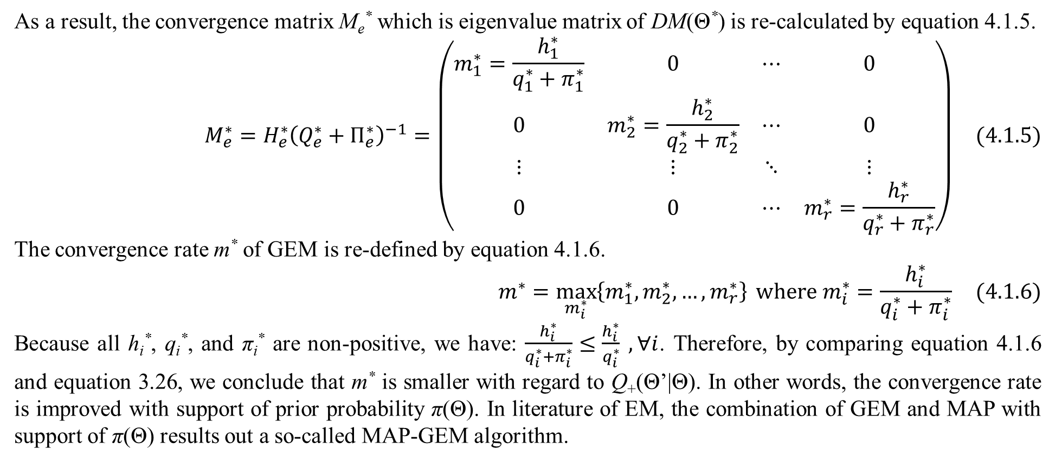
1. EM with prior probability
As a result, the convergence matrix M_{e}* which is eigenvalue matrix of DM(Θ*) is re-calculated by equation 4.1.5.
$$M_{e}^{∗}=H_{e}^{∗}{\left(Q_{e}^{∗}+Π_{e}^{∗}\right)}^{−1}=\left(\begin{matrix}m_{1}^{∗}=\frac{h_{1}^{∗}}{q_{1}^{∗}+π_{1}^{∗}} & 0 & ⋯ & 0 \\ 0 & m_{2}^{∗}=\frac{h_{2}^{∗}}{q_{2}^{∗}+π_{2}^{∗}} & ⋯ & 0 \\ ⋮ & ⋮ & ⋱ & ⋮ \\ 0 & 0 & ⋯ & m_{r}^{∗}=\frac{h_{r}^{∗}}{q_{r}^{∗}+π_{r}^{∗}}\end{matrix}\right) (4.1.5)$$
The convergence rate m* of GEM is re-defined by equation 4.1.6.
$$m^{∗}=\max_{m_{i}^{∗}}\left\{m_{1}^{∗},m_{2}^{∗},…,m_{r}^{∗}\right\} where m_{i}^{∗}=\frac{h_{i}^{∗}}{q_{i}^{∗}+π_{i}^{∗}} (4.1.6)$$
Because all h_{i}*, q_{i}*, and π_{i}* are non-positive, we have: $\frac{h_{i}^{∗}}{q_{i}^{∗}+π_{i}^{∗}}≤\frac{h_{i}^{∗}}{q_{i}^{∗}} ,∀i$. Therefore, by comparing equation 4.1.6 and equation 3.26, we conclude that m* is smaller with regard to Q₊(Θ’|Θ). In other words, the convergence rate is improved with support of prior probability π(Θ). In literature of EM, the combination of GEM and MAP with support of π(Θ) results out a so-called MAP-GEM algorithm.

Slide 9
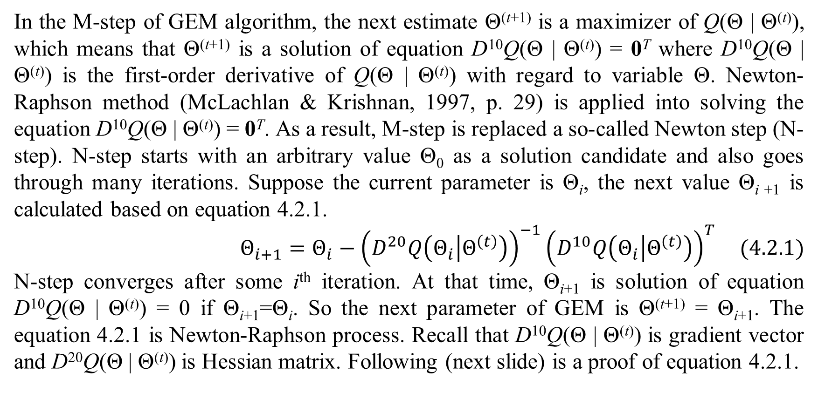
2. EM with Newton-Raphson method
In the M-step of GEM algorithm, the next estimate Θ^{(t+1)} is a maximizer of Q(Θ | Θ^{(t)}), which means that Θ^{(t+1)} is a solution of equation D¹⁰Q(Θ | Θ^{(t)}) = 0^{T} where D¹⁰Q(Θ | Θ^{(t)}) is the first-order derivative of Q(Θ | Θ^{(t)}) with regard to variable Θ. Newton-Raphson method (McLachlan & Krishnan, 1997, p. 29) is applied into solving the equation D¹⁰Q(Θ | Θ^{(t)}) = 0^{T}. As a result, M-step is replaced a so-called Newton step (N-step). N-step starts with an arbitrary value Θ₀ as a solution candidate and also goes through many iterations. Suppose the current parameter is Θ_{i}, the next value Θ_{i +1} is calculated based on equation 4.2.1.
$$Θ_{i+1}=Θ_{i}−{\left(D^{20}Q\left(Θ_{i} | Θ^{\left(t\right)}\right)\right)}^{−1}{\left(D^{10}Q\left(Θ_{i} | Θ^{\left(t\right)}\right)\right)}^{T} (4.2.1)$$
N-step converges after some i^{th} iteration. At that time, Θ_{i+1} is solution of equation D¹⁰Q(Θ | Θ^{(t)}) = 0 if Θ_{i+1}=Θ_{i}. So the next parameter of GEM is Θ^{(t+1)} = Θ_{i+1}. The equation 4.2.1 is Newton-Raphson process. Recall that D¹⁰Q(Θ | Θ^{(t)}) is gradient vector and D²⁰Q(Θ | Θ^{(t)}) is Hessian matrix. Following (next slide) is a proof of equation 4.2.1.

Slide 10
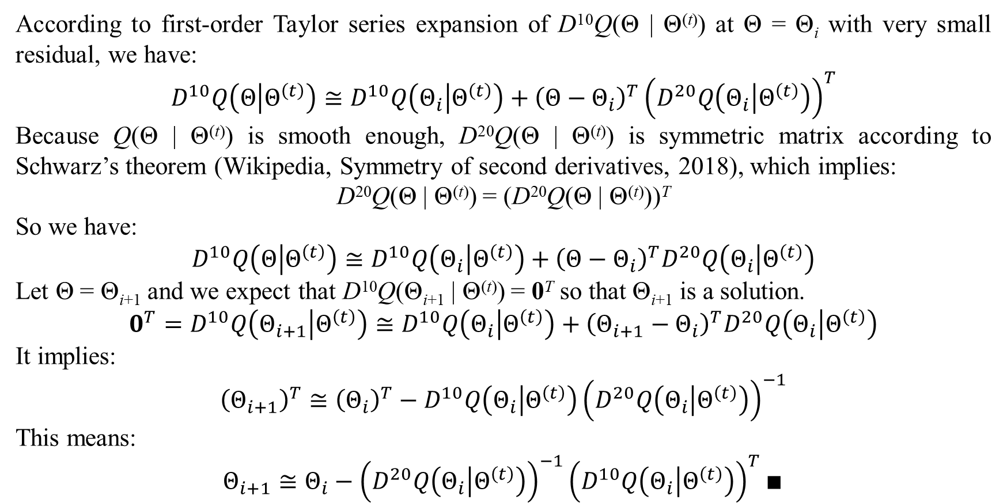
2. EM with Newton-Raphson method
According to first-order Taylor series expansion of D¹⁰Q(Θ | Θ^{(t)}) at Θ = Θ_{i} with very small residual, we have:
$$D^{10}Q\left(Θ | Θ^{\left(t\right)}\right)≅D^{10}Q\left(Θ_{i} | Θ^{\left(t\right)}\right)+{\left(Θ−Θ_{i}\right)}^{T}{\left(D^{20}Q\left(Θ_{i} | Θ^{\left(t\right)}\right)\right)}^{T}$$
Because Q(Θ | Θ^{(t)}) is smooth enough, D²⁰Q(Θ | Θ^{(t)}) is symmetric matrix according to Schwarz’s theorem (Wikipedia, Symmetry of second derivatives, 2018), which implies:
D²⁰Q(Θ | Θ^{(t)}) = (D²⁰Q(Θ | Θ^{(t)}))^{T}
So we have:
$$D^{10}Q\left(Θ | Θ^{\left(t\right)}\right)≅D^{10}Q\left(Θ_{i} | Θ^{\left(t\right)}\right)+{\left(Θ−Θ_{i}\right)}^{T}D^{20}Q\left(Θ_{i} | Θ^{\left(t\right)}\right)$$
Let Θ = Θ_{i+1} and we expect that D¹⁰Q(Θ_{i+1} | Θ^{(t)}) = 0^{T} so that Θ_{i+1} is a solution.
$$0^{T}=D^{10}Q\left(Θ_{i+1} | Θ^{\left(t\right)}\right)≅D^{10}Q\left(Θ_{i} | Θ^{\left(t\right)}\right)+{\left(Θ_{i+1}−Θ_{i}\right)}^{T}D^{20}Q\left(Θ_{i} | Θ^{\left(t\right)}\right)$$
It implies:
$${\left(Θ_{i+1}\right)}^{T}≅{\left(Θ_{i}\right)}^{T}−D^{10}Q\left(Θ_{i} | Θ^{\left(t\right)}\right){\left(D^{20}Q\left(Θ_{i} | Θ^{\left(t\right)}\right)\right)}^{−1}$$
This means:
$$Θ_{i+1}≅Θ_{i}−{\left(D^{20}Q\left(Θ_{i} | Θ^{\left(t\right)}\right)\right)}^{−1}{\left(D^{10}Q\left(Θ_{i} | Θ^{\left(t\right)}\right)\right)}^{T}∎$$

Slide 11
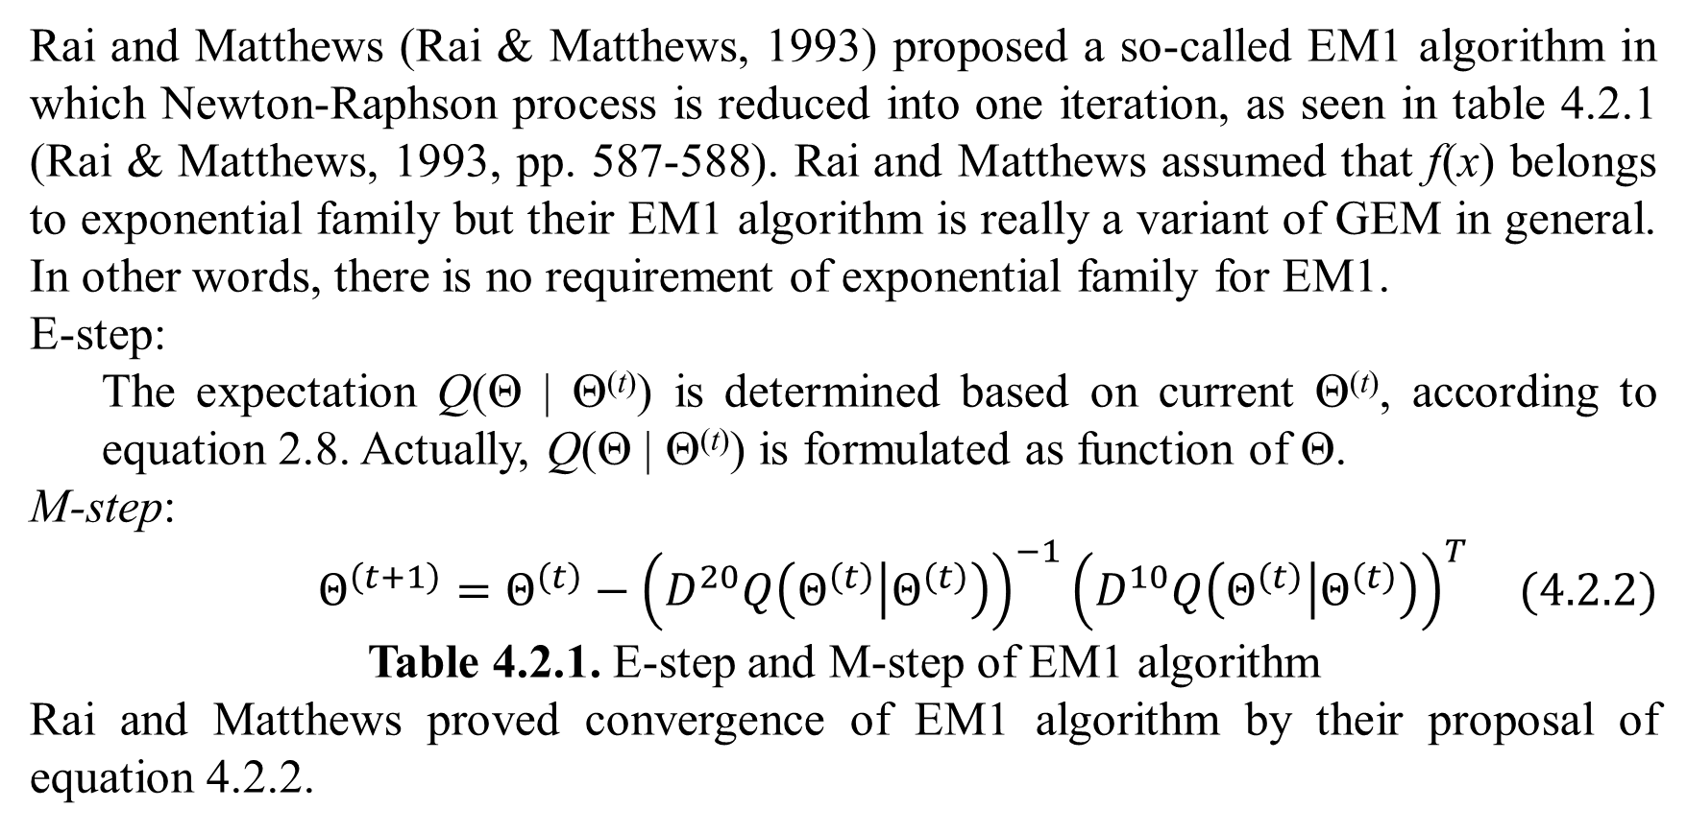
2. EM with Newton-Raphson method
Rai and Matthews (Rai & Matthews, 1993) proposed a so-called EM1 algorithm in which Newton-Raphson process is reduced into one iteration, as seen in table 4.2.1 (Rai & Matthews, 1993, pp. 587-588). Rai and Matthews assumed that f(x) belongs to exponential family but their EM1 algorithm is really a variant of GEM in general. In other words, there is no requirement of exponential family for EM1.
E-step:
The expectation Q(Θ | Θ^{(t)}) is determined based on current Θ^{(t)}, according to equation 2.8. Actually, Q(Θ | Θ^{(t)}) is formulated as function of Θ.
M-step:
$$Θ^{\left(t+1\right)}=Θ^{\left(t\right)}−{\left(D^{20}Q\left(Θ^{\left(t\right)} | Θ^{\left(t\right)}\right)\right)}^{−1}{\left(D^{10}Q\left(Θ^{\left(t\right)} | Θ^{\left(t\right)}\right)\right)}^{T} (4.2.2)$$
Table 4.2.1. E-step and M-step of EM1 algorithm
Rai and Matthews proved convergence of EM1 algorithm by their proposal of equation 4.2.2.

Slide 12
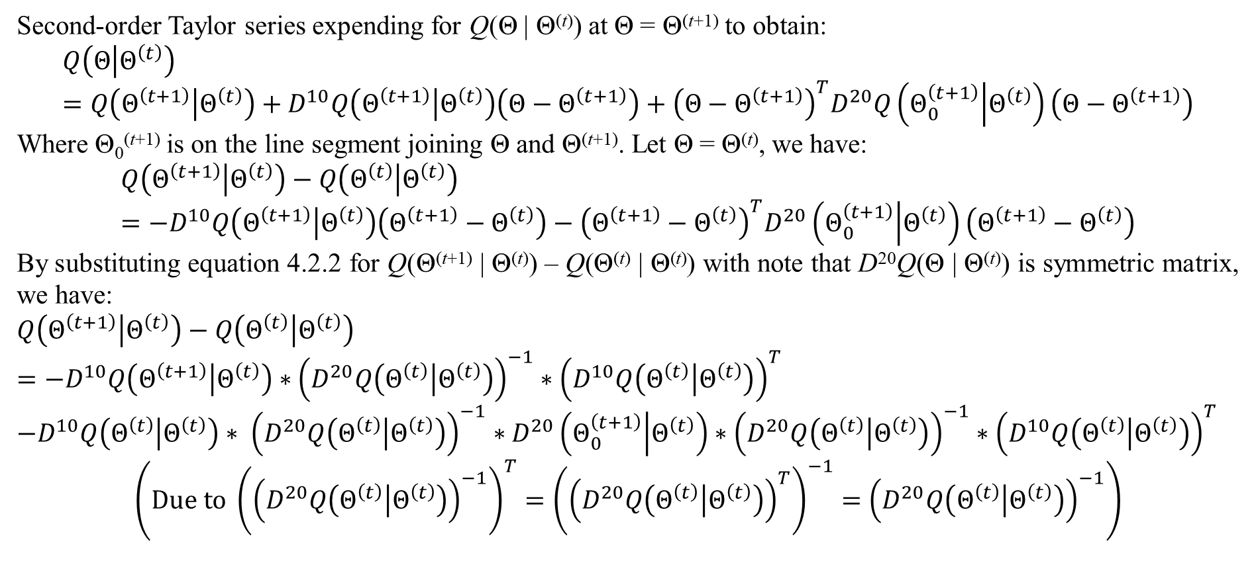
2. EM with Newton-Raphson method
Second-order Taylor series expending for Q(Θ | Θ^{(t)}) at Θ = Θ^{(t+1)} to obtain:
$$Q\left(Θ | Θ^{\left(t\right)}\right)=Q\left(Θ^{\left(t+1\right)} | Θ^{\left(t\right)}\right)+D^{10}Q\left(Θ^{\left(t+1\right)} | Θ^{\left(t\right)}\right)\left(Θ−Θ^{\left(t+1\right)}\right)+{\left(Θ−Θ^{\left(t+1\right)}\right)}^{T}D^{20}Q\left(Θ_{0}^{\left(t+1\right)} | Θ^{\left(t\right)}\right)\left(Θ−Θ^{\left(t+1\right)}\right)$$
Where Θ₀^{(t+1)} is on the line segment joining Θ and Θ^{(t+1)}. Let Θ = Θ^{(t)}, we have:
$$Q\left(Θ^{\left(t+1\right)} | Θ^{\left(t\right)}\right)−Q\left(Θ^{\left(t\right)} | Θ^{\left(t\right)}\right)=−D^{10}Q\left(Θ^{\left(t+1\right)} | Θ^{\left(t\right)}\right)\left(Θ^{\left(t+1\right)}−Θ^{\left(t\right)}\right)−{\left(Θ^{\left(t+1\right)}−Θ^{\left(t\right)}\right)}^{T}D^{20}\left(Θ_{0}^{\left(t+1\right)} | Θ^{\left(t\right)}\right)\left(Θ^{\left(t+1\right)}−Θ^{\left(t\right)}\right)$$
By substituting equation 4.2.2 for Q(Θ^{(t+1)} | Θ^{(t)}) – Q(Θ^{(t)} | Θ^{(t)}) with note that D²⁰Q(Θ | Θ^{(t)}) is symmetric matrix, we have:
$$Q\left(Θ^{\left(t+1\right)} | Θ^{\left(t\right)}\right)−Q\left(Θ^{\left(t\right)} | Θ^{\left(t\right)}\right)$$
$$=−D^{10}Q\left(Θ^{\left(t+1\right)} | Θ^{\left(t\right)}\right)∗{\left(D^{20}Q\left(Θ^{\left(t\right)} | Θ^{\left(t\right)}\right)\right)}^{−1}∗{\left(D^{10}Q\left(Θ^{\left(t\right)} | Θ^{\left(t\right)}\right)\right)}^{T}$$
$$−D^{10}Q\left(Θ^{\left(t\right)} | Θ^{\left(t\right)}\right)∗ {\left(D^{20}Q\left(Θ^{\left(t\right)} | Θ^{\left(t\right)}\right)\right)}^{−1}∗D^{20}\left(Θ_{0}^{\left(t+1\right)} | Θ^{\left(t\right)}\right)∗{\left(D^{20}Q\left(Θ^{\left(t\right)} | Θ^{\left(t\right)}\right)\right)}^{−1}∗{\left(D^{10}Q\left(Θ^{\left(t\right)} | Θ^{\left(t\right)}\right)\right)}^{T}$$
$$\left(Due to {\left({\left(D^{20}Q\left(Θ^{\left(t\right)} | Θ^{\left(t\right)}\right)\right)}^{−1}\right)}^{T}={\left({\left(D^{20}Q\left(Θ^{\left(t\right)} | Θ^{\left(t\right)}\right)\right)}^{T}\right)}^{−1}={\left(D^{20}Q\left(Θ^{\left(t\right)} | Θ^{\left(t\right)}\right)\right)}^{−1}\right)$$

Slide 13
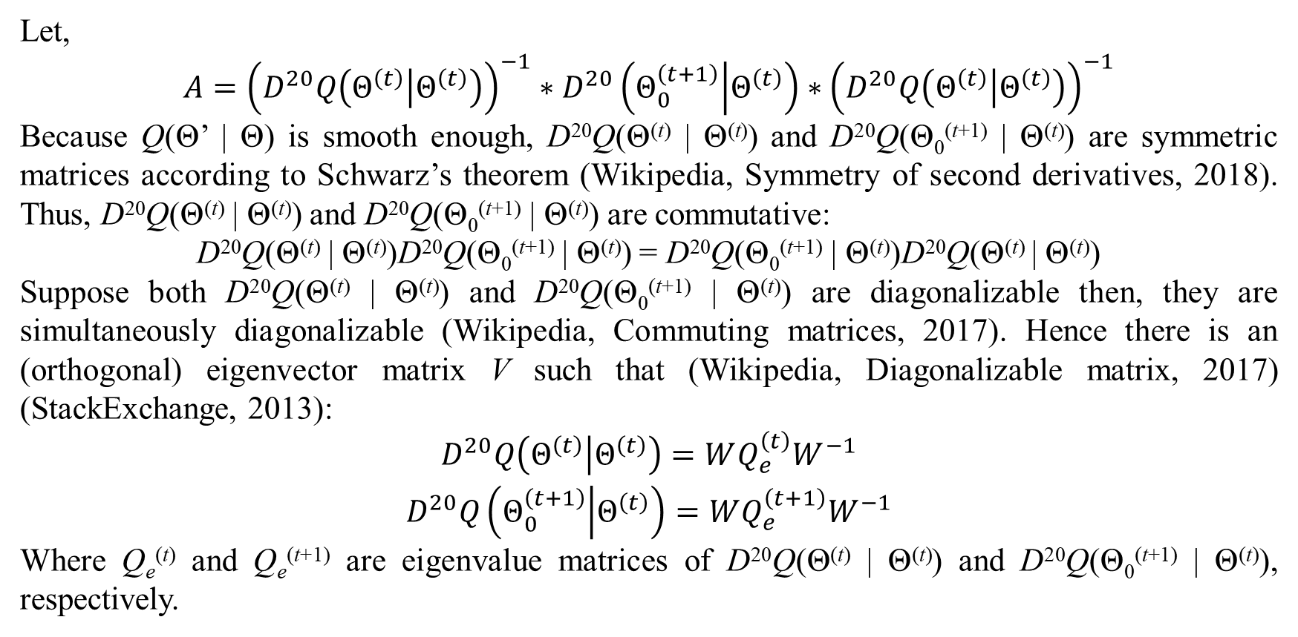
2. EM with Newton-Raphson method
Let,
$$A={\left(D^{20}Q\left(Θ^{\left(t\right)} | Θ^{\left(t\right)}\right)\right)}^{−1}∗D^{20}\left(Θ_{0}^{\left(t+1\right)} | Θ^{\left(t\right)}\right)∗{\left(D^{20}Q\left(Θ^{\left(t\right)} | Θ^{\left(t\right)}\right)\right)}^{−1}$$
Because Q(Θ’ | Θ) is smooth enough, D²⁰Q(Θ^{(t)} | Θ^{(t)}) and D²⁰Q(Θ₀^{(t+1)} | Θ^{(t)}) are symmetric matrices according to Schwarz’s theorem (Wikipedia, Symmetry of second derivatives, 2018). Thus, D²⁰Q(Θ^{(t)} | Θ^{(t)}) and D²⁰Q(Θ₀^{(t+1)} | Θ^{(t)}) are commutative:
D²⁰Q(Θ^{(t)} | Θ^{(t)})D²⁰Q(Θ₀^{(t+1)} | Θ^{(t)}) = D²⁰Q(Θ₀^{(t+1)} | Θ^{(t)})D²⁰Q(Θ^{(t)} | Θ^{(t)})
Suppose both D²⁰Q(Θ^{(t)} | Θ^{(t)}) and D²⁰Q(Θ₀^{(t+1)} | Θ^{(t)}) are diagonalizable then, they are simultaneously diagonalizable (Wikipedia, Commuting matrices, 2017). Hence there is an (orthogonal) eigenvector matrix V such that (Wikipedia, Diagonalizable matrix, 2017) (StackExchange, 2013):
$$\begin{matrix}D^{20}Q\left(Θ^{\left(t\right)} | Θ^{\left(t\right)}\right)=WQ_{e}^{\left(t\right)}W^{−1} \\ D^{20}Q\left(Θ_{0}^{\left(t+1\right)} | Θ^{\left(t\right)}\right)=WQ_{e}^{\left(t+1\right)}W^{−1}\end{matrix}$$
Where Q_{e}^{(t)} and Q_{e}^{(t+1)} are eigenvalue matrices of D²⁰Q(Θ^{(t)} | Θ^{(t)}) and D²⁰Q(Θ₀^{(t+1)} | Θ^{(t)}), respectively.

Slide 14
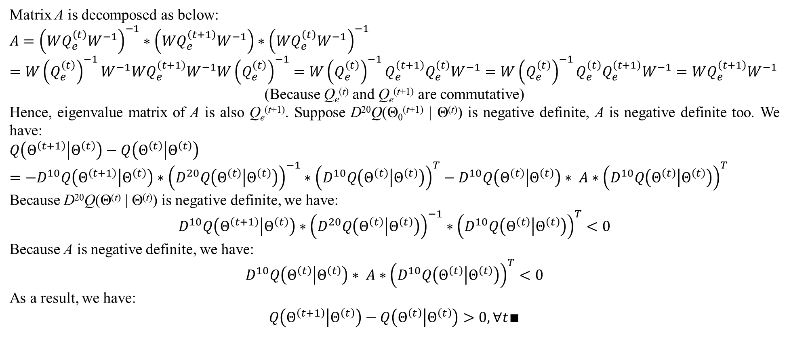
2. EM with Newton-Raphson method
Matrix A is decomposed as below:
$$A={\left(WQ_{e}^{\left(t\right)}W^{−1}\right)}^{−1}∗\left(WQ_{e}^{\left(t+1\right)}W^{−1}\right)∗{\left(WQ_{e}^{\left(t\right)}W^{−1}\right)}^{−1}$$
$$=W{\left(Q_{e}^{\left(t\right)}\right)}^{−1}W^{−1}WQ_{e}^{\left(t+1\right)}W^{−1}W{\left(Q_{e}^{\left(t\right)}\right)}^{−1}=W{\left(Q_{e}^{\left(t\right)}\right)}^{−1}Q_{e}^{\left(t+1\right)}Q_{e}^{\left(t\right)}W^{−1}=W{\left(Q_{e}^{\left(t\right)}\right)}^{−1}Q_{e}^{\left(t\right)}Q_{e}^{\left(t+1\right)}W^{−1}=WQ_{e}^{\left(t+1\right)}W^{−1}$$
(Because Q_{e}^{(t)} and Q_{e}^{(t+1)} are commutative)
Hence, eigenvalue matrix of A is also Q_{e}^{(t+1)}. Suppose D²⁰Q(Θ₀^{(t+1)} | Θ^{(t)}) is negative definite, A is negative definite too. We have:
$$Q\left(Θ^{\left(t+1\right)} | Θ^{\left(t\right)}\right)−Q\left(Θ^{\left(t\right)} | Θ^{\left(t\right)}\right)$$
$$=−D^{10}Q\left(Θ^{\left(t+1\right)} | Θ^{\left(t\right)}\right)∗{\left(D^{20}Q\left(Θ^{\left(t\right)} | Θ^{\left(t\right)}\right)\right)}^{−1}∗{\left(D^{10}Q\left(Θ^{\left(t\right)} | Θ^{\left(t\right)}\right)\right)}^{T}−D^{10}Q\left(Θ^{\left(t\right)} | Θ^{\left(t\right)}\right)∗ A∗{\left(D^{10}Q\left(Θ^{\left(t\right)} | Θ^{\left(t\right)}\right)\right)}^{T}$$
Because D²⁰Q(Θ^{(t)} | Θ^{(t)}) is negative definite, we have:
$$D^{10}Q\left(Θ^{\left(t+1\right)} | Θ^{\left(t\right)}\right)∗{\left(D^{20}Q\left(Θ^{\left(t\right)} | Θ^{\left(t\right)}\right)\right)}^{−1}∗{\left(D^{10}Q\left(Θ^{\left(t\right)} | Θ^{\left(t\right)}\right)\right)}^{T}<0$$
Because A is negative definite, we have:
$$D^{10}Q\left(Θ^{\left(t\right)} | Θ^{\left(t\right)}\right)∗ A∗{\left(D^{10}Q\left(Θ^{\left(t\right)} | Θ^{\left(t\right)}\right)\right)}^{T}<0$$
As a result, we have:
$$Q\left(Θ^{\left(t+1\right)} | Θ^{\left(t\right)}\right)−Q\left(Θ^{\left(t\right)} | Θ^{\left(t\right)}\right)>0,∀t∎$$

Slide 15
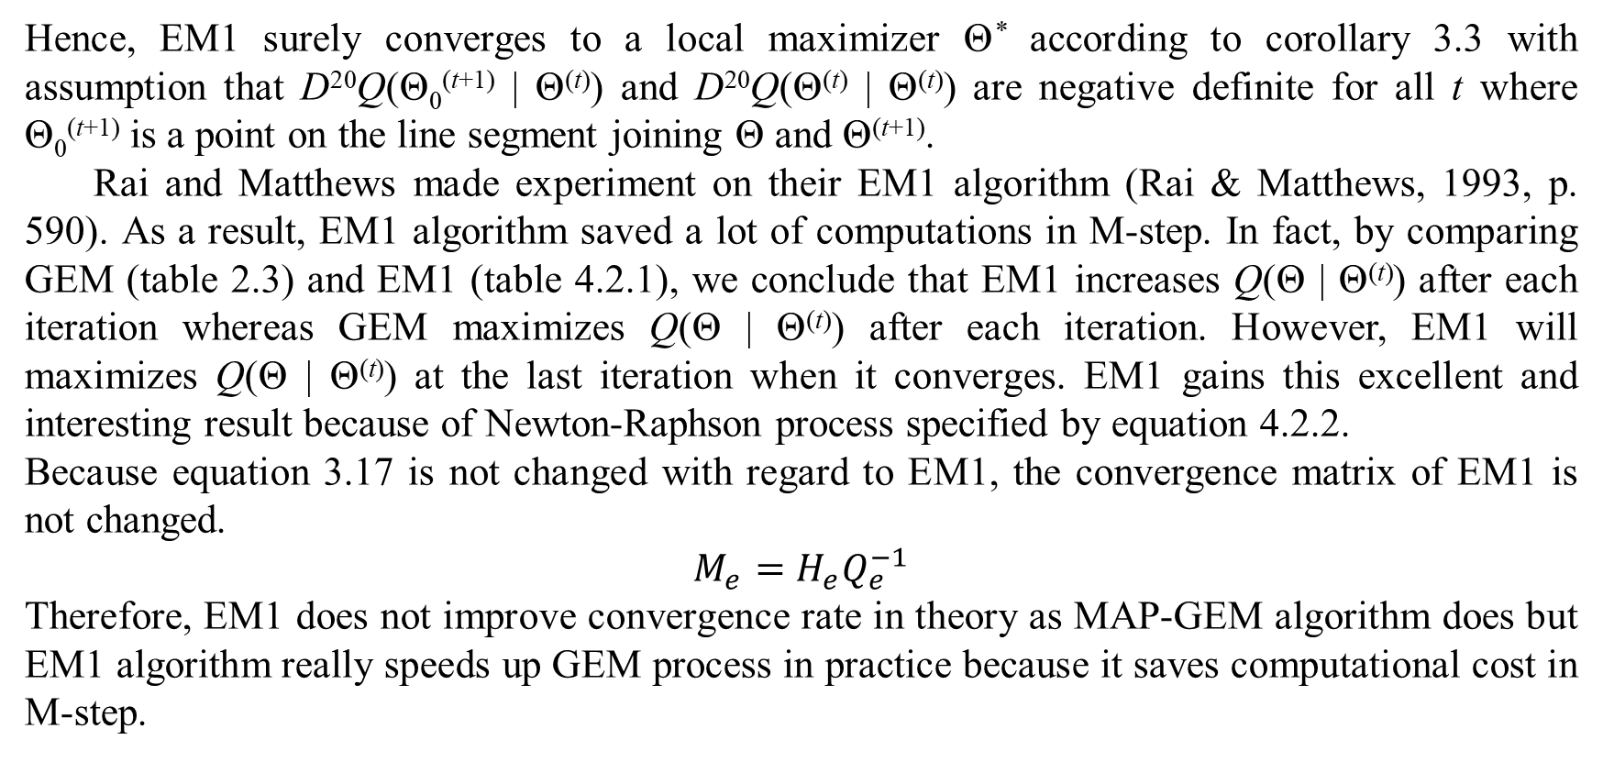
2. EM with Newton-Raphson method
Hence, EM1 surely converges to a local maximizer Θ* according to corollary 3.3 with assumption that D²⁰Q(Θ₀^{(t+1)} | Θ^{(t)}) and D²⁰Q(Θ^{(t)} | Θ^{(t)}) are negative definite for all t where Θ₀^{(t+1)} is a point on the line segment joining Θ and Θ^{(t+1)}.
Rai and Matthews made experiment on their EM1 algorithm (Rai & Matthews, 1993, p. 590). As a result, EM1 algorithm saved a lot of computations in M-step. In fact, by comparing GEM (table 2.3) and EM1 (table 4.2.1), we conclude that EM1 increases Q(Θ | Θ^{(t)}) after each iteration whereas GEM maximizes Q(Θ | Θ^{(t)}) after each iteration. However, EM1 will maximizes Q(Θ | Θ^{(t)}) at the last iteration when it converges. EM1 gains this excellent and interesting result because of Newton-Raphson process specified by equation 4.2.2.
Because equation 3.17 is not changed with regard to EM1, the convergence matrix of EM1 is not changed.
$$M_{e}=H_{e}Q_{e}^{−1}$$
Therefore, EM1 does not improve convergence rate in theory as MAP-GEM algorithm does but EM1 algorithm really speeds up GEM process in practice because it saves computational cost in M-step.

Slide 16
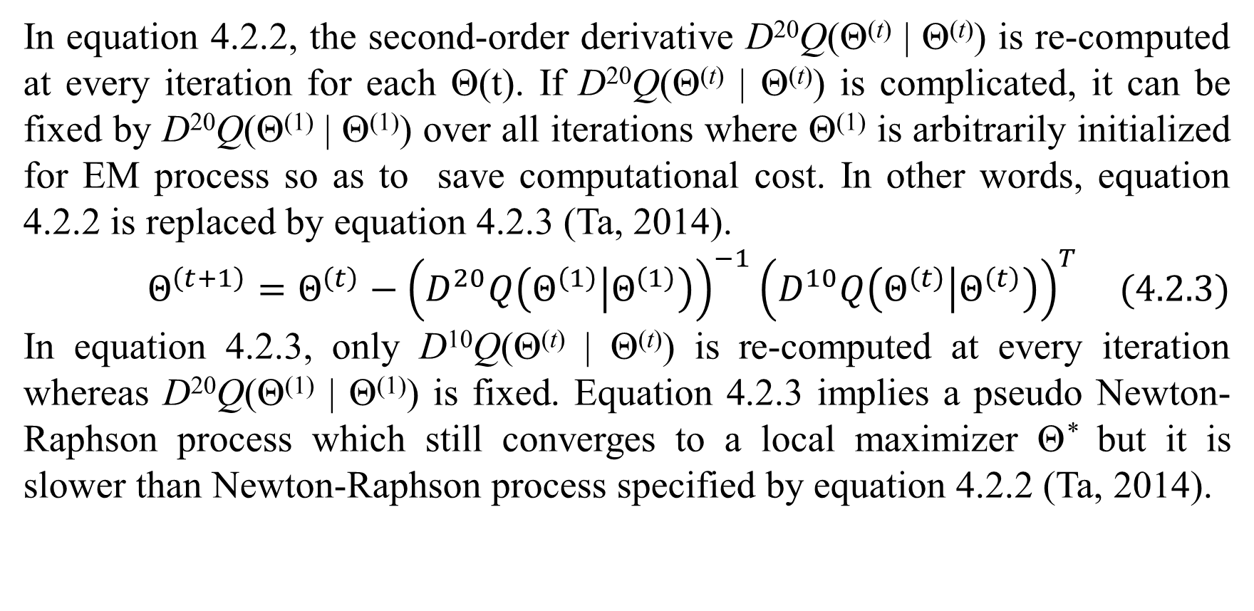
2. EM with Newton-Raphson method
In equation 4.2.2, the second-order derivative D²⁰Q(Θ^{(t)} | Θ^{(t)}) is re-computed at every iteration for each Θ(t). If D²⁰Q(Θ^{(t)} | Θ^{(t)}) is complicated, it can be fixed by D²⁰Q(Θ⁽¹⁾ | Θ⁽¹⁾) over all iterations where Θ⁽¹⁾ is arbitrarily initialized for EM process so as to save computational cost. In other words, equation 4.2.2 is replaced by equation 4.2.3 (Ta, 2014).
$$Θ^{\left(t+1\right)}=Θ^{\left(t\right)}−{\left(D^{20}Q\left(Θ^{\left(1\right)} | Θ^{\left(1\right)}\right)\right)}^{−1}{\left(D^{10}Q\left(Θ^{\left(t\right)} | Θ^{\left(t\right)}\right)\right)}^{T} (4.2.3)$$
In equation 4.2.3, only D¹⁰Q(Θ^{(t)} | Θ^{(t)}) is re-computed at every iteration whereas D²⁰Q(Θ⁽¹⁾ | Θ⁽¹⁾) is fixed. Equation 4.2.3 implies a pseudo Newton-Raphson process which still converges to a local maximizer Θ* but it is slower than Newton-Raphson process specified by equation 4.2.2 (Ta, 2014).

Slide 17
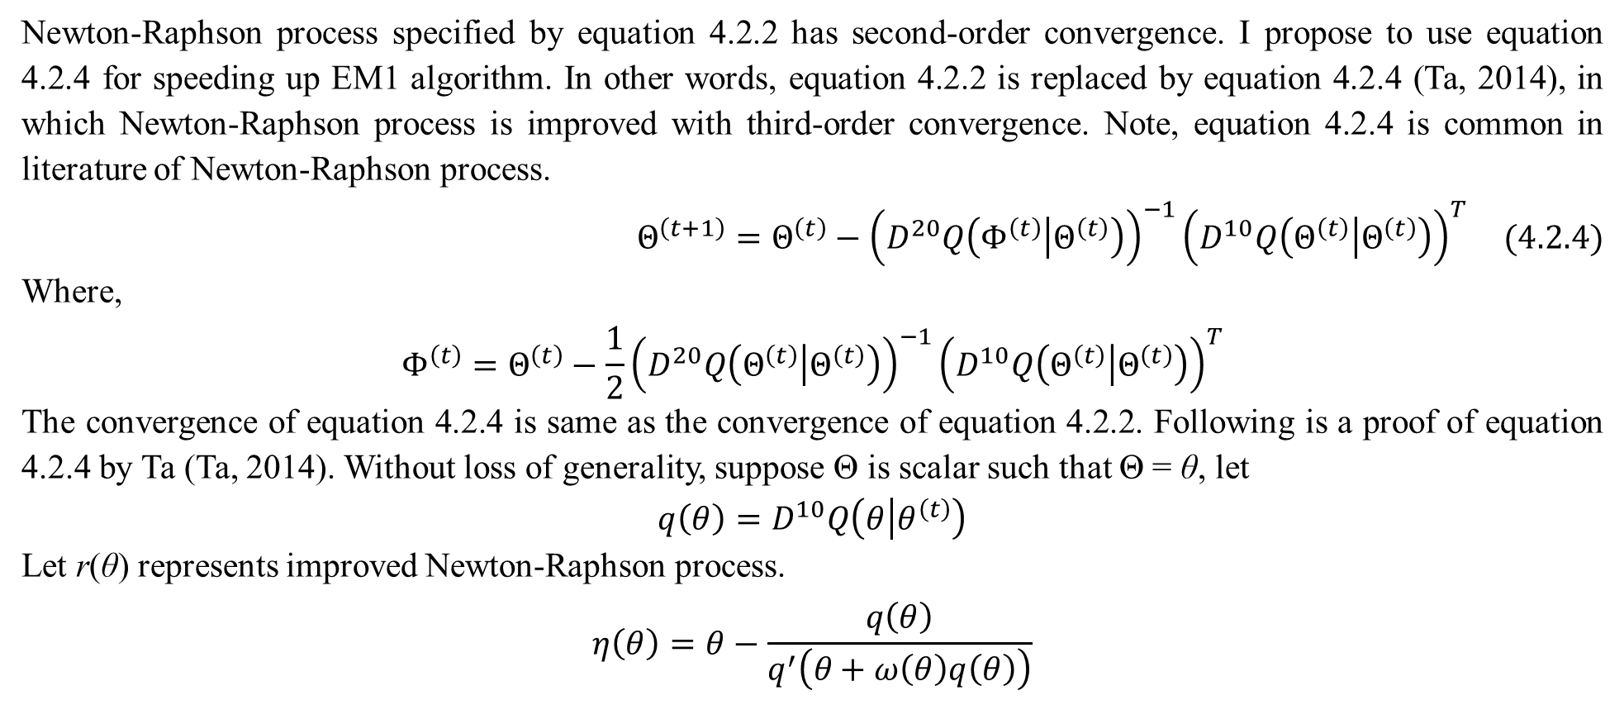
2. EM with Newton-Raphson method
Newton-Raphson process specified by equation 4.2.2 has second-order convergence. I propose to use equation 4.2.4 for speeding up EM1 algorithm. In other words, equation 4.2.2 is replaced by equation 4.2.4 (Ta, 2014), in which Newton-Raphson process is improved with third-order convergence. Note, equation 4.2.4 is common in literature of Newton-Raphson process.
$$Θ^{\left(t+1\right)}=Θ^{\left(t\right)}−{\left(D^{20}Q\left(Φ^{\left(t\right)} | Θ^{\left(t\right)}\right)\right)}^{−1}{\left(D^{10}Q\left(Θ^{\left(t\right)} | Θ^{\left(t\right)}\right)\right)}^{T} (4.2.4)$$
Where,
$$Φ^{\left(t\right)}=Θ^{\left(t\right)}−\frac{1}{2}{\left(D^{20}Q\left(Θ^{\left(t\right)} | Θ^{\left(t\right)}\right)\right)}^{−1}{\left(D^{10}Q\left(Θ^{\left(t\right)} | Θ^{\left(t\right)}\right)\right)}^{T}$$
The convergence of equation 4.2.4 is same as the convergence of equation 4.2.2. Following is a proof of equation 4.2.4 by Ta (Ta, 2014). Without loss of generality, suppose Θ is scalar such that Θ = θ, let
$$q\left(θ\right)=D^{10}Q\left(θ | θ^{\left(t\right)}\right)$$
Let r(θ) represents improved Newton-Raphson process.
$$η\left(θ\right)=θ−\frac{q\left(θ\right)}{q^{′}\left(θ+ω\left(θ\right)q\left(θ\right)\right)}$$

Slide 18
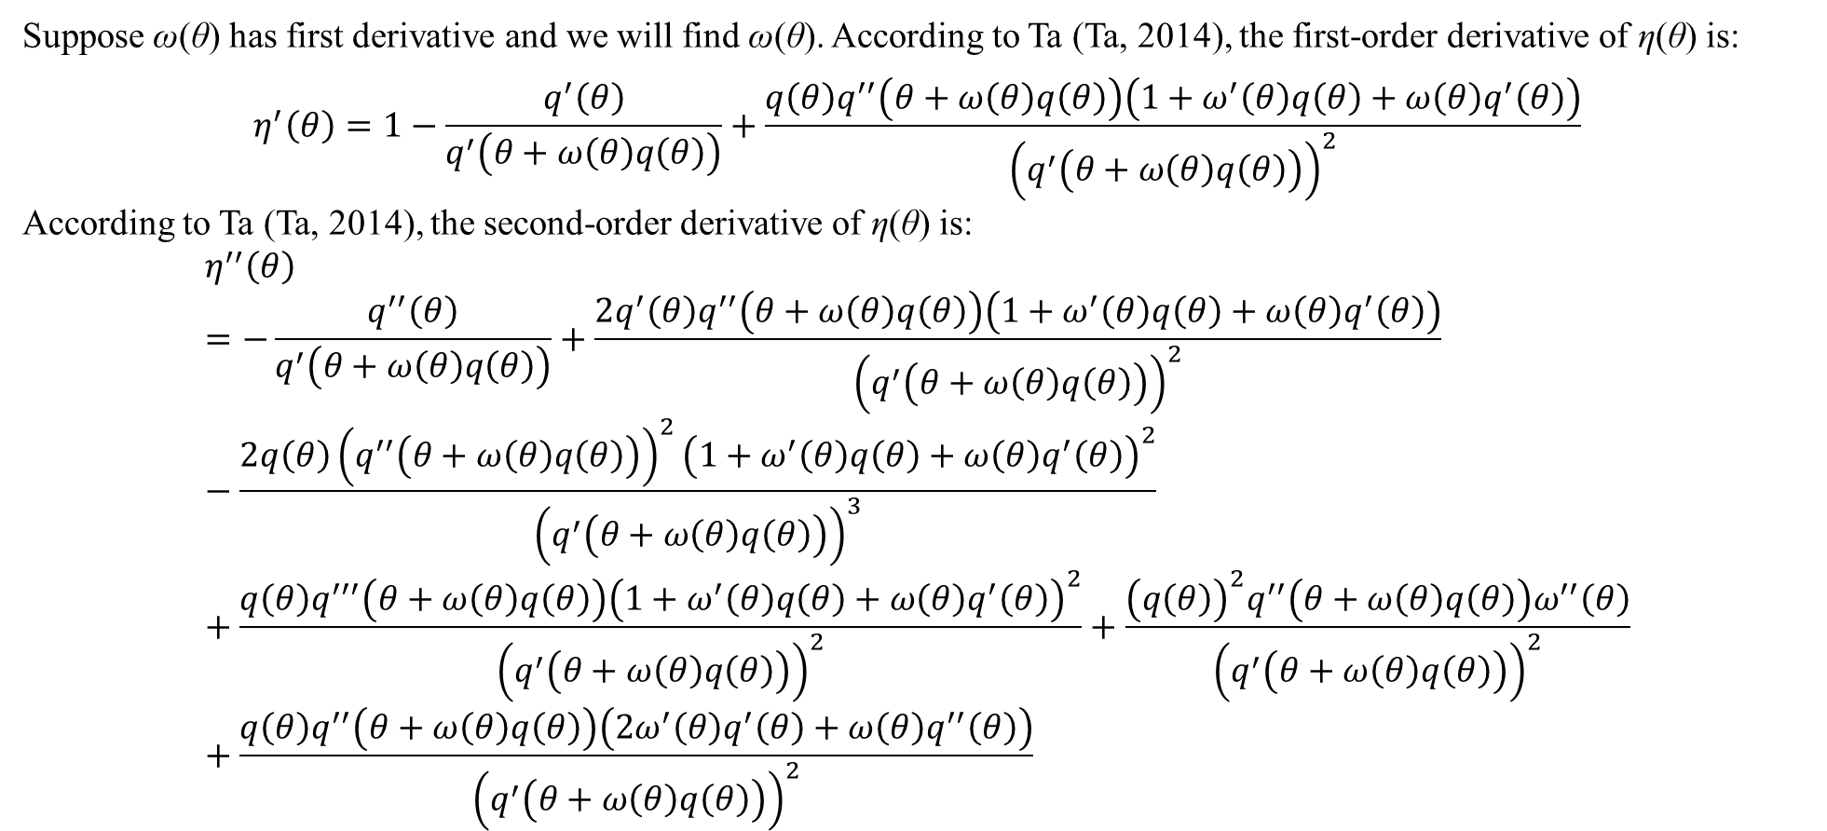
2. EM with Newton-Raphson method
Suppose ω(θ) has first derivative and we will find ω(θ). According to Ta (Ta, 2014), the first-order derivative of η(θ) is:
$$η^{′}\left(θ\right)=1−\frac{q^{′}\left(θ\right)}{q^{′}\left(θ+ω\left(θ\right)q\left(θ\right)\right)}+\frac{q\left(θ\right)q^{′′}\left(θ+ω\left(θ\right)q\left(θ\right)\right)\left(1+ω^{′}\left(θ\right)q\left(θ\right)+ω\left(θ\right)q^{′}\left(θ\right)\right)}{{\left(q^{′}\left(θ+ω\left(θ\right)q\left(θ\right)\right)\right)}^{2}}$$
According to Ta (Ta, 2014), the second-order derivative of η(θ) is:
$$η^{′′}\left(θ\right)=−\frac{q^{′′}\left(θ\right)}{q^{′}\left(θ+ω\left(θ\right)q\left(θ\right)\right)}+\frac{2q^{′}\left(θ\right)q^{′′}\left(θ+ω\left(θ\right)q\left(θ\right)\right)\left(1+ω^{′}\left(θ\right)q\left(θ\right)+ω\left(θ\right)q^{′}\left(θ\right)\right)}{{\left(q^{′}\left(θ+ω\left(θ\right)q\left(θ\right)\right)\right)}^{2}}−\frac{2q\left(θ\right){\left(q^{′′}\left(θ+ω\left(θ\right)q\left(θ\right)\right)\right)}^{2}{\left(1+ω^{′}\left(θ\right)q\left(θ\right)+ω\left(θ\right)q^{′}\left(θ\right)\right)}^{2}}{{\left(q^{′}\left(θ+ω\left(θ\right)q\left(θ\right)\right)\right)}^{3}}+\frac{q\left(θ\right)q^{′′′}\left(θ+ω\left(θ\right)q\left(θ\right)\right){\left(1+ω^{′}\left(θ\right)q\left(θ\right)+ω\left(θ\right)q^{′}\left(θ\right)\right)}^{2}}{{\left(q^{′}\left(θ+ω\left(θ\right)q\left(θ\right)\right)\right)}^{2}}+\frac{{\left(q\left(θ\right)\right)}^{2}q^{′′}\left(θ+ω\left(θ\right)q\left(θ\right)\right)ω^{′′}\left(θ\right)}{{\left(q^{′}\left(θ+ω\left(θ\right)q\left(θ\right)\right)\right)}^{2}}+\frac{q\left(θ\right)q^{′′}\left(θ+ω\left(θ\right)q\left(θ\right)\right)\left(2ω^{′}\left(θ\right)q^{′}\left(θ\right)+ω\left(θ\right)q^{′′}\left(θ\right)\right)}{{\left(q^{′}\left(θ+ω\left(θ\right)q\left(θ\right)\right)\right)}^{2}}$$

Slide 19
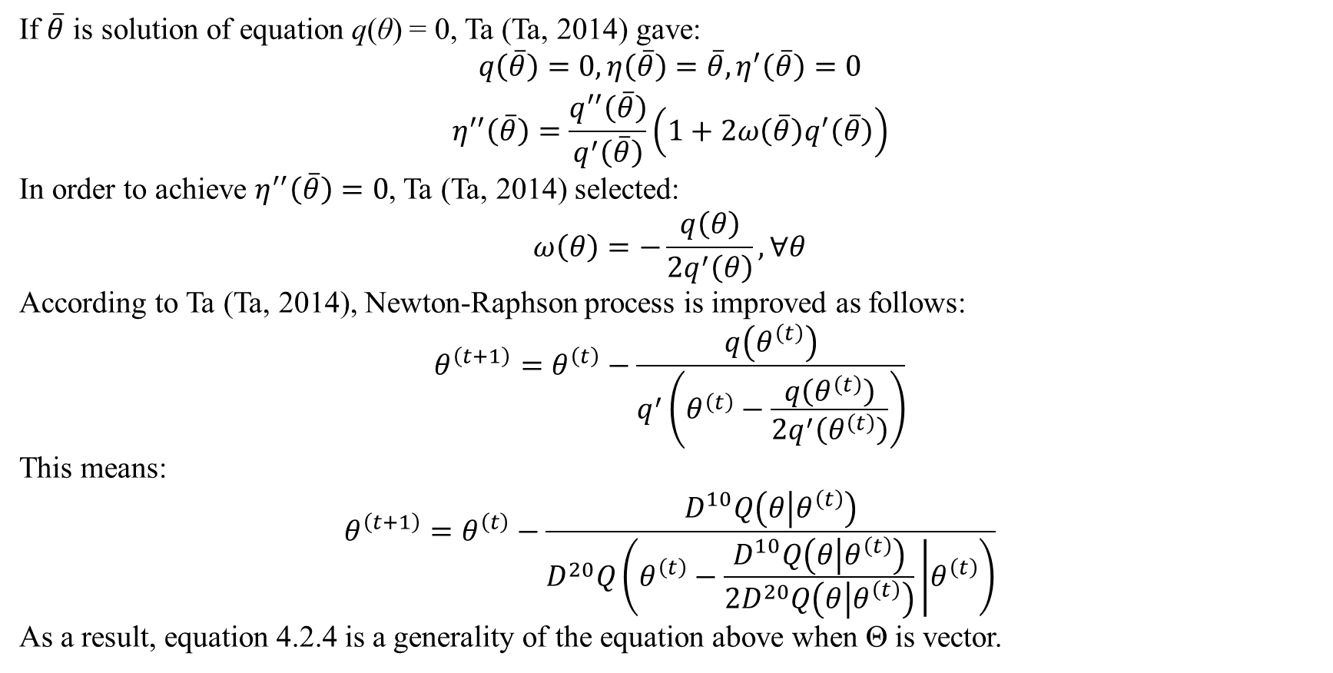
2. EM with Newton-Raphson method
If $\overline{θ}$ is solution of equation q(θ) = 0, Ta (Ta, 2014) gave:
$$\begin{matrix}q\left(\overline{θ}\right)=0,η\left(\overline{θ}\right)=\overline{θ},η^{′}\left(\overline{θ}\right)=0 \\ η^{′′}\left(\overline{θ}\right)=\frac{q^{′′}\left(\overline{θ}\right)}{q^{′}\left(\overline{θ}\right)}\left(1+2ω\left(\overline{θ}\right)q^{′}\left(\overline{θ}\right)\right)\end{matrix}$$
In order to achieve $η^{′′}\left(\overline{θ}\right)=0$, Ta (Ta, 2014) selected:
$$ω\left(θ\right)=−\frac{q\left(θ\right)}{2q^{′}\left(θ\right)},∀θ$$
According to Ta (Ta, 2014), Newton-Raphson process is improved as follows:
$$θ^{\left(t+1\right)}=θ^{\left(t\right)}−\frac{q\left(θ^{\left(t\right)}\right)}{q^{′}\left(θ^{\left(t\right)}−\frac{q\left(θ^{\left(t\right)}\right)}{2q^{′}\left(θ^{\left(t\right)}\right)}\right)}$$
This means:
$$θ^{\left(t+1\right)}=θ^{\left(t\right)}−\frac{D^{10}Q\left(θ | θ^{\left(t\right)}\right)}{D^{20}Q\left(θ^{\left(t\right)}−\frac{D^{10}Q\left(θ | θ^{\left(t\right)}\right)}{2D^{20}Q\left(θ | θ^{\left(t\right)}\right)} | θ^{\left(t\right)}\right)}$$
As a result, equation 4.2.4 is a generality of the equation above when Θ is vector.

Slide 20
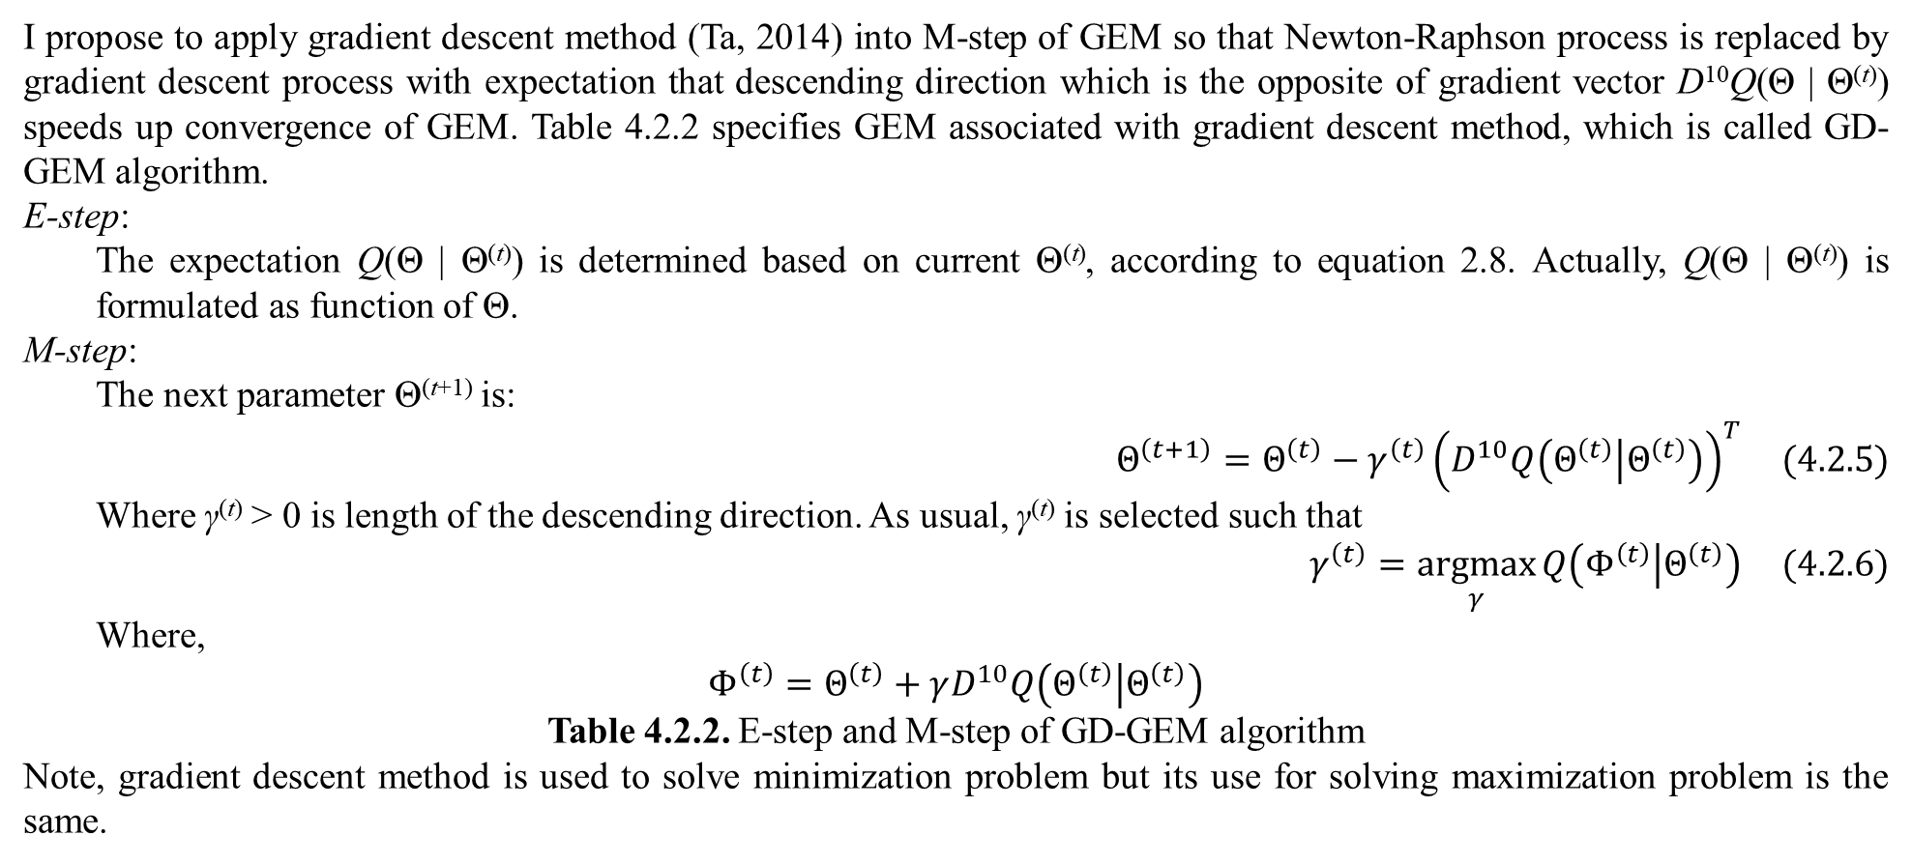
2. EM with Newton-Raphson method
I propose to apply gradient descent method (Ta, 2014) into M-step of GEM so that Newton-Raphson process is replaced by gradient descent process with expectation that descending direction which is the opposite of gradient vector D¹⁰Q(Θ | Θ^{(t)}) speeds up convergence of GEM. Table 4.2.2 specifies GEM associated with gradient descent method, which is called GD-GEM algorithm.
E-step:
The expectation Q(Θ | Θ^{(t)}) is determined based on current Θ^{(t)}, according to equation 2.8. Actually, Q(Θ | Θ^{(t)}) is formulated as function of Θ.
M-step:
The next parameter Θ^{(t+1)} is:
$$Θ^{\left(t+1\right)}=Θ^{\left(t\right)}−γ^{\left(t\right)}{\left(D^{10}Q\left(Θ^{\left(t\right)} | Θ^{\left(t\right)}\right)\right)}^{T} (4.2.5)$$
Where γ^{(t)} > 0 is length of the descending direction. As usual, γ^{(t)} is selected such that
$$γ^{\left(t\right)}=\underset{γ}{argmax}{Q\left(Φ^{\left(t\right)} | Θ^{\left(t\right)}\right)} (4.2.6)$$
Where,
$$Φ^{\left(t\right)}=Θ^{\left(t\right)}+γD^{10}Q\left(Θ^{\left(t\right)} | Θ^{\left(t\right)}\right)$$
Table 4.2.2. E-step and M-step of GD-GEM algorithm
Note, gradient descent method is used to solve minimization problem but its use for solving maximization problem is the same.

Slide 21
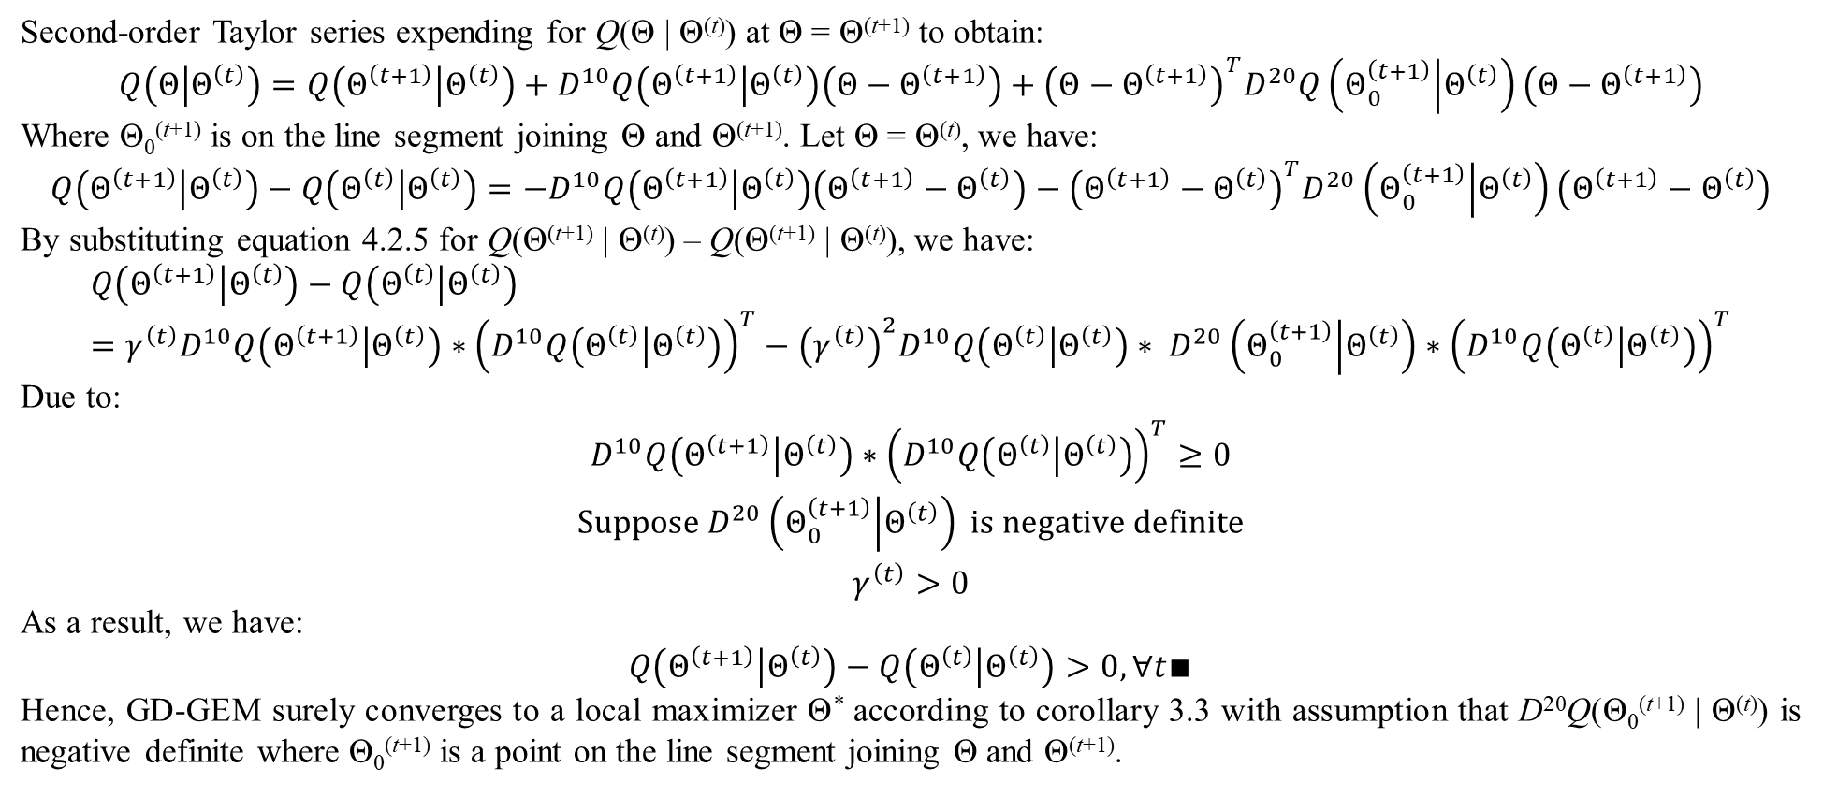
2. EM with Newton-Raphson method
Second-order Taylor series expending for Q(Θ | Θ^{(t)}) at Θ = Θ^{(t+1)} to obtain:
$$Q\left(Θ | Θ^{\left(t\right)}\right)=Q\left(Θ^{\left(t+1\right)} | Θ^{\left(t\right)}\right)+D^{10}Q\left(Θ^{\left(t+1\right)} | Θ^{\left(t\right)}\right)\left(Θ−Θ^{\left(t+1\right)}\right)+{\left(Θ−Θ^{\left(t+1\right)}\right)}^{T}D^{20}Q\left(Θ_{0}^{\left(t+1\right)} | Θ^{\left(t\right)}\right)\left(Θ−Θ^{\left(t+1\right)}\right)$$
Where Θ₀^{(t+1)} is on the line segment joining Θ and Θ^{(t+1)}. Let Θ = Θ^{(t)}, we have:
$$Q\left(Θ^{\left(t+1\right)} | Θ^{\left(t\right)}\right)−Q\left(Θ^{\left(t\right)} | Θ^{\left(t\right)}\right)=−D^{10}Q\left(Θ^{\left(t+1\right)} | Θ^{\left(t\right)}\right)\left(Θ^{\left(t+1\right)}−Θ^{\left(t\right)}\right)−{\left(Θ^{\left(t+1\right)}−Θ^{\left(t\right)}\right)}^{T}D^{20}\left(Θ_{0}^{\left(t+1\right)} | Θ^{\left(t\right)}\right)\left(Θ^{\left(t+1\right)}−Θ^{\left(t\right)}\right)$$
By substituting equation 4.2.5 for Q(Θ^{(t+1)} | Θ^{(t)}) – Q(Θ^{(t+1)} | Θ^{(t)}), we have:
$$Q\left(Θ^{\left(t+1\right)} | Θ^{\left(t\right)}\right)−Q\left(Θ^{\left(t\right)} | Θ^{\left(t\right)}\right)=γ^{\left(t\right)}D^{10}Q\left(Θ^{\left(t+1\right)} | Θ^{\left(t\right)}\right)∗{\left(D^{10}Q\left(Θ^{\left(t\right)} | Θ^{\left(t\right)}\right)\right)}^{T}−{\left(γ^{\left(t\right)}\right)}^{2}D^{10}Q\left(Θ^{\left(t\right)} | Θ^{\left(t\right)}\right)∗ D^{20}\left(Θ_{0}^{\left(t+1\right)} | Θ^{\left(t\right)}\right)∗{\left(D^{10}Q\left(Θ^{\left(t\right)} | Θ^{\left(t\right)}\right)\right)}^{T}$$
Due to:
$$\begin{matrix}D^{10}Q\left(Θ^{\left(t+1\right)} | Θ^{\left(t\right)}\right)∗{\left(D^{10}Q\left(Θ^{\left(t\right)} | Θ^{\left(t\right)}\right)\right)}^{T}≥0 \\ Suppose D^{20}\left(Θ_{0}^{\left(t+1\right)} | Θ^{\left(t\right)}\right) is negative definite \\ γ^{\left(t\right)}>0\end{matrix}$$
As a result, we have:
$$Q\left(Θ^{\left(t+1\right)} | Θ^{\left(t\right)}\right)−Q\left(Θ^{\left(t\right)} | Θ^{\left(t\right)}\right)>0,∀t∎$$
Hence, GD-GEM surely converges to a local maximizer Θ* according to corollary 3.3 with assumption that D²⁰Q(Θ₀^{(t+1)} | Θ^{(t)}) is negative definite where Θ₀^{(t+1)} is a point on the line segment joining Θ and Θ^{(t+1)}.

Slide 22
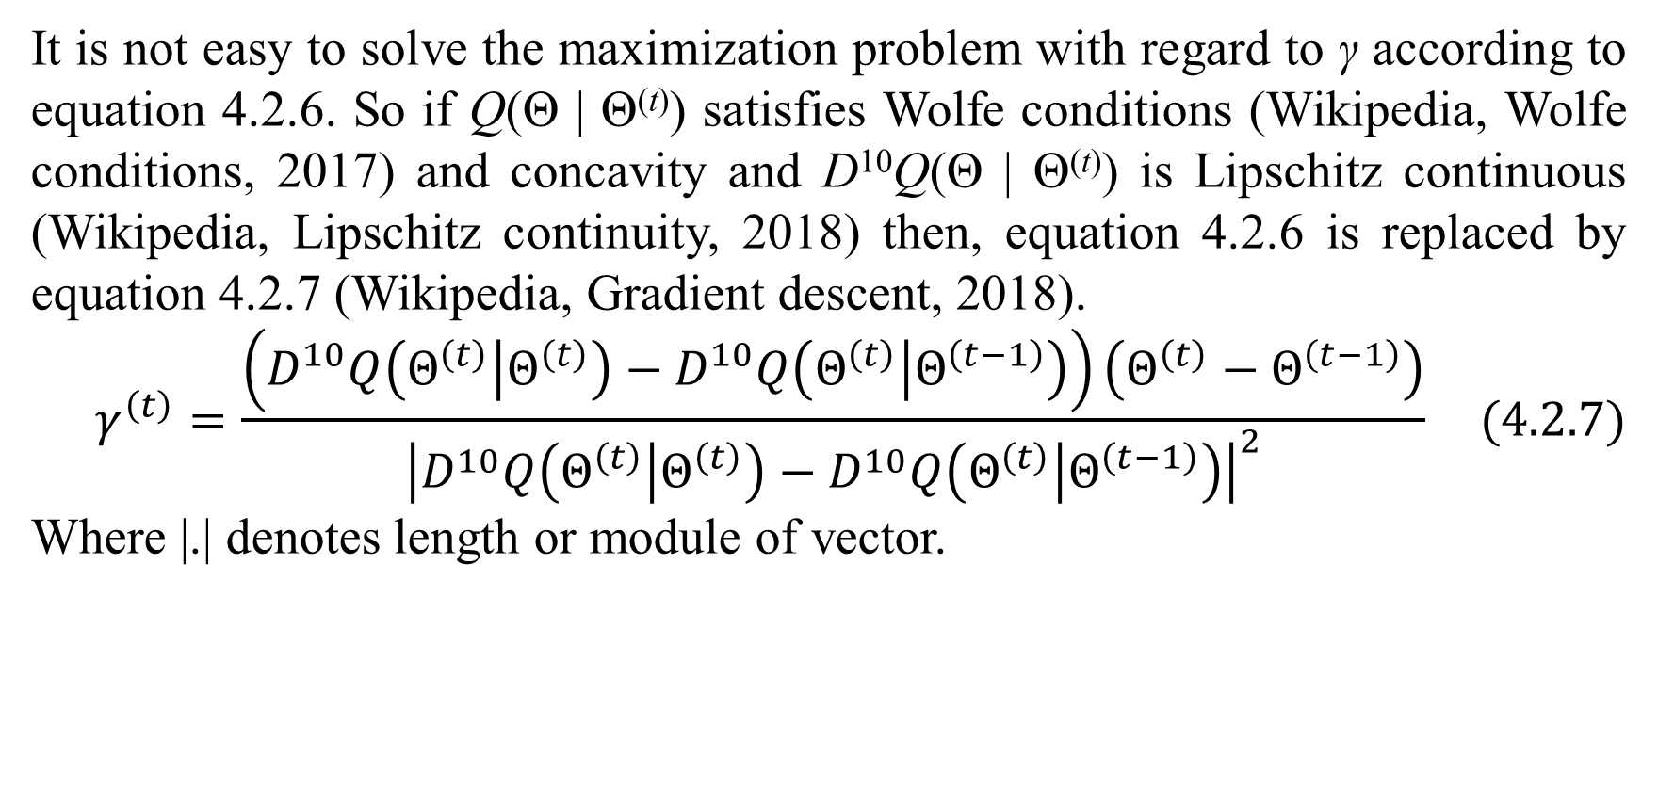
2. EM with Newton-Raphson method
It is not easy to solve the maximization problem with regard to γ according to equation 4.2.6. So if Q(Θ | Θ^{(t)}) satisfies Wolfe conditions (Wikipedia, Wolfe conditions, 2017) and concavity and D¹⁰Q(Θ | Θ^{(t)}) is Lipschitz continuous (Wikipedia, Lipschitz continuity, 2018) then, equation 4.2.6 is replaced by equation 4.2.7 (Wikipedia, Gradient descent, 2018).
$$γ^{\left(t\right)}=\frac{\left(D^{10}Q\left(Θ^{\left(t\right)} | Θ^{\left(t\right)}\right)−D^{10}Q\left(Θ^{\left(t\right)} | Θ^{\left(t−1\right)}\right)\right)\left(Θ^{\left(t\right)}−Θ^{\left(t−1\right)}\right)}{{\left|D^{10}Q\left(Θ^{\left(t\right)} | Θ^{\left(t\right)}\right)−D^{10}Q\left(Θ^{\left(t\right)} | Θ^{\left(t−1\right)}\right)\right|}^{2}} (4.2.7)$$
Where |.| denotes length or module of vector.

Slide 23
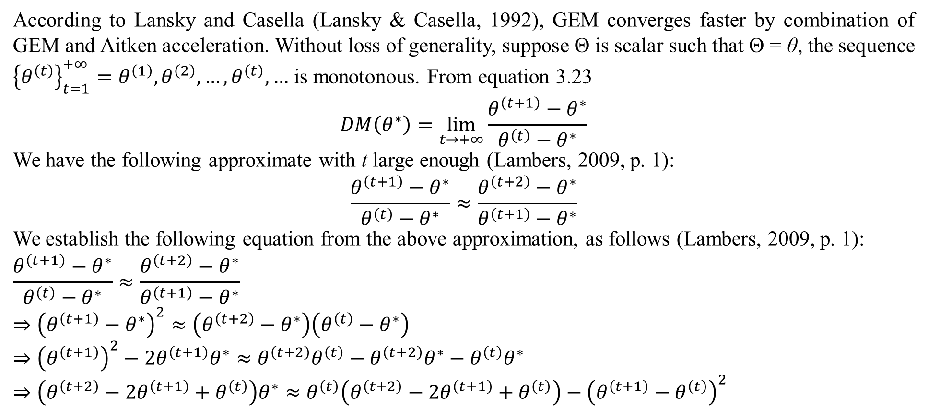
3. EM with Aitken acceleration
According to Lansky and Casella (Lansky & Casella, 1992), GEM converges faster by combination of GEM and Aitken acceleration. Without loss of generality, suppose Θ is scalar such that Θ = θ, the sequence ${\left\{θ^{\left(t\right)}\right\}}_{t=1}^{+∞}=θ^{\left(1\right)},θ^{\left(2\right)},…,θ^{\left(t\right)},…$ is monotonous. From equation 3.23
$$DM\left(θ^{∗}\right)=\lim_{t→+∞}{\frac{θ^{\left(t+1\right)}−θ^{∗}}{θ^{\left(t\right)}−θ^{∗}}}$$
We have the following approximate with t large enough (Lambers, 2009, p. 1):
$$\frac{θ^{\left(t+1\right)}−θ^{∗}}{θ^{\left(t\right)}−θ^{∗}}≈\frac{θ^{\left(t+2\right)}−θ^{∗}}{θ^{\left(t+1\right)}−θ^{∗}}$$
We establish the following equation from the above approximation, as follows (Lambers, 2009, p. 1):
$$\frac{θ^{\left(t+1\right)}−θ^{∗}}{θ^{\left(t\right)}−θ^{∗}}≈\frac{θ^{\left(t+2\right)}−θ^{∗}}{θ^{\left(t+1\right)}−θ^{∗}}$$
$$⇒{\left(θ^{\left(t+1\right)}−θ^{∗}\right)}^{2}≈\left(θ^{\left(t+2\right)}−θ^{∗}\right)\left(θ^{\left(t\right)}−θ^{∗}\right)$$
$$⇒{\left(θ^{\left(t+1\right)}\right)}^{2}−2θ^{\left(t+1\right)}θ^{∗}≈θ^{\left(t+2\right)}θ^{\left(t\right)}−θ^{\left(t+2\right)}θ^{∗}−θ^{\left(t\right)}θ^{∗}$$
$$⇒\left(θ^{\left(t+2\right)}−2θ^{\left(t+1\right)}+θ^{\left(t\right)}\right)θ^{∗}≈θ^{\left(t\right)}\left(θ^{\left(t+2\right)}−2θ^{\left(t+1\right)}+θ^{\left(t\right)}\right)−{\left(θ^{\left(t+1\right)}−θ^{\left(t\right)}\right)}^{2}$$

Slide 24
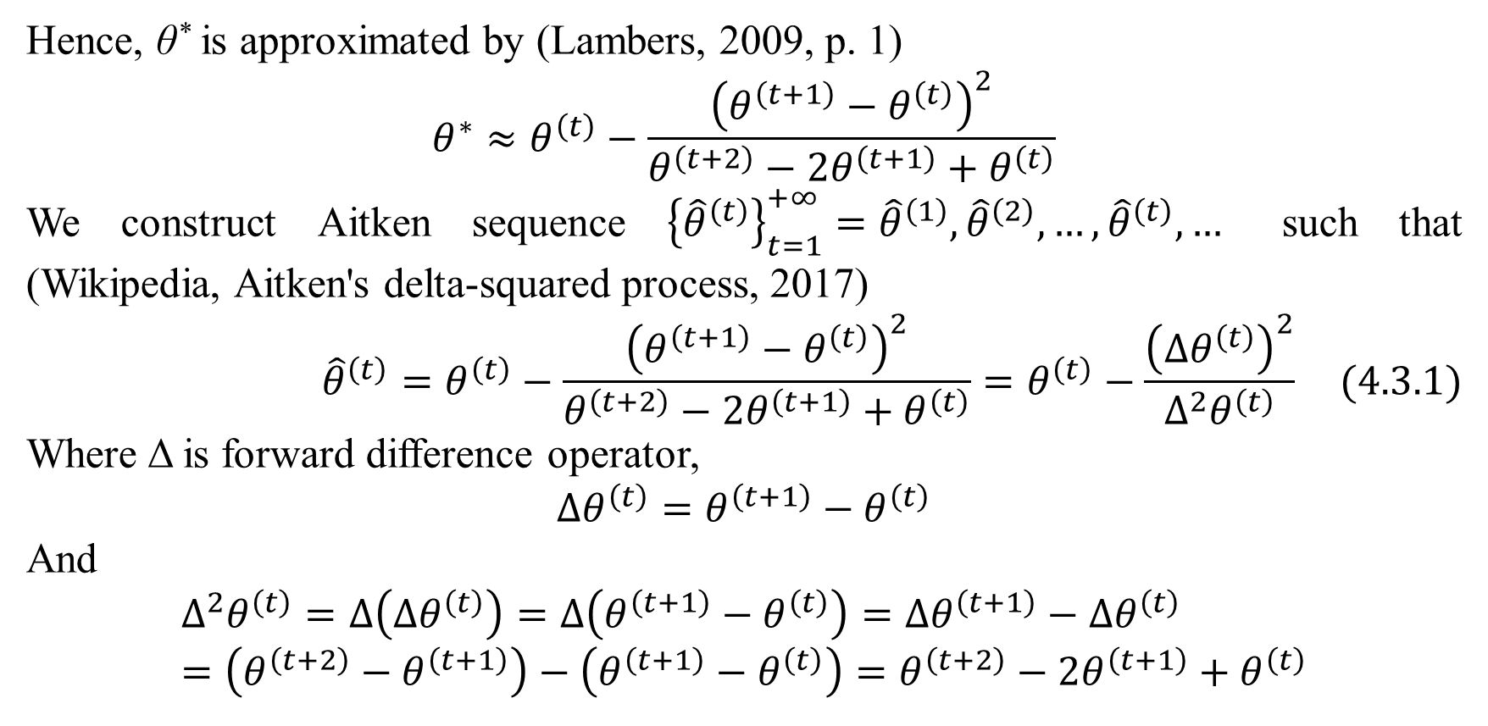
3. EM with Aitken acceleration
Hence, θ* is approximated by (Lambers, 2009, p. 1)
$$θ^{∗}≈θ^{\left(t\right)}−\frac{{\left(θ^{\left(t+1\right)}−θ^{\left(t\right)}\right)}^{2}}{θ^{\left(t+2\right)}−2θ^{\left(t+1\right)}+θ^{\left(t\right)}}$$
We construct Aitken sequence ${\left\{{\hat{θ}}^{\left(t\right)}\right\}}_{t=1}^{+∞}={\hat{θ}}^{\left(1\right)},{\hat{θ}}^{\left(2\right)},…,{\hat{θ}}^{\left(t\right)},…$ such that (Wikipedia, Aitken's delta-squared process, 2017)
$${\hat{θ}}^{\left(t\right)}=θ^{\left(t\right)}−\frac{{\left(θ^{\left(t+1\right)}−θ^{\left(t\right)}\right)}^{2}}{θ^{\left(t+2\right)}−2θ^{\left(t+1\right)}+θ^{\left(t\right)}}=θ^{\left(t\right)}−\frac{{\left(∆θ^{\left(t\right)}\right)}^{2}}{∆^{2}θ^{\left(t\right)}} (4.3.1)$$
Where Δ is forward difference operator,
$$∆θ^{\left(t\right)}=θ^{\left(t+1\right)}−θ^{\left(t\right)}$$
And
$$∆^{2}θ^{\left(t\right)}=∆\left(∆θ^{\left(t\right)}\right)=∆\left(θ^{\left(t+1\right)}−θ^{\left(t\right)}\right)=∆θ^{\left(t+1\right)}−∆θ^{\left(t\right)}=\left(θ^{\left(t+2\right)}−θ^{\left(t+1\right)}\right)−\left(θ^{\left(t+1\right)}−θ^{\left(t\right)}\right)=θ^{\left(t+2\right)}−2θ^{\left(t+1\right)}+θ^{\left(t\right)}$$

Slide 25
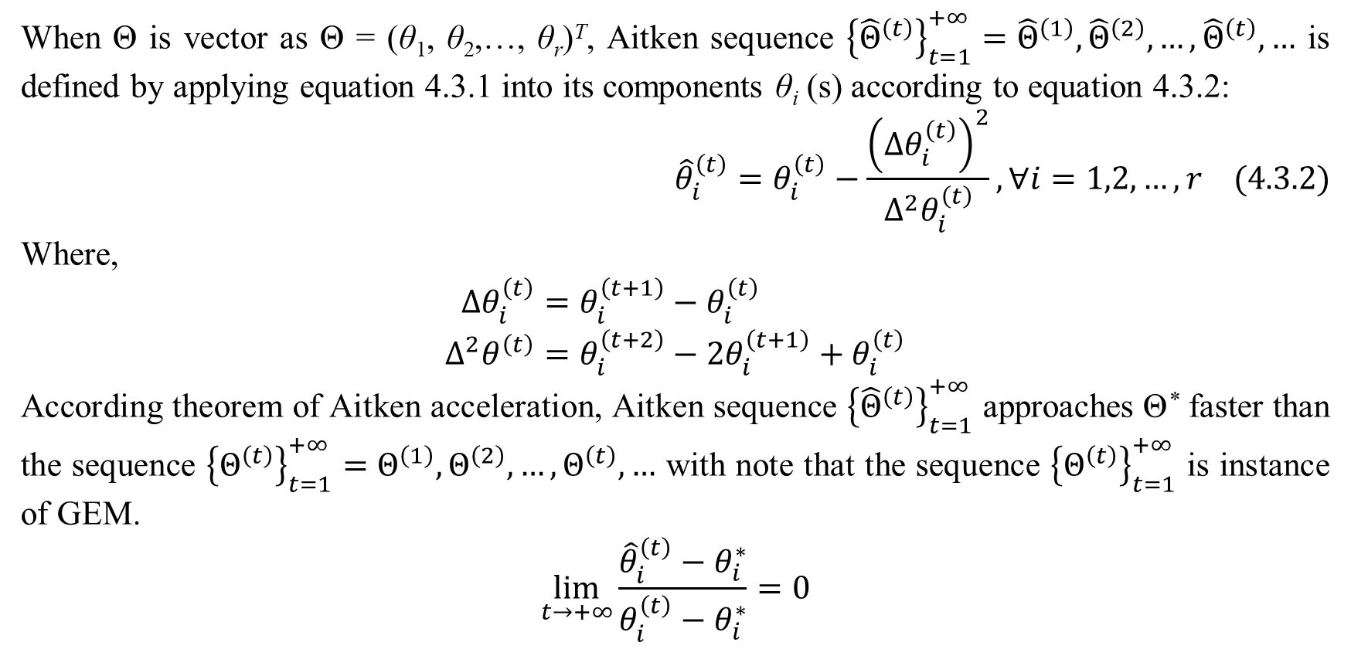
3. EM with Aitken acceleration
When Θ is vector as Θ = (θ₁, θ₂,…, θ_{r})^{T}, Aitken sequence ${\left\{{\hat{Θ}}^{\left(t\right)}\right\}}_{t=1}^{+∞}={\hat{Θ}}^{\left(1\right)},{\hat{Θ}}^{\left(2\right)},…,{\hat{Θ}}^{\left(t\right)},…$ is defined by applying equation 4.3.1 into its components θ_{i} (s) according to equation 4.3.2:
$${\hat{θ}}_{i}^{\left(t\right)}=θ_{i}^{\left(t\right)}−\frac{{\left(∆θ_{i}^{\left(t\right)}\right)}^{2}}{∆^{2}θ_{i}^{\left(t\right)}},∀i=1,2,…,r (4.3.2)$$
Where,
$$∆θ_{i}^{\left(t\right)}=θ_{i}^{\left(t+1\right)}−θ_{i}^{\left(t\right)} \\ ∆^{2}θ^{\left(t\right)}=θ_{i}^{\left(t+2\right)}−2θ_{i}^{\left(t+1\right)}+θ_{i}^{\left(t\right)}$$
According theorem of Aitken acceleration, Aitken sequence ${\left\{{\hat{Θ}}^{\left(t\right)}\right\}}_{t=1}^{+∞}$ approaches Θ* faster than the sequence ${\left\{Θ^{\left(t\right)}\right\}}_{t=1}^{+∞}=Θ^{\left(1\right)},Θ^{\left(2\right)},…,Θ^{\left(t\right)},…$ with note that the sequence ${\left\{Θ^{\left(t\right)}\right\}}_{t=1}^{+∞}$ is instance of GEM.
$$\lim_{t→+∞}{\frac{{\hat{θ}}_{i}^{\left(t\right)}−θ_{i}^{∗}}{θ_{i}^{\left(t\right)}−θ_{i}^{∗}}}=0$$

Slide 26
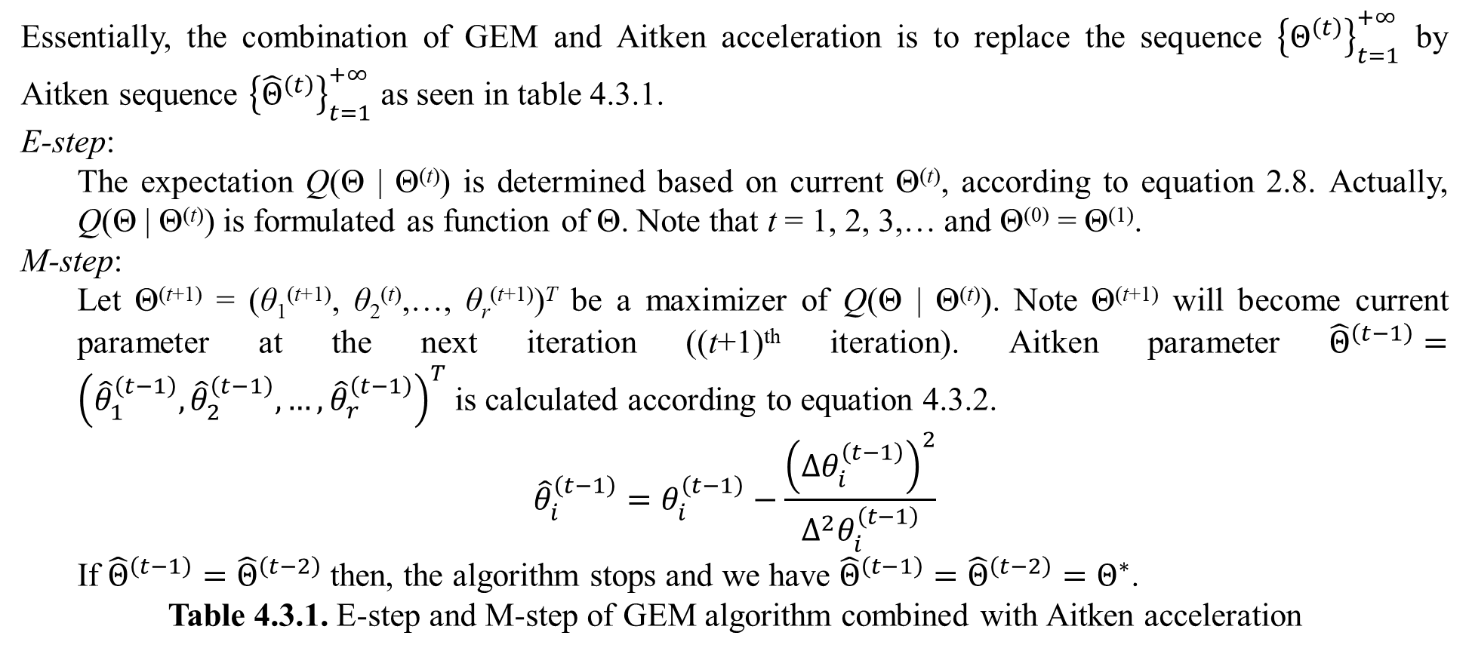
3. EM with Aitken acceleration
Essentially, the combination of GEM and Aitken acceleration is to replace the sequence ${\left\{Θ^{\left(t\right)}\right\}}_{t=1}^{+∞}$ by Aitken sequence ${\left\{{\hat{Θ}}^{\left(t\right)}\right\}}_{t=1}^{+∞}$ as seen in table 4.3.1.
E-step:
The expectation Q(Θ | Θ^{(t)}) is determined based on current Θ^{(t)}, according to equation 2.8. Actually, Q(Θ | Θ^{(t)}) is formulated as function of Θ. Note that t = 1, 2, 3,… and Θ⁽⁰⁾ = Θ⁽¹⁾.
M-step:
Let Θ^{(t+1)} = (θ₁^{(t+1)}, θ₂^{(t)},…, θ_{r}^{(t+1)})^{T} be a maximizer of Q(Θ | Θ^{(t)}). Note Θ^{(t+1)} will become current parameter at the next iteration ((t+1)^{th} iteration). Aitken parameter ${\hat{Θ}}^{\left(t−1\right)}={\left({\hat{θ}}_{1}^{\left(t−1\right)},{\hat{θ}}_{2}^{\left(t−1\right)},…,{\hat{θ}}_{r}^{\left(t−1\right)}\right)}^{T}$ is calculated according to equation 4.3.2.
$${\hat{θ}}_{i}^{\left(t−1\right)}=θ_{i}^{\left(t−1\right)}−\frac{{\left(∆θ_{i}^{\left(t−1\right)}\right)}^{2}}{∆^{2}θ_{i}^{\left(t−1\right)}}$$
If ${\hat{Θ}}^{\left(t−1\right)}={\hat{Θ}}^{\left(t−2\right)}$ then, the algorithm stops and we have ${\hat{Θ}}^{\left(t−1\right)}={\hat{Θ}}^{\left(t−2\right)}=Θ^{∗}$.
Table 4.3.1. E-step and M-step of GEM algorithm combined with Aitken acceleration

Slide 27
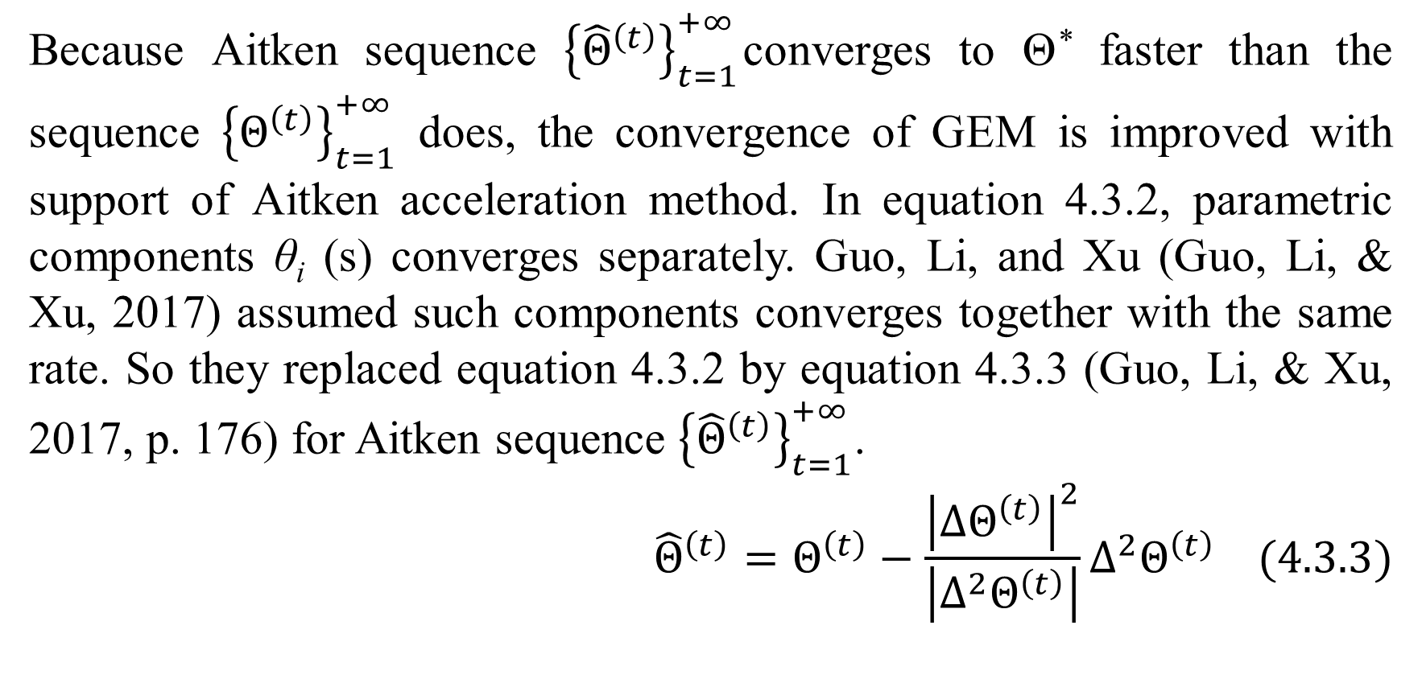
3. EM with Aitken acceleration
Because Aitken sequence ${\left\{{\hat{Θ}}^{\left(t\right)}\right\}}_{t=1}^{+∞}$converges to Θ* faster than the sequence ${\left\{Θ^{\left(t\right)}\right\}}_{t=1}^{+∞}$ does, the convergence of GEM is improved with support of Aitken acceleration method. In equation 4.3.2, parametric components θ_{i} (s) converges separately. Guo, Li, and Xu (Guo, Li, & Xu, 2017) assumed such components converges together with the same rate. So they replaced equation 4.3.2 by equation 4.3.3 (Guo, Li, & Xu, 2017, p. 176) for Aitken sequence ${\left\{{\hat{Θ}}^{\left(t\right)}\right\}}_{t=1}^{+∞}$.
$${\hat{Θ}}^{\left(t\right)}=Θ^{\left(t\right)}−\frac{{\left|∆Θ^{\left(t\right)}\right|}^{2}}{\left|∆^{2}Θ^{\left(t\right)}\right|}∆^{2}Θ^{\left(t\right)} (4.3.3)$$

Slide 28
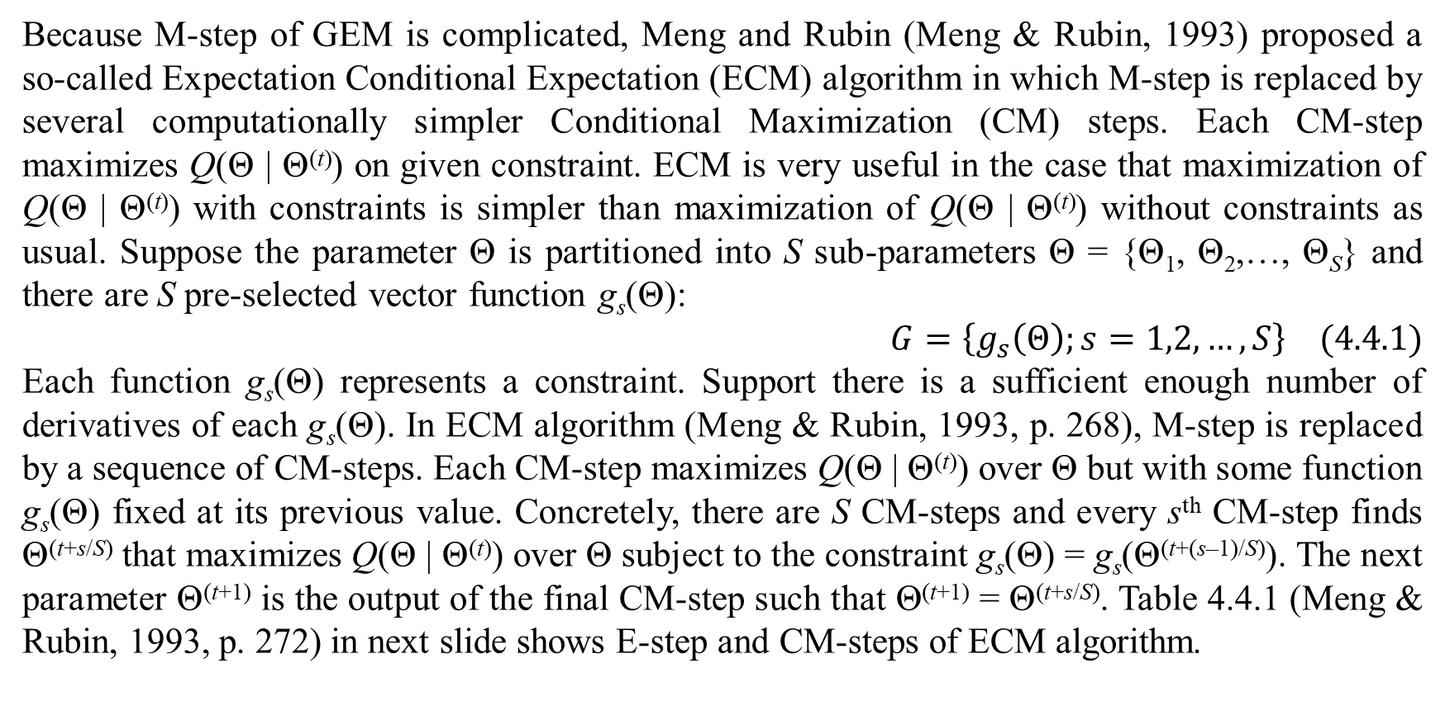
4. ECM algorithm
Because M-step of GEM is complicated, Meng and Rubin (Meng & Rubin, 1993) proposed a so-called Expectation Conditional Expectation (ECM) algorithm in which M-step is replaced by several computationally simpler Conditional Maximization (CM) steps. Each CM-step maximizes Q(Θ | Θ^{(t)}) on given constraint. ECM is very useful in the case that maximization of Q(Θ | Θ^{(t)}) with constraints is simpler than maximization of Q(Θ | Θ^{(t)}) without constraints as usual. Suppose the parameter Θ is partitioned into S sub-parameters Θ = {Θ₁, Θ₂,…, Θ_{S}} and there are S pre-selected vector function g_{s}(Θ):
$$G=\left\{g_{s}\left(Θ\right);s=1,2,…,S\right\} (4.4.1)$$
Each function g_{s}(Θ) represents a constraint. Support there is a sufficient enough number of derivatives of each g_{s}(Θ). In ECM algorithm (Meng & Rubin, 1993, p. 268), M-step is replaced by a sequence of CM-steps. Each CM-step maximizes Q(Θ | Θ^{(t)}) over Θ but with some function g_{s}(Θ) fixed at its previous value. Concretely, there are S CM-steps and every s^{th} CM-step finds Θ^{(t+s/S)} that maximizes Q(Θ | Θ^{(t)}) over Θ subject to the constraint g_{s}(Θ) = g_{s}(Θ^{(t+(s–1)/S)}). The next parameter Θ^{(t+1)} is the output of the final CM-step such that Θ^{(t+1)} = Θ^{(t+s/S)}. Table 4.4.1 (Meng & Rubin, 1993, p. 272) in next slide shows E-step and CM-steps of ECM algorithm.

Slide 29
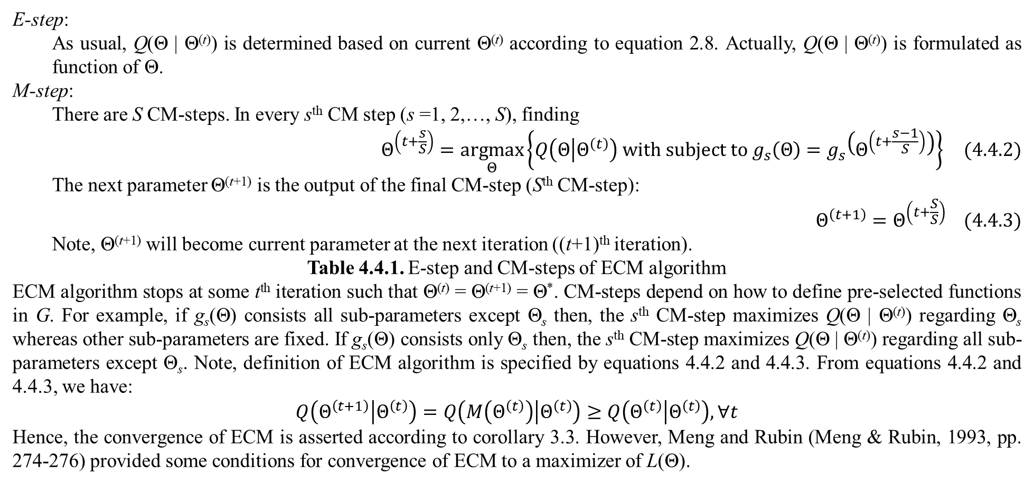
4. ECM algorithm
E-step:
As usual, Q(Θ | Θ^{(t)}) is determined based on current Θ^{(t)} according to equation 2.8. Actually, Q(Θ | Θ^{(t)}) is formulated as function of Θ.
M-step:
There are S CM-steps. In every s^{th} CM step (s =1, 2,…, S), finding
$$Θ^{\left(t+\frac{s}{S}\right)}=\underset{Θ}{argmax}\left\{Q\left(Θ | Θ^{\left(t\right)}\right) with subject to g_{s}\left(Θ\right)=g_{s}\left(Θ^{\left(t+\frac{s−1}{S}\right)}\right)\right\} (4.4.2)$$
The next parameter Θ^{(t+1)} is the output of the final CM-step (S^{th} CM-step):
$$Θ^{\left(t+1\right)}=Θ^{\left(t+\frac{S}{S}\right)} (4.4.3)$$
Note, Θ^{(t+1)} will become current parameter at the next iteration ((t+1)^{th} iteration).
Table 4.4.1. E-step and CM-steps of ECM algorithm
ECM algorithm stops at some t^{th} iteration such that Θ^{(t)} = Θ^{(t+1)} = Θ*. CM-steps depend on how to define pre-selected functions in G. For example, if g_{s}(Θ) consists all sub-parameters except Θ_{s} then, the s^{th} CM-step maximizes Q(Θ | Θ^{(t)}) regarding Θ_{s} whereas other sub-parameters are fixed. If g_{s}(Θ) consists only Θ_{s} then, the s^{th} CM-step maximizes Q(Θ | Θ^{(t)}) regarding all sub-parameters except Θ_{s}. Note, definition of ECM algorithm is specified by equations 4.4.2 and 4.4.3. From equations 4.4.2 and 4.4.3, we have:
$$Q\left(Θ^{\left(t+1\right)} | Θ^{\left(t\right)}\right)=Q\left(M\left(Θ^{\left(t\right)}\right) | Θ^{\left(t\right)}\right)≥Q\left(Θ^{\left(t\right)} | Θ^{\left(t\right)}\right),∀t$$
Hence, the convergence of ECM is asserted according to corollary 3.3. However, Meng and Rubin (Meng & Rubin, 1993, pp. 274-276) provided some conditions for convergence of ECM to a maximizer of L(Θ).

Slide 30
References
Dempster, A. P., Laird, N. M., & Rubin, D. B. (1977). Maximum Likelihood from Incomplete Data via the EM Algorithm. (M. Stone, Ed.) Journal of the Royal Statistical Society, Series B (Methodological), 39(1), 1-38.
Guo, X., Li, Q.-y., & Xu, W.-l. (2017, February). Acceleration of the EM Algorithm Using the Vector Aitken Method and Its Steffensen Form. Acta Mathematicae Applicatae Sinica, 33(1), 175-182. doi:10.1007/s10255-017-0648-3
Lambers, J. (2009). Accelerating Convergence. University of Southern Mississippi, Department of Mathematics. Hattiesburg: University of Southern Mississippi. Retrieved February 15, 2018, from http://www.math.usm.edu/lambers/mat460/fall09/lecture13.pdf
Lansky, D., & Casella, G. (1992). Improving the EM Algorithm. Computing Science and Statistics, 420-424. doi:10.1007/978-1-4612-2856-1_67
McLachlan, G., & Krishnan, T. (1997). The EM Algorithm and Extensions. New York, NY, USA: John Wiley & Sons. Retrieved from https://books.google.com.vn/books?id=NBawzaWoWa8C
Meng, X.-L., & Rubin, D. B. (1993, June 1). Maximum likelihood estimation via the ECM algorithm: A general framework. Biometrika, 80(2), 267-278. doi:10.2307/2337198
Rai, S. N., & Matthews, D. E. (1993, June). Improving the EM Algorithm. (C. A. McGilchrist, Ed.) Biometrics, 49(2), 587-591. doi:10.2307/2532570
StackExchange. (2013, November 19). Eigenvalues of the product of 2 symmetric matrices. (Stack Exchange Network) Retrieved February 9, 2018, from Mathematics StackExchange: https://math.stackexchange.com/questions/573583/eigenvalues-of-the-product-of-2-symmetric-matrices

Slide 31
References
Ta, P. D. (2014). Numerical Analysis Lecture Notes. Vietnam Institute of Mathematics, Numerical Analysis and Scientific Computing. Hanoi: Vietnam Institute of Mathematics. Retrieved 2014
Wikipedia. (2017, May 25). Aitken's delta-squared process. (Wikimedia Foundation) Retrieved February 15, 2018, from Wikipedia website: https://en.wikipedia.org/wiki/Aitken%27s_delta-squared_process
Wikipedia. (2017, February 27). Commuting matrices. (Wikimedia Foundation) Retrieved February 9, 2018, from Wikipedia website: https://en.wikipedia.org/wiki/Commuting_matrices
Wikipedia. (2017, November 27). Diagonalizable matrix. (Wikimedia Foundation) Retrieved February 10, 2018, from Wikipedia website: https://en.wikipedia.org/wiki/Diagonalizable_matrix#Simultaneous_diagonalization
Wikipedia. (2017, March 2). Maximum a posteriori estimation. (Wikimedia Foundation) Retrieved April 15, 2017, from Wikipedia website: https://en.wikipedia.org/wiki/Maximum_a_posteriori_estimation
Wikipedia. (2017, May 8). Wolfe conditions. (Wikimedia Foundation) Retrieved February 20, 2018, from Wikipedia website: https://en.wikipedia.org/wiki/Wolfe_conditions
Wikipedia. (2018, January 15). Conjugate prior. (Wikimedia Foundation) Retrieved February 15, 2018, from Wikipedia website: https://en.wikipedia.org/wiki/Conjugate_prior
Wikipedia. (2018, January 28). Gradient descent. (Wikimedia Foundation) Retrieved February 20, 2018, from Wikipedia website: https://en.wikipedia.org/wiki/Gradient_descent
Wikipedia. (2018, February 17). Lipschitz continuity. (Wikimedia Foundation) Retrieved February 20, 2018, from Wikipedia website: https://en.wikipedia.org/wiki/Lipschitz_continuity
Wikipedia. (2018, January 7). Symmetry of second derivatives. (Wikimedia Foundation) Retrieved February 10, 2018, from Wikipedia website: https://en.wikipedia.org/wiki/Symmetry_of_second_derivatives

Slide 32
Thank you for listening

