Slide 1
Tutorial on EM algorithm – Part 1
Prof. Dr. Loc Nguyen, PostDoc
Loc Nguyen’s Academic Network, Vietnam
Email: ng_phloc@yahoo.com
Homepage: www.locnguyen.net

Slide 2
Abstract
Maximum likelihood estimation (MLE) is a popular method for parameter estimation in both applied probability and statistics but MLE cannot solve the problem of incomplete data or hidden data because it is impossible to maximize likelihood function from hidden data. Expectation maximum (EM) algorithm is a powerful mathematical tool for solving this problem if there is a relationship between hidden data and observed data. Such hinting relationship is specified by a mapping from hidden data to observed data or by a joint probability between hidden data and observed data. In other words, the relationship helps us know hidden data by surveying observed data. The essential ideology of EM is to maximize the expectation of likelihood function over observed data based on the hinting relationship instead of maximizing directly the likelihood function of hidden data. Pioneers in EM algorithm proved its convergence. As a result, EM algorithm produces parameter estimators as well as MLE does. This tutorial aims to provide explanations of EM algorithm in order to help researchers comprehend it. Moreover some improvements of EM algorithm are also proposed in the tutorial such as combination of EM and third-order convergence Newton-Raphson process, combination of EM and gradient descent method, and combination of EM and particle swarm optimization (PSO) algorithm.

Slide 3
Table of contents
This report focuses on introduction of EM and related concepts.
Basic concepts
Parameter estimation
EM algorithm

Slide 4
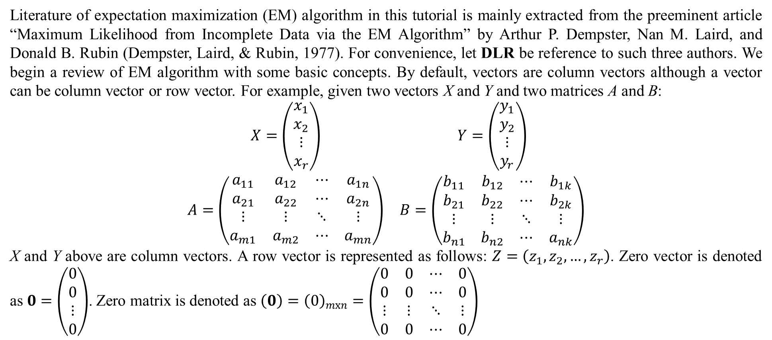
1. Basic concepts
Literature of expectation maximization (EM) algorithm in this tutorial is mainly extracted from the preeminent article “Maximum Likelihood from Incomplete Data via the EM Algorithm” by Arthur P. Dempster, Nan M. Laird, and Donald B. Rubin (Dempster, Laird, & Rubin, 1977). For convenience, let DLR be reference to such three authors. We begin a review of EM algorithm with some basic concepts. By default, vectors are column vectors although a vector can be column vector or row vector. For example, given two vectors X and Y and two matrices A and B:
$$\begin{matrix}X=\left(\begin{matrix}x_{1} \\ x_{2} \\ ⋮ \\ x_{r}\end{matrix}\right) & Y=\left(\begin{matrix}y_{1} \\ y_{2} \\ ⋮ \\ y_{r}\end{matrix}\right) \\ A=\left(\begin{matrix}a_{11} & a_{12} & ⋯ & a_{1n} \\ a_{21} & a_{22} & ⋯ & a_{2n} \\ ⋮ & ⋮ & ⋱ & ⋮ \\ a_{m1} & a_{m2} & ⋯ & a_{mn}\end{matrix}\right) & B=\left(\begin{matrix}b_{11} & b_{12} & ⋯ & b_{1k} \\ b_{21} & b_{22} & ⋯ & b_{2k} \\ ⋮ & ⋮ & ⋱ & ⋮ \\ b_{n1} & b_{n2} & ⋯ & a_{nk}\end{matrix}\right)\end{matrix}$$
X and Y above are column vectors. A row vector is represented as follows: $Z=\left(z_{1},z_{2},…,z_{r}\right)$. Zero vector is denoted as $0=\left(\begin{matrix}0 \\ 0 \\ ⋮ \\ 0\end{matrix}\right)$. Zero matrix is denoted as $\left(0\right)={\left(0\right)}_{mxn}=\left(\begin{matrix}0 & 0 & ⋯ & 0 \\ 0 & 0 & ⋯ & 0 \\ ⋮ & ⋮ & ⋱ & ⋮ \\ 0 & 0 & ⋯ & 0\end{matrix}\right)$

Slide 5
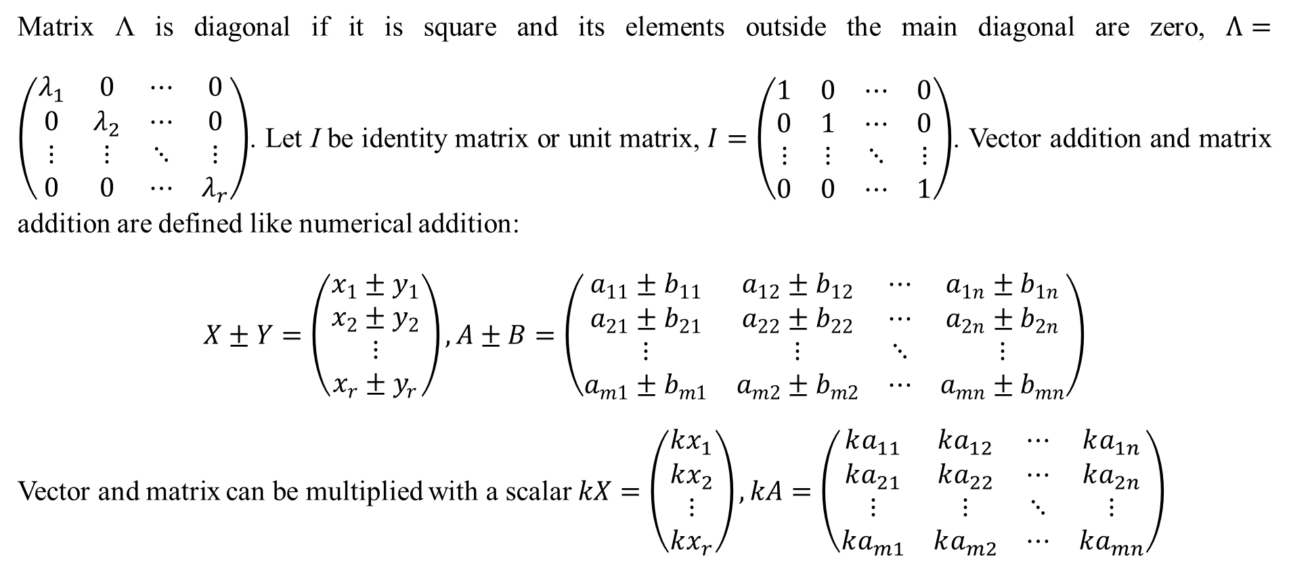
1. Basic concepts
Matrix Λ is diagonal if it is square and its elements outside the main diagonal are zero, $Λ=\left(\begin{matrix}λ_{1} & 0 & ⋯ & 0 \\ 0 & λ_{2} & ⋯ & 0 \\ ⋮ & ⋮ & ⋱ & ⋮ \\ 0 & 0 & ⋯ & λ_{r}\end{matrix}\right)$. Let I be identity matrix or unit matrix, $I=\left(\begin{matrix}1 & 0 & ⋯ & 0 \\ 0 & 1 & ⋯ & 0 \\ ⋮ & ⋮ & ⋱ & ⋮ \\ 0 & 0 & ⋯ & 1\end{matrix}\right)$. Vector addition and matrix addition are defined like numerical addition:
$$X±Y=\left(\begin{matrix}x_{1}±y_{1} \\ x_{2}±y_{2} \\ ⋮ \\ x_{r}±y_{r}\end{matrix}\right),A±B=\left(\begin{matrix}a_{11}±b_{11} & a_{12}±b_{12} & ⋯ & a_{1n}±b_{1n} \\ a_{21}±b_{21} & a_{22}±b_{22} & ⋯ & a_{2n}±b_{2n} \\ ⋮ & ⋮ & ⋱ & ⋮ \\ a_{m1}±b_{m1} & a_{m2}±b_{m2} & ⋯ & a_{mn}±b_{mn}\end{matrix}\right)$$
Vector and matrix can be multiplied with a scalar $kX=\left(\begin{matrix}kx_{1} \\ kx_{2} \\ ⋮ \\ kx_{r}\end{matrix}\right),kA=\left(\begin{matrix}ka_{11} & ka_{12} & ⋯ & ka_{1n} \\ ka_{21} & ka_{22} & ⋯ & ka_{2n} \\ ⋮ & ⋮ & ⋱ & ⋮ \\ ka_{m1} & ka_{m2} & ⋯ & ka_{mn}\end{matrix}\right)$

Slide 6
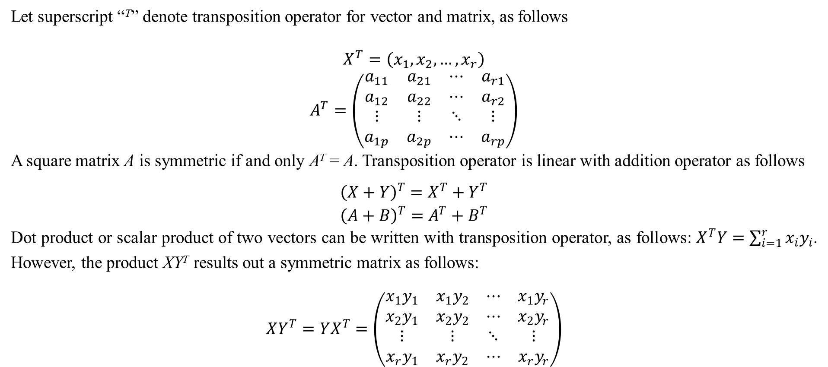
1. Basic concepts
Let superscript “^{T}” denote transposition operator for vector and matrix, as follows
$$\begin{matrix}X^{T}=\left(x_{1},x_{2},…,x_{r}\right) \\ A^{T}=\left(\begin{matrix}a_{11} & a_{21} & ⋯ & a_{r1} \\ a_{12} & a_{22} & ⋯ & a_{r2} \\ ⋮ & ⋮ & ⋱ & ⋮ \\ a_{1p} & a_{2p} & ⋯ & a_{rp}\end{matrix}\right)\end{matrix}$$
A square matrix A is symmetric if and only A^{T} = A. Transposition operator is linear with addition operator as follows
$$\begin{matrix}{\left(X+Y\right)}^{T}=X^{T}+Y^{T} \\ {\left(A+B\right)}^{T}=A^{T}+B^{T}\end{matrix}$$
Dot product or scalar product of two vectors can be written with transposition operator, as follows: $X^{T}Y=\sum_{i=1}^{r}{x_{i}y_{i}}$. However, the product XY^{T} results out a symmetric matrix as follows:
$$XY^{T}=YX^{T}=\left(\begin{matrix}x_{1}y_{1} & x_{1}y_{2} & ⋯ & x_{1}y_{r} \\ x_{2}y_{1} & x_{2}y_{2} & ⋯ & x_{2}y_{r} \\ ⋮ & ⋮ & ⋱ & ⋮ \\ x_{r}y_{1} & x_{r}y_{2} & ⋯ & x_{r}y_{r}\end{matrix}\right)$$

Slide 7
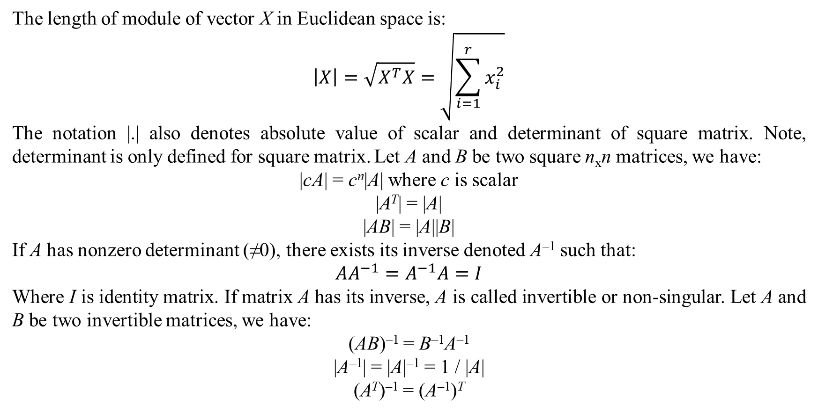
1. Basic concepts
The length of module of vector X in Euclidean space is:
$$\left|X\right|=\sqrt{X^{T}X}=\sqrt{\sum_{i=1}^{r}{x_{i}^{2}}}$$
The notation |.| also denotes absolute value of scalar and determinant of square matrix. Note, determinant is only defined for square matrix. Let A and B be two square n_{x}n matrices, we have:
|cA| = c^{n}|A| where c is scalar
|A^{T}| = |A|
|AB| = |A||B|
If A has nonzero determinant (≠0), there exists its inverse denoted A^{–1} such that:
$$AA^{−1}=A^{−1}A=I$$
Where I is identity matrix. If matrix A has its inverse, A is called invertible or non-singular. Let A and B be two invertible matrices, we have:
(AB)^{–1} = B^{–1}A^{–1}
|A^{–1}| = |A|^{–1} = 1 / |A|
(A^{T})^{–1} = (A^{–1})^{T}

Slide 8
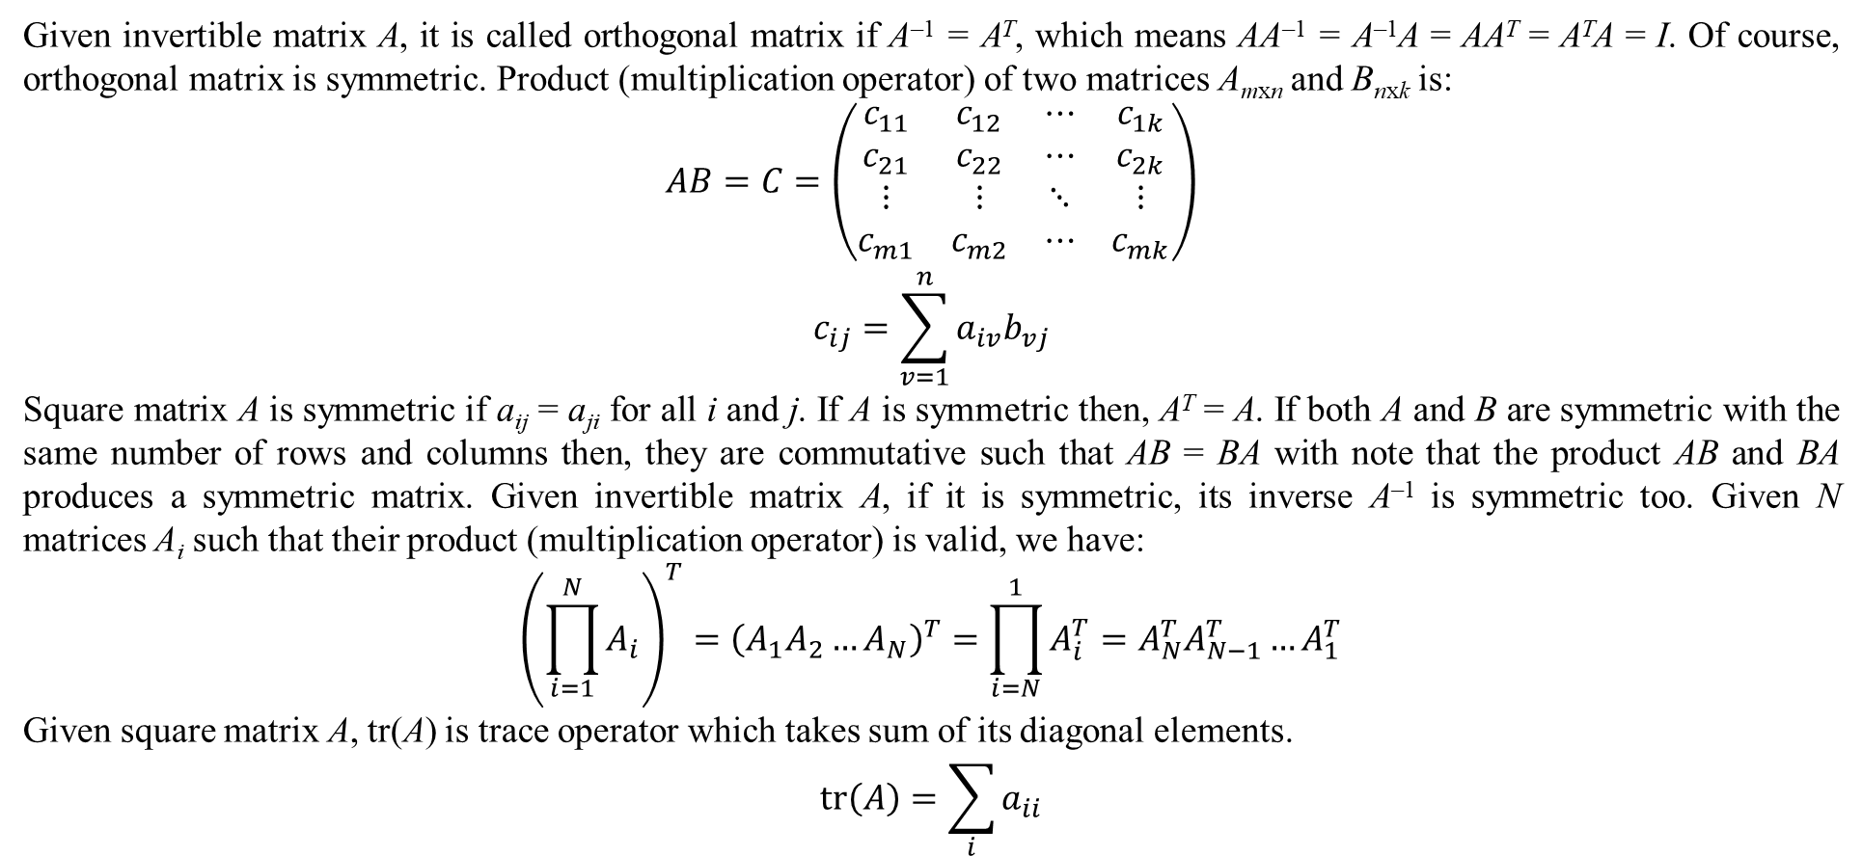
1. Basic concepts
Given invertible matrix A, it is called orthogonal matrix if A^{–1} = A^{T}, which means AA^{–1} = A^{–1}A = AA^{T} = A^{T}A = I. Of course, orthogonal matrix is symmetric. Product (multiplication operator) of two matrices A_{mxn} and B_{nxk} is:
$$\begin{matrix}AB=C=\left(\begin{matrix}c_{11} & c_{12} & ⋯ & c_{1k} \\ c_{21} & c_{22} & ⋯ & c_{2k} \\ ⋮ & ⋮ & ⋱ & ⋮ \\ c_{m1} & c_{m2} & ⋯ & c_{mk}\end{matrix}\right) \\ c_{ij}=\sum_{v=1}^{n}{a_{iv}b_{vj}}\end{matrix}$$
Square matrix A is symmetric if a_{ij} = a_{ji} for all i and j. If A is symmetric then, A^{T} = A. If both A and B are symmetric with the same number of rows and columns then, they are commutative such that AB = BA with note that the product AB and BA produces a symmetric matrix. Given invertible matrix A, if it is symmetric, its inverse A^{–1} is symmetric too. Given N matrices A_{i} such that their product (multiplication operator) is valid, we have:
$${\left(\prod_{i=1}^{N}{A_{i}}\right)}^{T}={\left(A_{1}A_{2}…A_{N}\right)}^{T}=\prod_{i=N}^{1}{A_{i}^{T}}=A_{N}^{T}A_{N−1}^{T}…A_{1}^{T}$$
Given square matrix A, tr(A) is trace operator which takes sum of its diagonal elements.
$$tr\left(A\right)=\sum_{i}{a_{ii}}$$

Slide 9
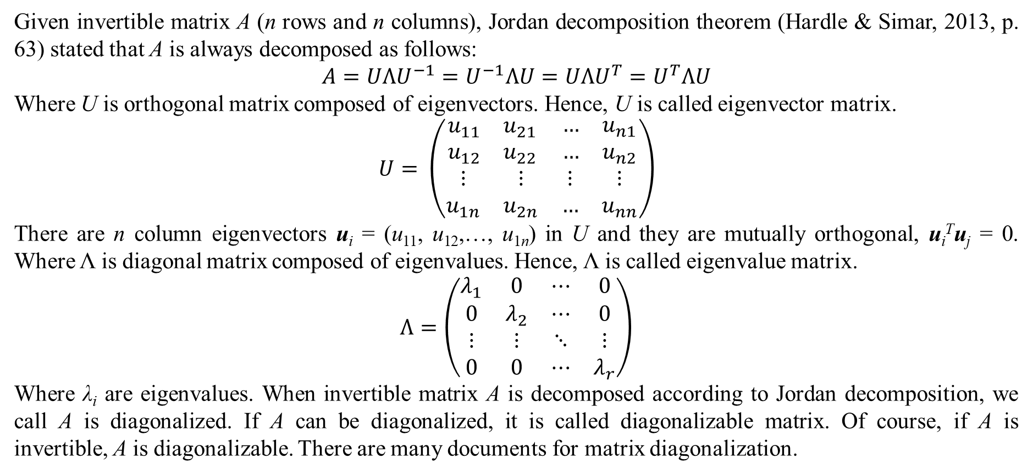
1. Basic concepts
Given invertible matrix A (n rows and n columns), Jordan decomposition theorem (Hardle & Simar, 2013, p. 63) stated that A is always decomposed as follows:
$$A=UΛU^{−1}=U^{−1}ΛU=UΛU^{T}=U^{T}ΛU$$
Where U is orthogonal matrix composed of eigenvectors. Hence, U is called eigenvector matrix.
$$U= \left(\begin{matrix}\begin{matrix}u_{11} & u_{21} \\ u_{12} & u_{22}\end{matrix} & \begin{matrix}… & u_{n1} \\ … & u_{n2}\end{matrix} \\ \begin{matrix}⋮ & ⋮ \\ u_{1n} & u_{2n}\end{matrix} & \begin{matrix}⋮ & ⋮ \\ … & u_{nn}\end{matrix}\end{matrix}\right)$$
There are n column eigenvectors u_{i} = (u₁₁, u₁₂,…, u_{1n}) in U and they are mutually orthogonal, u_{i}^{T}u_{j} = 0. Where Λ is diagonal matrix composed of eigenvalues. Hence, Λ is called eigenvalue matrix.
$$Λ=\left(\begin{matrix}λ_{1} & 0 & ⋯ & 0 \\ 0 & λ_{2} & ⋯ & 0 \\ ⋮ & ⋮ & ⋱ & ⋮ \\ 0 & 0 & ⋯ & λ_{r}\end{matrix}\right)$$
Where λ_{i} are eigenvalues. When invertible matrix A is decomposed according to Jordan decomposition, we call A is diagonalized. If A can be diagonalized, it is called diagonalizable matrix. Of course, if A is invertible, A is diagonalizable. There are many documents for matrix diagonalization.

Slide 10
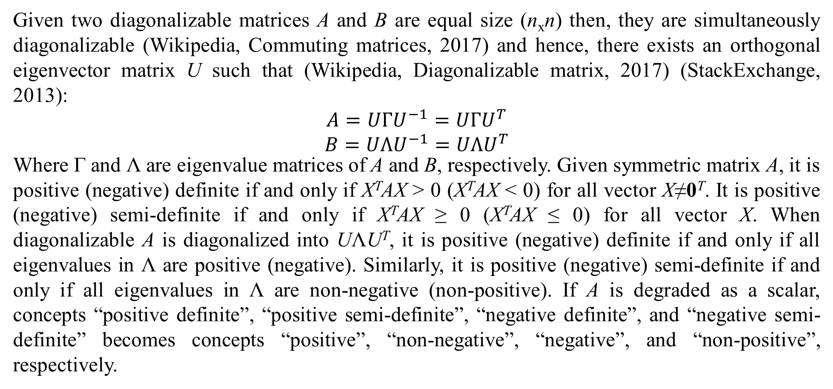
1. Basic concepts
Given two diagonalizable matrices A and B are equal size (n_{x}n) then, they are simultaneously diagonalizable (Wikipedia, Commuting matrices, 2017) and hence, there exists an orthogonal eigenvector matrix U such that (Wikipedia, Diagonalizable matrix, 2017) (StackExchange, 2013):
$$\begin{matrix}A=UΓU^{−1}=UΓU^{T} \\ B=UΛU^{−1}=UΛU^{T}\end{matrix}$$
Where Γ and Λ are eigenvalue matrices of A and B, respectively. Given symmetric matrix A, it is positive (negative) definite if and only if X^{T}AX > 0 (X^{T}AX < 0) for all vector X≠0^{T}. It is positive (negative) semi-definite if and only if X^{T}AX ≥ 0 (X^{T}AX ≤ 0) for all vector X. When diagonalizable A is diagonalized into UΛU^{T}, it is positive (negative) definite if and only if all eigenvalues in Λ are positive (negative). Similarly, it is positive (negative) semi-definite if and only if all eigenvalues in Λ are non-negative (non-positive). If A is degraded as a scalar, concepts “positive definite”, “positive semi-definite”, “negative definite”, and “negative semi-definite” becomes concepts “positive”, “non-negative”, “negative”, and “non-positive”, respectively.

Slide 11
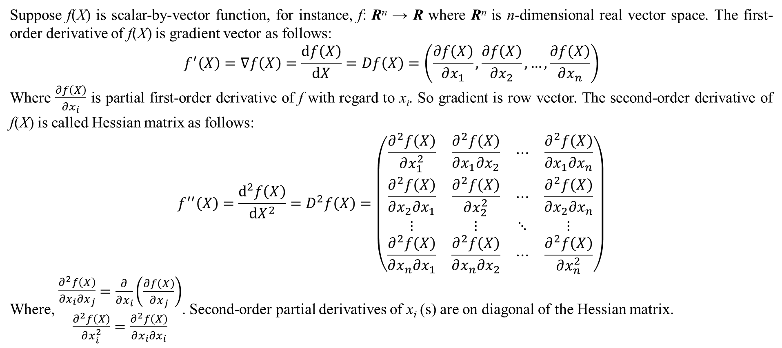
1. Basic concepts
Suppose f(X) is scalar-by-vector function, for instance, f: R^{n} → R where R^{n} is n-dimensional real vector space. The first-order derivative of f(X) is gradient vector as follows:
$$f^{′}\left(X\right)=∇f\left(X\right)=\frac{df\left(X\right)}{dX}=Df\left(X\right)=\left(\frac{∂f\left(X\right)}{∂x_{1}}, \frac{∂f\left(X\right)}{∂x_{2}},…,\frac{∂f\left(X\right)}{∂x_{n}}\right)$$
Where $\frac{∂f\left(X\right)}{∂x_{i}}$ is partial first-order derivative of f with regard to x_{i}. So gradient is row vector. The second-order derivative of f(X) is called Hessian matrix as follows:
$$f^{′′}\left(X\right)=\frac{d^{2}f\left(X\right)}{{dX}^{2}}=D^{2}f\left(X\right)=\left(\begin{matrix}\frac{∂^{2}f\left(X\right)}{∂x_{1}^{2}} & \frac{∂^{2}f\left(X\right)}{∂x_{1}∂x_{2}} & ⋯ & \frac{∂^{2}f\left(X\right)}{∂x_{1}∂x_{n}} \\ \frac{∂^{2}f\left(X\right)}{∂x_{2}∂x_{1}} & \frac{∂^{2}f\left(X\right)}{∂x_{2}^{2}} & ⋯ & \frac{∂^{2}f\left(X\right)}{∂x_{2}∂x_{n}} \\ ⋮ & ⋮ & ⋱ & ⋮ \\ \frac{∂^{2}f\left(X\right)}{∂x_{n}∂x_{1}} & \frac{∂^{2}f\left(X\right)}{∂x_{n}∂x_{2}} & ⋯ & \frac{∂^{2}f\left(X\right)}{∂x_{n}^{2}}\end{matrix}\right)$$
Where, $\begin{matrix}\begin{matrix}\frac{∂^{2}f\left(X\right)}{∂x_{i}∂x_{j}}\end{matrix}=\frac{∂}{∂x_{i}}\left(\frac{∂f\left(X\right)}{∂x_{j}}\right) \\ \frac{∂^{2}f\left(X\right)}{∂x_{i}^{2}}=\frac{∂^{2}f\left(X\right)}{∂x_{i}∂x_{i}}\end{matrix}$. Second-order partial derivatives of x_{i} (s) are on diagonal of the Hessian matrix.

Slide 12
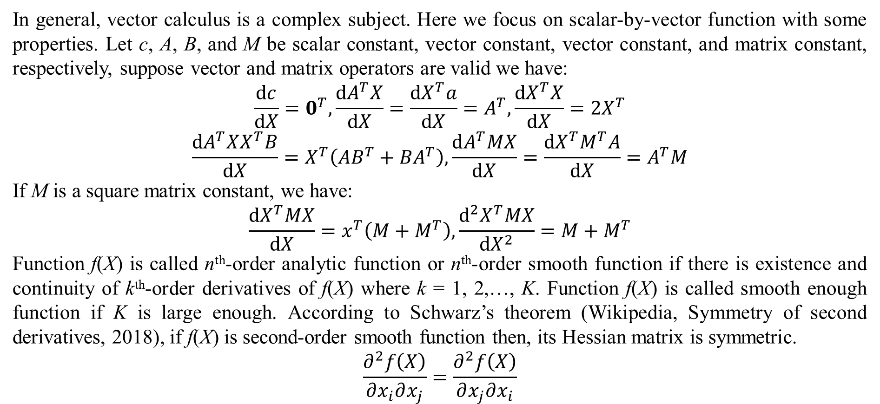
1. Basic concepts
In general, vector calculus is a complex subject. Here we focus on scalar-by-vector function with some properties. Let c, A, B, and M be scalar constant, vector constant, vector constant, and matrix constant, respectively, suppose vector and matrix operators are valid we have:
$$\frac{dc}{dX}=0^{T},\frac{dA^{T}X}{dX}=\frac{dX^{T}a}{dX}=A^{T},\frac{dX^{T}X}{dX}=2X^{T}$$
$$\frac{dA^{T}XX^{T}B}{dX}=X^{T}\left(AB^{T}+BA^{T}\right),\frac{dA^{T}MX}{dX}=\frac{dX^{T}M^{T}A}{dX}=A^{T}M$$
If M is a square matrix constant, we have:
$$\frac{dX^{T}MX}{dX}=x^{T}\left(M+M^{T}\right),\frac{d^{2}X^{T}MX}{dX^{2}}=M+M^{T}$$
Function f(X) is called n^{th}-order analytic function or n^{th}-order smooth function if there is existence and continuity of k^{th}-order derivatives of f(X) where k = 1, 2,…, K. Function f(X) is called smooth enough function if K is large enough. According to Schwarz’s theorem (Wikipedia, Symmetry of second derivatives, 2018), if f(X) is second-order smooth function then, its Hessian matrix is symmetric.
$$\frac{∂^{2}f\left(X\right)}{∂x_{i}∂x_{j}}=\frac{∂^{2}f\left(X\right)}{∂x_{j}∂x_{i}}$$

Slide 13
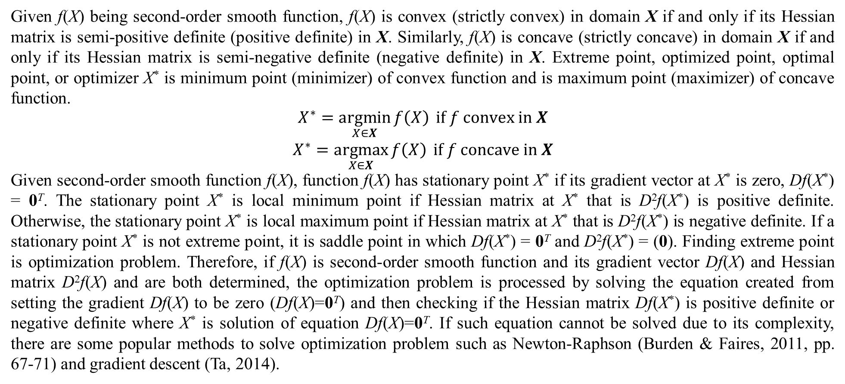
1. Basic concepts
Given f(X) being second-order smooth function, f(X) is convex (strictly convex) in domain X if and only if its Hessian matrix is semi-positive definite (positive definite) in X. Similarly, f(X) is concave (strictly concave) in domain X if and only if its Hessian matrix is semi-negative definite (negative definite) in X. Extreme point, optimized point, optimal point, or optimizer X* is minimum point (minimizer) of convex function and is maximum point (maximizer) of concave function.
$$\begin{matrix}X^{∗}=\underset{X∈X}{argmin}{f\left(X\right)} if f convex in X \\ X^{∗}=\underset{X∈X}{argmax}{f\left(X\right)} if f concave in X\end{matrix}$$
Given second-order smooth function f(X), function f(X) has stationary point X* if its gradient vector at X* is zero, Df(X*) = 0^{T}. The stationary point X* is local minimum point if Hessian matrix at X* that is D²f(X*) is positive definite. Otherwise, the stationary point X* is local maximum point if Hessian matrix at X* that is D²f(X*) is negative definite. If a stationary point X* is not extreme point, it is saddle point in which Df(X*) = 0^{T} and D²f(X*) = (0). Finding extreme point is optimization problem. Therefore, if f(X) is second-order smooth function and its gradient vector Df(X) and Hessian matrix D²f(X) and are both determined, the optimization problem is processed by solving the equation created from setting the gradient Df(X) to be zero (Df(X)=0^{T}) and then checking if the Hessian matrix Df(X*) is positive definite or negative definite where X* is solution of equation Df(X)=0^{T}. If such equation cannot be solved due to its complexity, there are some popular methods to solve optimization problem such as Newton-Raphson (Burden & Faires, 2011, pp. 67-71) and gradient descent (Ta, 2014).

Slide 14
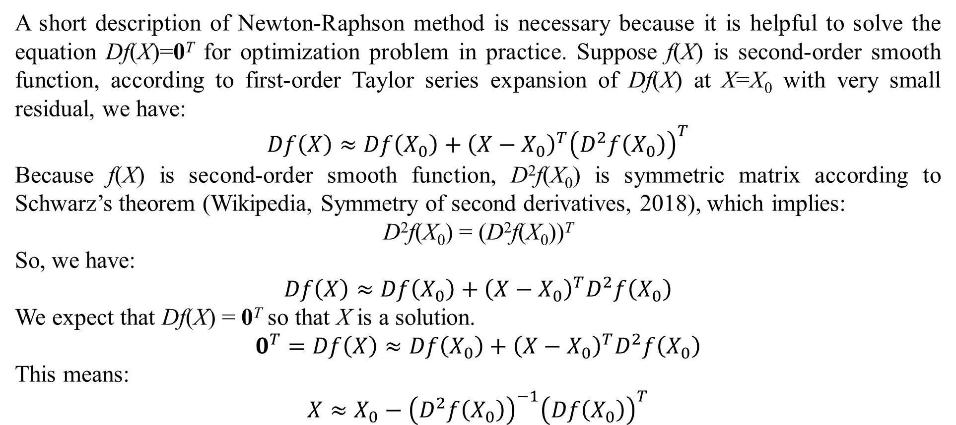
1. Basic concepts
A short description of Newton-Raphson method is necessary because it is helpful to solve the equation Df(X)=0^{T} for optimization problem in practice. Suppose f(X) is second-order smooth function, according to first-order Taylor series expansion of Df(X) at X=X₀ with very small residual, we have:
$$Df\left(X\right)≈Df\left(X_{0}\right)+{\left(X−X_{0}\right)}^{T}{\left(D^{2}f\left(X_{0}\right)\right)}^{T}$$
Because f(X) is second-order smooth function, D²f(X₀) is symmetric matrix according to Schwarz’s theorem (Wikipedia, Symmetry of second derivatives, 2018), which implies:
D²f(X₀) = (D²f(X₀))^{T}
So, we have:
$$Df\left(X\right)≈Df\left(X_{0}\right)+{\left(X−X_{0}\right)}^{T}D^{2}f\left(X_{0}\right)$$
We expect that Df(X) = 0^{T} so that X is a solution.
$$0^{T}=Df\left(X\right)≈Df\left(X_{0}\right)+{\left(X−X_{0}\right)}^{T}D^{2}f\left(X_{0}\right)$$
This means:
$$X≈X_{0}−{\left(D^{2}f\left(X_{0}\right)\right)}^{−1}{\left(Df\left(X_{0}\right)\right)}^{T}$$

Slide 15
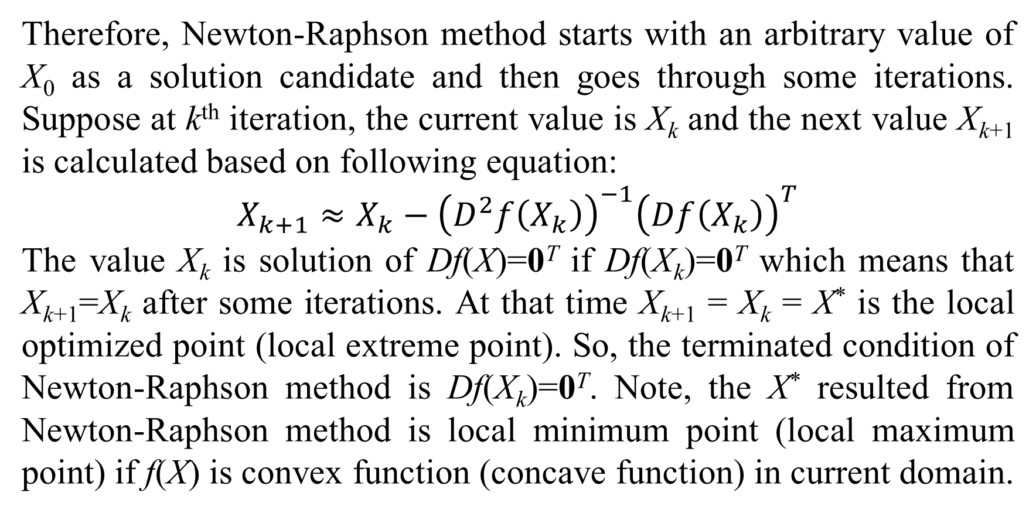
1. Basic concepts
Therefore, Newton-Raphson method starts with an arbitrary value of X₀ as a solution candidate and then goes through some iterations. Suppose at k^{th} iteration, the current value is X_{k} and the next value X_{k+1} is calculated based on following equation:
$$X_{k+1}≈X_{k}−{\left(D^{2}f\left(X_{k}\right)\right)}^{−1}{\left(Df\left(X_{k}\right)\right)}^{T}$$
The value X_{k} is solution of Df(X)=0^{T} if Df(X_{k})=0^{T} which means that X_{k+1}=X_{k} after some iterations. At that time X_{k+1} = X_{k} = X* is the local optimized point (local extreme point). So, the terminated condition of Newton-Raphson method is Df(X_{k})=0^{T}. Note, the X* resulted from Newton-Raphson method is local minimum point (local maximum point) if f(X) is convex function (concave function) in current domain.

Slide 16
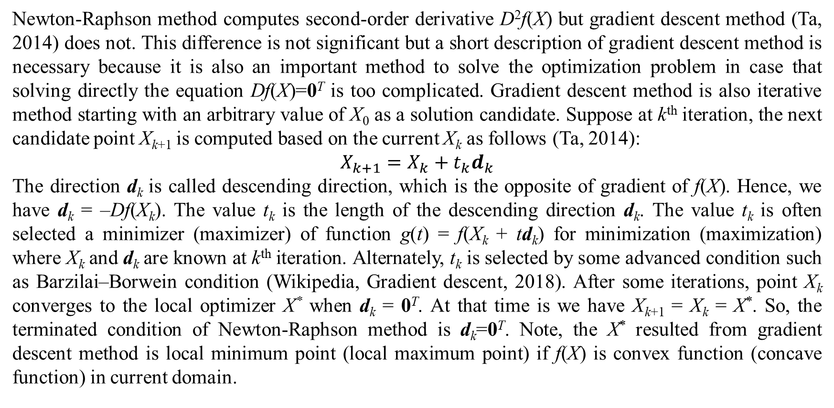
1. Basic concepts
Newton-Raphson method computes second-order derivative D²f(X) but gradient descent method (Ta, 2014) does not. This difference is not significant but a short description of gradient descent method is necessary because it is also an important method to solve the optimization problem in case that solving directly the equation Df(X)=0^{T} is too complicated. Gradient descent method is also iterative method starting with an arbitrary value of X₀ as a solution candidate. Suppose at k^{th} iteration, the next candidate point X_{k+1} is computed based on the current X_{k} as follows (Ta, 2014):
$$X_{k+1}=X_{k}+t_{k}d_{k}$$
The direction d_{k} is called descending direction, which is the opposite of gradient of f(X). Hence, we have d_{k} = –Df(X_{k}). The value t_{k} is the length of the descending direction d_{k}. The value t_{k} is often selected a minimizer (maximizer) of function g(t) = f(X_{k} + td_{k}) for minimization (maximization) where X_{k} and d_{k} are known at k^{th} iteration. Alternately, t_{k} is selected by some advanced condition such as Barzilai–Borwein condition (Wikipedia, Gradient descent, 2018). After some iterations, point X_{k} converges to the local optimizer X* when d_{k} = 0^{T}. At that time is we have X_{k+1} = X_{k} = X*. So, the terminated condition of Newton-Raphson method is d_{k}=0^{T}. Note, the X* resulted from gradient descent method is local minimum point (local maximum point) if f(X) is convex function (concave function) in current domain.

Slide 17
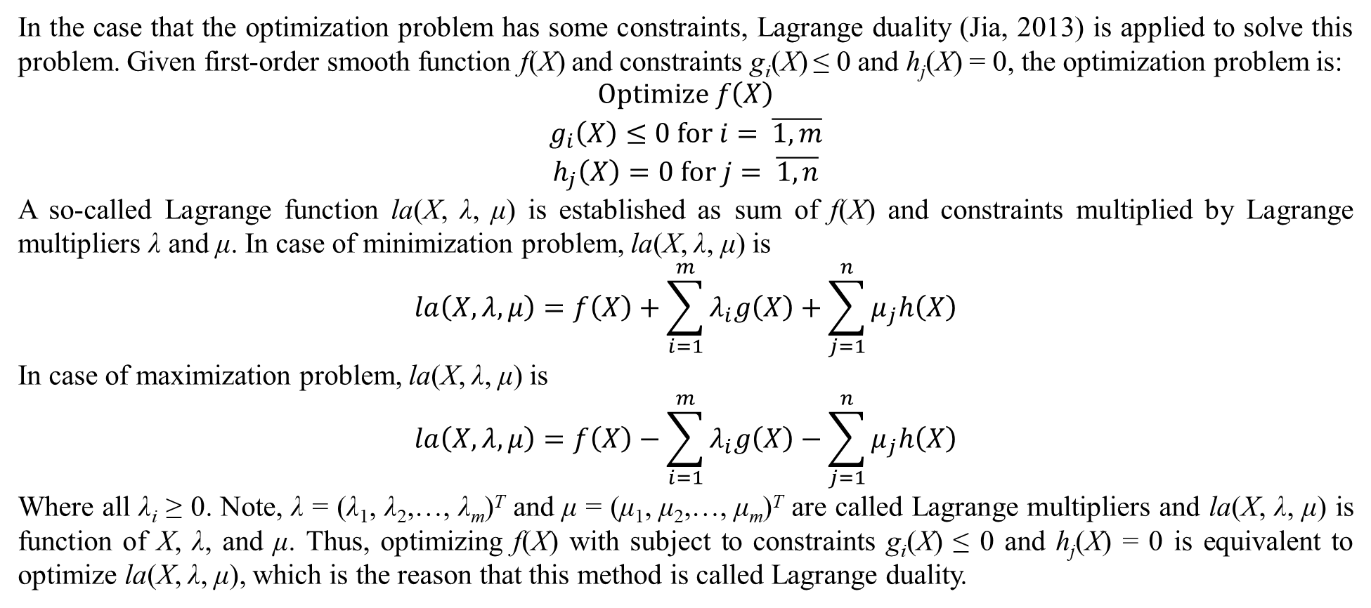
1. Basic concepts
In the case that the optimization problem has some constraints, Lagrange duality (Jia, 2013) is applied to solve this problem. Given first-order smooth function f(X) and constraints g_{i}(X) ≤ 0 and h_{j}(X) = 0, the optimization problem is:
$$\begin{matrix}Optimize f\left(X\right) \\ g_{i}\left(X\right)≤0 for i= \overline{1,m} \\ h_{j}\left(X\right)=0 for j= \overline{1,n}\end{matrix}$$
A so-called Lagrange function la(X, λ, μ) is established as sum of f(X) and constraints multiplied by Lagrange multipliers λ and μ. In case of minimization problem, la(X, λ, μ) is
$$la\left(X,λ,μ\right)=f\left(X\right)+\sum_{i=1}^{m}{λ_{i}g\left(X\right)}+\sum_{j=1}^{n}{μ_{j}h\left(X\right)}$$
In case of maximization problem, la(X, λ, μ) is
$$la\left(X,λ,μ\right)=f\left(X\right)−\sum_{i=1}^{m}{λ_{i}g\left(X\right)}−\sum_{j=1}^{n}{μ_{j}h\left(X\right)}$$
Where all λ_{i} ≥ 0. Note, λ = (λ₁, λ₂,…, λ_{m})^{T} and μ = (μ₁, μ₂,…, μ_{m})^{T} are called Lagrange multipliers and la(X, λ, μ) is function of X, λ, and μ. Thus, optimizing f(X) with subject to constraints g_{i}(X) ≤ 0 and h_{j}(X) = 0 is equivalent to optimize la(X, λ, μ), which is the reason that this method is called Lagrange duality.

Slide 18
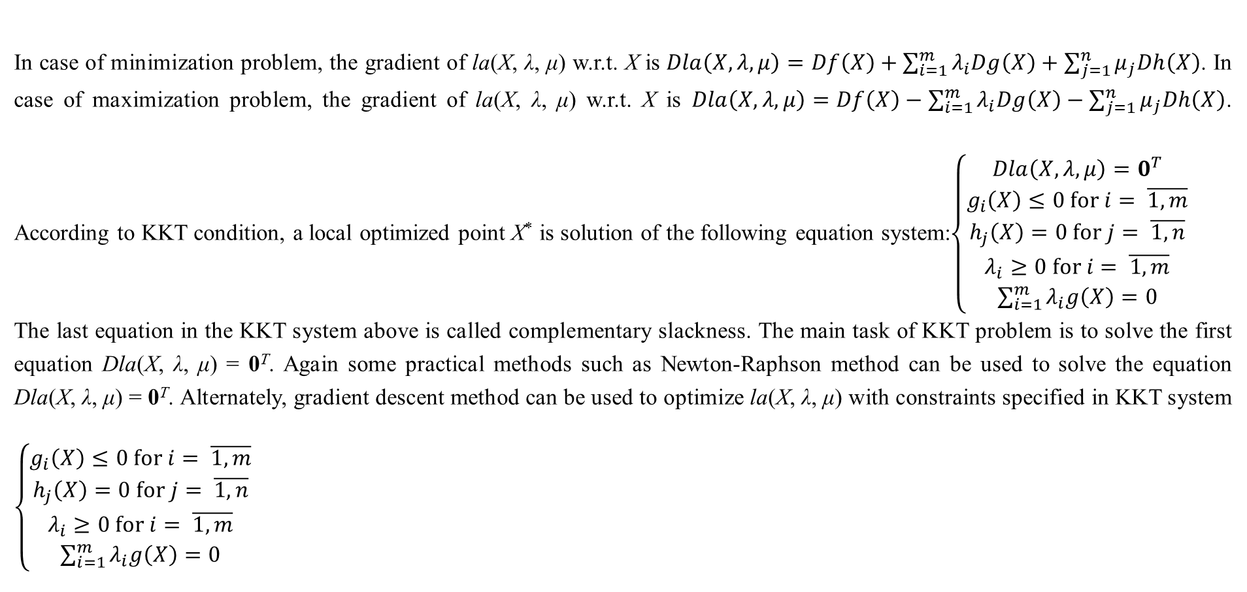
1. Basic concepts
In case of minimization problem, the gradient of la(X, λ, μ) w.r.t. X is $Dla\left(X,λ,μ\right)=Df\left(X\right)+\sum_{i=1}^{m}{λ_{i}Dg\left(X\right)}+\sum_{j=1}^{n}{μ_{j}Dh\left(X\right)}$. In case of maximization problem, the gradient of la(X, λ, μ) w.r.t. X is $Dla\left(X,λ,μ\right)=Df\left(X\right)−\sum_{i=1}^{m}{λ_{i}Dg\left(X\right)}−\sum_{j=1}^{n}{μ_{j}Dh\left(X\right)}$. According to KKT condition, a local optimized point X* is solution of the following equation system:$\left\{\begin{matrix}Dla\left(X,λ,μ\right)=0^{T} \\ g_{i}\left(X\right)≤0 for i= \overline{1,m} \\ h_{j}\left(X\right)=0 for j= \overline{1,n} \\ λ_{i}≥0 for i= \overline{1,m} \\ \sum_{i=1}^{m}{λ_{i}g\left(X\right)}=0\end{matrix}\right.$
The last equation in the KKT system above is called complementary slackness. The main task of KKT problem is to solve the first equation Dla(X, λ, μ) = 0^{T}. Again some practical methods such as Newton-Raphson method can be used to solve the equation Dla(X, λ, μ) = 0^{T}. Alternately, gradient descent method can be used to optimize la(X, λ, μ) with constraints specified in KKT system $\left\{\begin{matrix}g_{i}\left(X\right)≤0 for i= \overline{1,m} \\ h_{j}\left(X\right)=0 for j= \overline{1,n} \\ λ_{i}≥0 for i= \overline{1,m} \\ \sum_{i=1}^{m}{λ_{i}g\left(X\right)}=0\end{matrix}\right.$

Slide 19
References
Reference 1
Reference 2.
Reference 3.

Slide 20
Thank you for attention

