Slide 1
Conditional mixture model and its application for regression model
Prof. Dr. Loc Nguyen, PhD, Postdoc
Loc Nguyen’s Academic Network, Vietnam
Email: ng_phloc@yahoo.com
Homepage: www.locnguyen.net

Slide 2
Abstract
Expectation maximization (EM) algorithm is a powerful mathematical tool for estimating statistical parameter when data sample contains hidden part and observed part. EM is applied to learn finite mixture model in which the whole distribution of observed variable is average sum of partial distributions. Coverage ratio of every partial distribution is specified by the probability of hidden variable. An application of mixture model is soft clustering in which cluster is modeled by hidden variable whereas each data point can be assigned to more than one cluster and degree of such assignment is represented by the probability of hidden variable. However, such probability in traditional mixture model is simplified as a parameter, which can cause loss of valuable information. Therefore, in this research I propose a so-called conditional mixture model (CMM) in which the probability of hidden variable is modeled as a full probabilistic density function (PDF) that owns individual parameter. CMM aims to extend mixture model. I also propose an application of CMM which is called adaptive regression model (ARM). Traditional regression model is effective when data sample is scattered equally. If data points are grouped into clusters, regression model tries to learn a unified regression function which goes through all data points. Obviously, such unified function is not effective to evaluate response variable based on grouped data points. The concept “adaptive” of ARM means that ARM solves the ineffectiveness problem by selecting the best cluster of data points firstly and then evaluating response variable within such best cluster. In orther words, ARM reduces estimation space of regression model so as to gain high accuracy in calculation.

Slide 3
Table of contents
Introduction
Conditional mixture model
Adaptive regression model
Conclusions

Slide 4
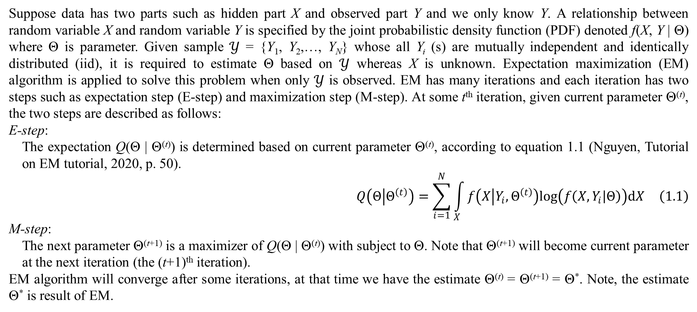
1. Introduction
Suppose data has two parts such as hidden part X and observed part Y and we only know Y. A relationship between random variable X and random variable Y is specified by the joint probabilistic density function (PDF) denoted f(X, Y | Θ) where Θ is parameter. Given sample $𝒴$ = {Y₁, Y₂,…, Y_{N}} whose all Y_{i} (s) are mutually independent and identically distributed (iid), it is required to estimate Θ based on $𝒴$ whereas X is unknown. Expectation maximization (EM) algorithm is applied to solve this problem when only $𝒴$ is observed. EM has many iterations and each iteration has two steps such as expectation step (E-step) and maximization step (M-step). At some t^{th} iteration, given current parameter Θ^{(t)}, the two steps are described as follows:
E-step:
The expectation Q(Θ | Θ^{(t)}) is determined based on current parameter Θ^{(t)}, according to equation 1.1 (Nguyen, Tutorial on EM tutorial, 2020, p. 50).
$$Q\left(Θ | Θ^{\left(t\right)}\right)=\sum_{i=1}^{N}{\int_{X}{f\left(X | Y_{i},Θ^{\left(t\right)}\right)log\left(f\left(X,Y_{i} | Θ\right)\right)dX}} \left(1.1\right)$$
M-step:
The next parameter Θ^{(t+1)} is a maximizer of Q(Θ | Θ^{(t)}) with subject to Θ. Note that Θ^{(t+1)} will become current parameter at the next iteration (the (t+1)^{th} iteration).
EM algorithm will converge after some iterations, at that time we have the estimate Θ^{(t)} = Θ^{(t+1)} = Θ*. Note, the estimate Θ* is result of EM.

Slide 5
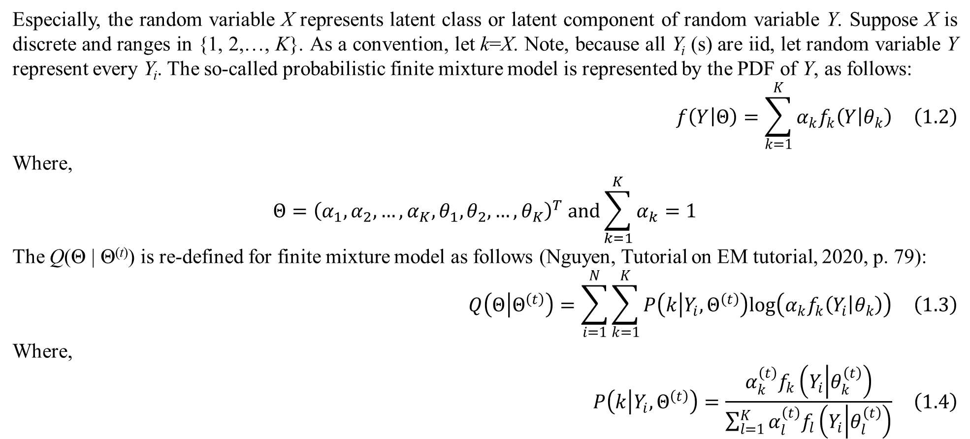
1. Introduction
Especially, the random variable X represents latent class or latent component of random variable Y. Suppose X is discrete and ranges in {1, 2,…, K}. As a convention, let k=X. Note, because all Y_{i} (s) are iid, let random variable Y represent every Y_{i}. The so-called probabilistic finite mixture model is represented by the PDF of Y, as follows:
$$f\left(Y | Θ\right)=\sum_{k=1}^{K}{α_{k}f_{k}\left(Y | θ_{k}\right)} \left(1.2\right)$$
Where,
$$Θ={\left(α_{1},α_{2},…,α_{K},θ_{1},θ_{2},…,θ_{K}\right)}^{T} and\sum_{k=1}^{K}{α_{k}}=1$$
The Q(Θ | Θ^{(t)}) is re-defined for finite mixture model as follows (Nguyen, Tutorial on EM tutorial, 2020, p. 79):
$$Q\left(Θ | Θ^{\left(t\right)}\right)=\sum_{i=1}^{N}{\sum_{k=1}^{K}{P\left(k | Y_{i},Θ^{\left(t\right)}\right)log\left(α_{k}f_{k}\left(Y_{i} | θ_{k}\right)\right)}} \left(1.3\right)$$
Where,
$$P\left(k | Y_{i},Θ^{\left(t\right)}\right)=\frac{α_{k}^{\left(t\right)}f_{k}\left(Y_{i} | θ_{k}^{\left(t\right)}\right)}{\sum_{l=1}^{K}{α_{l}^{\left(t\right)}f_{l}\left(Y_{i} | θ_{l}^{\left(t\right)}\right)}} \left(1.4\right)$$

Slide 6
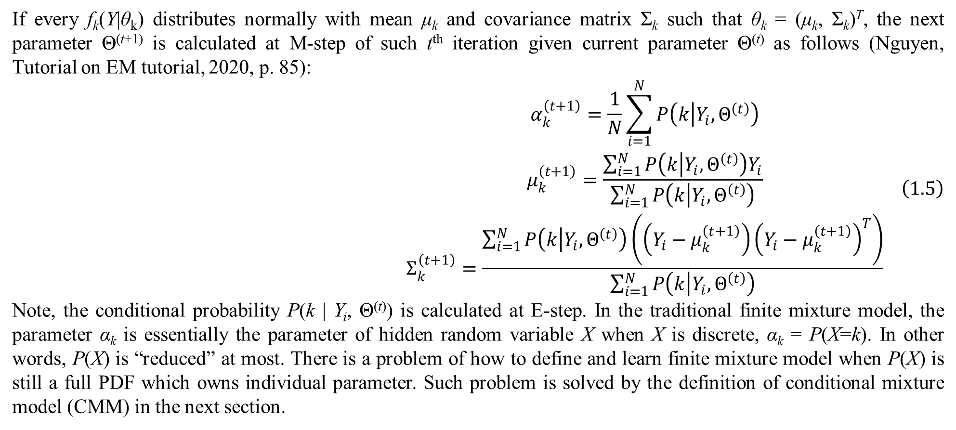
1. Introduction
If every f_{k}(Y|θ_{k}) distributes normally with mean μ_{k} and covariance matrix Σ_{k} such that θ_{k} = (μ_{k}, Σ_{k})^{T}, the next parameter Θ^{(t+1)} is calculated at M-step of such t^{th} iteration given current parameter Θ^{(t)} as follows (Nguyen, Tutorial on EM tutorial, 2020, p. 85):
$$\begin{matrix}α_{k}^{\left(t+1\right)}=\frac{1}{N}\sum_{i=1}^{N}{P\left(k | Y_{i},Θ^{\left(t\right)}\right)} \\ μ_{k}^{\left(t+1\right)}=\frac{\sum_{i=1}^{N}{P\left(k | Y_{i},Θ^{\left(t\right)}\right)Y_{i}}}{\sum_{i=1}^{N}{P\left(k | Y_{i},Θ^{\left(t\right)}\right)}} \\ Σ_{k}^{\left(t+1\right)}=\frac{\sum_{i=1}^{N}{P\left(k | Y_{i},Θ^{\left(t\right)}\right)\left(\left(Y_{i}−μ_{k}^{\left(t+1\right)}\right){\left(Y_{i}−μ_{k}^{\left(t+1\right)}\right)}^{T}\right)}}{\sum_{i=1}^{N}{P\left(k | Y_{i},Θ^{\left(t\right)}\right)}}\end{matrix} \left(1.5\right)$$
Note, the conditional probability P(k | Y_{i}, Θ^{(t)}) is calculated at E-step. In the traditional finite mixture model, the parameter α_{k} is essentially the parameter of hidden random variable X when X is discrete, α_{k} = P(X=k). In other words, P(X) is “reduced” at most. There is a problem of how to define and learn finite mixture model when P(X) is still a full PDF which owns individual parameter. Such problem is solved by the definition of conditional mixture model (CMM) in the next section.

Slide 7
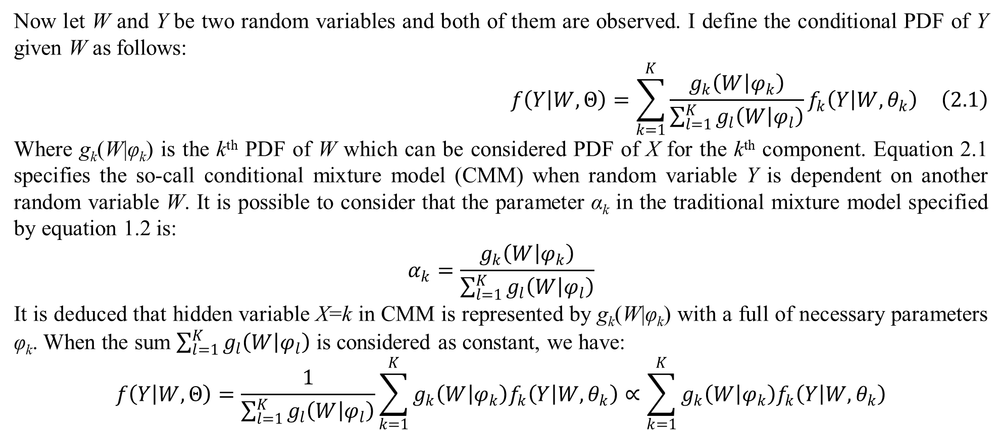
2. Conditional mixture model
Now let W and Y be two random variables and both of them are observed. I define the conditional PDF of Y given W as follows:
$$f\left(Y | W,Θ\right)=\sum_{k=1}^{K}{\frac{g_{k}\left(W | φ_{k}\right)}{\sum_{l=1}^{K}{g_{l}\left(W | φ_{l}\right)}}f_{k}\left(Y | W,θ_{k}\right)} \left(2.1\right)$$
Where g_{k}(W|φ_{k}) is the k^{th} PDF of W which can be considered PDF of X for the k^{th} component. Equation 2.1 specifies the so-call conditional mixture model (CMM) when random variable Y is dependent on another random variable W. It is possible to consider that the parameter α_{k} in the traditional mixture model specified by equation 1.2 is:
$$α_{k}=\frac{g_{k}\left(W | φ_{k}\right)}{\sum_{l=1}^{K}{g_{l}\left(W | φ_{l}\right)}}$$
It is deduced that hidden variable X=k in CMM is represented by g_{k}(W|φ_{k}) with a full of necessary parameters φ_{k}. When the sum $\sum_{l=1}^{K}{g_{l}\left(W | φ_{l}\right)}$ is considered as constant, we have:
$$f\left(Y | W,Θ\right)=\frac{1}{\sum_{l=1}^{K}{g_{l}\left(W | φ_{l}\right)}}\sum_{k=1}^{K}{g_{k}\left(W | φ_{k}\right)f_{k}\left(Y | W,θ_{k}\right)}∝\sum_{k=1}^{K}{g_{k}\left(W | φ_{k}\right)f_{k}\left(Y | W,θ_{k}\right)}$$

Slide 8
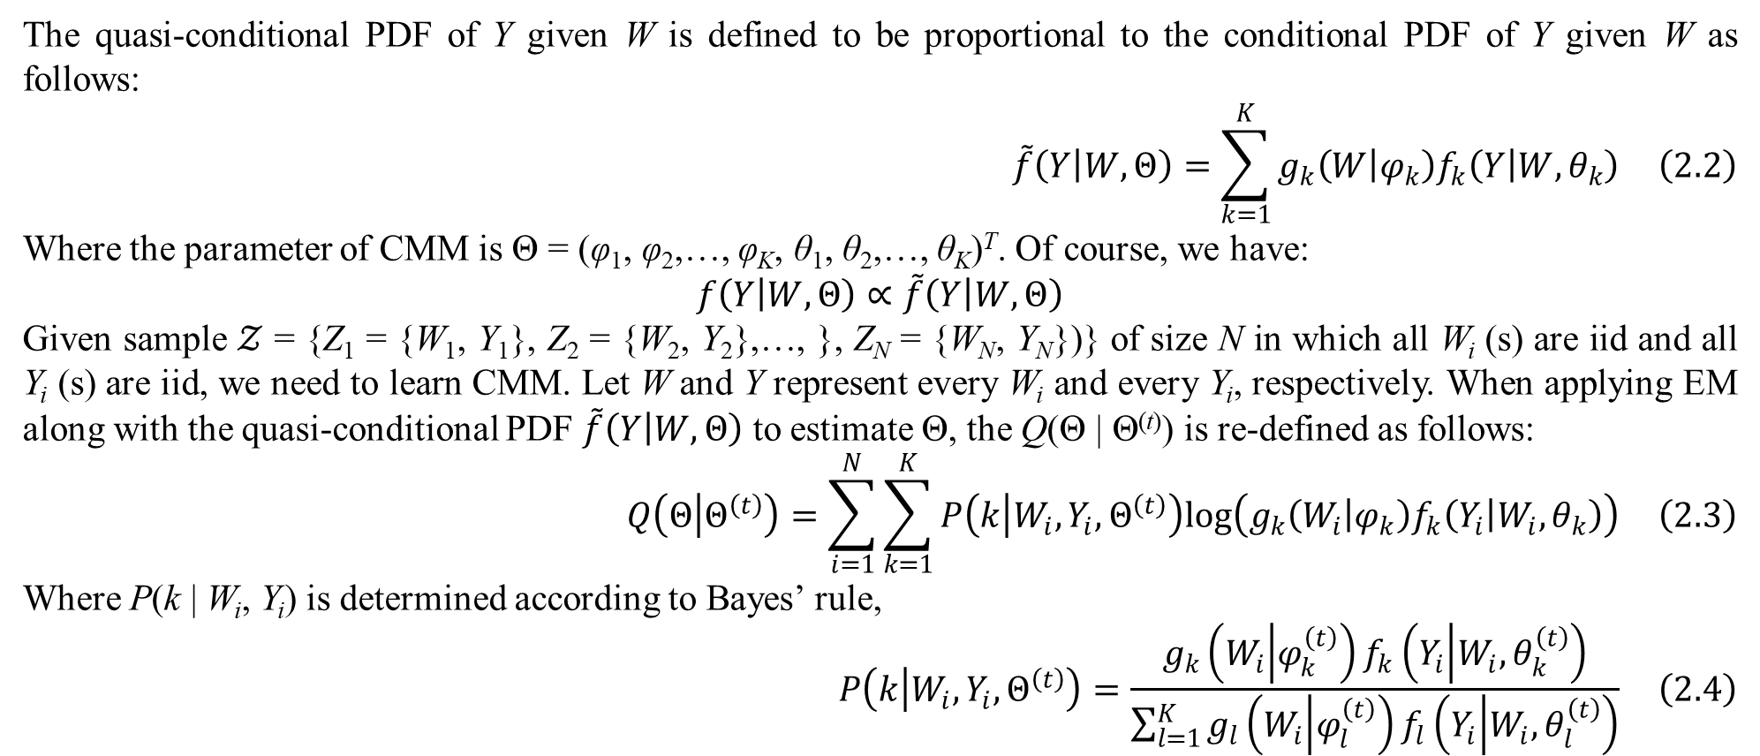
2. Conditional mixture model
The quasi-conditional PDF of Y given W is defined to be proportional to the conditional PDF of Y given W as follows:
$$\tilde{f}\left(Y | W,Θ\right)=\sum_{k=1}^{K}{g_{k}\left(W | φ_{k}\right)f_{k}\left(Y | W,θ_{k}\right)} \left(2.2\right)$$
Where the parameter of CMM is Θ = (φ₁, φ₂,…, φ_{K}, θ₁, θ₂,…, θ_{K})^{T}. Of course, we have:
$$f\left(Y | W,Θ\right)∝\tilde{f}\left(Y | W,Θ\right)$$
Given sample $𝒵$ = {Z₁ = {W₁, Y₁}, Z₂ = {W₂, Y₂},…, }, Z_{N} = {W_{N}, Y_{N}})} of size N in which all W_{i} (s) are iid and all Y_{i} (s) are iid, we need to learn CMM. Let W and Y represent every W_{i} and every Y_{i}, respectively. When applying EM along with the quasi-conditional PDF $\tilde{f}\left(Y | W,Θ\right)$ to estimate Θ, the Q(Θ | Θ^{(t)}) is re-defined as follows:
$$Q\left(Θ | Θ^{\left(t\right)}\right)=\sum_{i=1}^{N}{\sum_{k=1}^{K}{P\left(k | W_{i},Y_{i},Θ^{\left(t\right)}\right)log\left(g_{k}\left(W_{i} | φ_{k}\right)f_{k}\left(Y_{i} | W_{i},θ_{k}\right)\right)}} \left(2.3\right)$$
Where P(k | W_{i}, Y_{i}) is determined according to Bayes’ rule,
$$P\left(k | W_{i},Y_{i},Θ^{\left(t\right)}\right)=\frac{g_{k}\left(W_{i} | φ_{k}^{\left(t\right)}\right)f_{k}\left(Y_{i} | W_{i},θ_{k}^{\left(t\right)}\right)}{\sum_{l=1}^{K}{g_{l}\left(W_{i} | φ_{l}^{\left(t\right)}\right)f_{l}\left(Y_{i} | W_{i},θ_{l}^{\left(t\right)}\right)}} \left(2.4\right)$$

Slide 9
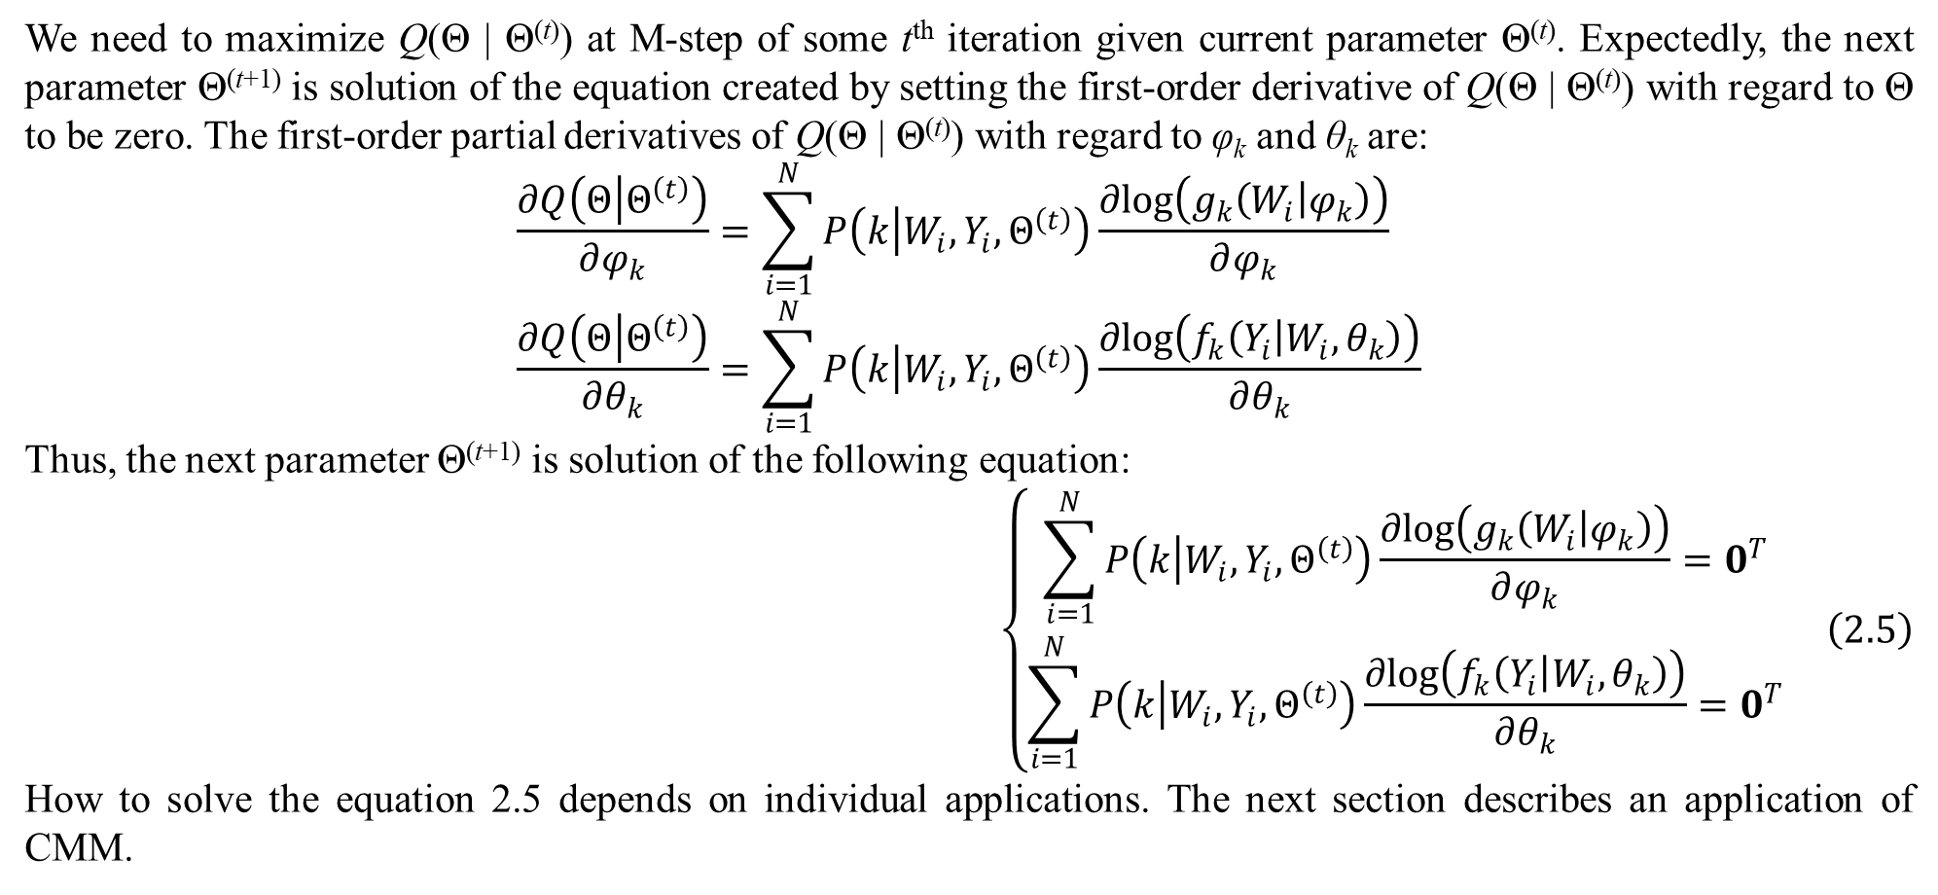
2. Conditional mixture model
We need to maximize Q(Θ | Θ^{(t)}) at M-step of some t^{th} iteration given current parameter Θ^{(t)}. Expectedly, the next parameter Θ^{(t+1)} is solution of the equation created by setting the first-order derivative of Q(Θ | Θ^{(t)}) with regard to Θ to be zero. The first-order partial derivatives of Q(Θ | Θ^{(t)}) with regard to φ_{k} and θ_{k} are:
$$\frac{∂Q\left(Θ | Θ^{\left(t\right)}\right)}{∂φ_{k}}=\sum_{i=1}^{N}{P\left(k | W_{i},Y_{i},Θ^{\left(t\right)}\right)\frac{∂log\left(g_{k}\left(W_{i} | φ_{k}\right)\right)}{∂φ_{k}}} \\ \frac{∂Q\left(Θ | Θ^{\left(t\right)}\right)}{∂θ_{k}}=\sum_{i=1}^{N}{P\left(k | W_{i},Y_{i},Θ^{\left(t\right)}\right)\frac{∂log\left(f_{k}\left(Y_{i} | W_{i},θ_{k}\right)\right)}{∂θ_{k}}}$$
Thus, the next parameter Θ^{(t+1)} is solution of the following equation:
$$\left\{\begin{matrix}\sum_{i=1}^{N}{P\left(k | W_{i},Y_{i},Θ^{\left(t\right)}\right)\frac{∂log\left(g_{k}\left(W_{i} | φ_{k}\right)\right)}{∂φ_{k}}}=0^{T} \\ \sum_{i=1}^{N}{P\left(k | W_{i},Y_{i},Θ^{\left(t\right)}\right)\frac{∂log\left(f_{k}\left(Y_{i} | W_{i},θ_{k}\right)\right)}{∂θ_{k}}}=0^{T}\end{matrix}\right. \left(2.5\right)$$
How to solve the equation 2.5 depends on individual applications. The next section describes an application of CMM.

Slide 10
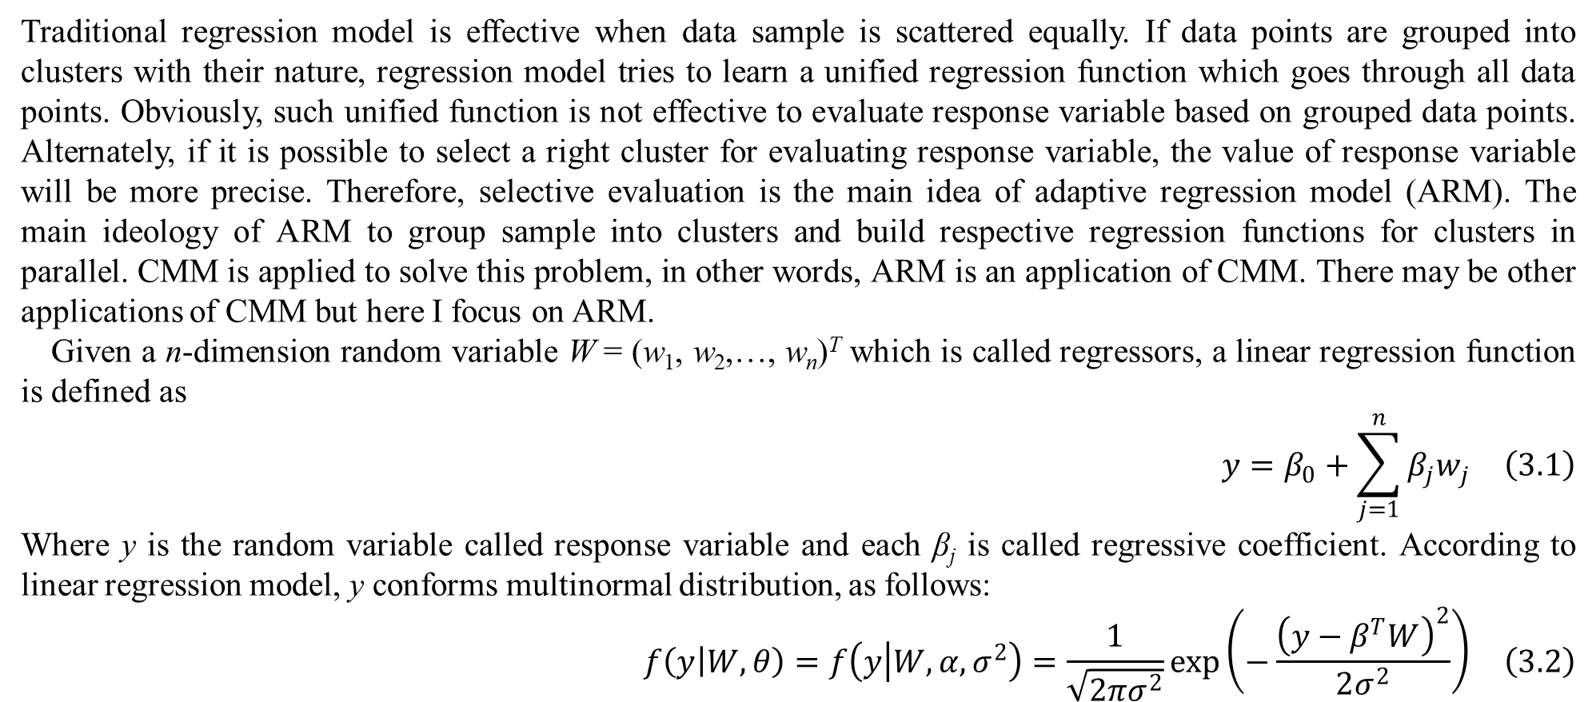
3. Adaptive regression model
Traditional regression model is effective when data sample is scattered equally. If data points are grouped into clusters with their nature, regression model tries to learn a unified regression function which goes through all data points. Obviously, such unified function is not effective to evaluate response variable based on grouped data points. Alternately, if it is possible to select a right cluster for evaluating response variable, the value of response variable will be more precise. Therefore, selective evaluation is the main idea of adaptive regression model (ARM). The main ideology of ARM to group sample into clusters and build respective regression functions for clusters in parallel. CMM is applied to solve this problem, in other words, ARM is an application of CMM. There may be other applications of CMM but here I focus on ARM.
Given a n-dimension random variable W = (w₁, w₂,…, w_{n})^{T} which is called regressors, a linear regression function is defined as
$$y=β_{0}+\sum_{j=1}^{n}{β_{j}w_{j}} \left(3.1\right)$$
Where y is the random variable called response variable and each β_{j} is called regressive coefficient. According to linear regression model, y conforms multinormal distribution, as follows:
$$f\left(y | W,θ\right)=f\left(y | W,α,σ^{2}\right)=\frac{1}{\sqrt{2πσ^{2}}}exp\left(−\frac{{\left(y−β^{T}W\right)}^{2}}{2σ^{2}}\right) \left(3.2\right)$$

Slide 11
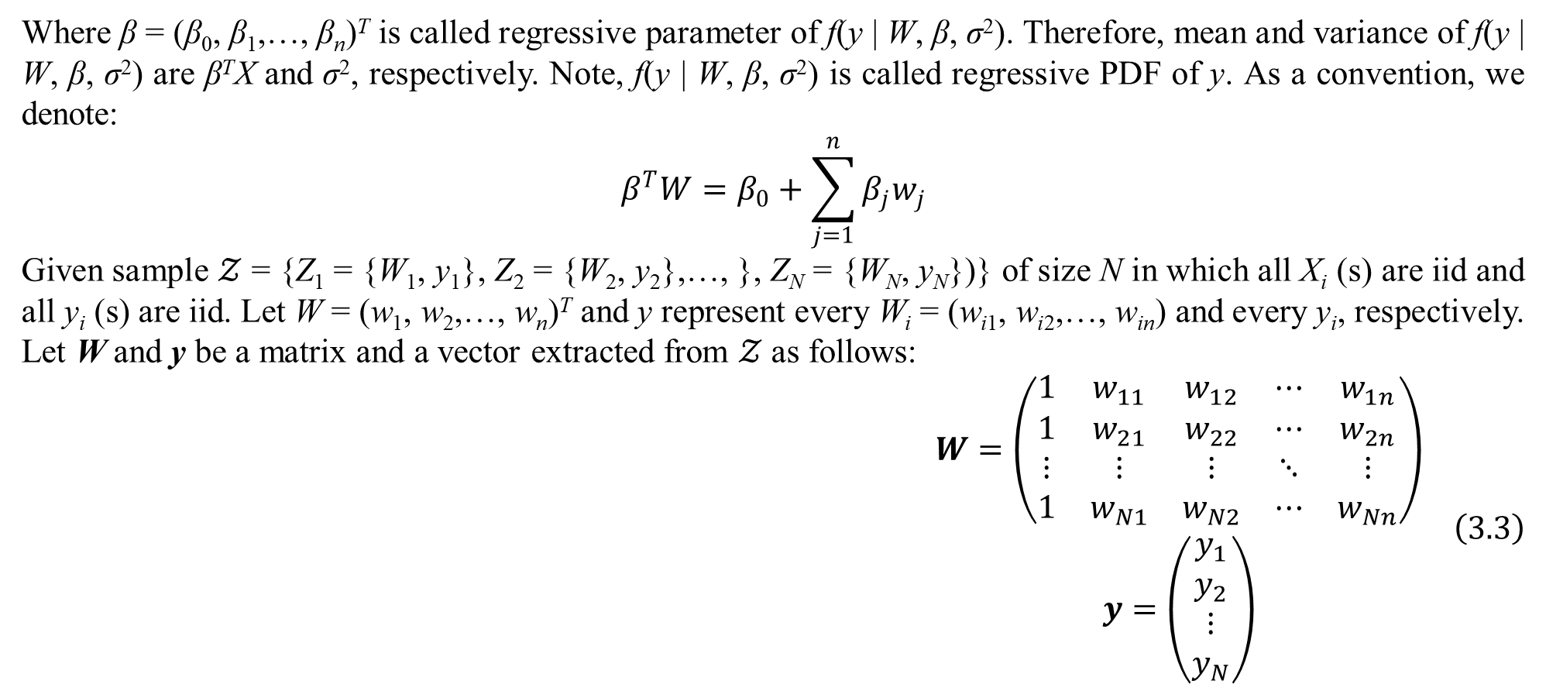
3. Adaptive regression model
Where β = (β₀, β₁,…, β_{n})^{T} is called regressive parameter of f(y | W, β, σ²). Therefore, mean and variance of f(y | W, β, σ²) are β^{T}X and σ², respectively. Note, f(y | W, β, σ²) is called regressive PDF of y. As a convention, we denote:
$$β^{T}W=β_{0}+\sum_{j=1}^{n}{β_{j}w_{j}}$$
Given sample $𝒵$ = {Z₁ = {W₁, y₁}, Z₂ = {W₂, y₂},…, }, Z_{N} = {W_{N}, y_{N}})} of size N in which all X_{i} (s) are iid and all y_{i} (s) are iid. Let W = (w₁, w₂,…, w_{n})^{T} and y represent every W_{i} = (w_{i1}, w_{i2},…, w_{in}) and every y_{i}, respectively. Let W and y be a matrix and a vector extracted from $𝒵$ as follows:
$$\begin{matrix}W=\left(\begin{matrix}1 & w_{11} & w_{12} & ⋯ & w_{1n} \\ 1 & w_{21} & w_{22} & ⋯ & w_{2n} \\ ⋮ & ⋮ & ⋮ & ⋱ & ⋮ \\ 1 & w_{N1} & w_{N2} & ⋯ & w_{Nn}\end{matrix}\right) \\ y=\left(\begin{matrix}y_{1} \\ y_{2} \\ ⋮ \\ y_{N}\end{matrix}\right)\end{matrix} \left(3.3\right)$$

Slide 12
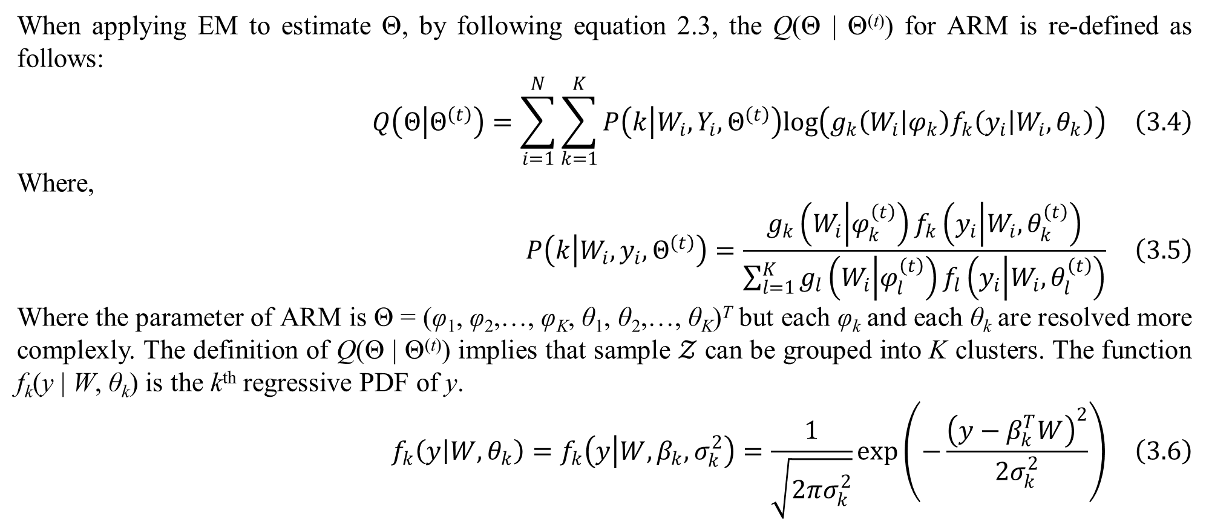
3. Adaptive regression model
When applying EM to estimate Θ, by following equation 2.3, the Q(Θ | Θ^{(t)}) for ARM is re-defined as follows:
$$Q\left(Θ | Θ^{\left(t\right)}\right)=\sum_{i=1}^{N}{\sum_{k=1}^{K}{P\left(k | W_{i},Y_{i},Θ^{\left(t\right)}\right)log\left(g_{k}\left(W_{i} | φ_{k}\right)f_{k}\left(y_{i} | W_{i},θ_{k}\right)\right)}} \left(3.4\right)$$
Where,
$$P\left(k | W_{i},y_{i},Θ^{\left(t\right)}\right)=\frac{g_{k}\left(W_{i} | φ_{k}^{\left(t\right)}\right)f_{k}\left(y_{i} | W_{i},θ_{k}^{\left(t\right)}\right)}{\sum_{l=1}^{K}{g_{l}\left(W_{i} | φ_{l}^{\left(t\right)}\right)f_{l}\left(y_{i} | W_{i},θ_{l}^{\left(t\right)}\right)}} \left(3.5\right)$$
Where the parameter of ARM is Θ = (φ₁, φ₂,…, φ_{K}, θ₁, θ₂,…, θ_{K})^{T} but each φ_{k} and each θ_{k} are resolved more complexly. The definition of Q(Θ | Θ^{(t)}) implies that sample $𝒵$ can be grouped into K clusters. The function f_{k}(y | W, θ_{k}) is the k^{th} regressive PDF of y.
$$f_{k}\left(y | W,θ_{k}\right)=f_{k}\left(y | W,β_{k},σ_{k}^{2}\right)=\frac{1}{\sqrt{2πσ_{k}^{2}}}exp\left(−\frac{{\left(y−β_{k}^{T}W\right)}^{2}}{2σ_{k}^{2}}\right) \left(3.6\right)$$

Slide 13
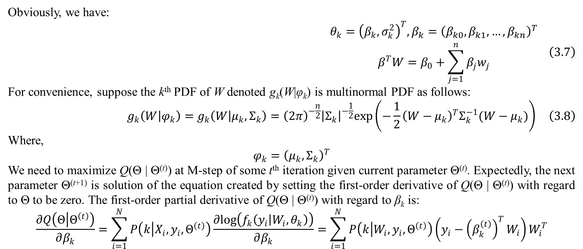
3. Adaptive regression model
Obviously, we have:
$$\begin{matrix}θ_{k}={\left(β_{k},σ_{k}^{2}\right)}^{T},β_{k}={\left(β_{k0},β_{k1},…,β_{kn}\right)}^{T} \\ β^{T}W=β_{0}+\sum_{j=1}^{n}{β_{j}w_{j}}\end{matrix} \left(3.7\right)$$
For convenience, suppose the k^{th} PDF of W denoted g_{k}(W|φ_{k}) is multinormal PDF as follows:
$$g_{k}\left(W | φ_{k}\right)=g_{k}\left(W | μ_{k},Σ_{k}\right)={\left(2π\right)}^{−\frac{n}{2}}{\left|Σ_{k}\right|}^{−\frac{1}{2}}exp\left(−\frac{1}{2}{\left(W−μ_{k}\right)}^{T}Σ_{k}^{−1}(W−μ_{k})\right) \left(3.8\right)$$
Where,
$$φ_{k}={\left(μ_{k},Σ_{k}\right)}^{T}$$
We need to maximize Q(Θ | Θ^{(t)}) at M-step of some t^{th} iteration given current parameter Θ^{(t)}. Expectedly, the next parameter Θ^{(t+1)} is solution of the equation created by setting the first-order derivative of Q(Θ | Θ^{(t)}) with regard to Θ to be zero. The first-order partial derivative of Q(Θ | Θ^{(t)}) with regard to β_{k} is:
$$\frac{∂Q\left(Θ | Θ^{\left(t\right)}\right)}{∂β_{k}}=\sum_{i=1}^{N}{P\left(k | X_{i},y_{i},Θ^{\left(t\right)}\right)\frac{∂log\left(f_{k}\left(y_{i} | W_{i},θ_{k}\right)\right)}{∂β_{k}}}=\sum_{i=1}^{N}{P\left(k | W_{i},y_{i},Θ^{\left(t\right)}\right)\left(y_{i}−{\left(β_{k}^{\left(t\right)}\right)}^{T}W_{i}\right)W_{i}^{T}}$$

Slide 14
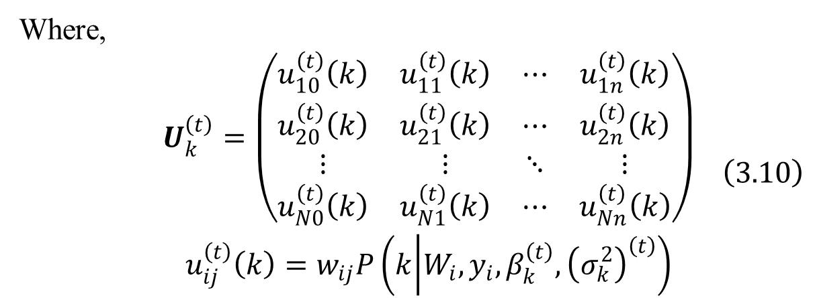
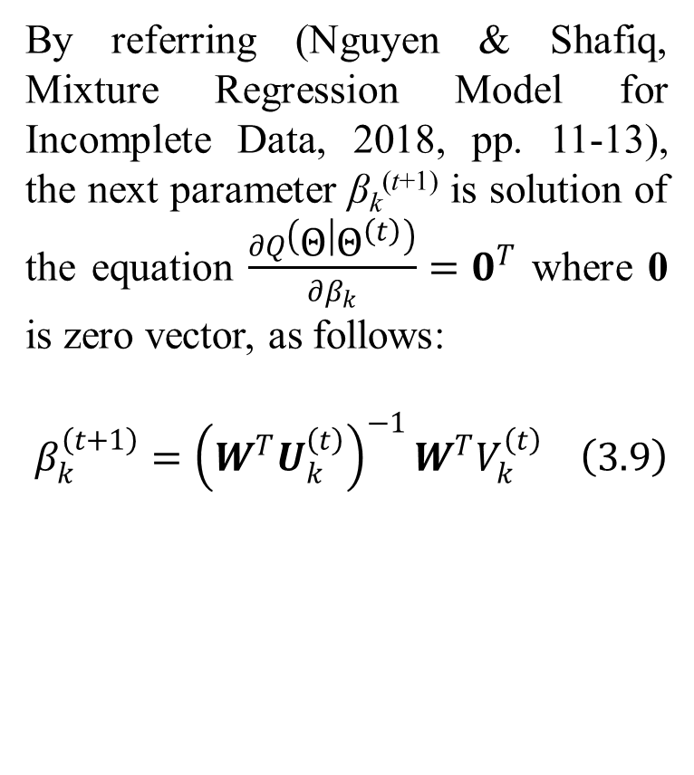
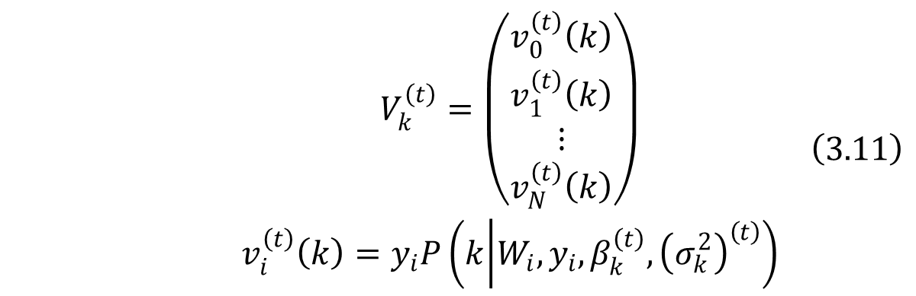
3. Adaptive regression model
By referring (Nguyen & Shafiq, Mixture Regression Model for Incomplete Data, 2018, pp. 11-13), the next parameter β_{k}^{(t+1)} is solution of the equation $\frac{∂Q\left(Θ | Θ^{\left(t\right)}\right)}{∂β_{k}}=0^{T}$ where 0 is zero vector, as follows:
$$β_{k}^{\left(t+1\right)}={\left(W^{T}U_{k}^{\left(t\right)}\right)}^{−1}W^{T}V_{k}^{\left(t\right)} \left(3.9\right)$$
Where,
$$\begin{matrix}U_{k}^{\left(t\right)}=\left(\begin{matrix}u_{10}^{\left(t\right)}\left(k\right) & u_{11}^{\left(t\right)}\left(k\right) & ⋯ & u_{1n}^{\left(t\right)}\left(k\right) \\ u_{20}^{\left(t\right)}\left(k\right) & u_{21}^{\left(t\right)}\left(k\right) & ⋯ & u_{2n}^{\left(t\right)}\left(k\right) \\ ⋮ & ⋮ & ⋱ & ⋮ \\ u_{N0}^{\left(t\right)}\left(k\right) & u_{N1}^{\left(t\right)}\left(k\right) & ⋯ & u_{Nn}^{\left(t\right)}\left(k\right)\end{matrix}\right) \\ u_{ij}^{\left(t\right)}\left(k\right)=w_{ij}P\left(k | W_{i},y_{i},β_{k}^{\left(t\right)},{\left(σ_{k}^{2}\right)}^{\left(t\right)}\right)\end{matrix} \left(3.10\right)$$
$$\begin{matrix}V_{k}^{\left(t\right)}=\left(\begin{matrix}v_{0}^{\left(t\right)}\left(k\right) \\ v_{1}^{\left(t\right)}\left(k\right) \\ ⋮ \\ v_{N}^{\left(t\right)}\left(k\right)\end{matrix}\right) \\ v_{i}^{\left(t\right)}\left(k\right)=y_{i}P\left(k | W_{i},y_{i},β_{k}^{\left(t\right)},{\left(σ_{k}^{2}\right)}^{\left(t\right)}\right)\end{matrix} \left(3.11\right)$$

Slide 15
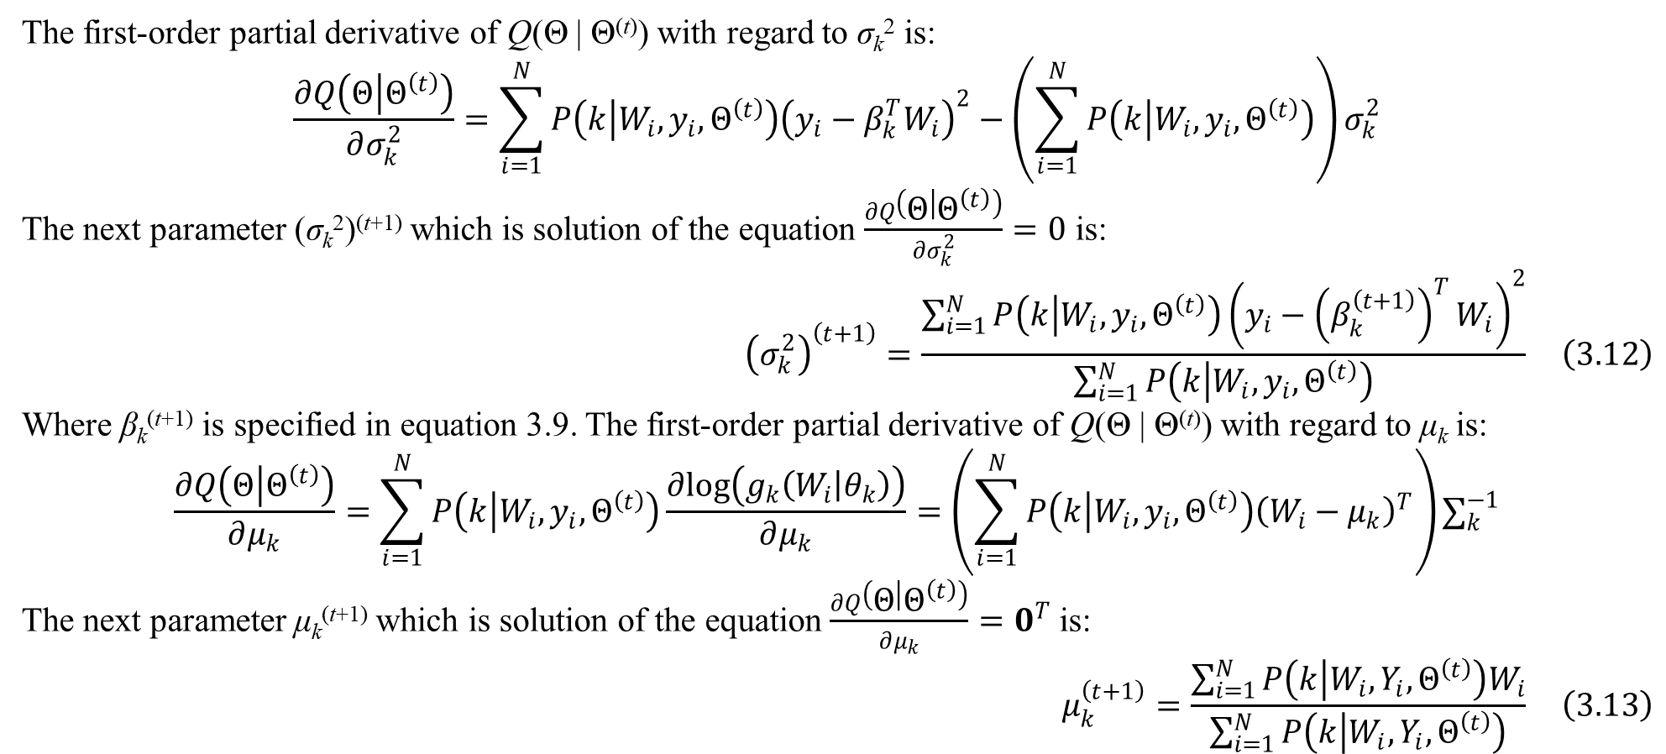
3. Adaptive regression model
The first-order partial derivative of Q(Θ | Θ^{(t)}) with regard to σ_{k}² is:
$$\frac{∂Q\left(Θ | Θ^{\left(t\right)}\right)}{∂σ_{k}^{2}}=\sum_{i=1}^{N}{P\left(k | W_{i},y_{i},Θ^{\left(t\right)}\right){\left(y_{i}−β_{k}^{T}W_{i}\right)}^{2}}−\left(\sum_{i=1}^{N}{P\left(k | W_{i},y_{i},Θ^{\left(t\right)}\right)}\right)σ_{k}^{2}$$
The next parameter (σ_{k}²)^{(t+1)} which is solution of the equation $\frac{∂Q\left(Θ | Θ^{\left(t\right)}\right)}{∂σ_{k}^{2}}=0$ is:
$${\left(σ_{k}^{2}\right)}^{\left(t+1\right)}=\frac{\sum_{i=1}^{N}{P\left(k | W_{i},y_{i},Θ^{\left(t\right)}\right){\left(y_{i}−{\left(β_{k}^{\left(t+1\right)}\right)}^{T}W_{i}\right)}^{2}}}{\sum_{i=1}^{N}{P\left(k | W_{i},y_{i},Θ^{\left(t\right)}\right)}} \left(3.12\right)$$
Where β_{k}^{(t+1)} is specified in equation 3.9. The first-order partial derivative of Q(Θ | Θ^{(t)}) with regard to μ_{k} is:
$$\frac{∂Q\left(Θ | Θ^{\left(t\right)}\right)}{∂μ_{k}}=\sum_{i=1}^{N}{P\left(k | W_{i},y_{i},Θ^{\left(t\right)}\right)\frac{∂log\left(g_{k}\left(W_{i} | θ_{k}\right)\right)}{∂μ_{k}}}=\left(\sum_{i=1}^{N}{P\left(k | W_{i},y_{i},Θ^{\left(t\right)}\right){\left(W_{i}−μ_{k}\right)}^{T}}\right)∑_{k}^{−1}$$
The next parameter μ_{k}^{(t+1)} which is solution of the equation $\frac{∂Q\left(Θ | Θ^{\left(t\right)}\right)}{∂μ_{k}}=0^{T}$ is:
$$μ_{k}^{\left(t+1\right)}=\frac{\sum_{i=1}^{N}{P\left(k | {W_{i},Y}_{i},Θ^{\left(t\right)}\right)W_{i}}}{\sum_{i=1}^{N}{P\left(k | W_{i},Y_{i},Θ^{\left(t\right)}\right)}} \left(3.13\right)$$

Slide 16
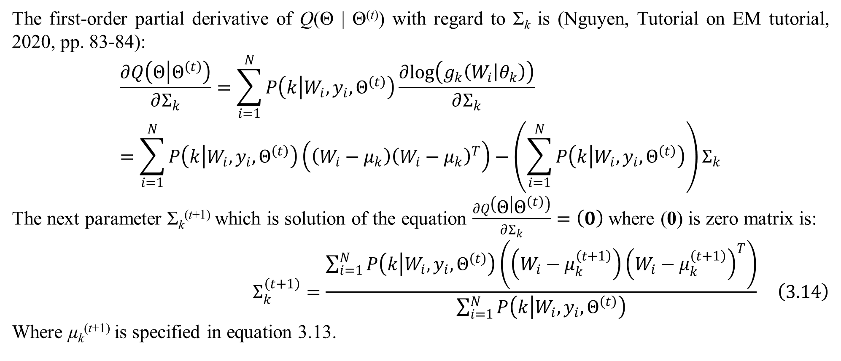
3. Adaptive regression model
The first-order partial derivative of Q(Θ | Θ^{(t)}) with regard to Σ_{k} is (Nguyen, Tutorial on EM tutorial, 2020, pp. 83-84):
$$\frac{∂Q\left(Θ | Θ^{\left(t\right)}\right)}{∂Σ_{k}}=\sum_{i=1}^{N}{P\left(k | W_{i},y_{i},Θ^{\left(t\right)}\right)\frac{∂log\left(g_{k}\left(W_{i} | θ_{k}\right)\right)}{∂Σ_{k}}}=\sum_{i=1}^{N}{P\left(k | W_{i},y_{i},Θ^{\left(t\right)}\right)\left(\left(W_{i}−μ_{k}\right){\left(W_{i}−μ_{k}\right)}^{T}\right)}−\left(\sum_{i=1}^{N}{P\left(k | W_{i},y_{i},Θ^{\left(t\right)}\right)}\right)Σ_{k}$$
The next parameter Σ_{k}^{(t+1)} which is solution of the equation $\frac{∂Q\left(Θ | Θ^{\left(t\right)}\right)}{∂Σ_{k}}=\left(0\right)$ where (0) is zero matrix is:
$$Σ_{k}^{\left(t+1\right)}=\frac{\sum_{i=1}^{N}{P\left(k | W_{i},y_{i},Θ^{\left(t\right)}\right)\left(\left(W_{i}−μ_{k}^{\left(t+1\right)}\right){\left(W_{i}−μ_{k}^{\left(t+1\right)}\right)}^{T}\right)}}{\sum_{i=1}^{N}{P\left(k | W_{i},y_{i},Θ^{\left(t\right)}\right)}} \left(3.14\right)$$
Where μ_{k}^{(t+1)} is specified in equation 3.13.

Slide 17
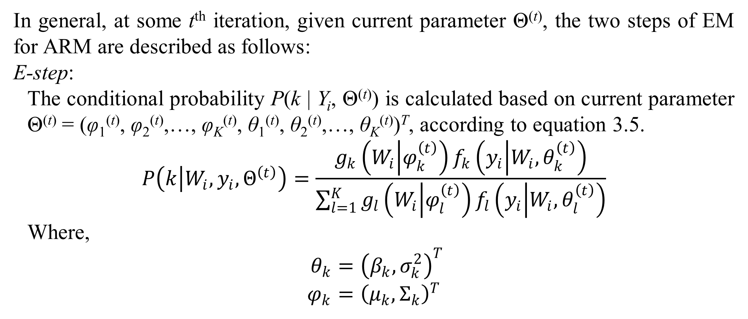
3. Adaptive regression model
In general, at some t^{th} iteration, given current parameter Θ^{(t)}, the two steps of EM for ARM are described as follows:
E-step:
The conditional probability P(k | Y_{i}, Θ^{(t)}) is calculated based on current parameter Θ^{(t)} = (φ₁^{(t)}, φ₂^{(t)},…, φ_{K}^{(t)}, θ₁^{(t)}, θ₂^{(t)},…, θ_{K}^{(t)})^{T}, according to equation 3.5.
$$P\left(k | W_{i},y_{i},Θ^{\left(t\right)}\right)=\frac{g_{k}\left(W_{i} | φ_{k}^{\left(t\right)}\right)f_{k}\left(y_{i} | W_{i},θ_{k}^{\left(t\right)}\right)}{\sum_{l=1}^{K}{g_{l}\left(W_{i} | φ_{l}^{\left(t\right)}\right)f_{l}\left(y_{i} | W_{i},θ_{l}^{\left(t\right)}\right)}}$$
Where,
$$θ_{k}={\left(β_{k},σ_{k}^{2}\right)}^{T} \\ φ_{k}={\left(μ_{k},Σ_{k}\right)}^{T}$$

Slide 18
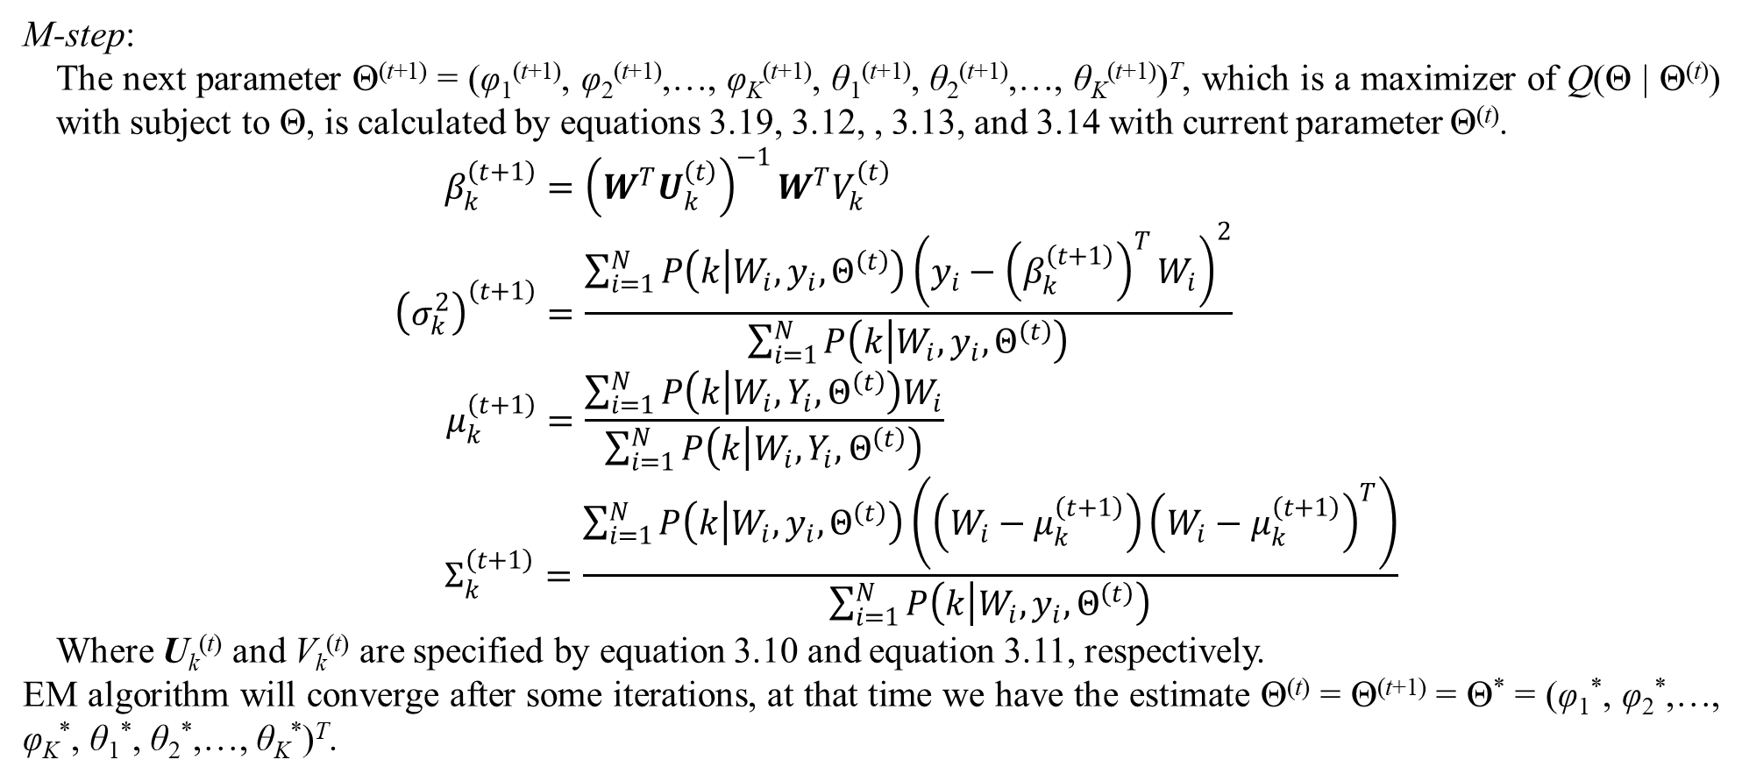
3. Adaptive regression model
M-step:
The next parameter Θ^{(t+1)} = (φ₁^{(t+1)}, φ₂^{(t+1)},…, φ_{K}^{(t+1)}, θ₁^{(t+1)}, θ₂^{(t+1)},…, θ_{K}^{(t+1)})^{T}, which is a maximizer of Q(Θ | Θ^{(t)}) with subject to Θ, is calculated by equations 3.19, 3.12, , 3.13, and 3.14 with current parameter Θ^{(t)}.
$$β_{k}^{\left(t+1\right)}={\left(W^{T}U_{k}^{\left(t\right)}\right)}^{−1}W^{T}V_{k}^{\left(t\right)} \\ {\left(σ_{k}^{2}\right)}^{\left(t+1\right)}=\frac{\sum_{i=1}^{N}{P\left(k | W_{i},y_{i},Θ^{\left(t\right)}\right){\left(y_{i}−{\left(β_{k}^{\left(t+1\right)}\right)}^{T}W_{i}\right)}^{2}}}{\sum_{i=1}^{N}{P\left(k | W_{i},y_{i},Θ^{\left(t\right)}\right)}} \\ μ_{k}^{\left(t+1\right)}=\frac{\sum_{i=1}^{N}{P\left(k | {W_{i},Y}_{i},Θ^{\left(t\right)}\right)W_{i}}}{\sum_{i=1}^{N}{P\left(k | W_{i},Y_{i},Θ^{\left(t\right)}\right)}} \\ Σ_{k}^{\left(t+1\right)}=\frac{\sum_{i=1}^{N}{P\left(k | W_{i},y_{i},Θ^{\left(t\right)}\right)\left(\left(W_{i}−μ_{k}^{\left(t+1\right)}\right){\left(W_{i}−μ_{k}^{\left(t+1\right)}\right)}^{T}\right)}}{\sum_{i=1}^{N}{P\left(k | W_{i},y_{i},Θ^{\left(t\right)}\right)}}$$
Where U_{k}^{(t)} and V_{k}^{(t)} are specified by equation 3.10 and equation 3.11, respectively.
EM algorithm will converge after some iterations, at that time we have the estimate Θ^{(t)} = Θ^{(t+1)} = Θ* = (φ₁*, φ₂*,…, φ_{K}*, θ₁*, θ₂*,…, θ_{K}*)^{T}.

Slide 19
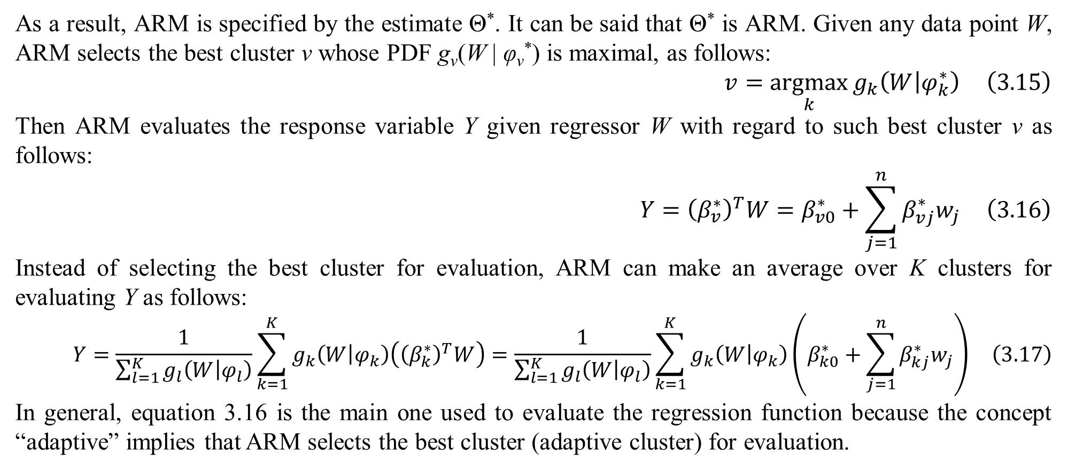
3. Adaptive regression model
As a result, ARM is specified by the estimate Θ*. It can be said that Θ* is ARM. Given any data point W, ARM selects the best cluster v whose PDF g_{v}(W | φ_{v}*) is maximal, as follows:
$$v=\underset{k}{argmax}{g_{k}\left(W | φ_{k}^{∗}\right)} \left(3.15\right)$$
Then ARM evaluates the response variable Y given regressor W with regard to such best cluster v as follows:
$$Y={\left(β_{v}^{∗}\right)}^{T}W=β_{v0}^{∗}+\sum_{j=1}^{n}{β_{vj}^{∗}w_{j}} \left(3.16\right)$$
Instead of selecting the best cluster for evaluation, ARM can make an average over K clusters for evaluating Y as follows:
$$Y=\frac{1}{\sum_{l=1}^{K}{g_{l}\left(W | φ_{l}\right)}}\sum_{k=1}^{K}{g_{k}\left(W | φ_{k}\right)\left({\left(β_{k}^{∗}\right)}^{T}W\right)}=\frac{1}{\sum_{l=1}^{K}{g_{l}\left(W | φ_{l}\right)}}\sum_{k=1}^{K}{g_{k}\left(W | φ_{k}\right)\left(β_{k0}^{∗}+\sum_{j=1}^{n}{β_{kj}^{∗}w_{j}}\right)} \left(3.17\right)$$
In general, equation 3.16 is the main one used to evaluate the regression function because the concept “adaptive” implies that ARM selects the best cluster (adaptive cluster) for evaluation.

Slide 20
4. Conclusions
The main ideology of CMM is to improve competence of mixture model, in which the probability of hidden variable is turned back its original form of PDF with full of parameters. As a result, its application ARM takes advantages of such hidden parameters in order to select best group or best cluster for making prediction of response value. In other words, ARM reduces estimation space of regression model so as to gain high accuracy in calculation. However, a new problem raised for CMM as well as ARM is how to pre-define the number K of clusters or components when CMM currently set fixed K. In the future, I will research some methods (Hoshikawa, 2013, p. 5) to pre-define K. Alternately, CMM can be improved or modified so that the number of clusters is updated in runtime (Nguyen & Shafiq, Mixture Regression Model for Incomplete Data, 2018, p. 16); in other words, there is no pre-definition of K and so K is determined dynamically.

Slide 21
References
Hoshikawa, T. (2013, June 30). Mixture regression for observational data, with application to functional regression models. arXiv preprint. Retrieved September 4, 2018, from https://arxiv.org/pdf/1307.0170
Nguyen, L. (2020). Tutorial on EM tutorial. MDPI. Preprints. doi:10.20944/preprints201802.0131.v8
Nguyen, L., & Shafiq, A. (2018, December 31). Mixture Regression Model for Incomplete Data. (L. d. Istael, Ed.) Revista Sociedade Científica, 1(3), 1-25. doi:10.5281/zenodo.2528978

Slide 22
Thank you for listening

