Slide 1
Conditional mixture model for modeling attributed dyadic data
Prof. Loc Nguyen, PhD
Independent scholar, Vietnam
Email: ng_phloc@yahoo.com
Homepage: www.locnguyen.net

Slide 2
Abstract
Dyadic data contains co-occurrences of objects, which is often modeled by finite mixture model which in turn is learned by expectation maximization (EM) algorithm. Objects in traditional dyadic data are identified by names, causing the drawback which is that it is impossible to extract implicit valuable knowledge under objects. In this research, I propose the so-called attributed dyadic data (ADD) in which each object has an informative attribute and each co-occurrence of two objects is associated with a value. ADD is flexible and covers most of structures / forms of dyadic data. Conditional mixture model (CMM), which is a variant of finite mixture model, is applied into learning ADD. Moreover, a significant feature of CMM is that any co-occurrence of two objects is based on some conditional variable. As a result, CMM can predict or estimate co-occurrent values based on regression model, which extends applications of ADD and CMM.

Slide 3
Table of contents
Introduction to dyadic data and mixture model
Learning attributed dyadic data (ADD) by conditional mixture model (CMM)
Conclusions

Slide 4
1. Introduction to dyadic data and mixture model
Suppose data has two parts such as hidden part X and observed part Y and we only know Y. A relationship between random variable X and random variable Y is specified by the joint probabilistic density function (PDF) denoted f(X, Y | Θ) where Θ is parameter. Given sample {Y₁, Y₂,…, Y_{N}} whose all Y_{i} (s) are mutually independent and identically distributed (iid), it is required to estimate Θ based on such sample whereas X is unknown.
Expectation maximization (EM) algorithm is applied to solve this problem when only Y_{i} (s) are observed. EM has many iterations and each iteration has two steps such as expectation step (E-step) and maximization step (M-step). At some t^{th} iteration, given current parameter Θ^{(t)}, the two steps are described as follows (next slide):

Slide 5
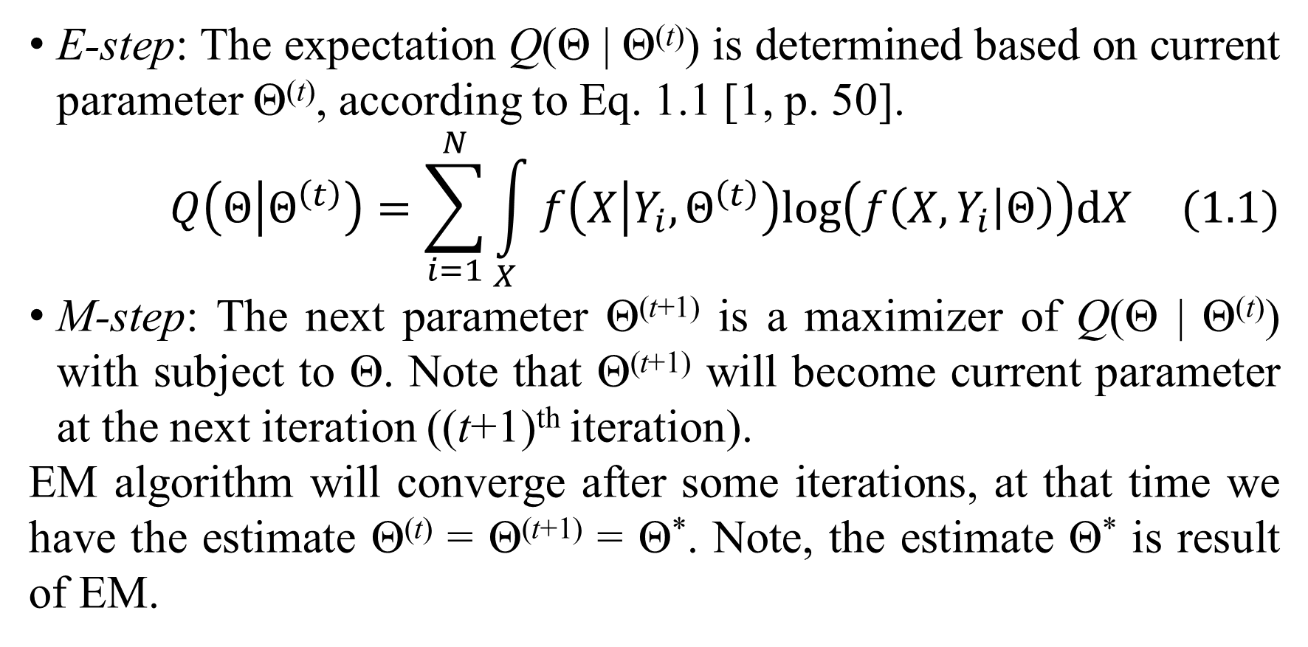
1. Introduction to dyadic data and mixture model
E-step: The expectation Q(Θ | Θ^{(t)}) is determined based on current parameter Θ^{(t)}, according to Eq. 1.1 [1, p. 50].
$$Q\left(Θ | Θ^{\left(t\right)}\right)=\sum_{i=1}^{N}{\int_{X}{f\left(X | Y_{i},Θ^{\left(t\right)}\right)log\left(f\left(X,Y_{i} | Θ\right)\right)dX}} (1.1)$$
M-step: The next parameter Θ^{(t+1)} is a maximizer of Q(Θ | Θ^{(t)}) with subject to Θ. Note that Θ^{(t+1)} will become current parameter at the next iteration ((t+1)^{th} iteration).
EM algorithm will converge after some iterations, at that time we have the estimate Θ^{(t)} = Θ^{(t+1)} = Θ*. Note, the estimate Θ* is result of EM.

Slide 6
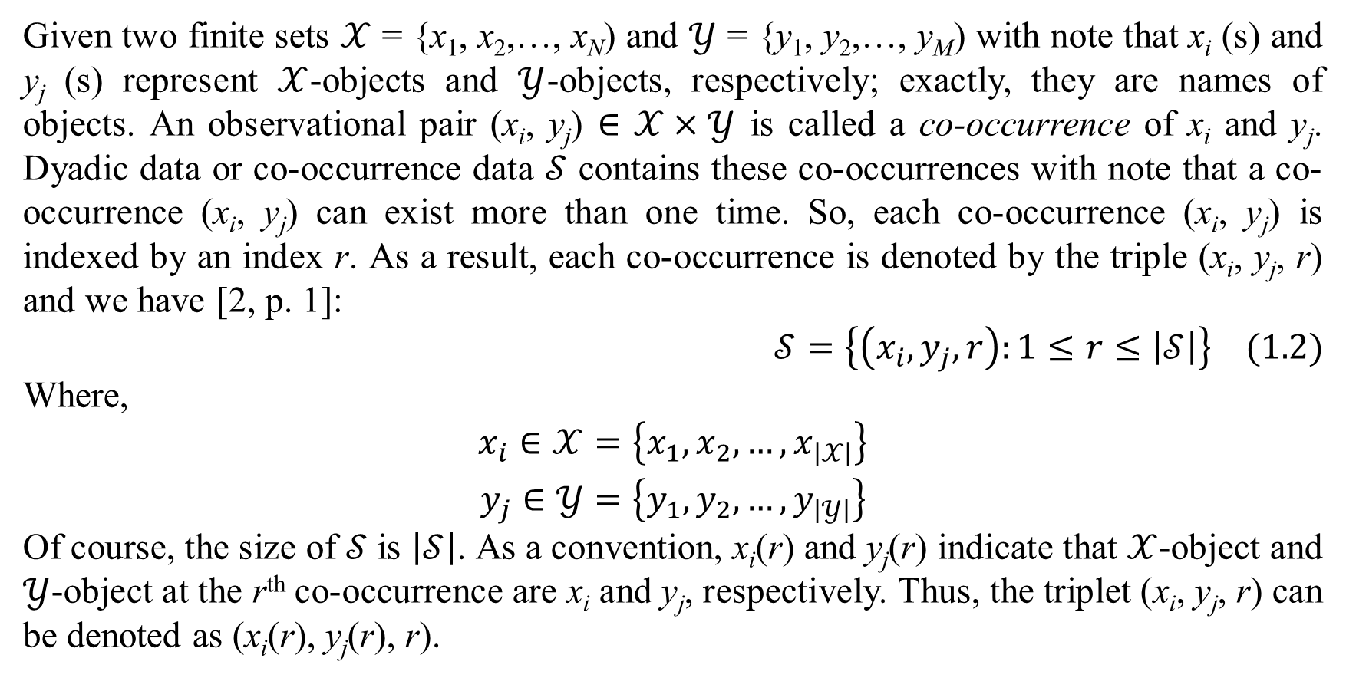
1. Introduction to dyadic data and mixture model
Given two finite sets $𝒳$ = {x₁, x₂,…, x_{N}) and $𝒴$ = {y₁, y₂,…, y_{M}) with note that x_{i} (s) and y_{j} (s) represent $𝒳$-objects and $𝒴$-objects, respectively; exactly, they are names of objects. An observational pair (x_{i}, y_{j}) $∈$ $𝒳×𝒴$ is called a co-occurrence of x_{i} and y_{j}. Dyadic data or co-occurrence data $𝒮$ contains these co-occurrences with note that a co-occurrence (x_{i}, y_{j}) can exist more than one time. So, each co-occurrence (x_{i}, y_{j}) is indexed by an index r. As a result, each co-occurrence is denoted by the triple (x_{i}, y_{j}, r) and we have [2, p. 1]:
$$𝒮=\left\{\left(x_{i},y_{j},r\right):1≤r≤\left|𝒮\right|\right\} (1.2)$$
Where,
$$\begin{matrix}x_{i}∈𝒳=\left\{x_{1},x_{2},…,x_{\left|𝒳\right|}\right\} \\ y_{j}∈𝒴=\left\{y_{1},y_{2},…,y_{\left|𝒴\right|}\right\}\end{matrix}$$
Of course, the size of $𝒮$ is $\left|𝒮\right|$. As a convention, x_{i}(r) and y_{j}(r) indicate that $𝒳$-object and $𝒴$-object at the r^{th} co-occurrence are x_{i} and y_{j}, respectively. Thus, the triplet (x_{i}, y_{j}, r) can be denoted as (x_{i}(r), y_{j}(r), r).

Slide 7
1. Introduction to dyadic data and mixture model
Suppose each co-occurrence (x_{i}, y_{j}) belongs to a latent variable C and C has K values c_{k} (s). These values c_{k} (s) are called classes or aspects and thus, mixture model for dyadic data is also called aspect model or latent class model which aims to discover the latent variable C. Without loss of generality, let c_{k} = k where k = 1, 2,…, K. The random variable C has discrete distribution such that every value has an associated probability α_{k}. Of course, there are K probabilities α_{k} (s).
There are three kinds of dyadic mixture model [2, p. 2] for dyadic data such as symmetric mixture model (SMM), asymmetric mixture model (AMM), and product-space mixture model (PMM). In this section, EM algorithm is applied to build up these mixture models. SMM, AMM, and PMM are mentioned in next slides.

Slide 8
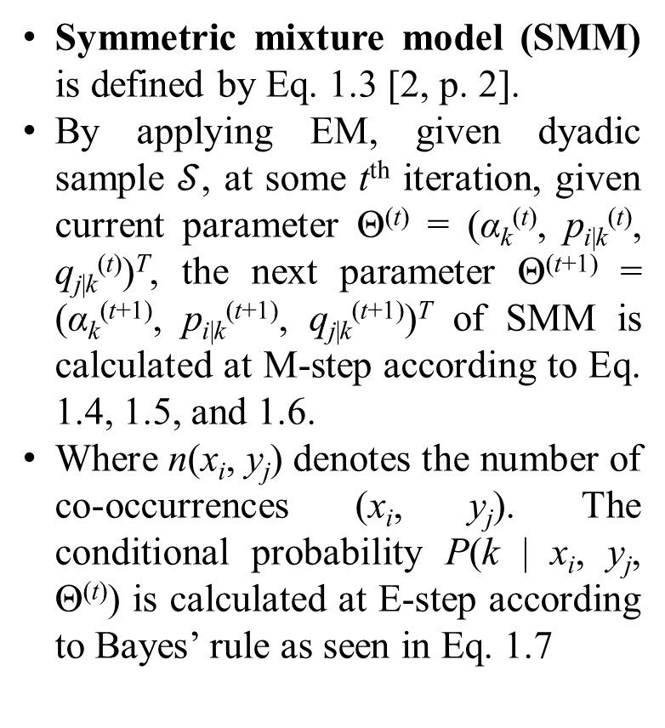
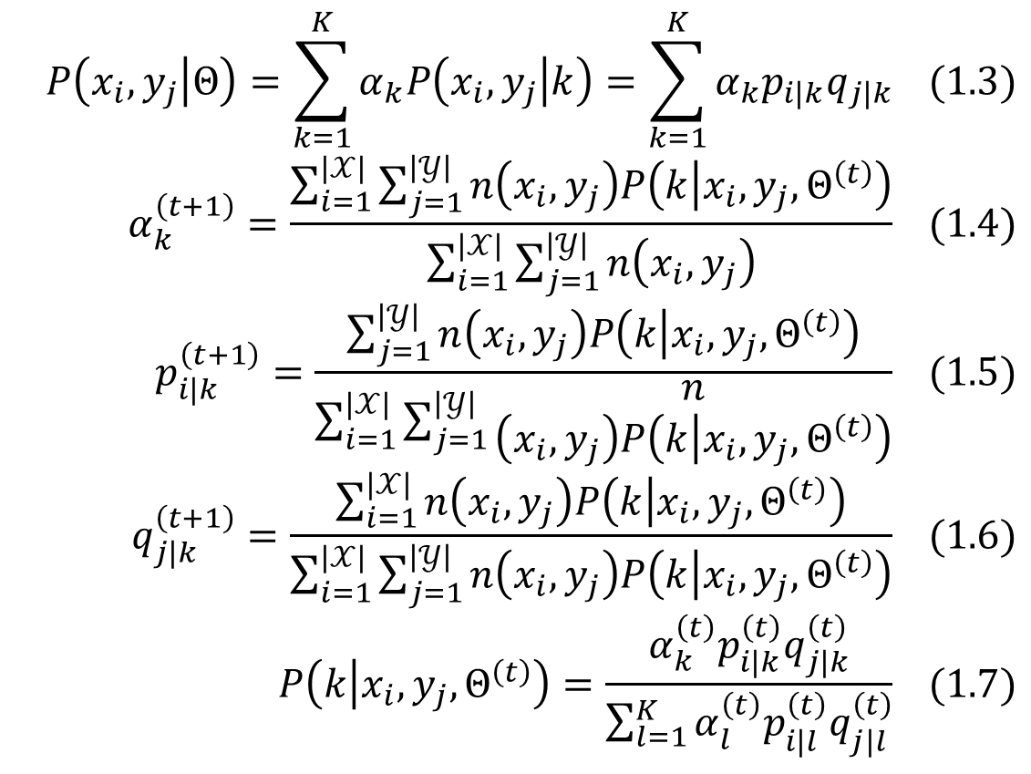
1. Introduction to dyadic data and mixture model
Symmetric mixture model (SMM) is defined by Eq. 1.3 [2, p. 2].
By applying EM, given dyadic sample $𝒮$, at some t^{th} iteration, given current parameter Θ^{(t)} = (α_{k}^{(t)}, p_{i|k}^{(t)}, q_{j|k}^{(t)})^{T}, the next parameter Θ^{(t+1)} = (α_{k}^{(t+1)}, p_{i|k}^{(t+1)}, q_{j|k}^{(t+1)})^{T} of SMM is calculated at M-step according to Eq. 1.4, 1.5, and 1.6.
Where n(x_{i}, y_{j}) denotes the number of co-occurrences (x_{i}, y_{j}). The conditional probability P(k | x_{i}, y_{j}, Θ^{(t)}) is calculated at E-step according to Bayes’ rule as seen in Eq. 1.7
$$P\left(x_{i},y_{j} | Θ\right)=\sum_{k=1}^{K}{α_{k}P\left(x_{i},y_{j} | k\right)}=\sum_{k=1}^{K}{α_{k}p_{i\left|k\right.}q_{j\left|k\right.}} (1.3)$$
$$α_{k}^{\left(t+1\right)}=\frac{\sum_{i=1}^{\left|𝒳\right|}{\sum_{j=1}^{\left|𝒴\right|}{n\left(x_{i},y_{j}\right)P\left(k | x_{i},y_{j},Θ^{\left(t\right)}\right)}}}{\sum_{i=1}^{\left|𝒳\right|}{\sum_{j=1}^{\left|𝒴\right|}{n\left(x_{i},y_{j}\right)}}} (1.4)$$
$$p_{i\left|k\right.}^{\left(t+1\right)}=\frac{\sum_{j=1}^{\left|𝒴\right|}{n\left(x_{i},y_{j}\right)P\left(k | x_{i},y_{j},Θ^{\left(t\right)}\right)}}{\sum_{i=1}^{\left|𝒳\right|}{\sum_{j=1}^{\left|𝒴\right|}{\begin{aligned}n \\ \left(x_{i},y_{j}\right)P\left(k | x_{i},y_{j},Θ^{\left(t\right)}\right)\end{aligned}}}} (1.5)$$
$$q_{j\left|k\right.}^{\left(t+1\right)}=\frac{\sum_{i=1}^{\left|𝒳\right|}{n\left(x_{i},y_{j}\right)P\left(k | x_{i},y_{j},Θ^{\left(t\right)}\right)}}{\sum_{i=1}^{\left|𝒳\right|}{\sum_{j=1}^{\left|𝒴\right|}{n\left(x_{i},y_{j}\right)P\left(k | x_{i},y_{j},Θ^{\left(t\right)}\right)}}} (1.6)$$
$$P\left(k | x_{i},y_{j},Θ^{\left(t\right)}\right)=\frac{α_{k}^{\left(t\right)}p_{i\left|k\right.}^{\left(t\right)}q_{j\left|k\right.}^{\left(t\right)}}{\sum_{l=1}^{K}{α_{l}^{\left(t\right)}p_{i\left|l\right.}^{\left(t\right)}q_{j\left|l\right.}^{\left(t\right)}}} (1.7)$$

Slide 9
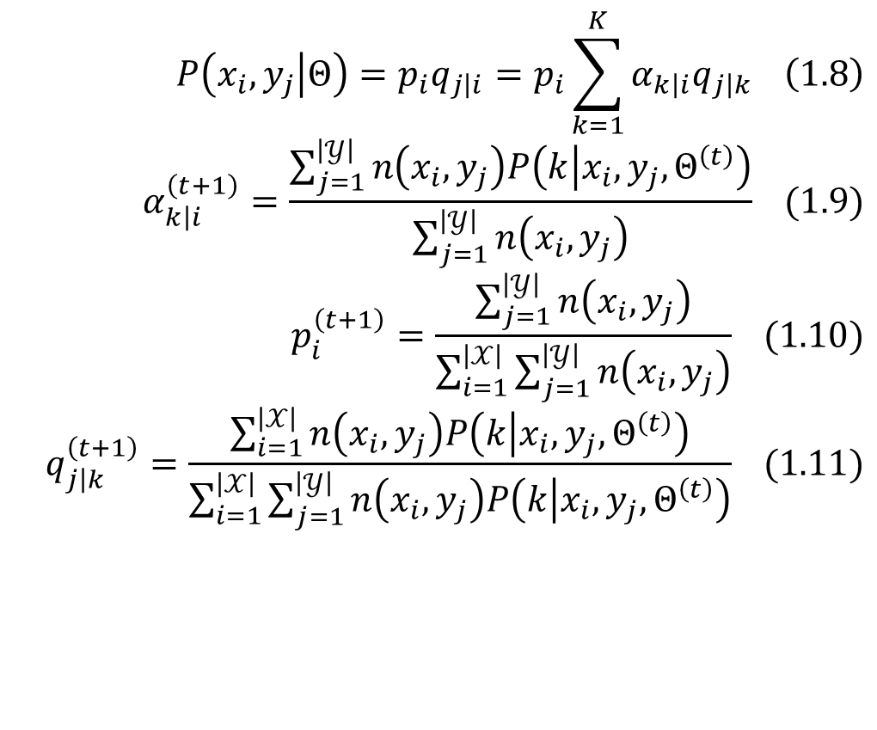
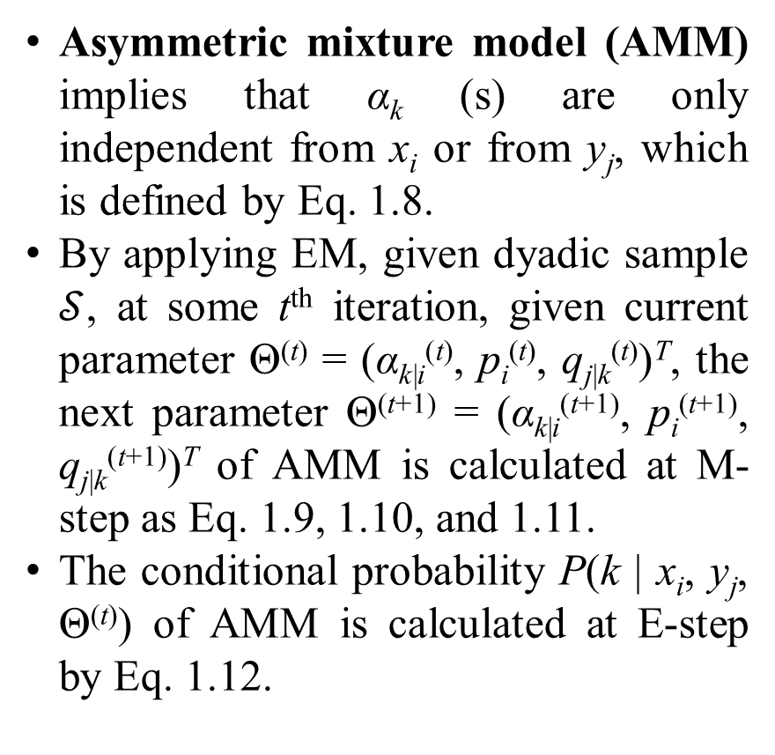
1. Introduction to dyadic data and mixture model
Asymmetric mixture model (AMM) implies that α_{k} (s) are only independent from x_{i} or from y_{j}, which is defined by Eq. 1.8.
By applying EM, given dyadic sample $𝒮$, at some t^{th} iteration, given current parameter Θ^{(t)} = (α_{k|i}^{(t)}, p_{i}^{(t)}, q_{j|k}^{(t)})^{T}, the next parameter Θ^{(t+1)} = (α_{k|i}^{(t+1)}, p_{i}^{(t+1)}, q_{j|k}^{(t+1)})^{T} of AMM is calculated at M-step as Eq. 1.9, 1.10, and 1.11.
The conditional probability P(k | x_{i}, y_{j}, Θ^{(t)}) of AMM is calculated at E-step by Eq. 1.12.
$$P\left(x_{i},y_{j} | Θ\right)=p_{i}q_{j\left|i\right.}=p_{i}\sum_{k=1}^{K}{α_{k\left|i\right.}q_{j\left|k\right.}} \left(1.8\right)$$
$$α_{k\left|i\right.}^{\left(t+1\right)}=\frac{\sum_{j=1}^{\left|𝒴\right|}{n\left(x_{i},y_{j}\right)P\left(k | x_{i},y_{j},Θ^{\left(t\right)}\right)}}{\sum_{j=1}^{\left|𝒴\right|}{n\left(x_{i},y_{j}\right)}} (1.9)$$
$$p_{i}^{\left(t+1\right)}=\frac{\sum_{j=1}^{\left|𝒴\right|}{n\left(x_{i},y_{j}\right)}}{\sum_{i=1}^{\left|𝒳\right|}{\sum_{j=1}^{\left|𝒴\right|}{n\left(x_{i},y_{j}\right)}}} (1.10)$$
$$q_{j\left|k\right.}^{\left(t+1\right)}=\frac{\sum_{i=1}^{\left|𝒳\right|}{n\left(x_{i},y_{j}\right)P\left(k | x_{i},y_{j},Θ^{\left(t\right)}\right)}}{\sum_{i=1}^{\left|𝒳\right|}{\sum_{j=1}^{\left|𝒴\right|}{n\left(x_{i},y_{j}\right)P\left(k | x_{i},y_{j},Θ^{\left(t\right)}\right)}}} (1.11)$$

Slide 10
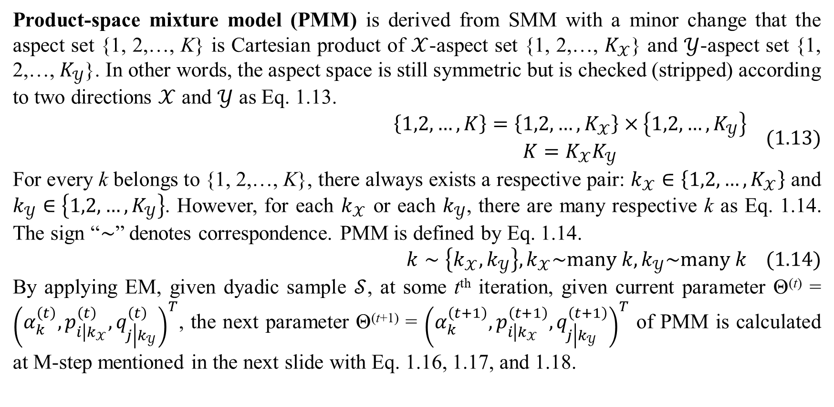
1. Introduction to dyadic data and mixture model
Product-space mixture model (PMM) is derived from SMM with a minor change that the aspect set {1, 2,…, K} is Cartesian product of $𝒳$-aspect set {1, 2,…, $K_{𝒳}$} and $𝒴$-aspect set {1, 2,…, $K_{𝒴}$}. In other words, the aspect space is still symmetric but is checked (stripped) according to two directions $𝒳$ and $𝒴$ as Eq. 1.13.
$$\begin{matrix}\left\{1,2,…,K\right\}=\left\{1,2,…,K_{𝒳}\right\}×\left\{1,2,…,K_{𝒴}\right\} \\ K=K_{𝒳}K_{𝒴}\end{matrix} (1.13)$$
For every k belongs to {1, 2,…, K}, there always exists a respective pair: $k_{𝒳}∈\left\{1,2,…,K_{𝒳}\right\}$ and $k_{𝒴}∈\left\{1,2,…,K_{𝒴}\right\}$. However, for each $k_{𝒳}$ or each $k_{𝒴}$, there are many respective k as Eq. 1.14. The sign “$∼$” denotes correspondence. PMM is defined by Eq. 1.14.
$$k∼\left\{k_{𝒳},k_{𝒴}\right\},k_{𝒳}\sim many k,k_{𝒴}\sim many k (1.14)$$
By applying EM, given dyadic sample $𝒮$, at some t^{th} iteration, given current parameter Θ^{(t)} = ${\left(α_{k}^{\left(t\right)},p_{i\left|k_{𝒳}\right.}^{\left(t\right)},q_{j\left|k_{𝒴}\right.}^{\left(t\right)}\right)}^{T}$, the next parameter Θ^{(t+1)} = ${\left(α_{k}^{\left(t+1\right)},p_{i\left|k_{𝒳}\right.}^{\left(t+1\right)},q_{j\left|k_{𝒴}\right.}^{\left(t+1\right)}\right)}^{T}$ of PMM is calculated at M-step mentioned in the next slide with Eq. 1.16, 1.17, and 1.18.

Slide 11
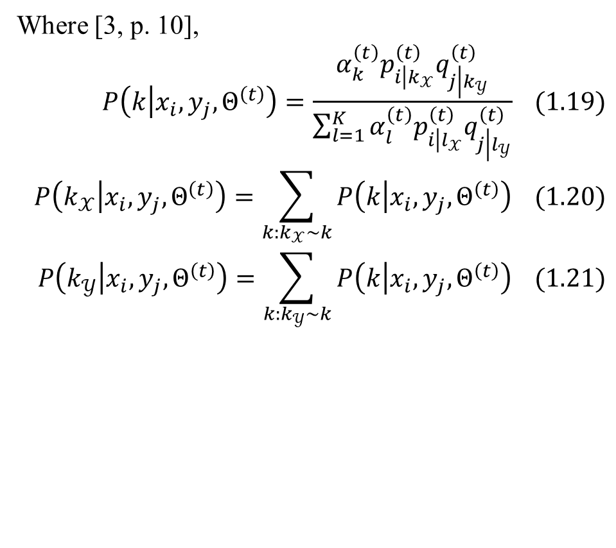
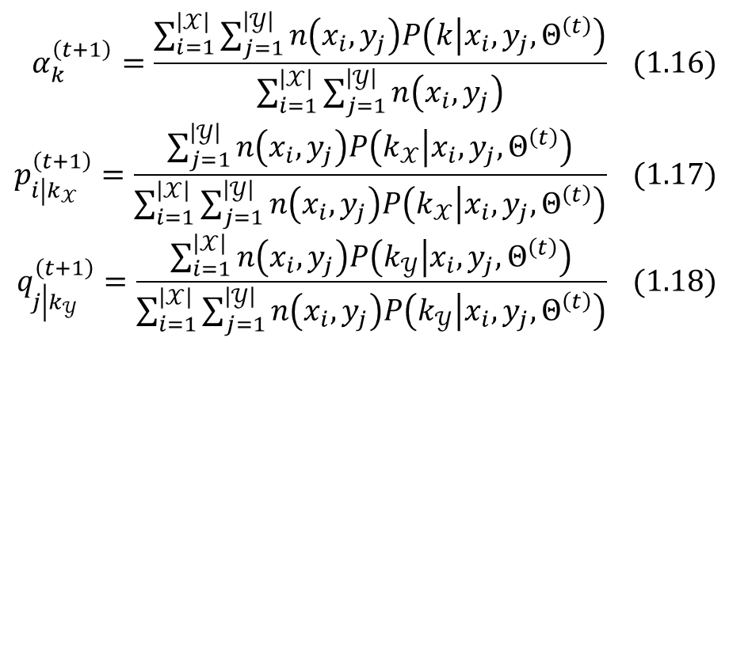
1. Introduction to dyadic data and mixture model
$$α_{k}^{\left(t+1\right)}=\frac{\sum_{i=1}^{\left|𝒳\right|}{\sum_{j=1}^{\left|𝒴\right|}{n\left(x_{i},y_{j}\right)P\left(k | x_{i},y_{j},Θ^{\left(t\right)}\right)}}}{\sum_{i=1}^{\left|𝒳\right|}{\sum_{j=1}^{\left|𝒴\right|}{n\left(x_{i},y_{j}\right)}}} (1.16)$$
$$p_{i\left|k_{𝒳}\right.}^{\left(t+1\right)}=\frac{\sum_{j=1}^{\left|𝒴\right|}{n\left(x_{i},y_{j}\right)P\left(k_{𝒳} | x_{i},y_{j},Θ^{\left(t\right)}\right)}}{\sum_{i=1}^{\left|𝒳\right|}{\sum_{j=1}^{\left|𝒴\right|}{n\left(x_{i},y_{j}\right)P\left(k_{𝒳} | x_{i},y_{j},Θ^{\left(t\right)}\right)}}} (1.17)$$
$$q_{j\left|k_{𝒴}\right.}^{\left(t+1\right)}=\frac{\sum_{i=1}^{\left|𝒳\right|}{n\left(x_{i},y_{j}\right)P\left(k_{𝒴} | x_{i},y_{j},Θ^{\left(t\right)}\right)}}{\sum_{i=1}^{\left|𝒳\right|}{\sum_{j=1}^{\left|𝒴\right|}{n\left(x_{i},y_{j}\right)P\left(k_{𝒴} | x_{i},y_{j},Θ^{\left(t\right)}\right)}}} (1.18)$$
Where [3, p. 10],
$$P\left(k | x_{i},y_{j},Θ^{\left(t\right)}\right)=\frac{α_{k}^{\left(t\right)}p_{i\left|k_{𝒳}\right.}^{\left(t\right)}q_{j\left|k_{𝒴}\right.}^{\left(t\right)}}{\sum_{l=1}^{K}{α_{l}^{\left(t\right)}p_{i\left|l_{𝒳}\right.}^{\left(t\right)}q_{j\left|l_{𝒴}\right.}^{\left(t\right)}}} (1.19)$$
$$P\left(k_{𝒳} | x_{i},y_{j},Θ^{\left(t\right)}\right)=\sum_{k:k_{𝒳}\sim k}{P\left(k | x_{i},y_{j},Θ^{\left(t\right)}\right)} (1.20)$$
$$P\left(k_{𝒴} | x_{i},y_{j},Θ^{\left(t\right)}\right)=\sum_{k:k_{𝒴}\sim k}{P\left(k | x_{i},y_{j},Θ^{\left(t\right)}\right)} (1.21)$$

Slide 12
1. Introduction to dyadic data and mixture model
SMM, AMM, and PMM are defined in case of traditional dyadic data.
The next section is main subject of this research where the so-called attributed dyadic data (ADD) is modeled by conditional mixture model (CMM).

Slide 13
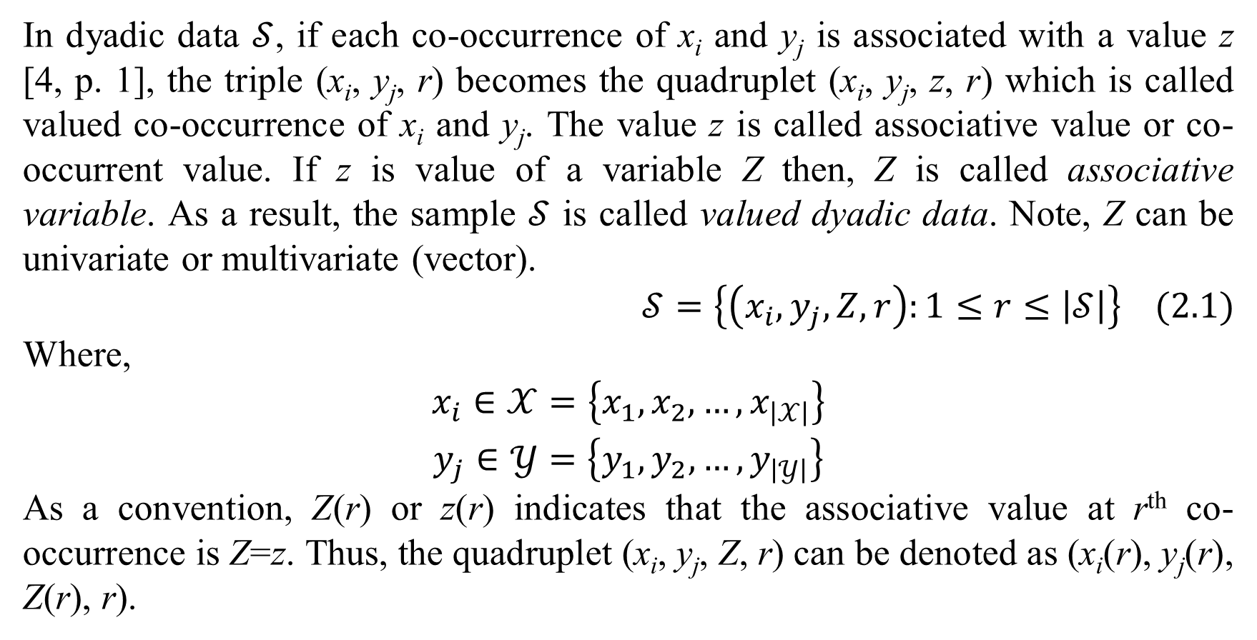
2. Learning ADD by CMM
In dyadic data $𝒮$, if each co-occurrence of x_{i} and y_{j} is associated with a value z [4, p. 1], the triple (x_{i}, y_{j}, r) becomes the quadruplet (x_{i}, y_{j}, z, r) which is called valued co-occurrence of x_{i} and y_{j}. The value z is called associative value or co-occurrent value. If z is value of a variable Z then, Z is called associative variable. As a result, the sample $𝒮$ is called valued dyadic data. Note, Z can be univariate or multivariate (vector).
$$𝒮=\left\{\left(x_{i},y_{j},Z,r\right):1≤r≤\left|𝒮\right|\right\} (2.1)$$
Where,
$$\begin{matrix}x_{i}∈𝒳=\left\{x_{1},x_{2},…,x_{\left|𝒳\right|}\right\} \\ y_{j}∈𝒴=\left\{y_{1},y_{2},…,y_{\left|𝒴\right|}\right\}\end{matrix}$$
As a convention, Z(r) or z(r) indicates that the associative value at r^{th} co-occurrence is Z=z. Thus, the quadruplet (x_{i}, y_{j}, Z, r) can be denoted as (x_{i}(r), y_{j}(r), Z(r), r).

Slide 14
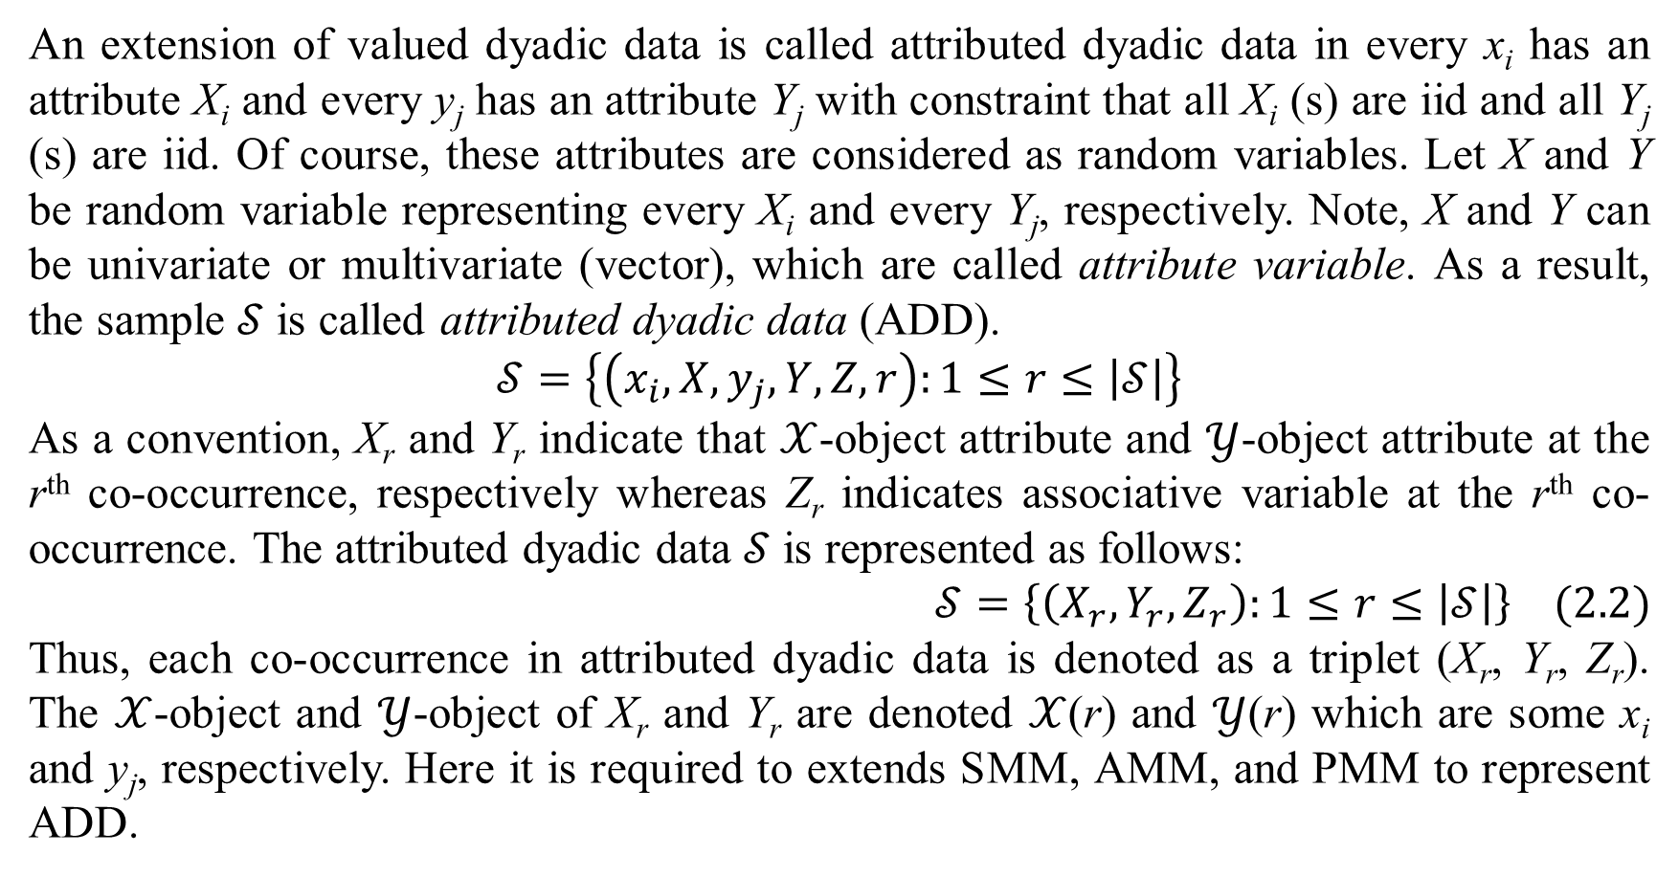
2. Learning ADD by CMM
An extension of valued dyadic data is called attributed dyadic data in every x_{i} has an attribute X_{i} and every y_{j} has an attribute Y_{j} with constraint that all X_{i} (s) are iid and all Y_{j} (s) are iid. Of course, these attributes are considered as random variables. Let X and Y be random variable representing every X_{i} and every Y_{j}, respectively. Note, X and Y can be univariate or multivariate (vector), which are called attribute variable. As a result, the sample $𝒮$ is called attributed dyadic data (ADD).
$$𝒮=\left\{\left(x_{i},X,y_{j},Y,Z,r\right):1≤r≤\left|𝒮\right|\right\}$$
As a convention, X_{r} and Y_{r} indicate that $𝒳$-object attribute and $𝒴$-object attribute at the r^{th} co-occurrence, respectively whereas Z_{r} indicates associative variable at the r^{th} co-occurrence. The attributed dyadic data $𝒮$ is represented as follows:
$$𝒮=\left\{\left(X_{r},Y_{r},Z_{r}\right):1≤r≤\left|𝒮\right|\right\} (2.2)$$
Thus, each co-occurrence in attributed dyadic data is denoted as a triplet (X_{r}, Y_{r}, Z_{r}). The $𝒳$-object and $𝒴$-object of X_{r} and Y_{r} are denoted $𝒳$(r) and $𝒴$(r) which are some x_{i} and y_{j}, respectively. Here it is required to extends SMM, AMM, and PMM to represent ADD.

Slide 15
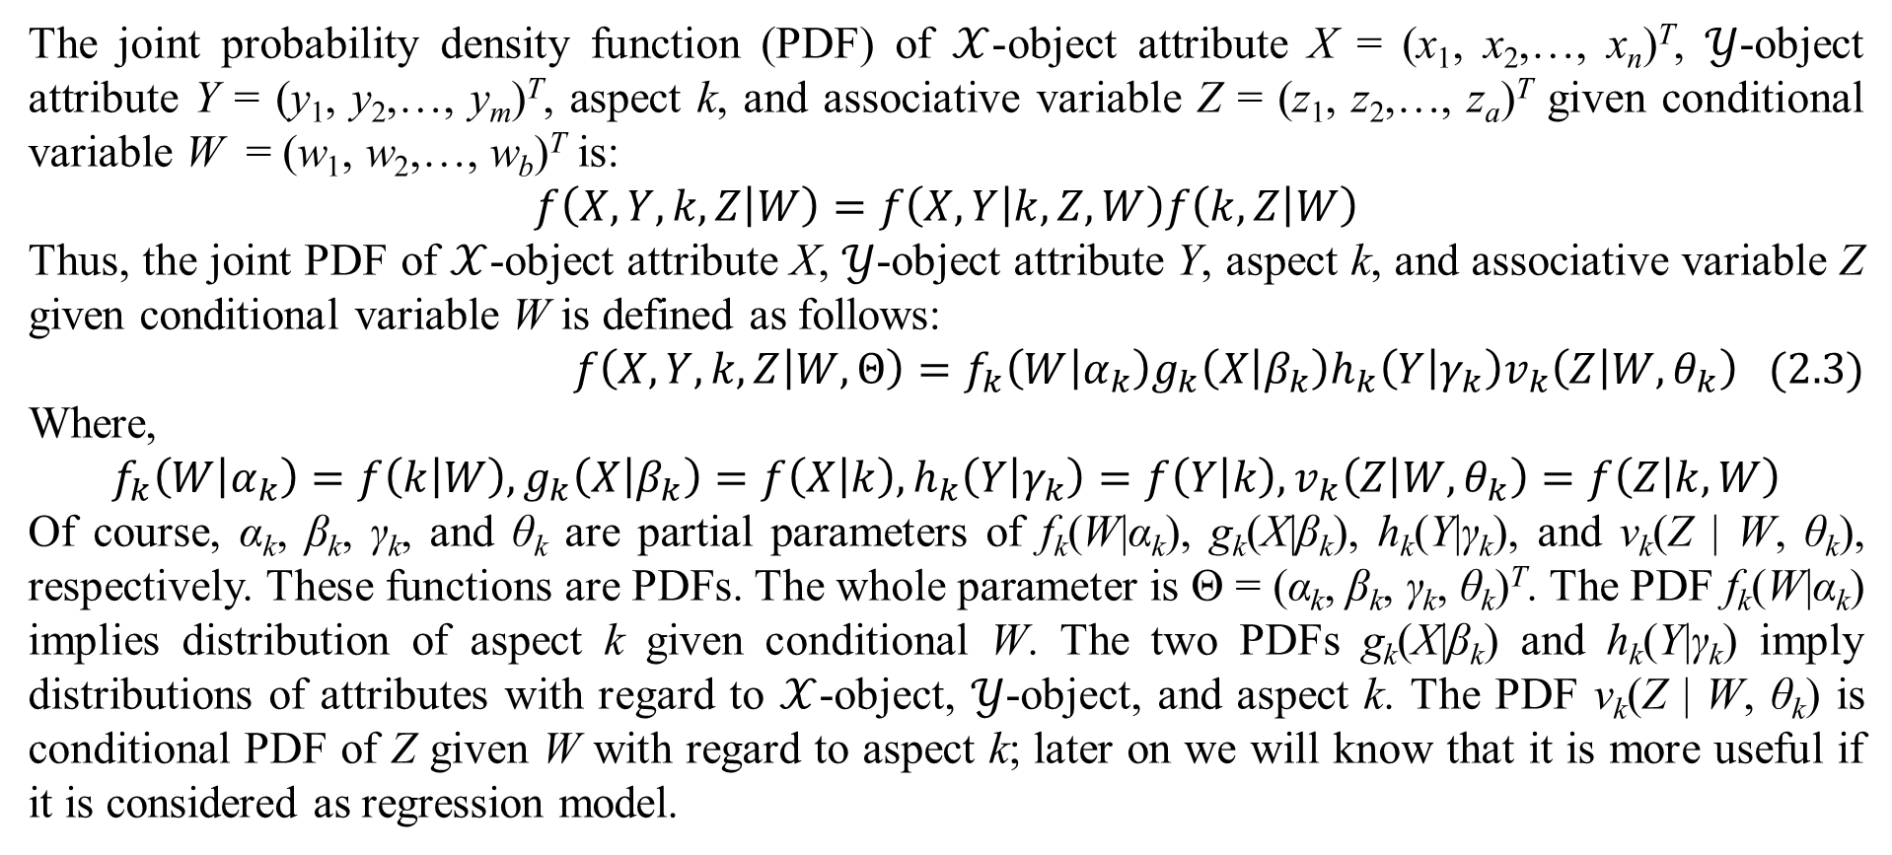
2. Learning ADD by CMM
The joint probability density function (PDF) of $𝒳$-object attribute X = (x₁, x₂,…, x_{n})^{T}, $𝒴$-object attribute Y = (y₁, y₂,…, y_{m})^{T}, aspect k, and associative variable Z = (z₁, z₂,…, z_{a})^{T} given conditional variable W = (w₁, w₂,…, w_{b})^{T} is:
$$f\left(X,Y,k,Z | W\right)=f\left(X,Y | k,Z,W\right)f\left(k,Z | W\right)$$
Thus, the joint PDF of $𝒳$-object attribute X, $𝒴$-object attribute Y, aspect k, and associative variable Z given conditional variable W is defined as follows:
$$f\left(X,Y,k,Z | W,Θ\right)=f_{k}\left(W | α_{k}\right)g_{k}\left(X | β_{k}\right)h_{k}\left(Y | γ_{k}\right)v_{k}\left(Z | W,θ_{k}\right) (2.3)$$
Where,
$$f_{k}\left(W | α_{k}\right)=f\left(k | W\right),g_{k}\left(X | β_{k}\right)=f\left(X | k\right),h_{k}\left(Y | γ_{k}\right)=f\left(Y | k\right),v_{k}\left(Z | W,θ_{k}\right)=f\left(Z | k,W\right)$$
Of course, α_{k}, β_{k}, γ_{k}, and θ_{k} are partial parameters of f_{k}(W|α_{k}), g_{k}(X|β_{k}), h_{k}(Y|γ_{k}), and v_{k}(Z | W, θ_{k}), respectively. These functions are PDFs. The whole parameter is Θ = (α_{k}, β_{k}, γ_{k}, θ_{k})^{T}. The PDF f_{k}(W|α_{k}) implies distribution of aspect k given conditional W. The two PDFs g_{k}(X|β_{k}) and h_{k}(Y|γ_{k}) imply distributions of attributes with regard to $𝒳$-object, $𝒴$-object, and aspect k. The PDF v_{k}(Z | W, θ_{k}) is conditional PDF of Z given W with regard to aspect k; later on we will know that it is more useful if it is considered as regression model.

Slide 16
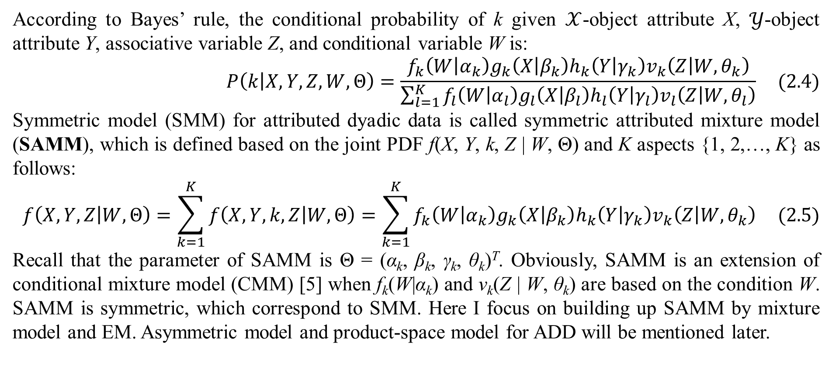
2. Learning ADD by CMM
According to Bayes’ rule, the conditional probability of k given $𝒳$-object attribute X, $𝒴$-object attribute Y, associative variable Z, and conditional variable W is:
$$P\left(k | X,Y,Z,W,Θ\right)=\frac{f_{k}\left(W | α_{k}\right)g_{k}\left(X | β_{k}\right)h_{k}\left(Y | γ_{k}\right)v_{k}\left(Z | W,θ_{k}\right)}{\sum_{l=1}^{K}{f_{l}\left(W | α_{l}\right)g_{l}\left(X | β_{l}\right)h_{l}\left(Y | γ_{l}\right)v_{l}\left(Z | W,θ_{l}\right)}} (2.4)$$
Symmetric model (SMM) for attributed dyadic data is called symmetric attributed mixture model (SAMM), which is defined based on the joint PDF f(X, Y, k, Z | W, Θ) and K aspects {1, 2,…, K} as follows:
$$f\left(X,Y,Z | W,Θ\right)=\sum_{k=1}^{K}{f\left(X,Y,k,Z | W,Θ\right)}=\sum_{k=1}^{K}{f_{k}\left(W | α_{k}\right)g_{k}\left(X | β_{k}\right)h_{k}\left(Y | γ_{k}\right)v_{k}\left(Z | W,θ_{k}\right)} (2.5)$$
Recall that the parameter of SAMM is Θ = (α_{k}, β_{k}, γ_{k}, θ_{k})^{T}. Obviously, SAMM is an extension of conditional mixture model (CMM) [5] when f_{k}(W|α_{k}) and v_{k}(Z | W, θ_{k}) are based on the condition W. SAMM is symmetric, which correspond to SMM. Here I focus on building up SAMM by mixture model and EM. Asymmetric model and product-space model for ADD will be mentioned later.

Slide 17
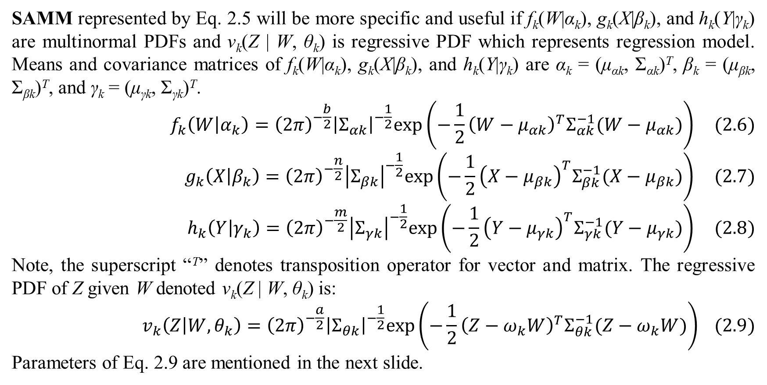
2. Learning ADD by CMM
SAMM represented by Eq. 2.5 will be more specific and useful if f_{k}(W|α_{k}), g_{k}(X|β_{k}), and h_{k}(Y|γ_{k}) are multinormal PDFs and v_{k}(Z | W, θ_{k}) is regressive PDF which represents regression model. Means and covariance matrices of f_{k}(W|α_{k}), g_{k}(X|β_{k}), and h_{k}(Y|γ_{k}) are α_{k} = (μ_{αk}, Σ_{αk})^{T}, β_{k} = (μ_{βk}, Σ_{βk})^{T}, and γ_{k} = (μ_{γk}, Σ_{γk})^{T}.
$$f_{k}\left(W | α_{k}\right)={\left(2π\right)}^{−\frac{b}{2}}{\left|Σ_{αk}\right|}^{−\frac{1}{2}}exp\left(−\frac{1}{2}{\left(W−μ_{αk}\right)}^{T}Σ_{αk}^{−1}(W−μ_{αk})\right) (2.6)$$
$$g_{k}\left(X | β_{k}\right)={\left(2π\right)}^{−\frac{n}{2}}{\left|Σ_{βk}\right|}^{−\frac{1}{2}}exp\left(−\frac{1}{2}{\left(X−μ_{βk}\right)}^{T}Σ_{βk}^{−1}(X−μ_{βk})\right) (2.7)$$
$$h_{k}\left(Y | γ_{k}\right)={\left(2π\right)}^{−\frac{m}{2}}{\left|Σ_{γk}\right|}^{−\frac{1}{2}}exp\left(−\frac{1}{2}{\left(Y−μ_{γk}\right)}^{T}Σ_{γk}^{−1}(Y−μ_{γk})\right) (2.8)$$
Note, the superscript “^{T}” denotes transposition operator for vector and matrix. The regressive PDF of Z given W denoted v_{k}(Z | W, θ_{k}) is:
$$v_{k}\left(Z | W,θ_{k}\right)={\left(2π\right)}^{−\frac{a}{2}}{\left|Σ_{θk}\right|}^{−\frac{1}{2}}exp\left(−\frac{1}{2}{\left(Z−ω_{k}W\right)}^{T}Σ_{θk}^{−1}(Z−ω_{k}W)\right) (2.9)$$
Parameters of Eq. 2.9 are mentioned in the next slide.

Slide 18
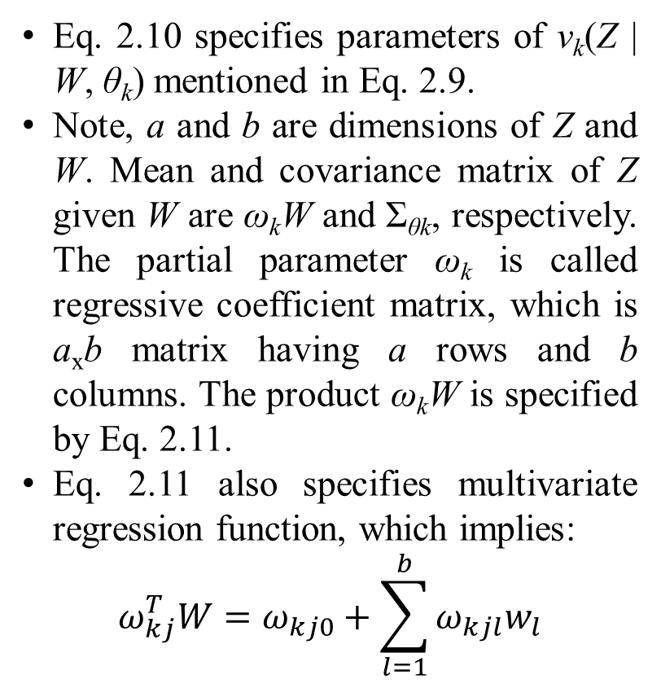
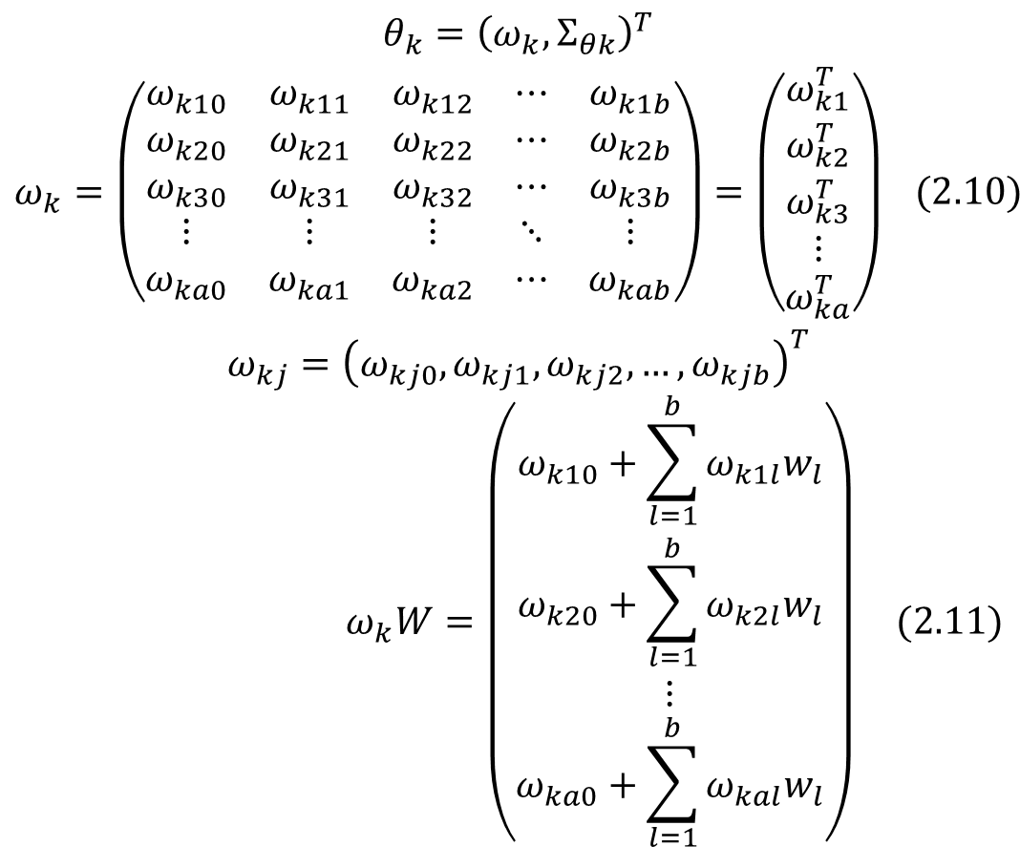
2. Learning ADD by CMM
Eq. 2.10 specifies parameters of v_{k}(Z | W, θ_{k}) mentioned in Eq. 2.9.
Note, a and b are dimensions of Z and W. Mean and covariance matrix of Z given W are ω_{k}W and Σ_{θk}, respectively. The partial parameter ω_{k} is called regressive coefficient matrix, which is a_{x}b matrix having a rows and b columns. The product ω_{k}W is specified by Eq. 2.11.
Eq. 2.11 also specifies multivariate regression function, which implies:
$$ω_{kj}^{T}W=ω_{kj0}+\sum_{l=1}^{b}{ω_{kjl}w_{l}}$$
$$\begin{matrix}θ_{k}={\left(ω_{k},Σ_{θk}\right)}^{T} \\ ω_{k}=\left(\begin{matrix}ω_{k10} & ω_{k11} & ω_{k12} & ⋯ & ω_{k1b} \\ ω_{k20} & ω_{k21} & ω_{k22} & ⋯ & ω_{k2b} \\ ω_{k30} & ω_{k31} & ω_{k32} & ⋯ & ω_{k3b} \\ ⋮ & ⋮ & ⋮ & ⋱ & ⋮ \\ ω_{ka0} & ω_{ka1} & ω_{ka2} & ⋯ & ω_{kab}\end{matrix}\right)=\left(\begin{matrix}ω_{k1}^{T} \\ ω_{k2}^{T} \\ ω_{k3}^{T} \\ ⋮ \\ ω_{ka}^{T}\end{matrix}\right) (2.10) \\ ω_{kj}={\left(ω_{kj0},ω_{kj1},ω_{kj2},…,ω_{kjb}\right)}^{T}\end{matrix}$$
$$ω_{k}W=\left(\begin{matrix}ω_{k10}+\sum_{l=1}^{b}{ω_{k1l}w_{l}} \\ ω_{k20}+\sum_{l=1}^{b}{ω_{k2l}w_{l}} \\ ⋮ \\ ω_{ka0}+\sum_{l=1}^{b}{ω_{kal}w_{l}}\end{matrix}\right) (2.11)$$

Slide 19
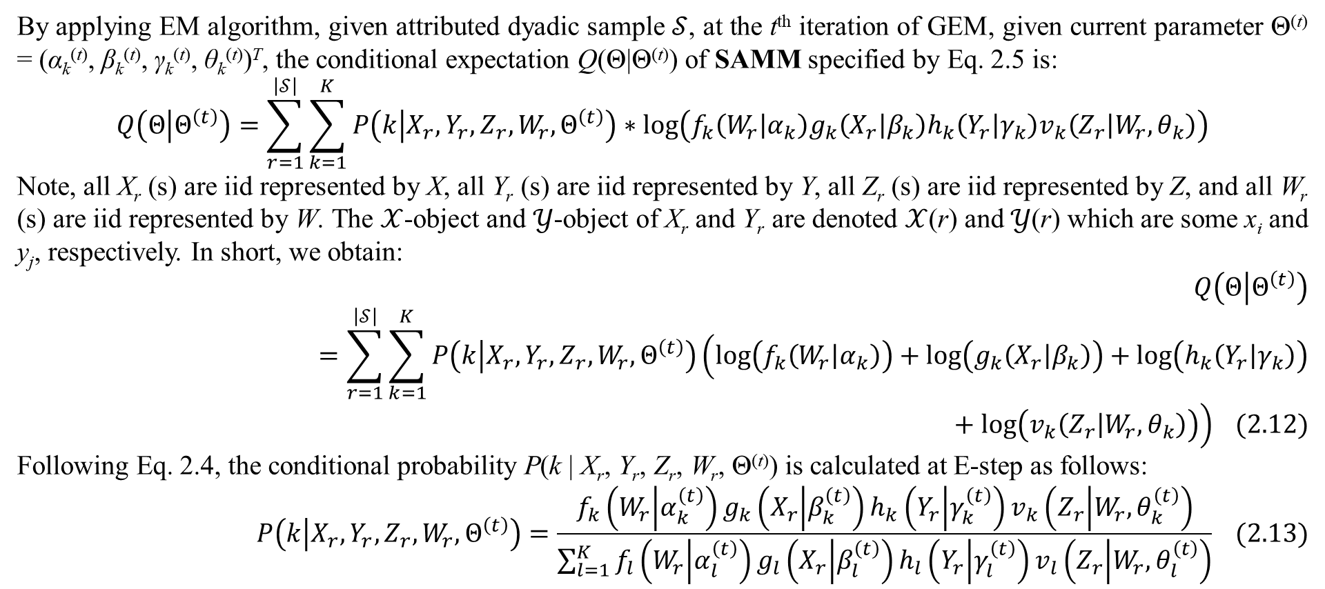
2. Learning ADD by CMM
By applying EM algorithm, given attributed dyadic sample $𝒮$, at the t^{th} iteration of GEM, given current parameter Θ^{(t)} = (α_{k}^{(t)}, β_{k}^{(t)}, γ_{k}^{(t)}, θ_{k}^{(t)})^{T}, the conditional expectation Q(Θ|Θ^{(t)}) of SAMM specified by Eq. 2.5 is:
$$Q\left(Θ | Θ^{\left(t\right)}\right)=\sum_{r=1}^{\left|𝒮\right|}{\sum_{k=1}^{K}{P\left(k | X_{r},Y_{r},Z_{r},W_{r},Θ^{\left(t\right)}\right)∗log\left(f_{k}\left(W_{r} | α_{k}\right)g_{k}\left(X_{r} | β_{k}\right)h_{k}\left(Y_{r} | γ_{k}\right)v_{k}\left(Z_{r} | W_{r},θ_{k}\right)\right)}}$$
Note, all X_{r} (s) are iid represented by X, all Y_{r} (s) are iid represented by Y, all Z_{r} (s) are iid represented by Z, and all W_{r} (s) are iid represented by W. The $𝒳$-object and $𝒴$-object of X_{r} and Y_{r} are denoted $𝒳$(r) and $𝒴$(r) which are some x_{i} and y_{j}, respectively. In short, we obtain:
$$Q\left(Θ | Θ^{\left(t\right)}\right)=\sum_{r=1}^{\left|𝒮\right|}{\sum_{k=1}^{K}{P\left(k | X_{r},Y_{r},Z_{r},W_{r},Θ^{\left(t\right)}\right)\left(log\left(f_{k}\left(W_{r} | α_{k}\right)\right)+log\left(g_{k}\left(X_{r} | β_{k}\right)\right)+log\left(h_{k}\left(Y_{r} | γ_{k}\right)\right)+log\left(v_{k}\left(Z_{r} | W_{r},θ_{k}\right)\right)\right)}} (2.12)$$
Following Eq. 2.4, the conditional probability P(k | X_{r}, Y_{r}, Z_{r}, W_{r}, Θ^{(t)}) is calculated at E-step as follows:
$$P\left(k | X_{r},Y_{r},Z_{r},W_{r},Θ^{\left(t\right)}\right)=\frac{f_{k}\left(W_{r} | α_{k}^{\left(t\right)}\right)g_{k}\left(X_{r} | β_{k}^{\left(t\right)}\right)h_{k}\left(Y_{r} | γ_{k}^{\left(t\right)}\right)v_{k}\left(Z_{r} | W_{r},θ_{k}^{\left(t\right)}\right)}{\sum_{l=1}^{K}{f_{l}\left(W_{r} | α_{l}^{\left(t\right)}\right)g_{l}\left(X_{r} | β_{l}^{\left(t\right)}\right)h_{l}\left(Y_{r} | γ_{l}^{\left(t\right)}\right)v_{l}\left(Z_{r} | W_{r},θ_{l}^{\left(t\right)}\right)}} (2.13)$$

Slide 20
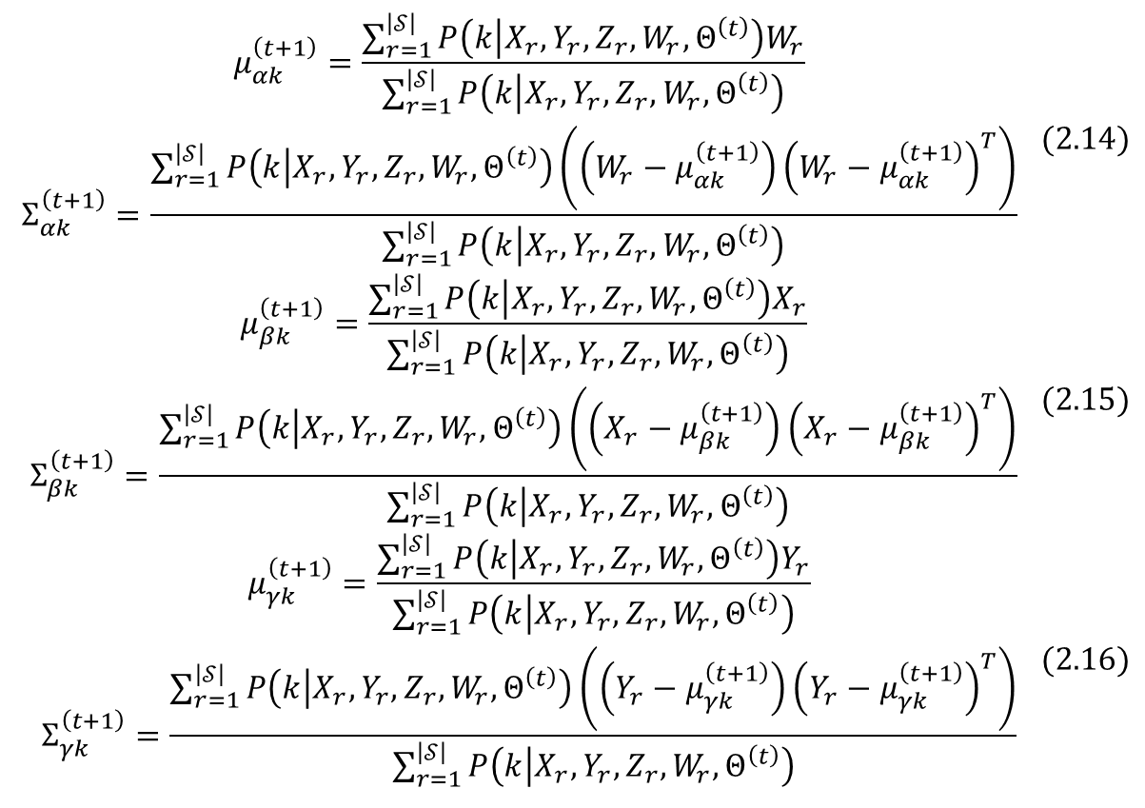
2. Learning ADD by CMM
The next parameter Θ^{(t+1)} = (α_{k}^{(t+1)}, β_{k}^{(t+1)}, γ_{k}^{(t+1)}, θ_{k}^{(t+1)})^{T} that maximizes Q(Θ|Θ^{(t)}) at M-step of some t^{th} iteration is solution of the equation formed by setting the first-order partial derivatives of Q(Θ|Θ^{(t)}) regarding Θ = (α_{k}, β_{k}, γ_{k}, θ_{k})^{T} to be zero. Because f_{k}(W|α_{k}), g_{k}(X|β_{k}), and h_{k}(Y|γ_{k}) distribute normally, by referring to [5, p. 2], the next parameters α_{k}^{(t+1)} = (μ_{αk}^{(t+1)}, Σ_{αk}^{(t+1)})^{T}, β_{k}^{(t+1)} = (μ_{βk}^{(t+1)}, Σ_{βk}^{(t+1)})^{T}, and γ_{k}^{(t+1)} = (μ_{γk}^{(t+1)}, Σ_{γk}^{(t+1)})^{T} for SAMM are calculated at M-step as follows:
$$\begin{matrix}μ_{αk}^{\left(t+1\right)}=\frac{\sum_{r=1}^{\left|𝒮\right|}{P\left(k | X_{r},Y_{r},Z_{r},W_{r},Θ^{\left(t\right)}\right)W_{r}}}{\sum_{r=1}^{\left|𝒮\right|}{P\left(k | X_{r},Y_{r},Z_{r},W_{r},Θ^{\left(t\right)}\right)}} \\ Σ_{αk}^{\left(t+1\right)}=\frac{\sum_{r=1}^{\left|𝒮\right|}{P\left(k | X_{r},Y_{r},Z_{r},W_{r},Θ^{\left(t\right)}\right)}\left(\left(W_{r}−μ_{αk}^{\left(t+1\right)}\right){\left(W_{r}−μ_{αk}^{\left(t+1\right)}\right)}^{T}\right)}{\sum_{r=1}^{\left|𝒮\right|}{P\left(k | X_{r},Y_{r},Z_{r},W_{r},Θ^{\left(t\right)}\right)}}\end{matrix} (2.14)$$
$$\begin{matrix}μ_{βk}^{\left(t+1\right)}=\frac{\sum_{r=1}^{\left|𝒮\right|}{P\left(k | X_{r},Y_{r},Z_{r},W_{r},Θ^{\left(t\right)}\right)X_{r}}}{\sum_{r=1}^{\left|𝒮\right|}{P\left(k | X_{r},Y_{r},Z_{r},W_{r},Θ^{\left(t\right)}\right)}} \\ Σ_{βk}^{\left(t+1\right)}=\frac{\sum_{r=1}^{\left|𝒮\right|}{P\left(k | X_{r},Y_{r},Z_{r},W_{r},Θ^{\left(t\right)}\right)}\left(\left(X_{r}−μ_{βk}^{\left(t+1\right)}\right){\left(X_{r}−μ_{βk}^{\left(t+1\right)}\right)}^{T}\right)}{\sum_{r=1}^{\left|𝒮\right|}{P\left(k | X_{r},Y_{r},Z_{r},W_{r},Θ^{\left(t\right)}\right)}}\end{matrix} (2.15)$$
$$\begin{matrix}μ_{γk}^{\left(t+1\right)}=\frac{\sum_{r=1}^{\left|𝒮\right|}{P\left(k | X_{r},Y_{r},Z_{r},W_{r},Θ^{\left(t\right)}\right)Y_{r}}}{\sum_{r=1}^{\left|𝒮\right|}{P\left(k | X_{r},Y_{r},Z_{r},W_{r},Θ^{\left(t\right)}\right)}} \\ Σ_{γk}^{\left(t+1\right)}=\frac{\sum_{r=1}^{\left|𝒮\right|}{P\left(k | X_{r},Y_{r},Z_{r},W_{r},Θ^{\left(t\right)}\right)}\left(\left(Y_{r}−μ_{γk}^{\left(t+1\right)}\right){\left(Y_{r}−μ_{γk}^{\left(t+1\right)}\right)}^{T}\right)}{\sum_{r=1}^{\left|𝒮\right|}{P\left(k | X_{r},Y_{r},Z_{r},W_{r},Θ^{\left(t\right)}\right)}}\end{matrix} (2.16)$$

Slide 21
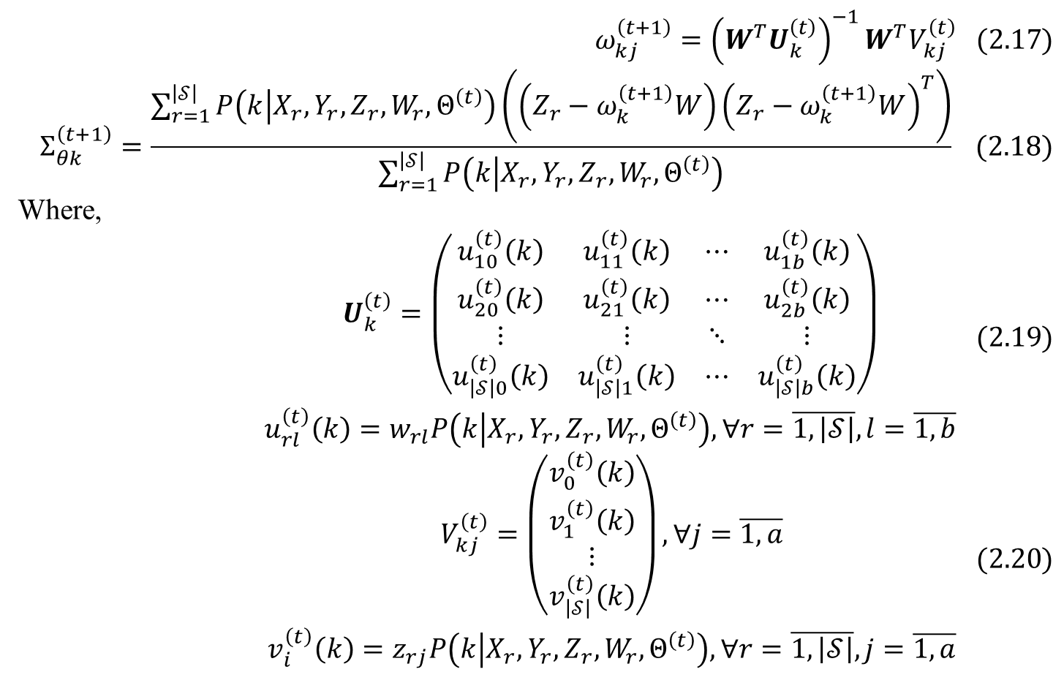
2. Learning ADD by CMM
Because v_{k}(Z | W, θ_{k}) is regressive PDF known as adaptive regression model (ARM), by referring to [5, pp. 5-6], the next parameter θ_{k}^{(t+1)} = (ω_{k}^{(t+1)}, Σ_{θk}^{(t+1)})^{T} is calculated by Eq. 2.17, 2.18:
$$ω_{kj}^{\left(t+1\right)}={\left(W^{T}U_{k}^{\left(t\right)}\right)}^{−1}W^{T}V_{kj}^{\left(t\right)} (2.17)$$
$$Σ_{θk}^{\left(t+1\right)}=\frac{\sum_{r=1}^{\left|𝒮\right|}{P\left(k | X_{r},Y_{r},Z_{r},W_{r},Θ^{\left(t\right)}\right)}\left(\left(Z_{r}−ω_{k}^{\left(t+1\right)}W\right){\left(Z_{r}−ω_{k}^{\left(t+1\right)}W\right)}^{T}\right)}{\sum_{r=1}^{\left|𝒮\right|}{P\left(k | X_{r},Y_{r},Z_{r},W_{r},Θ^{\left(t\right)}\right)}} (2.18)$$
Where,
$$\begin{matrix}U_{k}^{\left(t\right)}=\left(\begin{matrix}u_{10}^{\left(t\right)}\left(k\right) & u_{11}^{\left(t\right)}\left(k\right) & ⋯ & u_{1b}^{\left(t\right)}\left(k\right) \\ u_{20}^{\left(t\right)}\left(k\right) & u_{21}^{\left(t\right)}\left(k\right) & ⋯ & u_{2b}^{\left(t\right)}\left(k\right) \\ ⋮ & ⋮ & ⋱ & ⋮ \\ u_{\left|𝒮\right|0}^{\left(t\right)}\left(k\right) & u_{\left|𝒮\right|1}^{\left(t\right)}\left(k\right) & ⋯ & u_{\left|𝒮\right|b}^{\left(t\right)}\left(k\right)\end{matrix}\right) \\ u_{rl}^{\left(t\right)}\left(k\right)=w_{rl}P\left(k | X_{r},Y_{r},Z_{r},W_{r},Θ^{\left(t\right)}\right),∀r=\overline{1,\left|𝒮\right|},l=\overline{1,b}\end{matrix} (2.19)$$
$$\begin{matrix}V_{kj}^{\left(t\right)}=\left(\begin{matrix}v_{0}^{\left(t\right)}\left(k\right) \\ v_{1}^{\left(t\right)}\left(k\right) \\ ⋮ \\ v_{\left|𝒮\right|}^{\left(t\right)}\left(k\right)\end{matrix}\right),∀j=\overline{1,a} \\ v_{i}^{\left(t\right)}\left(k\right)=z_{rj}P\left(k | X_{r},Y_{r},Z_{r},W_{r},Θ^{\left(t\right)}\right),∀r=\overline{1,\left|𝒮\right|},j=\overline{1,a}\end{matrix} (2.20)$$

Slide 22
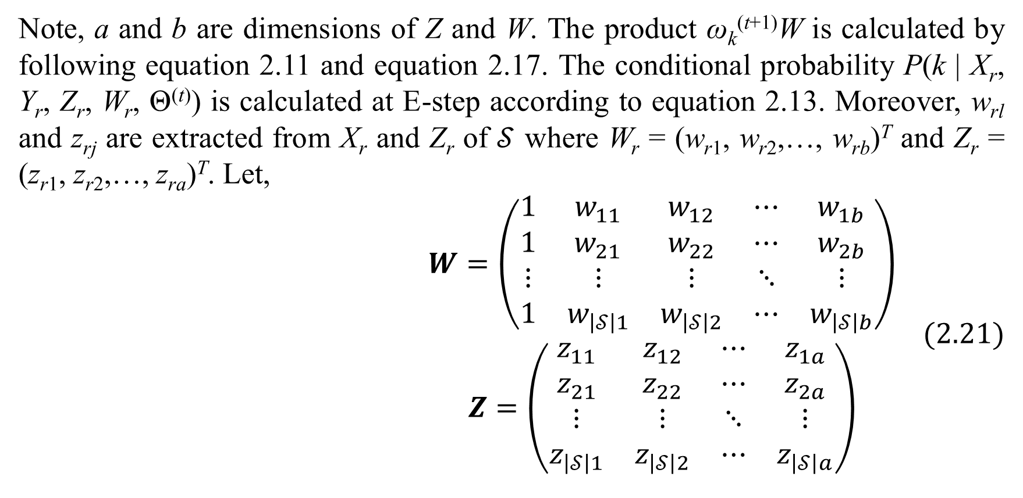
2. Learning ADD by CMM
Note, a and b are dimensions of Z and W. The product ω_{k}^{(t+1)}W is calculated by following equation 2.11 and equation 2.17. The conditional probability P(k | X_{r}, Y_{r}, Z_{r}, W_{r}, Θ^{(t)}) is calculated at E-step according to equation 2.13. Moreover, w_{rl} and z_{rj} are extracted from X_{r} and Z_{r} of $𝒮$ where W_{r} = (w_{r1}, w_{r2},…, w_{rb})^{T} and Z_{r} = (z_{r1}, z_{r2},…, z_{ra})^{T}. Let,
$$\begin{matrix}W=\left(\begin{matrix}1 & w_{11} & w_{12} & ⋯ & w_{1b} \\ 1 & w_{21} & w_{22} & ⋯ & w_{2b} \\ ⋮ & ⋮ & ⋮ & ⋱ & ⋮ \\ 1 & w_{\left|𝒮\right|1} & w_{\left|𝒮\right|2} & ⋯ & w_{\left|𝒮\right|b}\end{matrix}\right) \\ Z=\left(\begin{matrix}z_{11} & z_{12} & ⋯ & z_{1a} \\ z_{21} & z_{22} & ⋯ & z_{2a} \\ ⋮ & ⋮ & ⋱ & ⋮ \\ z_{\left|𝒮\right|1} & z_{\left|𝒮\right|2} & ⋯ & z_{\left|𝒮\right|a}\end{matrix}\right)\end{matrix} (2.21)$$

Slide 23
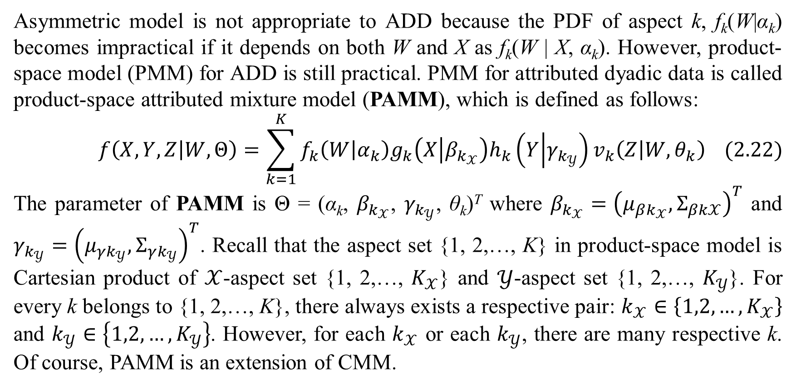
2. Learning ADD by CMM
Asymmetric model is not appropriate to ADD because the PDF of aspect k, f_{k}(W|α_{k}) becomes impractical if it depends on both W and X as f_{k}(W | X, α_{k}). However, product-space model (PMM) for ADD is still practical. PMM for attributed dyadic data is called product-space attributed mixture model (PAMM), which is defined as follows:
$$f\left(X,Y,Z | W,Θ\right)=\sum_{k=1}^{K}{f_{k}\left(W | α_{k}\right)g_{k}\left(X | β_{k_{𝒳}}\right)h_{k}\left(Y | γ_{k_{𝒴}}\right)v_{k}\left(Z | W,θ_{k}\right)} (2.22)$$
The parameter of PAMM is Θ = (α_{k}, $β_{k_{𝒳}}$, $γ_{k_{𝒴}}$, θ_{k})^{T} where $β_{k_{𝒳}}={\left(μ_{βk_{𝒳}},Σ_{βk𝒳}\right)}^{T}$ and $γ_{k_{𝒴}}={\left(μ_{γk_{𝒴}},Σ_{γk_{𝒴}}\right)}^{T}$. Recall that the aspect set {1, 2,…, K} in product-space model is Cartesian product of $𝒳$-aspect set {1, 2,…, $K_{𝒳}$} and $𝒴$-aspect set {1, 2,…, $K_{𝒴}$}. For every k belongs to {1, 2,…, K}, there always exists a respective pair: $k_{𝒳}∈\left\{1,2,…,K_{𝒳}\right\}$ and $k_{𝒴}∈\left\{1,2,…,K_{𝒴}\right\}$. However, for each $k_{𝒳}$ or each $k_{𝒴}$, there are many respective k. Of course, PAMM is an extension of CMM.

Slide 24
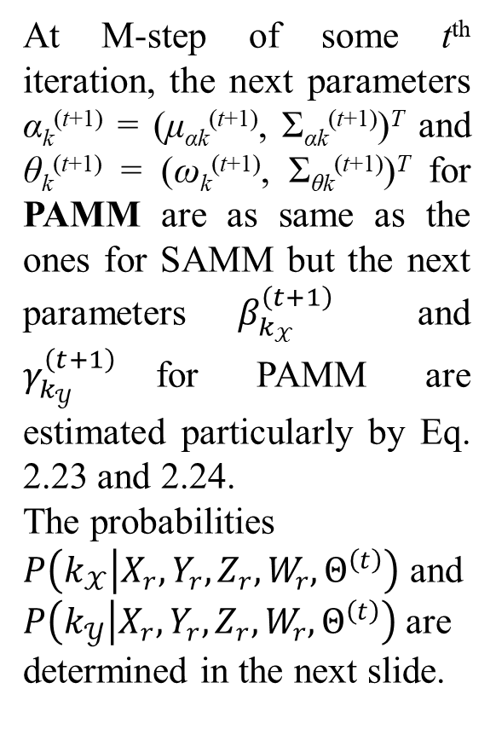
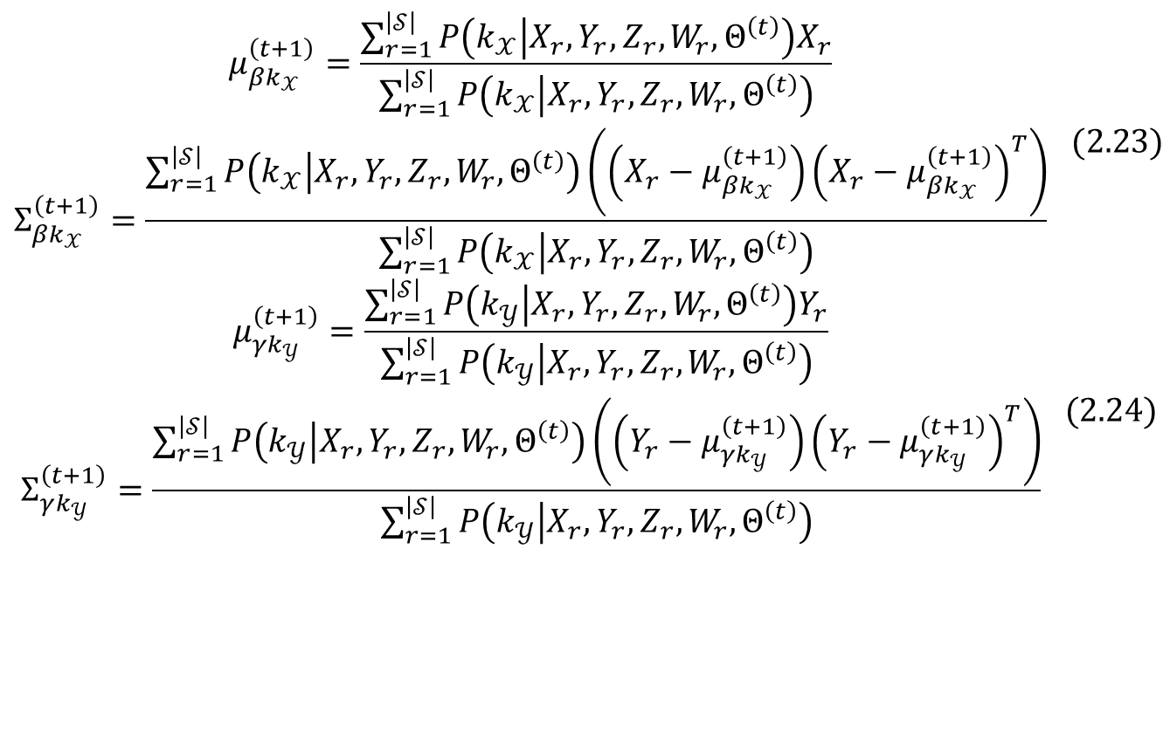
2. Learning ADD by CMM
At M-step of some t^{th} iteration, the next parameters α_{k}^{(t+1)} = (μ_{αk}^{(t+1)}, Σ_{αk}^{(t+1)})^{T} and θ_{k}^{(t+1)} = (ω_{k}^{(t+1)}, Σ_{θk}^{(t+1)})^{T} for PAMM are as same as the ones for SAMM but the next parameters $β_{k_{𝒳}}^{\left(t+1\right)}$ and $γ_{k_{𝒴}}^{\left(t+1\right)}$for PAMM are estimated particularly by Eq. 2.23 and 2.24.
The probabilities $P\left(k_{𝒳} | X_{r},Y_{r},Z_{r},W_{r},Θ^{\left(t\right)}\right)$ and $P\left(k_{𝒴} | X_{r},Y_{r},Z_{r},W_{r},Θ^{\left(t\right)}\right)$are determined in the next slide.
$$\begin{matrix}μ_{βk_{𝒳}}^{\left(t+1\right)}=\frac{\sum_{r=1}^{\left|𝒮\right|}{P\left(k_{𝒳} | X_{r},Y_{r},Z_{r},W_{r},Θ^{\left(t\right)}\right)X_{r}}}{\sum_{r=1}^{\left|𝒮\right|}{P\left(k_{𝒳} | X_{r},Y_{r},Z_{r},W_{r},Θ^{\left(t\right)}\right)}} \\ Σ_{βk_{𝒳}}^{\left(t+1\right)}=\frac{\sum_{r=1}^{\left|𝒮\right|}{P\left(k_{𝒳} | X_{r},Y_{r},Z_{r},W_{r},Θ^{\left(t\right)}\right)}\left(\left(X_{r}−μ_{βk_{𝒳}}^{\left(t+1\right)}\right){\left(X_{r}−μ_{βk_{𝒳}}^{\left(t+1\right)}\right)}^{T}\right)}{\sum_{r=1}^{\left|𝒮\right|}{P\left(k_{𝒳} | X_{r},Y_{r},Z_{r},W_{r},Θ^{\left(t\right)}\right)}}\end{matrix} (2.23)$$
$$\begin{matrix}μ_{γk_{𝒴}}^{\left(t+1\right)}=\frac{\sum_{r=1}^{\left|𝒮\right|}{P\left(k_{𝒴} | X_{r},Y_{r},Z_{r},W_{r},Θ^{\left(t\right)}\right)Y_{r}}}{\sum_{r=1}^{\left|𝒮\right|}{P\left(k_{𝒴} | X_{r},Y_{r},Z_{r},W_{r},Θ^{\left(t\right)}\right)}} \\ Σ_{γk_{𝒴}}^{\left(t+1\right)}=\frac{\sum_{r=1}^{\left|𝒮\right|}{P\left(k_{𝒴} | X_{r},Y_{r},Z_{r},W_{r},Θ^{\left(t\right)}\right)}\left(\left(Y_{r}−μ_{γk_{𝒴}}^{\left(t+1\right)}\right){\left(Y_{r}−μ_{γk_{𝒴}}^{\left(t+1\right)}\right)}^{T}\right)}{\sum_{r=1}^{\left|𝒮\right|}{P\left(k_{𝒴} | X_{r},Y_{r},Z_{r},W_{r},Θ^{\left(t\right)}\right)}}\end{matrix} (2.24)$$

Slide 25
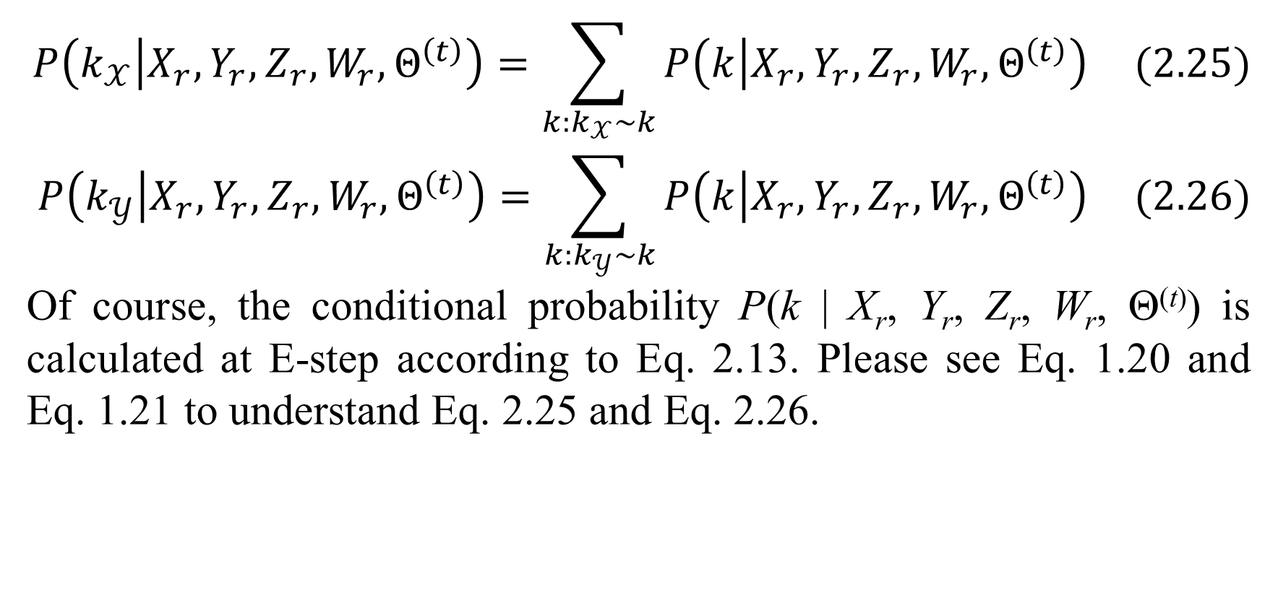
2. Learning ADD by CMM
$$P\left(k_{𝒳} | X_{r},Y_{r},Z_{r},W_{r},Θ^{\left(t\right)}\right)=\sum_{k:k_{𝒳}\sim k}{P\left(k | X_{r},Y_{r},Z_{r},W_{r},Θ^{\left(t\right)}\right)} (2.25)$$
$$P\left(k_{𝒴} | X_{r},Y_{r},Z_{r},W_{r},Θ^{\left(t\right)}\right)=\sum_{k:k_{𝒴}\sim k}{P\left(k | X_{r},Y_{r},Z_{r},W_{r},Θ^{\left(t\right)}\right)} (2.26)$$
Of course, the conditional probability P(k | X_{r}, Y_{r}, Z_{r}, W_{r}, Θ^{(t)}) is calculated at E-step according to Eq. 2.13. Please see Eq. 1.20 and Eq. 1.21 to understand Eq. 2.25 and Eq. 2.26.

Slide 26
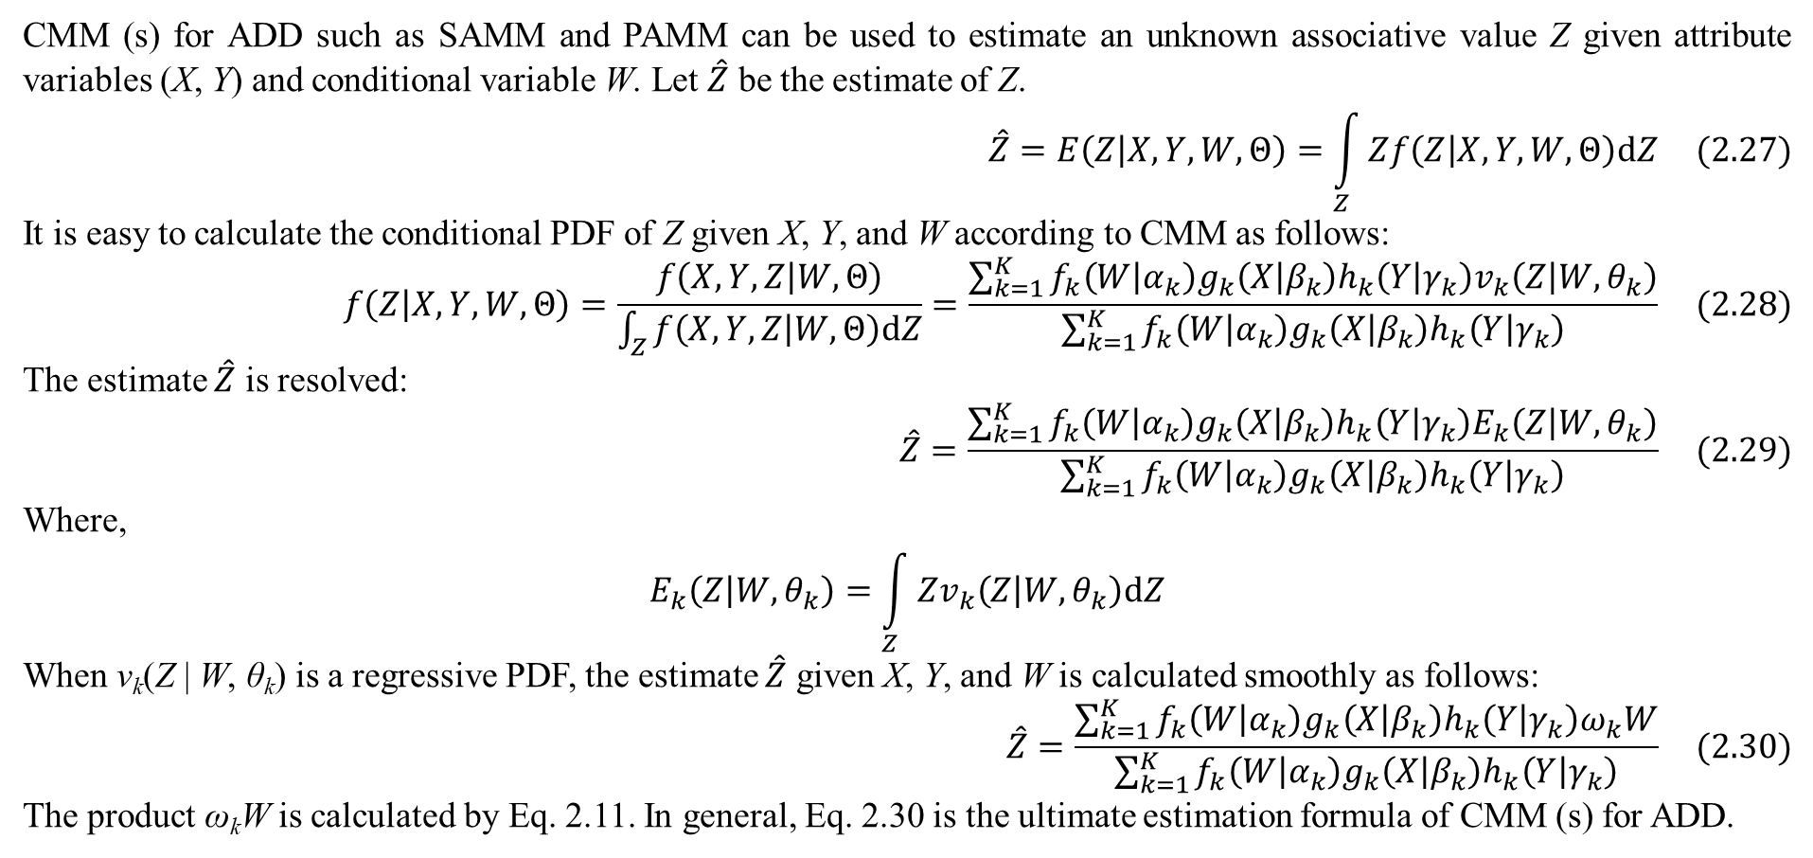
2. Learning ADD by CMM
CMM (s) for ADD such as SAMM and PAMM can be used to estimate an unknown associative value Z given attribute variables (X, Y) and conditional variable W. Let $\hat{Z}$ be the estimate of Z.
$$\hat{Z}=E\left(Z | X,Y,W,Θ\right)=\int_{Z}{Zf\left(Z | X,Y,W,Θ\right)dZ} (2.27)$$
It is easy to calculate the conditional PDF of Z given X, Y, and W according to CMM as follows:
$$f\left(Z | X,Y,W,Θ\right)=\frac{f\left(X,Y,Z | W,Θ\right)}{\int_{Z}{f\left(X,Y,Z | W,Θ\right)dZ}}=\frac{\sum_{k=1}^{K}{f_{k}\left(W | α_{k}\right)g_{k}\left(X | β_{k}\right)h_{k}\left(Y | γ_{k}\right)v_{k}\left(Z | W,θ_{k}\right)}}{\sum_{k=1}^{K}{f_{k}\left(W | α_{k}\right)g_{k}\left(X | β_{k}\right)h_{k}\left(Y | γ_{k}\right)}} (2.28)$$
The estimate $\hat{Z}$ is resolved:
$$\hat{Z}=\frac{\sum_{k=1}^{K}{f_{k}\left(W | α_{k}\right)g_{k}\left(X | β_{k}\right)h_{k}\left(Y | γ_{k}\right)E_{k}\left(Z | W,θ_{k}\right)}}{\sum_{k=1}^{K}{f_{k}\left(W | α_{k}\right)g_{k}\left(X | β_{k}\right)h_{k}\left(Y | γ_{k}\right)}} (2.29)$$
Where,
$$E_{k}\left(Z | W,θ_{k}\right)=\int_{Z}{Zv_{k}\left(Z | W,θ_{k}\right)dZ}$$
When v_{k}(Z | W, θ_{k}) is a regressive PDF, the estimate $\hat{Z}$ given X, Y, and W is calculated smoothly as follows:
$$\hat{Z}=\frac{\sum_{k=1}^{K}{f_{k}\left(W | α_{k}\right)g_{k}\left(X | β_{k}\right)h_{k}\left(Y | γ_{k}\right)ω_{k}W}}{\sum_{k=1}^{K}{f_{k}\left(W | α_{k}\right)g_{k}\left(X | β_{k}\right)h_{k}\left(Y | γ_{k}\right)}} (2.30)$$
The product ω_{k}W is calculated by Eq. 2.11. In general, Eq. 2.30 is the ultimate estimation formula of CMM (s) for ADD.

Slide 27
4. Conclusions
ADD is flexible and covers most of structures / forms of dyadic data. CMM (s) for ADD such as SAMM and PAMM help researchers to model ADD in a flexible, solid, reliable manner. For example, if aspects are independent from conditional variable, each PDF f_{k}(W|α_{k}) is reduced into a discrete probabilistic parameter. If each regressive PDF v_{k}(Z | W, θ_{k}) is not formed in favor of regression model, it must be formed as probabilistic distribution like conditional multinormal PDF.
An interesting application of SAMM is to build up a unified estimation model of content-based filtering, collaborative filtering, and context-awarded filtering, in which attributes along with g_{k}(X|β_{k}) and h_{k}(Y|γ_{k}) are responsible for content-based filtering whereas associative variable along with v_{k}(Z | W, θ_{k}) and f_{k}(W|α_{k}) are responsible for collaborative filtering and context-awarded filtering. The attributes X and Y represent information about users and items in rating data with note that users and items are knowns as objects. The associative variable Z represents rating values in rating data. The conditional variable W represents contexts. Eq. 2.30 is the ultimate formula of the unified estimation model. I hope that researchers will concern such proposed model because it is not realized yet when I compose this paper.

Slide 28
Thank you for attention

Slide 29
References
L. Nguyen, "Tutorial on EM tutorial," Preprints, 2020.
T. Hofmann and J. Puzicha, "Statistical Models for Co-occurrence Data," MIT Publisher, 1998.
L. Nguyen, "Learning Dyadic Data and Predicting Unaccomplished Co-Occurrent Values by Mixture Model," Preprints, p. 14, 2 November 2020.
T. Hofmann, J. Puzicha and M. I. Jordan, "Learning from Dyadic Data," in Advances in Neural Information Processing Systems 11 (NIPS 1998), Denver, 1998.
L. Nguyen, "Conditional Mixture Model and Its Application for Regression Model," Preprints, 28 October 2020.

