Slide 1
Finite mixture model with EM algorithm
Prof. Dr. Loc Nguyen, PostDoc
Loc Nguyen’s Academic Network, Vietnam
Email: ng_phloc@yahoo.com
Homepage: www.locnguyen.net

Slide 2
Abstract
Expectation maximization (EM) algorithm is a popular and powerful mathematical method for parameter estimation in case that there exist both observed data and hidden data. Therefore, EM is appropriate to applications which aim to exploit laten aspects under heterogeneous data. This report focuses on probabilistic finite mixture model which is a popular and successful application of EM, which is fully explained in (Nguyen, Tutorial on EM algorithm, 2020, pp. 78-88). I also proposed a special regression model associated with mixture model in which missing values are acceptable.

Slide 3
Table of contents
Introduction to EM algorithm
Finite mixture model
Mixture model with dyadic data
Mixture regression model

Slide 4
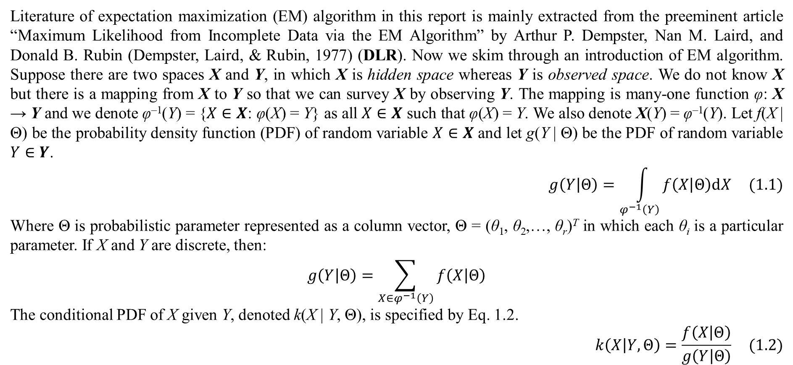
1. Introduction to EM algorithm
Literature of expectation maximization (EM) algorithm in this report is mainly extracted from the preeminent article “Maximum Likelihood from Incomplete Data via the EM Algorithm” by Arthur P. Dempster, Nan M. Laird, and Donald B. Rubin (Dempster, Laird, & Rubin, 1977) (DLR). Now we skim through an introduction of EM algorithm. Suppose there are two spaces X and Y, in which X is hidden space whereas Y is observed space. We do not know X but there is a mapping from X to Y so that we can survey X by observing Y. The mapping is many-one function φ: X → Y and we denote φ^{–1}(Y) = {$X∈X$: φ(X) = Y} as all $X∈X$ such that φ(X) = Y. We also denote X(Y) = φ^{–1}(Y). Let f(X | Θ) be the probability density function (PDF) of random variable $X∈X$ and let g(Y | Θ) be the PDF of random variable $Y∈Y$.
$$g\left(Y | Θ\right)=\int_{φ^{−1}\left(Y\right)}{f\left(X | Θ\right)dX} (1.1)$$
Where Θ is probabilistic parameter represented as a column vector, Θ = (θ₁, θ₂,…, θ_{r})^{T} in which each θ_{i} is a particular parameter. If X and Y are discrete, then:
$$g\left(Y | Θ\right)=\sum_{X∈φ^{−1}\left(Y\right)}{f\left(X | Θ\right)}$$
The conditional PDF of X given Y, denoted k(X | Y, Θ), is specified by Eq. 1.2.
$$k\left(X | Y,Θ\right)=\frac{f\left(X | Θ\right)}{g\left(Y | Θ\right)} (1.2)$$

Slide 5
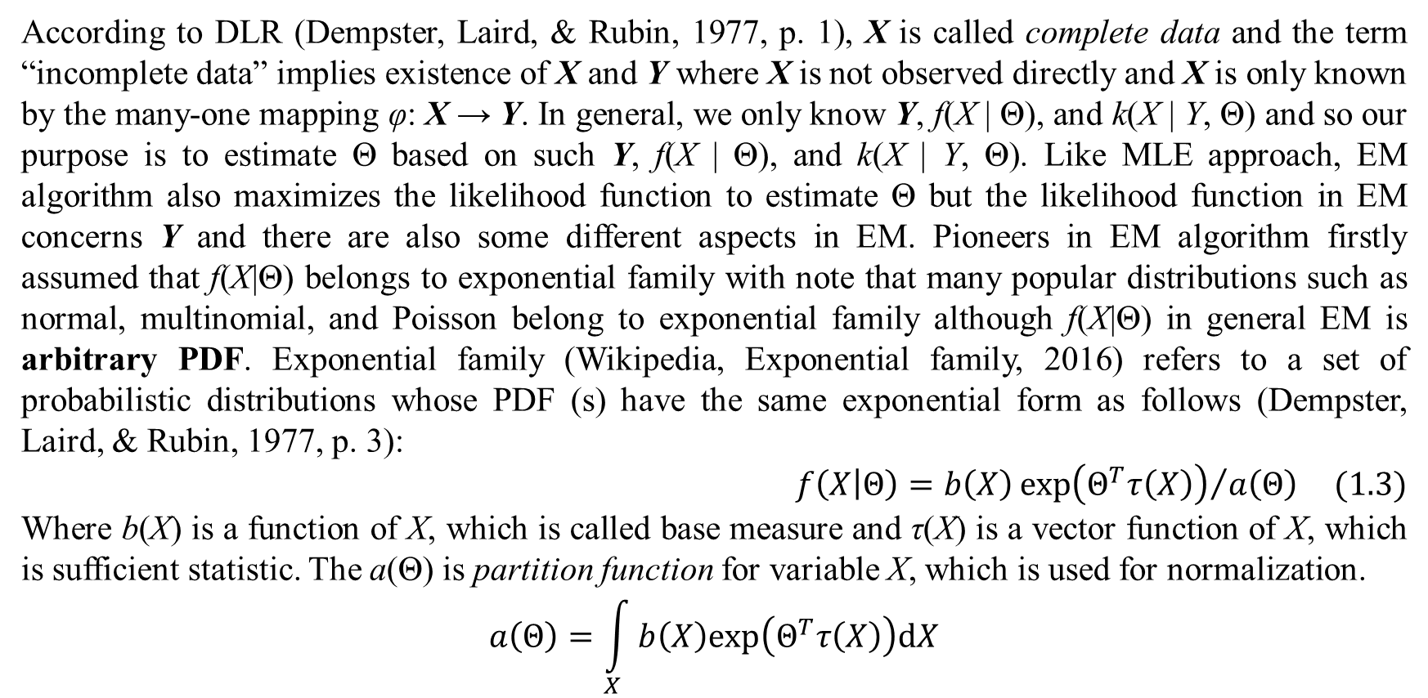
1. Introduction to EM algorithm
According to DLR (Dempster, Laird, & Rubin, 1977, p. 1), X is called complete data and the term “incomplete data” implies existence of X and Y where X is not observed directly and X is only known by the many-one mapping φ: X → Y. In general, we only know Y, f(X | Θ), and k(X | Y, Θ) and so our purpose is to estimate Θ based on such Y, f(X | Θ), and k(X | Y, Θ). Like MLE approach, EM algorithm also maximizes the likelihood function to estimate Θ but the likelihood function in EM concerns Y and there are also some different aspects in EM. Pioneers in EM algorithm firstly assumed that f(X|Θ) belongs to exponential family with note that many popular distributions such as normal, multinomial, and Poisson belong to exponential family although f(X|Θ) in general EM is arbitrary PDF. Exponential family (Wikipedia, Exponential family, 2016) refers to a set of probabilistic distributions whose PDF (s) have the same exponential form as follows (Dempster, Laird, & Rubin, 1977, p. 3):
$$f\left(X | Θ\right)=b\left(X\right){exp\left(Θ^{T}τ\left(X\right)\right)}/{a\left(Θ\right)} (1.3)$$
Where b(X) is a function of X, which is called base measure and τ(X) is a vector function of X, which is sufficient statistic. The a(Θ) is partition function for variable X, which is used for normalization.
$$a\left(Θ\right)=\int_{X}{b\left(X\right)exp\left(Θ^{T}τ\left(X\right)\right)dX}$$

Slide 6
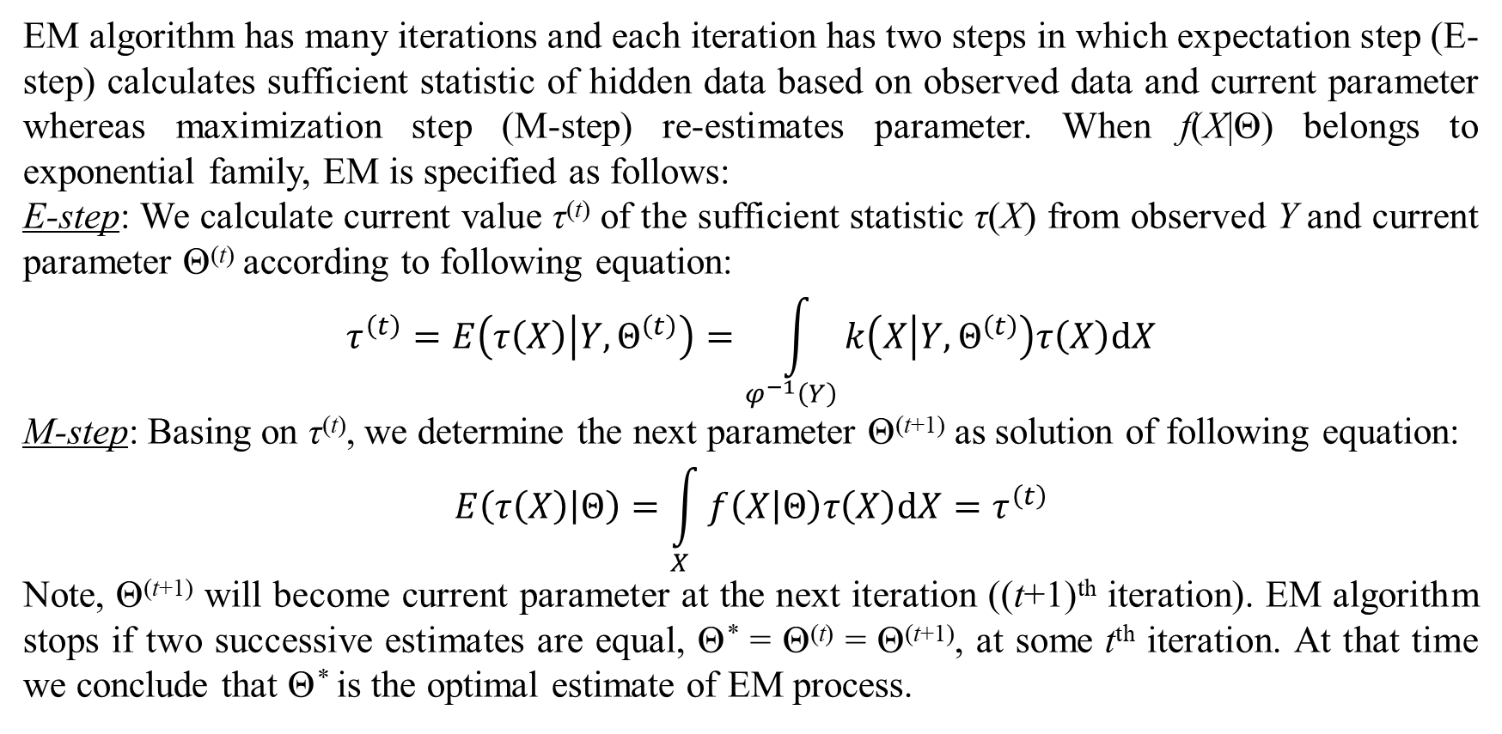
1. Introduction to EM algorithm
EM algorithm has many iterations and each iteration has two steps in which expectation step (E-step) calculates sufficient statistic of hidden data based on observed data and current parameter whereas maximization step (M-step) re-estimates parameter. When f(X|Θ) belongs to exponential family, EM is specified as follows:
E-step: We calculate current value τ^{(t)} of the sufficient statistic τ(X) from observed Y and current parameter Θ^{(t)} according to following equation:
$$τ^{\left(t\right)}=E\left(τ\left(X\right) | Y,Θ^{\left(t\right)}\right)=\int_{φ^{−1}\left(Y\right)}{k\left(X | Y,Θ^{\left(t\right)}\right)τ\left(X\right)dX}$$
M-step: Basing on τ^{(t)}, we determine the next parameter Θ^{(t+1)} as solution of following equation:
$$E\left(τ\left(X\right) | Θ\right)=\int_{X}{f\left(X | Θ\right)τ\left(X\right)dX}=τ^{\left(t\right)}$$
Note, Θ^{(t+1)} will become current parameter at the next iteration ((t+1)^{th} iteration). EM algorithm stops if two successive estimates are equal, Θ* = Θ^{(t)} = Θ^{(t+1)}, at some t^{th} iteration. At that time we conclude that Θ* is the optimal estimate of EM process.

Slide 7
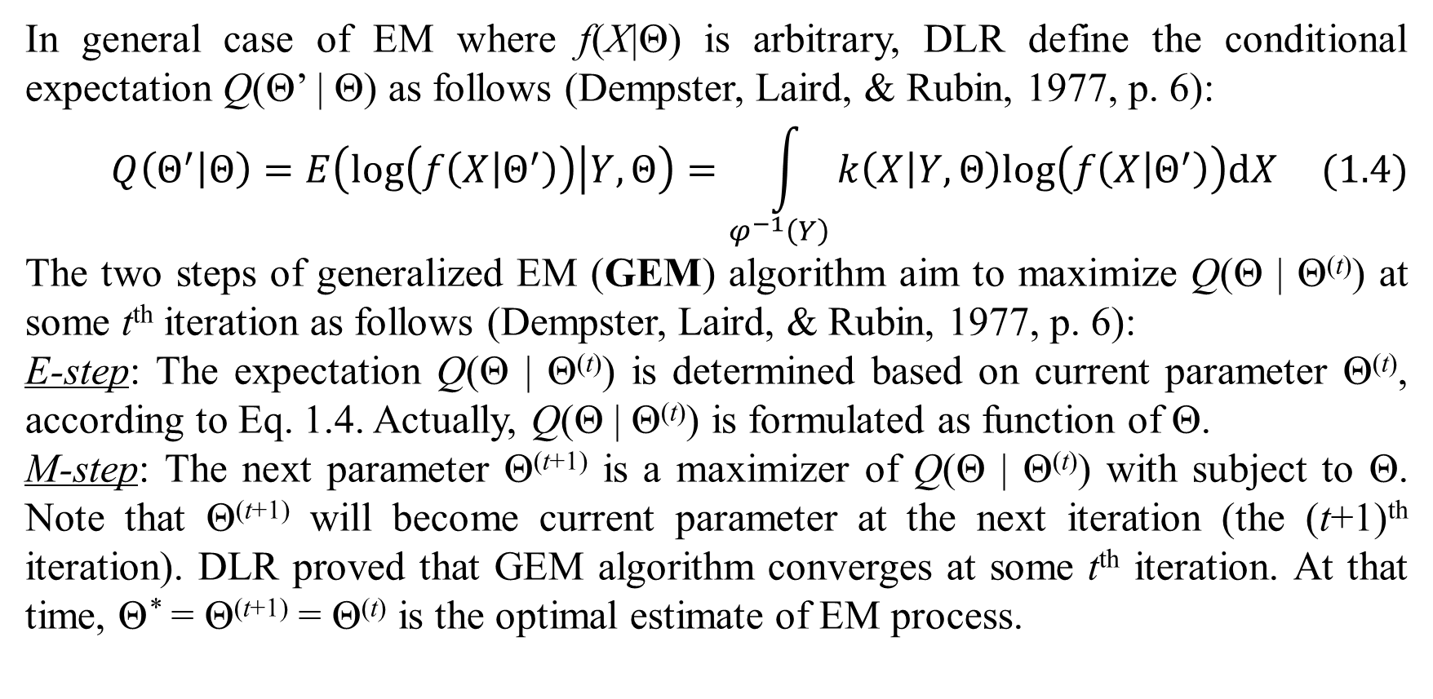
1. Introduction to EM algorithm
In general case of EM where f(X|Θ) is arbitrary, DLR define the conditional expectation Q(Θ’ | Θ) as follows (Dempster, Laird, & Rubin, 1977, p. 6):
$$Q\left(Θ^{′} | Θ\right)=E\left(log\left(f\left(X | Θ^{′}\right)\right) | Y,Θ\right)=\int_{φ^{−1}\left(Y\right)}{k\left(X | Y,Θ\right)log\left(f\left(X | Θ^{′}\right)\right)dX} (1.4)$$
The two steps of generalized EM (GEM) algorithm aim to maximize Q(Θ | Θ^{(t)}) at some t^{th} iteration as follows (Dempster, Laird, & Rubin, 1977, p. 6):
E-step: The expectation Q(Θ | Θ^{(t)}) is determined based on current parameter Θ^{(t)}, according to Eq. 1.4. Actually, Q(Θ | Θ^{(t)}) is formulated as function of Θ.
M-step: The next parameter Θ^{(t+1)} is a maximizer of Q(Θ | Θ^{(t)}) with subject to Θ. Note that Θ^{(t+1)} will become current parameter at the next iteration (the (t+1)^{th} iteration). DLR proved that GEM algorithm converges at some t^{th} iteration. At that time, Θ* = Θ^{(t+1)} = Θ^{(t)} is the optimal estimate of EM process.

Slide 8
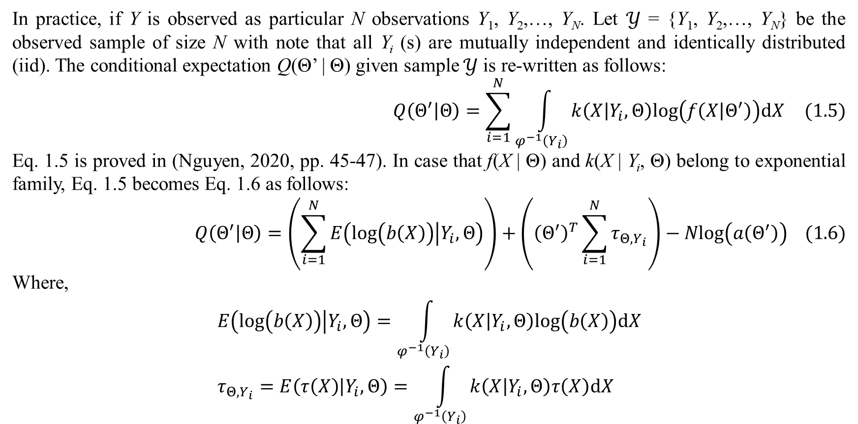
1. Introduction to EM algorithm
In practice, if Y is observed as particular N observations Y₁, Y₂,…, Y_{N}. Let $𝒴$ = {Y₁, Y₂,…, Y_{N}} be the observed sample of size N with note that all Y_{i} (s) are mutually independent and identically distributed (iid). The conditional expectation Q(Θ’ | Θ) given sample $𝒴$ is re-written as follows:
$$Q\left(Θ^{′} | Θ\right)=\sum_{i=1}^{N}{\int_{φ^{−1}\left(Y_{i}\right)}{k\left(X | Y_{i},Θ\right)log\left(f\left(X | Θ^{′}\right)\right)dX}} (1.5)$$
Eq. 1.5 is proved in (Nguyen, 2020, pp. 45-47). In case that f(X | Θ) and k(X | Y_{i}, Θ) belong to exponential family, Eq. 1.5 becomes Eq. 1.6 as follows:
$$Q\left(Θ^{′} | Θ\right)=\left(\sum_{i=1}^{N}{E\left(log\left(b\left(X\right)\right) | Y_{i},Θ\right)}\right)+\left({\left(Θ^{′}\right)}^{T}\sum_{i=1}^{N}{τ_{Θ,Y_{i}}}\right)−Nlog\left(a\left(Θ^{′}\right)\right) (1.6)$$
Where,
$$E\left(log\left(b\left(X\right)\right) | Y_{i},Θ\right)=\int_{φ^{−1}\left(Y_{i}\right)}{k\left(X | Y_{i},Θ\right)log\left(b\left(X\right)\right)dX} \\ τ_{Θ,Y_{i}}=E\left(τ\left(X\right) | Y_{i},Θ\right)=\int_{φ^{−1}\left(Y_{i}\right)}{k\left(X | Y_{i},Θ\right)τ\left(X\right)dX}$$

Slide 9
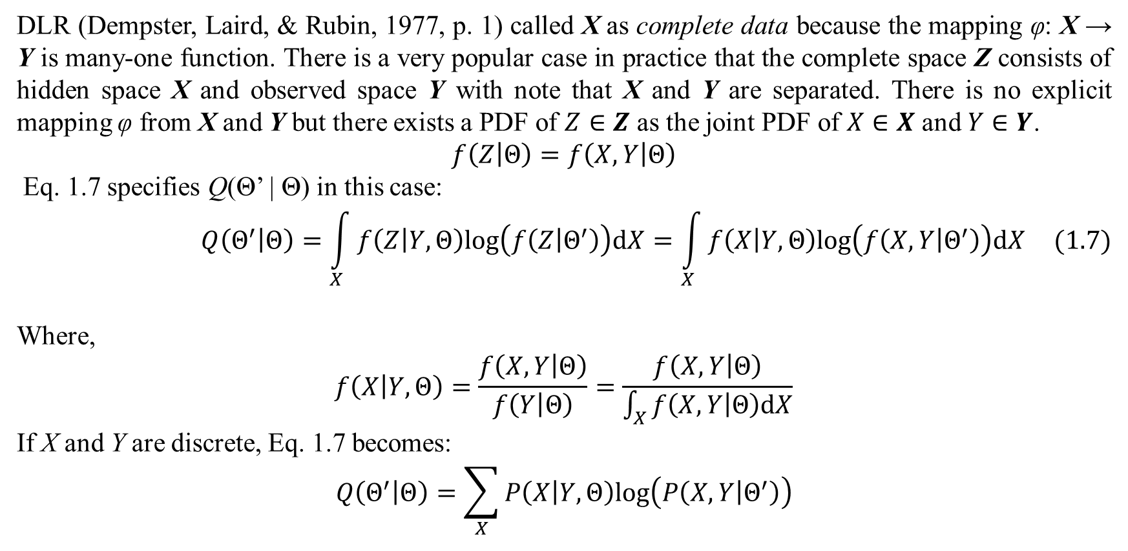
1. Introduction to EM algorithm
DLR (Dempster, Laird, & Rubin, 1977, p. 1) called X as complete data because the mapping φ: X → Y is many-one function. There is a very popular case in practice that the complete space Z consists of hidden space X and observed space Y with note that X and Y are separated. There is no explicit mapping φ from X and Y but there exists a PDF of $Z∈Z$ as the joint PDF of $X∈X$ and $Y∈Y$.
$$f\left(Z | Θ\right)=f\left(X,Y | Θ\right)$$
Eq. 1.7 specifies Q(Θ’ | Θ) in this case:
$$Q\left(Θ^{′} | Θ\right)=\int_{X}{f\left(Z | Y,Θ\right)log\left(f\left(Z | Θ^{′}\right)\right)dX}=\int_{X}{f\left(X | Y,Θ\right)log\left(f\left(X,Y | Θ^{′}\right)\right)dX} (1.7)$$
Where,
$$f\left(X | Y,Θ\right)=\frac{f\left(X,Y | Θ\right)}{f\left(Y | Θ\right)}=\frac{f\left(X,Y | Θ\right)}{\int_{X}{f\left(X,Y | Θ\right)dX}}$$
If X and Y are discrete, Eq. 1.7 becomes:
$$Q\left(Θ^{′} | Θ\right)=\sum_{X}{P\left(X | Y,Θ\right)log\left(P\left(X,Y | Θ^{′}\right)\right)}$$

Slide 10
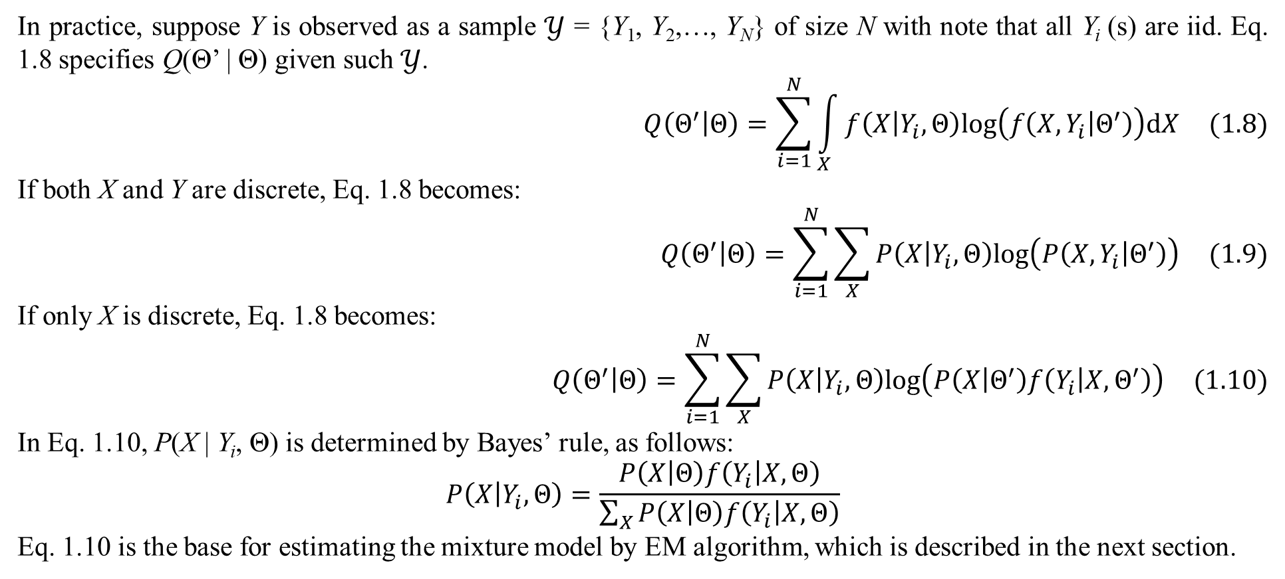
1. Introduction to EM algorithm
In practice, suppose Y is observed as a sample $𝒴$ = {Y₁, Y₂,…, Y_{N}} of size N with note that all Y_{i} (s) are iid. Eq. 1.8 specifies Q(Θ’ | Θ) given such $𝒴$.
$$Q\left(Θ^{′} | Θ\right)=\sum_{i=1}^{N}{\int_{X}{f\left(X | Y_{i},Θ\right)log\left(f\left(X,Y_{i} | Θ^{′}\right)\right)dX}} (1.8)$$
If both X and Y are discrete, Eq. 1.8 becomes:
$$Q\left(Θ^{′} | Θ\right)=\sum_{i=1}^{N}{\sum_{X}{P\left(X | Y_{i},Θ\right)log\left(P\left(X,Y_{i} | Θ^{′}\right)\right)}} (1.9)$$
If only X is discrete, Eq. 1.8 becomes:
$$Q\left(Θ^{′} | Θ\right)=\sum_{i=1}^{N}{\sum_{X}{P\left(X | Y_{i},Θ\right)log\left(P\left(X | Θ^{′}\right)f\left(Y_{i} | X,Θ^{′}\right)\right)}} (1.10)$$
In Eq. 1.10, P(X | Y_{i}, Θ) is determined by Bayes’ rule, as follows:
$$P\left(X | Y_{i},Θ\right)=\frac{P\left(X | Θ\right)f\left(Y_{i} | X,Θ\right)}{\sum_{X}{P\left(X | Θ\right)f\left(Y_{i} | X,Θ\right)}}$$
Eq. 1.10 is the base for estimating the mixture model by EM algorithm, which is described in the next section.

Slide 11
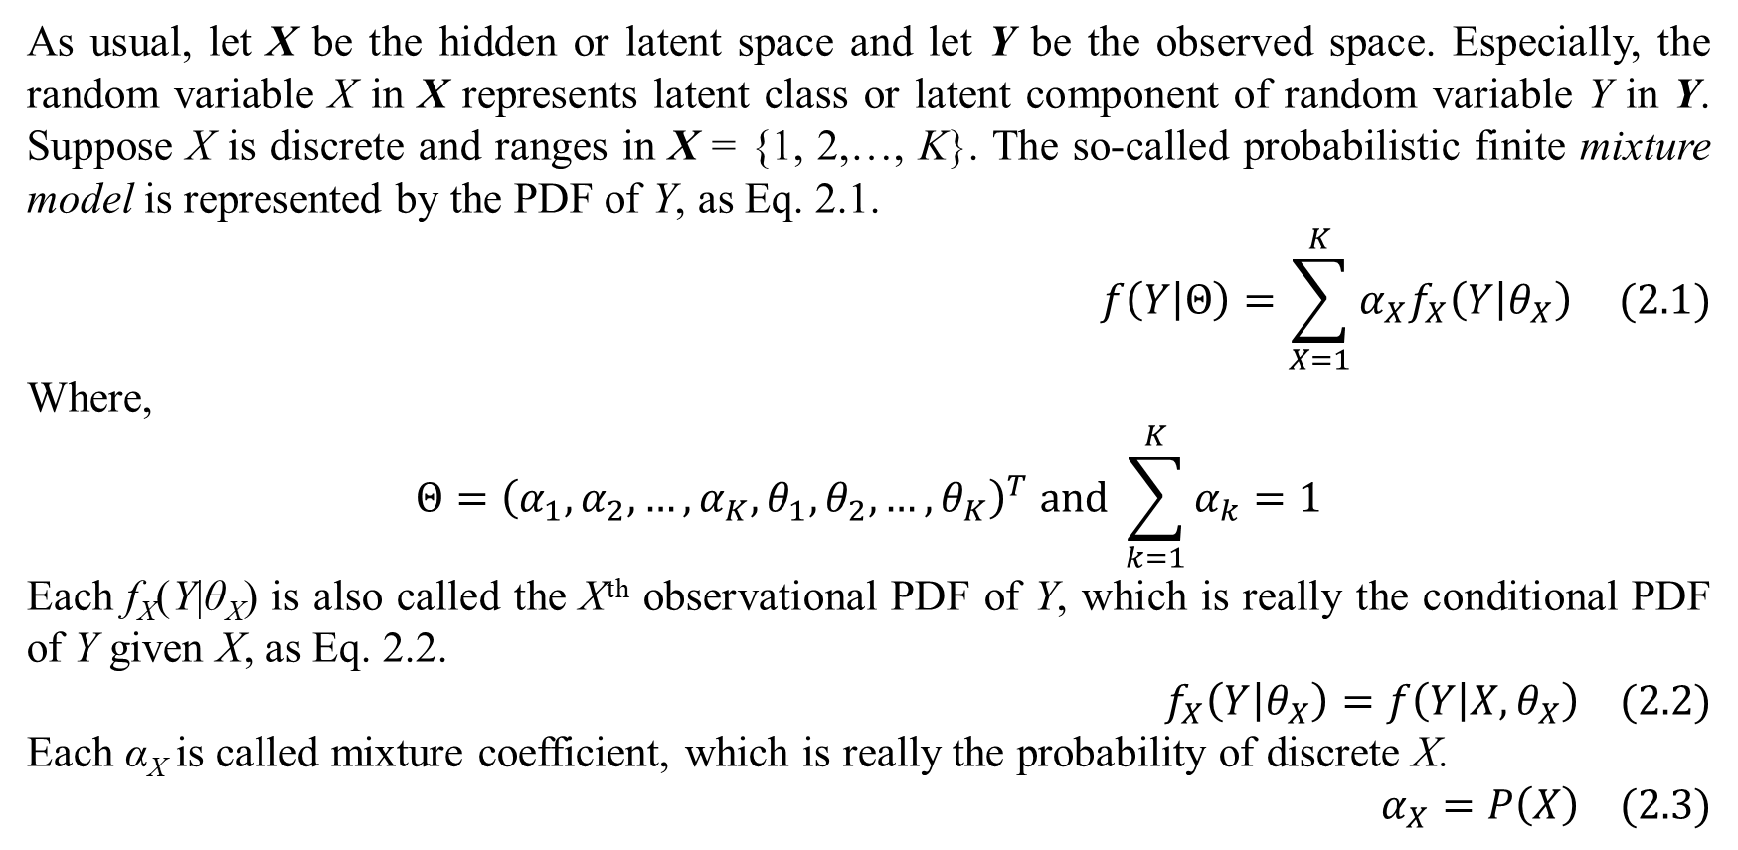
2. Finite mixture model
As usual, let X be the hidden or latent space and let Y be the observed space. Especially, the random variable X in X represents latent class or latent component of random variable Y in Y. Suppose X is discrete and ranges in X = {1, 2,…, K}. The so-called probabilistic finite mixture model is represented by the PDF of Y, as Eq. 2.1.
$$f\left(Y | Θ\right)=\sum_{X=1}^{K}{α_{X}f_{X}\left(Y | θ_{X}\right)} (2.1)$$
Where,
$$Θ={\left(α_{1},α_{2},…,α_{K},θ_{1},θ_{2},…,θ_{K}\right)}^{T} and \sum_{k=1}^{K}{α_{k}}=1$$
Each f_{X}(Y|θ_{X}) is also called the Xth observational PDF of Y, which is really the conditional PDF of Y given X, as Eq. 2.2.
$$f_{X}\left(Y | θ_{X}\right)=f\left(Y | X,θ_{X}\right) (2.2)$$
Each α_{X} is called mixture coefficient, which is really the probability of discrete X.
$$α_{X}=P\left(X\right) (2.3)$$

Slide 12
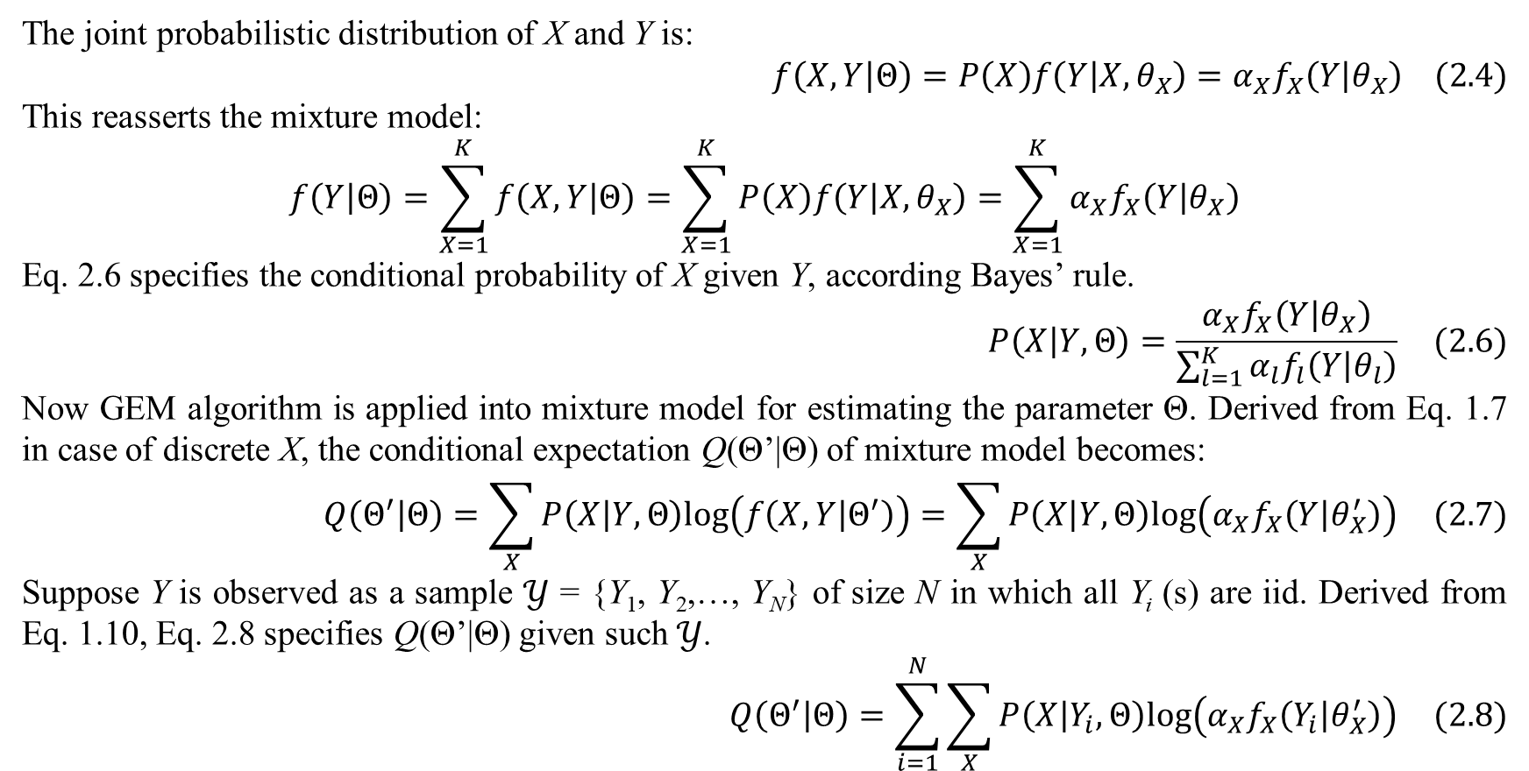
2. Finite mixture model
The joint probabilistic distribution of X and Y is:
$$f\left(X,Y | Θ\right)=P\left(X\right)f\left(Y | X,θ_{X}\right)=α_{X}f_{X}\left(Y | θ_{X}\right) (2.4)$$
This reasserts the mixture model:
$$f\left(Y | Θ\right)=\sum_{X=1}^{K}{f\left(X,Y | Θ\right)}=\sum_{X=1}^{K}{P\left(X\right)f\left(Y | X,θ_{X}\right)}=\sum_{X=1}^{K}{α_{X}f_{X}\left(Y | θ_{X}\right)}$$
Eq. 2.6 specifies the conditional probability of X given Y, according Bayes’ rule.
$$P\left(X | Y,Θ\right)=\frac{α_{X}f_{X}\left(Y | θ_{X}\right)}{\sum_{l=1}^{K}{α_{l}f_{l}\left(Y | θ_{l}\right)}} (2.6)$$
Now GEM algorithm is applied into mixture model for estimating the parameter Θ. Derived from Eq. 1.7 in case of discrete X, the conditional expectation Q(Θ’|Θ) of mixture model becomes:
$$Q\left(Θ^{′} | Θ\right)=\sum_{X}{P\left(X | Y,Θ\right)log\left(f\left(X,Y | Θ^{′}\right)\right)}=\sum_{X}{P\left(X | Y,Θ\right)log\left(α_{X}f_{X}\left(Y | θ_{X}^{′}\right)\right)} (2.7)$$
Suppose Y is observed as a sample $𝒴$ = {Y₁, Y₂,…, Y_{N}} of size N in which all Y_{i} (s) are iid. Derived from Eq. 1.10, Eq. 2.8 specifies Q(Θ’|Θ) given such $𝒴$.
$$Q\left(Θ^{′} | Θ\right)=\sum_{i=1}^{N}{\sum_{X}{P\left(X | Y_{i},Θ\right)log\left(α_{X}f_{X}\left(Y_{i} | θ_{X}^{′}\right)\right)}} (2.8)$$

Slide 13
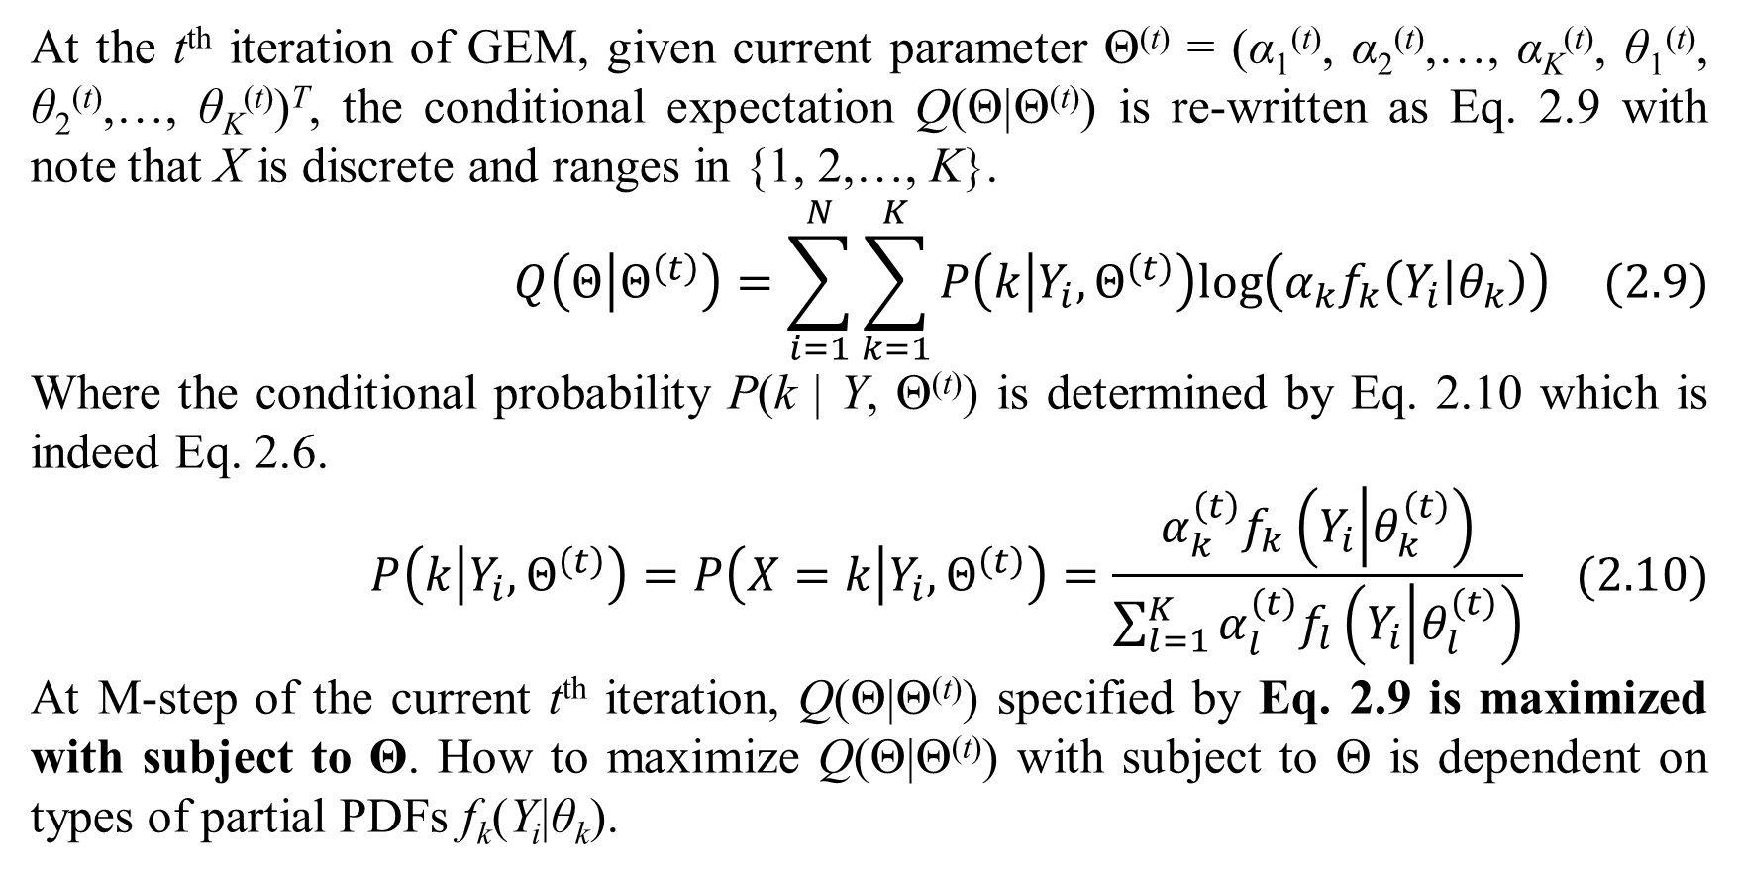
2. Finite mixture model
At the t^{th} iteration of GEM, given current parameter Θ^{(t)} = (α₁^{(t)}, α₂^{(t)},…, α_{K}^{(t)}, θ₁^{(t)}, θ₂^{(t)},…, θ_{K}^{(t)})^{T}, the conditional expectation Q(Θ|Θ^{(t)}) is re-written as Eq. 2.9 with note that X is discrete and ranges in {1, 2,…, K}.
$$Q\left(Θ | Θ^{\left(t\right)}\right)=\sum_{i=1}^{N}{\sum_{k=1}^{K}{P\left(k | Y_{i},Θ^{\left(t\right)}\right)log\left(α_{k}f_{k}\left(Y_{i} | θ_{k}\right)\right)}} (2.9)$$
Where the conditional probability P(k | Y, Θ^{(t)}) is determined by Eq. 2.10 which is indeed Eq. 2.6.
$$P\left(k | Y_{i},Θ^{\left(t\right)}\right)=P\left(X=k | Y_{i},Θ^{\left(t\right)}\right)=\frac{α_{k}^{\left(t\right)}f_{k}\left(Y_{i} | θ_{k}^{\left(t\right)}\right)}{\sum_{l=1}^{K}{α_{l}^{\left(t\right)}f_{l}\left(Y_{i} | θ_{l}^{\left(t\right)}\right)}} (2.10)$$
At M-step of the current t^{th} iteration, Q(Θ|Θ^{(t)}) specified by Eq. 2.9 is maximized with subject to Θ. How to maximize Q(Θ|Θ^{(t)}) with subject to Θ is dependent on types of partial PDFs f_{k}(Y_{i}|θ_{k}).

Slide 14
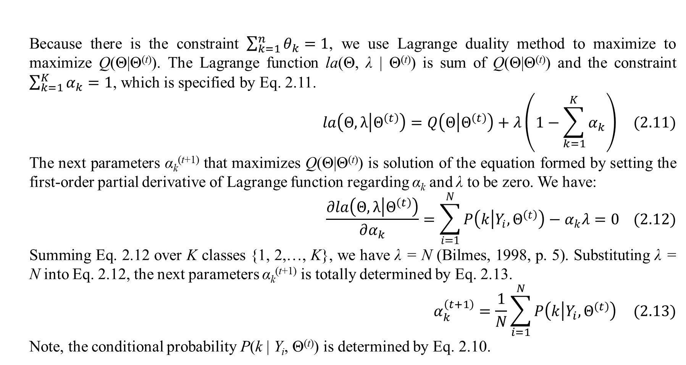
2. Finite mixture model
Because there is the constraint $\sum_{k=1}^{n}{θ_{k}}=1$, we use Lagrange duality method to maximize to maximize Q(Θ|Θ^{(t)}). The Lagrange function la(Θ, λ | Θ^{(t)}) is sum of Q(Θ|Θ^{(t)}) and the constraint $\sum_{k=1}^{K}{α_{k}}=1$, which is specified by Eq. 2.11.
$$la\left(Θ,λ | Θ^{\left(t\right)}\right)=Q\left(Θ | Θ^{\left(t\right)}\right)+λ\left(1−\sum_{k=1}^{K}{α_{k}}\right) (2.11)$$
The next parameters α_{k}^{(t+1)} that maximizes Q(Θ|Θ^{(t)}) is solution of the equation formed by setting the first-order partial derivative of Lagrange function regarding α_{k} and λ to be zero. We have:
$$\frac{∂la\left(Θ,λ | Θ^{\left(t\right)}\right)}{∂α_{k}}=\sum_{i=1}^{N}{P\left(k | Y_{i},Θ^{\left(t\right)}\right)}−α_{k}λ=0 (2.12)$$
Summing Eq. 2.12 over K classes {1, 2,…, K}, we have λ = N (Bilmes, 1998, p. 5). Substituting λ = N into Eq. 2.12, the next parameters α_{k}^{(t+1)} is totally determined by Eq. 2.13.
$$α_{k}^{\left(t+1\right)}=\frac{1}{N}\sum_{i=1}^{N}{P\left(k | Y_{i},Θ^{\left(t\right)}\right)} (2.13)$$
Note, the conditional probability P(k | Y_{i}, Θ^{(t)}) is determined by Eq. 2.10.

Slide 15
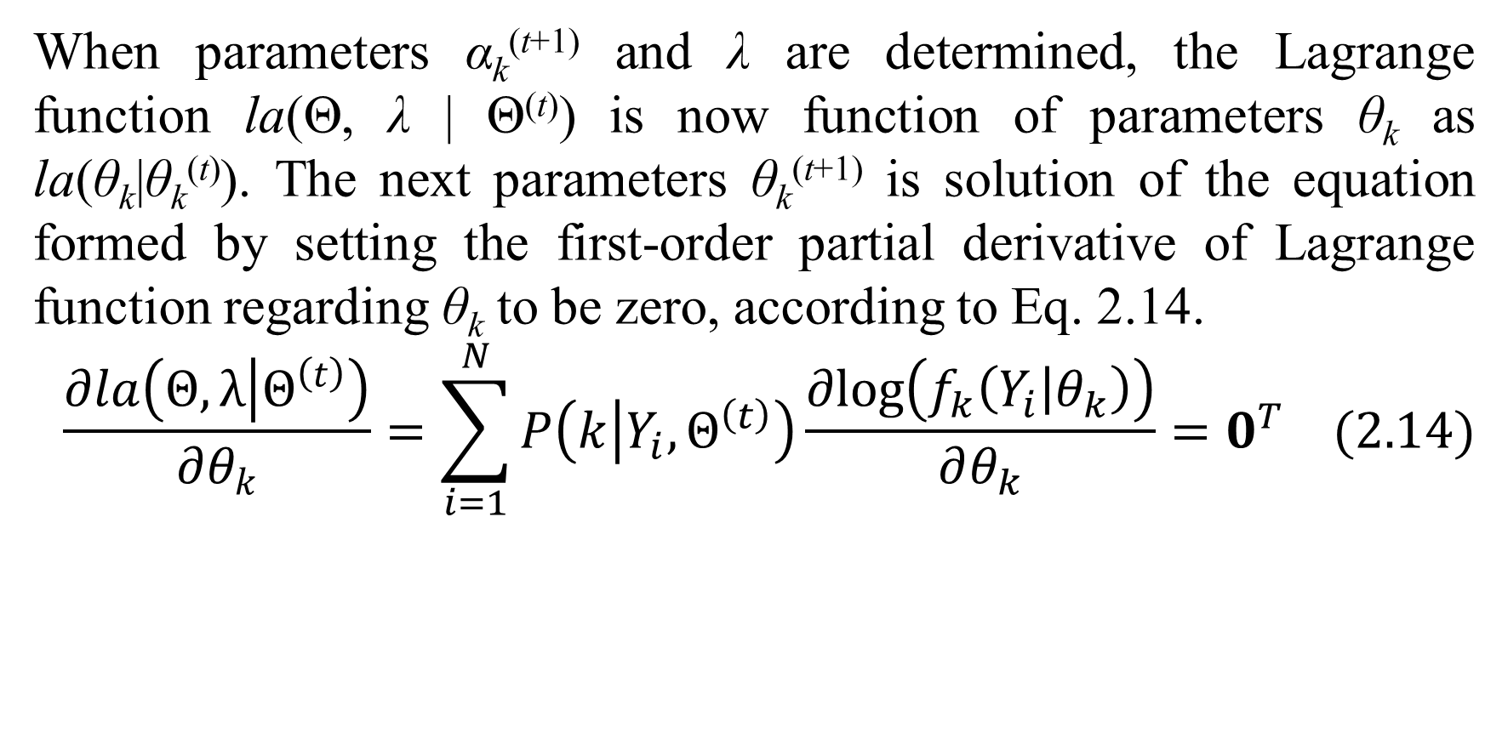
2. Finite mixture model
When parameters α_{k}^{(t+1)} and λ are determined, the Lagrange function la(Θ, λ | Θ^{(t)}) is now function of parameters θ_{k} as la(θ_{k}|θ_{k}^{(t)}). The next parameters θ_{k}^{(t+1)} is solution of the equation formed by setting the first-order partial derivative of Lagrange function regarding θ_{k} to be zero, according to Eq. 2.14.
$$\frac{∂la\left(Θ,λ | Θ^{\left(t\right)}\right)}{∂θ_{k}}=\sum_{i=1}^{N}{P\left(k | Y_{i},Θ^{\left(t\right)}\right)\frac{∂log\left(f_{k}\left(Y_{i} | θ_{k}\right)\right)}{∂θ_{k}}}=0^{T} (2.14)$$

Slide 16
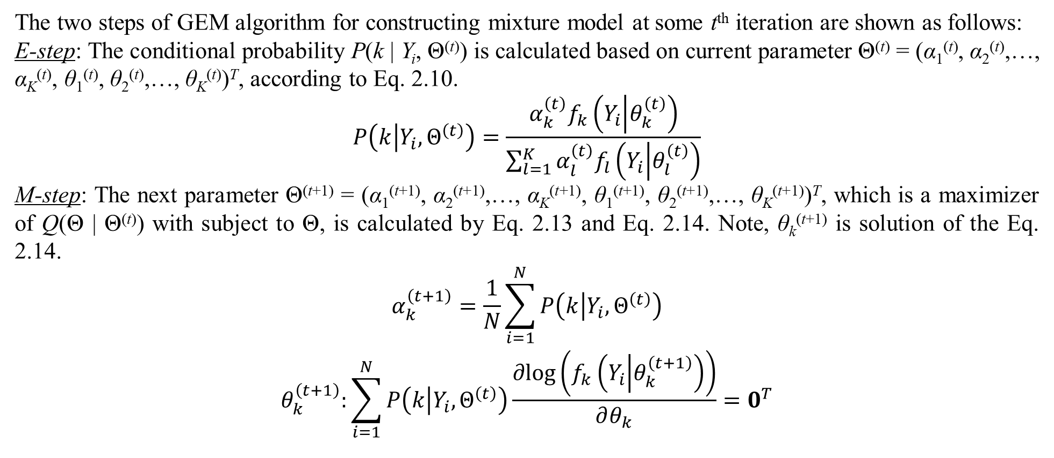
2. Finite mixture model
The two steps of GEM algorithm for constructing mixture model at some t^{th} iteration are shown as follows:
E-step: The conditional probability P(k | Y_{i}, Θ^{(t)}) is calculated based on current parameter Θ^{(t)} = (α₁^{(t)}, α₂^{(t)},…, α_{K}^{(t)}, θ₁^{(t)}, θ₂^{(t)},…, θ_{K}^{(t)})^{T}, according to Eq. 2.10.
$$P\left(k | Y_{i},Θ^{\left(t\right)}\right)=\frac{α_{k}^{\left(t\right)}f_{k}\left(Y_{i} | θ_{k}^{\left(t\right)}\right)}{\sum_{l=1}^{K}{α_{l}^{\left(t\right)}f_{l}\left(Y_{i} | θ_{l}^{\left(t\right)}\right)}}$$
M-step: The next parameter Θ^{(t+1)} = (α₁^{(t+1)}, α₂^{(t+1)},…, α_{K}^{(t+1)}, θ₁^{(t+1)}, θ₂^{(t+1)},…, θ_{K}^{(t+1)})^{T}, which is a maximizer of Q(Θ | Θ^{(t)}) with subject to Θ, is calculated by Eq. 2.13 and Eq. 2.14. Note, θ_{k}^{(t+1)} is solution of the Eq. 2.14.
$$\begin{matrix}α_{k}^{\left(t+1\right)}=\frac{1}{N}\sum_{i=1}^{N}{P\left(k | Y_{i},Θ^{\left(t\right)}\right)} \\ θ_{k}^{\left(t+1\right)}:\sum_{i=1}^{N}{P\left(k | Y_{i},Θ^{\left(t\right)}\right)\frac{∂log\left(f_{k}\left(Y_{i} | θ_{k}^{\left(t+1\right)}\right)\right)}{∂θ_{k}}}=0^{T}\end{matrix}$$

Slide 17
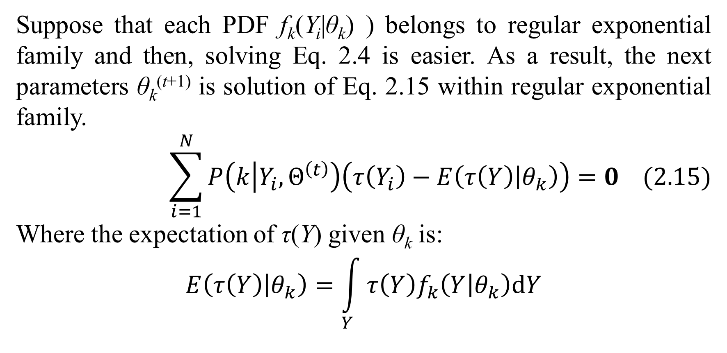
2. Finite mixture model
Suppose that each PDF f_{k}(Y_{i}|θ_{k}) ) belongs to regular exponential family and then, solving Eq. 2.4 is easier. As a result, the next parameters θ_{k}^{(t+1)} is solution of Eq. 2.15 within regular exponential family.
$$\sum_{i=1}^{N}{P\left(k | Y_{i},Θ^{\left(t\right)}\right)\left(τ\left(Y_{i}\right)−E\left(τ\left(Y\right) | θ_{k}\right)\right)}=0 (2.15)$$
Where the expectation of τ(Y) given θ_{k} is:
$$E\left(τ\left(Y\right) | θ_{k}\right)=\int_{Y}{τ\left(Y\right)f_{k}\left(Y | θ_{k}\right)dY}$$

Slide 18
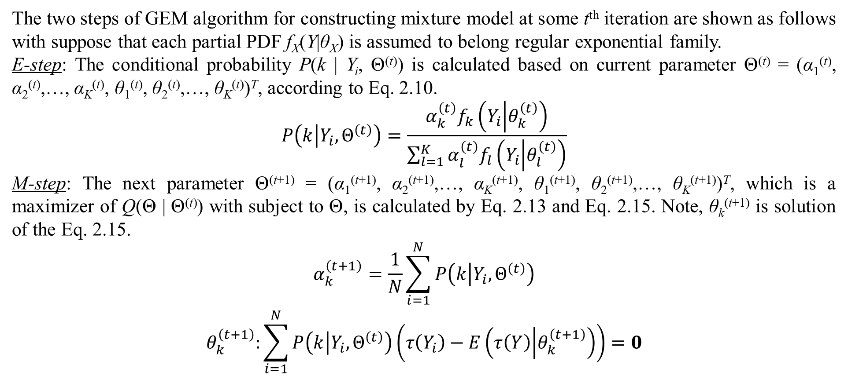
2. Finite mixture model
The two steps of GEM algorithm for constructing mixture model at some t^{th} iteration are shown as follows with suppose that each partial PDF f_{X}(Y|θ_{X}) is assumed to belong regular exponential family.
E-step: The conditional probability P(k | Y_{i}, Θ^{(t)}) is calculated based on current parameter Θ^{(t)} = (α₁^{(t)}, α₂^{(t)},…, α_{K}^{(t)}, θ₁^{(t)}, θ₂^{(t)},…, θ_{K}^{(t)})^{T}, according to Eq. 2.10.
$$P\left(k | Y_{i},Θ^{\left(t\right)}\right)=\frac{α_{k}^{\left(t\right)}f_{k}\left(Y_{i} | θ_{k}^{\left(t\right)}\right)}{\sum_{l=1}^{K}{α_{l}^{\left(t\right)}f_{l}\left(Y_{i} | θ_{l}^{\left(t\right)}\right)}}$$
M-step: The next parameter Θ^{(t+1)} = (α₁^{(t+1)}, α₂^{(t+1)},…, α_{K}^{(t+1)}, θ₁^{(t+1)}, θ₂^{(t+1)},…, θ_{K}^{(t+1)})^{T}, which is a maximizer of Q(Θ | Θ^{(t)}) with subject to Θ, is calculated by Eq. 2.13 and Eq. 2.15. Note, θ_{k}^{(t+1)} is solution of the Eq. 2.15.
$$\begin{matrix}α_{k}^{\left(t+1\right)}=\frac{1}{N}\sum_{i=1}^{N}{P\left(k | Y_{i},Θ^{\left(t\right)}\right)} \\ θ_{k}^{\left(t+1\right)}:\sum_{i=1}^{N}{P\left(k | Y_{i},Θ^{\left(t\right)}\right)\left(τ\left(Y_{i}\right)−E\left(τ\left(Y\right) | θ_{k}^{\left(t+1\right)}\right)\right)}=0\end{matrix}$$

Slide 19
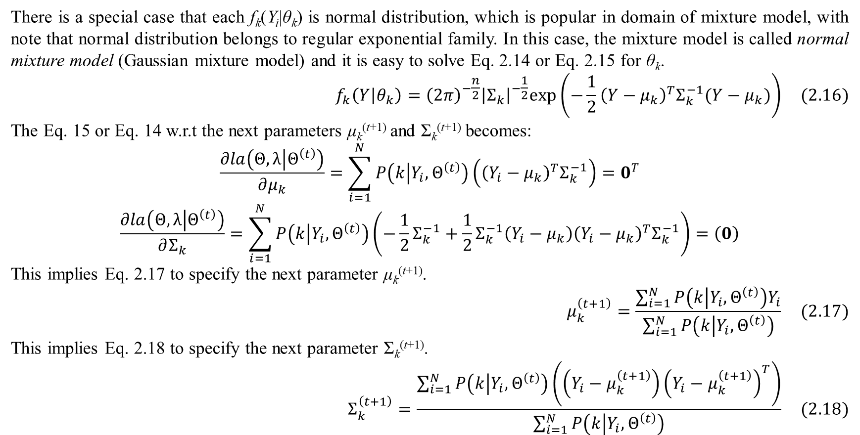
2. Finite mixture model
There is a special case that each f_{k}(Y_{i}|θ_{k}) is normal distribution, which is popular in domain of mixture model, with note that normal distribution belongs to regular exponential family. In this case, the mixture model is called normal mixture model (Gaussian mixture model) and it is easy to solve Eq. 2.14 or Eq. 2.15 for θ_{k}.
$$f_{k}\left(Y | θ_{k}\right)={\left(2π\right)}^{−\frac{n}{2}}{\left|Σ_{k}\right|}^{−\frac{1}{2}}exp\left(−\frac{1}{2}{\left(Y−μ_{k}\right)}^{T}Σ_{k}^{−1}(Y−μ_{k})\right) (2.16)$$
The Eq. 15 or Eq. 14 w.r.t the next parameters μ_{k}^{(t+1)} and Σ_{k}^{(t+1)} becomes:
$$\frac{∂la\left(Θ,λ | Θ^{\left(t\right)}\right)}{∂μ_{k}}=\sum_{i=1}^{N}{P\left(k | Y_{i},Θ^{\left(t\right)}\right)\left({\left(Y_{i}−μ_{k}\right)}^{T}Σ_{k}^{−1}\right)}=0^{T}$$
$$\frac{∂la\left(Θ,λ | Θ^{\left(t\right)}\right)}{∂Σ_{k}}=\sum_{i=1}^{N}{P\left(k | Y_{i},Θ^{\left(t\right)}\right)\left(−\frac{1}{2}Σ_{k}^{−1}+\frac{1}{2}Σ_{k}^{−1}\left(Y_{i}−μ_{k}\right){\left(Y_{i}−μ_{k}\right)}^{T}Σ_{k}^{−1}\right)}=\left(0\right)$$
This implies Eq. 2.17 to specify the next parameter μ_{k}^{(t+1)}.
$$μ_{k}^{\left(t+1\right)}=\frac{\sum_{i=1}^{N}{P\left(k | Y_{i},Θ^{\left(t\right)}\right)Y_{i}}}{\sum_{i=1}^{N}{P\left(k | Y_{i},Θ^{\left(t\right)}\right)}} (2.17)$$
This implies Eq. 2.18 to specify the next parameter Σ_{k}^{(t+1)}.
$$Σ_{k}^{\left(t+1\right)}=\frac{\sum_{i=1}^{N}{P\left(k | Y_{i},Θ^{\left(t\right)}\right)\left(\left(Y_{i}−μ_{k}^{\left(t+1\right)}\right){\left(Y_{i}−μ_{k}^{\left(t+1\right)}\right)}^{T}\right)}}{\sum_{i=1}^{N}{P\left(k | Y_{i},Θ^{\left(t\right)}\right)}} (2.18)$$

Slide 20
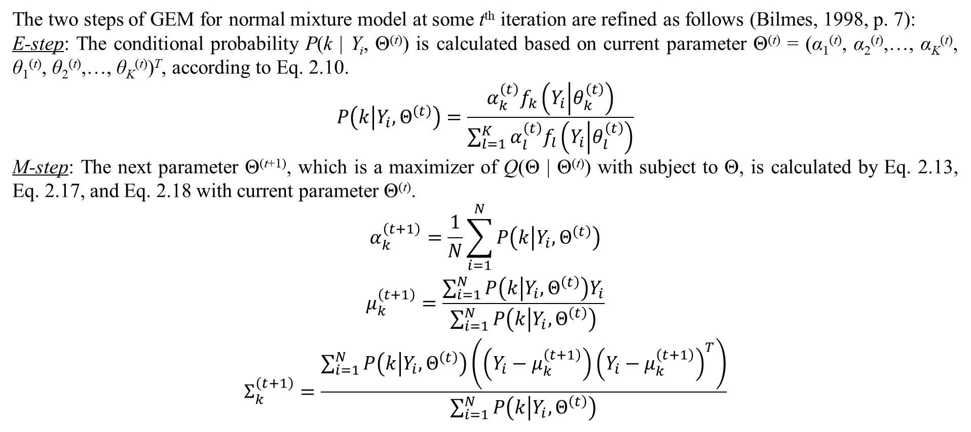
2. Finite mixture model
The two steps of GEM for normal mixture model at some t^{th} iteration are refined as follows (Bilmes, 1998, p. 7):
E-step: The conditional probability P(k | Y_{i}, Θ^{(t)}) is calculated based on current parameter Θ^{(t)} = (α₁^{(t)}, α₂^{(t)},…, α_{K}^{(t)}, θ₁^{(t)}, θ₂^{(t)},…, θ_{K}^{(t)})^{T}, according to Eq. 2.10.
$$P\left(k | Y_{i},Θ^{\left(t\right)}\right)=\frac{α_{k}^{\left(t\right)}f_{k}\left(Y_{i} | θ_{k}^{\left(t\right)}\right)}{\sum_{l=1}^{K}{α_{l}^{\left(t\right)}f_{l}\left(Y_{i} | θ_{l}^{\left(t\right)}\right)}}$$
M-step: The next parameter Θ^{(t+1)}, which is a maximizer of Q(Θ | Θ^{(t)}) with subject to Θ, is calculated by Eq. 2.13, Eq. 2.17, and Eq. 2.18 with current parameter Θ^{(t)}.
$$\begin{matrix}α_{k}^{\left(t+1\right)}=\frac{1}{N}\sum_{i=1}^{N}{P\left(k | Y_{i},Θ^{\left(t\right)}\right)} \\ μ_{k}^{\left(t+1\right)}=\frac{\sum_{i=1}^{N}{P\left(k | Y_{i},Θ^{\left(t\right)}\right)Y_{i}}}{\sum_{i=1}^{N}{P\left(k | Y_{i},Θ^{\left(t\right)}\right)}} \\ Σ_{k}^{\left(t+1\right)}=\frac{\sum_{i=1}^{N}{P\left(k | Y_{i},Θ^{\left(t\right)}\right)\left(\left(Y_{i}−μ_{k}^{\left(t+1\right)}\right){\left(Y_{i}−μ_{k}^{\left(t+1\right)}\right)}^{T}\right)}}{\sum_{i=1}^{N}{P\left(k | Y_{i},Θ^{\left(t\right)}\right)}}\end{matrix}$$

Slide 21
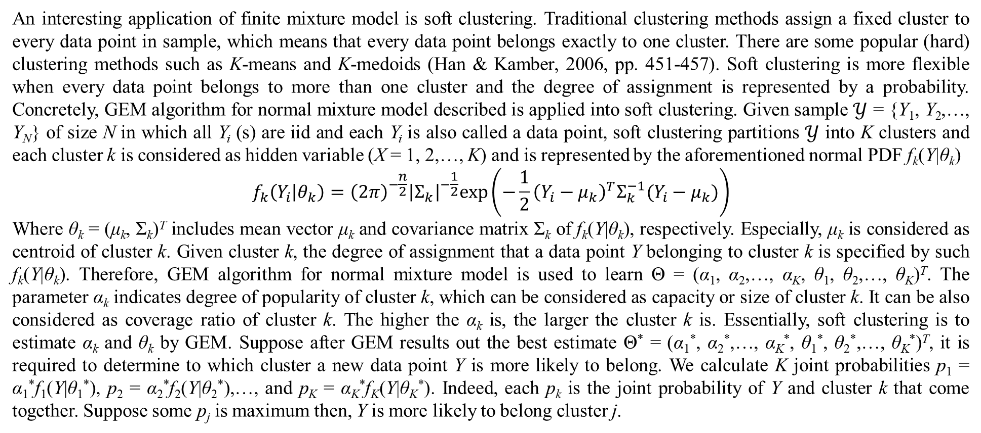
2. Finite mixture model
An interesting application of finite mixture model is soft clustering. Traditional clustering methods assign a fixed cluster to every data point in sample, which means that every data point belongs exactly to one cluster. There are some popular (hard) clustering methods such as K-means and K-medoids (Han & Kamber, 2006, pp. 451-457). Soft clustering is more flexible when every data point belongs to more than one cluster and the degree of assignment is represented by a probability. Concretely, GEM algorithm for normal mixture model described is applied into soft clustering. Given sample $𝒴$ = {Y₁, Y₂,…, Y_{N}} of size N in which all Y_{i} (s) are iid and each Y_{i} is also called a data point, soft clustering partitions $𝒴$ into K clusters and each cluster k is considered as hidden variable (X = 1, 2,…, K) and is represented by the aforementioned normal PDF f_{k}(Y|θ_{k})
$$f_{k}\left(Y_{i} | θ_{k}\right)={\left(2π\right)}^{−\frac{n}{2}}{\left|Σ_{k}\right|}^{−\frac{1}{2}}exp\left(−\frac{1}{2}{\left(Y_{i}−μ_{k}\right)}^{T}Σ_{k}^{−1}(Y_{i}−μ_{k})\right)$$
Where θ_{k} = (μ_{k}, Σ_{k})^{T} includes mean vector μ_{k} and covariance matrix Σ_{k} of f_{k}(Y|θ_{k}), respectively. Especially, μ_{k} is considered as centroid of cluster k. Given cluster k, the degree of assignment that a data point Y belonging to cluster k is specified by such f_{k}(Y|θ_{k}). Therefore, GEM algorithm for normal mixture model is used to learn Θ = (α₁, α₂,…, α_{K}, θ₁, θ₂,…, θ_{K})^{T}. The parameter α_{k} indicates degree of popularity of cluster k, which can be considered as capacity or size of cluster k. It can be also considered as coverage ratio of cluster k. The higher the α_{k} is, the larger the cluster k is. Essentially, soft clustering is to estimate α_{k} and θ_{k} by GEM. Suppose after GEM results out the best estimate Θ* = (α₁*, α₂*,…, α_{K}*, θ₁*, θ₂*,…, θ_{K}*)^{T}, it is required to determine to which cluster a new data point Y is more likely to belong. We calculate K joint probabilities p₁ = α₁*f₁(Y|θ₁*), p₂ = α₂*f₂(Y|θ₂*),…, and p_{K} = α_{K}*f_{K}(Y|θ_{K}*). Indeed, each p_{k} is the joint probability of Y and cluster k that come together. Suppose some p_{j} is maximum then, Y is more likely to belong cluster j.

Slide 22
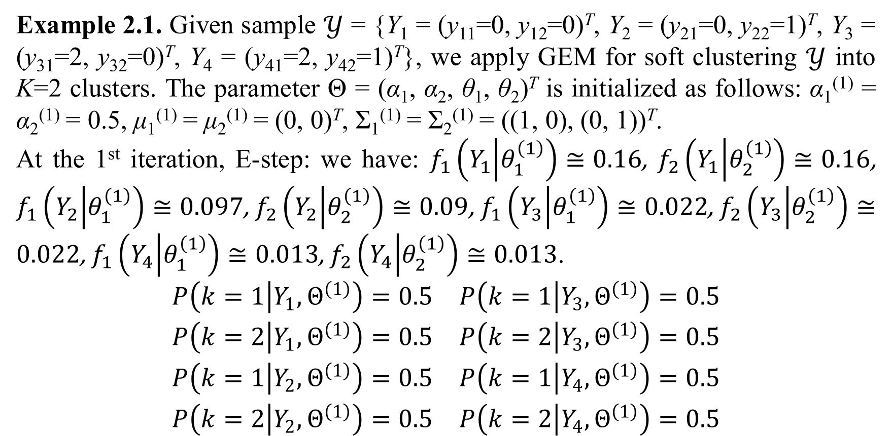
2. Finite mixture model
Example 2.1. Given sample $𝒴$ = {Y₁ = (y₁₁=0, y₁₂=0)^{T}, Y₂ = (y₂₁=0, y₂₂=1)^{T}, Y₃ = (y₃₁=2, y₃₂=0)^{T}, Y₄ = (y₄₁=2, y₄₂=1)^{T}}, we apply GEM for soft clustering $𝒴$ into K=2 clusters. The parameter Θ = (α₁, α₂, θ₁, θ₂)^{T} is initialized as follows: α₁⁽¹⁾ = α₂⁽¹⁾ = 0.5, μ₁⁽¹⁾ = μ₂⁽¹⁾ = (0, 0)^{T}, Σ₁⁽¹⁾ = Σ₂⁽¹⁾ = ((1, 0), (0, 1))^{T}.
At the 1st iteration, E-step: we have: $f_{1}\left(Y_{1} | θ_{1}^{\left(1\right)}\right)≅0.16$, $f_{2}\left(Y_{1} | θ_{2}^{\left(1\right)}\right)≅0.16$, $f_{1}\left(Y_{2} | θ_{1}^{\left(1\right)}\right)≅0.097$, $f_{2}\left(Y_{2} | θ_{2}^{\left(1\right)}\right)≅0.09$, $f_{1}\left(Y_{3} | θ_{1}^{\left(1\right)}\right)≅0.022$, $f_{2}\left(Y_{3} | θ_{2}^{\left(1\right)}\right)≅0.022$, $f_{1}\left(Y_{4} | θ_{1}^{\left(1\right)}\right)≅0.013$, $f_{2}\left(Y_{4} | θ_{2}^{\left(1\right)}\right)≅0.013$.
$$\begin{matrix}P\left(k=1 | Y_{1},Θ^{\left(1\right)}\right)=0.5 & P\left(k=1 | Y_{3},Θ^{\left(1\right)}\right)=0.5 \\ P\left(k=2 | Y_{1},Θ^{\left(1\right)}\right)=0.5 & P\left(k=2 | Y_{3},Θ^{\left(1\right)}\right)=0.5 \\ P\left(k=1 | Y_{2},Θ^{\left(1\right)}\right)=0.5 & P\left(k=1 | Y_{4},Θ^{\left(1\right)}\right)=0.5 \\ P\left(k=2 | Y_{2},Θ^{\left(1\right)}\right)=0.5 & P\left(k=2 | Y_{4},Θ^{\left(1\right)}\right)=0.5\end{matrix}$$

Slide 23
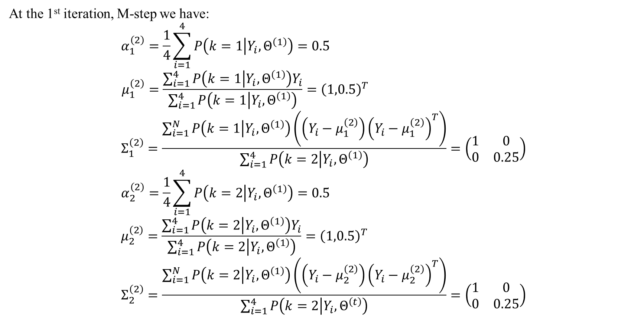
2. Finite mixture model
At the 1st iteration, M-step we have:
$$α_{1}^{\left(2\right)}=\frac{1}{4}\sum_{i=1}^{4}{P\left(k=1 | Y_{i},Θ^{\left(1\right)}\right)}=0.5 \\ μ_{1}^{\left(2\right)}=\frac{\sum_{i=1}^{4}{P\left(k=1 | Y_{i},Θ^{\left(1\right)}\right)Y_{i}}}{\sum_{i=1}^{4}{P\left(k=1 | Y_{i},Θ^{\left(1\right)}\right)}}={\left(1,0.5\right)}^{T} \\ Σ_{1}^{\left(2\right)}=\frac{\sum_{i=1}^{N}{P\left(k=1 | Y_{i},Θ^{\left(1\right)}\right)\left(\left(Y_{i}−μ_{1}^{\left(2\right)}\right){\left(Y_{i}−μ_{1}^{\left(2\right)}\right)}^{T}\right)}}{\sum_{i=1}^{4}{P\left(k=2 | Y_{i},Θ^{\left(1\right)}\right)}}=\left(\begin{matrix}1 & 0 \\ 0 & 0.25\end{matrix}\right) \\ α_{2}^{\left(2\right)}=\frac{1}{4}\sum_{i=1}^{4}{P\left(k=2 | Y_{i},Θ^{\left(1\right)}\right)}=0.5 \\ μ_{2}^{\left(2\right)}=\frac{\sum_{i=1}^{4}{P\left(k=2 | Y_{i},Θ^{\left(1\right)}\right)Y_{i}}}{\sum_{i=1}^{4}{P\left(k=2 | Y_{i},Θ^{\left(1\right)}\right)}}={\left(1,0.5\right)}^{T} \\ Σ_{2}^{\left(2\right)}=\frac{\sum_{i=1}^{N}{P\left(k=2 | Y_{i},Θ^{\left(1\right)}\right)\left(\left(Y_{i}−μ_{2}^{\left(2\right)}\right){\left(Y_{i}−μ_{2}^{\left(2\right)}\right)}^{T}\right)}}{\sum_{i=1}^{4}{P\left(k=2 | Y_{i},Θ^{\left(t\right)}\right)}}=\left(\begin{matrix}1 & 0 \\ 0 & 0.25\end{matrix}\right)$$

Slide 24
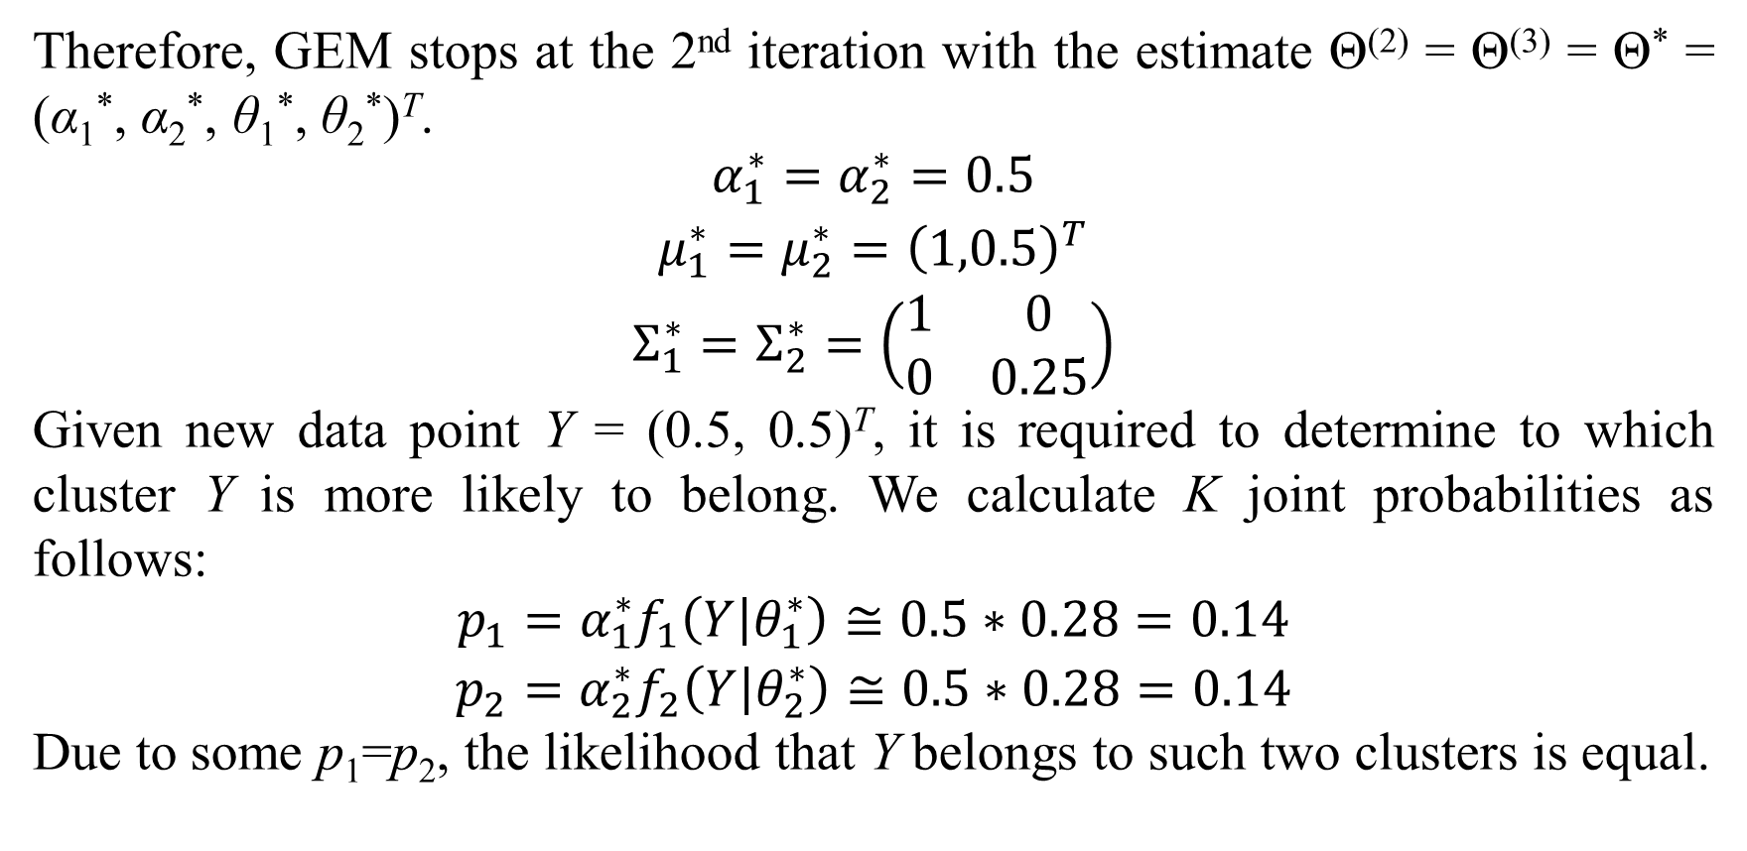
2. Finite mixture model
Therefore, GEM stops at the 2nd iteration with the estimate Θ⁽²⁾ = Θ⁽³⁾ = Θ* = (α₁*, α₂*, θ₁*, θ₂*)^{T}.
$$\begin{matrix}α_{1}^{∗}=α_{2}^{∗}=0.5 \\ μ_{1}^{∗}=μ_{2}^{∗}={\left(1,0.5\right)}^{T} \\ Σ_{1}^{∗}=Σ_{2}^{∗}=\left(\begin{matrix}1 & 0 \\ 0 & 0.25\end{matrix}\right)\end{matrix}$$
Given new data point Y = (0.5, 0.5)^{T}, it is required to determine to which cluster Y is more likely to belong. We calculate K joint probabilities as follows:
$$\begin{matrix}p_{1}=α_{1}^{∗}f_{1}\left(Y | θ_{1}^{∗}\right)≅0.5∗0.28=0.14 \\ p_{2}=α_{2}^{∗}f_{2}\left(Y | θ_{2}^{∗}\right)≅0.5∗0.28=0.14\end{matrix}$$
Due to some p₁=p₂, the likelihood that Y belongs to such two clusters is equal.

Slide 25
3. Mixture model with dyadic data

Slide 26
4. Mixture regression model
This section describes a special regression model associated with mixture model in which missing values are acceptable. Please read my papers “Mixture Regression Model for Incomplete Data” (Nguyen & Shafiq, Mixture Regression Model for Incomplete Data, 2018) and “Fetal Weight Estimation in Case of Missing Data” (Nguyen & Ho, Fetal Weight Estimation in Case of Missing Data, 2018) to comprehend regression model and incomplete data.

Slide 27
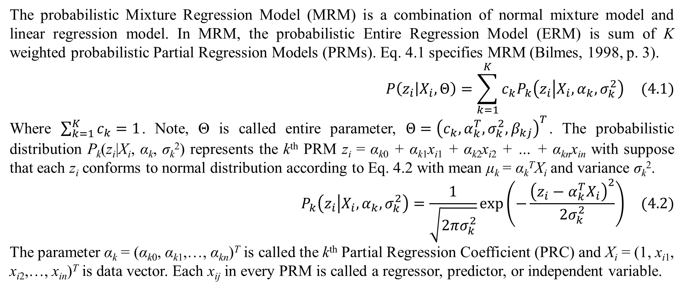
4. Mixture regression model
The probabilistic Mixture Regression Model (MRM) is a combination of normal mixture model and linear regression model. In MRM, the probabilistic Entire Regression Model (ERM) is sum of K weighted probabilistic Partial Regression Models (PRMs). Eq. 4.1 specifies MRM (Bilmes, 1998, p. 3).
$$P\left(z_{i} | X_{i},Θ\right)=\sum_{k=1}^{K}{c_{k}P_{k}\left(z_{i} | X_{i},α_{k},σ_{k}^{2}\right)} (4.1)$$
Where $\sum_{k=1}^{K}{c_{k}}=1$. Note, Θ is called entire parameter, $Θ={\left(c_{k},α_{k}^{T},σ_{k}^{2},β_{kj}\right)}^{T}$. The probabilistic distribution P_{k}(z_{i}|X_{i}, α_{k}, σ_{k}²) represents the k^{th} PRM z_{i} = α_{k0} + α_{k1}x_{i1} + α_{k2}x_{i2} + … + α_{kn}x_{in} with suppose that each z_{i} conforms to normal distribution according to Eq. 4.2 with mean μ_{k} = α_{k}^{T}X_{i} and variance σ_{k}².
$$P_{k}\left(z_{i} | X_{i},α_{k},σ_{k}^{2}\right)=\frac{1}{\sqrt{2πσ_{k}^{2}}}exp\left(−\frac{{\left(z_{i}−α_{k}^{T}X_{i}\right)}^{2}}{2σ_{k}^{2}}\right) (4.2)$$
The parameter α_{k} = (α_{k0}, α_{k1},…, α_{kn})^{T} is called the k^{th} Partial Regression Coefficient (PRC) and X_{i} = (1, x_{i1}, x_{i2},…, x_{in})^{T} is data vector. Each x_{ij} in every PRM is called a regressor, predictor, or independent variable.

Slide 28
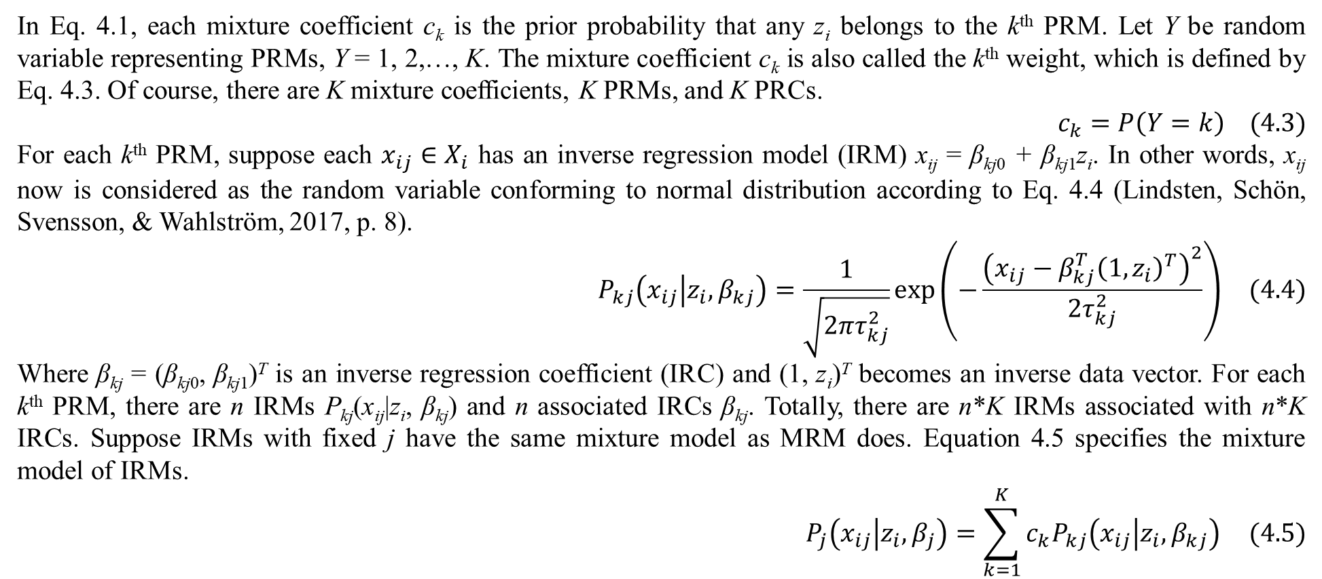
4. Mixture regression model
In Eq. 4.1, each mixture coefficient c_{k} is the prior probability that any z_{i} belongs to the k^{th} PRM. Let Y be random variable representing PRMs, Y = 1, 2,…, K. The mixture coefficient c_{k} is also called the k^{th} weight, which is defined by Eq. 4.3. Of course, there are K mixture coefficients, K PRMs, and K PRCs.
$$c_{k}=P\left(Y=k\right) (4.3)$$
For each k^{th} PRM, suppose each $x_{ij}∈X_{i}$ has an inverse regression model (IRM) x_{ij} = β_{kj0} + β_{kj1}z_{i}. In other words, x_{ij} now is considered as the random variable conforming to normal distribution according to Eq. 4.4 (Lindsten, Schön, Svensson, & Wahlström, 2017, p. 8).
$$P_{kj}\left(x_{ij} | z_{i},β_{kj}\right)=\frac{1}{\sqrt{2πτ_{kj}^{2}}}exp\left(−\frac{{\left(x_{ij}−β_{kj}^{T}{\left(1,z_{i}\right)}^{T}\right)}^{2}}{2τ_{kj}^{2}}\right) (4.4)$$
Where β_{kj} = (β_{kj0}, β_{kj1})^{T} is an inverse regression coefficient (IRC) and (1, z_{i})^{T} becomes an inverse data vector. For each k^{th} PRM, there are n IRMs P_{kj}(x_{ij}|z_{i}, β_{kj}) and n associated IRCs β_{kj}. Totally, there are n*K IRMs associated with n*K IRCs. Suppose IRMs with fixed j have the same mixture model as MRM does. Equation 4.5 specifies the mixture model of IRMs.
$$P_{j}\left(x_{ij} | z_{i},β_{j}\right)=\sum_{k=1}^{K}{c_{k}P_{kj}\left(x_{ij} | z_{i},β_{kj}\right)} (4.5)$$

Slide 29
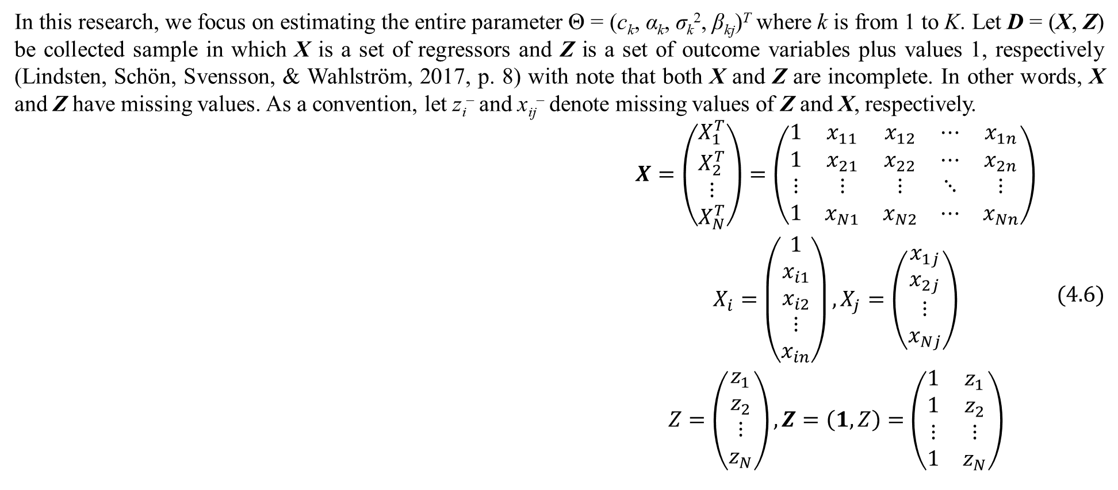
4. Mixture regression model
In this research, we focus on estimating the entire parameter Θ = (c_{k}, α_{k}, σ_{k}², β_{kj})^{T} where k is from 1 to K. Let D = (X, Z) be collected sample in which X is a set of regressors and Z is a set of outcome variables plus values 1, respectively (Lindsten, Schön, Svensson, & Wahlström, 2017, p. 8) with note that both X and Z are incomplete. In other words, X and Z have missing values. As a convention, let z_{i}– and x_{ij}– denote missing values of Z and X, respectively.
$$\begin{matrix}X=\left(\begin{matrix}X_{1}^{T} \\ X_{2}^{T} \\ ⋮ \\ X_{N}^{T}\end{matrix}\right)=\left(\begin{matrix}1 & x_{11} & x_{12} & ⋯ & x_{1n} \\ 1 & x_{21} & x_{22} & ⋯ & x_{2n} \\ ⋮ & ⋮ & ⋮ & ⋱ & ⋮ \\ 1 & x_{N1} & x_{N2} & ⋯ & x_{Nn}\end{matrix}\right) \\ X_{i}=\left(\begin{matrix}1 \\ x_{i1} \\ x_{i2} \\ ⋮ \\ x_{in}\end{matrix}\right),X_{j}=\left(\begin{matrix}x_{1j} \\ x_{2j} \\ ⋮ \\ x_{Nj}\end{matrix}\right) \\ Z=\left(\begin{matrix}z_{1} \\ z_{2} \\ ⋮ \\ z_{N}\end{matrix}\right),Z=\left(1,Z\right)=\left(\begin{matrix}1 & z_{1} \\ 1 & z_{2} \\ ⋮ & ⋮ \\ 1 & z_{N}\end{matrix}\right)\end{matrix} (4.6)$$

Slide 30
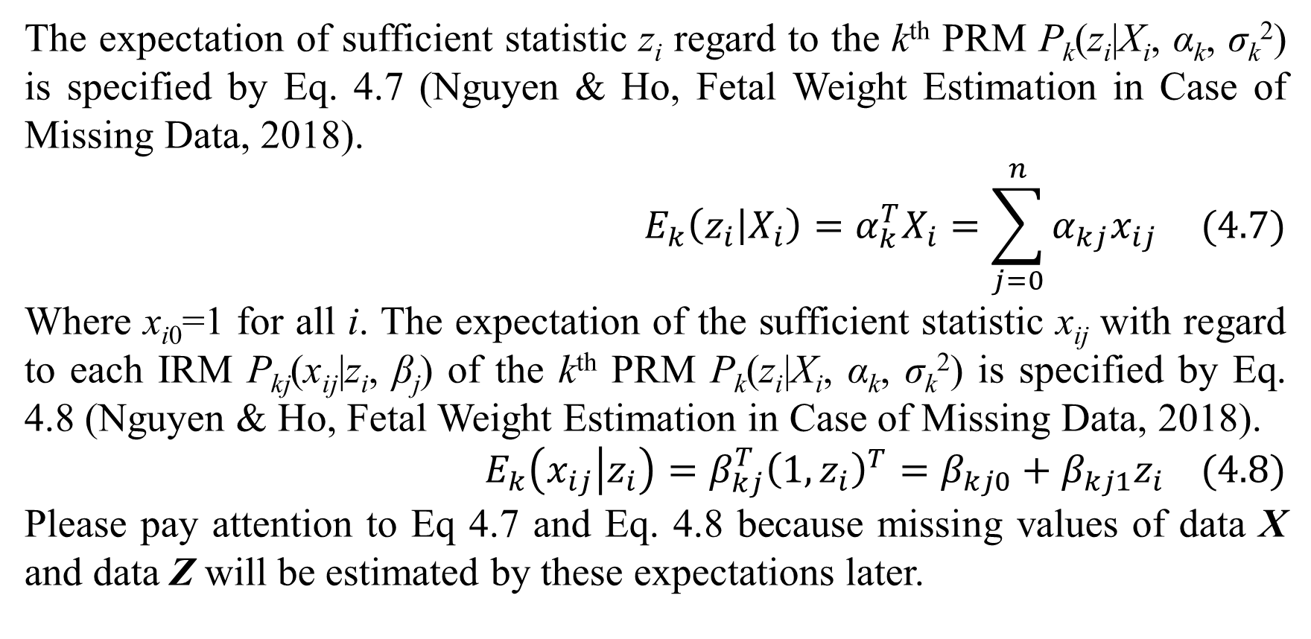
4. Mixture regression model
The expectation of sufficient statistic z_{i} regard to the k^{th} PRM P_{k}(z_{i}|X_{i}, α_{k}, σ_{k}²) is specified by Eq. 4.7 (Nguyen & Ho, Fetal Weight Estimation in Case of Missing Data, 2018).
$$E_{k}\left(z_{i} | X_{i}\right)=α_{k}^{T}X_{i}=\sum_{j=0}^{n}{α_{kj}x_{ij}} (4.7)$$
Where x_{i0}=1 for all i. The expectation of the sufficient statistic x_{ij} with regard to each IRM P_{kj}(x_{ij}|z_{i}, β_{j}) of the k^{th} PRM P_{k}(z_{i}|X_{i}, α_{k}, σ_{k}²) is specified by Eq. 4.8 (Nguyen & Ho, Fetal Weight Estimation in Case of Missing Data, 2018).
$$E_{k}\left(x_{ij} | z_{i}\right)=β_{kj}^{T}{\left(1,z_{i}\right)}^{T}=β_{kj0}+β_{kj1}z_{i} (4.8)$$
Please pay attention to Eq 4.7 and Eq. 4.8 because missing values of data X and data Z will be estimated by these expectations later.

Slide 31
4. Mixture regression model
Because X and Z are incomplete, we apply expectation maximization (EM) algorithm into estimating Θ* = (c_{k}*, α_{k}*, (σ_{k}²)*, β_{kj}*)^{T}. According to (Dempster, Laird, & Rubin, 1977), EM algorithm has many iterations and each iteration has expectation step (E-step) and maximization step (M-step) for estimating parameters. Given current parameter Θ^{(t)} = (c_{k}^{(t)}, α_{k}^{(t)}, (σ_{k}²)^{(t)}, β_{kj}^{(t)})^{T} at the t^{th} iteration, missing values z_{i}– and x_{ij}– are calculated in E-step so that X and Z become complete. In M-step, the next parameter Θ^{(t+1)} = (c_{k}^{(t+1)}, α_{k}^{(t+1)}, (σ_{k}²)^{(t+1)}, β_{kj}^{(t+1)})^{T} is determined based on the complete data X and Z fulfilled in E-step. Here we proposed a so-called Mixture Regression Expectation Maximization (MREM) which is the full combination of Regression Expectation Maximization (REM) algorithm (Nguyen & Ho, Fetal Weight Estimation in Case of Missing Data, 2018) and mixture model in which we use two EM processes in the same loop. Firstly, we use the first EM process for exponential family of probability distributions to estimate missing values in E-step. The technique is the same to the technique of REM in previous research (Nguyen & Ho, Fetal Weight Estimation in Case of Missing Data, 2018). Secondly, we use the second EM process to estimate Θ* for full mixture model in M-step.

Slide 32
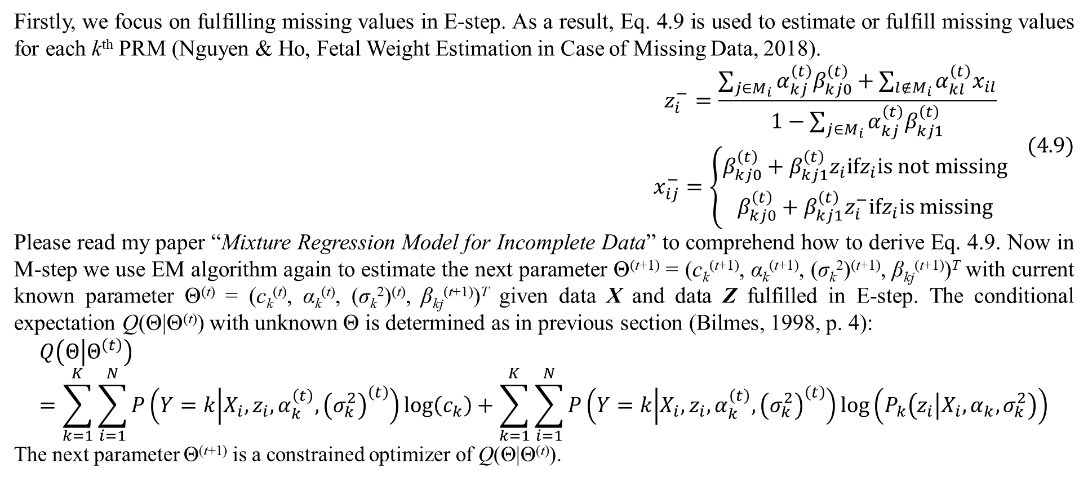
4. Mixture regression model
Firstly, we focus on fulfilling missing values in E-step. As a result, Eq. 4.9 is used to estimate or fulfill missing values for each k^{th} PRM (Nguyen & Ho, Fetal Weight Estimation in Case of Missing Data, 2018).
$$\begin{matrix}z_{i}^{−}=\frac{\sum_{j∈M_{i}}{α_{kj}^{\left(t\right)}β_{kj0}^{\left(t\right)}}+\sum_{l∉M_{i}}{α_{kl}^{\left(t\right)}x_{il}}}{1−\sum_{j∈M_{i}}{α_{kj}^{\left(t\right)}β_{kj1}^{\left(t\right)}}} \\ x_{ij}^{−}=\left\{\begin{matrix}β_{kj0}^{\left(t\right)}+β_{kj1}^{\left(t\right)}z_{i}ifz_{i}is not missing \\ β_{kj0}^{\left(t\right)}+β_{kj1}^{\left(t\right)}z_{i}^{−}ifz_{i}is missing\end{matrix}\right.\end{matrix} (4.9)$$
Please read my paper “Mixture Regression Model for Incomplete Data” to comprehend how to derive Eq. 4.9. Now in M-step we use EM algorithm again to estimate the next parameter Θ^{(t+1)} = (c_{k}^{(t+1)}, α_{k}^{(t+1)}, (σ_{k}²)^{(t+1)}, β_{kj}^{(t+1)})^{T} with current known parameter Θ^{(t)} = (c_{k}^{(t)}, α_{k}^{(t)}, (σ_{k}²)^{(t)}, β_{kj}^{(t+1)})^{T} given data X and data Z fulfilled in E-step. The conditional expectation Q(Θ|Θ^{(t)}) with unknown Θ is determined as in previous section (Bilmes, 1998, p. 4):
$$Q\left(Θ | Θ^{\left(t\right)}\right)=\sum_{k=1}^{K}{\sum_{i=1}^{N}{P\left(Y=k | X_{i},z_{i},α_{k}^{\left(t\right)},{\left(σ_{k}^{2}\right)}^{\left(t\right)}\right)log\left(c_{k}\right)}}+\sum_{k=1}^{K}{\sum_{i=1}^{N}{P\left(Y=k | X_{i},z_{i},α_{k}^{\left(t\right)},{\left(σ_{k}^{2}\right)}^{\left(t\right)}\right)log\left(P_{k}\left(z_{i} | X_{i},α_{k},σ_{k}^{2}\right)\right)}}$$
The next parameter Θ^{(t+1)} is a constrained optimizer of Q(Θ|Θ^{(t)}).

Slide 33
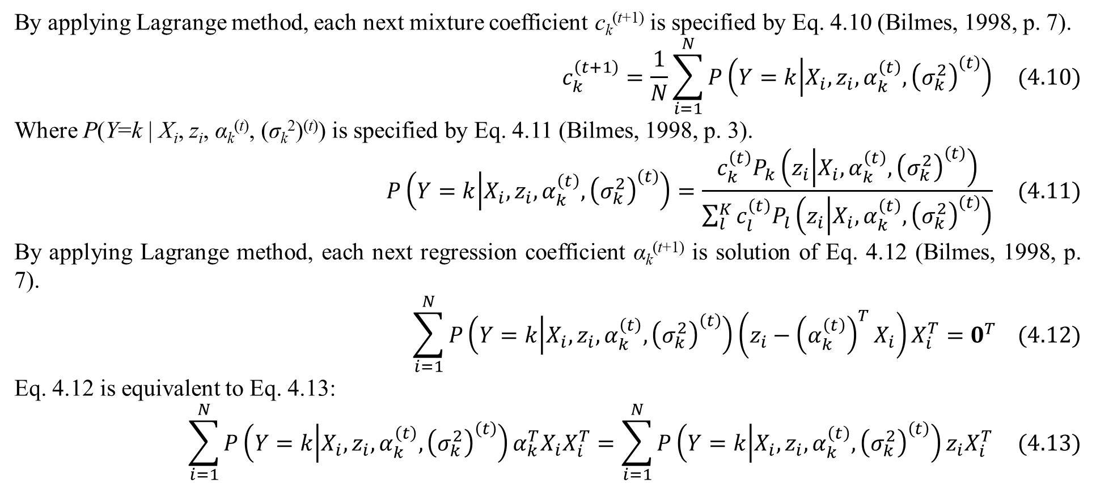
4. Mixture regression model
By applying Lagrange method, each next mixture coefficient c_{k}^{(t+1)} is specified by Eq. 4.10 (Bilmes, 1998, p. 7).
$$c_{k}^{\left(t+1\right)}=\frac{1}{N}\sum_{i=1}^{N}{P\left(Y=k | X_{i},z_{i},α_{k}^{\left(t\right)},{\left(σ_{k}^{2}\right)}^{\left(t\right)}\right)} (4.10)$$
Where P(Y=k | X_{i}, z_{i}, α_{k}^{(t)}, (σ_{k}²)^{(t)}) is specified by Eq. 4.11 (Bilmes, 1998, p. 3).
$$P\left(Y=k | X_{i},z_{i},α_{k}^{\left(t\right)},{\left(σ_{k}^{2}\right)}^{\left(t\right)}\right)=\frac{c_{k}^{\left(t\right)}P_{k}\left(z_{i} | X_{i},α_{k}^{\left(t\right)},{\left(σ_{k}^{2}\right)}^{\left(t\right)}\right)}{\sum_{l}^{K}{c_{l}^{\left(t\right)}P_{l}\left(z_{i} | X_{i},α_{k}^{\left(t\right)},{\left(σ_{k}^{2}\right)}^{\left(t\right)}\right)}} (4.11)$$
By applying Lagrange method, each next regression coefficient α_{k}^{(t+1)} is solution of Eq. 4.12 (Bilmes, 1998, p. 7).
$$\sum_{i=1}^{N}{P\left(Y=k | X_{i},z_{i},α_{k}^{\left(t\right)},{\left(σ_{k}^{2}\right)}^{\left(t\right)}\right)\left(z_{i}−{\left(α_{k}^{\left(t\right)}\right)}^{T}X_{i}\right)X_{i}^{T}}=0^{T} (4.12)$$
Eq. 4.12 is equivalent to Eq. 4.13:
$$\sum_{i=1}^{N}{P\left(Y=k | X_{i},z_{i},α_{k}^{\left(t\right)},{\left(σ_{k}^{2}\right)}^{\left(t\right)}\right)α_{k}^{T}X_{i}X_{i}^{T}}=\sum_{i=1}^{N}{P\left(Y=k | X_{i},z_{i},α_{k}^{\left(t\right)},{\left(σ_{k}^{2}\right)}^{\left(t\right)}\right)z_{i}X_{i}^{T}} (4.13)$$

Slide 34
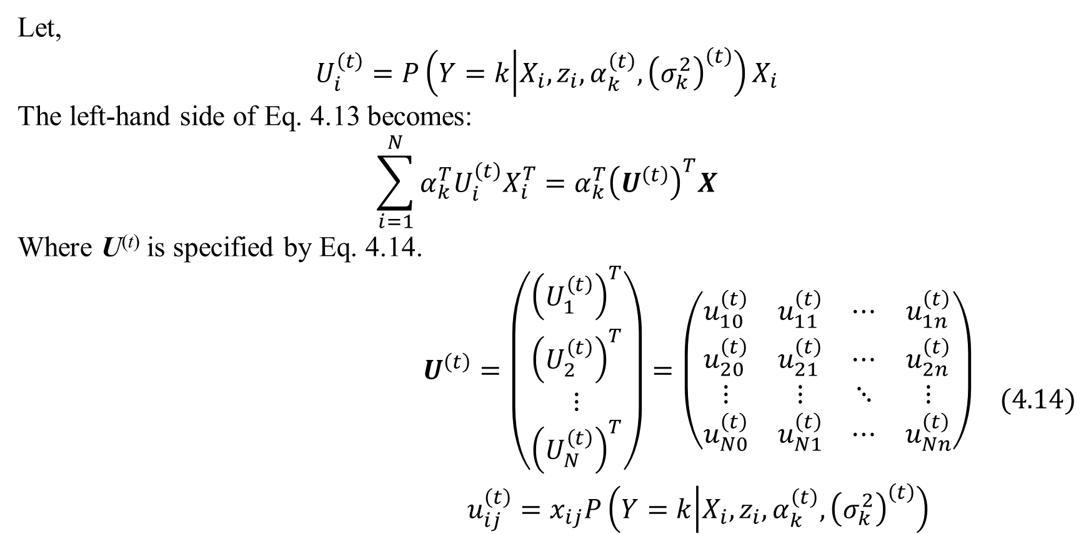
4. Mixture regression model
Let,
$$U_{i}^{\left(t\right)}=P\left(Y=k | X_{i},z_{i},α_{k}^{\left(t\right)},{\left(σ_{k}^{2}\right)}^{\left(t\right)}\right)X_{i}$$
The left-hand side of Eq. 4.13 becomes:
$$\sum_{i=1}^{N}{α_{k}^{T}U_{i}^{\left(t\right)}X_{i}^{T}}=α_{k}^{T}{\left(U^{\left(t\right)}\right)}^{T}X$$
Where U^{(t)} is specified by Eq. 4.14.
$$\begin{matrix}U^{\left(t\right)}=\left(\begin{matrix}{\left(U_{1}^{\left(t\right)}\right)}^{T} \\ {\left(U_{2}^{\left(t\right)}\right)}^{T} \\ ⋮ \\ {\left(U_{N}^{\left(t\right)}\right)}^{T}\end{matrix}\right)=\left(\begin{matrix}u_{10}^{\left(t\right)} & u_{11}^{\left(t\right)} & ⋯ & u_{1n}^{\left(t\right)} \\ u_{20}^{\left(t\right)} & u_{21}^{\left(t\right)} & ⋯ & u_{2n}^{\left(t\right)} \\ ⋮ & ⋮ & ⋱ & ⋮ \\ u_{N0}^{\left(t\right)} & u_{N1}^{\left(t\right)} & ⋯ & u_{Nn}^{\left(t\right)}\end{matrix}\right) \\ u_{ij}^{\left(t\right)}=x_{ij}P\left(Y=k | X_{i},z_{i},α_{k}^{\left(t\right)},{\left(σ_{k}^{2}\right)}^{\left(t\right)}\right)\end{matrix} (4.14)$$

Slide 35
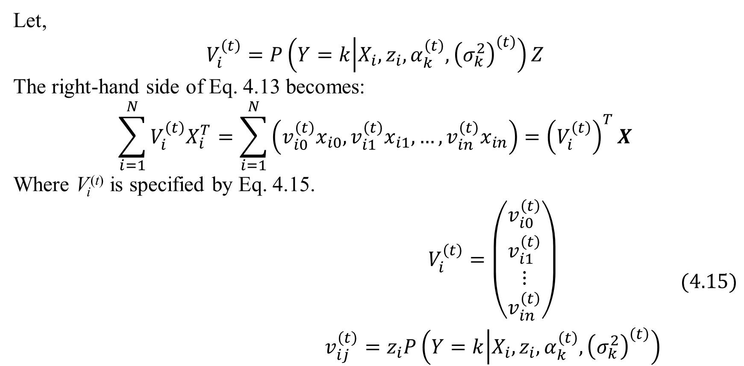
4. Mixture regression model
Let,
$$V_{i}^{\left(t\right)}=P\left(Y=k | X_{i},z_{i},α_{k}^{\left(t\right)},{\left(σ_{k}^{2}\right)}^{\left(t\right)}\right)Z$$
The right-hand side of Eq. 4.13 becomes:
$$\sum_{i=1}^{N}{V_{i}^{\left(t\right)}X_{i}^{T}}=\sum_{i=1}^{N}{\left(v_{i0}^{\left(t\right)}x_{i0},v_{i1}^{\left(t\right)}x_{i1},…,v_{in}^{\left(t\right)}x_{in}\right)}={\left(V_{i}^{\left(t\right)}\right)}^{T}X$$
Where V_{i}^{(t)} is specified by Eq. 4.15.
$$\begin{matrix}V_{i}^{\left(t\right)}=\left(\begin{matrix}v_{i0}^{\left(t\right)} \\ v_{i1}^{\left(t\right)} \\ ⋮ \\ v_{in}^{\left(t\right)}\end{matrix}\right) \\ v_{ij}^{\left(t\right)}=z_{i}P\left(Y=k | X_{i},z_{i},α_{k}^{\left(t\right)},{\left(σ_{k}^{2}\right)}^{\left(t\right)}\right)\end{matrix} (4.15)$$

Slide 36
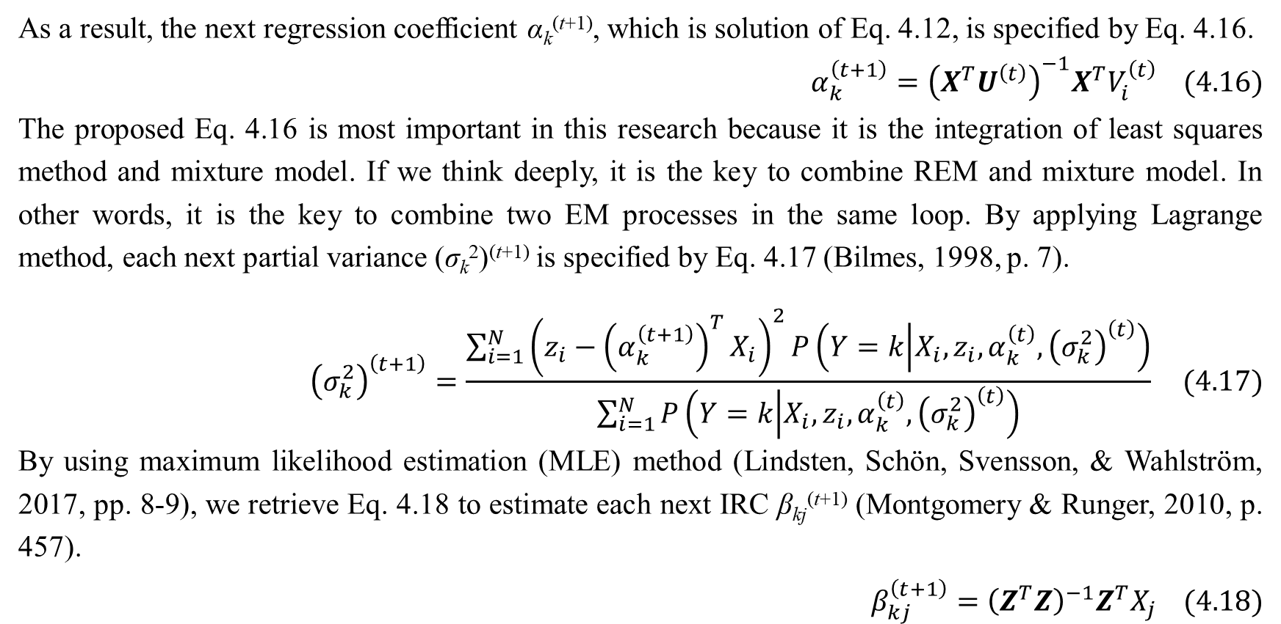
4. Mixture regression model
As a result, the next regression coefficient α_{k}^{(t+1)}, which is solution of Eq. 4.12, is specified by Eq. 4.16.
$$α_{k}^{\left(t+1\right)}={\left(X^{T}U^{\left(t\right)}\right)}^{−1}X^{T}V_{i}^{\left(t\right)} (4.16)$$
The proposed Eq. 4.16 is most important in this research because it is the integration of least squares method and mixture model. If we think deeply, it is the key to combine REM and mixture model. In other words, it is the key to combine two EM processes in the same loop. By applying Lagrange method, each next partial variance (σ_{k}²)^{(t+1)} is specified by Eq. 4.17 (Bilmes, 1998, p. 7).
$${\left(σ_{k}^{2}\right)}^{\left(t+1\right)}=\frac{\sum_{i=1}^{N}{{\left(z_{i}−{\left(α_{k}^{\left(t+1\right)}\right)}^{T}X_{i}\right)}^{2}P\left(Y=k | X_{i},z_{i},α_{k}^{\left(t\right)},{\left(σ_{k}^{2}\right)}^{\left(t\right)}\right)}}{\sum_{i=1}^{N}{P\left(Y=k | X_{i},z_{i},α_{k}^{\left(t\right)},{\left(σ_{k}^{2}\right)}^{\left(t\right)}\right)}} (4.17)$$
By using maximum likelihood estimation (MLE) method (Lindsten, Schön, Svensson, & Wahlström, 2017, pp. 8-9), we retrieve Eq. 4.18 to estimate each next IRC β_{kj}^{(t+1)} (Montgomery & Runger, 2010, p. 457).
$$β_{kj}^{\left(t+1\right)}={\left(Z^{T}Z\right)}^{−1}Z^{T}X_{j} (4.18)$$

Slide 37
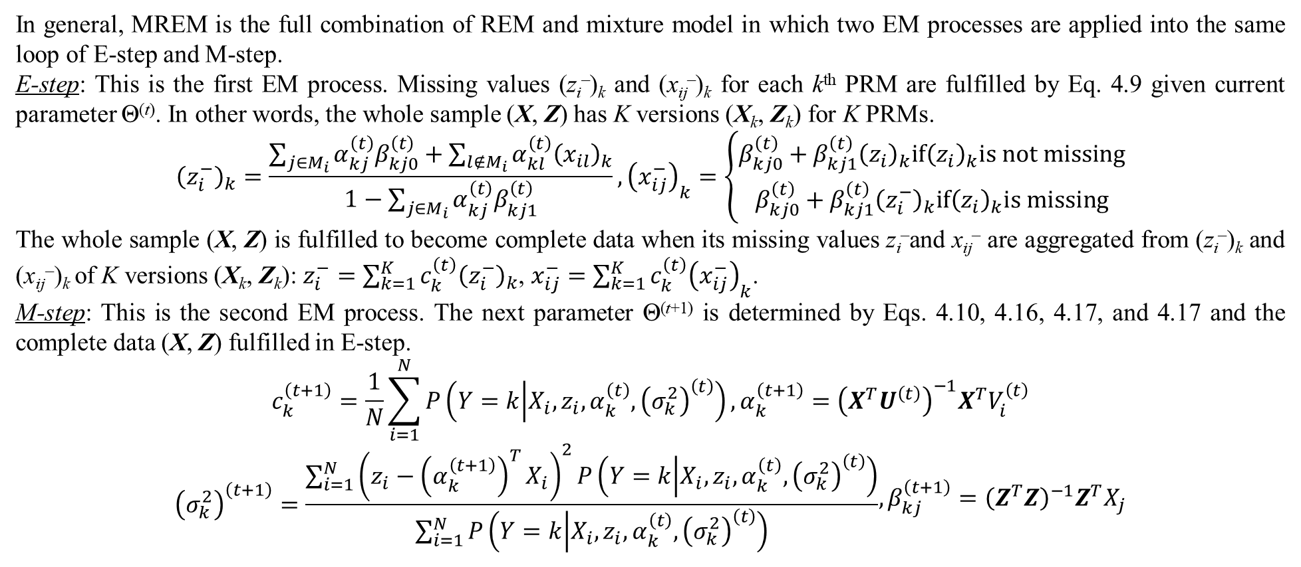
4. Mixture regression model
In general, MREM is the full combination of REM and mixture model in which two EM processes are applied into the same loop of E-step and M-step.
E-step: This is the first EM process. Missing values (z_{i}–)_{k} and (x_{ij}–)_{k} for each k^{th} PRM are fulfilled by Eq. 4.9 given current parameter Θ^{(t)}. In other words, the whole sample (X, Z) has K versions (X_{k}, Z_{k}) for K PRMs.
$${\left(z_{i}^{−}\right)}_{k}=\frac{\sum_{j∈M_{i}}{α_{kj}^{\left(t\right)}β_{kj0}^{\left(t\right)}}+\sum_{l∉M_{i}}{α_{kl}^{\left(t\right)}{\left(x_{il}\right)}_{k}}}{1−\sum_{j∈M_{i}}{α_{kj}^{\left(t\right)}β_{kj1}^{\left(t\right)}}},{\left(x_{ij}^{−}\right)}_{k}=\left\{\begin{matrix}β_{kj0}^{\left(t\right)}+β_{kj1}^{\left(t\right)}{\left(z_{i}\right)}_{k}if{\left(z_{i}\right)}_{k}is not missing \\ β_{kj0}^{\left(t\right)}+β_{kj1}^{\left(t\right)}{\left(z_{i}^{−}\right)}_{k}if{\left(z_{i}\right)}_{k}is missing\end{matrix}\right.$$
The whole sample (X, Z) is fulfilled to become complete data when its missing values z_{i}–and x_{ij}– are aggregated from (z_{i}–)_{k} and (x_{ij}–)_{k} of K versions (X_{k}, Z_{k}): $z_{i}^{−}=\sum_{k=1}^{K}{c_{k}^{\left(t\right)}{\left(z_{i}^{−}\right)}_{k}}$, $x_{ij}^{−}=\sum_{k=1}^{K}{c_{k}^{\left(t\right)}{\left(x_{ij}^{−}\right)}_{k}}$.
M-step: This is the second EM process. The next parameter Θ^{(t+1)} is determined by Eqs. 4.10, 4.16, 4.17, and 4.17 and the complete data (X, Z) fulfilled in E-step.
$$c_{k}^{\left(t+1\right)}=\frac{1}{N}\sum_{i=1}^{N}{P\left(Y=k | X_{i},z_{i},α_{k}^{\left(t\right)},{\left(σ_{k}^{2}\right)}^{\left(t\right)}\right)},α_{k}^{\left(t+1\right)}={\left(X^{T}U^{\left(t\right)}\right)}^{−1}X^{T}V_{i}^{\left(t\right)}$$
$$\begin{matrix}{\left(σ_{k}^{2}\right)}^{\left(t+1\right)}=\frac{\sum_{i=1}^{N}{{\left(z_{i}−{\left(α_{k}^{\left(t+1\right)}\right)}^{T}X_{i}\right)}^{2}P\left(Y=k | X_{i},z_{i},α_{k}^{\left(t\right)},{\left(σ_{k}^{2}\right)}^{\left(t\right)}\right)}}{\sum_{i=1}^{N}{P\left(Y=k | X_{i},z_{i},α_{k}^{\left(t\right)},{\left(σ_{k}^{2}\right)}^{\left(t\right)}\right)}}\end{matrix},β_{kj}^{\left(t+1\right)}={\left(Z^{T}Z\right)}^{−1}Z^{T}X_{j}$$

Slide 38
4. Mixture regression model
EM algorithm stops if at some t^{th} iteration, we have Θ^{(t)} = Θ^{(t+1)} = Θ*. Note, Θ⁽¹⁾ at the first iteration is initialized arbitrarily. Here MREM stops if ratio deviation between Θ^{(t)} and Θ^{(t+1)} is smaller than a small enough terminated threshold ε> 0 or MREM reaches a large enough number of iterations. The smaller the terminated threshold is, the more accurate MREM is. MREM uses both the terminated threshold ε = 0.1% = 0.001 and the maximum number of iterations (10000). The maximum number of iterations prevents MREM from running for a long time.
There are some more problems related to missing data inside the mixture regression model that I proposed but this report focuses on the mixture model. Therefore, I suspend discussion on mixture model here. I wish to have another opportunity to present more about mixture model and regression model.

Slide 39
References
Bilmes, J. A. (1998). A Gentle Tutorial of the EM Algorithm and its Application to Parameter Estimation for Gaussian Mixture and Hidden Markov Models. International Computer Science Institute, Department of Electrical Engineering and Computer Science. Berkeley: University of Washington. Retrieved from http://melodi.ee.washington.edu/people/bilmes/mypubs/bilmes1997-em.pdf
Burden, R. L., & Faires, D. J. (2011). Numerical Analysis (9th Edition ed.). (M. Julet, Ed.) Brooks/Cole Cengage Learning.
Dempster, A. P., Laird, N. M., & Rubin, D. B. (1977). Maximum Likelihood from Incomplete Data via the EM Algorithm. (M. Stone, Ed.) Journal of the Royal Statistical Society, Series B (Methodological), 39(1), 1-38.
Han, J., & Kamber, M. (2006). Data Mining: Concepts and Techniques (2nd Edition ed.). (J. Gray, Ed.) San Francisco, CA, USA: Morgan Kaufmann Publishers, Elsevier.
Lindsten, F., Schön, T. B., Svensson, A., & Wahlström, N. (2017). Probabilistic modeling – linear regression & Gaussian processes. Uppsala University, Department of Information Technology. Uppsala: Uppsala University. Retrieved January 24, 2018, from http://www.it.uu.se/edu/course/homepage/sml/literature/probabilistic_modeling_compendium.pdf
Montgomery, D. C., & Runger, G. C. (2010). Applied Statistics and Probability for Engineers (5th ed.). Hoboken, New Jersey, USA: John Wiley & Sons. Retrieved from https://books.google.com.vn/books?id=_f4KrEcNAfEC
Nguyen, L. (2015). Matrix Analysis and Calculus (1st ed.). (C. Evans, Ed.) Hanoi, Vietnam: Lambert Academic Publishing. Retrieved from https://www.shuyuan.sg/store/gb/book/matrix-analysis-and-calculus/isbn/978-3-659-69400-4
Nguyen, L. (2020). Tutorial on EM algorithm. MDPI. Preprints. doi:10.20944/preprints201802.0131.v8
Nguyen, L., & Ho, T.-H. T. (2018). Fetal Weight Estimation in Case of Missing Data. (T. Schmutte, Ed.) Experimental Medicine (EM) - Special Issue "Medicine and Healthy Food".
Nguyen, L., & Shafiq, A. (2018, December 31). Mixture Regression Model for Incomplete Data. (L. d. Istael, Ed.) Revista Sociedade Científica, 1(3), 1-25. doi:10.5281/zenodo.2528978
Ta, P. D. (2014). Numerical Analysis Lecture Notes. Vietnam Institute of Mathematics, Numerical Analysis and Scientific Computing. Hanoi: Vietnam Institute of Mathematics. Retrieved 2014
Wikipedia. (2014, August 4). Karush–Kuhn–Tucker conditions. (Wikimedia Foundation) Retrieved November 16, 2014, from Wikipedia website: http://en.wikipedia.org/wiki/Karush–Kuhn–Tucker_conditions
Wikipedia. (2016, March September). Exponential family. (Wikimedia Foundation) Retrieved 2015, from Wikipedia website: https://en.wikipedia.org/wiki/Exponential_family

Slide 40
Thank you for attention

