Slide 1
Tutorial on EM algorithm – Part 2
Prof. Dr. Loc Nguyen, PhD, PostDoc
Founder of Loc Nguyen’s Academic Network, Vietnam
Email: ng_phloc@yahoo.com
Homepage: www.locnguyen.net

Slide 2
Abstract

Slide 3
Table of contents
This report focuses on EM description in detail.
Traditional EM algorithm
Practical EM algorithm

Slide 4
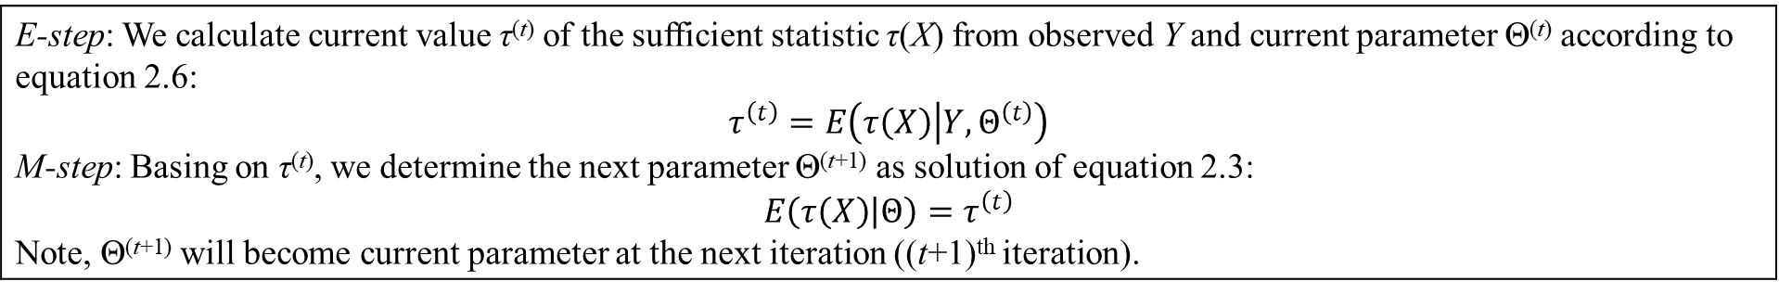
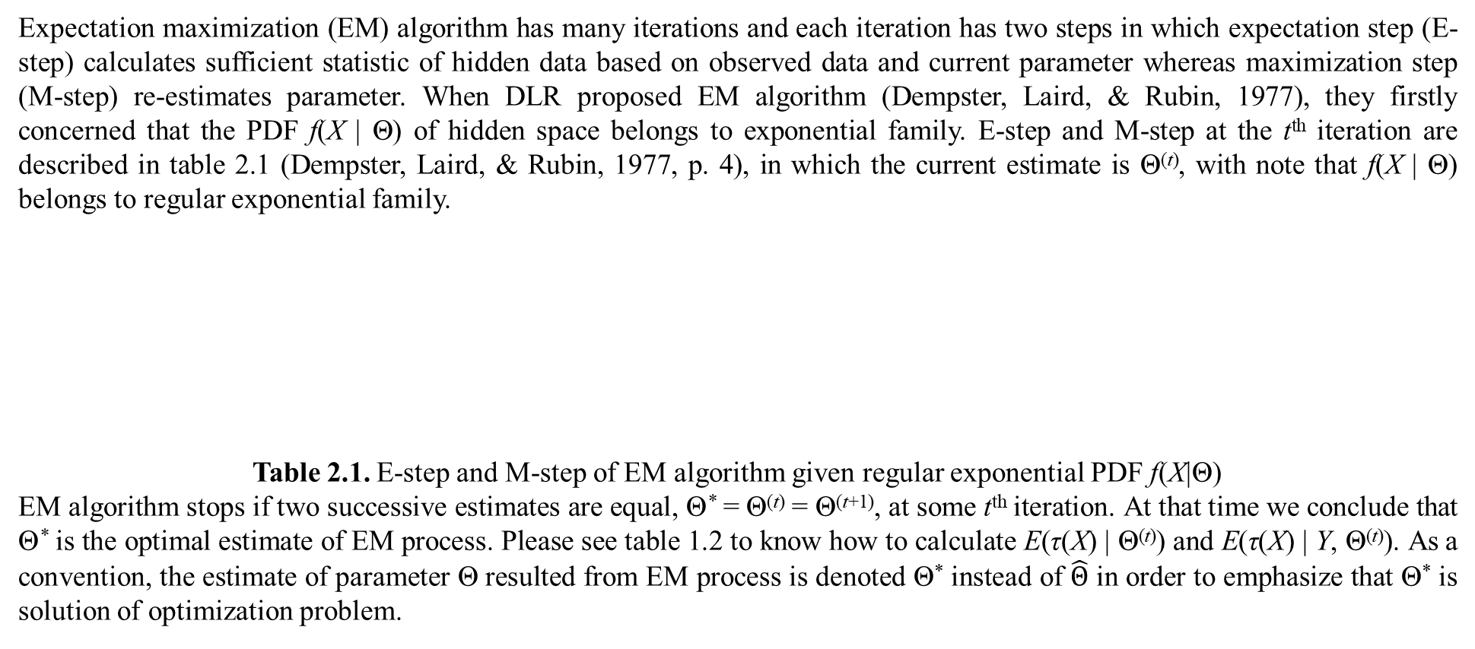
1. Traditional EM algorithm
Expectation maximization (EM) algorithm has many iterations and each iteration has two steps in which expectation step (E-step) calculates sufficient statistic of hidden data based on observed data and current parameter whereas maximization step (M-step) re-estimates parameter. When DLR proposed EM algorithm (Dempster, Laird, & Rubin, 1977), they firstly concerned that the PDF f(X | Θ) of hidden space belongs to exponential family. E-step and M-step at the t^{th} iteration are described in table 2.1 (Dempster, Laird, & Rubin, 1977, p. 4), in which the current estimate is Θ^{(t)}, with note that f(X | Θ) belongs to regular exponential family.
Table 2.1. E-step and M-step of EM algorithm given regular exponential PDF f(X|Θ)
EM algorithm stops if two successive estimates are equal, Θ* = Θ^{(t)} = Θ^{(t+1)}, at some t^{th} iteration. At that time we conclude that Θ* is the optimal estimate of EM process. Please see table 1.2 to know how to calculate E(τ(X) | Θ^{(t)}) and E(τ(X) | Y, Θ^{(t)}). As a convention, the estimate of parameter Θ resulted from EM process is denoted Θ* instead of $\hat{Θ}$ in order to emphasize that Θ* is solution of optimization problem.
E-step: We calculate current value τ^{(t)} of the sufficient statistic τ(X) from observed Y and current parameter Θ^{(t)} according to equation 2.6: $$τ^{\left(t\right)}=E\left(τ\left(X\right) | Y,Θ^{\left(t\right)}\right)$$ M-step: Basing on τ^{(t)}, we determine the next parameter Θ^{(t+1)} as solution of equation 2.3: $$E\left(τ\left(X\right) | Θ\right)=τ^{\left(t\right)}$$ Note, Θ^{(t+1)} will become current parameter at the next iteration ((t+1)^{th} iteration).

Slide 5
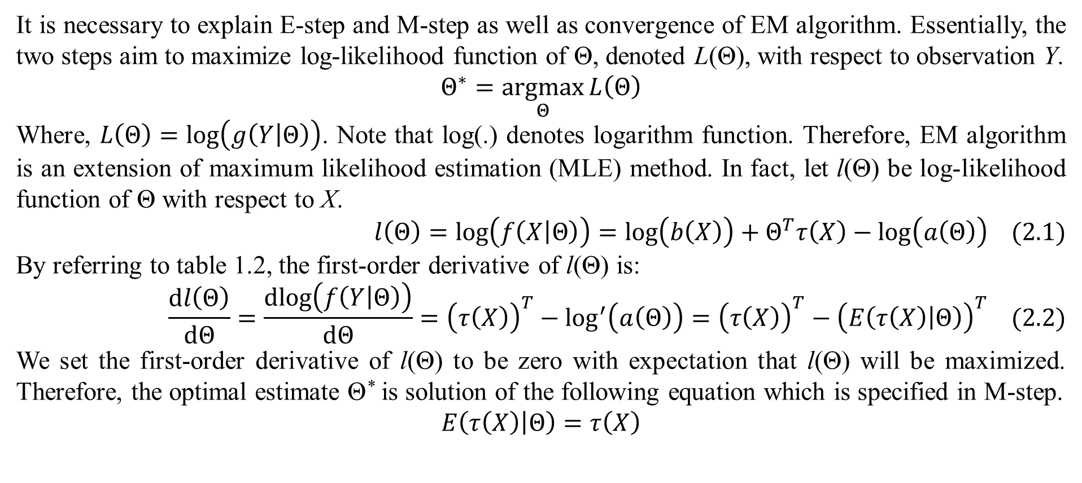
1. Traditional EM algorithm
It is necessary to explain E-step and M-step as well as convergence of EM algorithm. Essentially, the two steps aim to maximize log-likelihood function of Θ, denoted L(Θ), with respect to observation Y.
$$Θ^{∗}=\underset{Θ}{argmax}{L\left(Θ\right)}$$
Where, $L\left(Θ\right)=log\left(g\left(Y | Θ\right)\right)$. Note that log(.) denotes logarithm function. Therefore, EM algorithm is an extension of maximum likelihood estimation (MLE) method. In fact, let l(Θ) be log-likelihood function of Θ with respect to X.
$$l\left(Θ\right)=log\left(f\left(X | Θ\right)\right)=log\left(b\left(X\right)\right)+Θ^{T}τ\left(X\right)−log\left(a\left(Θ\right)\right) (2.1)$$
By referring to table 1.2, the first-order derivative of l(Θ) is:
$$\frac{dl\left(Θ\right)}{dΘ}=\frac{dlog\left(f\left(Y | Θ\right)\right)}{dΘ}={\left(τ\left(X\right)\right)}^{T}−\log^{′}\left(a\left(Θ\right)\right)={\left(τ\left(X\right)\right)}^{T}−{\left(E\left(τ\left(X\right) | Θ\right)\right)}^{T} (2.2)$$
We set the first-order derivative of l(Θ) to be zero with expectation that l(Θ) will be maximized. Therefore, the optimal estimate Θ* is solution of the following equation which is specified in M-step.
$$E\left(τ\left(X\right) | Θ\right)=τ\left(X\right)$$

Slide 6
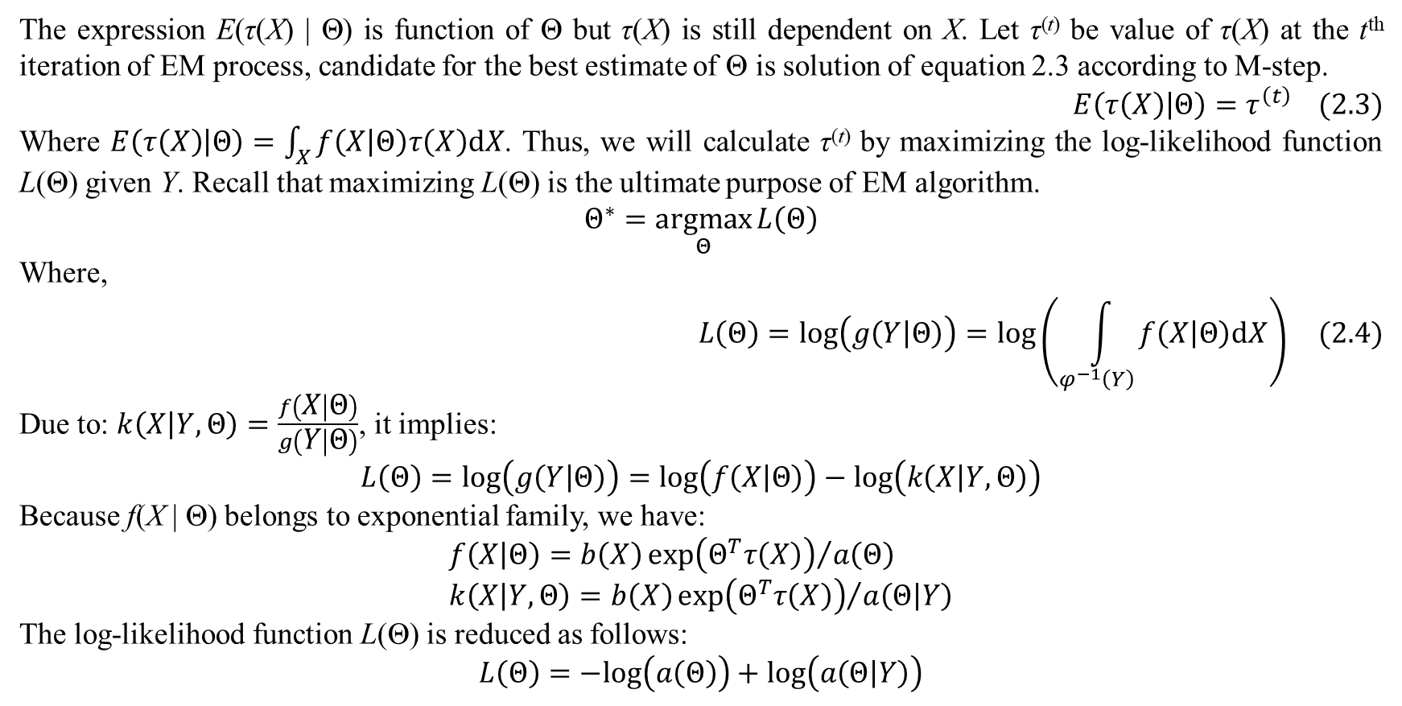
1. Traditional EM algorithm
The expression E(τ(X) | Θ) is function of Θ but τ(X) is still dependent on X. Let τ^{(t)} be value of τ(X) at the t^{th} iteration of EM process, candidate for the best estimate of Θ is solution of equation 2.3 according to M-step.
$$E\left(τ\left(X\right) | Θ\right)=τ^{\left(t\right)} (2.3)$$
Where $E\left(τ\left(X\right) | Θ\right)=\int_{X}{f\left(X | Θ\right)τ\left(X\right)dX}$. Thus, we will calculate τ^{(t)} by maximizing the log-likelihood function L(Θ) given Y. Recall that maximizing L(Θ) is the ultimate purpose of EM algorithm.
$$Θ^{∗}=\underset{Θ}{argmax}{L\left(Θ\right)}$$
Where,
$$L\left(Θ\right)=log\left(g\left(Y | Θ\right)\right)=log\left(\int_{φ^{−1}\left(Y\right)}{f\left(X | Θ\right)dX}\right) (2.4)$$
Due to: $k\left(X | Y,Θ\right)=\frac{f\left(X | Θ\right)}{g\left(Y | Θ\right)}$, it implies:
$$L\left(Θ\right)=log\left(g\left(Y | Θ\right)\right)=log\left(f\left(X | Θ\right)\right)−log\left(k\left(X | Y,Θ\right)\right)$$
Because f(X | Θ) belongs to exponential family, we have:
$$f\left(X | Θ\right)=b\left(X\right){exp\left(Θ^{T}τ\left(X\right)\right)}/{a\left(Θ\right)} \\ k\left(X | Y,Θ\right)=b\left(X\right){exp\left(Θ^{T}τ\left(X\right)\right)}/{a\left(Θ | Y\right)}$$
The log-likelihood function L(Θ) is reduced as follows:
$$L\left(Θ\right)=−log\left(a\left(Θ\right)\right)+log\left(a\left(Θ | Y\right)\right)$$

Slide 7
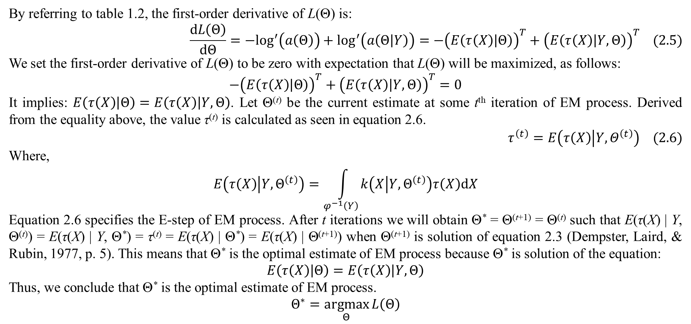
1. Traditional EM algorithm
By referring to table 1.2, the first-order derivative of L(Θ) is:
$$\frac{dL\left(Θ\right)}{dΘ}=−\log^{′}\left(a\left(Θ\right)\right)+\log^{′}\left(a\left(Θ | Y\right)\right)=−{\left(E\left(τ\left(X\right) | Θ\right)\right)}^{T}+{\left(E\left(τ\left(X\right) | Y,Θ\right)\right)}^{T} (2.5)$$
We set the first-order derivative of L(Θ) to be zero with expectation that L(Θ) will be maximized, as follows:
$$−{\left(E\left(τ\left(X\right) | Θ\right)\right)}^{T}+{\left(E\left(τ\left(X\right) | Y,Θ\right)\right)}^{T}=0$$
It implies: $E\left(τ\left(X\right) | Θ\right)=E\left(τ\left(X\right) | Y,Θ\right)$. Let Θ^{(t)} be the current estimate at some t^{th} iteration of EM process. Derived from the equality above, the value τ^{(t)} is calculated as seen in equation 2.6.
$$τ^{\left(t\right)}=E\left(τ\left(X\right) | Y,Θ^{\left(t\right)}\right) (2.6)$$
Where,
$$E\left(τ\left(X\right) | Y,Θ^{\left(t\right)}\right)=\int_{φ^{−1}\left(Y\right)}{k\left(X | Y,Θ^{\left(t\right)}\right)τ\left(X\right)dX}$$
Equation 2.6 specifies the E-step of EM process. After t iterations we will obtain Θ* = Θ^{(t+1)} = Θ^{(t)} such that E(τ(X) | Y, Θ^{(t)}) = E(τ(X) | Y, Θ*) = τ^{(t)} = E(τ(X) | Θ*) = E(τ(X) | Θ^{(t+1)}) when Θ^{(t+1)} is solution of equation 2.3 (Dempster, Laird, & Rubin, 1977, p. 5). This means that Θ* is the optimal estimate of EM process because Θ* is solution of the equation:
$$E\left(τ\left(X\right) | Θ\right)=E\left(τ\left(X\right) | Y,Θ\right)$$
Thus, we conclude that Θ* is the optimal estimate of EM process.
$$Θ^{∗}=\underset{Θ}{argmax}{L\left(Θ\right)}$$

Slide 8
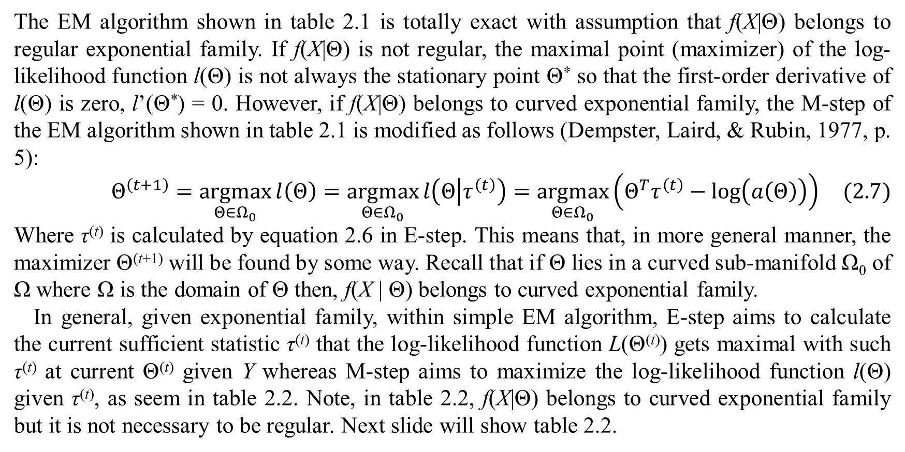
1. Traditional EM algorithm
The EM algorithm shown in table 2.1 is totally exact with assumption that f(X|Θ) belongs to regular exponential family. If f(X|Θ) is not regular, the maximal point (maximizer) of the log-likelihood function l(Θ) is not always the stationary point Θ* so that the first-order derivative of l(Θ) is zero, l’(Θ*) = 0. However, if f(X|Θ) belongs to curved exponential family, the M-step of the EM algorithm shown in table 2.1 is modified as follows (Dempster, Laird, & Rubin, 1977, p. 5):
$$Θ^{\left(t+1\right)}=\underset{Θ∈Ω_{0}}{argmax}{l\left(Θ\right)}=\underset{Θ∈Ω_{0}}{argmax}{l\left(Θ | τ^{\left(t\right)}\right)}=\underset{Θ∈Ω_{0}}{argmax}\left(Θ^{T}τ^{\left(t\right)}−log\left(a\left(Θ\right)\right)\right) (2.7)$$
Where τ^{(t)} is calculated by equation 2.6 in E-step. This means that, in more general manner, the maximizer Θ^{(t+1)} will be found by some way. Recall that if Θ lies in a curved sub-manifold Ω₀ of Ω where Ω is the domain of Θ then, f(X | Θ) belongs to curved exponential family.
In general, given exponential family, within simple EM algorithm, E-step aims to calculate the current sufficient statistic τ^{(t)} that the log-likelihood function L(Θ^{(t)}) gets maximal with such τ^{(t)} at current Θ^{(t)} given Y whereas M-step aims to maximize the log-likelihood function l(Θ) given τ^{(t)}, as seem in table 2.2. Note, in table 2.2, f(X|Θ) belongs to curved exponential family but it is not necessary to be regular. Next slide will show table 2.2.

Slide 9
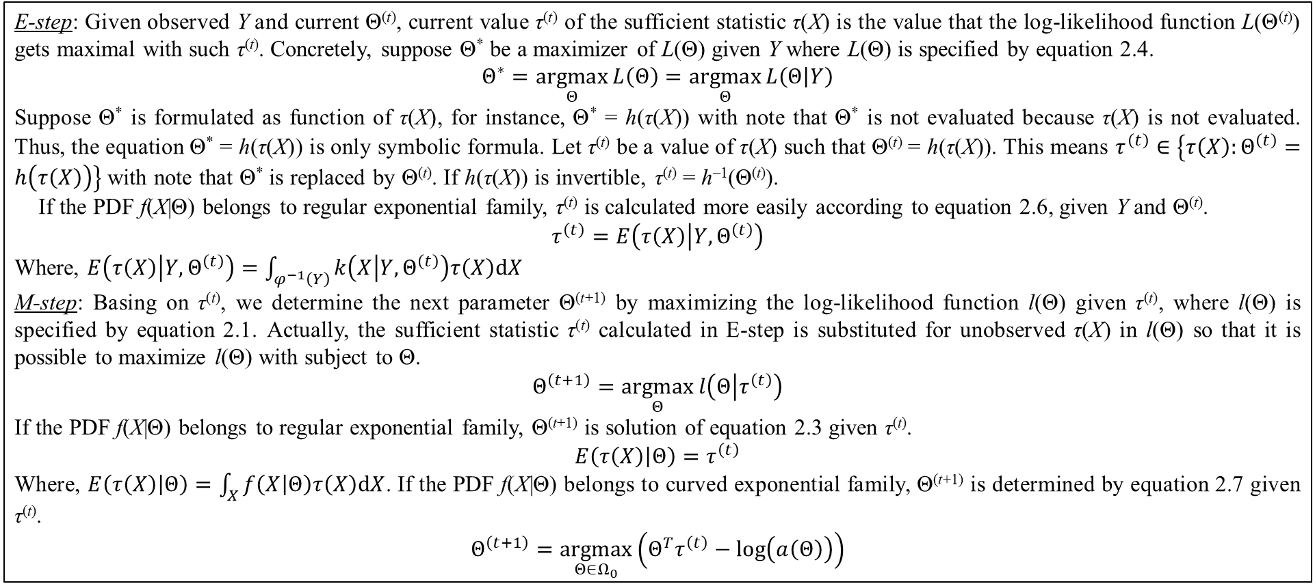
1. Traditional EM algorithm
E-step: Given observed Y and current Θ^{(t)}, current value τ^{(t)} of the sufficient statistic τ(X) is the value that the log-likelihood function L(Θ^{(t)}) gets maximal with such τ^{(t)}. Concretely, suppose Θ* be a maximizer of L(Θ) given Y where L(Θ) is specified by equation 2.4.
$$Θ^{∗}=\underset{Θ}{argmax}{L\left(Θ\right)}=\underset{Θ}{argmax}{L\left(Θ | Y\right)}$$
Suppose Θ* is formulated as function of τ(X), for instance, Θ* = h(τ(X)) with note that Θ* is not evaluated because τ(X) is not evaluated. Thus, the equation Θ* = h(τ(X)) is only symbolic formula. Let τ^{(t)} be a value of τ(X) such that Θ^{(t)} = h(τ(X)). This means $τ^{\left(t\right)}∈\left\{τ\left(X\right):Θ^{\left(t\right)}=h\left(τ\left(X\right)\right)\right\}$ with note that Θ* is replaced by Θ^{(t)}. If h(τ(X)) is invertible, τ^{(t)} = h^{–1}(Θ^{(t)}).
If the PDF f(X|Θ) belongs to regular exponential family, τ^{(t)} is calculated more easily according to equation 2.6, given Y and Θ^{(t)}.
$$τ^{\left(t\right)}=E\left(τ\left(X\right) | Y,Θ^{\left(t\right)}\right)$$
Where, $E\left(τ\left(X\right) | Y,Θ^{\left(t\right)}\right)=\int_{φ^{−1}\left(Y\right)}{k\left(X | Y,Θ^{\left(t\right)}\right)τ\left(X\right)dX}$
M-step: Basing on τ^{(t)}, we determine the next parameter Θ^{(t+1)} by maximizing the log-likelihood function l(Θ) given τ^{(t)}, where l(Θ) is specified by equation 2.1. Actually, the sufficient statistic τ^{(t)} calculated in E-step is substituted for unobserved τ(X) in l(Θ) so that it is possible to maximize l(Θ) with subject to Θ.
$$Θ^{\left(t+1\right)}=\underset{Θ}{argmax}{l\left(Θ | τ^{\left(t\right)}\right)}$$
If the PDF f(X|Θ) belongs to regular exponential family, Θ^{(t+1)} is solution of equation 2.3 given τ^{(t)}.
$$E\left(τ\left(X\right) | Θ\right)=τ^{\left(t\right)}$$
Where, $E\left(τ\left(X\right) | Θ\right)=\int_{X}{f\left(X | Θ\right)τ\left(X\right)dX}$. If the PDF f(X|Θ) belongs to curved exponential family, Θ^{(t+1)} is determined by equation 2.7 given τ^{(t)}.
$$Θ^{\left(t+1\right)}=\underset{Θ∈Ω_{0}}{argmax}\left(Θ^{T}τ^{\left(t\right)}−log\left(a\left(Θ\right)\right)\right)$$
Table 2.2. E-step and M-step of EM algorithm given exponential PDF f(X|Θ)

Slide 10
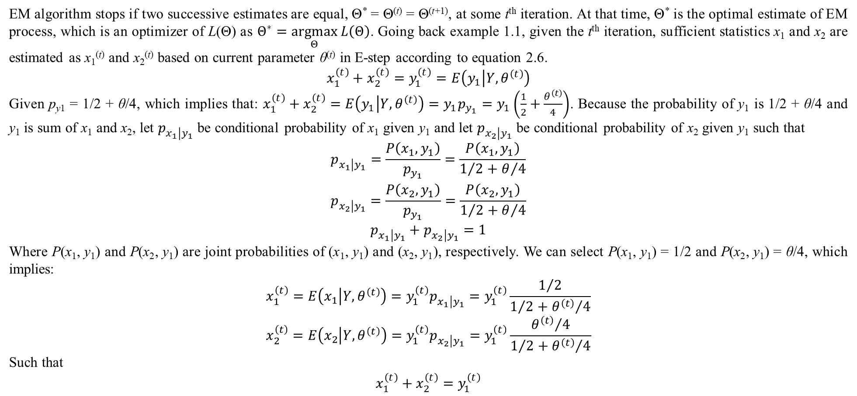
1. Traditional EM algorithm
EM algorithm stops if two successive estimates are equal, Θ* = Θ^{(t)} = Θ^{(t+1)}, at some t^{th} iteration. At that time, Θ* is the optimal estimate of EM process, which is an optimizer of L(Θ) as $Θ^{∗}=\underset{Θ}{argmax}{L\left(Θ\right)}$. Going back example 1.1, given the t^{th} iteration, sufficient statistics x₁ and x₂ are estimated as x₁^{(t)} and x₂^{(t)} based on current parameter θ^{(t)} in E-step according to equation 2.6.
$$x_{1}^{\left(t\right)}+x_{2}^{\left(t\right)}=y_{1}^{\left(t\right)}=E\left(y_{1} | Y,θ^{\left(t\right)}\right)$$
Given p_{y1} = 1/2 + θ/4, which implies that: $x_{1}^{\left(t\right)}+x_{2}^{\left(t\right)}=E\left(y_{1} | Y,θ^{\left(t\right)}\right)=y_{1}p_{y_{1}}=y_{1}\left(\frac{1}{2}+\frac{θ^{\left(t\right)}}{4}\right)$. Because the probability of y₁ is 1/2 + θ/4 and y₁ is sum of x₁ and x₂, let $p_{x_{1}\left|y_{1}\right.}$ be conditional probability of x₁ given y₁ and let $p_{x_{2}\left|y_{1}\right.}$ be conditional probability of x₂ given y₁ such that
$$\begin{matrix}p_{x_{1}\left|y_{1}\right.}=\frac{P\left(x_{1},y_{1}\right)}{p_{y_{1}}}=\frac{P\left(x_{1},y_{1}\right)}{1/2+θ/4} \\ p_{x_{2}\left|y_{1}\right.}=\frac{P\left(x_{2},y_{1}\right)}{p_{y_{1}}}=\frac{P\left(x_{2},y_{1}\right)}{1/2+θ/4} \\ p_{x_{1}\left|y_{1}\right.}+p_{x_{2}\left|y_{1}\right.}=1\end{matrix}$$
Where P(x₁, y₁) and P(x₂, y₁) are joint probabilities of (x₁, y₁) and (x₂, y₁), respectively. We can select P(x₁, y₁) = 1/2 and P(x₂, y₁) = θ/4, which implies:
$$x_{1}^{\left(t\right)}=E\left(x_{1} | Y,θ^{\left(t\right)}\right)=y_{1}^{\left(t\right)}p_{x_{1}\left|y_{1}\right.}=y_{1}^{\left(t\right)}\frac{1/2}{1/2+{θ^{\left(t\right)}}/4}$$
$$x_{2}^{\left(t\right)}=E\left(x_{2} | Y,θ^{\left(t\right)}\right)=y_{1}^{\left(t\right)}p_{x_{2}\left|y_{1}\right.}=y_{1}^{\left(t\right)}\frac{{θ^{\left(t\right)}}/4}{1/2+{θ^{\left(t\right)}}/4}$$
Such that
$$x_{1}^{\left(t\right)}+x_{2}^{\left(t\right)}=y_{1}^{\left(t\right)}$$

Slide 11
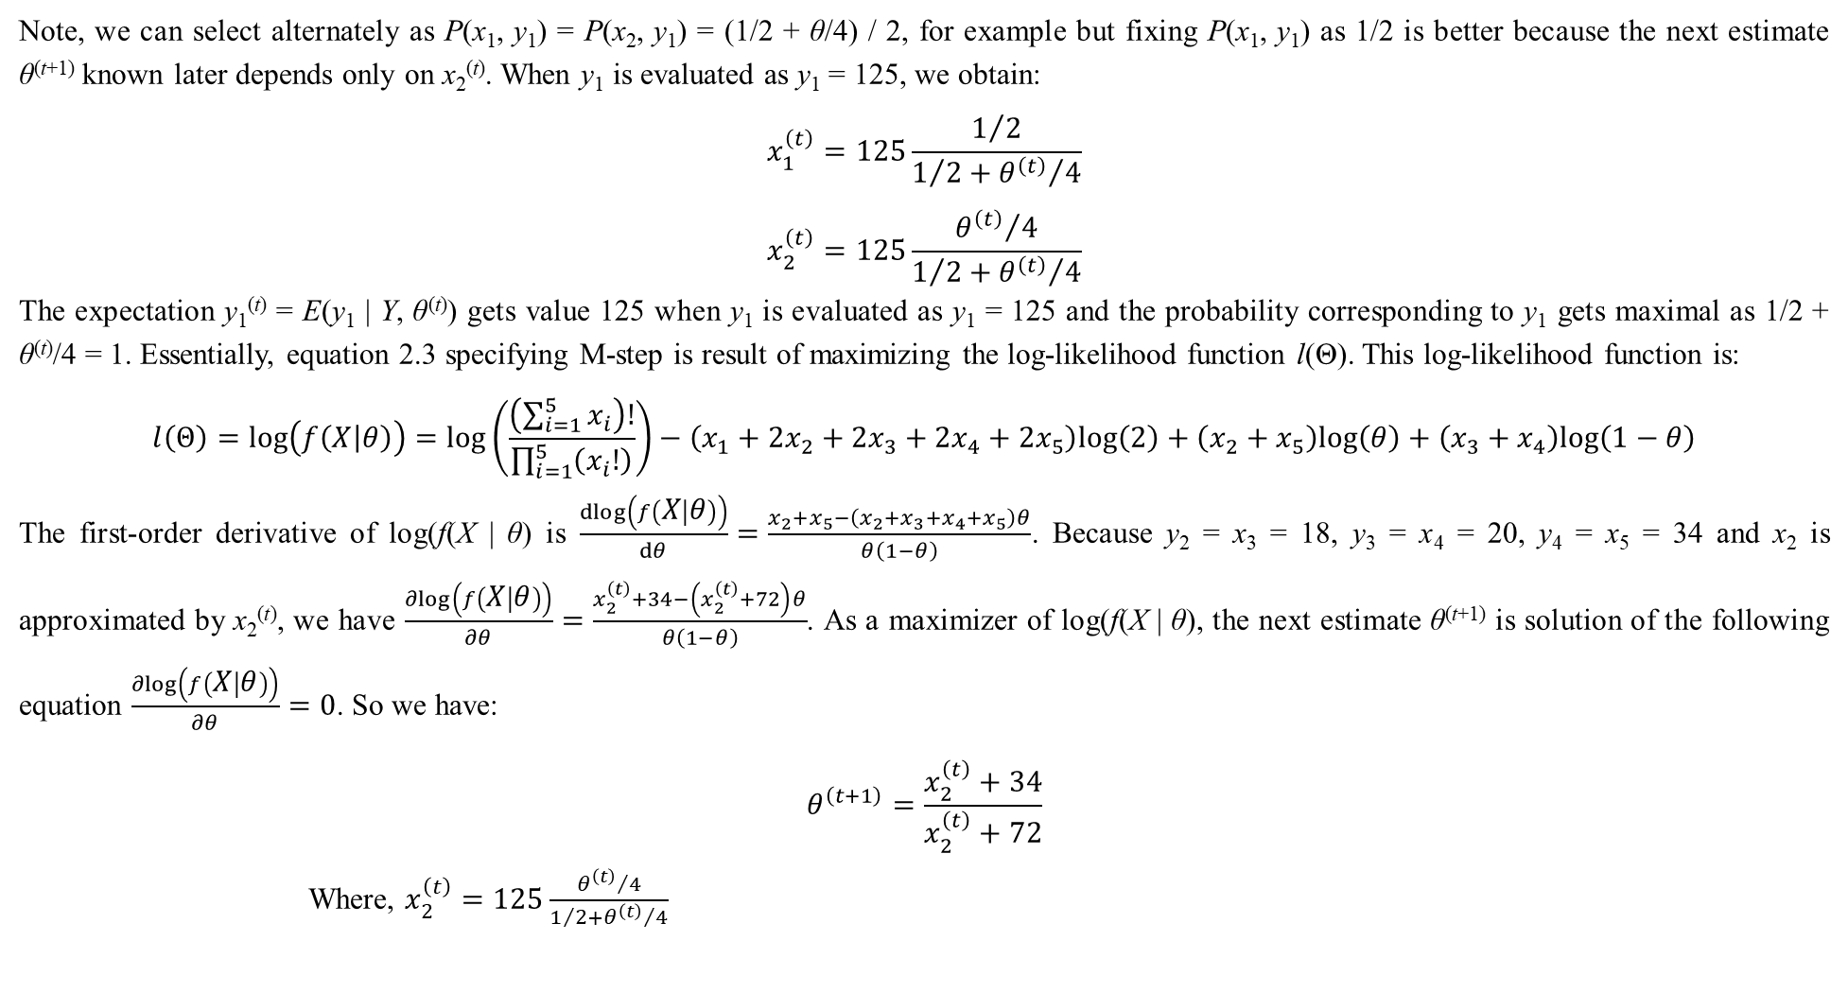
1. Traditional EM algorithm
Note, we can select alternately as P(x₁, y₁) = P(x₂, y₁) = (1/2 + θ/4) / 2, for example but fixing P(x₁, y₁) as 1/2 is better because the next estimate θ^{(t+1)} known later depends only on x₂^{(t)}. When y₁ is evaluated as y₁ = 125, we obtain:
$$x_{1}^{\left(t\right)}=125\frac{1/2}{1/2+{θ^{\left(t\right)}}/4}$$
$$x_{2}^{\left(t\right)}=125\frac{{θ^{\left(t\right)}}/4}{1/2+{θ^{\left(t\right)}}/4}$$
The expectation y₁^{(t)} = E(y₁ | Y, θ^{(t)}) gets value 125 when y₁ is evaluated as y₁ = 125 and the probability corresponding to y₁ gets maximal as 1/2 + θ^{(t)}/4 = 1. Essentially, equation 2.3 specifying M-step is result of maximizing the log-likelihood function l(Θ). This log-likelihood function is:
$$l\left(Θ\right)=log\left(f\left(X | θ\right)\right)=log\left(\frac{\left(\sum_{i=1}^{5}{x_{i}}\right)!}{\prod_{i=1}^{5}{\left(x_{i}!\right)}}\right)−\left(x_{1}+2x_{2}+2x_{3}+2x_{4}+2x_{5}\right)log\left(2\right)+\left(x_{2}+x_{5}\right)log\left(θ\right)+\left(x_{3}+x_{4}\right)log\left(1−θ\right)$$
The first-order derivative of log(f(X | θ) is $\frac{dlog\left(f\left(X | θ\right)\right)}{dθ}=\frac{x_{2}+x_{5}−\left(x_{2}+x_{3}+x_{4}+x_{5}\right)θ}{θ\left(1−θ\right)}$. Because y₂ = x₃ = 18, y₃ = x₄ = 20, y₄ = x₅ = 34 and x₂ is approximated by x₂^{(t)}, we have $\frac{∂log\left(f\left(X | θ\right)\right)}{∂θ}=\frac{x_{2}^{\left(t\right)}+34−\left(x_{2}^{\left(t\right)}+72\right)θ}{θ\left(1−θ\right)}$. As a maximizer of log(f(X | θ), the next estimate θ^{(t+1)} is solution of the following equation $\frac{∂log\left(f\left(X | θ\right)\right)}{∂θ}=0$. So we have:
$$θ^{\left(t+1\right)}=\frac{x_{2}^{\left(t\right)}+34}{x_{2}^{\left(t\right)}+72}$$
Where, $x_{2}^{\left(t\right)}=125\frac{{θ^{\left(t\right)}}/4}{1/2+{θ^{\left(t\right)}}/4}$

Slide 12
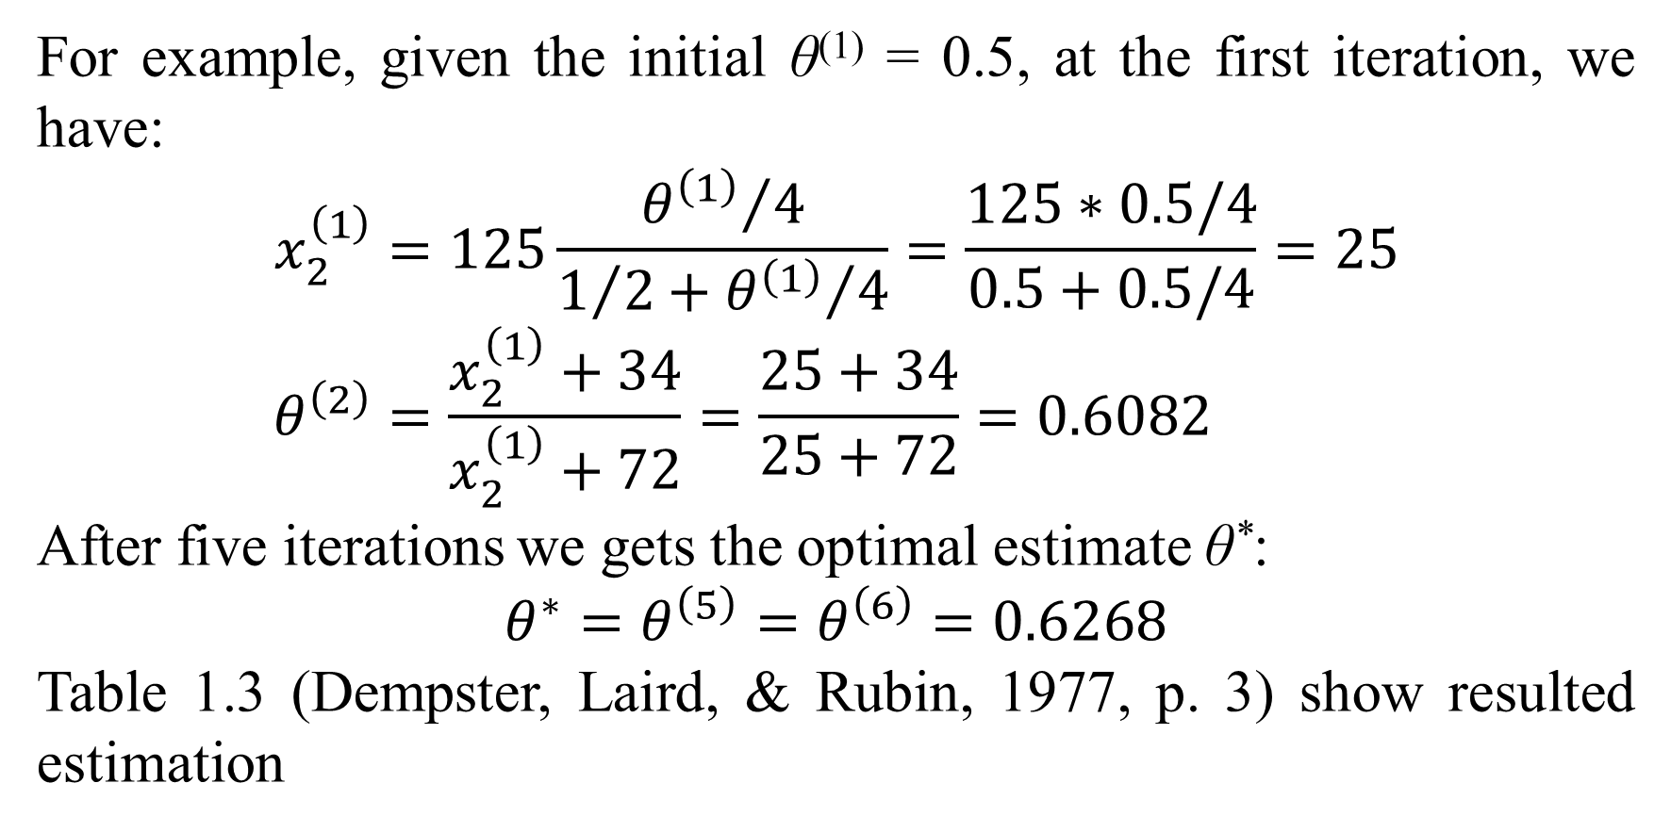
1. Traditional EM algorithm
For example, given the initial θ⁽¹⁾ = 0.5, at the first iteration, we have:
$$x_{2}^{\left(1\right)}=125\frac{{θ^{\left(1\right)}}/4}{1/2+{θ^{\left(1\right)}}/4}=\frac{125∗0.5/4}{0.5+0.5/4}=25 \\ θ^{\left(2\right)}=\frac{x_{2}^{\left(1\right)}+34}{x_{2}^{\left(1\right)}+72}=\frac{25+34}{25+72}=0.6082$$
After five iterations we gets the optimal estimate θ*:
$$θ^{∗}=θ^{\left(5\right)}=θ^{\left(6\right)}=0.6268$$
Table 1.3 (Dempster, Laird, & Rubin, 1977, p. 3) show resulted estimation

Slide 13
References

Slide 14
Thank you for attention

