Slide 1
Tutorial on EM algorithm – Part 2
Prof. Dr. Loc Nguyen, PhD, PostDoc
Founder of Loc Nguyen’s Academic Network, Vietnam
Email: ng_phloc@yahoo.com
Homepage: www.locnguyen.net

Slide 2
Abstract
This is the chapter 2 in my book “Tutorial on EM algorithm”, which focuses on essential description of EM algorithm.

Slide 3
Table of contents
This report focuses on EM description in detail.
Traditional EM algorithm
Practical EM algorithm

Slide 4
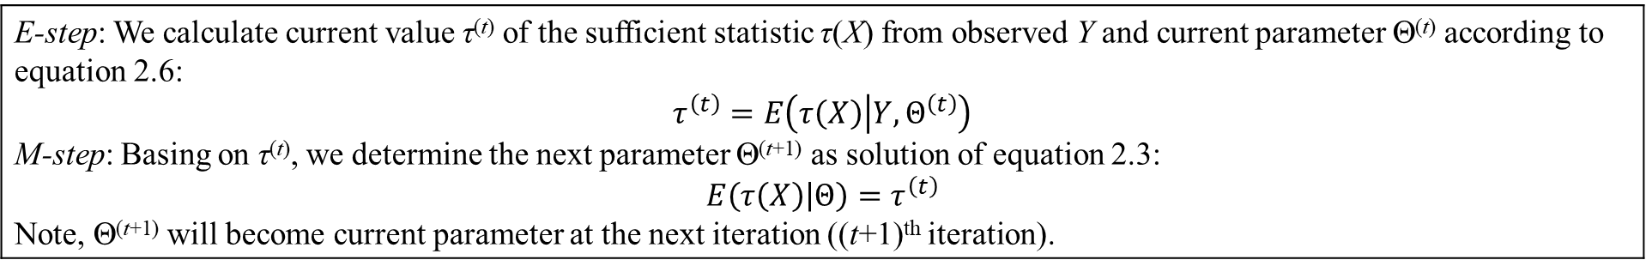
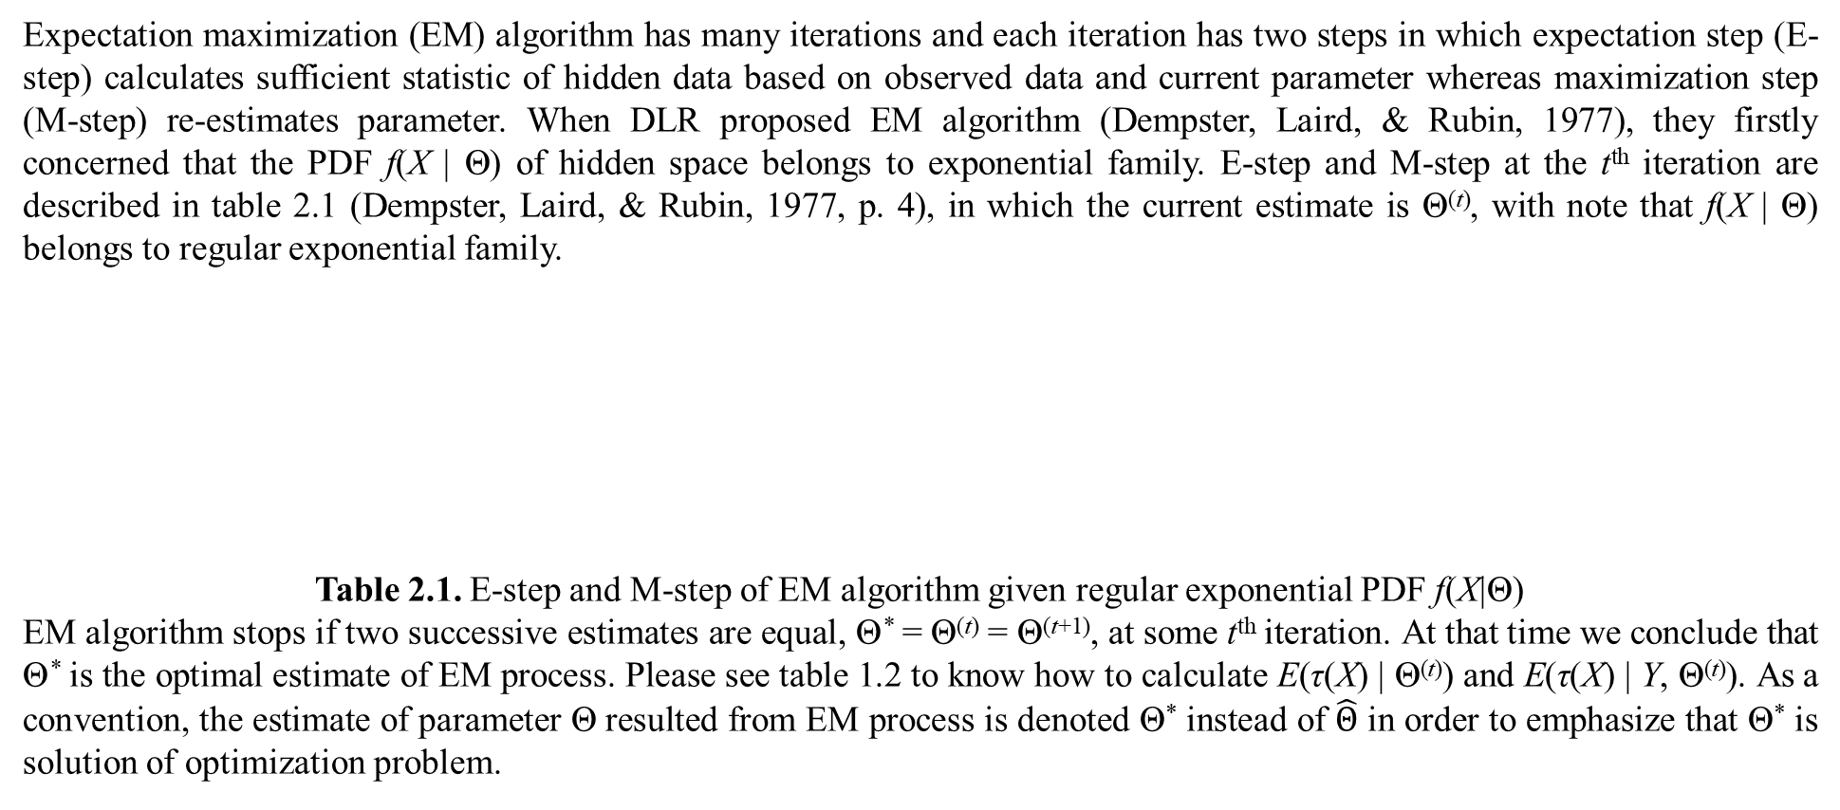
1. Traditional EM algorithm
Expectation maximization (EM) algorithm has many iterations and each iteration has two steps in which expectation step (E-step) calculates sufficient statistic of hidden data based on observed data and current parameter whereas maximization step (M-step) re-estimates parameter. When DLR proposed EM algorithm (Dempster, Laird, & Rubin, 1977), they firstly concerned that the PDF f(X | Θ) of hidden space belongs to exponential family. E-step and M-step at the t^{th} iteration are described in table 2.1 (Dempster, Laird, & Rubin, 1977, p. 4), in which the current estimate is Θ^{(t)}, with note that f(X | Θ) belongs to regular exponential family.
Table 2.1. E-step and M-step of EM algorithm given regular exponential PDF f(X|Θ)
EM algorithm stops if two successive estimates are equal, Θ* = Θ^{(t)} = Θ^{(t+1)}, at some t^{th} iteration. At that time we conclude that Θ* is the optimal estimate of EM process. Please see table 1.2 to know how to calculate E(τ(X) | Θ^{(t)}) and E(τ(X) | Y, Θ^{(t)}). As a convention, the estimate of parameter Θ resulted from EM process is denoted Θ* instead of $\hat{Θ}$ in order to emphasize that Θ* is solution of optimization problem.
E-step: We calculate current value τ^{(t)} of the sufficient statistic τ(X) from observed Y and current parameter Θ^{(t)} according to equation 2.6: $$τ^{\left(t\right)}=E\left(τ\left(X\right) | Y,Θ^{\left(t\right)}\right)$$ M-step: Basing on τ^{(t)}, we determine the next parameter Θ^{(t+1)} as solution of equation 2.3: $$E\left(τ\left(X\right) | Θ\right)=τ^{\left(t\right)}$$ Note, Θ^{(t+1)} will become current parameter at the next iteration ((t+1)^{th} iteration).

Slide 5
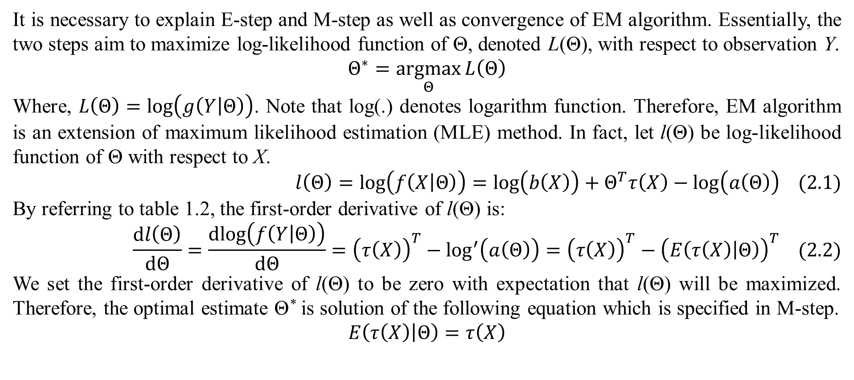
1. Traditional EM algorithm
It is necessary to explain E-step and M-step as well as convergence of EM algorithm. Essentially, the two steps aim to maximize log-likelihood function of Θ, denoted L(Θ), with respect to observation Y.
$$Θ^{∗}=\underset{Θ}{argmax}{L\left(Θ\right)}$$
Where, $L\left(Θ\right)=log\left(g\left(Y | Θ\right)\right)$. Note that log(.) denotes logarithm function. Therefore, EM algorithm is an extension of maximum likelihood estimation (MLE) method. In fact, let l(Θ) be log-likelihood function of Θ with respect to X.
$$l\left(Θ\right)=log\left(f\left(X | Θ\right)\right)=log\left(b\left(X\right)\right)+Θ^{T}τ\left(X\right)−log\left(a\left(Θ\right)\right) (2.1)$$
By referring to table 1.2, the first-order derivative of l(Θ) is:
$$\frac{dl\left(Θ\right)}{dΘ}=\frac{dlog\left(f\left(Y | Θ\right)\right)}{dΘ}={\left(τ\left(X\right)\right)}^{T}−\log^{′}\left(a\left(Θ\right)\right)={\left(τ\left(X\right)\right)}^{T}−{\left(E\left(τ\left(X\right) | Θ\right)\right)}^{T} (2.2)$$
We set the first-order derivative of l(Θ) to be zero with expectation that l(Θ) will be maximized. Therefore, the optimal estimate Θ* is solution of the following equation which is specified in M-step.
$$E\left(τ\left(X\right) | Θ\right)=τ\left(X\right)$$

Slide 6
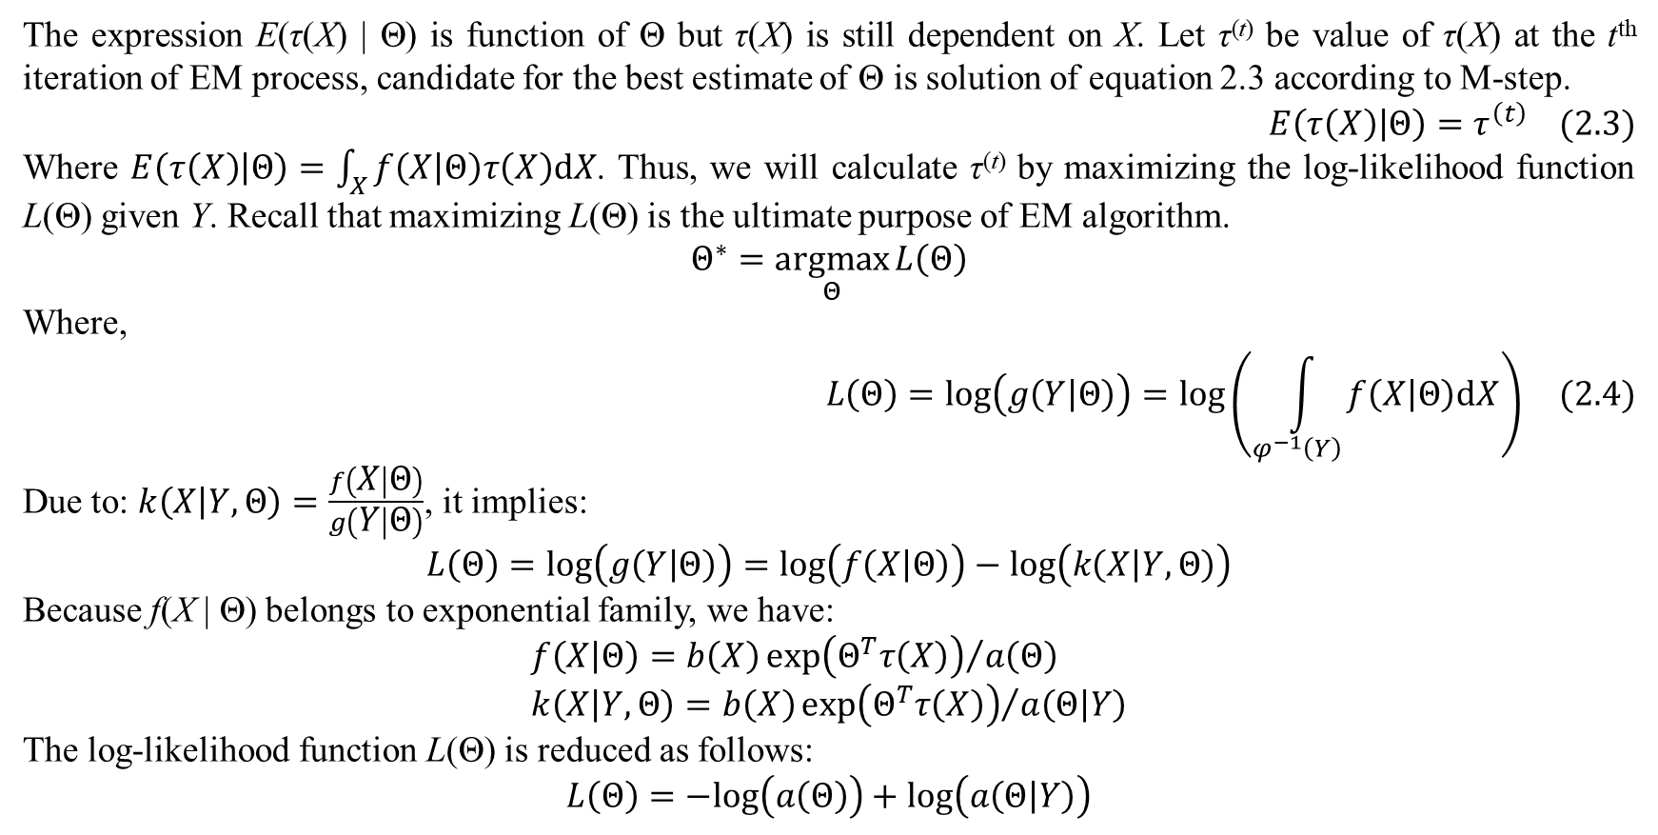
1. Traditional EM algorithm
The expression E(τ(X) | Θ) is function of Θ but τ(X) is still dependent on X. Let τ^{(t)} be value of τ(X) at the t^{th} iteration of EM process, candidate for the best estimate of Θ is solution of equation 2.3 according to M-step.
$$E\left(τ\left(X\right) | Θ\right)=τ^{\left(t\right)} (2.3)$$
Where $E\left(τ\left(X\right) | Θ\right)=\int_{X}{f\left(X | Θ\right)τ\left(X\right)dX}$. Thus, we will calculate τ^{(t)} by maximizing the log-likelihood function L(Θ) given Y. Recall that maximizing L(Θ) is the ultimate purpose of EM algorithm.
$$Θ^{∗}=\underset{Θ}{argmax}{L\left(Θ\right)}$$
Where,
$$L\left(Θ\right)=log\left(g\left(Y | Θ\right)\right)=log\left(\int_{φ^{−1}\left(Y\right)}{f\left(X | Θ\right)dX}\right) (2.4)$$
Due to: $k\left(X | Y,Θ\right)=\frac{f\left(X | Θ\right)}{g\left(Y | Θ\right)}$, it implies:
$$L\left(Θ\right)=log\left(g\left(Y | Θ\right)\right)=log\left(f\left(X | Θ\right)\right)−log\left(k\left(X | Y,Θ\right)\right)$$
Because f(X | Θ) belongs to exponential family, we have:
$$f\left(X | Θ\right)=b\left(X\right){exp\left(Θ^{T}τ\left(X\right)\right)}/{a\left(Θ\right)} \\ k\left(X | Y,Θ\right)=b\left(X\right){exp\left(Θ^{T}τ\left(X\right)\right)}/{a\left(Θ | Y\right)}$$
The log-likelihood function L(Θ) is reduced as follows:
$$L\left(Θ\right)=−log\left(a\left(Θ\right)\right)+log\left(a\left(Θ | Y\right)\right)$$

Slide 7
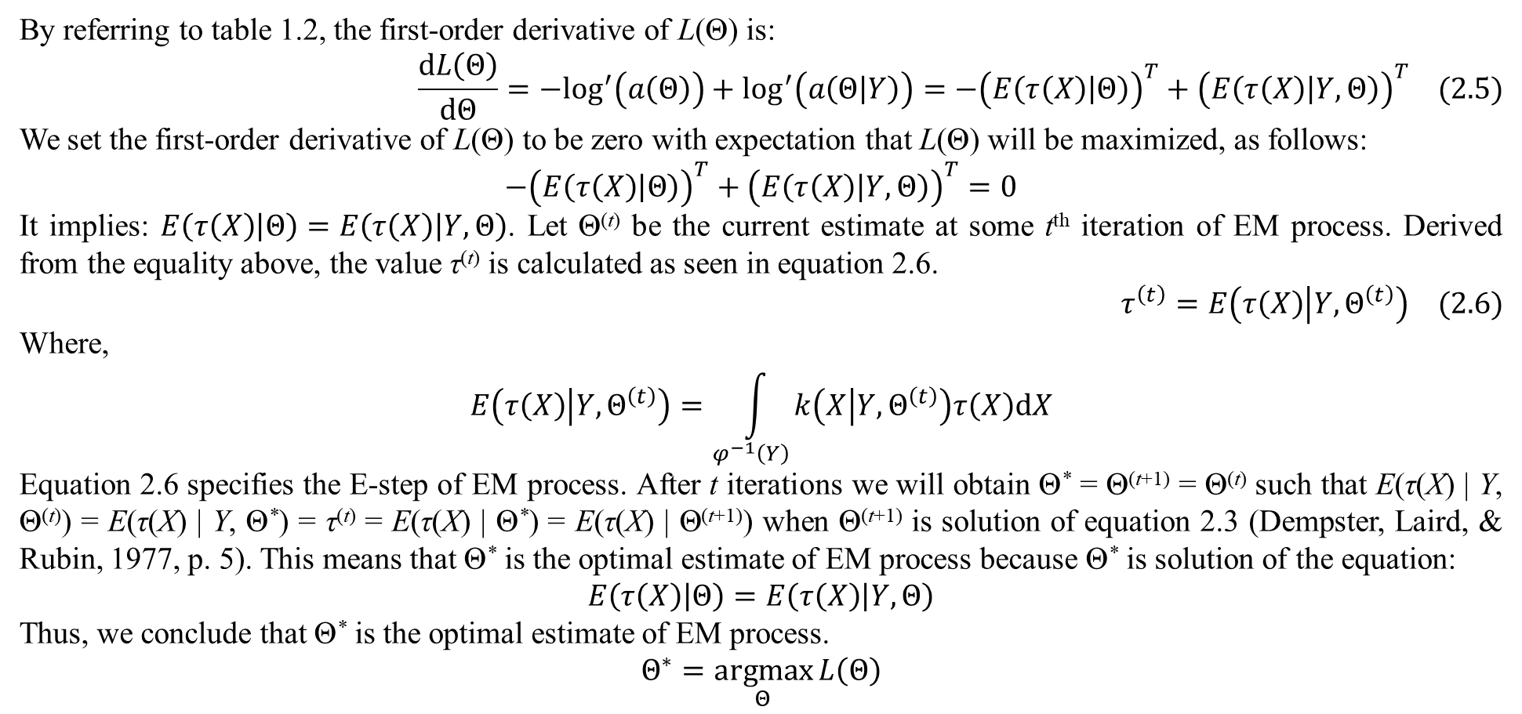
1. Traditional EM algorithm
By referring to table 1.2, the first-order derivative of L(Θ) is:
$$\frac{dL\left(Θ\right)}{dΘ}=−\log^{′}\left(a\left(Θ\right)\right)+\log^{′}\left(a\left(Θ | Y\right)\right)=−{\left(E\left(τ\left(X\right) | Θ\right)\right)}^{T}+{\left(E\left(τ\left(X\right) | Y,Θ\right)\right)}^{T} (2.5)$$
We set the first-order derivative of L(Θ) to be zero with expectation that L(Θ) will be maximized, as follows:
$$−{\left(E\left(τ\left(X\right) | Θ\right)\right)}^{T}+{\left(E\left(τ\left(X\right) | Y,Θ\right)\right)}^{T}=0$$
It implies: $E\left(τ\left(X\right) | Θ\right)=E\left(τ\left(X\right) | Y,Θ\right)$. Let Θ^{(t)} be the current estimate at some t^{th} iteration of EM process. Derived from the equality above, the value τ^{(t)} is calculated as seen in equation 2.6.
$$τ^{\left(t\right)}=E\left(τ\left(X\right) | Y,Θ^{\left(t\right)}\right) (2.6)$$
Where,
$$E\left(τ\left(X\right) | Y,Θ^{\left(t\right)}\right)=\int_{φ^{−1}\left(Y\right)}{k\left(X | Y,Θ^{\left(t\right)}\right)τ\left(X\right)dX}$$
Equation 2.6 specifies the E-step of EM process. After t iterations we will obtain Θ* = Θ^{(t+1)} = Θ^{(t)} such that E(τ(X) | Y, Θ^{(t)}) = E(τ(X) | Y, Θ*) = τ^{(t)} = E(τ(X) | Θ*) = E(τ(X) | Θ^{(t+1)}) when Θ^{(t+1)} is solution of equation 2.3 (Dempster, Laird, & Rubin, 1977, p. 5). This means that Θ* is the optimal estimate of EM process because Θ* is solution of the equation:
$$E\left(τ\left(X\right) | Θ\right)=E\left(τ\left(X\right) | Y,Θ\right)$$
Thus, we conclude that Θ* is the optimal estimate of EM process.
$$Θ^{∗}=\underset{Θ}{argmax}{L\left(Θ\right)}$$

Slide 8
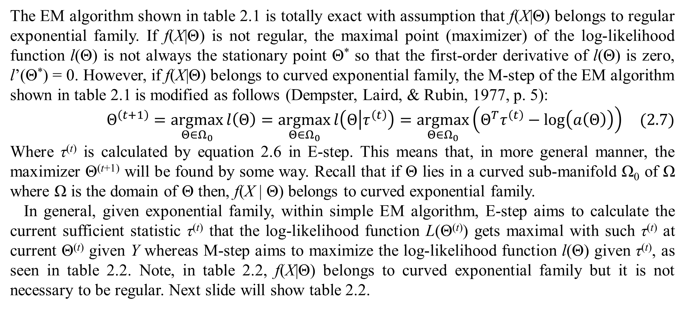
1. Traditional EM algorithm
The EM algorithm shown in table 2.1 is totally exact with assumption that f(X|Θ) belongs to regular exponential family. If f(X|Θ) is not regular, the maximal point (maximizer) of the log-likelihood function l(Θ) is not always the stationary point Θ* so that the first-order derivative of l(Θ) is zero, l’(Θ*) = 0. However, if f(X|Θ) belongs to curved exponential family, the M-step of the EM algorithm shown in table 2.1 is modified as follows (Dempster, Laird, & Rubin, 1977, p. 5):
$$Θ^{\left(t+1\right)}=\underset{Θ∈Ω_{0}}{argmax}{l\left(Θ\right)}=\underset{Θ∈Ω_{0}}{argmax}{l\left(Θ | τ^{\left(t\right)}\right)}=\underset{Θ∈Ω_{0}}{argmax}\left(Θ^{T}τ^{\left(t\right)}−log\left(a\left(Θ\right)\right)\right) (2.7)$$
Where τ^{(t)} is calculated by equation 2.6 in E-step. This means that, in more general manner, the maximizer Θ^{(t+1)} will be found by some way. Recall that if Θ lies in a curved sub-manifold Ω₀ of Ω where Ω is the domain of Θ then, f(X | Θ) belongs to curved exponential family.
In general, given exponential family, within simple EM algorithm, E-step aims to calculate the current sufficient statistic τ^{(t)} that the log-likelihood function L(Θ^{(t)}) gets maximal with such τ^{(t)} at current Θ^{(t)} given Y whereas M-step aims to maximize the log-likelihood function l(Θ) given τ^{(t)}, as seen in table 2.2. Note, in table 2.2, f(X|Θ) belongs to curved exponential family but it is not necessary to be regular. Next slide will show table 2.2.

Slide 9
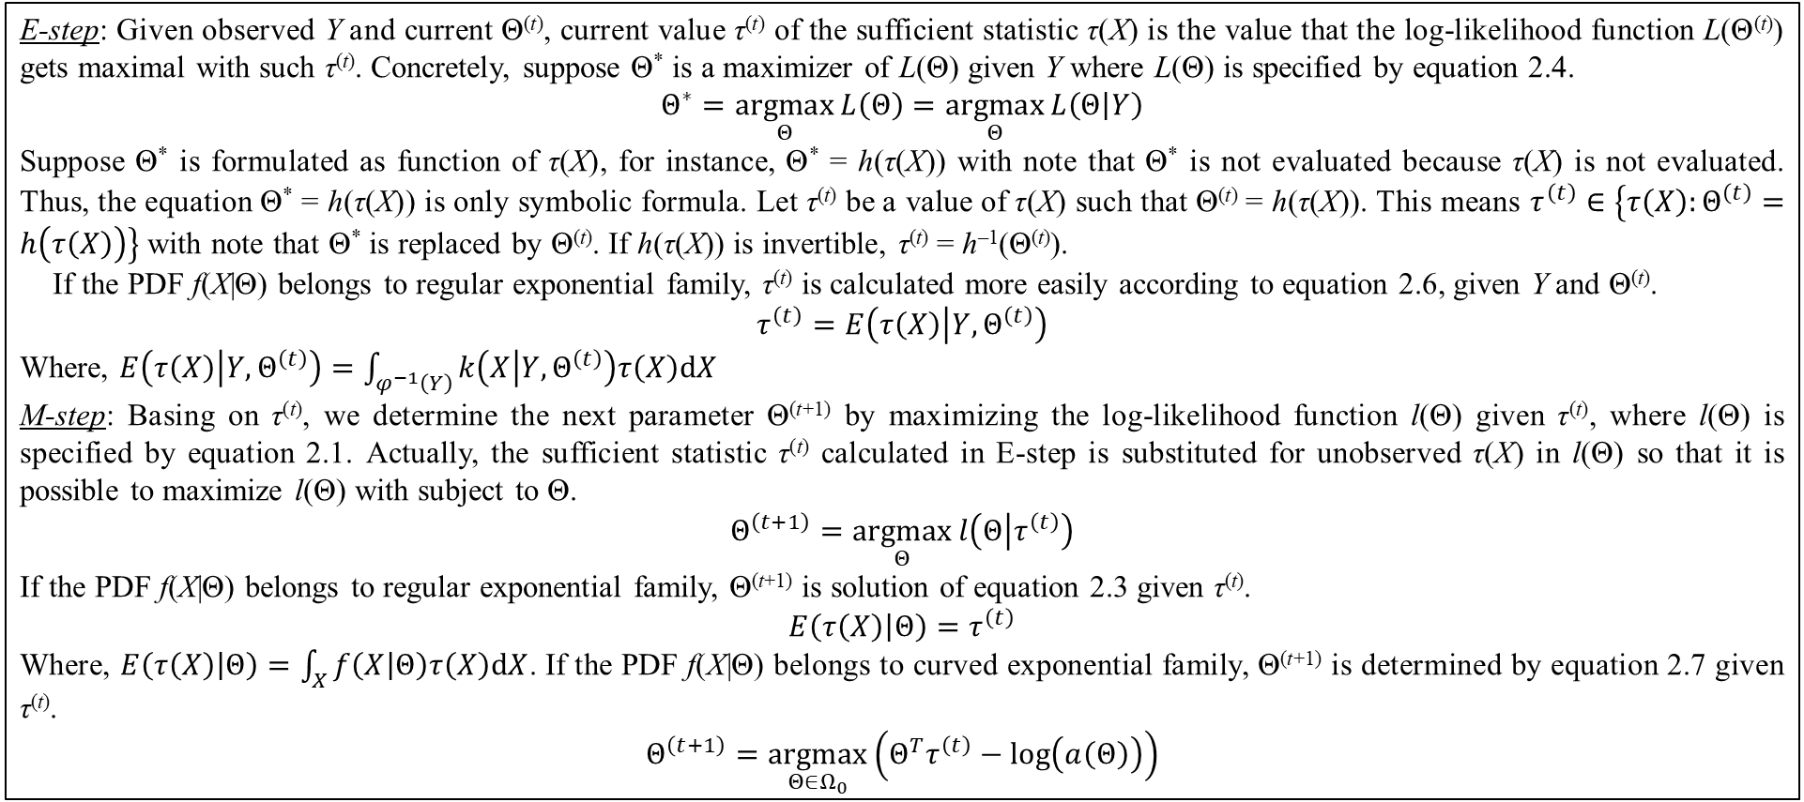
1. Traditional EM algorithm
E-step: Given observed Y and current Θ^{(t)}, current value τ^{(t)} of the sufficient statistic τ(X) is the value that the log-likelihood function L(Θ^{(t)}) gets maximal with such τ^{(t)}. Concretely, suppose Θ* is a maximizer of L(Θ) given Y where L(Θ) is specified by equation 2.4.
$$Θ^{∗}=\underset{Θ}{argmax}{L\left(Θ\right)}=\underset{Θ}{argmax}{L\left(Θ | Y\right)}$$
Suppose Θ* is formulated as function of τ(X), for instance, Θ* = h(τ(X)) with note that Θ* is not evaluated because τ(X) is not evaluated. Thus, the equation Θ* = h(τ(X)) is only symbolic formula. Let τ^{(t)} be a value of τ(X) such that Θ^{(t)} = h(τ(X)). This means $τ^{\left(t\right)}∈\left\{τ\left(X\right):Θ^{\left(t\right)}=h\left(τ\left(X\right)\right)\right\}$ with note that Θ* is replaced by Θ^{(t)}. If h(τ(X)) is invertible, τ^{(t)} = h^{–1}(Θ^{(t)}).
If the PDF f(X|Θ) belongs to regular exponential family, τ^{(t)} is calculated more easily according to equation 2.6, given Y and Θ^{(t)}.
$$τ^{\left(t\right)}=E\left(τ\left(X\right) | Y,Θ^{\left(t\right)}\right)$$
Where, $E\left(τ\left(X\right) | Y,Θ^{\left(t\right)}\right)=\int_{φ^{−1}\left(Y\right)}{k\left(X | Y,Θ^{\left(t\right)}\right)τ\left(X\right)dX}$
M-step: Basing on τ^{(t)}, we determine the next parameter Θ^{(t+1)} by maximizing the log-likelihood function l(Θ) given τ^{(t)}, where l(Θ) is specified by equation 2.1. Actually, the sufficient statistic τ^{(t)} calculated in E-step is substituted for unobserved τ(X) in l(Θ) so that it is possible to maximize l(Θ) with subject to Θ.
$$Θ^{\left(t+1\right)}=\underset{Θ}{argmax}{l\left(Θ | τ^{\left(t\right)}\right)}$$
If the PDF f(X|Θ) belongs to regular exponential family, Θ^{(t+1)} is solution of equation 2.3 given τ^{(t)}.
$$E\left(τ\left(X\right) | Θ\right)=τ^{\left(t\right)}$$
Where, $E\left(τ\left(X\right) | Θ\right)=\int_{X}{f\left(X | Θ\right)τ\left(X\right)dX}$. If the PDF f(X|Θ) belongs to curved exponential family, Θ^{(t+1)} is determined by equation 2.7 given τ^{(t)}.
$$Θ^{\left(t+1\right)}=\underset{Θ∈Ω_{0}}{argmax}\left(Θ^{T}τ^{\left(t\right)}−log\left(a\left(Θ\right)\right)\right)$$
Table 2.2. E-step and M-step of EM algorithm given exponential PDF f(X|Θ)

Slide 10
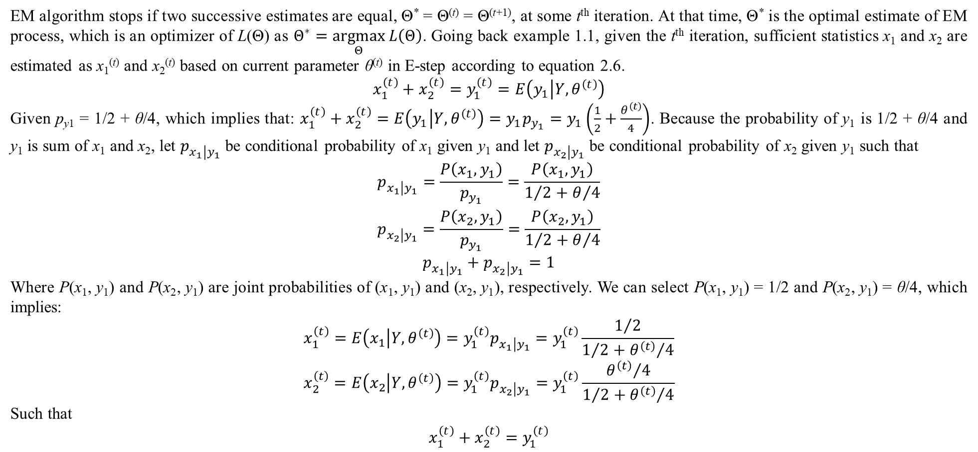
1. Traditional EM algorithm
EM algorithm stops if two successive estimates are equal, Θ* = Θ^{(t)} = Θ^{(t+1)}, at some t^{th} iteration. At that time, Θ* is the optimal estimate of EM process, which is an optimizer of L(Θ) as $Θ^{∗}=\underset{Θ}{argmax}{L\left(Θ\right)}$. Going back example 1.1, given the t^{th} iteration, sufficient statistics x₁ and x₂ are estimated as x₁^{(t)} and x₂^{(t)} based on current parameter θ^{(t)} in E-step according to equation 2.6.
$$x_{1}^{\left(t\right)}+x_{2}^{\left(t\right)}=y_{1}^{\left(t\right)}=E\left(y_{1} | Y,θ^{\left(t\right)}\right)$$
Given p_{y1} = 1/2 + θ/4, which implies that: $x_{1}^{\left(t\right)}+x_{2}^{\left(t\right)}=E\left(y_{1} | Y,θ^{\left(t\right)}\right)=y_{1}p_{y_{1}}=y_{1}\left(\frac{1}{2}+\frac{θ^{\left(t\right)}}{4}\right)$. Because the probability of y₁ is 1/2 + θ/4 and y₁ is sum of x₁ and x₂, let $p_{x_{1}\left|y_{1}\right.}$ be conditional probability of x₁ given y₁ and let $p_{x_{2}\left|y_{1}\right.}$ be conditional probability of x₂ given y₁ such that
$$\begin{matrix}p_{x_{1}\left|y_{1}\right.}=\frac{P\left(x_{1},y_{1}\right)}{p_{y_{1}}}=\frac{P\left(x_{1},y_{1}\right)}{1/2+θ/4} \\ p_{x_{2}\left|y_{1}\right.}=\frac{P\left(x_{2},y_{1}\right)}{p_{y_{1}}}=\frac{P\left(x_{2},y_{1}\right)}{1/2+θ/4} \\ p_{x_{1}\left|y_{1}\right.}+p_{x_{2}\left|y_{1}\right.}=1\end{matrix}$$
Where P(x₁, y₁) and P(x₂, y₁) are joint probabilities of (x₁, y₁) and (x₂, y₁), respectively. We can select P(x₁, y₁) = 1/2 and P(x₂, y₁) = θ/4, which implies:
$$x_{1}^{\left(t\right)}=E\left(x_{1} | Y,θ^{\left(t\right)}\right)=y_{1}^{\left(t\right)}p_{x_{1}\left|y_{1}\right.}=y_{1}^{\left(t\right)}\frac{1/2}{1/2+{θ^{\left(t\right)}}/4}$$
$$x_{2}^{\left(t\right)}=E\left(x_{2} | Y,θ^{\left(t\right)}\right)=y_{1}^{\left(t\right)}p_{x_{2}\left|y_{1}\right.}=y_{1}^{\left(t\right)}\frac{{θ^{\left(t\right)}}/4}{1/2+{θ^{\left(t\right)}}/4}$$
Such that
$$x_{1}^{\left(t\right)}+x_{2}^{\left(t\right)}=y_{1}^{\left(t\right)}$$

Slide 11
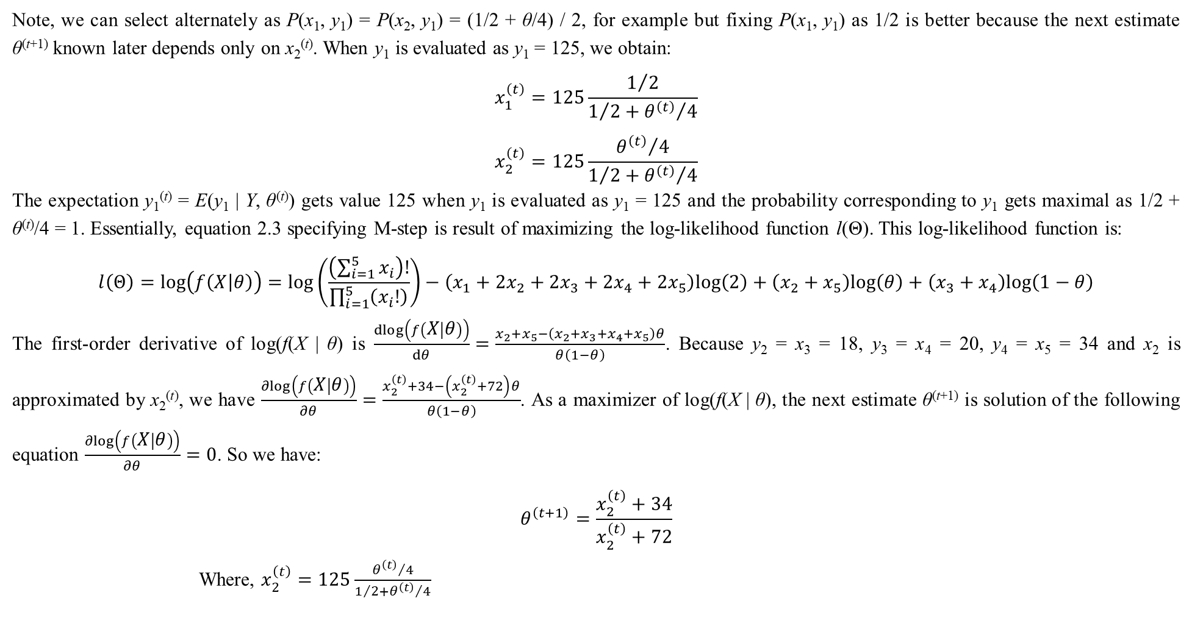
1. Traditional EM algorithm
Note, we can select alternately as P(x₁, y₁) = P(x₂, y₁) = (1/2 + θ/4) / 2, for example but fixing P(x₁, y₁) as 1/2 is better because the next estimate θ^{(t+1)} known later depends only on x₂^{(t)}. When y₁ is evaluated as y₁ = 125, we obtain:
$$x_{1}^{\left(t\right)}=125\frac{1/2}{1/2+{θ^{\left(t\right)}}/4}$$
$$x_{2}^{\left(t\right)}=125\frac{{θ^{\left(t\right)}}/4}{1/2+{θ^{\left(t\right)}}/4}$$
The expectation y₁^{(t)} = E(y₁ | Y, θ^{(t)}) gets value 125 when y₁ is evaluated as y₁ = 125 and the probability corresponding to y₁ gets maximal as 1/2 + θ^{(t)}/4 = 1. Essentially, equation 2.3 specifying M-step is result of maximizing the log-likelihood function l(Θ). This log-likelihood function is:
$$l\left(Θ\right)=log\left(f\left(X | θ\right)\right)=log\left(\frac{\left(\sum_{i=1}^{5}{x_{i}}\right)!}{\prod_{i=1}^{5}{\left(x_{i}!\right)}}\right)−\left(x_{1}+2x_{2}+2x_{3}+2x_{4}+2x_{5}\right)log\left(2\right)+\left(x_{2}+x_{5}\right)log\left(θ\right)+\left(x_{3}+x_{4}\right)log\left(1−θ\right)$$
The first-order derivative of log(f(X | θ) is $\frac{dlog\left(f\left(X | θ\right)\right)}{dθ}=\frac{x_{2}+x_{5}−\left(x_{2}+x_{3}+x_{4}+x_{5}\right)θ}{θ\left(1−θ\right)}$. Because y₂ = x₃ = 18, y₃ = x₄ = 20, y₄ = x₅ = 34 and x₂ is approximated by x₂^{(t)}, we have $\frac{∂log\left(f\left(X | θ\right)\right)}{∂θ}=\frac{x_{2}^{\left(t\right)}+34−\left(x_{2}^{\left(t\right)}+72\right)θ}{θ\left(1−θ\right)}$. As a maximizer of log(f(X | θ), the next estimate θ^{(t+1)} is solution of the following equation $\frac{∂log\left(f\left(X | θ\right)\right)}{∂θ}=0$. So we have:
$$θ^{\left(t+1\right)}=\frac{x_{2}^{\left(t\right)}+34}{x_{2}^{\left(t\right)}+72}$$
Where, $x_{2}^{\left(t\right)}=125\frac{{θ^{\left(t\right)}}/4}{1/2+{θ^{\left(t\right)}}/4}$

Slide 12
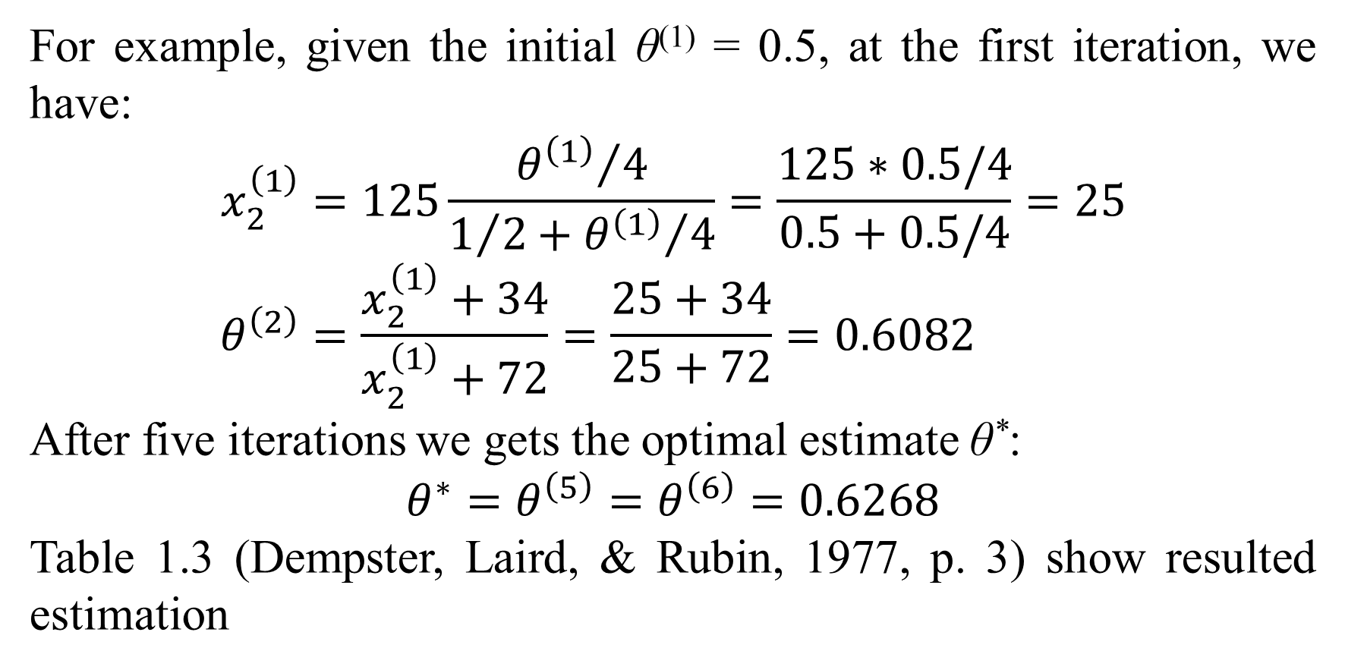
1. Traditional EM algorithm
For example, given the initial θ⁽¹⁾ = 0.5, at the first iteration, we have:
$$x_{2}^{\left(1\right)}=125\frac{{θ^{\left(1\right)}}/4}{1/2+{θ^{\left(1\right)}}/4}=\frac{125∗0.5/4}{0.5+0.5/4}=25 \\ θ^{\left(2\right)}=\frac{x_{2}^{\left(1\right)}+34}{x_{2}^{\left(1\right)}+72}=\frac{25+34}{25+72}=0.6082$$
After five iterations we gets the optimal estimate θ*:
$$θ^{∗}=θ^{\left(5\right)}=θ^{\left(6\right)}=0.6268$$
Table 1.3 (Dempster, Laird, & Rubin, 1977, p. 3) show resulted estimation

Slide 13
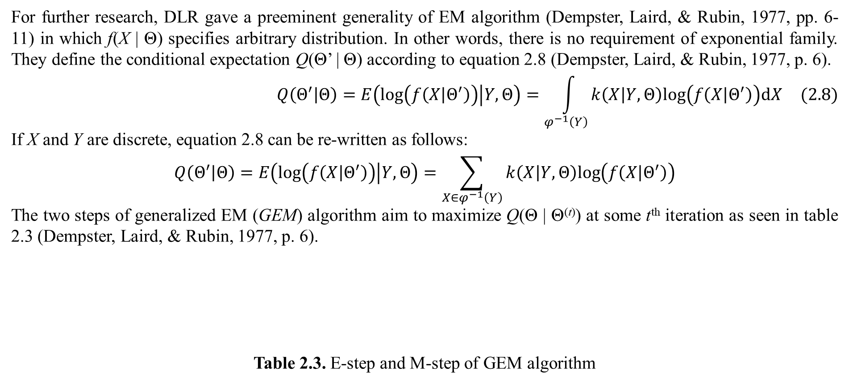
1. Traditional EM algorithm
For further research, DLR gave a preeminent generality of EM algorithm (Dempster, Laird, & Rubin, 1977, pp. 6-11) in which f(X | Θ) specifies arbitrary distribution. In other words, there is no requirement of exponential family. They define the conditional expectation Q(Θ’ | Θ) according to equation 2.8 (Dempster, Laird, & Rubin, 1977, p. 6).
$$Q\left(Θ^{′} | Θ\right)=E\left(log\left(f\left(X | Θ^{′}\right)\right) | Y,Θ\right)=\int_{φ^{−1}\left(Y\right)}{k\left(X | Y,Θ\right)log\left(f\left(X | Θ^{′}\right)\right)dX} (2.8)$$
If X and Y are discrete, equation 2.8 can be re-written as follows:
$$Q\left(Θ^{′} | Θ\right)=E\left(log\left(f\left(X | Θ^{′}\right)\right) | Y,Θ\right)=\sum_{X∈φ^{−1}\left(Y\right)}{k\left(X | Y,Θ\right)log\left(f\left(X | Θ^{′}\right)\right)}$$
The two steps of generalized EM (GEM) algorithm aim to maximize Q(Θ | Θ^{(t)}) at some t^{th} iteration as seen in table 2.3 (Dempster, Laird, & Rubin, 1977, p. 6).
Table 2.3. E-step and M-step of GEM algorithm
E-step: The expectation Q(Θ | Θ^{(t)}) is determined based on current parameter Θ^{(t)}, according to equation 2.8. Actually, Q(Θ | Θ^{(t)}) is formulated as function of Θ. M-step: The next parameter Θ^{(t+1)} is a maximizer of Q(Θ | Θ^{(t)}) with subject to Θ. Note that Θ^{(t+1)} will become current parameter at the next iteration (the (t+1)^{th} iteration).

Slide 14
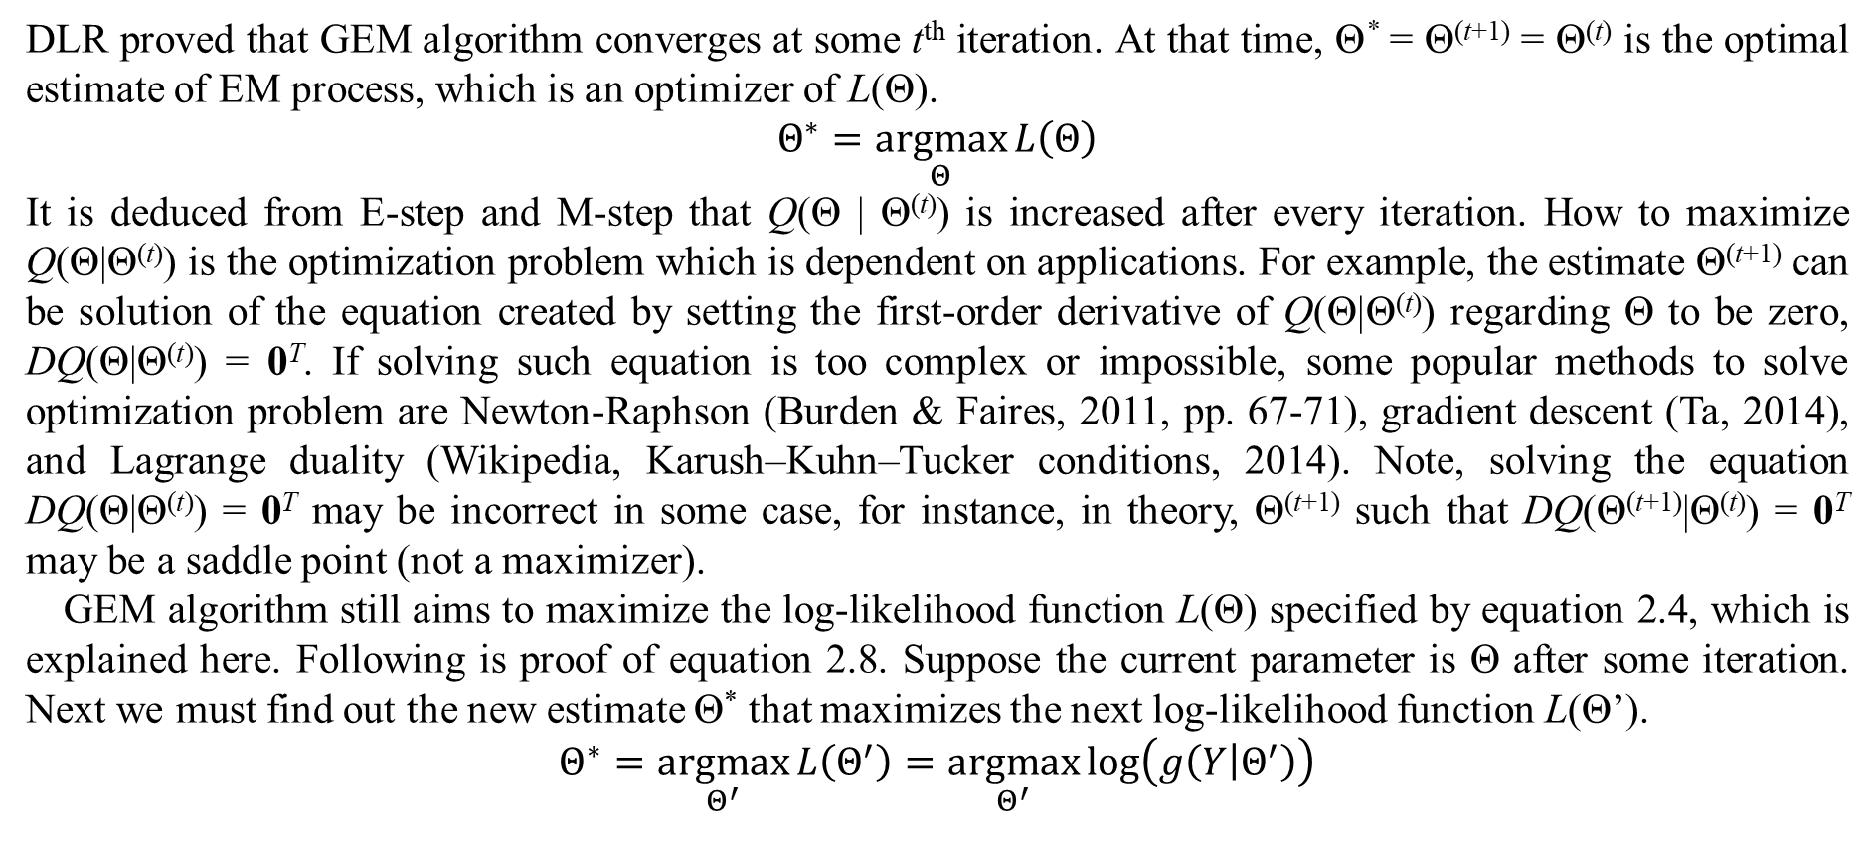
1. Traditional EM algorithm
DLR proved that GEM algorithm converges at some t^{th} iteration. At that time, Θ* = Θ^{(t+1)} = Θ^{(t)} is the optimal estimate of EM process, which is an optimizer of L(Θ).
$$Θ^{∗}=\underset{Θ}{argmax}{L\left(Θ\right)}$$
It is deduced from E-step and M-step that Q(Θ | Θ^{(t)}) is increased after every iteration. How to maximize Q(Θ|Θ^{(t)}) is the optimization problem which is dependent on applications. For example, the estimate Θ^{(t+1)} can be solution of the equation created by setting the first-order derivative of Q(Θ|Θ^{(t)}) regarding Θ to be zero, DQ(Θ|Θ^{(t)}) = 0^{T}. If solving such equation is too complex or impossible, some popular methods to solve optimization problem are Newton-Raphson (Burden & Faires, 2011, pp. 67-71), gradient descent (Ta, 2014), and Lagrange duality (Wikipedia, Karush–Kuhn–Tucker conditions, 2014). Note, solving the equation DQ(Θ|Θ^{(t)}) = 0^{T} may be incorrect in some case, for instance, in theory, Θ^{(t+1)} such that DQ(Θ^{(t+1)}|Θ^{(t)}) = 0^{T} may be a saddle point (not a maximizer).
GEM algorithm still aims to maximize the log-likelihood function L(Θ) specified by equation 2.4, which is explained here. Following is proof of equation 2.8. Suppose the current parameter is Θ after some iteration. Next we must find out the new estimate Θ* that maximizes the next log-likelihood function L(Θ’).
$$Θ^{∗}=\underset{Θ^{′}}{argmax}{L\left(Θ^{′}\right)}=\underset{Θ^{′}}{argmax}{log\left(g\left(Y | Θ^{′}\right)\right)}$$

Slide 15
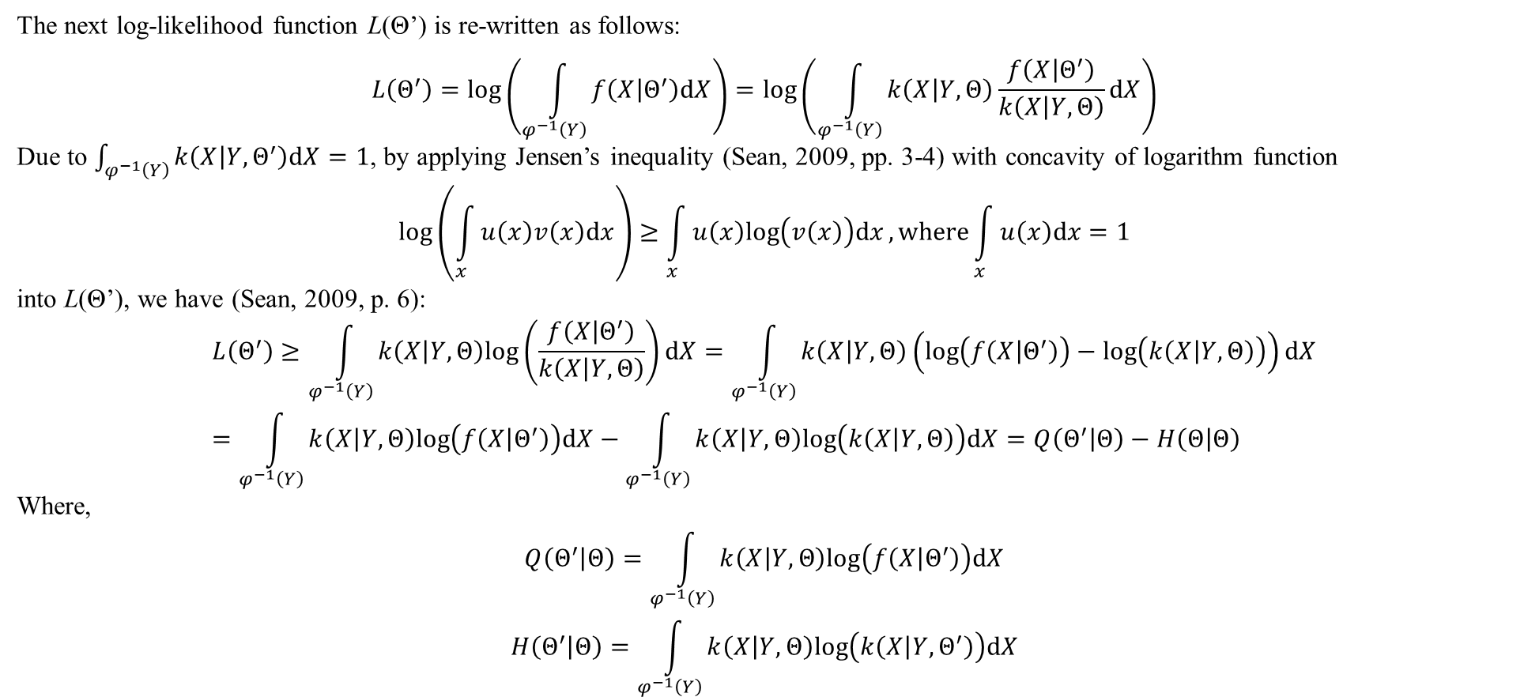
1. Traditional EM algorithm
The next log-likelihood function L(Θ’) is re-written as follows:
$$L\left(Θ^{′}\right)=log\left(\int_{φ^{−1}\left(Y\right)}{f\left(X | Θ^{′}\right)dX}\right)=log\left(\int_{φ^{−1}\left(Y\right)}{k\left(X | Y,Θ\right)\frac{f\left(X | Θ^{′}\right)}{k\left(X | Y,Θ\right)}dX}\right)$$
Due to $\int_{φ^{−1}\left(Y\right)}{k\left(X | Y,Θ^{′}\right)dX}=1$, by applying Jensen’s inequality (Sean, 2009, pp. 3-4) with concavity of logarithm function
$$log\left(\int_{x}{u\left(x\right)v\left(x\right)dx}\right)≥\int_{x}{u\left(x\right)log\left(v\left(x\right)\right)dx}, where\int_{x}{u\left(x\right)dx}=1$$
into L(Θ’), we have (Sean, 2009, p. 6):
$$L\left(Θ^{′}\right)≥\int_{φ^{−1}\left(Y\right)}{k\left(X | Y,Θ\right)log\left(\frac{f\left(X | Θ^{′}\right)}{k\left(X | Y,Θ\right)}\right)dX}=\int_{φ^{−1}\left(Y\right)}{k\left(X | Y,Θ\right)\left(log\left(f\left(X | Θ^{′}\right)\right)−log\left(k\left(X | Y,Θ\right)\right)\right)dX}=\int_{φ^{−1}\left(Y\right)}{k\left(X | Y,Θ\right)log\left(f\left(X | Θ^{′}\right)\right)dX}−\int_{φ^{−1}\left(Y\right)}{k\left(X | Y,Θ\right)log\left(k\left(X | Y,Θ\right)\right)dX}=Q\left(Θ^{′} | Θ\right)−H\left(Θ | Θ\right)$$
Where,
$$Q\left(Θ^{′} | Θ\right)=\int_{φ^{−1}\left(Y\right)}{k\left(X | Y,Θ\right)log\left(f\left(X | Θ^{′}\right)\right)dX}$$
$$H\left(Θ^{′} | Θ\right)=\int_{φ^{−1}\left(Y\right)}{k\left(X | Y,Θ\right)log\left(k\left(X | Y,Θ^{′}\right)\right)dX}$$

Slide 16
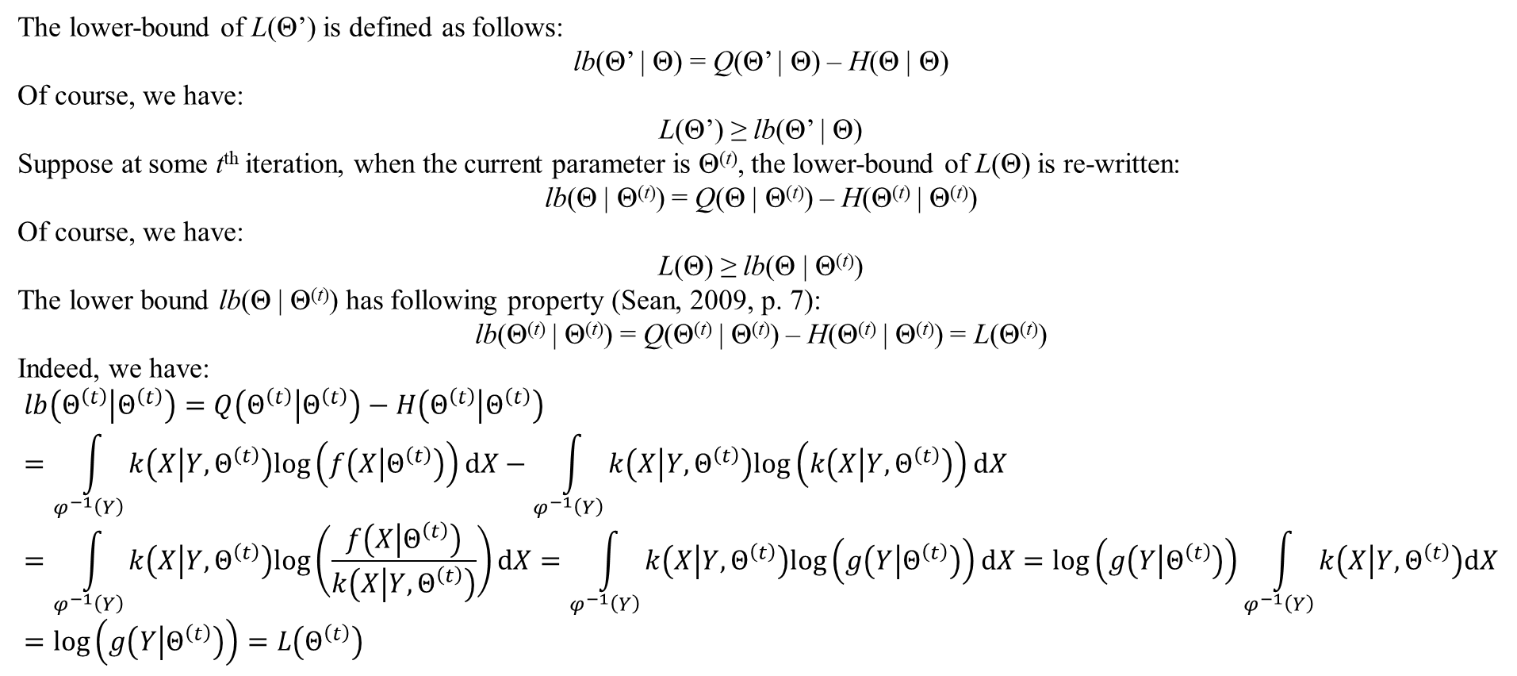
1. Traditional EM algorithm
The lower-bound of L(Θ’) is defined as follows:
lb(Θ’ | Θ) = Q(Θ’ | Θ) – H(Θ | Θ)
Of course, we have:
L(Θ’) ≥ lb(Θ’ | Θ)
Suppose at some t^{th} iteration, when the current parameter is Θ^{(t)}, the lower-bound of L(Θ) is re-written:
lb(Θ | Θ^{(t)}) = Q(Θ | Θ^{(t)}) – H(Θ^{(t)} | Θ^{(t)})
Of course, we have:
L(Θ) ≥ lb(Θ | Θ^{(t)})
The lower bound lb(Θ | Θ^{(t)}) has following property (Sean, 2009, p. 7):
lb(Θ^{(t)} | Θ^{(t)}) = Q(Θ^{(t)} | Θ^{(t)}) – H(Θ^{(t)} | Θ^{(t)}) = L(Θ^{(t)})
Indeed, we have:
$$lb\left(Θ^{\left(t\right)} | Θ^{\left(t\right)}\right)=Q\left(Θ^{\left(t\right)} | Θ^{\left(t\right)}\right)−H\left(Θ^{\left(t\right)} | Θ^{\left(t\right)}\right)=\int_{φ^{−1}\left(Y\right)}{k\left(X | Y,Θ^{\left(t\right)}\right)log\left(f\left(X | Θ^{\left(t\right)}\right)\right)dX}−\int_{φ^{−1}\left(Y\right)}{k\left(X | Y,Θ^{\left(t\right)}\right)log\left(k\left(X | Y,Θ^{\left(t\right)}\right)\right)dX}=\int_{φ^{−1}\left(Y\right)}{k\left(X | Y,Θ^{\left(t\right)}\right)log\left(\frac{f\left(X | Θ^{\left(t\right)}\right)}{k\left(X | Y,Θ^{\left(t\right)}\right)}\right)dX}=\int_{φ^{−1}\left(Y\right)}{k\left(X | Y,Θ^{\left(t\right)}\right)log\left(g\left(Y | Θ^{\left(t\right)}\right)\right)dX}=log\left(g\left(Y | Θ^{\left(t\right)}\right)\right)\int_{φ^{−1}\left(Y\right)}{k\left(X | Y,Θ^{\left(t\right)}\right)dX}=log\left(g\left(Y | Θ^{\left(t\right)}\right)\right)=L\left(Θ^{\left(t\right)}\right)$$

Slide 17
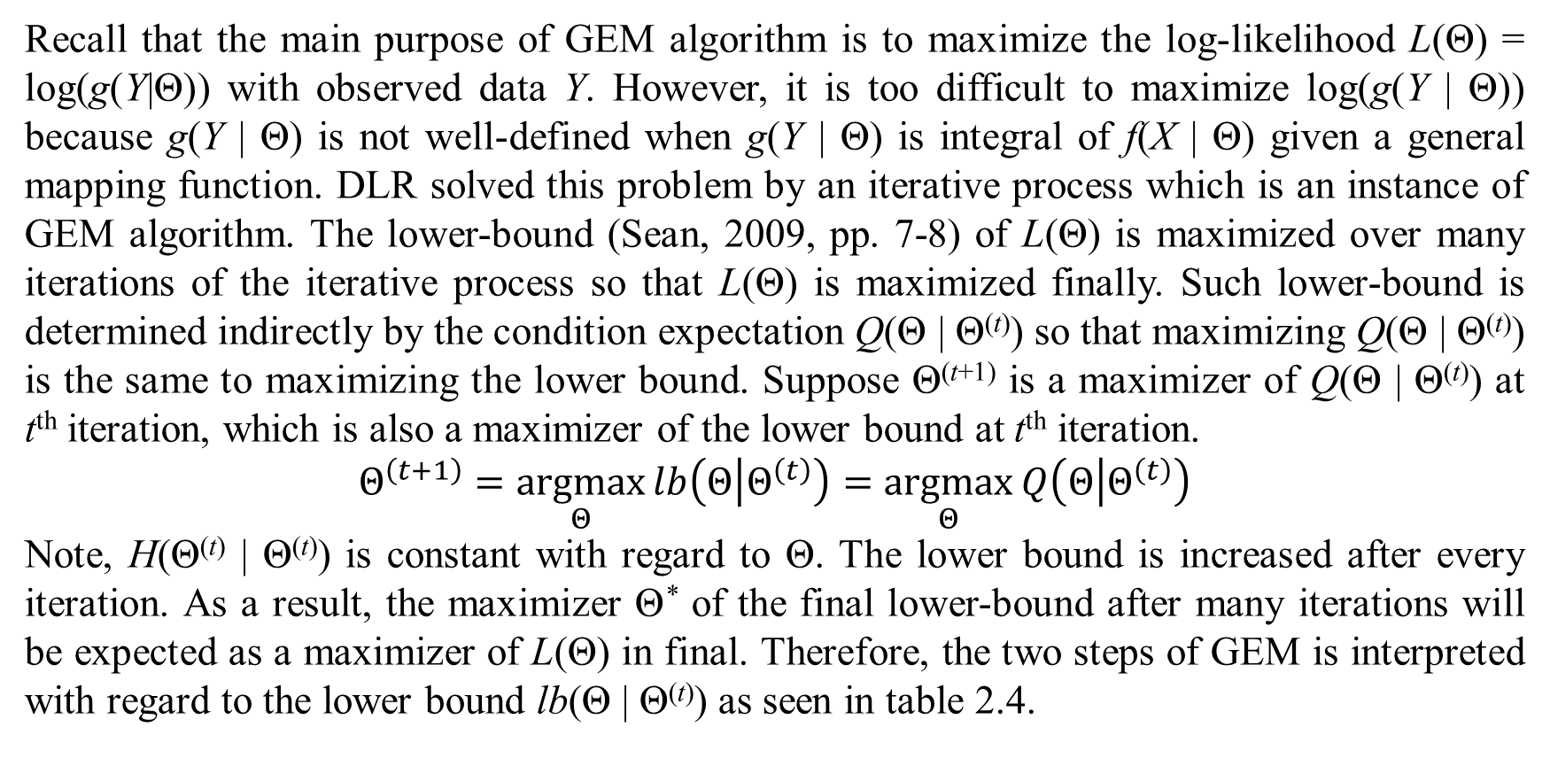
1. Traditional EM algorithm
Recall that the main purpose of GEM algorithm is to maximize the log-likelihood L(Θ) = log(g(Y|Θ)) with observed data Y. However, it is too difficult to maximize log(g(Y | Θ)) because g(Y | Θ) is not well-defined when g(Y | Θ) is integral of f(X | Θ) given a general mapping function. DLR solved this problem by an iterative process which is an instance of GEM algorithm. The lower-bound (Sean, 2009, pp. 7-8) of L(Θ) is maximized over many iterations of the iterative process so that L(Θ) is maximized finally. Such lower-bound is determined indirectly by the condition expectation Q(Θ | Θ^{(t)}) so that maximizing Q(Θ | Θ^{(t)}) is the same to maximizing the lower bound. Suppose Θ^{(t+1)} is a maximizer of Q(Θ | Θ^{(t)}) at t^{th} iteration, which is also a maximizer of the lower bound at t^{th} iteration.
$$Θ^{\left(t+1\right)}=\underset{Θ}{argmax}{lb\left(Θ | Θ^{\left(t\right)}\right)}=\underset{Θ}{argmax}{Q\left(Θ | Θ^{\left(t\right)}\right)}$$
Note, H(Θ^{(t)} | Θ^{(t)}) is constant with regard to Θ. The lower bound is increased after every iteration. As a result, the maximizer Θ* of the final lower-bound after many iterations will be expected as a maximizer of L(Θ) in final. Therefore, the two steps of GEM is interpreted with regard to the lower bound lb(Θ | Θ^{(t)}) as seen in table 2.4.

Slide 18
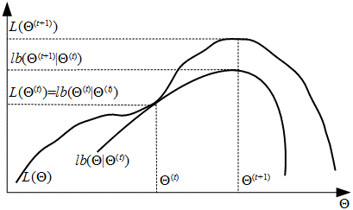
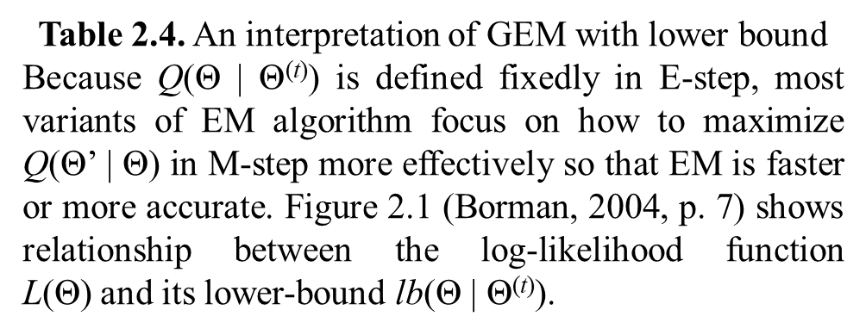
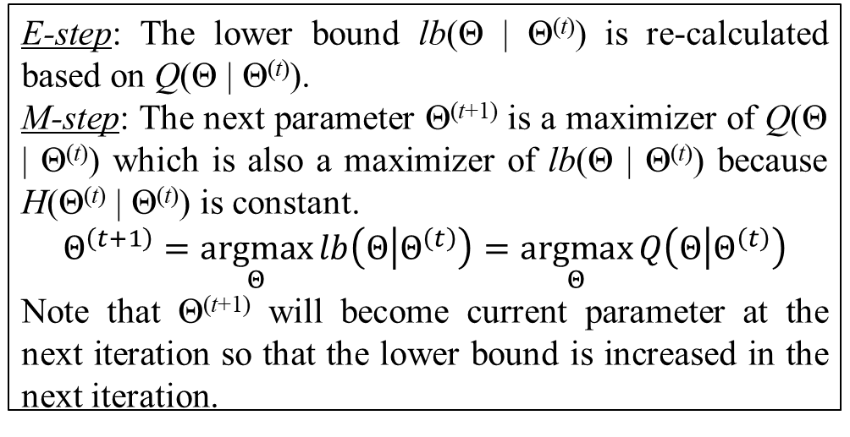
1. Traditional EM algorithm
E-step: The lower bound lb(Θ | Θ^{(t)}) is re-calculated based on Q(Θ | Θ^{(t)}).
M-step: The next parameter Θ^{(t+1)} is a maximizer of Q(Θ | Θ^{(t)}) which is also a maximizer of lb(Θ | Θ^{(t)}) because H(Θ^{(t)} | Θ^{(t)}) is constant.
$$Θ^{\left(t+1\right)}=\underset{Θ}{argmax}{lb\left(Θ | Θ^{\left(t\right)}\right)}=\underset{Θ}{argmax}{Q\left(Θ | Θ^{\left(t\right)}\right)}$$
Note that Θ^{(t+1)} will become current parameter at the next iteration so that the lower bound is increased in the next iteration.
Table 2.4. An interpretation of GEM with lower bound
Because Q(Θ | Θ^{(t)}) is defined fixedly in E-step, most variants of EM algorithm focus on how to maximize Q(Θ’ | Θ) in M-step more effectively so that EM is faster or more accurate. Figure 2.1 (Borman, 2004, p. 7) shows relationship between the log-likelihood function L(Θ) and its lower-bound lb(Θ | Θ^{(t)}).
Figure 2.1. Relationship between the log-likelihood function and its lower-bound
Now ideology of GEM is explained in detail.

Slide 19
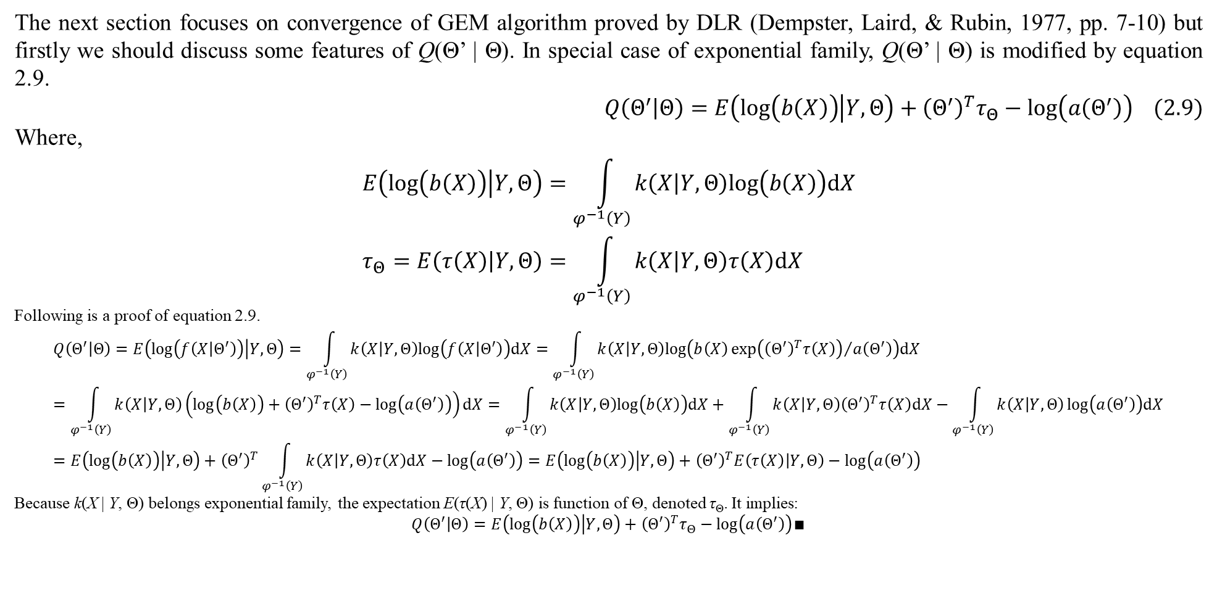
1. Traditional EM algorithm
The next section focuses on convergence of GEM algorithm proved by DLR (Dempster, Laird, & Rubin, 1977, pp. 7-10) but firstly we should discuss some features of Q(Θ’ | Θ). In special case of exponential family, Q(Θ’ | Θ) is modified by equation 2.9.
$$Q\left(Θ^{′} | Θ\right)=E\left(log\left(b\left(X\right)\right) | Y,Θ\right)+{\left(Θ^{′}\right)}^{T}τ_{Θ}−log\left(a\left(Θ^{′}\right)\right) (2.9)$$
Where,
$$E\left(log\left(b\left(X\right)\right) | Y,Θ\right)=\int_{φ^{−1}\left(Y\right)}{k\left(X | Y,Θ\right)log\left(b\left(X\right)\right)dX} \\ τ_{Θ}=E\left(τ\left(X\right) | Y,Θ\right)=\int_{φ^{−1}\left(Y\right)}{k\left(X | Y,Θ\right)τ\left(X\right)dX}$$
Following is a proof of equation 2.9.
$$Q\left(Θ^{′} | Θ\right)=E\left(log\left(f\left(X | Θ^{′}\right)\right) | Y,Θ\right)=\int_{φ^{−1}\left(Y\right)}{k\left(X | Y,Θ\right)log\left(f\left(X | Θ^{′}\right)\right)dX}=\int_{φ^{−1}\left(Y\right)}{k\left(X | Y,Θ\right)log\left(b\left(X\right){exp\left({\left(Θ^{′}\right)}^{T}τ\left(X\right)\right)}/{a\left(Θ^{′}\right)}\right)dX}=\int_{φ^{−1}\left(Y\right)}{k\left(X | Y,Θ\right)\left(log\left(b\left(X\right)\right)+{\left(Θ^{′}\right)}^{T}τ\left(X\right)−log\left(a\left(Θ^{′}\right)\right)\right)dX}=\int_{φ^{−1}\left(Y\right)}{k\left(X | Y,Θ\right)log\left(b\left(X\right)\right)dX}+\int_{φ^{−1}\left(Y\right)}{k\left(X | Y,Θ\right){\left(Θ^{′}\right)}^{T}τ\left(X\right)dX}−\int_{φ^{−1}\left(Y\right)}{k\left(X | Y,Θ\right)}log\left(a\left(Θ^{′}\right)\right)dX=E\left(log\left(b\left(X\right)\right) | Y,Θ\right)+{\left(Θ^{′}\right)}^{T}\int_{φ^{−1}\left(Y\right)}{k\left(X | Y,Θ\right)τ\left(X\right)dX}−log\left(a\left(Θ^{′}\right)\right)=E\left(log\left(b\left(X\right)\right) | Y,Θ\right)+{\left(Θ^{′}\right)}^{T}E\left(τ\left(X\right) | Y,Θ\right)−log\left(a\left(Θ^{′}\right)\right)$$
Because k(X | Y, Θ) belongs exponential family, the expectation E(τ(X) | Y, Θ) is function of Θ, denoted τ_{Θ}. It implies:
$$Q\left(Θ^{′} | Θ\right)=E\left(log\left(b\left(X\right)\right) | Y,Θ\right)+{\left(Θ^{′}\right)}^{T}τ_{Θ}−log\left(a\left(Θ^{′}\right)\right)∎$$

Slide 20
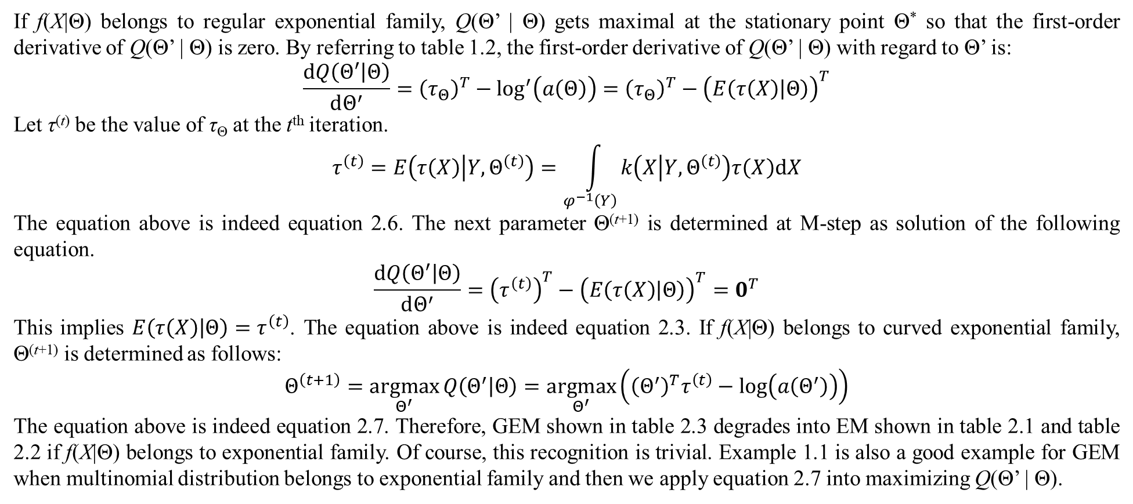
1. Traditional EM algorithm
If f(X|Θ) belongs to regular exponential family, Q(Θ’ | Θ) gets maximal at the stationary point Θ* so that the first-order derivative of Q(Θ’ | Θ) is zero. By referring to table 1.2, the first-order derivative of Q(Θ’ | Θ) with regard to Θ’ is:
$$\frac{dQ\left(Θ^{′} | Θ\right)}{dΘ^{′}}={\left(τ_{Θ}\right)}^{T}−\log^{′}\left(a\left(Θ\right)\right)={\left(τ_{Θ}\right)}^{T}−{\left(E\left(τ\left(X\right) | Θ\right)\right)}^{T}$$
Let τ^{(t)} be the value of τ_{Θ} at the t^{th} iteration.
$$τ^{\left(t\right)}=E\left(τ\left(X\right) | Y,Θ^{\left(t\right)}\right)=\int_{φ^{−1}\left(Y\right)}{k\left(X | Y,Θ^{\left(t\right)}\right)τ\left(X\right)dX}$$
The equation above is indeed equation 2.6. The next parameter Θ^{(t+1)} is determined at M-step as solution of the following equation.
$$\frac{dQ\left(Θ^{′} | Θ\right)}{dΘ^{′}}={\left(τ^{\left(t\right)}\right)}^{T}−{\left(E\left(τ\left(X\right) | Θ\right)\right)}^{T}=0^{T}$$
This implies $E\left(τ\left(X\right) | Θ\right)=τ^{\left(t\right)}$. The equation above is indeed equation 2.3. If f(X|Θ) belongs to curved exponential family, Θ^{(t+1)} is determined as follows:
$$Θ^{\left(t+1\right)}=\underset{Θ^{′}}{argmax}{Q\left(Θ^{′} | Θ\right)}=\underset{Θ^{′}}{argmax}\left({\left(Θ^{′}\right)}^{T}τ^{\left(t\right)}−log\left(a\left(Θ^{′}\right)\right)\right)$$
The equation above is indeed equation 2.7. Therefore, GEM shown in table 2.3 degrades into EM shown in table 2.1 and table 2.2 if f(X|Θ) belongs to exponential family. Of course, this recognition is trivial. Example 1.1 is also a good example for GEM when multinomial distribution belongs to exponential family and then we apply equation 2.7 into maximizing Q(Θ’ | Θ).

Slide 21
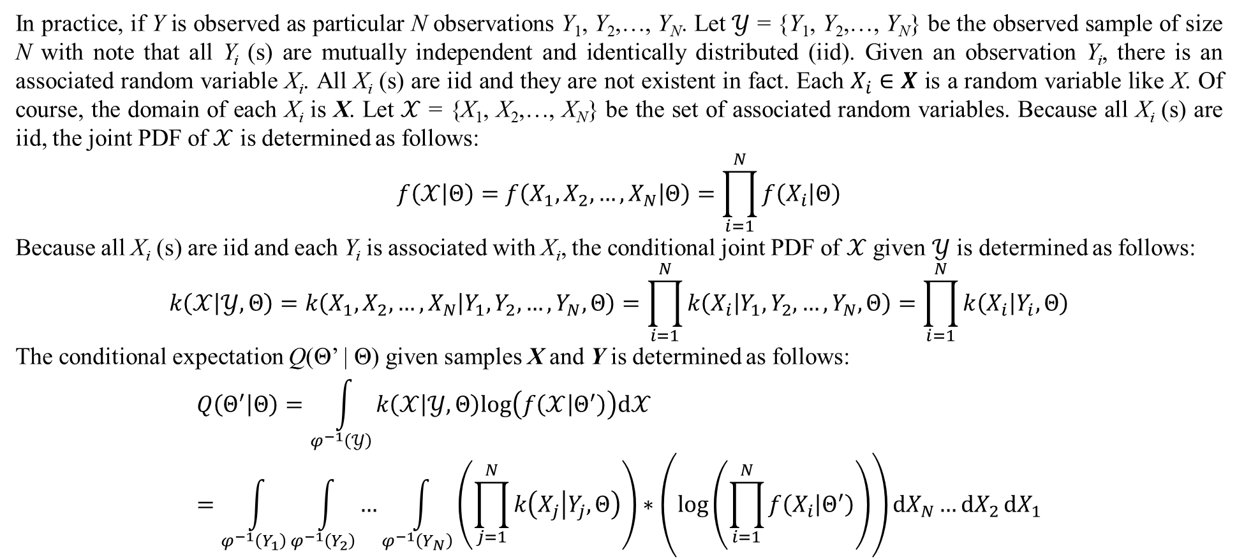
2. Practical EM algorithm
In practice, if Y is observed as particular N observations Y₁, Y₂,…, Y_{N}. Let $𝒴$ = {Y₁, Y₂,…, Y_{N}} be the observed sample of size N with note that all Y_{i} (s) are mutually independent and identically distributed (iid). Given an observation Y_{i}, there is an associated random variable X_{i}. All X_{i} (s) are iid and they are not existent in fact. Each $X_{i}∈X$ is a random variable like X. Of course, the domain of each X_{i} is X. Let $𝒳$ = {X₁, X₂,…, X_{N}} be the set of associated random variables. Because all X_{i} (s) are iid, the joint PDF of $𝒳$ is determined as follows:
$$f\left(𝒳 | Θ\right)=f\left(X_{1},X_{2},…,X_{N} | Θ\right)=\prod_{i=1}^{N}{f\left(X_{i} | Θ\right)}$$
Because all X_{i} (s) are iid and each Y_{i} is associated with X_{i}, the conditional joint PDF of $𝒳$ given $𝒴$ is determined as follows:
$$k\left(𝒳 | 𝒴,Θ\right)=k\left(X_{1},X_{2},…,X_{N} | Y_{1},Y_{2},…,Y_{N},Θ\right)=\prod_{i=1}^{N}{k\left(X_{i} | Y_{1},Y_{2},…,Y_{N},Θ\right)}=\prod_{i=1}^{N}{k\left(X_{i} | Y_{i},Θ\right)}$$
The conditional expectation Q(Θ’ | Θ) given samples X and Y is determined as follows:
$$Q\left(Θ^{′} | Θ\right)=\int_{φ^{−1}\left(𝒴\right)}{k\left(𝒳 | 𝒴,Θ\right)log\left(f\left(𝒳 | Θ^{′}\right)\right)d𝒳}=\int_{φ^{−1}\left(Y_{1}\right)}{\int_{φ^{−1}\left(Y_{2}\right)}{…\int_{φ^{−1}\left(Y_{N}\right)}{\left(\prod_{j=1}^{N}{k\left(X_{j} | Y_{j},Θ\right)}\right)∗\left(log\left(\prod_{i=1}^{N}{f\left(X_{i} | Θ^{′}\right)}\right)\right)dX_{N}}…dX_{2}}dX_{1}}$$

Slide 22
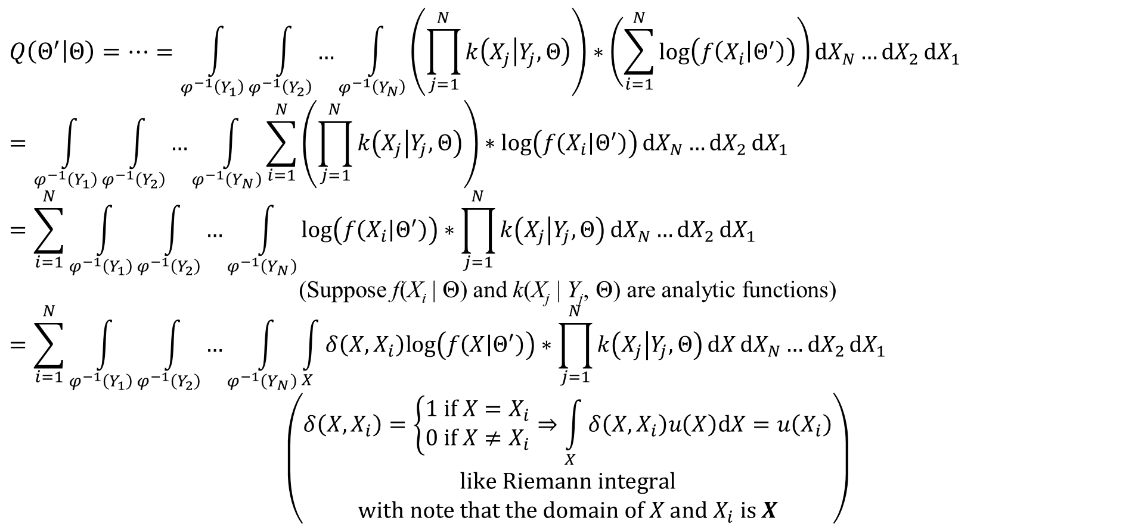
2. Practical EM algorithm
$$Q\left(Θ^{′} | Θ\right)=…=\int_{φ^{−1}\left(Y_{1}\right)}{\int_{φ^{−1}\left(Y_{2}\right)}{…\int_{φ^{−1}\left(Y_{N}\right)}{\left(\prod_{j=1}^{N}{k\left(X_{j} | Y_{j},Θ\right)}\right)∗\left(\sum_{i=1}^{N}{log\left(f\left(X_{i} | Θ^{′}\right)\right)}\right)dX_{N}}…dX_{2}}dX_{1}}$$
$$=\int_{φ^{−1}\left(Y_{1}\right)}{\int_{φ^{−1}\left(Y_{2}\right)}{…\int_{φ^{−1}\left(Y_{N}\right)}{\sum_{i=1}^{N}{\left(\prod_{j=1}^{N}{k\left(X_{j} | Y_{j},Θ\right)}\right)∗log\left(f\left(X_{i} | Θ^{′}\right)\right)}dX_{N}}…dX_{2}}dX_{1}}$$
$$=\sum_{i=1}^{N}{\int_{φ^{−1}\left(Y_{1}\right)}{\int_{φ^{−1}\left(Y_{2}\right)}{…\int_{φ^{−1}\left(Y_{N}\right)}{log\left(f\left(X_{i} | Θ^{′}\right)\right)∗\prod_{j=1}^{N}{k\left(X_{j} | Y_{j},Θ\right)}dX_{N}}…dX_{2}}dX_{1}}}$$
(Suppose f(X_{i} | Θ) and k(X_{j} | Y_{j}, Θ) are analytic functions)
$$=\sum_{i=1}^{N}{\int_{φ^{−1}\left(Y_{1}\right)}{\int_{φ^{−1}\left(Y_{2}\right)}{…\int_{φ^{−1}\left(Y_{N}\right)}{\int_{X}{δ\left(X,X_{i}\right)log\left(f\left(X | Θ^{′}\right)\right)∗\prod_{j=1}^{N}{k\left(X_{j} | Y_{j},Θ\right)}dX}dX_{N}}…dX_{2}}dX_{1}}}$$
$$\left(\begin{aligned}δ\left(X,X_{i}\right)=\left\{\begin{matrix}1 if X=X_{i} \\ 0 if X≠X_{i}\end{matrix}\right.⇒\int_{X}{δ\left(X,X_{i}\right)u\left(X\right)dX}=u\left(X_{i}\right) \\ like Riemann integral \\ with note that the domain of X and X_{i} is X\end{aligned}\right)$$

Slide 23
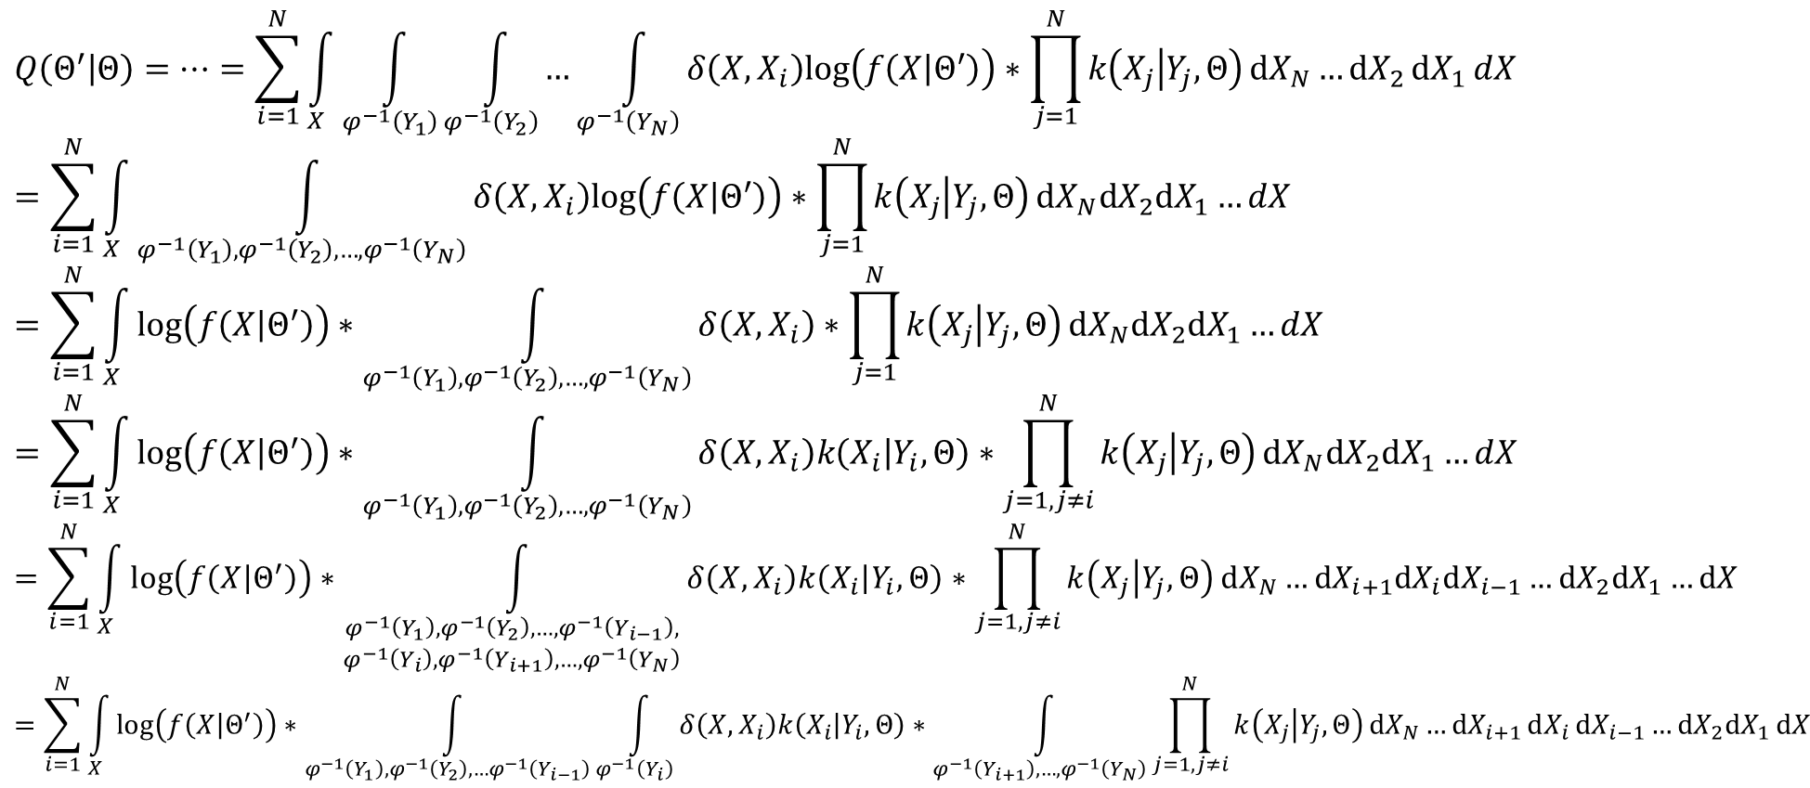
2. Practical EM algorithm
$$Q\left(Θ^{′} | Θ\right)=…=\sum_{i=1}^{N}{\int_{X}{\int_{φ^{−1}\left(Y_{1}\right)}{\int_{φ^{−1}\left(Y_{2}\right)}{…\int_{φ^{−1}\left(Y_{N}\right)}{δ\left(X,X_{i}\right)log\left(f\left(X | Θ^{′}\right)\right)∗\prod_{j=1}^{N}{k\left(X_{j} | Y_{j},Θ\right)}dX_{N}}…dX_{2}}dX_{1}}dX}}$$
$$=\sum_{i=1}^{N}{\int_{X}{\int_{φ^{−1}\left(Y_{1}\right),φ^{−1}\left(Y_{2}\right),…,φ^{−1}\left(Y_{N}\right)}{δ\left(X,X_{i}\right)log\left(f\left(X | Θ^{′}\right)\right)∗\prod_{j=1}^{N}{k\left(X_{j} | Y_{j},Θ\right)}dX_{N}dX_{2}dX_{1}…}dX}}$$
$$=\sum_{i=1}^{N}{\int_{X}{log\left(f\left(X | Θ^{′}\right)\right)∗\int_{φ^{−1}\left(Y_{1}\right),φ^{−1}\left(Y_{2}\right),…,φ^{−1}\left(Y_{N}\right)}{δ\left(X,X_{i}\right)∗\prod_{j=1}^{N}{k\left(X_{j} | Y_{j},Θ\right)}dX_{N}dX_{2}dX_{1}…}dX}}$$
$$=\sum_{i=1}^{N}{\int_{X}{log\left(f\left(X | Θ^{′}\right)\right)∗\int_{φ^{−1}\left(Y_{1}\right),φ^{−1}\left(Y_{2}\right),…,φ^{−1}\left(Y_{N}\right)}{δ\left(X,X_{i}\right)k\left(X_{i} | Y_{i},Θ\right)∗\prod_{j=1,j≠i}^{N}{k\left(X_{j} | Y_{j},Θ\right)}dX_{N}dX_{2}dX_{1}…}dX}}$$
$$=\sum_{i=1}^{N}{\int_{X}{log\left(f\left(X | Θ^{′}\right)\right)∗\int_{\begin{aligned}φ^{−1}\left(Y_{1}\right),φ^{−1}\left(Y_{2}\right),…,φ^{−1}\left(Y_{i−1}\right), \\ φ^{−1}\left(Y_{i}\right),φ^{−1}\left(Y_{i+1}\right),…,φ^{−1}\left(Y_{N}\right)\end{aligned}}{δ\left(X,X_{i}\right)k\left(X_{i} | Y_{i},Θ\right)∗\prod_{j=1,j≠i}^{N}{k\left(X_{j} | Y_{j},Θ\right)}dX_{N}…dX_{i+1}dX_{i}dX_{i−1}…dX_{2}dX_{1}…}dX}}$$
$$=\sum_{i=1}^{N}{\int_{X}{log\left(f\left(X | Θ^{′}\right)\right)∗\int_{φ^{−1}\left(Y_{1}\right),φ^{−1}\left(Y_{2}\right),…φ^{−1}\left(Y_{i−1}\right)}{\int_{φ^{−1}\left(Y_{i}\right)}{δ\left(X,X_{i}\right)k\left(X_{i} | Y_{i},Θ\right)∗\int_{φ^{−1}\left(Y_{i+1}\right),…,φ^{−1}\left(Y_{N}\right)}{\prod_{j=1,j≠i}^{N}{k\left(X_{j} | Y_{j},Θ\right)}dX_{N}…dX_{i+1}}dX_{i}}dX_{i−1}…dX_{2}dX_{1}}dX}}$$

Slide 24
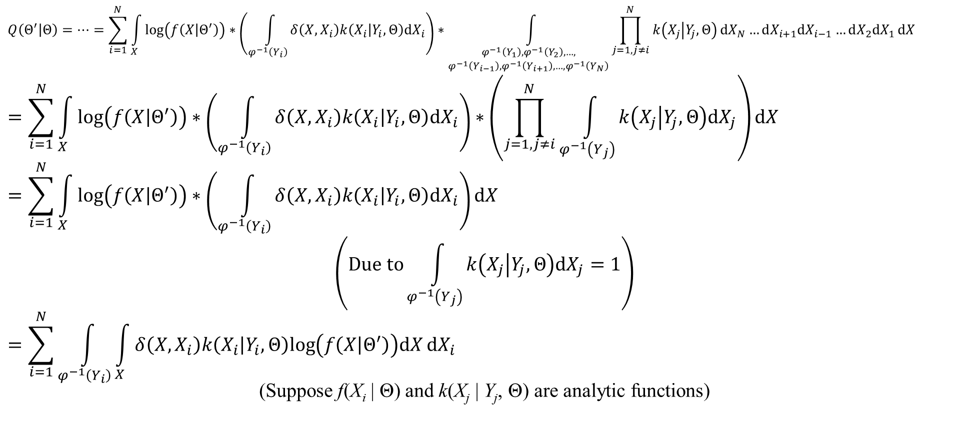
2. Practical EM algorithm
$$Q\left(Θ^{′} | Θ\right)=…=\sum_{i=1}^{N}{\int_{X}{log\left(f\left(X | Θ^{′}\right)\right)∗\left(\int_{φ^{−1}\left(Y_{i}\right)}{δ\left(X,X_{i}\right)k\left(X_{i} | Y_{i},Θ\right)dX_{i}}\right)∗\int_{\begin{aligned}φ^{−1}\left(Y_{1}\right),φ^{−1}\left(Y_{2}\right),…, \\ φ^{−1}\left(Y_{i−1}\right),φ^{−1}\left(Y_{i+1}\right),…,φ^{−1}\left(Y_{N}\right)\end{aligned}}{\prod_{j=1,j≠i}^{N}{k\left(X_{j} | Y_{j},Θ\right)}dX_{N}…dX_{i+1}dX_{i−1}…dX_{2}dX_{1}}dX}}$$
$$=\sum_{i=1}^{N}{\int_{X}{log\left(f\left(X | Θ^{′}\right)\right)∗\left(\int_{φ^{−1}\left(Y_{i}\right)}{δ\left(X,X_{i}\right)k\left(X_{i} | Y_{i},Θ\right)dX_{i}}\right)∗\left(\prod_{j=1,j≠i}^{N}{\int_{φ^{−1}\left(Y_{j}\right)}{k\left(X_{j} | Y_{j},Θ\right)dX_{j}}}\right)dX}}$$
$$=\sum_{i=1}^{N}{\int_{X}{log\left(f\left(X | Θ^{′}\right)\right)∗\left(\int_{φ^{−1}\left(Y_{i}\right)}{δ\left(X,X_{i}\right)k\left(X_{i} | Y_{i},Θ\right)dX_{i}}\right)dX}}$$
$$\left(Due to\int_{φ^{−1}\left(Y_{j}\right)}{k\left(X_{j} | Y_{j},Θ\right)dX_{j}}=1\right)$$
$$=\sum_{i=1}^{N}{\int_{φ^{−1}\left(Y_{i}\right)}{\int_{X}{δ\left(X,X_{i}\right)k\left(X_{i} | Y_{i},Θ\right)log\left(f\left(X | Θ^{′}\right)\right)dX}dX_{i}}}$$
(Suppose f(X_{i} | Θ) and k(X_{j} | Y_{j}, Θ) are analytic functions)

Slide 25
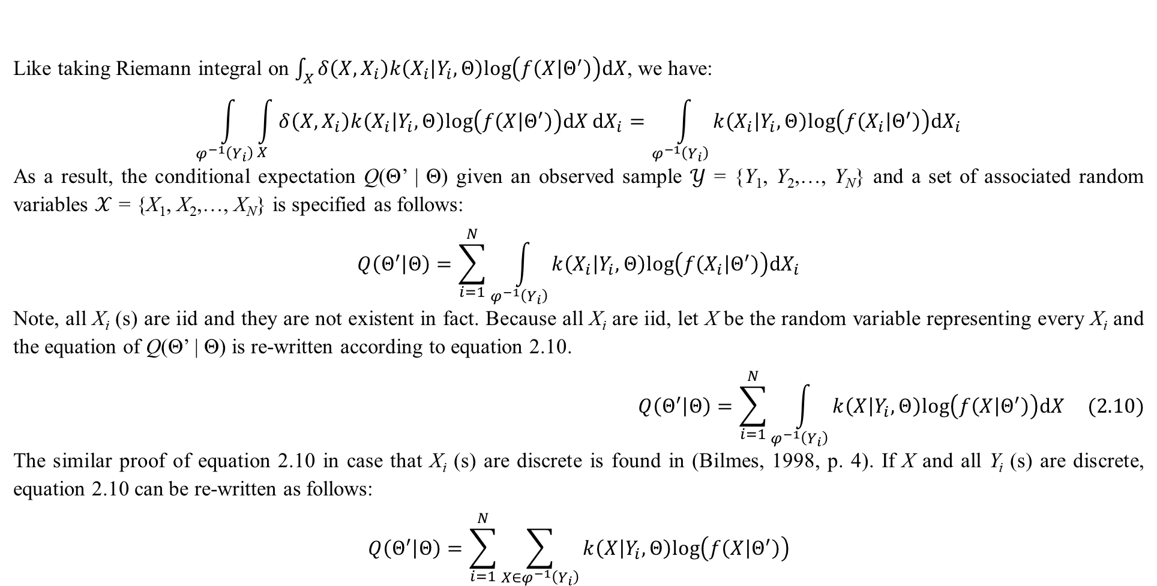
2. Practical EM algorithm
Like taking Riemann integral on $\int_{X}{δ\left(X,X_{i}\right)k\left(X_{i} | Y_{i},Θ\right)log\left(f\left(X | Θ^{′}\right)\right)dX}$, we have:
$$\int_{φ^{−1}\left(Y_{i}\right)}{\int_{X}{δ\left(X,X_{i}\right)k\left(X_{i} | Y_{i},Θ\right)log\left(f\left(X | Θ^{′}\right)\right)dX}dX_{i}}=\int_{φ^{−1}\left(Y_{i}\right)}{k\left(X_{i} | Y_{i},Θ\right)log\left(f\left(X_{i} | Θ^{′}\right)\right)dX_{i}}$$
As a result, the conditional expectation Q(Θ’ | Θ) given an observed sample $𝒴$ = {Y₁, Y₂,…, Y_{N}} and a set of associated random variables $𝒳$ = {X₁, X₂,…, X_{N}} is specified as follows:
$$Q\left(Θ^{′} | Θ\right)=\sum_{i=1}^{N}{\int_{φ^{−1}\left(Y_{i}\right)}{k\left(X_{i} | Y_{i},Θ\right)log\left(f\left(X_{i} | Θ^{′}\right)\right)dX_{i}}}$$
Note, all X_{i} (s) are iid and they are not existent in fact. Because all X_{i} are iid, let X be the random variable representing every X_{i} and the equation of Q(Θ’ | Θ) is re-written according to equation 2.10.
$$Q\left(Θ^{′} | Θ\right)=\sum_{i=1}^{N}{\int_{φ^{−1}\left(Y_{i}\right)}{k\left(X | Y_{i},Θ\right)log\left(f\left(X | Θ^{′}\right)\right)dX}} (2.10)$$
The similar proof of equation 2.10 in case that X_{i} (s) are discrete is found in (Bilmes, 1998, p. 4). If X and all Y_{i} (s) are discrete, equation 2.10 can be re-written as follows:
$$Q\left(Θ^{′} | Θ\right)=\sum_{i=1}^{N}{\sum_{X∈φ^{−1}\left(Y_{i}\right)}{k\left(X | Y_{i},Θ\right)log\left(f\left(X | Θ^{′}\right)\right)}}$$

Slide 26
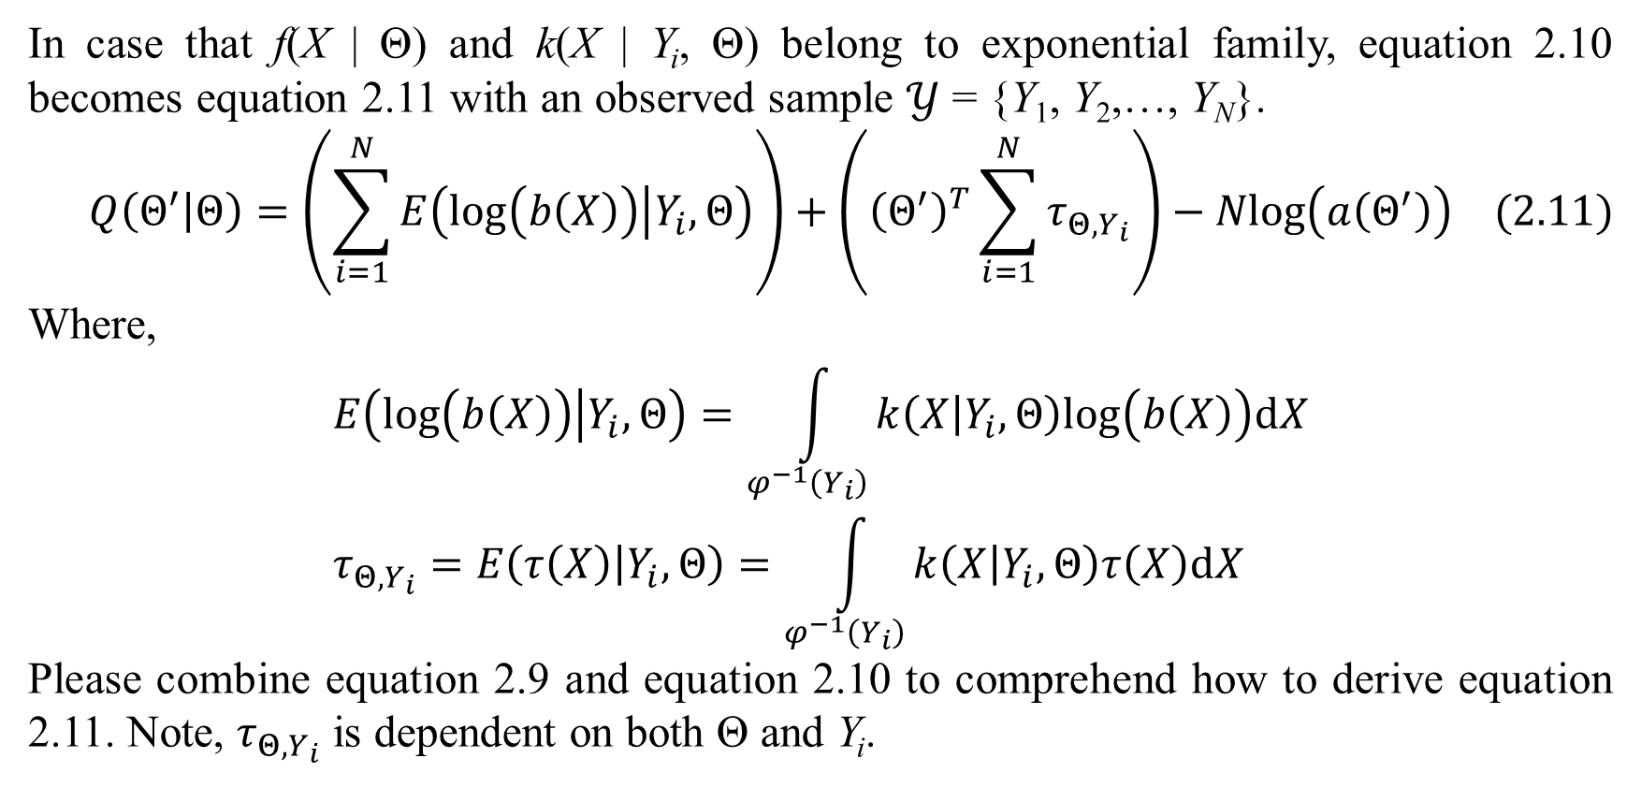
2. Practical EM algorithm
In case that f(X | Θ) and k(X | Y_{i}, Θ) belong to exponential family, equation 2.10 becomes equation 2.11 with an observed sample $𝒴$ = {Y₁, Y₂,…, Y_{N}}.
$$Q\left(Θ^{′} | Θ\right)=\left(\sum_{i=1}^{N}{E\left(log\left(b\left(X\right)\right) | Y_{i},Θ\right)}\right)+\left({\left(Θ^{′}\right)}^{T}\sum_{i=1}^{N}{τ_{Θ,Y_{i}}}\right)−Nlog\left(a\left(Θ^{′}\right)\right) (2.11)$$
Where,
$$E\left(log\left(b\left(X\right)\right) | Y_{i},Θ\right)=\int_{φ^{−1}\left(Y_{i}\right)}{k\left(X | Y_{i},Θ\right)log\left(b\left(X\right)\right)dX} \\ τ_{Θ,Y_{i}}=E\left(τ\left(X\right) | Y_{i},Θ\right)=\int_{φ^{−1}\left(Y_{i}\right)}{k\left(X | Y_{i},Θ\right)τ\left(X\right)dX}$$
Please combine equation 2.9 and equation 2.10 to comprehend how to derive equation 2.11. Note, $τ_{Θ,Y_{i}}$ is dependent on both Θ and Y_{i}.

Slide 27
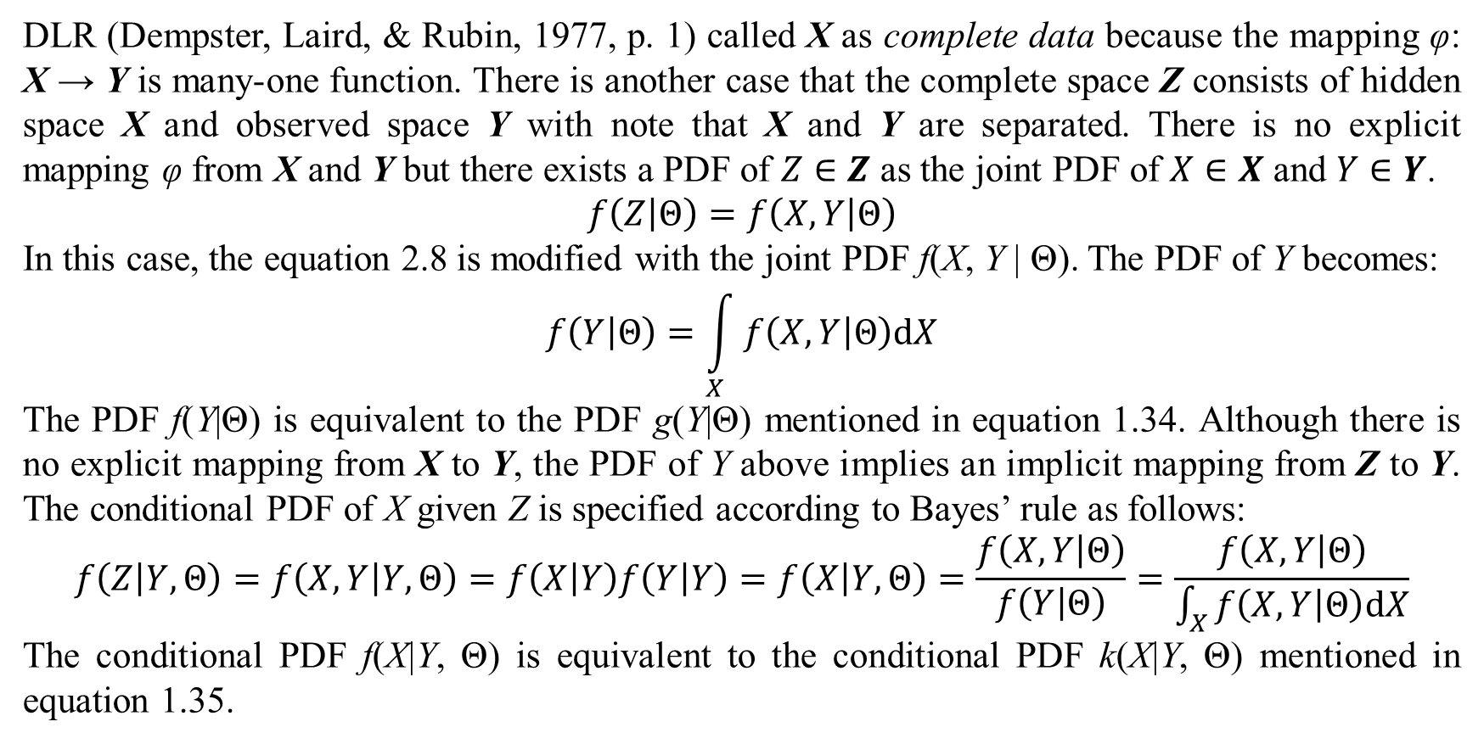
2. Practical EM algorithm
DLR (Dempster, Laird, & Rubin, 1977, p. 1) called X as complete data because the mapping φ: X → Y is many-one function. There is another case that the complete space Z consists of hidden space X and observed space Y with note that X and Y are separated. There is no explicit mapping φ from X and Y but there exists a PDF of $Z∈Z$ as the joint PDF of $X∈X$ and $Y∈Y$.
$$f\left(Z | Θ\right)=f\left(X,Y | Θ\right)$$
In this case, the equation 2.8 is modified with the joint PDF f(X, Y | Θ). The PDF of Y becomes:
$$f\left(Y | Θ\right)=\int_{X}{f\left(X,Y | Θ\right)dX}$$
The PDF f(Y|Θ) is equivalent to the PDF g(Y|Θ) mentioned in equation 1.34. Although there is no explicit mapping from X to Y, the PDF of Y above implies an implicit mapping from Z to Y. The conditional PDF of X given Z is specified according to Bayes’ rule as follows:
$$f\left(Z | Y,Θ\right)=f\left(X,Y | Y,Θ\right)=f\left(X | Y\right)f\left(Y | Y\right)=f\left(X | Y,Θ\right)=\frac{f\left(X,Y | Θ\right)}{f\left(Y | Θ\right)}=\frac{f\left(X,Y | Θ\right)}{\int_{X}{f\left(X,Y | Θ\right)dX}}$$
The conditional PDF f(X|Y, Θ) is equivalent to the conditional PDF k(X|Y, Θ) mentioned in equation 1.35.

Slide 28
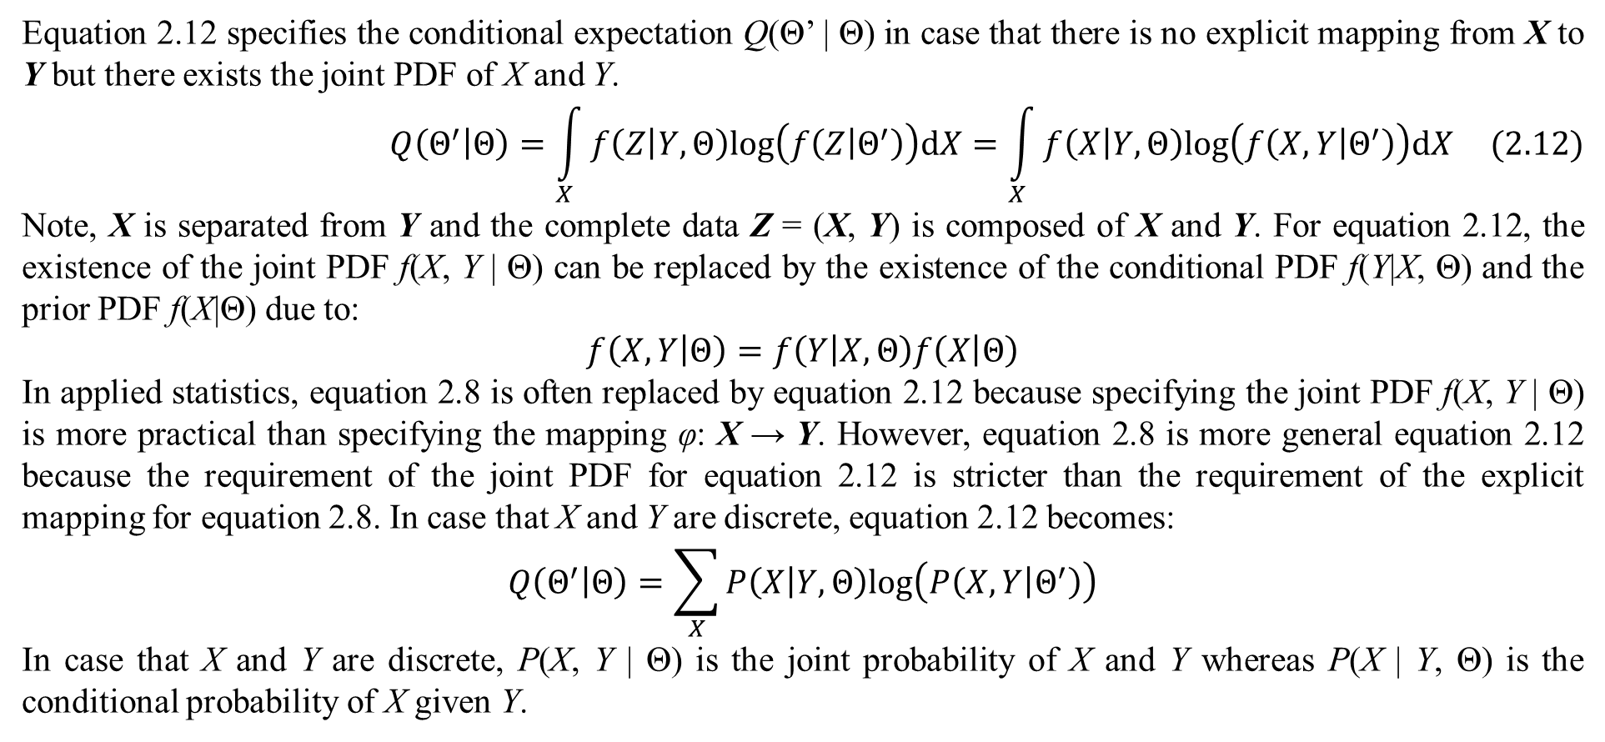
2. Practical EM algorithm
Equation 2.12 specifies the conditional expectation Q(Θ’ | Θ) in case that there is no explicit mapping from X to Y but there exists the joint PDF of X and Y.
$$Q\left(Θ^{′} | Θ\right)=\int_{X}{f\left(Z | Y,Θ\right)log\left(f\left(Z | Θ^{′}\right)\right)dX}=\int_{X}{f\left(X | Y,Θ\right)log\left(f\left(X,Y | Θ^{′}\right)\right)dX} (2.12)$$
Note, X is separated from Y and the complete data Z = (X, Y) is composed of X and Y. For equation 2.12, the existence of the joint PDF f(X, Y | Θ) can be replaced by the existence of the conditional PDF f(Y|X, Θ) and the prior PDF f(X|Θ) due to:
$$f\left(X,Y | Θ\right)=f\left(Y | X,Θ\right)f\left(X | Θ\right)$$
In applied statistics, equation 2.8 is often replaced by equation 2.12 because specifying the joint PDF f(X, Y | Θ) is more practical than specifying the mapping φ: X → Y. However, equation 2.8 is more general equation 2.12 because the requirement of the joint PDF for equation 2.12 is stricter than the requirement of the explicit mapping for equation 2.8. In case that X and Y are discrete, equation 2.12 becomes:
$$Q\left(Θ^{′} | Θ\right)=\sum_{X}{P\left(X | Y,Θ\right)log\left(P\left(X,Y | Θ^{′}\right)\right)}$$
In case that X and Y are discrete, P(X, Y | Θ) is the joint probability of X and Y whereas P(X | Y, Θ) is the conditional probability of X given Y.

Slide 29
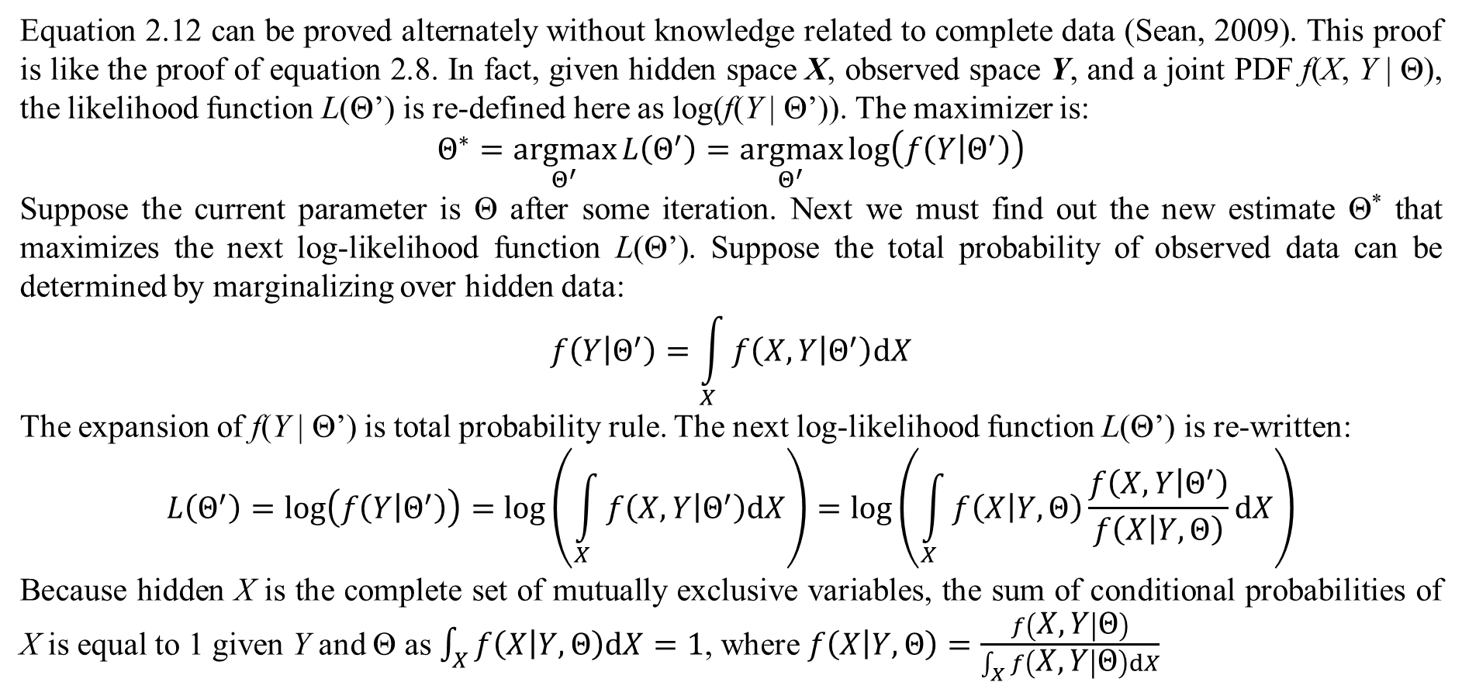
2. Practical EM algorithm
Equation 2.12 can be proved alternately without knowledge related to complete data (Sean, 2009). This proof is like the proof of equation 2.8. In fact, given hidden space X, observed space Y, and a joint PDF f(X, Y | Θ), the likelihood function L(Θ’) is re-defined here as log(f(Y | Θ’)). The maximizer is:
$$Θ^{∗}=\underset{Θ^{′}}{argmax}{L\left(Θ^{′}\right)}=\underset{Θ^{′}}{argmax}{log\left(f\left(Y | Θ^{′}\right)\right)}$$
Suppose the current parameter is Θ after some iteration. Next we must find out the new estimate Θ* that maximizes the next log-likelihood function L(Θ’). Suppose the total probability of observed data can be determined by marginalizing over hidden data:
$$f\left(Y | Θ^{′}\right)=\int_{X}{f\left(X,Y | Θ^{′}\right)dX}$$
The expansion of f(Y | Θ’) is total probability rule. The next log-likelihood function L(Θ’) is re-written:
$$L\left(Θ^{′}\right)=log\left(f\left(Y | Θ^{′}\right)\right)=log\left(\int_{X}{f\left(X,Y | Θ^{′}\right)dX}\right)=log\left(\int_{X}{f\left(X | Y,Θ\right)\frac{f\left(X,Y | Θ^{′}\right)}{f\left(X | Y,Θ\right)}}dX\right)$$
Because hidden X is the complete set of mutually exclusive variables, the sum of conditional probabilities of X is equal to 1 given Y and Θ as $\int_{X}{f\left(X | Y,Θ\right)dX}=1$, where $f\left(X | Y,Θ\right)=\frac{f\left(X,Y | Θ\right)}{\int_{X}{f\left(X,Y | Θ\right)dX}}$

Slide 30
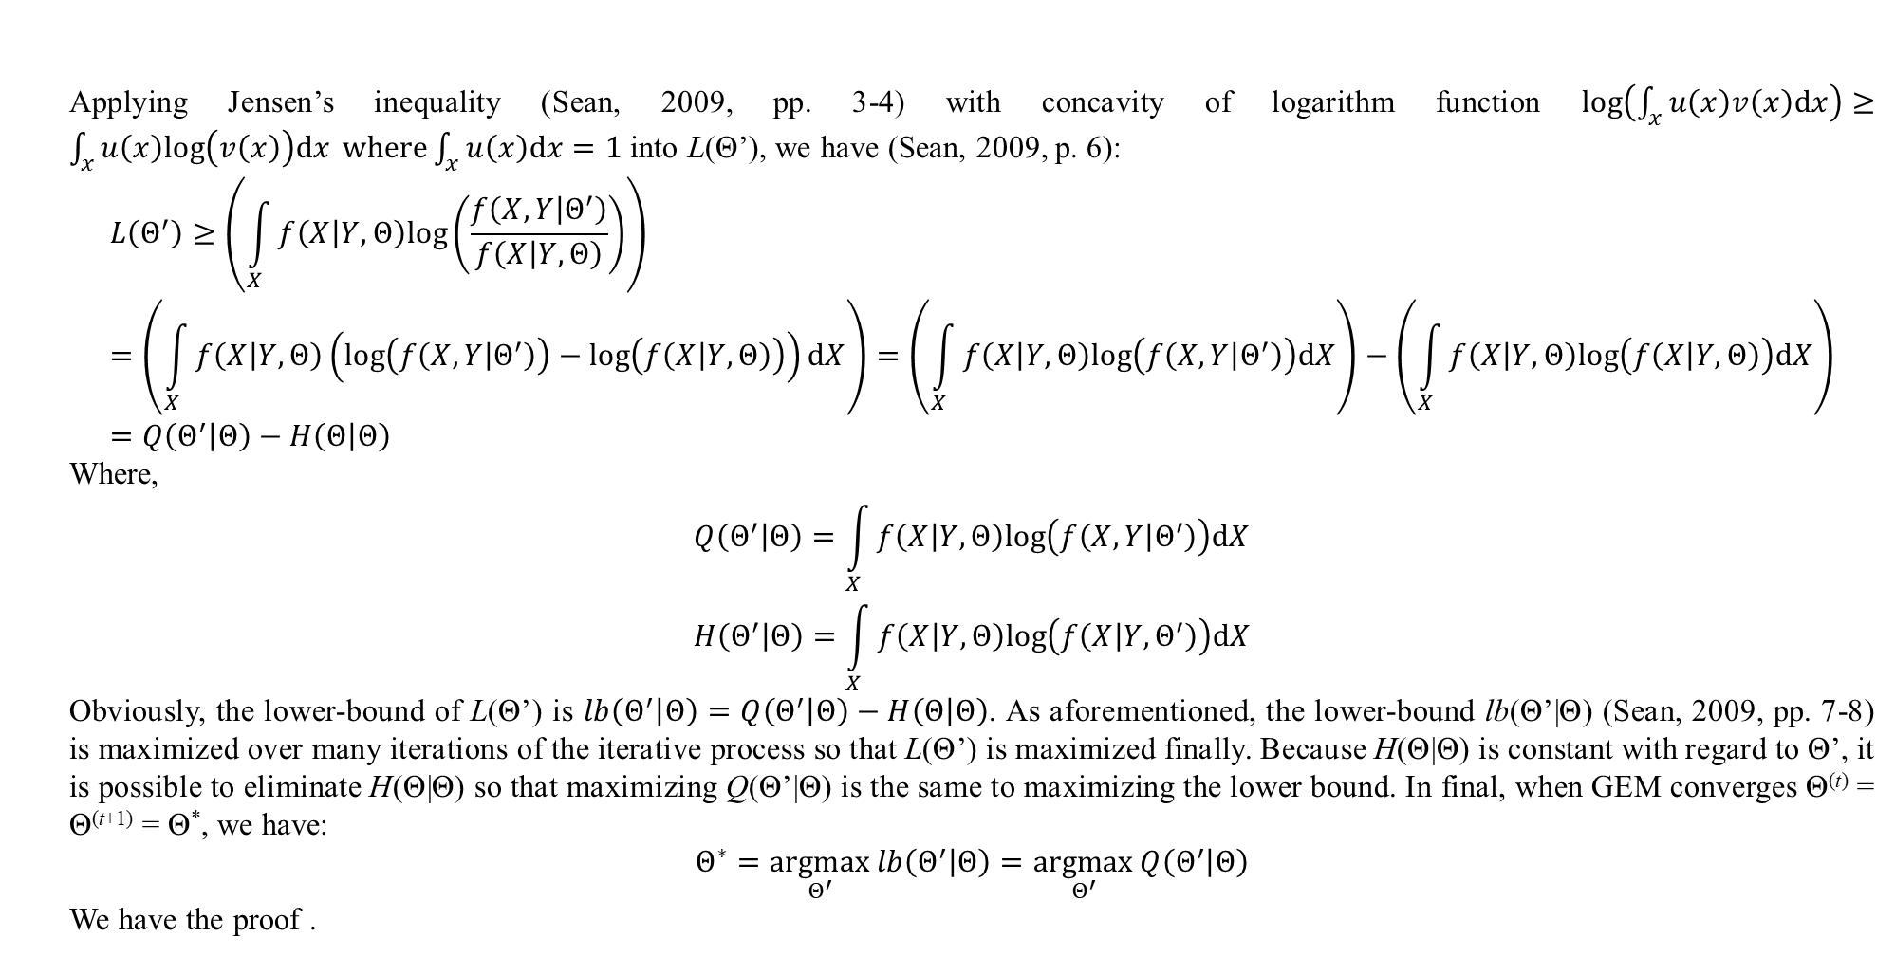
2. Practical EM algorithm
Applying Jensen’s inequality (Sean, 2009, pp. 3-4) with concavity of logarithm function $log\left(\int_{x}{u\left(x\right)v\left(x\right)dx}\right)≥\int_{x}{u\left(x\right)log\left(v\left(x\right)\right)dx} where\int_{x}{u\left(x\right)dx}=1$ into L(Θ’), we have (Sean, 2009, p. 6):
$$L\left(Θ^{′}\right)≥\left(\int_{X}{f\left(X | Y,Θ\right)log\left(\frac{f\left(X,Y | Θ^{′}\right)}{f\left(X | Y,Θ\right)}\right)}\right) \\ =\left(\int_{X}{f\left(X | Y,Θ\right)\left(log\left(f\left(X,Y | Θ^{′}\right)\right)−log\left(f\left(X | Y,Θ\right)\right)\right)dX}\right)=\left(\int_{X}{f\left(X | Y,Θ\right)log\left(f\left(X,Y | Θ^{′}\right)\right)dX}\right)−\left(\int_{X}{f\left(X | Y,Θ\right)log\left(f\left(X | Y,Θ\right)\right)dX}\right)=Q\left(Θ^{′} | Θ\right)−H\left(Θ | Θ\right)$$
Where,
$$Q\left(Θ^{′} | Θ\right)=\int_{X}{f\left(X | Y,Θ\right)log\left(f\left(X,Y | Θ^{′}\right)\right)dX}$$
$$H\left(Θ^{′} | Θ\right)=\int_{X}{f\left(X | Y,Θ\right)log\left(f\left(X | Y,Θ^{′}\right)\right)dX}$$
Obviously, the lower-bound of L(Θ’) is $lb\left(Θ^{′} | Θ\right)=Q\left(Θ^{′} | Θ\right)−H\left(Θ | Θ\right)$. As aforementioned, the lower-bound lb(Θ’|Θ) (Sean, 2009, pp. 7-8) is maximized over many iterations of the iterative process so that L(Θ’) is maximized finally. Because H(Θ|Θ) is constant with regard to Θ’, it is possible to eliminate H(Θ|Θ) so that maximizing Q(Θ’|Θ) is the same to maximizing the lower bound. In final, when GEM converges Θ^{(t)} = Θ^{(t+1)} = Θ*, we have:
$$Θ^{∗}=\underset{Θ^{′}}{argmax}{lb\left(Θ^{′} | Θ\right)}=\underset{Θ^{′}}{argmax}{Q\left(Θ^{′} | Θ\right)}$$
We have the proof .

Slide 31
2. Practical EM algorithm
Mixture model mentioned in subsection 5.1 is a good example for GEM without explicit mapping from X to Y. Another well-known example is three-coin toss example (Collins & Barzilay, 2005) which applies GEM into estimating parameters of binomial distributions without explicit mapping.
Example 2.1. There are three coins named coin 1, coin 2 and coin 3. Each coin has two sides such as head (H) side and tail (T) side. Let hidden random variable X represent coin 1 where X is binary (X = {H, T}). Let θ₁ be probability of coin 1 receiving head side.
θ₁ = P(X=H)
Of course, we have:
P(X=T) = 1 – θ₁
Let observed random variable Y represent a sequence of tossing coin 2 or coin 3 three times. Such sequence depends on first tossing coin 1. For instance, if coin 1 shows head side (X=H), the sequence is result of tossing coin 2 three times. Otherwise, if coin 1 shows tail side (X=T), the sequence is result of tossing coin 3 three times. For example, suppose first tossing coin 1 results X=H then, a possible result Y = HHT means that we toss coin 2 three times resulting head, head, and tail from coin 2. Obviously, X is hidden and Y is observed. In this example, we observe that
Y=HHT

Slide 32
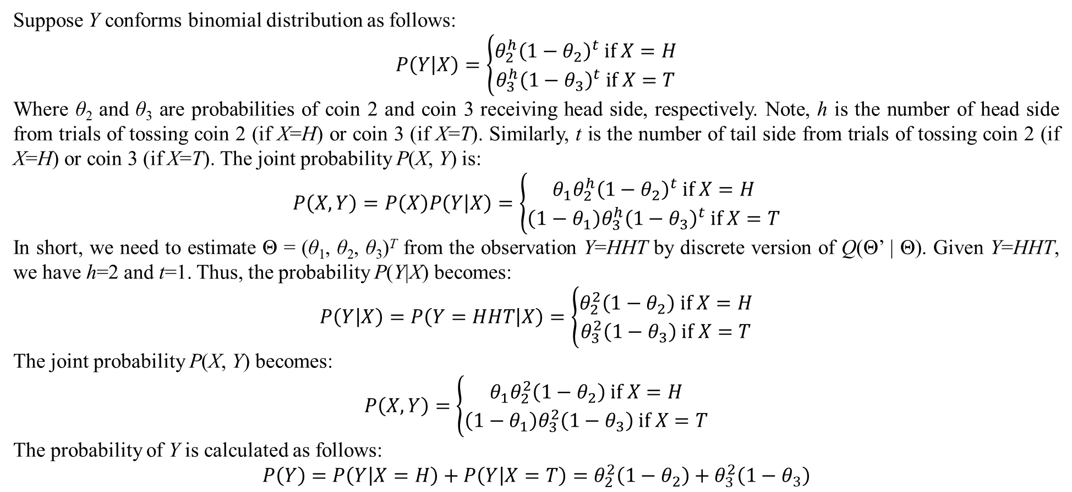
2. Practical EM algorithm
Suppose Y conforms binomial distribution as follows:
$$P\left(Y | X\right)=\left\{\begin{matrix}θ_{2}^{h}{\left(1−θ_{2}\right)}^{t} if X=H \\ θ_{3}^{h}{\left(1−θ_{3}\right)}^{t} if X=T\end{matrix}\right.$$
Where θ₂ and θ₃ are probabilities of coin 2 and coin 3 receiving head side, respectively. Note, h is the number of head side from trials of tossing coin 2 (if X=H) or coin 3 (if X=T). Similarly, t is the number of tail side from trials of tossing coin 2 (if X=H) or coin 3 (if X=T). The joint probability P(X, Y) is:
$$P\left(X,Y\right)=P\left(X\right)P\left(Y | X\right)=\left\{\begin{matrix}θ_{1}θ_{2}^{h}{\left(1−θ_{2}\right)}^{t} if X=H \\ \left(1−θ_{1}\right)θ_{3}^{h}{\left(1−θ_{3}\right)}^{t} if X=T\end{matrix}\right.$$
In short, we need to estimate Θ = (θ₁, θ₂, θ₃)^{T} from the observation Y=HHT by discrete version of Q(Θ’ | Θ). Given Y=HHT, we have h=2 and t=1. Thus, the probability P(Y|X) becomes:
$$P\left(Y | X\right)=P\left(Y=HHT | X\right)=\left\{\begin{matrix}θ_{2}^{2}\left(1−θ_{2}\right) if X=H \\ θ_{3}^{2}\left(1−θ_{3}\right) if X=T\end{matrix}\right.$$
The joint probability P(X, Y) becomes:
$$P\left(X,Y\right)=\left\{\begin{matrix}θ_{1}θ_{2}^{2}\left(1−θ_{2}\right) if X=H \\ \left(1−θ_{1}\right)θ_{3}^{2}\left(1−θ_{3}\right) if X=T\end{matrix}\right.$$
The probability of Y is calculated as follows:
$$P\left(Y\right)=P\left(Y | X=H\right)+P\left(Y | X=T\right)=θ_{2}^{2}\left(1−θ_{2}\right)+θ_{3}^{2}\left(1−θ_{3}\right)$$

Slide 33
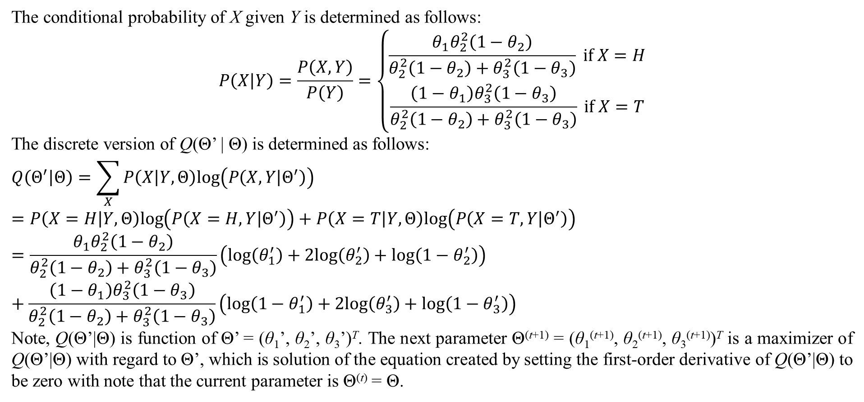
2. Practical EM algorithm
The conditional probability of X given Y is determined as follows:
$$P\left(X | Y\right)=\frac{P\left(X,Y\right)}{P\left(Y\right)}=\left\{\begin{matrix}\frac{θ_{1}θ_{2}^{2}\left(1−θ_{2}\right)}{θ_{2}^{2}\left(1−θ_{2}\right)+θ_{3}^{2}\left(1−θ_{3}\right)} if X=H \\ \frac{\left(1−θ_{1}\right)θ_{3}^{2}\left(1−θ_{3}\right)}{θ_{2}^{2}\left(1−θ_{2}\right)+θ_{3}^{2}\left(1−θ_{3}\right)} if X=T\end{matrix}\right.$$
The discrete version of Q(Θ’ | Θ) is determined as follows:
$$Q\left(Θ^{′} | Θ\right)=\sum_{X}{P\left(X | Y,Θ\right)log\left(P\left(X,Y | Θ^{′}\right)\right)}=P\left(X=H | Y,Θ\right)log\left(P\left(X=H,Y | Θ^{′}\right)\right)+P\left(X=T | Y,Θ\right)log\left(P\left(X=T,Y | Θ^{′}\right)\right)$$
$$=\frac{θ_{1}θ_{2}^{2}\left(1−θ_{2}\right)}{θ_{2}^{2}\left(1−θ_{2}\right)+θ_{3}^{2}\left(1−θ_{3}\right)}\left(log\left(θ_{1}^{′}\right)+2log\left(θ_{2}^{′}\right)+log\left(1−θ_{2}^{′}\right)\right)+\frac{\left(1−θ_{1}\right)θ_{3}^{2}\left(1−θ_{3}\right)}{θ_{2}^{2}\left(1−θ_{2}\right)+θ_{3}^{2}\left(1−θ_{3}\right)}\left(log\left(1−θ_{1}^{′}\right)+2log\left(θ_{3}^{′}\right)+log\left(1−θ_{3}^{′}\right)\right)$$
Note, Q(Θ’|Θ) is function of Θ’ = (θ₁’, θ₂’, θ₃’)^{T}. The next parameter Θ^{(t+1)} = (θ₁^{(t+1)}, θ₂^{(t+1)}, θ₃^{(t+1)})^{T} is a maximizer of Q(Θ’|Θ) with regard to Θ’, which is solution of the equation created by setting the first-order derivative of Q(Θ’|Θ) to be zero with note that the current parameter is Θ^{(t)} = Θ.

Slide 34
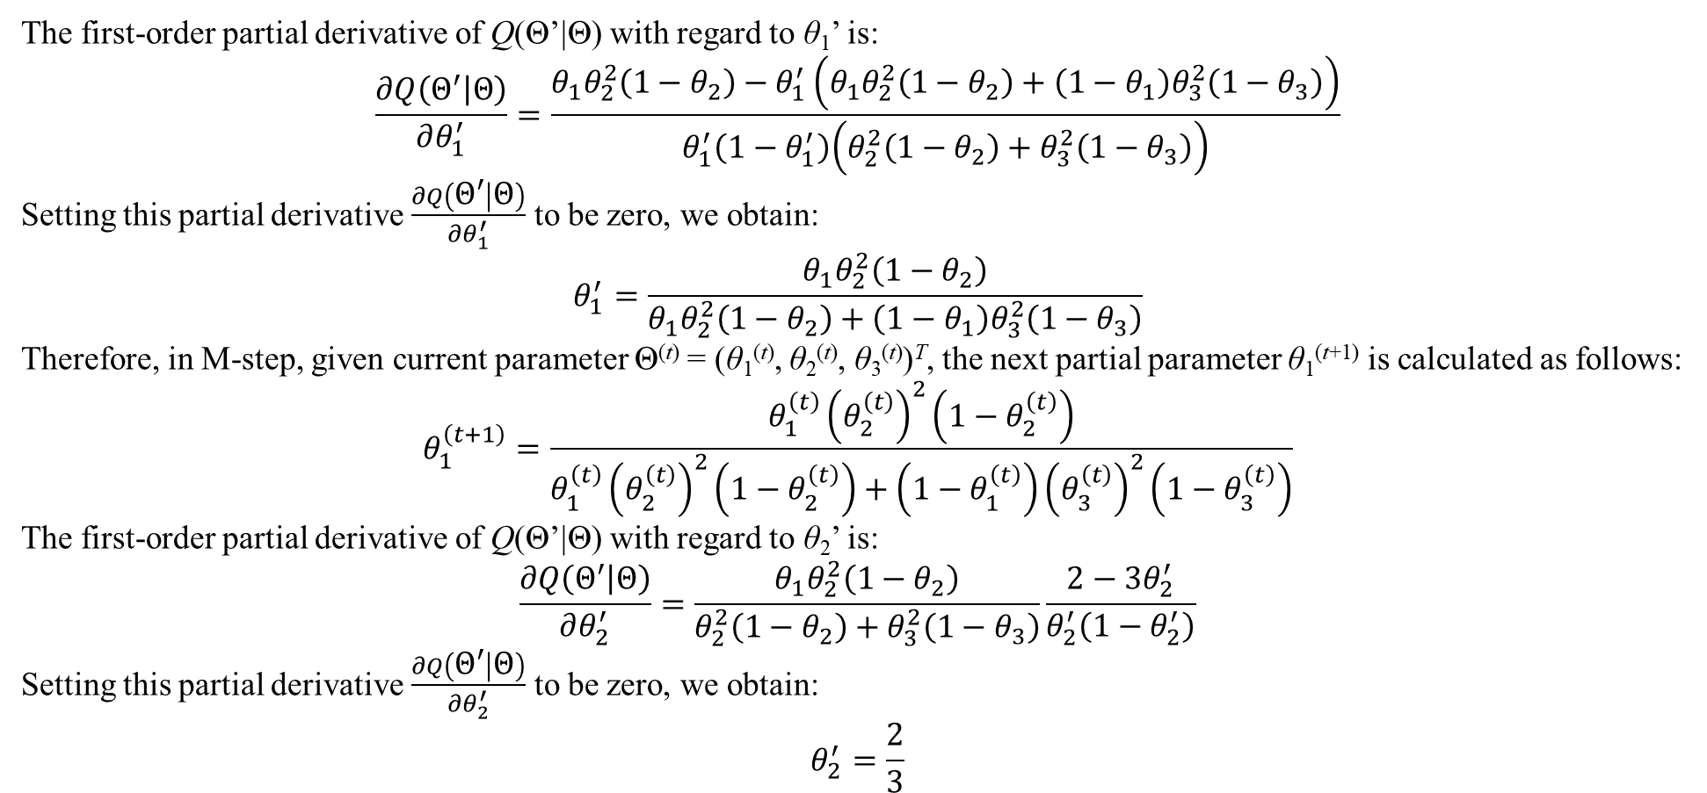
2. Practical EM algorithm
The first-order partial derivative of Q(Θ’|Θ) with regard to θ₁’ is:
$$\frac{∂Q\left(Θ^{′} | Θ\right)}{∂θ_{1}^{′}}=\frac{θ_{1}θ_{2}^{2}\left(1−θ_{2}\right)−θ_{1}^{′}\left(θ_{1}θ_{2}^{2}\left(1−θ_{2}\right)+\left(1−θ_{1}\right)θ_{3}^{2}\left(1−θ_{3}\right)\right)}{θ_{1}^{′}\left(1−θ_{1}^{′}\right)\left(θ_{2}^{2}\left(1−θ_{2}\right)+θ_{3}^{2}\left(1−θ_{3}\right)\right)}$$
Setting this partial derivative $\frac{∂Q\left(Θ^{′} | Θ\right)}{∂θ_{1}^{′}}$ to be zero, we obtain:
$$θ_{1}^{′}=\frac{θ_{1}θ_{2}^{2}\left(1−θ_{2}\right)}{θ_{1}θ_{2}^{2}\left(1−θ_{2}\right)+\left(1−θ_{1}\right)θ_{3}^{2}\left(1−θ_{3}\right)}$$
Therefore, in M-step, given current parameter Θ^{(t)} = (θ₁^{(t)}, θ₂^{(t)}, θ₃^{(t)})^{T}, the next partial parameter θ₁^{(t+1)} is calculated as follows:
$$θ_{1}^{\left(t+1\right)}=\frac{θ_{1}^{\left(t\right)}{\left(θ_{2}^{\left(t\right)}\right)}^{2}\left(1−θ_{2}^{\left(t\right)}\right)}{θ_{1}^{\left(t\right)}{\left(θ_{2}^{\left(t\right)}\right)}^{2}\left(1−θ_{2}^{\left(t\right)}\right)+\left(1−θ_{1}^{\left(t\right)}\right){\left(θ_{3}^{\left(t\right)}\right)}^{2}\left(1−θ_{3}^{\left(t\right)}\right)}$$
The first-order partial derivative of Q(Θ’|Θ) with regard to θ₂’ is:
$$\frac{∂Q\left(Θ^{′} | Θ\right)}{∂θ_{2}^{′}}=\frac{θ_{1}θ_{2}^{2}\left(1−θ_{2}\right)}{θ_{2}^{2}\left(1−θ_{2}\right)+θ_{3}^{2}\left(1−θ_{3}\right)}\frac{2−3θ_{2}^{′}}{θ_{2}^{′}\left(1−θ_{2}^{′}\right)}$$
Setting this partial derivative $\frac{∂Q\left(Θ^{′} | Θ\right)}{∂θ_{2}^{′}}$ to be zero, we obtain:
$$θ_{2}^{′}=\frac{2}{3}$$

Slide 35
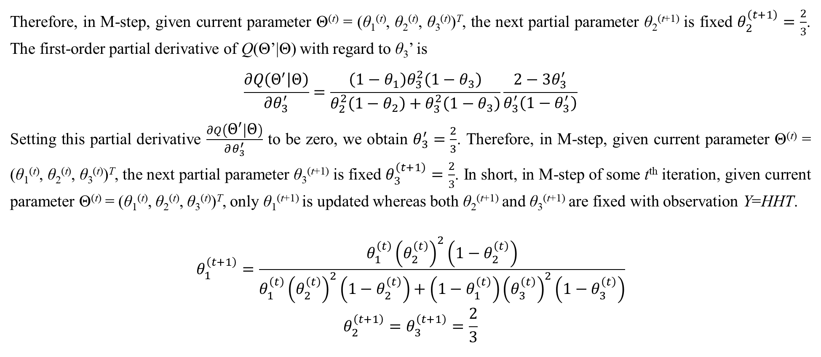
2. Practical EM algorithm
Therefore, in M-step, given current parameter Θ^{(t)} = (θ₁^{(t)}, θ₂^{(t)}, θ₃^{(t)})^{T}, the next partial parameter θ₂^{(t+1)} is fixed $θ_{2}^{\left(t+1\right)}=\frac{2}{3}$. The first-order partial derivative of Q(Θ’|Θ) with regard to θ₃’ is
$$\frac{∂Q\left(Θ^{′} | Θ\right)}{∂θ_{3}^{′}}=\frac{\left(1−θ_{1}\right)θ_{3}^{2}\left(1−θ_{3}\right)}{θ_{2}^{2}\left(1−θ_{2}\right)+θ_{3}^{2}\left(1−θ_{3}\right)}\frac{2−3θ_{3}^{′}}{θ_{3}^{′}\left(1−θ_{3}^{′}\right)}$$
Setting this partial derivative $\frac{∂Q\left(Θ^{′} | Θ\right)}{∂θ_{3}^{′}}$ to be zero, we obtain $θ_{3}^{′}=\frac{2}{3}$. Therefore, in M-step, given current parameter Θ^{(t)} = (θ₁^{(t)}, θ₂^{(t)}, θ₃^{(t)})^{T}, the next partial parameter θ₃^{(t+1)} is fixed $θ_{3}^{\left(t+1\right)}=\frac{2}{3}$. In short, in M-step of some t^{th} iteration, given current parameter Θ^{(t)} = (θ₁^{(t)}, θ₂^{(t)}, θ₃^{(t)})^{T}, only θ₁^{(t+1)} is updated whereas both θ₂^{(t+1)} and θ₃^{(t+1)} are fixed with observation Y=HHT.
$$\begin{matrix}θ_{1}^{\left(t+1\right)}=\frac{θ_{1}^{\left(t\right)}{\left(θ_{2}^{\left(t\right)}\right)}^{2}\left(1−θ_{2}^{\left(t\right)}\right)}{θ_{1}^{\left(t\right)}{\left(θ_{2}^{\left(t\right)}\right)}^{2}\left(1−θ_{2}^{\left(t\right)}\right)+\left(1−θ_{1}^{\left(t\right)}\right){\left(θ_{3}^{\left(t\right)}\right)}^{2}\left(1−θ_{3}^{\left(t\right)}\right)} \\ θ_{2}^{\left(t+1\right)}=θ_{3}^{\left(t+1\right)}=\frac{2}{3}\end{matrix}$$

Slide 36
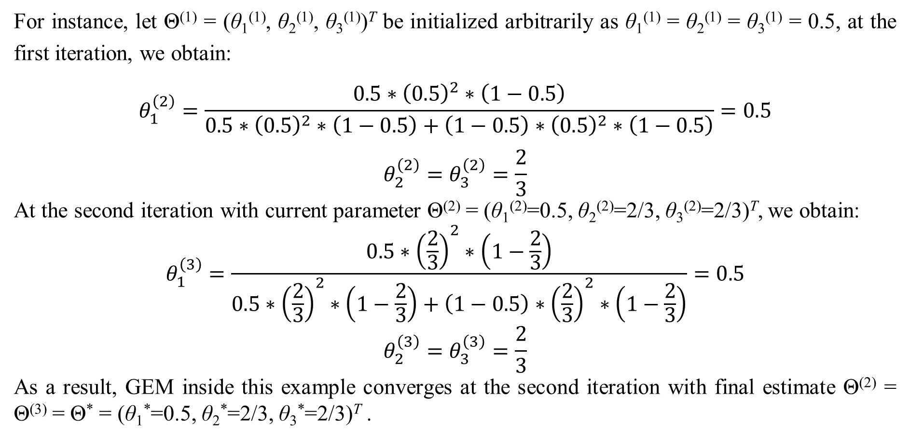
2. Practical EM algorithm
For instance, let Θ⁽¹⁾ = (θ₁⁽¹⁾, θ₂⁽¹⁾, θ₃⁽¹⁾)^{T} be initialized arbitrarily as θ₁⁽¹⁾ = θ₂⁽¹⁾ = θ₃⁽¹⁾ = 0.5, at the first iteration, we obtain:
$$θ_{1}^{\left(2\right)}=\frac{0.5∗{\left(0.5\right)}^{2}∗\left(1−0.5\right)}{0.5∗{\left(0.5\right)}^{2}∗\left(1−0.5\right)+\left(1−0.5\right)∗{\left(0.5\right)}^{2}∗\left(1−0.5\right)}=0.5$$
$$θ_{2}^{\left(2\right)}=θ_{3}^{\left(2\right)}=\frac{2}{3}$$
At the second iteration with current parameter Θ⁽²⁾ = (θ₁⁽²⁾=0.5, θ₂⁽²⁾=2/3, θ₃⁽²⁾=2/3)^{T}, we obtain:
$$θ_{1}^{\left(3\right)}=\frac{0.5∗{\left(\frac{2}{3}\right)}^{2}∗\left(1−\frac{2}{3}\right)}{0.5∗{\left(\frac{2}{3}\right)}^{2}∗\left(1−\frac{2}{3}\right)+\left(1−0.5\right)∗{\left(\frac{2}{3}\right)}^{2}∗\left(1−\frac{2}{3}\right)}=0.5$$
$$θ_{2}^{\left(3\right)}=θ_{3}^{\left(3\right)}=\frac{2}{3}$$
As a result, GEM inside this example converges at the second iteration with final estimate Θ⁽²⁾ = Θ⁽³⁾ = Θ* = (θ₁*=0.5, θ₂*=2/3, θ₃*=2/3)^{T} .

Slide 37
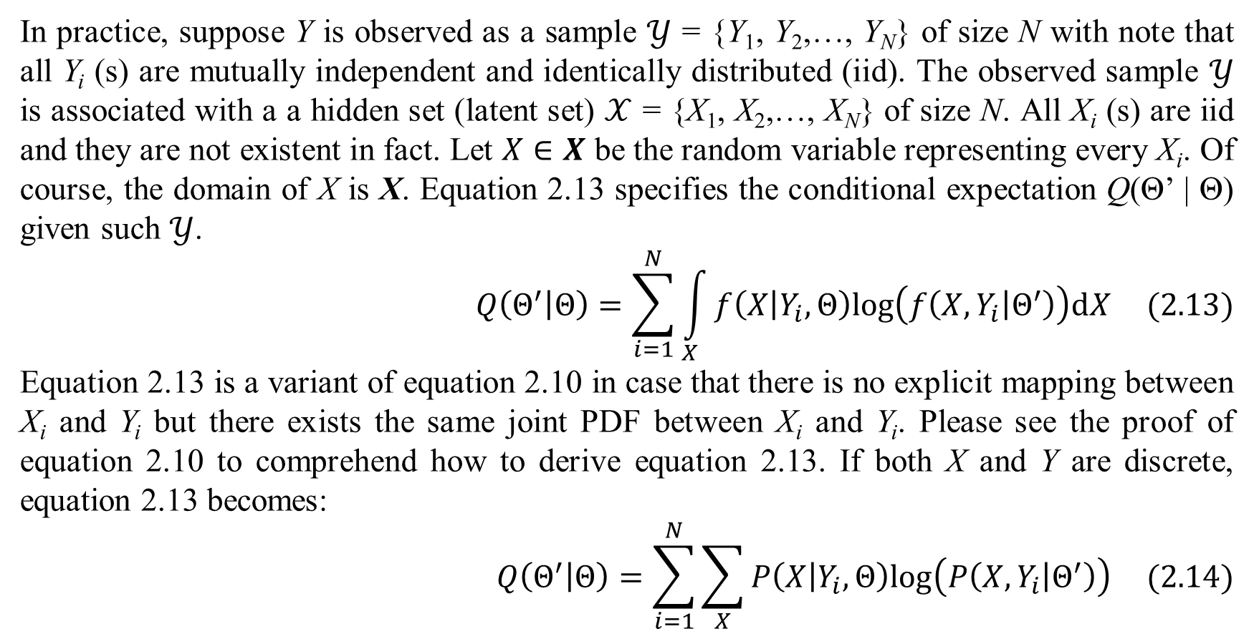
2. Practical EM algorithm
In practice, suppose Y is observed as a sample $𝒴$ = {Y₁, Y₂,…, Y_{N}} of size N with note that all Y_{i} (s) are mutually independent and identically distributed (iid). The observed sample $𝒴$ is associated with a a hidden set (latent set) $𝒳$ = {X₁, X₂,…, X_{N}} of size N. All X_{i} (s) are iid and they are not existent in fact. Let $X∈X$ be the random variable representing every X_{i}. Of course, the domain of X is X. Equation 2.13 specifies the conditional expectation Q(Θ’ | Θ) given such $𝒴$.
$$Q\left(Θ^{′} | Θ\right)=\sum_{i=1}^{N}{\int_{X}{f\left(X | Y_{i},Θ\right)log\left(f\left(X,Y_{i} | Θ^{′}\right)\right)dX}} (2.13)$$
Equation 2.13 is a variant of equation 2.10 in case that there is no explicit mapping between X_{i} and Y_{i} but there exists the same joint PDF between X_{i} and Y_{i}. Please see the proof of equation 2.10 to comprehend how to derive equation 2.13. If both X and Y are discrete, equation 2.13 becomes:
$$Q\left(Θ^{′} | Θ\right)=\sum_{i=1}^{N}{\sum_{X}{P\left(X | Y_{i},Θ\right)log\left(P\left(X,Y_{i} | Θ^{′}\right)\right)}} (2.14)$$

Slide 38
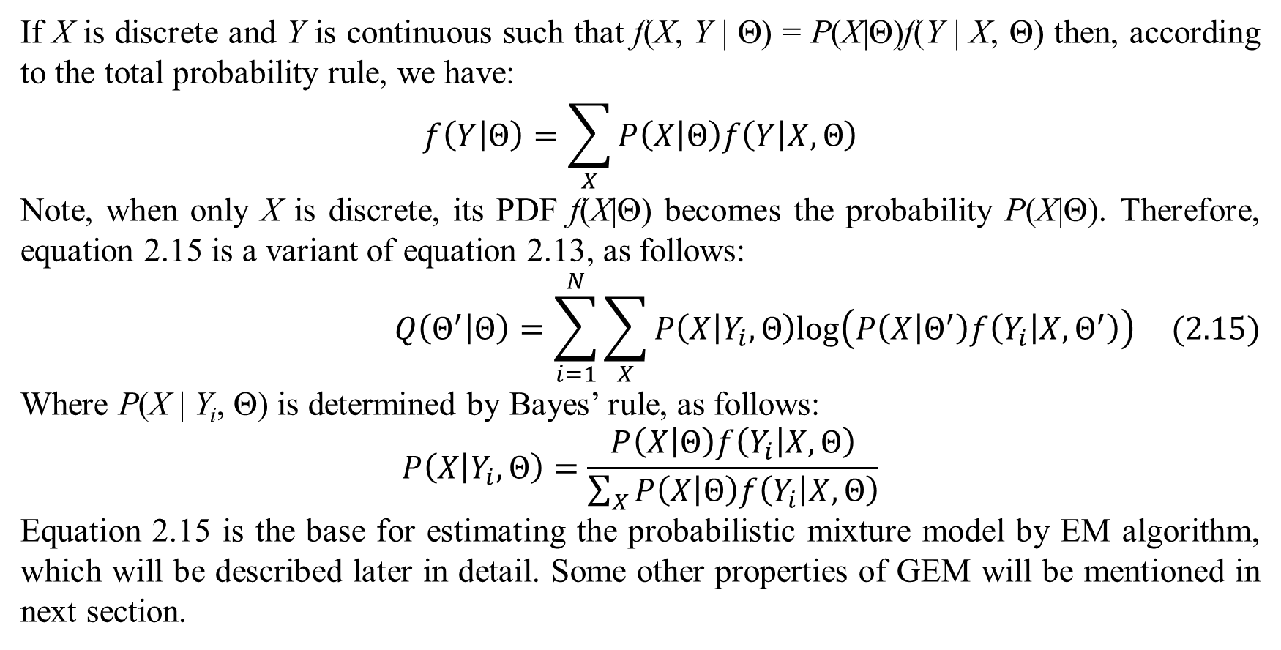
2. Practical EM algorithm
If X is discrete and Y is continuous such that f(X, Y | Θ) = P(X|Θ)f(Y | X, Θ) then, according to the total probability rule, we have:
$$f\left(Y | Θ\right)=\sum_{X}{P\left(X | Θ\right)f\left(Y | X,Θ\right)}$$
Note, when only X is discrete, its PDF f(X|Θ) becomes the probability P(X|Θ). Therefore, equation 2.15 is a variant of equation 2.13, as follows:
$$Q\left(Θ^{′} | Θ\right)=\sum_{i=1}^{N}{\sum_{X}{P\left(X | Y_{i},Θ\right)log\left(P\left(X | Θ^{′}\right)f\left(Y_{i} | X,Θ^{′}\right)\right)}} (2.15)$$
Where P(X | Y_{i}, Θ) is determined by Bayes’ rule, as follows:
$$P\left(X | Y_{i},Θ\right)=\frac{P\left(X | Θ\right)f\left(Y_{i} | X,Θ\right)}{\sum_{X}{P\left(X | Θ\right)f\left(Y_{i} | X,Θ\right)}}$$
Equation 2.15 is the base for estimating the probabilistic mixture model by EM algorithm, which will be described later in detail. Some other properties of GEM will be mentioned in next section.

Slide 39
References
Bilmes, J. A. (1998). A Gentle Tutorial of the EM Algorithm and its Application to Parameter Estimation for Gaussian Mixture and Hidden Markov Models. International Computer Science Institute, Department of Electrical Engineering and Computer Science. Berkeley: University of Washington. Retrieved from http://melodi.ee.washington.edu/people/bilmes/mypubs/bilmes1997-em.pdf
Borman, S. (2004). The Expectation Maximization Algorithm - A short tutorial. University of Notre Dame, Department of Electrical Engineering. South Bend, Indiana: Sean Borman's Home Page.
Burden, R. L., & Faires, D. J. (2011). Numerical Analysis (9th Edition ed.). (M. Julet, Ed.) Brooks/Cole Cengage Learning.
Collins, M., & Barzilay, R. (2005). Advanced Natural Language Processing - The EM Algorithm. Massachusetts Institute of Technology, Electrical Engineering and Computer Science. MIT OpenCourseWare. Retrieved October 9, 2020, from https://ocw.mit.edu/courses/electrical-engineering-and-computer-science/6-864-advanced-natural-language-processing-fall-2005/lecture-notes/lec5.pdf
Dempster, A. P., Laird, N. M., & Rubin, D. B. (1977). Maximum Likelihood from Incomplete Data via the EM Algorithm. (M. Stone, Ed.) Journal of the Royal Statistical Society, Series B (Methodological), 39(1), 1-38.
Sean, B. (2009). The Expectation Maximization Algorithm - A short tutorial. University of Notre Dame, Indiana, Department of Electrical Engineering. Sean Borman's Homepage.
Ta, P. D. (2014). Numerical Analysis Lecture Notes. Vietnam Institute of Mathematics, Numerical Analysis and Scientific Computing. Hanoi: Vietnam Institute of Mathematics. Retrieved 2014
Wikipedia. (2014, August 4). Karush–Kuhn–Tucker conditions. (Wikimedia Foundation) Retrieved November 16, 2014, from Wikipedia website: http://en.wikipedia.org/wiki/Karush–Kuhn–Tucker_conditions

Slide 40
Thank you for listening

