Slide 1
Expectation Maximization Algorithm with Combinatorial Assumption
Prof. Dr. Loc Nguyen, PostDoc
Loc Nguyen’s Academic Network, Vietnam
Email: ng_phloc@yahoo.com
Homepage: www.locnguyen.net

Slide 2
Abstract
Expectation maximization (EM) algorithm is a popular and powerful mathematical method for parameter estimation in case that there exist both observed data and hidden data. The EM process depends on an implicit relationship between observed data and hidden data which is specified by a mapping function in traditional EM and a joint probability density function (PDF) in practical EM. However, the mapping function is vague and impractical whereas the joint PDF is not easy to be defined because of heterogeneity between observed data and hidden data. The research aims to improve competency of EM by making it more feasible and easier to be specified, which removes the vagueness. Therefore, the research proposes an assumption that observed data is the combination of hidden data which is realized as an analytic function where data points are numerical. In other words, observed points are supposedly calculated from hidden points via regression model. Mathematical computations and proofs indicate feasibility and clearness of the proposed method which can be considered as an extension of EM.

Slide 3
Table of contents
Introduction
EM with combinatorial assumption
Case of scalar responsor
Without combinatorial assumption
Conclusions

Slide 4
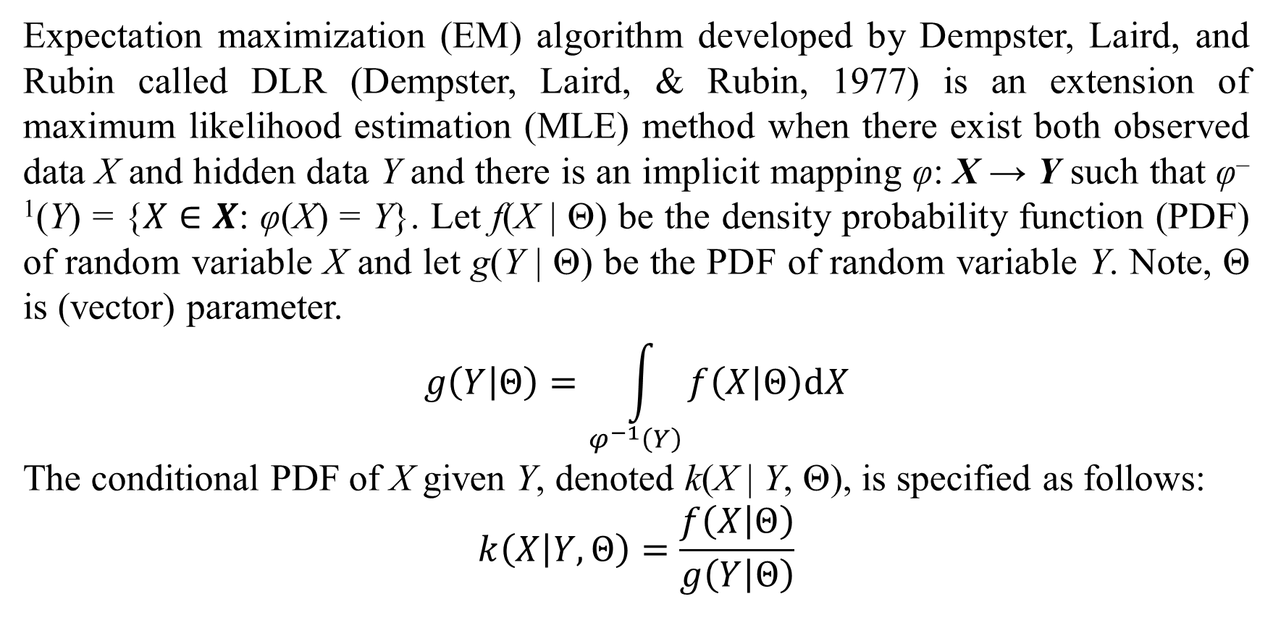
1. Introduction
Expectation maximization (EM) algorithm developed by Dempster, Laird, and Rubin called DLR (Dempster, Laird, & Rubin, 1977) is an extension of maximum likelihood estimation (MLE) method when there exist both observed data X and hidden data Y and there is an implicit mapping φ: X → Y such that φ^{–1}(Y) = {$X∈X$: φ(X) = Y}. Let f(X | Θ) be the density probability function (PDF) of random variable X and let g(Y | Θ) be the PDF of random variable Y. Note, Θ is (vector) parameter.
$$g\left(Y | Θ\right)=\int_{φ^{−1}\left(Y\right)}{f\left(X | Θ\right)dX}$$
The conditional PDF of X given Y, denoted k(X | Y, Θ), is specified as follows:
$$k\left(X | Y,Θ\right)=\frac{f\left(X | Θ\right)}{g\left(Y | Θ\right)}$$

Slide 5
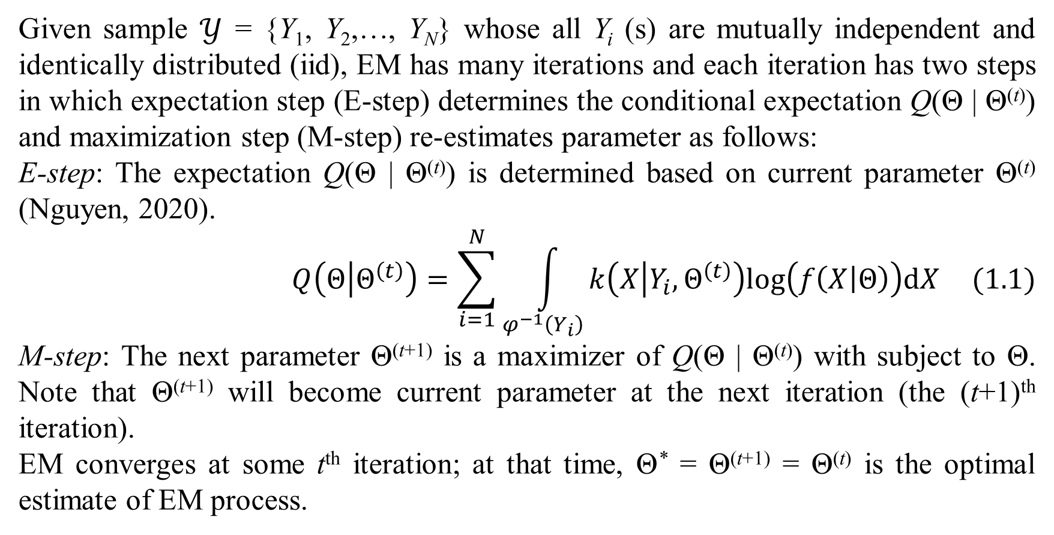
1. Introduction
Given sample $𝒴$ = {Y₁, Y₂,…, Y_{N}} whose all Y_{i} (s) are mutually independent and identically distributed (iid), EM has many iterations and each iteration has two steps in which expectation step (E-step) determines the conditional expectation Q(Θ | Θ^{(t)}) and maximization step (M-step) re-estimates parameter as follows:
E-step: The expectation Q(Θ | Θ^{(t)}) is determined based on current parameter Θ^{(t)} (Nguyen, 2020).
$$Q\left(Θ | Θ^{\left(t\right)}\right)=\sum_{i=1}^{N}{\int_{φ^{−1}\left(Y_{i}\right)}{k\left(X | Y_{i},Θ^{\left(t\right)}\right)log\left(f\left(X | Θ\right)\right)dX}} (1.1)$$
M-step: The next parameter Θ^{(t+1)} is a maximizer of Q(Θ | Θ^{(t)}) with subject to Θ. Note that Θ^{(t+1)} will become current parameter at the next iteration (the (t+1)^{th} iteration).
EM converges at some t^{th} iteration; at that time, Θ* = Θ^{(t+1)} = Θ^{(t)} is the optimal estimate of EM process.

Slide 6
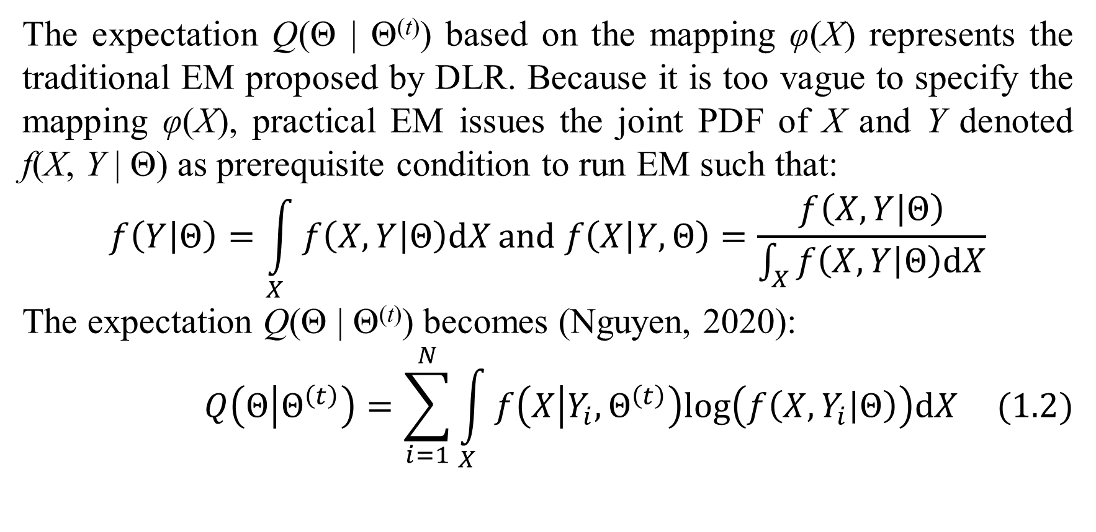
1. Introduction
The expectation Q(Θ | Θ^{(t)}) based on the mapping φ(X) represents the traditional EM proposed by DLR. Because it is too vague to specify the mapping φ(X), practical EM issues the joint PDF of X and Y denoted f(X, Y | Θ) as prerequisite condition to run EM such that:
$$f\left(Y | Θ\right)=\int_{X}{f\left(X,Y | Θ\right)dX}and f\left(X | Y,Θ\right)=\frac{f\left(X,Y | Θ\right)}{\int_{X}{f\left(X,Y | Θ\right)dX}}$$
The expectation Q(Θ | Θ^{(t)}) becomes (Nguyen, 2020):
$$Q\left(Θ | Θ^{\left(t\right)}\right)=\sum_{i=1}^{N}{\int_{X}{f\left(X | Y_{i},Θ^{\left(t\right)}\right)log\left(f\left(X,Y_{i} | Θ\right)\right)dX}} (1.2)$$

Slide 7
1. Introduction
If X and Y are too different in context due to data heterogeneity and they are not independent, it will be difficult to define the PDF f(X, Y | Θ). In general, it is not easy to specify both the mapping φ(X) in traditional EM and the joint PDF f(X, Y | Θ) in practical EM.
Therefore, the purpose of this research is to extend competency of EM, in which the observed data Y is assumed to be the combination of X, called combinatorial assumption (CA). In other words, Y can be calculated by an analytic function of X, which is more feasible than specifying the mapping φ(X) and easier than specifying the joint PDF f(X, Y).

Slide 8
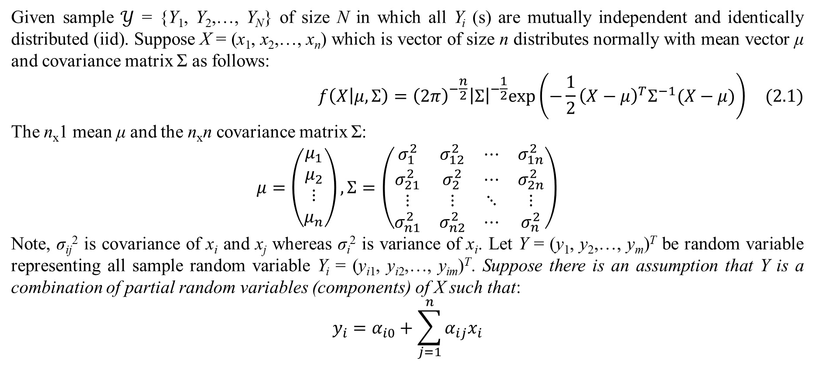
2. EM with combinatorial assumption
Given sample $𝒴$ = {Y₁, Y₂,…, Y_{N}} of size N in which all Y_{i} (s) are mutually independent and identically distributed (iid). Suppose X = (x₁, x₂,…, x_{n}) which is vector of size n distributes normally with mean vector μ and covariance matrix Σ as follows:
$$f\left(X | μ,Σ\right)={\left(2π\right)}^{−\frac{n}{2}}{\left|Σ\right|}^{−\frac{1}{2}}exp\left(−\frac{1}{2}{\left(X−μ\right)}^{T}Σ^{−1}(X−μ)\right) (2.1)$$
The n_{x}1 mean μ and the n_{x}n covariance matrix Σ:
$$μ=\left(\begin{matrix}μ_{1} \\ μ_{2} \\ ⋮ \\ μ_{n}\end{matrix}\right),Σ=\left(\begin{matrix}σ_{1}^{2} & σ_{12}^{2} & ⋯ & σ_{1n}^{2} \\ σ_{21}^{2} & σ_{2}^{2} & ⋯ & σ_{2n}^{2} \\ ⋮ & ⋮ & ⋱ & ⋮ \\ σ_{n1}^{2} & σ_{n2}^{2} & ⋯ & σ_{n}^{2}\end{matrix}\right)$$
Note, σ_{ij}² is covariance of x_{i} and x_{j} whereas σ_{i}² is variance of x_{i}. Let Y = (y₁, y₂,…, y_{m})^{T} be random variable representing all sample random variable Y_{i} = (y_{i1}, y_{i2},…, y_{im})^{T}. Suppose there is an assumption that Y is a combination of partial random variables (components) of X such that:
$$y_{i}=α_{i0}+\sum_{j=1}^{n}{α_{ij}x_{i}}$$

Slide 9
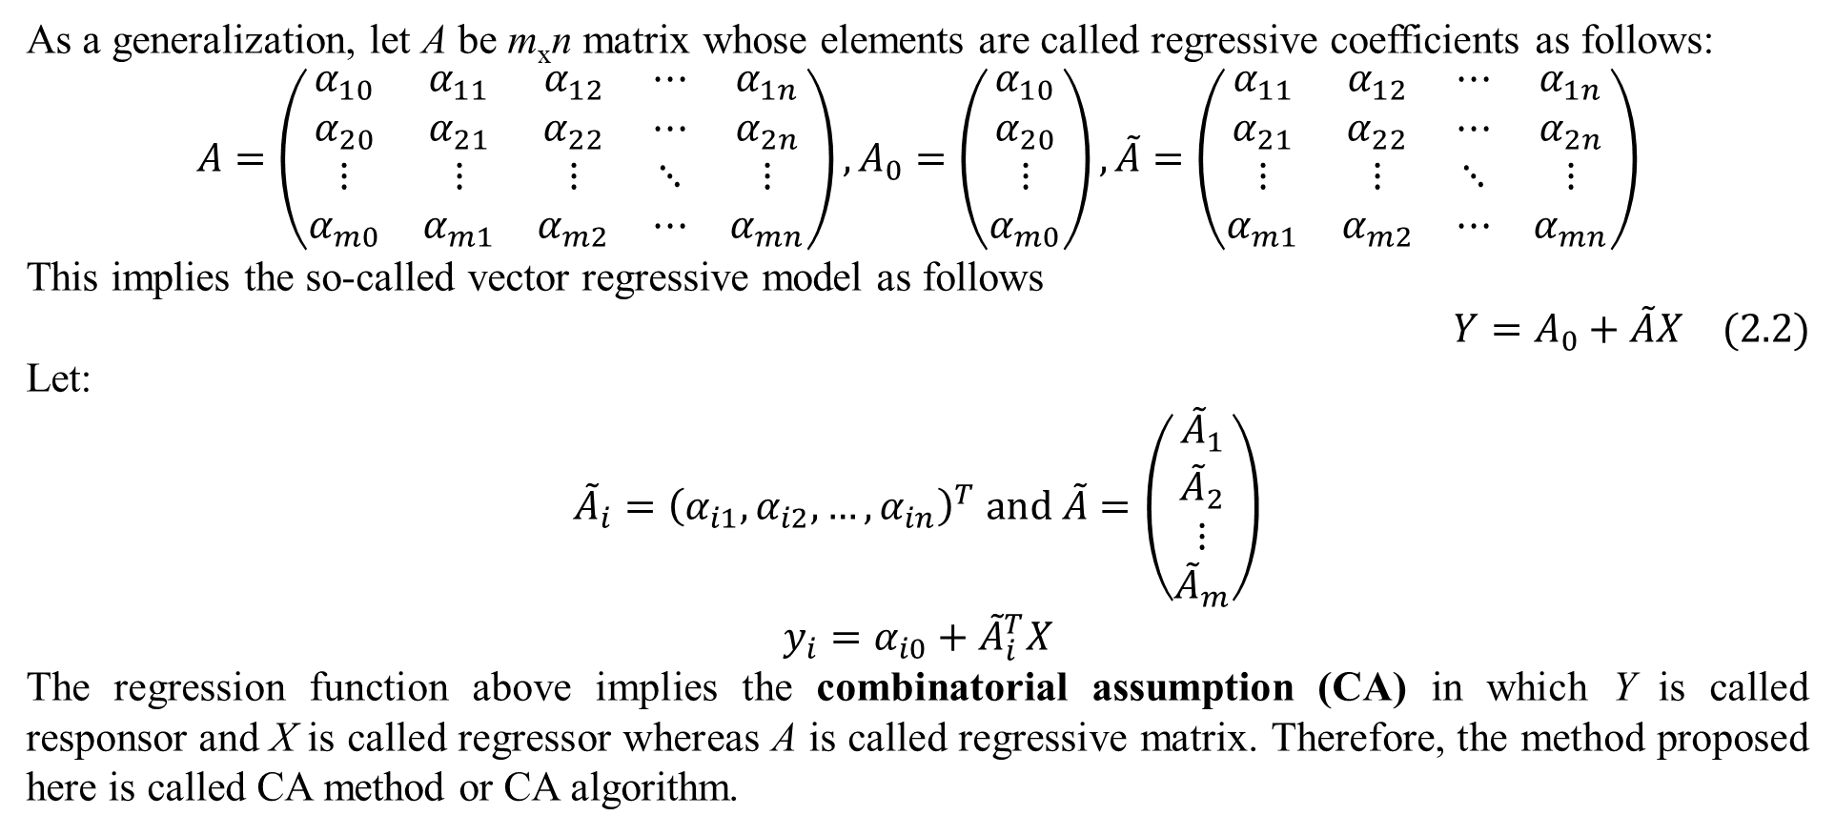
2. EM with combinatorial assumption
As a generalization, let A be m_{x}n matrix whose elements are called regressive coefficients as follows:
$$A=\left(\begin{matrix}α_{10} & α_{11} & α_{12} & ⋯ & α_{1n} \\ α_{20} & α_{21} & α_{22} & ⋯ & α_{2n} \\ ⋮ & ⋮ & ⋮ & ⋱ & ⋮ \\ α_{m0} & α_{m1} & α_{m2} & ⋯ & α_{mn}\end{matrix}\right),A_{0}=\left(\begin{matrix}α_{10} \\ α_{20} \\ ⋮ \\ α_{m0}\end{matrix}\right),\tilde{A}=\left(\begin{matrix}α_{11} & α_{12} & ⋯ & α_{1n} \\ α_{21} & α_{22} & ⋯ & α_{2n} \\ ⋮ & ⋮ & ⋱ & ⋮ \\ α_{m1} & α_{m2} & ⋯ & α_{mn}\end{matrix}\right)$$
This implies the so-called vector regressive model as follows
$$Y=A_{0}+\tilde{A}X (2.2)$$
Let:
$${\tilde{A}}_{i}={\left(α_{i1},α_{i2},…,α_{in}\right)}^{T} and \tilde{A}=\left(\begin{matrix}{\tilde{A}}_{1} \\ {\tilde{A}}_{2} \\ ⋮ \\ {\tilde{A}}_{m}\end{matrix}\right)$$
$$y_{i}=α_{i0}+{\tilde{A}}_{i}^{T}X$$
The regression function above implies the combinatorial assumption (CA) in which Y is called responsor and X is called regressor whereas A is called regressive matrix. Therefore, the method proposed here is called CA method or CA algorithm.

Slide 10
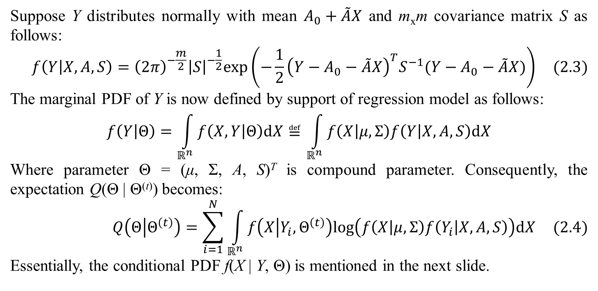
2. EM with combinatorial assumption
Suppose Y distributes normally with mean $A_{0}+\tilde{A}X$ and m_{x}m covariance matrix S as follows:
$$f\left(Y | X,A,S\right)={\left(2π\right)}^{−\frac{m}{2}}{\left|S\right|}^{−\frac{1}{2}}exp\left(−\frac{1}{2}{\left(Y−A_{0}−\tilde{A}X\right)}^{T}S^{−1}(Y−A_{0}−\tilde{A}X)\right) (2.3)$$
The marginal PDF of Y is now defined by support of regression model as follows:
$$f\left(Y | Θ\right)=\int_{ℝ^{n}}{f\left(X,Y | Θ\right)dX}≝\int_{ℝ^{n}}{f\left(X | μ,Σ\right)f\left(Y | X,A,S\right)dX}$$
Where parameter Θ = (μ, Σ, A, S)^{T} is compound parameter. Consequently, the expectation Q(Θ | Θ^{(t)}) becomes:
$$Q\left(Θ | Θ^{\left(t\right)}\right)=\sum_{i=1}^{N}{\int_{ℝ^{n}}{f\left(X | Y_{i},Θ^{\left(t\right)}\right)log\left(f\left(X | μ,Σ\right)f\left(Y_{i} | X,A,S\right)\right)dX}} (2.4)$$
Essentially, the conditional PDF f(X | Y, Θ) is mentioned in the next slide.

Slide 11
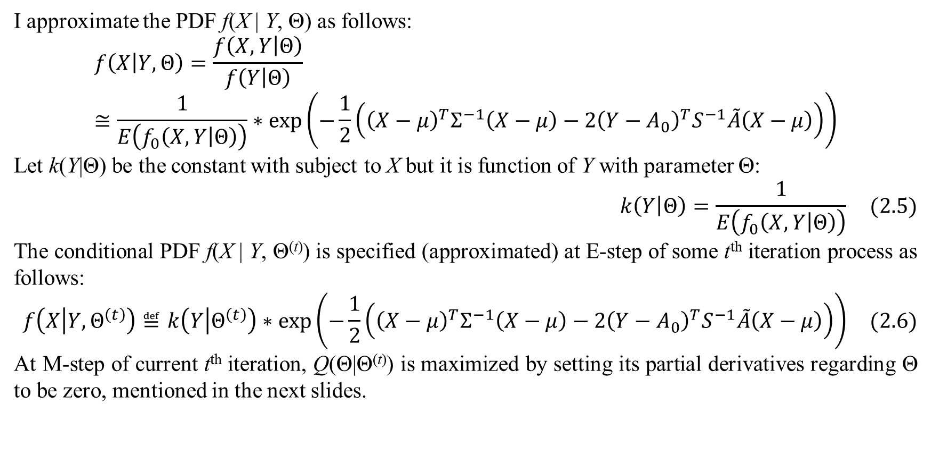
2. EM with combinatorial assumption
I approximate the PDF f(X | Y, Θ) as follows:
$$f\left(X | Y,Θ\right)=\frac{f\left(X,Y | Θ\right)}{f\left(Y | Θ\right)}≅\frac{1}{E\left(f_{0}\left(X,Y | Θ\right)\right)}∗exp\left(−\frac{1}{2}\left({\left(X−μ\right)}^{T}Σ^{−1}\left(X−μ\right)−2{\left(Y−A_{0}\right)}^{T}S^{−1}\tilde{A}\left(X−μ\right)\right)\right)$$
Let k(Y|Θ) be the constant with subject to X but it is function of Y with parameter Θ:
$$k\left(Y | Θ\right)=\frac{1}{E\left(f_{0}\left(X,Y | Θ\right)\right)} (2.5)$$
The conditional PDF f(X | Y, Θ^{(t)}) is specified (approximated) at E-step of some t^{th} iteration process as follows:
$$f\left(X | Y,Θ^{\left(t\right)}\right)≝k\left(Y | Θ^{\left(t\right)}\right)∗exp\left(−\frac{1}{2}\left({\left(X−μ\right)}^{T}Σ^{−1}\left(X−μ\right)−2{\left(Y−A_{0}\right)}^{T}S^{−1}\tilde{A}\left(X−μ\right)\right)\right) (2.6)$$
At M-step of current t^{th} iteration, Q(Θ|Θ^{(t)}) is maximized by setting its partial derivatives regarding Θ to be zero, mentioned in the next slides.

Slide 12
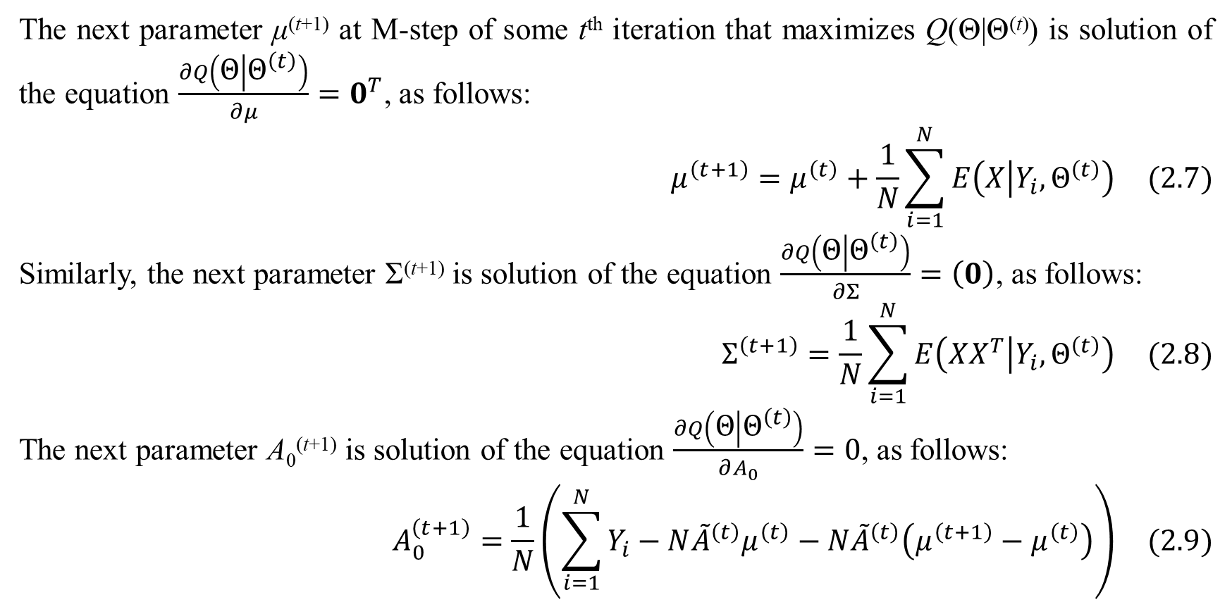
2. EM with combinatorial assumption
The next parameter μ^{(t+1)} at M-step of some t^{th} iteration that maximizes Q(Θ|Θ^{(t)}) is solution of the equation $\frac{∂Q\left(Θ | Θ^{\left(t\right)}\right)}{∂μ}=0^{T}$, as follows:
$$μ^{\left(t+1\right)}=μ^{\left(t\right)}+\frac{1}{N}\sum_{i=1}^{N}{E\left(X | Y_{i},Θ^{\left(t\right)}\right)} (2.7)$$
Similarly, the next parameter Σ^{(t+1)} is solution of the equation $\frac{∂Q\left(Θ | Θ^{\left(t\right)}\right)}{∂Σ}=\left(0\right)$, as follows:
$$Σ^{\left(t+1\right)}=\frac{1}{N}\sum_{i=1}^{N}{E\left(XX^{T} | Y_{i},Θ^{\left(t\right)}\right)} (2.8)$$
The next parameter A₀^{(t+1)} is solution of the equation $\frac{∂Q\left(Θ | Θ^{\left(t\right)}\right)}{∂A_{0}}=0$, as follows:
$$A_{0}^{\left(t+1\right)}=\frac{1}{N}\left(\sum_{i=1}^{N}{Y_{i}}−N{\tilde{A}}^{\left(t\right)}μ^{\left(t\right)}−N{\tilde{A}}^{\left(t\right)}\left(μ^{\left(t+1\right)}−μ^{\left(t\right)}\right)\right) (2.9)$$

Slide 13
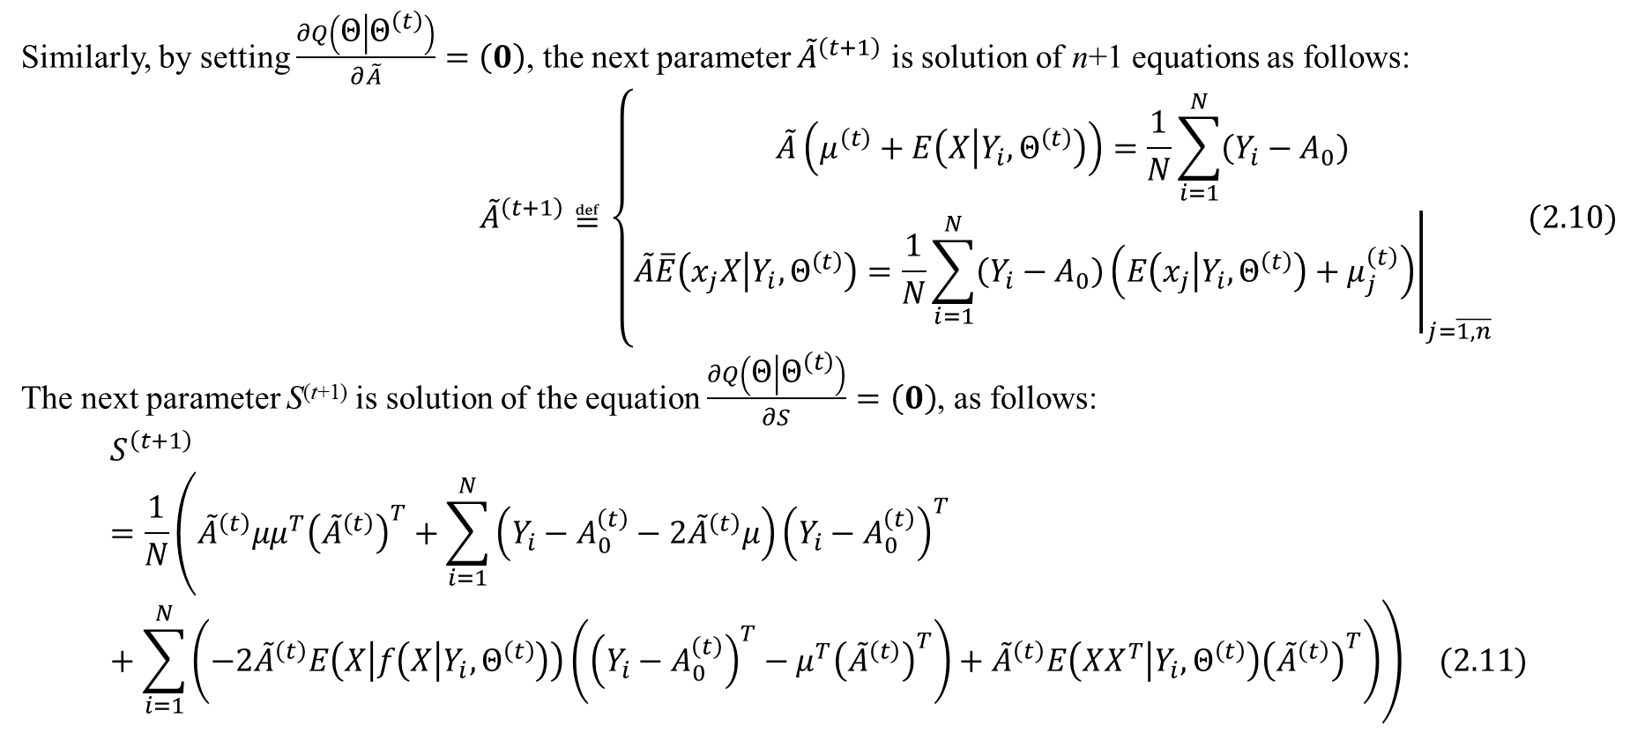
2. EM with combinatorial assumption
Similarly, by setting $\frac{∂Q\left(Θ | Θ^{\left(t\right)}\right)}{∂\tilde{A}}=\left(0\right)$, the next parameter ${\tilde{A}}^{\left(t+1\right)}$ is solution of n+1 equations as follows:
$${\tilde{A}}^{\left(t+1\right)}≝\left\{\begin{matrix}\tilde{A}\left(μ^{\left(t\right)}+E\left(X | Y_{i},Θ^{\left(t\right)}\right)\right)=\frac{1}{N}\sum_{i=1}^{N}{\left(Y_{i}−A_{0}\right)} \\ {\left.\tilde{A}\overline{E}\left(x_{j}X | Y_{i},Θ^{\left(t\right)}\right)=\frac{1}{N}\sum_{i=1}^{N}{\left(Y_{i}−A_{0}\right)\left(E\left(x_{j} | Y_{i},Θ^{\left(t\right)}\right)+μ_{j}^{\left(t\right)}\right)}\right|}_{j=\overline{1,n}}\end{matrix}\right. (2.10)$$
The next parameter S^{(t+1)} is solution of the equation $\frac{∂Q\left(Θ | Θ^{\left(t\right)}\right)}{∂S}=\left(0\right)$, as follows:
$$S^{\left(t+1\right)}=\frac{1}{N}\left({\tilde{A}}^{\left(t\right)}μμ^{T}{\left({\tilde{A}}^{\left(t\right)}\right)}^{T}+\sum_{i=1}^{N}{\left(Y_{i}−A_{0}^{\left(t\right)}−2{\tilde{A}}^{\left(t\right)}μ\right){\left(Y_{i}−A_{0}^{\left(t\right)}\right)}^{T}}+\sum_{i=1}^{N}{\left(−2{\tilde{A}}^{\left(t\right)}E\left(X | f\left(X | Y_{i},Θ^{\left(t\right)}\right)\right)\left({\left(Y_{i}−A_{0}^{\left(t\right)}\right)}^{T}−μ^{T}{\left({\tilde{A}}^{\left(t\right)}\right)}^{T}\right)+{\tilde{A}}^{\left(t\right)}E\left(XX^{T} | Y_{i},Θ^{\left(t\right)}\right){\left({\tilde{A}}^{\left(t\right)}\right)}^{T}\right)}\right) (2.11)$$

Slide 14
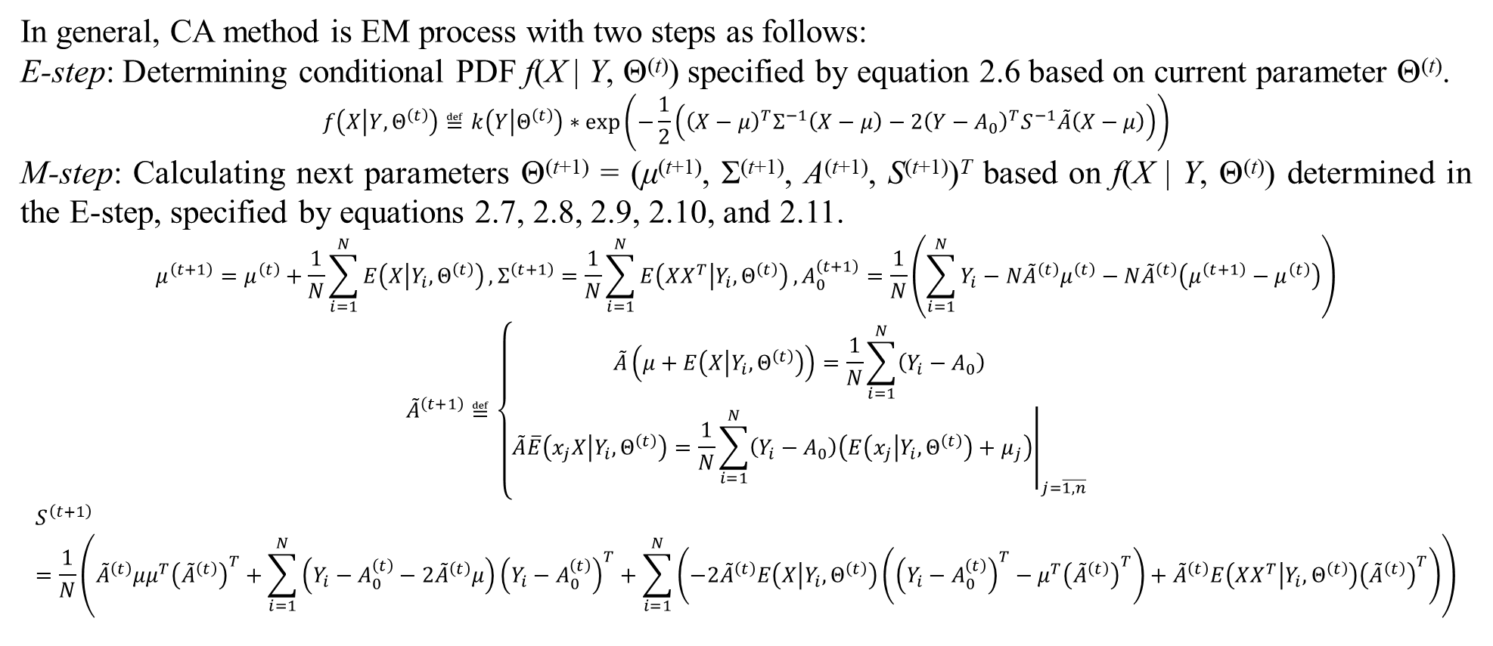
2. EM with combinatorial assumption
In general, CA method is EM process with two steps as follows:
E-step: Determining conditional PDF f(X | Y, Θ^{(t)}) specified by equation 2.6 based on current parameter Θ^{(t)}.
$$f\left(X | Y,Θ^{\left(t\right)}\right)≝k\left(Y | Θ^{\left(t\right)}\right)∗exp\left(−\frac{1}{2}\left({\left(X−μ\right)}^{T}Σ^{−1}\left(X−μ\right)−2{\left(Y−A_{0}\right)}^{T}S^{−1}\tilde{A}\left(X−μ\right)\right)\right)$$
M-step: Calculating next parameters Θ^{(t+1)} = (μ^{(t+1)}, Σ^{(t+1)}, A^{(t+1)}, S^{(t+1)})^{T} based on f(X | Y, Θ^{(t)}) determined in the E-step, specified by equations 2.7, 2.8, 2.9, 2.10, and 2.11.
$$μ^{\left(t+1\right)}=μ^{\left(t\right)}+\frac{1}{N}\sum_{i=1}^{N}{E\left(X | Y_{i},Θ^{\left(t\right)}\right)},Σ^{\left(t+1\right)}=\frac{1}{N}\sum_{i=1}^{N}{E\left(XX^{T} | Y_{i},Θ^{\left(t\right)}\right)},A_{0}^{\left(t+1\right)}=\frac{1}{N}\left(\sum_{i=1}^{N}{Y_{i}}−N{\tilde{A}}^{\left(t\right)}μ^{\left(t\right)}−N{\tilde{A}}^{\left(t\right)}\left(μ^{\left(t+1\right)}−μ^{\left(t\right)}\right)\right)$$
$${\tilde{A}}^{\left(t+1\right)}≝\left\{\begin{matrix}\tilde{A}\left(μ+E\left(X | Y_{i},Θ^{\left(t\right)}\right)\right)=\frac{1}{N}\sum_{i=1}^{N}{\left(Y_{i}−A_{0}\right)} \\ {\left.\tilde{A}\overline{E}\left(x_{j}X | Y_{i},Θ^{\left(t\right)}\right)=\frac{1}{N}\sum_{i=1}^{N}{\left(Y_{i}−A_{0}\right)\left(E\left(x_{j} | Y_{i},Θ^{\left(t\right)}\right)+μ_{j}\right)}\right|}_{j=\overline{1,n}}\end{matrix}\right.$$
$$S^{\left(t+1\right)}=\frac{1}{N}\left({\tilde{A}}^{\left(t\right)}μμ^{T}{\left({\tilde{A}}^{\left(t\right)}\right)}^{T}+\sum_{i=1}^{N}{\left(Y_{i}−A_{0}^{\left(t\right)}−2{\tilde{A}}^{\left(t\right)}μ\right){\left(Y_{i}−A_{0}^{\left(t\right)}\right)}^{T}}+\sum_{i=1}^{N}{\left(−2{\tilde{A}}^{\left(t\right)}E\left(X | Y_{i},Θ^{\left(t\right)}\right)\left({\left(Y_{i}−A_{0}^{\left(t\right)}\right)}^{T}−μ^{T}{\left({\tilde{A}}^{\left(t\right)}\right)}^{T}\right)+{\tilde{A}}^{\left(t\right)}E\left(XX^{T} | Y_{i},Θ^{\left(t\right)}\right){\left({\tilde{A}}^{\left(t\right)}\right)}^{T}\right)}\right)$$

Slide 15
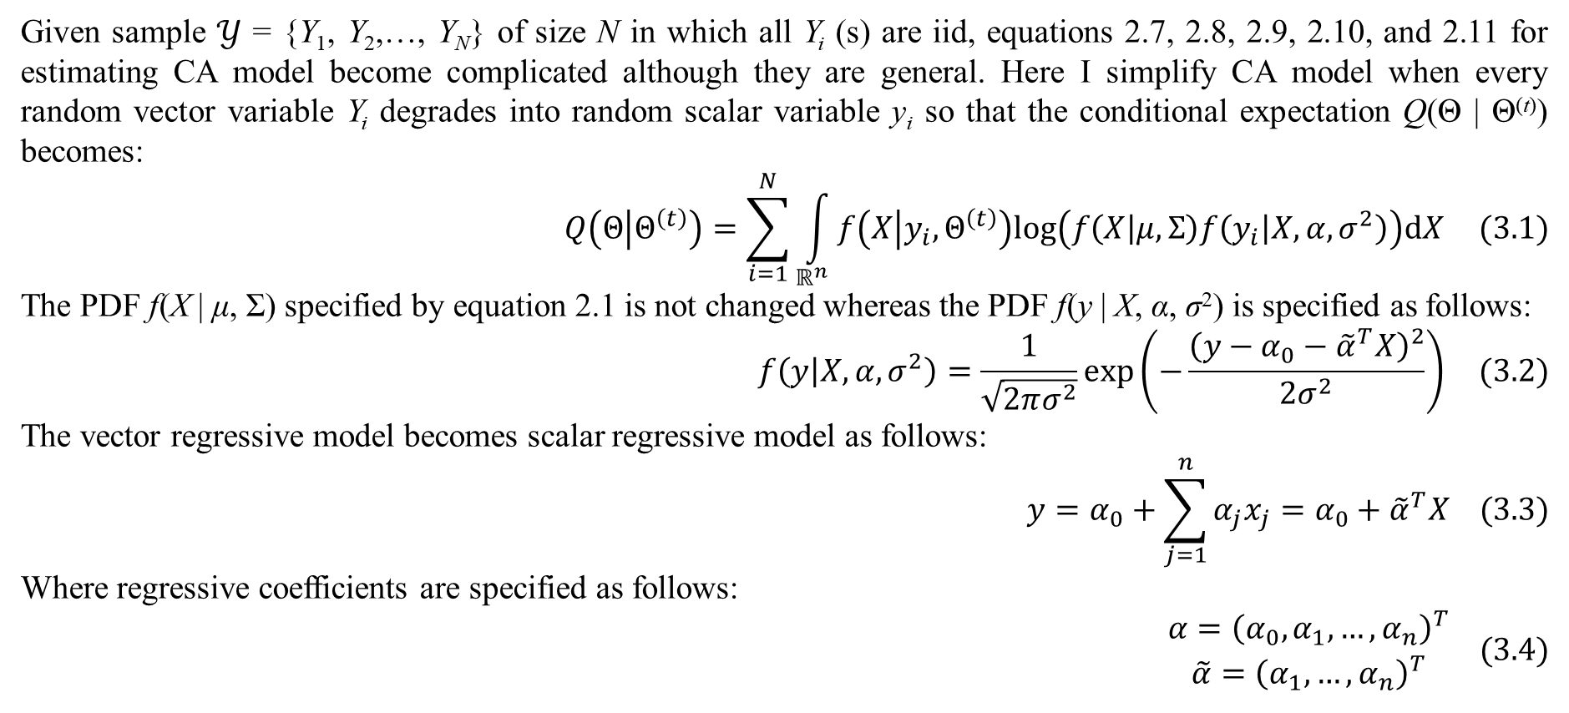
3. Case of scalar responsor
Given sample $𝒴$ = {Y₁, Y₂,…, Y_{N}} of size N in which all Y_{i} (s) are iid, equations 2.7, 2.8, 2.9, 2.10, and 2.11 for estimating CA model become complicated although they are general. Here I simplify CA model when every random vector variable Y_{i} degrades into random scalar variable y_{i} so that the conditional expectation Q(Θ | Θ^{(t)}) becomes:
$$Q\left(Θ | Θ^{\left(t\right)}\right)=\sum_{i=1}^{N}{\int_{ℝ^{n}}{f\left(X | y_{i},Θ^{\left(t\right)}\right)log\left(f\left(X | μ,Σ\right)f\left(y_{i} | X,α,σ^{2}\right)\right)dX}} (3.1)$$
The PDF f(X | μ, Σ) specified by equation 2.1 is not changed whereas the PDF f(y | X, α, σ²) is specified as follows:
$$f\left(y | X,α,σ^{2}\right)=\frac{1}{\sqrt{2πσ^{2}}}exp\left(−\frac{{\left(y−α_{0}−{\tilde{α}}^{T}X\right)}^{2}}{2σ^{2}}\right) (3.2)$$
The vector regressive model becomes scalar regressive model as follows:
$$y=α_{0}+\sum_{j=1}^{n}{α_{j}x_{j}}=α_{0}+{\tilde{α}}^{T}X (3.3)$$
Where regressive coefficients are specified as follows:
$$\begin{matrix}α={\left(α_{0},α_{1},…,α_{n}\right)}^{T} \\ \tilde{α}={\left(α_{1},…,α_{n}\right)}^{T}\end{matrix} (3.4)$$

Slide 16
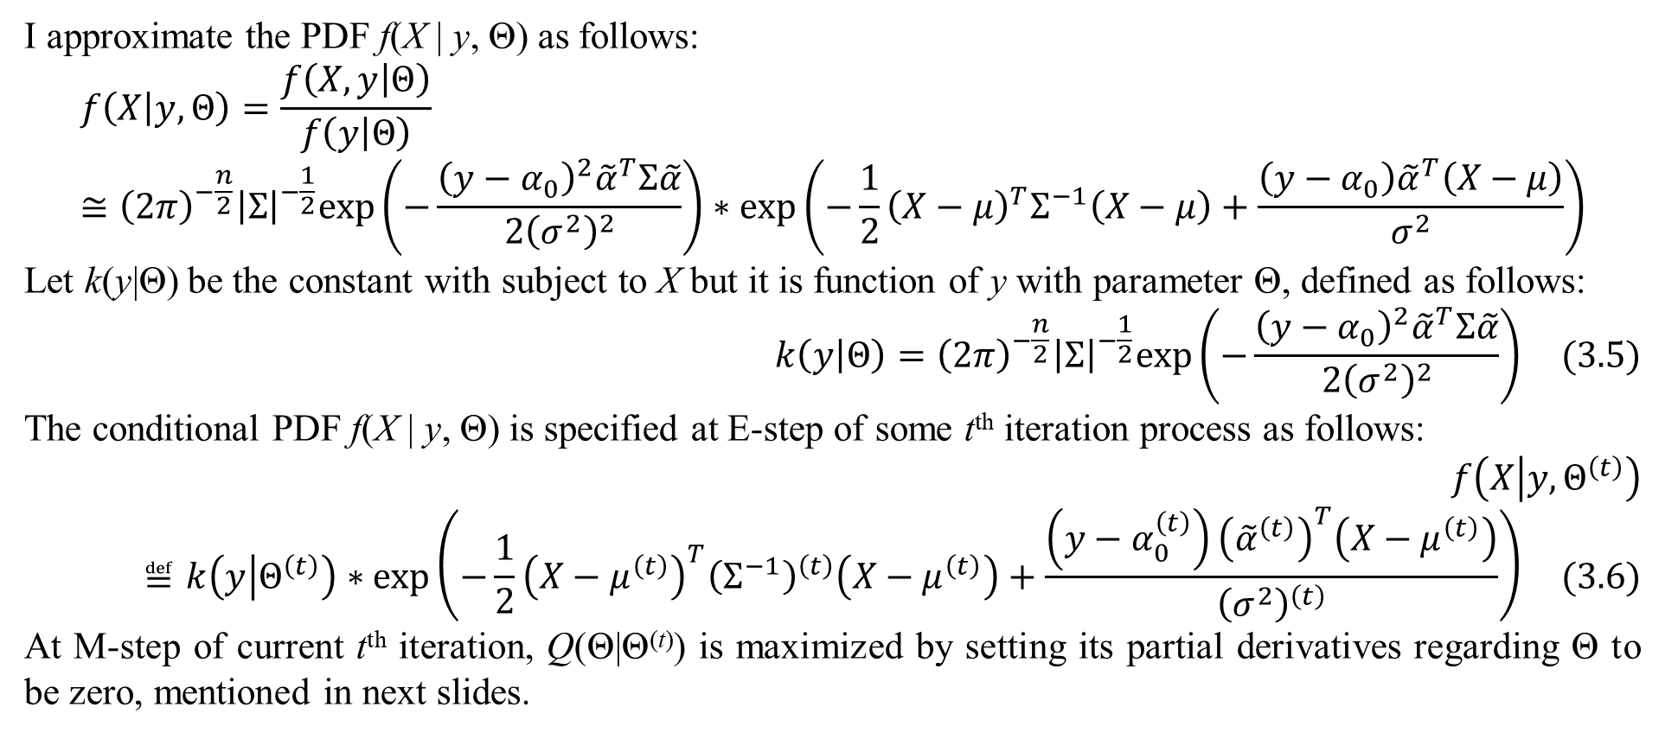
3. Case of scalar responsor
I approximate the PDF f(X | y, Θ) as follows:
$$f\left(X | y,Θ\right)=\frac{f\left(X,y | Θ\right)}{f\left(y | Θ\right)}≅{\left(2π\right)}^{−\frac{n}{2}}{\left|Σ\right|}^{−\frac{1}{2}}exp\left(−\frac{{\left(y−α_{0}\right)}^{2}{\tilde{α}}^{T}Σ\tilde{α}}{2{\left(σ^{2}\right)}^{2}}\right)∗exp\left(−\frac{1}{2}{\left(X−μ\right)}^{T}Σ^{−1}\left(X−μ\right)+\frac{\left(y−α_{0}\right){\tilde{α}}^{T}\left(X−μ\right)}{σ^{2}}\right)$$
Let k(y|Θ) be the constant with subject to X but it is function of y with parameter Θ, defined as follows:
$$k\left(y | Θ\right)={\left(2π\right)}^{−\frac{n}{2}}{\left|Σ\right|}^{−\frac{1}{2}}exp\left(−\frac{{\left(y−α_{0}\right)}^{2}{\tilde{α}}^{T}Σ\tilde{α}}{2{\left(σ^{2}\right)}^{2}}\right) (3.5)$$
The conditional PDF f(X | y, Θ) is specified at E-step of some t^{th} iteration process as follows:
$$f\left(X | y,Θ^{\left(t\right)}\right)≝k\left(y | Θ^{\left(t\right)}\right)∗exp\left(−\frac{1}{2}{\left(X−μ^{\left(t\right)}\right)}^{T}{\left(Σ^{−1}\right)}^{\left(t\right)}\left(X−μ^{\left(t\right)}\right)+\frac{\left(y−α_{0}^{\left(t\right)}\right){\left({\tilde{α}}^{\left(t\right)}\right)}^{T}\left(X−μ^{\left(t\right)}\right)}{{\left(σ^{2}\right)}^{\left(t\right)}}\right) (3.6)$$
At M-step of current t^{th} iteration, Q(Θ|Θ^{(t)}) is maximized by setting its partial derivatives regarding Θ to be zero, mentioned in next slides.

Slide 17
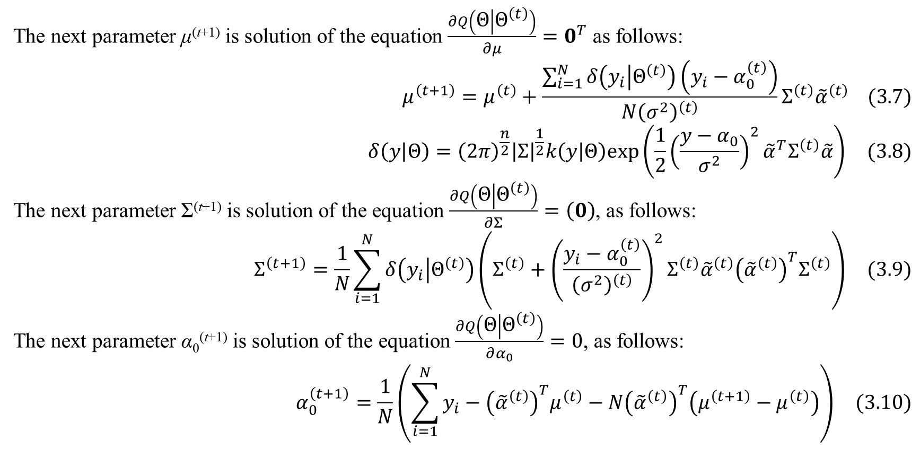
3. Case of scalar responsor
The next parameter μ^{(t+1)} is solution of the equation $\frac{∂Q\left(Θ | Θ^{\left(t\right)}\right)}{∂μ}=0^{T}$ as follows:
$$μ^{\left(t+1\right)}=μ^{\left(t\right)}+\frac{\sum_{i=1}^{N}{δ\left(y_{i} | Θ^{\left(t\right)}\right)\left(y_{i}−α_{0}^{\left(t\right)}\right)}}{N{\left(σ^{2}\right)}^{\left(t\right)}}Σ^{\left(t\right)}{\tilde{α}}^{\left(t\right)} (3.7)$$
$$δ\left(y | Θ\right)={\left(2π\right)}^{\frac{n}{2}}{\left|Σ\right|}^{\frac{1}{2}}k\left(y | Θ\right)exp\left(\frac{1}{2}{\left(\frac{y−α_{0}}{σ^{2}}\right)}^{2}{\tilde{α}}^{T}Σ^{\left(t\right)}\tilde{α}\right) (3.8)$$
The next parameter Σ^{(t+1)} is solution of the equation $\frac{∂Q\left(Θ | Θ^{\left(t\right)}\right)}{∂Σ}=\left(0\right)$, as follows:
$$Σ^{\left(t+1\right)}=\frac{1}{N}\sum_{i=1}^{N}{δ\left(y_{i} | Θ^{\left(t\right)}\right)\left(Σ^{\left(t\right)}+{\left(\frac{y_{i}−α_{0}^{\left(t\right)}}{{\left(σ^{2}\right)}^{\left(t\right)}}\right)}^{2}Σ^{\left(t\right)}{\tilde{α}}^{\left(t\right)}{\left({\tilde{α}}^{\left(t\right)}\right)}^{T}Σ^{\left(t\right)}\right)} (3.9)$$
The next parameter α₀^{(t+1)} is solution of the equation $\frac{∂Q\left(Θ | Θ^{\left(t\right)}\right)}{∂α_{0}}=0$, as follows:
$$α_{0}^{\left(t+1\right)}=\frac{1}{N}\left(\sum_{i=1}^{N}{y_{i}}−{\left({\tilde{α}}^{\left(t\right)}\right)}^{T}μ^{\left(t\right)}−N{\left({\tilde{α}}^{\left(t\right)}\right)}^{T}\left(μ^{\left(t+1\right)}−μ^{\left(t\right)}\right)\right) (3.10)$$

Slide 18
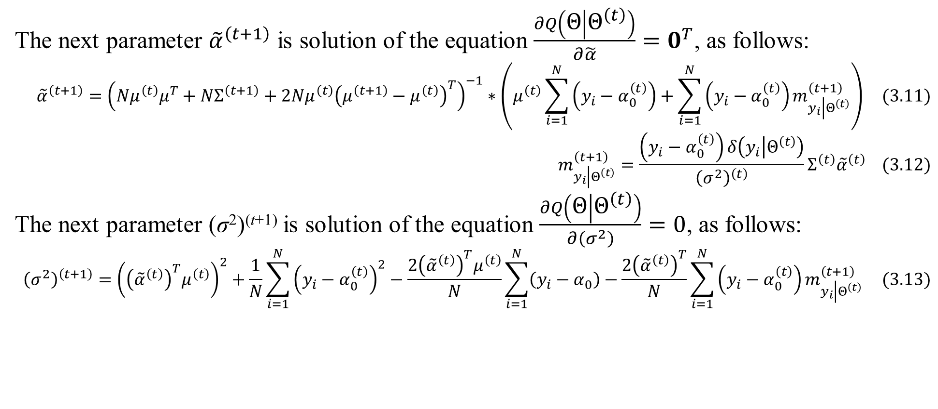
3. Case of scalar responsor
The next parameter ${\tilde{α}}^{\left(t+1\right)}$ is solution of the equation $\frac{∂Q\left(Θ | Θ^{\left(t\right)}\right)}{∂\tilde{α}}=0^{T}$, as follows:
$${\tilde{α}}^{\left(t+1\right)}={\left(Nμ^{\left(t\right)}μ^{T}+NΣ^{\left(t+1\right)}+2Nμ^{\left(t\right)}{\left(μ^{\left(t+1\right)}−μ^{\left(t\right)}\right)}^{T}\right)}^{−1}∗\left(μ^{\left(t\right)}\sum_{i=1}^{N}{\left(y_{i}−α_{0}^{\left(t\right)}\right)}+\sum_{i=1}^{N}{\left(y_{i}−α_{0}^{\left(t\right)}\right)m_{y_{i}\left|Θ^{\left(t\right)}\right.}^{\left(t+1\right)}}\right) (3.11)$$
$$m_{y_{i}\left|Θ^{\left(t\right)}\right.}^{\left(t+1\right)}=\frac{\left(y_{i}−α_{0}^{\left(t\right)}\right)δ\left(y_{i} | Θ^{\left(t\right)}\right)}{{\left(σ^{2}\right)}^{\left(t\right)}}Σ^{\left(t\right)}{\tilde{α}}^{\left(t\right)} (3.12)$$
The next parameter (σ²)^{(t+1)} is solution of the equation $\frac{∂Q\left(Θ | Θ^{\left(t\right)}\right)}{∂\left(σ^{2}\right)}=0$, as follows:
$${\left(σ^{2}\right)}^{\left(t+1\right)}={\left({\left({\tilde{α}}^{\left(t\right)}\right)}^{T}μ^{\left(t\right)}\right)}^{2}+\frac{1}{N}\sum_{i=1}^{N}{{\left(y_{i}−α_{0}^{\left(t\right)}\right)}^{2}}−\frac{2{\left({\tilde{α}}^{\left(t\right)}\right)}^{T}μ^{\left(t\right)}}{N}\sum_{i=1}^{N}{\left(y_{i}−α_{0}\right)}−\frac{2{\left({\tilde{α}}^{\left(t\right)}\right)}^{T}}{N}\sum_{i=1}^{N}{\left(y_{i}−α_{0}^{\left(t\right)}\right)m_{y_{i}\left|Θ^{\left(t\right)}\right.}^{\left(t+1\right)}} (3.13)$$

Slide 19
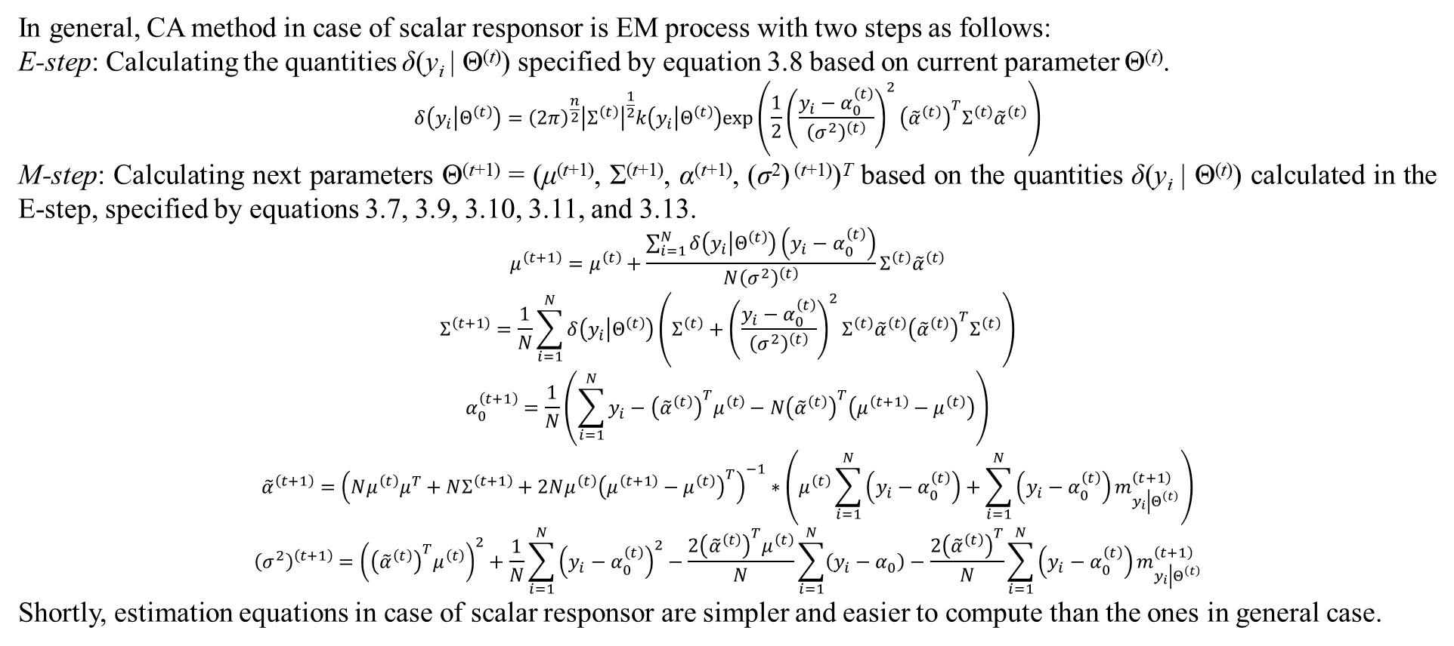
3. Case of scalar responsor
In general, CA method in case of scalar responsor is EM process with two steps as follows:
E-step: Calculating the quantities δ(y_{i} | Θ^{(t)}) specified by equation 3.8 based on current parameter Θ^{(t)}.
$$δ\left(y_{i} | Θ^{\left(t\right)}\right)={\left(2π\right)}^{\frac{n}{2}}{\left|Σ^{\left(t\right)}\right|}^{\frac{1}{2}}k\left(y_{i} | Θ^{\left(t\right)}\right)exp\left(\frac{1}{2}{\left(\frac{y_{i}−α_{0}^{\left(t\right)}}{{\left(σ^{2}\right)}^{\left(t\right)}}\right)}^{2}{\left({\tilde{α}}^{\left(t\right)}\right)}^{T}Σ^{\left(t\right)}{\tilde{α}}^{\left(t\right)}\right)$$
M-step: Calculating next parameters Θ^{(t+1)} = (μ^{(t+1)}, Σ^{(t+1)}, α^{(t+1)}, (σ²) ^{(t+1)})^{T} based on the quantities δ(y_{i} | Θ^{(t)}) calculated in the E-step, specified by equations 3.7, 3.9, 3.10, 3.11, and 3.13.
$$μ^{\left(t+1\right)}=μ^{\left(t\right)}+\frac{\sum_{i=1}^{N}{δ\left(y_{i} | Θ^{\left(t\right)}\right)\left(y_{i}−α_{0}^{\left(t\right)}\right)}}{N{\left(σ^{2}\right)}^{\left(t\right)}}Σ^{\left(t\right)}{\tilde{α}}^{\left(t\right)}$$
$$Σ^{\left(t+1\right)}=\frac{1}{N}\sum_{i=1}^{N}{δ\left(y_{i} | Θ^{\left(t\right)}\right)\left(Σ^{\left(t\right)}+{\left(\frac{y_{i}−α_{0}^{\left(t\right)}}{{\left(σ^{2}\right)}^{\left(t\right)}}\right)}^{2}Σ^{\left(t\right)}{\tilde{α}}^{\left(t\right)}{\left({\tilde{α}}^{\left(t\right)}\right)}^{T}Σ^{\left(t\right)}\right)}$$
$$α_{0}^{\left(t+1\right)}=\frac{1}{N}\left(\sum_{i=1}^{N}{y_{i}}−{\left({\tilde{α}}^{\left(t\right)}\right)}^{T}μ^{\left(t\right)}−N{\left({\tilde{α}}^{\left(t\right)}\right)}^{T}\left(μ^{\left(t+1\right)}−μ^{\left(t\right)}\right)\right)$$
$${\tilde{α}}^{\left(t+1\right)}={\left(Nμ^{\left(t\right)}μ^{T}+NΣ^{\left(t+1\right)}+2Nμ^{\left(t\right)}{\left(μ^{\left(t+1\right)}−μ^{\left(t\right)}\right)}^{T}\right)}^{−1}∗\left(μ^{\left(t\right)}\sum_{i=1}^{N}{\left(y_{i}−α_{0}^{\left(t\right)}\right)}+\sum_{i=1}^{N}{\left(y_{i}−α_{0}^{\left(t\right)}\right)m_{y_{i}\left|Θ^{\left(t\right)}\right.}^{\left(t+1\right)}}\right)$$
$${\left(σ^{2}\right)}^{\left(t+1\right)}={\left({\left({\tilde{α}}^{\left(t\right)}\right)}^{T}μ^{\left(t\right)}\right)}^{2}+\frac{1}{N}\sum_{i=1}^{N}{{\left(y_{i}−α_{0}^{\left(t\right)}\right)}^{2}}−\frac{2{\left({\tilde{α}}^{\left(t\right)}\right)}^{T}μ^{\left(t\right)}}{N}\sum_{i=1}^{N}{\left(y_{i}−α_{0}\right)}−\frac{2{\left({\tilde{α}}^{\left(t\right)}\right)}^{T}}{N}\sum_{i=1}^{N}{\left(y_{i}−α_{0}^{\left(t\right)}\right)m_{y_{i}\left|Θ^{\left(t\right)}\right.}^{\left(t+1\right)}}$$
Shortly, estimation equations in case of scalar responsor are simpler and easier to compute than the ones in general case.

Slide 20
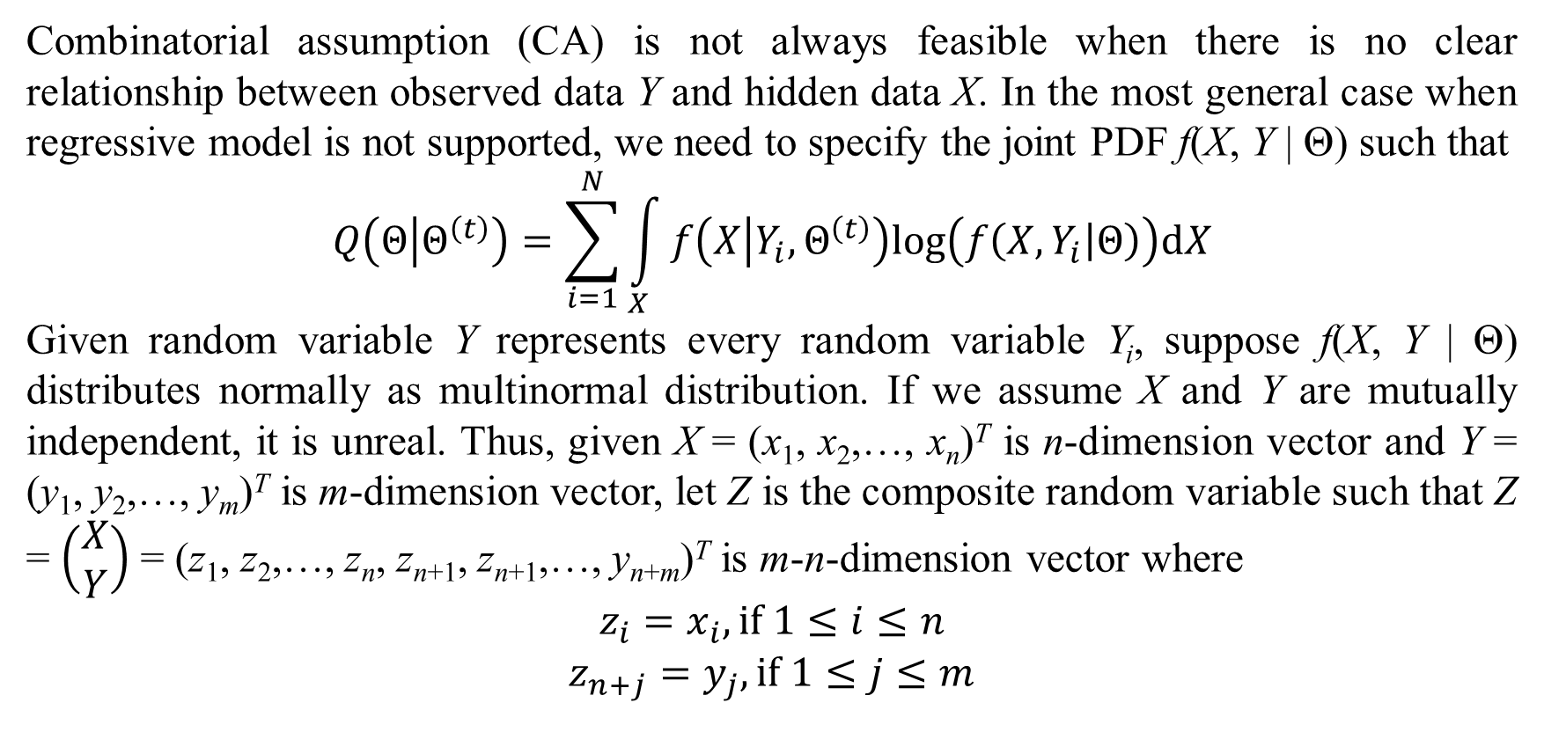
4. Without combinatorial assumption
Combinatorial assumption (CA) is not always feasible when there is no clear relationship between observed data Y and hidden data X. In the most general case when regressive model is not supported, we need to specify the joint PDF f(X, Y | Θ) such that
$$Q\left(Θ | Θ^{\left(t\right)}\right)=\sum_{i=1}^{N}{\int_{X}{f\left(X | Y_{i},Θ^{\left(t\right)}\right)log\left(f\left(X,Y_{i} | Θ\right)\right)dX}}$$
Given random variable Y represents every random variable Y_{i}, suppose f(X, Y | Θ) distributes normally as multinormal distribution. If we assume X and Y are mutually independent, it is unreal. Thus, given X = (x₁, x₂,…, x_{n})^{T} is n-dimension vector and Y = (y₁, y₂,…, y_{m})^{T} is m-dimension vector, let Z is the composite random variable such that Z = $\left(\begin{matrix}X \\ Y\end{matrix}\right)$ = (z₁, z₂,…, z_{n}, z_{n+1}, z_{n+1},…, y_{n+m})^{T} is m-n-dimension vector where
$$\begin{matrix}z_{i}=x_{i}, if 1≤i≤n \\ z_{n+j}=y_{j}, if 1≤j≤m\end{matrix}$$

Slide 21
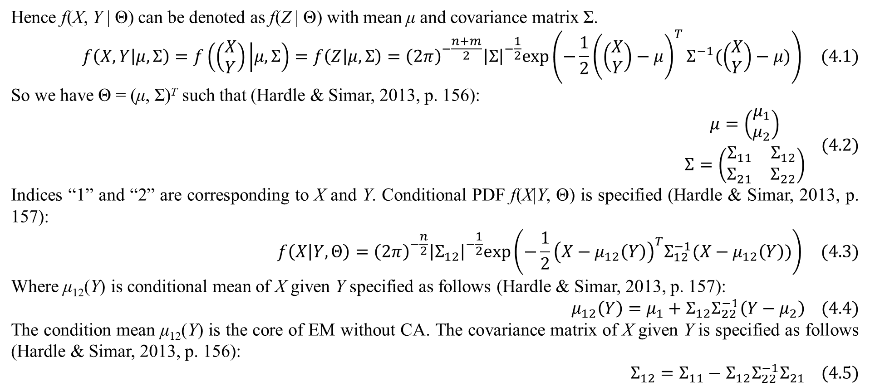
4. Without combinatorial assumption
Hence f(X, Y | Θ) can be denoted as f(Z | Θ) with mean μ and covariance matrix Σ.
$$f\left(X,Y | μ,Σ\right)=f\left(\left(\begin{matrix}X \\ Y\end{matrix}\right) | μ,Σ\right)=f\left(Z | μ,Σ\right)={\left(2π\right)}^{−\frac{n+m}{2}}{\left|Σ\right|}^{−\frac{1}{2}}exp\left(−\frac{1}{2}{\left(\left(\begin{matrix}X \\ Y\end{matrix}\right)−μ\right)}^{T}Σ^{−1}(\left(\begin{matrix}X \\ Y\end{matrix}\right)−μ)\right) (4.1)$$
So we have Θ = (μ, Σ)^{T} such that (Hardle & Simar, 2013, p. 156):
$$\begin{matrix}μ=\left(\begin{matrix}μ_{1} \\ μ_{2}\end{matrix}\right) \\ Σ=\left(\begin{matrix}Σ_{11} & Σ_{12} \\ Σ_{21} & Σ_{22}\end{matrix}\right)\end{matrix} (4.2)$$
Indices “1” and “2” are corresponding to X and Y. Conditional PDF f(X|Y, Θ) is specified (Hardle & Simar, 2013, p. 157):
$$f\left(X | Y,Θ\right)={\left(2π\right)}^{−\frac{n}{2}}{\left|Σ_{12}\right|}^{−\frac{1}{2}}exp\left(−\frac{1}{2}{\left(X−μ_{12}\left(Y\right)\right)}^{T}Σ_{12}^{−1}(X−μ_{12}\left(Y\right))\right) (4.3)$$
Where μ₁₂(Y) is conditional mean of X given Y specified as follows (Hardle & Simar, 2013, p. 157):
$$μ_{12}\left(Y\right)=μ_{1}+Σ_{12}Σ_{22}^{−1}\left(Y−μ_{2}\right) (4.4)$$
The condition mean μ₁₂(Y) is the core of EM without CA. The covariance matrix of X given Y is specified as follows (Hardle & Simar, 2013, p. 156):
$$Σ_{12}=Σ_{11}−Σ_{12}Σ_{22}^{−1}Σ_{21} (4.5)$$

Slide 22
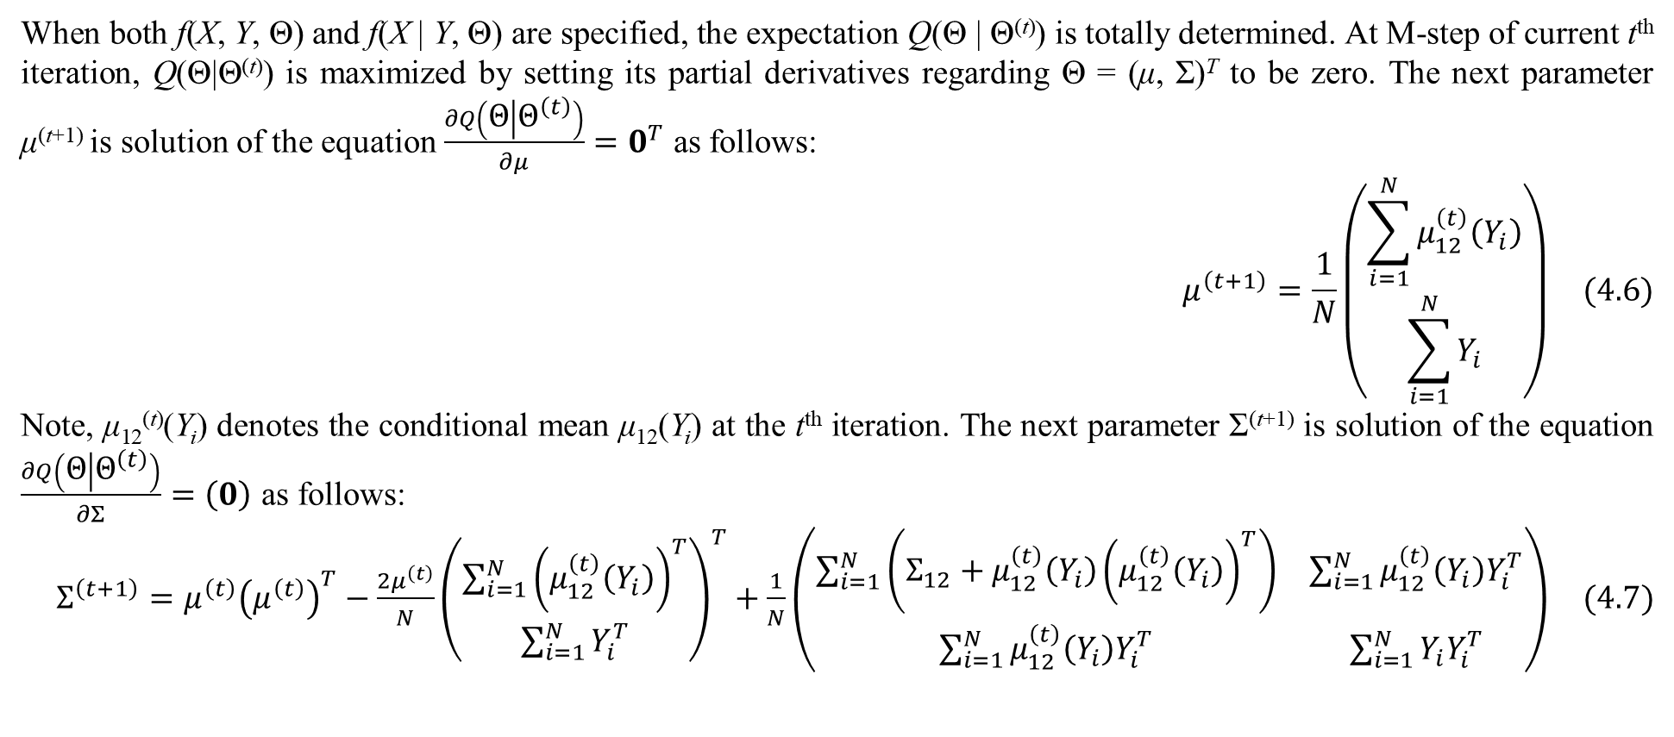
4. Without combinatorial assumption
When both f(X, Y, Θ) and f(X | Y, Θ) are specified, the expectation Q(Θ | Θ^{(t)}) is totally determined. At M-step of current t^{th} iteration, Q(Θ|Θ^{(t)}) is maximized by setting its partial derivatives regarding Θ = (μ, Σ)^{T} to be zero. The next parameter μ^{(t+1)} is solution of the equation $\frac{∂Q\left(Θ | Θ^{\left(t\right)}\right)}{∂μ}=0^{T}$ as follows:
$$μ^{\left(t+1\right)}=\frac{1}{N}\left(\begin{matrix}\sum_{i=1}^{N}{μ_{12}^{\left(t\right)}\left(Y_{i}\right)} \\ \sum_{i=1}^{N}{Y_{i}}\end{matrix}\right) (4.6)$$
Note, μ₁₂^{(t)}(Y_{i}) denotes the conditional mean μ₁₂(Y_{i}) at the t^{th} iteration. The next parameter Σ^{(t+1)} is solution of the equation $\frac{∂Q\left(Θ | Θ^{\left(t\right)}\right)}{∂Σ}=\left(0\right)$ as follows:
$Σ^{\left(t+1\right)}=μ^{\left(t\right)}{\left(μ^{\left(t\right)}\right)}^{T}−\frac{2μ^{\left(t\right)}}{N}{\left(\begin{matrix}\sum_{i=1}^{N}{{\left(μ_{12}^{\left(t\right)}\left(Y_{i}\right)\right)}^{T}} \\ \sum_{i=1}^{N}{Y_{i}^{T}}\end{matrix}\right)}^{T}+\frac{1}{N}\left(\begin{matrix}\sum_{i=1}^{N}{\left(Σ_{12}+μ_{12}^{\left(t\right)}\left(Y_{i}\right){\left(μ_{12}^{\left(t\right)}\left(Y_{i}\right)\right)}^{T}\right)} & \sum_{i=1}^{N}{μ_{12}^{\left(t\right)}\left(Y_{i}\right)Y_{i}^{T}} \\ \sum_{i=1}^{N}{μ_{12}^{\left(t\right)}\left(Y_{i}\right)Y_{i}^{T}} & \sum_{i=1}^{N}{Y_{i}Y_{i}^{T}}\end{matrix}\right) (4.7)$

Slide 23
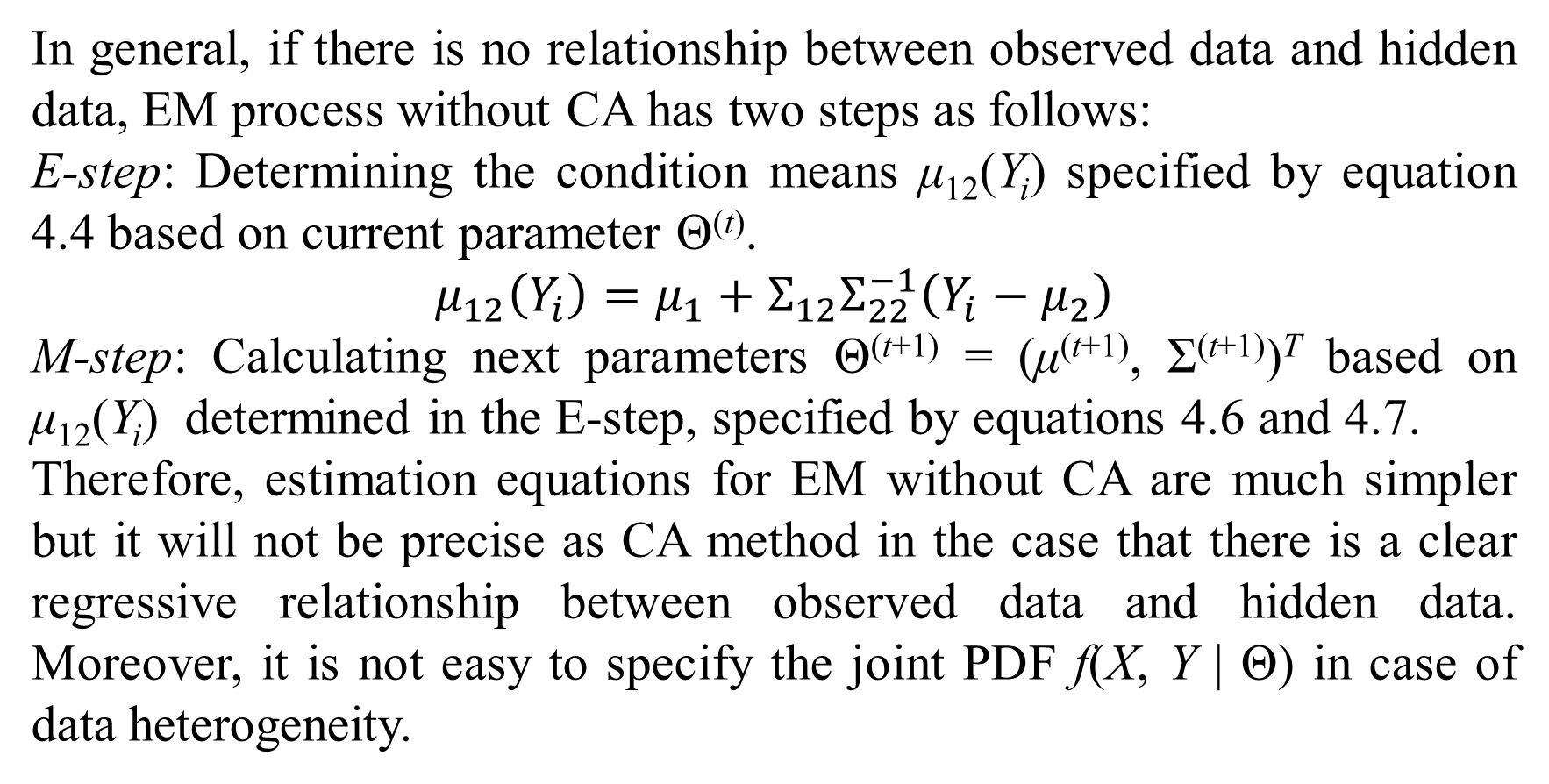
4. Without combinatorial assumption
In general, if there is no relationship between observed data and hidden data, EM process without CA has two steps as follows:
E-step: Determining the condition means μ₁₂(Y_{i}) specified by equation 4.4 based on current parameter Θ^{(t)}.
$$μ_{12}\left(Y_{i}\right)=μ_{1}+Σ_{12}Σ_{22}^{−1}\left(Y_{i}−μ_{2}\right)$$
M-step: Calculating next parameters Θ^{(t+1)} = (μ^{(t+1)}, Σ^{(t+1)})^{T} based on μ₁₂(Y_{i}) determined in the E-step, specified by equations 4.6 and 4.7.
Therefore, estimation equations for EM without CA are much simpler but it will not be precise as CA method in the case that there is a clear regressive relationship between observed data and hidden data. Moreover, it is not easy to specify the joint PDF f(X, Y | Θ) in case of data heterogeneity.

Slide 24
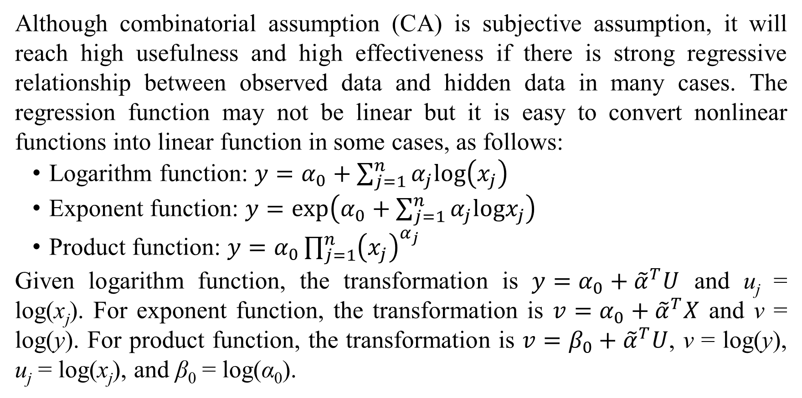
5. Discussions and conclusions
Although combinatorial assumption (CA) is subjective assumption, it will reach high usefulness and high effectiveness if there is strong regressive relationship between observed data and hidden data in many cases. The regression function may not be linear but it is easy to convert nonlinear functions into linear function in some cases, as follows:
Logarithm function: $y=α_{0}+\sum_{j=1}^{n}{α_{j}log\left(x_{j}\right)}$
Exponent function: $y=exp\left(α_{0}+\sum_{j=1}^{n}{α_{j}logx_{j}}\right)$
Product function: $y=α_{0}\prod_{j=1}^{n}{{\left(x_{j}\right)}^{α_{j}}}$
Given logarithm function, the transformation is $y=α_{0}+{\tilde{α}}^{T}U$ and u_{j} = log(x_{j}). For exponent function, the transformation is $v=α_{0}+{\tilde{α}}^{T}X$ and v = log(y). For product function, the transformation is $v=β_{0}+{\tilde{α}}^{T}U$, v = log(y), u_{j} = log(x_{j}), and β₀ = log(α₀).

Slide 25
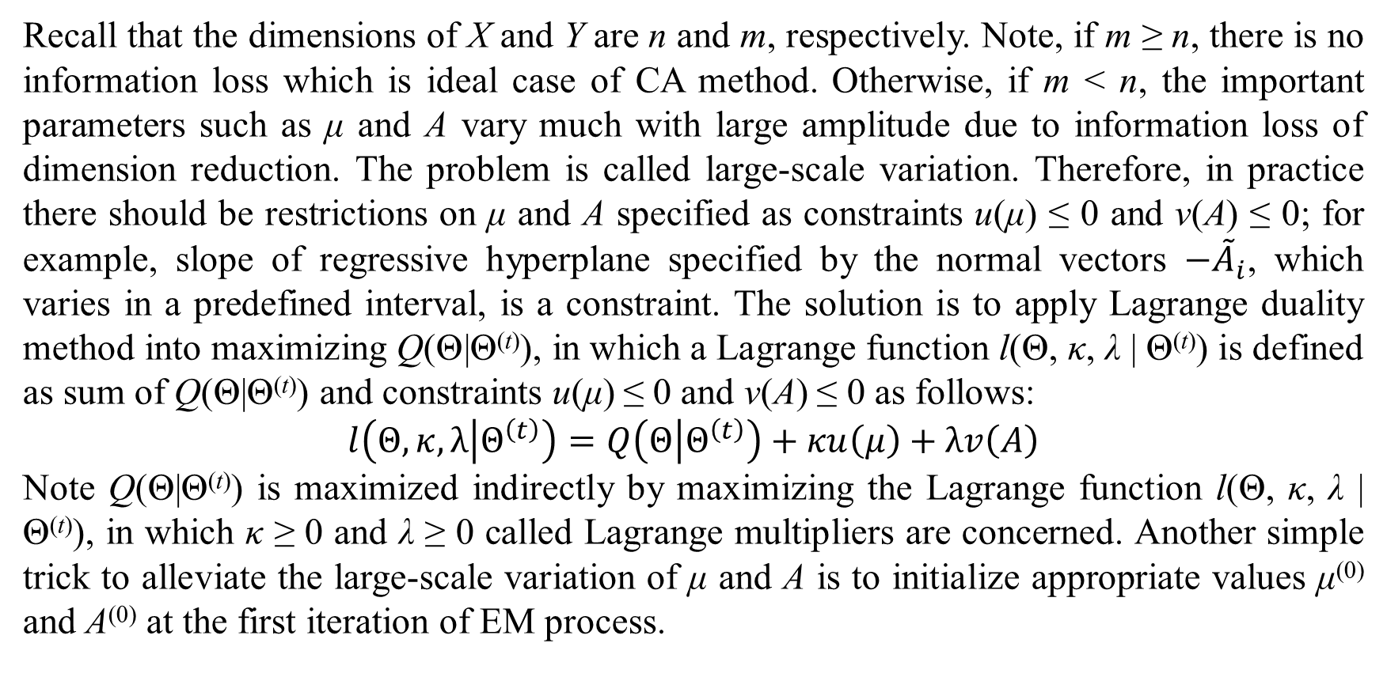
5. Discussions and conclusions
Recall that the dimensions of X and Y are n and m, respectively. Note, if m ≥ n, there is no information loss which is ideal case of CA method. Otherwise, if m < n, the important parameters such as μ and A vary much with large amplitude due to information loss of dimension reduction. The problem is called large-scale variation. Therefore, in practice there should be restrictions on μ and A specified as constraints u(μ) ≤ 0 and v(A) ≤ 0; for example, slope of regressive hyperplane specified by the normal vectors $−{\tilde{A}}_{i}$, which varies in a predefined interval, is a constraint. The solution is to apply Lagrange duality method into maximizing Q(Θ|Θ^{(t)}), in which a Lagrange function l(Θ, κ, λ | Θ^{(t)}) is defined as sum of Q(Θ|Θ^{(t)}) and constraints u(μ) ≤ 0 and v(A) ≤ 0 as follows:
$$l\left(Θ,κ,λ | Θ^{\left(t\right)}\right)=Q\left(Θ | Θ^{\left(t\right)}\right)+κu\left(μ\right)+λv\left(A\right)$$
Note Q(Θ|Θ^{(t)}) is maximized indirectly by maximizing the Lagrange function l(Θ, κ, λ | Θ^{(t)}), in which κ ≥ 0 and λ ≥ 0 called Lagrange multipliers are concerned. Another simple trick to alleviate the large-scale variation of μ and A is to initialize appropriate values μ⁽⁰⁾ and A⁽⁰⁾ at the first iteration of EM process.

Slide 26
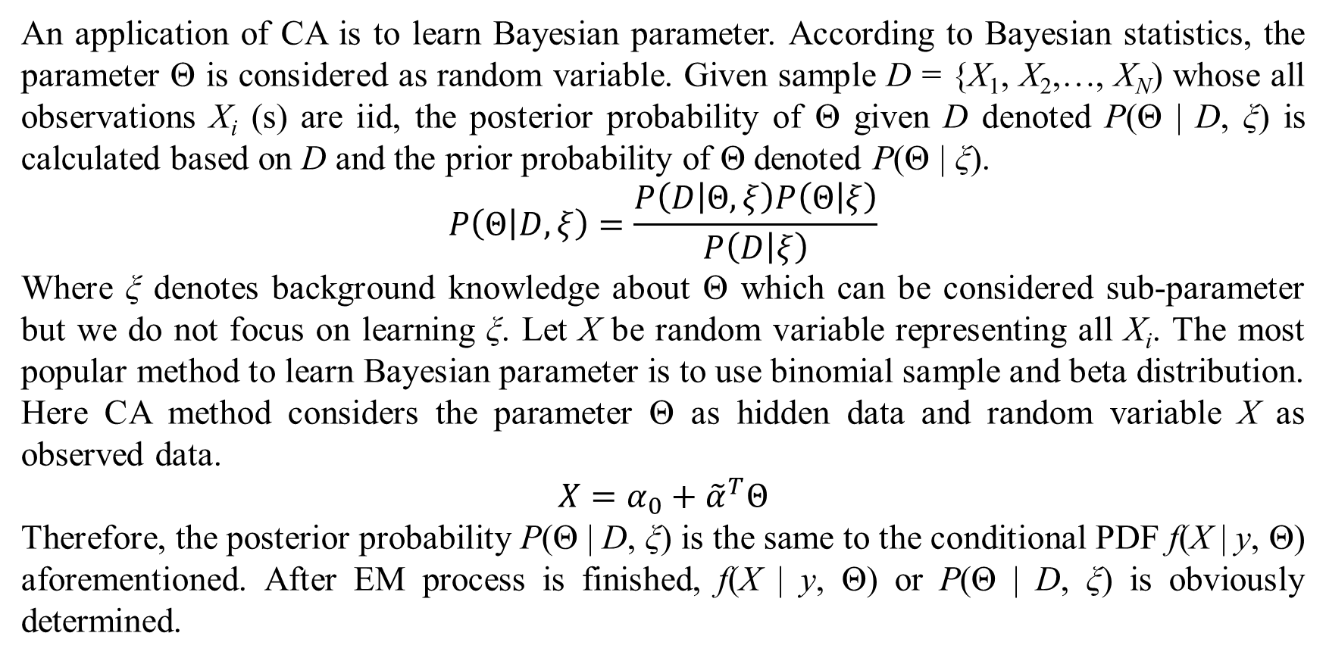
5. Discussions and conclusions
An application of CA is to learn Bayesian parameter. According to Bayesian statistics, the parameter Θ is considered as random variable. Given sample D = {X₁, X₂,…, X_{N}) whose all observations X_{i} (s) are iid, the posterior probability of Θ given D denoted P(Θ | D, ξ) is calculated based on D and the prior probability of Θ denoted P(Θ | ξ).
$$P\left(Θ | D,ξ\right)=\frac{P\left(D | Θ,ξ\right)P\left(Θ | ξ\right)}{P\left(D | ξ\right)}$$
Where ξ denotes background knowledge about Θ which can be considered sub-parameter but we do not focus on learning ξ. Let X be random variable representing all X_{i}. The most popular method to learn Bayesian parameter is to use binomial sample and beta distribution. Here CA method considers the parameter Θ as hidden data and random variable X as observed data.
$$X=α_{0}+{\tilde{α}}^{T}Θ$$
Therefore, the posterior probability P(Θ | D, ξ) is the same to the conditional PDF f(X | y, Θ) aforementioned. After EM process is finished, f(X | y, Θ) or P(Θ | D, ξ) is obviously determined.

Slide 27
5. Discussions and conclusions
In general, CA is an extension of EM, whose strong point is feasibility and simplicity with clearness of mathematic formulas. Especially, in the ideal case that dimension of Y (y) is larger than or equal to dimension of X, CA method will result out best estimates because there is no information loss. However, its drawback is the large-scale variation in determining important parameters μ and A when dimension of Y (y) is smaller than dimension of X. Therefore, in the future I will research Lagrange duality method to maximize the expectation Q(Θ|Θ^{(t)}) with constraints on μ and A.

Slide 28
References
Barazandeh, B., Ghafelebashi, A., Razaviyayn, M., & Sriharsha, R. (2021, May 12). Efficient Algorithms for Estimating the Parameters of Mixed Linear Regression Models. arXiv. Retrieved from https://arxiv.org/pdf/2105.05953
Dempster, A. P., Laird, N. M., & Rubin, D. B. (1977). Maximum Likelihood from Incomplete Data via the EM Algorithm. (M. Stone, Ed.) Journal of the Royal Statistical Society, Series B (Methodological), 39(1), 1-38.
Faria, S., & Soromenho, G. (2009, February 11). Fitting mixtures of linear regressions. Journal of Statistical Computation and Simulation, 80(2), 201-225. doi:10.1080/00949650802590261
Griffith, D. A., & Smith, A. (2010). Some simplifications for the expectationmaximization (em) algorithm: the linear regression model case. InterStat, 23. doi:10.1.1.613.8033
Hardle, W., & Simar, L. (2013). Applied Multivariate Statistical Analysis. Berlin, Germany: Research Data Center, School of Business and Economics, Humboldt University.
Kokic, P. (2002). The EM Algorithm for a Multivariate Regression Model: including its applications to a non-parametric regression model and a multivariate time series model. University of York, Department of Computer Science. York: University of York. Retrieved from https://www.cs.york.ac.uk/euredit/_temp/The%20Euredit%20Software/NAG%20Prototype%20platform/WorkingPaper4.pdf
Mathprof. (2013, March 22). Multidimensional Gaussian integral. (PlanetMath ) Retrieved November 23, 2021, from PlanetMath: https://planetmath.org/multidimensionalgaussianintegral
Nguyen, L. (2020). Tutorial on EM algorithm. MDPI. Preprints. doi:10.20944/preprints201802.0131.v8
Saliba, G. (2016, July 21). Not understanding derivative of a matrix-matrix product. (Stack Overflow) Retrieved December 06, 2021, from Mathematics Stack Exchange: https://math.stackexchange.com/questions/1866757/not-understanding-derivative-of-a-matrix-matrix-product
Wikipedia. (2021, December 3). List of integrals of exponential functions. (Wikimedia Foundation) Retrieved December 6, 2021, from Wikipedia website: https://en.wikipedia.org/wiki/List_of_integrals_of_exponential_functions
Zhang, X., Deng, J., & Su, R. (2016). The EM algorithm for a linear regression model with application to a diabetes data. 2016 International Conference on Progress in Informatics and Computing (PIC). Shanghai: IEEE. doi:10.1109/PIC.2016.7949477
Zhang, Z., & Rockette, H. E. (2006, November 4). An EM algorithm for regression analysis with incomplete covariate information. Journal of Statistical Computation and Simulation. doi:10.1080/10629360600565202

Slide 29
Thank you for attention

