Slide 1
A new method to determine separated hyper-plane for non-parametric sign test in multivariate data
Introduction to non-parametric sign test
Multivariate non-parametric sign test
Determining separated hyper-plane
PhD. Report: | A new method to determine separated hyper-plane for non-parametric sign test in multivariate data (June 5th 2013)
Researcher: | Nguyen Phuoc Loc
Affiliation: | Vietnam Insitute of Mathematics

Slide 2
I. Introduction to non-parametric sign test
Nonparametric testing is used in case of without knowledge about sample distribution; concretely, there is no assumption of normality.
The nonparametric testing begins with the test on sample median in univariate data. If distribution is symmetric, median is identical to mean.
Given the median μ₀ is the observation at which the left side data and the right side data are of equal accumulate probability: P(D < μ₀) = P(D > μ₀) = 0.5
PhD 2009

Slide 3
Sign test [Walpole, Myers, Myers, Ye 2012]
Assigning plus signs to sample observations whose values are greater than and minus signs to ones whose values are less than.
If the number of plus signs is nearly equal to the number of minus signs, then null hypothesis H₀ is true; otherwise H₀ is false. In other words, that the proportion of plus signs is significantly different from 0.5 cause to rejecting H₀ in flavor of H₁
PhD 2009

Slide 4
II. Multivariate non-parametric sign test
Basic idea
Traditional sign test cannot be applied into multivariate data because null hypothesis and alternative hypothesis are vectors and it is not likely to compare hypothesis vector with observation vector with regard to assign plus signs.
The basic idea is to determine a hyper-plane and its normal vector which is used to calculate signed-rank number.
The optimized hyper-plane is the one that contains null hypothesis and splits observations as discriminatively as possible.
PhD 2009

Slide 5
II. Multivariate non-parametric sign test
Multivariate non-parametric sign test includes three steps
Determining separated hyper-plane that contains null hypothesis μ₀ and splits observations as discriminatively as possible.
The normal vector W of separated hyper-plane is used to make sign of observations. Observations having the same direction to W are assigned plus sign and otherwise.
Null hypothesis μ₀ is rejected or accepted in flavor of alternative hypothesis based on the number of plus signs.
PhD 2009

Slide 6
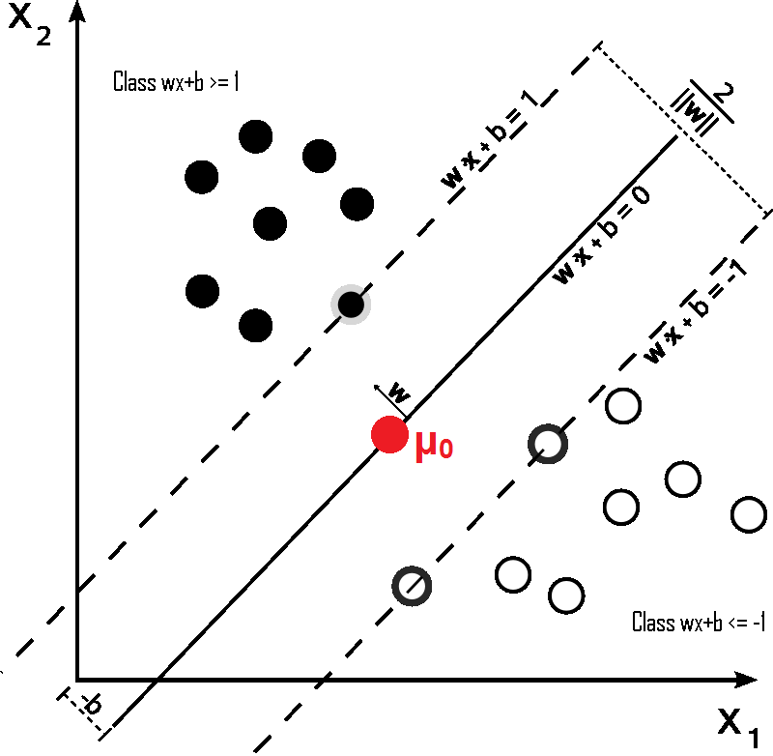

III. Determining separated hyper-plane
Optimally separated hyper-plane
Containing hypothesis μ₀.
Maximizing the margin between two half-spaces.
PhD 2009

Slide 7
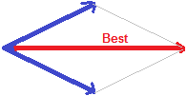
III. Determining separated hyper-plane
Finding optimal separated hyper-plane
Finding the hyper-plane that satisfies the first constraints 1 – W×X_{i} + W×μ₀ ≤ 0.
Finding the hyper-plane that satisfies the second constraints 1 + W×X_{i} – W×μ₀ ≤ 0.
The best-separated hyper-plane is the intermediate one between these two hyper-planes. So, its normal vector is the sum of two normal vectors of these two hyper-planes.
PhD 2009

Slide 8
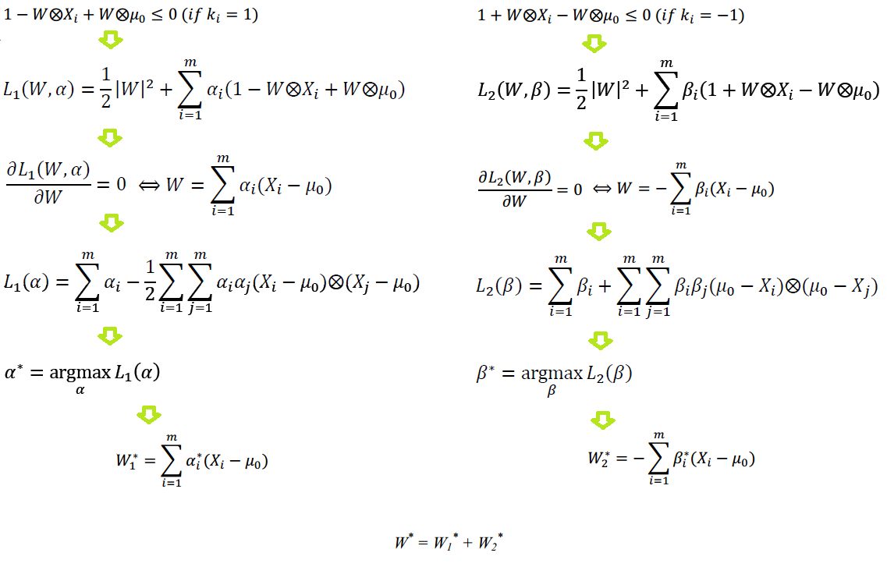
III. Determining separated hyper-plane
Finding optimal separated hyper-plane by using Lagrange method
PhD 2009

Slide 9
Conclusion
The main idea of this paper is to find out a separated hyper-plane, which aims to count the number of observations which fall in left side or right side of such hyper-plane.
The method to find out hyper-plane is a variant of support vector machine (SVM) [Cristianini, Shawe-Taylor 2000] method except that hyper-plane contains the null hypothesis. SVM assumes that data points are labeled with classes {1 and –1} but observations in case of hypothesis testing are not classed. This research solves this problem by two-step process of separation:
  Firstly, finding the hyper-plane that maximizes the distance between this hyper-plane and observations which fall in the right side.
  Secondly, finding the hyper-plane that maximizes the distance between this hyper-plane and observations which fall in the left side.
The best-separated hyper-plane is the intermediate one between these two hyper-planes.
PhD 2009

Slide 10
Reference
[Boyd, Vandenberghe 2004]. Stephen Boyd, Lieven Vandenberghe. Convex Optimization. Copyright © Cambridge University Press 2004. ISBN 978-0-521-83378-3.
[Cristianini, Shawe-Taylor 2000]. N. Cristianini and J. Shawe-Taylor. An Introduction to Support Vector Machines. Cambridge University Press, 2000.
[Montgomery, Runger 2003]. Douglas C. Montgomery, George C. Runger. Applied Statistics and Probability for Enginners, 3rd edition. Copyright 2003 © John Wiley & Son, Inc, 2003. ISBN: 0-471-20454-4.
[Walpole, Myers, Myers, Ye 2012]. Ronald E. Walpole, Raymond H. Myers, Sharon L. Myers, Keying Ye. Probability & Statistics for Engineers & Scientists, 9th edition. Copyright © 2012, 2007, 2002 Pearson Education, Inc. ISBN: 978-0-321-62911-1.
PhD 2009

Slide 11
THANK FOR CONSIDERATION
IT@EDU 2008

