Slide 1
Learning dyadic data and predicting unaccomplished co-occurrent values by mixture model
The 6th International Conference on Future Education 2023
06th – 07th July 2023, Kuala Lumpur, Malaysia
Prof. Dr. Loc Nguyen, PhD, Postdoc
Loc Nguyen’s Academic Network, Vietnam
Email: ng_phloc@yahoo.com, Homepage: www.locnguyen.net
Prof. Dr. Maryann H. Lanuza, PhD
Philippine Normal University, Manila, Philippines
Email: maryann.lanuza@pcu.edu.ph

Slide 2
Abstract
Dyadic data which is also called co-occurrence data (COD) contains co-occurrences of objects. Searching for statistical models to represent dyadic data is necessary. Fortunately, finite mixture model is a solid statistical model to learn and make inference on dyadic data because mixture model is built smoothly and reliably by expectation maximization (EM) algorithm which is suitable to inherent spareness of dyadic data. This research summarizes mixture models for dyadic data. When each co-occurrence in dyadic data is associated with a value, there are many unaccomplished values because a lot of co-occurrences are inexistent. In this research, these unaccomplished values are estimated as mean (expectation) of random variable given partial probabilistic distributions inside dyadic mixture model.

Slide 3
Table of contents
Introduction
Mixture models for dyadic data
Predicting unaccomplished co-occurrent values
Conclusions

Slide 4
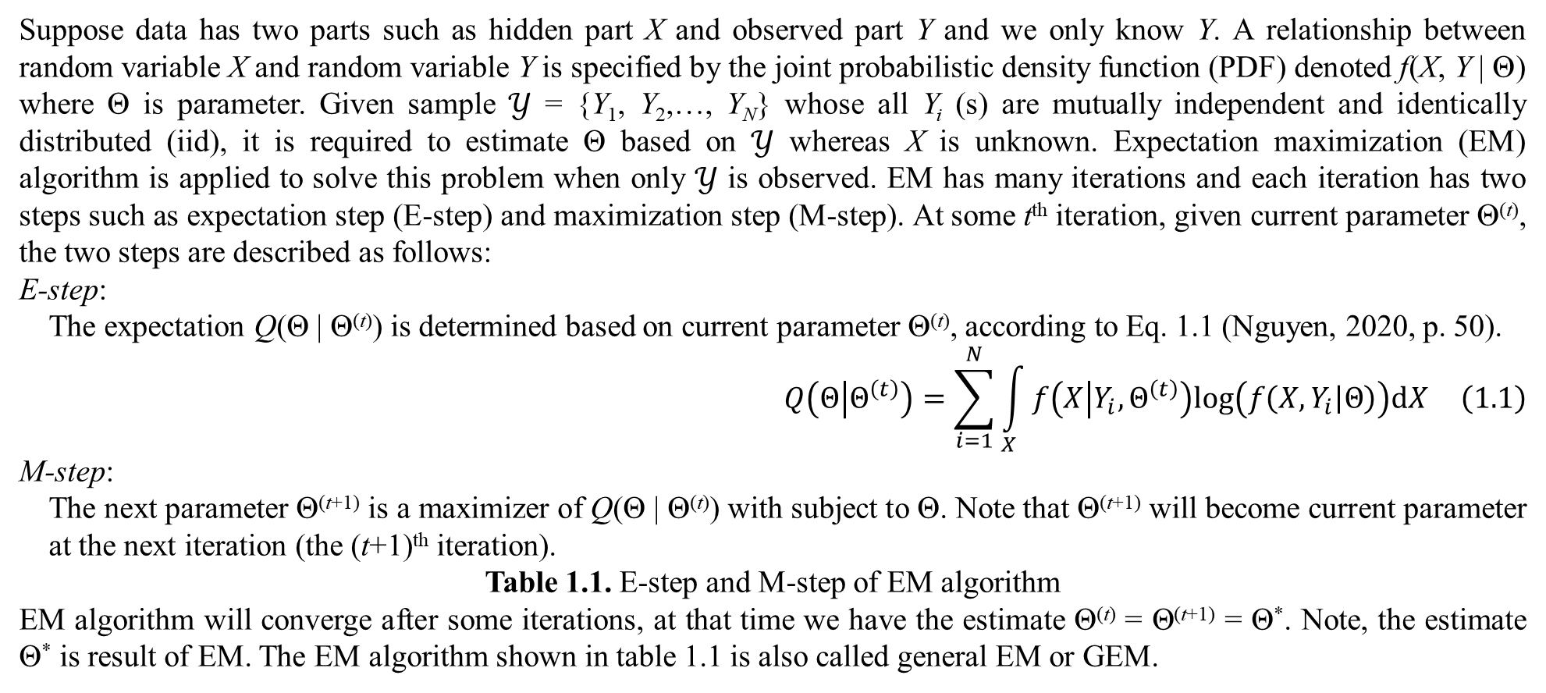
1. Introduction
Suppose data has two parts such as hidden part X and observed part Y and we only know Y. A relationship between random variable X and random variable Y is specified by the joint probabilistic density function (PDF) denoted f(X, Y | Θ) where Θ is parameter. Given sample $𝒴$ = {Y₁, Y₂,…, Y_{N}} whose all Y_{i} (s) are mutually independent and identically distributed (iid), it is required to estimate Θ based on $𝒴$ whereas X is unknown. Expectation maximization (EM) algorithm is applied to solve this problem when only $𝒴$ is observed. EM has many iterations and each iteration has two steps such as expectation step (E-step) and maximization step (M-step). At some t^{th} iteration, given current parameter Θ^{(t)}, the two steps are described as follows:
E-step:
The expectation Q(Θ | Θ^{(t)}) is determined based on current parameter Θ^{(t)}, according to Eq. 1.1 (Nguyen, 2020, p. 50).
$$Q\left(Θ | Θ^{\left(t\right)}\right)=\sum_{i=1}^{N}{\int_{X}{f\left(X | Y_{i},Θ^{\left(t\right)}\right)log\left(f\left(X,Y_{i} | Θ\right)\right)dX}} \left(1.1\right)$$
M-step:
The next parameter Θ^{(t+1)} is a maximizer of Q(Θ | Θ^{(t)}) with subject to Θ. Note that Θ^{(t+1)} will become current parameter at the next iteration (the (t+1)^{th} iteration).
Table 1.1. E-step and M-step of EM algorithm
EM algorithm will converge after some iterations, at that time we have the estimate Θ^{(t)} = Θ^{(t+1)} = Θ*. Note, the estimate Θ* is result of EM. The EM algorithm shown in table 1.1 is also called general EM or GEM.

Slide 5
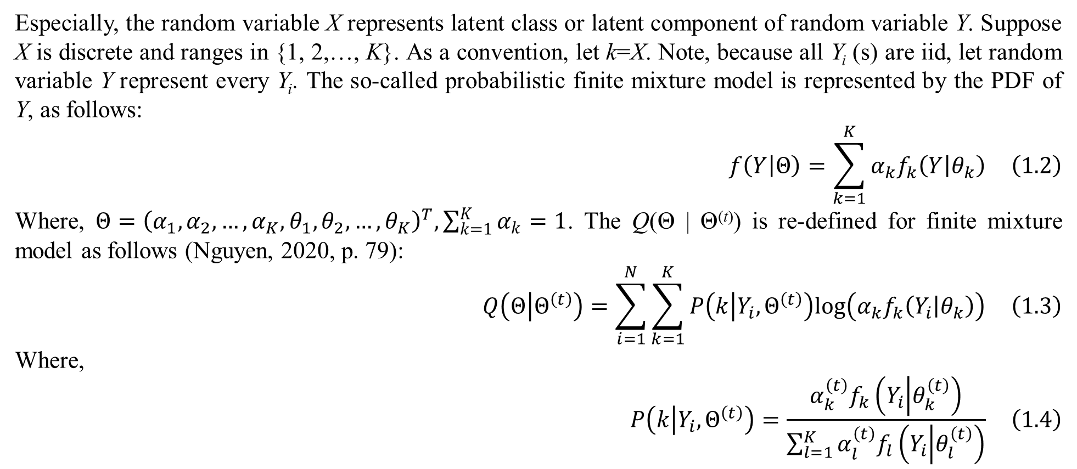
1. Introduction
Especially, the random variable X represents latent class or latent component of random variable Y. Suppose X is discrete and ranges in {1, 2,…, K}. As a convention, let k=X. Note, because all Y_{i} (s) are iid, let random variable Y represent every Y_{i}. The so-called probabilistic finite mixture model is represented by the PDF of Y, as follows:
$$f\left(Y | Θ\right)=\sum_{k=1}^{K}{α_{k}f_{k}\left(Y | θ_{k}\right)} \left(1.2\right)$$
Where, $Θ={\left(α_{1},α_{2},…,α_{K},θ_{1},θ_{2},…,θ_{K}\right)}^{T},\sum_{k=1}^{K}{α_{k}}=1$. The Q(Θ | Θ^{(t)}) is re-defined for finite mixture model as follows (Nguyen, 2020, p. 79):
$$Q\left(Θ | Θ^{\left(t\right)}\right)=\sum_{i=1}^{N}{\sum_{k=1}^{K}{P\left(k | Y_{i},Θ^{\left(t\right)}\right)log\left(α_{k}f_{k}\left(Y_{i} | θ_{k}\right)\right)}} \left(1.3\right)$$
Where,
$$P\left(k | Y_{i},Θ^{\left(t\right)}\right)=\frac{α_{k}^{\left(t\right)}f_{k}\left(Y_{i} | θ_{k}^{\left(t\right)}\right)}{\sum_{l=1}^{K}{α_{l}^{\left(t\right)}f_{l}\left(Y_{i} | θ_{l}^{\left(t\right)}\right)}} \left(1.4\right)$$

Slide 6
1. Introduction
An interesting application of finite mixture model is soft clustering. Traditional clustering methods assign a fixed cluster to every data point in sample, which means that every data point belongs exactly to one cluster. Soft clustering is more flexible when every data point belongs to more than one cluster and the degree of assignment is represented by a probability. It is easy to recognize that when mixture model is applied into soft clustering, latent class k represents a cluster.
Every observation in ordinary sample is univariate or multivariate but there is a case that ordinary sample becomes dyadic sample related to two sets of objects, which causes some modifications of mixture model. Dyadic data which is also called co-occurrence data (COD) contains co-occurrent events of objects. It is necessary to obtain statistical models to represent dyadic data and fortunately, finite mixture model is the one. Recall that EM is applied to learn mixture model. The next section focuses on mixture model for dyadic data.

Slide 7
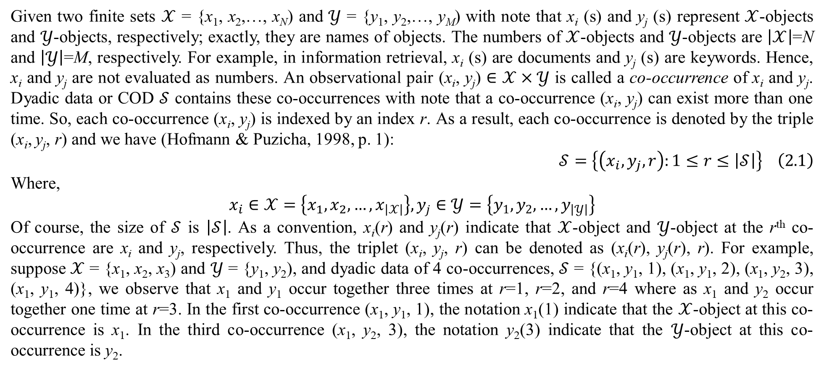
2. Mixture models for dyadic data
Given two finite sets $𝒳$ = {x₁, x₂,…, x_{N}) and $𝒴$ = {y₁, y₂,…, y_{M}) with note that x_{i} (s) and y_{j} (s) represent $𝒳$-objects and $𝒴$-objects, respectively; exactly, they are names of objects. The numbers of $𝒳$-objects and $𝒴$-objects are $\left|𝒳\right|$=N and $\left|𝒴\right|$=M, respectively. For example, in information retrieval, x_{i} (s) are documents and y_{j} (s) are keywords. Hence, x_{i} and y_{j} are not evaluated as numbers. An observational pair (x_{i}, y_{j}) $∈$ $𝒳×𝒴$ is called a co-occurrence of x_{i} and y_{j}. Dyadic data or COD $𝒮$ contains these co-occurrences with note that a co-occurrence (x_{i}, y_{j}) can exist more than one time. So, each co-occurrence (x_{i}, y_{j}) is indexed by an index r. As a result, each co-occurrence is denoted by the triple (x_{i}, y_{j}, r) and we have (Hofmann & Puzicha, 1998, p. 1):
$$𝒮=\left\{\left(x_{i},y_{j},r\right):1≤r≤\left|𝒮\right|\right\} \left(2.1\right)$$
Where,
$$x_{i}∈𝒳=\left\{x_{1},x_{2},…,x_{\left|𝒳\right|}\right\},y_{j}∈𝒴=\left\{y_{1},y_{2},…,y_{\left|𝒴\right|}\right\}$$
Of course, the size of $𝒮$ is $\left|𝒮\right|$. As a convention, x_{i}(r) and y_{j}(r) indicate that $𝒳$-object and $𝒴$-object at the r^{th} co-occurrence are x_{i} and y_{j}, respectively. Thus, the triplet (x_{i}, y_{j}, r) can be denoted as (x_{i}(r), y_{j}(r), r). For example, suppose $𝒳$ = {x₁, x₂, x₃) and $𝒴$ = {y₁, y₂), and dyadic data of 4 co-occurrences, $𝒮$ = {(x₁, y₁, 1), (x₁, y₁, 2), (x₁, y₂, 3), (x₁, y₁, 4)}, we observe that x₁ and y₁ occur together three times at r=1, r=2, and r=4 where as x₁ and y₂ occur together one time at r=3. In the first co-occurrence (x₁, y₁, 1), the notation x₁(1) indicate that the $𝒳$-object at this co-occurrence is x₁. In the third co-occurrence (x₁, y₂, 3), the notation y₂(3) indicate that the $𝒴$-object at this co-occurrence is y₂.

Slide 8
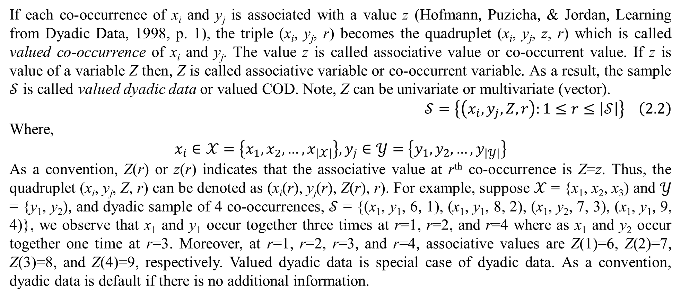
2. Mixture models for dyadic data
If each co-occurrence of x_{i} and y_{j} is associated with a value z (Hofmann, Puzicha, & Jordan, Learning from Dyadic Data, 1998, p. 1), the triple (x_{i}, y_{j}, r) becomes the quadruplet (x_{i}, y_{j}, z, r) which is called valued co-occurrence of x_{i} and y_{j}. The value z is called associative value or co-occurrent value. If z is value of a variable Z then, Z is called associative variable or co-occurrent variable. As a result, the sample $𝒮$ is called valued dyadic data or valued COD. Note, Z can be univariate or multivariate (vector).
$$𝒮=\left\{\left(x_{i},y_{j},Z,r\right):1≤r≤\left|𝒮\right|\right\} \left(2.2\right)$$
Where,
$$x_{i}∈𝒳=\left\{x_{1},x_{2},…,x_{\left|𝒳\right|}\right\},y_{j}∈𝒴=\left\{y_{1},y_{2},…,y_{\left|𝒴\right|}\right\}$$
As a convention, Z(r) or z(r) indicates that the associative value at r^{th} co-occurrence is Z=z. Thus, the quadruplet (x_{i}, y_{j}, Z, r) can be denoted as (x_{i}(r), y_{j}(r), Z(r), r). For example, suppose $𝒳$ = {x₁, x₂, x₃) and $𝒴$ = {y₁, y₂), and dyadic sample of 4 co-occurrences, $𝒮$ = {(x₁, y₁, 6, 1), (x₁, y₁, 8, 2), (x₁, y₂, 7, 3), (x₁, y₁, 9, 4)}, we observe that x₁ and y₁ occur together three times at r=1, r=2, and r=4 where as x₁ and y₂ occur together one time at r=3. Moreover, at r=1, r=2, r=3, and r=4, associative values are Z(1)=6, Z(2)=7, Z(3)=8, and Z(4)=9, respectively. Valued dyadic data is special case of dyadic data. As a convention, dyadic data is default if there is no additional information.

Slide 9
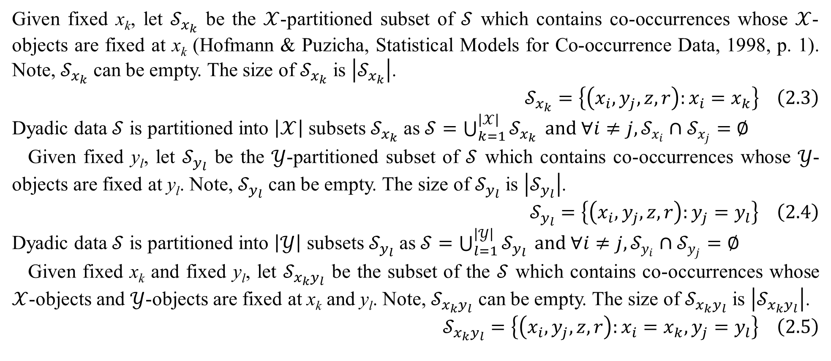
2. Mixture models for dyadic data
Given fixed x_{k}, let $𝒮_{x_{k}}$ be the $𝒳$-partitioned subset of $𝒮$ which contains co-occurrences whose $𝒳$-objects are fixed at x_{k} (Hofmann & Puzicha, Statistical Models for Co-occurrence Data, 1998, p. 1). Note, $𝒮_{x_{k}}$ can be empty. The size of $𝒮_{x_{k}}$ is $\left|𝒮_{x_{k}}\right|$.
$$𝒮_{x_{k}}=\left\{\left(x_{i},y_{j},z,r\right):x_{i}=x_{k}\right\} \left(2.3\right)$$
Dyadic data $𝒮$ is partitioned into $\left|𝒳\right|$ subsets $𝒮_{x_{k}}$ as $𝒮=\bigcup_{k=1}^{\left|𝒳\right|}{𝒮_{x_{k}}} and ∀i≠j,𝒮_{x_{i}}∩𝒮_{x_{j}}=∅$
Given fixed y_{l}, let $𝒮_{y_{l}}$ be the $𝒴$-partitioned subset of $𝒮$ which contains co-occurrences whose $𝒴$-objects are fixed at y_{l}. Note, $𝒮_{y_{l}}$ can be empty. The size of $𝒮_{y_{l}}$ is $\left|𝒮_{y_{l}}\right|$.
$$𝒮_{y_{l}}=\left\{\left(x_{i},y_{j},z,r\right):y_{j}=y_{l}\right\} \left(2.4\right)$$
Dyadic data $𝒮$ is partitioned into $\left|𝒴\right|$ subsets $𝒮_{y_{l}}$ as $𝒮=\bigcup_{l=1}^{\left|𝒴\right|}{𝒮_{y_{l}}} and ∀i≠j,𝒮_{y_{i}}∩𝒮_{y_{j}}=∅$
Given fixed x_{k} and fixed y_{l}, let $𝒮_{x_{k}y_{l}}$ be the subset of the $𝒮$ which contains co-occurrences whose $𝒳$-objects and $𝒴$-objects are fixed at x_{k} and y_{l}. Note, $𝒮_{x_{k}y_{l}}$ can be empty. The size of $𝒮_{x_{k}y_{l}}$ is $\left|𝒮_{x_{k}y_{l}}\right|$.
$$𝒮_{x_{k}y_{l}}=\left\{\left(x_{i},y_{j},z,r\right):x_{i}=x_{k},y_{j}=y_{l}\right\} \left(2.5\right)$$

Slide 10
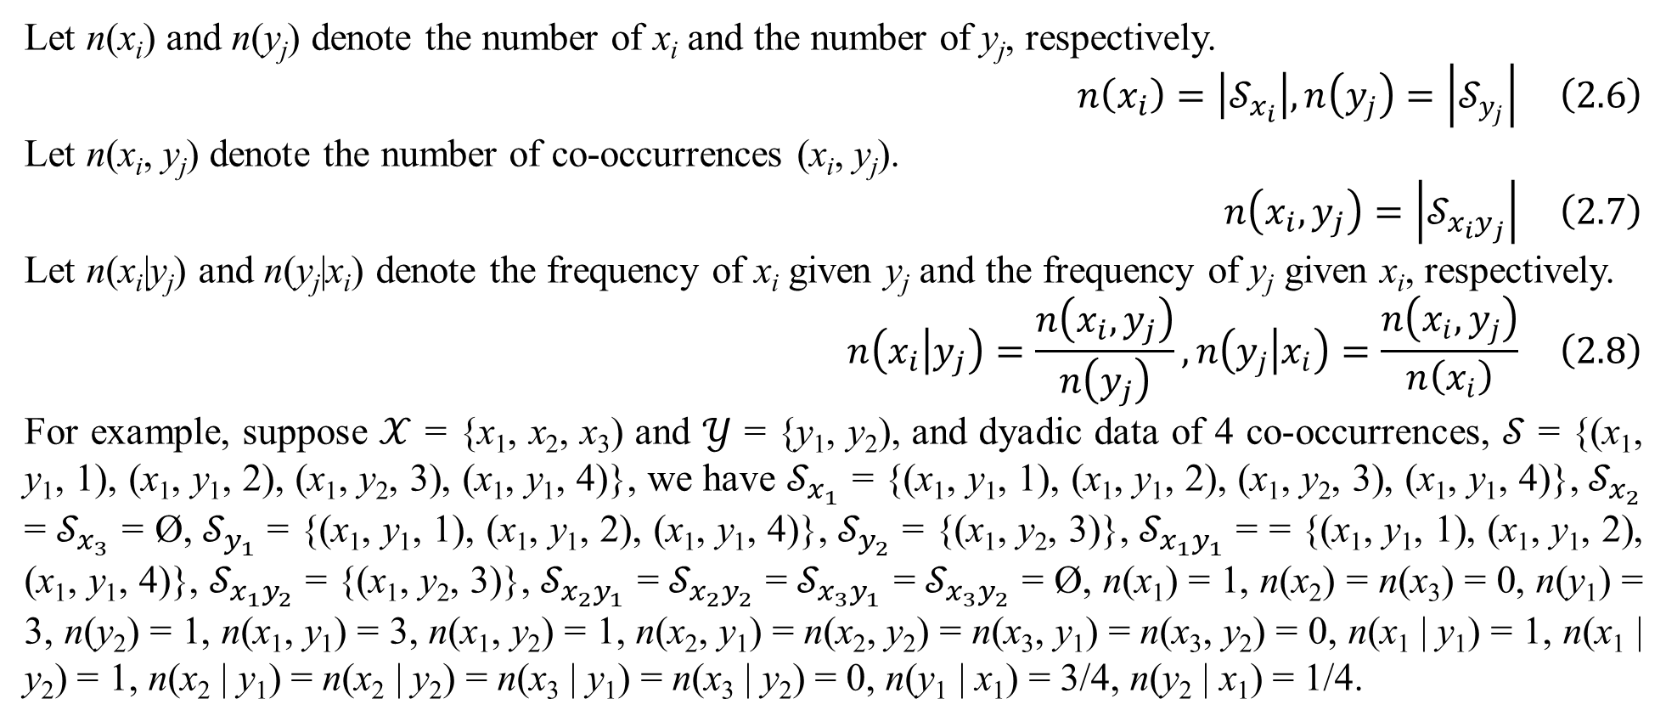
2. Mixture models for dyadic data
Let n(x_{i}) and n(y_{j}) denote the number of x_{i} and the number of y_{j}, respectively.
$$n\left(x_{i}\right)=\left|𝒮_{x_{i}}\right|,n\left(y_{j}\right)=\left|𝒮_{y_{j}}\right| \left(2.6\right)$$
Let n(x_{i}, y_{j}) denote the number of co-occurrences (x_{i}, y_{j}).
$$n\left(x_{i},y_{j}\right)=\left|𝒮_{x_{i}y_{j}}\right| \left(2.7\right)$$
Let n(x_{i}|y_{j}) and n(y_{j}|x_{i}) denote the frequency of x_{i} given y_{j} and the frequency of y_{j} given x_{i}, respectively.
$$n\left(x_{i} | y_{j}\right)=\frac{n\left(x_{i},y_{j}\right)}{n\left(y_{j}\right)},n\left(y_{j} | x_{i}\right)=\frac{n\left(x_{i},y_{j}\right)}{n\left(x_{i}\right)} \left(2.8\right)$$
For example, suppose $𝒳$ = {x₁, x₂, x₃) and $𝒴$ = {y₁, y₂), and dyadic data of 4 co-occurrences, $𝒮$ = {(x₁, y₁, 1), (x₁, y₁, 2), (x₁, y₂, 3), (x₁, y₁, 4)}, we have $𝒮_{x_{1}}$ = {(x₁, y₁, 1), (x₁, y₁, 2), (x₁, y₂, 3), (x₁, y₁, 4)}, $𝒮_{x_{2}}$ = $𝒮_{x_{3}}$ = Ø, $𝒮_{y_{1}}$ = {(x₁, y₁, 1), (x₁, y₁, 2), (x₁, y₁, 4)}, $𝒮_{y_{2}}$ = {(x₁, y₂, 3)}, $𝒮_{x_{1}y_{1}}$ = = {(x₁, y₁, 1), (x₁, y₁, 2), (x₁, y₁, 4)}, $𝒮_{x_{1}y_{2}}$ = {(x₁, y₂, 3)}, $𝒮_{x_{2}y_{1}}$ = $𝒮_{x_{2}y_{2}}$ = $𝒮_{x_{3}y_{1}}$ = $𝒮_{x_{3}y_{2}}$ = Ø, n(x₁) = 1, n(x₂) = n(x₃) = 0, n(y₁) = 3, n(y₂) = 1, n(x₁, y₁) = 3, n(x₁, y₂) = 1, n(x₂, y₁) = n(x₂, y₂) = n(x₃, y₁) = n(x₃, y₂) = 0, n(x₁ | y₁) = 1, n(x₁ | y₂) = 1, n(x₂ | y₁) = n(x₂ | y₂) = n(x₃ | y₁) = n(x₃ | y₂) = 0, n(y₁ | x₁) = 3/4, n(y₂ | x₁) = 1/4.

Slide 11
2. Mixture models for dyadic data
Suppose each co-occurrence (x_{i}, y_{j}) belongs to a latent variable C and C has K values c_{k} (s). These values c_{k} (s) are called classes or aspects and thus, mixture model for dyadic data is also called aspect model or latent class model which aims to discover the latent variable C. Without loss of generality, let c_{k} = k where k = 1, 2,…, K. The random variable C has discrete distribution such that every value has an associated probability α_{k}. Of course, there are K probabilities α_{k} (s). There are three kinds of dyadic mixture model for dyadic data such as symmetric mixture model (SMM), asymmetric mixture model (AMM), and product-space mixture model (PMM). This section only explains these models when they were introduced by Hofmann and Puzicha (Hofmann & Puzicha, Statistical Models for Co-occurrence Data, 1998).

Slide 12
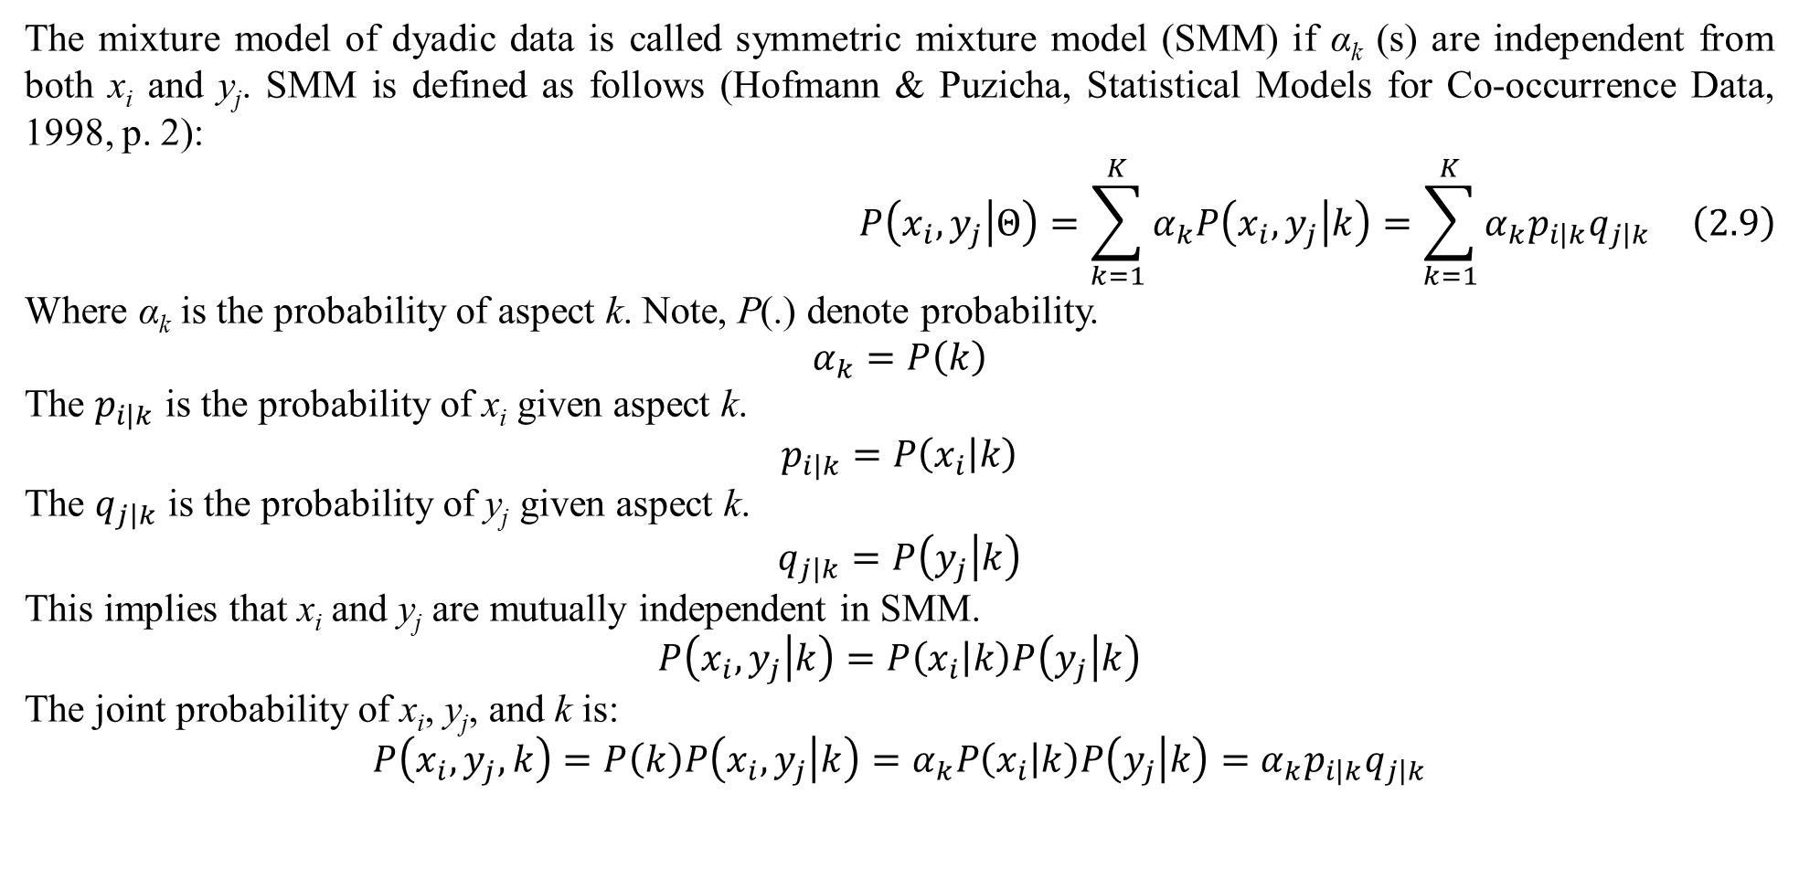
2. Mixture models for dyadic data
The mixture model of dyadic data is called symmetric mixture model (SMM) if α_{k} (s) are independent from both x_{i} and y_{j}. SMM is defined as follows (Hofmann & Puzicha, Statistical Models for Co-occurrence Data, 1998, p. 2):
$$P\left(x_{i},y_{j} | Θ\right)=\sum_{k=1}^{K}{α_{k}P\left(x_{i},y_{j} | k\right)}=\sum_{k=1}^{K}{α_{k}p_{i\left|k\right.}q_{j\left|k\right.}} \left(2.9\right)$$
Where α_{k} is the probability of aspect k. Note, P(.) denote probability.
$$α_{k}=P\left(k\right)$$
The $p_{i\left|k\right.}$ is the probability of x_{i} given aspect k.
$$p_{i\left|k\right.}=P\left(x_{i} | k\right)$$
The $q_{j\left|k\right.}$ is the probability of y_{j} given aspect k.
$$q_{j\left|k\right.}=P\left(y_{j} | k\right)$$
This implies that x_{i} and y_{j} are mutually independent in SMM.
$$P\left(x_{i},y_{j} | k\right)=P\left(x_{i} | k\right)P\left(y_{j} | k\right)$$
The joint probability of x_{i}, y_{j}, and k is:
$$P\left(x_{i},y_{j},k\right)=P\left(k\right)P\left(x_{i},y_{j} | k\right)=α_{k}P\left(x_{i} | k\right)P\left(y_{j} | k\right)=α_{k}p_{i\left|k\right.}q_{j\left|k\right.}$$

Slide 13
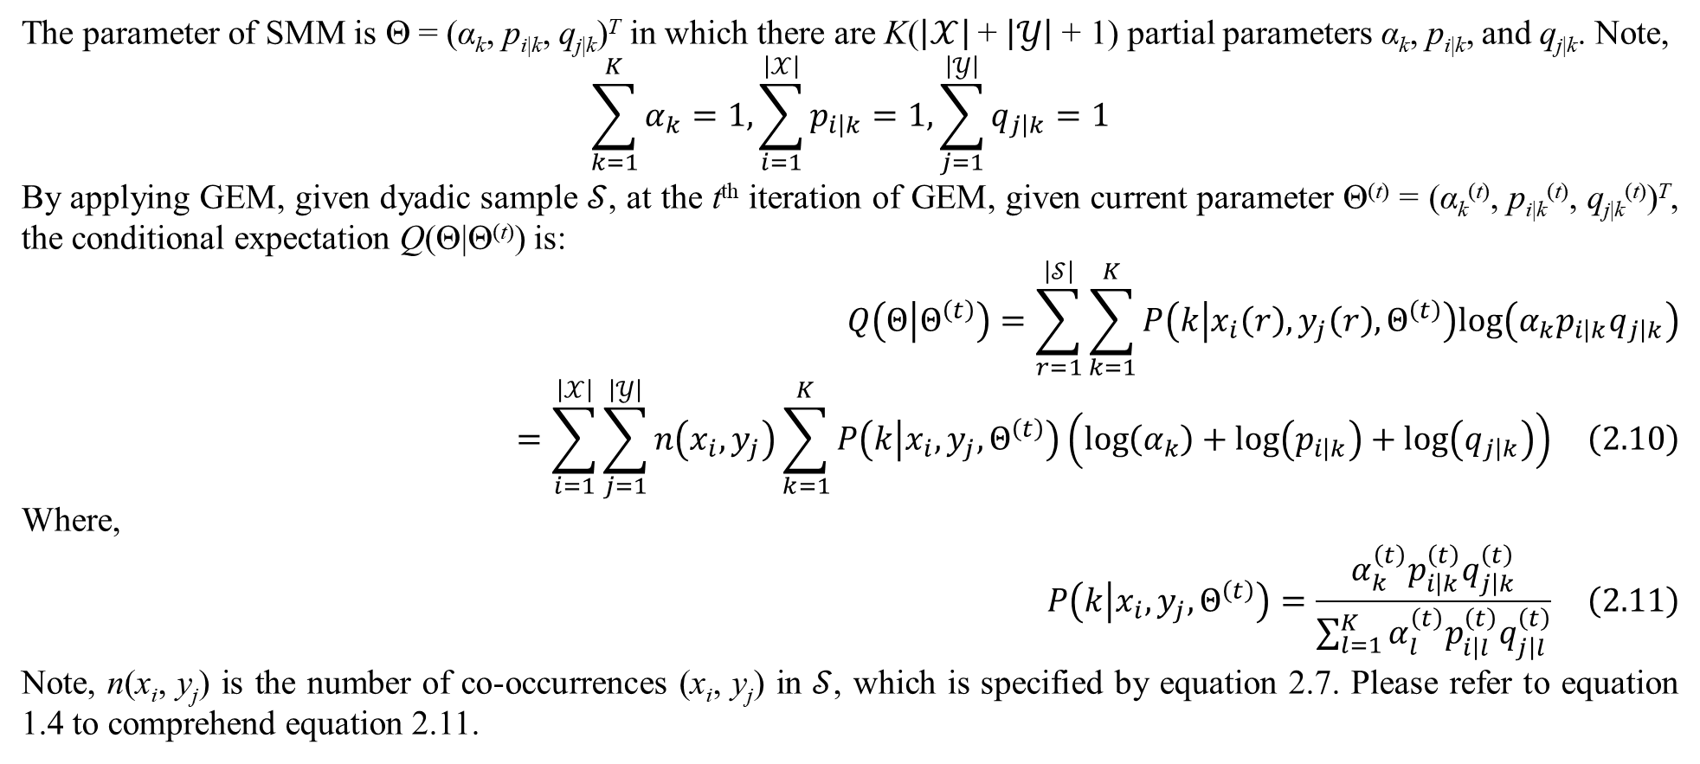
2. Mixture models for dyadic data
The parameter of SMM is Θ = (α_{k}, p_{i|k}, q_{j|k})^{T} in which there are K($\left|𝒳\right|$ + $\left|𝒴\right|$ + 1) partial parameters α_{k}, p_{i|k}, and q_{j|k}. Note,
$$\sum_{k=1}^{K}{α_{k}}=1,\sum_{i=1}^{\left|𝒳\right|}{p_{i\left|k\right.}}=1,\sum_{j=1}^{\left|𝒴\right|}{q_{j\left|k\right.}}=1$$
By applying GEM, given dyadic sample $𝒮$, at the t^{th} iteration of GEM, given current parameter Θ^{(t)} = (α_{k}^{(t)}, p_{i|k}^{(t)}, q_{j|k}^{(t)})^{T}, the conditional expectation Q(Θ|Θ^{(t)}) is:
$$Q\left(Θ | Θ^{\left(t\right)}\right)=\sum_{r=1}^{\left|𝒮\right|}{\sum_{k=1}^{K}{P\left(k | x_{i}\left(r\right),y_{j}\left(r\right),Θ^{\left(t\right)}\right)log\left(α_{k}p_{i\left|k\right.}q_{j\left|k\right.}\right)}}=\sum_{i=1}^{\left|𝒳\right|}{\sum_{j=1}^{\left|𝒴\right|}{n\left(x_{i},y_{j}\right)\sum_{k=1}^{K}{P\left(k | x_{i},y_{j},Θ^{\left(t\right)}\right)\left(log\left(α_{k}\right)+log\left(p_{i\left|k\right.}\right)+log\left(q_{j\left|k\right.}\right)\right)}}} \left(2.10\right)$$
Where,
$$P\left(k | x_{i},y_{j},Θ^{\left(t\right)}\right)=\frac{α_{k}^{\left(t\right)}p_{i\left|k\right.}^{\left(t\right)}q_{j\left|k\right.}^{\left(t\right)}}{\sum_{l=1}^{K}{α_{l}^{\left(t\right)}p_{i\left|l\right.}^{\left(t\right)}q_{j\left|l\right.}^{\left(t\right)}}} \left(2.11\right)$$
Note, n(x_{i}, y_{j}) is the number of co-occurrences (x_{i}, y_{j}) in $𝒮$, which is specified by equation 2.7. Please refer to equation 1.4 to comprehend equation 2.11.

Slide 14
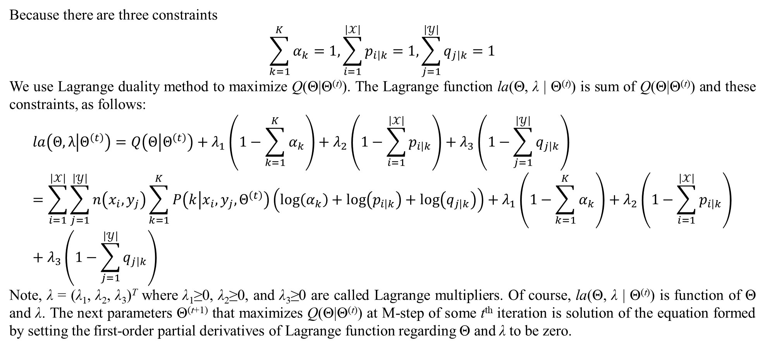
2. Mixture models for dyadic data
Because there are three constraints
$$\sum_{k=1}^{K}{α_{k}}=1,\sum_{i=1}^{\left|𝒳\right|}{p_{i\left|k\right.}}=1,\sum_{j=1}^{\left|𝒴\right|}{q_{j\left|k\right.}}=1$$
We use Lagrange duality method to maximize Q(Θ|Θ^{(t)}). The Lagrange function la(Θ, λ | Θ^{(t)}) is sum of Q(Θ|Θ^{(t)}) and these constraints, as follows:
$$la\left(Θ,λ | Θ^{\left(t\right)}\right)=Q\left(Θ | Θ^{\left(t\right)}\right)+λ_{1}\left(1−\sum_{k=1}^{K}{α_{k}}\right)+λ_{2}\left(1−\sum_{i=1}^{\left|𝒳\right|}{p_{i\left|k\right.}}\right)+λ_{3}\left(1−\sum_{j=1}^{\left|𝒴\right|}{q_{j\left|k\right.}}\right)=\sum_{i=1}^{\left|𝒳\right|}{\sum_{j=1}^{\left|𝒴\right|}{n\left(x_{i},y_{j}\right)\sum_{k=1}^{K}{P\left(k | x_{i},y_{j},Θ^{\left(t\right)}\right)\left(log\left(α_{k}\right)+log\left(p_{i\left|k\right.}\right)+log\left(q_{j\left|k\right.}\right)\right)}}}+λ_{1}\left(1−\sum_{k=1}^{K}{α_{k}}\right)+λ_{2}\left(1−\sum_{i=1}^{\left|𝒳\right|}{p_{i\left|k\right.}}\right)+λ_{3}\left(1−\sum_{j=1}^{\left|𝒴\right|}{q_{j\left|k\right.}}\right)$$
Note, λ = (λ₁, λ₂, λ₃)^{T} where λ₁≥0, λ₂≥0, and λ₃≥0 are called Lagrange multipliers. Of course, la(Θ, λ | Θ^{(t)}) is function of Θ and λ. The next parameters Θ^{(t+1)} that maximizes Q(Θ|Θ^{(t)}) at M-step of some t^{th} iteration is solution of the equation formed by setting the first-order partial derivatives of Lagrange function regarding Θ and λ to be zero.

Slide 15
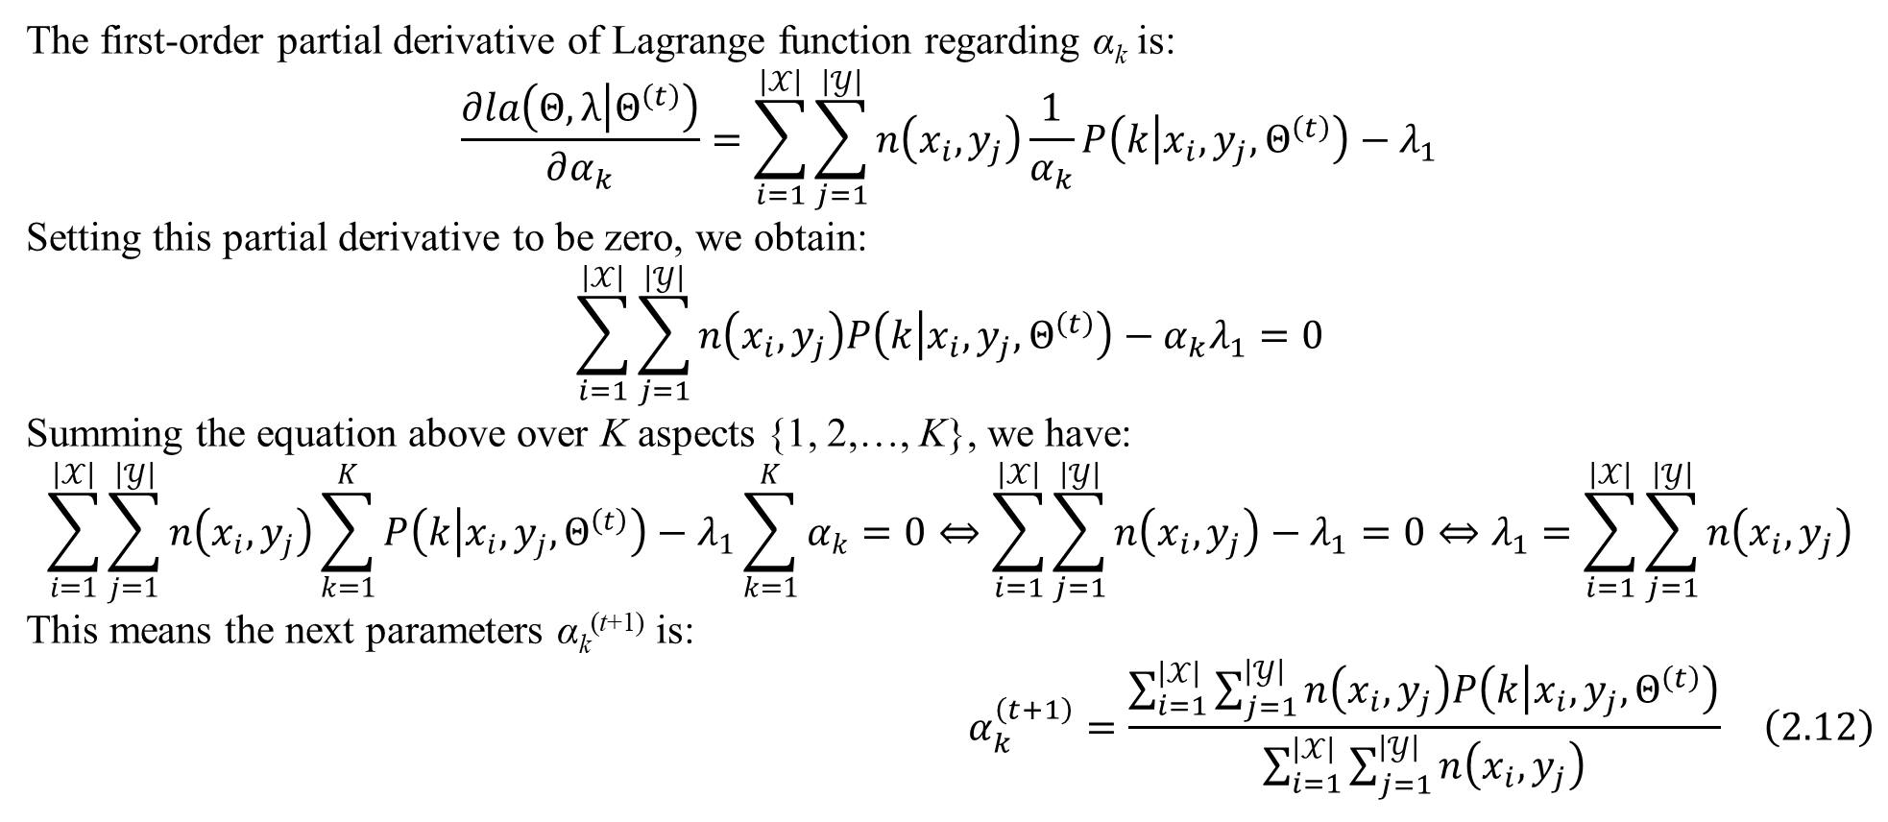
2. Mixture models for dyadic data
The first-order partial derivative of Lagrange function regarding α_{k} is:
$$\frac{∂la\left(Θ,λ | Θ^{\left(t\right)}\right)}{∂α_{k}}=\sum_{i=1}^{\left|𝒳\right|}{\sum_{j=1}^{\left|𝒴\right|}{n\left(x_{i},y_{j}\right)\frac{1}{α_{k}}P\left(k | x_{i},y_{j},Θ^{\left(t\right)}\right)}}−λ_{1}$$
Setting this partial derivative to be zero, we obtain:
$$\sum_{i=1}^{\left|𝒳\right|}{\sum_{j=1}^{\left|𝒴\right|}{n\left(x_{i},y_{j}\right)P\left(k | x_{i},y_{j},Θ^{\left(t\right)}\right)}}−α_{k}λ_{1}=0$$
Summing the equation above over K aspects {1, 2,…, K}, we have:
$$\sum_{i=1}^{\left|𝒳\right|}{\sum_{j=1}^{\left|𝒴\right|}{n\left(x_{i},y_{j}\right)\sum_{k=1}^{K}{P\left(k | x_{i},y_{j},Θ^{\left(t\right)}\right)}}}−λ_{1}\sum_{k=1}^{K}{α_{k}}=0⇔\sum_{i=1}^{\left|𝒳\right|}{\sum_{j=1}^{\left|𝒴\right|}{n\left(x_{i},y_{j}\right)}}−λ_{1}=0⇔λ_{1}=\sum_{i=1}^{\left|𝒳\right|}{\sum_{j=1}^{\left|𝒴\right|}{n\left(x_{i},y_{j}\right)}}$$
This means the next parameters α_{k}^{(t+1)} is:
$$α_{k}^{\left(t+1\right)}=\frac{\sum_{i=1}^{\left|𝒳\right|}{\sum_{j=1}^{\left|𝒴\right|}{n\left(x_{i},y_{j}\right)P\left(k | x_{i},y_{j},Θ^{\left(t\right)}\right)}}}{\sum_{i=1}^{\left|𝒳\right|}{\sum_{j=1}^{\left|𝒴\right|}{n\left(x_{i},y_{j}\right)}}} \left(2.12\right)$$

Slide 16
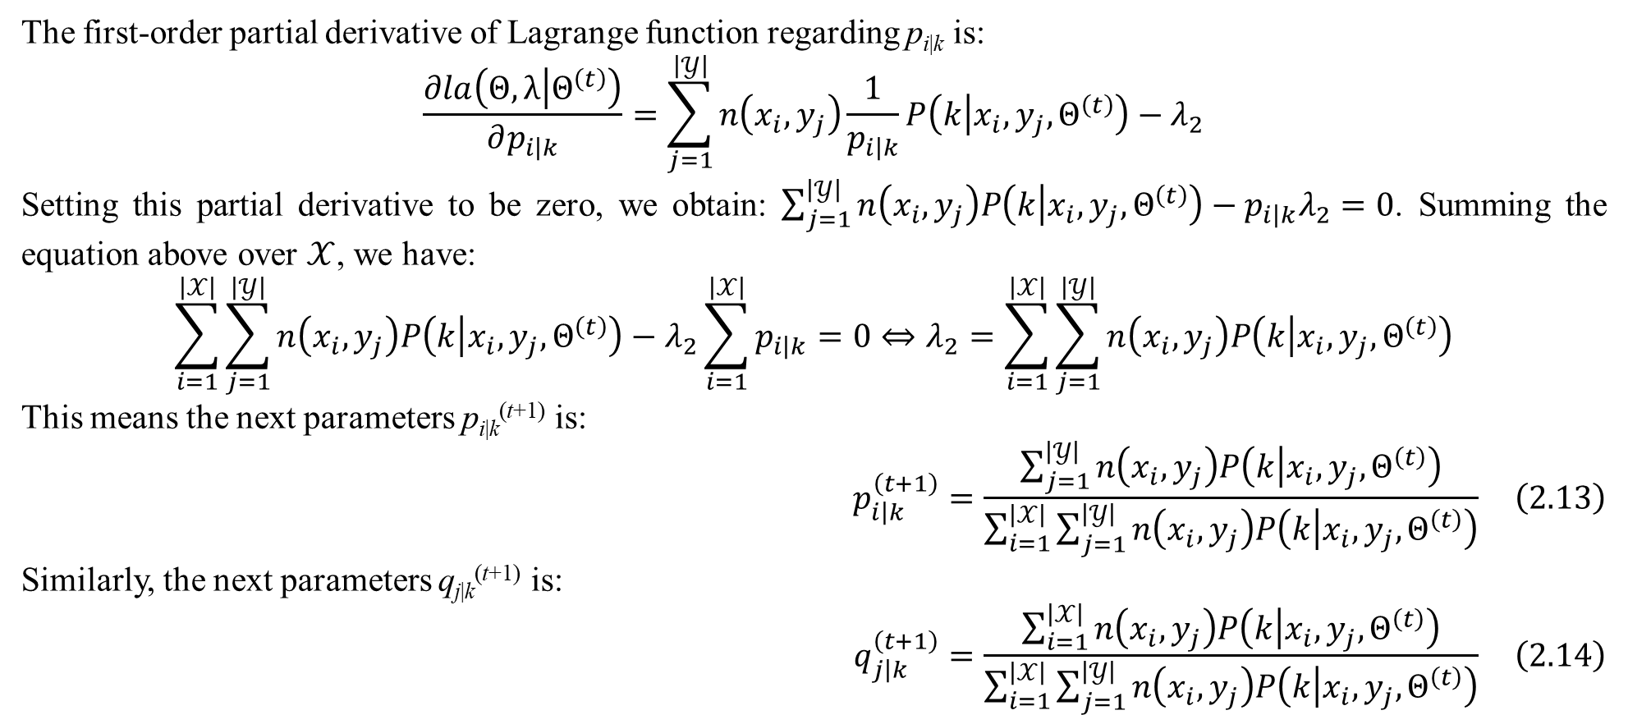
2. Mixture models for dyadic data
The first-order partial derivative of Lagrange function regarding p_{i|k} is:
$$\frac{∂la\left(Θ,λ | Θ^{\left(t\right)}\right)}{∂p_{i\left|k\right.}}=\sum_{j=1}^{\left|𝒴\right|}{n\left(x_{i},y_{j}\right)\frac{1}{p_{i\left|k\right.}}P\left(k | x_{i},y_{j},Θ^{\left(t\right)}\right)}−λ_{2}$$
Setting this partial derivative to be zero, we obtain: $\sum_{j=1}^{\left|𝒴\right|}{n\left(x_{i},y_{j}\right)P\left(k | x_{i},y_{j},Θ^{\left(t\right)}\right)}−p_{i\left|k\right.}λ_{2}=0$. Summing the equation above over $𝒳$, we have:
$$\sum_{i=1}^{\left|𝒳\right|}{\sum_{j=1}^{\left|𝒴\right|}{n\left(x_{i},y_{j}\right)P\left(k | x_{i},y_{j},Θ^{\left(t\right)}\right)}}−λ_{2}\sum_{i=1}^{\left|𝒳\right|}{p_{i\left|k\right.}}=0⇔λ_{2}=\sum_{i=1}^{\left|𝒳\right|}{\sum_{j=1}^{\left|𝒴\right|}{n\left(x_{i},y_{j}\right)P\left(k | x_{i},y_{j},Θ^{\left(t\right)}\right)}}$$
This means the next parameters p_{i|k}^{(t+1)} is:
$$p_{i\left|k\right.}^{\left(t+1\right)}=\frac{\sum_{j=1}^{\left|𝒴\right|}{n\left(x_{i},y_{j}\right)P\left(k | x_{i},y_{j},Θ^{\left(t\right)}\right)}}{\sum_{i=1}^{\left|𝒳\right|}{\sum_{j=1}^{\left|𝒴\right|}{n\left(x_{i},y_{j}\right)P\left(k | x_{i},y_{j},Θ^{\left(t\right)}\right)}}} \left(2.13\right)$$
Similarly, the next parameters q_{j|k}^{(t+1)} is:
$$q_{j\left|k\right.}^{\left(t+1\right)}=\frac{\sum_{i=1}^{\left|𝒳\right|}{n\left(x_{i},y_{j}\right)P\left(k | x_{i},y_{j},Θ^{\left(t\right)}\right)}}{\sum_{i=1}^{\left|𝒳\right|}{\sum_{j=1}^{\left|𝒴\right|}{n\left(x_{i},y_{j}\right)P\left(k | x_{i},y_{j},Θ^{\left(t\right)}\right)}}} \left(2.14\right)$$

Slide 17
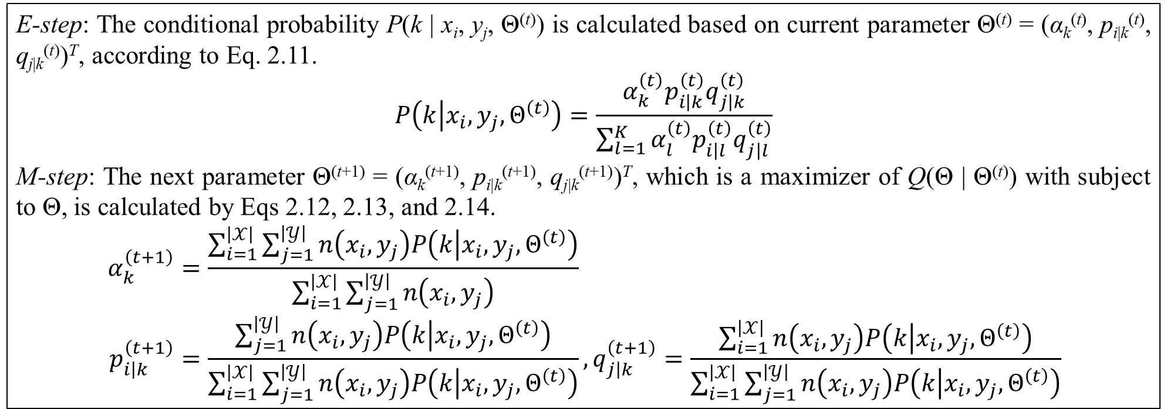
2. Mixture models for dyadic data
E-step: The conditional probability P(k | x_{i}, y_{j}, Θ^{(t)}) is calculated based on current parameter Θ^{(t)} = (α_{k}^{(t)}, p_{i|k}^{(t)}, q_{j|k}^{(t)})^{T}, according to Eq. 2.11.
$$P\left(k | x_{i},y_{j},Θ^{\left(t\right)}\right)=\frac{α_{k}^{\left(t\right)}p_{i\left|k\right.}^{\left(t\right)}q_{j\left|k\right.}^{\left(t\right)}}{\sum_{l=1}^{K}{α_{l}^{\left(t\right)}p_{i\left|l\right.}^{\left(t\right)}q_{j\left|l\right.}^{\left(t\right)}}}$$
M-step: The next parameter Θ^{(t+1)} = (α_{k}^{(t+1)}, p_{i|k}^{(t+1)}, q_{j|k}^{(t+1)})^{T}, which is a maximizer of Q(Θ | Θ^{(t)}) with subject to Θ, is calculated by Eqs 2.12, 2.13, and 2.14.
$$α_{k}^{\left(t+1\right)}=\frac{\sum_{i=1}^{\left|𝒳\right|}{\sum_{j=1}^{\left|𝒴\right|}{n\left(x_{i},y_{j}\right)P\left(k | x_{i},y_{j},Θ^{\left(t\right)}\right)}}}{\sum_{i=1}^{\left|𝒳\right|}{\sum_{j=1}^{\left|𝒴\right|}{n\left(x_{i},y_{j}\right)}}} \\ p_{i\left|k\right.}^{\left(t+1\right)}=\frac{\sum_{j=1}^{\left|𝒴\right|}{n\left(x_{i},y_{j}\right)P\left(k | x_{i},y_{j},Θ^{\left(t\right)}\right)}}{\sum_{i=1}^{\left|𝒳\right|}{\sum_{j=1}^{\left|𝒴\right|}{n\left(x_{i},y_{j}\right)P\left(k | x_{i},y_{j},Θ^{\left(t\right)}\right)}}},q_{j\left|k\right.}^{\left(t+1\right)}=\frac{\sum_{i=1}^{\left|𝒳\right|}{n\left(x_{i},y_{j}\right)P\left(k | x_{i},y_{j},Θ^{\left(t\right)}\right)}}{\sum_{i=1}^{\left|𝒳\right|}{\sum_{j=1}^{\left|𝒴\right|}{n\left(x_{i},y_{j}\right)P\left(k | x_{i},y_{j},Θ^{\left(t\right)}\right)}}}$$
Table 2.1. E-step and M-step of GEM algorithm for SMM
GEM algorithm converges at some t^{th} iteration. At that time, Θ* = Θ^{(t+1)} = Θ^{(t)} is the SMM itself. When SMM is applied into soft clustering, dyadic data is clustered according to blocks and each α_{k} is coverage ratio of cluster k (aspect k).

Slide 18
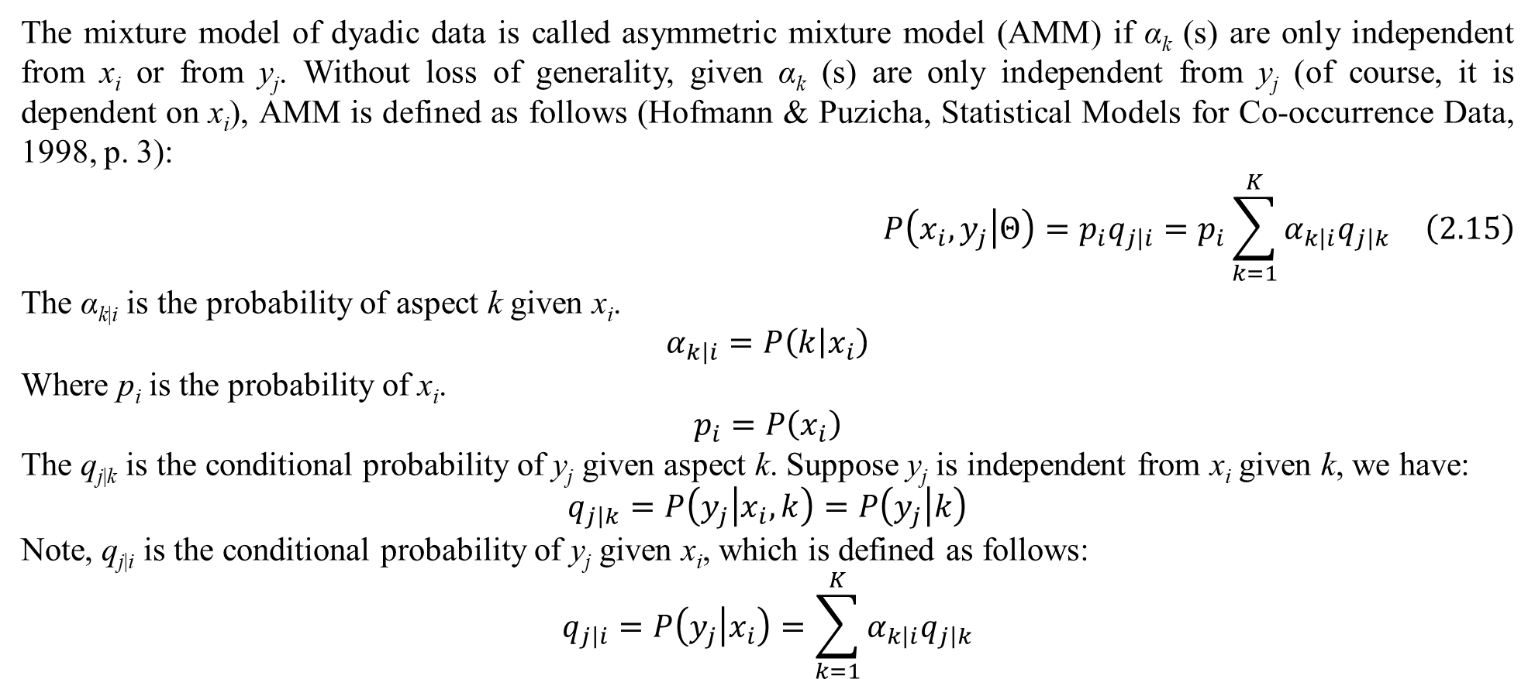
2. Mixture models for dyadic data
The mixture model of dyadic data is called asymmetric mixture model (AMM) if α_{k} (s) are only independent from x_{i} or from y_{j}. Without loss of generality, given α_{k} (s) are only independent from y_{j} (of course, it is dependent on x_{i}), AMM is defined as follows (Hofmann & Puzicha, Statistical Models for Co-occurrence Data, 1998, p. 3):
$$P\left(x_{i},y_{j} | Θ\right)=p_{i}q_{j\left|i\right.}=p_{i}\sum_{k=1}^{K}{α_{k\left|i\right.}q_{j\left|k\right.}} \left(2.15\right)$$
The α_{k|i} is the probability of aspect k given x_{i}.
$$α_{k\left|i\right.}=P\left(k | x_{i}\right)$$
Where p_{i} is the probability of x_{i}.
$$p_{i}=P\left(x_{i}\right)$$
The q_{j|k} is the conditional probability of y_{j} given aspect k. Suppose y_{j} is independent from x_{i} given k, we have:
$$q_{j\left|k\right.}=P\left(y_{j} | x_{i},k\right)=P\left(y_{j} | k\right)$$
Note, q_{j|i} is the conditional probability of y_{j} given x_{i}, which is defined as follows:
$$q_{j\left|i\right.}=P\left(y_{j} | x_{i}\right)=\sum_{k=1}^{K}{α_{k\left|i\right.}q_{j\left|k\right.}}$$

Slide 19
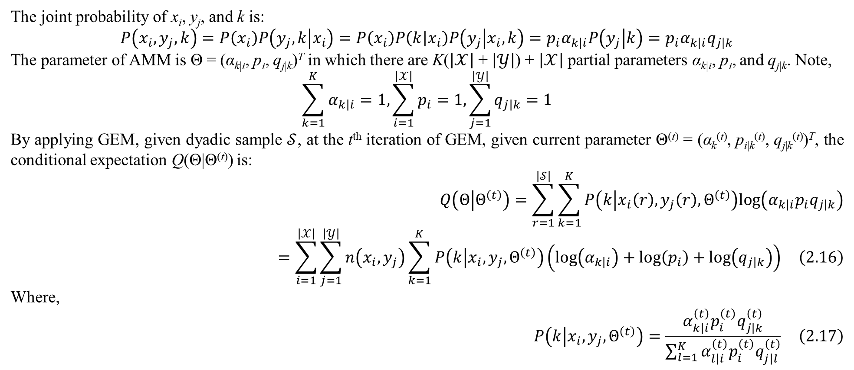
2. Mixture models for dyadic data
The joint probability of x_{i}, y_{j}, and k is:
$$P\left(x_{i},y_{j},k\right)=P\left(x_{i}\right)P\left(y_{j},k | x_{i}\right)=P\left(x_{i}\right)P\left(k | x_{i}\right)P\left(y_{j} | x_{i},k\right)=p_{i}α_{k\left|i\right.}P\left(y_{j} | k\right)=p_{i}α_{k\left|i\right.}q_{j\left|k\right.}$$
The parameter of AMM is Θ = (α_{k|i}, p_{i}, q_{j|k})^{T} in which there are K($\left|𝒳\right|$ + $\left|𝒴\right|$) + $\left|𝒳\right|$ partial parameters α_{k|i}, p_{i}, and q_{j|k}. Note,
$$\sum_{k=1}^{K}{α_{k\left|i\right.}}=1,\sum_{i=1}^{\left|𝒳\right|}{p_{i}}=1,\sum_{j=1}^{\left|𝒴\right|}{q_{j\left|k\right.}}=1$$
By applying GEM, given dyadic sample $𝒮$, at the t^{th} iteration of GEM, given current parameter Θ^{(t)} = (α_{k}^{(t)}, p_{i|k}^{(t)}, q_{j|k}^{(t)})^{T}, the conditional expectation Q(Θ|Θ^{(t)}) is:
$$Q\left(Θ | Θ^{\left(t\right)}\right)=\sum_{r=1}^{\left|𝒮\right|}{\sum_{k=1}^{K}{P\left(k | x_{i}\left(r\right),y_{j}\left(r\right),Θ^{\left(t\right)}\right)log\left(α_{k\left|i\right.}p_{i}q_{j\left|k\right.}\right)}}=\sum_{i=1}^{\left|𝒳\right|}{\sum_{j=1}^{\left|𝒴\right|}{n\left(x_{i},y_{j}\right)\sum_{k=1}^{K}{P\left(k | x_{i},y_{j},Θ^{\left(t\right)}\right)\left(log\left(α_{k\left|i\right.}\right)+log\left(p_{i}\right)+log\left(q_{j\left|k\right.}\right)\right)}}} \left(2.16\right)$$
Where,
$$P\left(k | x_{i},y_{j},Θ^{\left(t\right)}\right)=\frac{α_{k\left|i\right.}^{\left(t\right)}p_{i}^{\left(t\right)}q_{j\left|k\right.}^{\left(t\right)}}{\sum_{l=1}^{K}{α_{l\left|i\right.}^{\left(t\right)}p_{i}^{\left(t\right)}q_{j\left|l\right.}^{\left(t\right)}}} \left(2.17\right)$$

Slide 20
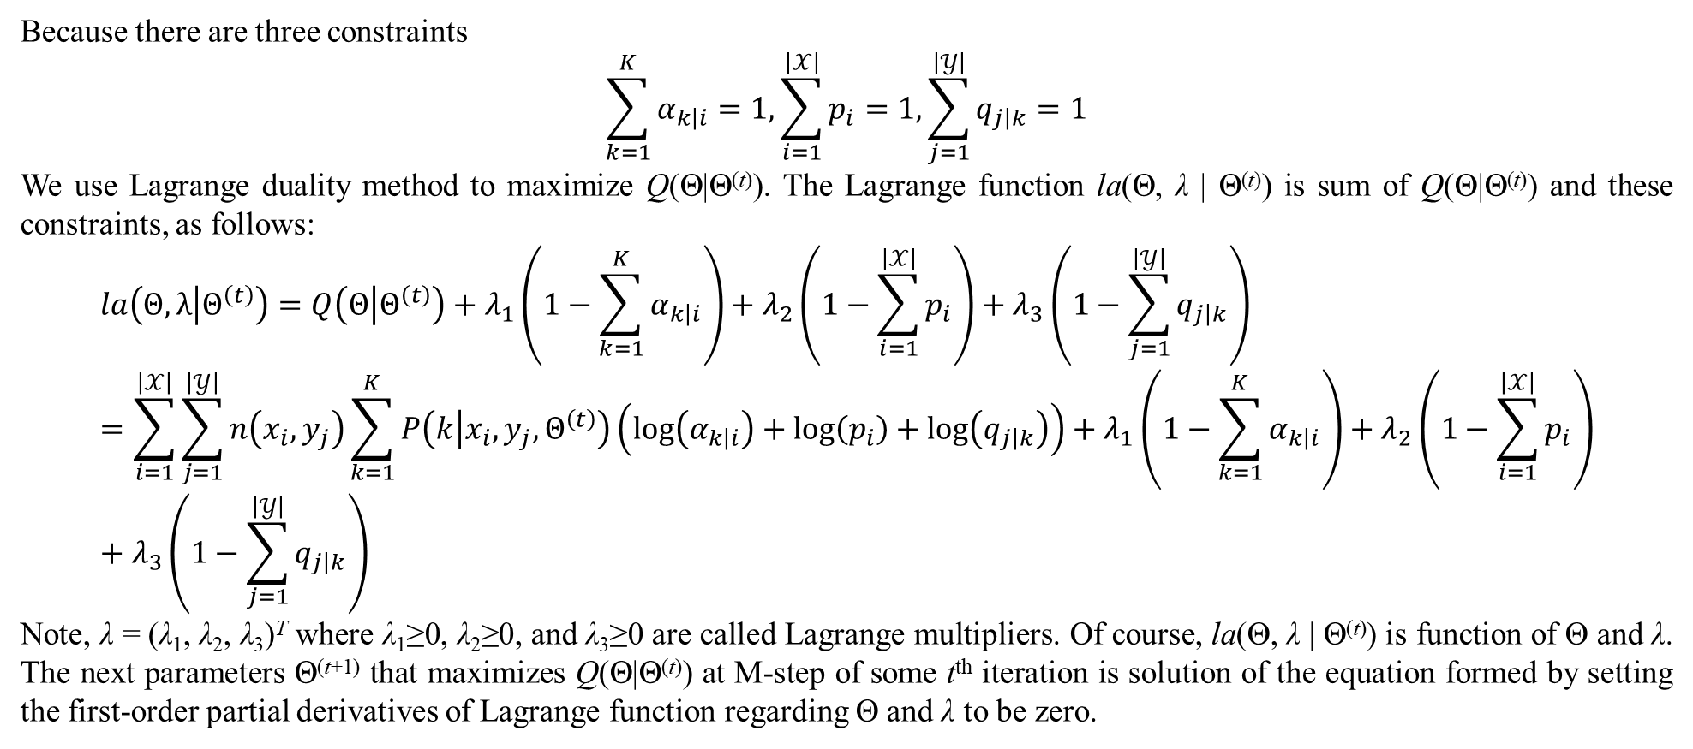
2. Mixture models for dyadic data
Because there are three constraints
$$\sum_{k=1}^{K}{α_{k\left|i\right.}}=1,\sum_{i=1}^{\left|𝒳\right|}{p_{i}}=1,\sum_{j=1}^{\left|𝒴\right|}{q_{j\left|k\right.}}=1$$
We use Lagrange duality method to maximize Q(Θ|Θ^{(t)}). The Lagrange function la(Θ, λ | Θ^{(t)}) is sum of Q(Θ|Θ^{(t)}) and these constraints, as follows:
$$la\left(Θ,λ | Θ^{\left(t\right)}\right)=Q\left(Θ | Θ^{\left(t\right)}\right)+λ_{1}\left(1−\sum_{k=1}^{K}{α_{k\left|i\right.}}\right)+λ_{2}\left(1−\sum_{i=1}^{\left|𝒳\right|}{p_{i}}\right)+λ_{3}\left(1−\sum_{j=1}^{\left|𝒴\right|}{q_{j\left|k\right.}}\right)=\sum_{i=1}^{\left|𝒳\right|}{\sum_{j=1}^{\left|𝒴\right|}{n\left(x_{i},y_{j}\right)\sum_{k=1}^{K}{P\left(k | x_{i},y_{j},Θ^{\left(t\right)}\right)\left(log\left(α_{k\left|i\right.}\right)+log\left(p_{i}\right)+log\left(q_{j\left|k\right.}\right)\right)}}}+λ_{1}\left(1−\sum_{k=1}^{K}{α_{k\left|i\right.}}\right)+λ_{2}\left(1−\sum_{i=1}^{\left|𝒳\right|}{p_{i}}\right)+λ_{3}\left(1−\sum_{j=1}^{\left|𝒴\right|}{q_{j\left|k\right.}}\right)$$
Note, λ = (λ₁, λ₂, λ₃)^{T} where λ₁≥0, λ₂≥0, and λ₃≥0 are called Lagrange multipliers. Of course, la(Θ, λ | Θ^{(t)}) is function of Θ and λ. The next parameters Θ^{(t+1)} that maximizes Q(Θ|Θ^{(t)}) at M-step of some t^{th} iteration is solution of the equation formed by setting the first-order partial derivatives of Lagrange function regarding Θ and λ to be zero.

Slide 21
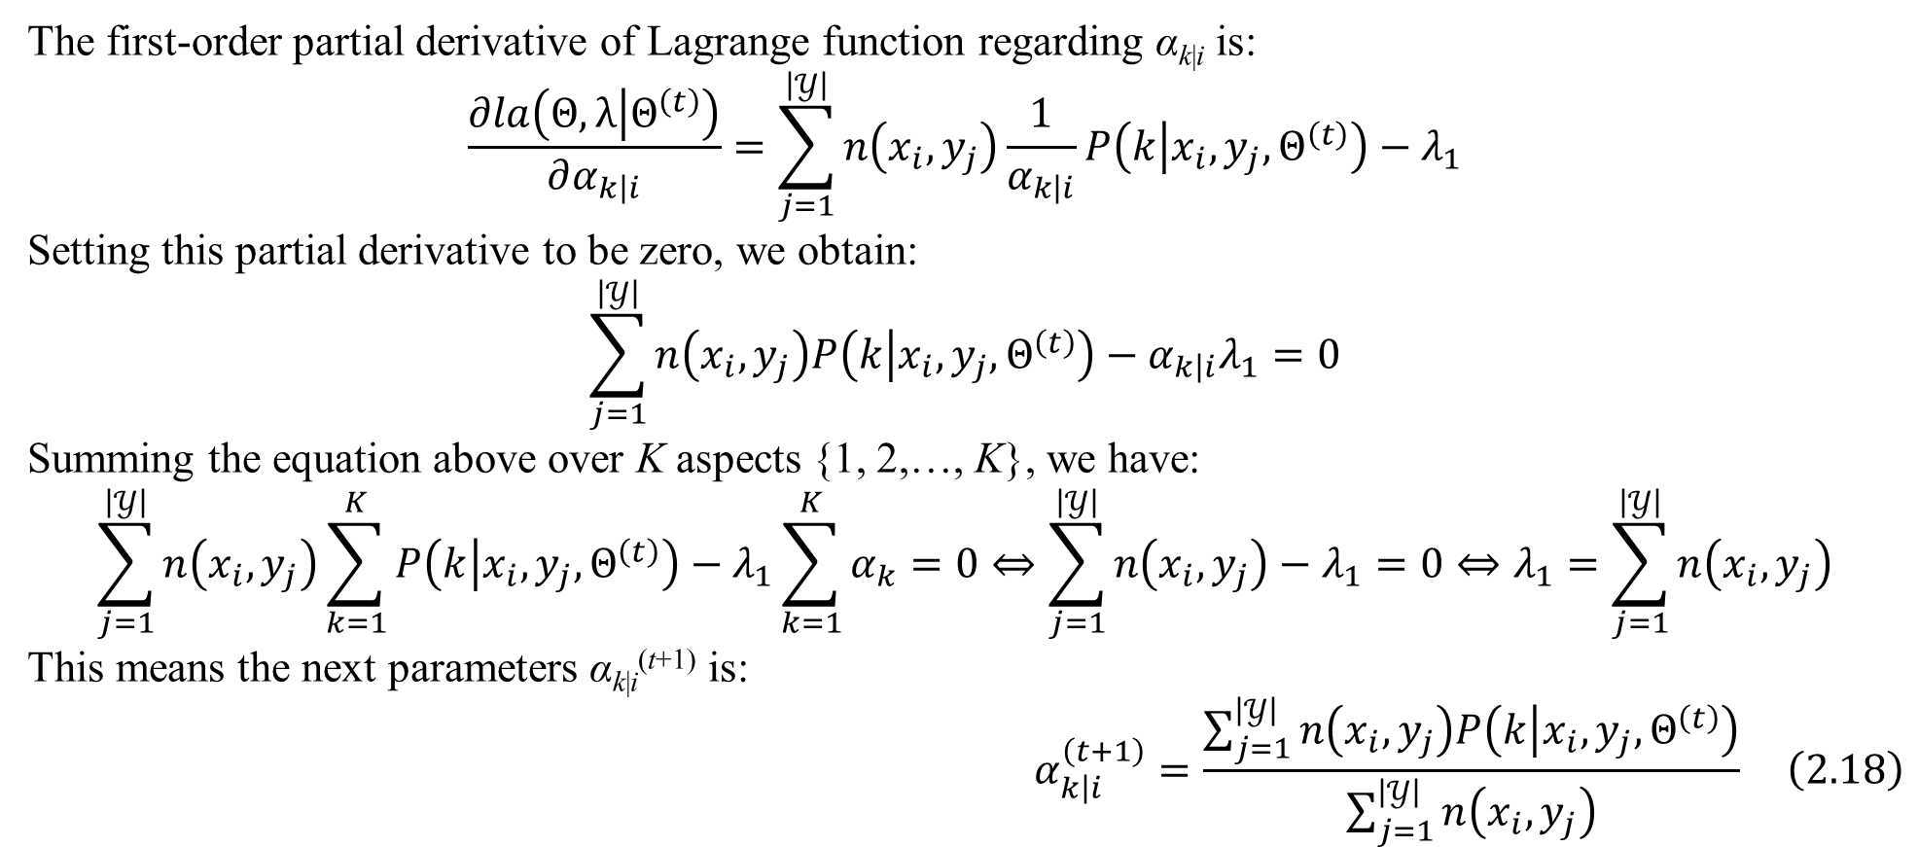
2. Mixture models for dyadic data
The first-order partial derivative of Lagrange function regarding α_{k|i} is:
$$\frac{∂la\left(Θ,λ | Θ^{\left(t\right)}\right)}{∂α_{k\left|i\right.}}=\sum_{j=1}^{\left|𝒴\right|}{n\left(x_{i},y_{j}\right)\frac{1}{α_{k\left|i\right.}}P\left(k | x_{i},y_{j},Θ^{\left(t\right)}\right)}−λ_{1}$$
Setting this partial derivative to be zero, we obtain:
$$\sum_{j=1}^{\left|𝒴\right|}{n\left(x_{i},y_{j}\right)P\left(k | x_{i},y_{j},Θ^{\left(t\right)}\right)}−α_{k\left|i\right.}λ_{1}=0$$
Summing the equation above over K aspects {1, 2,…, K}, we have:
$$\sum_{j=1}^{\left|𝒴\right|}{n\left(x_{i},y_{j}\right)\sum_{k=1}^{K}{P\left(k | x_{i},y_{j},Θ^{\left(t\right)}\right)}}−λ_{1}\sum_{k=1}^{K}{α_{k}}=0⇔\sum_{j=1}^{\left|𝒴\right|}{n\left(x_{i},y_{j}\right)}−λ_{1}=0⇔λ_{1}=\sum_{j=1}^{\left|𝒴\right|}{n\left(x_{i},y_{j}\right)}$$
This means the next parameters α_{k|i}^{(t+1)} is:
$$α_{k\left|i\right.}^{\left(t+1\right)}=\frac{\sum_{j=1}^{\left|𝒴\right|}{n\left(x_{i},y_{j}\right)P\left(k | x_{i},y_{j},Θ^{\left(t\right)}\right)}}{\sum_{j=1}^{\left|𝒴\right|}{n\left(x_{i},y_{j}\right)}} \left(2.18\right)$$

Slide 22
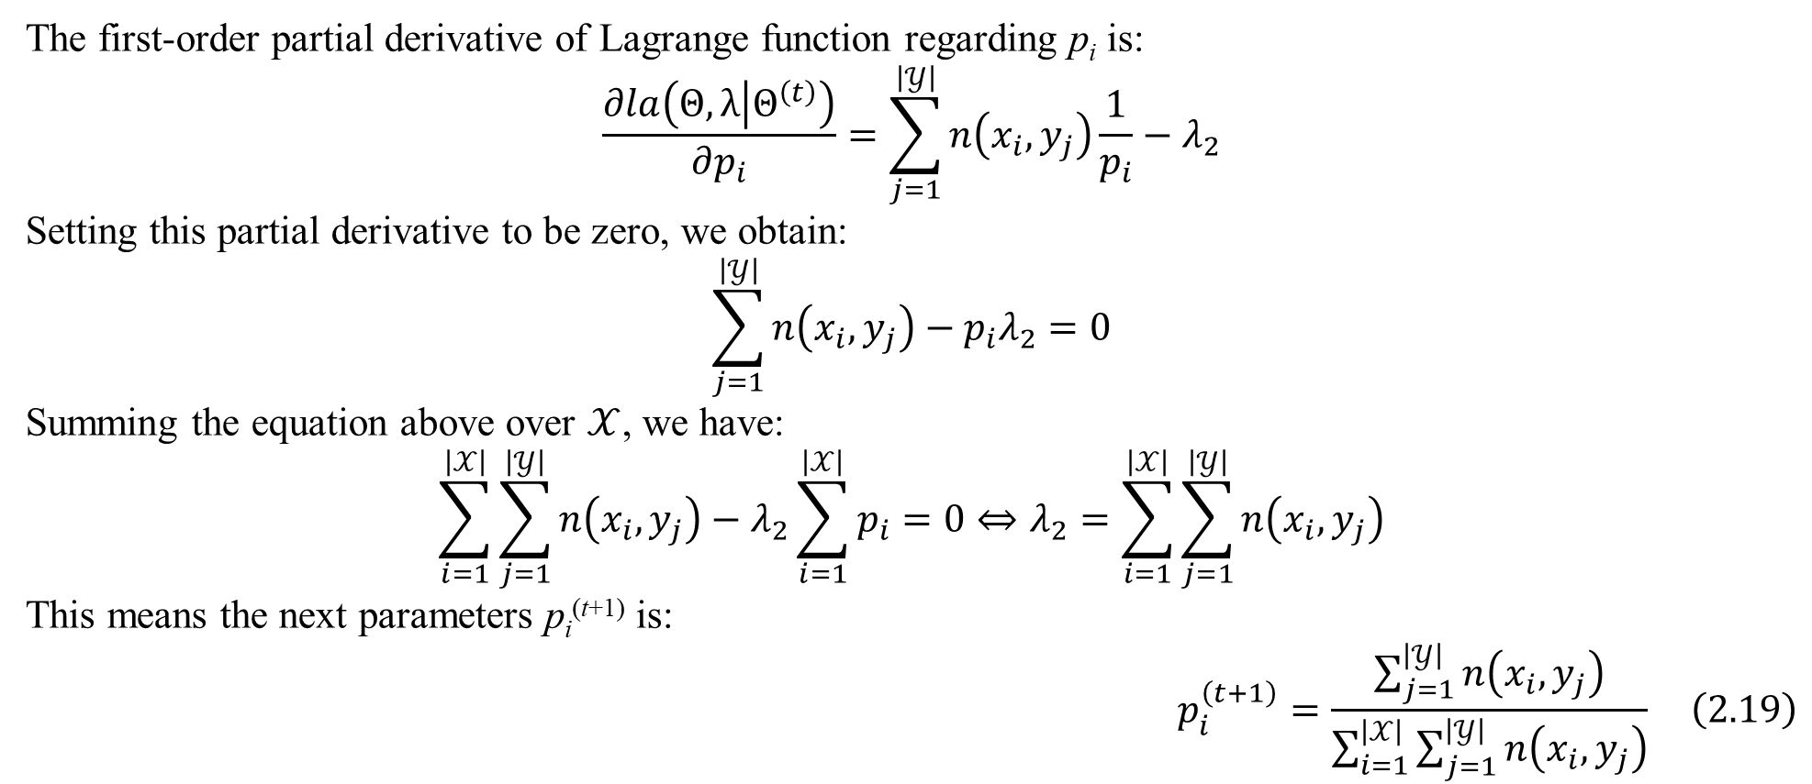
2. Mixture models for dyadic data
The first-order partial derivative of Lagrange function regarding p_{i} is:
$$\frac{∂la\left(Θ,λ | Θ^{\left(t\right)}\right)}{∂p_{i}}=\sum_{j=1}^{\left|𝒴\right|}{n\left(x_{i},y_{j}\right)\frac{1}{p_{i}}}−λ_{2}$$
Setting this partial derivative to be zero, we obtain:
$$\sum_{j=1}^{\left|𝒴\right|}{n\left(x_{i},y_{j}\right)}−p_{i}λ_{2}=0$$
Summing the equation above over $𝒳$, we have:
$$\sum_{i=1}^{\left|𝒳\right|}{\sum_{j=1}^{\left|𝒴\right|}{n\left(x_{i},y_{j}\right)}}−λ_{2}\sum_{i=1}^{\left|𝒳\right|}{p_{i}}=0⇔λ_{2}=\sum_{i=1}^{\left|𝒳\right|}{\sum_{j=1}^{\left|𝒴\right|}{n\left(x_{i},y_{j}\right)}}$$
This means the next parameters p_{i}^{(t+1)} is:
$$p_{i}^{\left(t+1\right)}=\frac{\sum_{j=1}^{\left|𝒴\right|}{n\left(x_{i},y_{j}\right)}}{\sum_{i=1}^{\left|𝒳\right|}{\sum_{j=1}^{\left|𝒴\right|}{n\left(x_{i},y_{j}\right)}}} \left(2.19\right)$$

Slide 23
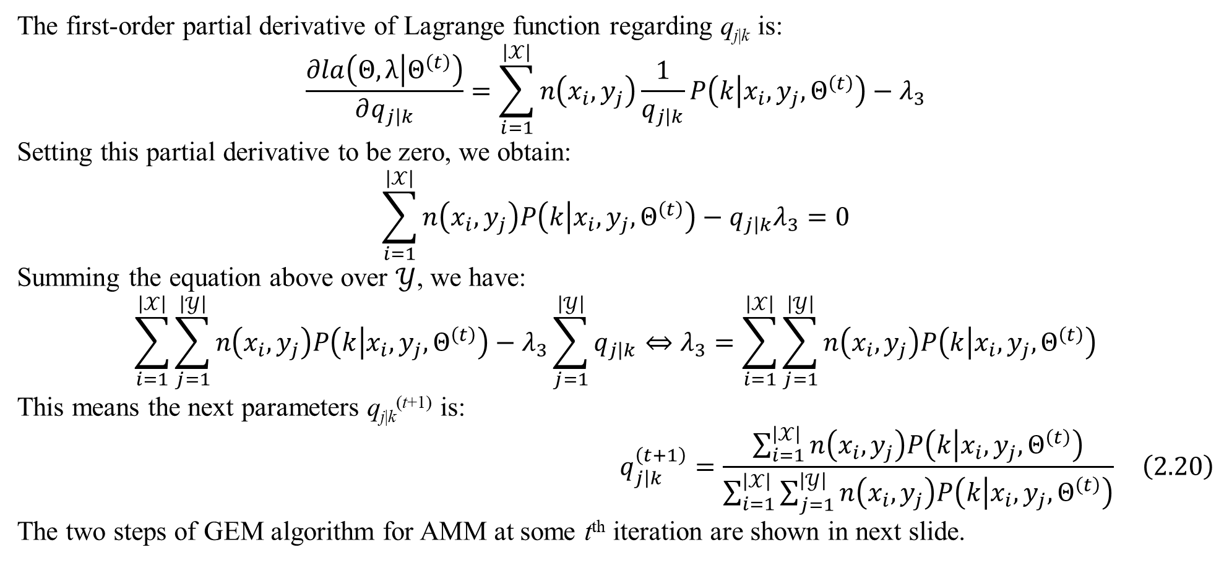
2. Mixture models for dyadic data
The first-order partial derivative of Lagrange function regarding q_{j|k} is:
$$\frac{∂la\left(Θ,λ | Θ^{\left(t\right)}\right)}{∂q_{j\left|k\right.}}=\sum_{i=1}^{\left|𝒳\right|}{n\left(x_{i},y_{j}\right)\frac{1}{q_{j\left|k\right.}}P\left(k | x_{i},y_{j},Θ^{\left(t\right)}\right)}−λ_{3}$$
Setting this partial derivative to be zero, we obtain:
$$\sum_{i=1}^{\left|𝒳\right|}{n\left(x_{i},y_{j}\right)P\left(k | x_{i},y_{j},Θ^{\left(t\right)}\right)}−q_{j\left|k\right.}λ_{3}=0$$
Summing the equation above over $𝒴$, we have:
$$\sum_{i=1}^{\left|𝒳\right|}{\sum_{j=1}^{\left|𝒴\right|}{n\left(x_{i},y_{j}\right)P\left(k | x_{i},y_{j},Θ^{\left(t\right)}\right)}}−λ_{3}\sum_{j=1}^{\left|𝒴\right|}{q_{j\left|k\right.}}⇔λ_{3}=\sum_{i=1}^{\left|𝒳\right|}{\sum_{j=1}^{\left|𝒴\right|}{n\left(x_{i},y_{j}\right)P\left(k | x_{i},y_{j},Θ^{\left(t\right)}\right)}}$$
This means the next parameters q_{j|k}^{(t+1)} is:
$$q_{j\left|k\right.}^{\left(t+1\right)}=\frac{\sum_{i=1}^{\left|𝒳\right|}{n\left(x_{i},y_{j}\right)P\left(k | x_{i},y_{j},Θ^{\left(t\right)}\right)}}{\sum_{i=1}^{\left|𝒳\right|}{\sum_{j=1}^{\left|𝒴\right|}{n\left(x_{i},y_{j}\right)P\left(k | x_{i},y_{j},Θ^{\left(t\right)}\right)}}} \left(2.20\right)$$
The two steps of GEM algorithm for AMM at some t^{th} iteration are shown in next slide.

Slide 24
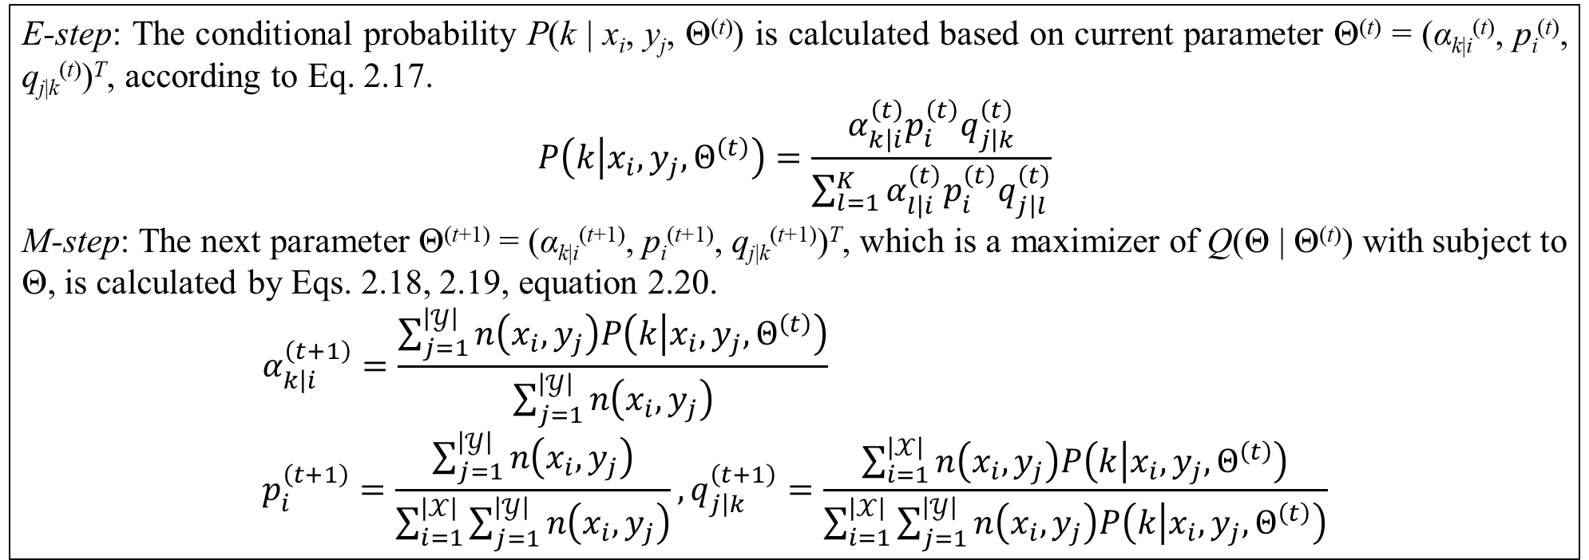
2. Mixture models for dyadic data
E-step: The conditional probability P(k | x_{i}, y_{j}, Θ^{(t)}) is calculated based on current parameter Θ^{(t)} = (α_{k|i}^{(t)}, p_{i}^{(t)}, q_{j|k}^{(t)})^{T}, according to Eq. 2.17.
$$P\left(k | x_{i},y_{j},Θ^{\left(t\right)}\right)=\frac{α_{k\left|i\right.}^{\left(t\right)}p_{i}^{\left(t\right)}q_{j\left|k\right.}^{\left(t\right)}}{\sum_{l=1}^{K}{α_{l\left|i\right.}^{\left(t\right)}p_{i}^{\left(t\right)}q_{j\left|l\right.}^{\left(t\right)}}}$$
M-step: The next parameter Θ^{(t+1)} = (α_{k|i}^{(t+1)}, p_{i}^{(t+1)}, q_{j|k}^{(t+1)})^{T}, which is a maximizer of Q(Θ | Θ^{(t)}) with subject to Θ, is calculated by Eqs. 2.18, 2.19, equation 2.20.
$$α_{k\left|i\right.}^{\left(t+1\right)}=\frac{\sum_{j=1}^{\left|𝒴\right|}{n\left(x_{i},y_{j}\right)P\left(k | x_{i},y_{j},Θ^{\left(t\right)}\right)}}{\sum_{j=1}^{\left|𝒴\right|}{n\left(x_{i},y_{j}\right)}} \\ p_{i}^{\left(t+1\right)}=\frac{\sum_{j=1}^{\left|𝒴\right|}{n\left(x_{i},y_{j}\right)}}{\sum_{i=1}^{\left|𝒳\right|}{\sum_{j=1}^{\left|𝒴\right|}{n\left(x_{i},y_{j}\right)}}},q_{j\left|k\right.}^{\left(t+1\right)}=\frac{\sum_{i=1}^{\left|𝒳\right|}{n\left(x_{i},y_{j}\right)P\left(k | x_{i},y_{j},Θ^{\left(t\right)}\right)}}{\sum_{i=1}^{\left|𝒳\right|}{\sum_{j=1}^{\left|𝒴\right|}{n\left(x_{i},y_{j}\right)P\left(k | x_{i},y_{j},Θ^{\left(t\right)}\right)}}}$$
Table 2.2. E-step and M-step of GEM algorithm for AMM
GEM algorithm converges at some t^{th} iteration. At that time, Θ* = Θ^{(t+1)} = Θ^{(t)} is the AMM itself. When AMM is applied into soft clustering, dyadic data is clustered vertically (horizontally) and each α_{k|i} is coverage ratio of cluster k (aspect k) according to x_{i}. Soft clustering with AMM is also called one-side clustering.

Slide 25
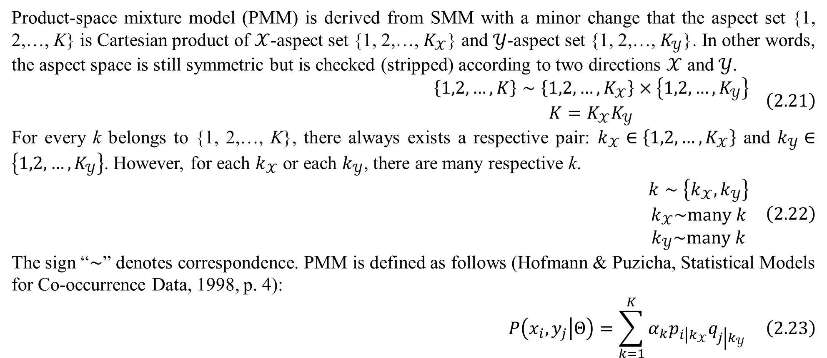
2. Mixture models for dyadic data
Product-space mixture model (PMM) is derived from SMM with a minor change that the aspect set {1, 2,…, K} is Cartesian product of $𝒳$-aspect set {1, 2,…, $K_{𝒳}$} and $𝒴$-aspect set {1, 2,…, $K_{𝒴}$}. In other words, the aspect space is still symmetric but is checked (stripped) according to two directions $𝒳$ and $𝒴$.
$$\begin{matrix}\left\{1,2,…,K\right\}∼\left\{1,2,…,K_{𝒳}\right\}×\left\{1,2,…,K_{𝒴}\right\} \\ K=K_{𝒳}K_{𝒴}\end{matrix} \left(2.21\right)$$
For every k belongs to {1, 2,…, K}, there always exists a respective pair: $k_{𝒳}∈\left\{1,2,…,K_{𝒳}\right\}$ and $k_{𝒴}∈\left\{1,2,…,K_{𝒴}\right\}$. However, for each $k_{𝒳}$ or each $k_{𝒴}$, there are many respective k.
$$\begin{matrix}k∼\left\{k_{𝒳},k_{𝒴}\right\} \\ k_{𝒳}\sim many k \\ k_{𝒴}\sim many k\end{matrix} \left(2.22\right)$$
The sign “$∼$” denotes correspondence. PMM is defined as follows (Hofmann & Puzicha, Statistical Models for Co-occurrence Data, 1998, p. 4):
$$P\left(x_{i},y_{j} | Θ\right)=\sum_{k=1}^{K}{α_{k}p_{i\left|k_{𝒳}\right.}q_{j\left|k_{𝒴}\right.}} \left(2.23\right)$$

Slide 26
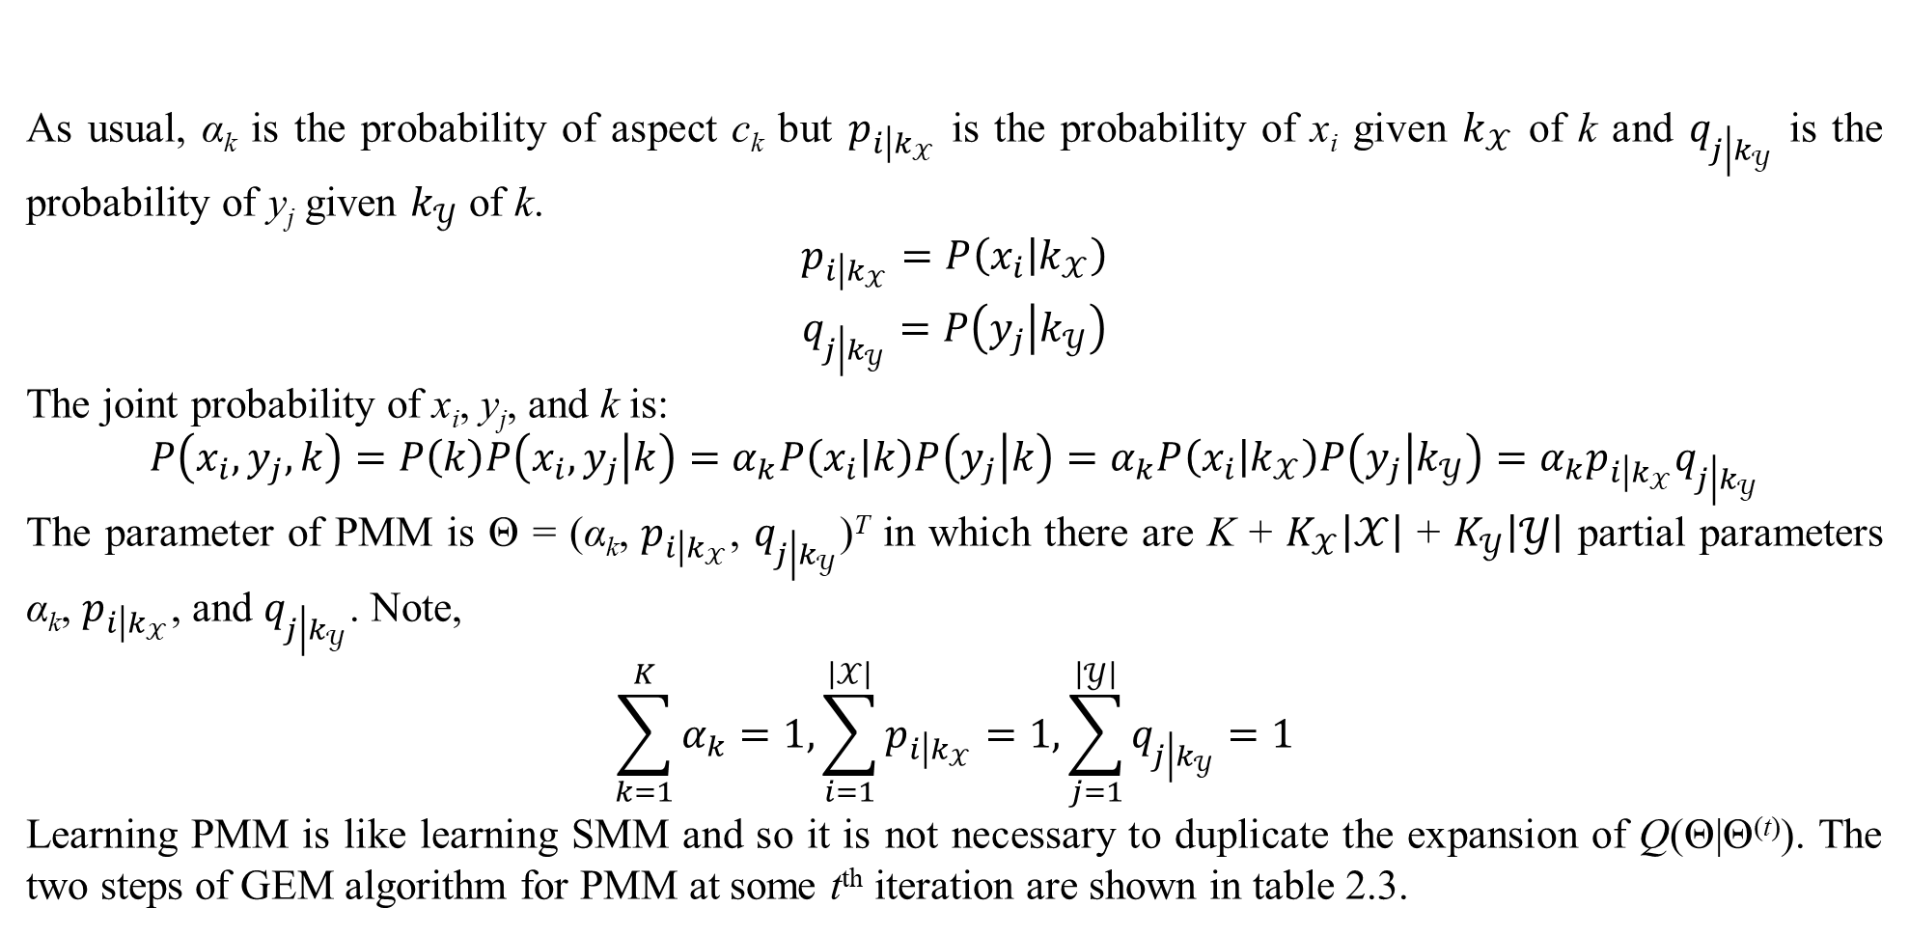
2. Mixture models for dyadic data
As usual, α_{k} is the probability of aspect c_{k} but $p_{i\left|k_{𝒳}\right.}$ is the probability of x_{i} given $k_{𝒳}$ of k and $q_{j\left|k_{𝒴}\right.}$ is the probability of y_{j} given $k_{𝒴}$ of k.
$$\begin{matrix}p_{i\left|k_{𝒳}\right.}=P\left(x_{i} | k_{𝒳}\right) \\ q_{j\left|k_{𝒴}\right.}=P\left(y_{j} | k_{𝒴}\right)\end{matrix}$$
The joint probability of x_{i}, y_{j}, and k is:
$$P\left(x_{i},y_{j},k\right)=P\left(k\right)P\left(x_{i},y_{j} | k\right)=α_{k}P\left(x_{i} | k\right)P\left(y_{j} | k\right)=α_{k}P\left(x_{i} | k_{𝒳}\right)P\left(y_{j} | k_{𝒴}\right)=α_{k}p_{i\left|k_{𝒳}\right.}q_{j\left|k_{𝒴}\right.}$$
The parameter of PMM is Θ = (α_{k}, $p_{i\left|k_{𝒳}\right.}$, $q_{j\left|k_{𝒴}\right.}$)^{T} in which there are K + $K_{𝒳}\left|𝒳\right|$ + $K_{𝒴}\left|𝒴\right|$ partial parameters α_{k}, $p_{i\left|k_{𝒳}\right.}$, and $q_{j\left|k_{𝒴}\right.}$. Note,
$$\sum_{k=1}^{K}{α_{k}}=1,\sum_{i=1}^{\left|𝒳\right|}{p_{i\left|k_{𝒳}\right.}}=1,\sum_{j=1}^{\left|𝒴\right|}{q_{j\left|k_{𝒴}\right.}}=1$$
Learning PMM is like learning SMM and so it is not necessary to duplicate the expansion of Q(Θ|Θ^{(t)}). The two steps of GEM algorithm for PMM at some t^{th} iteration are shown in table 2.3.

Slide 27
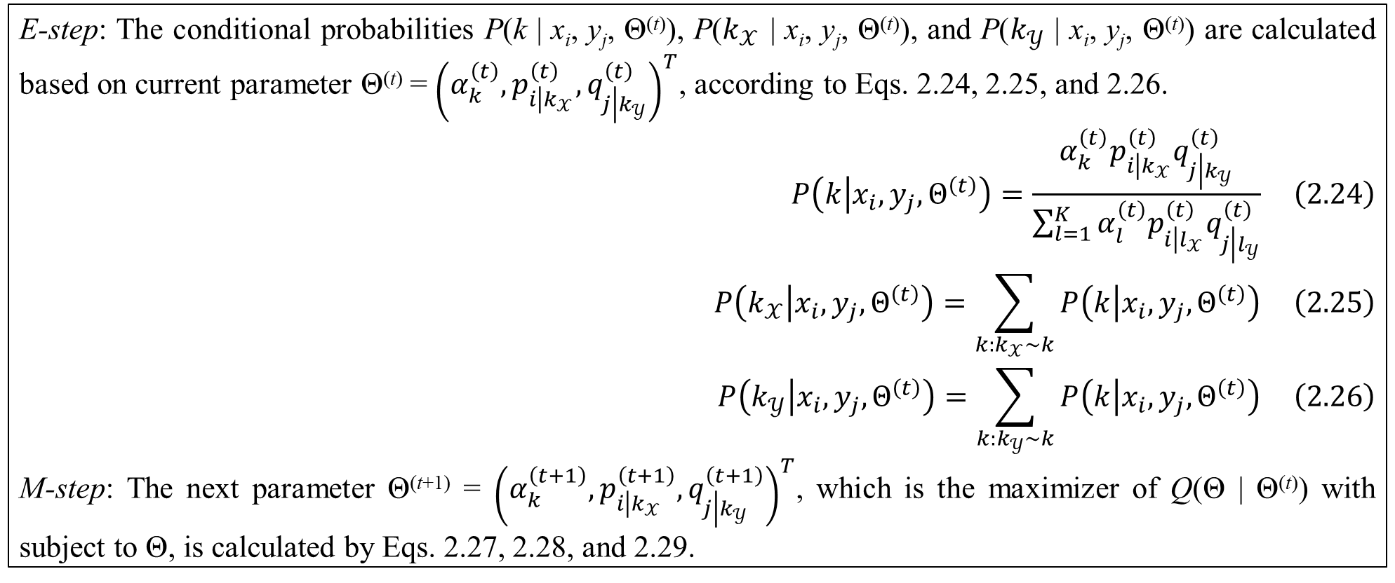
2. Mixture models for dyadic data
E-step: The conditional probabilities P(k | x_{i}, y_{j}, Θ^{(t)}), P($k_{𝒳}$ | x_{i}, y_{j}, Θ^{(t)}), and P($k_{𝒴}$ | x_{i}, y_{j}, Θ^{(t)}) are calculated based on current parameter Θ^{(t)} = ${\left(α_{k}^{\left(t\right)},p_{i\left|k_{𝒳}\right.}^{\left(t\right)},q_{j\left|k_{𝒴}\right.}^{\left(t\right)}\right)}^{T}$, according to Eqs. 2.24, 2.25, and 2.26.
$$P\left(k | x_{i},y_{j},Θ^{\left(t\right)}\right)=\frac{α_{k}^{\left(t\right)}p_{i\left|k_{𝒳}\right.}^{\left(t\right)}q_{j\left|k_{𝒴}\right.}^{\left(t\right)}}{\sum_{l=1}^{K}{α_{l}^{\left(t\right)}p_{i\left|l_{𝒳}\right.}^{\left(t\right)}q_{j\left|l_{𝒴}\right.}^{\left(t\right)}}} \left(2.24\right)$$
$$P\left(k_{𝒳} | x_{i},y_{j},Θ^{\left(t\right)}\right)=\sum_{k:k_{𝒳}\sim k}{P\left(k | x_{i},y_{j},Θ^{\left(t\right)}\right)} \left(2.25\right)$$
$$P\left(k_{𝒴} | x_{i},y_{j},Θ^{\left(t\right)}\right)=\sum_{k:k_{𝒴}\sim k}{P\left(k | x_{i},y_{j},Θ^{\left(t\right)}\right)} \left(2.26\right)$$
M-step: The next parameter Θ^{(t+1)} = ${\left(α_{k}^{\left(t+1\right)},p_{i\left|k_{𝒳}\right.}^{\left(t+1\right)},q_{j\left|k_{𝒴}\right.}^{\left(t+1\right)}\right)}^{T}$, which is the maximizer of Q(Θ | Θ^{(t)}) with subject to Θ, is calculated by Eqs. 2.27, 2.28, and 2.29.
Table 2.3. E-step and M-step of GEM algorithm for PMM

Slide 28
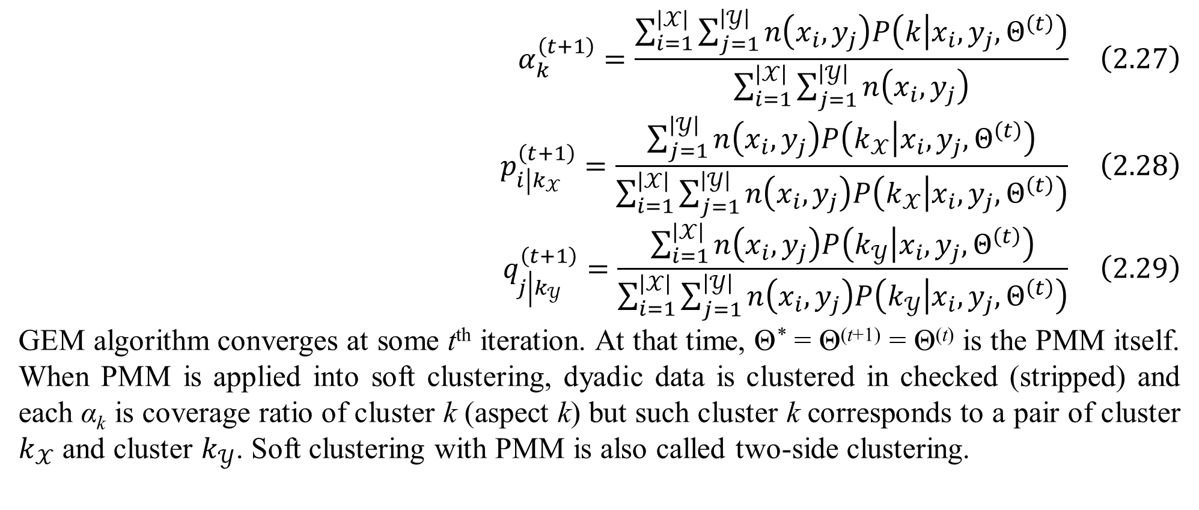
2. Mixture models for dyadic data
$$α_{k}^{\left(t+1\right)}=\frac{\sum_{i=1}^{\left|𝒳\right|}{\sum_{j=1}^{\left|𝒴\right|}{n\left(x_{i},y_{j}\right)P\left(k | x_{i},y_{j},Θ^{\left(t\right)}\right)}}}{\sum_{i=1}^{\left|𝒳\right|}{\sum_{j=1}^{\left|𝒴\right|}{n\left(x_{i},y_{j}\right)}}} \left(2.27\right)$$
$$p_{i\left|k_{𝒳}\right.}^{\left(t+1\right)}=\frac{\sum_{j=1}^{\left|𝒴\right|}{n\left(x_{i},y_{j}\right)P\left(k_{𝒳} | x_{i},y_{j},Θ^{\left(t\right)}\right)}}{\sum_{i=1}^{\left|𝒳\right|}{\sum_{j=1}^{\left|𝒴\right|}{n\left(x_{i},y_{j}\right)P\left(k_{𝒳} | x_{i},y_{j},Θ^{\left(t\right)}\right)}}} \left(2.28\right)$$
$$q_{j\left|k_{𝒴}\right.}^{\left(t+1\right)}=\frac{\sum_{i=1}^{\left|𝒳\right|}{n\left(x_{i},y_{j}\right)P\left(k_{𝒴} | x_{i},y_{j},Θ^{\left(t\right)}\right)}}{\sum_{i=1}^{\left|𝒳\right|}{\sum_{j=1}^{\left|𝒴\right|}{n\left(x_{i},y_{j}\right)P\left(k_{𝒴} | x_{i},y_{j},Θ^{\left(t\right)}\right)}}} \left(2.29\right)$$
GEM algorithm converges at some t^{th} iteration. At that time, Θ* = Θ^{(t+1)} = Θ^{(t)} is the PMM itself. When PMM is applied into soft clustering, dyadic data is clustered in checked (stripped) and each α_{k} is coverage ratio of cluster k (aspect k) but such cluster k corresponds to a pair of cluster $k_{𝒳}$ and cluster $k_{𝒴}$. Soft clustering with PMM is also called two-side clustering.

Slide 29
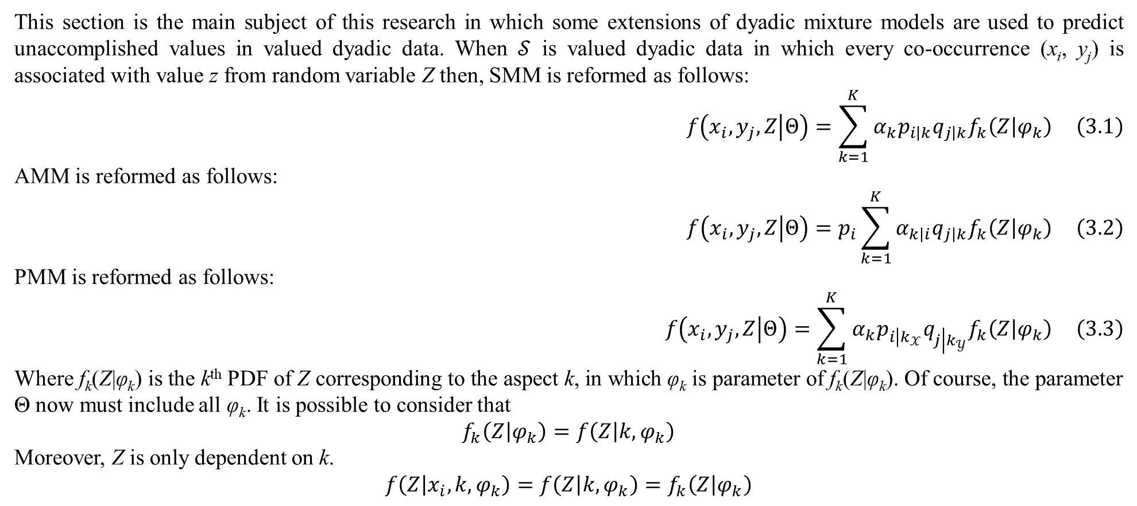
3. Predicting unaccomplished co-occurrent values
This section is the main subject of this research in which some extensions of dyadic mixture models are used to predict unaccomplished values in valued dyadic data. When $𝒮$ is valued dyadic data in which every co-occurrence (x_{i}, y_{j}) is associated with value z from random variable Z then, SMM is reformed as follows:
$$f\left(x_{i},y_{j},Z | Θ\right)=\sum_{k=1}^{K}{α_{k}p_{i\left|k\right.}q_{j\left|k\right.}f_{k}\left(Z | φ_{k}\right)} \left(3.1\right)$$
AMM is reformed as follows:
$$f\left(x_{i},y_{j},Z | Θ\right)=p_{i}\sum_{k=1}^{K}{α_{k\left|i\right.}q_{j\left|k\right.}f_{k}\left(Z | φ_{k}\right)} \left(3.2\right)$$
PMM is reformed as follows:
$$f\left(x_{i},y_{j},Z | Θ\right)=\sum_{k=1}^{K}{α_{k}p_{i\left|k_{𝒳}\right.}q_{j\left|k_{𝒴}\right.}f_{k}\left(Z | φ_{k}\right)} \left(3.3\right)$$
Where f_{k}(Z|φ_{k}) is the k^{th} PDF of Z corresponding to the aspect k, in which φ_{k} is parameter of f_{k}(Z|φ_{k}). Of course, the parameter Θ now must include all φ_{k}. It is possible to consider that
$$f_{k}\left(Z | φ_{k}\right)=f\left(Z | k,φ_{k}\right)$$
Moreover, Z is only dependent on k.
$$f\left(Z | x_{i},k,φ_{k}\right)=f\left(Z | k,φ_{k}\right)=f_{k}\left(Z | φ_{k}\right)$$

Slide 30
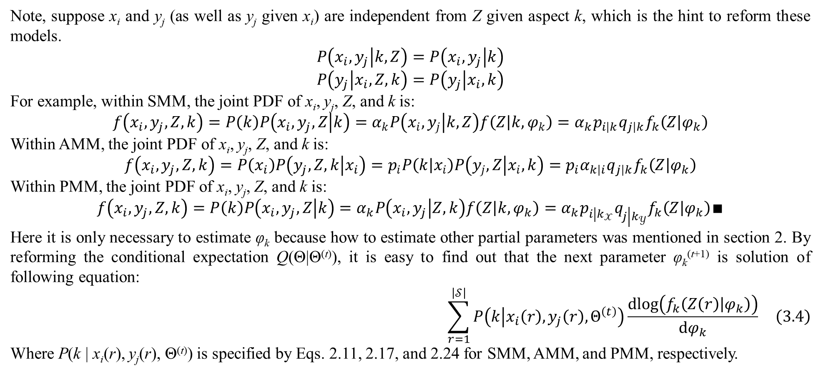
3. Predicting unaccomplished co-occurrent values
Note, suppose x_{i} and y_{j} (as well as y_{j} given x_{i}) are independent from Z given aspect k, which is the hint to reform these models.
$$P\left(x_{i},y_{j} | k,Z\right)=P\left(x_{i},y_{j} | k\right)$$
$$P\left(y_{j} | x_{i},Z,k\right)=P\left(y_{j} | x_{i},k\right)$$
For example, within SMM, the joint PDF of x_{i}, y_{j}, Z, and k is:
$$f\left(x_{i},y_{j},Z,k\right)=P\left(k\right)P\left(x_{i},y_{j},Z | k\right)=α_{k}P\left(x_{i},y_{j} | k,Z\right)f\left(Z | k,φ_{k}\right)=α_{k}p_{i\left|k\right.}q_{j\left|k\right.}f_{k}\left(Z | φ_{k}\right)$$
Within AMM, the joint PDF of x_{i}, y_{j}, Z, and k is:
$$f\left(x_{i},y_{j},Z,k\right)=P\left(x_{i}\right)P\left(y_{j},Z,k | x_{i}\right)=p_{i}P\left(k | x_{i}\right)P\left(y_{j},Z | x_{i},k\right)=p_{i}α_{k\left|i\right.}q_{j\left|k\right.}f_{k}\left(Z | φ_{k}\right)$$
Within PMM, the joint PDF of x_{i}, y_{j}, Z, and k is:
$$f\left(x_{i},y_{j},Z,k\right)=P\left(k\right)P\left(x_{i},y_{j},Z | k\right)=α_{k}P\left(x_{i},y_{j} | Z,k\right)f\left(Z | k,φ_{k}\right)=α_{k}p_{i\left|k_{𝒳}\right.}q_{j\left|k_{𝒴}\right.}f_{k}\left(Z | φ_{k}\right)∎$$
Here it is only necessary to estimate φ_{k} because how to estimate other partial parameters was mentioned in section 2. By reforming the conditional expectation Q(Θ|Θ^{(t)}), it is easy to find out that the next parameter φ_{k}^{(t+1)} is solution of following equation:
$$\sum_{r=1}^{\left|𝒮\right|}{P\left(k | x_{i}\left(r\right),y_{j}\left(r\right),Θ^{\left(t\right)}\right)\frac{dlog\left(f_{k}\left(Z\left(r\right) | φ_{k}\right)\right)}{dφ_{k}}} \left(3.4\right)$$
Where P(k | x_{i}(r), y_{j}(r), Θ^{(t)}) is specified by Eqs. 2.11, 2.17, and 2.24 for SMM, AMM, and PMM, respectively.

Slide 31
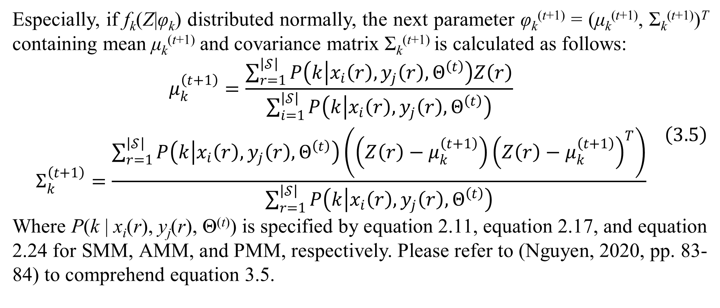
3. Predicting unaccomplished co-occurrent values
Especially, if f_{k}(Z|φ_{k}) distributed normally, the next parameter φ_{k}^{(t+1)} = (μ_{k}^{(t+1)}, Σ_{k}^{(t+1)})^{T} containing mean μ_{k}^{(t+1)} and covariance matrix Σ_{k}^{(t+1)} is calculated as follows:
$$\begin{matrix}μ_{k}^{\left(t+1\right)}=\frac{\sum_{r=1}^{\left|𝒮\right|}{P\left(k | x_{i}\left(r\right),y_{j}\left(r\right),Θ^{\left(t\right)}\right)Z\left(r\right)}}{\sum_{i=1}^{\left|𝒮\right|}{P\left(k | x_{i}\left(r\right),y_{j}\left(r\right),Θ^{\left(t\right)}\right)}} \\ Σ_{k}^{\left(t+1\right)}=\frac{\sum_{r=1}^{\left|𝒮\right|}{P\left(k | x_{i}\left(r\right),y_{j}\left(r\right),Θ^{\left(t\right)}\right)\left(\left(Z\left(r\right)−μ_{k}^{\left(t+1\right)}\right){\left(Z\left(r\right)−μ_{k}^{\left(t+1\right)}\right)}^{T}\right)}}{\sum_{r=1}^{\left|𝒮\right|}{P\left(k | x_{i}\left(r\right),y_{j}\left(r\right),Θ^{\left(t\right)}\right)}}\end{matrix} \left(3.5\right)$$
Where P(k | x_{i}(r), y_{j}(r), Θ^{(t)}) is specified by equation 2.11, equation 2.17, and equation 2.24 for SMM, AMM, and PMM, respectively. Please refer to (Nguyen, 2020, pp. 83-84) to comprehend equation 3.5.

Slide 32
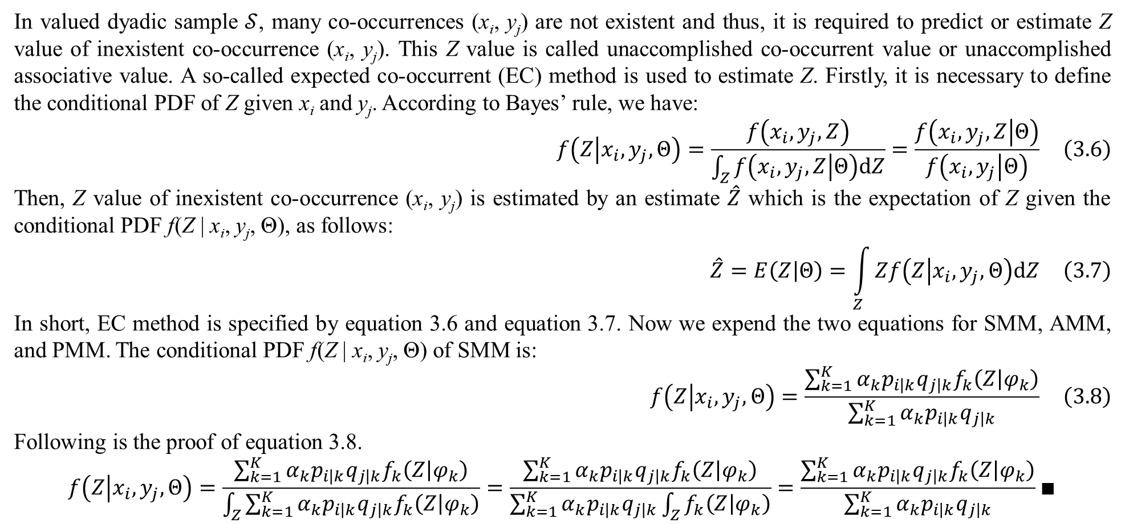
3. Predicting unaccomplished co-occurrent values
In valued dyadic sample $𝒮$, many co-occurrences (x_{i}, y_{j}) are not existent and thus, it is required to predict or estimate Z value of inexistent co-occurrence (x_{i}, y_{j}). This Z value is called unaccomplished co-occurrent value or unaccomplished associative value. A so-called expected co-occurrent (EC) method is used to estimate Z. Firstly, it is necessary to define the conditional PDF of Z given x_{i} and y_{j}. According to Bayes’ rule, we have:
$$f\left(Z | x_{i},y_{j},Θ\right)=\frac{f\left(x_{i},y_{j},Z\right)}{\int_{Z}{f\left(x_{i},y_{j},Z | Θ\right)dZ}}=\frac{f\left(x_{i},y_{j},Z | Θ\right)}{f\left(x_{i},y_{j} | Θ\right)} \left(3.6\right)$$
Then, Z value of inexistent co-occurrence (x_{i}, y_{j}) is estimated by an estimate $\hat{Z}$ which is the expectation of Z given the conditional PDF f(Z | x_{i}, y_{j}, Θ), as follows:
$$\hat{Z}=E\left(Z | Θ\right)=\int_{Z}{Zf\left(Z | x_{i},y_{j},Θ\right)dZ} \left(3.7\right)$$
In short, EC method is specified by equation 3.6 and equation 3.7. Now we expend the two equations for SMM, AMM, and PMM. The conditional PDF f(Z | x_{i}, y_{j}, Θ) of SMM is:
$$f\left(Z | x_{i},y_{j},Θ\right)=\frac{\sum_{k=1}^{K}{α_{k}p_{i\left|k\right.}q_{j\left|k\right.}f_{k}\left(Z | φ_{k}\right)}}{\sum_{k=1}^{K}{α_{k}p_{i\left|k\right.}q_{j\left|k\right.}}} \left(3.8\right)$$
Following is the proof of equation 3.8.
$$f\left(Z | x_{i},y_{j},Θ\right)=\frac{\sum_{k=1}^{K}{α_{k}p_{i\left|k\right.}q_{j\left|k\right.}f_{k}\left(Z | φ_{k}\right)}}{\int_{Z}{\sum_{k=1}^{K}{α_{k}p_{i\left|k\right.}q_{j\left|k\right.}f_{k}\left(Z | φ_{k}\right)}}}=\frac{\sum_{k=1}^{K}{α_{k}p_{i\left|k\right.}q_{j\left|k\right.}f_{k}\left(Z | φ_{k}\right)}}{\sum_{k=1}^{K}{α_{k}p_{i\left|k\right.}q_{j\left|k\right.}\int_{Z}{f_{k}\left(Z | φ_{k}\right)}}}=\frac{\sum_{k=1}^{K}{α_{k}p_{i\left|k\right.}q_{j\left|k\right.}f_{k}\left(Z | φ_{k}\right)}}{\sum_{k=1}^{K}{α_{k}p_{i\left|k\right.}q_{j\left|k\right.}}}∎$$

Slide 33
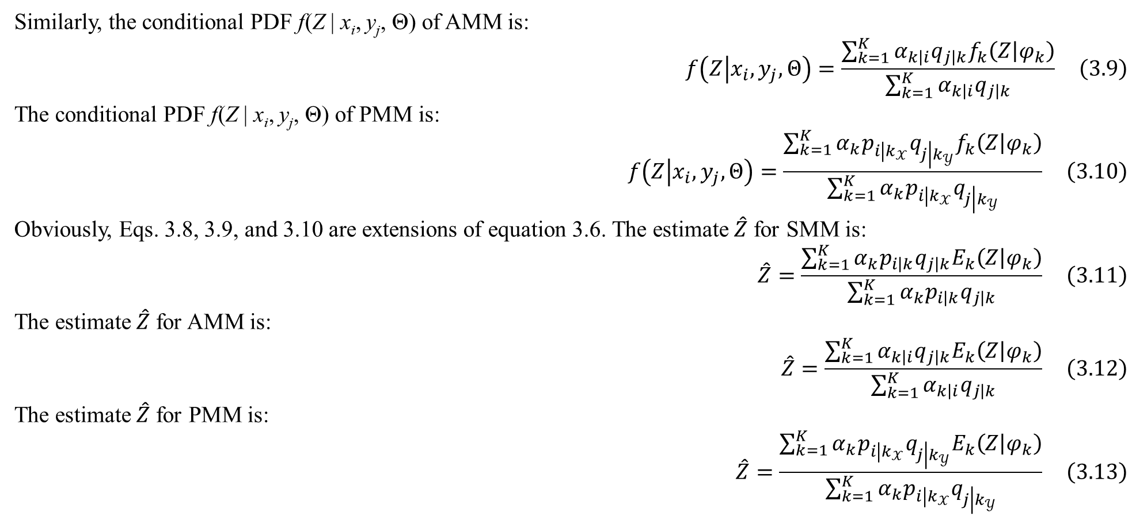
3. Predicting unaccomplished co-occurrent values
Similarly, the conditional PDF f(Z | x_{i}, y_{j}, Θ) of AMM is:
$$f\left(Z | x_{i},y_{j},Θ\right)=\frac{\sum_{k=1}^{K}{α_{k\left|i\right.}q_{j\left|k\right.}f_{k}\left(Z | φ_{k}\right)}}{\sum_{k=1}^{K}{α_{k\left|i\right.}q_{j\left|k\right.}}} \left(3.9\right)$$
The conditional PDF f(Z | x_{i}, y_{j}, Θ) of PMM is:
$$f\left(Z | x_{i},y_{j},Θ\right)=\frac{\sum_{k=1}^{K}{α_{k}p_{i\left|k_{𝒳}\right.}q_{j\left|k_{𝒴}\right.}f_{k}\left(Z | φ_{k}\right)}}{\sum_{k=1}^{K}{α_{k}p_{i\left|k_{𝒳}\right.}q_{j\left|k_{𝒴}\right.}}} \left(3.10\right)$$
Obviously, Eqs. 3.8, 3.9, and 3.10 are extensions of equation 3.6. The estimate $\hat{Z}$ for SMM is:
$$\hat{Z}=\frac{\sum_{k=1}^{K}{α_{k}p_{i\left|k\right.}q_{j\left|k\right.}E_{k}\left(Z | φ_{k}\right)}}{\sum_{k=1}^{K}{α_{k}p_{i\left|k\right.}q_{j\left|k\right.}}} \left(3.11\right)$$
The estimate $\hat{Z}$ for AMM is:
$$\hat{Z}=\frac{\sum_{k=1}^{K}{α_{k\left|i\right.}q_{j\left|k\right.}E_{k}\left(Z | φ_{k}\right)}}{\sum_{k=1}^{K}{α_{k\left|i\right.}q_{j\left|k\right.}}} \left(3.12\right)$$
The estimate $\hat{Z}$ for PMM is:
$$\hat{Z}=\frac{\sum_{k=1}^{K}{α_{k}p_{i\left|k_{𝒳}\right.}q_{j\left|k_{𝒴}\right.}E_{k}\left(Z | φ_{k}\right)}}{\sum_{k=1}^{K}{α_{k}p_{i\left|k_{𝒳}\right.}q_{j\left|k_{𝒴}\right.}}} \left(3.13\right)$$

Slide 34
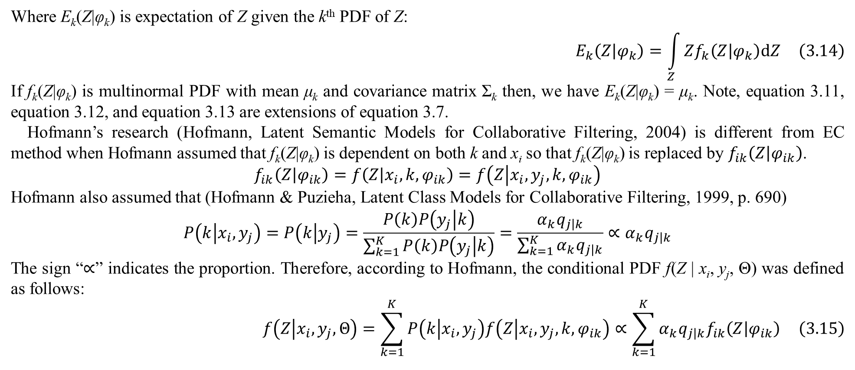
3. Predicting unaccomplished co-occurrent values
Where E_{k}(Z|φ_{k}) is expectation of Z given the k^{th} PDF of Z:
$$E_{k}\left(Z | φ_{k}\right)=\int_{Z}{Zf_{k}\left(Z | φ_{k}\right)dZ} \left(3.14\right)$$
If f_{k}(Z|φ_{k}) is multinormal PDF with mean μ_{k} and covariance matrix Σ_{k} then, we have E_{k}(Z|φ_{k}) = μ_{k}. Note, equation 3.11, equation 3.12, and equation 3.13 are extensions of equation 3.7.
Hofmann’s research (Hofmann, Latent Semantic Models for Collaborative Filtering, 2004) is different from EC method when Hofmann assumed that f_{k}(Z|φ_{k}) is dependent on both k and x_{i} so that f_{k}(Z|φ_{k}) is replaced by $f_{ik}\left(Z | φ_{ik}\right)$.
$$f_{ik}\left(Z | φ_{ik}\right)=f\left(Z | x_{i},k,φ_{ik}\right)=f\left(Z | x_{i},y_{j},k,φ_{ik}\right)$$
Hofmann also assumed that (Hofmann & Puzieha, Latent Class Models for Collaborative Filtering, 1999, p. 690)
$$P\left(k | x_{i},y_{j}\right)=P\left(k | y_{j}\right)=\frac{P\left(k\right)P\left(y_{j} | k\right)}{\sum_{k=1}^{K}{P\left(k\right)P\left(y_{j} | k\right)}}=\frac{α_{k}q_{j\left|k\right.}}{\sum_{k=1}^{K}{α_{k}q_{j\left|k\right.}}}∝α_{k}q_{j\left|k\right.}$$
The sign “$∝$” indicates the proportion. Therefore, according to Hofmann, the conditional PDF f(Z | x_{i}, y_{j}, Θ) was defined as follows:
$$f\left(Z | x_{i},y_{j},Θ\right)=\sum_{k=1}^{K}{P\left(k | x_{i},y_{j}\right)f\left(Z | x_{i},y_{j},k,φ_{ik}\right)}∝\sum_{k=1}^{K}{α_{k}q_{j\left|k\right.}f_{ik}\left(Z | φ_{ik}\right)} \left(3.15\right)$$

Slide 35
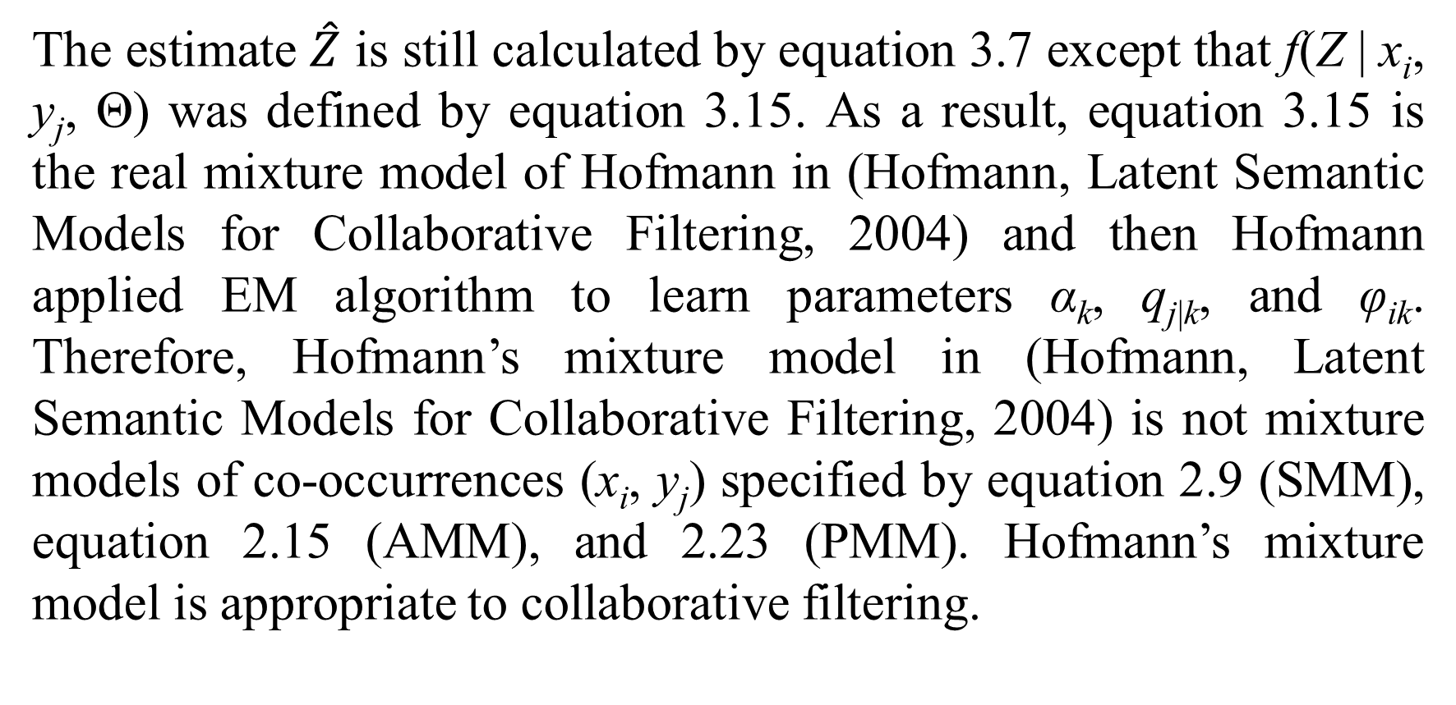
3. Predicting unaccomplished co-occurrent values
The estimate $\hat{Z}$ is still calculated by equation 3.7 except that f(Z | x_{i}, y_{j}, Θ) was defined by equation 3.15. As a result, equation 3.15 is the real mixture model of Hofmann in (Hofmann, Latent Semantic Models for Collaborative Filtering, 2004) and then Hofmann applied EM algorithm to learn parameters α_{k}, q_{j|k}, and φ_{ik}. Therefore, Hofmann’s mixture model in (Hofmann, Latent Semantic Models for Collaborative Filtering, 2004) is not mixture models of co-occurrences (x_{i}, y_{j}) specified by equation 2.9 (SMM), equation 2.15 (AMM), and 2.23 (PMM). Hofmann’s mixture model is appropriate to collaborative filtering.

Slide 36
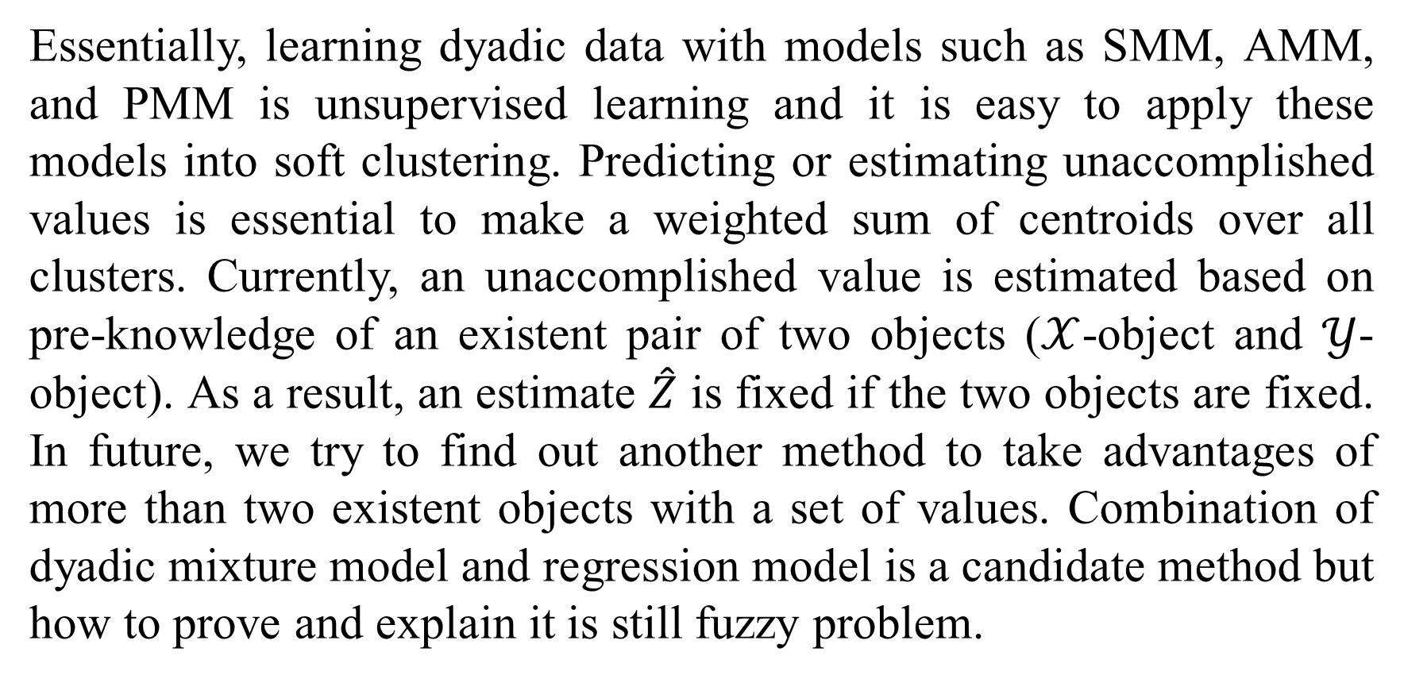
4. Conclusions
Essentially, learning dyadic data with models such as SMM, AMM, and PMM is unsupervised learning and it is easy to apply these models into soft clustering. Predicting or estimating unaccomplished values is essential to make a weighted sum of centroids over all clusters. Currently, an unaccomplished value is estimated based on pre-knowledge of an existent pair of two objects ($𝒳$-object and $𝒴$-object). As a result, an estimate $\hat{Z}$ is fixed if the two objects are fixed. In future, we try to find out another method to take advantages of more than two existent objects with a set of values. Combination of dyadic mixture model and regression model is a candidate method but how to prove and explain it is still fuzzy problem.

Slide 37
References
Hofmann, T. (2004, January). Latent Semantic Models for Collaborative Filtering. ACM Transactions on Information Systems (TOIS), 22(1), 89-115. doi:10.1145/963770.963774
Hofmann, T., & Puzicha, J. (1998). Statistical Models for Co-occurrence Data. Massachusetts Institute of Technology, Artificial Intelligence Laboratory. MIT Publisher. Retrieved from https://dspace.mit.edu/bitstream/handle/1721.1/7253/AIM-1625.pdf?sequence=2
Hofmann, T., & Puzieha, J. (1999). Latent Class Models for Collaborative Filtering. In T. Dean (Ed.), Proceedings of the Sixteenth International Joint Conference on Artificial Intelligence (IJCAI '99) (pp. 688-693). San Francisco, CA, USA: Morgan Kaufmann. Retrieved from https://dl.acm.org/citation.cfm?id=687583
Hofmann, T., Puzicha, J., & Jordan, M. I. (1998). Learning from Dyadic Data. In M. J. Kearns, S. A. Solla, & D. A. Cohn (Ed.), Advances in Neural Information Processing Systems 11 (NIPS 1998). 11, pp. 466-472. Denver: MIT Press. Retrieved from https://papers.nips.cc/paper/1503-learning-from-dyadic-data
Nguyen, L. (2020). Tutorial on EM algorithm. MDPI. Preprints. doi:10.20944/preprints201802.0131.v8

Slide 38
Thank you for attention

