Slide 1
Tutorial on EM algorithm – Part 3
Prof. Dr. Loc Nguyen, PhD, PostDoc
Founder of Loc Nguyen’s Academic Network, Vietnam
Email: ng_phloc@yahoo.com
Homepage: www.locnguyen.net

Slide 2
Abstract
This is the chapter 3 in my book “Tutorial on EM algorithm”, which focuses on mathematical explanation of the convergence of GEM algorithm given by DLR (Dempster, Laird, & Rubin, 1977, pp. 6-9).

Slide 3
Table of contents
Properties of EM
Convergence of EM

Slide 4
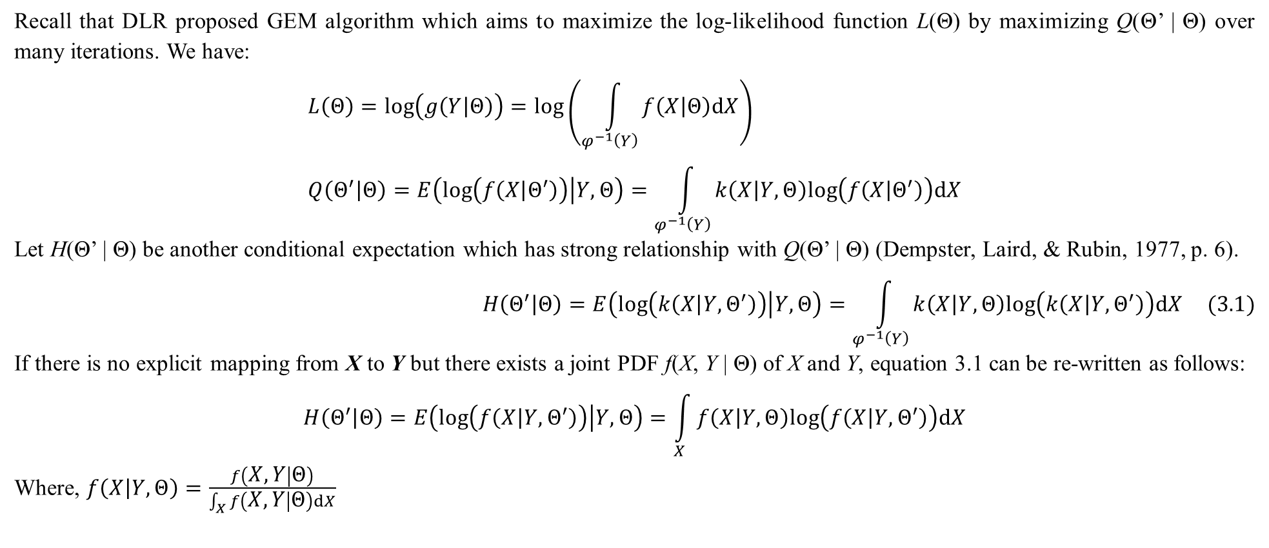
1. Properties of EM
Recall that DLR proposed GEM algorithm which aims to maximize the log-likelihood function L(Θ) by maximizing Q(Θ’ | Θ) over many iterations. We have:
$$L\left(Θ\right)=log\left(g\left(Y | Θ\right)\right)=log\left(\int_{φ^{−1}\left(Y\right)}{f\left(X | Θ\right)dX}\right) \\ Q\left(Θ^{′} | Θ\right)=E\left(log\left(f\left(X | Θ^{′}\right)\right) | Y,Θ\right)=\int_{φ^{−1}\left(Y\right)}{k\left(X | Y,Θ\right)log\left(f\left(X | Θ^{′}\right)\right)dX}$$
Let H(Θ’ | Θ) be another conditional expectation which has strong relationship with Q(Θ’ | Θ) (Dempster, Laird, & Rubin, 1977, p. 6).
$$H\left(Θ^{′} | Θ\right)=E\left(log\left(k\left(X | Y,Θ^{′}\right)\right) | Y,Θ\right)=\int_{φ^{−1}\left(Y\right)}{k\left(X | Y,Θ\right)log\left(k\left(X | Y,Θ^{′}\right)\right)dX} (3.1)$$
If there is no explicit mapping from X to Y but there exists a joint PDF f(X, Y | Θ) of X and Y, equation 3.1 can be re-written as follows:
$$H\left(Θ^{′} | Θ\right)=E\left(log\left(f\left(X | Y,Θ^{′}\right)\right) | Y,Θ\right)=\int_{X}{f\left(X | Y,Θ\right)log\left(f\left(X | Y,Θ^{′}\right)\right)dX}$$
Where, $f\left(X | Y,Θ\right)=\frac{f\left(X,Y | Θ\right)}{\int_{X}{f\left(X,Y | Θ\right)dX}}$

Slide 5
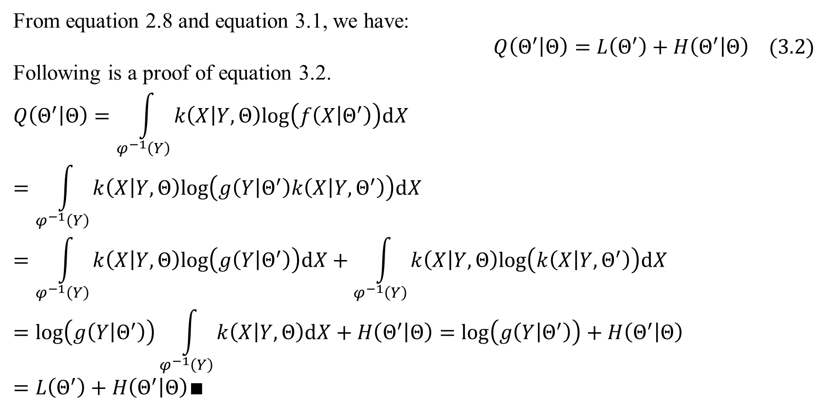
1. Properties of EM
From equation 2.8 and equation 3.1, we have:
$$Q\left(Θ^{′} | Θ\right)=L\left(Θ^{′}\right)+H\left(Θ^{′} | Θ\right) (3.2)$$
Following is a proof of equation 3.2.
$$Q\left(Θ^{′} | Θ\right)=\int_{φ^{−1}\left(Y\right)}{k\left(X | Y,Θ\right)log\left(f\left(X | Θ^{′}\right)\right)dX}=\int_{φ^{−1}\left(Y\right)}{k\left(X | Y,Θ\right)log\left(g\left(Y | Θ^{′}\right)k\left(X | Y,Θ^{′}\right)\right)dX}$$
$$=\int_{φ^{−1}\left(Y\right)}{k\left(X | Y,Θ\right)log\left(g\left(Y | Θ^{′}\right)\right)dX}+\int_{φ^{−1}\left(Y\right)}{k\left(X | Y,Θ\right)log\left(k\left(X | Y,Θ^{′}\right)\right)dX}$$
$$=log\left(g\left(Y | Θ^{′}\right)\right)\int_{φ^{−1}\left(Y\right)}{k\left(X | Y,Θ\right)dX}+H\left(Θ^{′} | Θ\right)=log\left(g\left(Y | Θ^{′}\right)\right)+H\left(Θ^{′} | Θ\right)=L\left(Θ^{′}\right)+H\left(Θ^{′} | Θ\right)∎$$

Slide 6
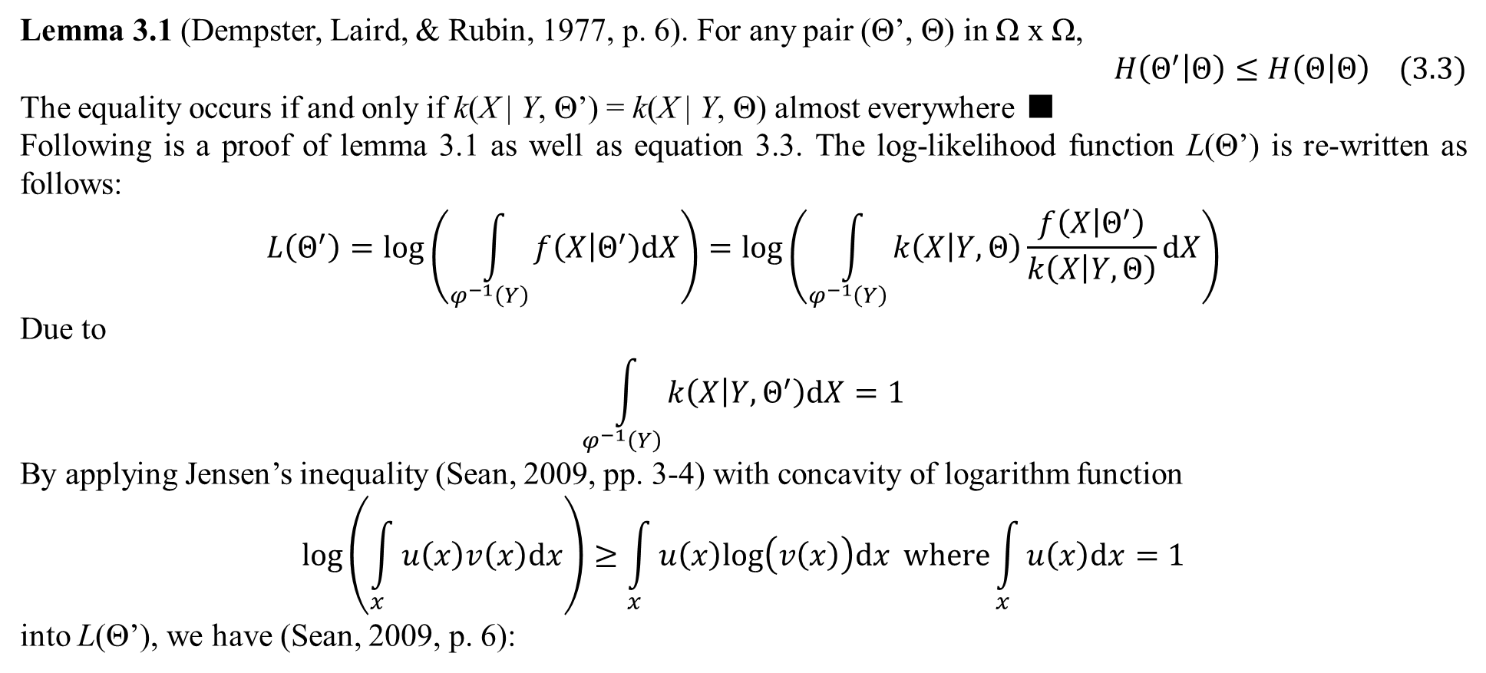
1. Properties of EM
Lemma 3.1 (Dempster, Laird, & Rubin, 1977, p. 6). For any pair (Θ’, Θ) in Ω x Ω,
$$H\left(Θ^{′} | Θ\right)≤H\left(Θ | Θ\right) (3.3)$$
The equality occurs if and only if k(X | Y, Θ’) = k(X | Y, Θ) almost everywhere ■
Following is a proof of lemma 3.1 as well as equation 3.3. The log-likelihood function L(Θ’) is re-written as follows:
$$L\left(Θ^{′}\right)=log\left(\int_{φ^{−1}\left(Y\right)}{f\left(X | Θ^{′}\right)dX}\right)=log\left(\int_{φ^{−1}\left(Y\right)}{k\left(X | Y,Θ\right)\frac{f\left(X | Θ^{′}\right)}{k\left(X | Y,Θ\right)}dX}\right)$$
Due to
$$\int_{φ^{−1}\left(Y\right)}{k\left(X | Y,Θ^{′}\right)dX}=1$$
By applying Jensen’s inequality (Sean, 2009, pp. 3-4) with concavity of logarithm function
$$log\left(\int_{x}{u\left(x\right)v\left(x\right)dx}\right)≥\int_{x}{u\left(x\right)log\left(v\left(x\right)\right)dx} where\int_{x}{u\left(x\right)dx}=1$$
into L(Θ’), we have (Sean, 2009, p. 6):

Slide 7
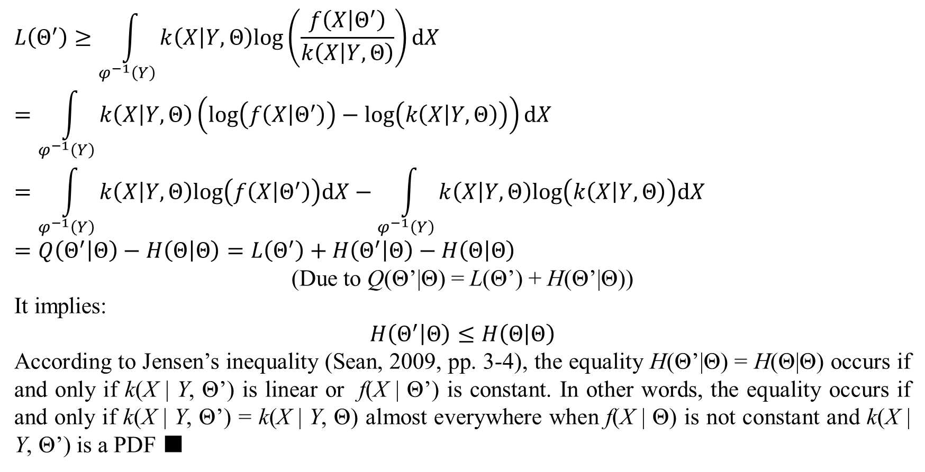
1. Properties of EM
$$L\left(Θ^{′}\right)≥\int_{φ^{−1}\left(Y\right)}{k\left(X | Y,Θ\right)log\left(\frac{f\left(X | Θ^{′}\right)}{k\left(X | Y,Θ\right)}\right)dX}$$
$$=\int_{φ^{−1}\left(Y\right)}{k\left(X | Y,Θ\right)\left(log\left(f\left(X | Θ^{′}\right)\right)−log\left(k\left(X | Y,Θ\right)\right)\right)dX}$$
$$=\int_{φ^{−1}\left(Y\right)}{k\left(X | Y,Θ\right)log\left(f\left(X | Θ^{′}\right)\right)dX}−\int_{φ^{−1}\left(Y\right)}{k\left(X | Y,Θ\right)log\left(k\left(X | Y,Θ\right)\right)dX}$$
$$=Q\left(Θ^{′} | Θ\right)−H\left(Θ | Θ\right)=L\left(Θ^{′}\right)+H\left(Θ^{′} | Θ\right)−H\left(Θ | Θ\right)$$
(Due to Q(Θ’|Θ) = L(Θ’) + H(Θ’|Θ))
It implies:
$$H\left(Θ^{′} | Θ\right)≤H\left(Θ | Θ\right)$$
According to Jensen’s inequality (Sean, 2009, pp. 3-4), the equality H(Θ’|Θ) = H(Θ|Θ) occurs if and only if k(X | Y, Θ’) is linear or f(X | Θ’) is constant. In other words, the equality occurs if and only if k(X | Y, Θ’) = k(X | Y, Θ) almost everywhere when f(X | Θ) is not constant and k(X | Y, Θ’) is a PDF ■

Slide 8
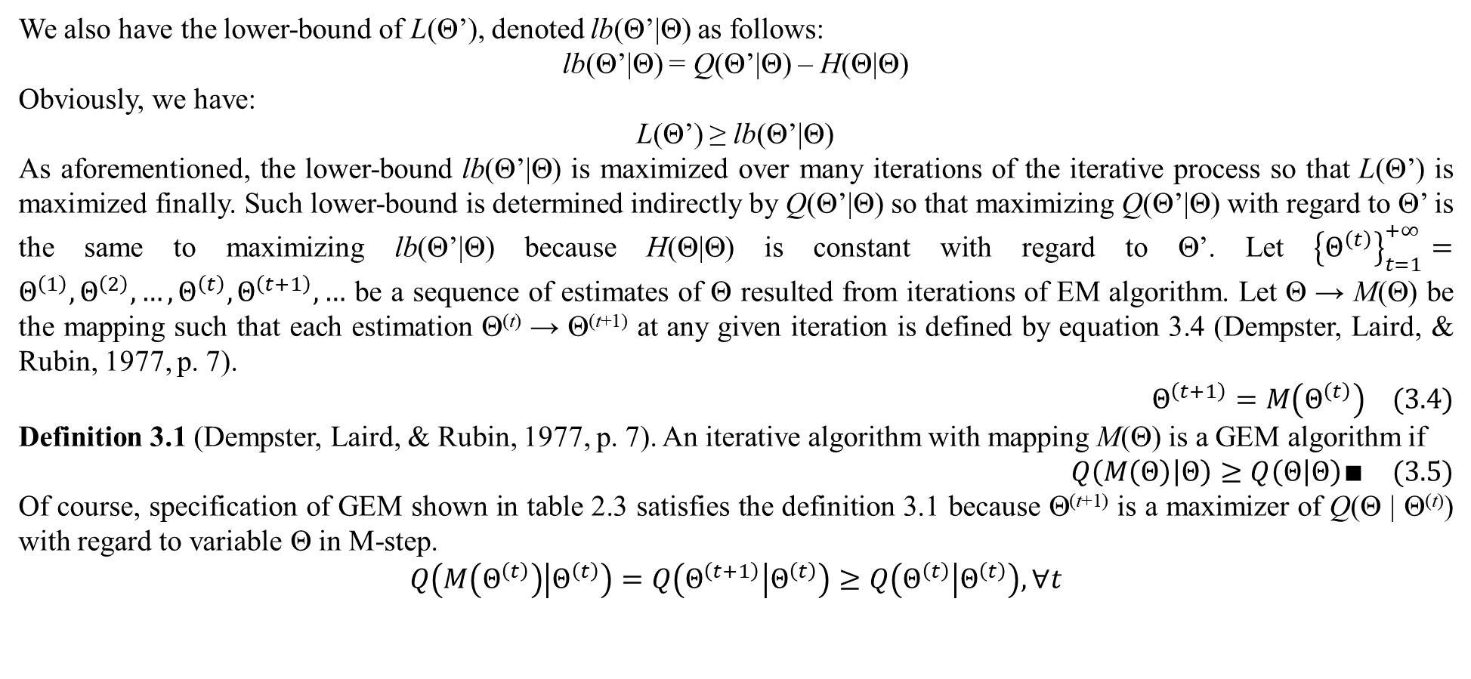
1. Properties of EM
We also have the lower-bound of L(Θ’), denoted lb(Θ’|Θ) as follows:
lb(Θ’|Θ) = Q(Θ’|Θ) – H(Θ|Θ)
Obviously, we have:
L(Θ’) ≥ lb(Θ’|Θ)
As aforementioned, the lower-bound lb(Θ’|Θ) is maximized over many iterations of the iterative process so that L(Θ’) is maximized finally. Such lower-bound is determined indirectly by Q(Θ’|Θ) so that maximizing Q(Θ’|Θ) with regard to Θ’ is the same to maximizing lb(Θ’|Θ) because H(Θ|Θ) is constant with regard to Θ’. Let ${\left\{Θ^{\left(t\right)}\right\}}_{t=1}^{+∞}=Θ^{\left(1\right)},Θ^{\left(2\right)},…,Θ^{\left(t\right)},Θ^{\left(t+1\right)},…$ be a sequence of estimates of Θ resulted from iterations of EM algorithm. Let Θ → M(Θ) be the mapping such that each estimation Θ^{(t)} → Θ^{(t+1)} at any given iteration is defined by equation 3.4 (Dempster, Laird, & Rubin, 1977, p. 7).
$$Θ^{\left(t+1\right)}=M\left(Θ^{\left(t\right)}\right) (3.4)$$
Definition 3.1 (Dempster, Laird, & Rubin, 1977, p. 7). An iterative algorithm with mapping M(Θ) is a GEM algorithm if
$$Q\left(M\left(Θ\right) | Θ\right)≥Q\left(Θ | Θ\right)∎ (3.5)$$
Of course, specification of GEM shown in table 2.3 satisfies the definition 3.1 because Θ^{(t+1)} is a maximizer of Q(Θ | Θ^{(t)}) with regard to variable Θ in M-step.
$$Q\left(M\left(Θ^{\left(t\right)}\right) | Θ^{\left(t\right)}\right)=Q\left(Θ^{\left(t+1\right)} | Θ^{\left(t\right)}\right)≥Q\left(Θ^{\left(t\right)} | Θ^{\left(t\right)}\right),∀t$$

Slide 9
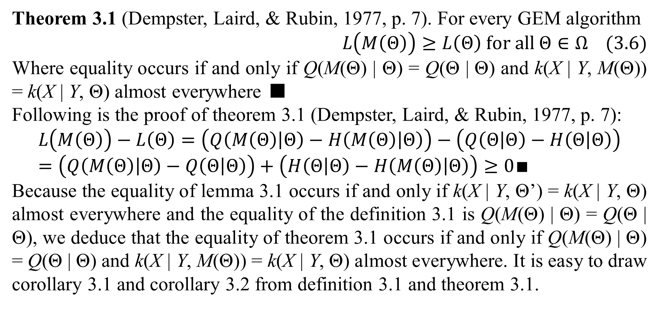
1. Properties of EM
Theorem 3.1 (Dempster, Laird, & Rubin, 1977, p. 7). For every GEM algorithm
$$L\left(M\left(Θ\right)\right)≥L\left(Θ\right) for all Θ∈Ω (3.6)$$
Where equality occurs if and only if Q(M(Θ) | Θ) = Q(Θ | Θ) and k(X | Y, M(Θ)) = k(X | Y, Θ) almost everywhere ■
Following is the proof of theorem 3.1 (Dempster, Laird, & Rubin, 1977, p. 7):
$$L\left(M\left(Θ\right)\right)−L\left(Θ\right)=\left(Q\left(M\left(Θ\right) | Θ\right)−H\left(M\left(Θ\right) | Θ\right)\right)−\left(Q\left(Θ | Θ\right)−H\left(Θ | Θ\right)\right)=\left(Q\left(M\left(Θ\right) | Θ\right)−Q\left(Θ | Θ\right)\right)+\left(H\left(Θ | Θ\right)−H\left(M\left(Θ\right) | Θ\right)\right)≥0∎$$
Because the equality of lemma 3.1 occurs if and only if k(X | Y, Θ’) = k(X | Y, Θ) almost everywhere and the equality of the definition 3.1 is Q(M(Θ) | Θ) = Q(Θ | Θ), we deduce that the equality of theorem 3.1 occurs if and only if Q(M(Θ) | Θ) = Q(Θ | Θ) and k(X | Y, M(Θ)) = k(X | Y, Θ) almost everywhere. It is easy to draw corollary 3.1 and corollary 3.2 from definition 3.1 and theorem 3.1.

Slide 10
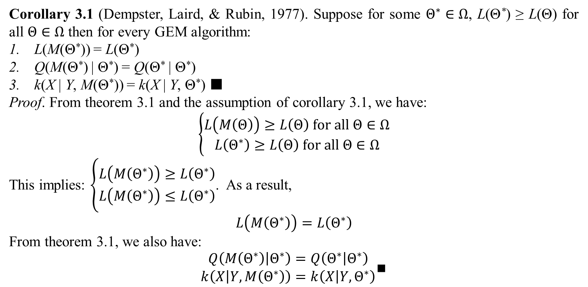
1. Properties of EM
Corollary 3.1 (Dempster, Laird, & Rubin, 1977). Suppose for some $Θ^{∗}∈Ω$, L(Θ*) ≥ L(Θ) for all $Θ∈Ω$ then for every GEM algorithm:
L(M(Θ*)) = L(Θ*)
Q(M(Θ*) | Θ*) = Q(Θ* | Θ*)
k(X | Y, M(Θ*)) = k(X | Y, Θ*) ■
Proof. From theorem 3.1 and the assumption of corollary 3.1, we have:
$$\left\{\begin{matrix}L\left(M\left(Θ\right)\right)≥L\left(Θ\right) for all Θ∈Ω \\ L\left(Θ^{∗}\right)≥L\left(Θ\right) for all Θ∈Ω\end{matrix}\right.$$
This implies: $\left\{\begin{matrix}L\left(M\left(Θ^{∗}\right)\right)≥L\left(Θ^{∗}\right) \\ L\left(M\left(Θ^{∗}\right)\right)≤L\left(Θ^{∗}\right)\end{matrix}\right.$. As a result,
$$L\left(M\left(Θ^{∗}\right)\right)=L\left(Θ^{∗}\right)$$
From theorem 3.1, we also have:
$$\begin{matrix}Q\left(M\left(Θ^{∗}\right) | Θ^{∗}\right)=Q\left(Θ^{∗} | Θ^{∗}\right) \\ k\left(X | Y,M\left(Θ^{∗}\right)\right)=k\left(X | Y,Θ^{∗}\right)\end{matrix}∎$$

Slide 11
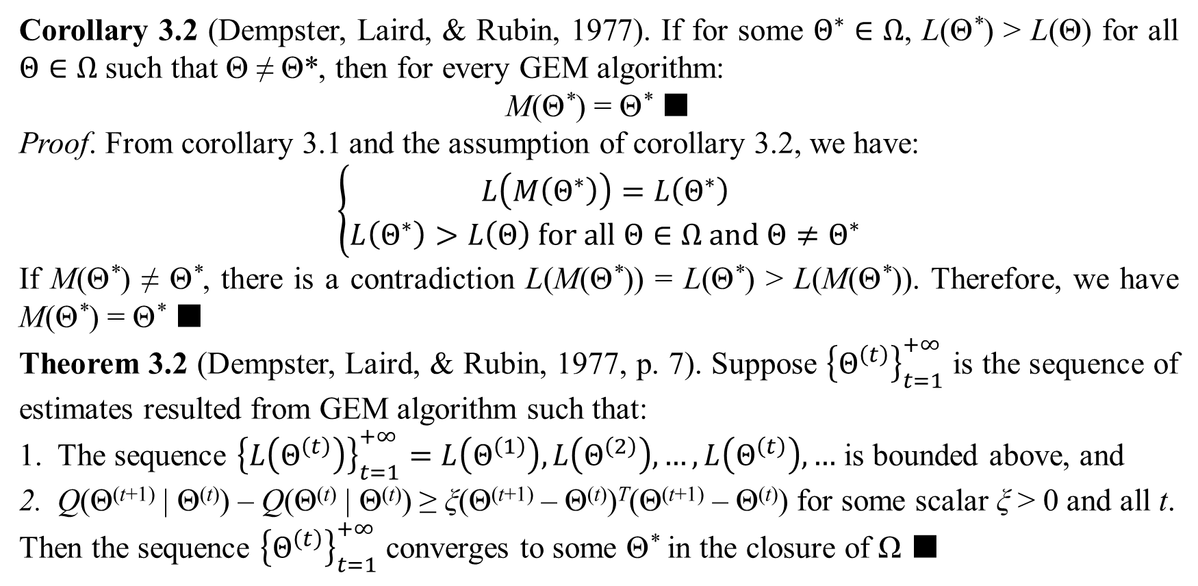
1. Properties of EM
Corollary 3.2 (Dempster, Laird, & Rubin, 1977). If for some $Θ^{∗}∈Ω$, L(Θ*) > L(Θ) for all $Θ∈Ω$ such that Θ ≠ Θ*, then for every GEM algorithm:
M(Θ*) = Θ* ■
Proof. From corollary 3.1 and the assumption of corollary 3.2, we have:
$$\left\{\begin{matrix}L\left(M\left(Θ^{∗}\right)\right)=L\left(Θ^{∗}\right) \\ L\left(Θ^{∗}\right)>L\left(Θ\right) for all Θ∈Ω and Θ≠Θ^{∗}\end{matrix}\right.$$
If M(Θ*) ≠ Θ*, there is a contradiction L(M(Θ*)) = L(Θ*) > L(M(Θ*)). Therefore, we have M(Θ*) = Θ* ■
Theorem 3.2 (Dempster, Laird, & Rubin, 1977, p. 7). Suppose ${\left\{Θ^{\left(t\right)}\right\}}_{t=1}^{+∞}$ is the sequence of estimates resulted from GEM algorithm such that:
The sequence ${\left\{L\left(Θ^{\left(t\right)}\right)\right\}}_{t=1}^{+∞}=L\left(Θ^{\left(1\right)}\right),L\left(Θ^{\left(2\right)}\right),…,L\left(Θ^{\left(t\right)}\right),…$ is bounded above, and
Q(Θ^{(t+1)} | Θ^{(t)}) – Q(Θ^{(t)} | Θ^{(t)}) ≥ ξ(Θ^{(t+1)} – Θ^{(t)})^{T}(Θ^{(t+1)} – Θ^{(t)}) for some scalar ξ > 0 and all t.
Then the sequence ${\left\{Θ^{\left(t\right)}\right\}}_{t=1}^{+∞}$ converges to some Θ* in the closure of Ω ■

Slide 12
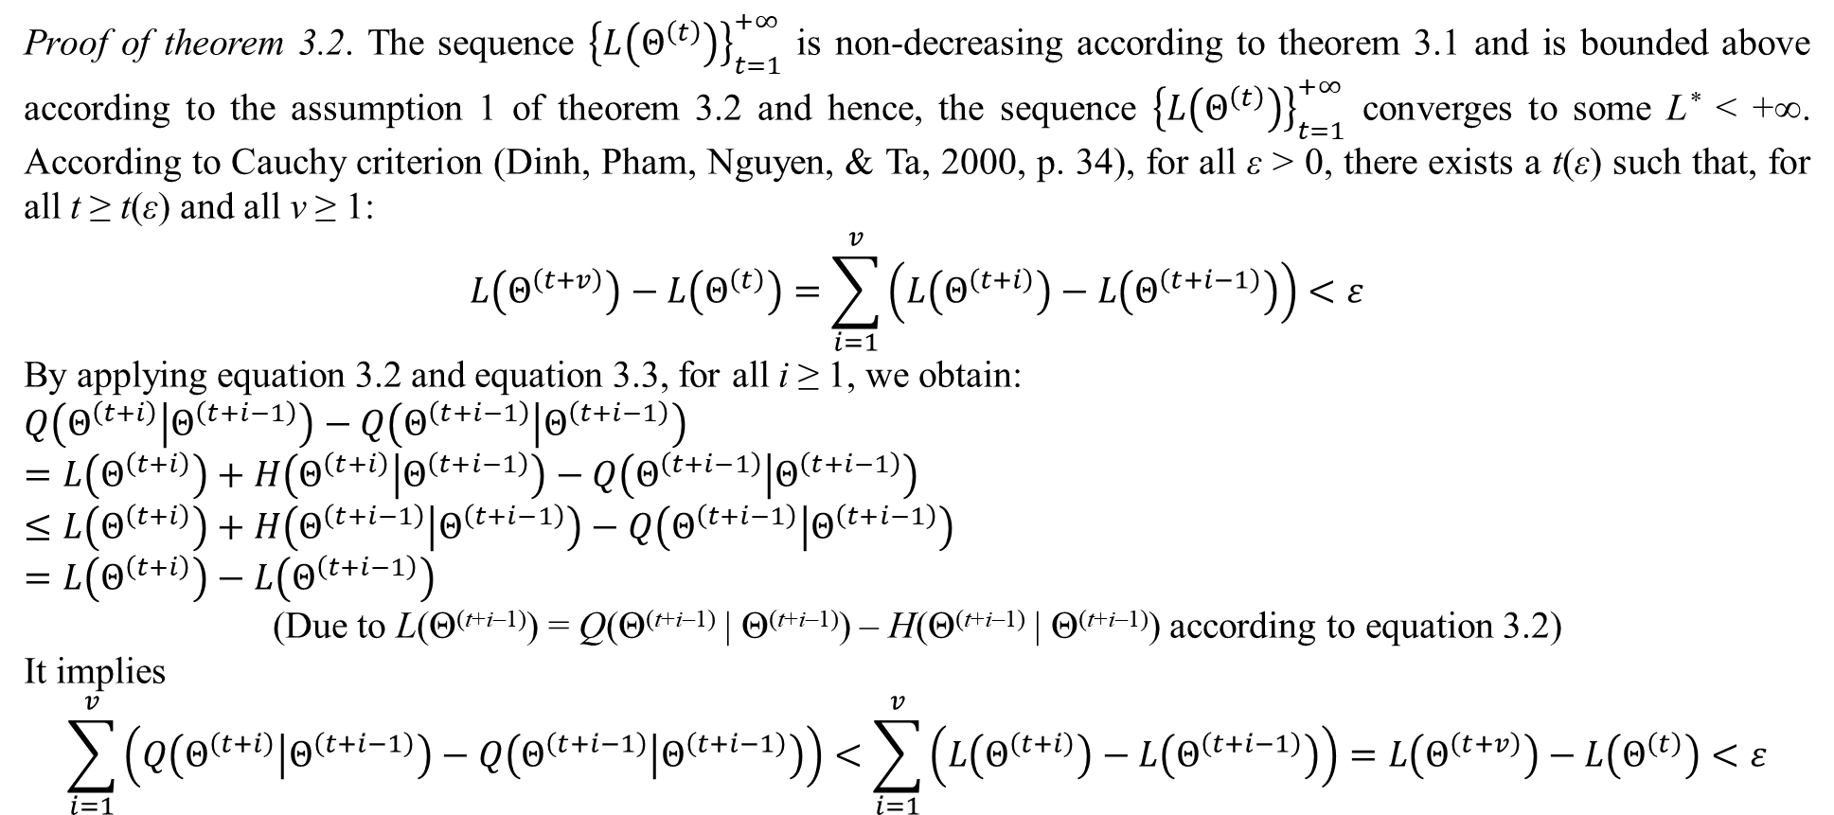
1. Properties of EM
Proof of theorem 3.2. The sequence ${\left\{L\left(Θ^{\left(t\right)}\right)\right\}}_{t=1}^{+∞}$ is non-decreasing according to theorem 3.1 and is bounded above according to the assumption 1 of theorem 3.2 and hence, the sequence ${\left\{L\left(Θ^{\left(t\right)}\right)\right\}}_{t=1}^{+∞}$ converges to some L* < +∞. According to Cauchy criterion (Dinh, Pham, Nguyen, & Ta, 2000, p. 34), for all ε > 0, there exists a t(ε) such that, for all t ≥ t(ε) and all v ≥ 1:
$$L\left(Θ^{\left(t+v\right)}\right)−L\left(Θ^{\left(t\right)}\right)=\sum_{i=1}^{v}{\left(L\left(Θ^{\left(t+i\right)}\right)−L\left(Θ^{\left(t+i−1\right)}\right)\right)}<ε$$
By applying equation 3.2 and equation 3.3, for all i ≥ 1, we obtain:
$$Q\left(Θ^{\left(t+i\right)} | Θ^{\left(t+i−1\right)}\right)−Q\left(Θ^{\left(t+i−1\right)} | Θ^{\left(t+i−1\right)}\right)$$
$=L\left(Θ^{\left(t+i\right)}\right)+H\left(Θ^{\left(t+i\right)} | Θ^{\left(t+i−1\right)}\right)−Q\left(Θ^{\left(t+i−1\right)} | Θ^{\left(t+i−1\right)}\right)$
$$≤L\left(Θ^{\left(t+i\right)}\right)+H\left(Θ^{\left(t+i−1\right)} | Θ^{\left(t+i−1\right)}\right)−Q\left(Θ^{\left(t+i−1\right)} | Θ^{\left(t+i−1\right)}\right)$$
$$=L\left(Θ^{\left(t+i\right)}\right)−L\left(Θ^{\left(t+i−1\right)}\right)$$
(Due to L(Θ^{(t+i–1)}) = Q(Θ^{(t+i–1)} | Θ^{(t+i–1)}) – H(Θ^{(t+i–1)} | Θ^{(t+i–1)}) according to equation 3.2)
It implies
$$\sum_{i=1}^{v}{\left(Q\left(Θ^{\left(t+i\right)} | Θ^{\left(t+i−1\right)}\right)−Q\left(Θ^{\left(t+i−1\right)} | Θ^{\left(t+i−1\right)}\right)\right)}<\sum_{i=1}^{v}{\left(L\left(Θ^{\left(t+i\right)}\right)−L\left(Θ^{\left(t+i−1\right)}\right)\right)}=L\left(Θ^{\left(t+v\right)}\right)−L\left(Θ^{\left(t\right)}\right)<ε$$

Slide 13
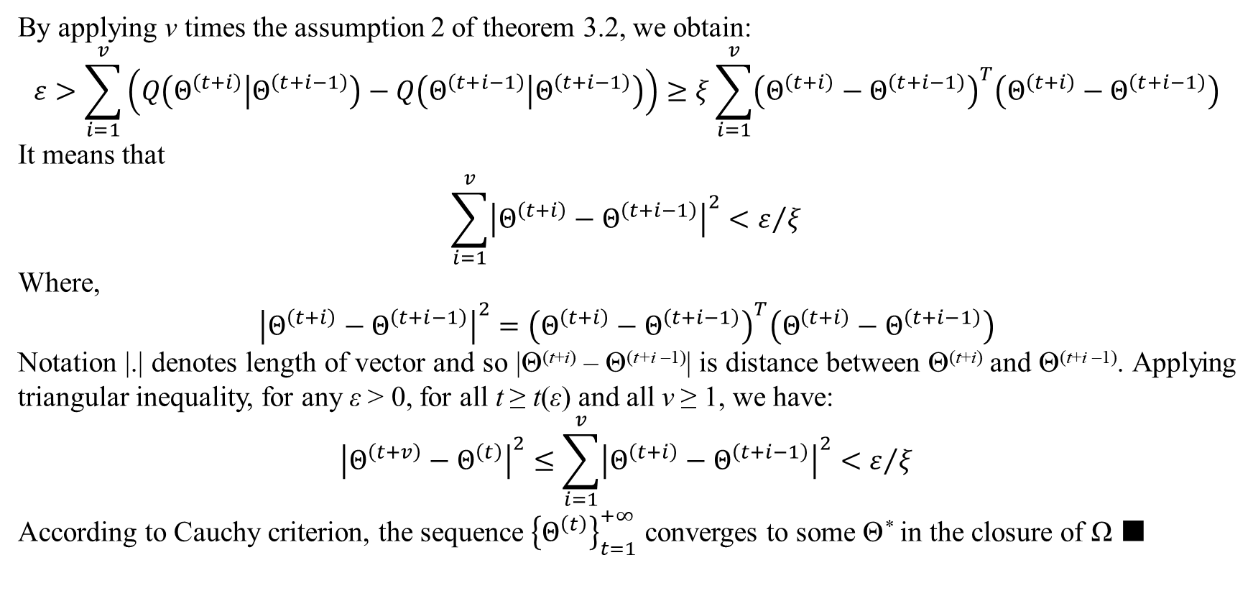
1. Properties of EM
By applying v times the assumption 2 of theorem 3.2, we obtain:
$$ε>\sum_{i=1}^{v}{\left(Q\left(Θ^{\left(t+i\right)} | Θ^{\left(t+i−1\right)}\right)−Q\left(Θ^{\left(t+i−1\right)} | Θ^{\left(t+i−1\right)}\right)\right)}≥ξ\sum_{i=1}^{v}{{\left(Θ^{\left(t+i\right)}−Θ^{\left(t+i−1\right)}\right)}^{T}\left(Θ^{\left(t+i\right)}−Θ^{\left(t+i−1\right)}\right)}$$
It means that
$$\sum_{i=1}^{v}{{\left|Θ^{\left(t+i\right)}−Θ^{\left(t+i−1\right)}\right|}^{2}}<ε/ξ$$
Where,
$${\left|Θ^{\left(t+i\right)}−Θ^{\left(t+i−1\right)}\right|}^{2}={\left(Θ^{\left(t+i\right)}−Θ^{\left(t+i−1\right)}\right)}^{T}\left(Θ^{\left(t+i\right)}−Θ^{\left(t+i−1\right)}\right)$$
Notation |.| denotes length of vector and so |Θ^{(t+i)} – Θ^{(t+i –1)}| is distance between Θ^{(t+i)} and Θ^{(t+i –1)}. Applying triangular inequality, for any ε > 0, for all t ≥ t(ε) and all v ≥ 1, we have:
$${\left|Θ^{\left(t+v\right)}−Θ^{\left(t\right)}\right|}^{2}≤\sum_{i=1}^{v}{{\left|Θ^{\left(t+i\right)}−Θ^{\left(t+i−1\right)}\right|}^{2}}<ε/ξ$$
According to Cauchy criterion, the sequence ${\left\{Θ^{\left(t\right)}\right\}}_{t=1}^{+∞}$ converges to some Θ* in the closure of Ω ■

Slide 14
1. Properties of EM
Theorem 3.1 indicates that L(Θ) is non-decreasing on every iteration of GEM algorithm and is strictly increasing on any iteration such that Q(Θ^{(t+1)} | Θ^{(t)}) > Q(Θ^{(t)} | Θ^{(t)}). The corollaries 3.1 and 3.2 indicate that the optimal estimate is a fixed point of GEM algorithm. Theorem 3.2 points out convergence condition of GEM algorithm but does not assert the converged point Θ* is maximizer of L(Θ). So, we need mathematical tools of derivative and differential to prove convergence of GEM to a maximizer Θ* in the next slides.

Slide 15
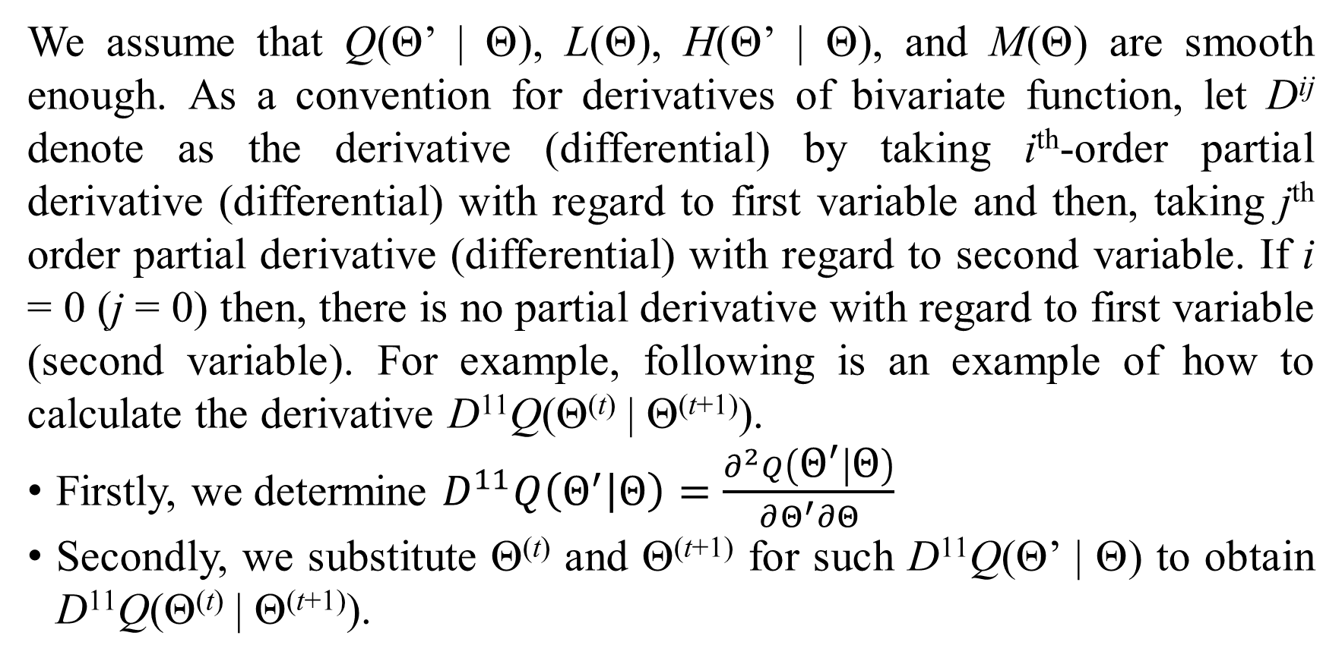
2. Convergence of EM
We assume that Q(Θ’ | Θ), L(Θ), H(Θ’ | Θ), and M(Θ) are smooth enough. As a convention for derivatives of bivariate function, let D^{ij} denote as the derivative (differential) by taking i^{th}-order partial derivative (differential) with regard to first variable and then, taking j^{th} order partial derivative (differential) with regard to second variable. If i = 0 (j = 0) then, there is no partial derivative with regard to first variable (second variable). For example, following is an example of how to calculate the derivative D¹¹Q(Θ^{(t)} | Θ^{(t+1)}).
Firstly, we determine $D^{11}Q\left(Θ^{′} | Θ\right)=\frac{∂^{2}Q\left(Θ^{′} | Θ\right)}{∂Θ^{′}∂Θ}$
Secondly, we substitute Θ^{(t)} and Θ^{(t+1)} for such D¹¹Q(Θ’ | Θ) to obtain D¹¹Q(Θ^{(t)} | Θ^{(t+1)}).

Slide 16
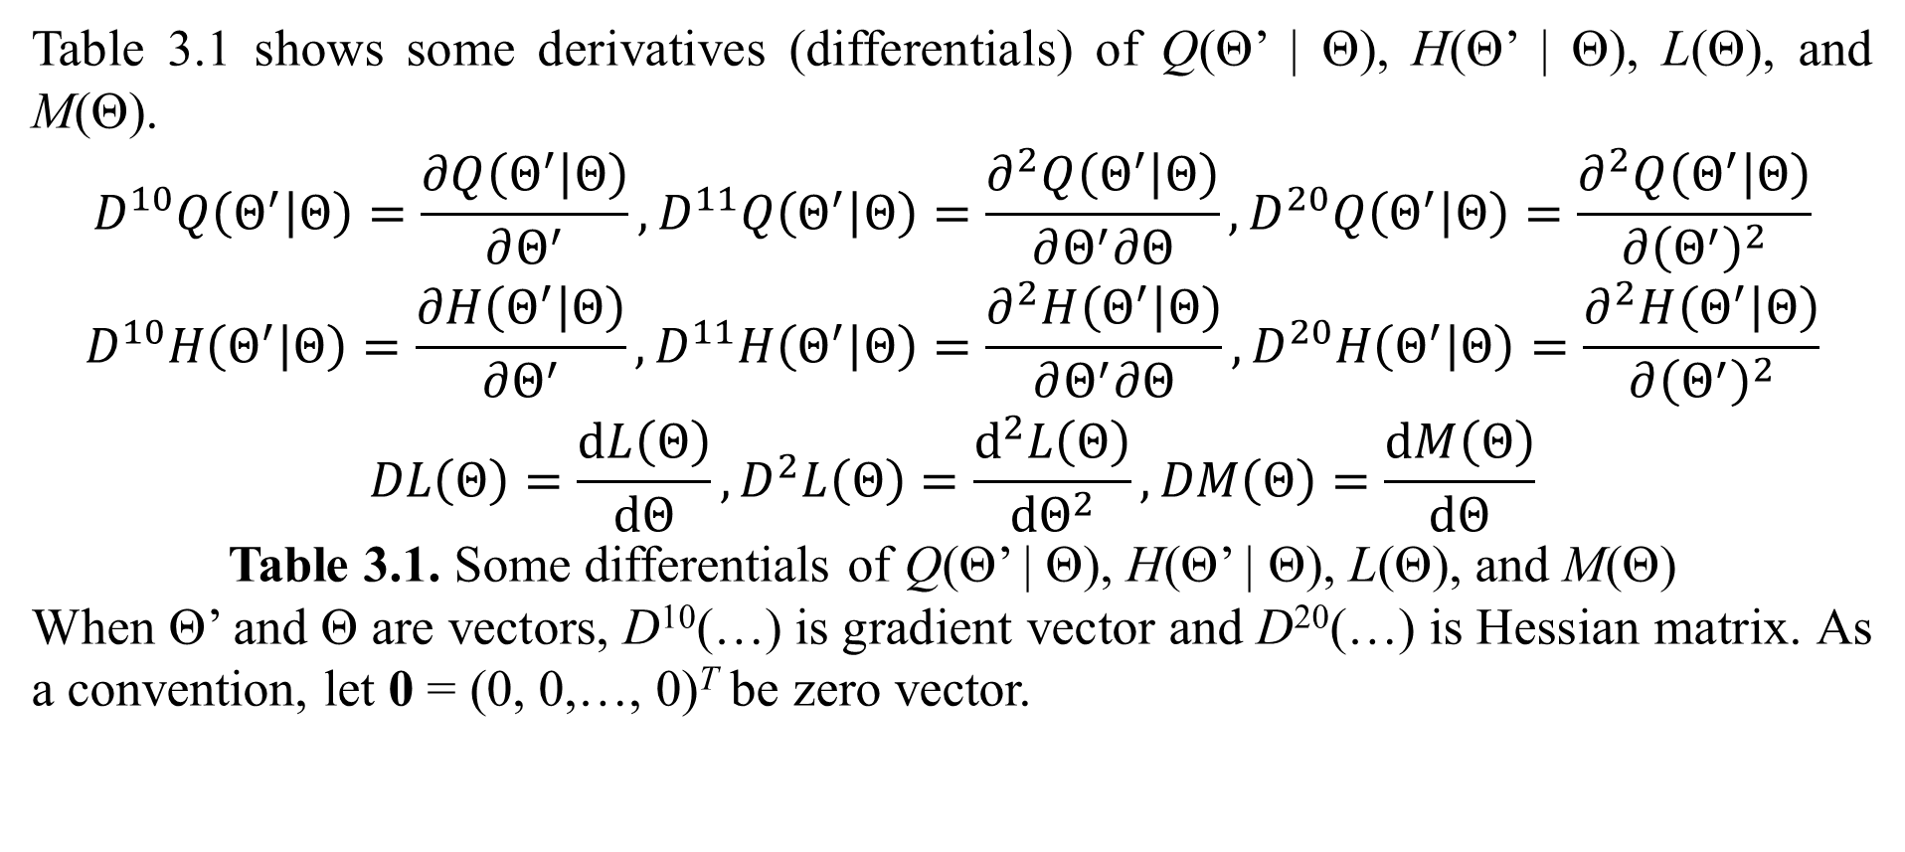
2. Convergence of EM
Table 3.1 shows some derivatives (differentials) of Q(Θ’ | Θ), H(Θ’ | Θ), L(Θ), and M(Θ).
$$D^{10}Q\left(Θ^{′} | Θ\right)=\frac{∂Q\left(Θ^{′} | Θ\right)}{∂Θ^{′}},D^{11}Q\left(Θ^{′} | Θ\right)=\frac{∂^{2}Q\left(Θ^{′} | Θ\right)}{∂Θ^{′}∂Θ},D^{20}Q\left(Θ^{′} | Θ\right)=\frac{∂^{2}Q\left(Θ^{′} | Θ\right)}{∂{\left(Θ^{′}\right)}^{2}}$$
$$D^{10}H\left(Θ^{′} | Θ\right)=\frac{∂H\left(Θ^{′} | Θ\right)}{∂Θ^{′}},D^{11}H\left(Θ^{′} | Θ\right)=\frac{∂^{2}H\left(Θ^{′} | Θ\right)}{∂Θ^{′}∂Θ},D^{20}H\left(Θ^{′} | Θ\right)=\frac{∂^{2}H\left(Θ^{′} | Θ\right)}{∂{\left(Θ^{′}\right)}^{2}}$$
$$DL\left(Θ\right)=\frac{dL\left(Θ\right)}{dΘ},D^{2}L\left(Θ\right)=\frac{d^{2}L\left(Θ\right)}{dΘ^{2}},DM\left(Θ\right)=\frac{dM\left(Θ\right)}{dΘ}$$
Table 3.1. Some differentials of Q(Θ’ | Θ), H(Θ’ | Θ), L(Θ), and M(Θ)
When Θ’ and Θ are vectors, D¹⁰(…) is gradient vector and D²⁰(…) is Hessian matrix. As a convention, let 0 = (0, 0,…, 0)^{T} be zero vector.

Slide 17
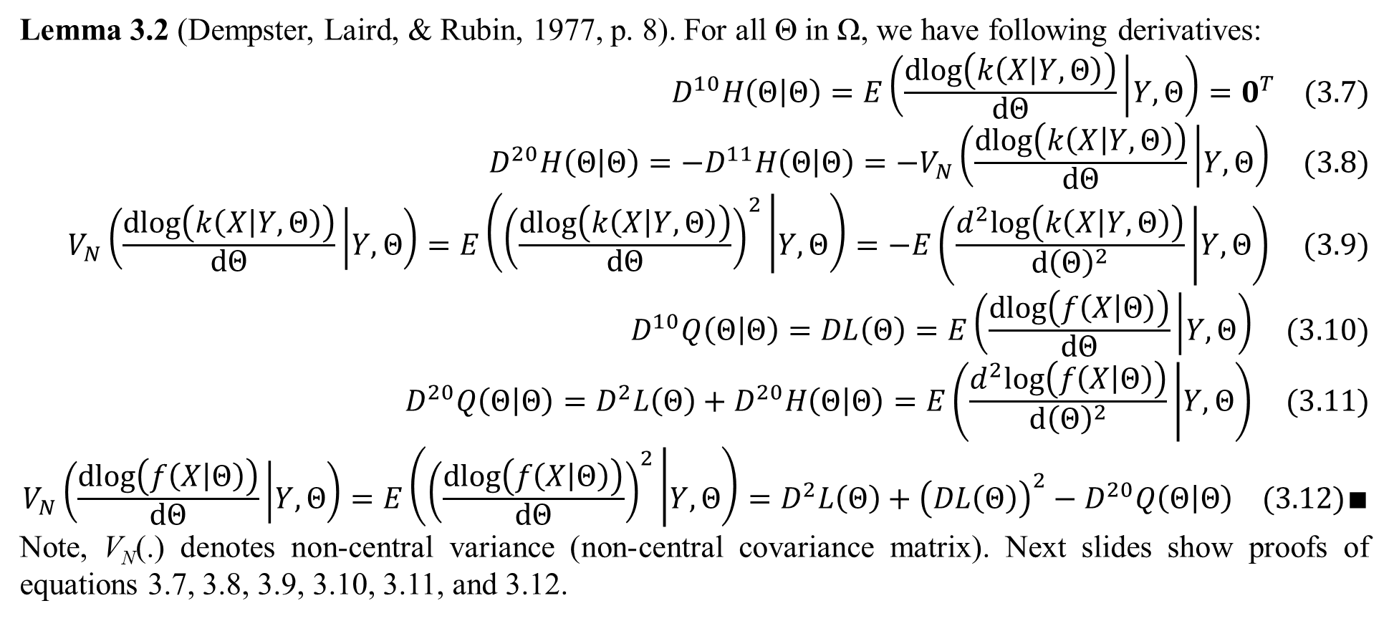
2. Convergence of EM
Lemma 3.2 (Dempster, Laird, & Rubin, 1977, p. 8). For all Θ in Ω, we have following derivatives:
$$D^{10}H\left(Θ | Θ\right)=E\left(\frac{dlog\left(k\left(X | Y,Θ\right)\right)}{dΘ} | Y,Θ\right)=0^{T} (3.7)$$
$$D^{20}H\left(Θ | Θ\right)=−D^{11}H\left(Θ | Θ\right)=−V_{N}\left(\frac{dlog\left(k\left(X | Y,Θ\right)\right)}{dΘ} | Y,Θ\right) (3.8)$$
$$V_{N}\left(\frac{dlog\left(k\left(X | Y,Θ\right)\right)}{dΘ} | Y,Θ\right)=E\left({\left(\frac{dlog\left(k\left(X | Y,Θ\right)\right)}{dΘ}\right)}^{2} | Y,Θ\right)=−E\left(\frac{d^{2}log\left(k\left(X | Y,Θ\right)\right)}{d{\left(Θ\right)}^{2}} | Y,Θ\right) (3.9)$$
$$D^{10}Q\left(Θ | Θ\right)=DL\left(Θ\right)=E\left(\frac{dlog\left(f\left(X | Θ\right)\right)}{dΘ} | Y,Θ\right) (3.10)$$
$$D^{20}Q\left(Θ | Θ\right)=D^{2}L\left(Θ\right)+D^{20}H\left(Θ | Θ\right)=E\left(\frac{d^{2}log\left(f\left(X | Θ\right)\right)}{d{\left(Θ\right)}^{2}} | Y,Θ\right) (3.11)$$
$$V_{N}\left(\frac{dlog\left(f\left(X | Θ\right)\right)}{dΘ} | Y,Θ\right)=E\left({\left(\frac{dlog\left(f\left(X | Θ\right)\right)}{dΘ}\right)}^{2} | Y,Θ\right)=D^{2}L\left(Θ\right)+{\left(DL\left(Θ\right)\right)}^{2}−D^{20}Q\left(Θ | Θ\right) (3.12)∎$$
Note, V_{N}(.) denotes non-central variance (non-central covariance matrix). Next slides show proofs of equations 3.7, 3.8, 3.9, 3.10, 3.11, and 3.12.

Slide 18
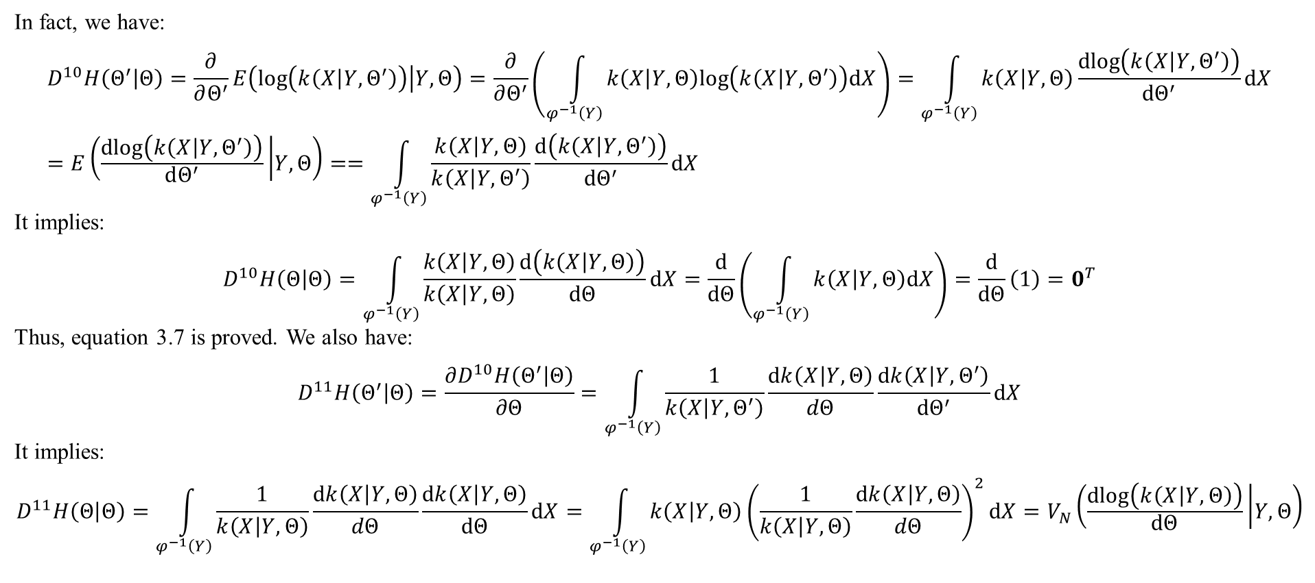
2. Convergence of EM
In fact, we have:
$$D^{10}H\left(Θ^{′} | Θ\right)=\frac{∂}{∂Θ^{′}}E\left(log\left(k\left(X | Y,Θ^{′}\right)\right) | Y,Θ\right)=\frac{∂}{∂Θ^{′}}\left(\int_{φ^{−1}\left(Y\right)}{k\left(X | Y,Θ\right)log\left(k\left(X | Y,Θ^{′}\right)\right)dX}\right)=\int_{φ^{−1}\left(Y\right)}{k\left(X | Y,Θ\right)\frac{dlog\left(k\left(X | Y,Θ^{′}\right)\right)}{dΘ^{′}}dX}=E\left(\frac{dlog\left(k\left(X | Y,Θ^{′}\right)\right)}{dΘ^{′}} | Y,Θ\right)==\int_{φ^{−1}\left(Y\right)}{\frac{k\left(X | Y,Θ\right)}{k\left(X | Y,Θ^{′}\right)}\frac{d\left(k\left(X | Y,Θ^{′}\right)\right)}{dΘ^{′}}dX}$$
It implies:
$$D^{10}H\left(Θ | Θ\right)=\int_{φ^{−1}\left(Y\right)}{\frac{k\left(X | Y,Θ\right)}{k\left(X | Y,Θ\right)}\frac{d\left(k\left(X | Y,Θ\right)\right)}{dΘ}dX}=\frac{d}{dΘ}\left(\int_{φ^{−1}\left(Y\right)}{k\left(X | Y,Θ\right)dX}\right)=\frac{d}{dΘ}\left(1\right)=0^{T}$$
Thus, equation 3.7 is proved. We also have:
$$D^{11}H\left(Θ^{′} | Θ\right)=\frac{∂D^{10}H\left(Θ^{′} | Θ\right)}{∂Θ}=\int_{φ^{−1}\left(Y\right)}{\frac{1}{k\left(X | Y,Θ^{′}\right)}\frac{dk\left(X | Y,Θ\right)}{dΘ}\frac{dk\left(X | Y,Θ^{′}\right)}{dΘ^{′}}dX}$$
It implies:
$$D^{11}H\left(Θ | Θ\right)=\int_{φ^{−1}\left(Y\right)}{\frac{1}{k\left(X | Y,Θ\right)}\frac{dk\left(X | Y,Θ\right)}{dΘ}\frac{dk\left(X | Y,Θ\right)}{dΘ}dX}=\int_{φ^{−1}\left(Y\right)}{k\left(X | Y,Θ\right){\left(\frac{1}{k\left(X | Y,Θ\right)}\frac{dk\left(X | Y,Θ\right)}{dΘ}\right)}^{2}dX}=V_{N}\left(\frac{dlog\left(k\left(X | Y,Θ\right)\right)}{dΘ} | Y,Θ\right)$$

Slide 19
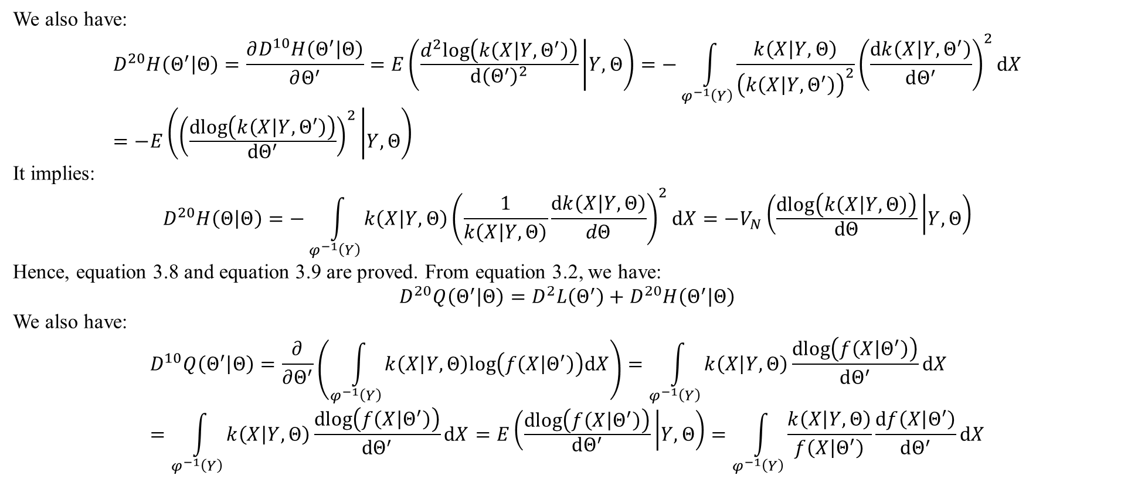
2. Convergence of EM
We also have:
$$D^{20}H\left(Θ^{′} | Θ\right)=\frac{∂D^{10}H\left(Θ^{′} | Θ\right)}{∂Θ^{′}}=E\left(\frac{d^{2}log\left(k\left(X | Y,Θ^{′}\right)\right)}{d{\left(Θ^{′}\right)}^{2}} | Y,Θ\right)=−\int_{φ^{−1}\left(Y\right)}{\frac{k\left(X | Y,Θ\right)}{{\left(k\left(X | Y,Θ^{′}\right)\right)}^{2}}{\left(\frac{dk\left(X | Y,Θ^{′}\right)}{dΘ^{′}}\right)}^{2}dX}=−E\left({\left(\frac{dlog\left(k\left(X | Y,Θ^{′}\right)\right)}{dΘ^{′}}\right)}^{2} | Y,Θ\right)$$
It implies:
$$D^{20}H\left(Θ | Θ\right)=−\int_{φ^{−1}\left(Y\right)}{k\left(X | Y,Θ\right){\left(\frac{1}{k\left(X | Y,Θ\right)}\frac{dk\left(X | Y,Θ\right)}{dΘ}\right)}^{2}dX}=−V_{N}\left(\frac{dlog\left(k\left(X | Y,Θ\right)\right)}{dΘ} | Y,Θ\right)$$
Hence, equation 3.8 and equation 3.9 are proved. From equation 3.2, we have:
$$D^{20}Q\left(Θ^{′} | Θ\right)=D^{2}L\left(Θ^{′}\right)+D^{20}H\left(Θ^{′} | Θ\right)$$
We also have:
$$D^{10}Q\left(Θ^{′} | Θ\right)=\frac{∂}{∂Θ^{′}}\left(\int_{φ^{−1}\left(Y\right)}{k\left(X | Y,Θ\right)log\left(f\left(X | Θ^{′}\right)\right)dX}\right)=\int_{φ^{−1}\left(Y\right)}{k\left(X | Y,Θ\right)\frac{dlog\left(f\left(X | Θ^{′}\right)\right)}{dΘ^{′}}dX}=\int_{φ^{−1}\left(Y\right)}{k\left(X | Y,Θ\right)\frac{dlog\left(f\left(X | Θ^{′}\right)\right)}{dΘ^{′}}dX}=E\left(\frac{dlog\left(f\left(X | Θ^{′}\right)\right)}{dΘ^{′}} | Y,Θ\right)=\int_{φ^{−1}\left(Y\right)}{\frac{k\left(X | Y,Θ\right)}{f\left(X | Θ^{′}\right)}\frac{df\left(X | Θ^{′}\right)}{dΘ^{′}}dX}$$

Slide 20
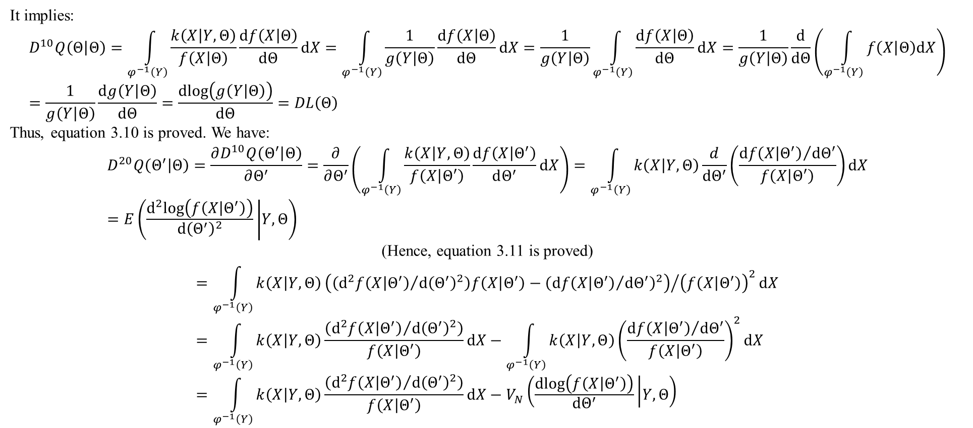
2. Convergence of EM
It implies:
$$D^{10}Q\left(Θ | Θ\right)=\int_{φ^{−1}\left(Y\right)}{\frac{k\left(X | Y,Θ\right)}{f\left(X | Θ\right)}\frac{df\left(X | Θ\right)}{dΘ}dX}=\int_{φ^{−1}\left(Y\right)}{\frac{1}{g\left(Y | Θ\right)}\frac{df\left(X | Θ\right)}{dΘ}dX}=\frac{1}{g\left(Y | Θ\right)}\int_{φ^{−1}\left(Y\right)}{\frac{df\left(X | Θ\right)}{dΘ}dX}=\frac{1}{g\left(Y | Θ\right)}\frac{d}{dΘ}\left(\int_{φ^{−1}\left(Y\right)}{f\left(X | Θ\right)dX}\right)=\frac{1}{g\left(Y | Θ\right)}\frac{dg\left(Y | Θ\right)}{dΘ}=\frac{dlog\left(g\left(Y | Θ\right)\right)}{dΘ}=DL\left(Θ\right)$$
Thus, equation 3.10 is proved. We have:
$$D^{20}Q\left(Θ^{′} | Θ\right)=\frac{∂D^{10}Q\left(Θ^{′} | Θ\right)}{∂Θ^{′}}=\frac{∂}{∂Θ^{′}}\left(\int_{φ^{−1}\left(Y\right)}{\frac{k\left(X | Y,Θ\right)}{f\left(X | Θ^{′}\right)}\frac{df\left(X | Θ^{′}\right)}{dΘ^{′}}dX}\right)=\int_{φ^{−1}\left(Y\right)}{k\left(X | Y,Θ\right)\frac{d}{dΘ^{′}}\left(\frac{{df\left(X | Θ^{′}\right)}/{dΘ^{′}}}{f\left(X | Θ^{′}\right)}\right)dX}=E\left(\frac{d^{2}log\left(f\left(X | Θ^{′}\right)\right)}{d{\left(Θ^{′}\right)}^{2}} | Y,Θ\right)$$
(Hence, equation 3.11 is proved)
$$=\int_{φ^{−1}\left(Y\right)}{k\left(X | Y,Θ\right){\left(\left({d^{2}f\left(X | Θ^{′}\right)}/{d{\left(Θ^{′}\right)}^{2}}\right)f\left(X | Θ^{′}\right)−{\left({df\left(X | Θ^{′}\right)}/{dΘ^{′}}\right)}^{2}\right)}/{{\left(f\left(X | Θ^{′}\right)\right)}^{2}}dX}=\int_{φ^{−1}\left(Y\right)}{k\left(X | Y,Θ\right)\frac{\left({d^{2}f\left(X | Θ^{′}\right)}/{d{\left(Θ^{′}\right)}^{2}}\right)}{f\left(X | Θ^{′}\right)}dX}−\int_{φ^{−1}\left(Y\right)}{k\left(X | Y,Θ\right){\left(\frac{{df\left(X | Θ^{′}\right)}/{dΘ^{′}}}{f\left(X | Θ^{′}\right)}\right)}^{2}dX}=\int_{φ^{−1}\left(Y\right)}{k\left(X | Y,Θ\right)\frac{\left({d^{2}f\left(X | Θ^{′}\right)}/{d{\left(Θ^{′}\right)}^{2}}\right)}{f\left(X | Θ^{′}\right)}dX}−V_{N}\left(\frac{dlog\left(f\left(X | Θ^{′}\right)\right)}{dΘ^{′}} | Y,Θ\right)$$

Slide 21
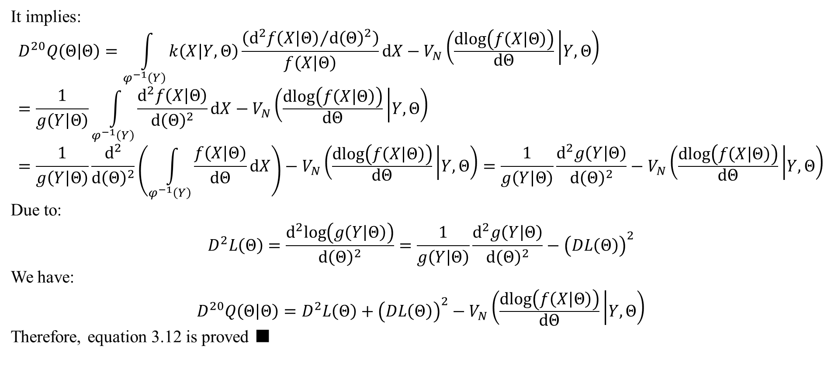
2. Convergence of EM
It implies:
$$D^{20}Q\left(Θ | Θ\right)=\int_{φ^{−1}\left(Y\right)}{k\left(X | Y,Θ\right)\frac{\left({d^{2}f\left(X | Θ\right)}/{d{\left(Θ\right)}^{2}}\right)}{f\left(X | Θ\right)}dX}−V_{N}\left(\frac{dlog\left(f\left(X | Θ\right)\right)}{dΘ} | Y,Θ\right)=\frac{1}{g\left(Y | Θ\right)}\int_{φ^{−1}\left(Y\right)}{\frac{d^{2}f\left(X | Θ\right)}{d{\left(Θ\right)}^{2}}dX}−V_{N}\left(\frac{dlog\left(f\left(X | Θ\right)\right)}{dΘ} | Y,Θ\right)=\frac{1}{g\left(Y | Θ\right)}\frac{d^{2}}{d{\left(Θ\right)}^{2}}\left(\int_{φ^{−1}\left(Y\right)}{\frac{f\left(X | Θ\right)}{dΘ}dX}\right)−V_{N}\left(\frac{dlog\left(f\left(X | Θ\right)\right)}{dΘ} | Y,Θ\right)=\frac{1}{g\left(Y | Θ\right)}\frac{d^{2}g\left(Y | Θ\right)}{d{\left(Θ\right)}^{2}}−V_{N}\left(\frac{dlog\left(f\left(X | Θ\right)\right)}{dΘ} | Y,Θ\right)$$
Due to:
$$D^{2}L\left(Θ\right)=\frac{d^{2}log\left(g\left(Y | Θ\right)\right)}{d{\left(Θ\right)}^{2}}=\frac{1}{g\left(Y | Θ\right)}\frac{d^{2}g\left(Y | Θ\right)}{d{\left(Θ\right)}^{2}}−{\left(DL\left(Θ\right)\right)}^{2}$$
We have:
$$D^{20}Q\left(Θ | Θ\right)=D^{2}L\left(Θ\right)+{\left(DL\left(Θ\right)\right)}^{2}−V_{N}\left(\frac{dlog\left(f\left(X | Θ\right)\right)}{dΘ} | Y,Θ\right)$$
Therefore, equation 3.12 is proved ■

Slide 22
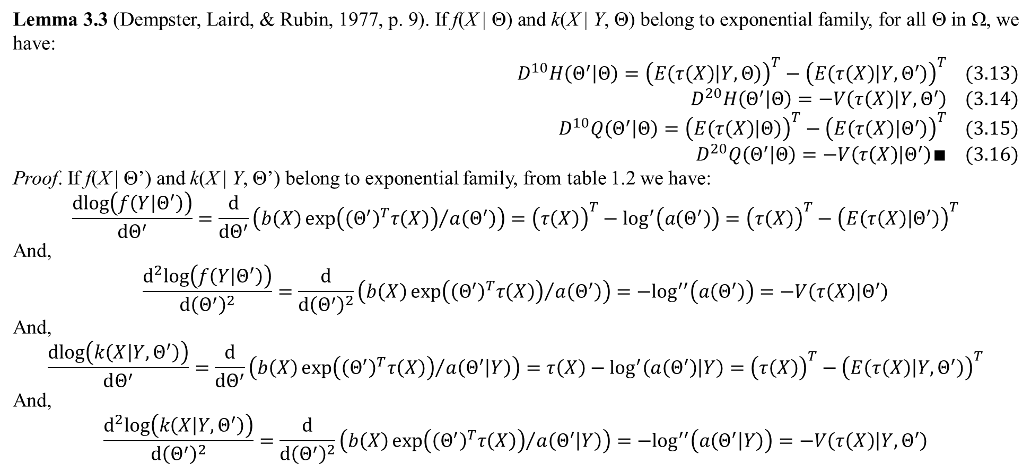
2. Convergence of EM
Lemma 3.3 (Dempster, Laird, & Rubin, 1977, p. 9). If f(X | Θ) and k(X | Y, Θ) belong to exponential family, for all Θ in Ω, we have:
$$D^{10}H\left(Θ^{′} | Θ\right)={\left(E\left(τ\left(X\right) | Y,Θ\right)\right)}^{T}−{\left(E\left(τ\left(X\right) | Y,Θ^{′}\right)\right)}^{T} (3.13)$$
$$D^{20}H\left(Θ^{′} | Θ\right)=−V\left(τ\left(X\right) | Y,Θ^{′}\right) (3.14)$$
$$D^{10}Q\left(Θ^{′} | Θ\right)={\left(E\left(τ\left(X\right) | Θ\right)\right)}^{T}−{\left(E\left(τ\left(X\right) | Θ^{′}\right)\right)}^{T} (3.15)$$
$$D^{20}Q\left(Θ^{′} | Θ\right)=−V\left(τ\left(X\right) | Θ^{′}\right)∎ (3.16)$$
Proof. If f(X | Θ’) and k(X | Y, Θ’) belong to exponential family, from table 1.2 we have:
$$\frac{dlog\left(f\left(Y | Θ^{′}\right)\right)}{dΘ^{′}}=\frac{d}{dΘ^{′}}\left(b\left(X\right){exp\left({\left(Θ^{′}\right)}^{T}τ\left(X\right)\right)}/{a\left(Θ^{′}\right)}\right)={\left(τ\left(X\right)\right)}^{T}−\log^{′}\left(a\left(Θ^{′}\right)\right)={\left(τ\left(X\right)\right)}^{T}−{\left(E\left(τ\left(X\right) | Θ^{′}\right)\right)}^{T}$$
And,
$$\frac{d^{2}log\left(f\left(Y | Θ^{′}\right)\right)}{d{\left(Θ^{′}\right)}^{2}}=\frac{d}{d{\left(Θ^{′}\right)}^{2}}\left(b\left(X\right){exp\left({\left(Θ^{′}\right)}^{T}τ\left(X\right)\right)}/{a\left(Θ^{′}\right)}\right)=−\log^{′′}\left(a\left(Θ^{′}\right)\right)=−V\left(τ\left(X\right) | Θ^{′}\right)$$
And,
$$\frac{dlog\left(k\left(X | Y,Θ^{′}\right)\right)}{dΘ^{′}}=\frac{d}{dΘ^{′}}\left(b\left(X\right){exp\left({\left(Θ^{′}\right)}^{T}τ\left(X\right)\right)}/{a\left(Θ^{′} | Y\right)}\right)=τ\left(X\right)−\log^{′}\left(a\left(Θ^{′}\right) | Y\right)={\left(τ\left(X\right)\right)}^{T}−{\left(E\left(τ\left(X\right) | Y,Θ^{′}\right)\right)}^{T}$$
And,
$$\frac{d^{2}log\left(k\left(X | Y,Θ^{′}\right)\right)}{d{\left(Θ^{′}\right)}^{2}}=\frac{d}{d{\left(Θ^{′}\right)}^{2}}\left(b\left(X\right){exp\left({\left(Θ^{′}\right)}^{T}τ\left(X\right)\right)}/{a\left(Θ^{′} | Y\right)}\right)=−\log^{′′}\left(a\left(Θ^{′} | Y\right)\right)=−V\left(τ\left(X\right) | Y,Θ^{′}\right)$$

Slide 23
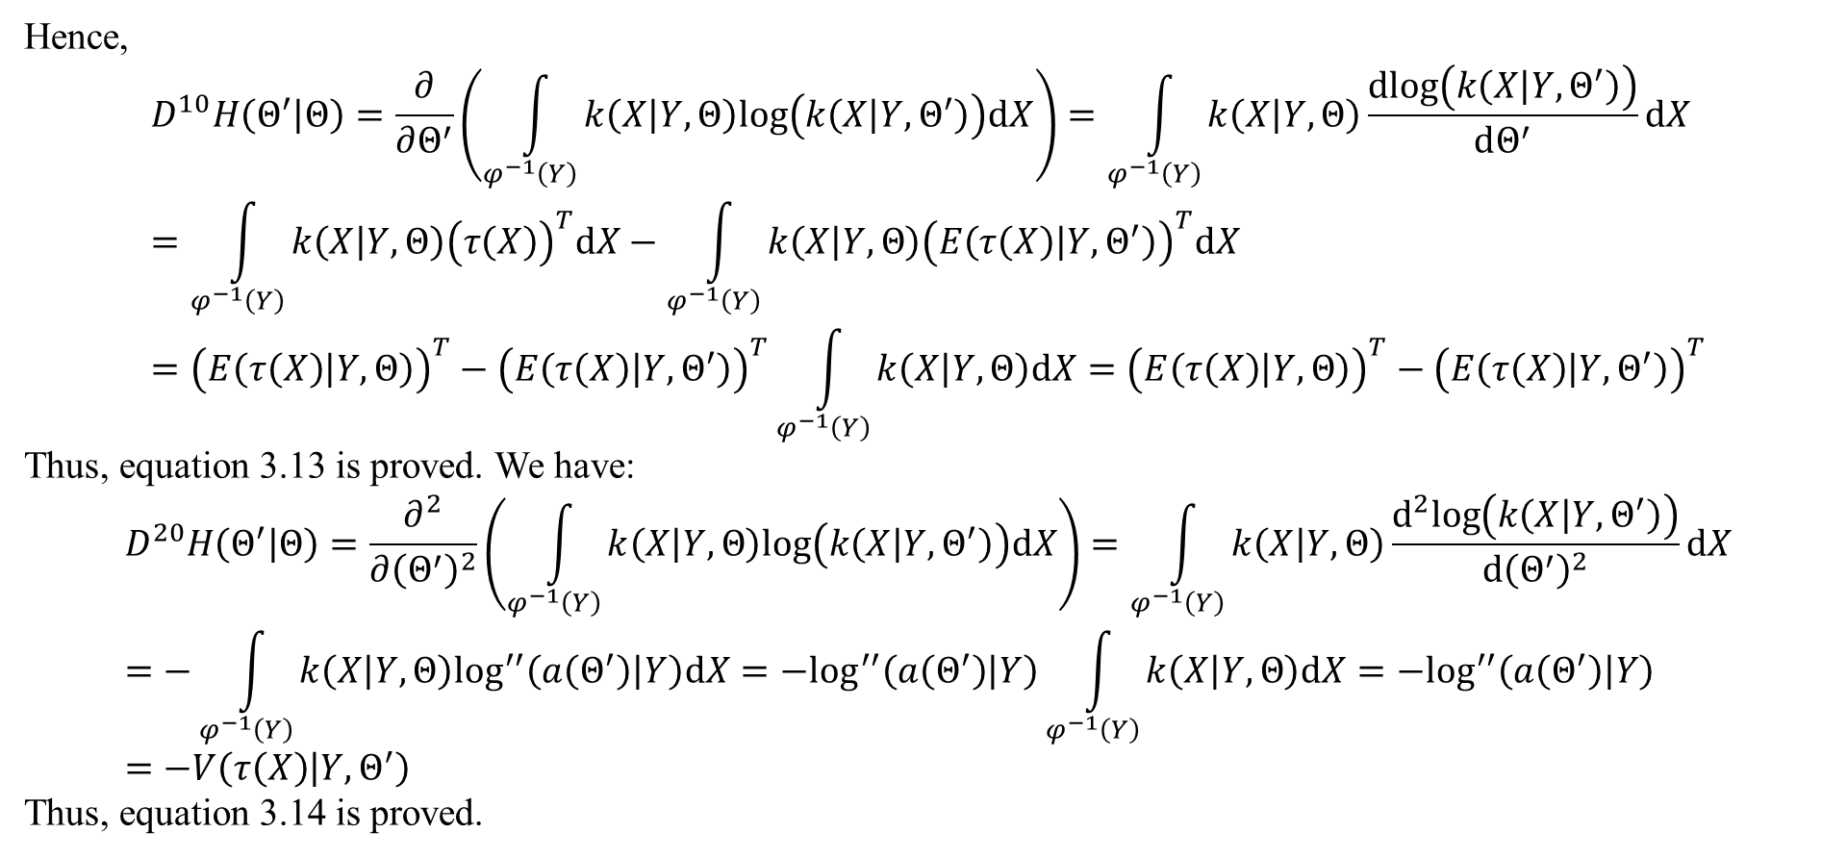
2. Convergence of EM
Hence,
$$D^{10}H\left(Θ^{′} | Θ\right)=\frac{∂}{∂Θ^{′}}\left(\int_{φ^{−1}\left(Y\right)}{k\left(X | Y,Θ\right)log\left(k\left(X | Y,Θ^{′}\right)\right)dX}\right)=\int_{φ^{−1}\left(Y\right)}{k\left(X | Y,Θ\right)\frac{dlog\left(k\left(X | Y,Θ^{′}\right)\right)}{dΘ^{′}}dX}=\int_{φ^{−1}\left(Y\right)}{k\left(X | Y,Θ\right){\left(τ\left(X\right)\right)}^{T}dX}−\int_{φ^{−1}\left(Y\right)}{k\left(X | Y,Θ\right){\left(E\left(τ\left(X\right) | Y,Θ^{′}\right)\right)}^{T}dX}={\left(E\left(τ\left(X\right) | Y,Θ\right)\right)}^{T}−{\left(E\left(τ\left(X\right) | Y,Θ^{′}\right)\right)}^{T}\int_{φ^{−1}\left(Y\right)}{k\left(X | Y,Θ\right)dX}={\left(E\left(τ\left(X\right) | Y,Θ\right)\right)}^{T}−{\left(E\left(τ\left(X\right) | Y,Θ^{′}\right)\right)}^{T}$$
Thus, equation 3.13 is proved. We have:
$$D^{20}H\left(Θ^{′} | Θ\right)=\frac{∂^{2}}{∂{\left(Θ^{′}\right)}^{2}}\left(\int_{φ^{−1}\left(Y\right)}{k\left(X | Y,Θ\right)log\left(k\left(X | Y,Θ^{′}\right)\right)dX}\right)=\int_{φ^{−1}\left(Y\right)}{k\left(X | Y,Θ\right)\frac{d^{2}log\left(k\left(X | Y,Θ^{′}\right)\right)}{d{\left(Θ^{′}\right)}^{2}}dX}=−\int_{φ^{−1}\left(Y\right)}{k\left(X | Y,Θ\right)\log^{′′}\left(a\left(Θ^{′}\right) | Y\right)dX}=−\log^{′′}\left(a\left(Θ^{′}\right) | Y\right)\int_{φ^{−1}\left(Y\right)}{k\left(X | Y,Θ\right)dX}=−\log^{′′}\left(a\left(Θ^{′}\right) | Y\right)=−V\left(τ\left(X\right) | Y,Θ^{′}\right)$$
Thus, equation 3.14 is proved.

Slide 24
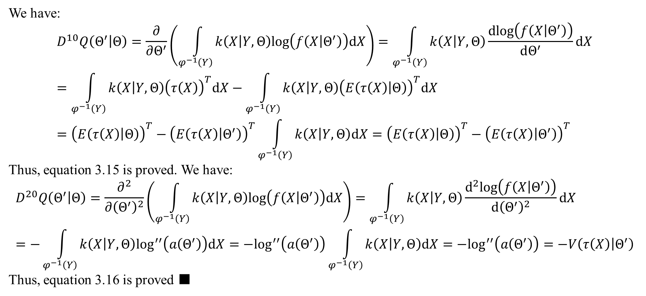
2. Convergence of EM
We have:
$$D^{10}Q\left(Θ^{′} | Θ\right)=\frac{∂}{∂Θ^{′}}\left(\int_{φ^{−1}\left(Y\right)}{k\left(X | Y,Θ\right)log\left(f\left(X | Θ^{′}\right)\right)dX}\right)=\int_{φ^{−1}\left(Y\right)}{k\left(X | Y,Θ\right)\frac{dlog\left(f\left(X | Θ^{′}\right)\right)}{dΘ^{′}}dX}=\int_{φ^{−1}\left(Y\right)}{k\left(X | Y,Θ\right){\left(τ\left(X\right)\right)}^{T}dX}−\int_{φ^{−1}\left(Y\right)}{k\left(X | Y,Θ\right){\left(E\left(τ\left(X\right) | Θ\right)\right)}^{T}dX}={\left(E\left(τ\left(X\right) | Θ\right)\right)}^{T}−{\left(E\left(τ\left(X\right) | Θ^{′}\right)\right)}^{T}\int_{φ^{−1}\left(Y\right)}{k\left(X | Y,Θ\right)dX}={\left(E\left(τ\left(X\right) | Θ\right)\right)}^{T}−{\left(E\left(τ\left(X\right) | Θ^{′}\right)\right)}^{T}$$
Thus, equation 3.15 is proved. We have:
$$D^{20}Q\left(Θ^{′} | Θ\right)=\frac{∂^{2}}{∂{\left(Θ^{′}\right)}^{2}}\left(\int_{φ^{−1}\left(Y\right)}{k\left(X | Y,Θ\right)log\left(f\left(X | Θ^{′}\right)\right)dX}\right)=\int_{φ^{−1}\left(Y\right)}{k\left(X | Y,Θ\right)\frac{d^{2}log\left(f\left(X | Θ^{′}\right)\right)}{d{\left(Θ^{′}\right)}^{2}}dX}=−\int_{φ^{−1}\left(Y\right)}{k\left(X | Y,Θ\right)\log^{′′}\left(a\left(Θ^{′}\right)\right)dX}=−\log^{′′}\left(a\left(Θ^{′}\right)\right)\int_{φ^{−1}\left(Y\right)}{k\left(X | Y,Θ\right)dX}=−\log^{′′}\left(a\left(Θ^{′}\right)\right)=−V\left(τ\left(X\right) | Θ^{′}\right)$$
Thus, equation 3.16 is proved ■

Slide 25
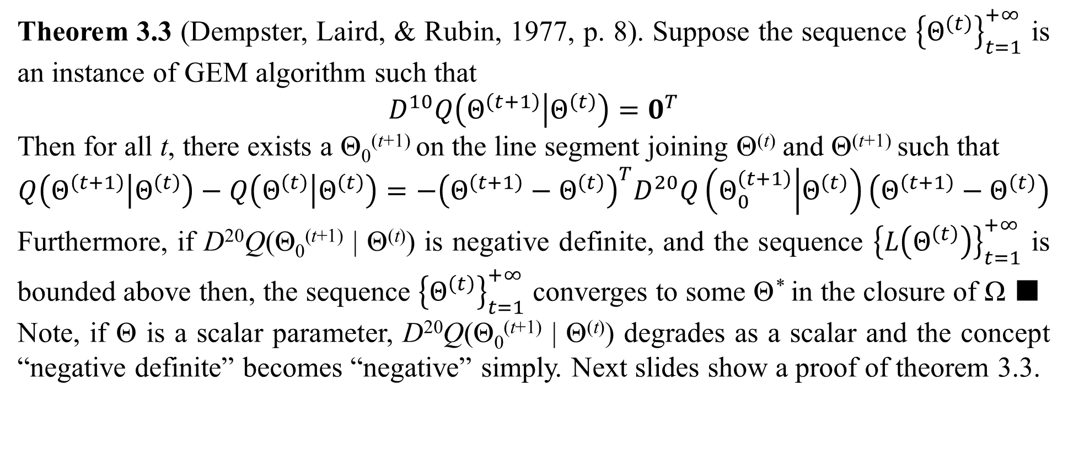
2. Convergence of EM
Theorem 3.3 (Dempster, Laird, & Rubin, 1977, p. 8). Suppose the sequence ${\left\{Θ^{\left(t\right)}\right\}}_{t=1}^{+∞}$ is an instance of GEM algorithm such that
$$D^{10}Q\left(Θ^{\left(t+1\right)} | Θ^{\left(t\right)}\right)=0^{T}$$
Then for all t, there exists a Θ₀^{(t+1)} on the line segment joining Θ^{(t)} and Θ^{(t+1)} such that
$$Q\left(Θ^{\left(t+1\right)} | Θ^{\left(t\right)}\right)−Q\left(Θ^{\left(t\right)} | Θ^{\left(t\right)}\right)=−{\left(Θ^{\left(t+1\right)}−Θ^{\left(t\right)}\right)}^{T}D^{20}Q\left(Θ_{0}^{\left(t+1\right)} | Θ^{\left(t\right)}\right)\left(Θ^{\left(t+1\right)}−Θ^{\left(t\right)}\right)$$
Furthermore, if D²⁰Q(Θ₀^{(t+1)} | Θ^{(t)}) is negative definite, and the sequence ${\left\{L\left(Θ^{\left(t\right)}\right)\right\}}_{t=1}^{+∞}$ is bounded above then, the sequence ${\left\{Θ^{\left(t\right)}\right\}}_{t=1}^{+∞}$ converges to some Θ* in the closure of Ω ■
Note, if Θ is a scalar parameter, D²⁰Q(Θ₀^{(t+1)} | Θ^{(t)}) degrades as a scalar and the concept “negative definite” becomes “negative” simply. Next slides show a proof of theorem 3.3.

Slide 26
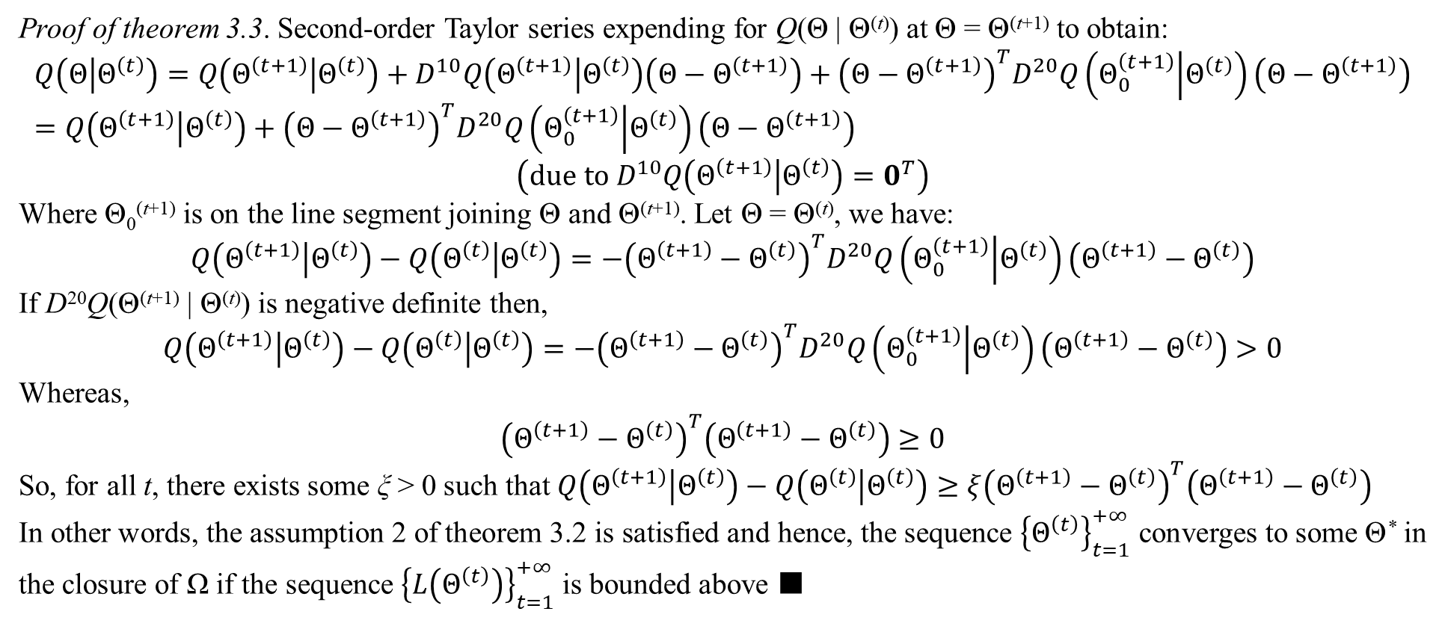
2. Convergence of EM
Proof of theorem 3.3. Second-order Taylor series expending for Q(Θ | Θ^{(t)}) at Θ = Θ^{(t+1)} to obtain:
$$Q\left(Θ | Θ^{\left(t\right)}\right)=Q\left(Θ^{\left(t+1\right)} | Θ^{\left(t\right)}\right)+D^{10}Q\left(Θ^{\left(t+1\right)} | Θ^{\left(t\right)}\right)\left(Θ−Θ^{\left(t+1\right)}\right)+{\left(Θ−Θ^{\left(t+1\right)}\right)}^{T}D^{20}Q\left(Θ_{0}^{\left(t+1\right)} | Θ^{\left(t\right)}\right)\left(Θ−Θ^{\left(t+1\right)}\right)=Q\left(Θ^{\left(t+1\right)} | Θ^{\left(t\right)}\right)+{\left(Θ−Θ^{\left(t+1\right)}\right)}^{T}D^{20}Q\left(Θ_{0}^{\left(t+1\right)} | Θ^{\left(t\right)}\right)\left(Θ−Θ^{\left(t+1\right)}\right)$$
$$\left(due to D^{10}Q\left(Θ^{\left(t+1\right)} | Θ^{\left(t\right)}\right)=0^{T}\right)$$
Where Θ₀^{(t+1)} is on the line segment joining Θ and Θ^{(t+1)}. Let Θ = Θ^{(t)}, we have:
$$Q\left(Θ^{\left(t+1\right)} | Θ^{\left(t\right)}\right)−Q\left(Θ^{\left(t\right)} | Θ^{\left(t\right)}\right)=−{\left(Θ^{\left(t+1\right)}−Θ^{\left(t\right)}\right)}^{T}D^{20}Q\left(Θ_{0}^{\left(t+1\right)} | Θ^{\left(t\right)}\right)\left(Θ^{\left(t+1\right)}−Θ^{\left(t\right)}\right)$$
If D²⁰Q(Θ^{(t+1)} | Θ^{(t)}) is negative definite then,
$$Q\left(Θ^{\left(t+1\right)} | Θ^{\left(t\right)}\right)−Q\left(Θ^{\left(t\right)} | Θ^{\left(t\right)}\right)=−{\left(Θ^{\left(t+1\right)}−Θ^{\left(t\right)}\right)}^{T}D^{20}Q\left(Θ_{0}^{\left(t+1\right)} | Θ^{\left(t\right)}\right)\left(Θ^{\left(t+1\right)}−Θ^{\left(t\right)}\right)>0$$
Whereas,
$${\left(Θ^{\left(t+1\right)}−Θ^{\left(t\right)}\right)}^{T}\left(Θ^{\left(t+1\right)}−Θ^{\left(t\right)}\right)≥0$$
So, for all t, there exists some ξ > 0 such that $Q\left(Θ^{\left(t+1\right)} | Θ^{\left(t\right)}\right)−Q\left(Θ^{\left(t\right)} | Θ^{\left(t\right)}\right)≥ξ{\left(Θ^{\left(t+1\right)}−Θ^{\left(t\right)}\right)}^{T}\left(Θ^{\left(t+1\right)}−Θ^{\left(t\right)}\right)$
In other words, the assumption 2 of theorem 3.2 is satisfied and hence, the sequence ${\left\{Θ^{\left(t\right)}\right\}}_{t=1}^{+∞}$ converges to some Θ* in the closure of Ω if the sequence ${\left\{L\left(Θ^{\left(t\right)}\right)\right\}}_{t=1}^{+∞}$ is bounded above ■

Slide 27
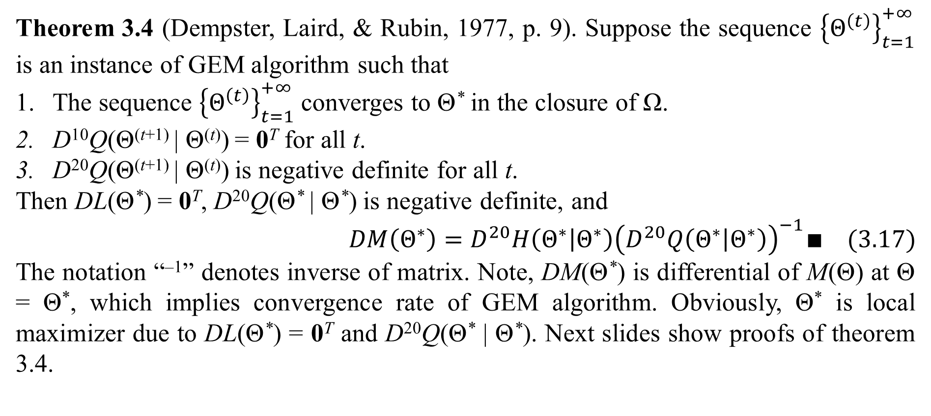
2. Convergence of EM
Theorem 3.4 (Dempster, Laird, & Rubin, 1977, p. 9). Suppose the sequence ${\left\{Θ^{\left(t\right)}\right\}}_{t=1}^{+∞}$ is an instance of GEM algorithm such that
The sequence ${\left\{Θ^{\left(t\right)}\right\}}_{t=1}^{+∞}$ converges to Θ* in the closure of Ω.
D¹⁰Q(Θ^{(t+1)} | Θ^{(t)}) = 0^{T} for all t.
D²⁰Q(Θ^{(t+1)} | Θ^{(t)}) is negative definite for all t.
Then DL(Θ*) = 0^{T}, D²⁰Q(Θ* | Θ*) is negative definite, and
$$DM\left(Θ^{∗}\right)=D^{20}H\left(Θ^{∗} | Θ^{∗}\right){\left(D^{20}Q\left(Θ^{∗} | Θ^{∗}\right)\right)}^{−1}∎ (3.17)$$
The notation “^{–1}” denotes inverse of matrix. Note, DM(Θ*) is differential of M(Θ) at Θ = Θ*, which implies convergence rate of GEM algorithm. Obviously, Θ* is local maximizer due to DL(Θ*) = 0^{T} and D²⁰Q(Θ* | Θ*). Next slides show proofs of theorem 3.4.

Slide 28
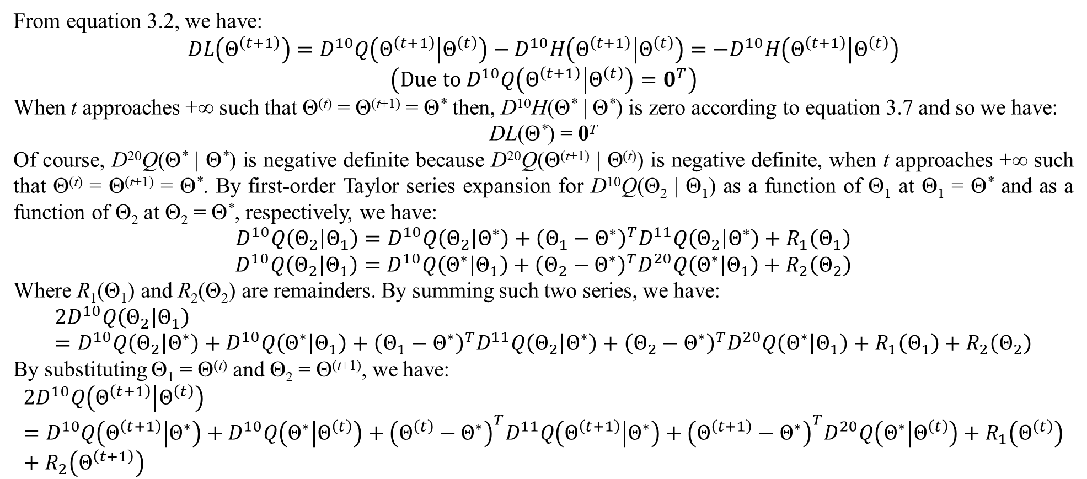
2. Convergence of EM
From equation 3.2, we have:
$$DL\left(Θ^{\left(t+1\right)}\right)=D^{10}Q\left(Θ^{\left(t+1\right)} | Θ^{\left(t\right)}\right)−D^{10}H\left(Θ^{\left(t+1\right)} | Θ^{\left(t\right)}\right)=−D^{10}H\left(Θ^{\left(t+1\right)} | Θ^{\left(t\right)}\right)$$
$$\left(Due to D^{10}Q\left(Θ^{\left(t+1\right)} | Θ^{\left(t\right)}\right)=0^{T}\right)$$
When t approaches +∞ such that Θ^{(t)} = Θ^{(t+1)} = Θ* then, D¹⁰H(Θ* | Θ*) is zero according to equation 3.7 and so we have:
DL(Θ*) = 0^{T}
Of course, D²⁰Q(Θ* | Θ*) is negative definite because D²⁰Q(Θ^{(t+1)} | Θ^{(t)}) is negative definite, when t approaches +∞ such that Θ^{(t)} = Θ^{(t+1)} = Θ*. By first-order Taylor series expansion for D¹⁰Q(Θ₂ | Θ₁) as a function of Θ₁ at Θ₁ = Θ* and as a function of Θ₂ at Θ₂ = Θ*, respectively, we have:
$$D^{10}Q\left(Θ_{2} | Θ_{1}\right)=D^{10}Q\left(Θ_{2} | Θ^{∗}\right)+{\left(Θ_{1}−Θ^{∗}\right)}^{T}D^{11}Q\left(Θ_{2} | Θ^{∗}\right)+R_{1}\left(Θ_{1}\right)$$
$$D^{10}Q\left(Θ_{2} | Θ_{1}\right)=D^{10}Q\left(Θ^{∗} | Θ_{1}\right)+{\left(Θ_{2}−Θ^{∗}\right)}^{T}D^{20}Q\left(Θ^{∗} | Θ_{1}\right)+R_{2}\left(Θ_{2}\right)$$
Where R₁(Θ₁) and R₂(Θ₂) are remainders. By summing such two series, we have:
$$2D^{10}Q\left(Θ_{2} | Θ_{1}\right)=D^{10}Q\left(Θ_{2} | Θ^{∗}\right)+D^{10}Q\left(Θ^{∗} | Θ_{1}\right)+{\left(Θ_{1}−Θ^{∗}\right)}^{T}D^{11}Q\left(Θ_{2} | Θ^{∗}\right)+{\left(Θ_{2}−Θ^{∗}\right)}^{T}D^{20}Q\left(Θ^{∗} | Θ_{1}\right)+R_{1}\left(Θ_{1}\right)+R_{2}\left(Θ_{2}\right)$$
By substituting Θ₁ = Θ^{(t)} and Θ₂ = Θ^{(t+1)}, we have:
$$2D^{10}Q\left(Θ^{\left(t+1\right)} | Θ^{\left(t\right)}\right)=D^{10}Q\left(Θ^{\left(t+1\right)} | Θ^{∗}\right)+D^{10}Q\left(Θ^{∗} | Θ^{\left(t\right)}\right)+{\left(Θ^{\left(t\right)}−Θ^{∗}\right)}^{T}D^{11}Q\left(Θ^{\left(t+1\right)} | Θ^{∗}\right)+{\left(Θ^{\left(t+1\right)}−Θ^{∗}\right)}^{T}D^{20}Q\left(Θ^{∗} | Θ^{\left(t\right)}\right)+R_{1}\left(Θ^{\left(t\right)}\right)+R_{2}\left(Θ^{\left(t+1\right)}\right)$$

Slide 29
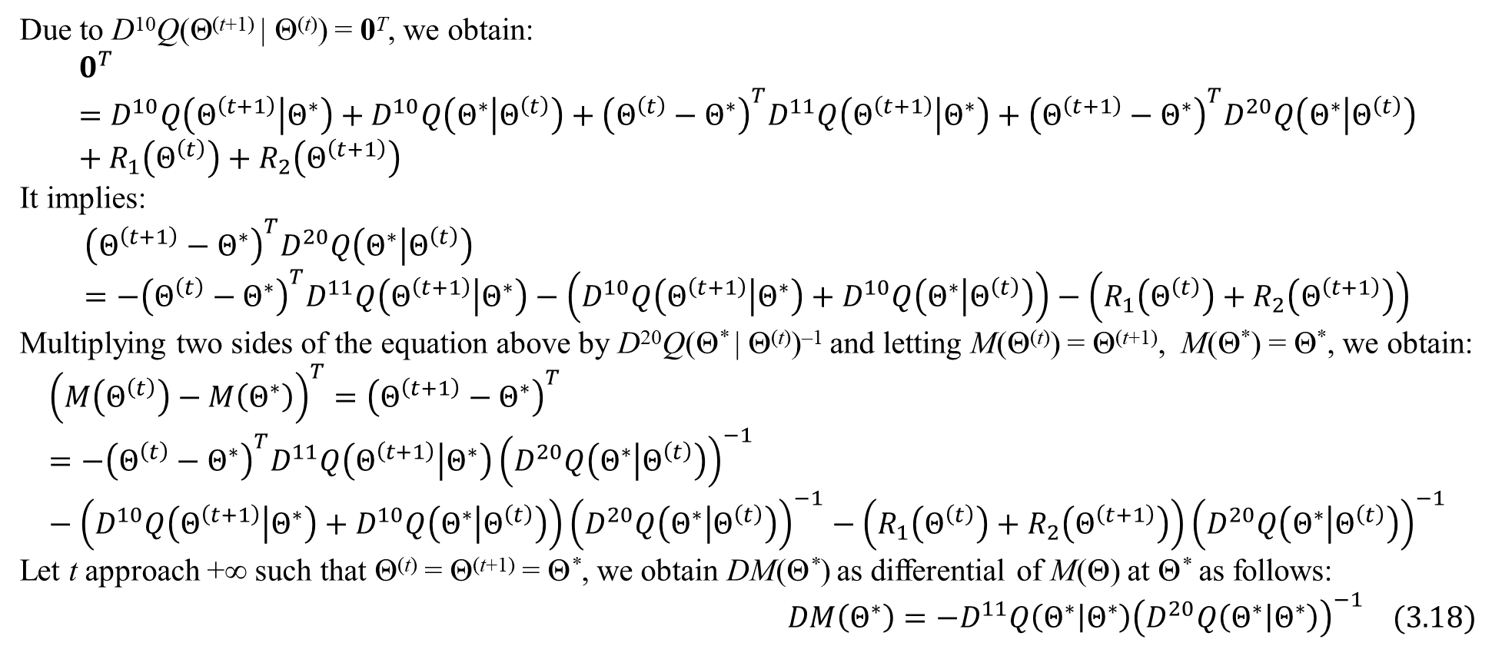
2. Convergence of EM
Due to D¹⁰Q(Θ^{(t+1)} | Θ^{(t)}) = 0^{T}, we obtain:
$$0^{T}=D^{10}Q\left(Θ^{\left(t+1\right)} | Θ^{∗}\right)+D^{10}Q\left(Θ^{∗} | Θ^{\left(t\right)}\right)+{\left(Θ^{\left(t\right)}−Θ^{∗}\right)}^{T}D^{11}Q\left(Θ^{\left(t+1\right)} | Θ^{∗}\right)+{\left(Θ^{\left(t+1\right)}−Θ^{∗}\right)}^{T}D^{20}Q\left(Θ^{∗} | Θ^{\left(t\right)}\right)+R_{1}\left(Θ^{\left(t\right)}\right)+R_{2}\left(Θ^{\left(t+1\right)}\right)$$
It implies:
$${\left(Θ^{\left(t+1\right)}−Θ^{∗}\right)}^{T}D^{20}Q\left(Θ^{∗} | Θ^{\left(t\right)}\right)=−{\left(Θ^{\left(t\right)}−Θ^{∗}\right)}^{T}D^{11}Q\left(Θ^{\left(t+1\right)} | Θ^{∗}\right)−\left(D^{10}Q\left(Θ^{\left(t+1\right)} | Θ^{∗}\right)+D^{10}Q\left(Θ^{∗} | Θ^{\left(t\right)}\right)\right)−\left(R_{1}\left(Θ^{\left(t\right)}\right)+R_{2}\left(Θ^{\left(t+1\right)}\right)\right)$$
Multiplying two sides of the equation above by D²⁰Q(Θ* | Θ^{(t)})^{–1} and letting M(Θ^{(t)}) = Θ^{(t+1)}, M(Θ*) = Θ*, we obtain:
$${\left(M\left(Θ^{\left(t\right)}\right)−M\left(Θ^{∗}\right)\right)}^{T}={\left(Θ^{\left(t+1\right)}−Θ^{∗}\right)}^{T}=−{\left(Θ^{\left(t\right)}−Θ^{∗}\right)}^{T}D^{11}Q\left(Θ^{\left(t+1\right)} | Θ^{∗}\right){\left(D^{20}Q\left(Θ^{∗} | Θ^{\left(t\right)}\right)\right)}^{−1}−\left(D^{10}Q\left(Θ^{\left(t+1\right)} | Θ^{∗}\right)+D^{10}Q\left(Θ^{∗} | Θ^{\left(t\right)}\right)\right){\left(D^{20}Q\left(Θ^{∗} | Θ^{\left(t\right)}\right)\right)}^{−1}−\left(R_{1}\left(Θ^{\left(t\right)}\right)+R_{2}\left(Θ^{\left(t+1\right)}\right)\right){\left(D^{20}Q\left(Θ^{∗} | Θ^{\left(t\right)}\right)\right)}^{−1}$$
Let t approach +∞ such that Θ^{(t)} = Θ^{(t+1)} = Θ*, we obtain DM(Θ*) as differential of M(Θ) at Θ* as follows:
$$DM\left(Θ^{∗}\right)=−D^{11}Q\left(Θ^{∗} | Θ^{∗}\right){\left(D^{20}Q\left(Θ^{∗} | Θ^{∗}\right)\right)}^{−1} (3.18)$$

Slide 30
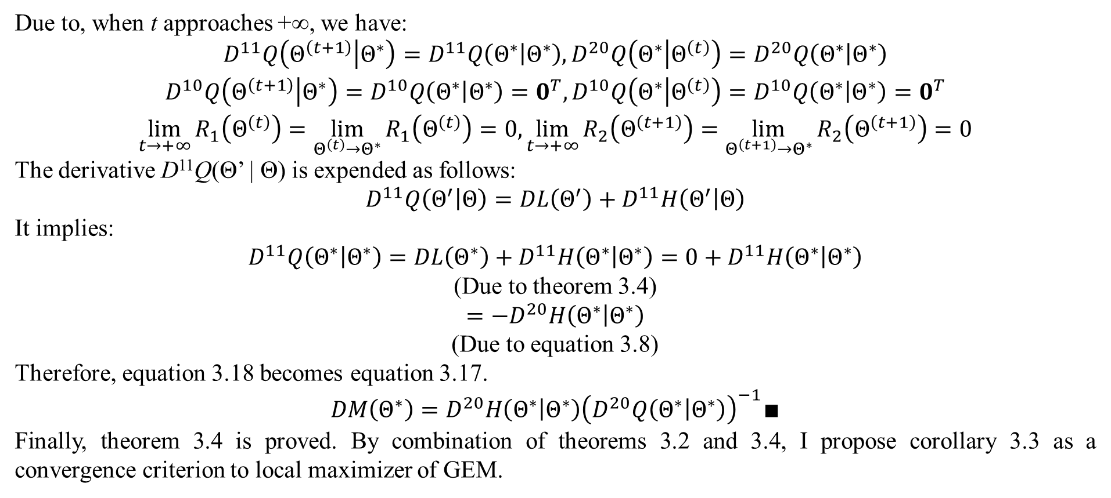
2. Convergence of EM
Due to, when t approaches +∞, we have:
$$\begin{matrix}D^{11}Q\left(Θ^{\left(t+1\right)} | Θ^{∗}\right)=D^{11}Q\left(Θ^{∗} | Θ^{∗}\right),D^{20}Q\left(Θ^{∗} | Θ^{\left(t\right)}\right)=D^{20}Q\left(Θ^{∗} | Θ^{∗}\right) \\ D^{10}Q\left(Θ^{\left(t+1\right)} | Θ^{∗}\right)=D^{10}Q\left(Θ^{∗} | Θ^{∗}\right)=0^{T},D^{10}Q\left(Θ^{∗} | Θ^{\left(t\right)}\right)=D^{10}Q\left(Θ^{∗} | Θ^{∗}\right)=0^{T} \\ \lim_{t→+∞}{R_{1}\left(Θ^{\left(t\right)}\right)}=\lim_{Θ^{\left(t\right)}→Θ^{∗}}{R_{1}\left(Θ^{\left(t\right)}\right)}=0,\lim_{t→+∞}{R_{2}\left(Θ^{\left(t+1\right)}\right)}=\lim_{Θ^{\left(t+1\right)}→Θ^{∗}}{R_{2}\left(Θ^{\left(t+1\right)}\right)}=0\end{matrix}$$
The derivative D¹¹Q(Θ’ | Θ) is expended as follows:
$$D^{11}Q\left(Θ^{′} | Θ\right)=DL\left(Θ^{′}\right)+D^{11}H\left(Θ^{′} | Θ\right)$$
It implies:
$$D^{11}Q\left(Θ^{∗} | Θ^{∗}\right)=DL\left(Θ^{∗}\right)+D^{11}H\left(Θ^{∗} | Θ^{∗}\right)=0+D^{11}H\left(Θ^{∗} | Θ^{∗}\right)$$
(Due to theorem 3.4)
$$=−D^{20}H\left(Θ^{∗} | Θ^{∗}\right)$$
(Due to equation 3.8)
Therefore, equation 3.18 becomes equation 3.17.
$$DM\left(Θ^{∗}\right)=D^{20}H\left(Θ^{∗} | Θ^{∗}\right){\left(D^{20}Q\left(Θ^{∗} | Θ^{∗}\right)\right)}^{−1}∎$$
Finally, theorem 3.4 is proved. By combination of theorems 3.2 and 3.4, I propose corollary 3.3 as a convergence criterion to local maximizer of GEM.

Slide 31
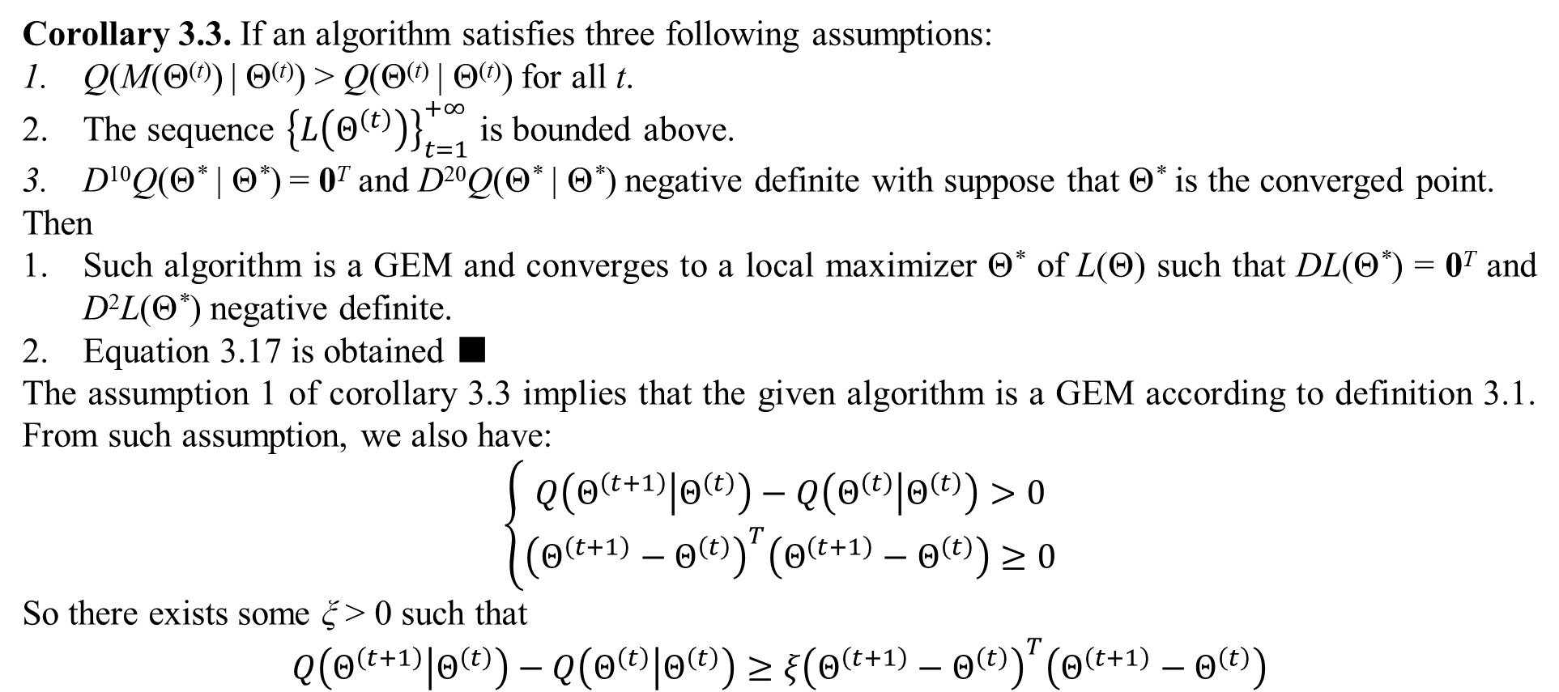
2. Convergence of EM
Corollary 3.3. If an algorithm satisfies three following assumptions:
Q(M(Θ^{(t)}) | Θ^{(t)}) > Q(Θ^{(t)} | Θ^{(t)}) for all t.
The sequence ${\left\{L\left(Θ^{\left(t\right)}\right)\right\}}_{t=1}^{+∞}$ is bounded above.
D¹⁰Q(Θ* | Θ*) = 0^{T} and D²⁰Q(Θ* | Θ*) negative definite with suppose that Θ* is the converged point.
Then
Such algorithm is a GEM and converges to a local maximizer Θ* of L(Θ) such that DL(Θ*) = 0^{T} and D²L(Θ*) negative definite.
Equation 3.17 is obtained ■
The assumption 1 of corollary 3.3 implies that the given algorithm is a GEM according to definition 3.1. From such assumption, we also have:
$$\left\{\begin{matrix}Q\left(Θ^{\left(t+1\right)} | Θ^{\left(t\right)}\right)−Q\left(Θ^{\left(t\right)} | Θ^{\left(t\right)}\right)>0 \\ {\left(Θ^{\left(t+1\right)}−Θ^{\left(t\right)}\right)}^{T}\left(Θ^{\left(t+1\right)}−Θ^{\left(t\right)}\right)≥0\end{matrix}\right.$$
So there exists some ξ > 0 such that
$$Q\left(Θ^{\left(t+1\right)} | Θ^{\left(t\right)}\right)−Q\left(Θ^{\left(t\right)} | Θ^{\left(t\right)}\right)≥ξ{\left(Θ^{\left(t+1\right)}−Θ^{\left(t\right)}\right)}^{T}\left(Θ^{\left(t+1\right)}−Θ^{\left(t\right)}\right)$$

Slide 32
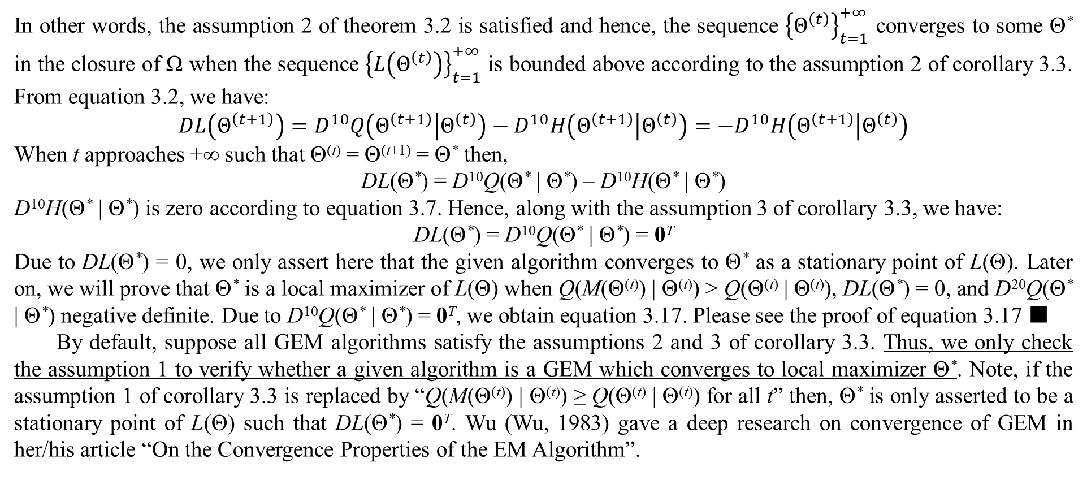
2. Convergence of EM
In other words, the assumption 2 of theorem 3.2 is satisfied and hence, the sequence ${\left\{Θ^{\left(t\right)}\right\}}_{t=1}^{+∞}$ converges to some Θ* in the closure of Ω when the sequence ${\left\{L\left(Θ^{\left(t\right)}\right)\right\}}_{t=1}^{+∞}$ is bounded above according to the assumption 2 of corollary 3.3. From equation 3.2, we have:
$$DL\left(Θ^{\left(t+1\right)}\right)=D^{10}Q\left(Θ^{\left(t+1\right)} | Θ^{\left(t\right)}\right)−D^{10}H\left(Θ^{\left(t+1\right)} | Θ^{\left(t\right)}\right)=−D^{10}H\left(Θ^{\left(t+1\right)} | Θ^{\left(t\right)}\right)$$
When t approaches +∞ such that Θ^{(t)} = Θ^{(t+1)} = Θ* then,
DL(Θ*) = D¹⁰Q(Θ* | Θ*) – D¹⁰H(Θ* | Θ*)
D¹⁰H(Θ* | Θ*) is zero according to equation 3.7. Hence, along with the assumption 3 of corollary 3.3, we have:
DL(Θ*) = D¹⁰Q(Θ* | Θ*) = 0^{T}
Due to DL(Θ*) = 0, we only assert here that the given algorithm converges to Θ* as a stationary point of L(Θ). Later on, we will prove that Θ* is a local maximizer of L(Θ) when Q(M(Θ^{(t)}) | Θ^{(t)}) > Q(Θ^{(t)} | Θ^{(t)}), DL(Θ*) = 0, and D²⁰Q(Θ* | Θ*) negative definite. Due to D¹⁰Q(Θ* | Θ*) = 0^{T}, we obtain equation 3.17. Please see the proof of equation 3.17 ■
By default, suppose all GEM algorithms satisfy the assumptions 2 and 3 of corollary 3.3. Thus, we only check the assumption 1 to verify whether a given algorithm is a GEM which converges to local maximizer Θ*. Note, if the assumption 1 of corollary 3.3 is replaced by “Q(M(Θ^{(t)}) | Θ^{(t)}) ≥ Q(Θ^{(t)} | Θ^{(t)}) for all t” then, Θ* is only asserted to be a stationary point of L(Θ) such that DL(Θ*) = 0^{T}. Wu (Wu, 1983) gave a deep research on convergence of GEM in her/his article “On the Convergence Properties of the EM Algorithm”.

Slide 33
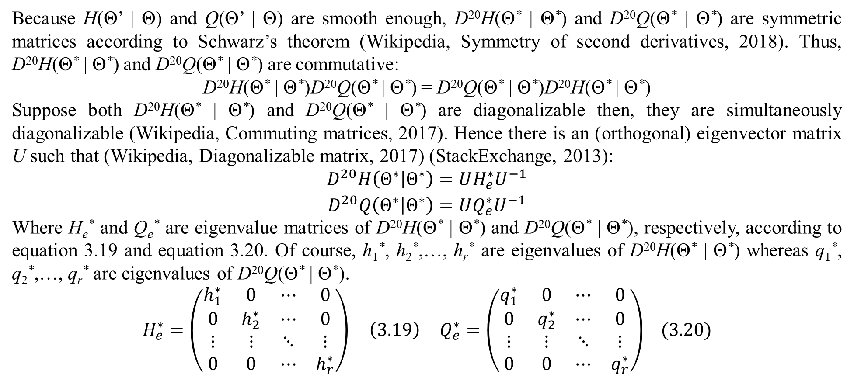
2. Convergence of EM
Because H(Θ’ | Θ) and Q(Θ’ | Θ) are smooth enough, D²⁰H(Θ* | Θ*) and D²⁰Q(Θ* | Θ*) are symmetric matrices according to Schwarz’s theorem (Wikipedia, Symmetry of second derivatives, 2018). Thus, D²⁰H(Θ* | Θ*) and D²⁰Q(Θ* | Θ*) are commutative:
D²⁰H(Θ* | Θ*)D²⁰Q(Θ* | Θ*) = D²⁰Q(Θ* | Θ*)D²⁰H(Θ* | Θ*)
Suppose both D²⁰H(Θ* | Θ*) and D²⁰Q(Θ* | Θ*) are diagonalizable then, they are simultaneously diagonalizable (Wikipedia, Commuting matrices, 2017). Hence there is an (orthogonal) eigenvector matrix U such that (Wikipedia, Diagonalizable matrix, 2017) (StackExchange, 2013):
$$\begin{matrix}D^{20}H\left(Θ^{∗} | Θ^{∗}\right)=UH_{e}^{∗}U^{−1} \\ D^{20}Q\left(Θ^{∗} | Θ^{∗}\right)=UQ_{e}^{∗}U^{−1}\end{matrix}$$
Where H_{e}* and Q_{e}* are eigenvalue matrices of D²⁰H(Θ* | Θ*) and D²⁰Q(Θ* | Θ*), respectively, according to equation 3.19 and equation 3.20. Of course, h₁*, h₂*,…, h_{r}* are eigenvalues of D²⁰H(Θ* | Θ*) whereas q₁*, q₂*,…, q_{r}* are eigenvalues of D²⁰Q(Θ* | Θ*).
$$\begin{matrix}H_{e}^{∗}=\left(\begin{matrix}h_{1}^{∗} & 0 & ⋯ & 0 \\ 0 & h_{2}^{∗} & ⋯ & 0 \\ ⋮ & ⋮ & ⋱ & ⋮ \\ 0 & 0 & ⋯ & h_{r}^{∗}\end{matrix}\right) \left(3.19\right) & Q_{e}^{∗}=\left(\begin{matrix}q_{1}^{∗} & 0 & ⋯ & 0 \\ 0 & q_{2}^{∗} & ⋯ & 0 \\ ⋮ & ⋮ & ⋱ & ⋮ \\ 0 & 0 & ⋯ & q_{r}^{∗}\end{matrix}\right)\end{matrix} (3.20)$$

Slide 34
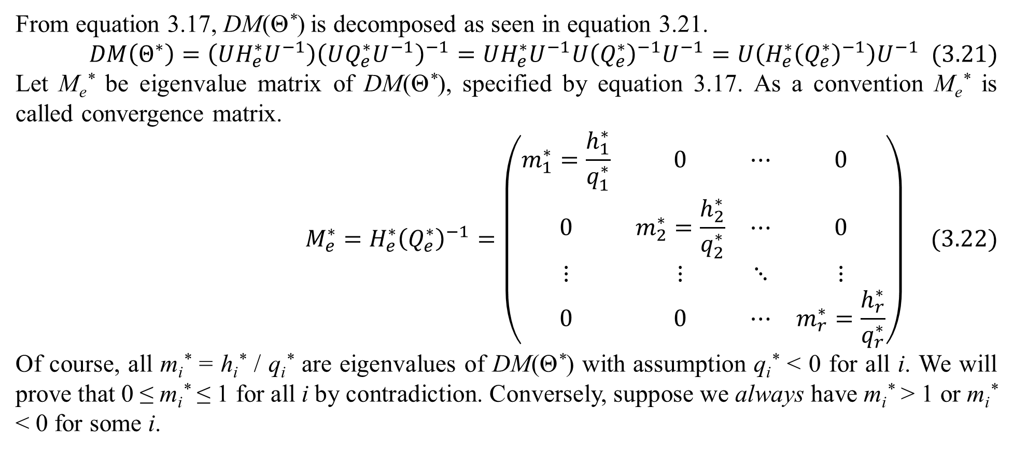
2. Convergence of EM
From equation 3.17, DM(Θ*) is decomposed as seen in equation 3.21.
$$DM\left(Θ^{∗}\right)=\left(UH_{e}^{∗}U^{−1}\right){\left(UQ_{e}^{∗}U^{−1}\right)}^{−1}=UH_{e}^{∗}U^{−1}U{\left(Q_{e}^{∗}\right)}^{−1}U^{−1}=U\left(H_{e}^{∗}{\left(Q_{e}^{∗}\right)}^{−1}\right)U^{−1} (3.21)$$
Let M_{e}* be eigenvalue matrix of DM(Θ*), specified by equation 3.17. As a convention M_{e}* is called convergence matrix.
$$M_{e}^{∗}=H_{e}^{∗}{\left(Q_{e}^{∗}\right)}^{−1}=\left(\begin{matrix}m_{1}^{∗}=\frac{h_{1}^{∗}}{q_{1}^{∗}} & 0 & ⋯ & 0 \\ 0 & m_{2}^{∗}=\frac{h_{2}^{∗}}{q_{2}^{∗}} & ⋯ & 0 \\ ⋮ & ⋮ & ⋱ & ⋮ \\ 0 & 0 & ⋯ & m_{r}^{∗}=\frac{h_{r}^{∗}}{q_{r}^{∗}}\end{matrix}\right) (3.22)$$
Of course, all m_{i}* = h_{i}* / q_{i}* are eigenvalues of DM(Θ*) with assumption q_{i}* < 0 for all i. We will prove that 0 ≤ m_{i}* ≤ 1 for all i by contradiction. Conversely, suppose we always have m_{i}* > 1 or m_{i}* < 0 for some i.

Slide 35
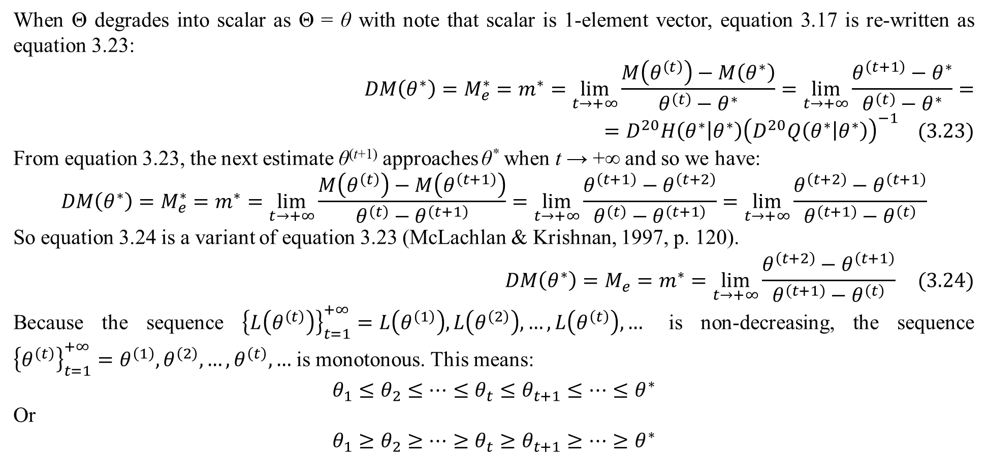
2. Convergence of EM
When Θ degrades into scalar as Θ = θ with note that scalar is 1-element vector, equation 3.17 is re-written as equation 3.23:
$$DM\left(θ^{∗}\right)=M_{e}^{∗}=m^{∗}=\lim_{t→+∞}{\frac{M\left(θ^{\left(t\right)}\right)−M\left(θ^{∗}\right)}{θ^{\left(t\right)}−θ^{∗}}}=\lim_{t→+∞}{\frac{θ^{\left(t+1\right)}−θ^{∗}}{θ^{\left(t\right)}−θ^{∗}}}==D^{20}H\left(θ^{∗} | θ^{∗}\right){\left(D^{20}Q\left(θ^{∗} | θ^{∗}\right)\right)}^{−1} (3.23)$$
From equation 3.23, the next estimate θ^{(t+1)} approaches θ* when t → +∞ and so we have:
$$DM\left(θ^{∗}\right)=M_{e}^{∗}=m^{∗}=\lim_{t→+∞}{\frac{M\left(θ^{\left(t\right)}\right)−M\left(θ^{\left(t+1\right)}\right)}{θ^{\left(t\right)}−θ^{\left(t+1\right)}}}=\lim_{t→+∞}{\frac{θ^{\left(t+1\right)}−θ^{\left(t+2\right)}}{θ^{\left(t\right)}−θ^{\left(t+1\right)}}}=\lim_{t→+∞}{\frac{θ^{\left(t+2\right)}−θ^{\left(t+1\right)}}{θ^{\left(t+1\right)}−θ^{\left(t\right)}}}$$
So equation 3.24 is a variant of equation 3.23 (McLachlan & Krishnan, 1997, p. 120).
$$DM\left(θ^{∗}\right)=M_{e}=m^{∗}=\lim_{t→+∞}{\frac{θ^{\left(t+2\right)}−θ^{\left(t+1\right)}}{θ^{\left(t+1\right)}−θ^{\left(t\right)}}} (3.24)$$
Because the sequence ${\left\{L\left(θ^{\left(t\right)}\right)\right\}}_{t=1}^{+∞}=L\left(θ^{\left(1\right)}\right),L\left(θ^{\left(2\right)}\right),…,L\left(θ^{\left(t\right)}\right),…$ is non-decreasing, the sequence ${\left\{θ^{\left(t\right)}\right\}}_{t=1}^{+∞}=θ^{\left(1\right)},θ^{\left(2\right)},…,θ^{\left(t\right)},…$ is monotonous. This means:
$$θ_{1}≤θ_{2}≤⋯≤θ_{t}≤θ_{t+1}≤⋯≤θ^{∗}$$
Or
$$θ_{1}≥θ_{2}≥⋯≥θ_{t}≥θ_{t+1}≥⋯≥θ^{∗}$$

Slide 36
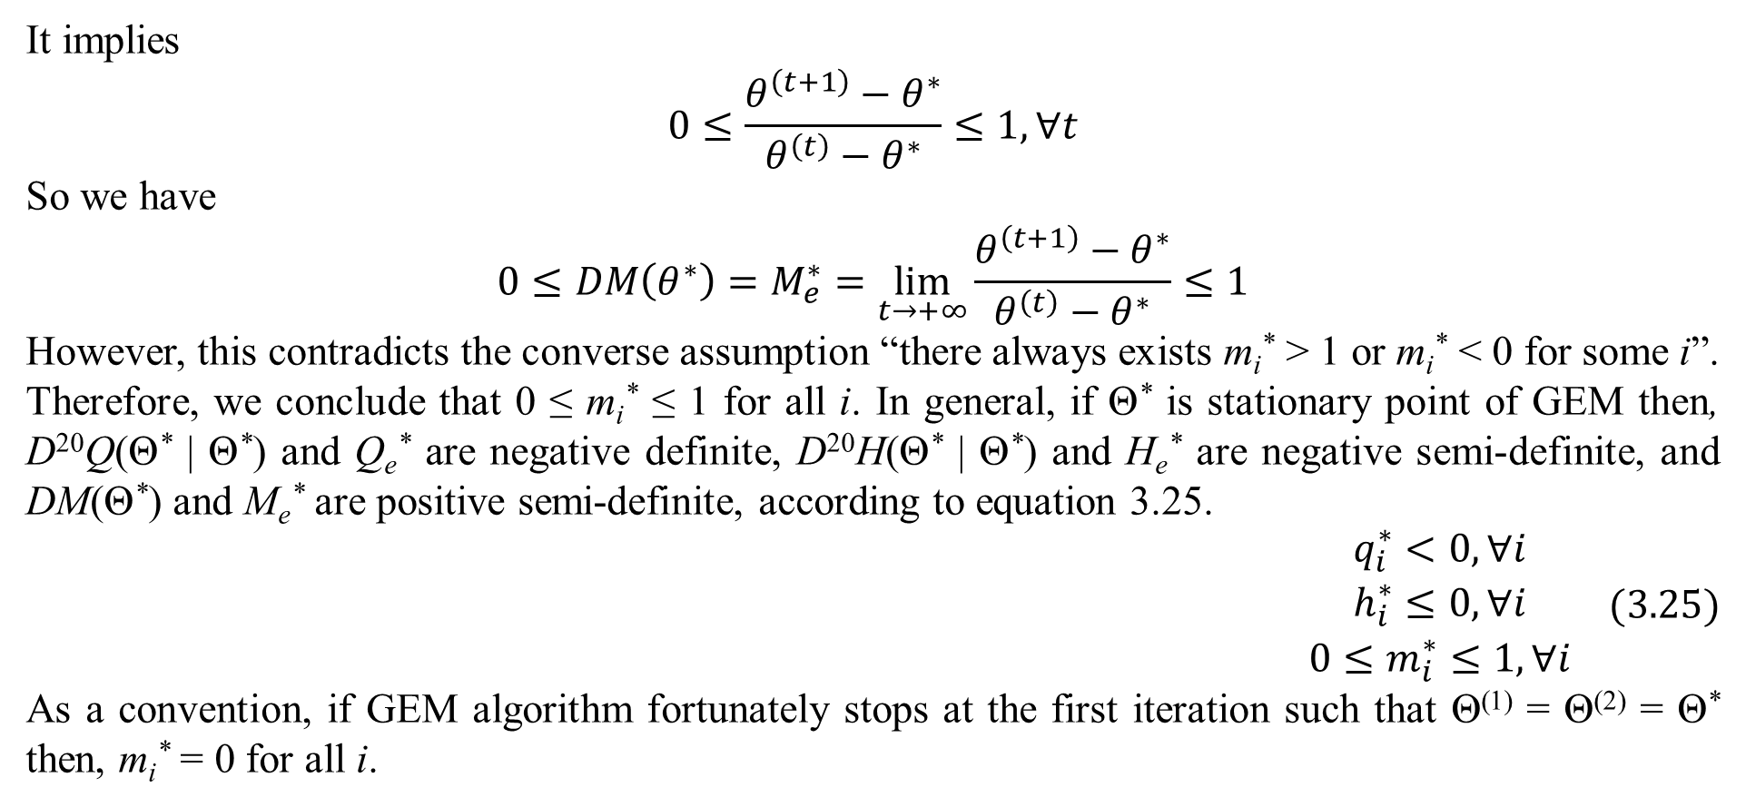
2. Convergence of EM
It implies
$$0≤\frac{θ^{\left(t+1\right)}−θ^{∗}}{θ^{\left(t\right)}−θ^{∗}}≤1,∀t$$
So we have
$$0≤DM\left(θ^{∗}\right)=M_{e}^{∗}=\lim_{t→+∞}{\frac{θ^{\left(t+1\right)}−θ^{∗}}{θ^{\left(t\right)}−θ^{∗}}}≤1$$
However, this contradicts the converse assumption “there always exists m_{i}* > 1 or m_{i}* < 0 for some i”. Therefore, we conclude that 0 ≤ m_{i}* ≤ 1 for all i. In general, if Θ* is stationary point of GEM then, D²⁰Q(Θ* | Θ*) and Q_{e}* are negative definite, D²⁰H(Θ* | Θ*) and H_{e}* are negative semi-definite, and DM(Θ*) and M_{e}* are positive semi-definite, according to equation 3.25.
$$\begin{matrix}q_{i}^{∗}<0,∀i \\ h_{i}^{∗}≤0,∀i \\ 0≤m_{i}^{∗}≤1,∀i\end{matrix} (3.25)$$
As a convention, if GEM algorithm fortunately stops at the first iteration such that Θ⁽¹⁾ = Θ⁽²⁾ = Θ* then, m_{i}* = 0 for all i.

Slide 37
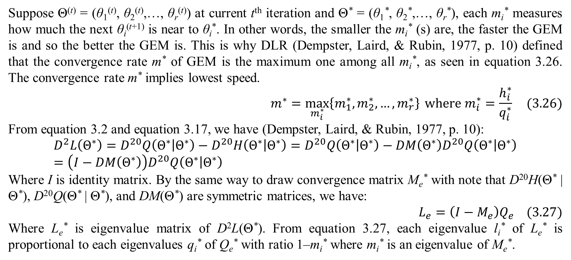
2. Convergence of EM
Suppose Θ^{(t)} = (θ₁^{(t)}, θ₂^{(t)},…, θ_{r}^{(t)}) at current t^{th} iteration and Θ* = (θ₁*, θ₂*,…, θ_{r}*), each m_{i}* measures how much the next θ_{i}^{(t+1)} is near to θ_{i}*. In other words, the smaller the m_{i}* (s) are, the faster the GEM is and so the better the GEM is. This is why DLR (Dempster, Laird, & Rubin, 1977, p. 10) defined that the convergence rate m* of GEM is the maximum one among all m_{i}*, as seen in equation 3.26. The convergence rate m* implies lowest speed.
$$m^{∗}=\max_{m_{i}^{∗}}\left\{m_{1}^{∗},m_{2}^{∗},…,m_{r}^{∗}\right\} where m_{i}^{∗}=\frac{h_{i}^{∗}}{q_{i}^{∗}} (3.26)$$
From equation 3.2 and equation 3.17, we have (Dempster, Laird, & Rubin, 1977, p. 10):
$$D^{2}L\left(Θ^{∗}\right)=D^{20}Q\left(Θ^{∗} | Θ^{∗}\right)−D^{20}H\left(Θ^{∗} | Θ^{∗}\right)=D^{20}Q\left(Θ^{∗} | Θ^{∗}\right)−DM\left(Θ^{∗}\right)D^{20}Q\left(Θ^{∗} | Θ^{∗}\right)=\left(I−DM\left(Θ^{∗}\right)\right)D^{20}Q\left(Θ^{∗} | Θ^{∗}\right)$$
Where I is identity matrix. By the same way to draw convergence matrix M_{e}* with note that D²⁰H(Θ* | Θ*), D²⁰Q(Θ* | Θ*), and DM(Θ*) are symmetric matrices, we have:
$$L_{e}=\left(I−M_{e}\right)Q_{e} (3.27)$$
Where L_{e}* is eigenvalue matrix of D²L(Θ*). From equation 3.27, each eigenvalue l_{i}* of L_{e}* is proportional to each eigenvalues q_{i}* of Q_{e}* with ratio 1–m_{i}* where m_{i}* is an eigenvalue of M_{e}*.

Slide 38
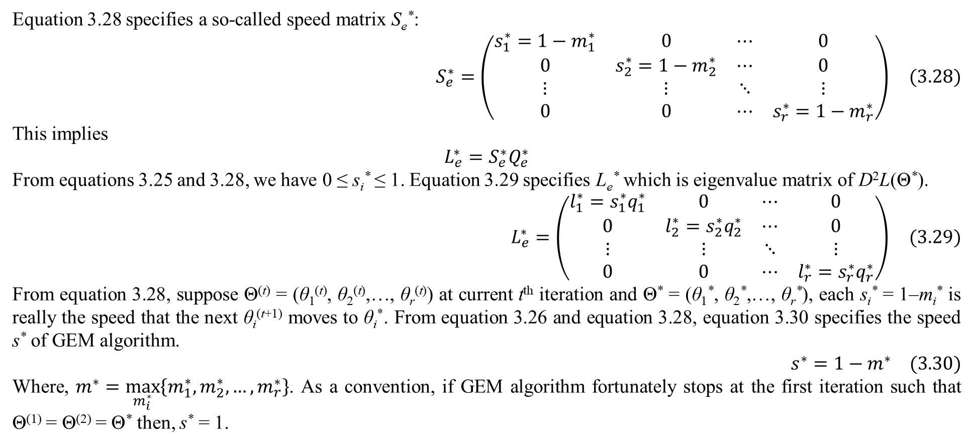
2. Convergence of EM
Equation 3.28 specifies a so-called speed matrix S_{e}*:
$$S_{e}^{∗}=\left(\begin{matrix}s_{1}^{∗}=1−m_{1}^{∗} & 0 & ⋯ & 0 \\ 0 & s_{2}^{∗}=1−m_{2}^{∗} & ⋯ & 0 \\ ⋮ & ⋮ & ⋱ & ⋮ \\ 0 & 0 & ⋯ & s_{r}^{∗}=1−m_{r}^{∗}\end{matrix}\right) (3.28)$$
This implies
$$L_{e}^{∗}=S_{e}^{∗}Q_{e}^{∗}$$
From equations 3.25 and 3.28, we have 0 ≤ s_{i}* ≤ 1. Equation 3.29 specifies L_{e}* which is eigenvalue matrix of D²L(Θ*).
$$L_{e}^{∗}=\left(\begin{matrix}l_{1}^{∗}=s_{1}^{∗}q_{1}^{∗} & 0 & ⋯ & 0 \\ 0 & l_{2}^{∗}=s_{2}^{∗}q_{2}^{∗} & ⋯ & 0 \\ ⋮ & ⋮ & ⋱ & ⋮ \\ 0 & 0 & ⋯ & l_{r}^{∗}=s_{r}^{∗}q_{r}^{∗}\end{matrix}\right) (3.29)$$
From equation 3.28, suppose Θ^{(t)} = (θ₁^{(t)}, θ₂^{(t)},…, θ_{r}^{(t)}) at current t^{th} iteration and Θ* = (θ₁*, θ₂*,…, θ_{r}*), each s_{i}* = 1–m_{i}* is really the speed that the next θ_{i}^{(t+1)} moves to θ_{i}*. From equation 3.26 and equation 3.28, equation 3.30 specifies the speed s* of GEM algorithm.
$$s^{∗}=1−m^{∗} (3.30)$$
Where, $m^{∗}=\max_{m_{i}^{∗}}\left\{m_{1}^{∗},m_{2}^{∗},…,m_{r}^{∗}\right\}$. As a convention, if GEM algorithm fortunately stops at the first iteration such that Θ⁽¹⁾ = Θ⁽²⁾ = Θ* then, s* = 1.

Slide 39
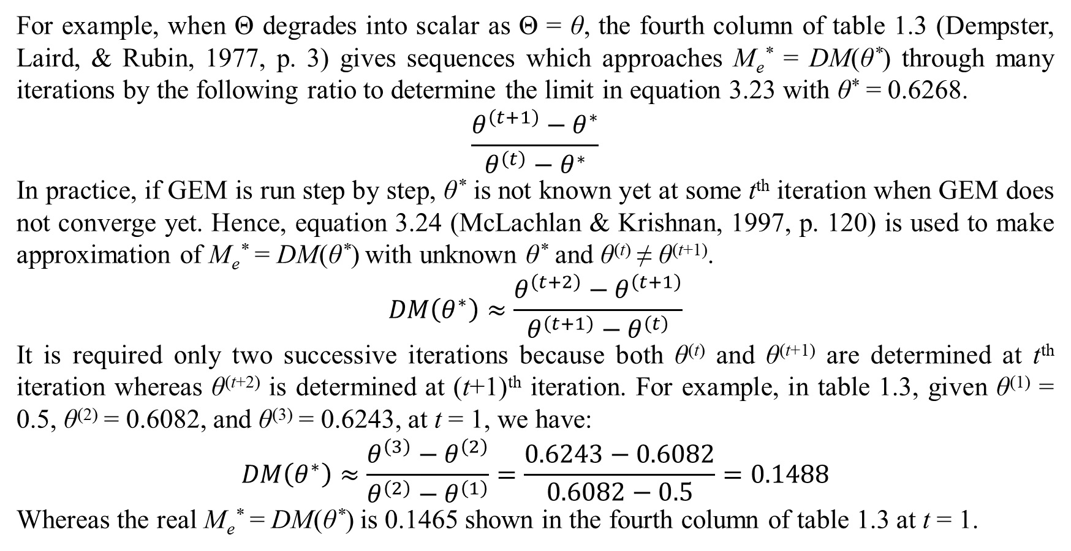
2. Convergence of EM
For example, when Θ degrades into scalar as Θ = θ, the fourth column of table 1.3 (Dempster, Laird, & Rubin, 1977, p. 3) gives sequences which approaches M_{e}* = DM(θ*) through many iterations by the following ratio to determine the limit in equation 3.23 with θ* = 0.6268.
$$\frac{θ^{\left(t+1\right)}−θ^{∗}}{θ^{\left(t\right)}−θ^{∗}}$$
In practice, if GEM is run step by step, θ* is not known yet at some t^{th} iteration when GEM does not converge yet. Hence, equation 3.24 (McLachlan & Krishnan, 1997, p. 120) is used to make approximation of M_{e}* = DM(θ*) with unknown θ* and θ^{(t)} ≠ θ^{(t+1)}.
$$DM\left(θ^{∗}\right)≈\frac{θ^{\left(t+2\right)}−θ^{\left(t+1\right)}}{θ^{\left(t+1\right)}−θ^{\left(t\right)}}$$
It is required only two successive iterations because both θ^{(t)} and θ^{(t+1)} are determined at t^{th} iteration whereas θ^{(t+2)} is determined at (t+1)^{th} iteration. For example, in table 1.3, given θ⁽¹⁾ = 0.5, θ⁽²⁾ = 0.6082, and θ⁽³⁾ = 0.6243, at t = 1, we have:
$$DM\left(θ^{∗}\right)≈\frac{θ^{\left(3\right)}−θ^{\left(2\right)}}{θ^{\left(2\right)}−θ^{\left(1\right)}}=\frac{0.6243−0.6082}{0.6082−0.5}=0.1488$$
Whereas the real M_{e}* = DM(θ*) is 0.1465 shown in the fourth column of table 1.3 at t = 1.

Slide 40
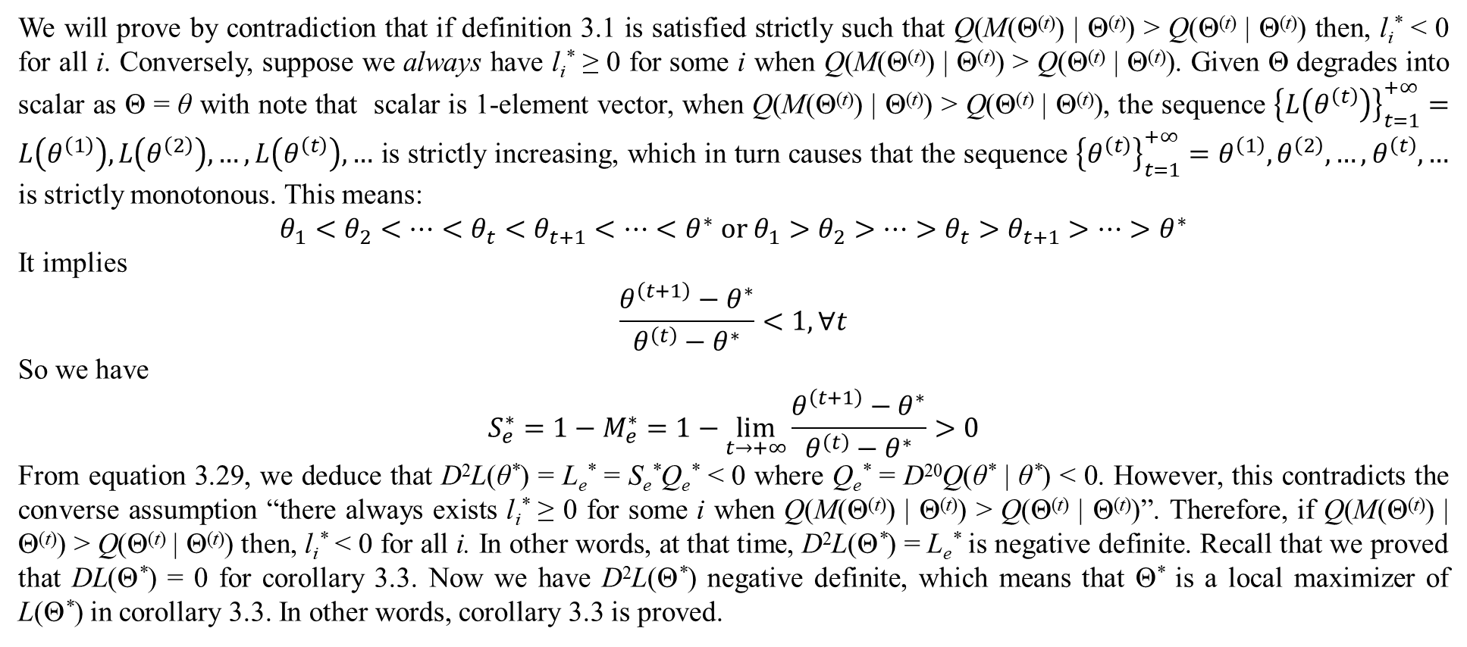
2. Convergence of EM
We will prove by contradiction that if definition 3.1 is satisfied strictly such that Q(M(Θ^{(t)}) | Θ^{(t)}) > Q(Θ^{(t)} | Θ^{(t)}) then, l_{i}* < 0 for all i. Conversely, suppose we always have l_{i}* ≥ 0 for some i when Q(M(Θ^{(t)}) | Θ^{(t)}) > Q(Θ^{(t)} | Θ^{(t)}). Given Θ degrades into scalar as Θ = θ with note that scalar is 1-element vector, when Q(M(Θ^{(t)}) | Θ^{(t)}) > Q(Θ^{(t)} | Θ^{(t)}), the sequence ${\left\{L\left(θ^{\left(t\right)}\right)\right\}}_{t=1}^{+∞}=L\left(θ^{\left(1\right)}\right),L\left(θ^{\left(2\right)}\right),…,L\left(θ^{\left(t\right)}\right),…$ is strictly increasing, which in turn causes that the sequence ${\left\{θ^{\left(t\right)}\right\}}_{t=1}^{+∞}=θ^{\left(1\right)},θ^{\left(2\right)},…,θ^{\left(t\right)},…$ is strictly monotonous. This means:
$$θ_{1}<θ_{2}<⋯<θ_{t}<θ_{t+1}<⋯<θ^{∗} or θ_{1}>θ_{2}>⋯>θ_{t}>θ_{t+1}>⋯>θ^{∗}$$
It implies
$$\frac{θ^{\left(t+1\right)}−θ^{∗}}{θ^{\left(t\right)}−θ^{∗}}<1,∀t$$
So we have
$$S_{e}^{∗}=1−M_{e}^{∗}=1−\lim_{t→+∞}{\frac{θ^{\left(t+1\right)}−θ^{∗}}{θ^{\left(t\right)}−θ^{∗}}}>0$$
From equation 3.29, we deduce that D²L(θ*) = L_{e}* = S_{e}*Q_{e}* < 0 where Q_{e}* = D²⁰Q(θ* | θ*) < 0. However, this contradicts the converse assumption “there always exists l_{i}* ≥ 0 for some i when Q(M(Θ^{(t)}) | Θ^{(t)}) > Q(Θ^{(t)} | Θ^{(t)})”. Therefore, if Q(M(Θ^{(t)}) | Θ^{(t)}) > Q(Θ^{(t)} | Θ^{(t)}) then, l_{i}* < 0 for all i. In other words, at that time, D²L(Θ*) = L_{e}* is negative definite. Recall that we proved that DL(Θ*) = 0 for corollary 3.3. Now we have D²L(Θ*) negative definite, which means that Θ* is a local maximizer of L(Θ*) in corollary 3.3. In other words, corollary 3.3 is proved.

Slide 41
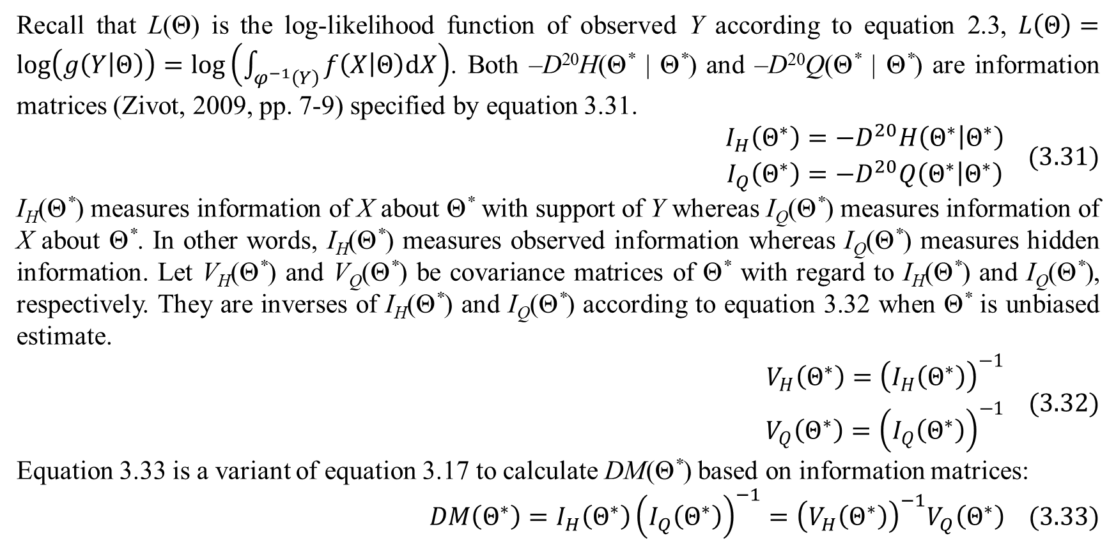
2. Convergence of EM
Recall that L(Θ) is the log-likelihood function of observed Y according to equation 2.3, $L\left(Θ\right)=log\left(g\left(Y | Θ\right)\right)=log\left(\int_{φ^{−1}\left(Y\right)}{f\left(X | Θ\right)dX}\right)$. Both –D²⁰H(Θ* | Θ*) and –D²⁰Q(Θ* | Θ*) are information matrices (Zivot, 2009, pp. 7-9) specified by equation 3.31.
$$\begin{matrix}I_{H}\left(Θ^{∗}\right)=−D^{20}H\left(Θ^{∗} | Θ^{∗}\right) \\ I_{Q}\left(Θ^{∗}\right)=−D^{20}Q\left(Θ^{∗} | Θ^{∗}\right)\end{matrix} (3.31)$$
I_{H}(Θ*) measures information of X about Θ* with support of Y whereas I_{Q}(Θ*) measures information of X about Θ*. In other words, I_{H}(Θ*) measures observed information whereas I_{Q}(Θ*) measures hidden information. Let V_{H}(Θ*) and V_{Q}(Θ*) be covariance matrices of Θ* with regard to I_{H}(Θ*) and I_{Q}(Θ*), respectively. They are inverses of I_{H}(Θ*) and I_{Q}(Θ*) according to equation 3.32 when Θ* is unbiased estimate.
$$\begin{matrix}V_{H}\left(Θ^{∗}\right)={\left(I_{H}\left(Θ^{∗}\right)\right)}^{−1} \\ V_{Q}\left(Θ^{∗}\right)={\left(I_{Q}\left(Θ^{∗}\right)\right)}^{−1}\end{matrix} (3.32)$$
Equation 3.33 is a variant of equation 3.17 to calculate DM(Θ*) based on information matrices:
$$DM\left(Θ^{∗}\right)=I_{H}\left(Θ^{∗}\right){\left(I_{Q}\left(Θ^{∗}\right)\right)}^{−1}={\left(V_{H}\left(Θ^{∗}\right)\right)}^{−1}V_{Q}\left(Θ^{∗}\right) (3.33)$$

Slide 42
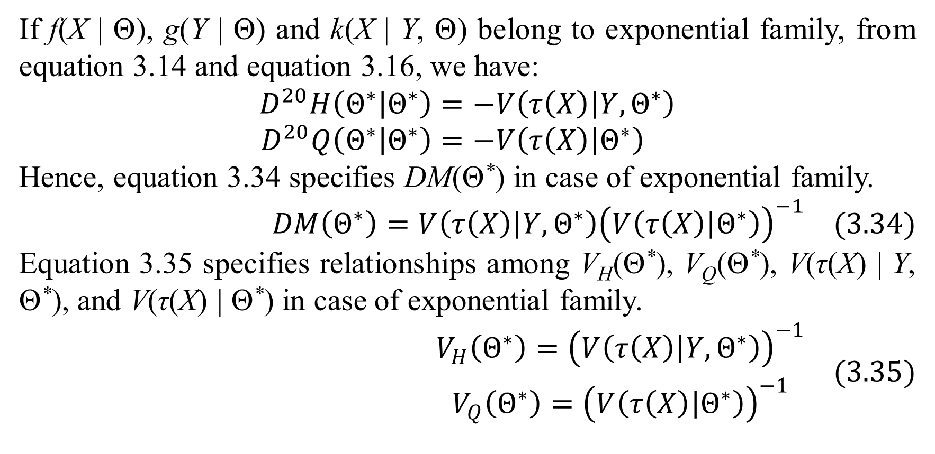
2. Convergence of EM
If f(X | Θ), g(Y | Θ) and k(X | Y, Θ) belong to exponential family, from equation 3.14 and equation 3.16, we have:
$$D^{20}H\left(Θ^{∗} | Θ^{∗}\right)=−V\left(τ\left(X\right) | Y,Θ^{∗}\right) \\ D^{20}Q\left(Θ^{∗} | Θ^{∗}\right)=−V\left(τ\left(X\right) | Θ^{∗}\right)$$
Hence, equation 3.34 specifies DM(Θ*) in case of exponential family.
$$DM\left(Θ^{∗}\right)=V\left(τ\left(X\right) | Y,Θ^{∗}\right){\left(V\left(τ\left(X\right) | Θ^{∗}\right)\right)}^{−1} (3.34)$$
Equation 3.35 specifies relationships among V_{H}(Θ*), V_{Q}(Θ*), V(τ(X) | Y, Θ*), and V(τ(X) | Θ*) in case of exponential family.
$$\begin{matrix}V_{H}\left(Θ^{∗}\right)={\left(V\left(τ\left(X\right) | Y,Θ^{∗}\right)\right)}^{−1} \\ V_{Q}\left(Θ^{∗}\right)={\left(V\left(τ\left(X\right) | Θ^{∗}\right)\right)}^{−1}\end{matrix} (3.35)$$

Slide 43
References
Dempster, A. P., Laird, N. M., & Rubin, D. B. (1977). Maximum Likelihood from Incomplete Data via the EM Algorithm. (M. Stone, Ed.) Journal of the Royal Statistical Society, Series B (Methodological), 39(1), 1-38.
Dinh, L. T., Pham, D. H., Nguyen, T. X., & Ta, P. D. (2000). Univariate Analysis - Principles and Practices. (K. H. Ha, T. V. Ngo, & D. H. Pham, Eds.) Hanoi, Vietnam: Hanoi National University Publisher. Retrieved from http://www.ebook.edu.vn/?page=1.14&view=11156
McLachlan, G., & Krishnan, T. (1997). The EM Algorithm and Extensions. New York, NY, USA: John Wiley & Sons. Retrieved from https://books.google.com.vn/books?id=NBawzaWoWa8C
Sean, B. (2009). The Expectation Maximization Algorithm - A short tutorial. University of Notre Dame, Indiana, Department of Electrical Engineering. Sean Borman's Homepage.
StackExchange. (2013, November 19). Eigenvalues of the product of 2 symmetric matrices. (Stack Exchange Network) Retrieved February 9, 2018, from Mathematics StackExchange: https://math.stackexchange.com/questions/573583/eigenvalues-of-the-product-of-2-symmetric-matrices
Wikipedia. (2017, February 27). Commuting matrices. (Wikimedia Foundation) Retrieved February 9, 2018, from Wikipedia website: https://en.wikipedia.org/wiki/Commuting_matrices
Wikipedia. (2017, November 27). Diagonalizable matrix. (Wikimedia Foundation) Retrieved February 10, 2018, from Wikipedia website: https://en.wikipedia.org/wiki/Diagonalizable_matrix#Simultaneous_diagonalization
Wikipedia. (2018, January 7). Symmetry of second derivatives. (Wikimedia Foundation) Retrieved February 10, 2018, from Wikipedia website: https://en.wikipedia.org/wiki/Symmetry_of_second_derivatives
Wu, J. C. (1983, March). On the Convergence Properties of the EM Algorithm. The Annals of Statistics, 11(1), 95-103. Retrieved from https://projecteuclid.org/euclid.aos/1176346060
Zivot, E. (2009). Maximum Likelihood Estimation. Lecture Notes on course "Econometric Theory I: Estimation and Inference (first quarter, second year PhD)", University of Washington, Seattle, Washington, USA.

Slide 44
Thank you for listening

