Slide 1
A short study on minima distribution
Prof. Loc Nguyen PhD, PostDoc
Loc Nguyen’s Academic Network, Vietnam
Email: ng_phloc@yahoo.com
Homepage: www.locnguyen.net

Slide 2
Abstract
Global optimization is an imperative development of local optimization because there are many problems in artificial intelligence and machine learning requires highly acute solutions over entire domain. There are many methods to resolve the global optimization, which can be classified into three groups such as analytic methods (purely mathematical methods), probabilistic methods, and heuristic methods. Especially, heuristic methods like particle swarm optimization and ant bee colony attract researchers because their effective and practical techniques which are easy to be implemented by computer programming languages. However, these heuristic methods are lacking in theoretical mathematical fundamental. Fortunately, minima distribution establishes a strict mathematical relationship between optimized target function and its global minima. In this research, I try to study minima distribution and apply it into explaining convergence and convergence speed of optimization algorithms. Especially, weak conditions of convergence and monotonicity within minima distribution are drawn so as to be appropriate to practical optimization methods.

Slide 3
Table of contents
Introduction
Weak conditions of convergence and monotonicity
Convergence speed
Experiment with PSO algorithm
Conclusions

Slide 4
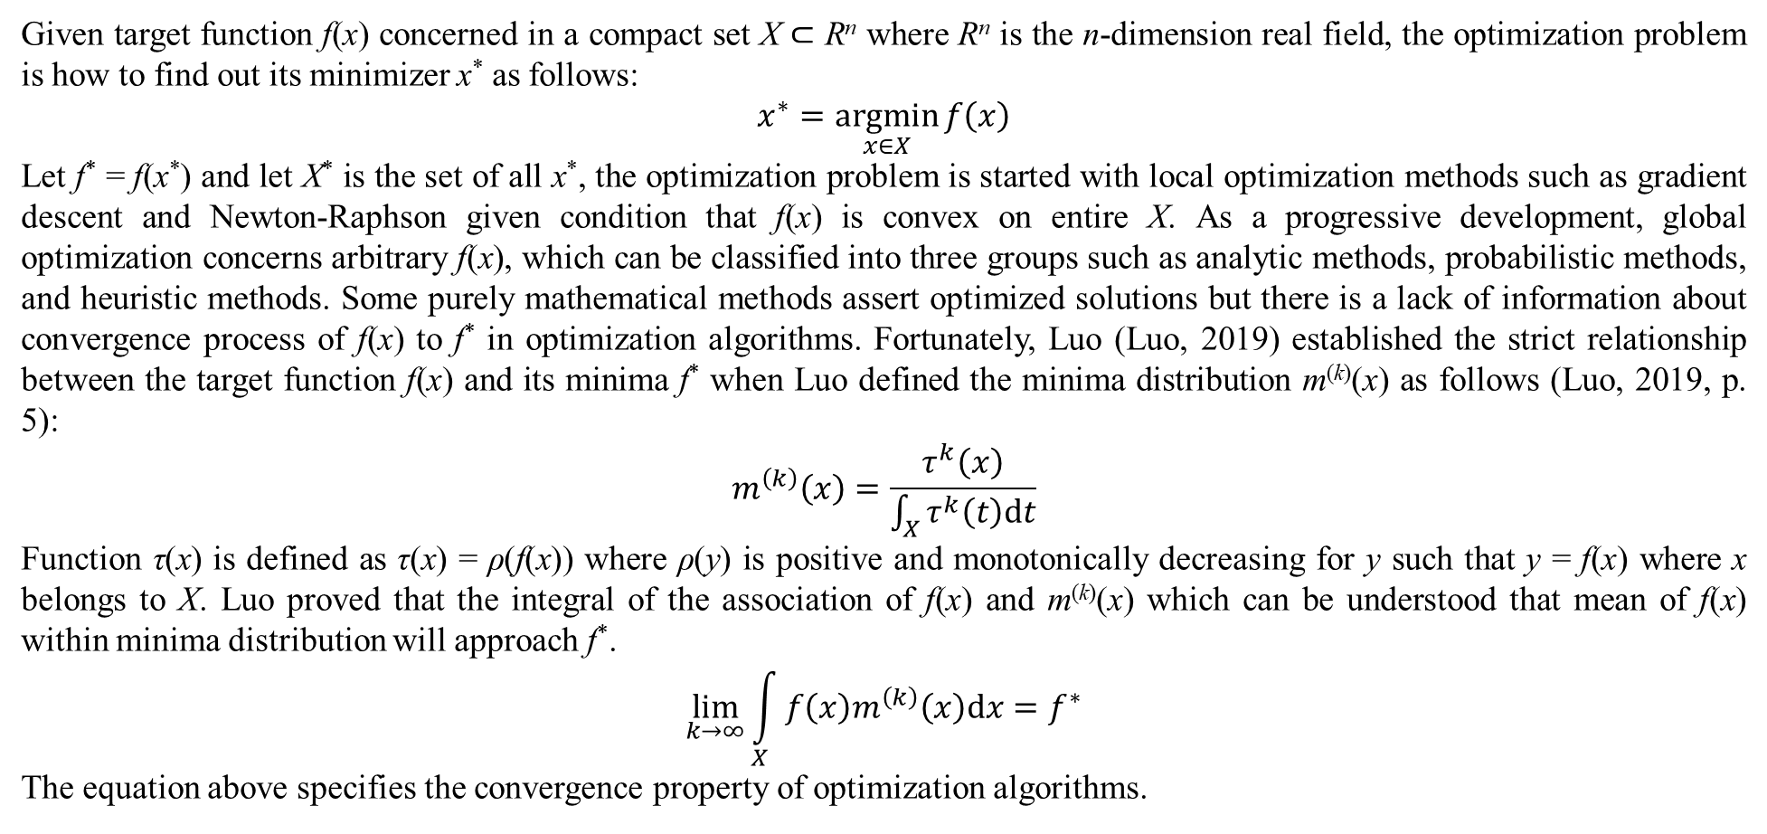
1. Introduction
Given target function f(x) concerned in a compact set X $⊂$ R^{n} where R^{n} is the n-dimension real field, the optimization problem is how to find out its minimizer x* as follows:
$$x^{∗}=\underset{x∈X}{argmin}{f\left(x\right)}$$
Let f* = f(x*) and let X* is the set of all x*, the optimization problem is started with local optimization methods such as gradient descent and Newton-Raphson given condition that f(x) is convex on entire X. As a progressive development, global optimization concerns arbitrary f(x), which can be classified into three groups such as analytic methods, probabilistic methods, and heuristic methods. Some purely mathematical methods assert optimized solutions but there is a lack of information about convergence process of f(x) to f* in optimization algorithms. Fortunately, Luo (Luo, 2019) established the strict relationship between the target function f(x) and its minima f* when Luo defined the minima distribution m^{(k)}(x) as follows (Luo, 2019, p. 5):
$$m^{\left(k\right)}\left(x\right)=\frac{τ^{k}\left(x\right)}{\int_{X}{τ^{k}\left(t\right)dt}}$$
Function τ(x) is defined as τ(x) = ρ(f(x)) where ρ(y) is positive and monotonically decreasing for y such that y = f(x) where x belongs to X. Luo proved that the integral of the association of f(x) and m^{(k)}(x) which can be understood that mean of f(x) within minima distribution will approach f*.
$$\lim_{k→∞}{\int_{X}{f\left(x\right)m^{\left(k\right)}\left(x\right)dx}}=f^{∗}$$
The equation above specifies the convergence property of optimization algorithms.

Slide 5
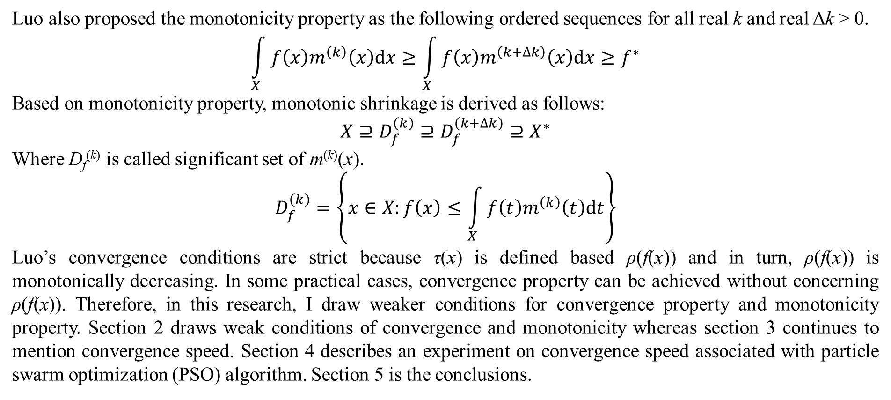
1. Introduction
Luo also proposed the monotonicity property as the following ordered sequences for all real k and real Δk > 0.
$$\int_{X}{f\left(x\right)m^{\left(k\right)}\left(x\right)dx}≥\int_{X}{f\left(x\right)m^{\left(k+∆k\right)}\left(x\right)dx}≥f^{∗}$$
Based on monotonicity property, monotonic shrinkage is derived as follows:
$$X⊇D_{f}^{\left(k\right)}⊇D_{f}^{\left(k+∆k\right)}⊇X^{∗}$$
Where D_{f}^{(k)} is called significant set of m^{(k)}(x).
$$D_{f}^{\left(k\right)}=\left\{x∈X:f\left(x\right)≤\int_{X}{f\left(t\right)m^{\left(k\right)}\left(t\right)dt}\right\}$$
Luo’s convergence conditions are strict because τ(x) is defined based ρ(f(x)) and in turn, ρ(f(x)) is monotonically decreasing. In some practical cases, convergence property can be achieved without concerning ρ(f(x)). Therefore, in this research, I draw weaker conditions for convergence property and monotonicity property. Section 2 draws weak conditions of convergence and monotonicity whereas section 3 continues to mention convergence speed. Section 4 describes an experiment on convergence speed associated with particle swarm optimization (PSO) algorithm. Section 5 is the conclusions.

Slide 6
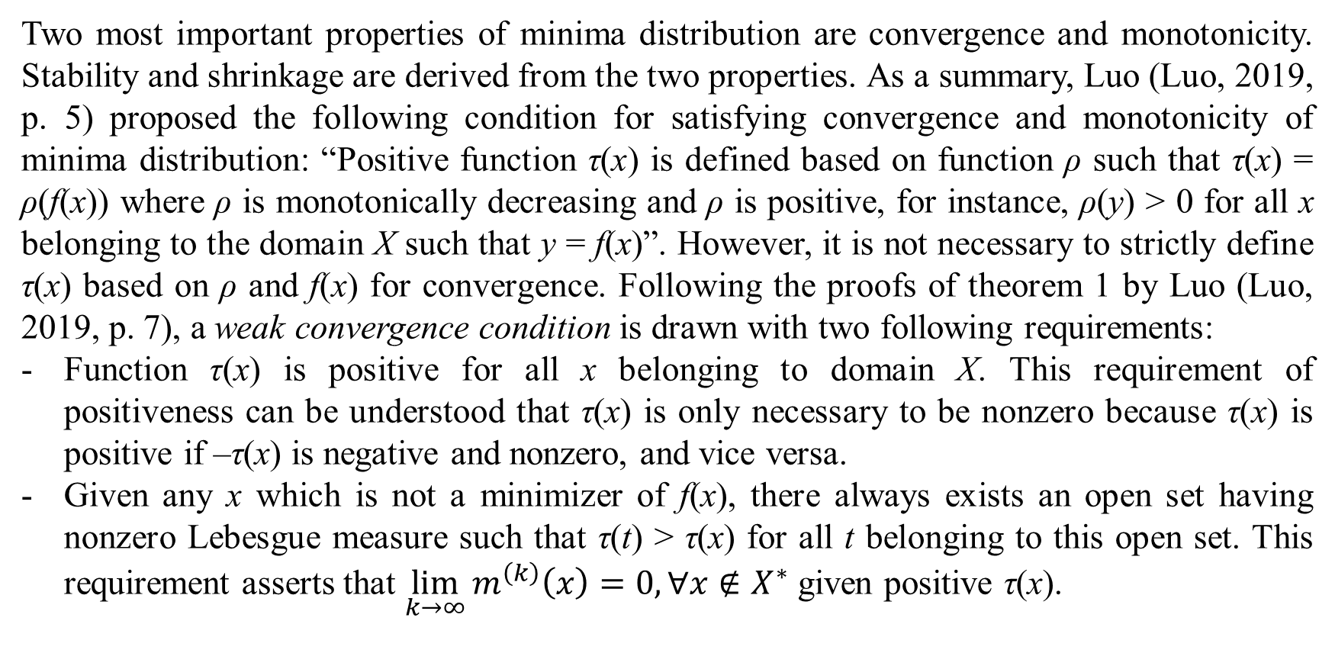
2. Weak conditions of convergence and monotonicity
Two most important properties of minima distribution are convergence and monotonicity. Stability and shrinkage are derived from the two properties. As a summary, Luo (Luo, 2019, p. 5) proposed the following condition for satisfying convergence and monotonicity of minima distribution: “Positive function τ(x) is defined based on function ρ such that τ(x) = ρ(f(x)) where ρ is monotonically decreasing and ρ is positive, for instance, ρ(y) > 0 for all x belonging to the domain X such that y = f(x)”. However, it is not necessary to strictly define τ(x) based on ρ and f(x) for convergence. Following the proofs of theorem 1 by Luo (Luo, 2019, p. 7), a weak convergence condition is drawn with two following requirements:
Function τ(x) is positive for all x belonging to domain X. This requirement of positiveness can be understood that τ(x) is only necessary to be nonzero because τ(x) is positive if –τ(x) is negative and nonzero, and vice versa.
Given any x which is not a minimizer of f(x), there always exists an open set having nonzero Lebesgue measure such that τ(t) > τ(x) for all t belonging to this open set. This requirement asserts that $\lim_{k→∞}{m^{\left(k\right)}\left(x\right)}=0,∀x∉X^{∗}$ given positive τ(x).

Slide 7
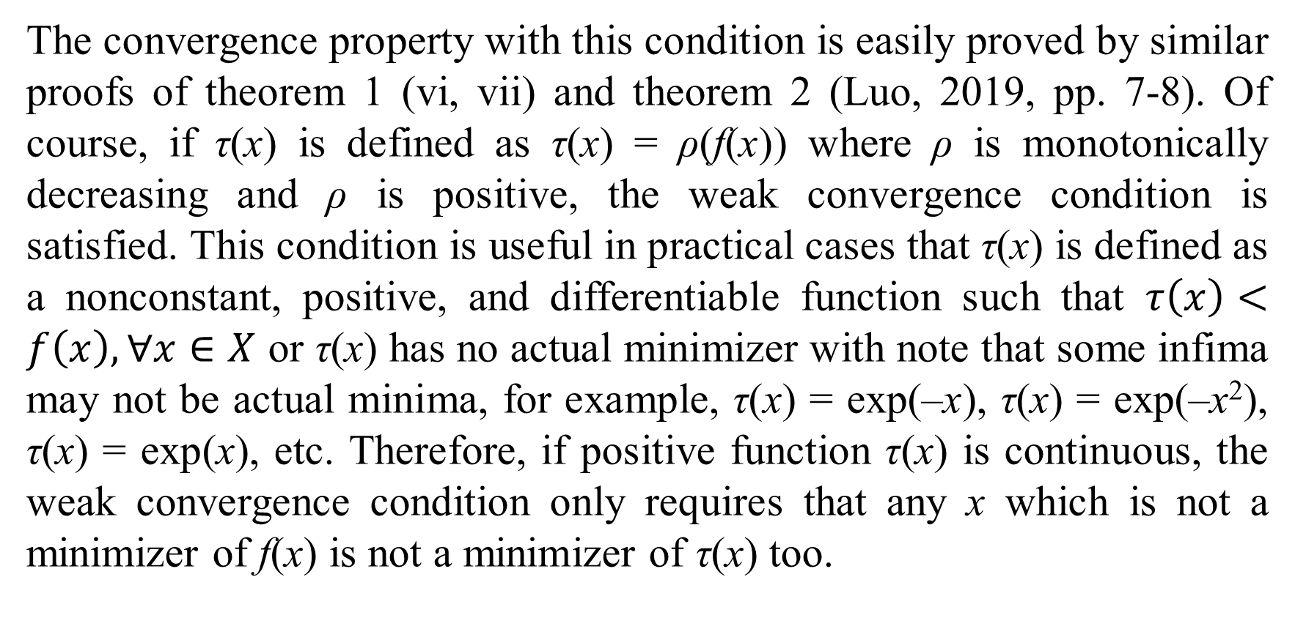
2. Weak conditions of convergence and monotonicity
The convergence property with this condition is easily proved by similar proofs of theorem 1 (vi, vii) and theorem 2 (Luo, 2019, pp. 7-8). Of course, if τ(x) is defined as τ(x) = ρ(f(x)) where ρ is monotonically decreasing and ρ is positive, the weak convergence condition is satisfied. This condition is useful in practical cases that τ(x) is defined as a nonconstant, positive, and differentiable function such that $τ\left(x\right)<f\left(x\right),∀x∈X$ or τ(x) has no actual minimizer with note that some infima may not be actual minima, for example, τ(x) = exp(–x), τ(x) = exp(–x²), τ(x) = exp(x), etc. Therefore, if positive function τ(x) is continuous, the weak convergence condition only requires that any x which is not a minimizer of f(x) is not a minimizer of τ(x) too.

Slide 8
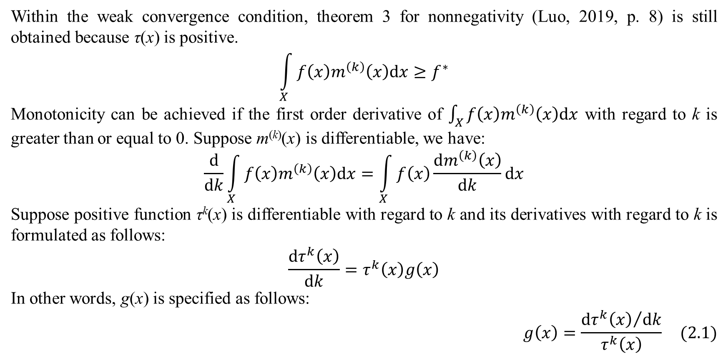
2. Weak conditions of convergence and monotonicity
Within the weak convergence condition, theorem 3 for nonnegativity (Luo, 2019, p. 8) is still obtained because τ(x) is positive.
$$\int_{X}{f\left(x\right)m^{\left(k\right)}\left(x\right)dx}≥f^{∗}$$
Monotonicity can be achieved if the first order derivative of $\int_{X}{f\left(x\right)m^{\left(k\right)}\left(x\right)dx}$ with regard to k is greater than or equal to 0. Suppose m^{(k)}(x) is differentiable, we have:
$$\frac{d}{dk}\int_{X}{f\left(x\right)m^{\left(k\right)}\left(x\right)dx}=\int_{X}{f\left(x\right)\frac{dm^{\left(k\right)}\left(x\right)}{dk}dx}$$
Suppose positive function τ^{k}(x) is differentiable with regard to k and its derivatives with regard to k is formulated as follows:
$$\frac{dτ^{k}\left(x\right)}{dk}=τ^{k}\left(x\right)g\left(x\right)$$
In other words, g(x) is specified as follows:
$$g\left(x\right)=\frac{{dτ^{k}\left(x\right)}/{dk}}{τ^{k}\left(x\right)} (2.1)$$

Slide 9
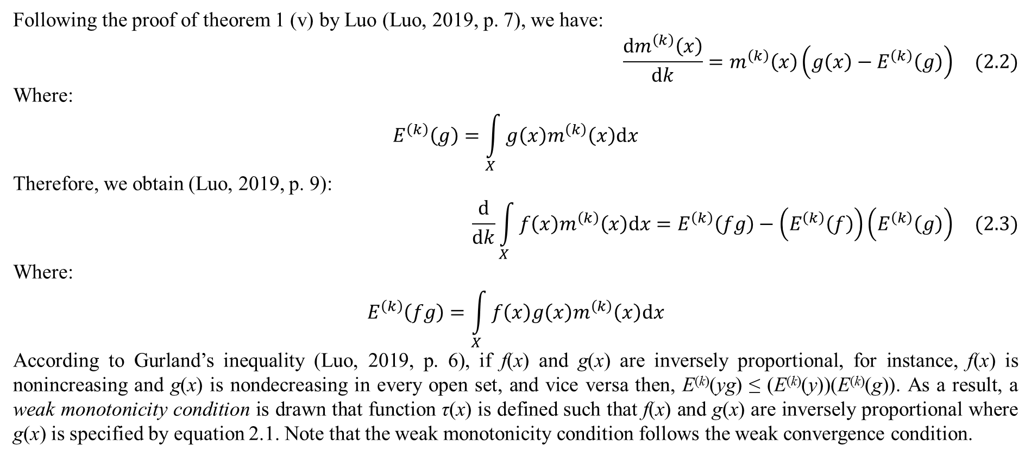
2. Weak conditions of convergence and monotonicity
Following the proof of theorem 1 (v) by Luo (Luo, 2019, p. 7), we have:
$$\frac{dm^{\left(k\right)}\left(x\right)}{dk}=m^{\left(k\right)}\left(x\right)\left(g\left(x\right)−E^{\left(k\right)}\left(g\right)\right) (2.2)$$
Where:
$$E^{\left(k\right)}\left(g\right)=\int_{X}{g\left(x\right)m^{\left(k\right)}\left(x\right)dx}$$
Therefore, we obtain (Luo, 2019, p. 9):
$$\frac{d}{dk}\int_{X}{f\left(x\right)m^{\left(k\right)}\left(x\right)dx}=E^{\left(k\right)}\left(fg\right)−\left(E^{\left(k\right)}\left(f\right)\right)\left(E^{\left(k\right)}\left(g\right)\right) (2.3)$$
Where:
$$E^{\left(k\right)}\left(fg\right)=\int_{X}{f\left(x\right)g\left(x\right)m^{\left(k\right)}\left(x\right)dx}$$
According to Gurland’s inequality (Luo, 2019, p. 6), if f(x) and g(x) are inversely proportional, for instance, f(x) is nonincreasing and g(x) is nondecreasing in every open set, and vice versa then, E^{(k)}(yg) ≤ (E^{(k)}(y))(E^{(k)}(g)). As a result, a weak monotonicity condition is drawn that function τ(x) is defined such that f(x) and g(x) are inversely proportional where g(x) is specified by equation 2.1. Note that the weak monotonicity condition follows the weak convergence condition.

Slide 10
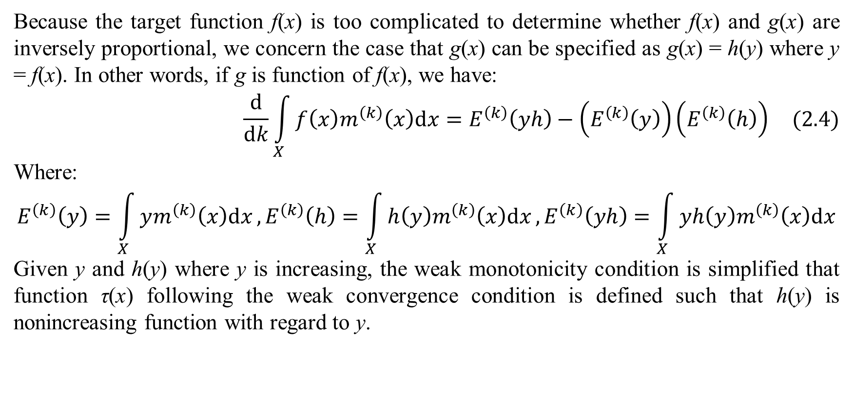
2. Weak conditions of convergence and monotonicity
Because the target function f(x) is too complicated to determine whether f(x) and g(x) are inversely proportional, we concern the case that g(x) can be specified as g(x) = h(y) where y = f(x). In other words, if g is function of f(x), we have:
$$\frac{d}{dk}\int_{X}{f\left(x\right)m^{\left(k\right)}\left(x\right)dx}=E^{\left(k\right)}\left(yh\right)−\left(E^{\left(k\right)}\left(y\right)\right)\left(E^{\left(k\right)}\left(h\right)\right) (2.4)$$
Where:
$$E^{\left(k\right)}\left(y\right)=\int_{X}{ym^{\left(k\right)}\left(x\right)dx},E^{\left(k\right)}\left(h\right)=\int_{X}{h\left(y\right)m^{\left(k\right)}\left(x\right)dx},E^{\left(k\right)}\left(yh\right)=\int_{X}{yh\left(y\right)m^{\left(k\right)}\left(x\right)dx}$$
Given y and h(y) where y is increasing, the weak monotonicity condition is simplified that function τ(x) following the weak convergence condition is defined such that h(y) is nonincreasing function with regard to y.

Slide 11
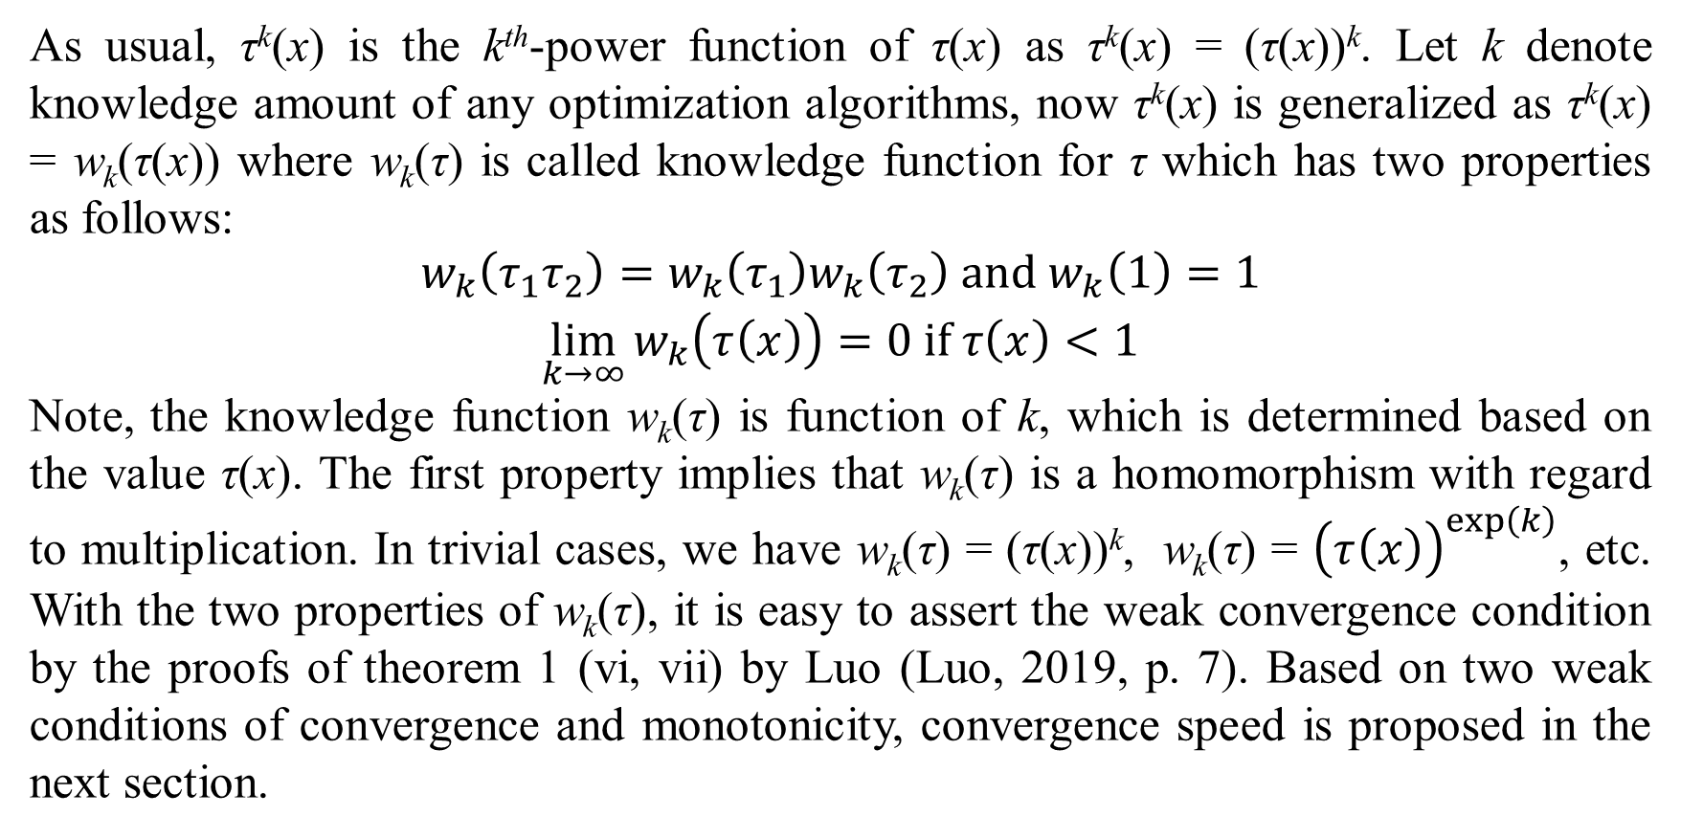
2. Weak conditions of convergence and monotonicity
As usual, τ^{k}(x) is the k^{th}-power function of τ(x) as τ^{k}(x) = (τ(x))^{k}. Let k denote knowledge amount of any optimization algorithms, now τ^{k}(x) is generalized as τ^{k}(x) = w_{k}(τ(x)) where w_{k}(τ) is called knowledge function for τ which has two properties as follows:
$$\begin{matrix}w_{k}\left(τ_{1}τ_{2}\right)=w_{k}\left(τ_{1}\right)w_{k}\left(τ_{2}\right) and w_{k}\left(1\right)=1 \\ \lim_{k→∞}{w_{k}\left(τ\left(x\right)\right)}=0 if τ\left(x\right)<1\end{matrix}$$
Note, the knowledge function w_{k}(τ) is function of k, which is determined based on the value τ(x). The first property implies that w_{k}(τ) is a homomorphism with regard to multiplication. In trivial cases, we have w_{k}(τ) = (τ(x))^{k}, w_{k}(τ) = ${\left(τ\left(x\right)\right)}^{exp\left(k\right)}$, etc. With the two properties of w_{k}(τ), it is easy to assert the weak convergence condition by the proofs of theorem 1 (vi, vii) by Luo (Luo, 2019, p. 7). Based on two weak conditions of convergence and monotonicity, convergence speed is proposed in the next section.

Slide 12
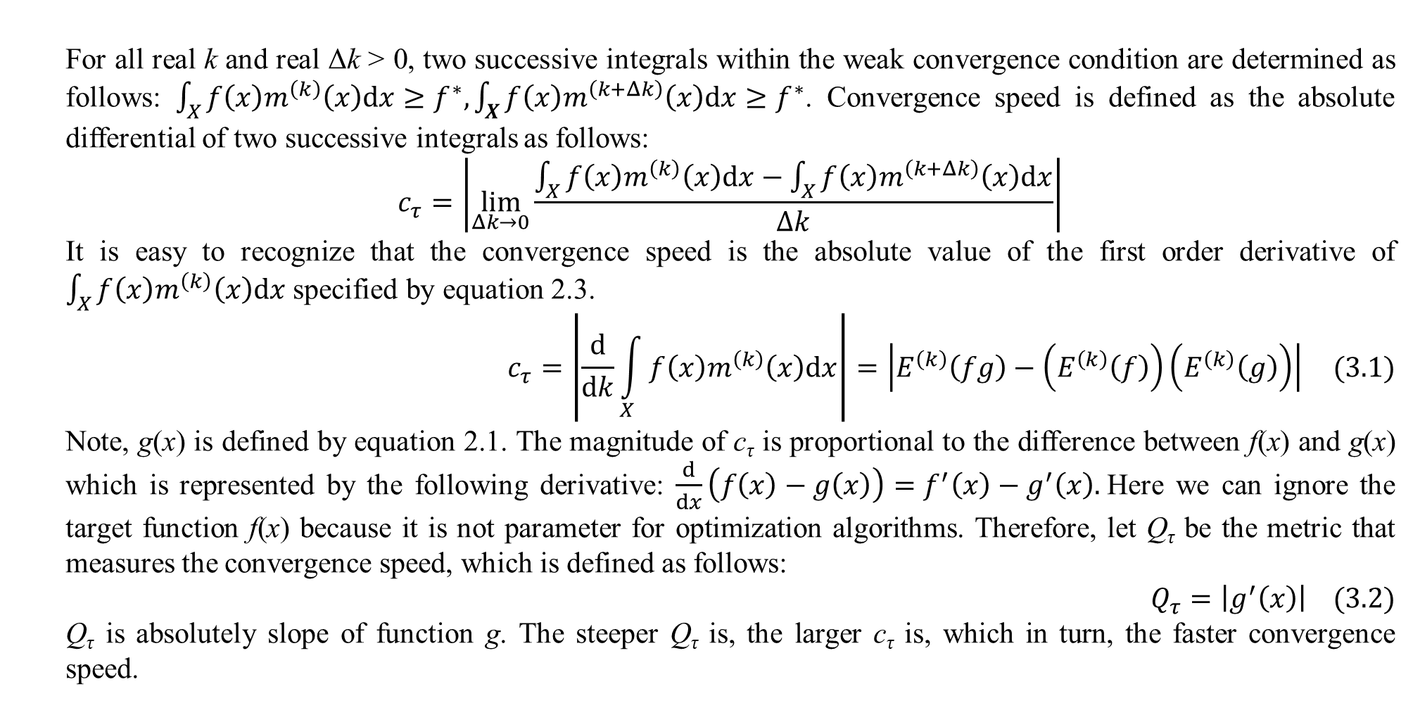
3. Convergence speed
For all real k and real Δk > 0, two successive integrals within the weak convergence condition are determined as follows: $\int_{X}{f\left(x\right)m^{\left(k\right)}\left(x\right)dx}≥f^{∗},\int_{X}{f\left(x\right)m^{\left(k+Δk\right)}\left(x\right)dx}≥f^{∗}$. Convergence speed is defined as the absolute differential of two successive integrals as follows:
$$c_{τ}=\left|\lim_{Δk→0}{\frac{\int_{X}{f\left(x\right)m^{\left(k\right)}\left(x\right)dx}−\int_{X}{f\left(x\right)m^{\left(k+Δk\right)}\left(x\right)dx}}{Δk}}\right|$$
It is easy to recognize that the convergence speed is the absolute value of the first order derivative of $\int_{X}{f\left(x\right)m^{\left(k\right)}\left(x\right)dx}$ specified by equation 2.3.
$$c_{τ}=\left|\frac{d}{dk}\int_{X}{f\left(x\right)m^{\left(k\right)}\left(x\right)dx}\right|=\left|E^{\left(k\right)}\left(fg\right)−\left(E^{\left(k\right)}\left(f\right)\right)\left(E^{\left(k\right)}\left(g\right)\right)\right| (3.1)$$
Note, g(x) is defined by equation 2.1. The magnitude of c_{τ} is proportional to the difference between f(x) and g(x) which is represented by the following derivative: $\frac{d}{dx}\left(f\left(x\right)−g\left(x\right)\right)=f^{′}\left(x\right)−g^{′}\left(x\right).$Here we can ignore the target function f(x) because it is not parameter for optimization algorithms. Therefore, let Q_{τ} be the metric that measures the convergence speed, which is defined as follows:
$$Q_{τ}=\left|g^{′}\left(x\right)\right| (3.2)$$
Q_{τ} is absolutely slope of function g. The steeper Q_{τ} is, the larger c_{τ} is, which in turn, the faster convergence speed.

Slide 13
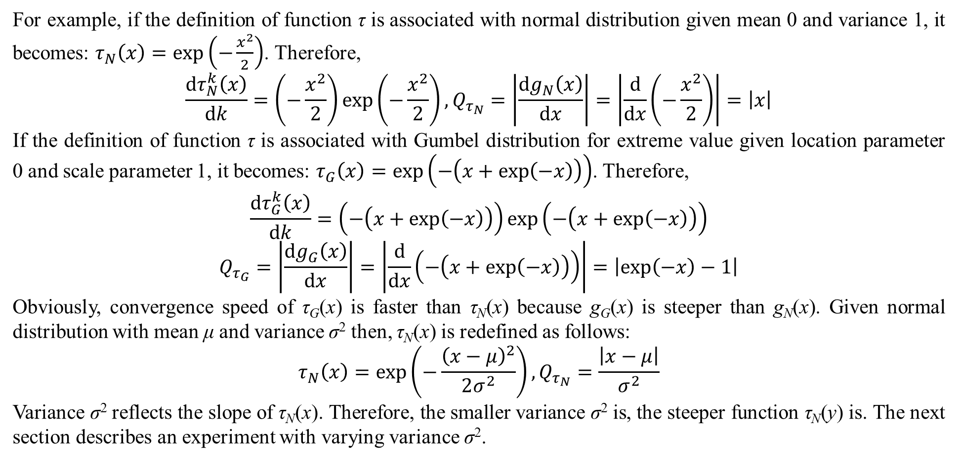
3. Convergence speed
For example, if the definition of function τ is associated with normal distribution given mean 0 and variance 1, it becomes: $τ_{N}\left(x\right)=exp\left(−\frac{x^{2}}{2}\right)$. Therefore,
$$\frac{dτ_{N}^{k}\left(x\right)}{dk}=\left(−\frac{x^{2}}{2}\right)exp\left(−\frac{x^{2}}{2}\right),Q_{τ_{N}}=\left|\frac{dg_{N}\left(x\right)}{dx}\right|=\left|\frac{d}{dx}\left(−\frac{x^{2}}{2}\right)\right|=\left|x\right|$$
If the definition of function τ is associated with Gumbel distribution for extreme value given location parameter 0 and scale parameter 1, it becomes: $τ_{G}\left(x\right)=exp\left(−\left(x+exp\left(−x\right)\right)\right)$. Therefore,
$$\frac{dτ_{G}^{k}\left(x\right)}{dk}=\left(−\left(x+exp\left(−x\right)\right)\right)exp\left(−\left(x+exp\left(−x\right)\right)\right)$$
$$Q_{τ_{G}}=\left|\frac{dg_{G}\left(x\right)}{dx}\right|=\left|\frac{d}{dx}\left(−\left(x+exp\left(−x\right)\right)\right)\right|=\left|exp\left(−x\right)−1\right|$$
Obviously, convergence speed of τ_{G}(x) is faster than τ_{N}(x) because g_{G}(x) is steeper than g_{N}(x). Given normal distribution with mean μ and variance σ² then, τ_{N}(x) is redefined as follows:
$$τ_{N}\left(x\right)=exp\left(−\frac{{\left(x−μ\right)}^{2}}{2σ^{2}}\right),Q_{τ_{N}}=\frac{\left|x−μ\right|}{σ^{2}}$$
Variance σ² reflects the slope of τ_{N}(x). Therefore, the smaller variance σ² is, the steeper function τ_{N}(y) is. The next section describes an experiment with varying variance σ².

Slide 14
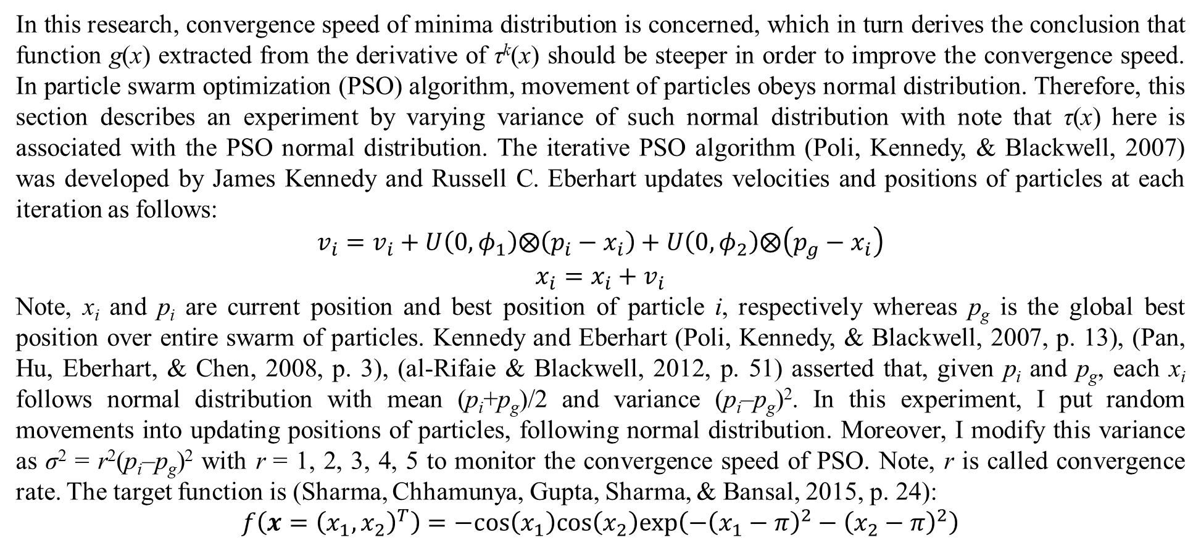
4. Experiment with PSO algorithm
In this research, convergence speed of minima distribution is concerned, which in turn derives the conclusion that function g(x) extracted from the derivative of τ^{k}(x) should be steeper in order to improve the convergence speed. In particle swarm optimization (PSO) algorithm, movement of particles obeys normal distribution. Therefore, this section describes an experiment by varying variance of such normal distribution with note that τ(x) here is associated with the PSO normal distribution. The iterative PSO algorithm (Poli, Kennedy, & Blackwell, 2007) was developed by James Kennedy and Russell C. Eberhart updates velocities and positions of particles at each iteration as follows:
$$v_{i}=v_{i}+U\left(0,φ_{1}\right)⨂\left(p_{i}−x_{i}\right)+U\left(0,φ_{2}\right)⨂\left(p_{g}−x_{i}\right)$$
$$x_{i}=x_{i}+v_{i}$$
Note, x_{i} and p_{i} are current position and best position of particle i, respectively whereas p_{g} is the global best position over entire swarm of particles. Kennedy and Eberhart (Poli, Kennedy, & Blackwell, 2007, p. 13), (Pan, Hu, Eberhart, & Chen, 2008, p. 3), (al-Rifaie & Blackwell, 2012, p. 51) asserted that, given p_{i} and p_{g}, each x_{i} follows normal distribution with mean (p_{i}+p_{g})/2 and variance (p_{i}–p_{g})². In this experiment, I put random movements into updating positions of particles, following normal distribution. Moreover, I modify this variance as σ² = r²(p_{i}–p_{g})² with r = 1, 2, 3, 4, 5 to monitor the convergence speed of PSO. Note, r is called convergence rate. The target function is (Sharma, Chhamunya, Gupta, Sharma, & Bansal, 2015, p. 24):
$$f\left(x={\left(x_{1},x_{2}\right)}^{T}\right)=−cos\left(x_{1}\right)cos\left(x_{2}\right)exp\left(−{\left(x_{1}−π\right)}^{2}−{\left(x_{2}−π\right)}^{2}\right)$$

Slide 15
4. Experiment with PSO algorithm
Given true minimizer x* = (3.1416, 3.1416)^{T} with true minimum f* = –1, table 4.1 shows the experimental results with minimum biases and iteration counts over convergence rates.
Table 4.1. Experimental results with increased convergence rates
From table 4.1, convergence speed is increased from r=1 to r=4 because the iteration count is decreased. Especially, at r = 5, convergence speed is not increased as expectation but the best converged value (–0.9999) is obtained with smallest bias (0.0001). Therefore, it is no doubt that convergence speed is improved by increasing the variance which makes function g(x) steeper. The PSO source code is available at
https://github.com/ngphloc/ai/tree/main/3_implementation/src/net/ea/pso
 | Minimum | Minimum bias | Minimizer | Iteration count
r=1 | –0.9996 | 0.0004 | (3.1275, 3.1327)^{T} | 18
r=2 | –0.9960 | 0.0040 | (3.1911, 3.1270)^{T} | 16
r=3 | –0.9982 | 0.0018 | (3.1231, 3.1127)^{T} | 14
r=4 | –0.9992 | 0.0008 | (3.1545, 3.1607)^{T} | 15
r=5 | –0.9999 | 0.0001 | (3.1356, 3.1465)^{T} | 23

Slide 16
5. Conclusions
Some optimization algorithms like PSO take advantages of distribution of x instead of taking advantages of f(x). In other words, they define implicitly τ(x) as function of x instead of function of f(x) like τ(x) = ρ(f(x)). Therefore, it is reasonable to assert their convergence by the weak convergence condition. The convergence speed also depends on acuteness of the knowledge function w_{k}(τ), besides the slope Q_{τ} of τ(x). It is inferred that w_{k}(τ) implies the knowledge amount of given optimization algorithm after each iteration. For PSO, heuristic movement of particles after each iteration reflects how fast the power function w_{k}(τ) approaches when k approaches positive infinity. In the future trend, I will research minima distribution with Bayesian optimization because Bayesian optimization takes full advantages of prior information which is the knowledge amount associated with the knowledge function.

Slide 17
References
al-Rifaie, M. M., & Blackwell, T. (2012). Bare Bones Particle Swarms with Jumps. In M. Dorigo, M. Birattari, C. Blum, A. L. Christensen, A. P. Engelbrecht, R. Groß, & T. Stützle (Ed.), International Conference on Swarm Intelligence. Lecture Notes in Computer Science 7461, pp. 49-60. Brussels: Springer Berlin. doi:10.1007/978-3-642-32650-9_5
Luo, X. (2019, May 24). Minima distribution for global optimization. arXiv preprint. doi:10.48550/arXiv.1812.03457
Pan, F., Hu, X., Eberhart, R., & Chen, Y. (2008, September 21). An Analysis of Bare Bones Particle Swarm. IEEE Swarm Intelligence Symposium 2008 (SIS 2008) (pp. 1-5). St. Louis, MO, US: IEEE. doi:10.1109/SIS.2008.4668301
Poli, R., Kennedy, J., & Blackwell, T. (2007, June). Particle swarm optimization. (M. Dorigo, Ed.) Swarm Intelligence, 1(1), 33-57. doi:10.1007/s11721-007-0002-0
Sharma, K., Chhamunya, V., Gupta, P. C., Sharma, H., & Bansal, J. C. (2015, September). Fitness based Particle Swarm Optimization. (A. K. Verma, P. K. Kapur, & U. Kumar, Eds.) International Journal of System Assurance Engineering and Management, 6(3), 319-329. doi:10.1007/s13198-015-0372-4

Slide 18
Thank you for listening

