Slide 1
Tutorial on particle swarm optimization
Prof. Dr. Loc Nguyen, PhD, PostDoc
Founder of Loc Nguyen’s Academic Network, Vietnam
Email: ng_phloc@yahoo.com
Homepage: www.locnguyen.net

Slide 2
Abstract
Local optimization with convex function is solved perfectly by traditional mathematical methods such as Newton-Raphson and gradient descent but it is not easy to solve the global optimization with arbitrary function although there are some purely mathematical approaches such as approximation, cutting plane, branch and bound, and interval method which can be impractical because of their complexity and high computation cost. Recently, some evolutional algorithms which are inspired from biological activities are proposed to solve the global optimization by acceptable heuristic level. Among them is particle swarm optimization (PSO) algorithm which is proved as an effective and feasible solution for global optimization in real applications. Although the ideology of PSO is not complicated, it derives many variants, which can make new researchers confused. Therefore, this tutorial focuses on describing, systemizing, and classifying PSO by succinct and straightforward way. Moreover, a combination of PSO and another evolutional algorithm as artificial bee colony (ABC) algorithm for improving PSO itself or solving other advanced problems are mentioned too.

Slide 3
Table of contents
Introduction
Variants of PSO
Simplified & improved PSOs
Dynamic PSO
PSO and artificial bee colony algorithm

Slide 4
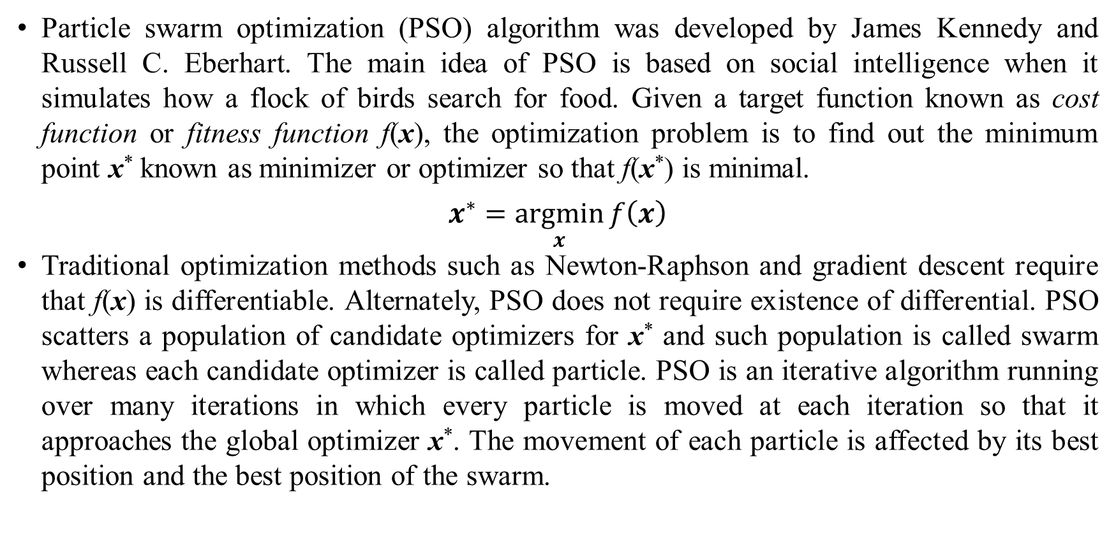
1. Introduction
Particle swarm optimization (PSO) algorithm was developed by James Kennedy and Russell C. Eberhart. The main idea of PSO is based on social intelligence when it simulates how a flock of birds search for food. Given a target function known as cost function or fitness function f(x), the optimization problem is to find out the minimum point x* known as minimizer or optimizer so that f(x*) is minimal.
$$x^{∗}=\underset{x}{argmin}{f\left(x\right)}$$
Traditional optimization methods such as Newton-Raphson and gradient descent require that f(x) is differentiable. Alternately, PSO does not require existence of differential. PSO scatters a population of candidate optimizers for x* and such population is called swarm whereas each candidate optimizer is called particle. PSO is an iterative algorithm running over many iterations in which every particle is moved at each iteration so that it approaches the global optimizer x*. The movement of each particle is affected by its best position and the best position of the swarm.

Slide 5
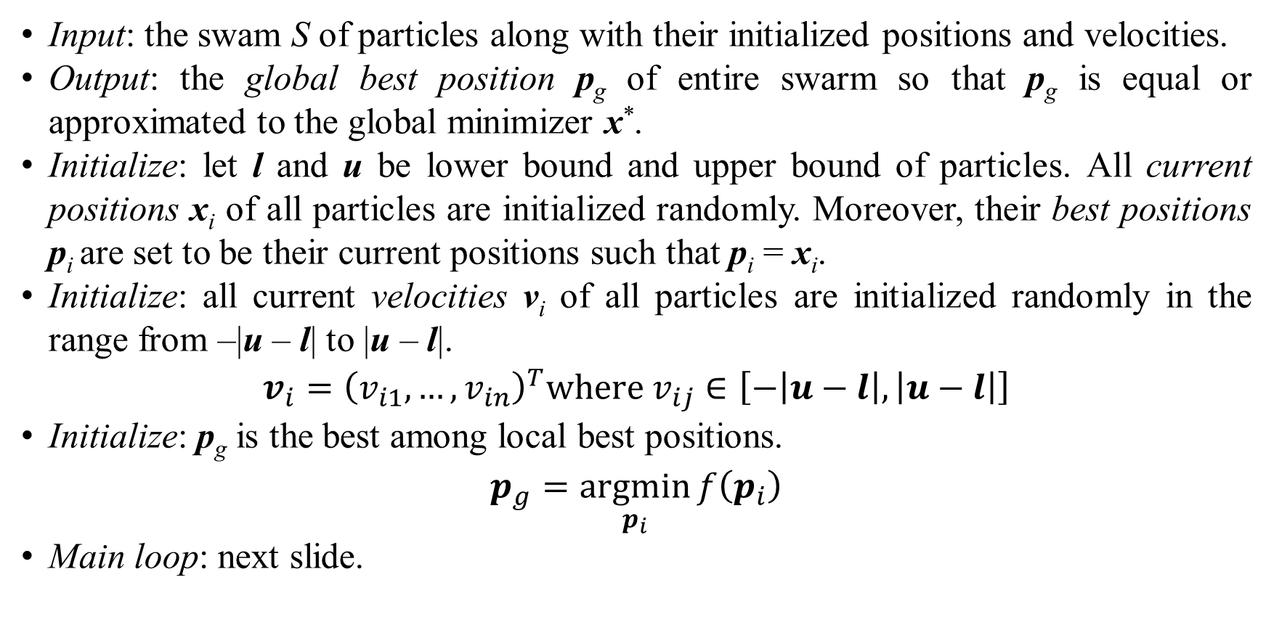
1. Introduction
Input: the swam S of particles along with their initialized positions and velocities.
Output: the global best position p_{g} of entire swarm so that p_{g} is equal or approximated to the global minimizer x*.
Initialize: let l and u be lower bound and upper bound of particles. All current positions x_{i} of all particles are initialized randomly. Moreover, their best positions p_{i} are set to be their current positions such that p_{i} = x_{i}.
Initialize: all current velocities v_{i} of all particles are initialized randomly in the range from –|u – l| to |u – l|.
$$v_{i}={\left(v_{i1},…,v_{in}\right)}^{T}where v_{ij}∈\left[−\left|u−l\right|,\left|u−l\right|\right]$$
Initialize: p_{g} is the best among local best positions.
$$p_{g}=\underset{p_{i}}{argmin}{f\left(p_{i}\right)}$$
Main loop: next slide.

Slide 6
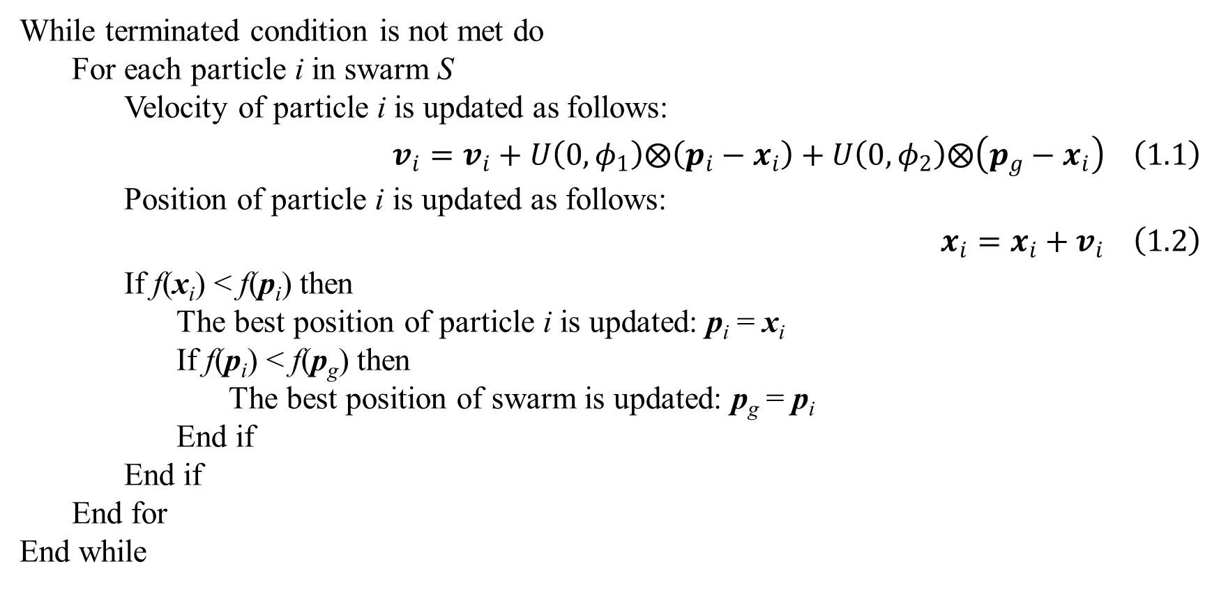
1. Introduction
While terminated condition is not met do
For each particle i in swarm S
Velocity of particle i is updated as follows:
$$v_{i}=v_{i}+U\left(0,φ_{1}\right)⨂\left(p_{i}−x_{i}\right)+U\left(0,φ_{2}\right)⨂\left(p_{g}−x_{i}\right) \left(1.1\right)$$
Position of particle i is updated as follows:
$$x_{i}=x_{i}+v_{i} \left(1.2\right)$$
If f(x_{i}) < f(p_{i}) then
The best position of particle i is updated: p_{i} = x_{i}
If f(p_{i}) < f(p_{g}) then
The best position of swarm is updated: p_{g} = p_{i}
End if
End if
End for
End while

Slide 7
1. Introduction
Equation 1.1 is the heart of PSO, which is velocity update rule. Equation 1.2 is position update rule.
Two most popular terminated conditions are that the cost function at p_{g} which is evaluated as f(p_{g}) is small enough or PSO ran over a large enough number of iterations.
Functions U(0, ϕ₁) and U(0, ϕ₂) generate random vector whose elements are random numbers in ranges [0, ϕ₁] and [0, ϕ₂], respectively.
The operator ⨂ denotes component-wise multiplication of two points (Poli, Kennedy, & Blackwell, 2007, p. 3).
Notes:
$$U\left(0,φ_{1}\right)={\left(r_{11},r_{12},…,r_{1n}\right)}^{T} where 0≤r_{1j}≤φ_{1}$$
$$U\left(0,φ_{2}\right)={\left(r_{21},r_{22},…,r_{2n}\right)}^{T} where 0≤r_{2j}≤φ_{2}$$
$$U\left(0,φ_{1}\right)⊗x_{j}=\left(\begin{matrix}r_{11}x_{i1} \\ r_{12}x_{i2} \\ ⋮ \\ r_{1n}x_{in}\end{matrix}\right)$$

Slide 8
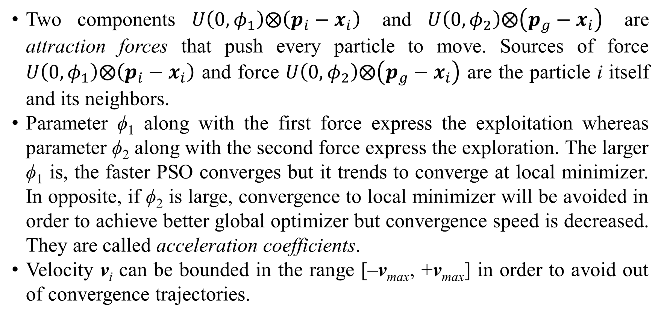
1. Introduction
Two components $U\left(0,φ_{1}\right)⨂\left(p_{i}−x_{i}\right)$ and $U\left(0,φ_{2}\right)⨂\left(p_{g}−x_{i}\right)$ are attraction forces that push every particle to move. Sources of force $U\left(0,φ_{1}\right)⨂\left(p_{i}−x_{i}\right)$ and force $U\left(0,φ_{2}\right)⨂\left(p_{g}−x_{i}\right)$ are the particle i itself and its neighbors.
Parameter ϕ₁ along with the first force express the exploitation whereas parameter ϕ₂ along with the second force express the exploration. The larger ϕ₁ is, the faster PSO converges but it trends to converge at local minimizer. In opposite, if ϕ₂ is large, convergence to local minimizer will be avoided in order to achieve better global optimizer but convergence speed is decreased. They are called acceleration coefficients.
Velocity v_{i} can be bounded in the range [–v_{max}, +v_{max}] in order to avoid out of convergence trajectories.
Notes:
Parameters ϕ₁ and ϕ₂ are also called acceleration coefficients or attraction coefficients. Especially, ϕ₁ is called cognitive weight and ϕ₂ is called social weight because ϕ₁ reflects thinking of particle itself in moving and ϕ₂ reflects influence of entire swarm on every particle in moving. The popular values of them are ϕ₁ = ϕ₂ = 1.4962.
The parameter v_{max} is not popular because there are some other parameters such as inertial weight and constriction coefficient (mentioned later) which are used to damp the dynamics of particles. Favorite values for the size of swarm (the number of particles) are ranged from 20 to 50.

Slide 9
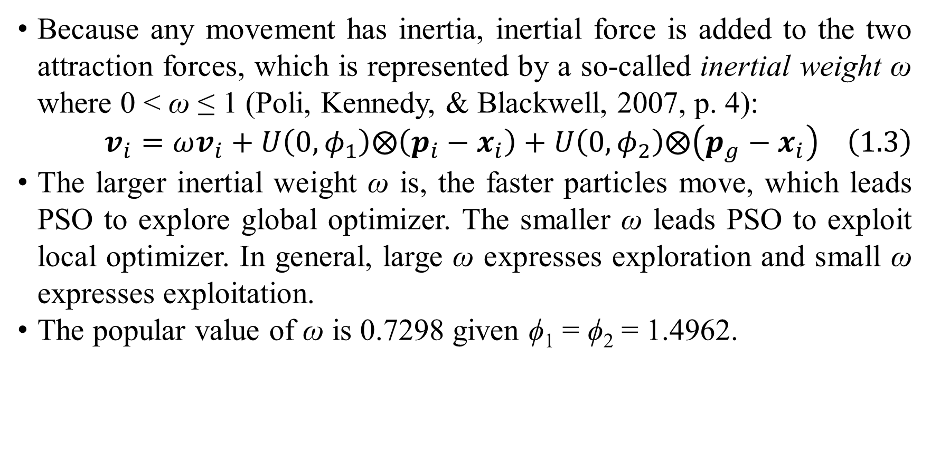
1. Introduction
Because any movement has inertia, inertial force is added to the two attraction forces, which is represented by a so-called inertial weight ω where 0 < ω ≤ 1 (Poli, Kennedy, & Blackwell, 2007, p. 4):
$$v_{i}=ωv_{i}+U\left(0,φ_{1}\right)⨂\left(p_{i}−x_{i}\right)+U\left(0,φ_{2}\right)⨂\left(p_{g}−x_{i}\right) \left(1.3\right)$$
The larger inertial weight ω is, the faster particles move, which leads PSO to explore global optimizer. The smaller ω leads PSO to exploit local optimizer. In general, large ω expresses exploration and small ω expresses exploitation.
The popular value of ω is 0.7298 given ϕ₁ = ϕ₂ = 1.4962.
Notes:
Note that moving fast does not imply fast convergence. The inverse 1–ω is known as friction coefficient.

Slide 10
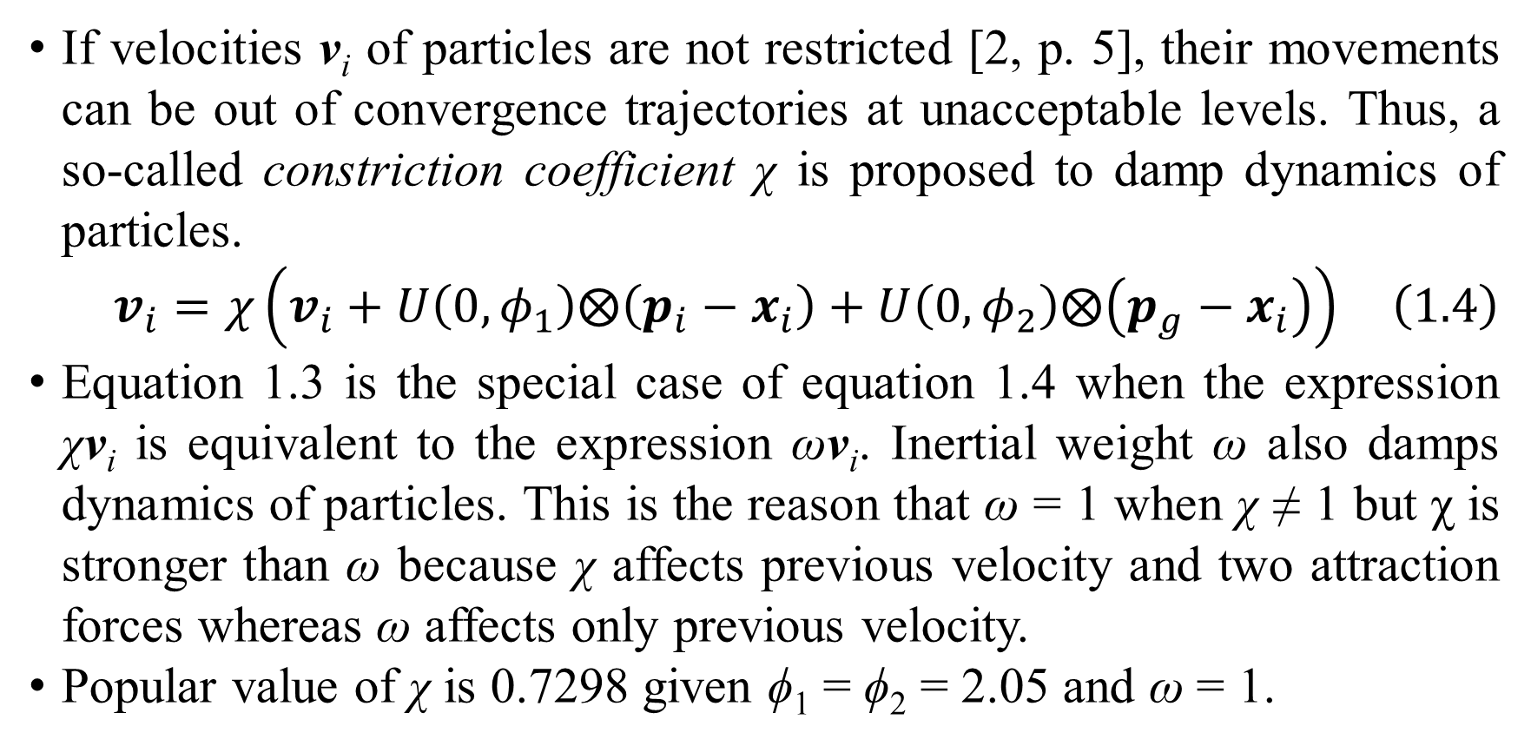
1. Introduction
If velocities v_{i} of particles are not restricted [2, p. 5], their movements can be out of convergence trajectories at unacceptable levels. Thus, a so-called constriction coefficient χ is proposed to damp dynamics of particles.
$$v_{i}=χ\left(v_{i}+U\left(0,φ_{1}\right)⨂\left(p_{i}−x_{i}\right)+U\left(0,φ_{2}\right)⨂\left(p_{g}−x_{i}\right)\right) \left(1.4\right)$$
Equation 1.3 is the special case of equation 1.4 when the expression χv_{i} is equivalent to the expression ωv_{i}. Inertial weight ω also damps dynamics of particles. This is the reason that ω = 1 when χ ≠ 1 but χ is stronger than ω because χ affects previous velocity and two attraction forces whereas ω affects only previous velocity.
Popular value of χ is 0.7298 given ϕ₁ = ϕ₂ = 2.05 and ω = 1.

Slide 11
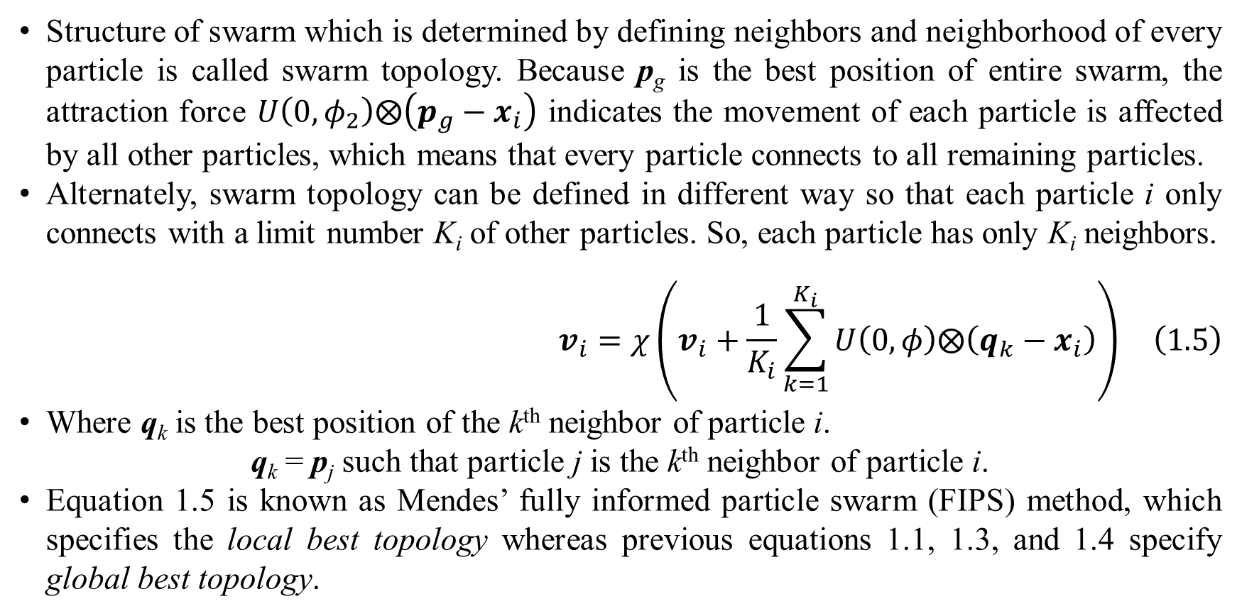
1. Introduction
Structure of swarm which is determined by defining neighbors and neighborhood of every particle is called swarm topology. Because p_{g} is the best position of entire swarm, the attraction force $U\left(0,φ_{2}\right)⨂\left(p_{g}−x_{i}\right)$ indicates the movement of each particle is affected by all other particles, which means that every particle connects to all remaining particles.
Alternately, swarm topology can be defined in different way so that each particle i only connects with a limit number K_{i} of other particles. So, each particle has only K_{i} neighbors.
$$v_{i}=χ\left(v_{i}+\frac{1}{K_{i}}\sum_{k=1}^{K_{i}}{U\left(0,φ\right)⨂\left(q_{k}−x_{i}\right)}\right) \left(1.5\right)$$
Where q_{k} is the best position of the k^{th} neighbor of particle i.
q_{k} = p_{j} such that particle j is the k^{th} neighbor of particle i.
Equation 1.5 is known as Mendes’ fully informed particle swarm (FIPS) method, which specifies the local best topology whereas previous equations 1.1, 1.3, and 1.4 specify global best topology.
Notes:
For explaining easily global best topology, suppose particles are vertices of a graph, fully connected swarm topology implies that such graph is fully connected, in which all vertices are connected together. In local best topology, particle i is also its neighbor. Thus, in equation 1.5, the set of K_{i} neighbors includes particle i. The two parameters ϕ₁ and ϕ₂ are reduced into only one parameter ϕ > 0, which implies the strengths of all attraction forces from all neighbors on particle i are equal. The popular value of ϕ is ϕ = 2.05 given χ = 0.7298.

Slide 12
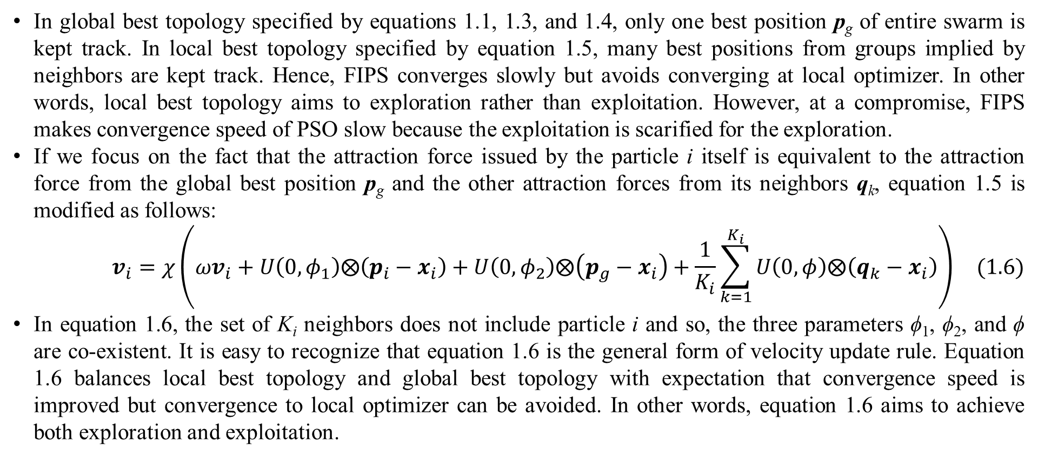
1. Introduction
In global best topology specified by equations 1.1, 1.3, and 1.4, only one best position p_{g} of entire swarm is kept track. In local best topology specified by equation 1.5, many best positions from groups implied by neighbors are kept track. Hence, FIPS converges slowly but avoids converging at local optimizer. In other words, local best topology aims to exploration rather than exploitation. However, at a compromise, FIPS makes convergence speed of PSO slow because the exploitation is scarified for the exploration.
If we focus on the fact that the attraction force issued by the particle i itself is equivalent to the attraction force from the global best position p_{g} and the other attraction forces from its neighbors q_{k}, equation 1.5 is modified as follows:
$$v_{i}=χ\left(ωv_{i}+U\left(0,φ_{1}\right)⨂\left(p_{i}−x_{i}\right)+U\left(0,φ_{2}\right)⨂\left(p_{g}−x_{i}\right)+\frac{1}{K_{i}}\sum_{k=1}^{K_{i}}{U\left(0,φ\right)⨂\left(q_{k}−x_{i}\right)}\right) (1.6)$$
In equation 1.6, the set of K_{i} neighbors does not include particle i and so, the three parameters ϕ₁, ϕ₂, and ϕ are co-existent. It is easy to recognize that equation 1.6 is the general form of velocity update rule. Equation 1.6 balances local best topology and global best topology with expectation that convergence speed is improved but convergence to local optimizer can be avoided. In other words, equation 1.6 aims to achieve both exploration and exploitation.

Slide 13
1. Introduction
In general, the two main aspects of PSO are exploration and exploitation. The exploration aspect aims to avoid premature converging so as to reach global optimizer whereas the exploitation aspect aims to motivate PSO to converge as fast as possible. Besides exploitation property can help PSO to converge more accurately regardless of local optimizer or global optimizer. These two aspects are equally important.
Consequently, two problems corresponding to the exploration and exploitation are premature problem and dynamic problem. Solutions of premature problem are to improve the exploration and solutions of dynamic problem are to improve the exploitation. Inertial weight and constriction coefficient are common solutions for dynamic problem. Currently, solutions of dynamic problem often relate to tuning coefficients which are PSO parameters. Solutions of premature problem relates to increase dynamic ability of particles such as: dynamic topology, change of fitness function, adaptation (including tuning coefficients, adding particles, removing particles, and changing particle properties), and diversity control.
Dynamic topology is popular in solving premature problem. The topology from equation 1.1, equation 1.3, equation 1.4, equation 1.5, and equation 1.6 is static (Poli, Kennedy, & Blackwell, 2007, p. 6) because it is kept intact over all iterations of PSO. In other words, neighbors and neighborhood in static topology are established fixedly. We will later research dynamic topology in which neighbors and neighborhood are changed at each iteration.

Slide 14
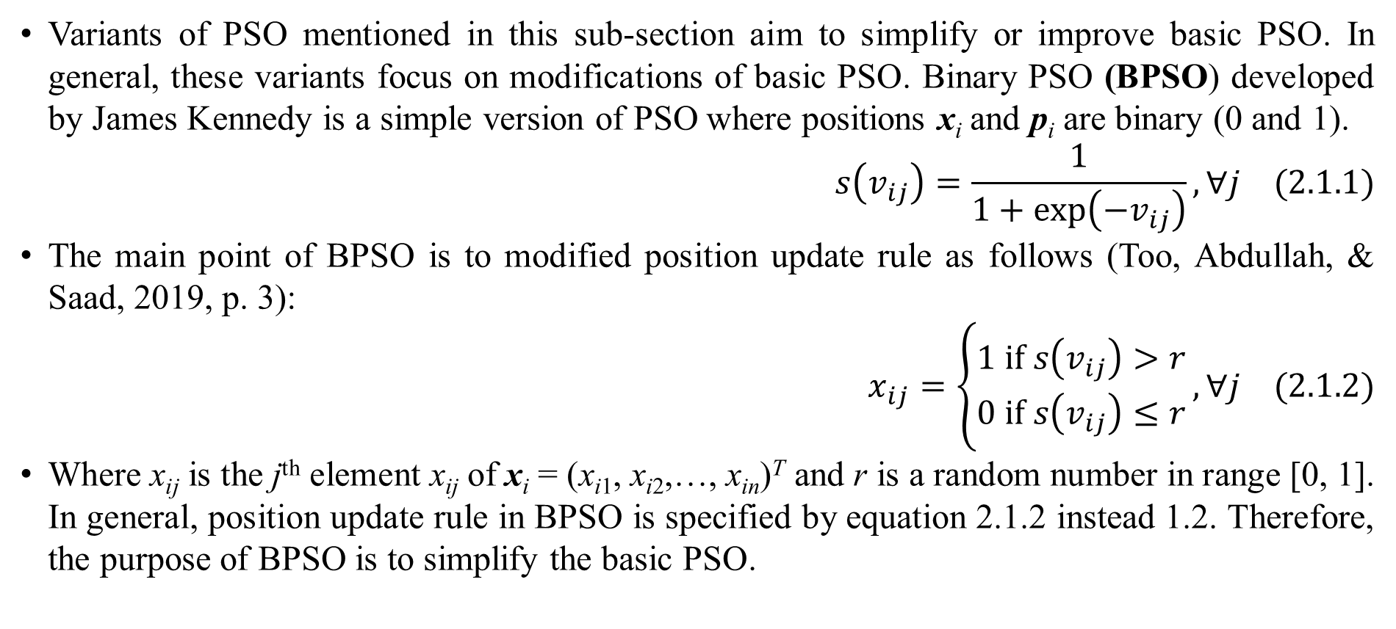
2. Variants of PSO – Simplified & improved PSOs
Variants of PSO mentioned in this sub-section aim to simplify or improve basic PSO. In general, these variants focus on modifications of basic PSO. Binary PSO (BPSO) developed by James Kennedy is a simple version of PSO where positions x_{i} and p_{i} are binary (0 and 1).
$$s\left(v_{ij}\right)=\frac{1}{1+exp\left(−v_{ij}\right)},∀j (2.1.1)$$
The main point of BPSO is to modified position update rule as follows (Too, Abdullah, & Saad, 2019, p. 3):
$$x_{ij}=\left\{\begin{matrix}1 if s\left(v_{ij}\right)>r \\ 0 if s\left(v_{ij}\right)≤r\end{matrix}\right.,∀j (2.1.2)$$
Where x_{ij} is the j^{th} element x_{ij} of x_{i} = (x_{i1}, x_{i2},…, x_{in})^{T} and r is a random number in range [0, 1]. In general, position update rule in BPSO is specified by equation 2.1.2 instead 1.2. Therefore, the purpose of BPSO is to simplify the basic PSO.

Slide 15
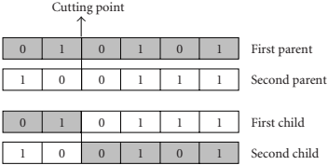
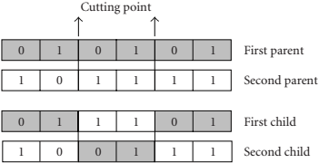
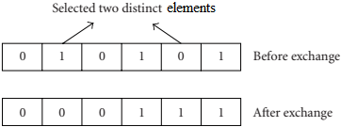
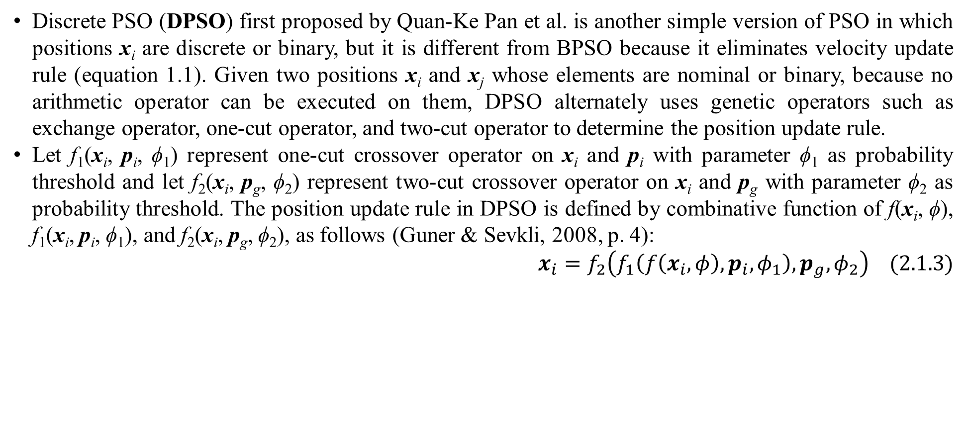
2. Variants of PSO – Simplified & improved PSOs
Discrete PSO (DPSO) first proposed by Quan-Ke Pan et al. is another simple version of PSO in which positions x_{i} are discrete or binary, but it is different from BPSO because it eliminates velocity update rule (equation 1.1). Given two positions x_{i} and x_{j­} whose elements are nominal or binary, because no arithmetic operator can be executed on them, DPSO alternately uses genetic operators such as exchange operator, one-cut operator, and two-cut operator to determine the position update rule.
Let f₁(x_{i}, p_{i}, ϕ₁) represent one-cut crossover operator on x_{i} and p_{i} with parameter ϕ₁ as probability threshold and let f₂(x_{i}, p_{g}, ϕ₂) represent two-cut crossover operator on x_{i} and p_{g} with parameter ϕ₂ as probability threshold. The position update rule in DPSO is defined by combinative function of f(x_{i}, ϕ), f₁(x_{i}, p_{i}, ϕ₁), and f₂(x_{i}, p_{g}, ϕ₂), as follows (Guner & Sevkli, 2008, p. 4):
$$x_{i}=f_{2}\left(f_{1}\left(f\left(x_{i},φ\right),p_{i},φ_{1}\right),p_{g},φ_{2}\right) (2.1.3)$$

Slide 16
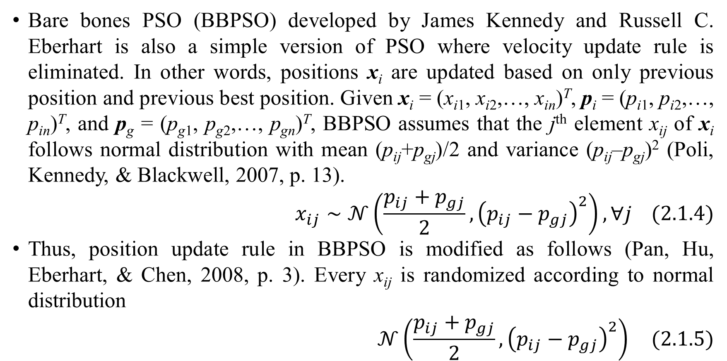
2. Variants of PSO – Simplified & improved PSOs
Bare bones PSO (BBPSO) developed by James Kennedy and Russell C. Eberhart is also a simple version of PSO where velocity update rule is eliminated. In other words, positions x_{i} are updated based on only previous position and previous best position. Given x_{i} = (x_{i1}, x_{i2},…, x_{in})^{T}, p_{i} = (p_{i1}, p_{i2},…, p_{in})^{T}, and p_{g} = (p_{g1}, p_{g2},…, p_{gn})^{T}, BBPSO assumes that the j^{th} element x_{ij} of x_{i} follows normal distribution with mean (p_{ij}+p_{gj})/2 and variance (p_{ij}–p_{gj})² (Poli, Kennedy, & Blackwell, 2007, p. 13).
$$x_{ij}∼𝒩\left(\frac{p_{ij}+p_{gj}}{2},{\left(p_{ij}−p_{gj}\right)}^{2}\right),∀j (2.1.4)$$
Thus, position update rule in BBPSO is modified as follows (Pan, Hu, Eberhart, & Chen, 2008, p. 3). Every x_{ij} is randomized according to normal distribution
$$𝒩\left(\frac{p_{ij}+p_{gj}}{2},{\left(p_{ij}−p_{gj}\right)}^{2}\right) (2.1.5)$$

Slide 17
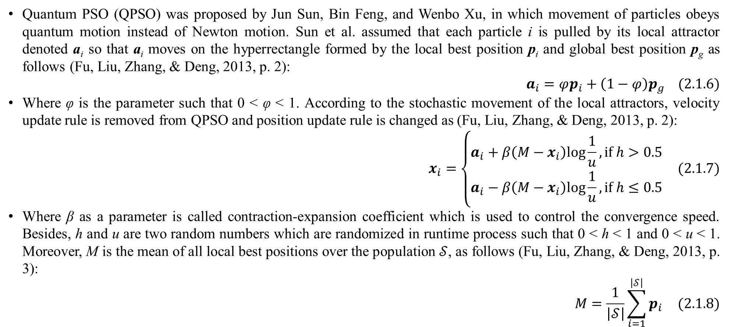
2. Variants of PSO – Simplified & improved PSOs
Quantum PSO (QPSO) was proposed by Jun Sun, Bin Feng, and Wenbo Xu, in which movement of particles obeys quantum motion instead of Newton motion. Sun et al. assumed that each particle i is pulled by its local attractor denoted a_{i} so that a_{i} moves on the hyperrectangle formed by the local best position p_{i} and global best position p_{g} as follows (Fu, Liu, Zhang, & Deng, 2013, p. 2):
$$a_{i}=φp_{i}+\left(1−φ\right)p_{g} (2.1.6)$$
Where φ is the parameter such that 0 < φ < 1. According to the stochastic movement of the local attractors, velocity update rule is removed from QPSO and position update rule is changed as (Fu, Liu, Zhang, & Deng, 2013, p. 2):
$$x_{i}=\left\{\begin{matrix}a_{i}+β\left(M−x_{i}\right)log\frac{1}{u}, if h>0.5 \\ a_{i}−β\left(M−x_{i}\right)log\frac{1}{u}, if h≤0.5\end{matrix}\right. (2.1.7)$$
Where β as a parameter is called contraction-expansion coefficient which is used to control the convergence speed. Besides, h and u are two random numbers which are randomized in runtime process such that 0 < h < 1 and 0 < u < 1. Moreover, M is the mean of all local best positions over the population $𝒮$, as follows (Fu, Liu, Zhang, & Deng, 2013, p. 3):
$$M=\frac{1}{\left|𝒮\right|}\sum_{i=1}^{\left|𝒮\right|}{p_{i}} (2.1.8)$$

Slide 18
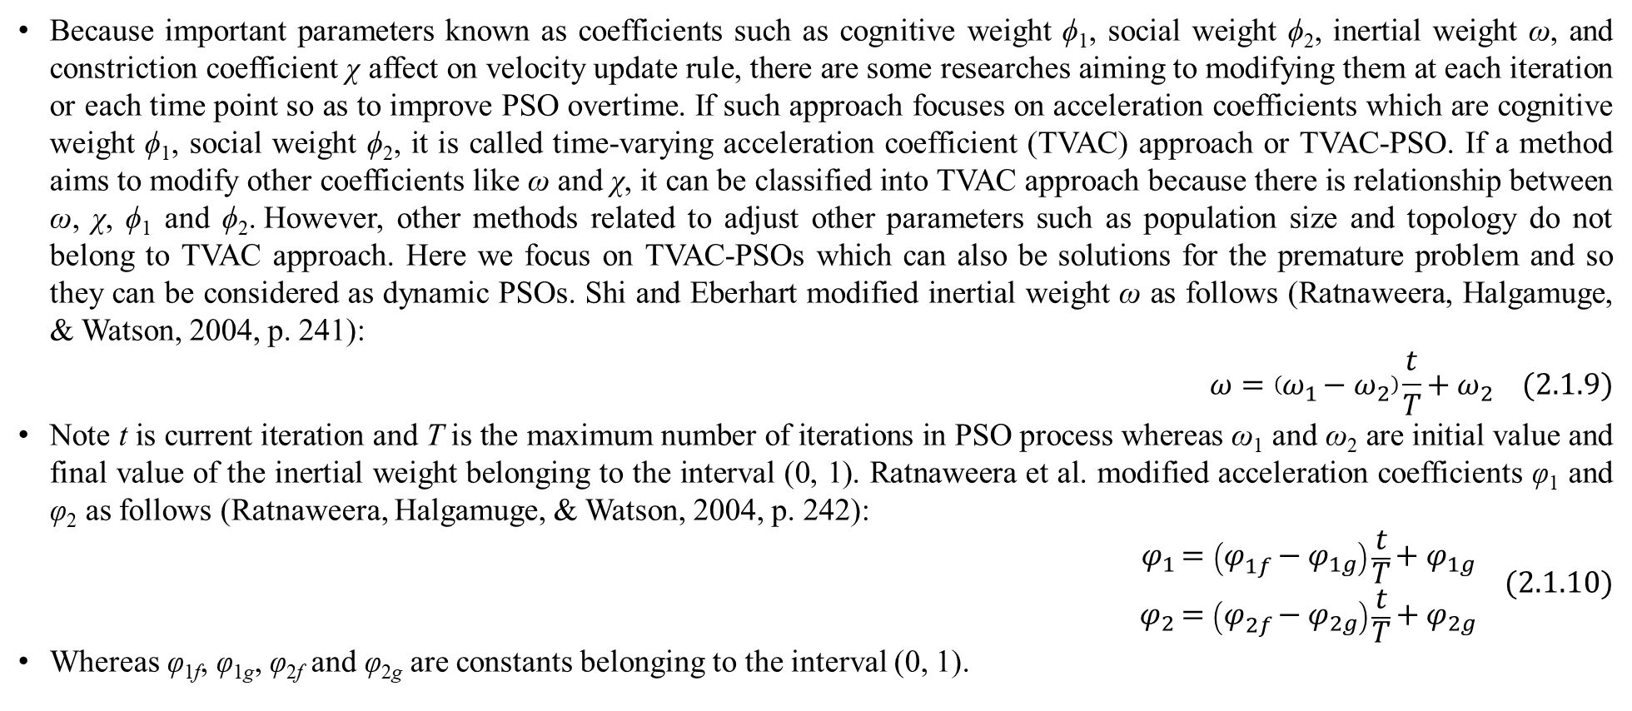
2. Variants of PSO – Simplified & improved PSOs
Because important parameters known as coefficients such as cognitive weight ϕ₁, social weight ϕ₂, inertial weight ω, and constriction coefficient χ affect on velocity update rule, there are some researches aiming to modifying them at each iteration or each time point so as to improve PSO overtime. If such approach focuses on acceleration coefficients which are cognitive weight ϕ₁, social weight ϕ₂, it is called time-varying acceleration coefficient (TVAC) approach or TVAC-PSO. If a method aims to modify other coefficients like ω and χ, it can be classified into TVAC approach because there is relationship between ω, χ, ϕ₁ and ϕ₂. However, other methods related to adjust other parameters such as population size and topology do not belong to TVAC approach. Here we focus on TVAC-PSOs which can also be solutions for the premature problem and so they can be considered as dynamic PSOs. Shi and Eberhart modified inertial weight ω as follows (Ratnaweera, Halgamuge, & Watson, 2004, p. 241):
$$ω=\left(ω_{1}−ω_{2}\right)\frac{t}{T}+ω_{2} (2.1.9)$$
Note t is current iteration and T is the maximum number of iterations in PSO process whereas ω₁ and ω₂ are initial value and final value of the inertial weight belonging to the interval (0, 1). Ratnaweera et al. modified acceleration coefficients φ₁ and φ₂ as follows (Ratnaweera, Halgamuge, & Watson, 2004, p. 242):
$$\begin{matrix}φ_{1}=\left(φ_{1f}−φ_{1g}\right)\frac{t}{T}+φ_{1g} \\ φ_{2}=\left(φ_{2f}−φ_{2g}\right)\frac{t}{T}+φ_{2g}\end{matrix} (2.1.10)$$
Whereas φ_{1f}, φ_{1g}, φ_{2f} and φ_{2g} are constants belonging to the interval (0, 1).

Slide 19
2. Variants of PSO – Dynamic PSO
As aforementioned, two main problems of PSO are premature problem and dynamic problem. Solutions of premature problem are to improve the exploration so that PSO is not trapped in local optimizer. Exactly, these solutions relate to increase dynamic ability of particles such as dynamic topology, change of fitness function, adaptation (tuning coefficients, adding particles, removing particles, changing particle properties), and diversity control over iterations. As a convention, the solutions for premature problem derive so-called dynamic PSOs.
Recall that the topology from equations 1.1, 1.3, 1.4, 1.5, and 1.6 is static topology because it is kept intact over all iterations of PSO. Recall that topology implies groups of particles inside swarm population. For easily understandable explanation, suppose particles are vertices of a graph and a connection between two vertices indicates the interaction or the neighborhood of two particles so that such graph is the easily understandable representation of topology. If the graph is fully connected, the topology is called global topology (gbest topology) which is typically specified by equations 1.1, 1.3, and 1.4. If the graph is separated into many fully connected sub-graphs, the topology is called local topology (lbest topology) which is typically specified by equations 1.5 and 1.6. Here we research dynamic topology in which neighbors and neighborhood are changed at each iteration.

Slide 20
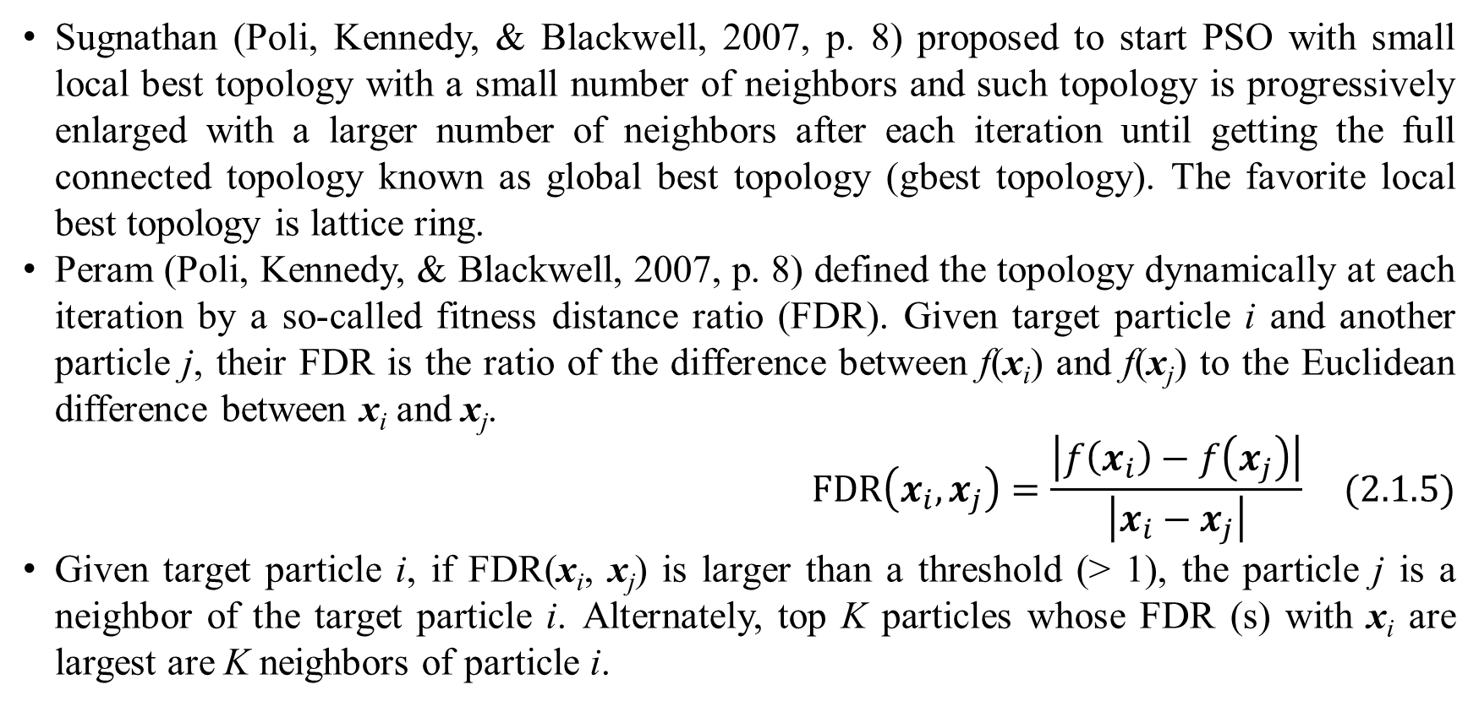
2. Variants of PSO – Dynamic PSO
Sugnathan (Poli, Kennedy, & Blackwell, 2007, p. 8) proposed to start PSO with small local best topology with a small number of neighbors and such topology is progressively enlarged with a larger number of neighbors after each iteration until getting the full connected topology known as global best topology (gbest topology). The favorite local best topology is lattice ring.
Peram (Poli, Kennedy, & Blackwell, 2007, p. 8) defined the topology dynamically at each iteration by a so-called fitness distance ratio (FDR). Given target particle i and another particle j, their FDR is the ratio of the difference between f(x_{i}) and f(x_{j}) to the Euclidean difference between x_{i} and x_{j}.
$$FDR\left(x_{i},x_{j}\right)=\frac{\left|f\left(x_{i}\right)−f\left(x_{j}\right)\right|}{\left|x_{i}−x_{j}\right|} (2.1.5)$$
Given target particle i, if FDR(x_{i}, x_{j}) is larger than a threshold (> 1), the particle j is a neighbor of the target particle i. Alternately, top K particles whose FDR (s) with x_{i} are largest are K neighbors of particle i.

Slide 21
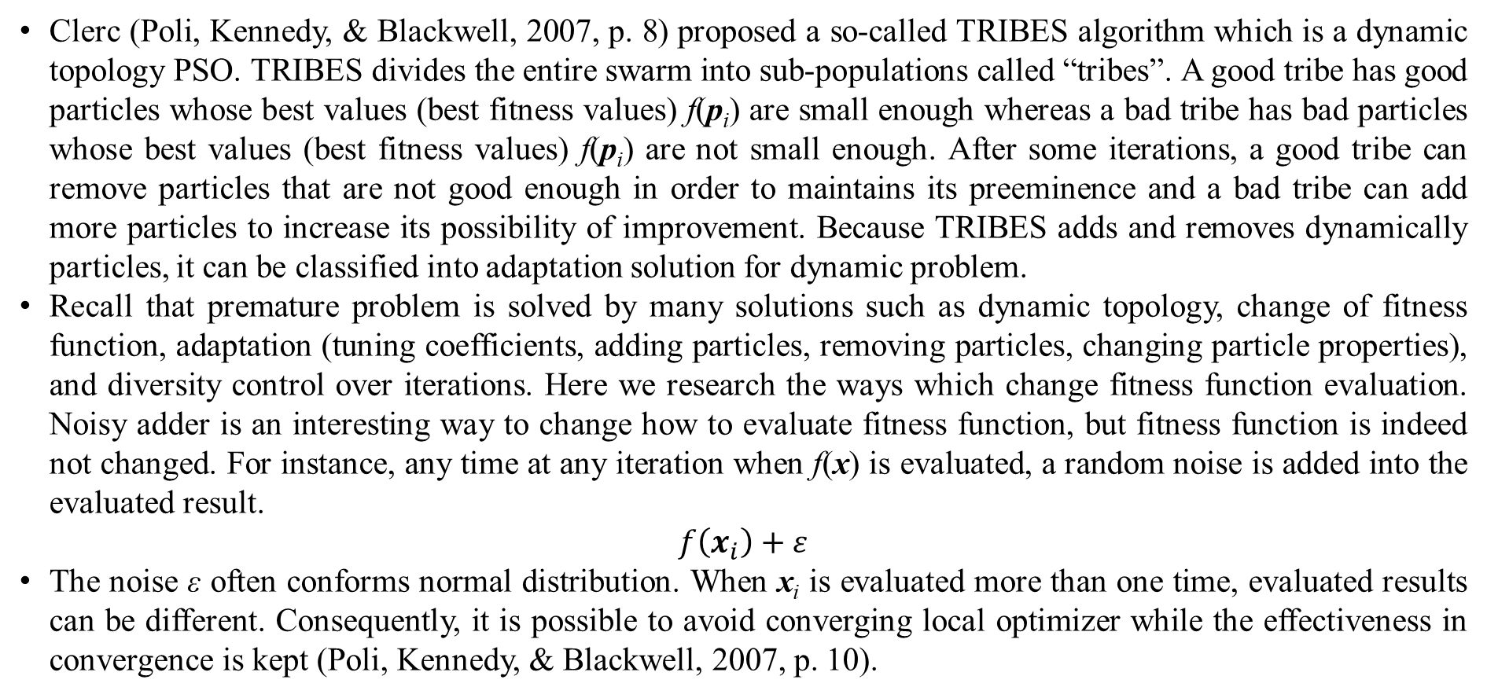
2. Variants of PSO – Dynamic PSO
Clerc (Poli, Kennedy, & Blackwell, 2007, p. 8) proposed a so-called TRIBES algorithm which is a dynamic topology PSO. TRIBES divides the entire swarm into sub-populations called “tribes”. A good tribe has good particles whose best values (best fitness values) f(p_{i}) are small enough whereas a bad tribe has bad particles whose best values (best fitness values) f(p_{i}) are not small enough. After some iterations, a good tribe can remove particles that are not good enough in order to maintains its preeminence and a bad tribe can add more particles to increase its possibility of improvement. Because TRIBES adds and removes dynamically particles, it can be classified into adaptation solution for dynamic problem.
Recall that premature problem is solved by many solutions such as dynamic topology, change of fitness function, adaptation (tuning coefficients, adding particles, removing particles, changing particle properties), and diversity control over iterations. Here we research the ways which change fitness function evaluation. Noisy adder is an interesting way to change how to evaluate fitness function, but fitness function is indeed not changed. For instance, any time at any iteration when f(x) is evaluated, a random noise is added into the evaluated result.
$$f\left(x_{i}\right)+ε$$
The noise ε often conforms normal distribution. When x_{i} is evaluated more than one time, evaluated results can be different. Consequently, it is possible to avoid converging local optimizer while the effectiveness in convergence is kept (Poli, Kennedy, & Blackwell, 2007, p. 10).

Slide 22
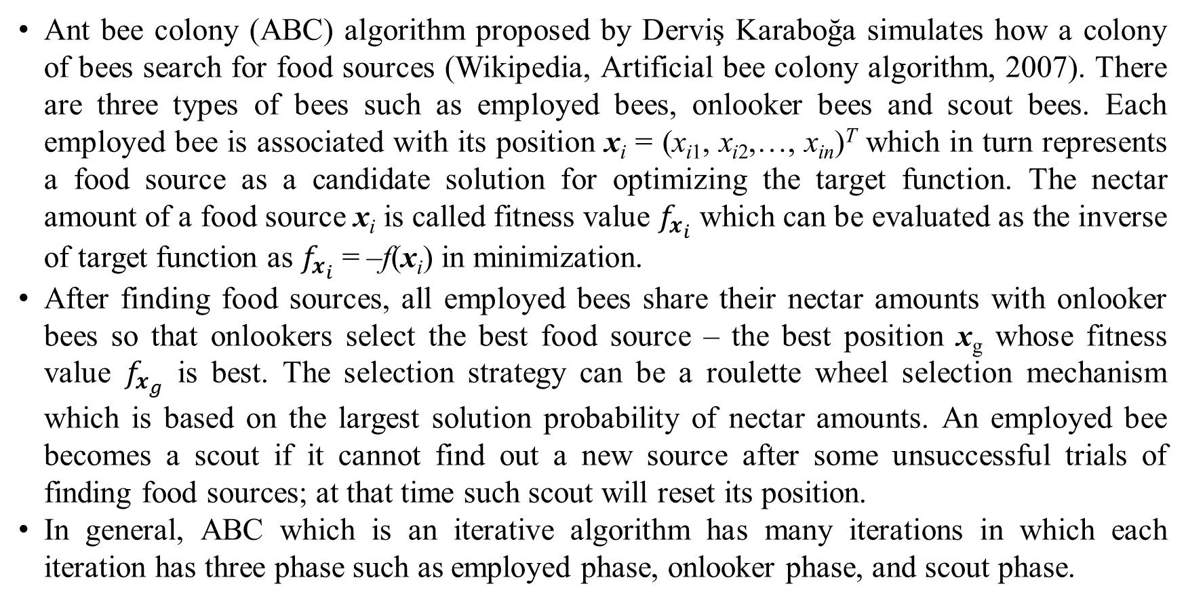
3. PSO and artificial bee colony algorithm
Ant bee colony (ABC) algorithm proposed by Derviş Karaboğa simulates how a colony of bees search for food sources (Wikipedia, Artificial bee colony algorithm, 2007). There are three types of bees such as employed bees, onlooker bees and scout bees. Each employed bee is associated with its position x_{i} = (x_{i1}, x_{i2},…, x_{in})^{T} which in turn represents a food source as a candidate solution for optimizing the target function. The nectar amount of a food source x_{i} is called fitness value $f_{x_{i}}$ which can be evaluated as the inverse of target function as $f_{x_{i}}$ = –f(x_{i}) in minimization.
After finding food sources, all employed bees share their nectar amounts with onlooker bees so that onlookers select the best food source – the best position x_{g} whose fitness value $f_{x_{g}}$ is best. The selection strategy can be a roulette wheel selection mechanism which is based on the largest solution probability of nectar amounts. An employed bee becomes a scout if it cannot find out a new source after some unsuccessful trials of finding food sources; at that time such scout will reset its position.
In general, ABC which is an iterative algorithm has many iterations in which each iteration has three phase such as employed phase, onlooker phase, and scout phase.

Slide 23
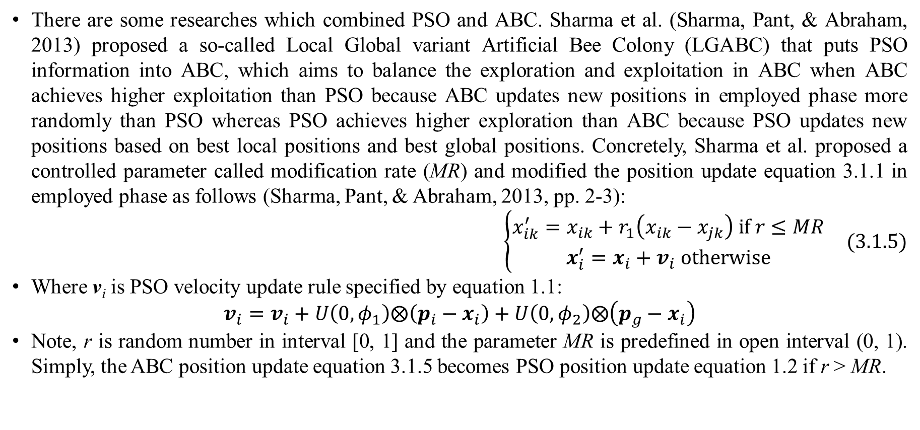
3. PSO and artificial bee colony algorithm
There are some researches which combined PSO and ABC. Sharma et al. (Sharma, Pant, & Abraham, 2013) proposed a so-called Local Global variant Artificial Bee Colony (LGABC) that puts PSO information into ABC, which aims to balance the exploration and exploitation in ABC when ABC achieves higher exploitation than PSO because ABC updates new positions in employed phase more randomly than PSO whereas PSO achieves higher exploration than ABC because PSO updates new positions based on best local positions and best global positions. Concretely, Sharma et al. proposed a controlled parameter called modification rate (MR) and modified the position update equation 3.1.1 in employed phase as follows (Sharma, Pant, & Abraham, 2013, pp. 2-3):
$$\left\{\begin{matrix}x_{ik}^{′}=x_{ik}+r_{1}\left(x_{ik}−x_{jk}\right) if r≤MR \\ x_{i}^{′}=x_{i}+v_{i} otherwise\end{matrix}\right. (3.1.5)$$
Where v_{i} is PSO velocity update rule specified by equation 1.1:
$$v_{i}=v_{i}+U\left(0,φ_{1}\right)⨂\left(p_{i}−x_{i}\right)+U\left(0,φ_{2}\right)⨂\left(p_{g}−x_{i}\right)$$
Note, r is random number in interval [0, 1] and the parameter MR is predefined in open interval (0, 1). Simply, the ABC position update equation 3.1.5 becomes PSO position update equation 1.2 if r > MR.

Slide 24
References
al-Rifaie, M. M., & Blackwell, T. (2012). Bare Bones Particle Swarms with Jumps. In M. Dorigo, M. Birattari, C. Blum, A. L. Christensen, A. P. Engelbrecht, R. Groß, & T. Stützle (Ed.), International Conference on Swarm Intelligence. Lecture Notes in Computer Science 7461, pp. 49-60. Brussels: Springer Berlin. doi:10.1007/978-3-642-32650-9_5
Bonyadi, M. R., & Michalewicz, Z. (2017, March 2). Particle Swarm Optimization for Single Objective Continuous Space Problems: A Review. (N. Lindsay, Ed.) Evolutionary Computation, 25(1), 1-54. doi:10.1162/EVCO_r_00180
Fu, X., Liu, W., Zhang, B., & Deng, H. (2013, October 24). Quantum Behaved Particle Swarm Optimization with Neighborhood Search for Numerical Optimization. Mathematical Problems in Engineering, 2013. doi:10.1155/2013/469723
Guner, A. R., & Sevkli, M. (2008, April 8). A Discrete Particle Swarm Optimization Algorithm for Uncapacitated Facility Location Problem. Journal of Artificial Evolution and Applications, 2008, 1-9. doi:10.1155/2008/861512
Karaboga, D., & Akay, B. (2009, April 11). A comparative study of Artificial Bee Colony algorithm. Applied Mathematics and Computation, 214(1), 108-132. doi:10.1016/j.amc.2009.03.090
Pan, F., Hu, X., Eberhart, R., & Chen, Y. (2008, September 21). An Analysis of Bare Bones Particle Swarm. IEEE Swarm Intelligence Symposium 2008 (SIS 2008) (pp. 1-5). St. Louis, MO, US: IEEE. doi:10.1109/SIS.2008.4668301
Poli, R., Kennedy, J., & Blackwell, T. (2007, June). Particle swarm optimization. (M. Dorigo, Ed.) Swarm Intelligence, 1(1), 33-57. doi:10.1007/s11721-007-0002-0
Ratnaweera, A., Halgamuge, S. K., & Watson, H. C. (2004, June 14). Self-organizing hierarchical particle swarm optimizer with time-varying acceleration coefficients. (R. C. Eberhart, & Y. Shi, Eds.) IEEE Transactions on Evolutionary Computation, 8(3), 240-255. doi:10.1109/TEVC.2004.826071

Slide 25
References
Sharma, T. K., Pant, M., & Abraham, A. (2013). Blend of Local and Global Variant of PSO in ABC. The 2013 World Congress on Nature and Biologically Inspired Computing. IEEE. doi:10.1109/NaBIC.2013.6617848
Too, J., Abdullah, A. R., & Saad, N. M. (2019, May 8). A New Co-Evolution Binary Particle Swarm Optimization with Multiple Inertia Weight Strategy for Feature Selection. (A. Bryant, R. Theron, K. Sedig, & D. J. Lizotte, Eds.) informatics, 6(2), 1-14. doi:10.3390/informatics6020021
Wikipedia. (2007, November 23). Artificial bee colony algorithm. (Wikimedia Foundation) Retrieved from Wikipedia website: https://en.wikipedia.org/wiki/Artificial_bee_colony_algorithm
Wikipedia. (2017, March 7). Particle swarm optimization. (Wikimedia Foundation) Retrieved April 8, 2017, from Wikipedia website: https://en.wikipedia.org/wiki/Particle_swarm_optimization
Zhang, Y., Wang, S., & Ji, G. (2015, October 7). A Comprehensive Survey on Particle Swarm Optimization Algorithm and Its Applications. (G. Xie, Ed.) Mathematical Problems in Engineering, 2015(Special Issue: Artificial Intelligence and Its Applications 2014), 1-38. doi:10.1155/2015/931256.

Slide 26
Thank you for listening

