Slide 1
Is matrix neural network the alternative of convolutional neural network?
Professor Dr. Loc Nguyen, PhD, Postdoc
Loc Nguyen’s Academic Network, Vietnam
Email: ng_phloc@yahoo.com
Homepage: www.locnguyen.net

Slide 2
Abstract
Currently (2025), deep learning is the most important and popular methodology in artificial intelligence (AI) and artificial neural network (ANN) is the foundation of deep learning. The main drawback of ANN is the boom problem of a huge number of parametric weights when ANN in deep learning establishes a large number of hidden layers. The excellent solution for image processing within context of deep learning is convolutional neural network (CNN) where a so-called filtering kernel which is often 3x3 or 5x5 matrix which is convoluted over entire image data. Another solution of the boom problem is that large parametric weight vector is organized as matrix that is the same structure of 2-dimension data like image, which leads to a so-called matrix neural network (MNN). Computation cost of MNN is decreased significantly in comparison with ANN but it is necessary to test the effectiveness of MNN with respect to CNN according to the main hypothesis “whether MNN is the alternative of CNN”. Moreover, transformer which is the new trend (2025) in AI and deep learning, which aims to improve/replace traditional ANN by self-supervised learning, in which attention is the significant mechanism of self-supervised learning. Therefore, the implicit deep meanings of attention and filtering kernel are similar, which represents feature of data, which does not go beyond parametric weights too. In general, the research has two goals: 1) explaining and implementing ANN, CNN, and transformer (attention) and 2) applying analysis of variance (ANOVA) into evaluating the effectiveness of ANN, CNN, and transformer (attention) within context of image classification. The ultimate result is that it is not asserted that MNN is the alternative of CNN but MNN can be an optional choice for implementing ANN in context of image processing instead of focusing on the unique CNN solution. Moreover, the incorporation of MNN and attention in implementing transformer produces a compromising solution of high performance and computational cost.

Slide 3
Table of contents
Introduction
Related works
Matrix neural network
Experimental design
Results and discussions
Conclusions

Slide 4
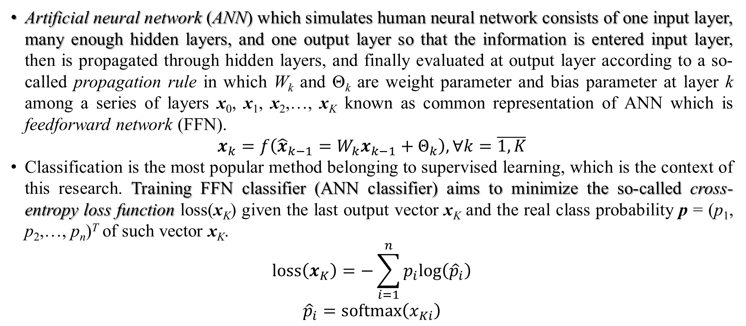
1. Introduction (main)
Artificial neural network (ANN) which simulates human neural network consists of one input layer, many enough hidden layers, and one output layer so that the information is entered input layer, then is propagated through hidden layers, and finally evaluated at output layer according to a so-called propagation rule in which W_{k} and Θ_{k} are weight parameter and bias parameter at layer k among a series of layers x₀, x₁, x₂,…, x_{K} known as common representation of ANN which is feedforward network (FFN).
$$x_{k}=f\left({\hat{x}}_{k−1}=W_{k}x_{k−1}+Θ_{k}\right),∀k=\overline{1,K}$$
Classification is the most popular method belonging to supervised learning, which is the context of this research. Training FFN classifier (ANN classifier) aims to minimize the so-called cross-entropy loss function loss(x_{K}) given the last output vector x_{K} and the real class probability p = (p₁, p₂,…, p_{n})^{T} of such vector x_{K}.
$$loss\left(x_{K}\right)=−\sum_{i=1}^{n}{p_{i}log\left({\hat{p}}_{i}\right)}$$
$${\hat{p}}_{i}=softmax\left(x_{Ki}\right)$$

Slide 5
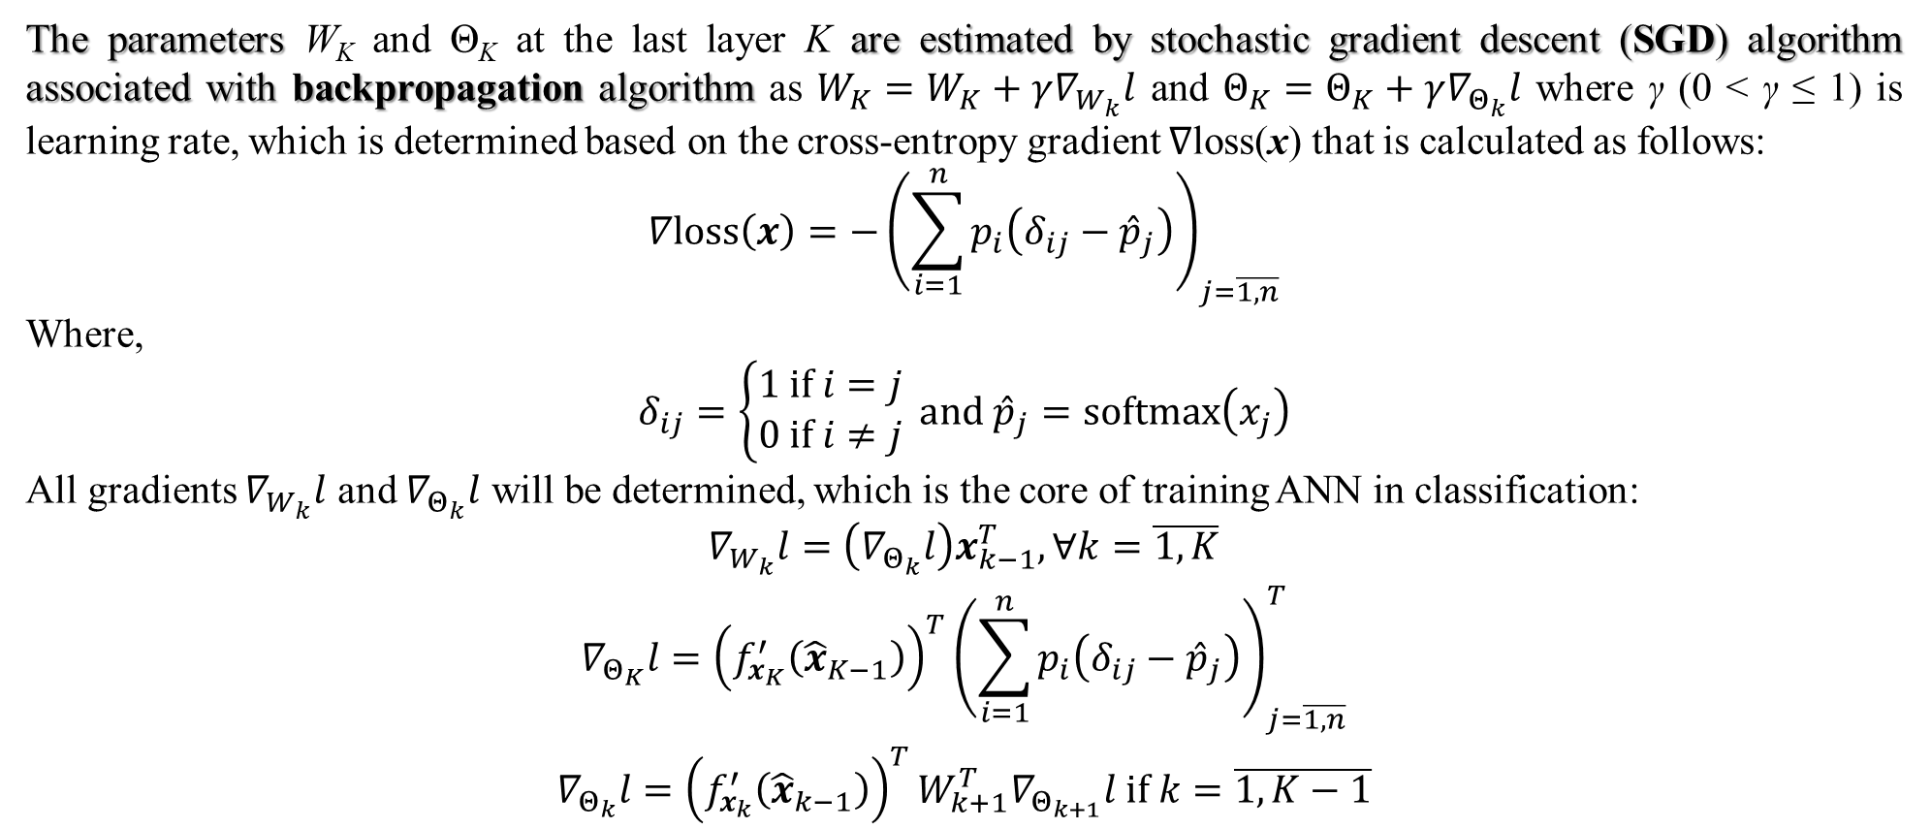
1. Introduction (main)
The parameters W_{K} and Θ_{K} at the last layer K are estimated by stochastic gradient descent (SGD) algorithm associated with backpropagation algorithm as $W_{K}=W_{K}+γ∇_{W_{k}}l$ and $Θ_{K}=Θ_{K}+γ∇_{Θ_{k}}l$ where γ (0 < γ ≤ 1) is learning rate, which is determined based on the cross-entropy gradient ∇loss(x) that is calculated as follows:
$$∇loss\left(x\right)=−{\left(\sum_{i=1}^{n}{p_{i}\left(δ_{ij}−{\hat{p}}_{j}\right)}\right)}_{j=\overline{1,n}}$$
Where,
$$δ_{ij}=\left\{\begin{matrix}1 if i=j \\ 0 if i≠j\end{matrix}\right. and {\hat{p}}_{j}=softmax\left(x_{j}\right)$$
All gradients $∇_{W_{k}}l$ and $∇_{Θ_{k}}l$ will be determined, which is the core of training ANN in classification:
$$\begin{matrix}∇_{W_{k}}l=\left(∇_{Θ_{k}}l\right)x_{k−1}^{T},∀k=\overline{1,K} \\ ∇_{Θ_{K}}l={\left(f_{x_{K}}^{′}\left({\hat{x}}_{K−1}\right)\right)}^{T}{\left(\sum_{i=1}^{n}{p_{i}\left(δ_{ij}−{\hat{p}}_{j}\right)}\right)}_{j=\overline{1,n}}^{T} \\ ∇_{Θ_{k}}l={\left(f_{x_{k}}^{′}\left({\hat{x}}_{k−1}\right)\right)}^{T}W_{k+1}^{T}∇_{Θ_{k+1}}l if k=\overline{1,K−1}\end{matrix}$$

Slide 6
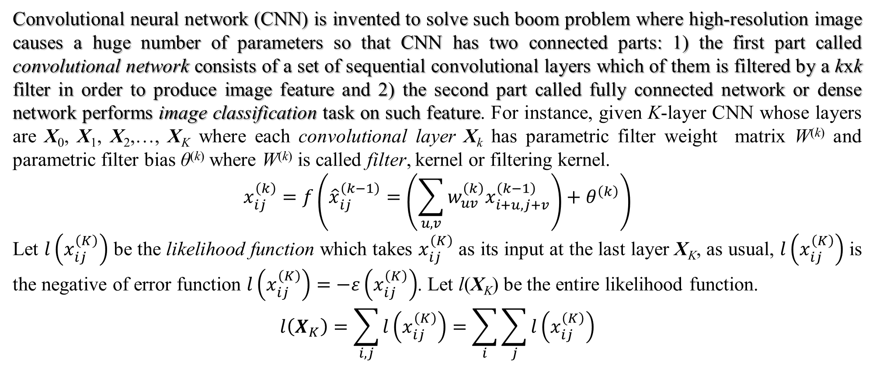
1. Introduction(main)
Convolutional neural network (CNN) is invented to solve such boom problem where high-resolution image causes a huge number of parameters so that CNN has two connected parts: 1) the first part called convolutional network consists of a set of sequential convolutional layers which of them is filtered by a kxk filter in order to produce image feature and 2) the second part called fully connected network or dense network performs image classification task on such feature. For instance, given K-layer CNN whose layers are X₀, X₁, X₂,…, X_{K} where each convolutional layer X_{k} has parametric filter weight matrix W^{(k)} and parametric filter bias θ^{(k)} where W^{(k)} is called filter, kernel or filtering kernel.
$$x_{ij}^{\left(k\right)}=f\left({\hat{x}}_{ij}^{\left(k−1\right)}=\left(\sum_{u,v}{w_{uv}^{\left(k\right)}x_{i+u,j+v}^{\left(k−1\right)}}\right)+θ^{\left(k\right)}\right)$$
Let $l\left(x_{ij}^{\left(K\right)}\right)$ be the likelihood function which takes $x_{ij}^{\left(K\right)}$ as its input at the last layer X_{K}, as usual, $l\left(x_{ij}^{\left(K\right)}\right)$ is the negative of error function $l\left(x_{ij}^{\left(K\right)}\right)=−ε\left(x_{ij}^{\left(K\right)}\right)$. Let l(X_{K}) be the entire likelihood function.
$$l\left(X_{K}\right)=\sum_{i,j}{l\left(x_{ij}^{\left(K\right)}\right)}=\sum_{i}{\sum_{j}{l\left(x_{ij}^{\left(K\right)}\right)}}$$

Slide 7
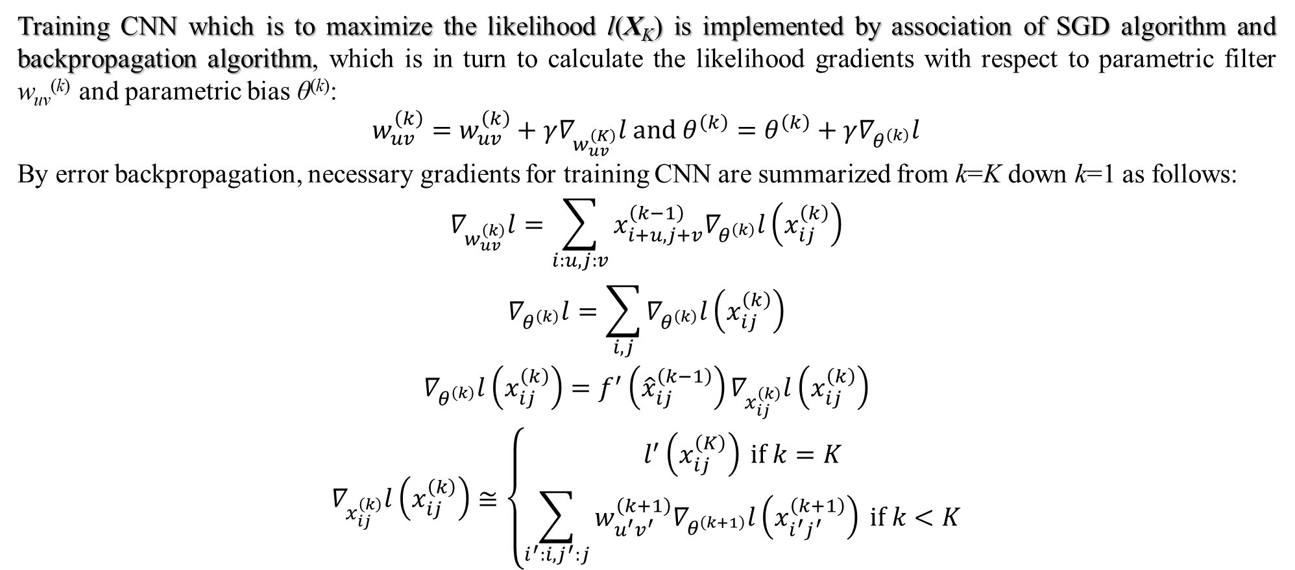
1. Introduction (main)
Training CNN which is to maximize the likelihood l(X_{K}) is implemented by association of SGD algorithm and backpropagation algorithm, which is in turn to calculate the likelihood gradients with respect to parametric filter w_{uv}^{(k)} and parametric bias θ^{(k)}:
$$\begin{matrix}w_{uv}^{\left(k\right)}=w_{uv}^{\left(k\right)}+γ∇_{w_{uv}^{\left(K\right)}}l and θ^{\left(k\right)}=θ^{\left(k\right)}+γ∇_{θ^{\left(k\right)}}l\end{matrix}$$
By error backpropagation, necessary gradients for training CNN are summarized from k=K down k=1 as follows:
$$\begin{matrix}∇_{w_{uv}^{\left(k\right)}}l=\sum_{i:u,j:v}{x_{i+u,j+v}^{\left(k−1\right)}∇_{θ^{\left(k\right)}}l\left(x_{ij}^{\left(k\right)}\right)} \\ ∇_{θ^{\left(k\right)}}l=\sum_{i,j}{∇_{θ^{\left(k\right)}}l\left(x_{ij}^{\left(k\right)}\right)} \\ ∇_{θ^{\left(k\right)}}l\left(x_{ij}^{\left(k\right)}\right)=f^{′}\left({\hat{x}}_{ij}^{\left(k−1\right)}\right)∇_{x_{ij}^{\left(k\right)}}l\left(x_{ij}^{\left(k\right)}\right) \\ ∇_{x_{ij}^{\left(k\right)}}l\left(x_{ij}^{\left(k\right)}\right)≅\left\{\begin{matrix}l^{′}\left(x_{ij}^{\left(K\right)}\right) if k=K \\ \sum_{i^{′}:i,j^{′}:j}{w_{u^{′}v^{′}}^{\left(k+1\right)}∇_{θ^{\left(k+1\right)}}l\left(x_{i^{′}j^{′}}^{\left(k+1\right)}\right)} if k<K\end{matrix}\right.\end{matrix}$$

Slide 8
1. Introduction
Although it is no doubt about the preeminence of CNN in training image data, it is not meaningful enough to expend CNN into other high-dimension data different from image because CNN filter is appropriate to extract image feature. Moreover, data is changed or distorted after it goes through CNN so that original data with complete or full meaning is not kept intact within CNN methodology. Therefore, this research focuses on evaluating the hypothesis “whether matrix neural network is the alternative of CNN” and so, image classification by CNN and matrix neural network called deep image classification is applied into testing the hypothesis.
The next section mentions some other works related to deep image classification and the later section describes the main methodology of this research which focuses on matrix neural network.

Slide 9
2. Related works (main)
As a convention, convolutional layer is called c-layer with filtering kernel (filter) and pooling layer with pooling kernel is called p-layer whereas traditional layer in dense network with parametric weights is simply called w-layer.
CNN-based classification methods are grouped in three approaches (Chen, et al., 2021): 1) traditional CNN-based approach called classic approach conforms strictly definition of CNN including two networks such as convolutional network (convolutional layers + pooling layers) and dense network, 2) Inception-based approach follows the concept of Inception, 3) residual approach follows the concept of residual network aiming to solve overfitting problem due to another problem of gradient vanishing, 4) attention-based approach applies attention mechanism into CNN classifier, 5) transformer-based approach which is the most recent approach until now (2025) applies transformer developed in large language model (LLM) into CNN-based classifier.

Slide 10
2. Related works (skip)
In 1998, LeCun et al. (LeCun, Bottou, Bengio, & Haffner, 1998) developed LeNet model well-known as pioneering research which established fundamental principles of classic approach for CNN classifier. LeNet model also called LeNet-5 network consists of two successive network such as convolutional network and dense network where convolutional network has 4 c-layers and dense network has 3 w-layers, which means that LeNet-5 has 7 layers.
More than ten years later, in 2012, Krizhevsky et al. (Krizhevsky, Sutskever, & Hinton, 2012) proposed AlexNet model which gave better result in CNN classification consists of two successive networks such as convolutional network and dense network where convolutional network has 8 c-layers and dense network has 3 w-layers, which means that AlexNet has 11 layers. AlexNet still belongs to classic approach but there are many significant improvements of AlexNet in comparison with LeNet-5 (Chen, et al., 2021, p. 10).
The VGG model developed by Simonyan and Zisserman (Simonyan & Zisserman, 2015), which belongs to classic approach, aims to define a well-structured model by modular architecture. Exactly, VGG architecture still includes convolutional network and dense network but its convolutional network is modularized into five blocks and each bock has some c-layers and one p-layer (Gemini 2025). Output dimension is decreased doubly block-after-block, which is called dimensionality reduction, whereas the number of filters (filtering kernels) is increased doubly block-after-block, which is called filter progression (Gemini 2025).

Slide 11
2. Related works (skip)
Network-in-network (NiN) model proposed by Lin et al. (Lin, Chen, & Yan, 2014) which is the last generation one belonging to classic approach is an significantly methodology in CNN based classification because NiN decreases significantly complexity of linear filter operator in multi-channels by proposing a so-called micro filtering kernel which is 1x1 window including only one weight. As a result, given any two successive convolutional layers in NiN, there is a sub-network between the two c-layers, called multilayer perceptron convolutional network (mlpconv) including some sub-layers called micro-layers whose filtering kernels are micro filtering kernels, which supports cross max-pooling over many image channels.
GoogleLeNet also called Inception V1 developed by Szegedy et al. (Szegedy, et al., 2015) improved CNN based classifier through a far distance by proposing the concept of Inception model where Inception inherits from both the modular mechanism of VGG and the micro-filtering operator of NiN so that every Inception module has some convolutional layers which include: 1) normal filtering kernel with matrix kernel, 2) 1x1 micro-filtering kernel with one weight, 3) max-pooling kernel, and 4) global average pool (GAP). Especially, the most important aspect of Inception is that these convolutional layers are operated in parallel so that the final layer called filter concatenation layer will concatenate outputs of such convolutional layers in depth according to predefined number of channels.

Slide 12
2. Related works (skip)
The overfitting problem which occurs frequently in deep neural network (DNN) with many hidden layers, which decrease significantly accuracy. The main cause of overfitting problem is the event that gradient of activation function become too small nearly zero after a chain of gradient calculations by SGD algorithm and backpropagation algorithm, which is known as vanishing gradient problem. There are two popular approaches to solve vanishing gradient problem such as dropout (dilution) technique and residual connection (RC) technique. Kaiming He et al. (He, Zhang, Ren, & Sun, 2016) proposed RC technique and applied RC into training convolutional filtering kernel (weights) so as to produce a so-called ResNet for CNN-based classification. The significant effectiveness of ResNet makes itself become a CNN-based image approach known as residual approach. In general, RC is applied into any artificial neural network (ANN) besides CNN.
Attention is the concept to indicate the self-structure of a data entity, which is the starting point of self-supervised learning that is the middle one between supervised learning and unsupervised learning. The self-structure is often internal relationship or hidden meaning, which is generalized as attention in AI. Firstly, attention-based approach in image classification began with the Residual Attention Network (RAN) proposed by Wang et al. (Wang, et al., 2017) in which Wang et al. (Wang, et al., 2017) proposed attention as product of source entity and the mask. Given input data x, let H(x) denote the output of attention module which is the composition (product) of trunk branch T(x) and mask branch M(x) as H(x) = M(x)*T(x).

Slide 13
2. Related works
Transformer-based approach whose typical model is ViT (vision transformer) developed by Dosovitskiy et al. (Dosovitskiy, et al., 2020) is the recent approach for image classification with note that transformer is also developed as self-supervised learning model where attention mechanism is improved more than the mechanism of product of mask branch and trunk branch aforementioned. Transformer-based approach with ViT is most different from other CNN-based classification methods because attention of transformer can replace convolutional layers. The only problem of transformer-based image classification is that the huge dimension of image data prevents transformer from effective computation. There are two solutions of the huge dimension problem (Gemini 2025): 1) image is divided into patches which are fed to transformer and 2) the auxiliary learnable parameter called class token is attached to the input of transformer (patch) and such digest which is actually weight vector becomes a digest of image after it is processed through transformer so that such image digest is input of classification network (dense network). That image digest is much smaller than image helps transformer to maintain effective computation.

Slide 14
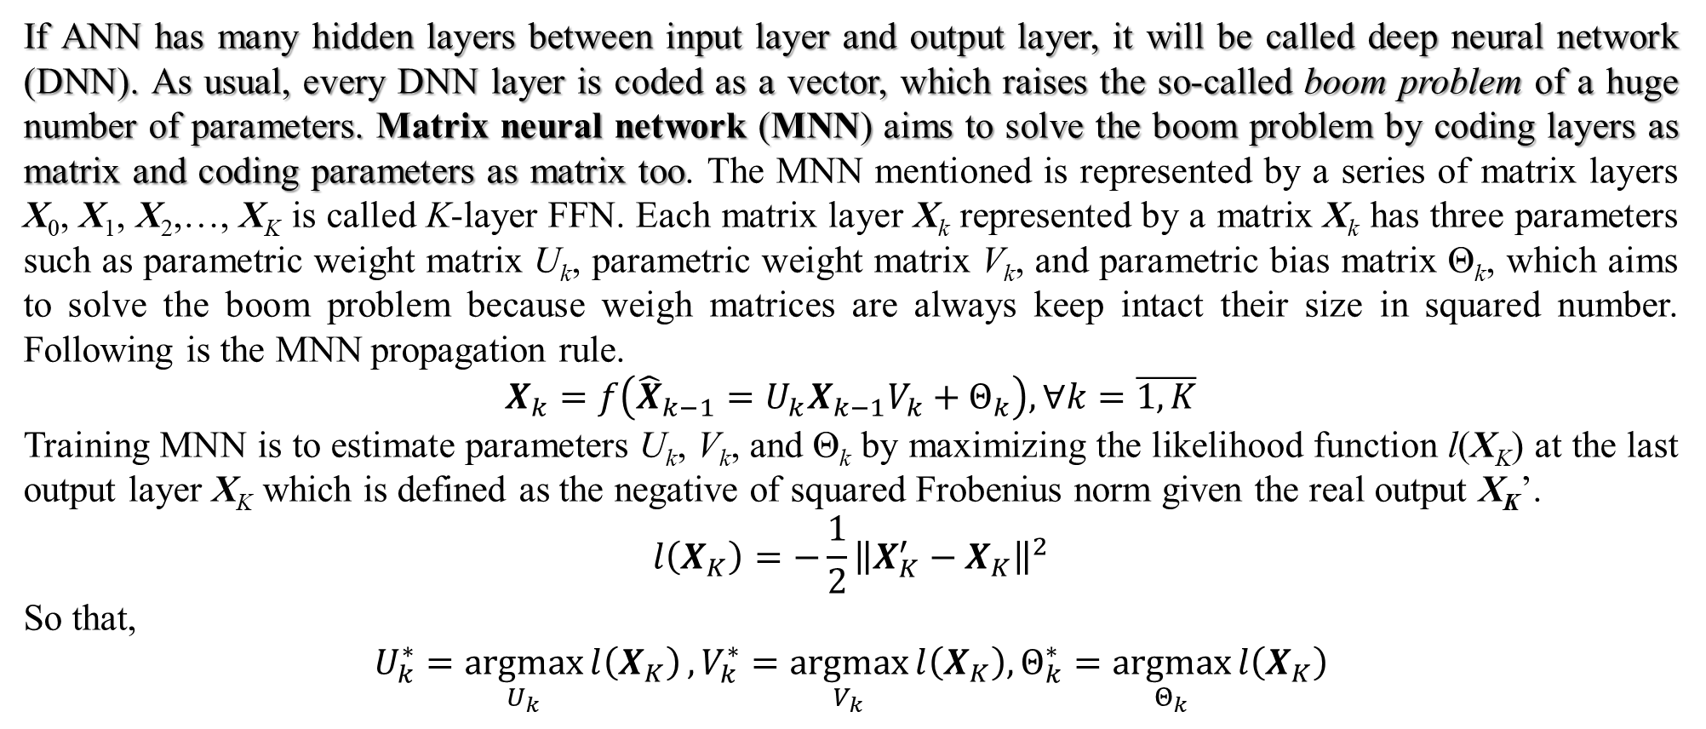
3. Matrix neural network (main)
If ANN has many hidden layers between input layer and output layer, it will be called deep neural network (DNN). As usual, every DNN layer is coded as a vector, which raises the so-called boom problem of a huge number of parameters. Matrix neural network (MNN) aims to solve the boom problem by coding layers as matrix and coding parameters as matrix too. The MNN mentioned is represented by a series of matrix layers X₀, X₁, X₂,…, X_{K} is called K-layer FFN. Each matrix layer X_{k} represented by a matrix X_{k} has three parameters such as parametric weight matrix U_{k}, parametric weight matrix V_{k}, and parametric bias matrix Θ_{k}, which aims to solve the boom problem because weigh matrices are always keep intact their size in squared number. Following is the MNN propagation rule.
$$X_{k}=f\left({\hat{X}}_{k−1}=U_{k}X_{k−1}V_{k}+Θ_{k}\right),∀k=\overline{1,K}$$
Training MNN is to estimate parameters U_{k}, V_{k}, and Θ_{k} by maximizing the likelihood function l(X_{K}) at the last output layer X_{K} which is defined as the negative of squared Frobenius norm given the real output X_{K}’.
$$l\left(X_{K}\right)=−\frac{1}{2}{\left\|X_{K}^{′}−X_{K}\right\|}^{2}$$
So that,
$$U_{k}^{∗}=\underset{U_{k}}{argmax}{l\left(X_{K}\right)},V_{k}^{∗}=\underset{V_{k}}{argmax}{l\left(X_{K}\right),Θ_{k}^{∗}=\underset{Θ_{k}}{argmax}{l\left(X_{K}\right)}}$$

Slide 15
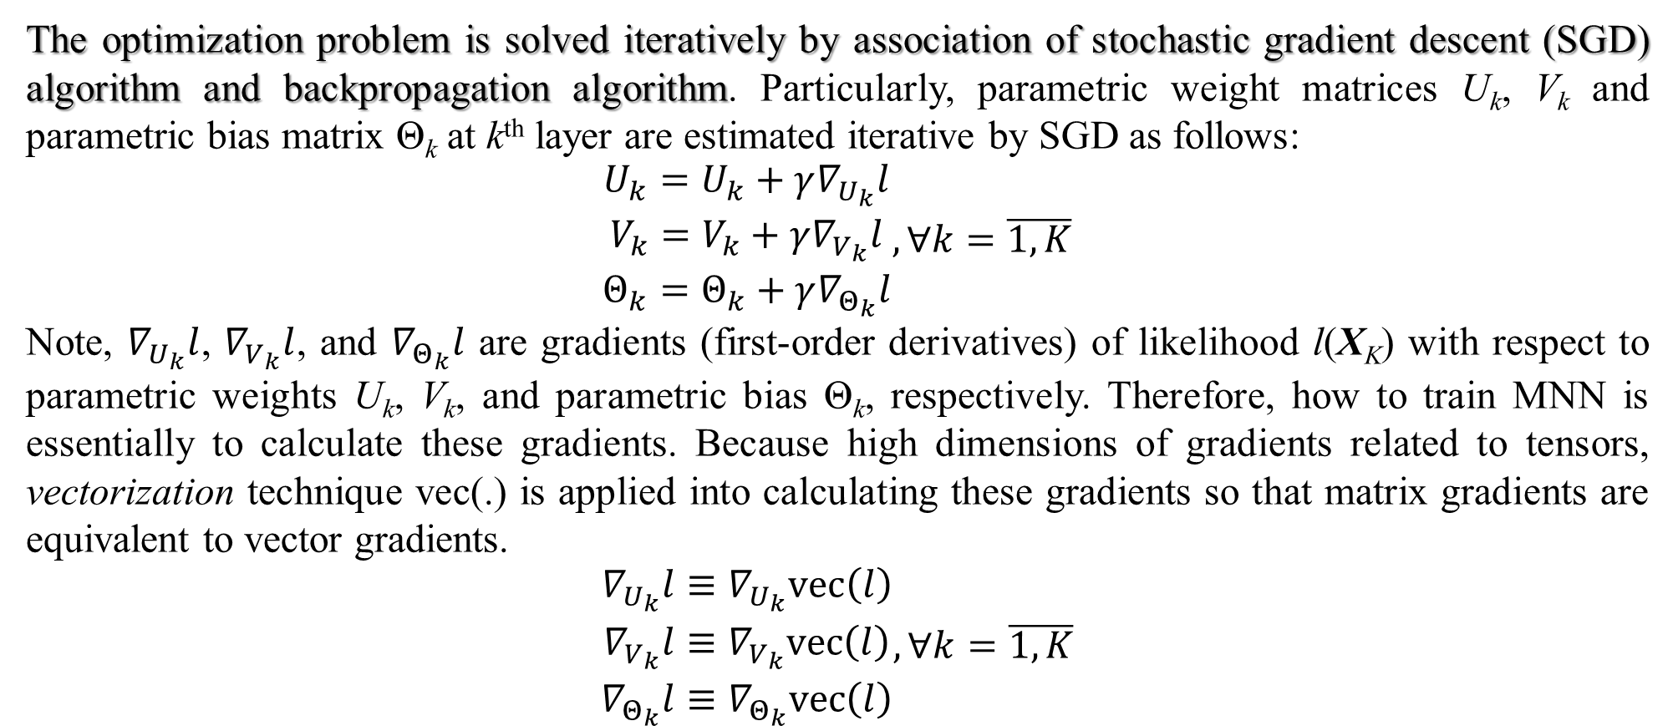
3. Matrix neural network
The optimization problem is solved iteratively by association of stochastic gradient descent (SGD) algorithm and backpropagation algorithm. Particularly, parametric weight matrices U_{k}, V_{k} and parametric bias matrix Θ_{k} at k^{th} layer are estimated iterative by SGD as follows:
$$\begin{matrix}U_{k}=U_{k}+γ∇_{U_{k}}l \\ V_{k}=V_{k}+γ∇_{V_{k}}l \\ Θ_{k}=Θ_{k}+γ∇_{Θ_{k}}l\end{matrix},∀k=\overline{1,K}$$
Note, $∇_{U_{k}}l$, $∇_{V_{k}}l$, and $∇_{Θ_{k}}l$ are gradients (first-order derivatives) of likelihood l(X_{K}) with respect to parametric weights U_{k}, V_{k}, and parametric bias Θ_{k}, respectively. Therefore, how to train MNN is essentially to calculate these gradients. Because high dimensions of gradients related to tensors, vectorization technique vec(.) is applied into calculating these gradients so that matrix gradients are equivalent to vector gradients.
$$\begin{matrix}∇_{U_{k}}l≡∇_{U_{k}}vec\left(l\right) \\ ∇_{V_{k}}l≡∇_{V_{k}}vec\left(l\right) \\ ∇_{Θ_{k}}l≡∇_{Θ_{k}}vec\left(l\right)\end{matrix},∀k=\overline{1,K}$$

Slide 16
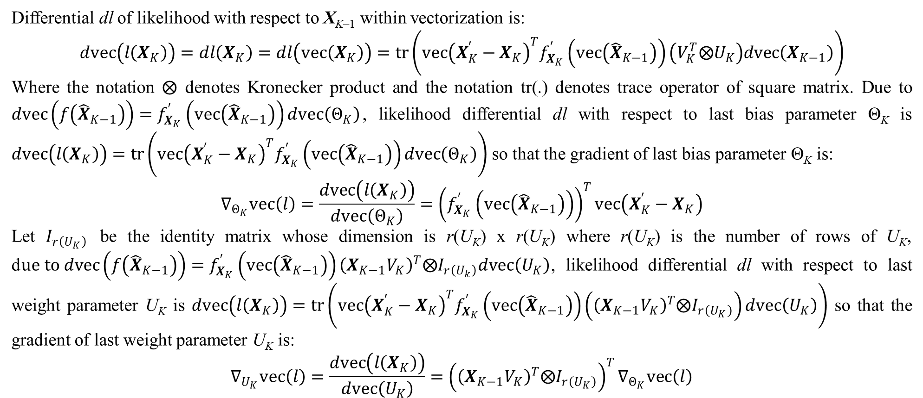
3. Matrix neural network (skip)
Differential dl of likelihood with respect to X_{K–1} within vectorization is:
$$dvec\left(l\left(X_{K}\right)\right)=dl\left(X_{K}\right)=dl\left(vec\left(X_{K}\right)\right)=tr\left({vec\left(X_{K}^{′}−X_{K}\right)}^{T}f_{X_{K}}^{′}\left(vec\left({\hat{X}}_{K−1}\right)\right)\left(V_{K}^{T}⨂U_{K}\right)dvec\left(X_{K−1}\right)\right)$$
Where the notation $⨂$ denotes Kronecker product and the notation tr(.) denotes trace operator of square matrix. Due to $dvec\left(f\left({\hat{X}}_{K−1}\right)\right)=f_{X_{K}}^{′}\left(vec\left({\hat{X}}_{K−1}\right)\right)dvec\left(Θ_{K}\right)$, likelihood differential dl with respect to last bias parameter Θ_{K} is $dvec\left(l\left(X_{K}\right)\right)=tr\left({vec\left(X_{K}^{′}−X_{K}\right)}^{T}f_{X_{K}}^{′}\left(vec\left({\hat{X}}_{K−1}\right)\right)dvec\left(Θ_{K}\right)\right)$ so that the gradient of last bias parameter Θ_{K} is:
$$∇_{Θ_{K}}vec\left(l\right)=\frac{dvec\left(l\left(X_{K}\right)\right)}{dvec\left(Θ_{K}\right)}={\left(f_{X_{K}}^{′}\left(vec\left({\hat{X}}_{K−1}\right)\right)\right)}^{T}vec\left(X_{K}^{′}−X_{K}\right)$$
Let $I_{r\left(U_{K}\right)}$ be the identity matrix whose dimension is r(U_{K}) x r(U_{K}) where r(U_{K}) is the number of rows of U_{K}, d$ue to dvec\left(f\left({\hat{X}}_{K−1}\right)\right)=f_{X_{K}}^{′}\left(vec\left({\hat{X}}_{K−1}\right)\right){\left(X_{K−1}V_{K}\right)}^{T}⨂I_{r\left(U_{k}\right)}dvec\left(U_{K}\right)$, likelihood differential dl with respect to last weight parameter U_{K} is $dvec\left(l\left(X_{K}\right)\right)=tr\left({vec\left(X_{K}^{′}−X_{K}\right)}^{T}f_{X_{K}}^{′}\left(vec\left({\hat{X}}_{K−1}\right)\right)\left({\left(X_{K−1}V_{K}\right)}^{T}⨂I_{r\left(U_{K}\right)}\right)dvec\left(U_{K}\right)\right)$ so that the gradient of last weight parameter U_{K} is:
$$∇_{U_{K}}vec\left(l\right)=\frac{dvec\left(l\left(X_{K}\right)\right)}{dvec\left(U_{K}\right)}={\left({\left(X_{K−1}V_{K}\right)}^{T}⨂I_{r\left(U_{K}\right)}\right)}^{T}∇_{Θ_{K}}vec\left(l\right)$$
Notes:
There are some mathematical calculations to estimate MNN parameters.

Slide 17
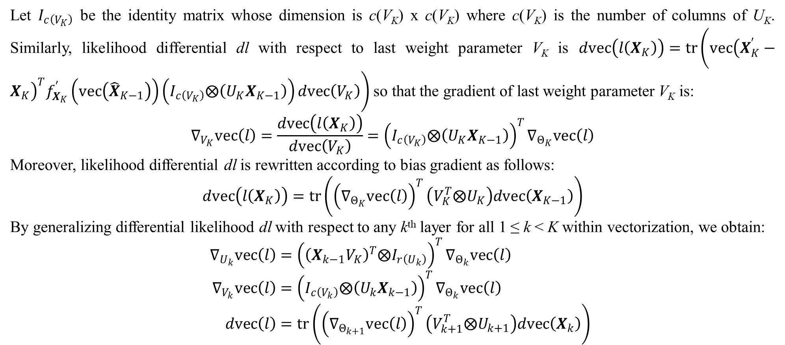
3. Matrix neural network (skip)
Let $I_{c\left(V_{K}\right)}$ be the identity matrix whose dimension is c(V_{K}) x c(V_{K}) where c(V_{K}) is the number of columns of U_{K}. Similarly, likelihood differential dl with respect to last weight parameter V_{K} is $dvec\left(l\left(X_{K}\right)\right)=tr\left({vec\left(X_{K}^{′}−X_{K}\right)}^{T}f_{X_{K}}^{′}\left(vec\left({\hat{X}}_{K−1}\right)\right)\left(I_{c\left(V_{K}\right)}⨂\left(U_{K}X_{K−1}\right)\right)dvec\left(V_{K}\right)\right)$ so that the gradient of last weight parameter V_{K} is:
$$∇_{V_{K}}vec\left(l\right)=\frac{dvec\left(l\left(X_{K}\right)\right)}{dvec\left(V_{K}\right)}={\left(I_{c\left(V_{K}\right)}⨂\left(U_{K}X_{K−1}\right)\right)}^{T}∇_{Θ_{K}}vec\left(l\right)$$
Moreover, likelihood differential dl is rewritten according to bias gradient as follows:
$$dvec\left(l\left(X_{K}\right)\right)=tr\left({\left(∇_{Θ_{K}}vec\left(l\right)\right)}^{T}\left(V_{K}^{T}⨂U_{K}\right)dvec\left(X_{K−1}\right)\right)$$
By generalizing differential likelihood dl with respect to any k^{th} layer for all 1 ≤ k < K within vectorization, we obtain:
$$∇_{U_{k}}vec\left(l\right)={\left({\left(X_{k−1}V_{K}\right)}^{T}⨂I_{r\left(U_{k}\right)}\right)}^{T}∇_{Θ_{k}}vec\left(l\right) \\ ∇_{V_{k}}vec\left(l\right)={\left(I_{c\left(V_{k}\right)}⨂\left(U_{k}X_{k−1}\right)\right)}^{T}∇_{Θ_{k}}vec\left(l\right) \\ dvec\left(l\right)=tr\left({\left(∇_{Θ_{k+1}}vec\left(l\right)\right)}^{T}\left(V_{k+1}^{T}⨂U_{k+1}\right)dvec\left(X_{k}\right)\right)$$

Slide 18
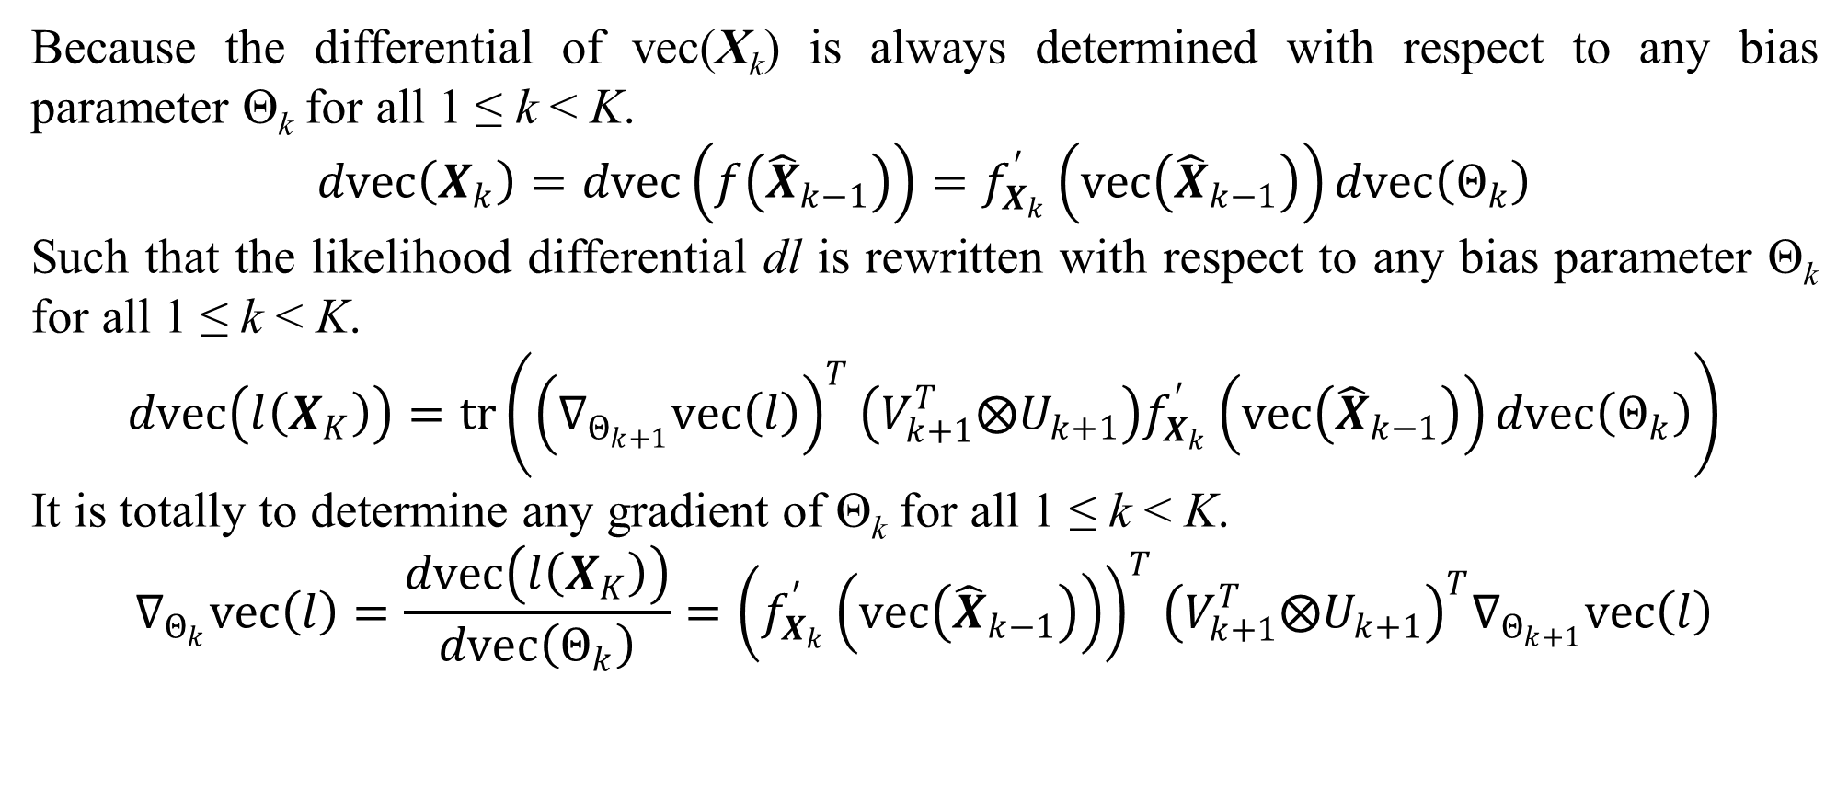
3. Matrix neural network (skip)
Because the differential of vec(X_{k}) is always determined with respect to any bias parameter Θ_{k} for all 1 ≤ k < K.
$$dvec\left(X_{k}\right)=dvec\left(f\left({\hat{X}}_{k−1}\right)\right)=f_{X_{k}}^{′}\left(vec\left({\hat{X}}_{k−1}\right)\right)dvec\left(Θ_{k}\right)$$
Such that the likelihood differential dl is rewritten with respect to any bias parameter Θ_{k} for all 1 ≤ k < K.
$$dvec\left(l\left(X_{K}\right)\right)=tr\left({\left(∇_{Θ_{k+1}}vec\left(l\right)\right)}^{T}\left(V_{k+1}^{T}⨂U_{k+1}\right)f_{X_{k}}^{′}\left(vec\left({\hat{X}}_{k−1}\right)\right)dvec\left(Θ_{k}\right)\right)$$
It is totally to determine any gradient of Θ_{k} for all 1 ≤ k < K.
$$∇_{Θ_{k}}vec\left(l\right)=\frac{dvec\left(l\left(X_{K}\right)\right)}{dvec\left(Θ_{k}\right)}={\left(f_{X_{k}}^{′}\left(vec\left({\hat{X}}_{k−1}\right)\right)\right)}^{T}{\left(V_{k+1}^{T}⨂U_{k+1}\right)}^{T}∇_{Θ_{k+1}}vec\left(l\right)$$

Slide 19
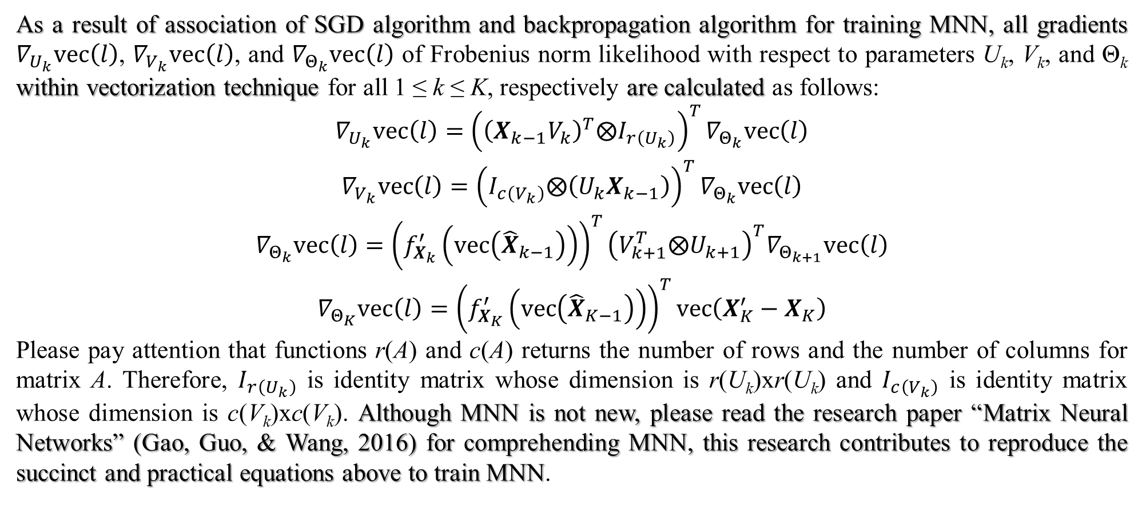
3. Matrix neural network (main)
As a result of association of SGD algorithm and backpropagation algorithm for training MNN, all gradients $∇_{U_{k}}vec\left(l\right)$, $∇_{V_{k}}vec\left(l\right)$, and $∇_{Θ_{k}}vec\left(l\right)$ of Frobenius norm likelihood with respect to parameters U_{k}, V_{k}, and Θ_{k} within vectorization technique for all 1 ≤ k ≤ K, respectively are calculated as follows:
$$\begin{matrix}∇_{U_{k}}vec\left(l\right)={\left({\left(X_{k−1}V_{k}\right)}^{T}⨂I_{r\left(U_{k}\right)}\right)}^{T}∇_{Θ_{k}}vec\left(l\right) \\ ∇_{V_{k}}vec\left(l\right)={\left(I_{c\left(V_{k}\right)}⨂\left(U_{k}X_{k−1}\right)\right)}^{T}∇_{Θ_{k}}vec\left(l\right) \\ ∇_{Θ_{k}}vec\left(l\right)={\left(f_{X_{k}}^{′}\left(vec\left({\hat{X}}_{k−1}\right)\right)\right)}^{T}{\left(V_{k+1}^{T}⨂U_{k+1}\right)}^{T}∇_{Θ_{k+1}}vec\left(l\right) \\ ∇_{Θ_{K}}vec\left(l\right)={\left(f_{X_{K}}^{′}\left(vec\left({\hat{X}}_{K−1}\right)\right)\right)}^{T}vec\left(X_{K}^{′}−X_{K}\right)\end{matrix}$$
Please pay attention that functions r(A) and c(A) returns the number of rows and the number of columns for matrix A. Therefore, $I_{r\left(U_{k}\right)}$ is identity matrix whose dimension is r(U_{k})xr(U_{k}) and $I_{c\left(V_{k}\right)}$ is identity matrix whose dimension is c(V_{k})xc(V_{k}). Although MNN is not new, please read the research paper “Matrix Neural Networks” (Gao, Guo, & Wang, 2016) for comprehending MNN, this research contributes to reproduce the succinct and practical equations above to train MNN.

Slide 20
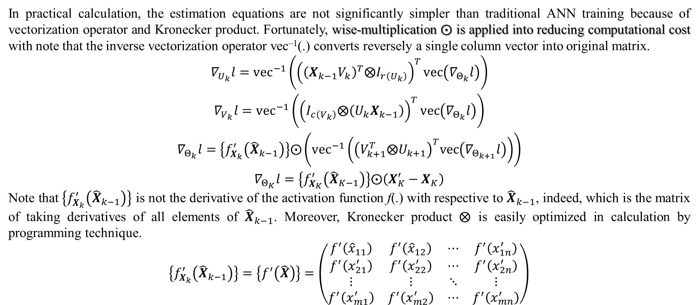
3. Matrix neural network
In practical calculation, the estimation equations are not significantly simpler than traditional ANN training because of vectorization operator and Kronecker product. Fortunately, wise-multiplication $⨀$ is applied into reducing computational cost with note that the inverse vectorization operator vec^{–1}(.) converts reversely a single column vector into original matrix.
$$\begin{matrix}∇_{U_{k}}l={vec}^{−1}\left({\left({\left(X_{k−1}V_{k}\right)}^{T}⨂I_{r\left(U_{k}\right)}\right)}^{T}vec\left(∇_{Θ_{k}}l\right)\right) \\ ∇_{V_{k}}l={vec}^{−1}\left({\left(I_{c\left(V_{k}\right)}⨂\left(U_{k}X_{k−1}\right)\right)}^{T}vec\left(∇_{Θ_{k}}l\right)\right) \\ ∇_{Θ_{k}}l=\left\{f_{X_{k}}^{′}\left({\hat{X}}_{k−1}\right)\right\}⨀\left({vec}^{−1}\left({\left(V_{k+1}^{T}⨂U_{k+1}\right)}^{T}vec\left(∇_{Θ_{k+1}}l\right)\right)\right) \\ ∇_{Θ_{K}}l=\left\{f_{X_{K}}^{′}\left({\hat{X}}_{K−1}\right)\right\}⨀\left(X_{K}^{′}−X_{K}\right)\end{matrix}$$
Note that $\left\{f_{X_{k}}^{′}\left({\hat{X}}_{k−1}\right)\right\}$ is not the derivative of the activation function f(.) with respective to ${\hat{X}}_{k−1}$, indeed, which is the matrix of taking derivatives of all elements of ${\hat{X}}_{k−1}$. Moreover, Kronecker product $⨂$ is easily optimized in calculation by programming technique.
$$\left\{f_{X_{k}}^{′}\left({\hat{X}}_{k−1}\right)\right\}=\left\{f^{′}\left(\hat{X}\right)\right\}=\left(\begin{matrix}f^{′}\left({\hat{x}}_{11}\right) & f^{′}\left({\hat{x}}_{12}\right) & ⋯ & f^{′}\left(x_{1n}^{′}\right) \\ f^{′}\left(x_{21}^{′}\right) & f^{′}\left(x_{22}^{′}\right) & ⋯ & f^{′}\left(x_{2n}^{′}\right) \\ ⋮ & ⋮ & ⋱ & ⋮ \\ f^{′}\left(x_{m1}^{′}\right) & f^{′}\left(x_{m2}^{′}\right) & ⋯ & f^{′}\left(x_{mn}^{′}\right)\end{matrix}\right)$$

Slide 21
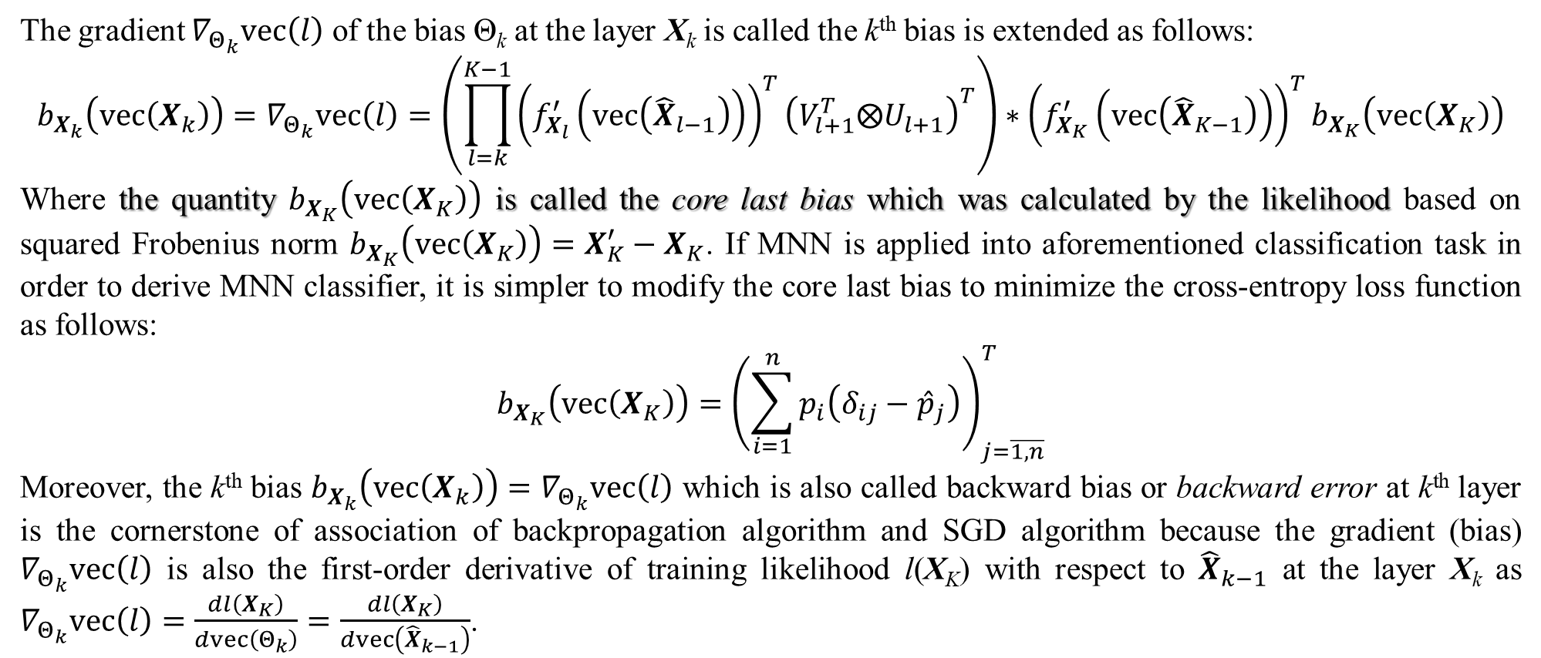
3. Matrix neural network
The gradient $∇_{Θ_{k}}vec\left(l\right)$ of the bias Θ_{k} at the layer X_{k} is called the k^{th} bias is extended as follows:
$$b_{X_{k}}\left(vec\left(X_{k}\right)\right)=∇_{Θ_{k}}vec\left(l\right)=\left(\prod_{l=k}^{K−1}{{\left(f_{X_{l}}^{′}\left(vec\left({\hat{X}}_{l−1}\right)\right)\right)}^{T}{\left(V_{l+1}^{T}⨂U_{l+1}\right)}^{T}}\right)∗{\left(f_{X_{K}}^{′}\left(vec\left({\hat{X}}_{K−1}\right)\right)\right)}^{T}b_{X_{K}}\left(vec\left(X_{K}\right)\right)$$
Where the quantity $b_{X_{K}}\left(vec\left(X_{K}\right)\right)$ is called the core last bias which was calculated by the likelihood based on squared Frobenius norm $b_{X_{K}}\left(vec\left(X_{K}\right)\right)=X_{K}^{′}−X_{K}$. If MNN is applied into aforementioned classification task in order to derive MNN classifier, it is simpler to modify the core last bias to minimize the cross-entropy loss function as follows:
$$b_{X_{K}}\left(vec\left(X_{K}\right)\right)={\left(\sum_{i=1}^{n}{p_{i}\left(δ_{ij}−{\hat{p}}_{j}\right)}\right)}_{j=\overline{1,n}}^{T}$$
Moreover, the k^{th} bias $b_{X_{k}}\left(vec\left(X_{k}\right)\right)=∇_{Θ_{k}}vec\left(l\right)$ which is also called backward bias or backward error at k^{th} layer is the cornerstone of association of backpropagation algorithm and SGD algorithm because the gradient (bias) $∇_{Θ_{k}}vec\left(l\right)$ is also the first-order derivative of training likelihood l(X_{K}) with respect to ${\hat{X}}_{k−1}$ at the layer X_{k} as $∇_{Θ_{k}}vec\left(l\right)=\frac{dl\left(X_{K}\right)}{dvec\left(Θ_{k}\right)}=\frac{dl\left(X_{K}\right)}{dvec\left({\hat{X}}_{k−1}\right)}$.

Slide 22
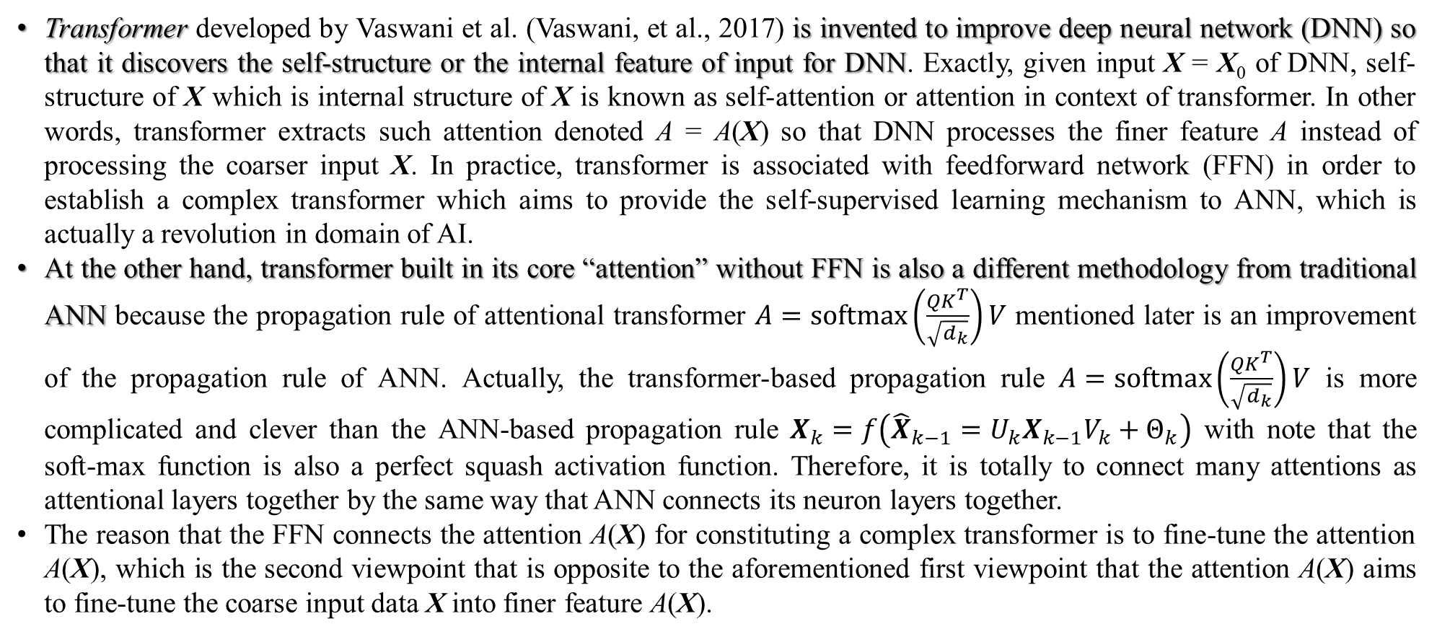
3. Matrix neural network (main)
Transformer developed by Vaswani et al. (Vaswani, et al., 2017) is invented to improve deep neural network (DNN) so that it discovers the self-structure or the internal feature of input for DNN. Exactly, given input X = X₀ of DNN, self-structure of X which is internal structure of X is known as self-attention or attention in context of transformer. In other words, transformer extracts such attention denoted A = A(X) so that DNN processes the finer feature A instead of processing the coarser input X. In practice, transformer is associated with feedforward network (FFN) in order to establish a complex transformer which aims to provide the self-supervised learning mechanism to ANN, which is actually a revolution in domain of AI.
At the other hand, transformer built in its core “attention” without FFN is also a different methodology from traditional ANN because the propagation rule of attentional transformer $A=softmax\left(\frac{QK^{T}}{\sqrt{d_{k}}}\right)V$ mentioned later is an improvement of the propagation rule of ANN. Actually, the transformer-based propagation rule $A=softmax\left(\frac{QK^{T}}{\sqrt{d_{k}}}\right)V$ is more complicated and clever than the ANN-based propagation rule $X_{k}=f\left({\hat{X}}_{k−1}=U_{k}X_{k−1}V_{k}+Θ_{k}\right)$ with note that the soft-max function is also a perfect squash activation function. Therefore, it is totally to connect many attentions as attentional layers together by the same way that ANN connects its neuron layers together.
The reason that the FFN connects the attention A(X) for constituting a complex transformer is to fine-tune the attention A(X), which is the second viewpoint that is opposite to the aforementioned first viewpoint that the attention A(X) aims to fine-tune the coarse input data X into finer feature A(X).

Slide 23
3. Matrix neural network
The essence of convolutional neural network (CNN) is to extract feature of image whereas the essence of transformer-based attention discovering is to extract feature of general data in matrix form. That is the reason of the main hypothesis of this research “Is matrix neural network (MNN) the alternative of CNN?”, which also implies that whether attention extracted by transformer can be the alternative of convolutional layer resulted by CNN when attention of transformer is always based on matrix. The first hazard problem is that CNN processes fast convolutional layer because of the implication of filter operating by small size of kernel whereas there is the aforementioned boom problem of ANN depends on flattening high-dimensional matrix-form data like image into vector-form input layer.
Fortunately, the first hazard problem is solved exactly by MNN where parameters of MNN are in matrix form. As a result, the fact that FFN of transformer is MNN is application of MNN into transformer so that the research focuses on the effectiveness of MNN in comparison with CNN in order to evaluate the hypothesis “Is MNN the alternative of CNN?” with note that convergence speed is also concerned when evaluating this hypothesis. Anyhow, it is necessary to sketch transformer and its extraction mechanism for extracting attention.

Slide 24
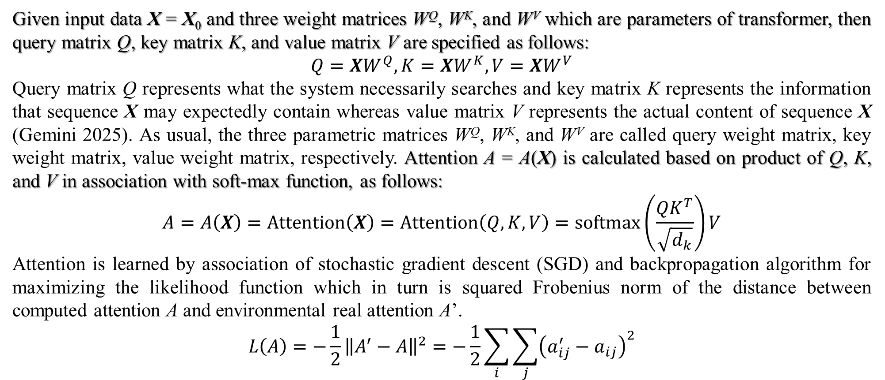
3. Matrix neural network (main)
Given input data X = X₀ and three weight matrices W^{Q}, W^{K}, and W^{V} which are parameters of transformer, then query matrix Q, key matrix K, and value matrix V are specified as follows:
$$Q=XW^{Q},K=XW^{K},V=XW^{V}$$
Query matrix Q represents what the system necessarily searches and key matrix K represents the information that sequence X may expectedly contain whereas value matrix V represents the actual content of sequence X (Gemini 2025). As usual, the three parametric matrices W^{Q}, W^{K}, and W^{V} are called query weight matrix, key weight matrix, value weight matrix, respectively. Attention A = A(X) is calculated based on product of Q, K, and V in association with soft-max function, as follows:
$$A=A\left(X\right)=Attention\left(X\right)=Attention\left(Q,K,V\right)=softmax\left(\frac{QK^{T}}{\sqrt{d_{k}}}\right)V$$
Attention is learned by association of stochastic gradient descent (SGD) and backpropagation algorithm for maximizing the likelihood function which in turn is squared Frobenius norm of the distance between computed attention A and environmental real attention A’.
$$L\left(A\right)=−\frac{1}{2}{\left\|A^{′}−A\right\|}^{2}=−\frac{1}{2}\sum_{i}{\sum_{j}{{\left(a_{ij}^{′}−a_{ij}\right)}^{2}}}$$

Slide 25
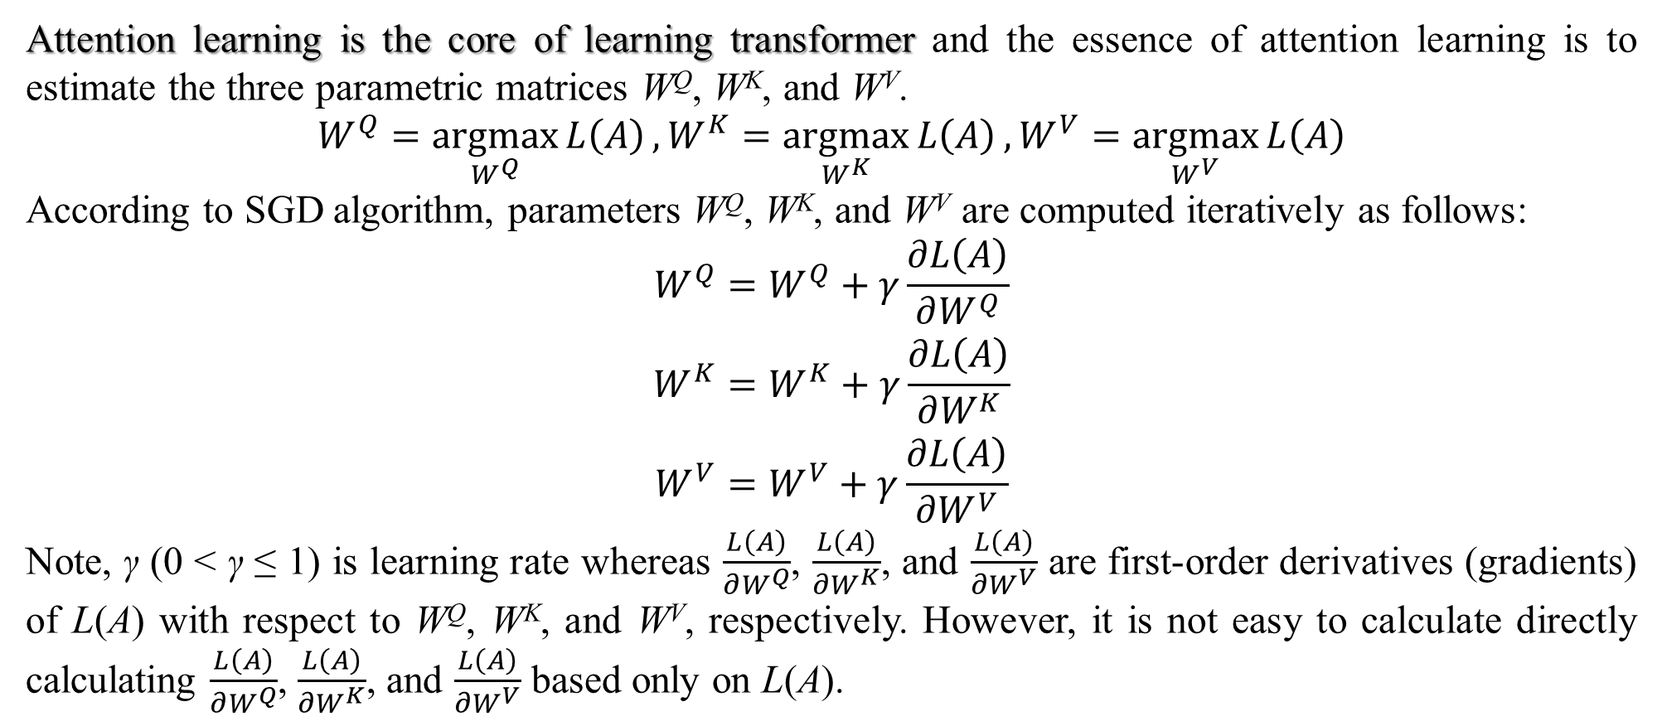
3. Matrix neural network
Attention learning is the core of learning transformer and the essence of attention learning is to estimate the three parametric matrices W^{Q}, W^{K}, and W^{V}.
$$W^{Q}=\underset{W^{Q}}{argmax}{L\left(A\right)},W^{K}=\underset{W^{K}}{argmax}{L\left(A\right)},W^{V}=\underset{W^{V}}{argmax}{L\left(A\right)}$$
According to SGD algorithm, parameters W^{Q}, W^{K}, and W^{V} are computed iteratively as follows:
$$\begin{matrix}W^{Q}=W^{Q}+γ\frac{∂L\left(A\right)}{∂W^{Q}} \\ W^{K}=W^{K}+γ\frac{∂L\left(A\right)}{∂W^{K}} \\ W^{V}=W^{V}+γ\frac{∂L\left(A\right)}{∂W^{V}}\end{matrix}$$
Note, γ (0 < γ ≤ 1) is learning rate whereas $\frac{L\left(A\right)}{∂W^{Q}}$, $\frac{L\left(A\right)}{∂W^{K}}$, and $\frac{L\left(A\right)}{∂W^{V}}$ are first-order derivatives (gradients) of L(A) with respect to W^{Q}, W^{K}, and W^{V}, respectively. However, it is not easy to calculate directly calculating $\frac{L\left(A\right)}{∂W^{Q}}$, $\frac{L\left(A\right)}{∂W^{K}}$, and $\frac{L\left(A\right)}{∂W^{V}}$ based only on L(A).

Slide 26
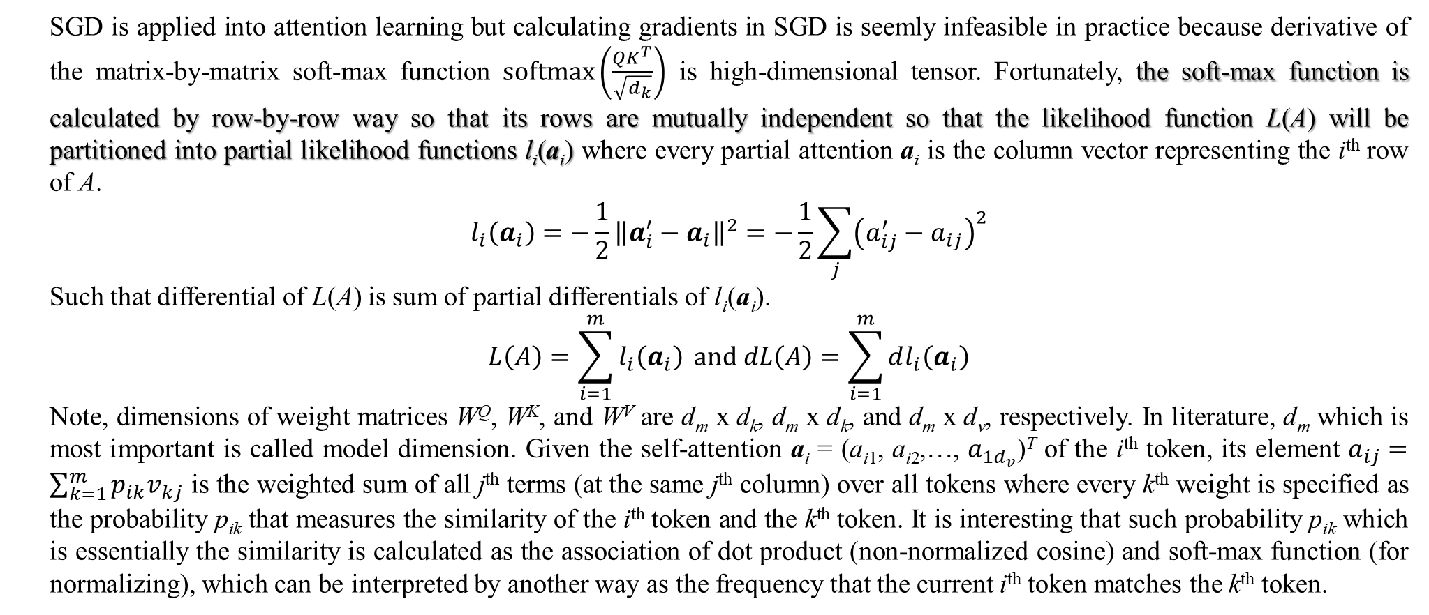
3. Matrix neural network
SGD is applied into attention learning but calculating gradients in SGD is seemly infeasible in practice because derivative of the matrix-by-matrix soft-max function $softmax\left(\frac{QK^{T}}{\sqrt{d_{k}}}\right)$ is high-dimensional tensor. Fortunately, the soft-max function is calculated by row-by-row way so that its rows are mutually independent so that the likelihood function L(A) will be partitioned into partial likelihood functions l_{i}(a_{i}) where every partial attention a_{i} is the column vector representing the i^{th} row of A.
$$l_{i}\left(a_{i}\right)=−\frac{1}{2}{\left\|a_{i}^{′}−a_{i}\right\|}^{2}=−\frac{1}{2}\sum_{j}{{\left(a_{ij}^{′}−a_{ij}\right)}^{2}}$$
Such that differential of L(A) is sum of partial differentials of l_{i}(a_{i}).
$$L\left(A\right)=\sum_{i=1}^{m}{l_{i}\left(a_{i}\right)} and dL\left(A\right)=\sum_{i=1}^{m}{dl_{i}\left(a_{i}\right)}$$
Note, dimensions of weight matrices W^{Q}, W^{K}, and W^{V} are d_{m} x d_{k}, d_{m} x d_{k}, and d_{m} x d_{v}, respectively. In literature, d_{m} which is most important is called model dimension. Given the self-attention a_{i} = (a_{i1}, a_{i2},…, $a_{1d_{v}}$)^{T} of the i^{th} token, its element $a_{ij}=\sum_{k=1}^{m}{p_{ik}v_{kj}}$ is the weighted sum of all j^{th} terms (at the same j^{th} column) over all tokens where every k^{th} weight is specified as the probability p_{ik} that measures the similarity of the i^{th} token and the k^{th} token. It is interesting that such probability p_{ik} which is essentially the similarity is calculated as the association of dot product (non-normalized cosine) and soft-max function (for normalizing), which can be interpreted by another way as the frequency that the current i^{th} token matches the k^{th} token.

Slide 27
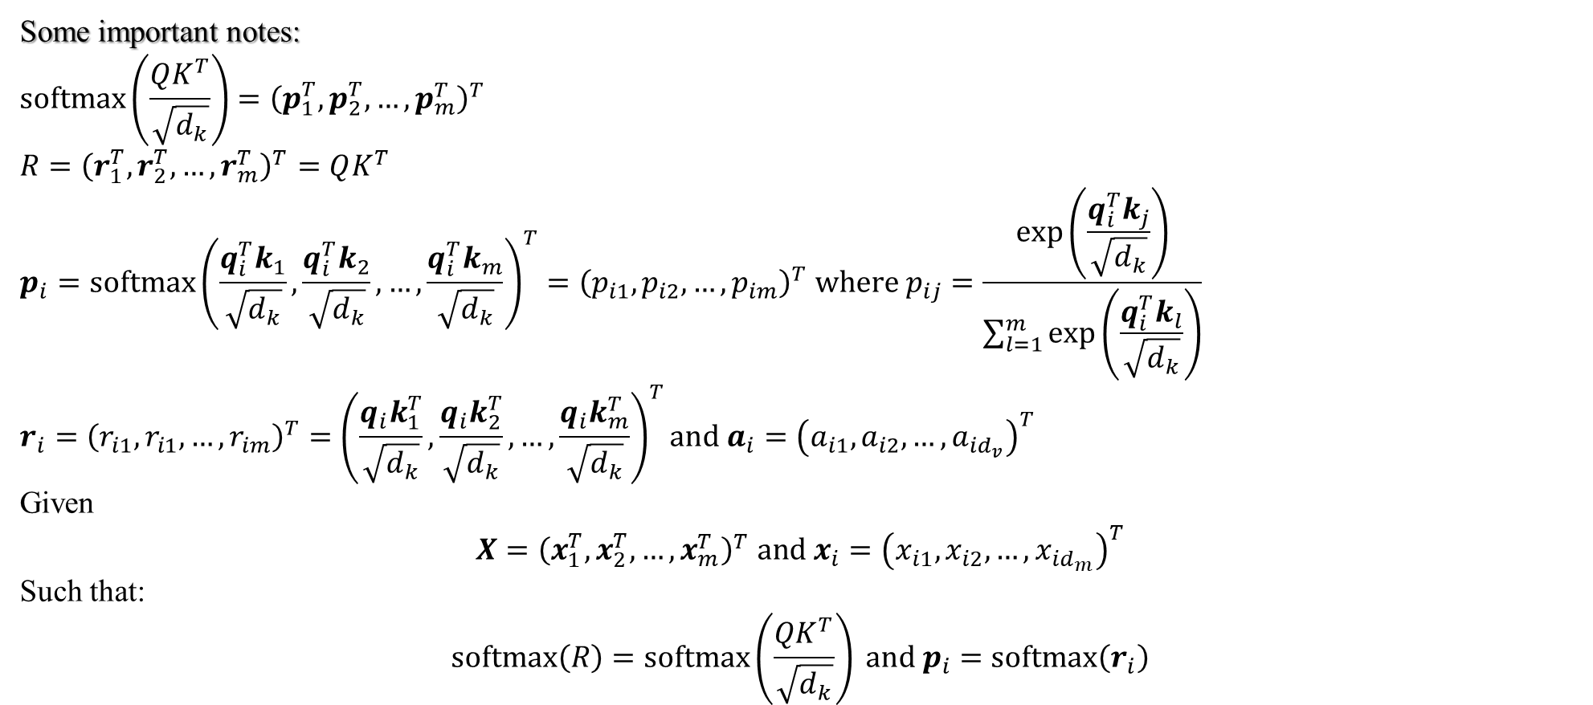
3. Matrix neural network (skip)
Some important notes:
$$softmax\left(\frac{QK^{T}}{\sqrt{d_{k}}}\right)={\left(p_{1}^{T},p_{2}^{T},…,p_{m}^{T}\right)}^{T}$$
$$R={\left(r_{1}^{T},r_{2}^{T},…,r_{m}^{T}\right)}^{T}=QK^{T}$$
$$p_{i}=softmax{\left(\frac{q_{i}^{T}k_{1}}{\sqrt{d_{k}}},\frac{q_{i}^{T}k_{2}}{\sqrt{d_{k}}},…,\frac{q_{i}^{T}k_{m}}{\sqrt{d_{k}}}\right)}^{T}={\left(p_{i1},p_{i2},…,p_{im}\right)}^{T} where p_{ij}=\frac{exp\left(\frac{q_{i}^{T}k_{j}}{\sqrt{d_{k}}}\right)}{\sum_{l=1}^{m}{exp\left(\frac{q_{i}^{T}k_{l}}{\sqrt{d_{k}}}\right)}}$$
$$r_{i}={\left(r_{i1},r_{i1},…,r_{im}\right)}^{T}={\left(\frac{q_{i}k_{1}^{T}}{\sqrt{d_{k}}},\frac{q_{i}k_{2}^{T}}{\sqrt{d_{k}}},…,\frac{q_{i}k_{m}^{T}}{\sqrt{d_{k}}}\right)}^{T}and a_{i}={\left(a_{i1},a_{i2},…,a_{id_{v}}\right)}^{T}$$
Given
$$X={\left(x_{1}^{T},x_{2}^{T},…,x_{m}^{T}\right)}^{T} and x_{i}={\left(x_{i1},x_{i2},…,x_{id_{m}}\right)}^{T}$$
Such that:
$$softmax\left(R\right)=softmax\left(\frac{QK^{T}}{\sqrt{d_{k}}}\right) and p_{i}=softmax\left(r_{i}\right)$$

Slide 28
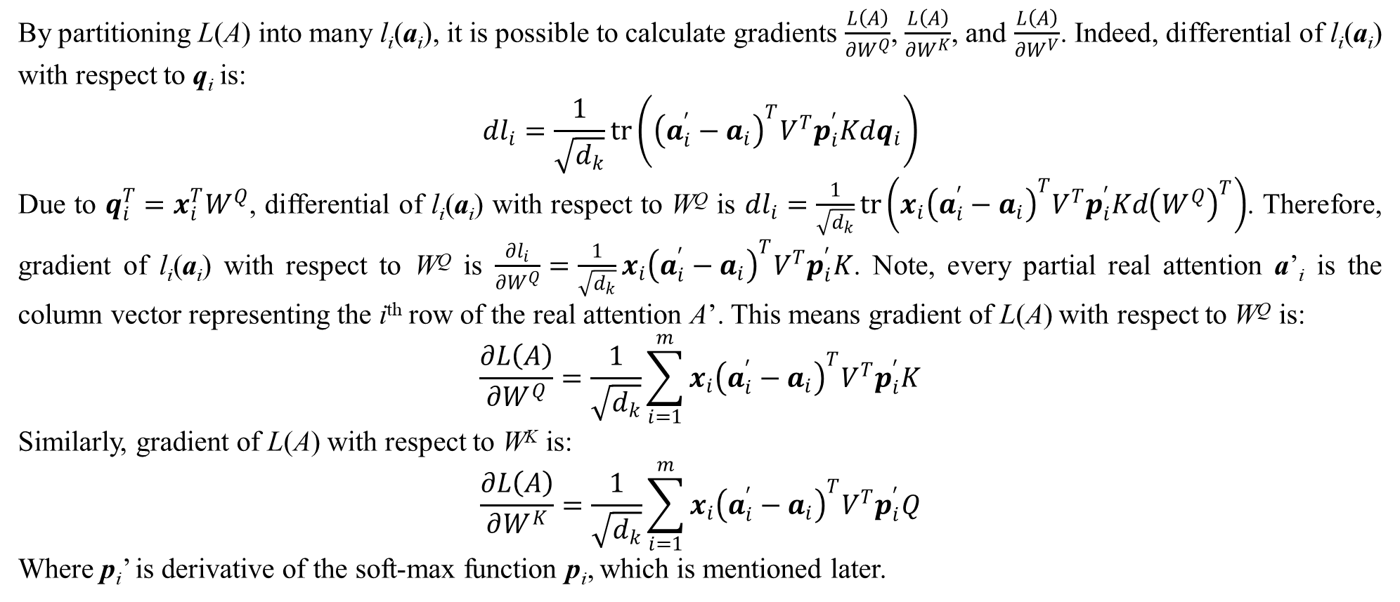
3. Matrix neural network (skip)
By partitioning L(A) into many l_{i}(a_{i}), it is possible to calculate gradients $\frac{L\left(A\right)}{∂W^{Q}}$, $\frac{L\left(A\right)}{∂W^{K}}$, and $\frac{L\left(A\right)}{∂W^{V}}$. Indeed, differential of l_{i}(a_{i}) with respect to q_{i} is:
$$dl_{i}=\frac{1}{\sqrt{d_{k}}}tr\left({\left(a_{i}^{′}−a_{i}\right)}^{T}V^{T}p_{i}^{′}Kdq_{i}\right)$$
Due to $q_{i}^{T}=x_{i}^{T}W^{Q}$, differential of l_{i}(a_{i}) with respect to W^{Q} is $dl_{i}=\frac{1}{\sqrt{d_{k}}}tr\left({x_{i}\left(a_{i}^{′}−a_{i}\right)}^{T}V^{T}p_{i}^{′}Kd{\left(W^{Q}\right)}^{T}\right)$. Therefore, gradient of l_{i}(a_{i}) with respect to W^{Q} is $\frac{∂l_{i}}{∂W^{Q}}=\frac{1}{\sqrt{d_{k}}}{x_{i}\left(a_{i}^{′}−a_{i}\right)}^{T}V^{T}p_{i}^{′}K$. Note, every partial real attention a’_{i} is the column vector representing the i^{th} row of the real attention A’. This means gradient of L(A) with respect to W^{Q} is:
$$\frac{∂L\left(A\right)}{∂W^{Q}}=\frac{1}{\sqrt{d_{k}}}\sum_{i=1}^{m}{{x_{i}\left(a_{i}^{′}−a_{i}\right)}^{T}V^{T}p_{i}^{′}K}$$
Similarly, gradient of L(A) with respect to W^{K} is:
$$\frac{∂L\left(A\right)}{∂W^{K}}=\frac{1}{\sqrt{d_{k}}}\sum_{i=1}^{m}{x_{i}{\left(a_{i}^{′}−a_{i}\right)}^{T}V^{T}p_{i}^{′}Q}$$
Where p_{i}’ is derivative of the soft-max function p_{i}, which is mentioned later.
Notes:
Some mathematical calculations to estimate transformer parameters.

Slide 29
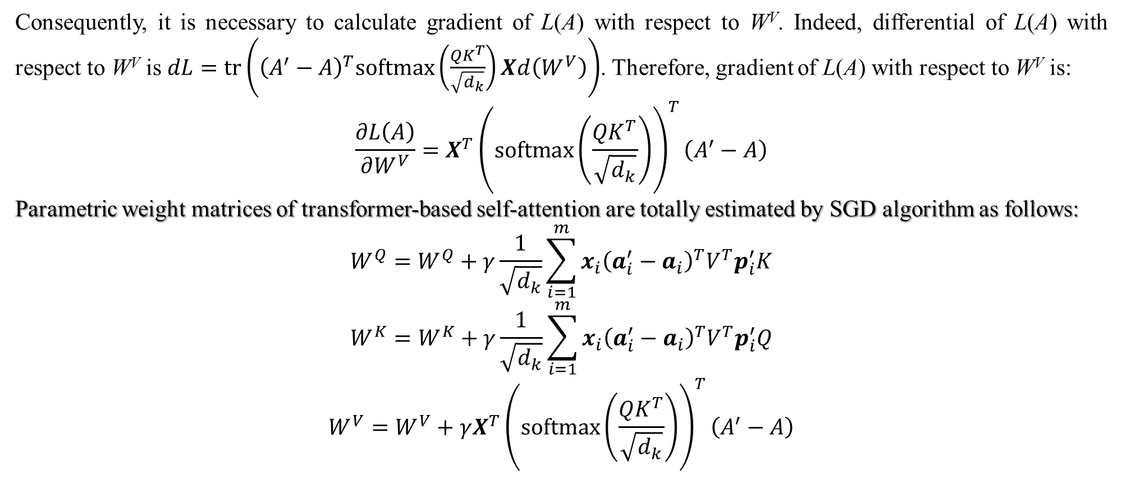
3. Matrix neural network (main)
Consequently, it is necessary to calculate gradient of L(A) with respect to W^{V}. Indeed, differential of L(A) with respect to W^{V} is $dL=tr\left({\left(A^{′}−A\right)}^{T}softmax\left(\frac{QK^{T}}{\sqrt{d_{k}}}\right)Xd\left(W^{V}\right)\right)$. Therefore, gradient of L(A) with respect to W^{V} is:
$$\frac{∂L\left(A\right)}{∂W^{V}}=X^{T}{\left(softmax\left(\frac{QK^{T}}{\sqrt{d_{k}}}\right)\right)}^{T}\left(A^{′}−A\right)$$
Parametric weight matrices of transformer-based self-attention are totally estimated by SGD algorithm as follows:
$$W^{Q}=W^{Q}+γ\frac{1}{\sqrt{d_{k}}}\sum_{i=1}^{m}{{x_{i}\left(a_{i}^{′}−a_{i}\right)}^{T}V^{T}p_{i}^{′}K}$$
$$W^{K}=W^{K}+γ\frac{1}{\sqrt{d_{k}}}\sum_{i=1}^{m}{{x_{i}\left(a_{i}^{′}−a_{i}\right)}^{T}V^{T}p_{i}^{′}Q}$$
$$W^{V}=W^{V}+γX^{T}{\left(softmax\left(\frac{QK^{T}}{\sqrt{d_{k}}}\right)\right)}^{T}\left(A^{′}−A\right)$$

Slide 30
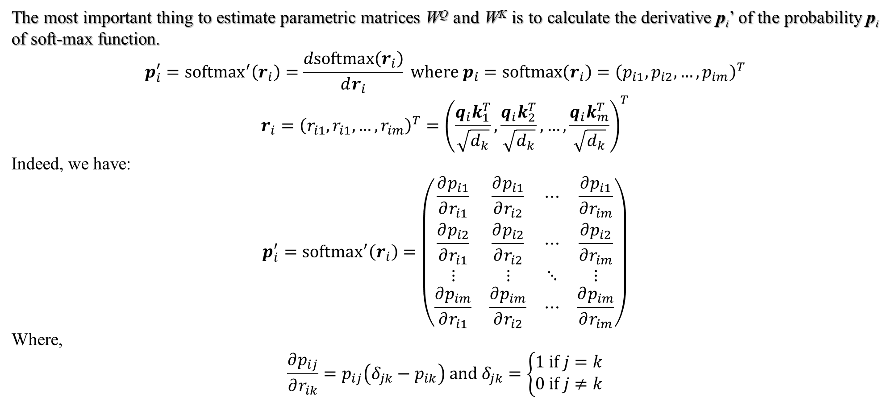
3. Matrix neural network
The most important thing to estimate parametric matrices W^{Q} and W^{K} is to calculate the derivative p_{i}’ of the probability p_{i} of soft-max function.
$$p_{i}^{′}={softmax}^{′}\left(r_{i}\right)=\frac{dsoftmax\left(r_{i}\right)}{dr_{i}} where p_{i}=softmax\left(r_{i}\right)={\left(p_{i1},p_{i2},…,p_{im}\right)}^{T}$$
$$r_{i}={\left(r_{i1},r_{i1},…,r_{im}\right)}^{T}={\left(\frac{q_{i}k_{1}^{T}}{\sqrt{d_{k}}},\frac{q_{i}k_{2}^{T}}{\sqrt{d_{k}}},…,\frac{q_{i}k_{m}^{T}}{\sqrt{d_{k}}}\right)}^{T}$$
Indeed, we have:
$$p_{i}^{′}={softmax}^{′}\left(r_{i}\right)=\left(\begin{matrix}\frac{∂p_{i1}}{∂r_{i1}} & \frac{∂p_{i1}}{∂r_{i2}} & ⋯ & \frac{∂p_{i1}}{∂r_{im}} \\ \frac{∂p_{i2}}{∂r_{i1}} & \frac{∂p_{i2}}{∂r_{i2}} & ⋯ & \frac{∂p_{i2}}{∂r_{im}} \\ ⋮ & ⋮ & ⋱ & ⋮ \\ \frac{∂p_{im}}{∂r_{i1}} & \frac{∂p_{im}}{∂r_{i2}} & ⋯ & \frac{∂p_{im}}{∂r_{im}}\end{matrix}\right)$$
Where,
$$\frac{∂p_{ij}}{∂r_{ik}}=p_{ij}\left(δ_{jk}−p_{ik}\right) and δ_{jk}=\left\{\begin{matrix}1 if j=k \\ 0 if j≠k\end{matrix}\right.$$

Slide 31
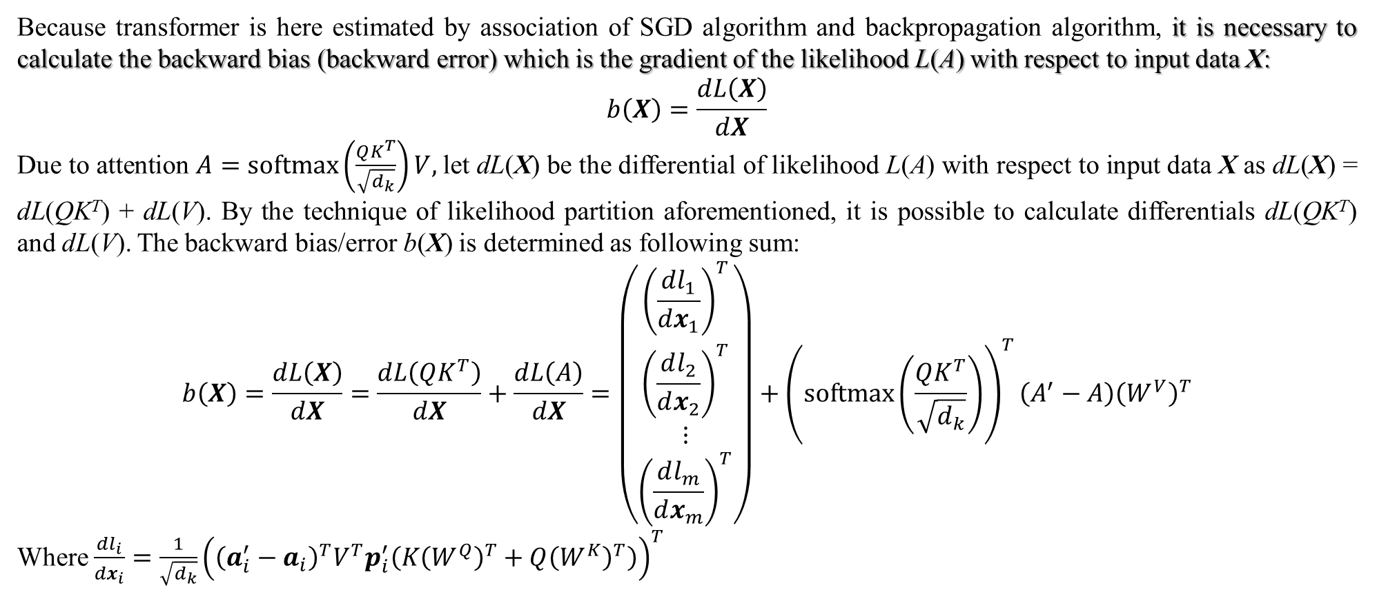
3. Matrix neural network
Because transformer is here estimated by association of SGD algorithm and backpropagation algorithm, it is necessary to calculate the backward bias (backward error) which is the gradient of the likelihood L(A) with respect to input data X:
$$b\left(X\right)=\frac{dL\left(X\right)}{dX}$$
Due to attention $A=softmax\left(\frac{QK^{T}}{\sqrt{d_{k}}}\right)V,$let dL(X) be the differential of likelihood L(A) with respect to input data X as dL(X) = dL(QK^{T}) + dL(V). By the technique of likelihood partition aforementioned, it is possible to calculate differentials dL(QK^{T}) and dL(V). The backward bias/error b(X) is determined as following sum:
$$b\left(X\right)=\frac{dL\left(X\right)}{dX}=\frac{dL\left(QK^{T}\right)}{dX}+\frac{dL\left(A\right)}{dX}=\left(\begin{matrix}{\left(\frac{dl_{1}}{dx_{1}}\right)}^{T} \\ {\left(\frac{dl_{2}}{dx_{2}}\right)}^{T} \\ ⋮ \\ {\left(\frac{dl_{m}}{dx_{m}}\right)}^{T}\end{matrix}\right)+{\left(softmax\left(\frac{QK^{T}}{\sqrt{d_{k}}}\right)\right)}^{T}\left(A^{′}−A\right){\left(W^{V}\right)}^{T}$$
Where $\frac{dl_{i}}{dx_{i}}=\frac{1}{\sqrt{d_{k}}}{\left({\left(a_{i}^{′}−a_{i}\right)}^{T}V^{T}p_{i}^{′}\left(K{\left(W^{Q}\right)}^{T}+Q{\left(W^{K}\right)}^{T}\right)\right)}^{T}$

Slide 32
3. Matrix neural network (main)
Recall that this research focuses on evaluating the hypothesis “whether matrix neural network is the alternative of convolutional neural network”, which means to test the preeminence of matrix neural network (MNN) in comparison with convolutional neural network (CNN). Moreover, the hypothesis in this research relates to transformer too because attention, which is the first part of transformer, is totally based on matrix although the second part of transformer, which is feed-forward network (FFN), can be matrix artificial neural network called MNN or vector artificial neural network called vector ANN. As a convention, the transformer whose FFN is MNN is called matrix transformer and the transformer whose FFN is vector ANN is called vector transformer. Among many applications related to CNN and transformer, this research focuses on application of image classification and thus, image classification is tested with ANN, MNN, matrix transformer and vector transformer. Therefore, the main hypothesis “whether MNN is the alternative of CNN” will lead to the first auxiliary hypothesis “whether attention is the alternative of CNN too” when attention plays the role of feature like convolutional layer although the attention-based feature is self-structure or internal structure, actually.
Besides, if both MNN and attention are good enough in comparison with CNN although both of them cannot totally replace CNN, then FFN of transformer should be MNN because of the harmonization of both computational cost and accuracy. In other words, the second auxiliary hypothesis “whether FFN of transformer should be MNN” (whether matrix transformer is preferred to vector transformer) is tested.

Slide 33
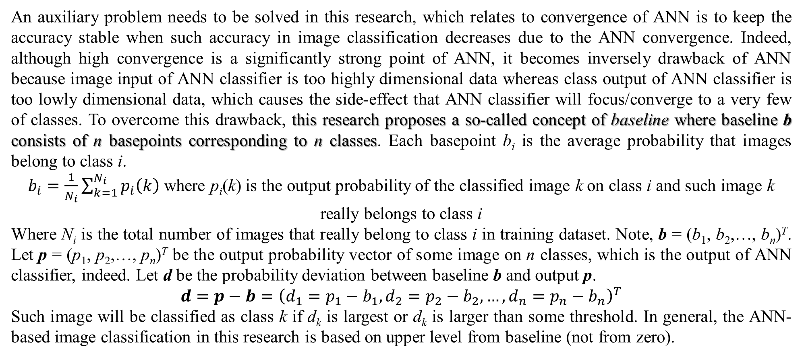
3. Matrix neural network (main)
An auxiliary problem needs to be solved in this research, which relates to convergence of ANN is to keep the accuracy stable when such accuracy in image classification decreases due to the ANN convergence. Indeed, although high convergence is a significantly strong point of ANN, it becomes inversely drawback of ANN because image input of ANN classifier is too highly dimensional data whereas class output of ANN classifier is too lowly dimensional data, which causes the side-effect that ANN classifier will focus/converge to a very few of classes. To overcome this drawback, this research proposes a so-called concept of baseline where baseline b consists of n basepoints corresponding to n classes. Each basepoint b_{i} is the average probability that images belong to class i.
$b_{i}=\frac{1}{N_{i}}\sum_{k=1}^{N_{i}}{p_{i}\left(k\right)}$ where p_{i}(k) is the output probability of the classified image k on class i and such image k really belongs to class i
Where N_{i} is the total number of images that really belong to class i in training dataset. Note, b = (b₁, b₂,…, b_{n})^{T}. Let p = (p₁, p₂,…, p_{n})^{T} be the output probability vector of some image on n classes, which is the output of ANN classifier, indeed. Let d be the probability deviation between baseline b and output p.
$$d=p−b={\left(d_{1}=p_{1}−b_{1},d_{2}=p_{2}−b_{2},…,d_{n}=p_{n}−b_{n}\right)}^{T}$$
Such image will be classified as class k if d_{k} is largest or d_{k} is larger than some threshold. In general, the ANN-based image classification in this research is based on upper level from baseline (not from zero).

Slide 34
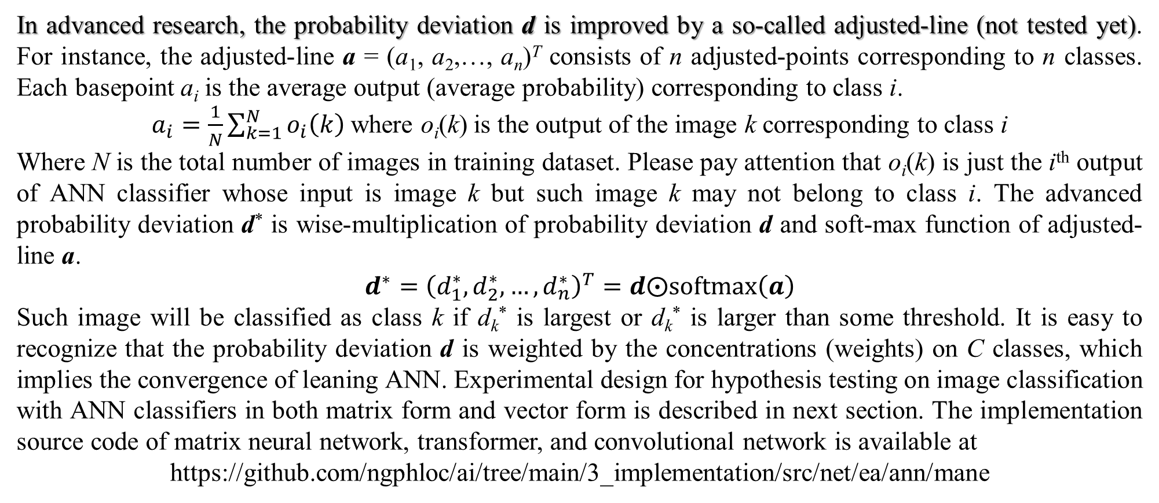
3. Matrix neural network
In advanced research, the probability deviation d is improved by a so-called adjusted-line (not tested yet). For instance, the adjusted-line a = (a₁, a₂,…, a_{n})^{T} consists of n adjusted-points corresponding to n classes. Each basepoint a_{i} is the average output (average probability) corresponding to class i.
$a_{i}=\frac{1}{N}\sum_{k=1}^{N}{o_{i}\left(k\right)}$ where o_{i}(k) is the output of the image k corresponding to class i
Where N is the total number of images in training dataset. Please pay attention that o_{i}(k) is just the i^{th} output of ANN classifier whose input is image k but such image k may not belong to class i. The advanced probability deviation d* is wise-multiplication of probability deviation d and soft-max function of adjusted-line a.
$$d^{∗}={\left(d_{1}^{∗},d_{2}^{∗},…,d_{n}^{∗}\right)}^{T}=d⨀softmax\left(a\right)$$
Such image will be classified as class k if d_{k}* is largest or d_{k}* is larger than some threshold. It is easy to recognize that the probability deviation d is weighted by the concentrations (weights) on C classes, which implies the convergence of leaning ANN. Experimental design for hypothesis testing on image classification with ANN classifiers in both matrix form and vector form is described in next section. The implementation source code of matrix neural network, transformer, and convolutional network is available at
https://github.com/ngphloc/ai/tree/main/3_implementation/src/net/ea/ann/mane

Slide 35
4. Experimental design (main)
The experiments in this research focus on image classification by matrix neural network (MNN) called MNN classifier, convolutional neural network (CNN) called CNN classifier, and transformer called transformer-based classifier (TB classifier). The main purpose of this experimental design is to evaluate the preeminence of matrix neural network in comparisons among MNN classifier, CNN classifier, and TB classifier, which is also related to diversity metric and convergence speed although accuracy metric in classification is also concerned because there are many excellent research resulting out very high accuracy in image classification. In testing dataset, MNN classifier, TB classifier, and CNN classifier are represented by the “feature” field whose values are “weight”, “trans”, and “conv”, respectively. The aspect of traditional artificial neural network is that its layers are vectors, in other word, its aspect is vectorization. Therefore, testing dataset has the second field called “vec” field whose values are true and false representing whether or not MNN classifier, TB classifier, and CNN classifier are vectorized. When each classifier is vectorized, only its feedforward network (FFN) is vectorized because each classifier always has two parts: 1) the first part for feature extraction is always MNN, attention, or convolutional layers and 2) the second part for classification is always FFN.
Experimental design also aims to two-way analysis of variance (two-way ANOVA) whose groups are feature field and vec field. Ultimately, the two-way ANOVA aims to test the three hypotheses: 1) whether MNN is the alternative of CNN, which focuses on testing the preeminence of MNN classifier in comparison with TB classifier and CNN classifier via testing the feature group, 2) whether attention is the alternative of CNN, which focuses on testing the preeminence of TB classifier in comparison with MNN classifier and CNN classifier via testing the feature group, and 3) whether FFN of transformer should be MNN via testing the vec group.

Slide 36
4. Experimental design
Recall that the three classifiers such MNN classifier, TB classifier, and CNN classifier have always two parts such as first part for image feature extraction and second part for feature classification. Therefore, MNN classifier has one MNN and one FFN and TB classifier has one attentional network and one FNN whereas CNN classifier has one convolutional network and one FFN. Please pay attention that MNN, attentional network, and convolutional network follow VGG architecture.
MNN, attentional network, and convolutional network are indicated by the common term which is feature extraction network (FEN) so that FFN is called feature classification network (FCN). A FEN has some blocks and each block is a set of sequential layers. A FCN has two layers which are always traditional neural network layer.
Every FEN layer is always associated with a so-called FEN filter but please distinguish FEN filter from filtering kernel aforementioned. FEN filter of matrix layer is parametric weight matrix as usual, which is called matrix filter. FEN filter of attentional layer is attention itself, which is called attentional filter. FEN filter of convolutional layer is filtering kernel as usual, which is called convolutional filter. However, please pay attention that the last layer of any FEN block is the specific layer called max-pooling layer whose filter is aforementioned max-pooling kernel which is called max-pooling filter.

Slide 37
4. Experimental design (main)
The experimental design has two important configuration variable such as experimental variable “base” and experimental variable “layer” with respect to FEN. The current setting of base variable is 2 and there are two values of layer variable such as 2 and 3. The base variable (base=2) is the divisor of block size, which leads that all classifiers (MNN, TB, CNN) in the experimental design have two FEN blocks. Layer variable (2, 3) is the number of layers in each block. Exactly, given layer=2, the first FEN block has two FEN layers and the second FEN block has three FEN layers and one max-pooling layer so that FEN has five layers. Similarly, given layer=3, the first FEN block has two FEN layers and the second FEN block has three FEN layers and one max-pooling layer so that FEN has seven layers.
Suppose layer size follows three-dimension size like width x height x depth, all layers in the same block have the same width x height size and such width x height size is decreased according to block ordering by divisor base. Therefore, the width x height size of all layers in the same block is considered as width x height block size or block size. Recall that the base variable (base=2) is the divisor of block size so that block size is decreased according to block ordering by divisor base. Suppose the first block has size of 32 x 32, then the second block has size of 16 x 16. The depth of all layers in the same block is considered as block depth. Block depth is also the count of filters (filter count) in every layer in the same block. Block depth is increased according to block ordering by exponential function of variable layer.

Slide 38
4. Experimental design (skip)
Following table summarizes the configuration of FEN for every classifier (MNN, TB, CNN) given layer=2.
Following table summarizes the configuration of FEN for every classifier (MNN, TB, CNN) given layer=3.
The experimental design establishes FCN to have always two layers where the last layer (output layer) is the set of image classes. Recall that whether or not FCN is vectorized depends on “vec” field in dataset (vec group in ANOVA). Finally, each classifier (MNN, TB, CNN) including FEN and FCN has 7 layers given layer=2 and has 9 layers given layer=3.
Block | Layer | Input dimension | Filter dimension | Filter count | Output dimension
1 | layer1_1 | 32 x 32 x 3 | 3 x 3 x 3 | 2 | 32 x 32 x 2
 | layer1_2 | 32 x 32 x 2 | 3 x 3 x 2 | 2 | 32 x 32 x 2
 | maxpool1 | 32 x 32 x 2 | 2 x 2 |  | 16 x 16 x 2
2 | layer2_1 | 16 x 16 x 2 | 3 x 3 x 2 | 4 | 16 x 16 x 4
 | layer2_2 | 16 x 16 x 4 | 3 x 3 x 4 | 4 | 16 x 16 x 4
Block | Layer | Input dimension | Filter dimension | Filter count | Output dimension
1 | layer1_1 | 32 x 32 x 3 | 3 x 3 x 3 | 3 | 32 x 32 x 3
 | layer1_2 | 32 x 32 x 3 | 3 x 3 x 3 | 3 | 32 x 32 x 3
 | layer1_3 | 32 x 32 x 3 | 3 x 3 x 3 | 3 | 32 x 32 x 3
 | maxpool1 | 32 x 32 x 3 | 2 x 2 |  | 16 x 16 x 3
2 | layer2_1 | 16 x 16 x 3 | 3 x 3 x 3 | 9 | 16 x 16 x 9
 | layer2_2 | 16 x 16 x 9 | 3 x 3 x 9 | 9 | 16 x 16 x 9
 | layer2_3 | 16 x 16 x 9 | 3 x 3 x 9 | 9 | 16 x 16 x 9

Slide 39
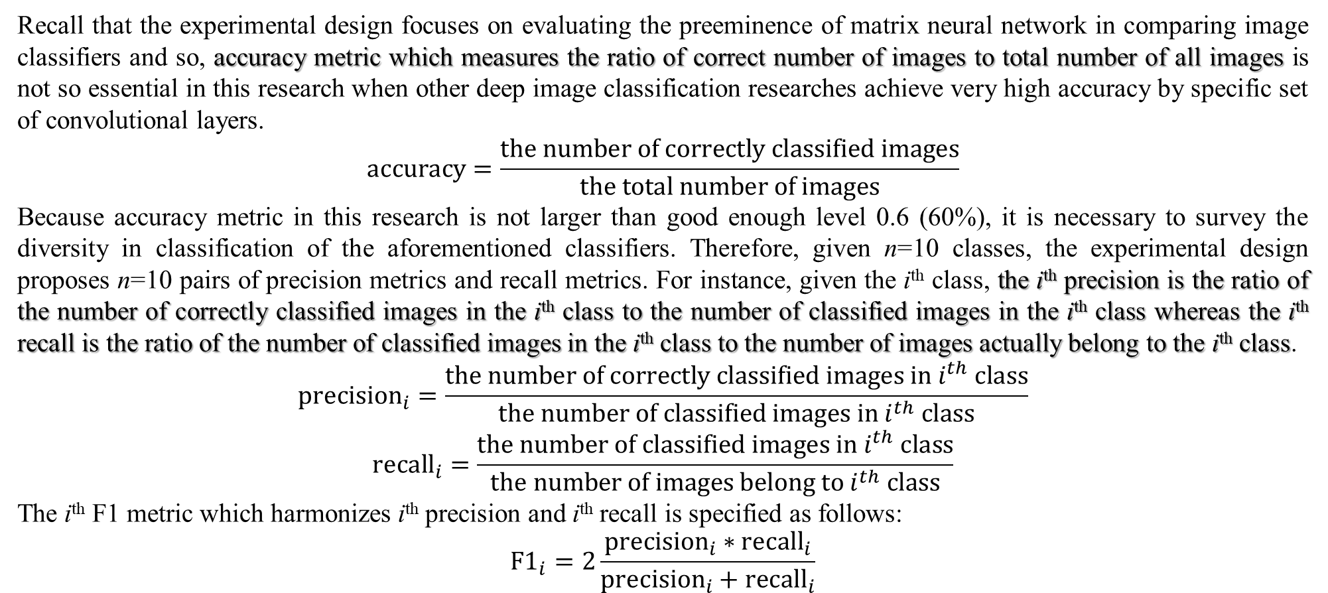
4. Experimental design
Recall that the experimental design focuses on evaluating the preeminence of matrix neural network in comparing image classifiers and so, accuracy metric which measures the ratio of correct number of images to total number of all images is not so essential in this research when other deep image classification researches achieve very high accuracy by specific set of convolutional layers.
$$accuracy=\frac{the number of correctly classified images}{the total number of images}$$
Because accuracy metric in this research is not larger than good enough level 0.6 (60%), it is necessary to survey the diversity in classification of the aforementioned classifiers. Therefore, given n=10 classes, the experimental design proposes n=10 pairs of precision metrics and recall metrics. For instance, given the i^{th} class, the i^{th} precision is the ratio of the number of correctly classified images in the i^{th} class to the number of classified images in the i^{th} class whereas the i^{th} recall is the ratio of the number of classified images in the i^{th} class to the number of images actually belong to the i^{th} class.
$${precision}_{i}=\frac{the number of correctly classified images in i^{th} class}{the number of classified images in i^{th} class}$$
$${recall}_{i}=\frac{the number of classified images in i^{th} class}{the number of images belong to i^{th} class}$$
The i^{th} F1 metric which harmonizes i^{th} precision and i^{th} recall is specified as follows:
$${F1}_{i}=2\frac{{precision}_{i}∗{recall}_{i}}{{precision}_{i}+{recall}_{i}}$$

Slide 40
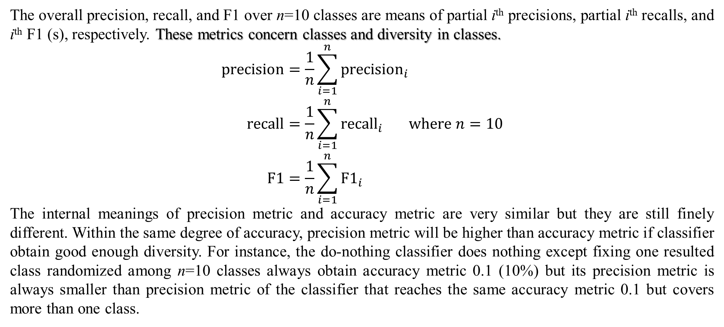
4. Experimental design (skip)
The overall precision, recall, and F1 over n=10 classes are means of partial i^{th} precisions, partial i^{th} recalls, and i^{th} F1 (s), respectively. These metrics concern classes and diversity in classes.
$$\begin{matrix}precision=\frac{1}{n}\sum_{i=1}^{n}{{precision}_{i}} \\ recall=\frac{1}{n}\sum_{i=1}^{n}{{recall}_{i}} \\ F1=\frac{1}{n}\sum_{i=1}^{n}{{F1}_{i}}\end{matrix}where n=10$$
The internal meanings of precision metric and accuracy metric are very similar but they are still finely different. Within the same degree of accuracy, precision metric will be higher than accuracy metric if classifier obtain good enough diversity. For instance, the do-nothing classifier does nothing except fixing one resulted class randomized among n=10 classes always obtain accuracy metric 0.1 (10%) but its precision metric is always smaller than precision metric of the classifier that reaches the same accuracy metric 0.1 but covers more than one class.

Slide 41
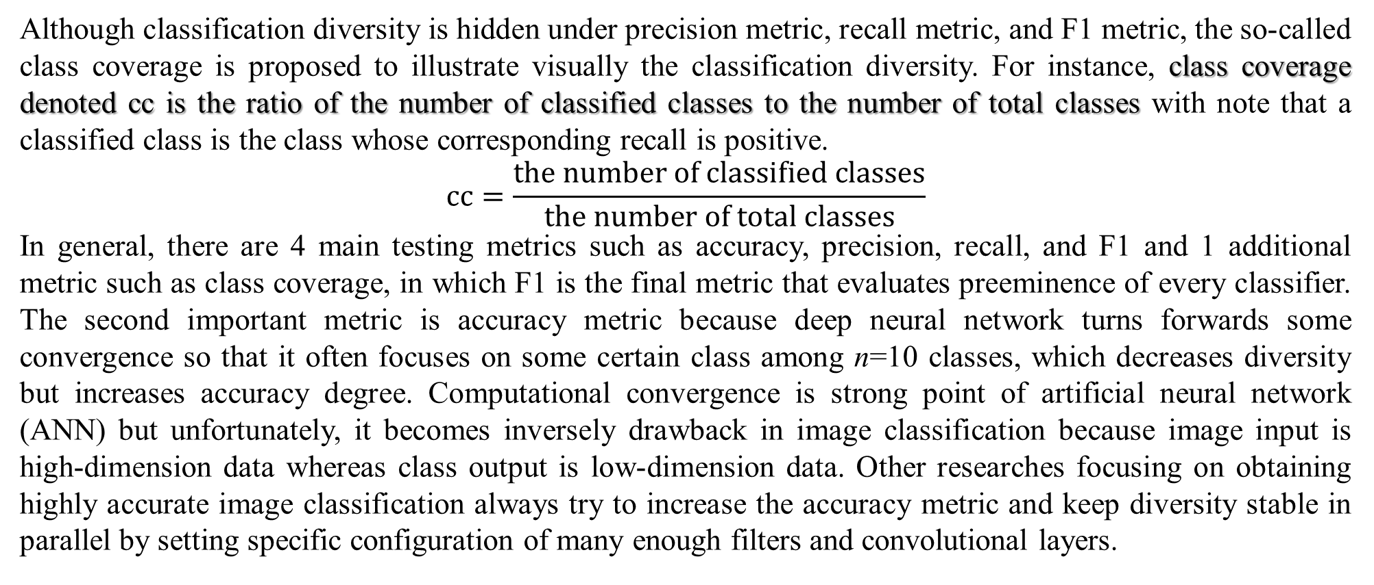
4. Experimental design (skip)
Although classification diversity is hidden under precision metric, recall metric, and F1 metric, the so-called class coverage is proposed to illustrate visually the classification diversity. For instance, class coverage denoted cc is the ratio of the number of classified classes to the number of total classes with note that a classified class is the class whose corresponding recall is positive.
$$cc=\frac{the number of classified classes}{the number of total classes}$$
In general, there are 4 main testing metrics such as accuracy, precision, recall, and F1 and 1 additional metric such as class coverage, in which F1 is the final metric that evaluates preeminence of every classifier. The second important metric is accuracy metric because deep neural network turns forwards some convergence so that it often focuses on some certain class among n=10 classes, which decreases diversity but increases accuracy degree. Computational convergence is strong point of artificial neural network (ANN) but unfortunately, it becomes inversely drawback in image classification because image input is high-dimension data whereas class output is low-dimension data. Other researches focusing on obtaining highly accurate image classification always try to increase the accuracy metric and keep diversity stable in parallel by setting specific configuration of many enough filters and convolutional layers.

Slide 42
5. Results and discussions (main)
The experimental dataset is CIFAR-10 dataset including 5 training folders and 1 testing folder where each folder has 10000 images grouped in 10 classes and every class has equal number of 1000 images. Given experimental variable “layer” is 2, CIFAR-10 dataset is tested 10 times for 3 values (“weight”, “trans”, “conv”) of feature group and 2 values (“true”, “false”) of vec group in order to derive 60 records of ANOVA dataset whose groups are “vec” and “feature” and whose treatments are “accuracy”, “precision”, “recall”, and “F1” corresponding to accuracy metric, precision metric, recall metric, and F1 metric aforementioned. Given experimental variable “layer” is 3, CIFAR-10 dataset is tested again 10 times for 3 values (“weight”, “trans”, “conv”) of feature group and 2 values (“true”, “false”) of vec group in order to derive other 60 records of ANOVA dataset. The next slide illustrates 120 records of full ANOVA dataset. The ANOVA dataset is available at https://github.com/ngphloc/ai/blob/main/4_testing/mac/2026.01.22/cifar10-lr0.1-max-anova.csv
Recall that the two-way ANOVA aims to test the three hypotheses on the ANOVA dataset of size 120: 1) whether MNN is the alternative of CNN, which focuses on testing the preeminence of MNN classifier in comparison with TB classifier and CNN classifier via testing the feature group, 2) whether attention is the alternative of CNN, which focuses on testing the preeminence of TB classifier in comparison with MNN classifier and CNN classifier via testing the feature group, and 3) whether FFN of transformer should be MNN via testing the vec group. The research applies Gemini 2025 into making ANOVA test. Moreover, only baseline is applied into improving classification task and adjusted-line is not applied.

Slide 43
5. Results and discussions (skip)
 | layer | vec | feature | accuracy | precision | recall | F1 | cc
1 | 2 | false | weight | 0.0826 | 0.0980 | 0.7623 | 0.1678 | 1.0000
2 |  | false | trans | 0.0727 | 0.0841 | 0.7903 | 0.1350 | 1.0000
3 |  | false | conv | 0.1000 | 0.0400 | 0.4000 | 0.0727 | 0.4000
4 |  | true | weight | 0.0831 | 0.0872 | 0.7244 | 0.1524 | 1.0000
5 |  | true | trans | 0.0995 | 0.1028 | 0.7543 | 0.1745 | 1.0000
6 |  | true | conv | 0.0995 | 0.0896 | 0.4219 | 0.1090 | 0.9000
 |  | … | … | … | … | … | … | …
55 |  | false | weight | 0.0782 | 0.0844 | 0.7532 | 0.1480 | 1.0000
56 |  | false | trans | 0.0869 | 0.0861 | 0.8044 | 0.1502 | 1.0000
57 |  | false | conv | 0.1018 | 0.1484 | 0.3899 | 0.1212 | 1.0000
58 |  | true | weight | 0.1012 | 0.1078 | 0.8043 | 0.1843 | 1.0000
59 |  | true | trans | 0.0866 | 0.0995 | 0.7281 | 0.1537 | 1.0000
60 |  | true | conv | 0.0828 | 0.0838 | 0.7532 | 0.1476 | 1.0000
61 | 3 | false | weight | 0.1010 | 0.1110 | 0.8207 | 0.1866 | 1.0000
62 |  | false | trans | 0.0783 | 0.0815 | 0.8688 | 0.1450 | 1.0000
63 |  | false | conv | 0.1000 | 0.0200 | 0.2000 | 0.0364 | 0.2000
64 |  | true | weight | 0.0794 | 0.0833 | 0.7425 | 0.1466 | 1.0000
65 |  | true | trans | 0.0800 | 0.0850 | 0.7450 | 0.1443 | 1.0000
66 |  | true | conv | 0.1000 | 0.0300 | 0.3000 | 0.0545 | 0.3000
 |  | … | … | … | … | … | … | …
115 |  | false | weight | 0.0712 | 0.0701 | 0.7380 | 0.1177 | 1.0000
116 |  | false | trans | 0.0756 | 0.0872 | 0.7852 | 0.1446 | 1.0000
117 |  | false | conv | 0.1000 | 0.0300 | 0.3000 | 0.0545 | 0.3000
118 |  | true | weight | 0.0814 | 0.0889 | 0.8168 | 0.1480 | 1.0000
119 |  | true | trans | 0.0858 | 0.0838 | 0.8438 | 0.1479 | 1.0000
120 |  | true | conv | 0.0969 | 0.0924 | 0.5054 | 0.1203 | 1.0000
Illustration of ANOVA dataset

Slide 44
5. Results and discussions (skip)
The ANOVA dataset is available at
https://github.com/ngphloc/ai/blob/main/4_testing/mac/2026.01.22/cifar10-lr0.1-max-anova.csv
Recall that the two-way ANOVA aims to test the three hypotheses on the ANOVA dataset of size 120: 1) whether MNN is the alternative of CNN, which focuses on testing the preeminence of MNN classifier in comparison with TB classifier and CNN classifier via testing the feature group, 2) whether attention is the alternative of CNN, which focuses on testing the preeminence of TB classifier in comparison with MNN classifier and CNN classifier via testing the feature group, and 3) whether FFN of transformer should be MNN via testing the vec group. The research applies Gemini 2025 into making ANOVA test. Moreover, only baseline is applied into improving classification task and adjusted-line is not applied.

Slide 45
5. Results and discussions (main)
Firstly, the two-way ANOVA test focuses on groups “vec” and “feature” against treatments “accuracy” and “F1” in which accuracy metric measures the entire accuracy of classifiers over dataset whereas F1 metric makes the compromise between diversity and accuracy. The following table shows the ANOVA results for accuracy metric, which indicates how groups “vec” and “feature” affect on treatment “accuracy” (Gemini 2025).
Note, the source “vec:feature” represents the interaction effect between group “vec” and group “feature”. From the result table above, group “feature” affects highly significantly on treatment “accuracy” in comparison with group “vec” because the F-statistic of group “feature” (65.0845) is highly larger than the F-statistic of group “vec” (0.0121) with very small P-value (< 0.0001). Moreover, there is no significant interaction between group “vec” and group “feature” because the F-statistic of the interaction effect “vec:feature” (0.6604) is small and its P-value (0.5186) is too larger than 0.05.
Source | SS | DF | F-statistic | P-value | Significant
vec | 6.31e-07 | 1 | 0.0121 | 0.9125 | No
feature | 0.00677 | 2 | 65.0845 | < 0.0001 | Yes
vec:feature | 6.87e-05 | 2 | 0.6604 | 0.5186 | No
Residual | 0.00593 | 114

Slide 46
5. Results and discussions (skip)
The following table shows the ANOVA results for F1 metric, which indicates how groups “vec” and “feature” affect on treatment “F1” (Gemini 2025).
From the result table above, group “feature” affects highly significantly on treatment “F1” in comparison with group “vec” because the F-statistic of group “feature” (118.3605) is highly larger than the F-statistic of group “vec” (1.7781) with very small P-value (< 0.0001). Moreover, there is no significant interaction between group “vec” and group “feature” because the F-statistic of the interaction effect “vec:feature” (1.6758) is small and its P-value (0.1917) is too larger than 0.05.
Source | SS | DF | F-statistic | P-value | Significant
vec | 0.00074 | 1 | 1.7781 | 0.1850 | No
feature | 0.09846 | 2 | 118.3605 | < 0.0001 | Yes
vec:feature | 0.00139 | 2 | 1.6758 | 0.1917 | No
Residual | 0.04741 | 114

Slide 47
5. Results and discussions (skip)
The two-way ANOVA test focuses again on groups “vec” and “feature” against treatments “precision” and “recall” in which precision metric leans forwards accuracy and recall metric leans forward diversity with note F1 is the compromiser of precision and recall. The following table shows the ANOVA results for precision metric, which indicates how groups “vec” and “feature” affect on treatment “precision” (Gemini 2025).
From the result table above, group “feature” affects highly significantly on treatment “precision” in comparison with group “vec” because the F-statistic of group “feature” (23.3842) is highly larger than the F-statistic of group “vec” (0.118) with very small P-value (< 0.0001). Moreover, there is no significant interaction between group “vec” and group “feature” because the F-statistic of the interaction effect “vec:feature” (0.2909) is small and its P-value (0.7481) is too larger than 0.05.
Source | SS | DF | F-statistic | P-value | Significant
vec | 4.8e-5 | 1 | 0.1180 | 0.7318 | No
feature | 0.01908 | 2 | 23.3842 | < 0.0001 | Yes
vec:feature | 0.00024 | 2 | 0.2909 | 0.7481 | No
Residual | 0.0465 | 114

Slide 48
5. Results and discussions (skip)
The following table shows the ANOVA results for recall metric, which indicates how groups “vec” and “feature” affect on treatment “recall” (Gemini 2025).
From the result table above, group “feature” affects highly significantly on treatment “recall” in comparison with group “vec” because the F-statistic of group “feature” (315.5278) is highly larger than the F-statistic of group “vec” (1.5663) with very small P-value (< 0.0001). Moreover, there is no significant interaction between group “vec” and group “feature” because the F-statistic of the interaction effect “vec:feature” (1.1690) is small and its P-value (0.3144) is too larger than 0.05.
Source | SS | DF | F-statistic | P-value | Significant
vec | 0.00809 | 1 | 1.5663 | 0.2133 | No
feature | 3.25747 | 2 | 315.5278 | < 0.0001 | Yes
vec:feature | 0.01207 | 2 | 1.1690 | 0.3144 | No
Residual | 0.58846 | 114

Slide 49
5. Results and discussions (main)
In general, within metrics accuracy, F1, precision, and recall, for the third hypothesis “FFN of transformer should be MNN (vector FEC is better than matrix FEC)”, it is possible to conclude that FFN/FEC of MNN classifier and TB classifier should be matrix because it is not necessary to vectorize FEC to obtain better classification while vectorized FEC (vector FEC) consumes much more computational resources. Exactly, there is significant evidence to reject null hypothesis of the third hypothesis or there is significant evidence to support the third hypothesis.

Slide 50
5. Results and discussions
Although the experiment focuses on testing the three hypotheses by ANOVA tests on significant differences, it is necessary to summarize means of metrics “accuracy”, “F1”, “precision”, and “recall” with respect to groups “vec” and “feature” (Gemini 2025).
vec | feature | Accuracy | F1 | Precision | Recall
false | conv | 0.0991 | 0.0845 | 0.0614 | 0.4154
false | trans | 0.0834 | 0.1508 | 0.0881 | 0.7751
false | weight | 0.0816 | 0.1530 | 0.0887 | 0.7963
true | conv | 0.0980 | 0.0983 | 0.0631 | 0.4601
true | trans | 0.0857 | 0.1547 | 0.0926 | 0.7790
true | weight | 0.0809 | 0.1502 | 0.0863 | 0.7970
 | conv | 0.0986 | 0.0914 | 0.0623 | 0.4377
 | trans | 0.0846 | 0.1527 | 0.0903 | 0.7771
 | weight | 0.0812 | 0.1516 | 0.0875 | 0.7966
false |  | 0.0880 | 0.1294 | 0.0794 | 0.6623
true |  | 0.0882 | 0.1344 | 0.0807 | 0.6787

Slide 51
5. Results and discussions (main)
Because feature “weight”, “trans”, and “conv” represent classifiers MNN, TB, and CNN, respectively, for the result table above, CNN classifier (0.0986) is better than both TB classifier (0.0846) and MNN classifier (0.0812) in accuracy metric but both MNN classifier and TB classifier are better than CNN classifier in remaining metrics such as F1, precision, and recall. Although both F1 and precision measure the accurate aspect in classification task, they reflect the diversity too. Therefore, CNN classifier is the best in accuracy because accuracy metric is the pure metric to measure the ratio of correct number of images to total number of all images in classifying entire dataset.
Recall metric is the intermediate metric between accuracy and diversity but it leans forwards the diversity, which leads that TB classifier within context of transformer can harmonize MNN classifier and CNN classifier because recall metric of TB classifier (0.7771) is between recall metrics of CNN classifier (0.4377) and MNN classifier (0.7966). Moreover, accuracy metric of TB classifier (0.0846) is between accuracy metrics of CNN classifier (0.0986) and MNN classifier (0.0812). Especially, F1 metric of TB classifier (0.1527) is best and precision metric of TB classifier (0.0903) is best, which concludes that TB classifier can be the preeminent one in compromising all factors.
Although there is significant evidence to support the third hypothesis which means it is not necessary to vectorize FEC to obtain better classification, vector FEC (accuracy=0.0880, F1=0.1294, precision=0.0794, recall=0.6623) is always slightly better than matrix FEC (accuracy=0.0882, F1=0.1344, precision=0.0807, recall=0.6787).

Slide 52
5. Results and discussions (main)
Secondly, because it is concluded that group “feature” is the most significant factor on accuracy metric and F1 metric, it is necessary to make Post-Hoc Tukey HSD (Honestly Significant Difference) test on values “weight”, “trans”, “conv” of independent variable “feature” in order to test the first hypothesis and second hypothesis. The following table shows the Post-Hoc Tukey HSD results for feature group within accuracy metric, which indicates which specific values (“weight”, “trans”, “conv”) are significantly different among them with context of treatment “accuracy” (Gemini 2025).
For the result table above, the feature “conv” is significantly much larger than features “weight” and “trans” in accuracy metric because its absolute mean differences with respect to feature “weight” and feature “trans” are larger (|–0.0173|, |–0.014|) with P-values (< 0.001) are too smaller than 0.05. Because these differences are negative, the feature “conv” is significantly much better than features “weight” and “trans”. Conversely, there is no significantly difference between feature “weight” and feature “trans” because the P-value (0.0932) given their absolute mean difference (|–0.0034|) is larger than 0.05.
Treatment 1 | Treatment 2 | Mean Difference | Adjusted P-value | Significant
conv | trans | –0.0140 | < 0.001 | Yes (conv > trans)
conv | weight | –0.0173 | < 0.001 | Yes (conv > weight)
trans | weight | –0.0034 | 0.0932 | No

Slide 53
5. Results and discussions (skip)
Therefore, there is significant evidence to reject the first hypothesis “MNN is the alternative of CNN” and there is no significant evidence to support the second hypothesis “attention is the alternative of CNN”, within accuracy metric. Of course, CNN is better than both MNN and attention within accuracy metric. In other words, within accuracy metric, MNN should not be the alternative of CNN and it is not necessary to replace MNN by attention but attention is slightly better than MNN because the mean difference between feature “weight” and feature “trans” is negative (weight – trans) = –0.0034.

Slide 54
5. Results and discussions (skip)
The following table shows the Post-Hoc Tukey HSD results for feature group within F1 metric, which indicates which specific values (“weight”, “trans”, “conv”) are significantly different among them with context of treatment “F1” (Gemini 2025).
For the result table above, the feature “conv” is significantly much larger than features “weight” and “trans” in F1 metric because its absolute mean differences with respect to feature “weight” and feature “trans” are larger |0.0602|, (|0.0613|) with P-values (< 0.001) are too smaller than 0.05. Because these differences are positive, the feature “conv” is significantly much worse than features “weight” and “trans”. Conversely, there is no significantly difference between feature “weight” and feature “trans” because the P-value (0.9687) given their absolute mean difference (|–0.0011|) is larger than 0.05. Therefore (skip), there is significant evidence to support the first hypothesis “MNN is the alternative of CNN” and there is no significant evidence to support the second hypothesis “attention is the alternative of CNN”, within F1 metric. Of course, CNN is worse than both MNN and attention within F1 metric. In other words, within F1 metric, MNN should be the alternative of CNN and it is not necessary to replace MNN by attention but attention is slightly better than MNN because the mean difference between feature “weight” and feature “trans” is negative (weight – trans) = –0.0011.
Treatment 1 | Treatment 2 | Mean Difference | Adjusted P-value | Significant
conv | trans | 0.0613 | < 0.001 | Yes (trans > conv)
conv | weight | 0.0602 | < 0.001 | Yes (weight > conv)
trans | weight | –0.0011 | 0.9687 | No

Slide 55
5. Results and discussions (skip)
The following table shows the Post-Hoc Tukey HSD results for feature group within precision metric, which indicates which specific values (“weight”, “trans”, “conv”) are significantly different among them with context of treatment “precision” (Gemini 2025).
For the result table above, the feature “conv” is significantly much larger than features “weight” and “trans” in precision metric because its absolute mean differences with respect to feature “weight” and feature “trans” are larger (|0.0252|, |0.0280|) with P-values (< 0.001) are too smaller than 0.05. Because these differences are positive, the feature “conv” is significantly much worse than features “weight” and “trans”. Conversely, there is no significantly difference between feature “weight” and feature “trans” because the P-value (0.806) given their absolute mean difference (|–0.0028|) is larger than 0.05. Therefore (skip), there is significant evidence to support the first hypothesis “MNN is the alternative of CNN” and there is no significant evidence to support the second hypothesis “attention is the alternative of CNN”, within precision metric. Of course, CNN is worse than both MNN and attention within precision metric. In other words, within precision metric, MNN should be the alternative of CNN and it is not necessary to replace MNN by attention but attention is slightly better than MNN because the mean difference between feature “weight” and feature “trans” is negative (weight – trans) = –0.0028.
Treatment 1 | Treatment 2 | Mean Difference | Adjusted P-value | Significant
conv | trans | 0.0280 | < 0.001 | Yes (trans > conv)
conv | weight | 0.0252 | < 0.001 | Yes (weight > conv)
trans | weight | –0.0028 | 0.806 | No

Slide 56
5. Results and discussions (skip)
The following table shows the Post-Hoc Tukey HSD results for feature group within recall metric, which indicates which specific values (“weight”, “trans”, “conv”) are significantly different among them with context of treatment “recall” (Gemini 2025).
For the result table above, the feature “conv” is significantly much larger than features “weight” and “trans” in recall metric because its absolute mean differences with respect to feature “weight” and feature “trans” are larger (|0.3589|, |0.3393|) with P-values (< 0.001) are too smaller than 0.05. Because these differences are positive, the feature “conv” is significantly much worse than features “weight” and “trans”. Conversely, there is no significantly difference between feature “weight” and feature “trans” because the P-value (0.4481) given their absolute mean difference (|0.0196|) is larger than 0.05. Therefore (skip), there is significant evidence to support the first hypothesis “MNN is the alternative of CNN” and there is no significant evidence to support the second hypothesis “attention is the alternative of CNN”, within recall metric. Of course, CNN is worse than both MNN and attention within recall metric. In other words, within recall metric, MNN should be the alternative of CNN and it is not necessary to replace MNN by attention but attention is slightly worse than MNN because the mean difference between feature “weight” and feature “trans” is positive (weight – trans) = 0.0196.
Treatment 1 | Treatment 2 | Mean Difference | Adjusted P-value | Significant
conv | trans | 0.3393 | < 0.001 | Yes (trans > conv)
conv | weight | 0.3589 | < 0.001 | Yes (weight > conv)
trans | weight | 0.0196 | 0.4481 | No

Slide 57
5. Results and discussions (main)
In general, following table summarizes results of hypothesis testing on the three hypotheses: 1) MNN is the alternative of CNN, 2) attention is the alternative of CNN, and 3) FFN of transformer should be MNN.
 | Hypothesis 1 | Hypothesis 2 | Hypothesis 3
accuracy | Not supported. CNN is the best. | Not supported. TB is slightly better than MNN but worse than CNN. | Supported. Vector FEC is slightly better than matrix FEC.
F1 | Supported. CNN is worse than both TB and MNN. | Not supported. TB is slightly better than both MNN and CNN. | Supported. Vector FEC is slightly better than matrix FEC.
precision | Supported. CNN is worse than both TB and MNN. | Not supported. TB is slightly better than both MNN and CNN. | Supported. Vector FEC is slightly better than matrix FEC.
recall | Supported. CNN is worse than both TB and MNN. | Not supported. TB is slightly worse than MNN and better than CNN. | Supported. Vector FEC is slightly better than matrix FEC.
Please pay attention that supporting is not acceptance, which means that supporting is slightly stronger than not rejecting. The third hypothesis “MNN is the alternative of CNN” is not supported by only accuracy metric but accuracy metric is the most important metric about accuracy aspect of classification method and so, CNN classifier is the best classifier in accuracy. The second hypothesis “attention is the alternative of CNN” is always not supported but TB is slightly better than MNN (except recall metric) and better than CNN. Moreover, CNN classifier is worse than both TB classifier and MNN classifier in F1 metric which is the compromiser of accuracy and diversity in image classification. This implies that TB classifier is the best classifier in harmonizing all factors (metrics). The third hypothesis “FFN of transformer should be MNN” is always supported although vector FEC is slightly better than matrix FEC, which implies that it is possible to replace traditional neural network (vector ANN) by matrix neural network (MNN) with note that vector ANN consumes much more computational resources due to boom problem of a huge number of parameters. Moreover, attention of transformer can overcome drawback of vector ANN in accuracy.

Slide 58
6. Conclusions
In general, although it is not asserted that matrix neural network (MNN) is the alternative of convolutional neural network (CNN), transformer is surely preeminent approach in deep learning because of three reasons: 1) its attention is an excellent mechanism to extract internal structure / relationship / feature of any kind of high-dimension data according to self-supervised learning, 2) transformer is different from the methodology of traditional ANN consisting of simple layers equipped by parametric weights when attention of transformer concerns both explicit information via value matrix and implicit information via query matrix and key matrix, and 3) ANN and attention are incorporated into transformer so that deep learning still always takes advantages of excellent aspects of ANN.
Again, although it is not asserted that MNN is the alternative of CNN, it is not strict to implement FFN of transformer by vector ANN. Therefore, it is totally possible that MNN and attention are incorporated into transformer with note that MNN is the ANN implemented by parametric weight matrices in order to reduce significantly computational resources so that its accuracy (performance) is not decreased significantly. Attentional mechanism built in transformer can alleviate the drawback of MNN in performance, especially, in case of huge data. Moreover, for high-dimension data whose dimension is larger than 2, MNN is a possible technique to process such tensor-based data.

Slide 59
References
Chen, L., Li, S., Bai, Q., Yang, J., Jiang, S., & Miao, Y. (2021, November 21). Review of Image Classification Algorithms Based on Convolutional Neural Networks. (S. Paheding, Z. Alom, M. Maimaitijiang, & M. Maimaitiyiming, Eds.) Remote Sensing, 13(22), 4712-4763. doi:10.3390/rs13224712
D'Ascoli, S., Touvron, H., Leavitt, M. L., Morcos, A. S., Biroli, G., & Sagun, L. (2021). ConViT: Improving Vision Transformers with Soft Convolutional Inductive Biases. Proceedings of the 38th International Conference on Machine Learning. 139, pp. 2286-2296. PMLR. Retrieved from https://proceedings.mlr.press/v139/d-ascoli21a.html
Dosovitskiy, A., Beyer, L., Kolesnikov, A., Weissenborn, D., Zhai, X., Unterthiner, T., . . . Houlsby, N. (2020). An Image is Worth 16x16 Words: Transformers for Image Recognition at Scale. arXiv Computer Vision and Pattern Recognition. doi:10.48550/arXiv.2010.11929
Gao, J., Guo, Y., & Wang, Z. (2016, December 9). Matrix Neural Networks. arXiv Preprints, 1-28. doi:10.48550/arXiv.1601.03805
He, K., Zhang, X., Ren, S., & Sun, J. (2016). Deep Residual Learning for Image Recognition. Proceedings of the 2016 IEEE Conference on Computer Vision and Pattern Recognition (CVPR 2016) (pp. 770-778). IEEE. doi:10.1109/CVPR.2016.90
Krizhevsky, A., Sutskever, I., & Hinton, G. E. (2012). ImageNet Classification with Deep Convolutional Neural Networks. (F. Pereira, C. Burges, L. Bottou, & K. Weinberger, Eds.) Advances in Neural Information Processing Systems 25 (NIPS 2012). doi:10.1145/3065386

Slide 60
References
LeCun, Y., Bottou, L., Bengio, Y., & Haffner, P. (1998, November 30). Gradient-Based Learning Applied to Document Recognition. Proceedings of the IEEE, 86(11), 2278-2324. doi:10.1109/5.726791
Lin, M., Chen, Q., & Yan, S. (2014, March 4). Network In Network. arXiv Neural and Evolutionary Computing. doi:10.48550/arXiv.1312.4400
Simonyan, K., & Zisserman, A. (2015, April 10). Very Deep Convolutional Networks for Large-Scale Image Recognition. arXiv Computer Vision and Pattern Recognition. doi:10.48550/arXiv.1409.1556
Szegedy, C., Liu, W., Jia, Y., Sermanet, P., Reed, S., Anguelov, D., . . . Rabinovich, A. (2015). Going Deeper With Convolutions. Proceedings of the IEEE Conference on Computer Vision and Pattern Recognition (CVPR 2015) (pp. 1-9). IEEE. Retrieved from https://www.cv-foundation.org/openaccess/content_cvpr_2015/html/Szegedy_Going_Deeper_With_2015_CVPR_paper.html
Vaswani, A., Shazeer, N., Parmar, N., Uszkoreit, J., Jones, L., Gomez, A. N., . . . Polosukhin, I. (2017). Attention Is All You Need. In I. Guyon, U. Von Luxburg, S. Bengio, H. Wallach, R. Fergus, & S. Vishwanathan (Ed.), Advances in Neural Information Processing Systems (NIPS 2017). 30. Long Beach: NeurIPS. Retrieved from https://arxiv.org/abs/1706.03762
Wang, F., Jiang, M., Qian, C., Yang, S., Li, C., Zhang, H., . . . Tang, X. (2017, April 23). Residual Attention Network for Image Classification. Proceedings of the IEEE Conference on Computer Vision and Pattern Recognition (CVPR 2017) (pp. 3156-3164). IEEE. Retrieved from https://openaccess.thecvf.com/content_cvpr_2017/html/Wang_Residual_Attention_Network_CVPR_2017_paper.html

Slide 61
Thank you for listening

