Slide 1
Matrix algebra & calculus
Teacher: Prf. Ho Minh Toan
Student: Nguyen Phuoc Loc

Slide 2
Matrix algebra & calculus
Matrix analysis
Matrix derivative
Composite derivative
Matrix applications

Slide 3

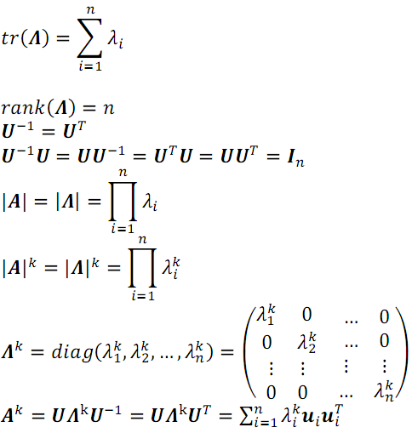
I. Matrix analysis
Jordan decomposition
Jordan decomposition

Slide 4
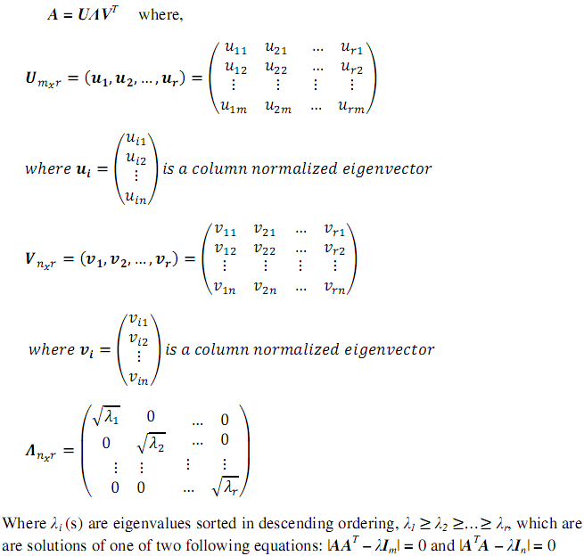
I. Matrix analysis
Singular value decomposition (SVD)

Slide 5
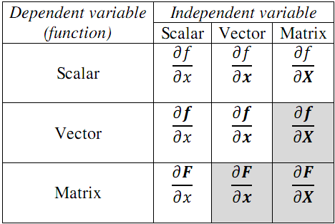
II. Matrix derivative

Slide 6

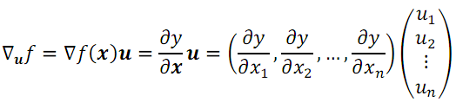
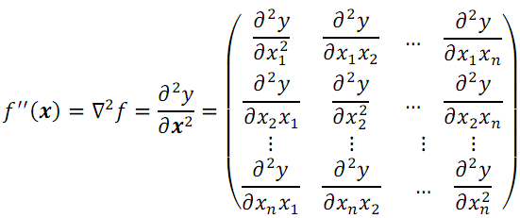
II. Matrix derivative
Scalar-by-vector
Derivative or
Gradient vector
Directional derivative
Second-order
derivative

Slide 7
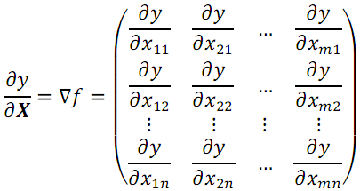

II. Matrix derivative
Scalar-by-matrix
Derivative or
Gradient matrix
Directional
derivative

Slide 8
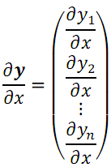
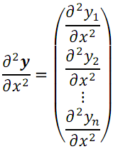
II. Matrix derivative
Vector-by-scalar
Derivative or
Tangent vector
Second-order
derivative

Slide 9
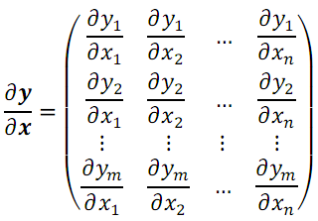
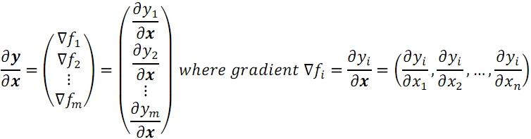
II. Matrix derivative
Vector-by-vector
Derivative or
Jacobian matrix

Slide 10
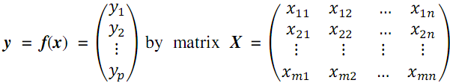
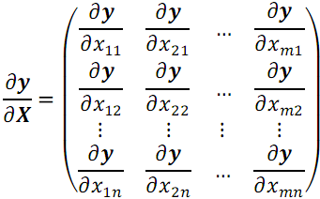
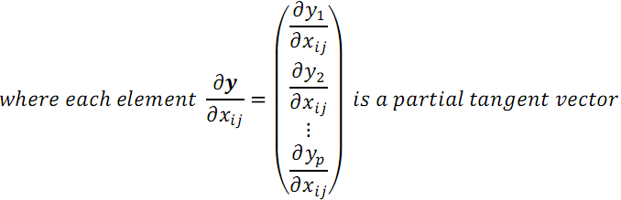
II. Matrix derivative
Vector-by-matrix
Derivative or compound gradient matrix

Slide 11
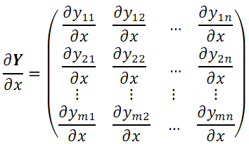
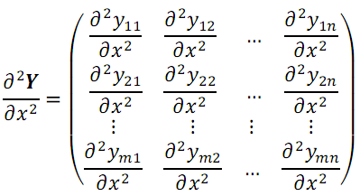
II. Matrix derivative
Matrix-by-scalar
Derivative or
Tangent matrix
Second-order
derivative

Slide 12
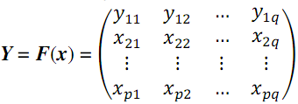
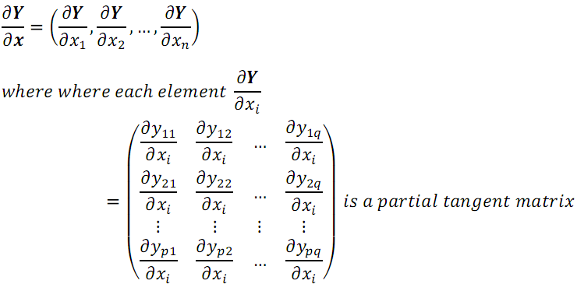
II. Matrix derivative
Matrix-by-vector
Derivative or compound gradient vector

Slide 13
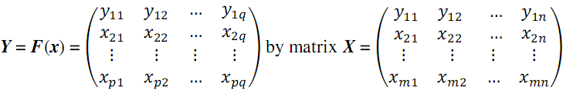
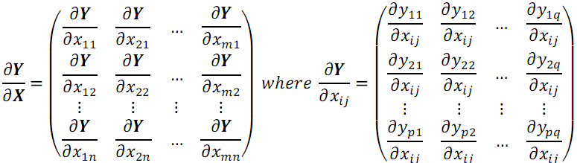
II. Matrix derivative
Matrix-by-matrix
Derivative or compound gradient matrix

Slide 14
III. Composite derivative
Chain rule: Make sense the compatibility between vector function f and g.
Product rule: Make sense to define what product is and how the order of product.
Sum rule: Make sense to condition that f and g belong to the same kind

Slide 15
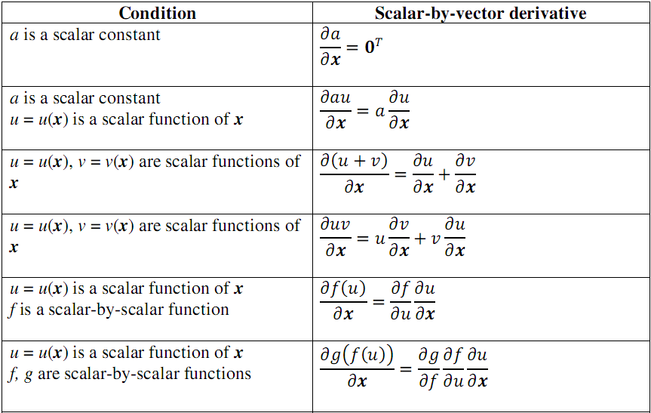
III. Composite derivative

Slide 16
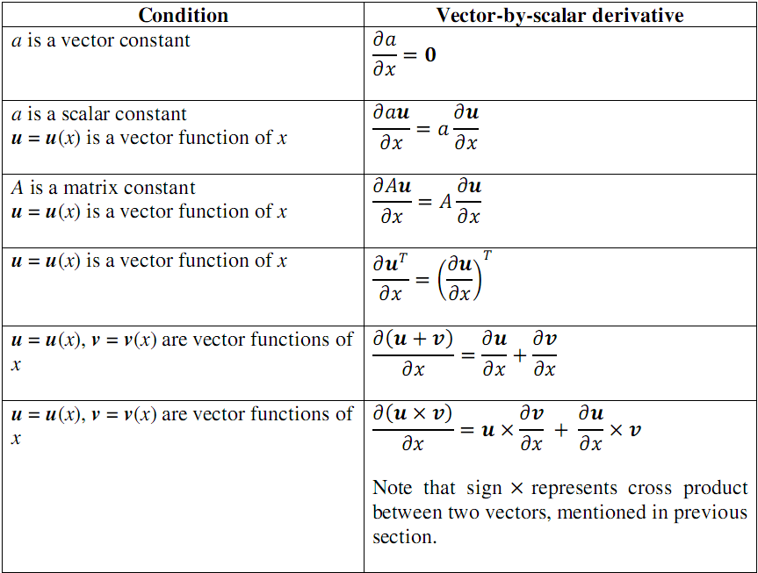
III. Composite derivative

Slide 17
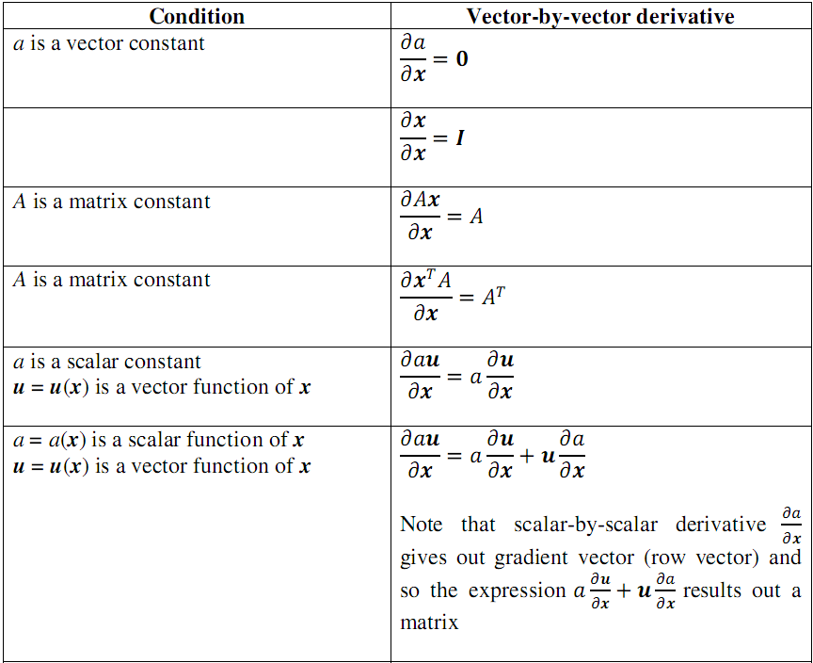
III. Composite derivative

Slide 18
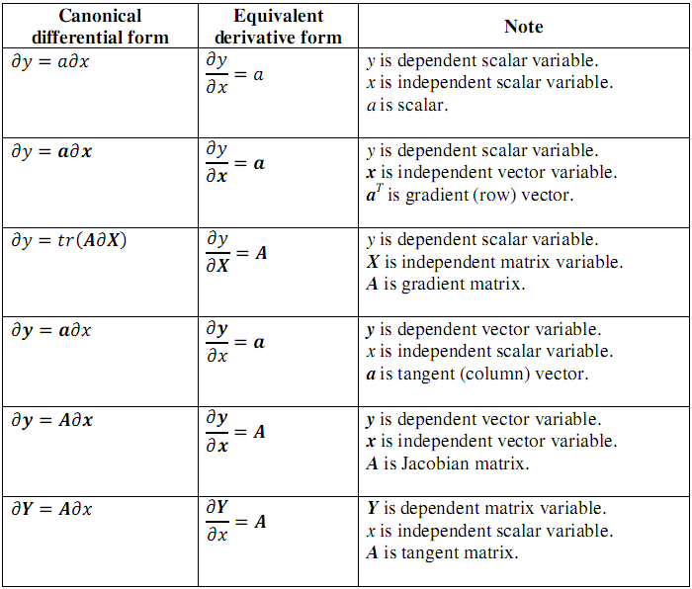
III. Composite derivative

Slide 19
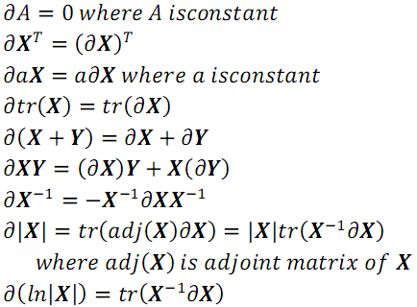
III. Composite derivative
Matrix differential

Slide 20
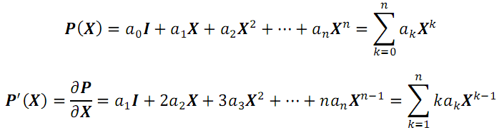
III. Composite derivative
Matrix polynomial

Slide 21
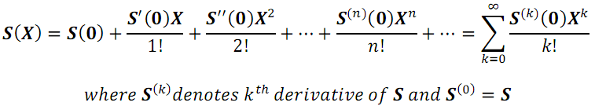
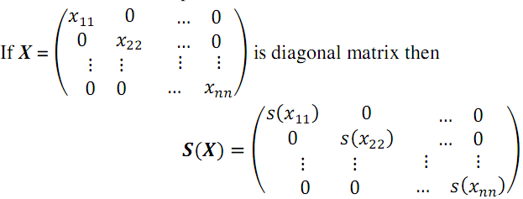
III. Composite derivative
Matrix-power-series functions such as E^{X}, LNX, SINX, COSX

Slide 22

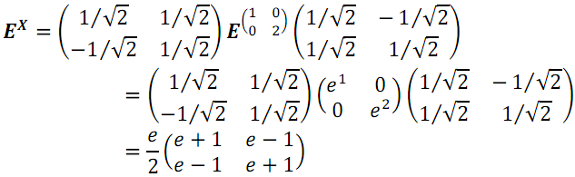
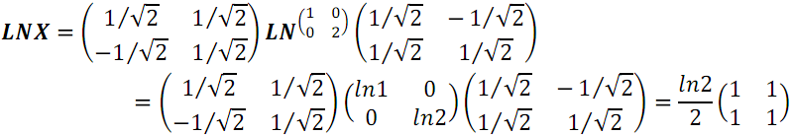
III. Composite derivative
Matrix-power-series function example

Slide 23
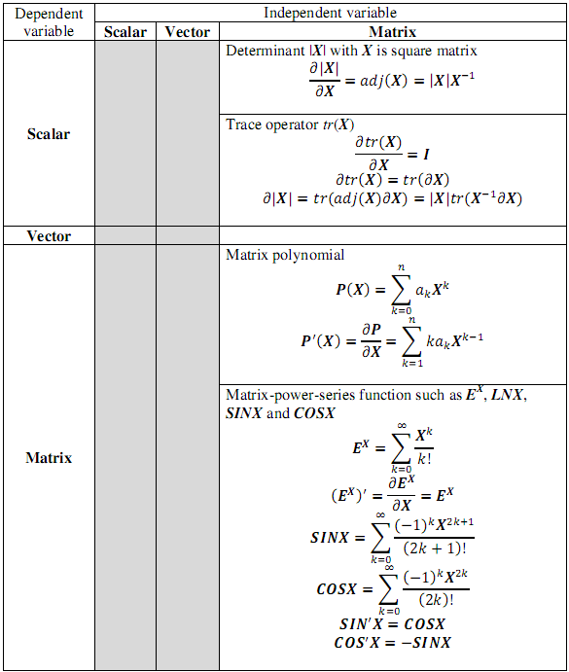
III. Composite derivative

Slide 24
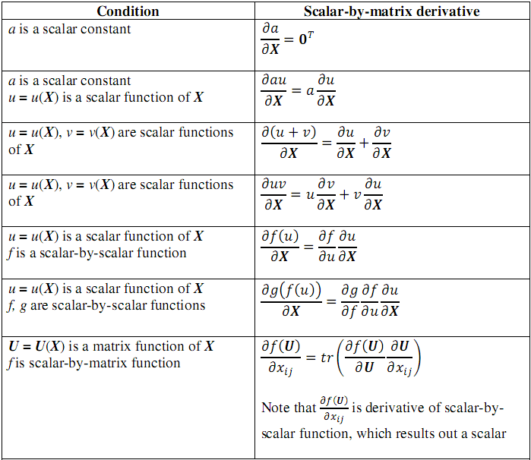
III. Composite derivative

Slide 25
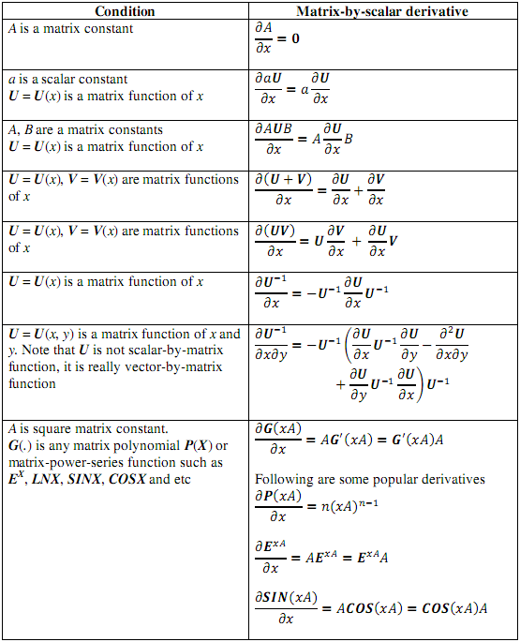
III. Composite derivative

Slide 26
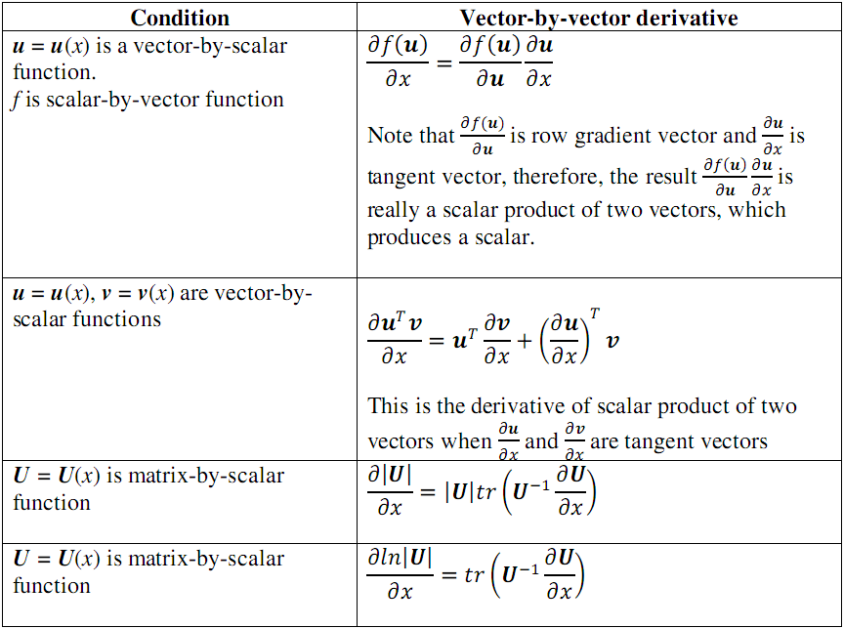
III. Composite derivative

Slide 27
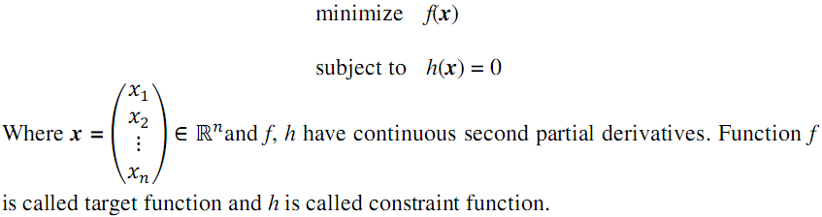
IV. Matrix applications

Slide 28
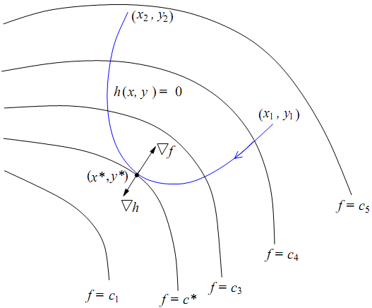
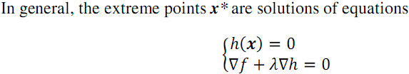
IV. Matrix applications

Slide 29
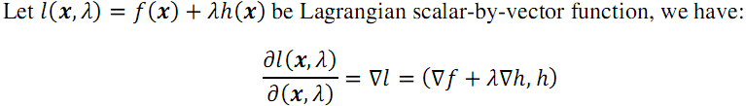
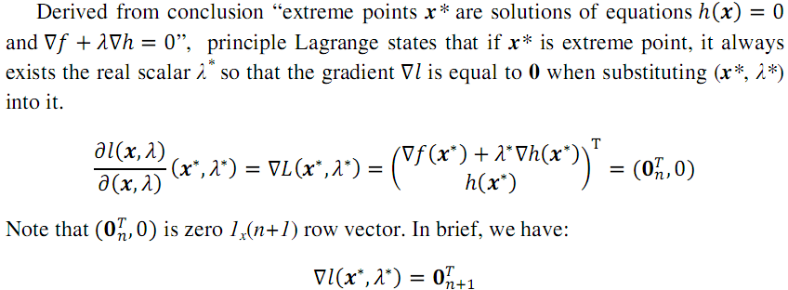
IV. Matrix applications

Slide 30
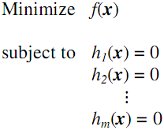

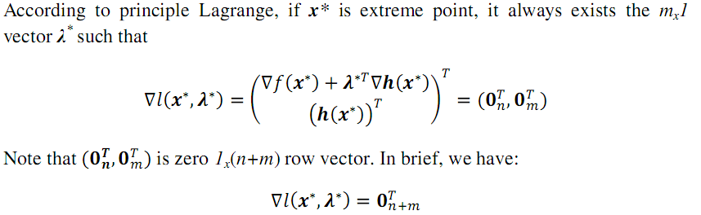
IV. Matrix applications

Slide 31
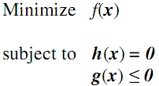
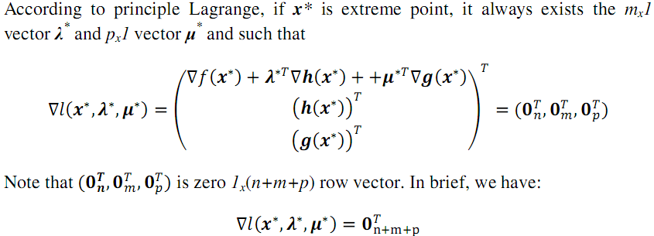
IV. Matrix applications

Slide 32
Thank for your attention

