Slide 1
Converting Graphic Relationships into Conditional Probabilities in Bayesian Network
Prof. Loc Nguyen PhD, MD, MBA
An Giang University, Vietnam
Email: ng_phloc@yahoo.com
Homepage: www.locnguyen.net

Slide 2
Abstract
Bayesian network (BN) is a powerful mathematical tool for prediction and diagnosis applications. A large BN can be constituted of many simple networks which in turn are constructed from simple graphs. A simple graph consists of one child node and many parent nodes. The strength of each relationship between a child node and a parent node is quantified by a weight and all relationships share the same semantics such as prerequisite, diagnostic, and aggregation. The research focuses on converting graphic relationships into conditional probabilities in order to construct a simple BN from a graph. Diagnostic relationship is the main research object, in which sufficient diagnostic proposition is proposed for validating diagnostic relationship. Relationship conversion is adhered to logic gates such as AND, OR, and XOR, which is essential feature of the research.

Slide 3
Table of contents
Introduction
Diagnostic relationship
X-gate inferences
Multi-hypothesis diagnostic relationship
Conclusion

Slide 4
1. Introduction
In general, Bayesian network (BN) is a directed acyclic graph (DAG) consisting of a set of nodes and a set of arcs. Each node is a random variable. Each arc represents a relationship between two nodes.
The strength of relationship in a graph can be quantified by a number called weight. There are some important relationships such as prerequisite, diagnostic, and aggregation.
The difference between BN and normal graph is that the strength of every relationship in BN is represented by a conditional probability table (CPT) whose entries are conditional probabilities of a child node given parent nodes.
There are two main approaches to construct a BN:
The first approach aims to learn BN from training data by learning machine algorithms.
The second approach is that experts define some graph patterns according to specific relationships and then, BN is constructed based on such patterns along with determined CPT (s). This research focuses on such second approach.

Slide 5
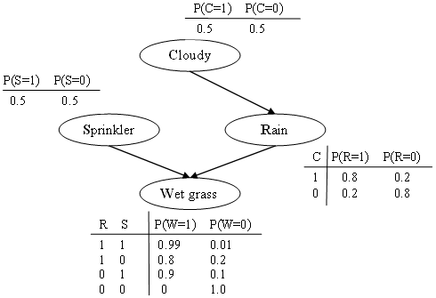
1. Introduction
An example of BN, event “cloudy” is cause of event “rain” which in turn is cause of “grass is wet” (Murphy, 1998).
Binary random variables (nodes) C, S, R, and W denote events such as cloudy, sprinkler, rain, and wet grass. Each node is associated with a CPT.
Given “wet grass” evidence W=1, due to P(S=1|W=1) = 0.7 > P(R=1|W=1) = 0.67, which leads to conclusion that sprinkler is the most likely cause of wet grass.

Slide 6
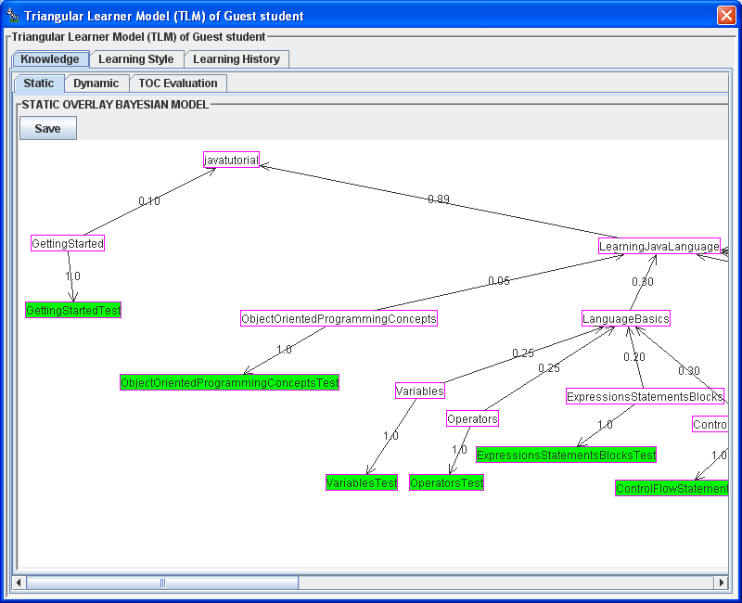
1. Giới thiệu
Application of BN for adaptive learning, in which the course is modeled by BN.
Suppose the course “Java Tutorial” has two main topics such as “Getting Started” and “Learning Java Language”. Each topic have many subjects. All topics and subjects are hypothesis nodes.
Each leaf subject is attached to a test which modeled as a evidence node.

Slide 7
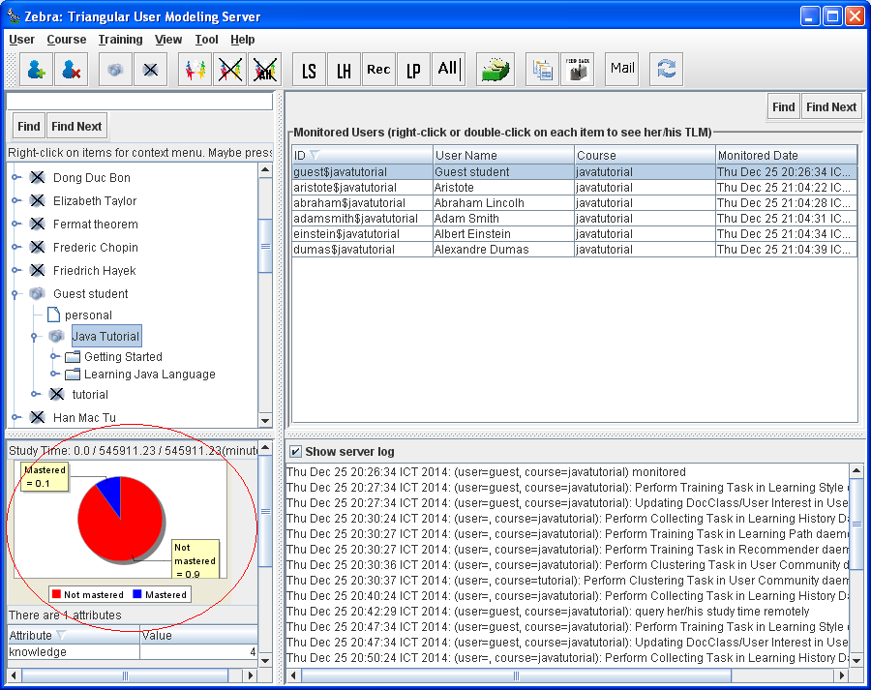
1. Giới thiệu
BN is used to evaluate users’ knowledge (mastered or not mastered).

Slide 8
1. Introduction
Relationship conversion aims to determined conditional probabilities based on weights and meanings of relationships. Especially, these relationships are adhered to logic X-gates (Wikipedia, 2016) such as AND-gate, OR-gate, and SIGMA-gate. The X-gate inference in this research is derived and inspired from noisy OR-gate described in the book “Learning Bayesian Networks” by author (Neapolitan, 2003, pp. 157-159).
Authors (Díez & Druzdzel, 2007) also researched OR/MAX, AND/MIN, noisy XOR inferences but they focused on canonical models, deterministic models, ICI models whereas I focus on logic gate and graphic relationships.
Factor graph (Wikipedia, Factor graph, 2015) represents factorization of a global function into many partial functions. Pearl’s propagation algorithm (Pearl, 1986), a variant of factor graph, is very successful in BN inference. I did not use factor graph for constructing BN. The concept “X-gate inference” only implies how to convert simple graph into BN.

Slide 9
1. Introduction
In general, my research focuses on applied probability adhered to Bayesian network, logic gates, and Bayesian user modeling (Millán & Pérez-de-la-Cruz, 2002). The scientific results are shared with authors Eva Millán and José Luis Pérez-de-la-Cruz.
As default, the research is applied in learning context in which BN is used to assess students’ knowledge.
Evidences are tests, exams, exercises, etc. and hypotheses are learning concepts, knowledge items, etc.
Diagnostic relationship is very important to Bayesian evaluation in learning context because it is used to evaluate student’s mastery of concepts. Now we start relationship conversion with a research on diagnostic relationship in the next section.

Slide 10
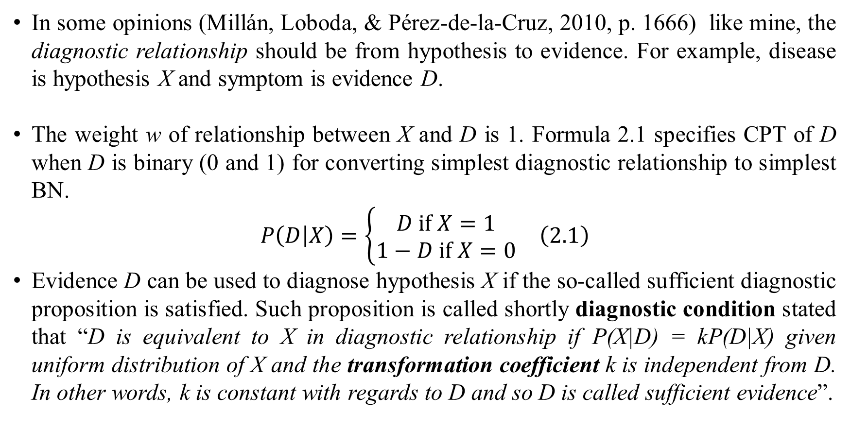
2. Diagnostic relationship
In some opinions (Millán, Loboda, & Pérez-de-la-Cruz, 2010, p. 1666) like mine, the diagnostic relationship should be from hypothesis to evidence. For example, disease is hypothesis X and symptom is evidence D.
The weight w of relationship between X and D is 1. Formula 2.1 specifies CPT of D when D is binary (0 and 1) for converting simplest diagnostic relationship to simplest BN.
$$\begin{matrix}P\left(D | X\right)=\left\{\begin{matrix}D if X=1 \\ 1−D if X=0\end{matrix}\right. & \left(2.1\right)\end{matrix}$$
Evidence D can be used to diagnose hypothesis X if the so-called sufficient diagnostic proposition is satisfied. Such proposition is called shortly diagnostic condition stated that “D is equivalent to X in diagnostic relationship if P(X|D) = kP(D|X) given uniform distribution of X and the transformation coefficient k is independent from D. In other words, k is constant with regards to D and so D is called sufficient evidence”.
X
1
D

Slide 11
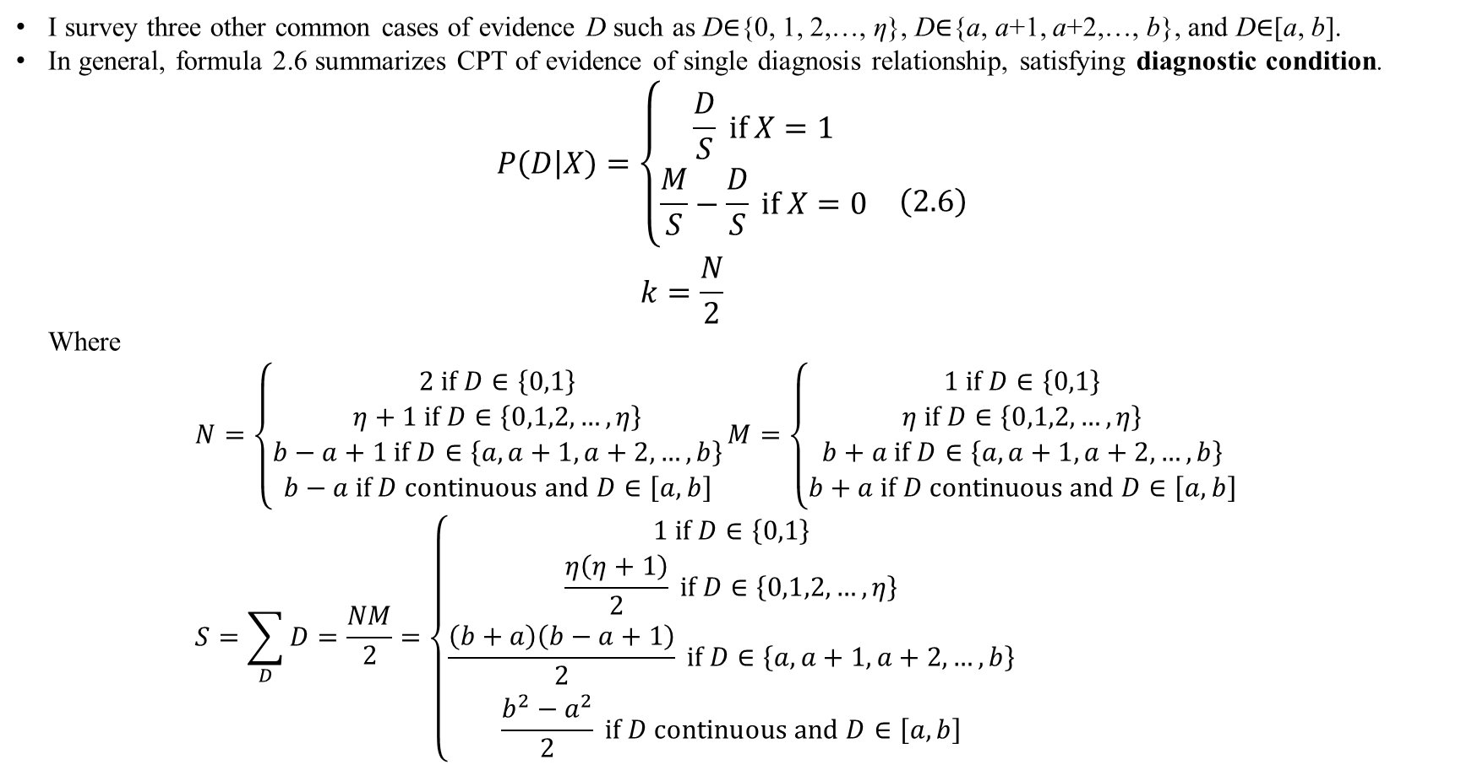
2. Diagnostic relationship
I survey three other common cases of evidence D such as D$∈${0, 1, 2,…, η}, D$∈${a, a+1, a+2,…, b}, and D$∈$[a, b].
In general, formula 2.6 summarizes CPT of evidence of single diagnosis relationship, satisfying diagnostic condition.
$$\begin{matrix}\begin{matrix}P\left(D | X\right)=\left\{\begin{matrix}\frac{D}{S} if X=1 \\ \frac{M}{S}−\frac{D}{S} if X=0\end{matrix}\right. \\ k=\frac{N}{2}\end{matrix} & \left(2.6\right)\end{matrix}$$
Where
$$N=\left\{\begin{matrix}2 if D∈\left\{0,1\right\} \\ η+1 if D∈\left\{0,1,2,…,η\right\} \\ b−a+1 if D∈\left\{a,a+1,a+2,…,b\right\} \\ b−a if D continuous and D∈\left[a,b\right]\end{matrix}\right.M=\left\{\begin{matrix}1 if D∈\left\{0,1\right\} \\ η if D∈\left\{0,1,2,…,η\right\} \\ b+a if D∈\left\{a,a+1,a+2,…,b\right\} \\ b+a if D continuous and D∈\left[a,b\right]\end{matrix}\right. \\ S=\sum_{D}{D}=\frac{NM}{2}=\left\{\begin{matrix}1 if D∈\left\{0,1\right\} \\ \frac{η\left(η+1\right)}{2} if D∈\left\{0,1,2,…,η\right\} \\ \frac{\left(b+a\right)\left(b−a+1\right)}{2} if D∈\left\{a,a+1,a+2,…,b\right\} \\ \frac{b^{2}−a^{2}}{2} if D continuous and D∈\left[a,b\right]\end{matrix}\right.$$

Slide 12
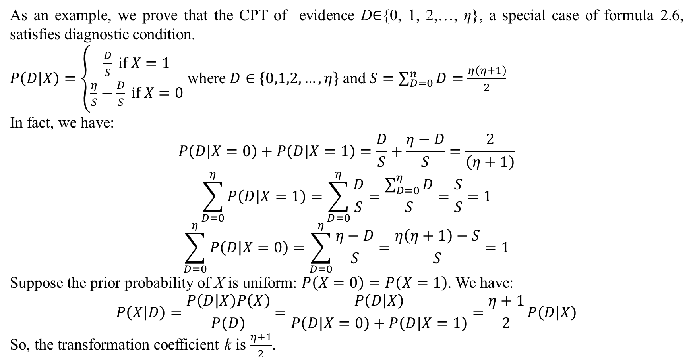
2. Diagnostic relationship
As an example, we prove that the CPT of evidence D$∈${0, 1, 2,…, η}, a special case of formula 2.6, satisfies diagnostic condition.
$P\left(D | X\right)=\left\{\begin{matrix}\frac{D}{S} if X=1 \\ \frac{η}{S}−\frac{D}{S} if X=0\end{matrix}\right.$ where $D∈\left\{0,1,2,…,η\right\}$ and $S=\sum_{D=0}^{n}{D}=\frac{η\left(η+1\right)}{2}$
In fact, we have:
$$P\left(D | X=0\right)+P\left(D | X=1\right)=\frac{D}{S}+\frac{η−D}{S}=\frac{2}{\left(η+1\right)}$$
$$\sum_{D=0}^{η}{P\left(D | X=1\right)}=\sum_{D=0}^{η}{\frac{D}{S}}=\frac{\sum_{D=0}^{η}{D}}{S}=\frac{S}{S}=1$$
$$\sum_{D=0}^{η}{P\left(D | X=0\right)}=\sum_{D=0}^{η}{\frac{η−D}{S}}=\frac{η\left(η+1\right)−S}{S}=1$$
Suppose the prior probability of X is uniform: $P\left(X=0\right)=P\left(X=1\right)$. We have:
$$P\left(X | D\right)=\frac{P\left(D | X\right)P\left(X\right)}{P\left(D\right)}=\frac{P\left(D | X\right)}{P\left(D | X=0\right)+P\left(D | X=1\right)}=\frac{η+1}{2}P\left(D | X\right)$$
So, the transformation coefficient k is $\frac{η+1}{2}$.

Slide 13
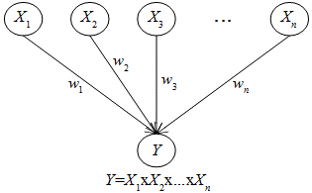
3. X-gate inferences
The diagnostic relationship is now extended with more than one hypothesis. Given a simple graph consisting of one child variable Y and n parent variables X_{i}. Each relationship from X_{i} to Y is quantified by a normalized weight w_{i} where 0 ≤ w_{i} ≤ 1.
Now we convert graphic relationships of simple graph into CPT (s) of simple BN. These relationships are adhere to X-gates such as AND-gate, OR-gate, and SIGMA-gate. Relationship conversion is to determine X-gate inference. The simple graph is also called X-gate graph or X-gate network.
X-gate network

Slide 14
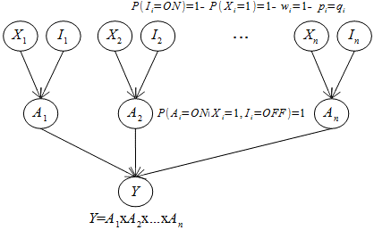
3. X-gate inferences
X-gate inference is based on three following assumptions mentioned in (Neapolitan, 2003, p. 157)
X-gate inhibition: Given a relationship from source X_{i} to target Y, there is a factor I_{i} that inhibits X_{i} from integrated into Y.
Inhibition independence: Inhibitions are mutually independent.
Accountability: X-gate network is established by accountable variables A_{i} for X_{i} and I_{i}. Each X-gate inference owns particular combination of A_{i} (s).
extended X-gate network with accountable variables

Slide 15
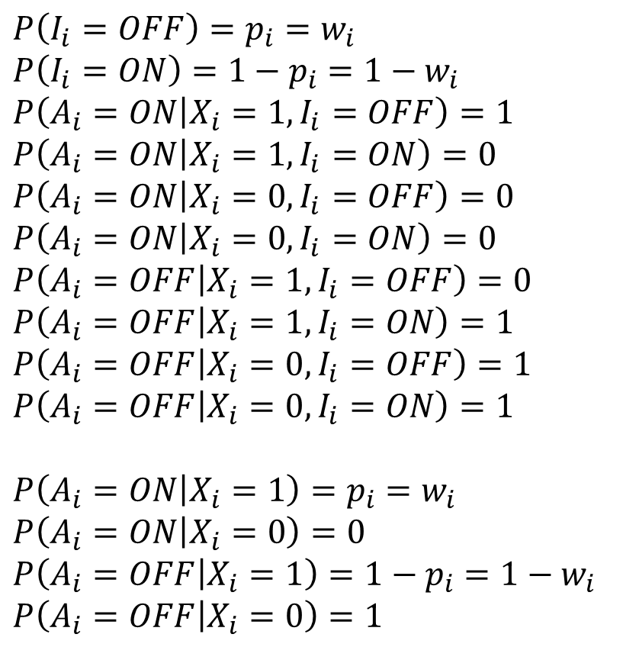
3. X-gate inferences
Probabilities of inhibitions I_{i} (s) and accountable variables A_{i} with formulas 3.2, 3.3
$$P\left(I_{i}=OFF\right)=p_{i}=w_{i}$$
$$P\left(I_{i}=ON\right)=1−p_{i}=1−w_{i}$$
$$P\left(A_{i}=ON | X_{i}=1,I_{i}=OFF\right)=1$$
$$P\left(A_{i}=ON | X_{i}=1,I_{i}=ON\right)=0$$
$$P\left(A_{i}=ON | X_{i}=0,I_{i}=OFF\right)=0$$
$$P\left(A_{i}=ON | X_{i}=0,I_{i}=ON\right)=0$$
$$P\left(A_{i}=OFF | X_{i}=1,I_{i}=OFF\right)=0$$
$$P\left(A_{i}=OFF | X_{i}=1,I_{i}=ON\right)=1$$
$$P\left(A_{i}=OFF | X_{i}=0,I_{i}=OFF\right)=1$$
$$P\left(A_{i}=OFF | X_{i}=0,I_{i}=ON\right)=1$$
$$P\left(A_{i}=ON | X_{i}=1\right)=p_{i}=w_{i}$$
$$P\left(A_{i}=ON | X_{i}=0\right)=0$$
$$P\left(A_{i}=OFF | X_{i}=1\right)=1−p_{i}=1−w_{i}$$
$$P\left(A_{i}=OFF | X_{i}=0\right)=1$$

Slide 16
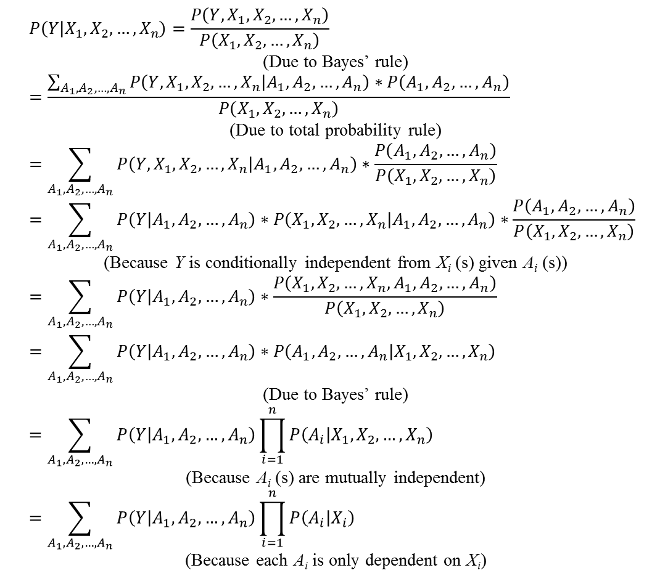
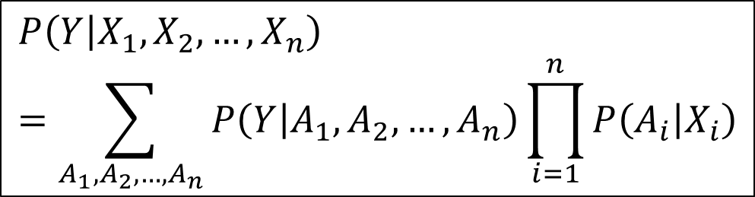
3. X-gate inferences
$$P\left(Y | X_{1},X_{2},…,X_{n}\right)=\frac{P\left(Y,X_{1},X_{2},…,X_{n}\right)}{P\left(X_{1},X_{2},…,X_{n}\right)}$$
(Due to Bayes’ rule)
$$=\frac{\sum_{A_{1},A_{2},…,A_{n}}{P\left(Y,X_{1},X_{2},…,X_{n} | A_{1},A_{2},…,A_{n}\right)∗P\left(A_{1},A_{2},…,A_{n}\right)}}{P\left(X_{1},X_{2},…,X_{n}\right)}$$
(Due to total probability rule)
$$=\sum_{A_{1},A_{2},…,A_{n}}{P\left(Y,X_{1},X_{2},…,X_{n} | A_{1},A_{2},…,A_{n}\right)∗\frac{P\left(A_{1},A_{2},…,A_{n}\right)}{P\left(X_{1},X_{2},…,X_{n}\right)}}$$
$$=\sum_{A_{1},A_{2},…,A_{n}}{P\left(Y | A_{1},A_{2},…,A_{n}\right)∗P\left(X_{1},X_{2},…,X_{n} | A_{1},A_{2},…,A_{n}\right)∗\frac{P\left(A_{1},A_{2},…,A_{n}\right)}{P\left(X_{1},X_{2},…,X_{n}\right)}}$$
(Because Y is conditionally independent from X_{i} (s) given A_{i} (s))
$$=\sum_{A_{1},A_{2},…,A_{n}}{P\left(Y | A_{1},A_{2},…,A_{n}\right)∗\frac{P\left(X_{1},X_{2},…,X_{n},A_{1},A_{2},…,A_{n}\right)}{P\left(X_{1},X_{2},…,X_{n}\right)}}$$
$$=\sum_{A_{1},A_{2},…,A_{n}}{P\left(Y | A_{1},A_{2},…,A_{n}\right)∗P\left(A_{1},A_{2},…,A_{n} | X_{1},X_{2},…,X_{n}\right)}$$
(Due to Bayes’ rule)
$$=\sum_{A_{1},A_{2},…,A_{n}}{P\left(Y | A_{1},A_{2},…,A_{n}\right)\prod_{i=1}^{n}{P\left(A_{i} | X_{1},X_{2},…,X_{n}\right)}}$$
(Because A_{i} (s) are mutually independent)
$$=\sum_{A_{1},A_{2},…,A_{n}}{P\left(Y | A_{1},A_{2},…,A_{n}\right)\prod_{i=1}^{n}{P\left(A_{i} | X_{i}\right)}}$$
(Because each A_{i} is only dependent on X_{i})
$$P\left(Y | X_{1},X_{2},…,X_{n}\right)=\sum_{A_{1},A_{2},…,A_{n}}{P\left(Y | A_{1},A_{2},…,A_{n}\right)\prod_{i=1}^{n}{P\left(A_{i} | X_{i}\right)}}$$
X-gate probability (3.4)
The X-gate inference is represented by X-gate probability P(Y=1 | X₁, X₂,…, X_{n}) specified by (Neapolitan, 2003, p. 159)

Slide 17
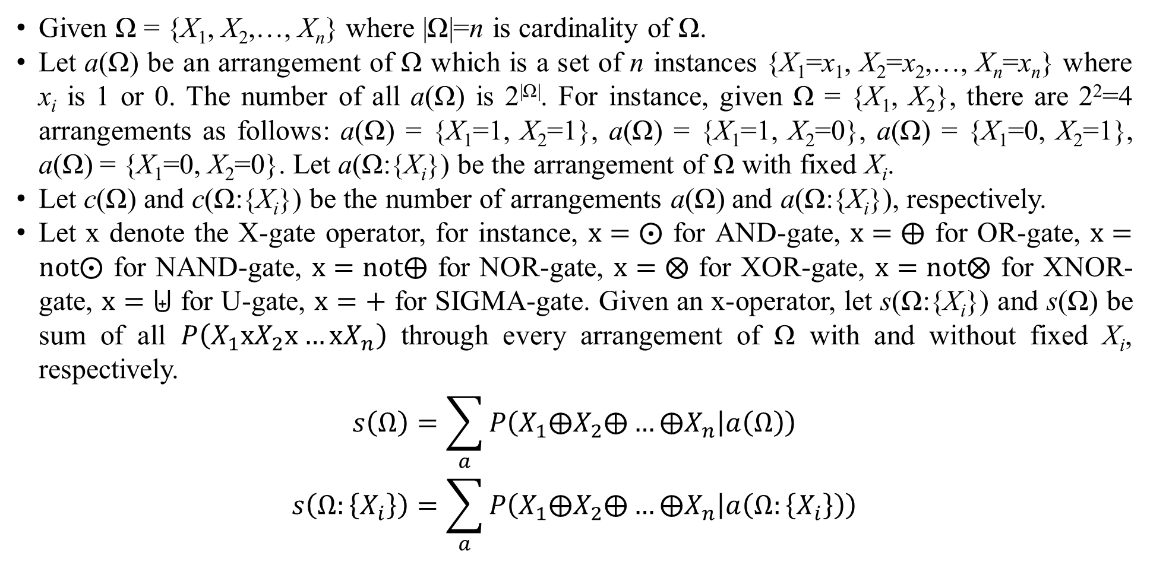
3. X-gate inferences
Given Ω = {X₁, X₂,…, X_{n}} where |Ω|=n is cardinality of Ω.
Let a(Ω) be an arrangement of Ω which is a set of n instances {X₁=x₁, X₂=x₂,…, X_{n}=x_{n}} where x_{i} is 1 or 0. The number of all a(Ω) is 2^{|Ω|}. For instance, given Ω = {X₁, X₂}, there are 2²=4 arrangements as follows: a(Ω) = {X₁=1, X₂=1}, a(Ω) = {X₁=1, X₂=0}, a(Ω) = {X₁=0, X₂=1}, a(Ω) = {X₁=0, X₂=0}. Let a(Ω:{X_{i}}) be the arrangement of Ω with fixed X_{i}.
Let c(Ω) and c(Ω:{X_{i}}) be the number of arrangements a(Ω) and a(Ω:{X_{i}}), respectively.
Let x denote the X-gate operator, for instance, $x=⨀$ for AND-gate, $x=⨁$ for OR-gate, $x=not⨀$ for NAND-gate, $x=not⨁$ for NOR-gate, $x=⨂$ for XOR-gate, $x=not⨂$ for XNOR-gate, $x=⨄$ for U-gate, $x=+$ for SIGMA-gate. Given an x-operator, let s(Ω:{X_{i}}) and s(Ω) be sum of all $P\left(X_{1}xX_{2}x…xX_{n}\right)$ through every arrangement of Ω with and without fixed X_{i}, respectively.
$$s\left(Ω\right)=\sum_{a}{P\left(X_{1}⨁X_{2}⨁…⨁X_{n} | a\left(Ω\right)\right)} \\ s\left(Ω:\left\{X_{i}\right\}\right)=\sum_{a}{P\left(X_{1}⨁X_{2}⨁…⨁X_{n} | a\left(Ω:\left\{X_{i}\right\}\right)\right)}$$

Slide 18
3. X-gate inferences
public class ArrangementGenerator {
private ArrayList<int[]> arrangements; private int n, r;
private ArrangementGenerator(int n, int r) {
this.n = n; this.r = r; this.arrangements = new ArrayList();
}
private void create(int[] a, int i) {
for(int j = 0; j < n; j++) {
a[i] = j;
if(i < r - 1) create(a, i + 1);
else if(i == r -1) {
int[] b = new int[a.length];
for(int k = 0; k < a.length; k++) b[k] = a[k];
arrangements.add(b);
}
}
}
}
code for producing all arrangements

Slide 19
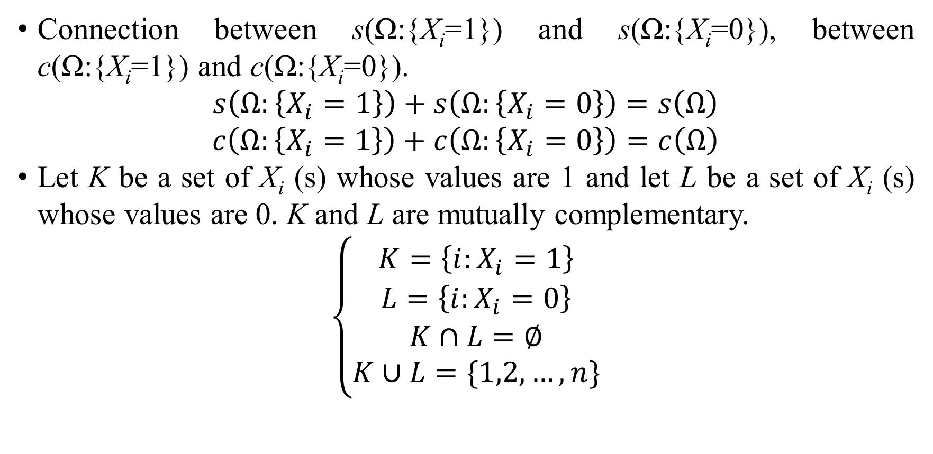
3. X-gate inferences
Connection between s(Ω:{X_{i}=1}) and s(Ω:{X_{i}=0}), between c(Ω:{X_{i}=1}) and c(Ω:{X_{i}=0}).
$$s\left(Ω:\left\{X_{i}=1\right\}\right)+s\left(Ω:\left\{X_{i}=0\right\}\right)=s\left(Ω\right)$$
$$c\left(Ω:\left\{X_{i}=1\right\}\right)+c\left(Ω:\left\{X_{i}=0\right\}\right)=c\left(Ω\right)$$
Let K be a set of X_{i} (s) whose values are 1 and let L be a set of X_{i} (s) whose values are 0. K and L are mutually complementary.
$$\left\{\begin{matrix}K=\left\{i:X_{i}=1\right\} \\ L=\left\{i:X_{i}=0\right\} \\ K∩L=∅ \\ K∪L=\{1,2,…,n\}\end{matrix}\right.$$

Slide 20
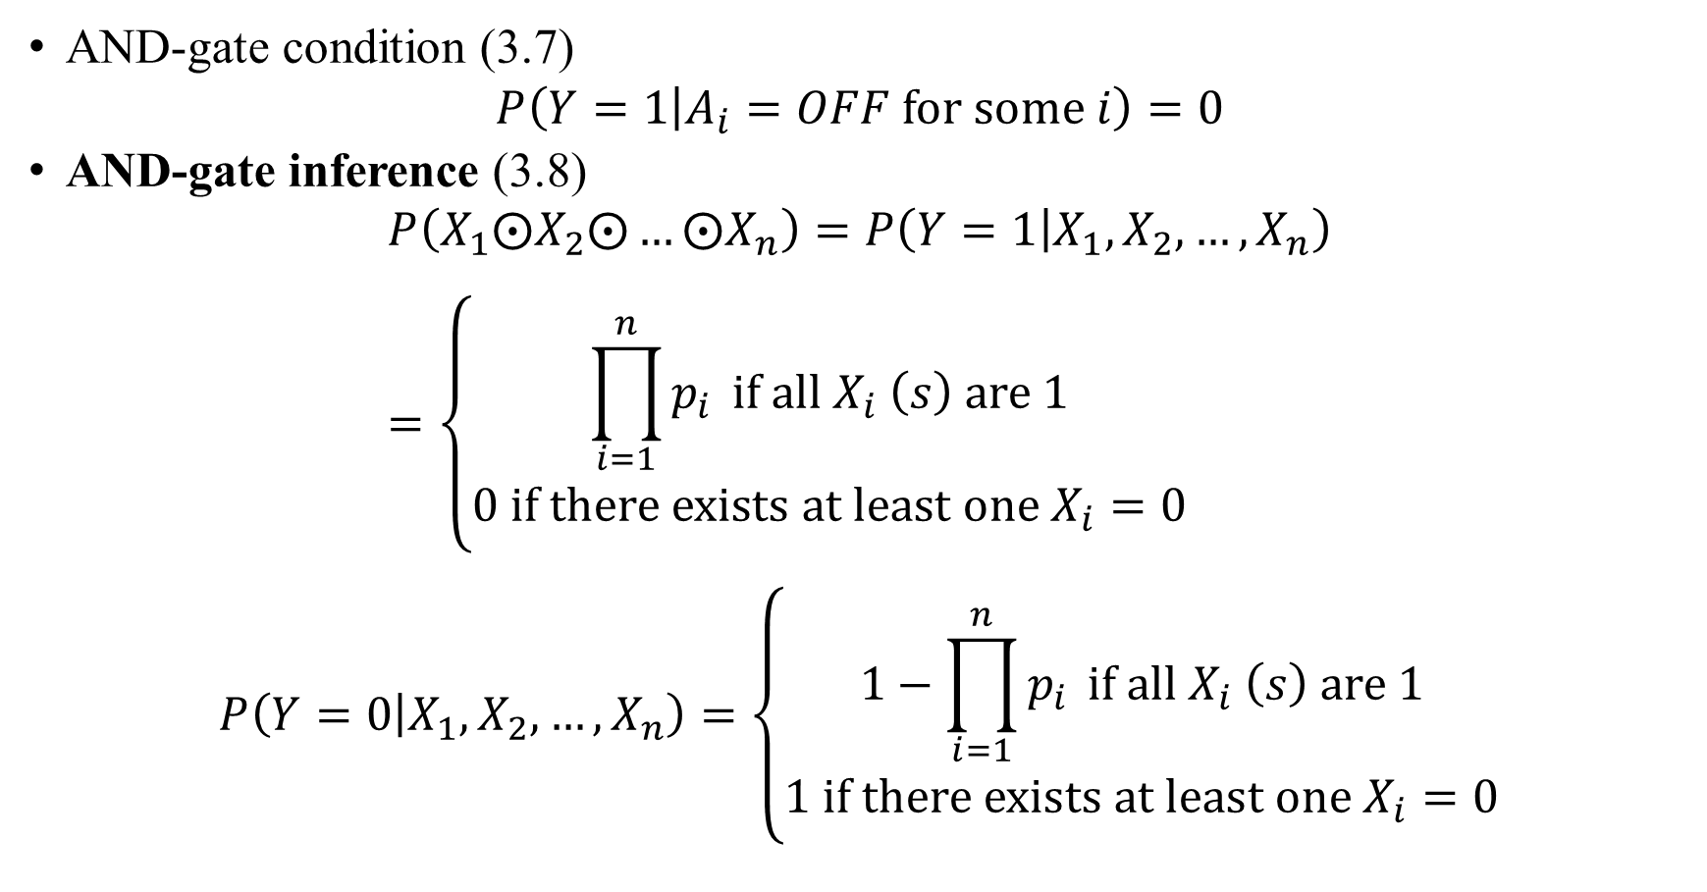
3. X-gate inferences
AND-gate condition (3.7)
$$P\left(Y=1 | A_{i}=OFF for some i\right)=0$$
AND-gate inference (3.8)
$$P\left(X_{1}⨀X_{2}⨀…⨀X_{n}\right)=P\left(Y=1 | X_{1},X_{2},…,X_{n}\right)=\left\{\begin{matrix}\prod_{i=1}^{n}{p_{i}} if all X_{i} \left(s\right) are 1 \\ 0 if there exists at least one X_{i}=0\end{matrix}\right.$$
$$P\left(Y=0 | X_{1},X_{2},…,X_{n}\right)=\left\{\begin{matrix}1−\prod_{i=1}^{n}{p_{i}} if all X_{i} \left(s\right) are 1 \\ 1 if there exists at least one X_{i}=0\end{matrix}\right.$$

Slide 21
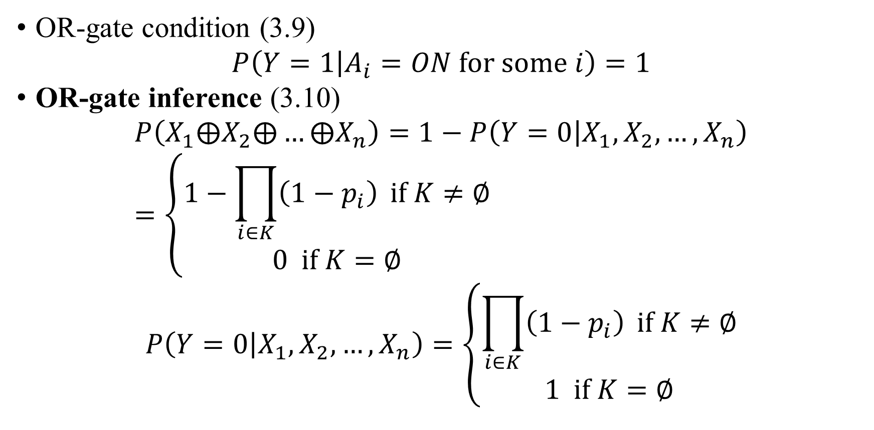
3. X-gate inferences
OR-gate condition (3.9)
$$P\left(Y=1 | A_{i}=ON for some i\right)=1$$
OR-gate inference (3.10)
$$P\left(X_{1}⨁X_{2}⨁…⨁X_{n}\right)=1−P\left(Y=0 | X_{1},X_{2},…,X_{n}\right)=\left\{\begin{matrix}1−\prod_{i∈K}{\left(1−p_{i}\right)} if K≠∅ \\ 0 if K=∅\end{matrix}\right.$$
$$P\left(Y=0 | X_{1},X_{2},…,X_{n}\right)=\left\{\begin{matrix}\prod_{i∈K}{\left(1−p_{i}\right)} if K≠∅ \\ 1 if K=∅\end{matrix}\right.$$

Slide 22
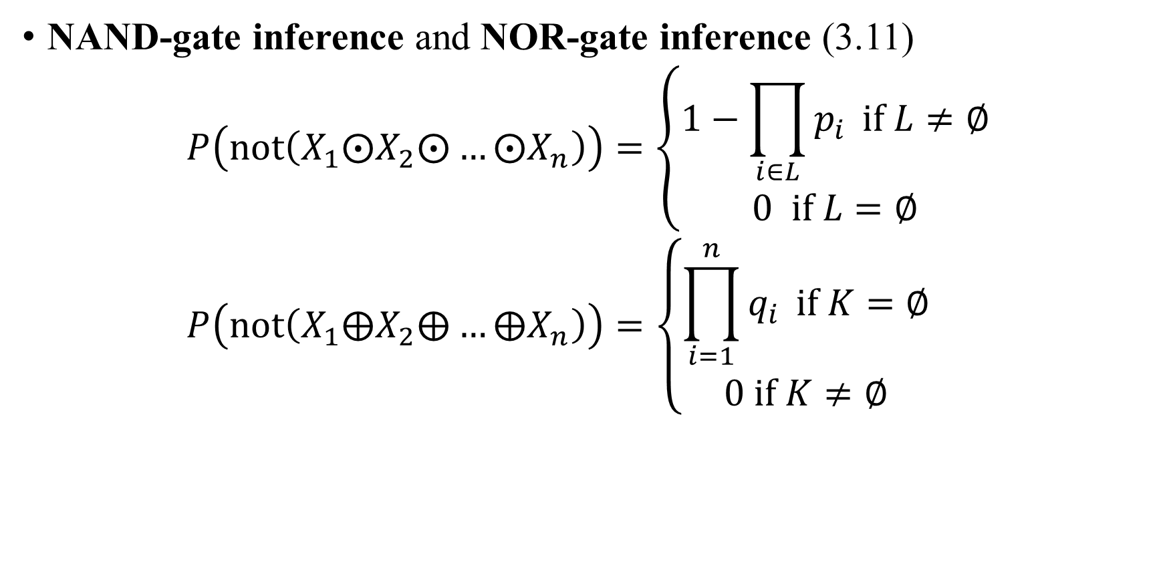
3. X-gate inferences
NAND-gate inference and NOR-gate inference (3.11)
$$P\left(not\left(X_{1}⨀X_{2}⨀…⨀X_{n}\right)\right)=\left\{\begin{matrix}1−\prod_{i∈L}{p_{i}} if L≠∅ \\ 0 if L=∅\end{matrix}\right. \\ P\left(not\left(X_{1}⨁X_{2}⨁…⨁X_{n}\right)\right)=\left\{\begin{matrix}\prod_{i=1}^{n}{q_{i}} if K=∅ \\ 0 if K≠∅\end{matrix}\right.$$

Slide 23
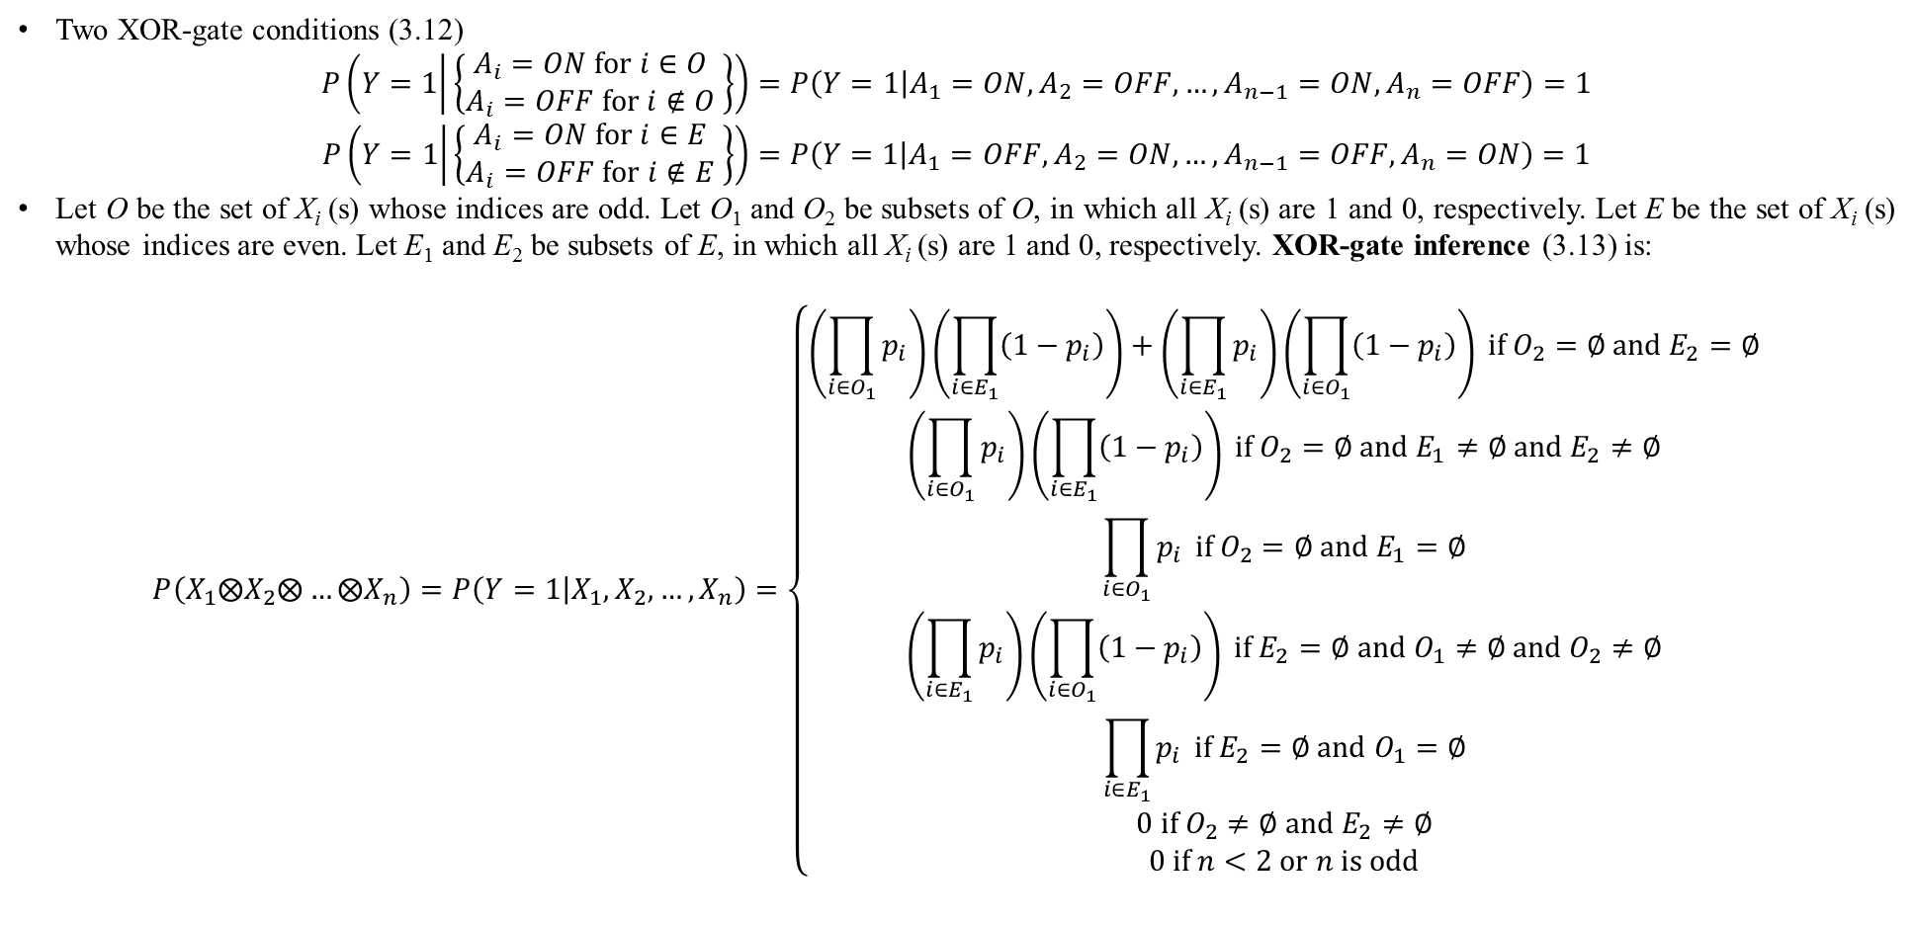
3. X-gate inferences
Two XOR-gate conditions (3.12)
$$P\left(Y=1 | \left\{\begin{matrix}A_{i}=ON for i∈O \\ A_{i}=OFF for i∉O \end{matrix}\right\}\right)=P\left(Y=1 | A_{1}=ON,A_{2}=OFF,…,A_{n−1}=ON,A_{n}=OFF\right)=1$$
$$P\left(Y=1 | \left\{\begin{matrix}A_{i}=ON for i∈E \\ A_{i}=OFF for i∉E \end{matrix}\right\}\right)=P\left(Y=1 | A_{1}=OFF,A_{2}=ON,…,A_{n−1}=OFF,A_{n}=ON\right)=1$$
Let O be the set of X_{i} (s) whose indices are odd. Let O₁ and O₂ be subsets of O, in which all X_{i} (s) are 1 and 0, respectively. Let E be the set of X_{i} (s) whose indices are even. Let E₁ and E₂ be subsets of E, in which all X_{i} (s) are 1 and 0, respectively. XOR-gate inference (3.13) is:
$$P\left(X_{1}⨂X_{2}⨂…⨂X_{n}\right)=P\left(Y=1 | X_{1},X_{2},…,X_{n}\right)=\left\{\begin{matrix}\left(\prod_{i∈O_{1}}{p_{i}}\right)\left(\prod_{i∈E_{1}}{\left(1−p_{i}\right)}\right)+\left(\prod_{i∈E_{1}}{p_{i}}\right)\left(\prod_{i∈O_{1}}{\left(1−p_{i}\right)}\right) if O_{2}=∅ and E_{2}=∅ \\ \left(\prod_{i∈O_{1}}{p_{i}}\right)\left(\prod_{i∈E_{1}}{\left(1−p_{i}\right)}\right) if O_{2}=∅ and E_{1}≠∅ and E_{2}≠∅ \\ \prod_{i∈O_{1}}{p_{i}} if O_{2}=∅ and E_{1}=∅ \\ \left(\prod_{i∈E_{1}}{p_{i}}\right)\left(\prod_{i∈O_{1}}{\left(1−p_{i}\right)}\right) if E_{2}=∅ and O_{1}≠∅ and O_{2}≠∅ \\ \prod_{i∈E_{1}}{p_{i}} if E_{2}=∅ and O_{1}=∅ \\ 0 if O_{2}≠∅ and E_{2}≠∅ \\ 0 if n<2 or n is odd\end{matrix}\right.$$

Slide 24
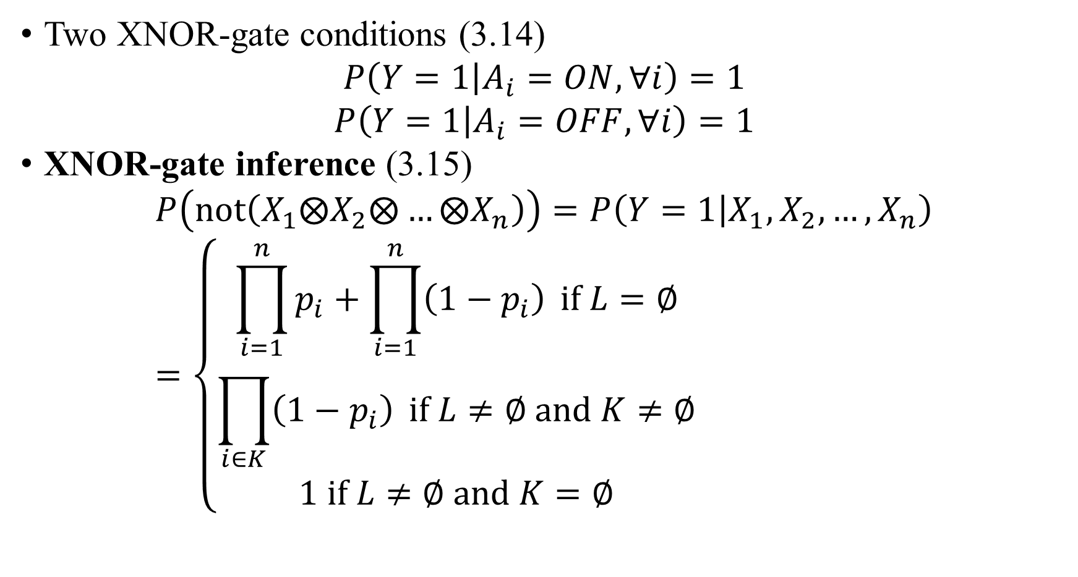
3. X-gate inferences
Two XNOR-gate conditions (3.14)
$$P\left(Y=1 | A_{i}=ON,∀i\right)=1$$
$$P\left(Y=1 | A_{i}=OFF,∀i\right)=1$$
XNOR-gate inference (3.15)
$$P\left(not\left(X_{1}⨂X_{2}⨂…⨂X_{n}\right)\right)=P\left(Y=1 | X_{1},X_{2},…,X_{n}\right)=\left\{\begin{matrix}\prod_{i=1}^{n}{p_{i}}+\prod_{i=1}^{n}{\left(1−p_{i}\right)} if L=∅ \\ \prod_{i∈K}{\left(1−p_{i}\right)} if L≠∅ and K≠∅ \\ 1 if L≠∅ and K=∅\end{matrix}\right.$$

Slide 25
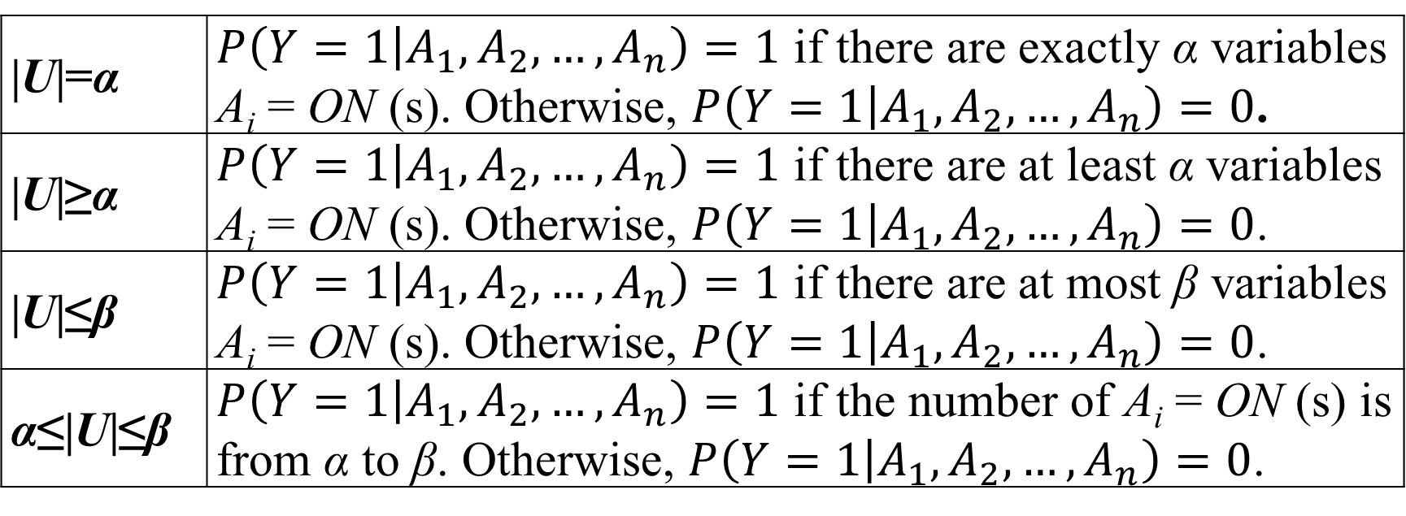
3. X-gate inferences
Let U be a set of indices such that A_{i}=ON and let α ≥ 0 and β ≥ 0 be predefined numbers. The U-gate inference is defined based on α, β and cardinality of U. Formula 3.16 specifies three common U-gate conditions.
|U|=α | $P\left(Y=1 | A_{1},A_{2},…,A_{n}\right)=1$ if there are exactly α variables A_{i} = ON (s). Otherwise, $P\left(Y=1 | A_{1},A_{2},…,A_{n}\right)=0$.
|U|≥α | $P\left(Y=1 | A_{1},A_{2},…,A_{n}\right)=1$ if there are at least α variables A_{i} = ON (s). Otherwise, $P\left(Y=1 | A_{1},A_{2},…,A_{n}\right)=0$.
|U|≤β | $P\left(Y=1 | A_{1},A_{2},…,A_{n}\right)=1$ if there are at most β variables A_{i} = ON (s). Otherwise, $P\left(Y=1 | A_{1},A_{2},…,A_{n}\right)=0$.
α≤|U|≤β | $P\left(Y=1 | A_{1},A_{2},…,A_{n}\right)=1$ if the number of A_{i} = ON (s) is from α to β. Otherwise, $P\left(Y=1 | A_{1},A_{2},…,A_{n}\right)=0$.

Slide 26
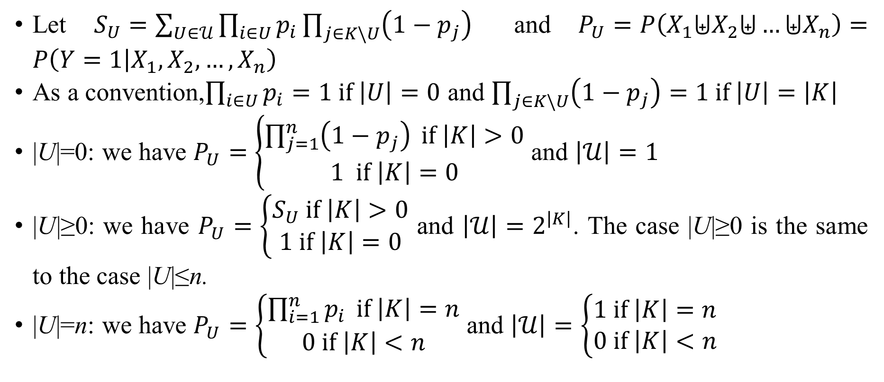
3. X-gate inferences
Let P_{U} be the U-gate probability, following formula 3.17 specifies U-gate inference and cardinality of $𝒰$ where $𝒰$ is the set of subsets (U) of K
Let $S_{U}=\sum_{U∈𝒰}{\prod_{i∈U}{p_{i}}\prod_{j∈K\backslash U}{\left(1−p_{j}\right)}}$ and $P_{U}=P\left(X_{1}⨄X_{2}⨄…⨄X_{n}\right)=P\left(Y=1 | X_{1},X_{2},…,X_{n}\right)$
As a convention,$\prod_{i∈U}{p_{i}}=1 if \left|U\right|=0$ and $\prod_{j∈K\backslash U}{\left(1−p_{j}\right)}=1 if \left|U\right|=\left|K\right|$
|U|=0: we have $P_{U}=\left\{\begin{matrix}\prod_{j=1}^{n}{\left(1−p_{j}\right)} if \left|K\right|>0 \\ 1 if \left|K\right|=0\end{matrix}\right.$ and $\left|𝒰\right|=1$
|U|≥0: we have $P_{U}=\left\{\begin{matrix}S_{U} if \left|K\right|>0 \\ 1 if \left|K\right|=0\end{matrix}\right.$ and $\left|𝒰\right|=2^{\left|K\right|}$. The case |U|≥0 is the same to the case |U|≤n.
|U|=n: we have $P_{U}=\left\{\begin{matrix}\prod_{i=1}^{n}{p_{i}} if \left|K\right|=n \\ 0 if \left|K\right|<n\end{matrix}\right.$ and $\left|𝒰\right|=\left\{\begin{matrix}1 if \left|K\right|=n \\ 0 if \left|K\right|<n\end{matrix}\right.$

Slide 27
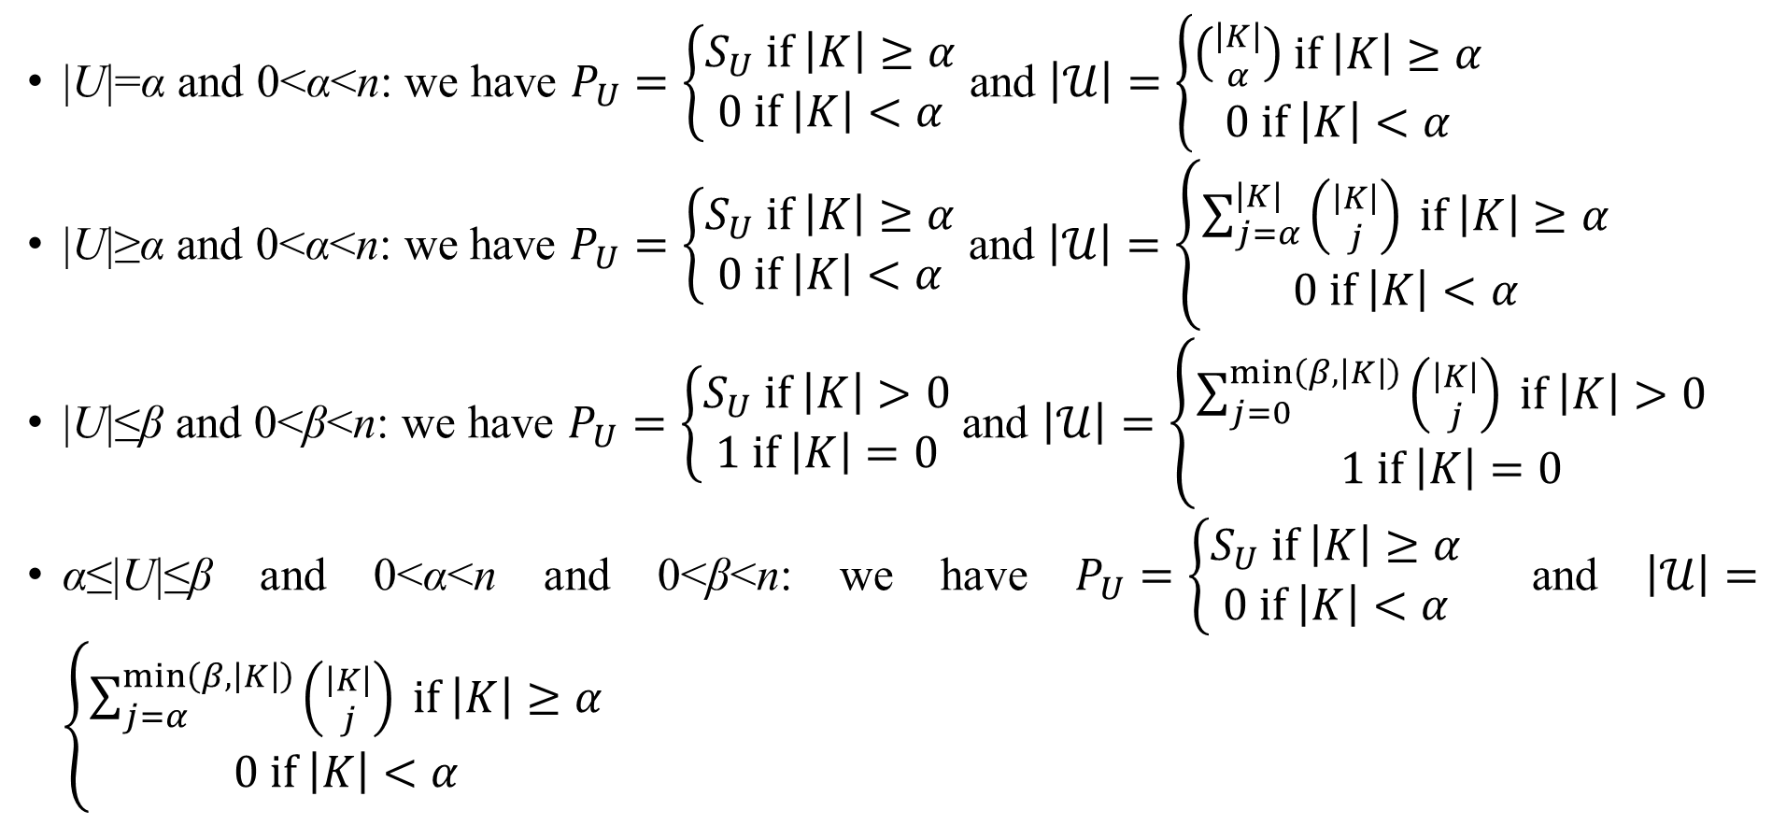
3. X-gate inferences
U-gate inference (continue)
|U|=α and 0<α<n: we have $P_{U}=\left\{\begin{matrix}S_{U} if \left|K\right|≥α \\ 0 if \left|K\right|<α\end{matrix}\right.$ and $\left|𝒰\right|=\left\{\begin{matrix}\left({\left|K\right| \atop α}\right) if \left|K\right|≥α \\ 0 if \left|K\right|<α\end{matrix}\right.$
|U|≥α and 0<α<n: we have $P_{U}=\left\{\begin{matrix}S_{U} if \left|K\right|≥α \\ 0 if \left|K\right|<α\end{matrix}\right.$ and $\left|𝒰\right|=\left\{\begin{matrix}\sum_{j=α}^{\left|K\right|}{\left({\left|K\right| \atop j}\right)} if \left|K\right|≥α \\ 0 if \left|K\right|<α\end{matrix}\right.$
|U|≤β and 0<β<n: we have $P_{U}=\left\{\begin{matrix}S_{U} if \left|K\right|>0 \\ 1 if \left|K\right|=0\end{matrix}\right.$ and $\left|𝒰\right|=\left\{\begin{matrix}\sum_{j=0}^{min\left(β,\left|K\right|\right)}{\left({\left|K\right| \atop j}\right)} if \left|K\right|>0 \\ 1 if \left|K\right|=0\end{matrix}\right.$
α≤|U|≤β and 0<α<n and 0<β<n: we have $P_{U}=\left\{\begin{matrix}S_{U} if \left|K\right|≥α \\ 0 if \left|K\right|<α\end{matrix}\right.$ and $\left|𝒰\right|=\left\{\begin{matrix}\sum_{j=α}^{min\left(β,\left|K\right|\right)}{\left({\left|K\right| \atop j}\right)} if \left|K\right|≥α \\ 0 if \left|K\right|<α\end{matrix}\right.$

Slide 28
3. X-gate inferences
U-gate condition on |U| can be arbitrary and it is only relevant to A_{i} (s) (ON or OFF) and the way to combine A_{i} (s). For example, AND-gate and OR-gate are specific cases of U-gate with |U|=n and |U|≥1, respectively. XOR-gate and XNOR-gate are also specific cases of U-gate with specific conditions on A_{i} (s).
In this research, U-gate is the most general nonlinear gate where U-gate probability contains products of weights.
Next, we will research a so-called SIGMA-gate that contains only linear combination of weights.

Slide 29
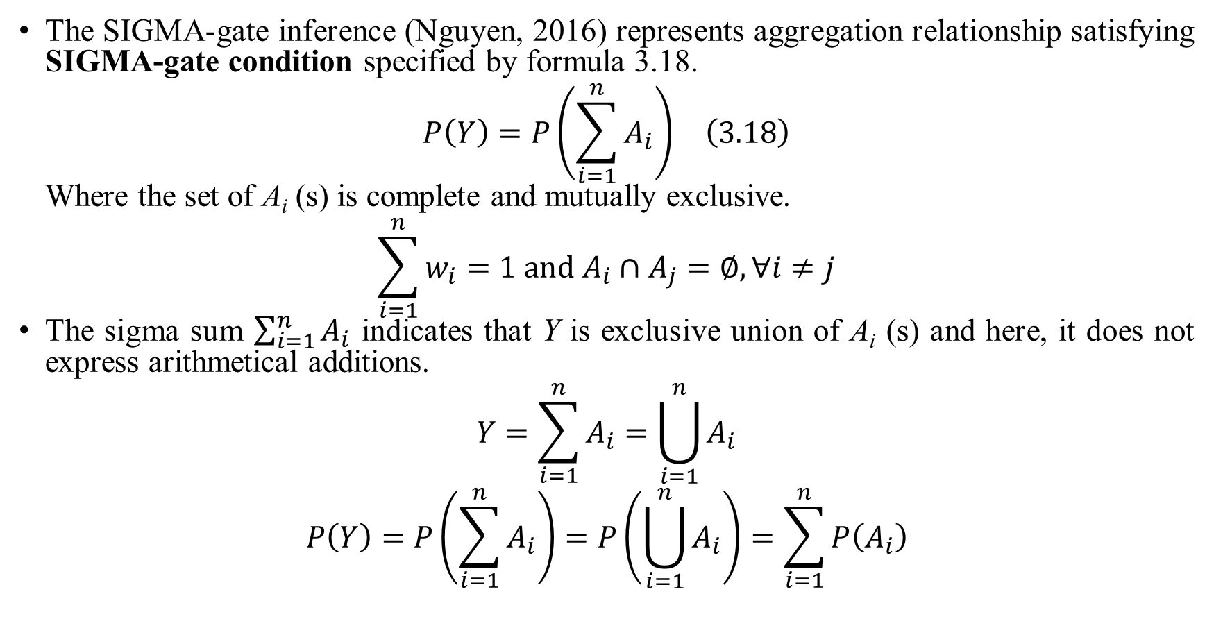
3. X-gate inferences
The SIGMA-gate inference (Nguyen, 2016) represents aggregation relationship satisfying SIGMA-gate condition specified by formula 3.18.
$$\begin{matrix}P\left(Y\right)=P\left(\sum_{i=1}^{n}{A_{i}}\right) & \left(3.18\right)\end{matrix}$$
Where the set of A_{i} (s) is complete and mutually exclusive.
$$\sum_{i=1}^{n}{w_{i}}=1 and A_{i}∩A_{j}=∅,∀i≠j$$
The sigma sum $\sum_{i=1}^{n}{A_{i}}$ indicates that Y is exclusive union of A_{i} (s) and here, it does not express arithmetical additions.
$$Y=\sum_{i=1}^{n}{A_{i}}=\bigcup_{i=1}^{n}{A_{i}}$$
$$P\left(Y\right)=P\left(\sum_{i=1}^{n}{A_{i}}\right)=P\left(\bigcup_{i=1}^{n}{A_{i}}\right)=\sum_{i=1}^{n}{P\left(A_{i}\right)}$$

Slide 30
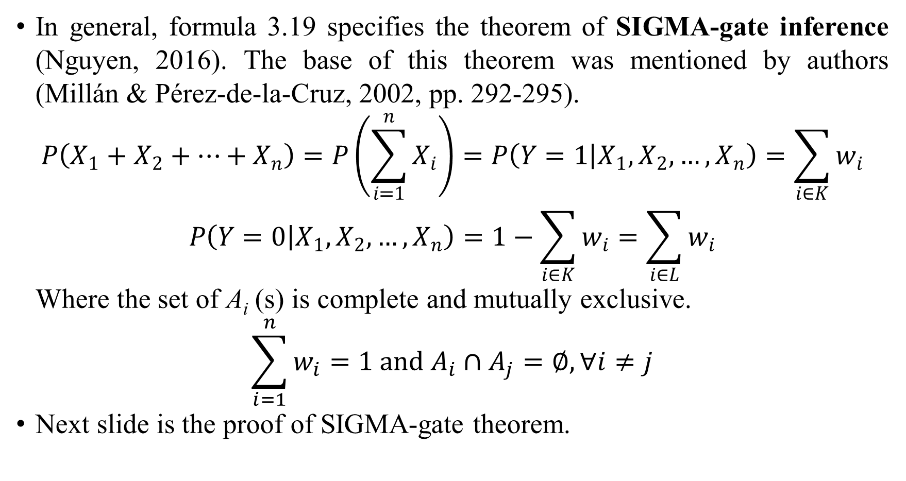
3. X-gate inferences
In general, formula 3.19 specifies the theorem of SIGMA-gate inference (Nguyen, 2016). The base of this theorem was mentioned by authors (Millán & Pérez-de-la-Cruz, 2002, pp. 292-295).
$$P\left(X_{1}+X_{2}+…+X_{n}\right)=P\left(\sum_{i=1}^{n}{X_{i}}\right)=P\left(Y=1 | X_{1},X_{2},…,X_{n}\right)=\sum_{i∈K}{w_{i}}$$
$$P\left(Y=0 | X_{1},X_{2},…,X_{n}\right)=1−\sum_{i∈K}{w_{i}}=\sum_{i∈L}{w_{i}}$$
Where the set of A_{i} (s) is complete and mutually exclusive.
$$\sum_{i=1}^{n}{w_{i}}=1 and A_{i}∩A_{j}=∅,∀i≠j$$
Next slide is the proof of SIGMA-gate theorem.

Slide 31
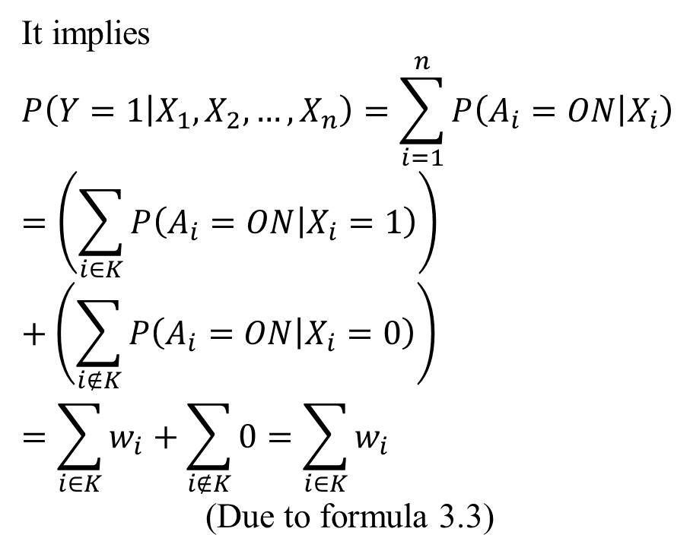
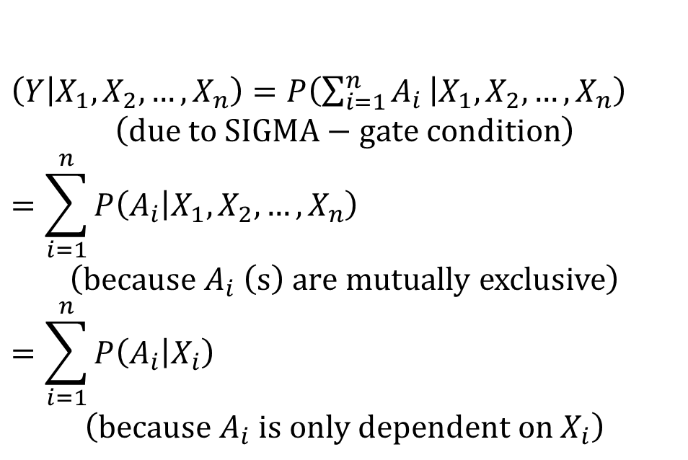
3. X-gate inferences
Proof of SIGMA-gate theorem
$$\left(Y | X_{1},X_{2},…,X_{n}\right)=P\left(\sum_{i=1}^{n}{A_{i}} | X_{1},X_{2},…,X_{n}\right)$$
$$\left(due to SIGMA−gate condition\right)$$
$$=\sum_{i=1}^{n}{P\left(A_{i} | X_{1},X_{2},…,X_{n}\right)}$$
$$\left(because A_{i} \left(s\right) are mutually exclusive\right)$$
$$=\sum_{i=1}^{n}{P\left(A_{i} | X_{i}\right)}$$
$$\left(because A_{i} is only dependent on X_{i}\right)$$
It implies
$$P\left(Y=1 | X_{1},X_{2},…,X_{n}\right)=\sum_{i=1}^{n}{P\left(A_{i}=ON | X_{i}\right)}$$
$$=\left(\sum_{i∈K}{P\left(A_{i}=ON | X_{i}=1\right)}\right)+\left(\sum_{i∉K}{P\left(A_{i}=ON | X_{i}=0\right)}\right)$$
$$=\sum_{i∈K}{w_{i}}+\sum_{i∉K}{0}=\sum_{i∈K}{w_{i}}$$
(Due to formula 3.3)

Slide 32
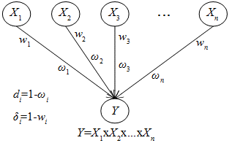
3. X-gate inferences
As usual, each arc in simple graph is associated with a “clockwise” strength of relationship between X_{i} and Y. Event X_{i}=1 causes event A_{i}=ON with “clockwise” weight w_{i}.
I define a so-called “counterclockwise” strength of relationship between X_{i} and Y denoted ω_{i}. Event X_{i}=0 causes event A_{i}=OFF with “counterclockwise” weight ω_{i}.
In other words, each arc in simple graph is associated with a clockwise weight w_{i} and a counterclockwise weight ω_{i}. Such graph is called bi-weight simple graph.
Bi-weight simple graph

Slide 33
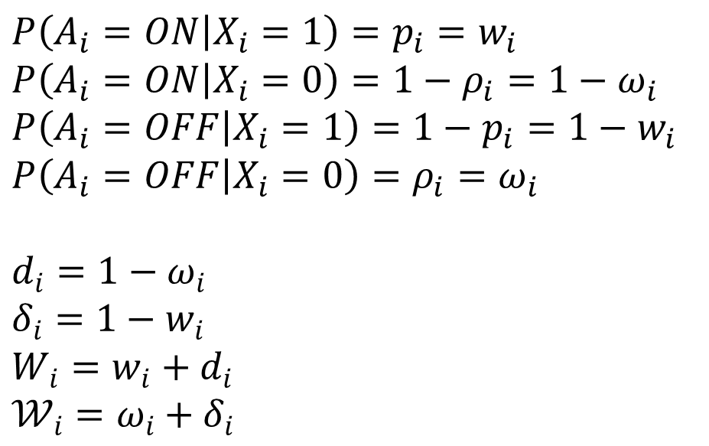
3. X-gate inferences
$$P\left(A_{i}=ON | X_{i}=1\right)=p_{i}=w_{i}$$
$$P\left(A_{i}=ON | X_{i}=0\right)=1−ρ_{i}=1−ω_{i}$$
$$P\left(A_{i}=OFF | X_{i}=1\right)=1−p_{i}=1−w_{i}$$
$$P\left(A_{i}=OFF | X_{i}=0\right)=ρ_{i}=ω_{i}$$
$$d_{i}=1−ω_{i}$$
$$δ_{i}=1−w_{i}$$
$$W_{i}=w_{i}+d_{i}$$
$$𝒲_{i}=ω_{i}+δ_{i}$$
Bi-weight simple graph

Slide 34
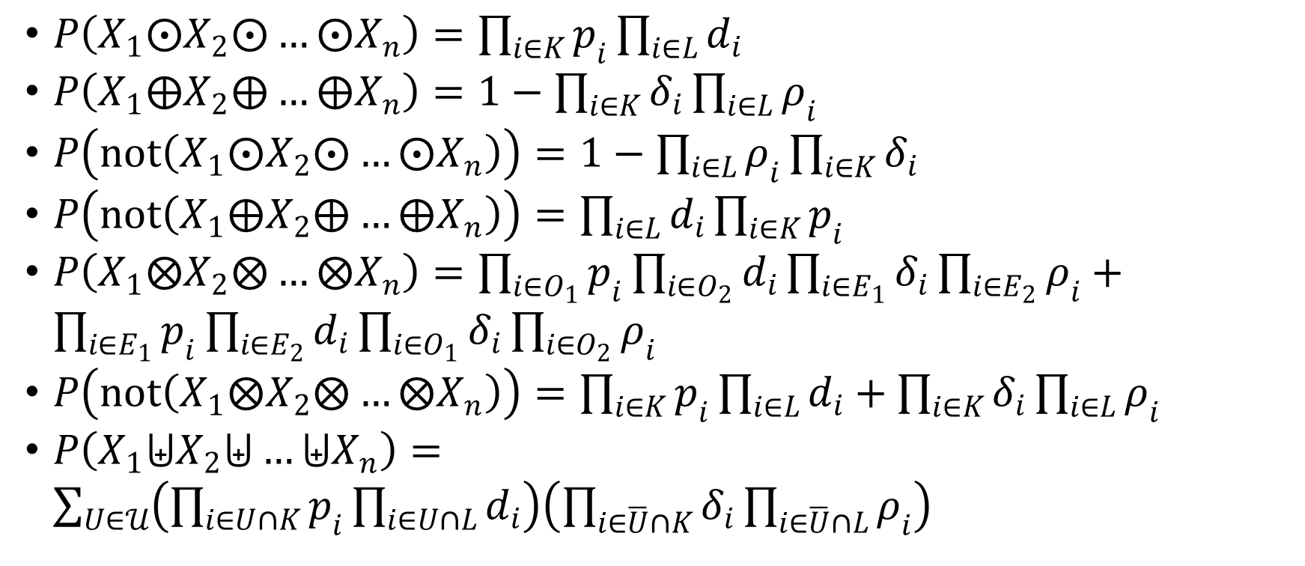
3. X-gate inferences
From bi-weight graph, we get bi-inferences for AND-gate, OR-gate, NAND-gate, NOR-gate, XOR-gate, XNOR-gate, and U-gate
$P\left(X_{1}⨀X_{2}⨀…⨀X_{n}\right)=\prod_{i∈K}{p_{i}}\prod_{i∈L}{d_{i}}$
$P\left(X_{1}⨁X_{2}⨁…⨁X_{n}\right)=1−\prod_{i∈K}{δ_{i}}\prod_{i∈L}{ρ_{i}}$
$P\left(not\left(X_{1}⨀X_{2}⨀…⨀X_{n}\right)\right)=1−\prod_{i∈L}{ρ_{i}}\prod_{i∈K}{δ_{i}}$
$P\left(not\left(X_{1}⨁X_{2}⨁…⨁X_{n}\right)\right)=\prod_{i∈L}{d_{i}}\prod_{i∈K}{p_{i}}$
$P\left(X_{1}⨂X_{2}⨂…⨂X_{n}\right)=\prod_{i∈O_{1}}{p_{i}}\prod_{i∈O_{2}}{d_{i}}\prod_{i∈E_{1}}{δ_{i}}\prod_{i∈E_{2}}{ρ_{i}}+\prod_{i∈E_{1}}{p_{i}}\prod_{i∈E_{2}}{d_{i}}\prod_{i∈O_{1}}{δ_{i}}\prod_{i∈O_{2}}{ρ_{i}}$
$P\left(not\left(X_{1}⨂X_{2}⨂…⨂X_{n}\right)\right)=\prod_{i∈K}{p_{i}}\prod_{i∈L}{d_{i}}+\prod_{i∈K}{δ_{i}}\prod_{i∈L}{ρ_{i}}$
$P\left(X_{1}⨄X_{2}⨄…⨄X_{n}\right)=\sum_{U∈𝒰}{\left(\prod_{i∈U∩K}{p_{i}}\prod_{i∈U∩L}{d_{i}}\right)\left(\prod_{i∈\overline{U}∩K}{δ_{i}}\prod_{i∈\overline{U}∩L}{ρ_{i}}\right)}$

Slide 35
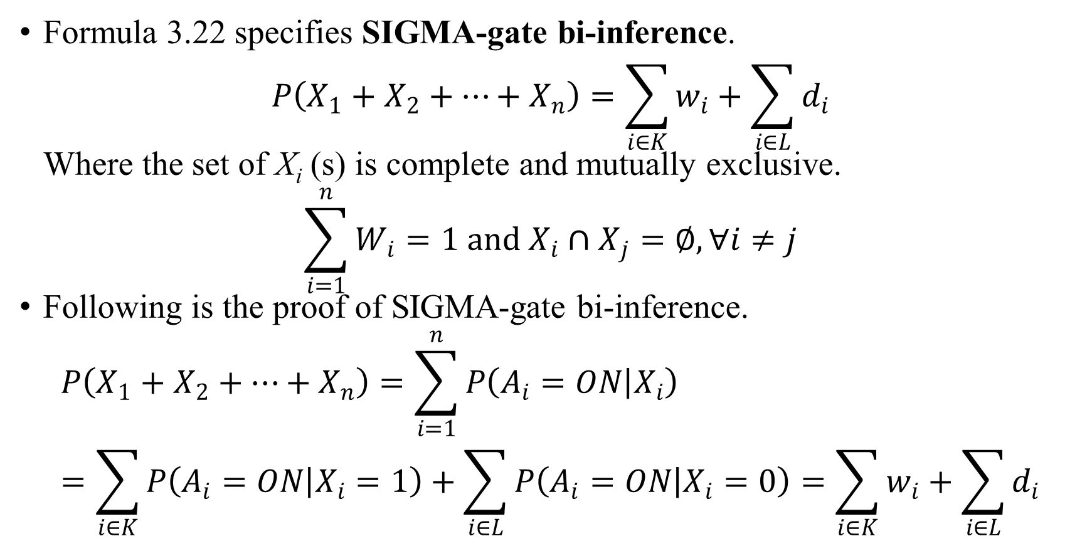
3. X-gate inferences
Formula 3.22 specifies SIGMA-gate bi-inference.
$$P\left(X_{1}+X_{2}+…+X_{n}\right)=\sum_{i∈K}{w_{i}}+\sum_{i∈L}{d_{i}}$$
Where the set of X_{i} (s) is complete and mutually exclusive.
$$\sum_{i=1}^{n}{W_{i}}=1 and X_{i}∩X_{j}=∅,∀i≠j$$
Following is the proof of SIGMA-gate bi-inference.
$$P\left(X_{1}+X_{2}+…+X_{n}\right)=\sum_{i=1}^{n}{P\left(A_{i}=ON | X_{i}\right)}=\sum_{i∈K}{P\left(A_{i}=ON | X_{i}=1\right)}+\sum_{i∈L}{P\left(A_{i}=ON | X_{i}=0\right)}=\sum_{i∈K}{w_{i}}+\sum_{i∈L}{d_{i}}$$

Slide 36
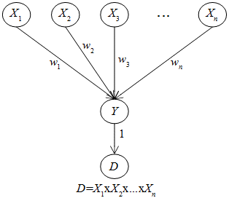
4. Multi-hypothesis diagnostic relationship
Given a simple graph, if we replace the target source Y by an evidence D, we get a so-called multi-hypothesis diagnostic relationship whose property adheres to X-gate inference. Such relationship is called shortly X-gate diagnostic relationship.
According to aforementioned X-gate network, the target variable must be binary whereas evidence D can be numeric. Thus, we add an augmented target binary variable Y and then, the evidence D is connected directly to Y. Finally, we have X-gate diagnostic network or X-D network.

Slide 37
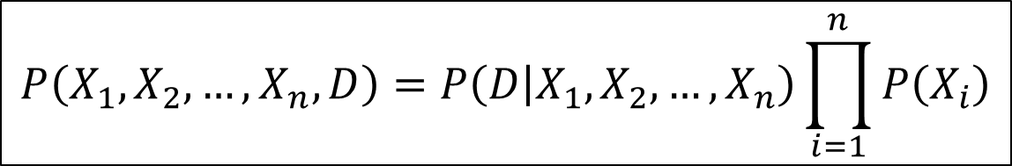
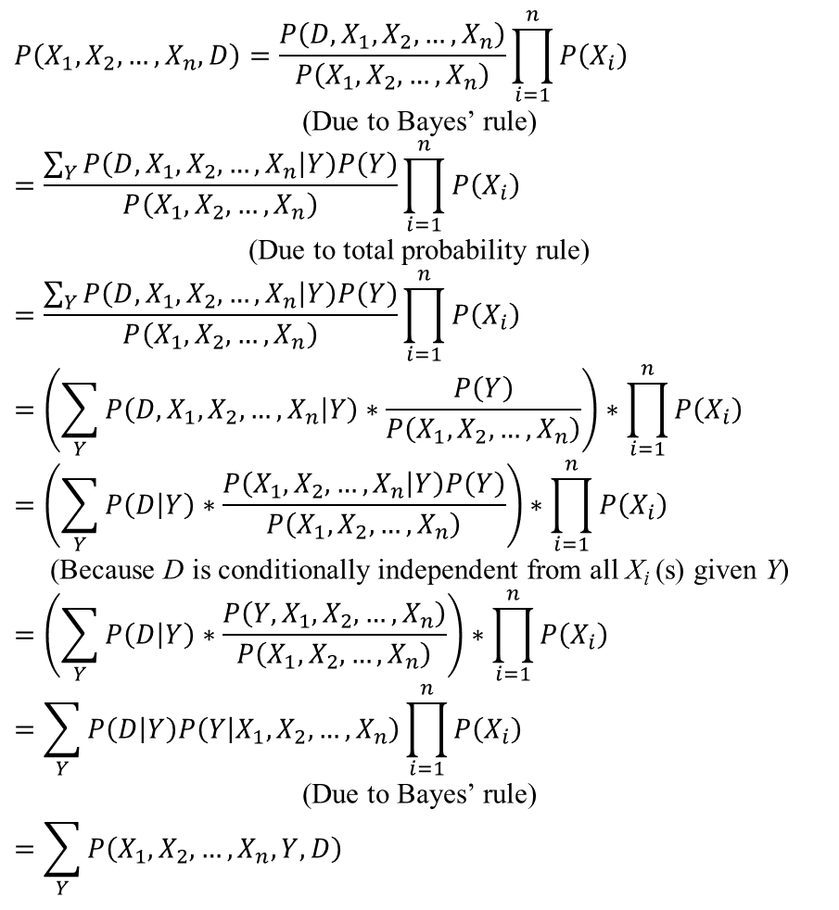
4. Multi-hypothesis diagnostic relationship
$$P\left(X_{1},X_{2},…,X_{n},D\right)=\frac{P\left(D,X_{1},X_{2},…,X_{n}\right)}{P\left(X_{1},X_{2},…,X_{n}\right)}\prod_{i=1}^{n}{P\left(X_{i}\right)}$$
(Due to Bayes’ rule)
$$=\frac{\sum_{Y}{P\left(D,X_{1},X_{2},…,X_{n} | Y\right)P\left(Y\right)}}{P\left(X_{1},X_{2},…,X_{n}\right)}\prod_{i=1}^{n}{P\left(X_{i}\right)}$$
(Due to total probability rule)
$$=\frac{\sum_{Y}{P\left(D,X_{1},X_{2},…,X_{n} | Y\right)P\left(Y\right)}}{P\left(X_{1},X_{2},…,X_{n}\right)}\prod_{i=1}^{n}{P\left(X_{i}\right)}$$
$$=\left(\sum_{Y}{P\left(D,X_{1},X_{2},…,X_{n} | Y\right)∗\frac{P\left(Y\right)}{P\left(X_{1},X_{2},…,X_{n}\right)}}\right)∗\prod_{i=1}^{n}{P\left(X_{i}\right)}$$
$$=\left(\sum_{Y}{P\left(D | Y\right)∗\frac{P\left(X_{1},X_{2},…,X_{n} | Y\right)P\left(Y\right)}{P\left(X_{1},X_{2},…,X_{n}\right)}}\right)∗\prod_{i=1}^{n}{P\left(X_{i}\right)}$$
(Because D is conditionally independent from all X_{i} (s) given Y)
$$=\left(\sum_{Y}{P\left(D | Y\right)∗\frac{P\left(Y,X_{1},X_{2},…,X_{n}\right)}{P\left(X_{1},X_{2},…,X_{n}\right)}}\right)∗\prod_{i=1}^{n}{P\left(X_{i}\right)}$$
$$=\sum_{Y}{P\left(D | Y\right)P\left(Y | X_{1},X_{2},…,X_{n}\right)\prod_{i=1}^{n}{P\left(X_{i}\right)}}$$
(Due to Bayes’ rule)
$$=\sum_{Y}{P\left(X_{1},X_{2},…,X_{n},Y,D\right)}$$
$$P\left(X_{1},X_{2},…,X_{n},D\right)=P\left(D | X_{1},X_{2},…,X_{n}\right)\prod_{i=1}^{n}{P\left(X_{i}\right)}$$
Joint probability of X-D network (4.1)

Slide 38
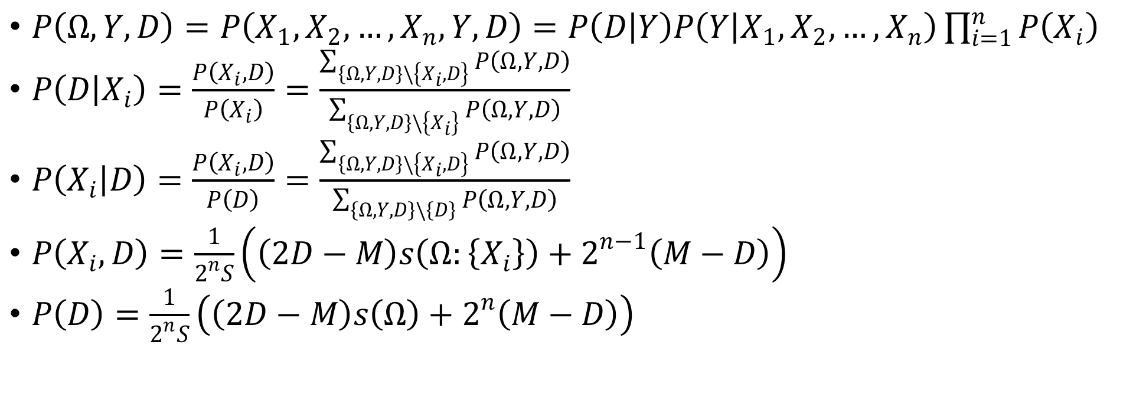
4. Multi-hypothesis diagnostic relationship
Basic probabilities relevant to X-D network with uniform distribution
$P\left(Ω,Y,D\right)=P\left(X_{1},X_{2},…,X_{n},Y,D\right)=P\left(D | Y\right)P\left(Y | X_{1},X_{2},…,X_{n}\right)\prod_{i=1}^{n}{P\left(X_{i}\right)}$
$P\left(D | X_{i}\right)=\frac{P\left(X_{i},D\right)}{P\left(X_{i}\right)}=\frac{\sum_{\left\{Ω,Y,D\right\}\backslash \left\{X_{i},D\right\}}{P\left(Ω,Y,D\right)}}{\sum_{\left\{Ω,Y,D\right\}\backslash \left\{X_{i}\right\}}{P\left(Ω,Y,D\right)}}$
$P\left(X_{i} | D\right)=\frac{P\left(X_{i},D\right)}{P\left(D\right)}=\frac{\sum_{\left\{Ω,Y,D\right\}\backslash \left\{X_{i},D\right\}}{P\left(Ω,Y,D\right)}}{\sum_{\left\{Ω,Y,D\right\}\backslash \left\{D\right\}}{P\left(Ω,Y,D\right)}}$
$P\left(X_{i},D\right)=\frac{1}{2^{n}S}\left(\left(2D−M\right)s\left(Ω:\left\{X_{i}\right\}\right)+2^{n−1}\left(M−D\right)\right)$
$P\left(D\right)=\frac{1}{2^{n}S}\left(\left(2D−M\right)s\left(Ω\right)+2^{n}\left(M−D\right)\right)$

Slide 39
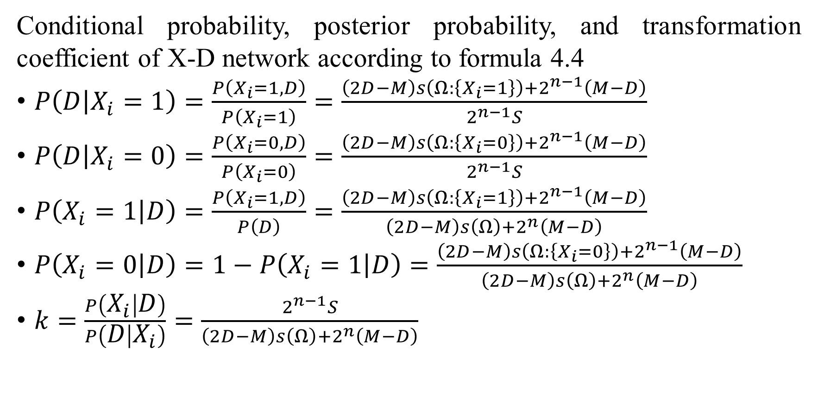
4. Multi-hypothesis diagnostic relationship
Conditional probability, posterior probability, and transformation coefficient of X-D network according to formula 4.4
$P\left(D | X_{i}=1\right)=\frac{P\left(X_{i}=1,D\right)}{P\left(X_{i}=1\right)}=\frac{\left(2D−M\right)s\left(Ω:\left\{X_{i}=1\right\}\right)+2^{n−1}\left(M−D\right)}{2^{n−1}S}$
$P\left(D | X_{i}=0\right)=\frac{P\left(X_{i}=0,D\right)}{P\left(X_{i}=0\right)}=\frac{\left(2D−M\right)s\left(Ω:\left\{X_{i}=0\right\}\right)+2^{n−1}\left(M−D\right)}{2^{n−1}S}$
$P\left(X_{i}=1 | D\right)=\frac{P\left(X_{i}=1,D\right)}{P\left(D\right)}=\frac{\left(2D−M\right)s\left(Ω:\left\{X_{i}=1\right\}\right)+2^{n−1}\left(M−D\right)}{\left(2D−M\right)s\left(Ω\right)+2^{n}\left(M−D\right)}$
$P\left(X_{i}=0 | D\right)=1−P\left(X_{i}=1 | D\right)=\frac{\left(2D−M\right)s\left(Ω:\left\{X_{i}=0\right\}\right)+2^{n−1}\left(M−D\right)}{\left(2D−M\right)s\left(Ω\right)+2^{n}\left(M−D\right)}$
$k=\frac{P\left(X_{i} | D\right)}{P\left(D | X_{i}\right)}=\frac{2^{n−1}S}{\left(2D−M\right)s\left(Ω\right)+2^{n}\left(M−D\right)}$

Slide 40
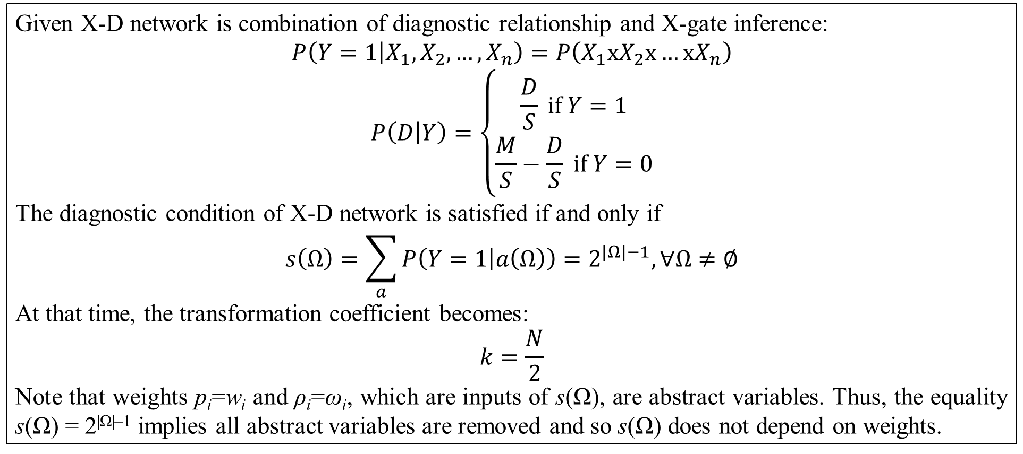
4. Multi-hypothesis diagnostic relationship
Diagnostic theorem
Given X-D network is combination of diagnostic relationship and X-gate inference:
$$P\left(Y=1 | X_{1},X_{2},…,X_{n}\right)=P\left(X_{1}xX_{2}x…xX_{n}\right)$$
$$P\left(D | Y\right)=\left\{\begin{matrix}\frac{D}{S} if Y=1 \\ \frac{M}{S}−\frac{D}{S} if Y=0\end{matrix}\right.$$
The diagnostic condition of X-D network is satisfied if and only if
$$s\left(Ω\right)=\sum_{a}{P\left(Y=1 | a\left(Ω\right)\right)}=2^{\left|Ω\right|−1},∀Ω≠∅$$
At that time, the transformation coefficient becomes:
$$k=\frac{N}{2}$$
Note that weights p_{i}=w_{i} and ρ_{i}=ω_{i}, which are inputs of s(Ω), are abstract variables. Thus, the equality s(Ω) = 2^{|Ω|–1} implies all abstract variables are removed and so s(Ω) does not depend on weights.

Slide 41
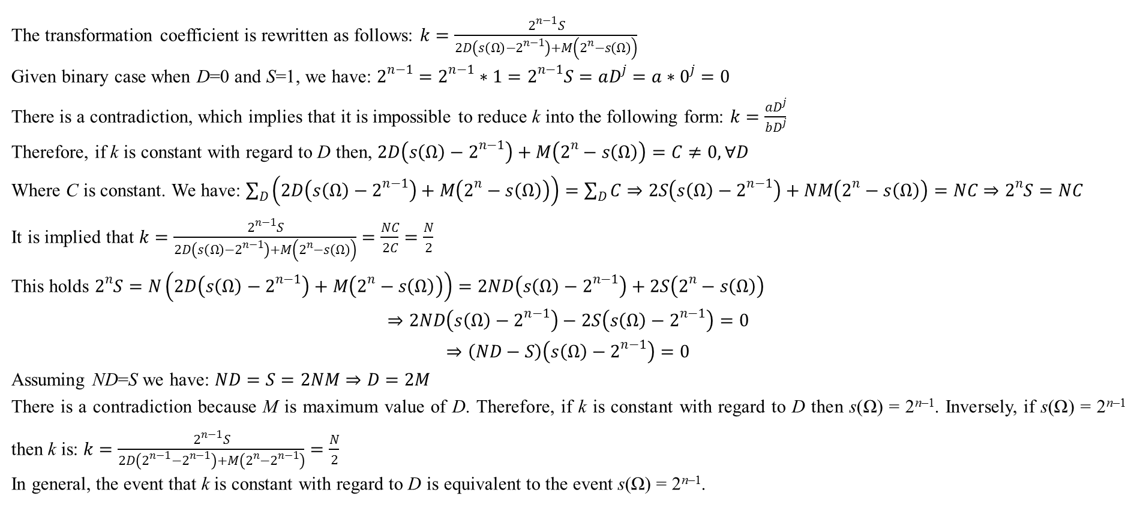
4. Multi-hypothesis diagnostic relationship
Proof of diagnostic theorem
The transformation coefficient is rewritten as follows: $k=\frac{2^{n−1}S}{2D\left(s\left(Ω\right)−2^{n−1}\right)+M\left(2^{n}−s\left(Ω\right)\right)}$
Given binary case when D=0 and S=1, we have: $2^{n−1}=2^{n−1}∗1=2^{n−1}S=aD^{j}=a∗0^{j}=0$
There is a contradiction, which implies that it is impossible to reduce k into the following form: $k=\frac{aD^{j}}{bD^{j}}$
Therefore, if k is constant with regard to D then, $2D\left(s\left(Ω\right)−2^{n−1}\right)+M\left(2^{n}−s\left(Ω\right)\right)=C≠0,∀D$
Where C is constant. We have: $\sum_{D}{\left(2D\left(s\left(Ω\right)−2^{n−1}\right)+M\left(2^{n}−s\left(Ω\right)\right)\right)}=\sum_{D}{C}⇒2S\left(s\left(Ω\right)−2^{n−1}\right)+NM\left(2^{n}−s\left(Ω\right)\right)=NC⇒2^{n}S=NC$
It is implied that $k=\frac{2^{n−1}S}{2D\left(s\left(Ω\right)−2^{n−1}\right)+M\left(2^{n}−s\left(Ω\right)\right)}=\frac{NC}{2C}=\frac{N}{2}$
This holds $2^{n}S=N\left(2D\left(s\left(Ω\right)−2^{n−1}\right)+M\left(2^{n}−s\left(Ω\right)\right)\right)=2ND\left(s\left(Ω\right)−2^{n−1}\right)+2S\left(2^{n}−s\left(Ω\right)\right)$
$$⇒2ND\left(s\left(Ω\right)−2^{n−1}\right)−2S\left(s\left(Ω\right)−2^{n−1}\right)=0$$
$$⇒\left(ND−S\right)\left(s\left(Ω\right)−2^{n−1}\right)=0$$
Assuming ND=S we have: $ND=S=2NM⇒D=2M$
There is a contradiction because M is maximum value of D. Therefore, if k is constant with regard to D then s(Ω) = 2^{n–1}. Inversely, if s(Ω) = 2^{n–1} then k is: $k=\frac{2^{n−1}S}{2D\left(2^{n−1}−2^{n−1}\right)+M\left(2^{n}−2^{n−1}\right)}=\frac{N}{2}$
In general, the event that k is constant with regard to D is equivalent to the event s(Ω) = 2^{n–1}.

Slide 42
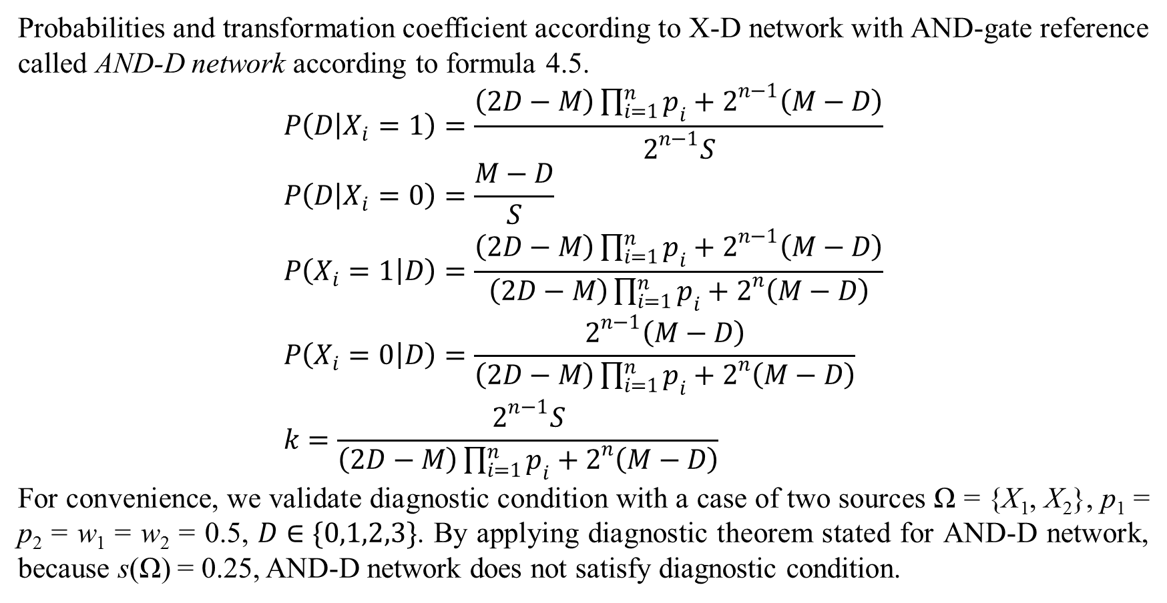
4. Multi-hypothesis diagnostic relationship
Probabilities and transformation coefficient according to X-D network with AND-gate reference called AND-D network according to formula 4.5.
$$P\left(D | X_{i}=1\right)=\frac{\left(2D−M\right)\prod_{i=1}^{n}{p_{i}}+2^{n−1}\left(M−D\right)}{2^{n−1}S} \\ P\left(D | X_{i}=0\right)=\frac{M−D}{S} \\ P\left(X_{i}=1 | D\right)=\frac{\left(2D−M\right)\prod_{i=1}^{n}{p_{i}}+2^{n−1}\left(M−D\right)}{\left(2D−M\right)\prod_{i=1}^{n}{p_{i}}+2^{n}\left(M−D\right)} \\ P\left(X_{i}=0 | D\right)=\frac{2^{n−1}\left(M−D\right)}{\left(2D−M\right)\prod_{i=1}^{n}{p_{i}}+2^{n}\left(M−D\right)} \\ k=\frac{2^{n−1}S}{\left(2D−M\right)\prod_{i=1}^{n}{p_{i}}+2^{n}\left(M−D\right)}$$
For convenience, we validate diagnostic condition with a case of two sources Ω = {X₁, X₂}, p₁ = p₂ = w₁ = w₂ = 0.5, $D∈\{0,1,2,3\}$. By applying diagnostic theorem stated for AND-D network, because s(Ω) = 0.25, AND-D network does not satisfy diagnostic condition.

Slide 43
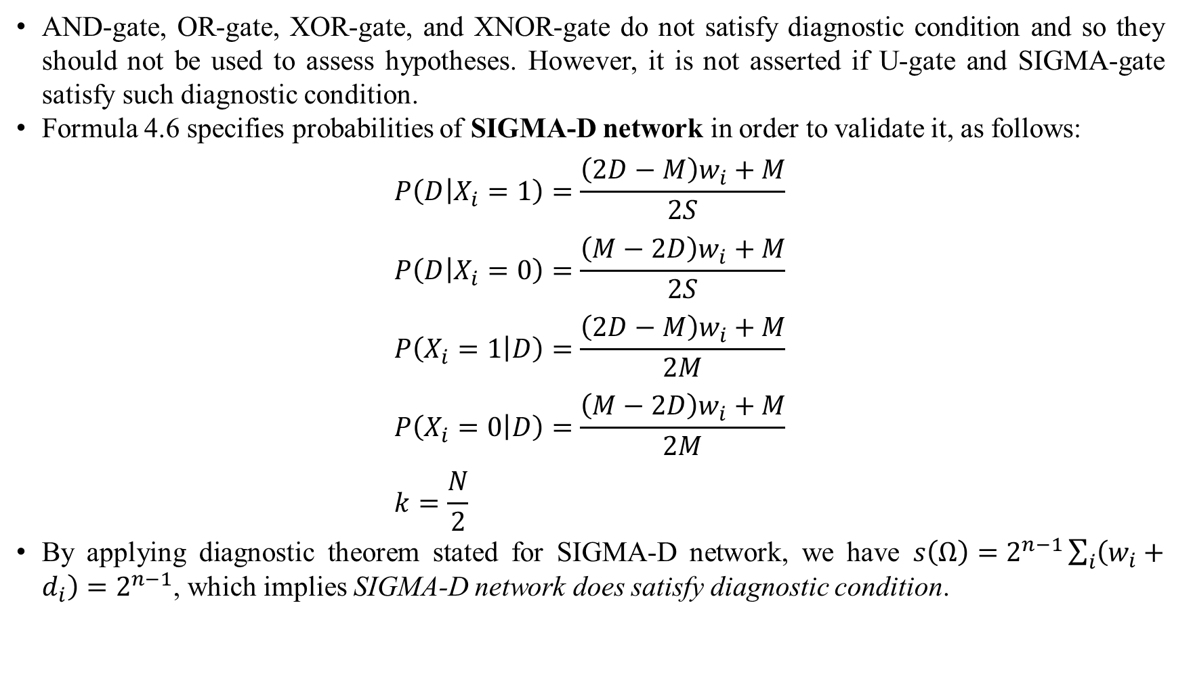
4. Multi-hypothesis diagnostic relationship
AND-gate, OR-gate, XOR-gate, and XNOR-gate do not satisfy diagnostic condition and so they should not be used to assess hypotheses. However, it is not asserted if U-gate and SIGMA-gate satisfy such diagnostic condition.
Formula 4.6 specifies probabilities of SIGMA-D network in order to validate it, as follows:
$$P\left(D | X_{i}=1\right)=\frac{\left(2D−M\right)w_{i}+M}{2S} \\ P\left(D | X_{i}=0\right)=\frac{\left(M−2D\right)w_{i}+M}{2S} \\ P\left(X_{i}=1 | D\right)=\frac{\left(2D−M\right)w_{i}+M}{2M} \\ P\left(X_{i}=0 | D\right)=\frac{\left(M−2D\right)w_{i}+M}{2M} \\ k=\frac{N}{2}$$
By applying diagnostic theorem stated for SIGMA-D network, we have $s\left(Ω\right)=2^{n−1}\sum_{i}{\left(w_{i}+d_{i}\right)}=2^{n−1}$, which implies SIGMA-D network does satisfy diagnostic condition.

Slide 44
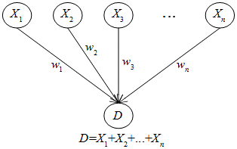
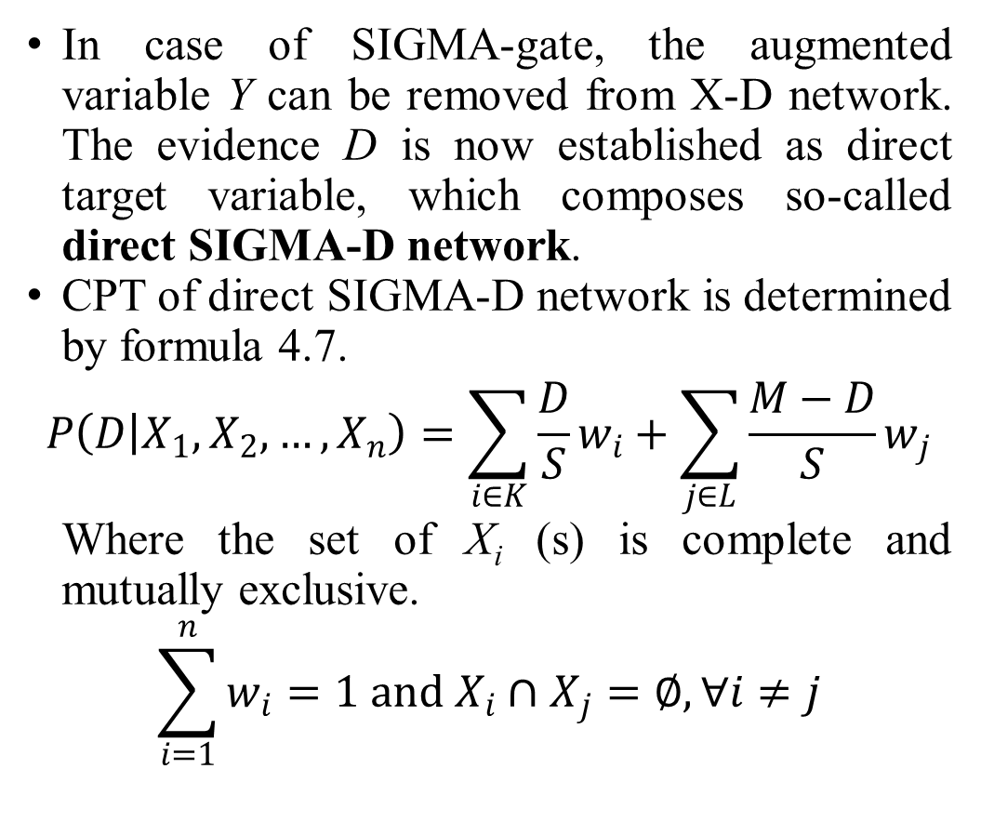
4. Multi-hypothesis diagnostic relationship
In case of SIGMA-gate, the augmented variable Y can be removed from X-D network. The evidence D is now established as direct target variable, which composes so-called direct SIGMA-D network.
CPT of direct SIGMA-D network is determined by formula 4.7.
$$P\left(D | X_{1},X_{2},…,X_{n}\right)=\sum_{i∈K}{\frac{D}{S}w_{i}}+\sum_{j∈L}{\frac{M−D}{S}w_{j}}$$
Where the set of X_{i} (s) is complete and mutually exclusive.
$$\sum_{i=1}^{n}{w_{i}}=1 and X_{i}∩X_{j}=∅,∀i≠j$$

Slide 45
4. Multi-hypothesis diagnostic relationship
Direct SIGMA-D network shares the same conditional probabilities P(X_{i}|D) and P(D|X_{i}) with SIGMA-D network, as seen in formula 4.6.
Direct SIGMA-D network also satisfies diagnostic condition when its s(Ω) = 2^{n–1}.

Slide 46
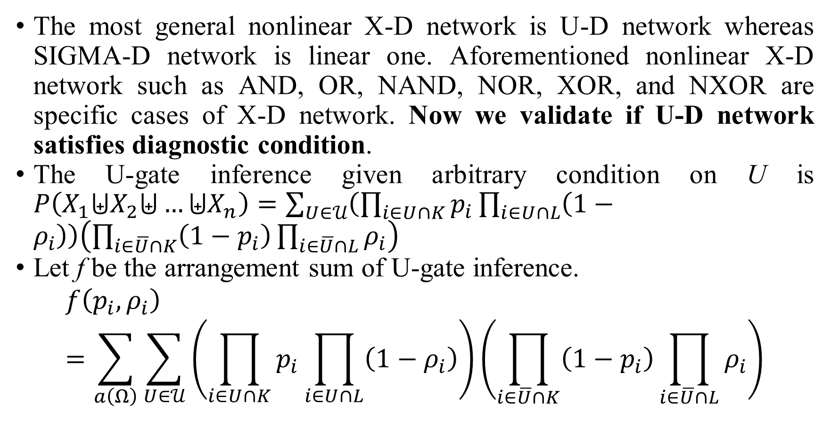
4. Multi-hypothesis diagnostic relationship
The most general nonlinear X-D network is U-D network whereas SIGMA-D network is linear one. Aforementioned nonlinear X-D network such as AND, OR, NAND, NOR, XOR, and NXOR are specific cases of X-D network. Now we validate if U-D network satisfies diagnostic condition.
The U-gate inference given arbitrary condition on U is $P\left(X_{1}⨄X_{2}⨄…⨄X_{n}\right)=\sum_{U∈𝒰}{\left(\prod_{i∈U∩K}{p_{i}}\prod_{i∈U∩L}{\left(1−ρ_{i}\right)}\right)\left(\prod_{i∈\overline{U}∩K}{\left(1−p_{i}\right)}\prod_{i∈\overline{U}∩L}{ρ_{i}}\right)}$
Let f be the arrangement sum of U-gate inference.
$$f\left(p_{i},ρ_{i}\right)=\sum_{a\left(Ω\right)}{\sum_{U∈𝒰}{\left(\prod_{i∈U∩K}{p_{i}}\prod_{i∈U∩L}{\left(1−ρ_{i}\right)}\right)\left(\prod_{i∈\overline{U}∩K}{\left(1−p_{i}\right)}\prod_{i∈\overline{U}∩L}{ρ_{i}}\right)}}$$

Slide 47
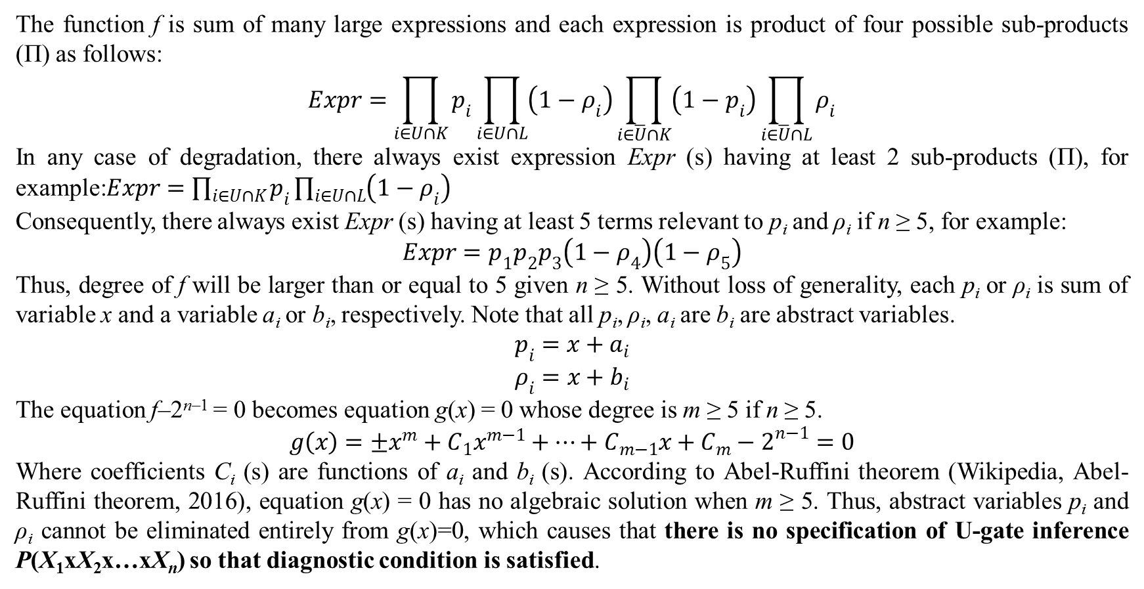
4. Multi-hypothesis diagnostic relationship
The function f is sum of many large expressions and each expression is product of four possible sub-products (Π) as follows:
$$Expr=\prod_{i∈U∩K}{p_{i}}\prod_{i∈U∩L}{\left(1−ρ_{i}\right)}\prod_{i∈\overline{U}∩K}{\left(1−p_{i}\right)}\prod_{i∈\overline{U}∩L}{ρ_{i}}$$
In any case of degradation, there always exist expression Expr (s) having at least 2 sub-products (Π), for example:$Expr=\prod_{i∈U∩K}{p_{i}}\prod_{i∈U∩L}{\left(1−ρ_{i}\right)}$
Consequently, there always exist Expr (s) having at least 5 terms relevant to p_{i} and ρ_{i} if n ≥ 5, for example:
$$Expr=p_{1}p_{2}p_{3}\left(1−ρ_{4}\right)\left(1−ρ_{5}\right)$$
Thus, degree of f will be larger than or equal to 5 given n ≥ 5. Without loss of generality, each p_{i} or ρ_{i} is sum of variable x and a variable a_{i} or b_{i}, respectively. Note that all p_{i}, ρ_{i}, a_{i} are b_{i} are abstract variables.
$$p_{i}=x+a_{i}$$
$$ρ_{i}=x+b_{i}$$
The equation f–2^{n–1} = 0 becomes equation g(x) = 0 whose degree is m ≥ 5 if n ≥ 5.
$$g\left(x\right)=±x^{m}+C_{1}x^{m−1}+…+C_{m−1}x+C_{m}−2^{n−1}=0$$
Where coefficients C_{i} (s) are functions of a_{i} and b_{i} (s). According to Abel-Ruffini theorem (Wikipedia, Abel-Ruffini theorem, 2016), equation g(x) = 0 has no algebraic solution when m ≥ 5. Thus, abstract variables p_{i} and ρ_{i} cannot be eliminated entirely from g(x)=0, which causes that there is no specification of U-gate inference P(X₁xX₂x…xX_{n}) so that diagnostic condition is satisfied.

Slide 48
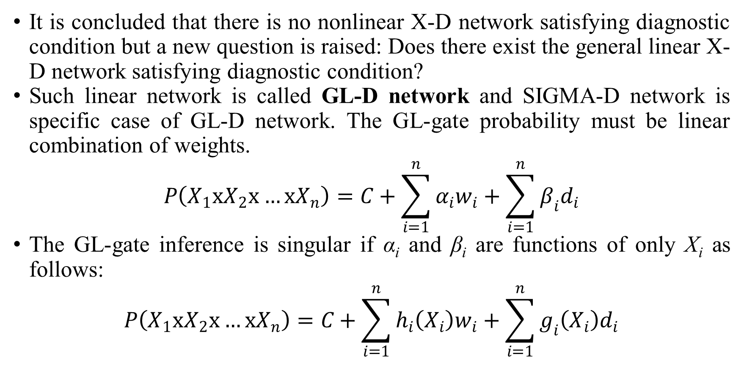
4. Multi-hypothesis diagnostic relationship
It is concluded that there is no nonlinear X-D network satisfying diagnostic condition but a new question is raised: Does there exist the general linear X-D network satisfying diagnostic condition?
Such linear network is called GL-D network and SIGMA-D network is specific case of GL-D network. The GL-gate probability must be linear combination of weights.
$$P\left(X_{1}xX_{2}x…xX_{n}\right)=C+\sum_{i=1}^{n}{α_{i}w_{i}}+\sum_{i=1}^{n}{β_{i}d_{i}}$$
The GL-gate inference is singular if α_{i} and β_{i} are functions of only X_{i} as follows:
$$P\left(X_{1}xX_{2}x…xX_{n}\right)=C+\sum_{i=1}^{n}{h_{i}\left(X_{i}\right)w_{i}}+\sum_{i=1}^{n}{g_{i}\left(X_{i}\right)d_{i}}$$

Slide 49
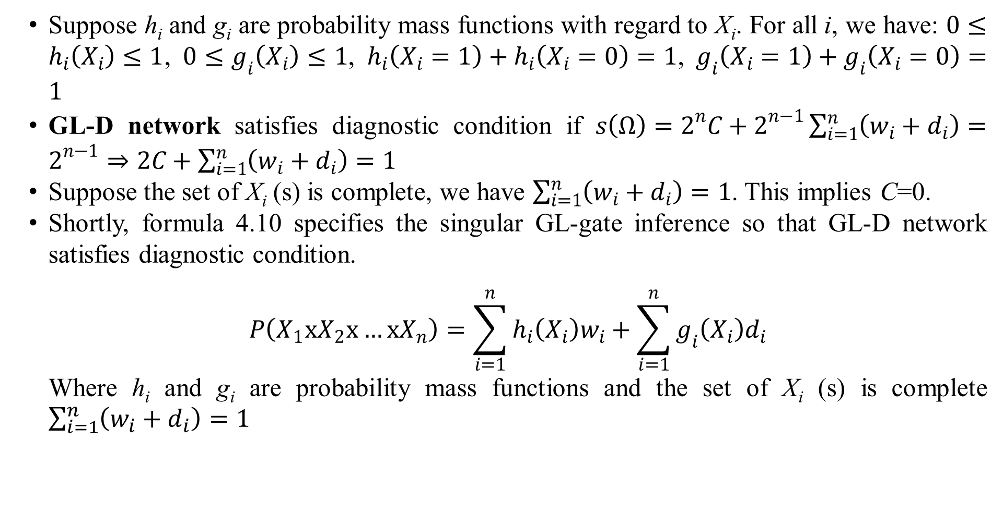
4. Multi-hypothesis diagnostic relationship
Suppose h_{i} and g_{i} are probability mass functions with regard to X_{i}. For all i, we have: $0≤h_{i}\left(X_{i}\right)≤1$, $0≤g_{i}\left(X_{i}\right)≤1$, $h_{i}\left(X_{i}=1\right)+h_{i}\left(X_{i}=0\right)=1$, $g_{i}\left(X_{i}=1\right)+g_{i}\left(X_{i}=0\right)=1$
GL-D network satisfies diagnostic condition if $s\left(Ω\right)=2^{n}C+2^{n−1}\sum_{i=1}^{n}{\left(w_{i}+d_{i}\right)}=2^{n−1}⇒2C+\sum_{i=1}^{n}{\left(w_{i}+d_{i}\right)}=1$
Suppose the set of X_{i} (s) is complete, we have $\sum_{i=1}^{n}{\left(w_{i}+d_{i}\right)}=1$. This implies C=0.
Shortly, formula 4.10 specifies the singular GL-gate inference so that GL-D network satisfies diagnostic condition.
$$P\left(X_{1}xX_{2}x…xX_{n}\right)=\sum_{i=1}^{n}{h_{i}\left(X_{i}\right)w_{i}}+\sum_{i=1}^{n}{g_{i}\left(X_{i}\right)d_{i}}$$
Where h_{i} and g_{i} are probability mass functions and the set of X_{i} (s) is complete $\sum_{i=1}^{n}{\left(w_{i}+d_{i}\right)}=1$

Slide 50
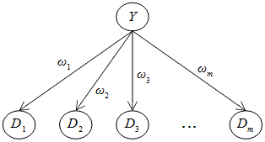
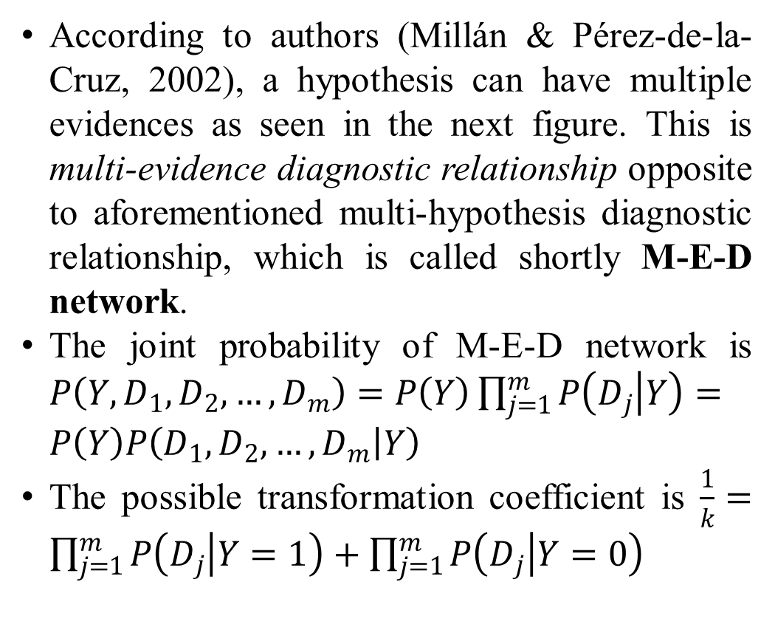
4. Multi-hypothesis diagnostic relationship
According to authors (Millán & Pérez-de-la-Cruz, 2002), a hypothesis can have multiple evidences as seen in the next figure. This is multi-evidence diagnostic relationship opposite to aforementioned multi-hypothesis diagnostic relationship, which is called shortly M-E-D network.
The joint probability of M-E-D network is $P\left(Y,D_{1},D_{2},…,D_{m}\right)=P\left(Y\right)\prod_{j=1}^{m}{P\left(D_{j} | Y\right)}=P\left(Y\right)P\left(D_{1},D_{2},…,D_{m} | Y\right)$
The possible transformation coefficient is $\frac{1}{k}=\prod_{j=1}^{m}{P\left(D_{j} | Y=1\right)}+\prod_{j=1}^{m}{P\left(D_{j} | Y=0\right)}$

Slide 51
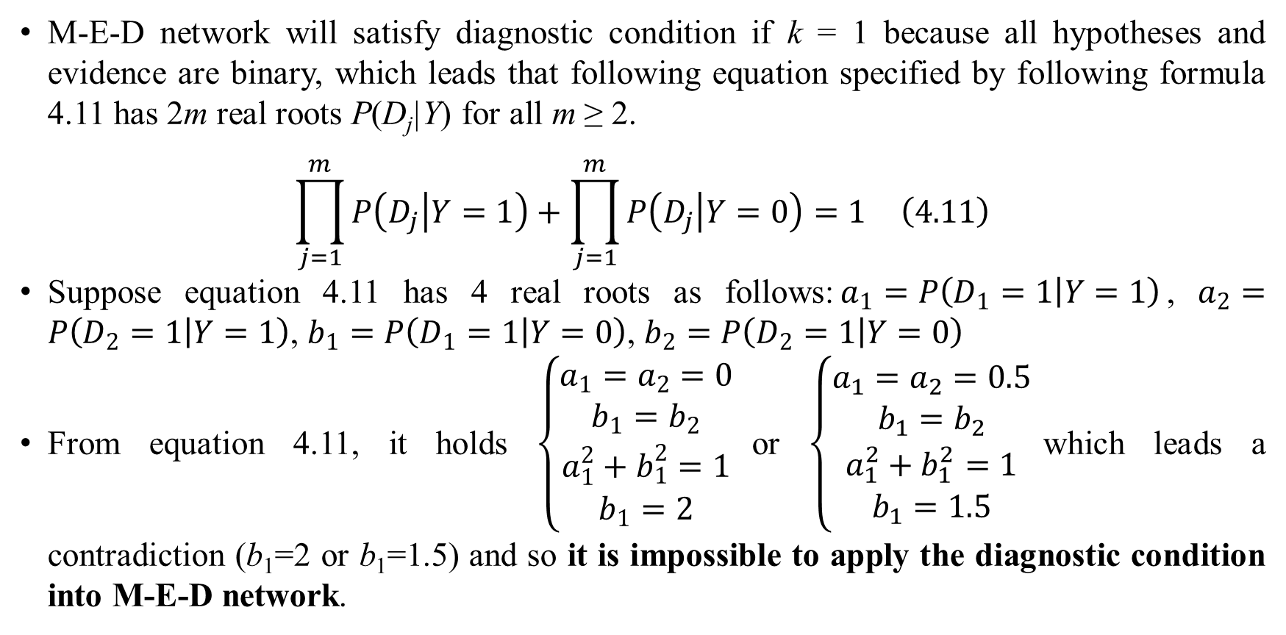
4. Multi-hypothesis diagnostic relationship
M-E-D network will satisfy diagnostic condition if k = 1 because all hypotheses and evidence are binary, which leads that following equation specified by following formula 4.11 has 2m real roots P(D_{j}|Y) for all m ≥ 2.
$$\begin{matrix}\prod_{j=1}^{m}{P\left(D_{j} | Y=1\right)}+\prod_{j=1}^{m}{P\left(D_{j} | Y=0\right)}=1 & \left(4.11\right)\end{matrix}$$
Suppose equation 4.11 has 4 real roots as follows:$a_{1}=P\left(D_{1}=1 | Y=1\right)$, $a_{2}=P\left(D_{2}=1 | Y=1\right)$, $b_{1}=P\left(D_{1}=1 | Y=0\right)$, $b_{2}=P\left(D_{2}=1 | Y=0\right)$
From equation 4.11, it holds $\left\{\begin{matrix}a_{1}=a_{2}=0 \\ b_{1}=b_{2} \\ a_{1}^{2}+b_{1}^{2}=1 \\ b_{1}=2\end{matrix}\right.$or $\left\{\begin{matrix}a_{1}=a_{2}=0.5 \\ b_{1}=b_{2} \\ a_{1}^{2}+b_{1}^{2}=1 \\ b_{1}=1.5\end{matrix}\right.$which leads a contradiction (b₁=2 or b₁=1.5) and so it is impossible to apply the diagnostic condition into M-E-D network.

Slide 52
4. Multi-hypothesis diagnostic relationship
It is impossible to model M-E-D network by X-gates. The potential solution for this problem is to group many evidences D₁, D₂,…, D_{m} into one representative evidence D which in turn is dependent on hypothesis Y but this solution will be inaccurate in specifying conditional probabilities because directions of dependencies become inconsistent (relationships from D_{j} to D and from Y to D) except that all D_{j} (s) are removed and D becomes a vector. However evidence vector does not simplify the hazardous problem and it changes the current problem into a new problem..
Another solution is to reverse the direction of relationship, in which the hypothesis is dependent on evidences so as to take advantages of X-gate inference as usual. However, the reversion method violates the viewpoint in this research where diagnostic relationship must be from hypothesis to evidence.

Slide 53
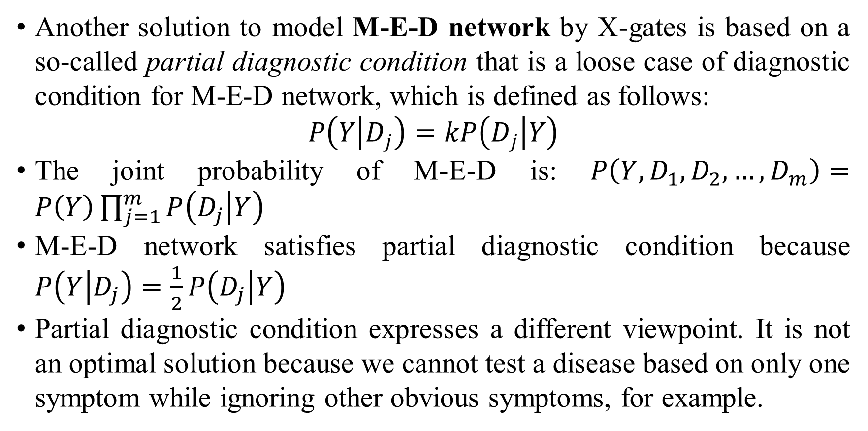
4. Multi-hypothesis diagnostic relationship
Another solution to model M-E-D network by X-gates is based on a so-called partial diagnostic condition that is a loose case of diagnostic condition for M-E-D network, which is defined as follows:
$$P\left(Y | D_{j}\right)=kP\left(D_{j} | Y\right)$$
The joint probability of M-E-D is: $P\left(Y,D_{1},D_{2},…,D_{m}\right)=P\left(Y\right)\prod_{j=1}^{m}{P\left(D_{j} | Y\right)}$
M-E-D network satisfies partial diagnostic condition because $P\left(Y | D_{j}\right)=\frac{1}{2}P\left(D_{j} | Y\right)$
Partial diagnostic condition expresses a different viewpoint. It is not an optimal solution because we cannot test a disease based on only one symptom while ignoring other obvious symptoms, for example.

Slide 54
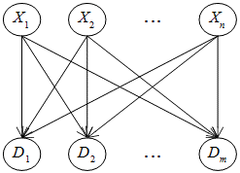
4. Multi-hypothesis diagnostic relationship
If we are successful in specifying conditional probabilities of M-E-D network, it is possible to define an extended network which is constituted of n hypotheses X₁, X₂,…, X_{n} and m evidences D₁, D₂,…, D_{m}. Such extended network represents multi-hypothesis multi-evidence diagnostic relationship, called M-HE-D network.
The M-HE-D network is the most general case of diagnostic network, which was mentioned in (Millán & Pérez-de-la-Cruz, 2002, p. 297). We can construct any large diagnostic BN from M-HE-D networks and so the research is still open.

Slide 55
5. Conclusion
In short, relationship conversion is to determine conditional probabilities based on logic gates that is adhered to semantics of relationships. The weak point of logic gates is to require that all variables must be binary.
In order to lessen the impact of such weak point, I use numeric evidence for extending capacity of simple BN. However, combination of binary hypothesis and numeric evidence leads to errors or biases in inference. Therefore, I propose the diagnostic condition so as to confirm that numeric evidence is adequate to make complicated inference tasks in BN.
A large BN can be constituted of many simple BN (s). Inference in large BN is hazardous problem. In future, I will research effective inference methods for the special BN that is constituted of X-gate BN (s).
Moreover, I try my best to research deeply M-E-D network and M-HE-D network whose problems I cannot solve absolutely now.

Slide 56
5. Conclusion
Two main documents I referred to do this research are the book “Learning Bayesian Networks” by the author (Neapolitan, 2003) and the article “A Bayesian Diagnostic Algorithm for Student Modeling and its Evaluation” by authors (Millán & Pérez-de-la-Cruz, 2002).
Especially, the SIGMA-gate inference is based on and derived from the work of the authors Eva Millán and José Luis Pérez-de-la-Cruz.
This research is originated from my PhD research “A User Modeling System for Adaptive Learning” (Nguyen, 2014).
Other references relevant to user modeling, overlay model, and Bayesian network are (Fröschl, 2005), (De Bra, Smits, & Stash, 2006), (Murphy, 1998), and (Heckerman, 1995).

Slide 57
Thank you for attention

Slide 58
References
De Bra, P., Smits, D., & Stash, N. (2006). The Design of AHA! In U. K. Wiil, P. J. Nürnberg, & J. Rubart (Ed.), Proceedings of the seventeenth ACM Hypertext Conference on Hypertext and hypermedia (Hypertext '06) (pp. 171-195). Odense, Denmark: ACM Press.
Díez, F. J., & Druzdzel, M. J. (2007). Canonical Probabilistic Models. National University for Distance Education, Department of Inteligencia Artificial. Madrid: Research Centre on Intelligent Decision-Support Systems. Retrieved May 9, 2016, from http://www.cisiad.uned.es/techreports/canonical.pdf
Fröschl, C. (2005). User Modeling and User Profiling in Adaptive E-learning Systems. Master Thesis, Graz University of Technology, Austria.
Heckerman, D. (1995). A Tutorial on Learning With Bayesian Networks. Microsoft Corporation, Microsoft Research. Redmond: Microsoft Research. Retrieved from ftp://ftp.research.microsoft.com/pub/dtg/david/tutorial.ps
Kschischang, F. R., Frey, B. J., & Loeliger, H.-A. (2001, February). Factor Graphs and the Sum-Product Algorithm. IEEE Transactions on Information Theory, 47(2), 498-519. doi:10.1109/18.910572
Millán, E., & Pérez-de-la-Cruz, J. L. (2002, June). A Bayesian Diagnostic Algorithm for Student Modeling and its Evaluation. (A. Kobsa, Ed.) User Modeling and User-Adapted Interaction, 12(2-3), 281-330. doi:10.1023/A:1015027822614
Millán, E., Loboda, T., & Pérez-de-la-Cruz, J. L. (2010, July 29). Bayesian networks for student model engineering. (R. S. Heller, J. D. Underwood, & C.-C. Tsai, Eds.) Computers & Education, 55(4), 1663-1683. doi:10.1016/j.compedu.2010.07.010
Murphy, K. P. (1998). A Brief Introduction to Graphical Models and Bayesian Networks. Retrieved 2008, from Kevin P. Murphy's home page: http://www.cs.ubc.ca/~murphyk/Bayes/bnintro.html
Neapolitan, R. E. (2003). Learning Bayesian Networks. Upper Saddle River, New Jersey, USA: Prentice Hall.
Nguyen, L. (2014, April). A User Modeling System for Adaptive Learning. University of Science, Ho Chi Minh city, Vietnam. Abuja, Nigeria: Standard Research Journals. Retrieved from http://standresjournals.org/journals/SSRE/Abstract/2014/april/Loc.html
Nguyen, L. (2016, March 28). Theorem of SIGMA-gate Inference in Bayesian Network. (V. S. Franz, Ed.) Wulfenia Journal, 23(3), 280-289.
Pearl, J. (1986, September). Fusion, propagation, and structuring in belief networks. Artificial Intelligence, 29(3), 241-288. doi:10.1016/0004-3702(86)90072-X
Wikipedia. (2014, October 10). Set (mathematics). (A. Rubin, Editor, & Wikimedia Foundation) Retrieved October 11, 2014, from Wikipedia website: http://en.wikipedia.org/wiki/Set_(mathematics)
Wikipedia. (2015, November 22). Factor graph. (Wikimedia Foundation) Retrieved February 8, 2017, from Wikipedia website: https://en.wikipedia.org/wiki/Factor_graph
Wikipedia. (2016, June 10). Abel-Ruffini theorem. (Wikimedia Foundation) Retrieved June 26, 2016, from Wikipedia website: https://en.wikipedia.org/wiki/Abel%E2%80%93Ruffini_theorem
Wikipedia. (2016, June 2). Logic gate. (Wikimedia Foundation) Retrieved June 4, 2016, from Wikipedia website: https://en.wikipedia.org/wiki/Logic_gate

