Slide 1

A User Modeling System for Adaptive Learning
Triangular Learner Model (TLM)
A user modeling system for TLM
Demonstration
ICL WEEF 2014 : | A User Modeling System for Adaptive Learning (December 06 2014)
Author: | Loc Nguyen
Sponsor: | Prof. Dr. Dong Thi Bich Thuy
Affiliation: | Department of IS, Faculty of IT, University of Science
ICL WEEF 2014
Notes:
Good morning madam and sir
To day, it is my presentation about subject user modeling
Its title is “A User Modeling System for Adaptive Learning”
My sponsor is Professor Dong Thi Bich Thuy
Affiliation is the department of information system, Faculty of IT, University of Science
This presentation is includes three parts:
The proposed user model: Triangular Learner Model (TLM in abbreviation) which has three sub-models: knowledge, learning style and learning history
The user modeling system that manipulate TLM, it is called Zebra
Last, one sub-model in TLM, knowledge sub-model

Slide 2
I. Triangular Leaner Model
Adaptive System
User Modeling System
Selection Rules
User Model
Learning Materials
TARGET: Adaptive System changes its action to provide learning materials for every student in accordance with her/his model
ICL WEEF 2014
Notes:
- The first thing that we discuss is concepts of user modeling and adaptive system
- User modeling system: collects user information and model them as user model. User model is the presentation of information/characteristics about user, which must be managed by user modeling system
- Adaptive system: changes its action to provide learning materials for every student according to user model
Note that the terms: user, learner, student are the same in learning context.

Slide 3
I. Triangular Leaner Model
User model is the presentation of information/characteristics about user, which must be manipulated by user modeling system (UMS). Following are existing user modeling systems:
User modeling shell
User modeling server
Agent-based user model
Mobile user model
ICL WEEF 2014
Notes:
There are four existing user modeling systems
- Shell is the component separated from adaptive application but it isn’t work independently. It is integrated into adaptive system
- Server runs as database server. Instead of managing data table, it manages user information. Server provides information to other adaptive systems
- Agent-based user model is built up as agent, each agent is independent unit collecting information about user.
- Mobile user model is stored on mobile device. Its volume (content) is restricted by the storage capacity of mobile device.

Slide 4
I. Triangular Leaner Model
Problems of User Modeling
Too much information about individuals to model all users’ characteristics → it is necessary to choose essential characteristics from which a stable architecture of user model is built.
Some user modeling systems (UMS) lack of powerful inference mechanism → need a solid and powerful inference UMS
ICL WEEF 2014
Notes:
1. Because of much information about user. Some UMS so-called generic UMS focus on generic user information like demographics, interest, etc but these UMS aren’t really useful in learning machine. It is necessary to choose essential characteristics from which a stable architecture of user model is built.
2. Some user modeling systems (UMS) lack of powerful inference mechanism → need a solid and powerful inference UMS
Say more:
Some UMS aiming to provide data like DBMS but adaptive applications require more new information that inferred from user model. The inference mechanism is more and more important to modern UMS.
The hazard is each inference method is suitable to a concrete user characteristic -> It requires the solid and appropriate inference

Slide 5
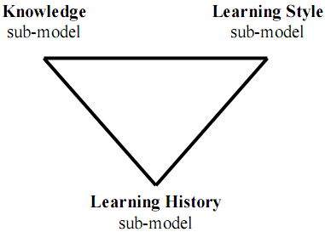
I. Triangular Leaner Model (TLM)
Triangular Learner Model (TLM)
Knowledge (K) sub-model represents user knowledge, which is the combination of overlay model and Bayesian network.
Learning style (LS) sub-model is defined as the composite of characteristic cognitive, affective and psychological factors .
Learning history (LH) is defined as a transcript of all learners’ actions such as learning materials accesses, duration of computer uses, doing exercises, taking examinations, doing tests, communicating with teachers or classmates, etc .
ICL WEEF 2014
Notes:
And now I propose an user model so-called Triangular Learner Model (TLM in short). It is composed of three sub-models: knowledge, learning style and learning history
Referring slide and explaining more as below
Knowledge sub-model representes user knowledge. It uses Bayesian network for inference
Learning style sub-model uses hidden Markov model to discovering user learning style such as whether user is verbal/visual, activist/reflector, pragmatist/theorist
Learning history is the most important sub-model because it has four main responsibilities:
1. Providing necessary information for two remaining sub-models: learning style sub-model and knowledge sub-model so that they perform inference
tasks. For example, knowledge sub-model needs learning evidences like learner’s results of test, frequency of accessing lectures
2. Supporting learning concept recommendation.
3. Mining learners’ educational data in order to discover other learners’ characteristics such as interests, background, goals…
Supporting collaborative learning through constructing learner groups. Recommendation is given to each group instead of individuals. Student can learni together in each group
That is the reason that LH sub-model is draw as base bottom vertex.

Slide 6
I. Triangular Leaner Model
Why TLM?
Knowledge, learning styles and learning history are prerequisite for modeling learner.
While learning history changes themselves frequently, learning styles and knowledge are relatively stable. The combination of them ensures the integrity of information about learner.
User knowledge is domain specific information and learning styles are personal traits. The combination of them supports user modeling system to take full advantages of both domain specific information and domain independent information.
ICL WEEF 2014
Notes:
Now I tell you the reason we use TLM
Referring slides
Prerequisite
Integrity
Take full advantages of both domain specific information and domain independent information

Slide 7
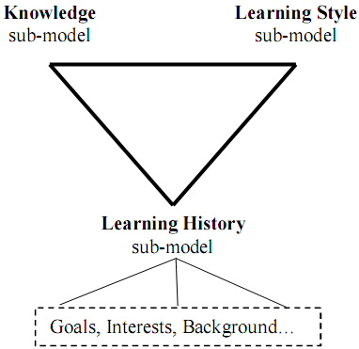
I. Triangular Leaner Model
extended Triangular Leaner Model
ICL WEEF 2014
Notes:
The TLM can be extended by using LH sub-model. LH sub-model apply mining technique to discover other information about user apart from user knowedge and learning style such as goals, interest, background, etc.
Please see slide 5
The learning history sub-model has four responsibilties:
1. Providing necessary information for two remaining sub-models: learning style sub-model and knowledge sub-model so that they perform inference
tasks. For example, knowledge sub-model needs learning evidences like learner’s results of test, frequency of accessing lectures
2. Supporting learning concept recommendation.
3. Mining learners’ educational data in order to discover other learners’ characteristics such as interests, background, goals…
Supporting collaborative learning through constructing learner groups.

Slide 8


I. Triangular Leaner Model
How to build up TLM?
How to manipulate (manage) TLM?
How to infer new information from TLM?
→ Zebra: the user modeling system for TLM
ICL WEEF 2014
Notes:
Now you can ask:
- How to build up TLM?
- How to manipulate (manage) TLM?
- How to infer new information from TLM?
And the only one answer for three above questions is Zebra – the usering model system for TLM.
We will discuss Zebra in next slide
More explanation
The expectation is that Zebra is strong and run fast as African zebra
Moreover it is difficult to discover zebras when they are running on wild field because their strikes cause the illusion. This is similar to data disturbance technique in data mining privacy. The future trend is to apply privacy mechanism into user model so as to make it more secure.

Slide 9
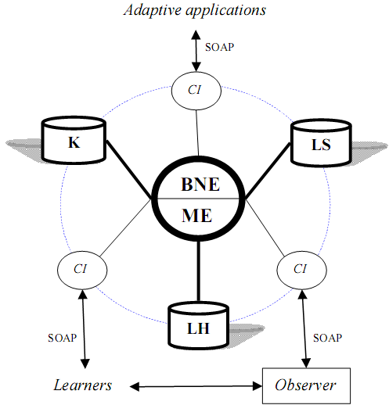
II. A user modeling system for TLM
Mining Engine (ME) manages learning history sub-model of TLM.
Belief Network Engine (BNE) manages knowledge sub-model and learning style sub-model of TLM.
Communication Interfaces (CI) allows users and adaptive systems to see or modify restrictedly TLM .
Zebra
ICL WEEF 2014
Notes:
The architecture of Zebra has two engines: mining engine and belief network engine in its core
and Zebra many communication interfaces (CI) around its core
Referring slide
More explanation
Outside applications and learner can’t access or intervene ME and BNE, they can only retrieve user information through CI via network protocol like SOAP, RMI, HTTP, Socket.

Slide 10
II. A user modeling system for TLM
Mining Engine
Collecting learners’ data, monitoring their actions, structuring and updating TLM.
Providing important information to belief network engine.
Supporting learning concept recommendation.
Discovering some other characteristics (beyond knowledge and learning styles) such as interests, goals, etc.
Supporting collaborative learning through constructing learner groups (communities).
ICL WEEF 2014
Notes:
Mining engine uses mining and machine learning techniques to build up and manipulate learning history sub-model. It is very important
It has four responsibilities
Referring slide

Slide 11
II. A user modeling system for TLM
Belief Network Engine
Inferring new personal traits from TLM by using deduction mechanism available in belief network.
This engine applies Bayesian network and hidden Markov model into inference mechanism.
Two sub-models: knowledge & learning style are managed by this engine .
ICL WEEF 2014
Notes:
It has four responsibilities
Referring slide
Believe network engine uses belief networks such as Bayesian network, Markov model, Kalman filter. It is the most intelligent engine for inferring new information.

Slide 12
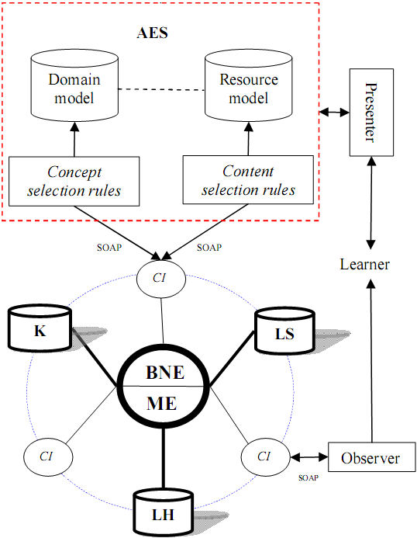
II. A user modeling system for TLM
The extended architecture of Zebra when interacting with AES
ICL WEEF 2014
Notes:
The extended architecture of Zebra when interacting with AES
Adaptive education system (AES) retrieves information from TLM by interacting with mining engine and belief network engine via CI.
Students learn lessons via AES and are modeled by Zebra
More explanation
The adaptation in AES is supported through two kinds of rules: concept selection rules and content selection rules
Concept selection rules: what concepts user should learn
Content selection rules: what learning material (lecture, exercise) user should read/do
Domain model is mapped to resource model, for example one concept can have one or more lectures/exercises
AES manages domain model and resource model but user model (TLM) is stored in Zebra

Slide 13
III. Demonstration
I invented 11 formulas and methods in the research
Triangular Learner Model (TLM) and user modeling Zebra architecture.
Combination of overlay model and Bayesian network and transforming arc weights into conditional probability table.
Dynamic Bayesian network and the optimal approach to construct dynamic Bayesian network.
Specifying prior probability for beta distribution.
Learning styles and hidden Markov model.
Learning concept recommendation based on sequential pattern mining.
Discovering user interests by document classification.
Constructing user groups or user communities.
Methods and formulas to evaluate adaptive learning model.
Estimating examinee’s ability in Computerized Adaptive Testing.
Methods and formulas to evaluate adaptive learning model .
ICL WEEF 2014
Notes:
Referring slide
Experiments are done through three steps:
Implementing an solid architecture. It is was built up as an intelligent software that runs fast and stablely. The correctness of TLM is proved by this implementation. If the architecture is wrong then it can’t be implemented. This step is done
Satisfying simulation data. This step is done
However adaptive application should be satisfy end-user. The software needs to be public for student using and student’s feedback will be collected and analyzed. I have just proposed some measures for evaluating user study.

Slide 14
III. Demonstration
Such all works is organized a book available at
https://sites.google.com/site/ngphloc/st/dissertations/zebra
Moreover, the proposed user modeling system Zebra is implemented as computer software that is
demonstrated here
ICL WEEF 2014
Notes:
Introducing the book before demonstration
Referring slide
Experiments are done through three steps:
Implementing an solid architecture. It is was built up as an intelligent software that runs fast and in stable. The correctness of TLM is proved by this implementation. If the architecture is wrong then it can’t be implemented. This step is done
Satisfying simulation data. This step is done
However adaptive application should be satisfy end-user. The software needs to be public for student using and student’s feedback will be collected and analyzed. I have just proposed some measures for evaluating user study.

Slide 15
THANK FOR YOUR ATTENTION
ICL WEEF 2014

