Slide 1
Phoebe – A Framework of age and weight estimation HOSREM Annual Conference, 26th November 2016, Ho Chi Minh city, Vietnam
Loc Nguyen
Sunflower Soft Company, Ho Chi Minh, Vietnam
Email: ng_phloc@yahoo.com
Thu-Hang T. Ho
Vinh Long General Hospital, Vinh Long, Vietnam
Email: bshangvl2000@yahoo.com

Slide 2
I. Introduction – Problems to solve
Fetal ultrasound measures such as bi-parietal diameter (bpd), head circumference (hc), abdominal circumference (ac), fetal length (fl), thigh volume (thigh_vol), and arm volume (arm_vol) are recorded and considered as the input sample for regression analysis which results in a regression function. This function is formula for estimating fetal age and weight according to ultrasound measures such as bpd, hc, ac, fl, thigh_vol, and arm_vol.
There are many estimate formulas resulted from gestational researches such as (Hadlock et al., 1985), (Phan, 1985), (Phạm, 2000), (Ho, 2011), (Campbell & Wilkin, 1975), (Lee, et al., 2009), (Chang, et al., 1997), and (Varol, et al., 2001). Some of them gain high accuracy but they are only appropriate to population, community or ethnic group where such researches are done. If we apply these formulas into other community such as Vietnam, they are no longer accurate.
Moreover, it is very difficult to find out a new and effective estimate formula or the cost of time and (computer) resources of formula discovery is expensive.

Slide 3
I. Introduction – Research Goals
The first goal is to propose an effective algorithm which produces highly accurate formulas that are easy to tune with specified population.
The second goal is to give facilities to physicians and researchers by introducing them a framework that is called Phoebe framework. The framework sets up the new algorithm in first goal and builds up a statistical tool which supports physicians and researchers in birth estimation domain. Moreover, physicians and researchers can discover new estimate formulas by themselves.

Slide 4
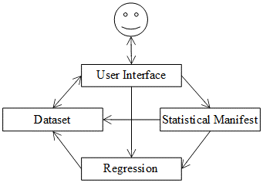
I. Introduction – Phoebe Architecture
Dataset component is responsible for managing information about fetal ultrasound measures such as bpd, hc, ac, fl.
Regression model component represents estimate formula or regression function.
Statistical manifest component describes statistical information of both ultrasound measures and regression function in numerical format and graph format.
User interface (UI) component is responsible for providing interaction between system and users such as physicians and researchers.

Slide 5
II. Algorithm in framework – Problem to solve
Suppose a linear regression function Y = α₀ + α₁X₁ + α₂X₂ + … + α_{n}X_{n} where Y is fetal age or weight whereas X_{i} (s) are gestational ultrasound measures such as bpd, hc, ac, and fl.
The number of combinations over all X_{i} (s) is huge which causes that it is impossible to find out the best function.
Moreover there are many kinds of regression function such as linear, quadric, cube, logarithm, exponent, and product.
So we propose a new algorithm which overcomes this drawback and always find out the optimal function.

Slide 6
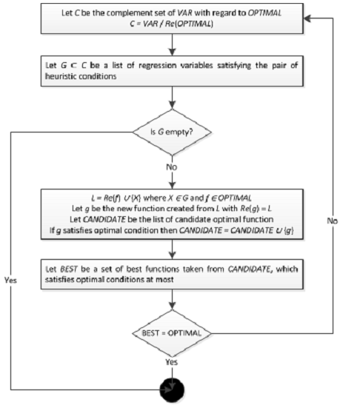
II. Algorithm in framework
The minimum heuristic condition: The correlation coefficient of any pair of X_{i} and X_{j} is less than a minimum threshold δ > 0.
The maximum heuristic condition: The correlation coefficient of any X_{i} and real Y is greater than a maximum threshold ε > 0

Slide 7
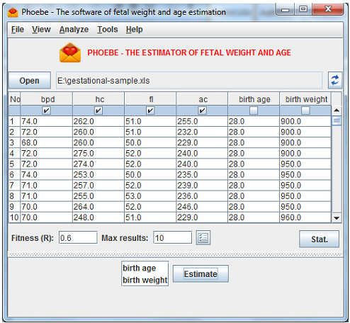
III. Use case – Discovering optimal formulas
Given gestational data (Ho & Phan, 2011) is composed of 2-dimension ultrasound measures of pregnant women. These women and their husbands are Vietnamese.
These measures are taken at Vinh Long polyclinic, which include bpd, hc, ac, fl, birth age and birth weight.

Slide 8
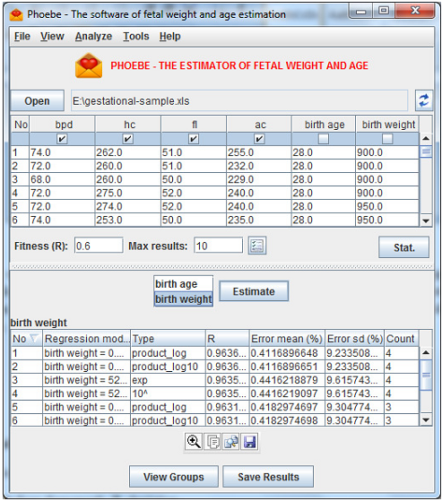
III. Use case – Discovering optimal formulas
Specify fitness value.
Choose which measures are regression variables and response variable.
Click button “Estimate” to find out optimal formulas.

Slide 9
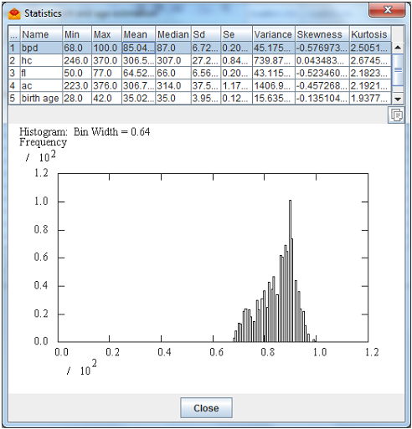
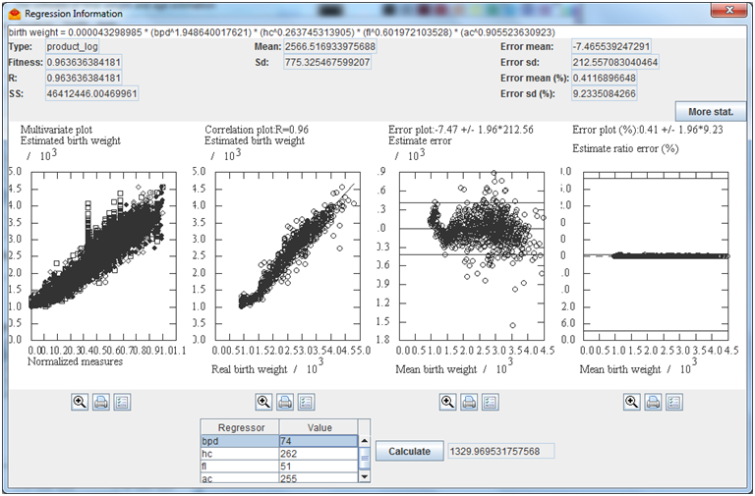
III. Use case – Providing statistical information
Gestational information contains statistical attributes about fetal measures.
Estimation information contains attributes about estimate formula, for example: correlation coefficient, sum of residuals and estimate error of estimate formula.

Slide 10
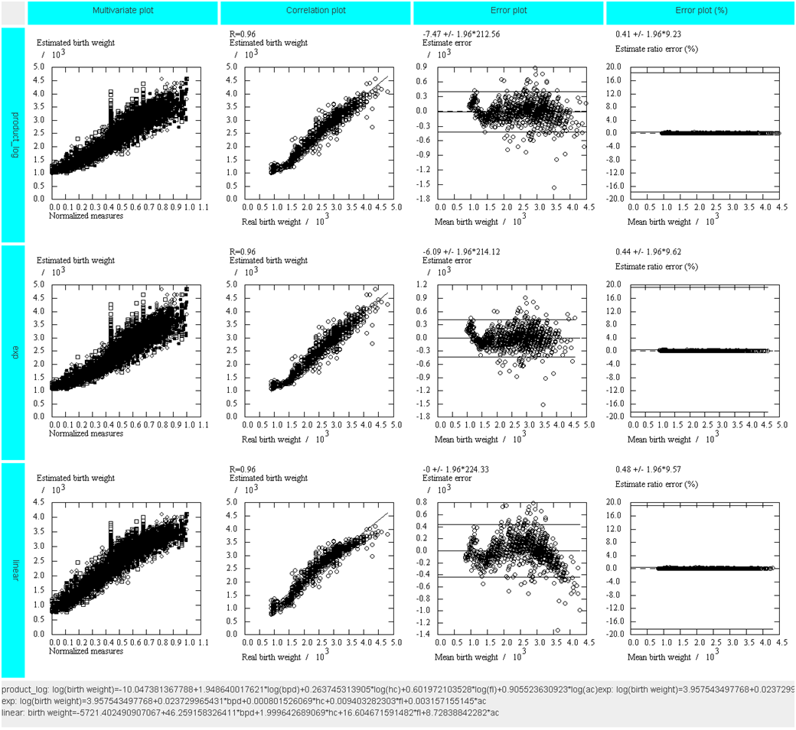
III. Use Case – Comparison among different formulas
Rows represents formulas.
Four criteria: multivariate correlation, estimate correlation, error range and ratio error range are arranged in three respective columns

Slide 11
IV. Experimental Results
We use two samples in which the first sample includes 2-dimension ultrasound measures of 1027 cases and the second sample includes 3-dimension ultrasound measures of 506 cases.
Samples are collected from Vinh Long General Hospital, obeying strictly all medical ethical criteria.
As experimental results, the proposed framework produces optimal formulas with high adequacy and accuracy

Slide 12
IV. Experimental Results – Age estimation 2D
Formula | Expression | R | Error Range
Our formula | age = 11.241790279345 * exp(0.002011545172 * bpd + 0.000934094686 * hc + 0.005469775639 * fl + 0.001042107315 * ac) | 0.9303 | -0.0292±1.4500
Ho 1 | age = 331.022307583389 - 1.611773915587 * (hc + ac) + 0.002779686994 * ((hc + ac)^2) - 0.000001530428 * ((hc + ac)^3) | 0.9212 | 0±1.5384
Varol 6 | age = 11.769 + 1.275 * fl/10 + 0.449 * ((fl/10)^2) - 0.02 * ((fl/10)^3) | 0.8949 | -1.6807±1.8525
Varol 1 | age = 5.596 + 0.941 * ac/10 | 0.8941 | -0.5683±1.7711
Varol 5 | age = 1.863 + 6.280 * fl/10 - 0.211 * ((fl/10)^2) | 0.8934 | -1.5182±2.1150

Slide 13
IV. Experimental Results – Weight estimation 2D
Formula | Expression | R | Error Range
Our formula | weight = 0.000043298985 * (bpd^1.948640017621) * (hc^0.263745313905) * (fl^0.601972103528) * (ac^0.905523630923) | 0.9636 | -7.4656±212.5573
Sherpard | weight = 10^(1.2508 + 0.166 * bpd/10 + 0.046 * ac/10 - 0.002646 * ac * bpd/100) | 0.9619 | -65.8121±219.0392
Ho 2 | weight = 10^(1.746 + 0.0124 * bpd + 0.001906 * ac) | 0.9602 | -11.5576±223.5124
Hadlock | weight = 10^(1.304 + 0.05281 * ac/10 + 0.1938 * fl/10 - 0.004 * ac * fl/100) | 0.9395 | -76.4960±272.9474
Campbell & Wilkin | weight = 1000 * exp(-4.564 + 0.282 * ac/10 - 0.00331 * ac * ac/100) | 0.9215 | 68.1261±308.5728

Slide 14
IV. Experimental Result – Age estimation 3D
Formula | Expression | R | Error Range
Our formula | age = 20.759762531262 + 0.170858541042 * (thigh_vol + arm_vol) - 0.000544722555 * ((thigh_vol + arm_vol)^2) + 0.000000914897 * ((thigh_vol + arm_vol)^3) | 0.9970 | 0±0.2696
Ho 3 | age = 21.1148 + 0.2381 * thigh_vol - 0.001 * (thigh_vol^2) + 0.000002 * (thigh_vol^3) | 0.9960 | -0.0150±0.3173
Ho 4 | age = 167.079078948836 - 1.553704882894 * ac + 0.005559118365 * (ac^2) - 0.000006184312 * (ac^3) | 0.8482 | 0.3723±1.8985

Slide 15
IV. Experimental Result – Weight estimation 3D
Formula | Expression | R | Error Range
Our formula | weight = -3617.936174872692 + 0.513171264916 * hc + 1.960175553517 * ac + 39.804645398677 * bpd + 17.016936212461 * fl + 8.366404260334 * thigh_vol + 5.828808072346 * arm_vol | 0.9708 | -0.0001±180.9803
Ho 5 | weight = -3306 + 55.477 * bpd + 13.483 * thigh_vol | 0.9663 | -0.0072±194.0956
Lee 3 | weight = exp(0.5046 + 1.9665 * log(bpd/10) - 0.3040 * (log(bpd/10)^2) + 0.9675 * log(ac/10) + 0.3557 * log(arm_vol)) | 0.9620 | 247.8761±206.1607
Lee 5 | weight = exp(2.1264 + 1.1461 * log(ac/10) + 0.4314 * log(thigh_vol)) | 0.9514 | 289.2660±234.0763
Lee 2 | weight = exp(-3.6138 + 4.6761 * log(ac/10) - 0.4959 * (log(ac/10)^2) + 0.3795 * log(arm_vol)) | 0.9472 | 316.4974±242.7964
Ho 6 | weight = -882.7049 + 73.9955 * thigh_vol - 0.497 * (thigh_vol^2) + 0.0014 * (thigh_vol^3) | 0.9385 | -7.5001±260.4596
Lee 4 | weight = exp(4.7806 + 0.7596 * log(thigh_vol)) | 0.9298 | 737.4932±344.1904
Lee 1 | weight = exp(4.9588 + 1.0721 * log(arm_vol) - 0.0526 * (log(arm_vol)^2)) | 0.9281 | 867.0836±309.5779
Chang | weight = 1080.8735 + 22.44701 * thigh_vol | 0.9229 | 456.5168±298.2517

Slide 16
Conclusion
In general, this paper proposes the framework that gives scientists and physicians three utilities:
Firstly, discovering new estimate formulas.
Secondly, providing statistical information.
Thirdly, comparison among different formulas based on pre-defined evaluation criterions.
As experimental results, the proposed framework produces optimal formulas with high adequacy and accuracy. With the built-in heuristic algorithm, the proposed framework can be totally used for any regression application beyond birth estimation.
Because the algorithm used to construct estimate formulas is based on heuristic assumptions, it gives optimal formulas but can lose other good formulas. In the future, we improve this algorithm by adding constraints into heuristic assumptions.

Slide 17
References
Campbell, S., & Wilkin, D. (1975, September). Ultrasonic measurement of fetal abdomen circumference in the estimation of fetal weight. BJOG: An International Journal of Obstetrics & Gynaecology, 82(9), 689-697. Retrieved from https://www.ncbi.nlm.nih.gov/pubmed/1101942
Chang, F.-M., Liang, R.-I., Ko, H.-C., Yao, B.-L., Chang, C.-H., & Yu, C.-H. (1997, September). Three-dimensional ultrasound-assessed fetal thigh volumetry in predicting birth weight. Obstetrics & Gynecology, 90(3), 331-339. doi:10.1016/S0029-7844(97)00280-9
Flanagan, M. T. (2004, May 2). Java Scientific Library. Michael Thomas Flanagan's Java Scientific Library. (M. T. Flanagan, Ed.) London, Enland, UK: University College London. Retrieved from http://www.ee.ucl.ac.uk/~mflanaga/java
Hadlock, F. P., Harrist, R. B., Sharman, R. S., Deter, R. L., & Park, S. K. (1985, February 1). Estimation of fetal weight with use of head, body and femur measurements: A prospective study. American Journal of Obstetrics and Gynecology, 151(3), 333-337. doi:10.1016/0002-9378(85)90298-4
Ho, T. T. (2011). Nghiên Cứu Phương Pháp Ước Lượng Trọng Lượng Thai, Tuổi Thai Bằng Siêu Âm Hai và Ba Chiều. Hanoi Univerisy of Medicine. Hanoi: Hanoi Univerisy of Medicine. Retrieved 2011
Ho, T. T., & Phan, D. T. (2011, December). Ước lượng cân nặng của thai từ 37 – 42 tuần bằng siêu âm 2 chiều. (D. Thai, Ed.) Journal of Practical Medicine, 12(797), 8-9.
Ho, T.-H. T., & Phan, D. T. (2011, December). Ước lượng tuổi thai qua các số đo thể tích cánh tay bằng siêu âm 3 chiều và các số đo bằng siêu âm 2 chiều. (D. Thai, Ed.) Journal of Practical Medicine, 12(798), 12-15.
Jong, J. d. (2010, January 31). A Java expression parser. A Java expression parser. Rotterdam, Netherlands: SpeQ Mathematics. Retrieved 2011, from http://www.speqmath.com/tutorials/expression_parser_java
Lee, W., Balasubramaniam, M., Deter, R. L., Yeo, L., Hassan, S. S., Gotsch, F., . . . Romero, R. (2009, November 1). New fetal weight estimation models using fractional limb volume. (M. A. Zoppi, Ed.) Ultrasound in Obstetrics & Gynecology, 34(5), 556-565. doi:10.1002/uog.7327
Oracle. (n.d.). Java language. (Oracle Corporation) Retrieved December 25, 2014, from Java website: https://www.oracle.com/java
Phạm, T. T. (2000). Ước lượng cân nặng thai nhi qua các số đo của thai trên siêu âm. Ho Chi Minh University of Medicine and Pharmacy. Ho Chi Minh: Ho Chi Minh University of Medicine and Pharmacy.
Phan, D. T. (1985). Ứng dụng siêu âm để chẩn đoán tuổi thai và cân nặng thai trong tử cung. Hanoi University of Medicine. Hanoi: Hanoi University of Medicine.
Shepard, J. M., Richards, A. V., Berkowitz, L. R., Warsof, L. S., & Hobbins, C. J. (1982, January 1). An evaluation of two equations for predicting fetal weight by ultrasound. American Journal of Obstetrics and Gynecology, 142(1), 47-54. Retrieved from https://www.ncbi.nlm.nih.gov/pubmed/7055171
Varol, F., Saltik, A., Kaplan, P. B., Kilic, T., & Yardim, T. (2001, June). Evaluation of Gestational Age Based on Ultrasound Fetal Growth Measurements. (J.-W. Park, Ed.) Yonsei Medical Journal, 42(3), 299-303. doi:10.3349/ymj.2001.42.3.299

Slide 18
Thank for your attention

