Slide 1
Mixture Regression Model for Incomplete Data
Dr. Loc Nguyen
Independent scholar
Email: ng_phloc@yahoo.com
Homepage: www.locnguyen.net

Slide 2
Abstract
The Regression Expectation Maximization (REM) algorithm, which is a variant of Expectation Maximization (EM) algorithm, uses parallelly a long regression model and many short regression models to solve the problem of incomplete data. Long regression model is entire regression function which is the resulted model and short regression models are partial regression functions which are inverses of entire regression function. I proposed REM in a different research in which one entire regression function is built parallelly with many partial inverse regression functions and then missing values are fulfilled by expectations relevant to both entire regression function and inverse regression functions. Experimental results proved resistance of REM to incomplete data, but accuracy of REM decreases insignificantly when data sample is made sparse with loss ratios up to 80%.

Slide 3
Abstract
Like traditional regression analysis methods, accuracy of REM can be decreased if data varies complicatedly with many trends. In this research, I propose a so-called Mixture Regression Expectation Maximization (MREM) algorithm. MREM is full combination of REM and mixture model in which I use two EM processes in the same loop. MREM uses the first EM process for exponential family of probability distributions to estimate missing values as REM does. Consequently, MREM uses the second EM process to estimate parameters as mixture model method does. The purpose of MREM is to take advantages of both REM and mixture model. Unexpectedly, experimental result shows that MREM is less accurate than REM. I try to weight partial models of MREM by product of component probabilities and conditional probabilities or to select most appropriate partial model in order to improve estimation accuracy, but the final results are not as good as expected. However, MREM is essential because a different approach for mixture model can be referred by fusing linear equations of MREM into a unique curve equation proposed by some other researches.

Slide 4
Table of contents
Introduction
Methodologies
Results and discussions
Conclusions

Slide 5
1. Introduction
As a convention, regression model is a linear regression function Z = α₀ + α₁X₁ + α₂X₂ + … + α_{n}X_{n} in which variable Z is called response variable or dependent variable whereas each X_{i} is called regression variable or independent variable. Each α_{i} is called regression coefficient.
When sample is complete, these coefficients are determined by least squares method [1]. When sample is incomplete, there are some approximation approaches to estimate regression coefficients such as complete case method, ad-hoc method, multiple imputation, maximum likelihood, weighting method, and Bayesian method.
I focus on applying expectation maximization (EM) algorithm into constructing regression model in case of missing data with note that EM algorithm belongs to maximum likelihood approach. In previous research [3], I proposed a so-called Regression Expectation Maximization (REM) algorithm to learn linear regression function from incomplete data in which some values of Z and X_{i} are missing. REM is a variant of EM algorithm, which is used to estimate regression coefficients.
Here I combine REM and mixture model with expectation that the accuracy is improved, especially in case that data is incomplete and has many trends. Our proposed algorithm is called Mixture Regression Expectation Maximization (MREM) algorithm. The purpose of MREM is to take advantages of both REM and mixture model.

Slide 6
1. Introduction
We need to survey some works related to application of EM algorithm to regression analysis. Kokic [5] proposed an excellent method to calculate expectation of errors for estimating coefficients of multivariate linear regression model. In Kokic’s method, response variable Z has missing values.
Ghitany, Karlis, Al-Mutairi, and Al-Awadhi [6] calculated the expectation of function of mixture random variable in expectation step (E-step) of EM algorithm and then used such expectation for estimating parameters of multivariate mixed Poisson regression model in the maximization step (M-step).
Anderson and Hardin [7] used reject inference technique to estimate coefficients of logistic regression model when response variable Z is missing but characteristic variables (regressors X_{i}) are fully observed. Anderson and Hardin replaced missing Z by its conditional expectation on regressors X_{i} where such expectation is logistic function.
Zhang, Deng, and Su [8] used EM algorithm to build up linear regression model for studying glycosylated hemoglobin from partial missing data. In other words, Zhang, Deng, and Su [8] aim to discover relationship between independent variables (predictors) and diabetes.

Slide 7
1. Introduction
Besides EM algorithm, there are other approaches to solve the problem of incomplete data in regression analysis. Haitovsky [9] stated that there are two main approaches to solve such problem. The first approach is to ignore missing data and to apply the least squares method into observations. The second approach is to calculate covariance matrix of regressors and then to apply such covariance matrix into constructing the system of normal equations.
Robins, Rotnitzki, and Zhao [10] proposed a class of inverse probability of censoring weighted estimators for estimating coefficients of regression model. Their approach is based on the dependency of mean vector of response variable Z on vector of regressors X_{i} when Z has missing values.
Horton and Kleinman [2] classified 6 methods of regression analysis in case of missing data such as complete case method, ad-hoc method, multiple imputation, maximum likelihood, weighting method, and Bayesian method. EM algorithm belongs to maximum likelihood method, which has two steps such as expectation step (E-step) and maximization step (M-step). In E-step, multiple entries are created in an augmented dataset for each observation of missing values and then probability of the observation is estimated based on current parameter [2]. In M-step, regression model is built from augmented dataset.
The REM algorithm proposed in this research is different from the traditional EM for regression analysis because we replace missing values in E-step by expectation of sufficient statistics via mutual balance process instead of estimating the probability of observation.

Slide 8
1. Introduction
Recall that MREM is the combination of REM and mixture model and so we need to survey other works related to regression model with support of mixture model. As a convention, such regression model is called mixture regression model.
In literature, there are two approaches of mixture regression model:
The first approach is to use logistic function to estimate the mixture coefficients.
The second approach is to construct a joint probability distribution as product of the probability distribution of response variable Z and the probability distribution of independent variables X_{i}.
In general, the two approaches in literature do not implement regression mixture model according to EM process in full because they aim to simplify the estimation process and data sample is assumed to be completed.
Here I proposed MREM algorithm which is the full combination of REM [3] and mixture model in which I use two EM processes in the same loop. Detail of MREM will be described in next section.

Slide 9
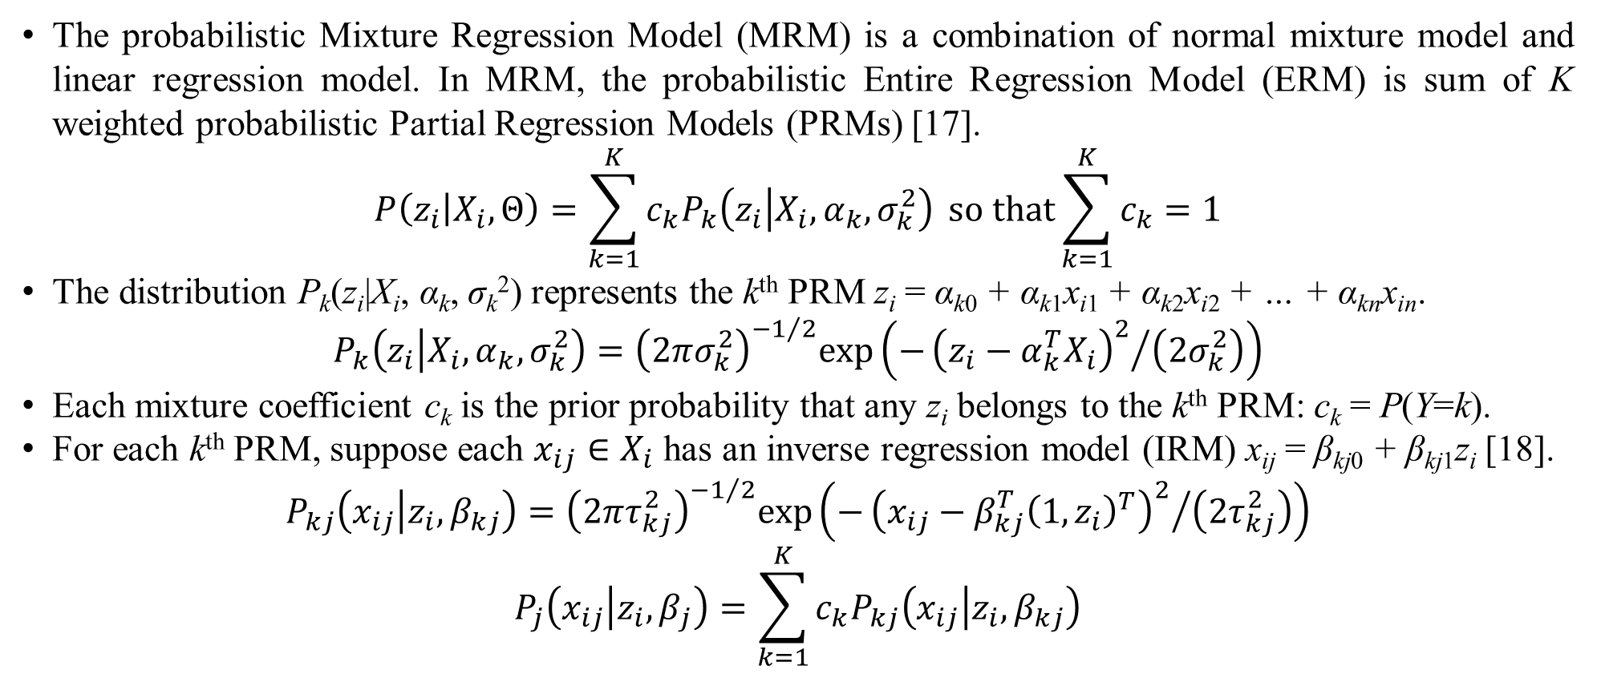
2. Methodologies
The probabilistic Mixture Regression Model (MRM) is a combination of normal mixture model and linear regression model. In MRM, the probabilistic Entire Regression Model (ERM) is sum of K weighted probabilistic Partial Regression Models (PRMs) [17].
$$P\left(z_{i} | X_{i},Θ\right)=\sum_{k=1}^{K}{c_{k}P_{k}\left(z_{i} | X_{i},α_{k},σ_{k}^{2}\right)} \text{so} \text{that}\sum_{k=1}^{K}{c_{k}}=1$$
The distribution P_{k}(z_{i}|X_{i}, α_{k}, σ_{k}²) represents the k^{th} PRM z_{i} = α_{k0} + α_{k1}x_{i1} + α_{k2}x_{i2} + … + α_{kn}x_{in}.
$$P_{k}\left(z_{i} | X_{i},α_{k},σ_{k}^{2}\right)={\left(2πσ_{k}^{2}\right)}^{−1/2}exp\left(−{{\left(z_{i}−α_{k}^{T}X_{i}\right)}^{2}}/{\left(2σ_{k}^{2}\right)}\right)$$
Each mixture coefficient c_{k} is the prior probability that any z_{i} belongs to the k^{th} PRM: c_{k} = P(Y=k).
For each k^{th} PRM, suppose each $x_{ij}∈X_{i}$ has an inverse regression model (IRM) x_{ij} = β_{kj0} + β_{kj1}z_{i} [18].
$$P_{kj}\left(x_{ij} | z_{i},β_{kj}\right)={\left(2πτ_{kj}^{2}\right)}^{−1/2}exp\left(−{{\left(x_{ij}−β_{kj}^{T}{\left(1,z_{i}\right)}^{T}\right)}^{2}}/{\left(2τ_{kj}^{2}\right)}\right)$$
$$P_{j}\left(x_{ij} | z_{i},β_{j}\right)=\sum_{k=1}^{K}{c_{k}P_{kj}\left(x_{ij} | z_{i},β_{kj}\right)}$$

Slide 10
2. Methodologies
Let D = (X, Z) be collected sample in which X is a set of regressors and Z is a set of outcome variables plus values 1, respectively [18] with note that both X and Z are incomplete. As a convention, let z_{i}– and x_{ij}– denote missing values of Z and X, respectively.
Our mission is to estimate both missing values and the parameter Θ = (c_{k}, α_{k}, σ_{k}², β_{kj} ) of MRM.
Here I proposed a so-called Mixture Regression Expectation Maximization (MREM) which is the full combination of REM algorithm [3] and mixture model in which we use two EM processes in the same loop.
Firstly, I use the first EM process to estimate missing values in E-step [3]. This first process is actually REM algorithm.
Secondly, I use the second EM process to estimate Θ* for full mixture model in M-step.

Slide 11
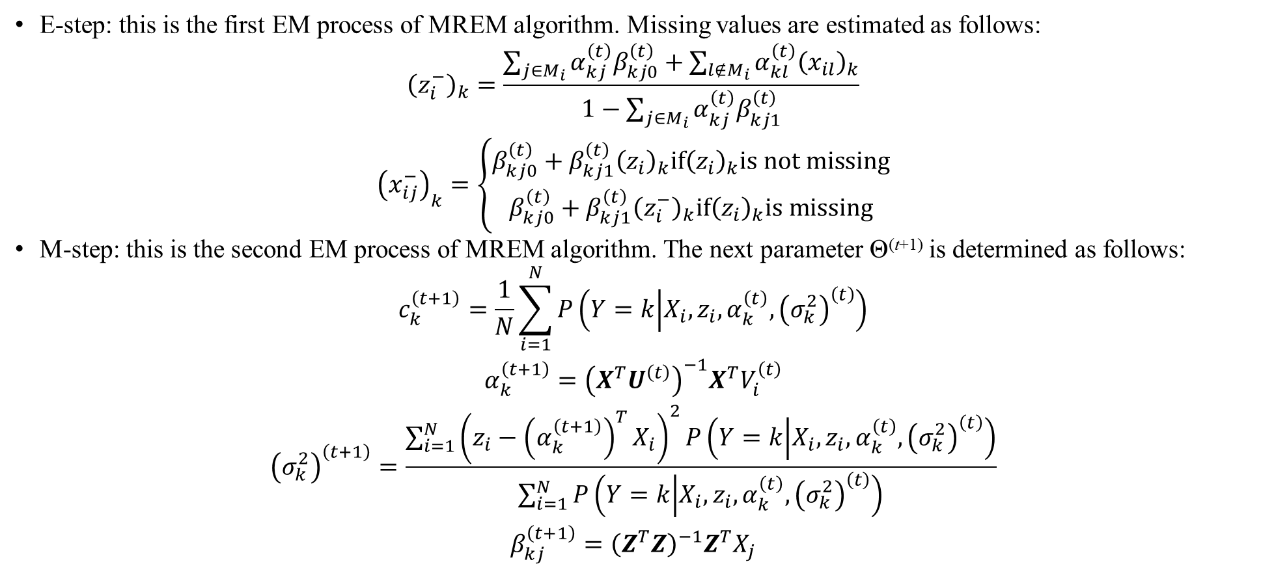
2. Methodologies
E-step: this is the first EM process of MREM algorithm. Missing values are estimated as follows:
$$\begin{matrix}{\left(z_{i}^{−}\right)}_{k}=\frac{\sum_{j∈M_{i}}{α_{kj}^{\left(t\right)}β_{kj0}^{\left(t\right)}}+\sum_{l∉M_{i}}{α_{kl}^{\left(t\right)}{\left(x_{il}\right)}_{k}}}{1−\sum_{j∈M_{i}}{α_{kj}^{\left(t\right)}β_{kj1}^{\left(t\right)}}} \\ {\left(x_{ij}^{−}\right)}_{k}=\left\{\begin{matrix}β_{kj0}^{\left(t\right)}+β_{kj1}^{\left(t\right)}{\left(z_{i}\right)}_{k}if{\left(z_{i}\right)}_{k}is not missing \\ β_{kj0}^{\left(t\right)}+β_{kj1}^{\left(t\right)}{\left(z_{i}^{−}\right)}_{k}if{\left(z_{i}\right)}_{k}is missing\end{matrix}\right.\end{matrix}$$
M-step: this is the second EM process of MREM algorithm. The next parameter Θ^{(t+1)} is determined as follows:
$$\begin{matrix}c_{k}^{\left(t+1\right)}=\frac{1}{N}\sum_{i=1}^{N}{P\left(Y=k | X_{i},z_{i},α_{k}^{\left(t\right)},{\left(σ_{k}^{2}\right)}^{\left(t\right)}\right)} \\ α_{k}^{\left(t+1\right)}={\left(X^{T}U^{\left(t\right)}\right)}^{−1}X^{T}V_{i}^{\left(t\right)} \\ {\left(σ_{k}^{2}\right)}^{\left(t+1\right)}=\frac{\sum_{i=1}^{N}{{\left(z_{i}−{\left(α_{k}^{\left(t+1\right)}\right)}^{T}X_{i}\right)}^{2}P\left(Y=k | X_{i},z_{i},α_{k}^{\left(t\right)},{\left(σ_{k}^{2}\right)}^{\left(t\right)}\right)}}{\sum_{i=1}^{N}{P\left(Y=k | X_{i},z_{i},α_{k}^{\left(t\right)},{\left(σ_{k}^{2}\right)}^{\left(t\right)}\right)}} \\ β_{kj}^{\left(t+1\right)}={\left(Z^{T}Z\right)}^{−1}Z^{T}X_{j}\end{matrix}$$

Slide 12
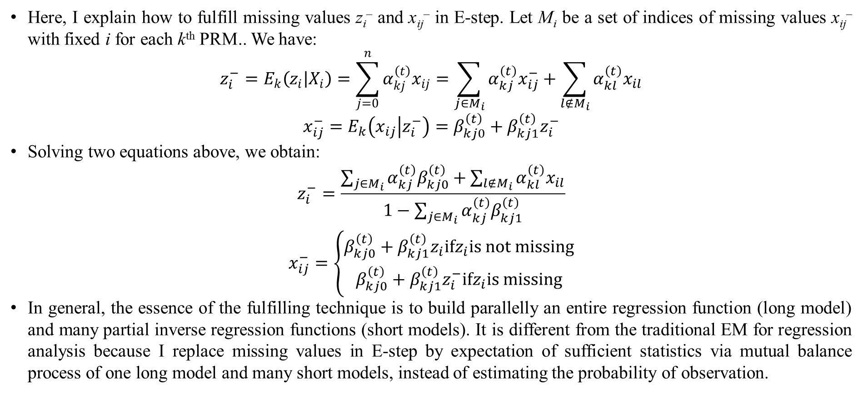
2. Methodologies
Here, I explain how to fulfill missing values z_{i}– and x_{ij}– in E-step. Let M_{i} be a set of indices of missing values x_{ij}– with fixed i for each k^{th} PRM.. We have:
$$z_{i}^{−}=E_{k}\left(z_{i} | X_{i}\right)=\sum_{j=0}^{n}{α_{kj}^{\left(t\right)}x_{ij}}=\sum_{j∈M_{i}}{α_{kj}^{\left(t\right)}x_{ij}^{−}}+\sum_{l∉M_{i}}{α_{kl}^{\left(t\right)}x_{il}}$$
$$x_{ij}^{−}=E_{k}\left(x_{ij} | z_{i}^{−}\right)=β_{kj0}^{\left(t\right)}+β_{kj1}^{\left(t\right)}z_{i}^{−}$$
Solving two equations above, we obtain:
$$\begin{matrix}z_{i}^{−}=\frac{\sum_{j∈M_{i}}{α_{kj}^{\left(t\right)}β_{kj0}^{\left(t\right)}}+\sum_{l∉M_{i}}{α_{kl}^{\left(t\right)}x_{il}}}{1−\sum_{j∈M_{i}}{α_{kj}^{\left(t\right)}β_{kj1}^{\left(t\right)}}} \\ x_{ij}^{−}=\left\{\begin{matrix}β_{kj0}^{\left(t\right)}+β_{kj1}^{\left(t\right)}z_{i}ifz_{i}is not missing \\ β_{kj0}^{\left(t\right)}+β_{kj1}^{\left(t\right)}z_{i}^{−}ifz_{i}is missing\end{matrix}\right.\end{matrix}$$
In general, the essence of the fulfilling technique is to build parallelly an entire regression function (long model) and many partial inverse regression functions (short models). It is different from the traditional EM for regression analysis because I replace missing values in E-step by expectation of sufficient statistics via mutual balance process of one long model and many short models, instead of estimating the probability of observation.

Slide 13
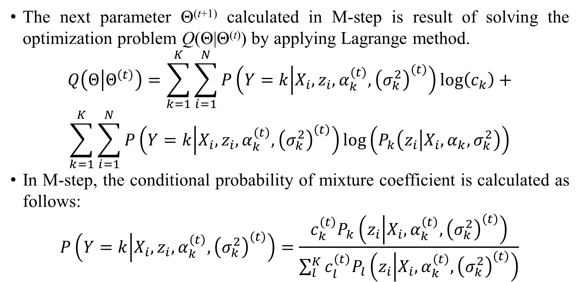
2. Methodologies
The next parameter Θ^{(t+1)} calculated in M-step is result of solving the optimization problem Q(Θ|Θ^{(t)}) by applying Lagrange method.
$$Q\left(Θ | Θ^{\left(t\right)}\right)=\sum_{k=1}^{K}{\sum_{i=1}^{N}{P\left(Y=k | X_{i},z_{i},α_{k}^{\left(t\right)},{\left(σ_{k}^{2}\right)}^{\left(t\right)}\right)log\left(c_{k}\right)}}+$$
$$\sum_{k=1}^{K}{\sum_{i=1}^{N}{P\left(Y=k | X_{i},z_{i},α_{k}^{\left(t\right)},{\left(σ_{k}^{2}\right)}^{\left(t\right)}\right)log\left(P_{k}\left(z_{i} | X_{i},α_{k},σ_{k}^{2}\right)\right)}}$$
In M-step, the conditional probability of mixture coefficient is calculated as follows:
$$P\left(Y=k | X_{i},z_{i},α_{k}^{\left(t\right)},{\left(σ_{k}^{2}\right)}^{\left(t\right)}\right)=\frac{c_{k}^{\left(t\right)}P_{k}\left(z_{i} | X_{i},α_{k}^{\left(t\right)},{\left(σ_{k}^{2}\right)}^{\left(t\right)}\right)}{\sum_{l}^{K}{c_{l}^{\left(t\right)}P_{l}\left(z_{i} | X_{i},α_{k}^{\left(t\right)},{\left(σ_{k}^{2}\right)}^{\left(t\right)}\right)}}$$

Slide 14
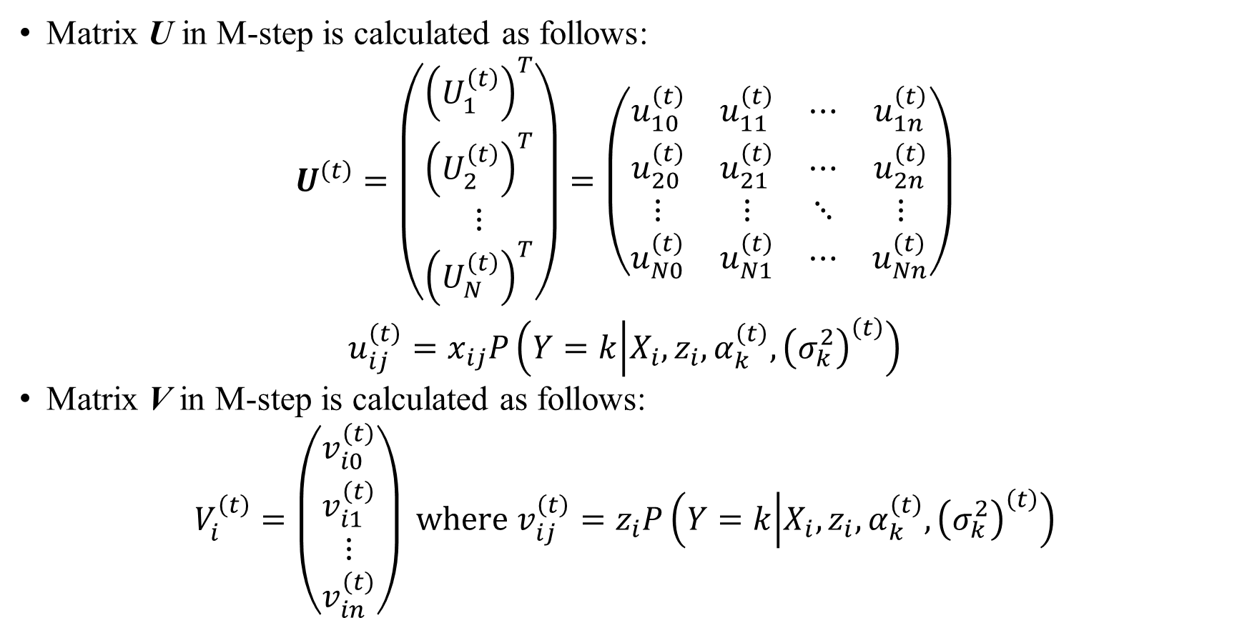
2. Methodologies
Matrix U in M-step is calculated as follows:
$$\begin{matrix}U^{\left(t\right)}=\left(\begin{matrix}{\left(U_{1}^{\left(t\right)}\right)}^{T} \\ {\left(U_{2}^{\left(t\right)}\right)}^{T} \\ ⋮ \\ {\left(U_{N}^{\left(t\right)}\right)}^{T}\end{matrix}\right)=\left(\begin{matrix}u_{10}^{\left(t\right)} & u_{11}^{\left(t\right)} & ⋯ & u_{1n}^{\left(t\right)} \\ u_{20}^{\left(t\right)} & u_{21}^{\left(t\right)} & ⋯ & u_{2n}^{\left(t\right)} \\ ⋮ & ⋮ & ⋱ & ⋮ \\ u_{N0}^{\left(t\right)} & u_{N1}^{\left(t\right)} & ⋯ & u_{Nn}^{\left(t\right)}\end{matrix}\right) \\ u_{ij}^{\left(t\right)}=x_{ij}P\left(Y=k | X_{i},z_{i},α_{k}^{\left(t\right)},{\left(σ_{k}^{2}\right)}^{\left(t\right)}\right)\end{matrix}$$
Matrix V in M-step is calculated as follows:
$$\begin{matrix}V_{i}^{\left(t\right)}=\left(\begin{matrix}v_{i0}^{\left(t\right)} \\ v_{i1}^{\left(t\right)} \\ ⋮ \\ v_{in}^{\left(t\right)}\end{matrix}\right) \text{where} v_{ij}^{\left(t\right)}=z_{i}P\left(Y=k | X_{i},z_{i},α_{k}^{\left(t\right)},{\left(σ_{k}^{2}\right)}^{\left(t\right)}\right)\end{matrix}$$

Slide 15
2. Methodologies
MREM does not use the joint probability distribution. MREM does not either use logistic function to estimate mixture coefficients as the first approach does.
MREM is the full combination of REM [3] and mixture model in which I use two EM processes in the same loop for estimating missing values and parameters.
Variance σ_{k}² and regression coefficient α_{k} of the probability P_{k}(Z|α_{k}^{T}X, σ_{k}²) in MREM are estimated and balanced by both full mixture model and maximum likelihood estimation (MLE).
Mixture regression models in literature are learned from complete data whereas MREM supports incomplete data.

Slide 16
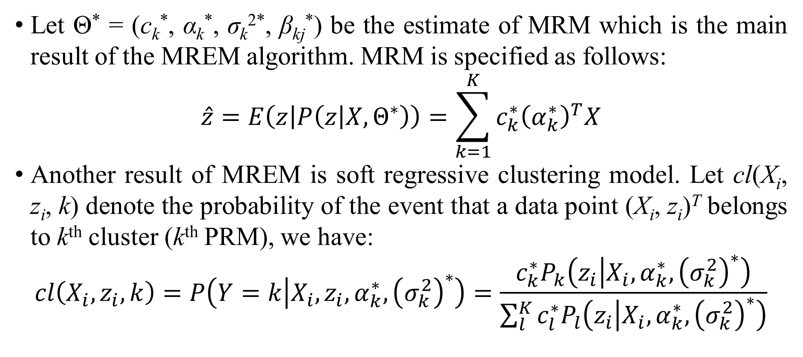
2. Methodologies
Let Θ* = (c_{k}*, α_{k}*, σ_{k}^{2*}, β_{kj}*) be the estimate of MRM which is the main result of the MREM algorithm. MRM is specified as follows:
$$\hat{z}=E\left(z | P\left(z | X,Θ^{∗}\right)\right)=\sum_{k=1}^{K}{c_{k}^{∗}{\left(α_{k}^{∗}\right)}^{T}X}$$
Another result of MREM is soft regressive clustering model. Let cl(X_{i}, z_{i}, k) denote the probability of the event that a data point (X_{i}, z_{i})^{T} belongs to k^{th} cluster (k^{th} PRM), we have:
$$cl\left(X_{i},z_{i},k\right)=P\left(Y=k | X_{i},z_{i},α_{k}^{∗},{\left(σ_{k}^{2}\right)}^{∗}\right)=\frac{c_{k}^{∗}P_{k}\left(z_{i} | X_{i},α_{k}^{∗},{\left(σ_{k}^{2}\right)}^{∗}\right)}{\sum_{l}^{K}{c_{l}^{∗}P_{l}\left(z_{i} | X_{i},α_{k}^{∗},{\left(σ_{k}^{2}\right)}^{∗}\right)}}$$

Slide 17
3. Results and discussions
I use xclara sample [21]] for testing MREM and REM. It has 3000 points with 3 clusters. There are two numerical variables V1 and V2 as x and y coordinates of points in the xclara dataset. I consider V1 as regressor and V2 as response variable. .
The dataset is split separately into one training dataset (50% sample) and one testing dataset (50% sample). Later on, the training dataset is made sparse with loss ratios 10%, 20%, 30%, 40%, 50%, 60%, 70%, 80%, and 90% [20].
Each pair of incomplete training dataset and testing dataset is called testing pair. The 0th pair is called complete pair whereas the 1st, 2nd, 3rd, 4th, 5th, 6th, 7th, 8th, and 9th pairs are called incomplete pairs.

Slide 18
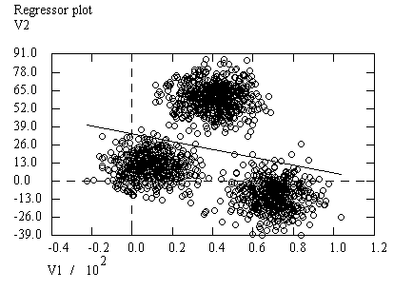
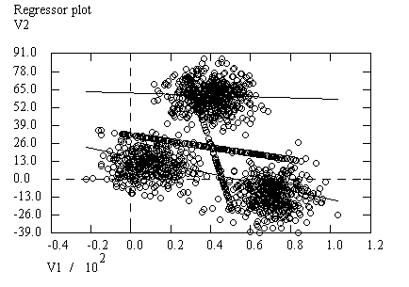
3. Results and discussions
Unique cluster of the 0th pair:
V2 = 34.0445 - 0.2790*(V1)
Two clusters of the 1st pair:
{V2 = 16.6425 - 0.3065*(V1): c₁=0.6654}
{V2 = 62.3919 - 0.0429*(V1): c₂=0.3346}

Slide 19
3. Results and discussions
RMAE metric measures ratio deviation between real value and estimated value. The smaller the RMAE is, the more accurate the algorithm is. Following is comparison of REM and MREM with regard to RMAE given xclara sample.
Pair RMAE (REM) RMAE (MREM)
0 5.4722 5.4722
1 5.3672 5.7804
2 5.2846 5.6044
3 4.6337 5.1166
4 4.3681 5.3686
5 4.3025 5.5701
8 4.9120 5.2689
7 4.3025 5.5701
8 6.1709 6.1709
9 7.2932 7.2932
Average 5.2107 5.7215
Unexpectedly, MREM is less accurate than REM according RMAE metric. The reason is that we do not choose a right regressive cluster for given regressors X to estimate response value z.

Slide 20
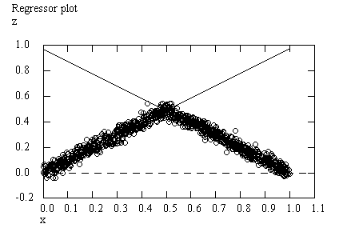
3. Results and Discussions
If we can choose a right regressive cluster for estimation, the accuracy will be optimal. For example, I generate a sample with two clearly separated cluster as follows:
The approximation of equation z = x is z = 0.0036 + 0.9765*(x) with coefficient c₁ = 0.4634 whereas the approximation of equation z = 1 – x is z = 0.9767 - 0.9713*(x) with coefficient c₂ = 0.5366. If MREM can select the equation z = 0.0036 + 0.9765*(x) and the equation z = 0.9767 - 0.9713*(x) for estimating response values for 0 ≤ x < 0.5 and 0.5 ≤ x ≤ 1, respectively then, the RMAE of MREM becomes 0.4 which is better the RMAE of REM (2.5790).

Slide 21
3. Results and Discussions
In previous research [3], experimental results proved resistance of REM to incomplete data up to loss ratio 80%. We use a gestational sample of 1027 cases in which each case includes ultrasound measures, fetus age, and fetus weight. Following is RMAE evaluation of REM, which is considered as the percentage of decrease in accuracy.
Pair RMAE (REM)
1 0.0093
2 0.0300
3 0.0366
4 0.0412
5 0.0773
8 0.0875
7 0.0415
8 0.6408
We make a one-way paired t-test of loss ratios (10%, 20%, 30%, 40%, 50%, 60%, 70%, 80%) and RMAE values. Given significant level 95% (t_{0.05,7} = 1.895), difference between the percentage of missing values and the percentage of decrease in accuracy of REM is significant with pairs 1st, 2nd, 3rd, 4th, 5th, 6th, 7th, and 8th. We assert that the resistance of REM to missing values given MAE metric is significant because the bias ratios are much smaller than percentages of missing values in case that loss ratios are equal to or smaller than 80%.

Slide 22
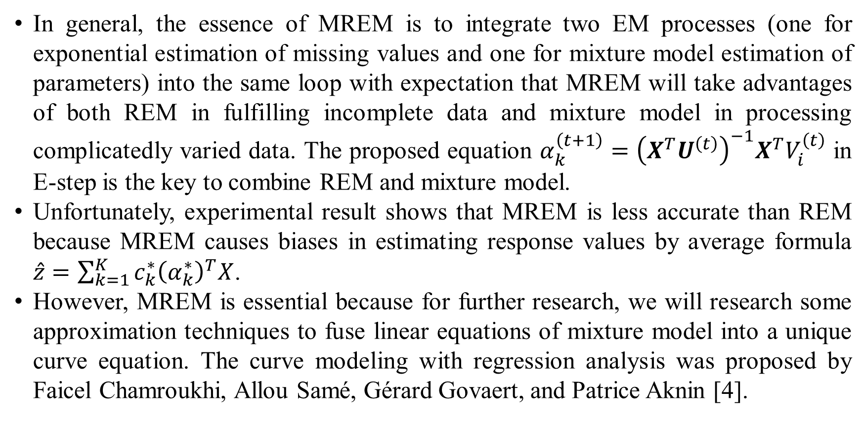
4. Conclusions
In general, the essence of MREM is to integrate two EM processes (one for exponential estimation of missing values and one for mixture model estimation of parameters) into the same loop with expectation that MREM will take advantages of both REM in fulfilling incomplete data and mixture model in processing complicatedly varied data. The proposed equation $α_{k}^{\left(t+1\right)}={\left(X^{T}U^{\left(t\right)}\right)}^{−1}X^{T}V_{i}^{\left(t\right)}$ in E-step is the key to combine REM and mixture model.
Unfortunately, experimental result shows that MREM is less accurate than REM because MREM causes biases in estimating response values by average formula $\hat{z}=\sum_{k=1}^{K}{c_{k}^{∗}{\left(α_{k}^{∗}\right)}^{T}X}$.
However, MREM is essential because for further research, we will research some approximation techniques to fuse linear equations of mixture model into a unique curve equation. The curve modeling with regression analysis was proposed by Faicel Chamroukhi, Allou Samé, Gérard Govaert, and Patrice Aknin [4].

Slide 23
Thank you for attention

Slide 24
References
Montgomery, D. C.; Runger, G. C. Applied Statistics and Probability for Engineers, 5th ed.; John Wiley & Sons: Hoboken, New Jersey, USA, 2010; p. 792. Available online: https://books.google.com.vn/books?id=_f4KrEcNAfEC (accessed on 6th September 2016).
Horton, N. J.; Kleinman, K. P. Much ado about nothing: A comparison of missing data methods and software to fit incomplete data regression models. The American Statistician, February 2007, vol. 61, no. 1, pp. 79-90. DOI:10.1198/000313007X172556.
Nguyen, L.; Ho, T.-H. T. Fetal Weight Estimation in Case of Missing Data. Experimental Medicine (EM) - Special Issue “Medicine and Healthy Food”, December 17th 2018, vol. 1, no. 2, pp. 45-65. DOI:10.31058/j.em.2018.12004.
Chamroukhi, F.; Samé, A.; Govaert, G.; Aknin, P. (2010, March). A hidden process regression model for functional data description: Application to curve discrimination. (Wang, Z.; Hoi, S.; Eds.) Neurocomputing, March 2010, 73(7-9), 1210-1221, DOI:10.1016/j.neucom.2009.12.023. Available online:https://www.sciencedirect.com/science/article/pii/S0925231210000287 (accessed on 12ndOctober 2018).
Kokic, P. The EM Algorithm for a Multivariate Regression Model: including its applications to a non-parametric regression model and a multivariate time series model. QantarisGmbH, Frankfurt, 2002. Available online: https://www.cs.york.ac.uk/euredit/_temp/The%20Euredit%20Software/NAG%20Prototype%20platform/WorkingPaper4.pdf (accessed on 30th June 2018).
Ghitany, M. E.; Karlis, D.; Al-Mutairi, D. K.; Al-Awadhi, F. An EM Algorithm for Multivariate Mixed Poisson Regression Models and its Application. Applied Mathematical Sciences, 2012, vol.6, no.137, pp.6843-6856. Available online: http://www.m-hikari.com/ams/ams-2012/ams-137-140-2012/ghitanyAMS137-140-2012.pdf (accessed on 3rd July2018).
Anderson, B.; Hardin, M. J. Modified logistic regression using the EM algorithm for reject inference. International Journal of Data Analysis Techniques and Strategies, 1st January 2013, vol. 5, no. 4, pp.359-373. DOI:10.1504/IJDATS.2013.058582.
Zhang, X.; Deng, J.; Su, R. The EM algorithm for a linear regression model with application to a diabetes data. In Proceedings of the 2016 International Conference on Progress in Informatics and Computing (PIC), Shanghai, China, 2016. DOI:10.1109/PIC.2016.7949477.
Haitovsky, Y. Missing Data in Regression Analysis. Journal of the Royal Statistical Society: Series B (Methodological), 1st January 1968, vol. 30, no. 1, pp. 67-82. Available online: https://www.jstor.org/stable/2984459 (accessed on 3rdJuly2018).
Robins, J. M.; Rotnitzki, A.; Zhao, L. P. Analysis of Semiparametric Regression Models for Repeated Outcomes in the Presence of Missing Data. Journal of the American Statistical Association, March 1995, vol. 90, no. 429, pp. 106-121. DOI:10.2307/2291134.

Slide 25
References
Lamont, A. E.; Vermunt, J. K.; Lee, V. H. M. Regression mixture models: Does modeling the covariance between independent variables and latent classes improve the results? Multivariate Behavioral Research, January 2016, vol. 51, no. 1, pp. 35-52. DOI:10.1080/00273171.2015.1095063.
Hoshikawa, T. Mixture regression for observational data, with application to functional regression models. arXiv preprint, 30th June 2013. arXiv:1307.0170.
Nguyen, H. D. Finite Mixture Models for Regression Problems. The University of Queensland, Brisbane, 2015. DOI:10.14264/uql.2015.584.
Sung, H. G. Gaussian Mixture Regression and Classification. Rice University, Houston, 2004. Available online: https://scholarship.rice.edu/handle/1911/18710 (accessed on 4th September2018).
Tian, Y.; Sigal, L.; Badino, H.; Torre, F. D. l.; Liu, Y. Latent Gaussian Mixture Regression for Human Pose Estimation. In Lecture Notes in Computer Science, vol 6494, Proceedings of The 10th Asian Conference on Computer Vision (ACCV 2010), Queens town, 2010. DOI:10.1007/978-3-642-19318-7_53.
Grün, B.; Leisch, F. Finite Mixtures of Generalized Linear Regression Models. University of Munich, Munich, 2007. Available online: https://pdfs.semanticscholar.org/e0d5/6ac54b80a1a4e274f11b1d86840461cc542c.pdf (accessed on 4th September2018).
Bilmes, J. A. A Gentle Tutorial of the EM Algorithm and its Application to Parameter Estimation for Gaussian Mixture and Hidden Markov Models. University of Washington, Berkeley, 1998. Available online: http://melodi.ee.washington.edu/people/bilmes/mypubs/bilmes1997-em.pdf (accessed on 17th September 2013).
Lindsten, F.; Schön, T. B.; Svensson, A.; Wahlström, N. Probabilistic modeling–linear regression & Gaussian processes. Uppsala University, Uppsala, 2017. Available online: http://www.it.uu.se/edu/course/homepage/sml/literature/probabilistic_modeling_compendium.pdf (accessed on 24th January 2018).
Dempster, A. P.; Laird, N. M.; Rubin, D. B. Maximum Likelihood from Incomplete Data via the EM Algorithm. Journal of the Royal Statistical Society, Series B (Methodological), 1977, vol. 39, no. 1, pp. 1-38.
Nguyen, L.; Ho, T.-H. T. Early Fetal Weight Estimation with Expectation Maximization Algorithm. Experimental Medicine (EM), 2018, 1(1), 12-30. DOI:10.31058/j.em.2018.11002.
Arel-Bundock, V. (2018, June 28). R datasets - An archive of datasets distributed with R. GitHub, 28th June 2018. Available online: http://vincentarelbundock.github.io/Rdatasets/csv/cluster/xclara.csv (accessed on 11st September 2018).
Struyf, A.; Hubert, M.; Rousseeuw, P. J. (1996). Clustering in an Object-Oriented Environment. Journal of Statistical Software, 1996, 1(4), 1-30, DOI:10.18637/jss.v001.i04. Available online: http://www.jstatsoft.org/v01/i04 (accessed on 10th October 2018).
Pinette, M. G.; Pan, Y.; Pinette, S. G.; Blackstone, J.; Garrett, J.; Cartin, A. Estimation of Fetal Weight: Mean Value from Multiple Formulas. Journal of Ultrasound in Medicine, 1st December 1999, vol. 18, no. 12, pp. 813-817. Available online: https://www.ncbi.nlm.nih.gov/pubmed/10591444 (accessed on 9th October 2016).

