Slide 1
Nam Toàn Cầu: kỳ vọng và hiện thực TS Nguyễn Phước Lộc, PhD, Postdoc Nghiên cứu độc lập, Việt Nam Email: ng_phloc@yahoo.com Homepage: www.locnguyen.net
NTC – Nguyễn Phước Lộc – Global South 2024 – TBD

Slide 2
Contents
Introduction to this template
Making the most of this template
Best practice
Example slides Text
Master slides
Fonts
Chart example
Table example
Images
Image and statement
Image and title only
Full page image
Final points and close

Slide 3
Introduction to this template

Slide 4
Making the most of this template
Introduction to this template
All slides you can see use this template. Delete slides or update content for your use.
Notes:
To avoid overloading the slides with text, use speaker notes to add more detail and prompts.

Slide 5
Best practice 1
Introduction to this template
Impact
For maximum impact, use as little text on a slide as possible. Deliver the detail of your message through speech and avoid reading word for word from the slide.
Notes:
To avoid overloading the slides with text, use speaker notes to add more detail and prompts.

Slide 6
Best practice 2
Introduction to this template
Engagement
Context
Land your message by setting the scene and telling your story.
Structure and cadence
Land your message by setting a good pace. Use section breaks to segment your content into easily digestible chapters.
Notes:
To avoid overloading the slides with text, use speaker notes to add more detail and prompts.

Slide 7
Best practice 3
Introduction to this template
Accessibility
Use the PowerPoint accessibility checker: File > Check for Issues > Check Accessibility.
Or use Search Engine (Alt + Q) with keyword “Check Accessibility”
Notes:
To avoid overloading the slides with text, use speaker notes to add more detail and prompts.

Slide 8
Example slides – text

Slide 9
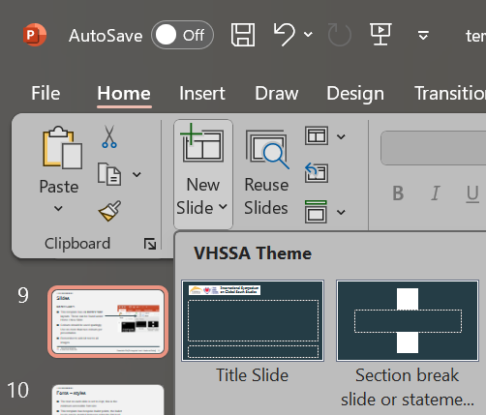
Slides
Example slides – text
Master Slides
This template has 20 master slide layouts. These can be found under Home / New Slide.
Colours should be used sparingly. If adding colour, use no more than two from the palette.
Remember to add Alt text to all images.

Slide 10
Fonts – styles
Example slides – text
The text on each slide is set to 24pt, this is the minimum accessible font size.
This template has bespoke bullet points, the bullet levels can be toggled between using the list level buttons, or using the tab key at the start of the paragraph.
Level 2
Level 3
Keep text clear and concise.

Slide 11
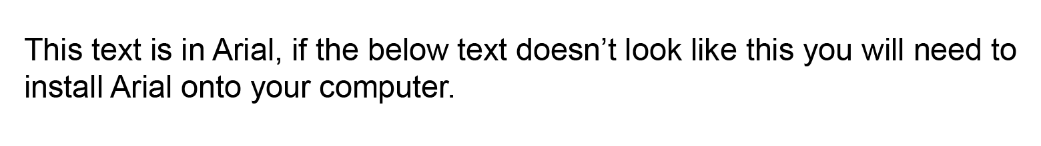
Fonts – typeface
Example slides – text
This text is in Arial, if this text doesn’t look like the above you will need to install Arial onto your computer.

Slide 12
Chart example
Example slides – text
Add bullet text to comment on and explain the chart
Use tabbing or List Level buttons to toggle level
Or remove bullets altogether
Use varying textures in graphs, use a key, and add alt text.

Slide 13
Timeline example
Example slides – text
Today
00 March 2020
00 July 2020
Roll out
00 January 2020
Key milestone 01 and brief explanation
00 May 2020
Key stakeholder sign off
00 February 2020
Key milestone or goals
00 April 2020
Key milestone or goals
00 June 2020
Project delivery

Slide 14
Table example
Example slides – text
Title | Title | Title
Body Text goes here | Body Text | Body Text
Body Text goes here | Body Text | Body Text
Title | Title | Title | Title
Body Text | Body Text | Body Text | Body Text
Body Text | Body Text | Body Text | Body Text
To add a table go to the Insert Tab and select Table

Slide 15
Example slides – images

Slide 16
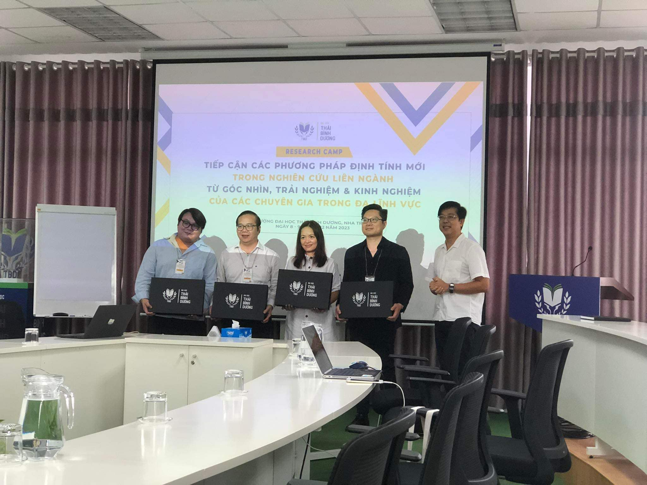
Image and statement
Example slides – images
Add statement text or quote in the space, use 34pt or 24pt text
Receiving Certificates of Research Camp 2023 Vietnamese Humanities & Social Sciences Association (VHSSA) | Photograph: Cassie Dong

Slide 17
Image and title only
Example slides – images
Receiving Certificates of Research Camp 2023 Vietnamese Humanities & Social Sciences Association (VHSSA) | Photograph: Cassie Dong

Slide 18
Receiving Certificates of Research Camp 2023 Vietnamese Humanities & Social Sciences Association (VHSSA) | Photograph: Cassie Dong

Slide 19
Final points and close

Slide 20
Final points
Use this slide for slides with text only
Do not reduce font size
Heading text can be made bold
If adding colour, use no more than two from the palette

Slide 21
Cảm ơn đã lắng nghe

