Slide 1
Future of education with support of technology
ASEAN Conference on Educational Management and International Research and Development
Naga College Foundation, Inc
Universidad de Sta. Isabel, Naga City, Philippines, October 21-22 & 29, 2023
Professor Dr. Loc Nguyen, PhD, Postdoc
Founder of Loc Nguyen’s Academic Network, Vietnam
Email: ng_phloc@yahoo.com
Homepage: www.locnguyen.net

Slide 2
Paradoxes of technology
It is undoubtful that technology helps our world to be rich and wealthy, but technology also deepens the gap between the rich and the poor. It is not difficult to recognize this paradox of technology, which is the price we must pay for development.
It seems that the paradox is opposite to this topic mentioning the engineering and technology can help us to solve the problem of inequality.
Fortunately, besides the paradox, technology can really solve the inequality problem by an indirect way. Such indirect way is education.
Yes, technology can give studying chances to everyone at anywhere as well as bring universities back to home, which change educational form in essence. When a person who can obtain good knowledge as well as technology from such amazing education, she/he can create more wealth besides moving up upper classes in society. We must accept that society classification is motivation of development although we have to narrow distances between classes.
This is a miracle effect of technology when it causes two paradoxes about the inequality as well as its indirect solution via educational key.

Slide 3
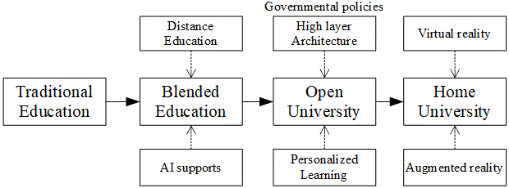
Future of education
Currently there are three supporting forms of education.
Distance education with tools as online meeting (Zoom) and LMS.
Artificial intelligence tools as ChatGPT.
Virtual reality and augmented reality.
Blended teaching is key teaching method.
Open university is an intermediate step for home university in a long journey.

Slide 4
Understanding is better than remembering
Understanding is better than remembering and therefore, understanding is the compulsory step for creative activities.
Emotional feeling is as important as understanding and therefore, it is better than remembering, which is also another compulsory step for creative activities, even though for technical innovations. You think much and carefully about a problem for a long time and so you understood such problem, but an innovative (also lucky) idea may happen in a very short time that may depend on your emotion at that time. If you do not catch it, you will miss it.
Forgetting is a powerful ability of human so that every child can develop in a unique way so as to expend human knowledge. In this viewpoint and in this speech without pulverized analysis, artificial intelligence (AI) may be an optical illusion about its preeminent intelligence over human. Even though, in the general viewpoint, the total sum of human knowledge is still larger than any machine knowledge.
Therefore, amount of knowledge to teach may be so much and examinations may not be so important, but how to measure how much to understand is a new and difficult problem. A minor solution is to encourage students to self-study.

Slide 5
A message to climate change
Love and compassion are relative to human intelligence by some way that that I still cannot understand exactly. However, of course, love and compassion are necessary to modern education because the grained viewpoint of home university may concern love and compassion not much enough. Anyhow, love and compassion are related to ability of understanding in studying. This vagueness may be illuminated by emotional effects.
Besides support of technology, educational training should include activities returning nature. As a result, the concerning of climate change is to manifest and understand love and compassion.
Therefore, by going though many prisms, technology may help education to recognize the importance of love.

Slide 6
Jigsaw (puzzle) is as good as fusing
There are many subjects/topics as well as many technologies. Because they have some implicit or explicit connections, we cannot totally separate them or put them into a big bag.
For some related subjects, we can fuse them into a unified one, which is an ideal case where their strong points are improved as much as possible, and their drawbacks are decreased as much as possible.
However, we can assemble them as jigsaw puzzle by joining many pieces into a whole picture. As a result, Jigsaw (puzzle) can be as good as fusing. In some cases, an amazing transformation may happen so that its results may go beyond our started calculations.

Slide 7
Thank you for listening and attention

