Slide 1
Technological Accessibility: Learning Platform Among Senior High School Students
ASEAN Seminar on Research and Culture
A.V.R CBSUA-Sipocot, Camarines Sur, Philippines, October 24, 2023
Professor Dr. Loc Nguyen, PhD, Postdoc
Loc Nguyen’s Academic Network, Vietnam
Email: ng_phloc@yahoo.com
Homepage: www.locnguyen.net

Slide 2


Maze and Cobweb
[Dreamstime]
[Dreamstime]
How to find out the way
How to find out the connection

Slide 3
Returning nature
God created nature and human created society. Therefore, falling in line with society “is” to return “nature” within the same semantics.
Technology is transportation means for the returning road and so, technology accessibility is method to enjoy such transportation means.
How to take advantages of technology accessibility is really life skill in the nature “society”, which is only strengthened.

Slide 4
Dilemma of technology accessibility
Technology accessibility which is life skill is only strengthened but it also causes many problems such as evil information and untruthful games for youths.
Solutions to defeat the dilemma are based on two assumptions:
God or lucky fortune bless us.
Youth spirit is pure, and purity is power.

Slide 5
Solutions to technology accessibility
Let youths develop by themselves as much as possible.
Security control tools such as web restrictions and firewall.
Encourage love and compassion via literature and art.
Some cultural pillars as core values which may be implicit.

Slide 6
Orienting early career
Following your passion because you are often good at what you are passionate for.
If there is some mistake, for example, you are not really good (or not best) at passionate job, then the life (or God) will fix it for you. Some mistake becomes your invaluable experience, or even necessary material for new successful job.
However, what happens if the life do not fix such mistake? Simply, this is your fate. Indeed, there may be hidden secrets about which it is not easy to describe in a short time, for example, it is difficult to define what is success too. Please returning pure spirit.

Slide 7
Maze and Cobweb
[Dreamstime]
[Dreamstime]
How to find out the way
How to find out the connection

Slide 8
Researching career is optional
Researching is ability of pulverizing hard problems, based deep understanding as well as prissiness.
However, pulverization is one of aspects about intelligence and so, please following your passion as well as ambition.
Energy of negative emotions like prissiness are as important as energy of positive emotions like passion. Let these emotions be ballot-papers voting for your choice/success.
Besides benefit and calculation, the emotions, which are even contrary, can contribute to the success by integrating together according to some order, especially, within a fair voting system inside your life.

Slide 9
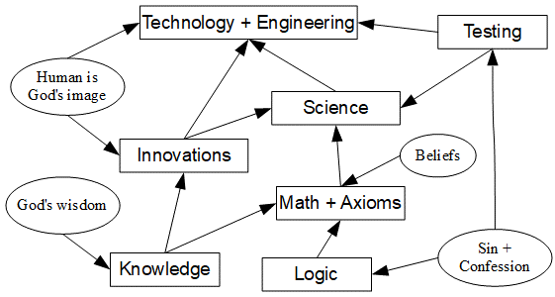
Research and Jigsaw

Slide 10
Some shared thoughts about research
Methodologies: planting, implanting, breeding, software development, chip design, etc.
Data analysis: parameter estimation and hypothesis testing.
Social researches: qualitative research, self-reflection, story telling.

Slide 11
Researching steps
Understanding carefully your topic.
Full of energy as well as passion and ambition.
Establishing a researching group.
Making a proposal about idea/hypothesis.
Discussing about implementation method.
Making research design.
Implementing your method: collecting data, creating something.
Obtaining experimental results.
Writing/review papers.

Slide 12
Research design
Think carefully about your proposed method to implement/test your idea/hypothesis.
Think about competitors.
Make decision as soon as possible.
Estimate time and cost.
Estimate profits/results.

Slide 13
Implementation: water fall or agile development
Requirement and design (linked to research design)
Implementation: building, creating, collecting data, hypothesis testing.
Testing
Deployment / Publishing
Maintenance

Slide 14
About data analysis
Selecting available data or collecting data.
Collecting data.
Estimating sample size.
Collecting sample from population (vertical or horizontal)
Preprocessing data / reading data.
Choose statistical tools such as R and SPSS to analyze data.
Obtain estimated parameters or hypothesis testing results.

Slide 15
About data analysis
Sample size is also important.
There are many statistical models which must be suitable to your research.
Understanding deeply about antithesis: if you want to prove hypothesis A, you must give the opposite null hypothesis B. If the data analysis result discard B, the A can be right.
Understanding P-value and significant level.

Slide 16
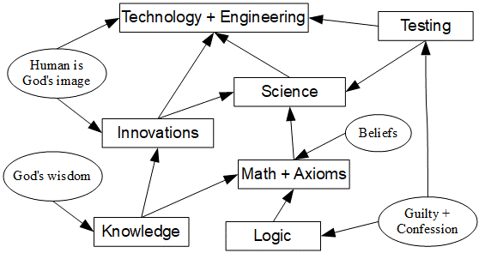
Bayesian statistics
Traditional statistics: random is focused.
Bayesian statistics: objective hypothesis and consolidation of evidence.

Slide 17
About developing software
Should follow waterfall model or agile model.
Fixing bugs frequently.
Need to use subversion storage system like Git for group working

Slide 18
IMRAD [Elsevier]
Introduction
Methodology
Results And Discussion

Slide 19
IMRAD+
Title
Abstract
Introduction
Related works
Methodology
Results And Discussion
Conclusions
References

Slide 20
Thank you for listening and attention

