Slide 1
We are angel?
Asian Multidisciplinary Research Conference 2025
“Convergence of Knowledge: Influencing the Future through Multidisciplinary Approaches”
June 14, 2025, Bangkok, Thailand
Faculty of Humanities and Social Sciences, Suan Sunandha Rajabhat University
Professor Dr. Loc Nguyen, PhD, Postdoc
Loc Nguyen’s Academic Network, Vietnam
Email: ng_phloc@yahoo.com
Homepage: www.locnguyen.net

Slide 2
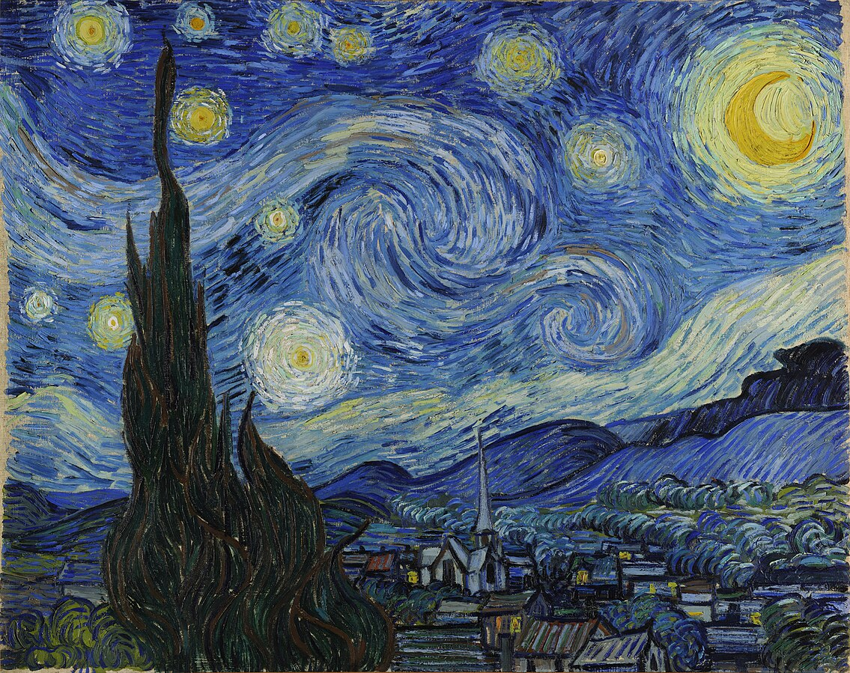
We are angel?
Vincent Willem van Gogh (1853 – 1890) began his career as a painting seller with a comfortable life. He loved painting and frequently gave good comments on pictures that he expected buyers would purchase but disappointedly they did not buy ones recommended by him. He got furious, which makes him to create excellent oil paintings as masterpieces which make descendants passionate as well as make his life destitute. In his contemporary life, his masterpieces were not highly appreciated but now are most valuable works.
He is genius and his genius may be related to his craziness and moreover he got some disease in eye which makes him seeing something in yellow and so, his paintings have often been in queer yellow. For instance, please see his masterpiece “The Starry Night” with full of fierce, passion, craziness, and mystery.
Moreover, you can see the making disturbance which is ambushed by known internal relationship, which aims to achieve another achievement.

Slide 3
We are angel?
Fermat’s Last Theorem stated around 1637 by the great mathematician Pierre de Fermat that there is no three positive integers a, b, c such that c^{n} = a^{n} + b^{n} given positive integer n larger than 2. Pierre de Fermat (1607 – 1665) is a genius as well as a nobleman with a very successful career as a judge. However, Fermat’s Last Theorem cannot be proved by Euclidean geometric construction in 350 years. Until 1994, the mathematician Andrew Wiles proved successfully Fermat’s Last Theorem by complex concepts of modern mathematics. The proof of Andrew Wiles is huge having more than 100 pages, which makes him become a great mathematician in 20th century.
Vincent Willem van Gogh, Pierre de Fermat, Abel, Mozart, etc. are inborn geniuses, some of them are lightning leaving eternal light in our sky and some of them are eternal suns in our sky with great life-works. They are pioneers and innovators who are creators and therefore, they are respected as angels. (Maybe, they are real angels because of their miracle and mysterious flashing).
However, great person like the great mathematician Andrew Wiles also contribute to create our world with the same achievements to inborn geniuses. They are really geniuses too and are trained genius, which implies that education and self-studying always deliver great human, where patience and enthusiasm are heightened.
In general, we are both human and angel. I always self-study to achieve more successes with innovative scientific works when I aim to be a creative man with full of enthusiasm. However, sometimes, I think I am an angel when I have often composed poems with the passion like Vincent Willem van Gogh did painting. Therefore, I would like to introduce you my poems in my book “Loc’s poems” in the next slide.

Slide 4
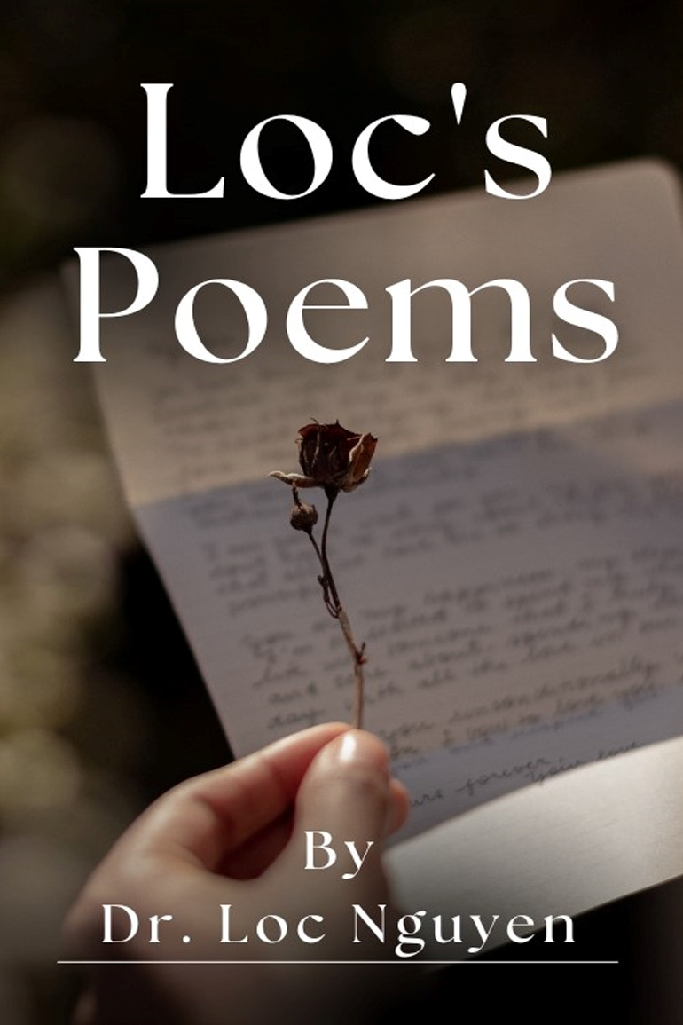
Poetic collection “Loc’s poems”
Loc’s poems – this piece of work is dedicated to God, my family and friends. Ultimately, I dedicate this collection to our beautiful life as well as great poets who are angels among mundane world.
Selected collection LOC’S POEMS (THƠ LỘC) includes native poems in Vietnamese and Chinese, created by poet Loc Nguyen (Nguyễn Phước Lộc) from 1993 to 2022. These poems are classified into 9 collections and 1 verse narrative such as “Tặng”, “Ca dao blog”, “Chưa đặt tên”, “Lại chưa đặt tên”, “华语”, “Viết tiếp thơ ơi”, “Vẽ”, “Tình”, “Diệu”, and “Lục Kiều thời @”.
My poems, which would rather lean forward melody than lean forward prosody, are half popular half academic, half elegant half vulgar, half deep half humorous, half queer half naive, half modern half ancient. There are mundane men with many careers, as well as many fairies, ghosts, heroes, nymphs in my poems. There are also tears, smiles, unreal stories, hot news and many things. I see myself in my poems and I will be very glad if catching you in my poems.

Slide 5
Dual working
The last idea I would like to share in the representation is dual working which often occurs in real world but we may ignore it. The dual working include two steps.
Firstly, some innovative person called A like artist and pioneer creates a work called w.
Secondly, another person called B analyzes and researches the work w in order to summarize or draw some knowledge / conclusion from the work w. Person B is often researcher and criticizer.
Indeed, the roles of A and B are equally important because A may not understand thoroughly her/his work w yet. Especially, the role of B is often supported by educational organizations like universities and institutes, which implies that the role of education is much more important in the age of AI and diversity.
The variant of this dual working is implementation and supervising in our world.

Slide 6
Thank you for listening

