Slide 1
A Proposal of Two-step Autoregressive Model
Prof. Dr. Loc Nguyen PhD, PostDoc
Loc Nguyen’s Academic Network, Vietnam
Email: ng_phloc@yahoo.com
Homepage: www.locnguyen.net

Slide 2
Abstract
Autoregressive (AR) model and conditional autoregressive (CAR) model are specific regressive models in which independent variables and dependent variable imply the same object. They are powerful statistical tools to predict values based on correlation of time domain and space domain, which are useful in epidemiology analysis. In this research, I combine them by the simple way in which AR and CAR is estimated in two separate steps so as to cover time domain and space domain in spatial-temporal data analysis. Moreover, I integrate logistic model into CAR model, which aims to improve competence of autoregressive models.

Slide 3
Table of contents
Two-step autoregressive model
Integrated with logistic function
Conclusions

Slide 4
1. Two-step autoregressive model
Autoregressive (AR) model evaluates new value of a variable based on its old values; in other words, independent variables called regressors and dependent variable called responsor refer to the same concerned object (CO). AR model is often used to predict new values in time series, which is called temporal autoregressive model. Conditional autoregressive (CAR) model also follows ideology of AR model where regressors and responsor imply the same CO but CAR model added more values of neighbors of CO. Therefore, CAR model is often used to predict new values in space domain, which is called spatial autoregressive model. There are some researches like (Mariella & Tarantino, 2010) to integrate AR model and CAR model but here I combine them consequently by the simple way in which AR and CAR is estimated in two separate processes. In other words, the research uses mainly autoregressive model through two steps:
Step 1: CAR model known as spatial autoregressive model is estimated to predict responsor based on its neighbors and its environmental features like humidity, precipitation, etc. As a convention, responsor is called case like disease case in epidemiology.
Step 2: AR model known as temporal autoregressive model is estimated to forecast next case based on current cases.

Slide 5
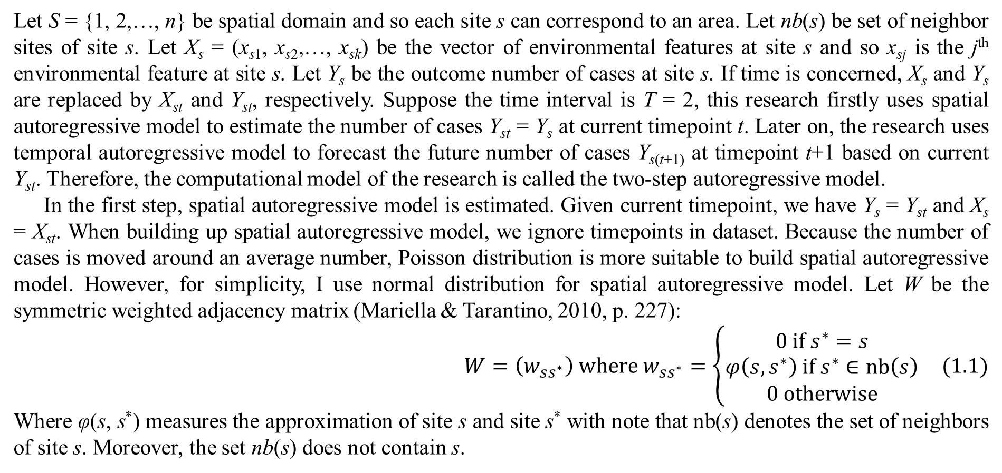
1. Two-step autoregressive model
Let S = {1, 2,…, n} be spatial domain and so each site s can correspond to an area. Let nb(s) be set of neighbor sites of site s. Let X_{s} = (x_{s1}, x_{s2},…, x_{sk}) be the vector of environmental features at site s and so x_{sj} is the j^{th} environmental feature at site s. Let Y_{s} be the outcome number of cases at site s. If time is concerned, X_{s} and Y_{s} are replaced by X_{st} and Y_{st}, respectively. Suppose the time interval is T = 2, this research firstly uses spatial autoregressive model to estimate the number of cases Y_{st} = Y_{s} at current timepoint t. Later on, the research uses temporal autoregressive model to forecast the future number of cases Y_{s(t+1)} at timepoint t+1 based on current Y_{st}. Therefore, the computational model of the research is called the two-step autoregressive model.
In the first step, spatial autoregressive model is estimated. Given current timepoint, we have Y_{s} = Y_{st} and X_{s} = X_{st}. When building up spatial autoregressive model, we ignore timepoints in dataset. Because the number of cases is moved around an average number, Poisson distribution is more suitable to build spatial autoregressive model. However, for simplicity, I use normal distribution for spatial autoregressive model. Let W be the symmetric weighted adjacency matrix (Mariella & Tarantino, 2010, p. 227):
$$W=\left(w_{ss^{∗}}\right) where w_{ss^{∗}}=\left\{\begin{matrix}0 if s^{∗}=s \\ φ\left(s,s^{∗}\right) if s^{∗}∈nb\left(s\right) \\ 0 otherwise\end{matrix}\right. (1.1)$$
Where φ(s, s*) measures the approximation of site s and site s* with note that nb(s) denotes the set of neighbors of site s. Moreover, the set nb(s) does not contain s.

Slide 6
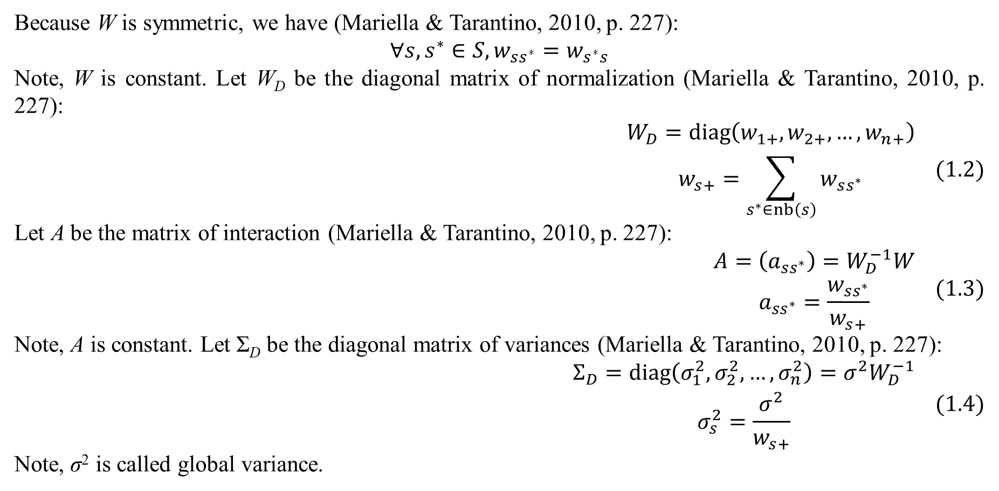
1. Two-step autoregressive model
Because W is symmetric, we have (Mariella & Tarantino, 2010, p. 227):
$$∀s,s^{∗}∈S,w_{ss^{∗}}=w_{s^{∗}s}$$
Note, W is constant. Let W_{D} be the diagonal matrix of normalization (Mariella & Tarantino, 2010, p. 227):
$$\begin{matrix}W_{D}=diag\left(w_{1+},w_{2+},…,w_{n+}\right) \\ w_{s+}=\sum_{s^{∗}∈nb\left(s\right)}{w_{ss^{∗}}}\end{matrix} (1.2)$$
Let A be the matrix of interaction (Mariella & Tarantino, 2010, p. 227):
$$\begin{matrix}A=\left(a_{ss^{∗}}\right)=W_{D}^{−1}W \\ a_{ss^{∗}}=\frac{w_{ss^{∗}}}{w_{s+}}\end{matrix} (1.3)$$
Note, A is constant. Let Σ_{D} be the diagonal matrix of variances (Mariella & Tarantino, 2010, p. 227):
$$\begin{matrix}Σ_{D}=diag\left(σ_{1}^{2},σ_{2}^{2},…,σ_{n}^{2}\right)=σ^{2}W_{D}^{−1} \\ σ_{s}^{2}=\frac{σ^{2}}{w_{s+}}\end{matrix} (1.4)$$
Note, σ² is called global variance.

Slide 7
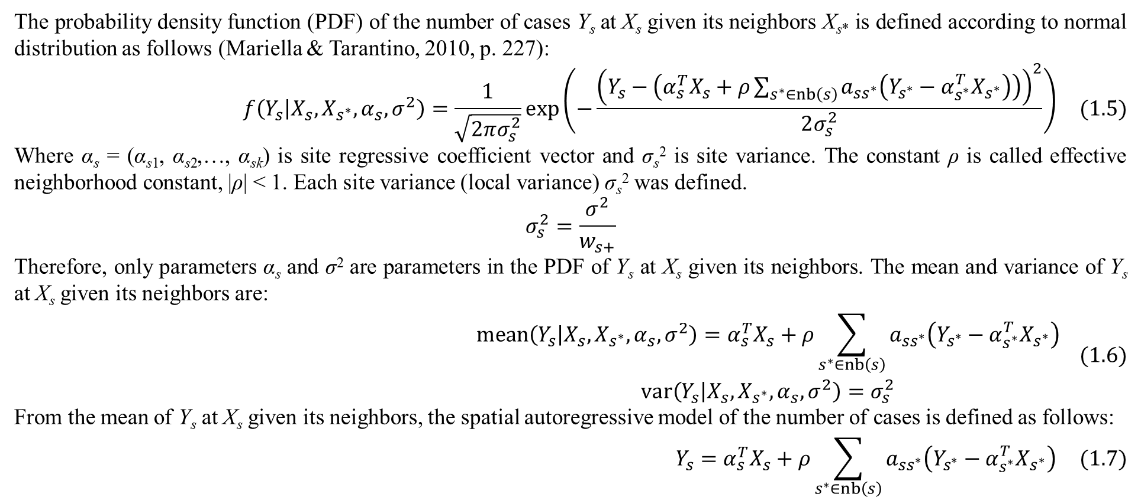
1. Two-step autoregressive model
The probability density function (PDF) of the number of cases Y_{s} at X_{s} given its neighbors X_{s*} is defined according to normal distribution as follows (Mariella & Tarantino, 2010, p. 227):
$$f\left(Y_{s} | X_{s},X_{s^{∗}},α_{s},σ^{2}\right)=\frac{1}{\sqrt{2πσ_{s}^{2}}}exp\left(−\frac{{\left(Y_{s}−\left(α_{s}^{T}X_{s}+ρ\sum_{s^{∗}∈nb\left(s\right)}{a_{ss^{∗}}\left(Y_{s^{∗}}−α_{s^{∗}}^{T}X_{s^{∗}}\right)}\right)\right)}^{2}}{2σ_{s}^{2}}\right) (1.5)$$
Where α_{s} = (α_{s1}, α_{s2},…, α_{sk}) is site regressive coefficient vector and σ_{s}² is site variance. The constant ρ is called effective neighborhood constant, |ρ| < 1. Each site variance (local variance) σ_{s}² was defined.
$$σ_{s}^{2}=\frac{σ^{2}}{w_{s+}}$$
Therefore, only parameters α_{s} and σ² are parameters in the PDF of Y_{s} at X_{s} given its neighbors. The mean and variance of Y_{s} at X_{s} given its neighbors are:
$$\begin{matrix}mean\left(Y_{s} | X_{s},X_{s^{∗}},α_{s},σ^{2}\right)=α_{s}^{T}X_{s}+ρ\sum_{s^{∗}∈nb\left(s\right)}{a_{ss^{∗}}\left(Y_{s^{∗}}−α_{s^{∗}}^{T}X_{s^{∗}}\right)} \\ var\left(Y_{s} | X_{s},X_{s^{∗}},α_{s},σ^{2}\right)=σ_{s}^{2}\end{matrix} (1.6)$$
From the mean of Y_{s} at X_{s} given its neighbors, the spatial autoregressive model of the number of cases is defined as follows:
$$Y_{s}=α_{s}^{T}X_{s}+ρ\sum_{s^{∗}∈nb\left(s\right)}{a_{ss^{∗}}\left(Y_{s^{∗}}−α_{s^{∗}}^{T}X_{s^{∗}}\right)} (1.7)$$

Slide 8
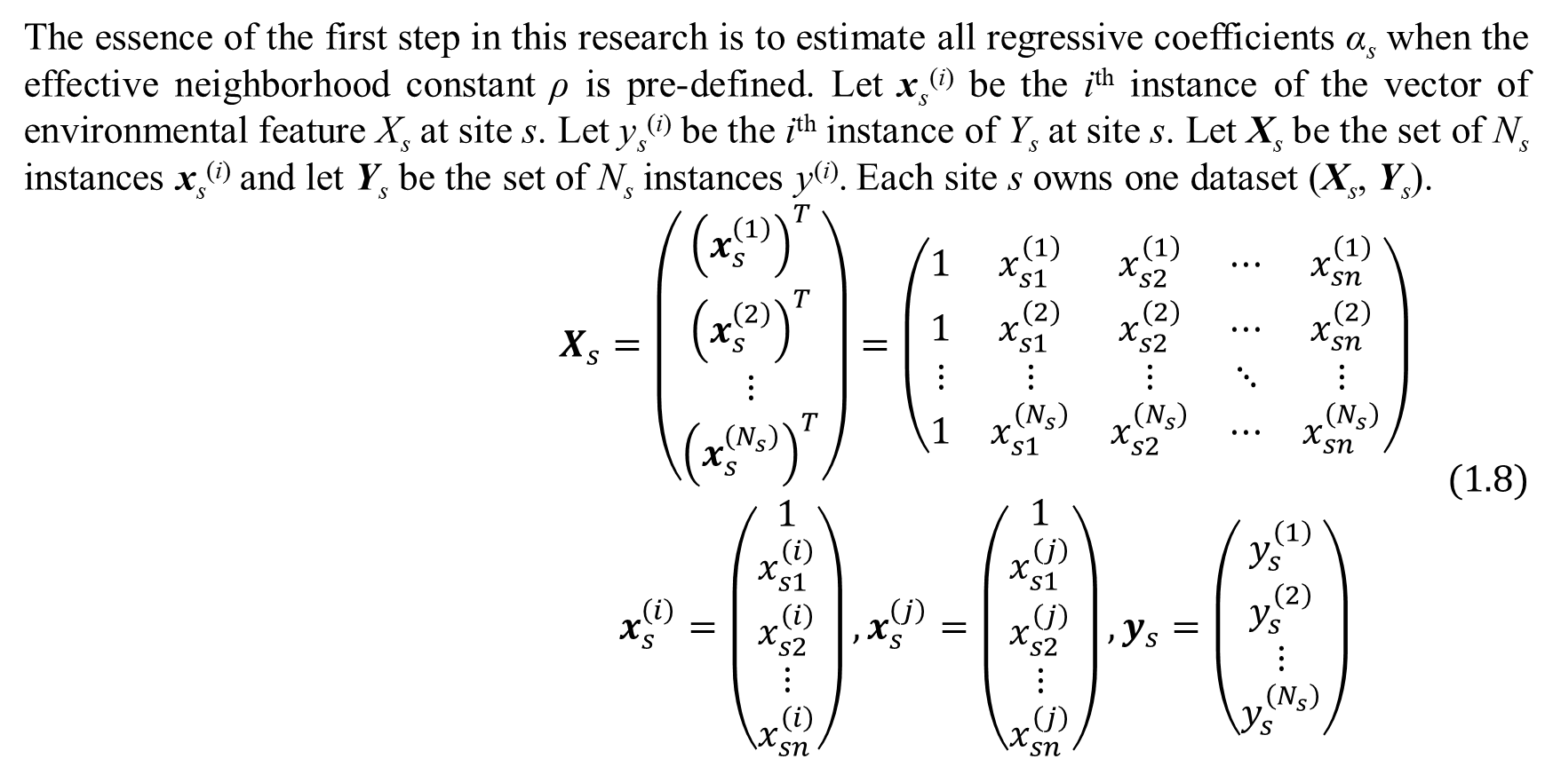
1. Two-step autoregressive model
The essence of the first step in this research is to estimate all regressive coefficients α_{s} when the effective neighborhood constant ρ is pre-defined. Let x_{s}^{(i)} be the i^{th} instance of the vector of environmental feature X_{s} at site s. Let y_{s}^{(i)} be the i^{th} instance of Y_{s} at site s. Let X_{s} be the set of N_{s} instances x_{s}^{(i)} and let Y_{s} be the set of N_{s} instances y^{(i)}. Each site s owns one dataset (X_{s}, Y_{s}).
$$\begin{matrix}X_{s}=\left(\begin{matrix}{\left(x_{s}^{\left(1\right)}\right)}^{T} \\ {\left(x_{s}^{\left(2\right)}\right)}^{T} \\ ⋮ \\ {\left(x_{s}^{\left(N_{s}\right)}\right)}^{T}\end{matrix}\right)=\left(\begin{matrix}1 & x_{s1}^{\left(1\right)} & x_{s2}^{\left(1\right)} & ⋯ & x_{sn}^{\left(1\right)} \\ 1 & x_{s1}^{\left(2\right)} & x_{s2}^{\left(2\right)} & ⋯ & x_{sn}^{\left(2\right)} \\ ⋮ & ⋮ & ⋮ & ⋱ & ⋮ \\ 1 & x_{s1}^{\left(N_{s}\right)} & x_{s2}^{\left(N_{s}\right)} & ⋯ & x_{sn}^{\left(N_{s}\right)}\end{matrix}\right) \\ x_{s}^{\left(i\right)}=\left(\begin{matrix}1 \\ x_{s1}^{\left(i\right)} \\ x_{s2}^{\left(i\right)} \\ ⋮ \\ x_{sn}^{\left(i\right)}\end{matrix}\right),x_{s}^{\left(j\right)}=\left(\begin{matrix}1 \\ x_{s1}^{\left(j\right)} \\ x_{s2}^{\left(j\right)} \\ ⋮ \\ x_{sn}^{\left(j\right)}\end{matrix}\right),y_{s}=\left(\begin{matrix}y_{s}^{\left(1\right)} \\ y_{s}^{\left(2\right)} \\ ⋮ \\ y_{s}^{\left(N_{s}\right)}\end{matrix}\right)\end{matrix} (1.8)$$

Slide 9
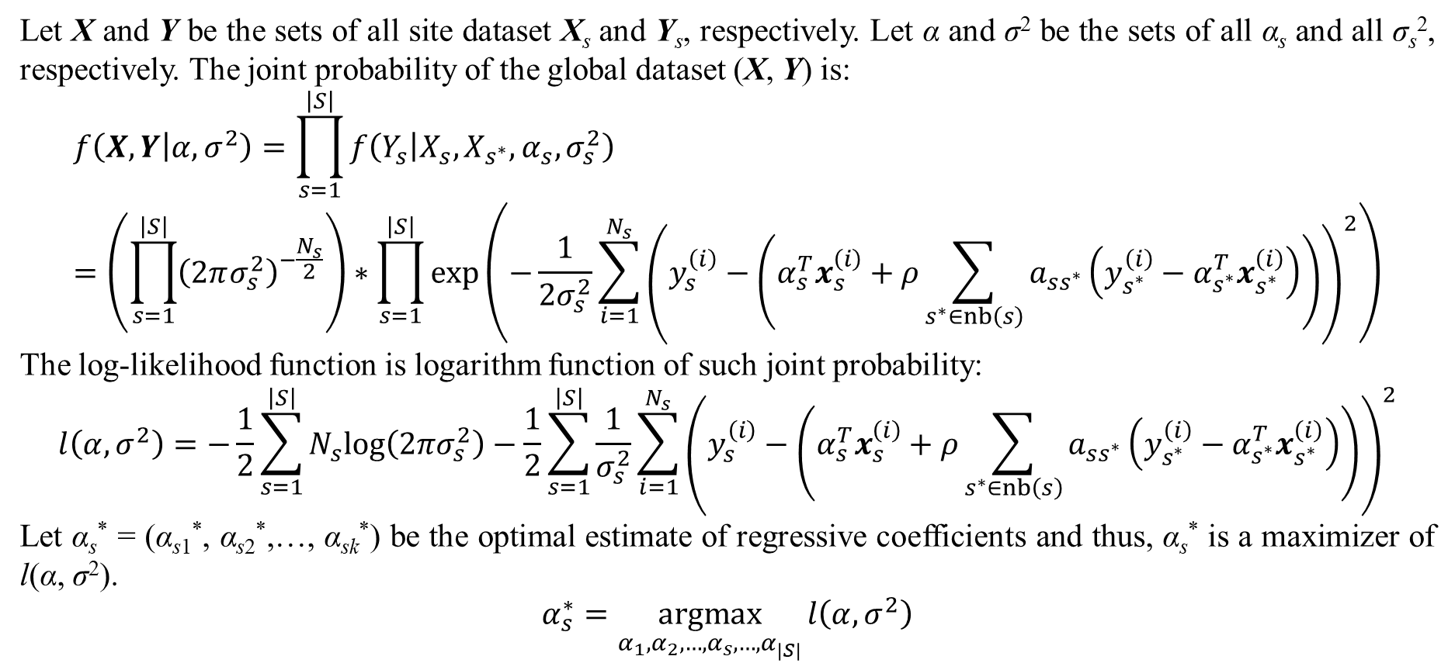
1. Two-step autoregressive model
Let X and Y be the sets of all site dataset X_{s} and Y_{s}, respectively. Let α and σ² be the sets of all α_{s} and all σ_{s}², respectively. The joint probability of the global dataset (X, Y) is:
$$f\left(X,Y | α,σ^{2}\right)=\prod_{s=1}^{\left|S\right|}{f\left(Y_{s} | X_{s},X_{s^{∗}},α_{s},σ_{s}^{2}\right)}=\left(\prod_{s=1}^{\left|S\right|}{{\left(2πσ_{s}^{2}\right)}^{−\frac{N_{s}}{2}}}\right)∗\prod_{s=1}^{\left|S\right|}{exp\left(−\frac{1}{2σ_{s}^{2}}\sum_{i=1}^{N_{s}}{{\left(y_{s}^{\left(i\right)}−\left(α_{s}^{T}x_{s}^{\left(i\right)}+ρ\sum_{s^{∗}∈nb\left(s\right)}{a_{ss^{∗}}\left(y_{s^{∗}}^{\left(i\right)}−α_{s^{∗}}^{T}x_{s^{∗}}^{\left(i\right)}\right)}\right)\right)}^{2}}\right)}$$
The log-likelihood function is logarithm function of such joint probability:
$$l\left(α,σ^{2}\right)=−\frac{1}{2}\sum_{s=1}^{\left|S\right|}{N_{s}log\left(2πσ_{s}^{2}\right)}−\frac{1}{2}\sum_{s=1}^{\left|S\right|}{\frac{1}{σ_{s}^{2}}\sum_{i=1}^{N_{s}}{{\left(y_{s}^{\left(i\right)}−\left(α_{s}^{T}x_{s}^{\left(i\right)}+ρ\sum_{s^{∗}∈nb\left(s\right)}{a_{ss^{∗}}\left(y_{s^{∗}}^{\left(i\right)}−α_{s^{∗}}^{T}x_{s^{∗}}^{\left(i\right)}\right)}\right)\right)}^{2}}}$$
Let α_{s}* = (α_{s1}*, α_{s2}*,…, α_{sk}*) be the optimal estimate of regressive coefficients and thus, α_{s}* is a maximizer of l(α, σ²).
$$α_{s}^{∗}=\underset{α_{1},α_{2},…,α_{s},…,α_{\left|S\right|}}{argmax}{l\left(α,σ^{2}\right)}$$

Slide 10
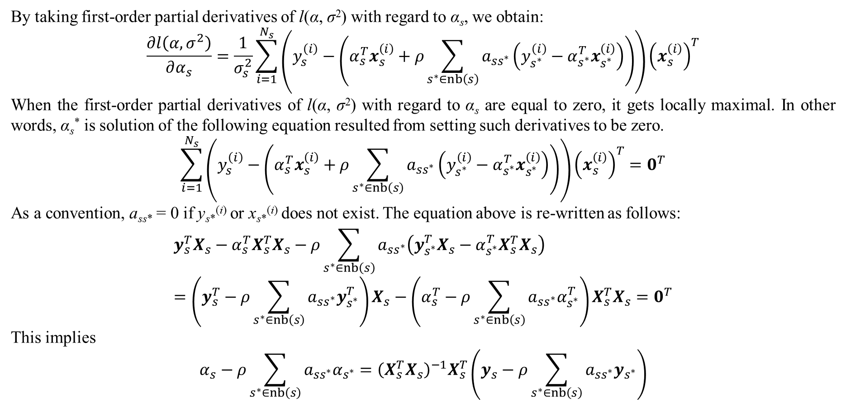
1. Two-step autoregressive model
By taking first-order partial derivatives of l(α, σ²) with regard to α_{s}, we obtain:
$$\frac{∂l\left(α,σ^{2}\right)}{∂α_{s}}=\frac{1}{σ_{s}^{2}}\sum_{i=1}^{N_{s}}{\left(y_{s}^{\left(i\right)}−\left(α_{s}^{T}x_{s}^{\left(i\right)}+ρ\sum_{s^{∗}∈nb\left(s\right)}{a_{ss^{∗}}\left(y_{s^{∗}}^{\left(i\right)}−α_{s^{∗}}^{T}x_{s^{∗}}^{\left(i\right)}\right)}\right)\right){\left(x_{s}^{\left(i\right)}\right)}^{T}}$$
When the first-order partial derivatives of l(α, σ²) with regard to α_{s} are equal to zero, it gets locally maximal. In other words, α_{s}* is solution of the following equation resulted from setting such derivatives to be zero.
$$\sum_{i=1}^{N_{s}}{\left(y_{s}^{\left(i\right)}−\left(α_{s}^{T}x_{s}^{\left(i\right)}+ρ\sum_{s^{∗}∈nb\left(s\right)}{a_{ss^{∗}}\left(y_{s^{∗}}^{\left(i\right)}−α_{s^{∗}}^{T}x_{s^{∗}}^{\left(i\right)}\right)}\right)\right){\left(x_{s}^{\left(i\right)}\right)}^{T}}=0^{T}$$
As a convention, a_{ss*} = 0 if y_{s*}^{(i)} or x_{s*}^{(i)} does not exist. The equation above is re-written as follows:
$$y_{s}^{T}X_{s}−α_{s}^{T}X_{s}^{T}X_{s}−ρ\sum_{s^{∗}∈nb\left(s\right)}{a_{ss^{∗}}\left(y_{s^{∗}}^{T}X_{s}−α_{s^{∗}}^{T}X_{s}^{T}X_{s}\right)}=\left(y_{s}^{T}−ρ\sum_{s^{∗}∈nb\left(s\right)}{a_{ss^{∗}}y_{s^{∗}}^{T}}\right)X_{s}−\left(α_{s}^{T}−ρ\sum_{s^{∗}∈nb\left(s\right)}{a_{ss^{∗}}α_{s^{∗}}^{T}}\right)X_{s}^{T}X_{s}=0^{T}$$
This implies
$$α_{s}−ρ\sum_{s^{∗}∈nb\left(s\right)}{a_{ss^{∗}}α_{s^{∗}}}={\left(X_{s}^{T}X_{s}\right)}^{−1}X_{s}^{T}\left(y_{s}−ρ\sum_{s^{∗}∈nb\left(s\right)}{a_{ss^{∗}}y_{s^{∗}}}\right)$$

Slide 11
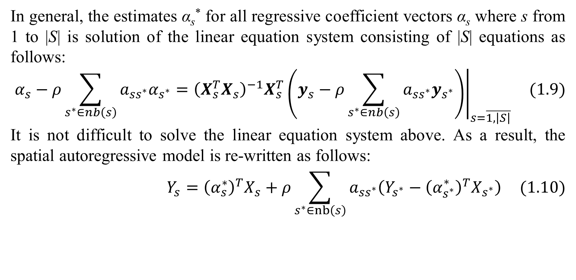
1. Two-step autoregressive model
In general, the estimates α_{s}* for all regressive coefficient vectors α_{s} where s from 1 to |S| is solution of the linear equation system consisting of |S| equations as follows:
$${\left.α_{s}−ρ\sum_{s^{∗}∈nb\left(s\right)}{a_{ss^{∗}}α_{s^{∗}}}={\left(X_{s}^{T}X_{s}\right)}^{−1}X_{s}^{T}\left(y_{s}−ρ\sum_{s^{∗}∈nb\left(s\right)}{a_{ss^{∗}}y_{s^{∗}}}\right)\right|}_{s=\overline{1,\left|S\right|}} (1.9)$$
It is not difficult to solve the linear equation system above. As a result, the spatial autoregressive model is re-written as follows:
$$Y_{s}={\left(α_{s}^{∗}\right)}^{T}X_{s}+ρ\sum_{s^{∗}∈nb\left(s\right)}{a_{ss^{∗}}\left(Y_{s^{∗}}−{\left(α_{s^{∗}}^{∗}\right)}^{T}X_{s^{∗}}\right)} (1.10)$$

Slide 12
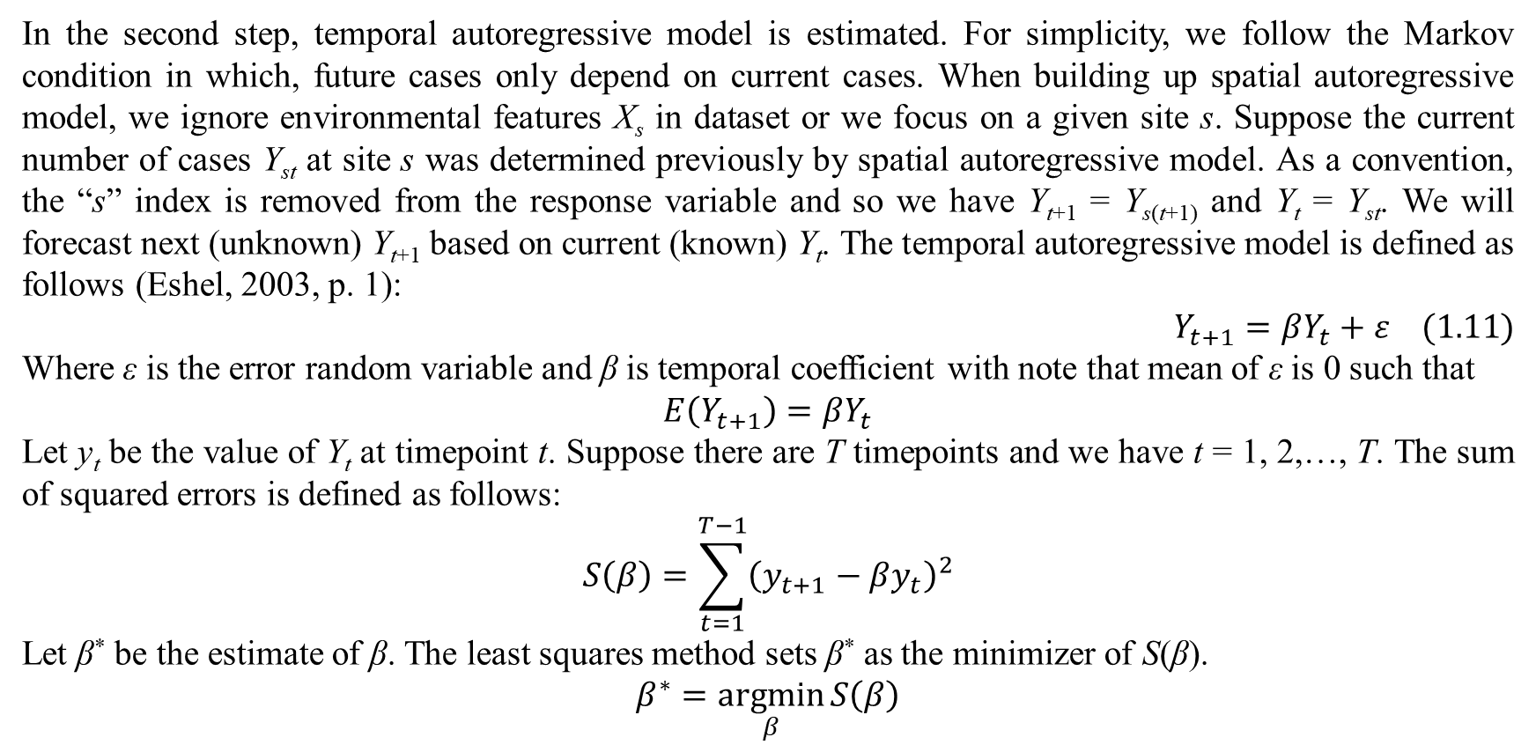
1. Two-step autoregressive model
In the second step, temporal autoregressive model is estimated. For simplicity, we follow the Markov condition in which, future cases only depend on current cases. When building up spatial autoregressive model, we ignore environmental features X_{s} in dataset or we focus on a given site s. Suppose the current number of cases Y_{st} at site s was determined previously by spatial autoregressive model. As a convention, the “s” index is removed from the response variable and so we have Y_{t+1} = Y_{s(t+1)} and Y_{t} = Y_{st}. We will forecast next (unknown) Y_{t+1} based on current (known) Y_{t}. The temporal autoregressive model is defined as follows (Eshel, 2003, p. 1):
$$Y_{t+1}=βY_{t}+ε (1.11)$$
Where ε is the error random variable and β is temporal coefficient with note that mean of ε is 0 such that
$$E\left(Y_{t+1}\right)=βY_{t}$$
Let y_{t} be the value of Y_{t} at timepoint t. Suppose there are T timepoints and we have t = 1, 2,…, T. The sum of squared errors is defined as follows:
$$S\left(β\right)=\sum_{t=1}^{T−1}{{\left(y_{t+1}−βy_{t}\right)}^{2}}$$
Let β* be the estimate of β. The least squares method sets β* as the minimizer of S(β).
$$β^{∗}=\underset{β}{argmin}{S\left(β\right)}$$

Slide 13
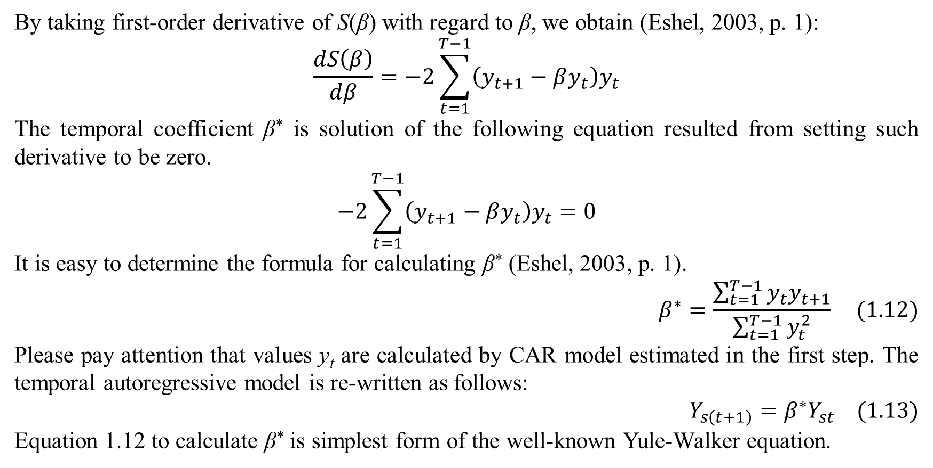
1. Two-step autoregressive model
By taking first-order derivative of S(β) with regard to β, we obtain (Eshel, 2003, p. 1):
$$\frac{dS\left(β\right)}{dβ}=−2\sum_{t=1}^{T−1}{\left(y_{t+1}−βy_{t}\right)y_{t}}$$
The temporal coefficient β* is solution of the following equation resulted from setting such derivative to be zero.
$$−2\sum_{t=1}^{T−1}{\left(y_{t+1}−βy_{t}\right)y_{t}}=0$$
It is easy to determine the formula for calculating β* (Eshel, 2003, p. 1).
$$β^{∗}=\frac{\sum_{t=1}^{T−1}{y_{t}y_{t+1}}}{\sum_{t=1}^{T−1}{y_{t}^{2}}} (1.12)$$
Please pay attention that values y_{t} are calculated by CAR model estimated in the first step. The temporal autoregressive model is re-written as follows:
$$Y_{s\left(t+1\right)}=β^{∗}Y_{st} (1.13)$$
Equation 1.12 to calculate β* is simplest form of the well-known Yule-Walker equation.

Slide 14
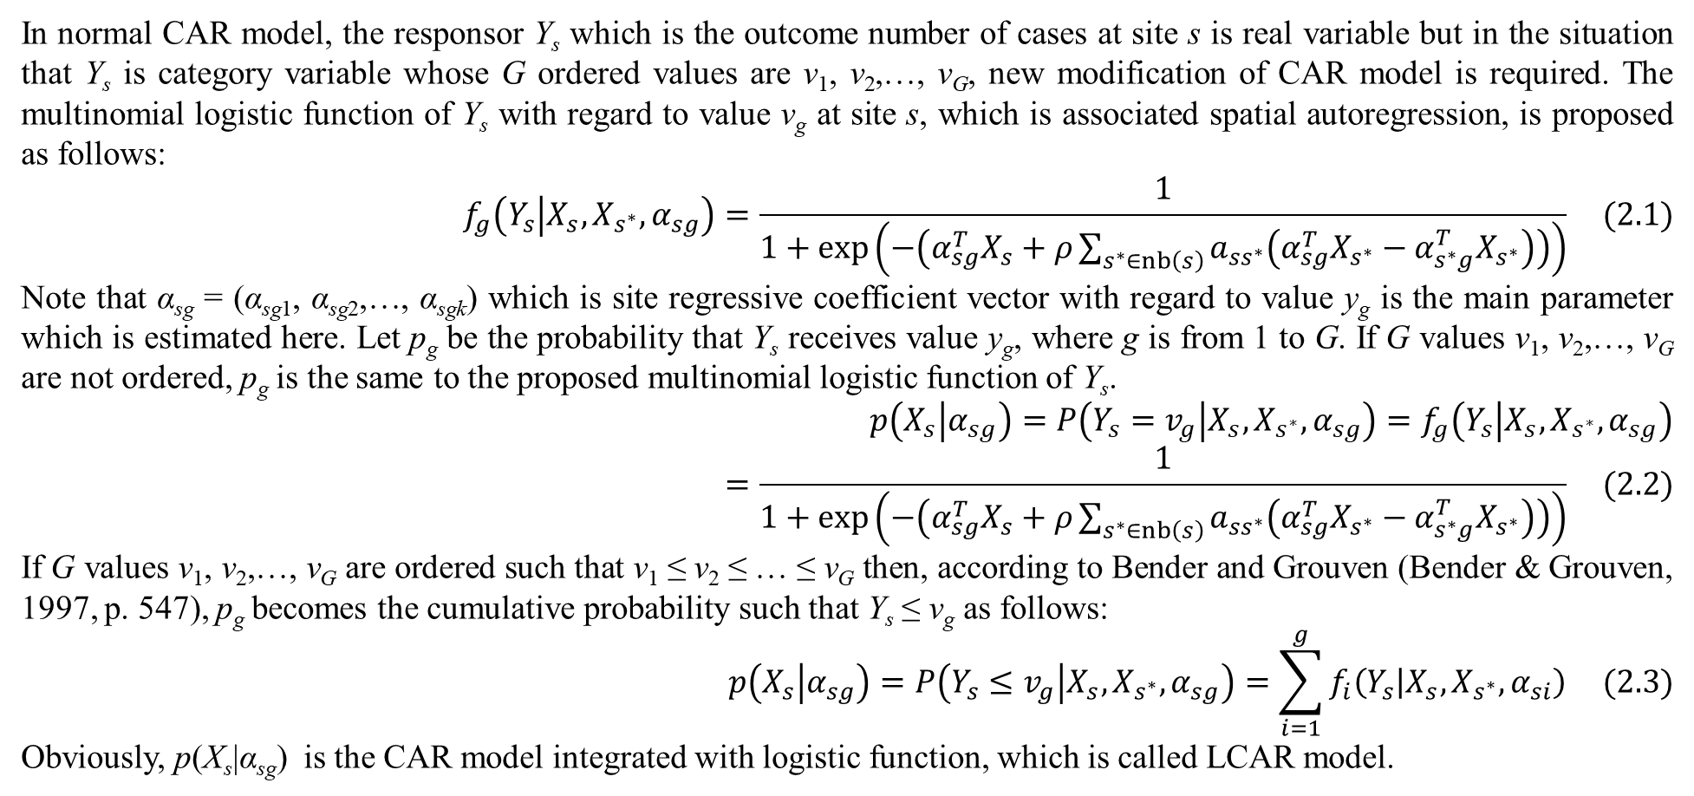
2. Integrated with logistic function
In normal CAR model, the responsor Y_{s} which is the outcome number of cases at site s is real variable but in the situation that Y_{s} is category variable whose G ordered values are v₁, v₂,…, v_{G}, new modification of CAR model is required. The multinomial logistic function of Y_{s} with regard to value v_{g} at site s, which is associated spatial autoregression, is proposed as follows:
$$f_{g}\left(Y_{s} | X_{s},X_{s^{∗}},α_{sg}\right)=\frac{1}{1+exp\left(−\left(α_{sg}^{T}X_{s}+ρ\sum_{s^{∗}∈nb\left(s\right)}{a_{ss^{∗}}\left(α_{sg}^{T}X_{s^{∗}}−α_{s^{∗}g}^{T}X_{s^{∗}}\right)}\right)\right)} (2.1)$$
Note that α_{sg} = (α_{sg1}, α_{sg2},…, α_{sgk}) which is site regressive coefficient vector with regard to value y_{g} is the main parameter which is estimated here. Let p_{g} be the probability that Y_{s} receives value y_{g}, where g is from 1 to G. If G values v₁, v₂,…, v_{G} are not ordered, p_{g} is the same to the proposed multinomial logistic function of Y_{s}.
$$p\left(X_{s} | α_{sg}\right)=P\left(Y_{s}=v_{g} | X_{s},X_{s^{∗}},α_{sg}\right)=f_{g}\left(Y_{s} | X_{s},X_{s^{∗}},α_{sg}\right)=\frac{1}{1+exp\left(−\left(α_{sg}^{T}X_{s}+ρ\sum_{s^{∗}∈nb\left(s\right)}{a_{ss^{∗}}\left(α_{sg}^{T}X_{s^{∗}}−α_{s^{∗}g}^{T}X_{s^{∗}}\right)}\right)\right)} (2.2)$$
If G values v₁, v₂,…, v_{G} are ordered such that v₁ ≤ v₂ ≤ … ≤ v_{G} then, according to Bender and Grouven (Bender & Grouven, 1997, p. 547), p_{g} becomes the cumulative probability such that Y_{s} ≤ v_{g} as follows:
$$p\left(X_{s} | α_{sg}\right)=P\left(Y_{s}≤v_{g} | X_{s},X_{s^{∗}},α_{sg}\right)=\sum_{i=1}^{g}{f_{i}\left(Y_{s} | X_{s},X_{s^{∗}},α_{si}\right)} (2.3)$$
Obviously, p(X_{s}|α_{sg}) is the CAR model integrated with logistic function, which is called LCAR model.

Slide 15
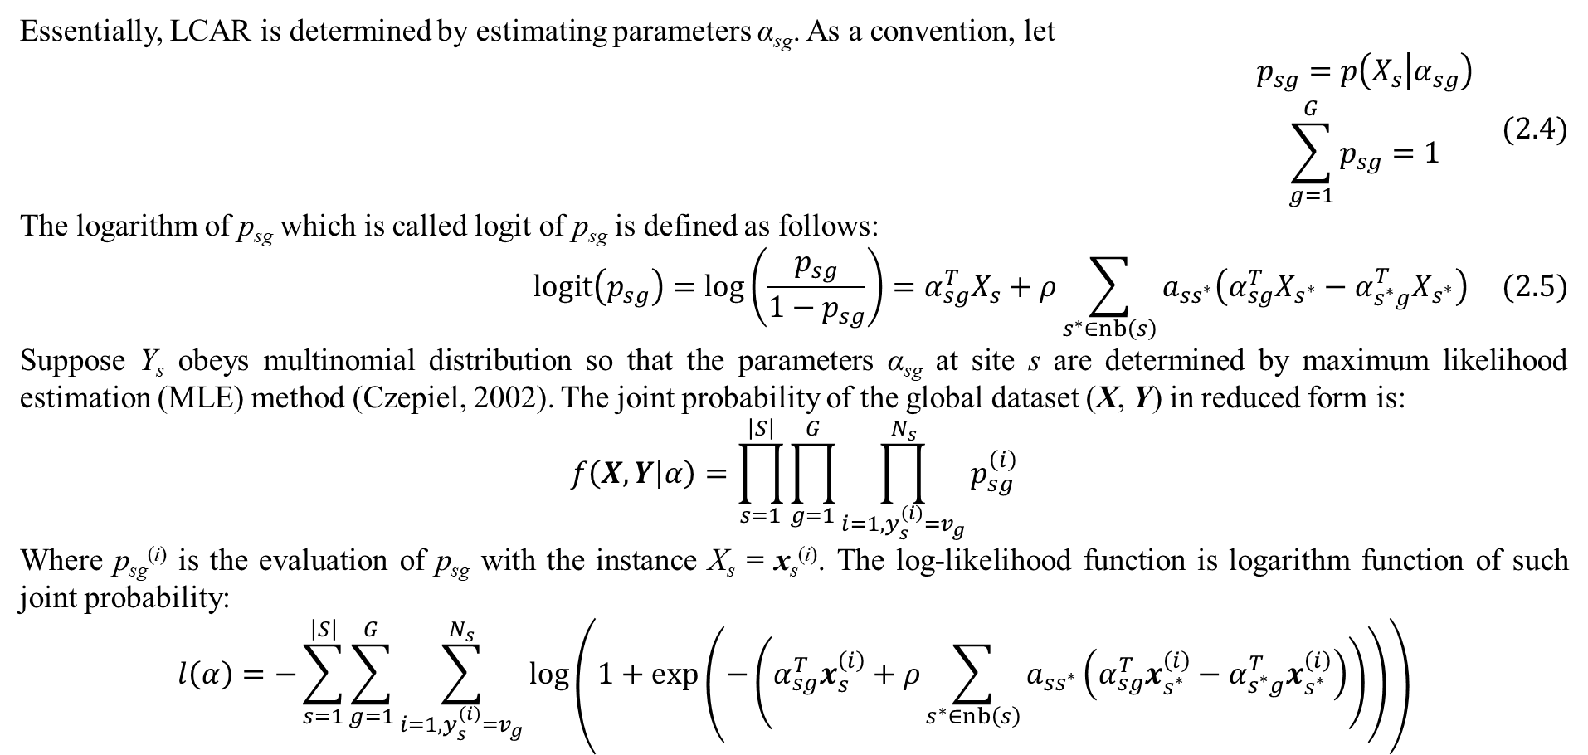
2. Integrated with logistic function
Essentially, LCAR is determined by estimating parameters α_{sg}. As a convention, let
$$\begin{matrix}p_{sg}=p\left(X_{s} | α_{sg}\right) \\ \sum_{g=1}^{G}{p_{sg}}=1\end{matrix} (2.4)$$
The logarithm of p_{sg} which is called logit of p_{sg} is defined as follows:
$$logit\left(p_{sg}\right)=log\left(\frac{p_{sg}}{1−p_{sg}}\right)=α_{sg}^{T}X_{s}+ρ\sum_{s^{∗}∈nb\left(s\right)}{a_{ss^{∗}}\left(α_{sg}^{T}X_{s^{∗}}−α_{s^{∗}g}^{T}X_{s^{∗}}\right)} (2.5)$$
Suppose Y_{s} obeys multinomial distribution so that the parameters α_{sg} at site s are determined by maximum likelihood estimation (MLE) method (Czepiel, 2002). The joint probability of the global dataset (X, Y) in reduced form is:
$$f\left(X,Y | α\right)=\prod_{s=1}^{\left|S\right|}{\prod_{g=1}^{G}{\prod_{i=1,y_{s}^{\left(i\right)}=v_{g}}^{N_{s}}{p_{sg}^{\left(i\right)}}}}$$
Where p_{sg}^{(i)} is the evaluation of p_{sg} with the instance X_{s} = x_{s}^{(i)}. The log-likelihood function is logarithm function of such joint probability:
$$l\left(α\right)=−\sum_{s=1}^{\left|S\right|}{\sum_{g=1}^{G}{\sum_{i=1,y_{s}^{\left(i\right)}=v_{g}}^{N_{s}}{log\left(1+exp\left(−\left(α_{sg}^{T}x_{s}^{\left(i\right)}+ρ\sum_{s^{∗}∈nb\left(s\right)}{a_{ss^{∗}}\left(α_{sg}^{T}x_{s^{∗}}^{\left(i\right)}−α_{s^{∗}g}^{T}x_{s^{∗}}^{\left(i\right)}\right)}\right)\right)\right)}}}$$

Slide 16
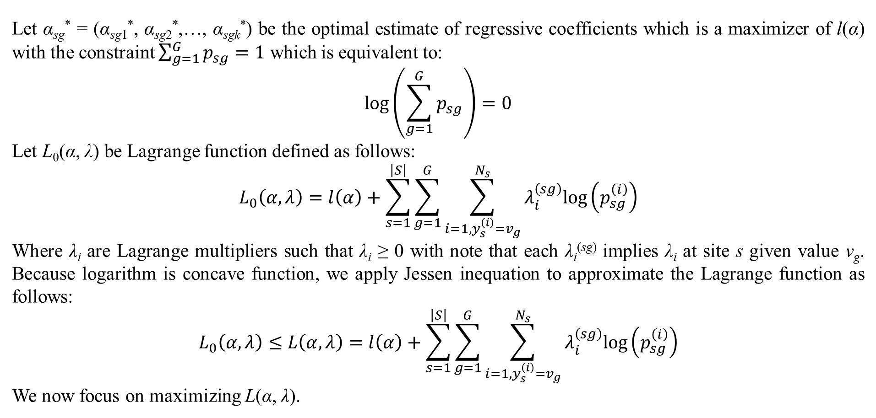
2. Integrated with logistic function
Let α_{sg}* = (α_{sg1}*, α_{sg2}*,…, α_{sgk}*) be the optimal estimate of regressive coefficients which is a maximizer of l(α) with the constraint $\sum_{g=1}^{G}{p_{sg}}=1$ which is equivalent to:
$$log\left(\sum_{g=1}^{G}{p_{sg}}\right)=0$$
Let L₀(α, λ) be Lagrange function defined as follows:
$$L_{0}\left(α,λ\right)=l\left(α\right)+\sum_{s=1}^{\left|S\right|}{\sum_{g=1}^{G}{\sum_{i=1,y_{s}^{\left(i\right)}=v_{g}}^{N_{s}}{λ_{i}^{\left(sg\right)}log\left(p_{sg}^{\left(i\right)}\right)}}}$$
Where λ_{i} are Lagrange multipliers such that λ_{i} ≥ 0 with note that each λ_{i}^{(sg)} implies λ_{i} at site s given value v_{g}. Because logarithm is concave function, we apply Jessen inequation to approximate the Lagrange function as follows:
$$L_{0}\left(α,λ\right)≤L\left(α,λ\right)=l\left(α\right)+\sum_{s=1}^{\left|S\right|}{\sum_{g=1}^{G}{\sum_{i=1,y_{s}^{\left(i\right)}=v_{g}}^{N_{s}}{λ_{i}^{\left(sg\right)}log\left(p_{sg}^{\left(i\right)}\right)}}}$$
We now focus on maximizing L(α, λ).

Slide 17
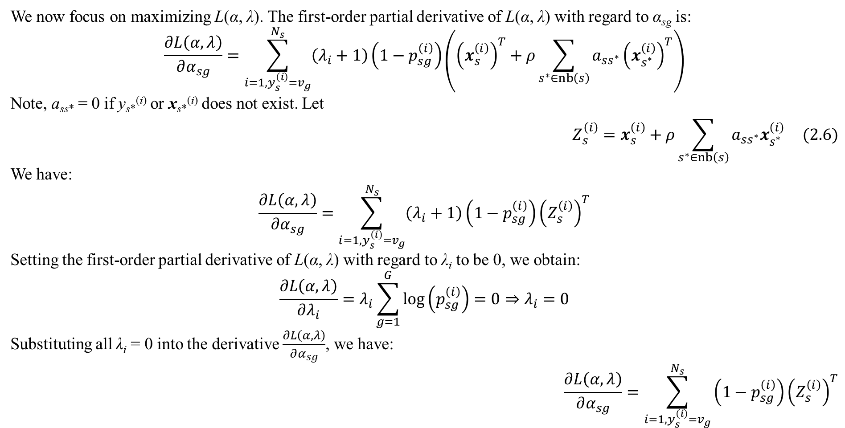
2. Integrated with logistic function
We now focus on maximizing L(α, λ). The first-order partial derivative of L(α, λ) with regard to α_{sg} is:
$$\frac{∂L\left(α,λ\right)}{∂α_{sg}}=\sum_{i=1,y_{s}^{\left(i\right)}=v_{g}}^{N_{s}}{\left(λ_{i}+1\right)\left(1−p_{sg}^{\left(i\right)}\right)\left({\left(x_{s}^{\left(i\right)}\right)}^{T}+ρ\sum_{s^{∗}∈nb\left(s\right)}{a_{ss^{∗}}{\left(x_{s^{∗}}^{\left(i\right)}\right)}^{T}}\right)}$$
Note, a_{ss*} = 0 if y_{s*}^{(i)} or x_{s*}^{(i)} does not exist. Let
$$Z_{s}^{\left(i\right)}=x_{s}^{\left(i\right)}+ρ\sum_{s^{∗}∈nb\left(s\right)}{a_{ss^{∗}}x_{s^{∗}}^{\left(i\right)}} (2.6)$$
We have:
$$\frac{∂L\left(α,λ\right)}{∂α_{sg}}=\sum_{i=1,y_{s}^{\left(i\right)}=v_{g}}^{N_{s}}{\left(λ_{i}+1\right)\left(1−p_{sg}^{\left(i\right)}\right){\left(Z_{s}^{\left(i\right)}\right)}^{T}}$$
Setting the first-order partial derivative of L(α, λ) with regard to λ_{i} to be 0, we obtain:
$$\frac{∂L\left(α,λ\right)}{∂λ_{i}}=λ_{i}\sum_{g=1}^{G}{log\left(p_{sg}^{\left(i\right)}\right)}=0⇒λ_{i}=0$$
Substituting all λ_{i} = 0 into the derivative $\frac{∂L\left(α,λ\right)}{∂α_{sg}}$, we have:
$$\frac{∂L\left(α,λ\right)}{∂α_{sg}}=\sum_{i=1,y_{s}^{\left(i\right)}=v_{g}}^{N_{s}}{\left(1−p_{sg}^{\left(i\right)}\right){\left(Z_{s}^{\left(i\right)}\right)}^{T}}$$

Slide 18
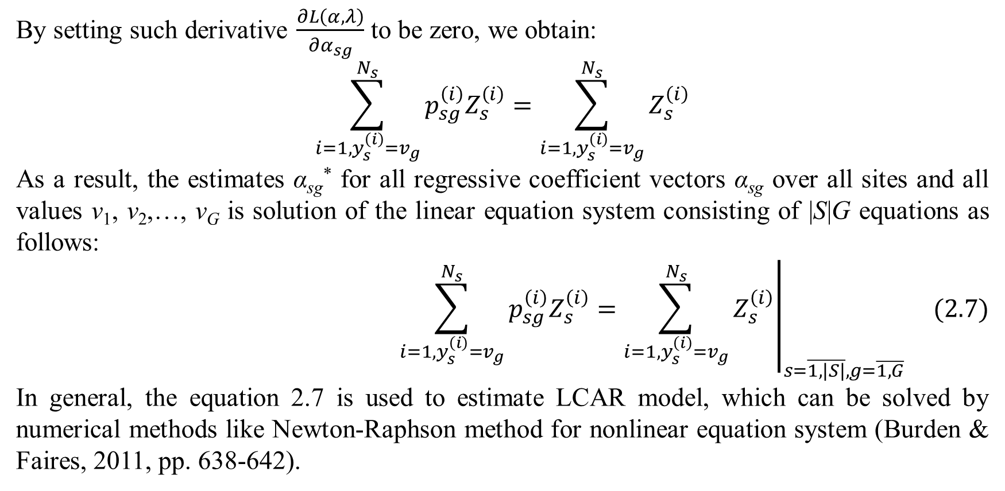
2. Integrated with logistic function
By setting such derivative $\frac{∂L\left(α,λ\right)}{∂α_{sg}}$ to be zero, we obtain:
$$\sum_{i=1,y_{s}^{\left(i\right)}=v_{g}}^{N_{s}}{p_{sg}^{\left(i\right)}Z_{s}^{\left(i\right)}}=\sum_{i=1,y_{s}^{\left(i\right)}=v_{g}}^{N_{s}}{Z_{s}^{\left(i\right)}}$$
As a result, the estimates α_{sg}* for all regressive coefficient vectors α_{sg} over all sites and all values v₁, v₂,…, v_{G} is solution of the linear equation system consisting of |S|G equations as follows:
$${\left.\sum_{i=1,y_{s}^{\left(i\right)}=v_{g}}^{N_{s}}{p_{sg}^{\left(i\right)}Z_{s}^{\left(i\right)}}=\sum_{i=1,y_{s}^{\left(i\right)}=v_{g}}^{N_{s}}{Z_{s}^{\left(i\right)}}\right|}_{s=\overline{1,\left|S\right|},g=\overline{1,G}} (2.7)$$
In general, the equation 2.7 is used to estimate LCAR model, which can be solved by numerical methods like Newton-Raphson method for nonlinear equation system (Burden & Faires, 2011, pp. 638-642).

Slide 19
3. Conclusions
In this research, I proposed a simple integration model for spatial-temporal autoregression which consists of two consequent and separated steps. Moreover, I also proposed the integration of logistic model and autoregressive model called LCAR which is slightly different from traditional CAR model. However, the traditional AR model known as temporal autoregressive model is still simple with assumption of first-order Markov property. In the future trend, I will improve AR model with autoregressive moving average (ARMA) and autoregressive integrated moving average (ARIMA).

Slide 20
References
Bender, R., & Grouven, U. (1997, September 5). Ordinal logistic regression in medical research. Journal of the Royal College of Physicians of London, 31(5), 546-551. Retrieved from https://pubmed.ncbi.nlm.nih.gov/9429194/
Burden, R. L., & Faires, D. J. (2011). Numerical Analysis (9th Edition ed.). (M. Julet, Ed.) Brooks/Cole Cengage Learning.
Czepiel, S. A. (2002). Maximum Likelihood Estimation of Logistic Regression Models: Theory and Implementation. Czepiel's website http://czep.net.
Eshel, G. (2003). The Yule Walker Equations for the AR Coefficients. University of Wharton, Statistics Department. Michael Steele Homepage. Retrieved 11 24, 2018, from http://www-stat.wharton.upenn.edu/~steele/Courses/956/ResourceDetails/YWSourceFiles/YW-Eshel.pdf
Mariella, L., & Tarantino, M. (2010). Spatial Temporal Conditional Auto-Regressive Model: A New Autoregressive Matrix. Austrian Journal of Statistics, 39(3), 223-244. doi:10.17713/ajs.v39i3.246

Slide 21
Thank you for listening

