Slide 1

Adaptive Learning
What is Adaptive Learning?
Intelligent Tutoring System (ITS)
Adaptive Educational Hypermedia System (AEHS)
PhD. Report: | Adaptive Learning (August 24th 2009)
Professor: | Pr. Dr. Dong Thi Bich Thuy
Researcher: | Nguyen Phuoc Loc
Affiliation: | Department of IS, Faculty of IT, University of Science

Slide 2
I. What is Adaptive Learning
The traditional learning with live interactions between teacher and students has achieved many successes but nowadays it raises the demand of personalized learning when computer and internet are booming
The term adaptive is defined as: “able to change when necessary in order to deal with different situations”.
In learning context, the adaptive learning system must have ability to change its action to provide learning content and pedagogic environment/method for every student in accordance with her/his individual characteristics such as knowledge, goal, experience, interest, background

Slide 3
I. What is Adaptive Learning
There are five main trends of adaptive systems
Macro-adaptive system
Micro-adaptive system
Aptitude-treatment interactions system (ATI)
Adaptive Hypermedia System (or Adaptive Educational Hypermedia System)

Slide 4
I. What is Adaptive Learning
Macro-adaptive system: adapting the instructional performances to students on the macro level.
  Students are classified into groups by grades from tests.
  Students in the same group have similar adaptive instruction
Aptitude-treatment interactions system (ATI):
  This system adapts specific instructional strategies to specific student’s characteristics (aptitudes) such as knowledge, learning styles, intellectual abilities, cognitive styles…
  ATI also permits user to control partially or totally the learning process
Micro-adaptive system:
  performing adaptivities on micro level since it discovers and analyzes individuals need to provide user the appropriate instructions.
  When student is ongoing learning process, system observes and diagnoses continuously his/her activities

Slide 5
I. What is Adaptive Learning
Intelligent tutoring system (ITS)
  It is the hybrid approach coordinates aspects of micro-adaptive system and ATI.
  ITS is implemented by artificial intelligence methods.
  This is the first system applying user modeling techniques
Adaptive Hypermedia System (AHS) the next generation of ITS.
  AHS combine adaptive instructional systems (macro-adaptive, ATI, micro-adaptive, ITS) and hypermedia systems
  Learning materials are in form of hypermedia which is an extension of hypertext which makes use of multiple forms of media, such as text, video, audio, graphics, etc…
  There are two kinds of adaptation: adaptive presentation and adaptive navigation
Adaptive Hypermedia System (AEHS)
  Specific AHS applied in learning context
  Hypermedia space in AEHS is re-organized and tracked strictly
  There is separate knowledge space including knowledge items; each item is mapped to hypermedia in hypermedia space
  There is instruction strategies in AEHS

Slide 6
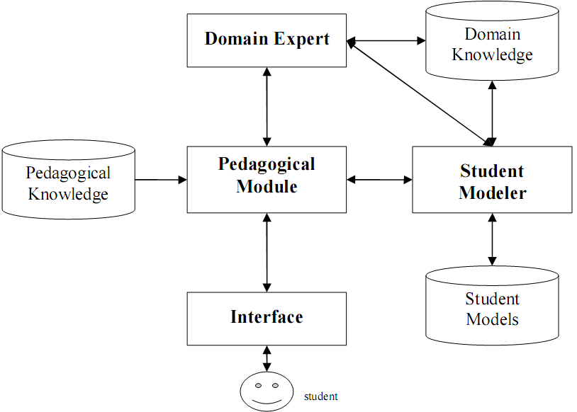
II. Intelligent Tutoring System
The architecture of ITS
There are four modules: domain expert, pedagogical (tutoring or didactics), student modeler and interface

Slide 7
II. Intelligent Tutoring System
Domain expert module
Domain expert is responsible for structuring, storing and manipulating knowledge space (domain knowledge).
The quality of domain knowledge depends on domain expert.
Knowledge space contents many knowledge items which student must be mastered in course.
Domain expert supports directly pedagogical module to perform adaptive functions.

Slide 8
II. Intelligent Tutoring System
User modeler module
Constructs and manages user information represented by user model
User modeler also interacts with pedagogical module to catch and log user’s tasks
User model can be stored in database or XML files. It has critical role when help pedagogical module to make decisions in the proper way

Slide 9
II. Intelligent Tutoring System
Pedagogical module
The centric component in ITS, which adapts instructional procedures to students
It makes decisions about the teaching process relating to the next problem selection, next topic selection, adaptive presentation of error messages…
It co-operates with the user modeler and domain expert to draw information about domain knowledge and user when making decisions

Slide 10
III. Adaptive Educational Hypermedia System
AEHS inherits basic components of ITS in respect of implementation but take advantage of plentiful supplies of learning material in hypermedia space
When hypermedia is the combination of hypertext and multimedia, AEHS can be known as the system providing learner with learning material in form of hypertext and multimedia (like hyper book, electronic book…) adapting to learner’s preference

Slide 11
III. Adaptive Educational Hypermedia System
There are two forms of adaptation
Adaptive presentation refers to the information which is show, in other word, what is shown to the user
Adaptive navigation refers to manipulation of the links, thereby; the user can navigate through in hypermedia. In other word, it is where user can go

Slide 12
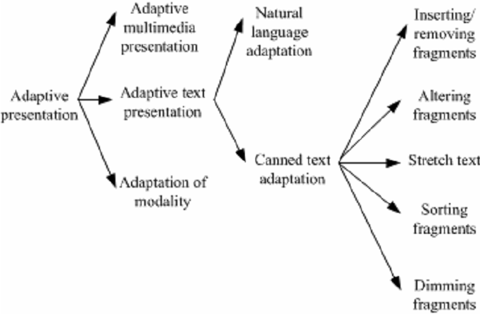
III. Adaptive Educational Hypermedia System
Adaptive Presentation

Slide 13
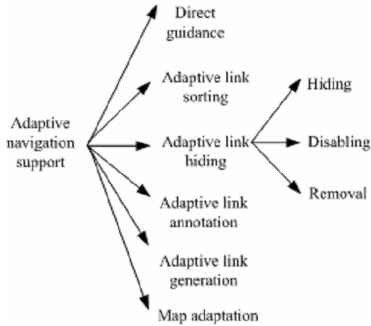
III. Adaptive Educational Hypermedia System
Adaptive Navigation

Slide 14
III. Adaptive Educational Hypermedia System
An example about Adaptive Presentation
Before reading information about HCMUS
…
In ĐH KHTN (227 Nguyễn Văn Cừ, Q5, HCMC thành lập năm 1927), có khoa CNTN
…
After reading information about HCMUS
…
In ĐH KHTN, có khoa CNTN
…

Slide 15
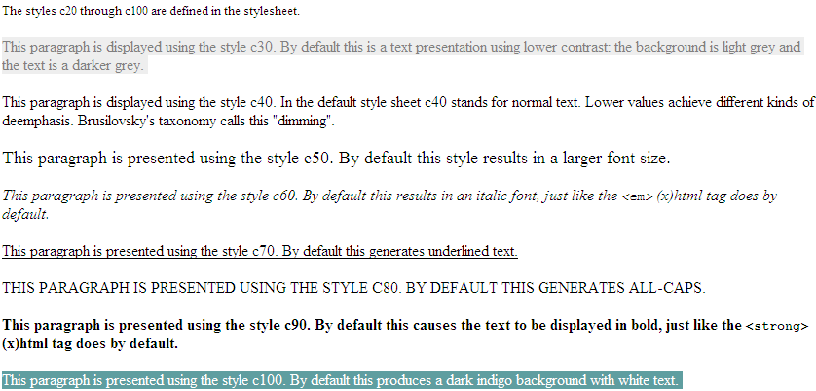
III. Adaptive Educational Hypermedia System
Another example about Adaptive Presentation

Slide 16
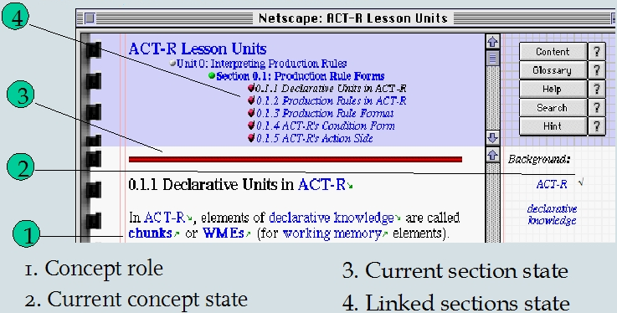
III. Adaptive Educational Hypermedia System
An example about Adaptive Navigation

Slide 17
III. Adaptive Educational Hypermedia System
The architecture of AEHS has two layers: runtime layer and storage layer
Runtime layer has responsibility for presenting adaptive learning material to user and observing user in order to update learner model
Storage layer is the main engine which controls adaptive process with some tasks such as
  Initialize and update learner model
  Choose concepts in domain model, educational resource in Media Space by selection rules
  Store learning resources, domain ontology, learner model

Slide 18
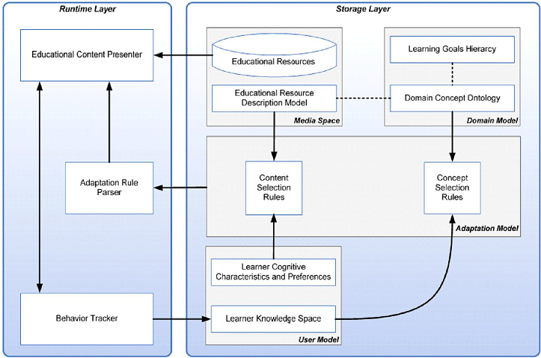
III. Adaptive Educational Hypermedia System
The architecture of AEHS

Slide 19
III. Adaptive Educational Hypermedia System
Storage layer has four models
Media model: contains learning resource and associated descriptive information (metadata).
Domain model: constitutes the structure of domain knowledge. Domain model was often showed in the form of graph. Nowadays, researchers intend to build domain model according to ontology.
Adaptation model: is the centric component which gives effect to adaptation, including content selection rules and concept selection rules.
  content selection rules used to choose suitable educational resource from medial model.
  concept selection rules used to choose appropriate concept from domain model..
User Model: information and data about user .

Slide 20
III. Adaptive Educational Hypermedia System
AHA!
AHA! is a Java-based open source soft is based on Dexter Hypertext Reference Model and aims to general-purpose adaptive hypermedia system
The AHA! architecture so-called AHAM complies with the standards of general architecture of AEHS
AHAM has three layers: runtime layer, storage layer, within-component layer

Slide 21
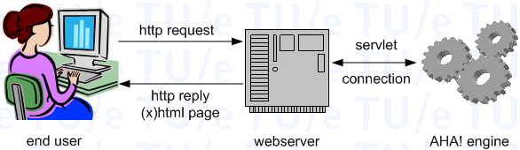
III. Adaptive Educational Hypermedia System
Implemented framework of AHA!

Slide 22
III. Adaptive Educational Hypermedia System
AHA! Engine manipulates three below models
Domain model (DM) contains domain concepts associated web learning resources. The relationships between concepts are also specified.
User model (UM) describes user information. UM is built up by applying overlay modeling approach. Hence, UM is the mastered subset of DM.
Adaptation model (AM) contains adaptive rules; each rule is associated to a domain concept and used to update UM when executing

Slide 23
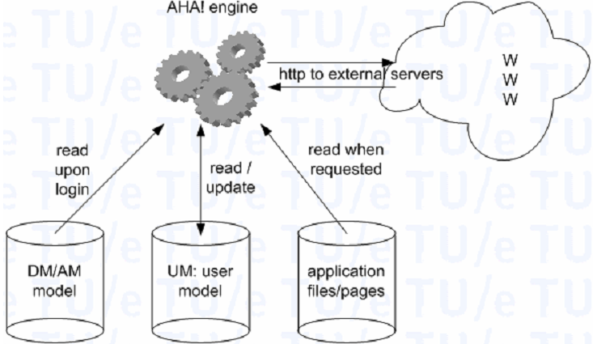
III. Adaptive Educational Hypermedia System
AHA! Engine

Slide 24
III. Adaptive Educational Hypermedia System
Adaptive procedure
Adaptive procedure is processed by the AHA! engine
The interaction between user and AHA! happens through HTTP protocol
Whenever users send the HHTP request since the click on the link in course pages, adaptive process occurs as 4 steps: finding request concept, retrieving UM, executing adaptive rules, retrieving resource

Slide 25
III. Adaptive Educational Hypermedia System
Adaptive procedure
Finding the request concept in DM and getting the resource (web pages, exercises, tests…) associated this concept
Retrieving UM
Executing adaptive rules (in AM) attached to the request concept. These rules will update attributes of UM (users’ characteristics). The executing process spreads over AM since the update can trigger other rules associated updated attributes. So this process continues until no rule is triggered. UM is updated
The resources associated to request concept are retrieved and filtered by adaptive rules in AM so that they are suitable to users (tuned to UM).

Slide 26
Conclusion
We already described architecture and basic features of adaptive learning systems in which ITS and AEHS are researched and developed continuously nowadays
When AEHS and ITS are compared, their architectures are very similar. For example, adaptation component in AEHS “play the role” of pedagogical module in ITS
However AEHS has some prominent advantages when it makes use of web technology

Slide 27
Conclusion
Hypermedia space in AEHS is more plentiful and convenient with non-linear navigation than knowledge space in ITS
Moreover, the interface in AEHS is more friendly than ITS due to using web page and HTTP protocol as means of interaction between user – machine in learning environment
That client-server architecture is implemented perfectly in AEHS through HTTP protocol will provide user the collaborative environment in e-learning; learners can share their experiments over network.

Slide 28
Conclusion
AEHS has some variants such as Adaptive Educational Web-Based System (AEWBS ), Adaptive Intelligent Educational Web-Based System (AIEWBS), etc.
However the ideology of such variants does not go beyond AEHS. So, we don’t include them in this chapter.

Slide 29
Reference
Peter Brusilovsky. Methods and Techniques of Adaptive Hypermedia. User Modeling and User-Adapted Interaction, 6, 1996, 87-129. (Reprinted in Adaptive Hypertext and Hypermedia, Kluwer Academic Publishers, 1998, 1-43)
Nicola Henze, Wolfgang Nejdl. A Logical Characterization of Adaptive Educational Hypermedia. New Review of Hypermedia and Multimedia (NRHM), 10 (1), 77-113. 2004.
Ian H. Beaumont. User modeling in the interactive anatomy tutoring system ANATOM-TUTOR. In User Models and User Adapted Interaction, 4(1), pages 21–45, 1994
Wenger, E. (1987). Artificial Intelligence and Tutoring Systems: Computational and Cognitive Approaches to the Communication of Knowledge. Los Altos, CA: Morgan Kaufmann Publishers, Inc.
Paul De Bra, Licia Calvi. AHA! An open Adaptive Hypermedia Architecture. The New Review of Hypermedia and Multimedia, vol. 4, pp. 115-139, Taylor Graham Publishers, 1998
David Hauger and Mirjam Köck. State of the Art of Adaptivity in E-Learning Platforms. Proceedings of the 15th Workshop on Adaptivity and User Modeling in Interactive Systems (ABIS 2007). ISBN: 978-3-86010-907-6 (2007)
Owen Conlan. State of the Art: Adaptive Hypermedia. M-Zones State of the Art Paper, soa paper 05/03, Ireland. 2003.
Tomáš Kubeš. Overview of Existing Adaptive Hypermedia e-Learning Systems. Published in Proceedings of the 6th seminar Technologies for e-learning, TPEV 2007.[Pask 1976]. G. Pask. Styles and Strategies of Learning. British Journal of Educational Psychology, 1976.
IT@EDU 2008

Slide 30
THANK FOR CONSIDERATION
IT@EDU 2008

